Slide 1
Breaking bad news
done by:
Anas Ali
Omar Alsulaiman
Mohammed Alshabanat

Slide 2
Q1. which one of the following is true regarding a bad news?
It has to be fatal
Needs a surgical intervention
Has a permanent lasting effect in patient’s life
Results in a negative alteration to patients' anticipation about their present and future

Slide 3
Q2. 55 years old male came to hospital with his son for following up, the son told the doctor not telling his father about his DM because that will make him feel depressed, what would you do?
accept his idea
ignore him
tell him about what doctors should do in these cases and be honest with patient in right way.
criticize the patient

Slide 4
Q3. Which one of the following is correct about dealing with Patient’s family reactions:
Preventing them from getting angery or crying
Assess and respond to patient’s family reactions
Ignore the Patient’s family suggestions
Tell them it is okay and I have seen who is worse

Slide 5
Q4. Which one of the following is important to ensure in preparing to break bad news?
A comfortable environment
Privacy
A lack of interruptions or unwelcome distractions
All of the above

Slide 6
Q5. Which of the following should you avoid when breaking bad news?
Maintaining eye contact
Giving the patient very detailed information about her or his condition
Asking the patient about her or his concerns
Allowing the patient time to cry

Slide 7
Objectives:
Reasons communicating bad news is important.
Strategy approaches to deliver bad news :
Getting started
What does the patient know?
How much does the patient know?
Sharing the information
Responding to patient and family feelings
Planning and follow-up
Examples how to break news for reports of cancer, hepatitis C or B, newly discovered diabetes, the result of HIV positive
Role playing / Video

Slide 8
What is the definition of Bad news?

Slide 9
Bad news definition
Bad news may be defined as “any information which adversely and seriously affects an individual's view of his or her future”

Slide 10
Why is it important ??
Breaking the bad news in the proper way is crucial to improve the coping abilities of patients and their families
Providing emotional support to the patient
Strengthens the physician-patient relationship

Slide 11
Continue- why is it important??
Studies have shown that most of the patients want to know the truth about their illness
Full disclosure allows patients to make informed decisions about their health and medical care that are consistent with their values.

Slide 13
Methods of delivering bad news
ABCDE approach
SPIKES approach

Slide 14
ABCDE approach

Slide 15
ABCDE approach
Advance Preparation
Build a therapeutic environment/relationship
Communicate Well
Deal with patient and family reactions
Encourage and validate emotions, Evaluate the News

Slide 16
Advance Preparation
What the patient already know/understand already?
Arrange for the presence of a support person and appropriate family
Arrange a time and place to be undisturbed
Prepare yourself emotionally
Decide on which words and phrases to use—write a script

Slide 17
Build a therapeutic environment/relationship
Arrange a private, quiet place without interruptions
Provide adequate seating for all
Sit close enough to touch if appropriate
Reassure about pain, suffering, abandonment

Slide 18
Communicate Well
Be direct - "I am sorry that I have bad news for you."
Do not use euphemisms, jargon, acronyms
Use the words – "Cancer," "AIDS," "Death" as appropriate
Allow for silence
Use touch appropriately

Slide 19
Deal with patient and family reactions
Assess patient reaction: physiologic responses, cognitive coping strategies, affective responses
Listen actively, explore, have empathy

Slide 20
Encourage and validate emotions, Evaluate the News
Address further needs: What are the patient’s immediate and near-term plans, suicidality?
Make appropriate referrals for more support
Explore what the news means to the patient
Express your own feelings

Slide 21
SPIKES approach

Slide 22
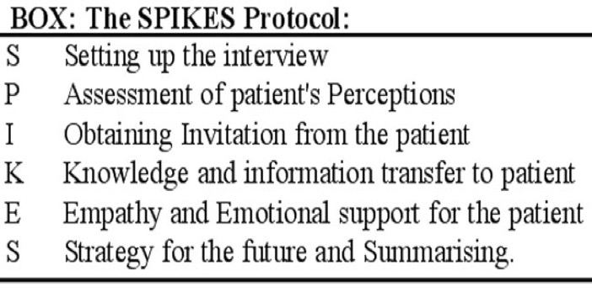
SPIKES

Slide 23
SETTING UP the Interview
Arrange for some privacy.
Involve significant others.
Sit down.
Make connection with the patient.
Manage time constraints and interruptions.

Slide 24
Assessing the Patient's PERCEPTION
Before discussing the medical findings, use open-ended questions to create a reasonably accurate picture of how the patient perceives his/her medical situation.
“What have you been told about your medical situation so far?” or “What is your understanding of the reasons we did the MRI?”
Based on this information you can correct misinformation and tailor the bad news to what the patient understands.

Slide 25
Obtaining the Patient's INVITATION
Ask the patient: “do you want to hear the test results? How would you like me to give the information about the test results? Would you like me to give you all the information or sketch out the results and spend more time discussing the treatment plan?”
When a clinician hears a patient expresses a desire for information, it may lessen the anxiety associated with delivering the bad news.

Slide 26
Giving KNOWLEDGE and Information to the Patient
Warning the patient that bad news is coming may lessen the shock that can follow the disclosure of bad news.
“Unfortunately I've got some bad news to tell you” or “I'm sorry to tell you that…”.
Try to use non-medical words.
“spread” instead of “metastasized” and “sample of tissue” instead of “biopsy”.
Avoid excessive bluntness,
“You have very bad cancer and unless you get treatment immediately you are going to die.”
Give information in small chunks and check periodically as to the patient’s understanding.
When the prognosis is poor, avoid using phrases such as
“There is nothing more we can do for you.”

Slide 27
Addressing the Patient's EMOTIONS with Empathic Responses
Observe for any emotion on the part of the patient.
After you have given the patient a brief period of time to express his or her feelings, let the patient know that you have connected the emotion with the reason for the emotion by making a connecting statement.

Slide 28
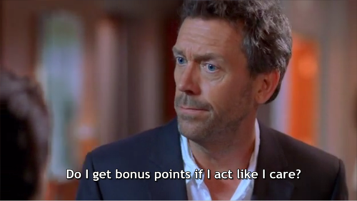
Examples how to break news

Slide 29
Example 1
You have an old patient who recently died and you have to call his son by the phone , what is the appropriate thing to do ?

Slide 30
Example 2
mohammed is a 30-year-old man who presents with fatigue and weight loss. He is very active and has played competitive football for the last 7 years and he has always been healthy.
He came to see you because he noticed some lumps in his neck when he was shaving. Initially he thought these were because he had a slight sore throat but they did not go away. Lymph node biopsy reveals Hodgkins Disease.
what is your plan to tell him about the tumor?

Slide 31
ROLE PLAY

Slide 33
References
https://www.ncbi.nlm.nih.gov/pmc/articles/PMC3144432/
Baile, W. F. "SPIKES--A Six-Step Protocol For Delivering Bad News: Application To The Patient With Cancer". N.p., 2017. Print.
https://www.cpd.utoronto.ca/endoflife/Cases%20and%20Teaching%20Tips/Communications%20Case%20and%20Teaching%20Tips.pdf
https://www.med.unc.edu/aging/files/2018/06/Giving-Bad-News.pdf
https://www.researchgate.net/publication/285581809_Communicating_bad_news

