Slide 1
General Anaesthesia
King Saud university
College of Medicine
045 course Jan 2019
Dr. Abdullah Alharbi m.b.b.s, fanzca
Consultant and assistant professor of anaesthesia

Slide 2
Lecture Objectives
Know the term: anaesthesia
Recognize the role of the anaesthetist.
Know the different types of anaesthesia
Understand the definition of “General anaesthesia”
Know the components of General anaesthesia
Know the requirements for providing safe general anaesthesia
Know the common complications of GA.

Slide 3
What is Anaesthesia/Anesthesia ?
Without sensation

Slide 4
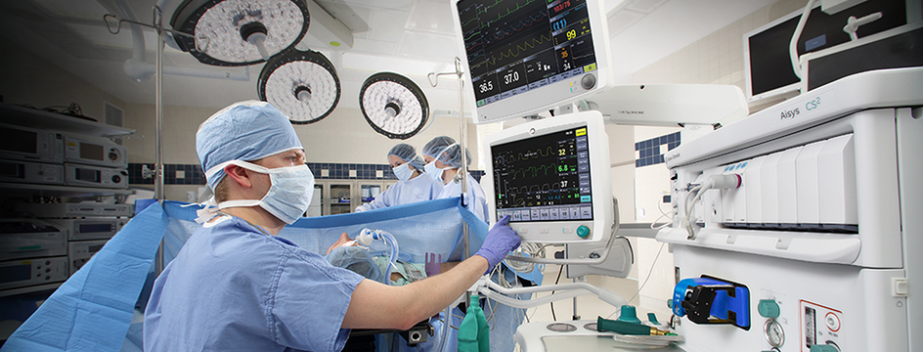
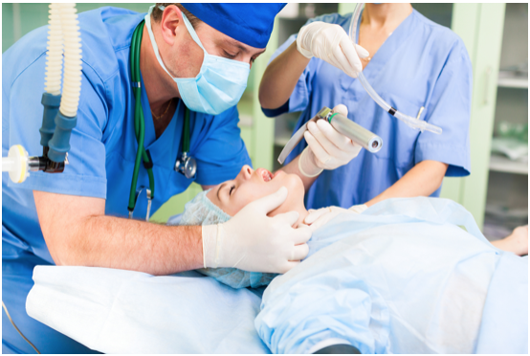
What is the role of the anaesthetist?
Lives Saving and Pain Fighting!

Slide 5
What is the role of the anaesthetist?
Preoperative
Intraoperative care.
Postoperative care
Surgical ICU management.

Slide 6
What is the role of the anaesthetist?
Perioperative medicine :
Preoperative evaluation and risk assessment.
Optimisation of patient’s condition prior to surgery.

Slide 7
What is the role of the anaesthetist?
Intraoperative care:
Provide continual medical assessment of the patient.
Continuous Monitoring of the patient’s vital life functions.
Control of the patient’s pain and level of consciousness in order to facilitate successful surgical procedure.

Slide 8
What is the role of the anaesthetist?
Management of acute pain:
Surgical
Obstetric
Medical

Slide 9
What is the role of the anaesthetist?
Rescue and management of airway crisis.
Rescue and management of medical emergencies along with other medical teams, i.e. Code Blue, Trauma codes
Education, Simulation and Research.

Slide 11
What I love about being an anesthesiologist
“I constantly listen to the sounds of their hearts.
I breathe for them when they are unable.
I keep them warm in the cold operating room.
I provide the fluids that their bodies need.
I pad their arms and legs and other pressure points.
I watch the operation step by step, anticipating and responding.
I learn from their bodies’ response to anesthesia to give the right amount.
I prevent and relieve their pain.
I protect them from dangers of which they are unaware”.
Edward R. Mariano

Slide 12
Types of Anaesthesia :
Local
Regional anaesthesia
Neuro-axial anaesthesia
Spinal,
Epidural ,
Caudal.
Sedation
General anaesthesia

Slide 13
Definition of General Anaesthesia
Reversible drug induced loss of consciousness during which patients are not arousable even by painful stimulation.

Slide 14
Components of General Anaesthesia:
Amnesia
Analgesia
Muscle relaxation.

Slide 15
Before we give GA:
Preoperative visit and planning
Consent
Check Equipment and Monitors
PACU availability
Support in case of crisis : backup Logistic /Drugs.

Slide 16
Requirements for providing GA
Qualified anaesthesia provider with a trained assistance
O2 Source and a method to deliver positive pressure ventilation
Standard Monitors
Fluid, IV access and IV Set.
Suction device.
Airway adjuncts
Anesthetic drugs.
Emergency drugs.

Slide 17
Standard Monitoring:
Anaesthesia provider, Airway, Breathing and Circulation.
SpO2
Etco2
HR, ECG, NiBP
Temperature

Slide 21
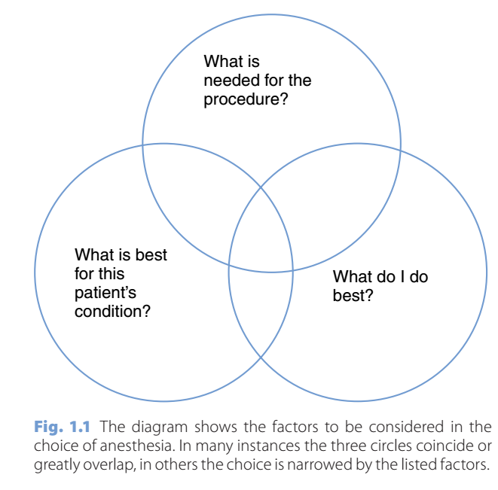
Anaesthetic plan

Slide 22
Types of General Anesthesia
Amnesia can be achieved through:
Inhalational :
Intravenous anaesthesia
Analgesia: Opioids, NSAIDS, Paracetamol.
Muscle relaxation: Depolarizing and non depolarizing muscle relaxants.

Slide 23
Inhalational
Nitrous Oxide
Halogenated ethers eg. Sevoflurane.
Xenon
The dose is calculated by Minimum alveolar concentration- MAC.

Slide 24
Intravenous anaesthesia
Hypnotic drugs:
Propofol
Thiopentone
Ketamine
Etomidate
Benzodiazipine

Slide 28
16 OCT 1846 A.D

Slide 29
Complications of Anaesthesia
Airway: Hypoxia, laryngospasm, Bronchospasms and pulmonary Aspiration.
Breathing: hypoventilation and apnoea
Circulation: Hypotension and bradycardia, anaphylaxis.
Nausea and vomiting
Dental damage
Positioning-related injury
Awareness under anaesthesia
Malignant hyperthermia

Slide 30
Malignant Hyperthermia
Rare disease with geographic variation.
Autosomal–dominant inherited disease.
Triggered by Suxamethonium and volatile anaesthetics.
Loss of regulation of intracellular Ca++ uptake, leads to sustained muscular contraction and hyper metabolism.
Fatal if not diagnosed and treated early.
Treated by Dantrolene and supportive care.

Slide 31
Any questions?

Slide 33
Further resources:
What I love about being an anesthesiologist.EDWARD R. MARIANO, MD | PHYSICIAN | OCTOBER 20, 2014.https://www.kevinmd.com/blog/2014/10/love-anesthesiologist.html. retrieved 5 march 2018.
The Role of the Anesthesiologist from Surgical Anesthesia to Critical Care Medicine and Pain Medicine.Texas soceity of anesthesiologists. http://www.tsa.org/public/anesthesiologist_role.php
Media , https://youtu.be/poXEMYiMWnw
Anaesthesia at a Glance.Julian Stone, William Fawcett

