Slide 1
Pharmacology of Anesthesia
Dr. Mansoor Aqil
Professor Anesthesiology
February 27, 2019

Slide 2
Lecture Objectives..
Students at the end of the lecture will be able to:
Understand pharmacokinetics and pharmacodynamics of general anaesthetic agents: intravenous agents, inhalation agents, Opioids, neuromuscular blocking agents and reversal agents as well as local anaesthetic agents.
Learn about the main uses, advantages and disadvantages of these agents.
How to deal with adverse reactions diagnosis and management of Malignant hyperthermia and Succinylcholine apnea.

Slide 3
Anesthetic Agents
Intravenous Anesthetics:
Barbiturates, Propofol, Etomidate, Ketamine.
Opioids.
Inhalational Anesthetics:
Sevoflurane, Isoflurane, Desflurane, Halothane and Nitrous Oxide.
Neuromuscular blocking drugs.
Adjunct to General Anesthesia: Benzodiazepines.
Local Anesthetics: Lidocaine, Bupivacaine, Ropivacaine.

Slide 4
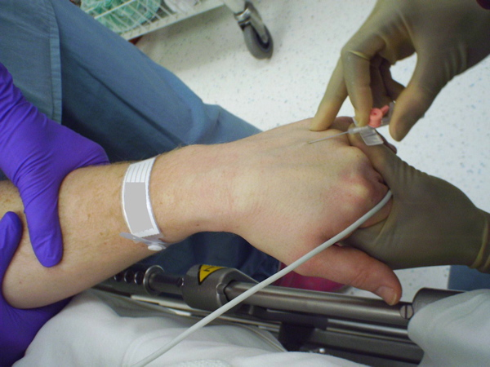
Intravenous Anesthetics

Slide 5
Barbiturates
Thiopental (thiopentone sodium) is a thiobarbiturate.
  Mechanism of action
    Facilitate inhibitory neurotransmission by enhancing GABAA receptor function.
    Inhibit excitatory neurotransmission via glutamate and nicotinic acetylcholine receptors.
  Pharmacokinetics
    Metabolism and elimination is hepatic.
    Multiple doses or prolonged infusions may produce prolonged sedation or unconsciousness

Slide 6
    Pharmacodynamics
    CNS
      Dose-dependent CNS depression. ↓ in (CMRO2), cause ↓ in ICP and (CBF).
    Cardiovascular system
      Depress myocardial contractility, leading to dose-dependent ↓ in BP and cardiac output,
      Baroreceptor reflexes remain largely intact.
    Respiratory system
      Dose-dependent decrease in RR and TV.
      Apnea may last for 30 to 90 seconds after induction dose.
      Laryngeal reflexes remain more intact compared to propofol so higher incidence of cough and laryngospasm.

Slide 7
    Primary Use:
    Induction of anesthesia.
Advantages:
  Rapid onset (30 - 45 sec), short duration (5 – 8 min) initial dose; redistributed from brain to muscle resulting in return of consciousness.
  It has potent anticonvulsant properties.
  Adverse effects:
  Dose dependent histamine release.
      Myoclonus and hiccups .
      Absolutely contraindicated in Porphyria
      Venous irritation and tissue damage

Slide 8
      Thiopental can cause severe pain and tissue necrosis if injected subcutaneously or intra-arterially.
      If intra-arterial administration occurs, heparin, vasodilators, and regional sympathetic blockade may be helpful in treatment.
  Dosage and administration
  Induction: IV 3-6 mg/kg
  Sedation IV 0.5-1.5 mg/kg
  N.B. Reduce doses in hypovolemic, elderly, or hemodynamically compromised patients.

Slide 9
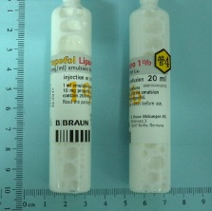
PROPOFOL (2, 6- diisopropylphenol)
It is the most widely used induction agent. 1% isotonic oil-in-water emulsion, which contains egg lecithin, glycerol, and soybean oil.
Mechanism of action
  Facilitates inhibitory neurotransmission by enhancing the function (GABAA) receptors in CNS .
Pharmacokinetics
  Hepatic and extrahepatic metabolism leads to inactive metabolites which are excreted by renal route .

Slide 10
    Pharmacodynamics
    CNS
    Induction : rapid onset of unconsciousness (30 to 45 seconds), followed by a rapid termination of effect by redistribution, so emergence is rapid .
    Weak analgesic effects .
    ↓ (ICP) and ↓ (CPP) due to markedly ↓ (MAP). Anticonvulsant .
    Less (PONV) occurs.
    Cardiovascular System
      Dose-dependent ↓ in preload, afterload, and contractility lead to ↓ in (BP) and COP.

Slide 11
    Hypotension may be marked in hypovolemic, elderly,
    or hemodynamically compromised patients.
    Heart rate (HR) is minimally affected, and baroreceptor reflex is blunted.
    Respiratory system
      Dose-dependent decrease in (RR) and (TV).
      ↓Ventilatory response to hypoxia and hypercarbia.
    Primary Uses
  A sedative/hypnotic in OR & ICU.
  Induction of anesthesia.
  Maintenance of anesthesia (TIVA).

Slide 12
Advantages
    Produces Laryngeal & pharyngeal muscle relaxation, allowing LMA insertion.
    Safe in Malignant hyperthermia (MH) & Porphyria patients.
    Antiemetic properties.
    Suitable for day case surgery to avoid prolong postoperative hangover (drowsiness, ataxia).
    Situations where volatile anesthetics cannot be used (MH, transfer of sedated patients, airway surgery).
    --

Slide 13
Adverse effects
    Venous irritation.
    Bacterial growth
    Lipid disorders. used cautiously in disorders of lipid metabolism (e.g., hyperlipidemia and pancreatitis).
    Myoclonus and hiccups
    Propofol infusion syndrome :
      A rare fatal disorder that occurs in critically ill patients (usually children) subjected to prolonged, high-dose propofol infusions. (Rhabdomyolysis, metabolic acidosis, cardiac failure, and renal failure).

Slide 14
Dosage and administration
Induction: IV 1-2.5mg/kg
Sedation : IV 25-100 µ/kg/min
  Titrate with incremental doses in hypovolemic, elderly, or hemodynamically compromised patients or if administered with other anesthetics.

Slide 15
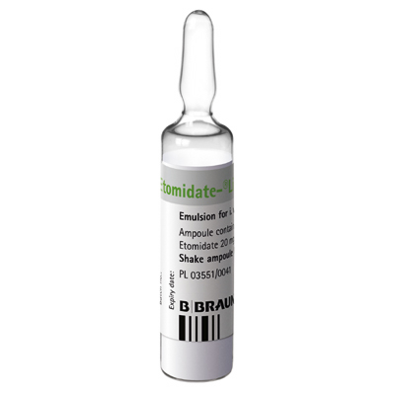
Etomidate
It is a carboxylated imidazole.
Mechanism of action
Facilitates inhibitory neurotransmission by enhancing the function (GABAA) receptors.
Pharmacokinetics
  Effects of a single bolus dose are terminated by redistribution.
  Very high clearance in the liver and by circulating esterases to inactive metabolites.

Slide 16
    Pharmacodynamics
    CNS
      No analgesic properties.
      ↓ (CBF), cerebral metabolic rate, (CMR), and (ICP).
    Cardiovascular System
      Minimal changes in HR, BP, and COP.
    Respiratory system
      Dose-dependent ↓ in ( RR) & (TV).
      Transient apnea may occur.
    Primary Uses
Induction of anesthesia in patients with cardiovascular problems.

Slide 17
Advantages
  Short acting and potent, with CVS and RS stability, suitable
  for elderly and shocked patients.
Adverse effects
Excitatory phenomena (Involuntary limb twitches), myoclonus
Nausea and vomiting .
Venous irritation and superficial thrombophlebitis
Adrenal suppression, (Inhibits 11β & 17 α hydroxylase ).
A single dose suppresses adrenal steroid synthesis for up to 24 hours. Repeated doses /infusion is associated with increased mortality in ICU patients.
Dosage and administration
Induction: IV 0.2-0.5 mg/kg

Slide 18
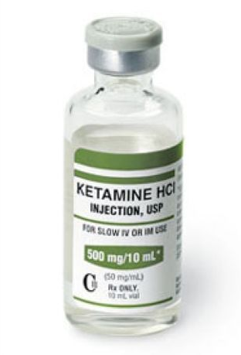
Ketamine
It is phencyclidine derivative causing
‘dissociative anesthesia’
Mechanism of action
  Mainly attributed to noncompetitive antagonism of NMDA receptors in the CNS
Pharmacokinetics
  Unconsciousness in 30 to 60 s after an IV.
  Terminated by redistribution in 15 to 20 minutes.
  Metabolized rapidly in the liver to multiple metabolites, some of which have modest activity (e.g.,norketamine).
  Elimination half-life is 2 to 3 hours.

Slide 19
    Pharmacodynamics
    CNS
      Amnesia and profound analgesia.
      ↑ (CBF), ↑ (CMR), and ↑(ICP) pressure.
    Cardiovascular System
      ↑ HR, COP, and BP .
      Used in hemodynamically compromised patients.
    Respiratory system
      Mild depression of ( RR) and (TV).
      Potent bronchodilator.
      Laryngeal protective reflexes are maintained.

Slide 20
    Primary Uses
  Induction of general anesthesia.
  Sedation and analgesia.
Advantages
  CVS stability makes it suitable for shocked patients.
  Preservation of airway reflexes & less respiratory depression makes it suitable for procedures – radiological interventions, radiotherapy, burns & dressing changes.
Adverse effects
  ↑ salivation, PONV.
  Emotional disturbance, agitation & hallucinations.
  Contraindicated in patients with head trauma
Dosage and administration
  Induction: IV 1-2mg/kg , IM 3-5mg/kg
  N.B. Useful for IM induction in patients with no IV access (e.g., children).

Slide 21
Opioids

Slide 22
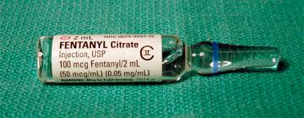
Opioids
Opioids produce moderate sedation and profound analgesia.
Fentanyl, Sufentanil, Alfentanil, Remifentanil, Meperidine, Morphine.
Mechanism of action
  They exert their effects by binding with opioid receptors in CNS 3 major opioid receptors μ (mu), κ (kappa), and δ (delta).

Slide 23
    Primary Uses
  They mimic endogenous compounds: Endorphins, enkephalins & dynorphins.
  Principally provides analgesia and some degree of sedation.
  Large doses can produce general anesthesia.
Advantages
  Minimal cardiac effects (No myocardial depression).

Slide 24
Adverse effects
Miosis
Nausea & vomiting, slow gastric emptying, constipation
Drowsiness or sedation
Chest wall rigidity & respiratory depression
Bradycardia in large doses
Some peripheral vasodilation and histamine release – hypotension
Itching
Urinary retention & biliary colic,

Slide 25
Fentanyl
  A potent synthetic opioid agonist with100 times, the analgesic potency of morphine.
  Used for induction and maintenance of G.A and to supplement regional and spinal anesthesia.
  Ability to maintain cardiac stability.
Sufentanil citrate (Sufenta)
  10 times as potent as fentanyl
  Rapid elimination
  Relatively more rapid recovery as compared with fentanyl.
Alfentanil
Shorter duration of action compared to fentanyl and sufentanil,

Slide 26
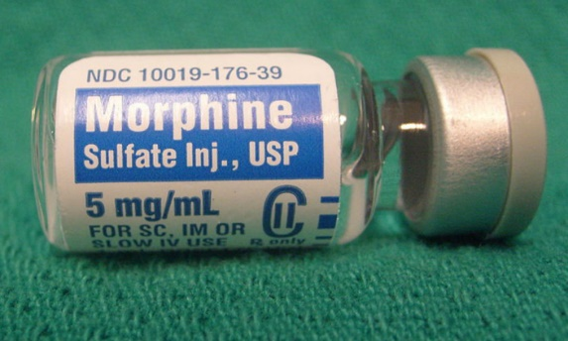
Remifentanil (Ultiva)
Ultra short acting and rapidly cleared
Widespread extrahepatic metabolism by blood and tissue nonspecific esterases
Morphine
May produce hypotension and bronchoconstriction as a consequence of its histamine-releasing action.
    Morphine may be a poor choice for a patient with renal failure.

Slide 27
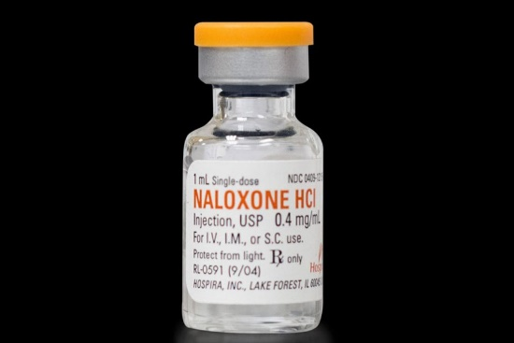
Naloxone
A specific opiate receptor antagonist, binding the receptor.
The effective dose is 1 to 4 μg/kg IV, and the duration of action is 30 to 45 min.
Dose may need to be repeated or as an infusion
  Adverse effects
  Reversal of analgesia, nausea, vomiting,
  Increased sympathetic nervous system activity (tachycardia, hypertension, pulmonary edema, and cardiac dysrhythmias).

Slide 28
Benzodiazepines
Midazolam, lorazepam, and diazepam.
Mechanism of action
  Enhance inhibitory neurotransmission by increasing the affinity of GABAA receptors for GABA.
Pharmacokinetics
Effects are terminated by redistribution.
All are metabolized in the liver.
Hydroxymidazolam cause sedation in Pt with renal failure.
Diazepam clearance is reduced in the elderly.

Slide 29
    Pharmacodynamics
    CNS
    Amnesic, anticonvulsant, anxiolytic,
    and sedative-hypnotic (dose-dependent manner).
    No analgesia.
    Cardiovascular System
      Mild systemic vasodilation and ↓ in cardiac output. HR is usually unchanged.
    Respiratory system
      Mild dose-dependent ↓ in RR and TV.
      Respiratory depression may be more if administered with an opioid

Slide 30
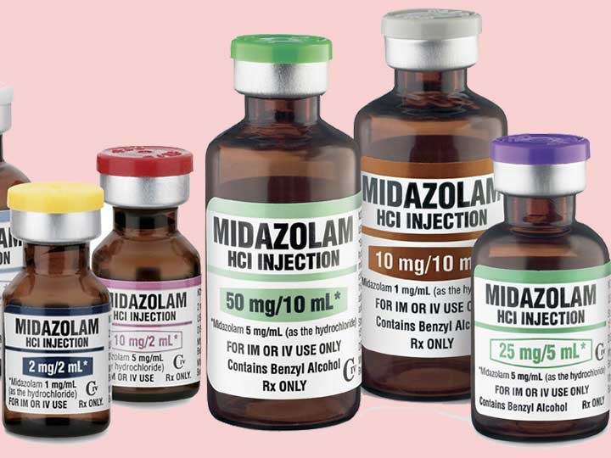
    Primary Uses
  Sedation, amnesia, anxiolytic use
  as premedication or as adjunct to GA
Adverse effects
Drug interactions with anticonvulsant (valproate)
Pregnancy and labor :
  Risk of cleft lip and palate in the first trimester.
  CNS depression in the neonate.
Superficial thrombophlebitis and injection pain by diazepam and lorazepam.
They cause mild respiratory depression but can be marked in elderly leading to apnea.

Slide 31
Midazolam (Dormicum)
  Water soluble, so drug of choice for IV administration
  More rapid onset and more rapid elimination
  The most potent amnestic
  Diazepam (Valium)
  Water-insoluble, so IV use can cause local irritation/pain
  Lorazepam (Ativan)
  Water-insoluble.

Slide 32
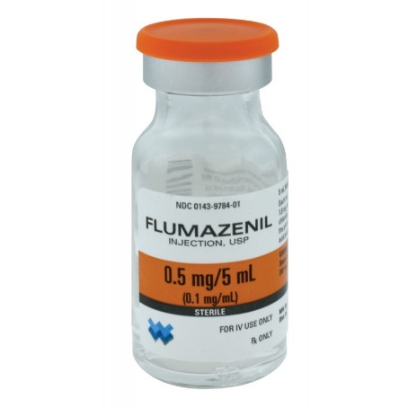
Flumazenil
  A competitive antagonist at the
  benzodiazepine binding site of
  GABAA receptors in the CNS.
  Reversal of sedative effects occurs within 2 min; peak effects at 10 min.
  Half-life is shorter than the benzodiazepine
  Metabolized to inactive metabolites in the liver.
  Dose. 0.3 mg IV every 30 to 60 seconds (to a maximum dose of 5 mg).
  Initial dose in pediatric: 0.01 mg/kg IV over 15 seconds
  Contraindicated in patients receiving benzodiazepines for the control of seizures or elevated ICP.

Slide 33
Inhalational Anesthetics

Slide 34
Characteristics of the ideal inhaled anesthetic agent:
Non - toxic, non-.allergenic, non - irritant.
Stable in storage, non – flammable
No extra specialist equipment required.
Low solubility in blood and tissues.
Resistance to physical and metabolic degradation.
Analgesic.
CVS- no effect.
No respiratory depression.
Environmentally inert.
No reaction to soda lime/ breathing circuit.
Not a malignant hyperthermia (MH) trigger.

Slide 35
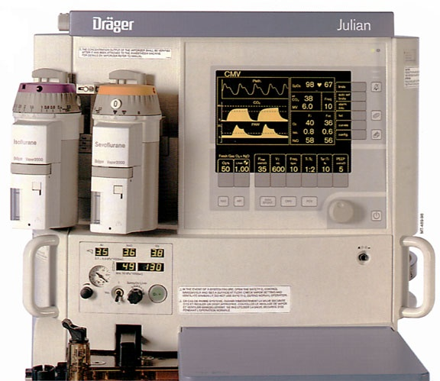
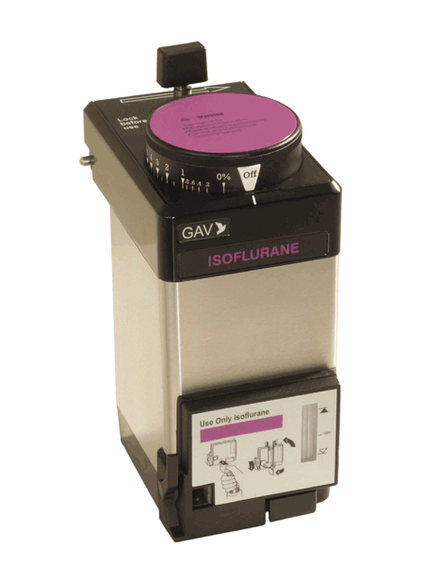
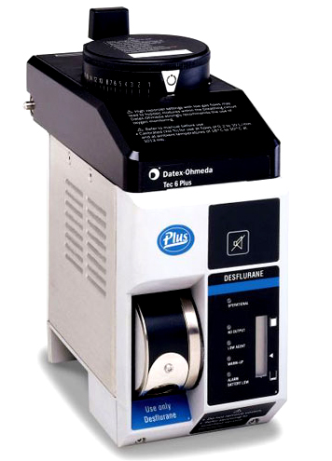
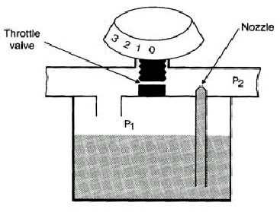
Volatile anesthetics
Present as liquids at room temperature and pressure.
Vaporized into gases for administration

Slide 36
The minimum alveolar concentration (MAC)
‘The amount of vapor (%) needed to render 50% of spontaneously breathing patients unresponsive to a standard painful surgical stimulus.’
  Halothane 0.75%
  Isoflurane, 1.15%
  Sevoflurane, 1.85%
  Desflurane 6.0% at one atmosphere.

Slide 37
  Mechanism of action
  Various ion channels in the CNS involved in synaptic transmission (including GABA_{A}, glycine, and glutamate receptors) may play a role.
Pharmacokinetics
The higher the vapor pressure, the more volatile the anesthetic.
Blood solubility determines the speed of build-up / elimination from blood / brain
Lower blood solubility means (faster induction/recovery)
  Inspired air → Alveolar air → Blood → Brain
    Metabolism: hepatic .
    Exhalation:This is the predominant route of elimination:

Slide 38
    Pharmacodynamics
    CNS
    Unconsciousness and amnesia . ↑ cerebral blood flow (CBF).
    Respiratory System
    Dose-dependent respiratory depression
    Airway irritation and, during light levels of anesthesia, may precipitate coughing, laryngospasm, or bronchospasm (sevoflurane makes it more suitable )
    Bronchodilator (with the exception of desflurane).
    Inhibit hypoxic pulmonary vasoconstriction.
    Renal system.
    ↓ renal blood flow .

Slide 39
    Cardiovascular System
    Myocardial depression & systemic vasodilation.
    HR tends to be unchanged, except desflurane
    Sensitize the myocardium to the arrhythmogenic effects of catecholamines.
    Neuromuscular system
    Dose-dependent ↓ in skeletal muscle tone.
    May precipitate malignant hyperthermia … A dramatic increase in body temperature, acidosis, electrolyte imbalance and shock.
    Management is removal of triggering agent, 100% Oxygen, active cooling measures & Dantrolene (1 to 10 mg/kg)
    Hepatic System
    ↓ hepatic perfusion.

Slide 40
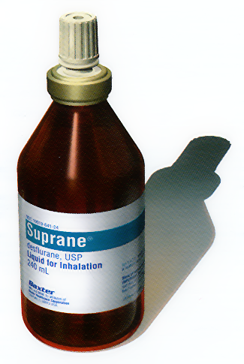
Desflurane
Advantages
Rapid onset and recovery of anesthesia
(outpatient procedures)
One of least metabolized to toxic byproducts
Disadvantages
Requires a special vaporizer
Pungent and irritating to the airway (leading to more coughing, laryngospasm)
High inspired gas concentrations lead to a significant ↑ in the patient’s BP & HR.

Slide 41
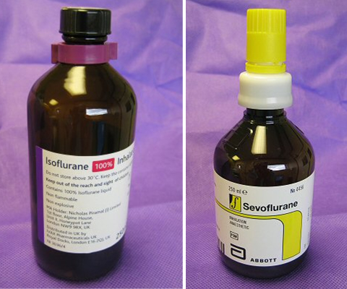
Sevoflurane
Advantages
Low solubility in blood-- produces rapid induction and emergence
Pleasant smelling (suitable for children)
Has good bronchodilating properties
Agent of choice in asthma, bronchitis, and COPD.
It has little effect on the heart rate.
Mild respiratory and cardiac suppression
Disadvantages
Carbon dioxide absorbents in anesthesia machines degrade sevoflurane to Compound A

Slide 42
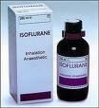
Isoflurane:
Advantages:
It causes peripheral vasodilation and increased coronary blood flow .
Disadvantages:
Moderate solubility, so recovery from anesthesia may be delayed
Isoflurane can make the heart “more sensitive” to circulating catecholamines (like epinephrine).

Slide 43
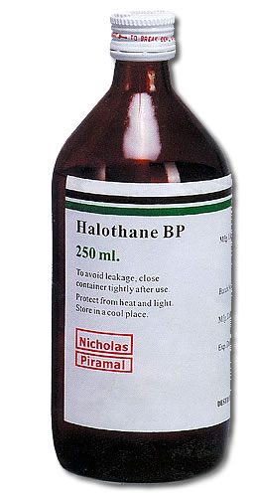
Halothane
Used for induction in children (sweet pleasant odor);
Sensitize the myocardium to the arrhythmogenic effects of catecholamines.
Blood pressure usually falls.
Very soluble in blood and adipose tissue
Prolonged emergence
“Halothane hepatitis” (rare).

Slide 44
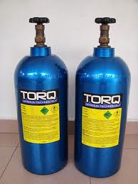
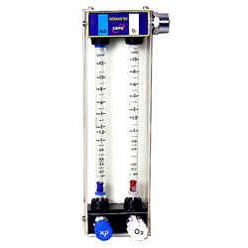
Nitrous Oxide
MAC is 104% at one atmosphere
CNS
  Antagonism of NMDA receptors in CNS.
  Weak anesthetic, produce analgesia.
  Usually combined with other anesthetics.
  Used alone e.g. dental procedures.
Cardiovascular system
Mild myocardial depressant & a mild sympathetic stimulant.
HR and BP are usually unchanged.
↑ pulmonary vascular resistance.
Respiratory system
Little effect on respiration

Slide 45
Nausea/vomiting.
Risk of bone marrow depression
Inhibits vitamin B-12 metabolism
Expansion of closed gas spaces. Nitrous oxide is 35 times more soluble in blood than nitrogen. Contraindicated in (e.g. air embolus, pneumothorax, Middle Ear Surgery etc)
Diffuse into the cuff of ETT.
Diffusion hypoxia. After discontinuation, its rapid elimination from the blood into the lung may lead to a low partial pressure of oxygen in the alveoli.

Slide 46
Neuromuscular blocking drugs

Slide 47
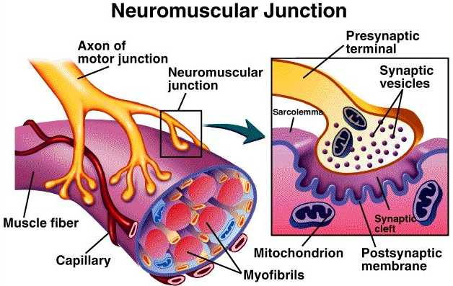
Neuromuscular blocking drugs
Primary Uses
Perform tracheal intubation.
Facilitate ventilation.
Provides optimal surgical operating conditions.

Slide 48
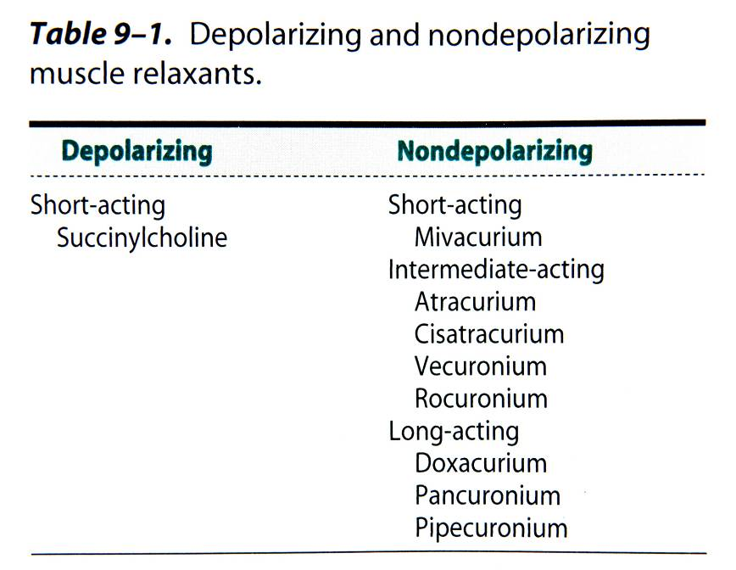
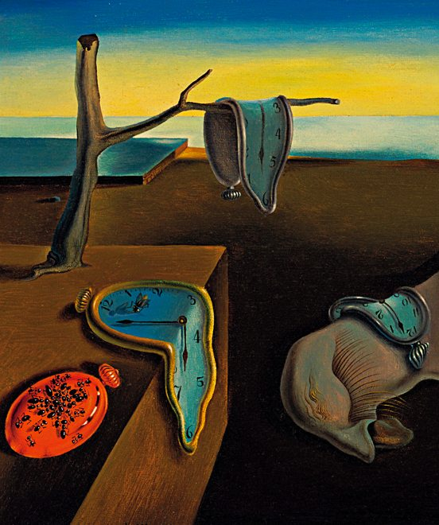
Neuromuscular blockers

Slide 49
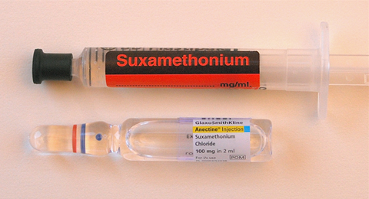
Depolarizing
(Succinycholine)
Structurally similar to acetylcholine … activate the acetylcholine receptors (Ach) … depolarization of post junctional membrane.
Very short duration of action (onset 60 seconds/ duration 10 minutes)
For short time intubation (Rapid sequence induction)
Metabolized very quickly by plasma cholinesterase.
Characterized by transient muscle fasciculations followed by relaxation.
Acetylcholine esterase (AChE) inhibitors potentiate rather than reverse the block.

Slide 50
    Adverse Effects
    Cardiac dysrhythmias: sinus bradycardia, junctional rhythm, and even asystole after the first dose in children and following repeated dose within a short time interval in adults.
    Hyperkalemia.( burns, RF, muscular dystrophies & paraplegia)
    A transient increase in intraocular pressure (IOP)
    Increase in intracranial & intragastic pressure.
    Myalgia : abdomen, back, and neck.
    Histamine release.
    Dual block.

Slide 51
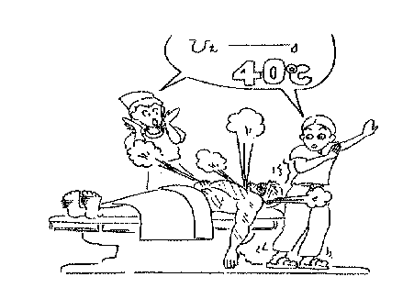
    Succinylcholine apnea
    Low levels of plasma cholinesterase (severe liver or kidney disease)
    A drug-induced inhibition of its activity, a genetically atypical enzyme.
    Management is supportive, especially to avoid awareness.
    Anaphylaxis. over 50% of anaphylactic reactions to NMBDs.
    Malignant hyperthermia (MH).

Slide 52
Nondepolarizing blockers
They act by competitively blocking the binding of ACh to its receptors and inhibit muscular contraction.
It is characterized by :
Absence of fasciculation.
Potentiation by other nondepolarizing NMBDs and volatile anesthetic agents.
Reversal by AChE inhibitors.

Slide 53
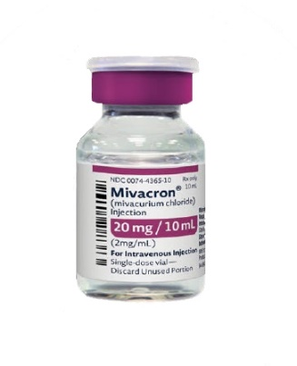
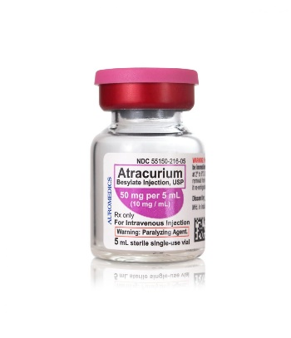
  MIVACURIUM:
  Short-acting,
  rapidly hydrolyzed by plasma cholinesterase.
    Histamine release causing a transient hypotension and tachycardia.
  ATRACURIUM:
  Widely used and have an intermediate onset and duration of action.
  Histamine release.
No direct cardiovascular effects.
Metabolism is by Hofmann degradation and ester hydrolysis in the plasma. Its duration of action is independent of renal and hepatic function.
A breakdown product of atracurium, (laudanosine) may accumulate and cause seizures

Slide 54
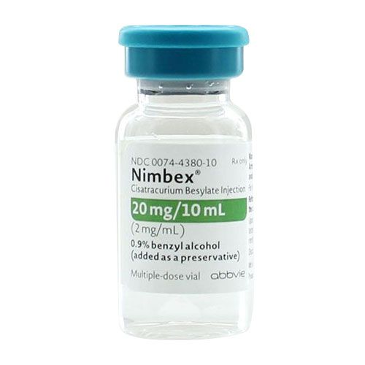
CISATRACURIUM: Isomer of atracurium
Hofmann degradation and does not accumulate in renal failure.
Relatively slow onset of action.
Does not release histamine.
Less laudanosine .
ROCURONIUM: The most rapid onset of the clinically available non-depolarizing NMBDs.
Intubating conditions can be achieved in 60-90 seconds after an induction dose of 0.6 mg/Kg.
Increasing the dose to 1.2 mg/kg shortens the time can be used for rapid sequence induction when Suxamethonium is contraindicated.
An intermediate duration of action. Histamine is not released.
Higher incidence of anaphylactic reaction.

Slide 55
CHOICE OF NMBD
Urgency for tracheal intubation.
Duration of the procedure,
Coexisting medical conditions that may affect the NMJ.
Side effects & metabolism
Cost-effectiveness
Suxamethonium makes it a good choice for rapid intubation .
Rocuronium will decrease the risk of hyperkalemia in patients with burns.
Pancuronium can produce a tachycardia that is undesirable in patients with severe IHD, but its vagolytic effects may be appropriate in pediatrics.

Slide 56
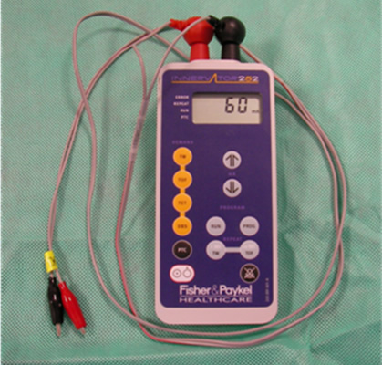
Peripheral nerve stimulator
Check the depth of neuromuscular blockade
Determine that neuromuscular blockade is reversed
At least 3 twitches on a train of four should be detected before attempting reversal.

Slide 57
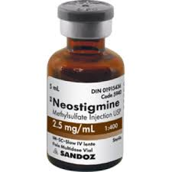
Anticholinesterases (Neostigmine)
They inhibit the action of the acetylcholinesterase enzyme at the NMJ resulting in increase in the concentration of Ach at NMJ.
Clinical tests of adequate resolution of neuromuscular block include the ability to lift the head from the bed for 5 seconds.
Intravenous injection at a dose of 0.05 mg/kg (maximum 5mg).
To minimize adverse effects such as bradycardia, miosis, GI upset, nausea, bronchospasm, increased sweating, salivation & bronchial secretions, an an antimuscarinic such as glycopyrronium 0.01 mg/kg or atropine 0.02 mg/kg must be administered along with the anticholinesterase.

Slide 58
Local anesthetics (LAs)

Slide 59
Local anesthetics
LAs are drugs which reversibly prevent the transmission of pain
stimuli locally at their site of administration.
Mechanism of action
Reversibly blocking sodium channels to prevent depolarization
Lipid solubility: potency, plasma protein binding determines, duration of action of local anesthetics.
Addition of vasoconstrictor:
Prolongation of anesthetic action, decreased risk of toxicity and decrease in bleeding from surgical manipulation.

Slide 60
1. Esters (metabolized by plasma cholinesterase)
  Cocaine (out of date)
  Benzocaine
  Procaine
  Tertracaine
  2. Amides (metabolized by cytochrome p-450)
Lidocaine
Bupivacaine
Mepivacaine
Prilocaine
Ropivacaine

Slide 61
Applications of local anesthesia
Nerve block: (e.g., dental and other minor surgical procedures)
Topical application: To skin for analgesia (e.g., benzocaine) or mucous membranes (for diagnostic procedures)
Spinal & epidural anesthesia:
Local infiltration: At end of surgery to produce long-lasting post-surgical analgesia (reduces need for narcotics)
I/V infusion: For control of cardiac arrhythmias (e.g., lidocaine for ventricular arrhythmias)

Slide 62
Choice of local anesthetics
Onset
Duration
Sensory vs. motor block
Potential for toxicity

Slide 63
LIDOCAINE: The most commonly used amide type local anesthetic.
Rapid onset and a duration of 60-75 minutes, extended with epinephrine for up to 2 hours.
Metabolized in the liver and excreted by the kidneys.
Contraindicated in patients with a known sensitivity.
Has also antiarrhythmic action.
BUPIVACAINE:
Onset of action is slower than lidocaine and anesthesia is long acting - 2-4 hours, extended with epinephrine for up to 7 hours.
More cardio-toxic than lidocaine and ropivacine and difficult to treat.
Metabolized in the liver and excreted by the kidneys
Contraindication: known hypersensitivity

Slide 64
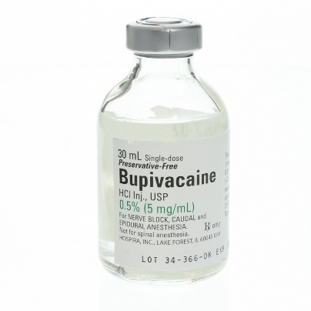
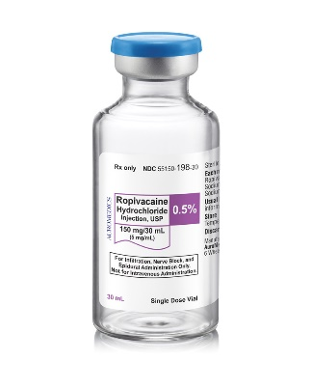
ROPIVACAINE:
Less toxic, long-lasting LA.
Undergoes extensive hepatic metabolism, with only 1% of the drug eliminated unchanged in the urine.
Ropivacaine is slightly less potent than bupivacaine.

Slide 65
Local Anesthetic Toxicity
CNS:
Initially circumoral numbness, dizziness, tinnitus, visual change. Later drowsiness, disorientation, slurred speech, loss of consciousness, convulsions & finally respiratory depression
Cardiovascular System:
Myocardial depression and vasodilation-- hypotension and circulatory collapse
Allergic reactions:
rare (less than 1%) rash, bronchospasm

Slide 66
Prevention and Treatment of Toxicity
All Cases: Assure adequate ventilation & administer supplemental Oxygen.
Seizures: Midazolam
Hypotension: Trendelenburg position
(head down , legs up),
IV fluid bolus (Isotonic Saline or LR),
Vasopressor (Dopamine if refractory to above).
Dysrhythmias: As per ACLS protocol (but do not administer further Lidocaine)

Slide 67
Thank You

Slide 68
CASE DISCUSSION
A 4 years old male patient booked for Rt. eye squint surgery.
How you will assess this patient preoperatively?
Discuss fasting time & premedication?
The patient seen in preoperative anesthesia clinic & cleared
What are the physiological difference b/w adult & pediatric patient?
Discuss anesthesia consideration & special concern for such surgery?
Discuss anesthesia plan?
During surgery the patient developed severe bradycardia
Discuss the cause and treatment?
Surgery lasted for 2 hours, extubated & shifted to recovery
What is your post-operative treatment plan?

