Slide 1
Anaesthetic emergencies in the operating theatre
&post operative complications
Dr. Ashraf Arafat
Assistant Professor , KSU

Slide 2
Intraoperative complications
Damage to teeth
Endotracheal tube –
Kinks,
Obstruction,
Endobronchial;
Airway – failed intubation, laryngeal spasm, foreign body, aspiration;
Breathing – difficult to ventilate, e.g.
Tube occlusion,
Bronchospasm,
Pneumothorax,
Aspiration,
Lack of neuromuscular blocking drug (NMBD),
Pulmonary oedema;
Others related to CVP line (pneumothorax )
Intraoperative hypotension
Excess anaesthetic agent,
Hypovolaemia ,
Myocardial ischaemia/MI,
Dysrhythmia,
Sepsis,
Tension pneumothorax,
Sympathetic block
(e.g. spinal or epidural);

Slide 3
Aspiration
Definition:- inhalation of gastric contents can occur in patients who do not have impaired protective airway reflexes.
Patients at risk include:
Full stomach
Delayed gastric emptying (e.g. bowel obstruction, pregnancy .
Insufficient/lack of cricoid pressure at induction of anaesthesia.
Signs :
• SaO2
• Wheeze/stridor
• Tachycardia
• Airway pressure
Gastric contents visible within breathing circuit/airway adjunct (e.g. LMA)

Slide 4
Treatment
100% oxygen
Call for help
30% Head-down position to prevent/limit aspiration
Oropharyngeal suction
Tracheal intubation & suctioning if needed,
Postoperatively: physiotherapy, oxygen, Antibiotics and steroids

Slide 5
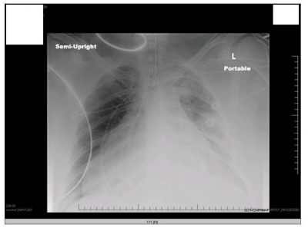

Slide 6
Air embolism
Definition: air embolism results from inadvertent introduction of air into the circulation, usually though the venous system.
Causes:
Neurosurgery (dural sinuses are non-collapsible)
Caesarean section .
Central line insertion.
Epidural catheter placement (if loss of resistance to air is used)
Entrainment through an intravenous line (especially if pressure-assisted)
Situations where high pressure gas is used (laparoscopy).

Slide 7
Signs:
Treatment:
100% Oxygen
Airway, breathing, circulation and call for help
Flood surgical site with saline
Position patient in Trendelenburg/left lateral decubitus position
Consider inserting a central venous catheter to aspirate gas
• HR
• BP
• SaO2
• ETCO2 (ventilation–perfusion mismatch)
• Murmur (millwheel,due to air circulating around the cardiac champers )

Slide 8
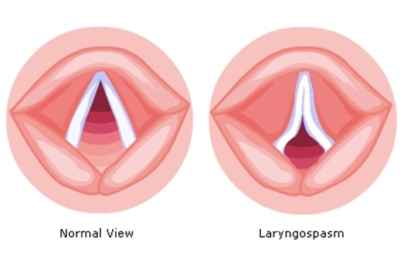
Laryngospasm
Definition:- is the complete or partial adduction of the vocal cords, resulting in a variable degree of airway obstruction.

Slide 9
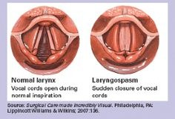

Slide 10
Laryngospasm
Signs
Partial/complete airway obstruction
Paradoxical respiratory effort in a spontaneously breathing patient (abdominal/ chest see-saw movements as respiratory effort attempts to overcome the obstruction).
Causes:
• Airway manipulation
• Surgical stimulus
• Blood/secretions in oropharynx
• Failure to deliver anaesthetic agent

Slide 11
Complications
SaO2
Aspiration
Bradycardia (especially in children)
Pulmonary oedema
Treatment
• Positive pressure ventilation with high flow oxygen (e.g. CPAP or IPPV)
• Deepening of anaesthesia
• Suxamethonium : with or without tracheal intubation .
NB: Some or all might be needed:

Slide 12
Failed intubation
Problems:
• Difficult mask ventilation
• Difficult laryngoscopy
• Difficult intubation
•Difficult supraglottic airway placement
Difficult surgical airway access
Failed intubation
Direct laryngoscopy
Any problems
Call for help

Slide 14
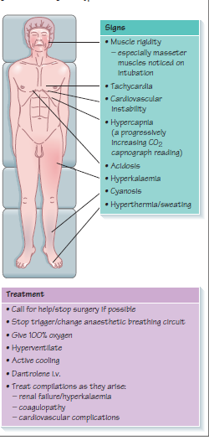
Malignant hyperthermia
Definition:- it occurs after exposure to a triggering agent (volatile anaesthetics or suxamethonium) and results in loss of normal calcium homeostasis within skeletal muscle cells.
Hypermetabolism leads to hypoxia, hypercapnia, hyperthermia
and acidosis.
Cell damage results in release of potassium,
myoglobin and creatine kinase.

Slide 15
Anaphylaxis
Definition:- an acute severe type 1 hypersensitivity reaction when an antigen (trigger) reacts with immunoglobulin IgE bound to histamine rich mast cells and basophils.
Symptoms :
• Anxiety
• Rash, itch
• Wheeze, shortness of breath
• Abdominal pain, diarrhoea, vomiting
• Chest pain
Signs:
• Angioedema, e.g. skin, lips, throat
• Rash, flushing, urticaria
• Tachycardia, bradycardia, dysrhythmias
• Hypotension
• Bronchospasm

Slide 16
Secondary treatment:
• Chlorpheniramine 10mg (H1 antagonist)
• Hydrocortisone 200mg
• Consider alternative vasopressor if unresponsive to epinephrine
• Consider salbutamol i.v./nebulizer, aminophylline,
• High dependency or intensive care transfer
Treatment:
Basic resuscitation based on Airway Breathing Circulation (ABC)
• Remove suspected cause
• Call for help
• 100% oxygen, tracheal intubation if necessary
• Elevate legs if hypotension
• Start cardiopulmonary resuscitation (CPR) if needed
• Give epinephrine 50μg in repeated doses; consider epinephrine infusion
• Give large volumes of fluid, e.g. normal saline

Slide 17
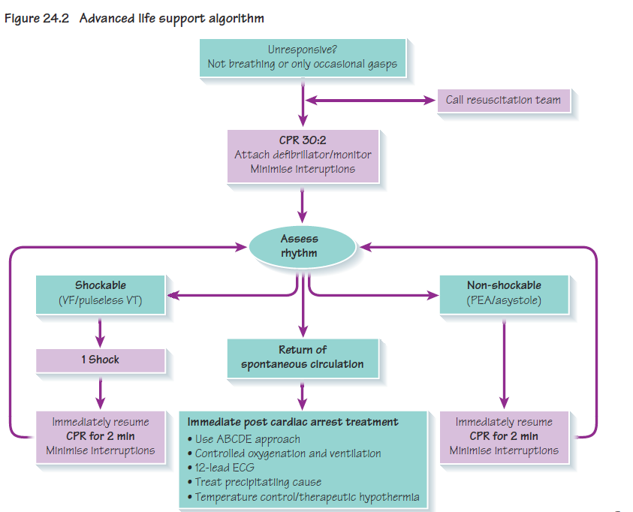

Cardiac arrest
Advanced life support algorithm

Slide 18
During CPR:
• Ensure high-quality CPR rate, depth, recoil
• Plan actions before interrupting CPR
• Give oxygen
• Consider advanced airway and capnography
• Continuous chest compressions when advanced airway in place
• Vascular access (intravenous, intraosseous)
• Give adrenaline every 3–5 min
• Correct reversible causes
Reversible causes:
• Hypoxia
• Hypovolaemia
• Hypo-/hyperkalemia/metabolic
• Hypothermia
• Thrombosis – coronary or pulmonary
• Tamponade – cardiac
• Toxins
• Tension pneumothorax

Slide 19
Status asthmaticus
This is a severe acute exacerbation of asthma refractory to conventional β2 agonist therapy and is a medical emergency.
Signs:-
• Tachypnoea;
• Use of accessory respiratory muscles (e.g. abdominal, sternocleidomastoid), intercostal and subcostal recession;
• Wheeze might be minimal or absent;
• Tachycardia;
• Pulsus paradoxus >10 mmHg (a reduction in blood pressure on inspiration);
• Sweating;
• Confusion.
Treatment
• Supplemental oxygen to maintain SaO294–98%;
• β2 agonist (either salbutamol or terbutaline) via O2 driven nebulizer;
• Steroids –i.v. hydrocortisone;
• Nebulized ipratropium (anticholinergic);
• I.v. magnesium sulphate .
Aminophylline.

Slide 20
Some specific complications of regional anaesthesia
Post-dural puncture headache
Very common after spinal anaesthesia and especially in young adults and obstetrics.
It is enhanced by use of larger-gauge needles and reduced by pencil-tipped needles.
Treated with analgesia, bed rest and adequate hydration , epidural blood patch , Caffeine , include gabapentin, theophylline and hydrocortisone
Total spinal block
It is detected by a high sensory level and rapid muscle paralysis.
May need to be intubated and ventilated until the spinal block wears off.
Hypotension
Neurological deficits
Cauda equina syndrome may occur and can be transient or permanent.
Adhesive arachnoiditis is a longer-term sequela of spinal anaesthesia, occurring weeks and even months later, results in gradual sensory and motor deficits from ischaemia and infarction of the spinal cord.

Slide 21
Post Anesthesia Care Unit (PACU)
Admission to PACU
Steps:
Coordinate prior to arrival,
Assess airway,
Administer oxygen,
Receive report from anesthesia personnel.
Monitor & Observe & Manage
  ➔ To Achieve
    Cardiovascular stability
    Respiratory stability
    Pain control
Discharge from PACU
Design should match function
Location:
  Close to the OR.
  Access to x-ray, blood bank & clinical labs.
Monitoring equipment
Emergency equipment
Personnel

Slide 22
Aldrete Score
Score | Activity | Respiration | Circulation | Consciousness | Oxygen Saturation
2 | Moves all extremities | Breaths deeply and coughs freely. | BP + 20 mm of preanesth. level | Fully awake | Spo2 > 92% on room air
1 | Moves 2 extremities | Dyspneic, or shallow breathing | BP + 20-50 mm of preanesth. level | Arousable on calling | Spo2 >90% With suppl. O2
0 | Unable to move | Apneic | BP + 50 mm of preanesth. level | Not responding | Spo2 <92% With suppl. O2

Slide 23
Common PACU Problems
Sore throat
“PONV”
General‐headache, dizziness, drowsiness
Bleeding
Agitation
Delayed recovery
Pain
Oliguria
• Shivering
• Fever
•
Airway obstruction
Hypoxemia
Hypoventilation
Hypotension
Hypertension
Cardiac dysrhythmias
Hypothermia

Slide 24
1. Airway Obstruction
Management of Airway Obstruction
Patient’s stimulation,
Suction,
Oral Airway,
Nasal Airway,
Others:
  Tracheal intubation
  Cricothyroidotomy
  Tracheotomy
Most common causes:
Posterior tongue displacement
Soft tissue collapse ➔ posterior pharynx
Larynx (laryngeal edema, laryngospasm,
vocal cord paralysis),
Trachea due to extrinsic compression
May be foreign body
Inadequate relaxant reversal
Residual anesthesia,

Slide 25
2. Hypoventilation
Causes
Residual anesthesia
  Narcotics
  Inhalation agent
  Muscle Relaxant
Treatment of Hypoventilation
Close observation,
Assess the problem,
Treatment of the cause:
  Reverse (or Antidote):
    Muscle relaxant ⇦ Neostigmine
    Opioids ⇦ Naloxone
    Midazolam ⇦ Anexate

Slide 26
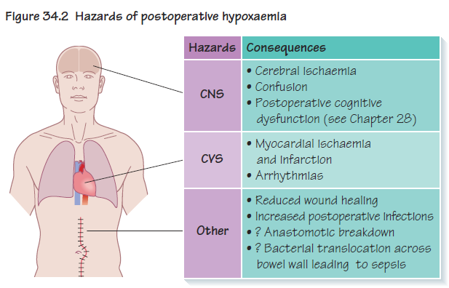

Slide 27
3. Hypertension
Common causes: e.g.
  Pain
  Full Bladder
Hypertensive patients :aggravated, by hypothermia, hypoxemia, hypercapnia, confusion or pain.
Fluid overload
Excessive use of vasopressors
Treatment of Hypertension
Effective pain control
Sedation
Anti-hypertensives:
  Beta blockers
  Alpha blockers
  Vasodilating medicine
  Hydralazine (Apresoline)
  Calcium channel blockers
Untreated case can result in neurological & cardiovascular complications

Slide 28
4. Hypotension
Causes :
Decreased venous return
  Hypovolemia, most common
    ⬇ fluid intake
    ⬆ losses
    Bleeding
  Sympathectomy,
  Cardiac arrhythmias
  3rd space loss,
  Left ventricular dysfunction

Slide 29
5. Dysrhythmias
Mostly benign
Causes :
Secondary to
  Hypoxemia
  Hypercarbia
  Hypothermia
  Altered acid–base status
  Catecholamines
  Electrolyte abnormalities.
  Previous cardiovascular diseases
Treatment of Dysrhythmia
Early recognition of arrhythmia
Treat the cause,
Stabilizing hemodynamics
Assure oxygenation,
Pharmacological
N.B: Tachycardia, can lead to ischemia through increased
myocardial oxygen consumption

Slide 30
6. Urine Output
Oliguria
  Mechanical blocking of catheter.
  Hypovolemia,
  Surgical trauma,
  Impaired renal function,
Treatment:
  Assess catheter patency
  Fluid bolus
  Diuretics e.g. Lasix

Slide 31
7. Post op Bleeding
Causes:
Usually Surgical Problem :poor surgical hemostasis
Coagulopathy,
Drug induced
Treatment:
Start i.v. lines ➢ push fluids
Blood sample,
  CBC,
  Cross matching,
  Coagulopathy
Notify the surgeon, immediate reoperation if needed
Correction of the cause

Slide 32
8. Hypothermia
Most of patients will arrive cold
Treatment:
  Get baseline temperature
  Actively rewarm, warming mattress, fluid warmers and warm liquids, room temperature
  Shivering TREATED by oxygen, pethidine, Tramadol, α2-Adrenergic Agonists, Clonidine, Dexmedetomidine
  , ketamine, Ondansetron,
  Take care for:
    Pediatric,
    Geriatric.
Risk Factors
Endocrine disorders such as hypothyroidism, hypothalamic dysfunction hypoadrenalism .
Severe burns and other dermal diseases .
Extremes of age .
Drug, including alcohol

Slide 33
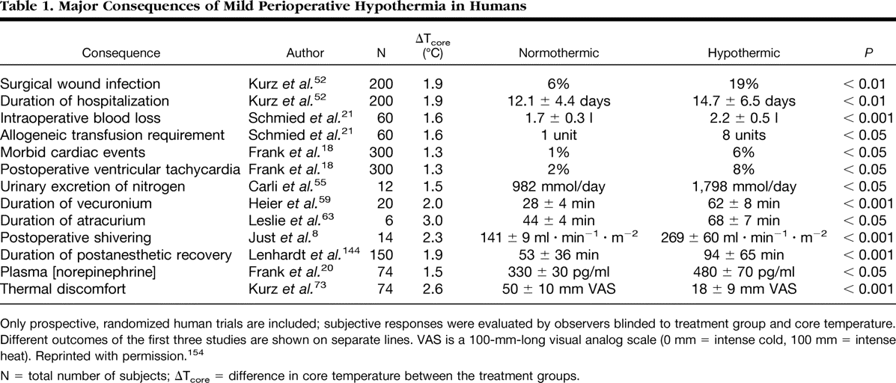

Slide 34
9. Neurologic complications
Emergence delirium, a state of psychomotor agitation with disorganized thinking
and emotional distress after emerging from general anesthesia
Causes :
Reaction to drugs?
  Drugs e.g. sedatives, anticholinergics
  Drug abusers
Pain
Full bladder
Hypoventilation
Low COP
CVA
Treatment
Reassurances,
Preventing from injury or damage
Evaluate the cause,
Treatment of symptoms,
Sedatives / Opioids if necessary.

Slide 35
10.Residual neuromuscular block or re-relaxation
General weakness
Inability to speak, cough, swallow or smile
Inability to breathe deeply
Trouble lifting head for > 5 s.
Weak hand grip
Blurred or double vision
Trouble keeping eyes open for > 5 s.
If not detected, it leads to:
Post-operative pulmonary complications:
Breathing difficulties,
Airway obstruction,
Aspiration of gastric contents,
Retention of carbon dioxide.

Slide 36
11. Delayed Recovery
Systematic evaluation
  Pre-op status
  Intraoperative events
  Ventilation
  Response to Stimulation
  Cardiovascular status
The most common cause:
  Residual anesthesia ➢ Consider reversal
Hypothermia,
Metabolic e.g. diabetic coma,
Underlying psychiatric problem
CVA

Slide 37
12. Postoperative Nausea & Vomiting “PONV”
Risk factors
  Type & duration of surgery, (cholecystectomy, laparoscopic, gynecological)
  Type of anesthesia, General vs. regional anesthesia
  Drugs, opioids, nitrous oxide , volatile anesthetics
  Female sex
  Medical problems,
  History of PONV or Motion Sickness
  Non‐smoking
  Muscle relaxant antagonists
Prevention
Avoidance of general anesthesia
Avoidance of nitrous oxide
Avoidance of volatile anesthetics
Minimization use of opioids
Adequate hydration
NPO status
Dexamothasone, Ondansetron,
Metoclopramide, Droperidol,

Slide 38
13.Peripheral nerve damage
If a nerve is stretched, compressed for prolonged periods of time .
The most common nerves affected are :
The ulnar nerve
The common peroneal nerve.
More rarely, the brachial plexus.
The severity varies and recovery may be prolonged.

Slide 39
14.Awareness
This is extremely rare (0.03%)
Due to an inadequate depth of anesthesia during surgery,
it can cause:
Post-operative anxiety,
Depression
Post-traumatic stress disorder.
Prevented through the use of thorough monitoring and anesthetic use

Slide 40
15. Postoperative Pain
Causes:
Incisional Skin and subcutaneous tissue
Laparoscopy Insuflation of Co₂
Others:
  Deep cutting, coagulation, trauma
  Positional nerve compression, traction & bed sore.
  IV site needle trauma, extravasation, venous irritation
  Tubes drains, nasogastric tube, ETT
  Surgical complication of surgery
  Others cast, dressing too tight, urinary retention

Slide 41
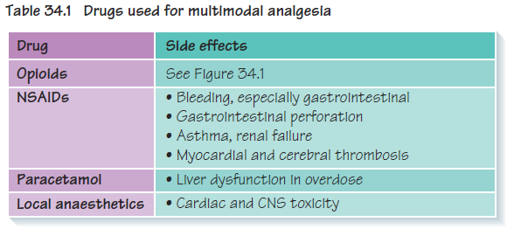
Analgesia

Slide 42
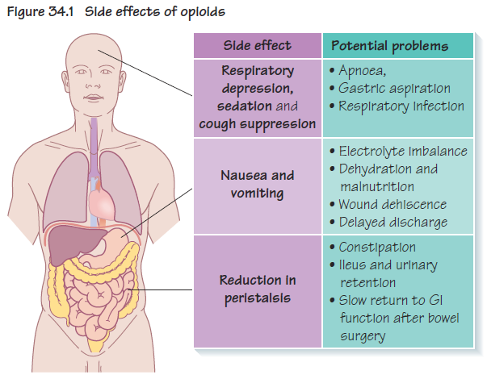

Slide 43
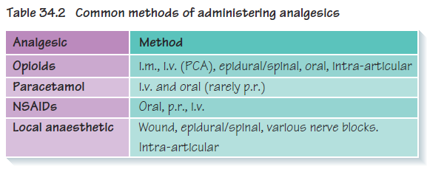

Slide 44
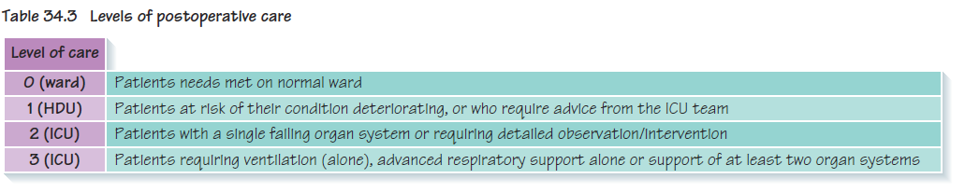
Referral to high dependency unit/intensive care unit

Slide 45


Thank
You

Slide 46
Normal core body temperature is approximately 37 °C.
The human body tightly controls core temperature through a variety of mechanisms including behavioral modification, autonomic nervous system stimulation, surface skin sweating, and increased heat production via shivering and non-shivering thermogenesis

