Slide 1
Vascular Access
Dr. Mueen Ullah Khan
Associate Professor and Consultant
Department of Anesthesia
King Saud University Riyadh

Slide 2
Lecture Objectives..
At the end of the lecture you will be able to:
Examine the construction of the commonly used venous catheters.
Anatomical considerations regarding peripheral and central venous access.
Choice of catheter size.
Prepare and set-up an IV infusion set.
The choice of sites for placement of IV catheters.
What are the different sites suitable for central venous catheter and arterial catheter placement?
Universal precautions.
Indications and complications of central venous access
Indications and complications of arterial access

Slide 3
Medical Asepsis
Removal or destruction of disease-causing organisms or infected material
Sterile technique (surgical asepsis)
Clean technique
Copyright © 2007, 2006, 2001, 1994 by Mosby, Inc., an affiliate of Elsevier Inc.

Slide 4
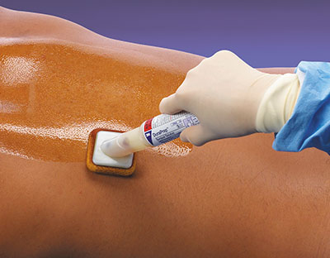
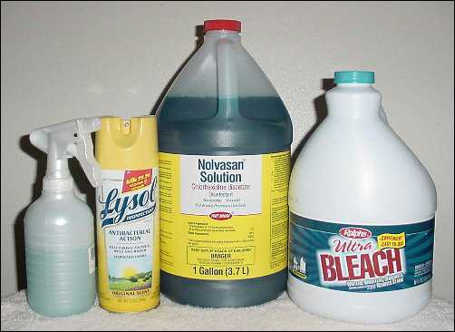
Antiseptics and Disinfectants
Chemical agents used to kill specific microorganisms
Disinfectants
Used on nonliving objects
Toxic to living tissue
Antiseptics
Applied to living tissue
More dilute to prevent cell damage
Some chemical agents have antiseptic and disinfectant properties
Copyright © 2007, 2006, 2001, 1994 by Mosby, Inc., an affiliate of Elsevier Inc.

Slide 5
Universal Precautions
Universal standard precautions on every patient
Observe hand washing and gloving procedures
Face shields indicated during clean procedures
Sterile gowns plus above all for sterile procedures.
In clean procedure like iv access no need ,just wash hand gloves

Slide 6
Types of IV Catheters
Hollow needles
Butterfly type
Indwelling plastic catheter over hollow needle
Indwelling plastic catheter inserted through a hollow needle
Intracath
Copyright © 2007, 2006, 2001, 1994 by Mosby, Inc., an affiliate of Elsevier Inc.

Slide 7
Needles
Vary in length and gauge
Larger gauge means a smaller needle
Copyright © 2007, 2006, 2001, 1994 by Mosby, Inc., an affiliate of Elsevier Inc.

Slide 8
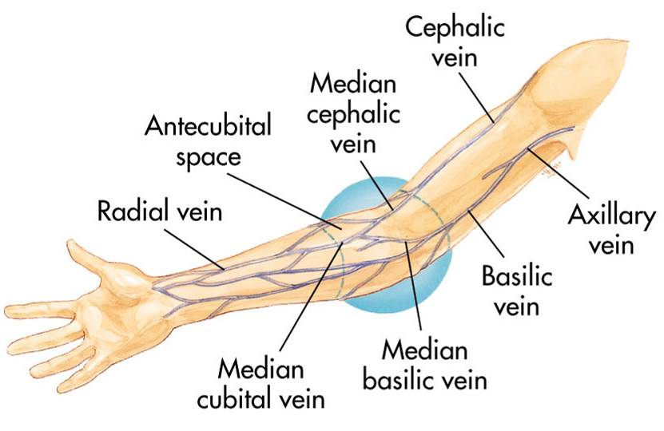
Peripheral IV Insertion
Common sites:
Hands and arms
Antecubital fossa (AC space)
Copyright © 2007, 2006, 2001, 1994 by Mosby, Inc., an affiliate of Elsevier Inc.

Slide 9
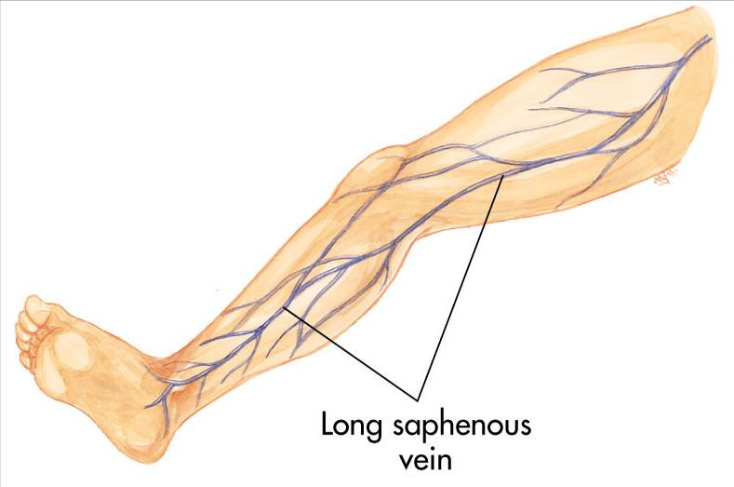
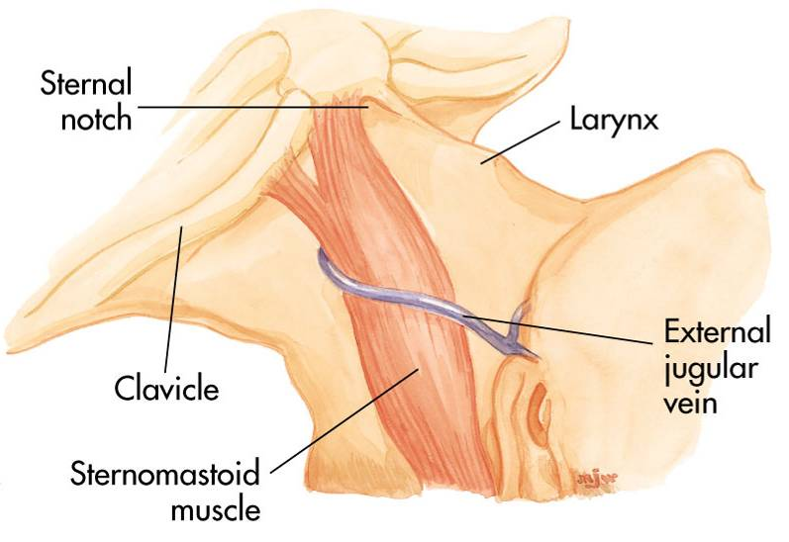
Peripheral IV Insertion
Alternate sites:
Long saphenous veins
External jugular veins
Embolism and infection rates higher
Copyright © 2007, 2006, 2001, 1994 by Mosby, Inc., an affiliate of Elsevier Inc.

Slide 10
Peripheral IV Insertion
Avoid sites that have injury or disease:
Trauma
Dialysis fistula
History of mastectomy
Copyright © 2007, 2006, 2001, 1994 by Mosby, Inc., an affiliate of Elsevier Inc.

Slide 11
Peripheral IV Procedure
Explain procedure
Assemble equipment
Inspect fluid for contamination, appearance, and expiration date
Prepare infusion set
Attach infusion set to bag of solution
Copyright © 2007, 2006, 2001, 1994 by Mosby, Inc., an affiliate of Elsevier Inc.

Slide 12
Peripheral IV Procedure
Clamp tubing and squeeze reservoir on infusion set until it fills half way
Open clamp and flush air from tubing
Close clamp
Maintain aseptic technique
Copyright © 2007, 2006, 2001, 1994 by Mosby, Inc., an affiliate of Elsevier Inc.

Slide 13
Peripheral IV Procedure
Select catheter:
Large-bore catheter used for fluid replacement
14 to 16 gauge
Smaller bore catheter used for “keep open” lines
18 to 20 gauge
Prepare other equipment
Copyright © 2007, 2006, 2001, 1994 by Mosby, Inc., an affiliate of Elsevier Inc.

Slide 14
Peripheral IV Procedure
Put on gloves
Select site
Apply tourniquet above antecubital space
Prepare site
Cleanse area with alcohol or iodine wipes (per protocol)
Check for iodine allergy
Copyright © 2007, 2006, 2001, 1994 by Mosby, Inc., an affiliate of Elsevier Inc.

Slide 15
Peripheral IV Procedure
Stabilize vein
Apply pressure and tension to point of entry
Copyright © 2007, 2006, 2001, 1994 by Mosby, Inc., an affiliate of Elsevier Inc.

Slide 16
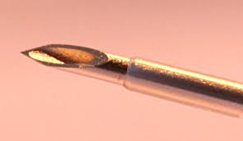
Peripheral IV Insertion
Bevel of the needle up in adults
May be down in infants and children
Pass needle through skin into vein from side or directly on top
Copyright © 2007, 2006, 2001, 1994 by Mosby, Inc., an affiliate of Elsevier Inc.

Slide 17
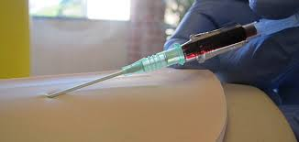
Peripheral IV Procedure
Advance needle and catheter about 2 mm past point where blood return is seen in hub of needle
Slide catheter over needle and into vein
Copyright © 2007, 2006, 2001, 1994 by Mosby, Inc., an affiliate of Elsevier Inc.

Slide 18
Peripheral IV Procedure
Withdraw needle while stabilizing catheter
Lock in protective sheath if present
Apply pressure on proximal end of catheter to stop escaping blood
Obtain blood samples if needed
Copyright © 2007, 2006, 2001, 1994 by Mosby, Inc., an affiliate of Elsevier Inc.

Slide 19
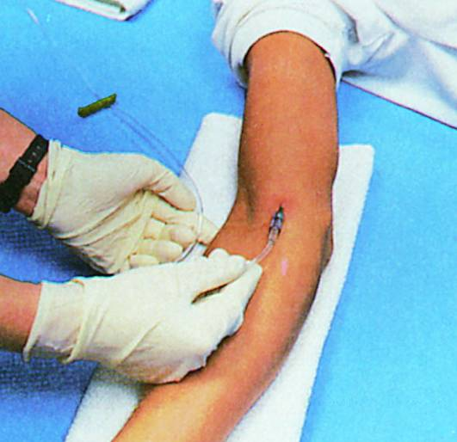
Peripheral IV Procedure
Release tourniquet
Attach IV tubing
Copyright © 2007, 2006, 2001, 1994 by Mosby, Inc., an affiliate of Elsevier Inc.

Slide 20
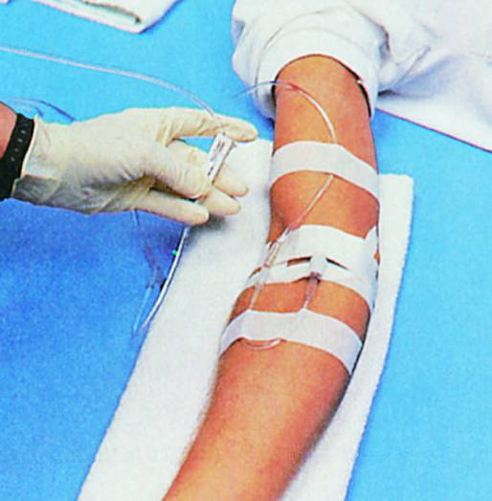
Peripheral IV Procedure
Open tubing clamp and allow fluid infusion to begin at prescribed flow rate
Copyright © 2007, 2006, 2001, 1994 by Mosby, Inc., an affiliate of Elsevier Inc.

Slide 21
Peripheral IV Procedure
Cover puncture site dressing
Antibiotic ointment if indicated by protocol
Anchor tubing
Secure catheter
Document procedure
Monitor flow
Copyright © 2007, 2006, 2001, 1994 by Mosby, Inc., an affiliate of Elsevier Inc.

Slide 22
Local Complications
Pain and irritation
Infiltration and extravasation
Phlebitis
Thrombosis and thrombophlebitis
Hematoma formation
Venous spasm
Vessel collapse
Cellulitis
Nerve, tendon, ligament, and limb damage
Copyright © 2007, 2006, 2001, 1994 by Mosby, Inc., an affiliate of Elsevier Inc.

Slide 23
Infiltration—Causes
Dislodgement of catheter or needle cannula during venipuncture
Puncture of vein wall during venipuncture
Leakage of solution into surrounding tissue from insertion site
Poorly secured IV
Poor vein or site selection
Irritating solution inflames vein’s intima
Improper cannula size
High delivery rate or pressure
Copyright © 2007, 2006, 2001, 1994 by Mosby, Inc., an affiliate of Elsevier Inc.

Slide 24
Infiltration—Signs & Symptoms
Cool skin around IV site
Swelling at IV site
With or without pain
Sluggish or absent flow
Infusion flows when pressure is applied to vein above tip of cannula
No backflow of blood into IV tubing when clamp is fully opened and solution container is lowered below IV site
Copyright © 2007, 2006, 2001, 1994 by Mosby, Inc., an affiliate of Elsevier Inc.

Slide 25
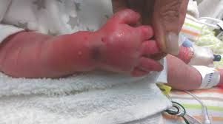

Slide 26
Infiltration—Management
Lower fluid reservoir to check for presence of backflow of blood into the tubing
Absence of backflow suggests infiltration
Discontinue IV infusion
Remove needle or catheter
Apply a pressure dressing to the site
Choose new site
Initiate IV therapy with new equipment
Document
Copyright © 2007, 2006, 2001, 1994 by Mosby, Inc., an affiliate of Elsevier Inc.

Slide 27
Central Venous Access
Requires special training
Authorization from medical direction
Not for rapid fluid replacement in pre-hospital setting
Within scope of paramedic practice in some EMS systems
Copyright © 2007, 2006, 2001, 1994 by Mosby, Inc., an affiliate of Elsevier Inc.

Slide 28
Central Venous Access
Common Sites include:
Femoral vein
Internal jugular vein
Subclavian vein
Copyright © 2007, 2006, 2001, 1994 by Mosby, Inc., an affiliate of Elsevier Inc.

Slide 29
Central Venous Access
Prepare as for peripheral veins
Sterile procedure
Success depends on:
Patient's body position
Knowledge of anatomy
Familiarity with the procedure and equipment
Copyright © 2007, 2006, 2001, 1994 by Mosby, Inc., an affiliate of Elsevier Inc.

Slide 30
Femoral Vein Anatomy

Slide 31
Femoral Vein Cannulation
Copyright © 2007, 2006, 2001, 1994 by Mosby, Inc., an affiliate of Elsevier Inc.

Slide 32
Internal Jugular Vein Anatomy
Copyright © 2007, 2006, 2001, 1994 by Mosby, Inc., an affiliate of Elsevier Inc.

Slide 33
Internal Jugular Vein Cannulation
Posterior approach
Posterior approach -> at the posterior head if SCM muscle , Also called the higher approach with a risk of injuring the cervical plexus or puncturing the vertebral arteries and causing a hematoma that would compress the nerve.
Copyright © 2007, 2006, 2001, 1994 by Mosby, Inc., an affiliate of Elsevier Inc.

Slide 34
Internal Jugular Vein Cannulation
Central approach→ easiest approach the needle is placed between the two heads of the muscle. , with a chance of hitting the dome of the lung.
Central approach
Copyright © 2007, 2006, 2001, 1994 by Mosby, Inc., an affiliate of Elsevier Inc.

Slide 35
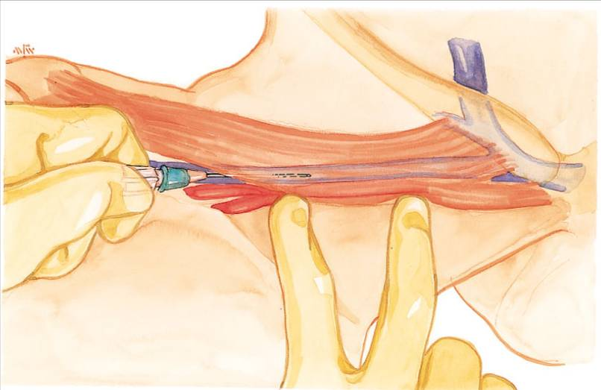
Internal Jugular Vein Cannulation
Anterior approach →at the anterior edge of the sternocledomatiod , with a chance of hitting the carotid artry
Anterior approach
Copyright © 2007, 2006, 2001, 1994 by Mosby, Inc., an affiliate of Elsevier Inc.

Slide 36
Subclavian Vein Anatomy
Copyright © 2007, 2006, 2001, 1994 by Mosby, Inc., an affiliate of Elsevier Inc.

Slide 37
Subclavian Vein Cannulation
Subclavian Vein Cannulation→ is found between the clavicle and the firt rib.
Copyright © 2007, 2006, 2001, 1994 by Mosby, Inc., an affiliate of Elsevier Inc.

Slide 38
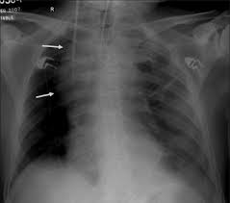
Central Venous Access

Slide 39
Central Venous Access
Indications
Available when peripheral vessels collapse
Access to central pressure measurements
In-hospital procedure
Safer vasopressor administration
Copyright © 2007, 2006, 2001, 1994 by Mosby, Inc., an affiliate of Elsevier Inc.

Slide 40
Central Venous Access
Disadvantages
Excessive time for placement
Sterile technique
Special equipment
Skill deterioration
High complication rate
Pneumothorax, arterial injury, abnormal placement
Chest x-ray should be obtained immediately
Copyright © 2007, 2006, 2001, 1994 by Mosby, Inc., an affiliate of Elsevier Inc.

Slide 41
Central Venous Access
Disadvantages
Can’t initiate during other patient care activities
Not generally considered to be a useful prehospital technique
Lower flow rates than peripheral IV
Copyright © 2007, 2006, 2001, 1994 by Mosby, Inc., an affiliate of Elsevier Inc.

Slide 42
Systemic Complications
Contamination and infection
Hypersensitivity reactions
Sepsis
Speed shock
Emboli (blood clot, air, and catheter)
Copyright © 2007, 2006, 2001, 1994 by Mosby, Inc., an affiliate of Elsevier Inc.

Slide 43
Air Embolism
Uncommon but can be fatal
Air enters bloodstream through catheter tubing
Risk greatest with catheter in central circulation
Negative pressure may pull air in
Copyright © 2007, 2006, 2001, 1994 by Mosby, Inc., an affiliate of Elsevier Inc.

Slide 44
Air Embolism
Air can enter circulation
During catheter insertion
If tubing is disconnected
If enough air enters the heart chamber:
Blood flow is impeded
Shock develops
Copyright © 2007, 2006, 2001, 1994 by Mosby, Inc., an affiliate of Elsevier Inc.

Slide 45
Air Embolism
Signs and symptoms
Hypotension
Cyanosis
Weak and rapid pulse
Loss of consciousness
Copyright © 2007, 2006, 2001, 1994 by Mosby, Inc., an affiliate of Elsevier Inc.

Slide 46
Air Embolism
Management
Close the tubing
Turn patient on left side with head down
Check tubing for leaks
Administer100% Oxygen
Notify medical direction
this directs the air to the apex of the heart and prevents it from reaching the pulmonary circulation
Copyright © 2007, 2006, 2001, 1994 by Mosby, Inc., an affiliate of Elsevier Inc.

Slide 47
Complications—Central Veins
Femoral vein
Local complications
Systemic complications
Internal jugular and subclavian veins
Local complications
Systemic complications
Copyright © 2007, 2006, 2001, 1994 by Mosby, Inc., an affiliate of Elsevier Inc.

Slide 48
Indwelling Vascular Devices
Heparin or saline lock
Copyright © 2007, 2006, 2001, 1994 by Mosby, Inc., an affiliate of Elsevier Inc.

Slide 49
Indwelling Vascular Devices
Single-, dual-, and triple-lumen catheters
Copyright © 2007, 2006, 2001, 1994 by Mosby, Inc., an affiliate of Elsevier Inc.

Slide 50
Ultrasound guided IV insertion

Slide 51
Ultrasound guided CVC insertion

Slide 52
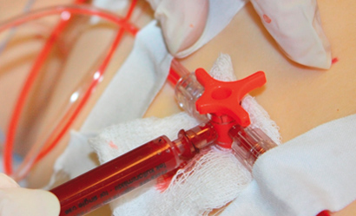
Arterial Line Placement
Provide continuous blood pressure (BP) monitoring
Arterial blood sampling

Slide 53
Arterial line placement Indications
Continuous arterial BP monitoring - more accurate than NIBP
Inability to use indirect BP monitoring (eg, in patients with severe burns or morbid obesity)
Frequent blood sampling
Frequent arterial blood gas sampling

Slide 54
Contraindications for arterial line placement
Absolute
Relative
Absent pulse
Thromboangiitis obliterans (Buerger disease)
Full-thickness burns over the cannulation site
Inadequate circulation to the extremity
Raynaud syndrome
Anticoagulation
Atherosclerosis
Coagulopathy
Inadequate collateral flow
Infection at the cannulation site
Partial-thickness burn at the cannulation site
Previous surgery in the area
Synthetic vascular graft

Slide 55
Technical Considerations
Not entirely without risks,
Requires appropriate knowledge of the anatomy and procedural skills.
Arterial line placement is considered a safe.
Major complications that is below 1%.
Common site of cannulation
radial, ulnar, brachial, axillary, posterior tibial, femoral, and dorsalis pedis arteries.

Slide 56
Allen test
The Allen test is a worldwide used test to determine whether the patency of the radial or ulnar artery is normal.
It is performed prior to radial cannulation or catheterization.
The test is used to reduce the risk of ischemia to the hand.

Slide 57
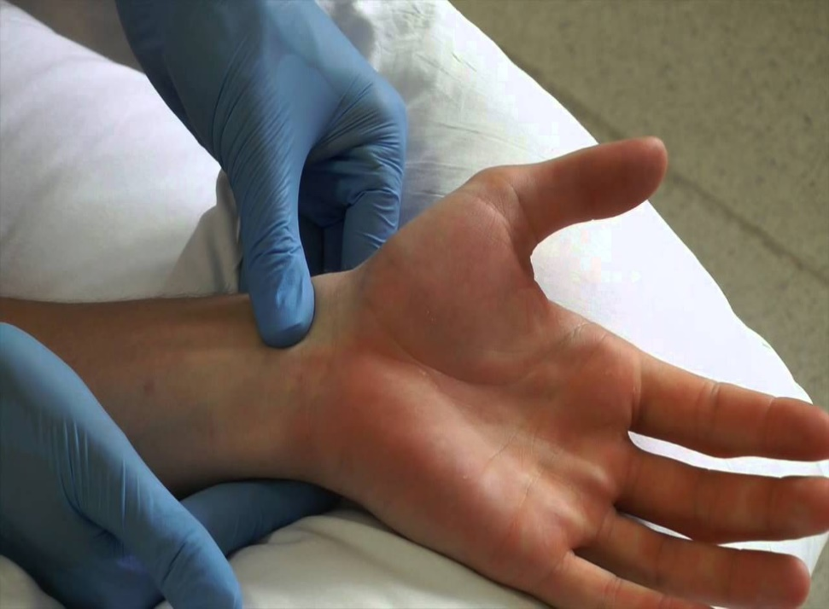
Allen test
Instruct the patient to clench his or her fist OR hand tightly.
Using your fingers, apply occlusive pressure to both the ulnar and radial arteries, to obstruct blood flow to the hand.
While applying occlusive pressure to both arteries, have the patient relax his or her hand, and check whether the palm and fingers have blanched. If this is not the case, you have not completely occluded the arteries with your fingers.

Slide 59
Allen test
positive
negative

Slide 60
Allen test- Release the occlusive pressure on the ulnar artery
Positive modified Allen test – hand flushes within 5-15 seconds it indicates that the ulnar artery has good blood flow; this normal flushing of the hand is considered to be a positive test.
Negative modified Allen test – If the hand does not flush within 5-15 seconds, it indicates that ulnar circulation is inadequate or nonexistent; in this situation, the radial artery supplying arterial blood to that hand should not be punctured.

Slide 61
Radial artery Aatomic consideration
Originates in the cubital fossa from the brachial artery
At the wrist, the radial artery sits proximal and medial to the radial styloid process and just lateral to the flexor carpi radialis tendon.

Slide 62
Femoral artery Anatomic consideration
Originates at the inguinal ligament from the external iliac artery
Medial to the femoral nerve and lateral to the femoral vein and lymphatics.

Slide 63
Arterial Line Placement Equipment
Sterile gloves
Sterile gauze
Sterile towels
Chlorhexidine or povidone-iodine skin preparation solution
1% Lidocaine needle
5-mL syringe
Appropriate-sized cannula for artery
Scalpel (No. 11 blade)
Nonabsorbable suture (3-0 to 4-0)
Adhesive tape or strips
Sterile nonabsorbable dressing
Three-way stopcock
Pressure transducer kit
Pressure tubing
Arm board of appropriate size for the patient (eg, neonate, pediatric, adult)
Needle holder
Intravenous (IV) tubing T-connector

Slide 64
Arterial Line Placement Patient Preparation
UNCOSCIOS PATIENT
Anesthesia/ Sedation is not required.
CONSCIOUS PATIENT
provided LA -lidocaine 1%
UNCOPERATIVE PATIENT
sedation or general anesthesia may be required.

Slide 65
Arterial Line Placement Positioning
The patient is placed in the supine position.
The arm is placed up on a flat surface in neutral position, with the palm up and the wrist adequately exposed.
The wrist is dorsiflexed to 30-45° and supported in this position with a towel or gauze under its dorsal aspect

Slide 66
Arterial Line Placement
The most commonly used methods
Catheter over needle
Catheter over wire (including direct Seldinger and modified Seldinger techniques)

Slide 67
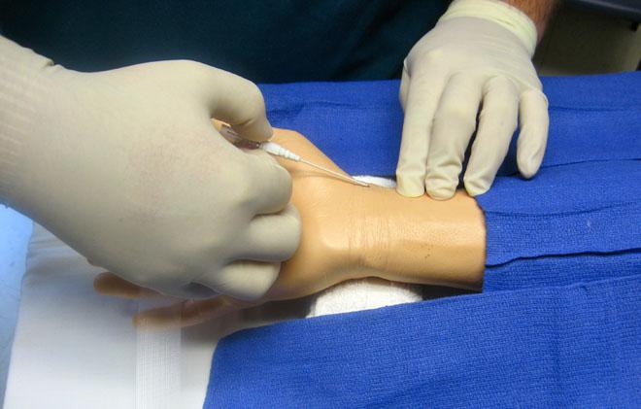
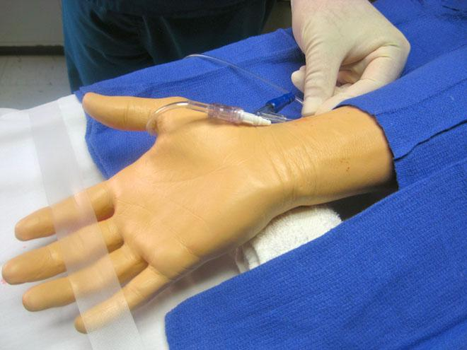
Catheter over needle technique

Slide 68
Catheter over needle technique

Slide 69
Radial artery cannulation (Seldinger). Advancement of catheter over guide wire.

Slide 70
Complications of arterial line placement
Common
Less common
Temporary radial artery occlusion (19.7%)
Hematoma/bleeding (14.4%)
Localized catheter site infection (0.72%) - The risk increases with the length of time the catheter is in place
Hemorrhage (0.53%)
Sepsis (0.13%)
Permanent ischemic damage (0.09%)
Pseudoaneurysm formation (0.09%)

