Slide 1
Cutaneous Manifestations Of Connective Tissue Disease (Lupus, Dermatomyositis and Scleroderma)
Prof. Fahad AlSaif Professor, Department of Dermatology, College of Medicine, King Saud University

Slide 2
Objectives
Differentiate between the various types of CLE
How to diagnose and investigate CLE
Identify all of the current treatment options available for CLE
To learn how to diagnose and investigate dermatomyositis.
How to manage dermatomyositis.
To learn the presentation of morphea and systemic sclerosis and ways to manage them

Slide 3
Cutaneous Lupus Erythematosus (CLE)
1

Slide 4
Cutaneous Lupus Erythematosus (CLE)
Lupus Erythematosus (LE): is a chronic, autoimmune disease that includes a broad spectrum of clinical manifestations.
Its course and organs involvement are unpredictable(Great Imitator) .
LE is divided into:
systemic form (SLE) and cutaneous form (CLE).
They can occur both together or separately

Slide 5
Cutaneous Lupus Erythematosus (CLE)
Cutaneous manifestations of LE can be divided based on histopathological findings into :
1- Histopathologically specific CLE:
Acute cutaneous LE (ACLE)
Subacute cutaneous LE (SCLE)
Chronic cutaneous LE (DLE)
2- Histopathologically non-specific LE-skin manifestations which are not exclusive to LE disease

Slide 6
Cutaneous Lupus Erythematosus (CLE)
Risk for systemic disease:
-ACLE: 100%
-SCLE: 50%
-CCLE: 10%

Slide 7
Cutaneous Lupus Erythematosus (CLE) EPIDEMIOLOGY
Incidence of CLE in Sweden and USA is 4/100,000.
The female to male ratio is about 6:1 for ACLE and about 3:1 for both DLE and SCLE
Skin involvement is seen in about 70 to 80% of LE patients. Cutaneous lesions constitute 4 of the 17 new criteria of SLE(ACLE, CCLE, oral ulceration and non-scaring alopecia). SLICC 2012 classification criteria
DLE is common among African Americans and SCLE is common in Caucasians.
DLE is the most common subset (80%).

Slide 8
- Lupus. 2010 Oct;19(12):1365-73. doi: 10.1177/0961203310374305.
Epidemiology of systemic lupus erythematosus in Asia.
Prevalence data are available from 24 countries, and generally fall within 30-50/100,000 population. However, one survey showed a higher prevalence of 70 (Shanghai), while three others showed a lower prevalence of 3.2-19.3 (India, Japan, Saudi Arabia).
Lupus. 2009 Apr;18(5):465-73. doi: 10.1177/0961203308100660.
Clinical and immunological manifestations in 624 SLE patients in Saudi Arabia.
Al Arfaj AS¹, Khalil N.
retrospective study, which covered a 27-year period (1980-2006), 624 SLE patients referring to King Khalid University hospital, Riyadh were included. There were 566 females and 58 males (9.8:1) with a mean age of 34.3 (range 8-71) years and mean age at disease onset of 25.3 years (range 0.08-67).
Journal of the Saudi Society of Dermatology & Dermatologic Surgery
Volume 16, Issue 1, January 2012, Pages 9-12
open access Discoid lupus erythematosus in a Saudi population: Clinical and histopathological study
Of the 56 DLE patients, females outnumbered males by 1.5:1. Mean age of onset was 36.5 ± 13.7 years and mean duration of the disease was 18.5 ± 24.6 months. Majority of patients (91.1%) had atrophic type. The scalp and face were the commonest sites of involvement.

Slide 9
Cutaneous Lupus Erythematosus (CLE) PATHOGENESIS
The pathogenesis of CLE remains unclear
CLE is multifactorial and polygenic.
Complex interactions between genetics, environment, and cells.
More than 25 risk loci have been identified.
Ultraviolet radiation
Drug-induced subacute CLE and DLE: hydrochlorothiazide, terbinafine, TNF-α inhibitors, antiepileptic, minocycline and proton-pump inhibitors.

Slide 10
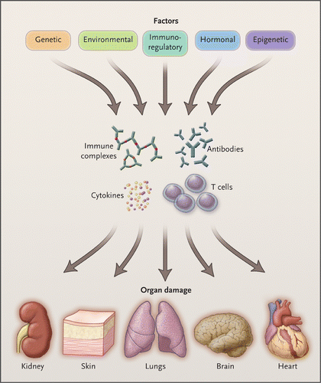

Slide 11
Cutaneous Lupus Erythematosus (CLE) Histopathology
Focal or continuous epidermal atrophy
Follicular keratin plugs
Vacuolar degeneration along the dermoepidermal junction zone
Individual necrotic keratinocytes
Thickening of basement membrane
Abundant interstitial mucin deposits in the reticular dermis
Moderate to dense superficial and deep perivascular and periadnexal lymphocytic infiltrate

Slide 12
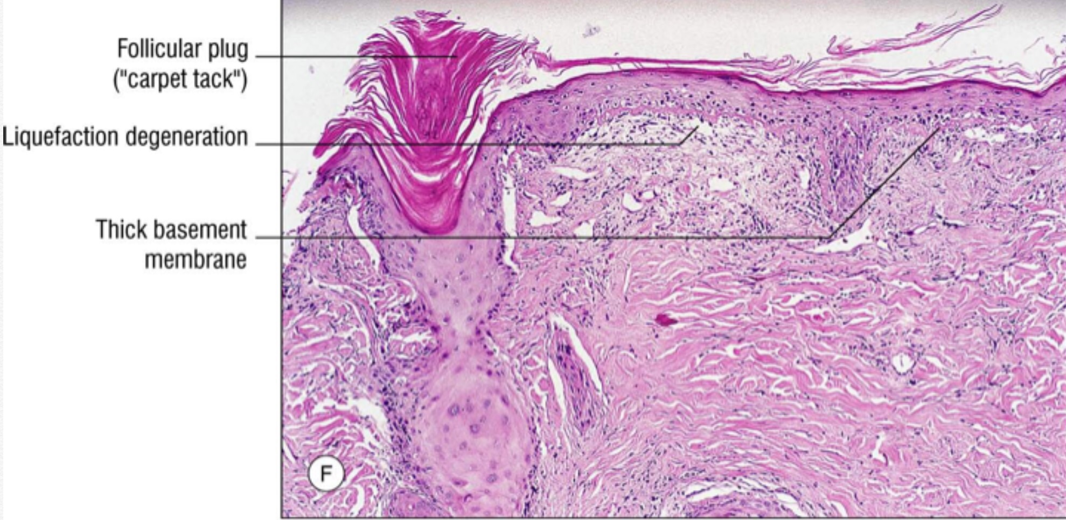

Slide 13
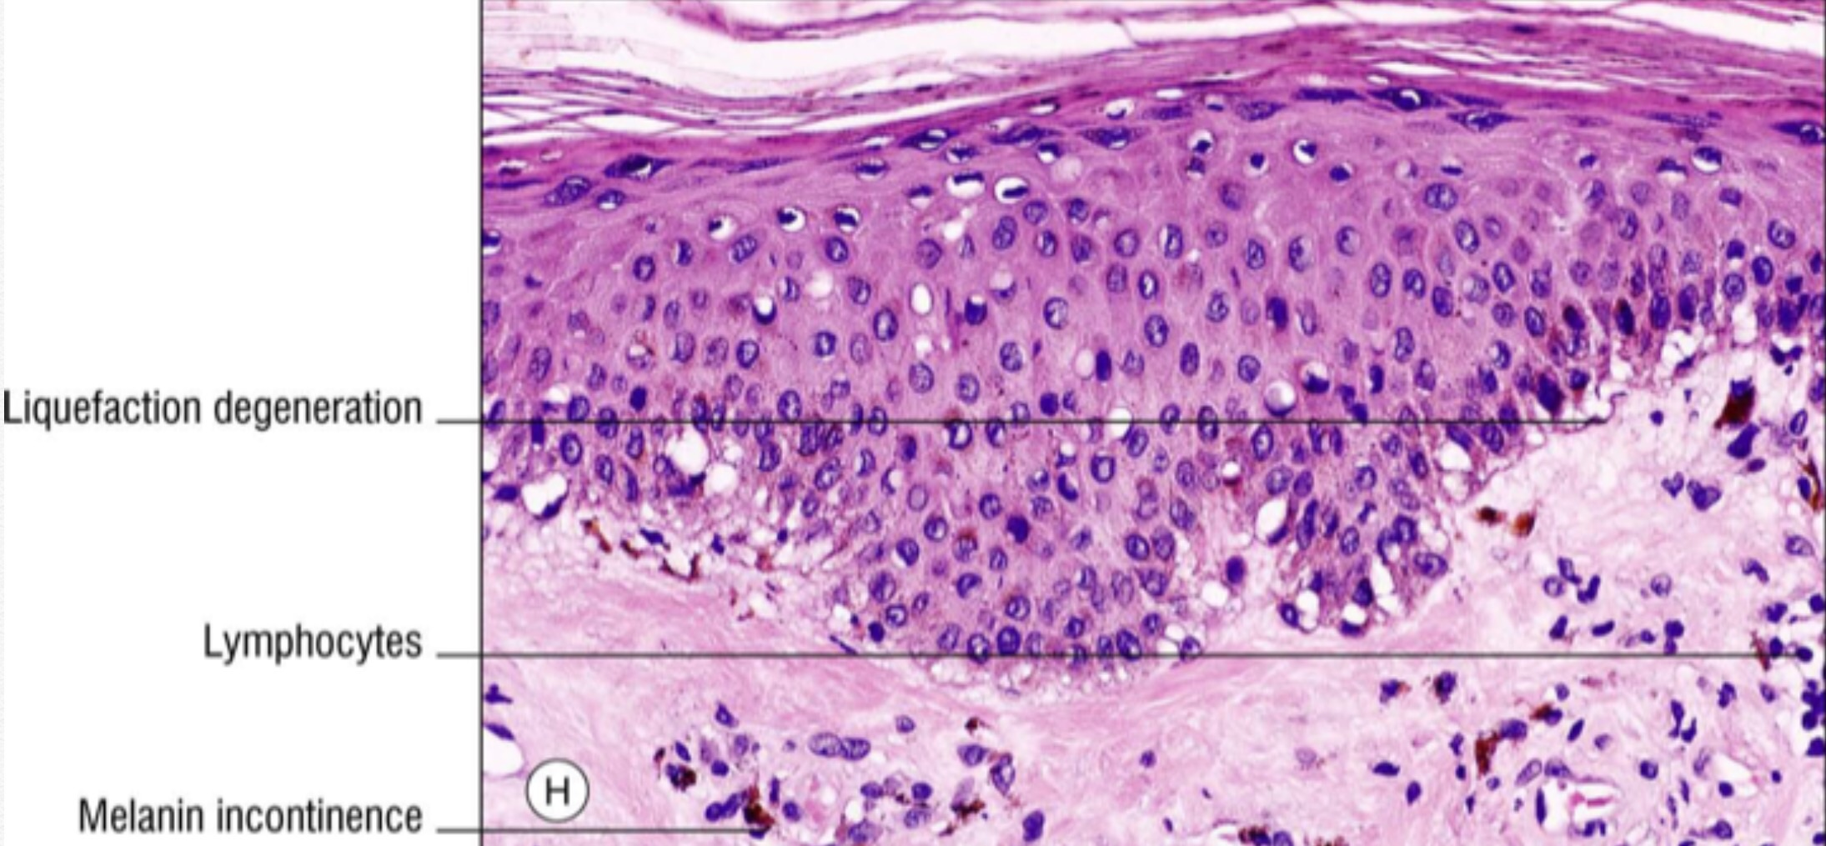

Slide 14
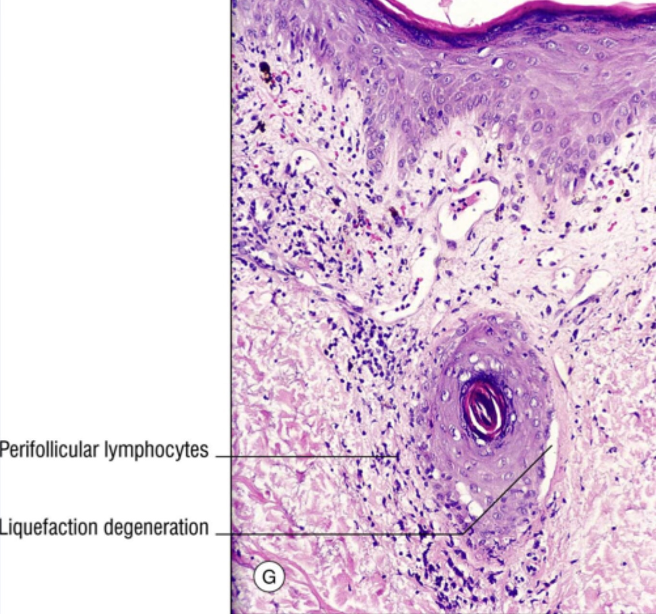

Slide 15
LE-specific skin manifestations

Slide 16
1- Acute CLE :
Almost always associated with systemic disease
Localized (concentrated above the neck) or generalized
Malar rash or butterfly erythema is the most typical localized lesion.
An erythema (and/or oedema) over the malar eminence with a tendency to spare the nasolabial folds

Slide 17
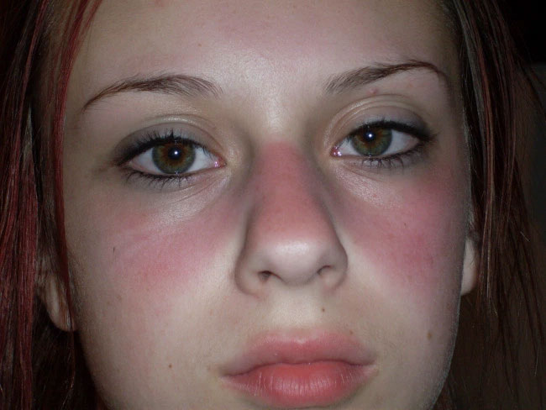

Slide 18
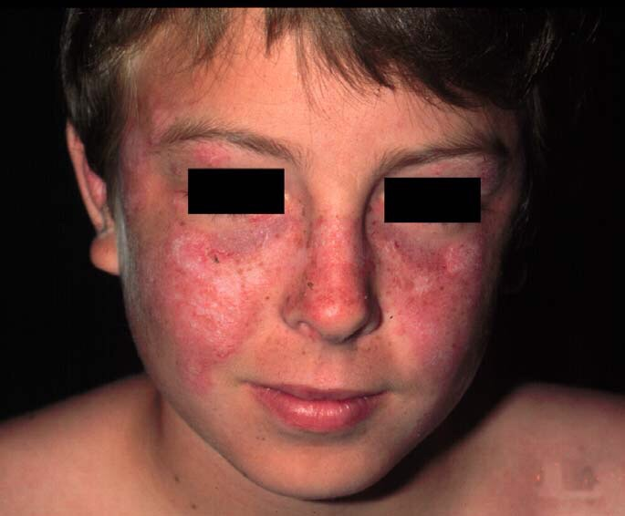

Slide 19
1- Acute CLE :
The generalized form of acute CLE is uncommon.
Generalized maculo-papular exanthema or Photosensitive lupus dermatitis
Preferably located to sun-exposed areas
Associated with a previous sun exposure

Slide 20
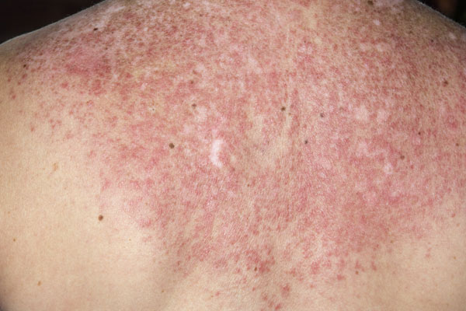

Slide 21
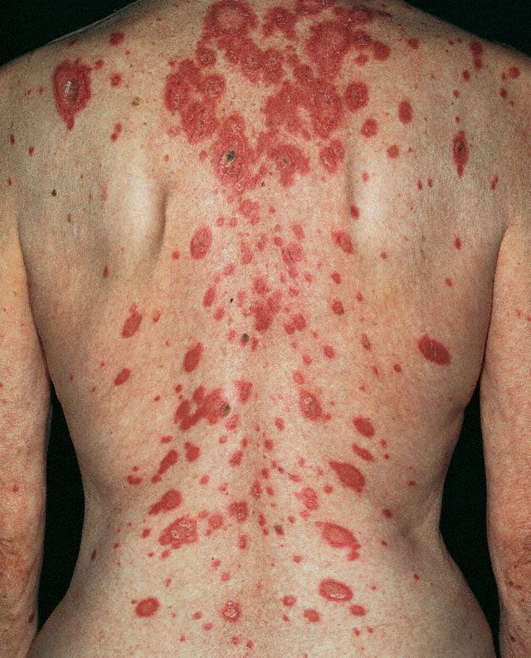

Slide 22
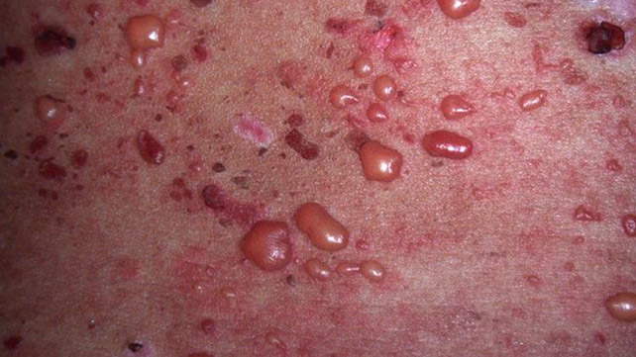

Slide 23
2-Subacute CLE :
Subgroup of SLE with well-defined cutaneous and serological features.
There are two morphologic variants of SCLE:
1- Psoriasiform type 2- Annular, polycyclic type
Photosensitivity (triggering factor)
Subacute CLE is strongly associated with the anti- Ro/SSA and anti-la.
15-20% of SCLE patients also have other types of CLE lesions
50% of SCLE patients fulfill the American College of Rheumatology (ACR) criteria for SLE

Slide 24
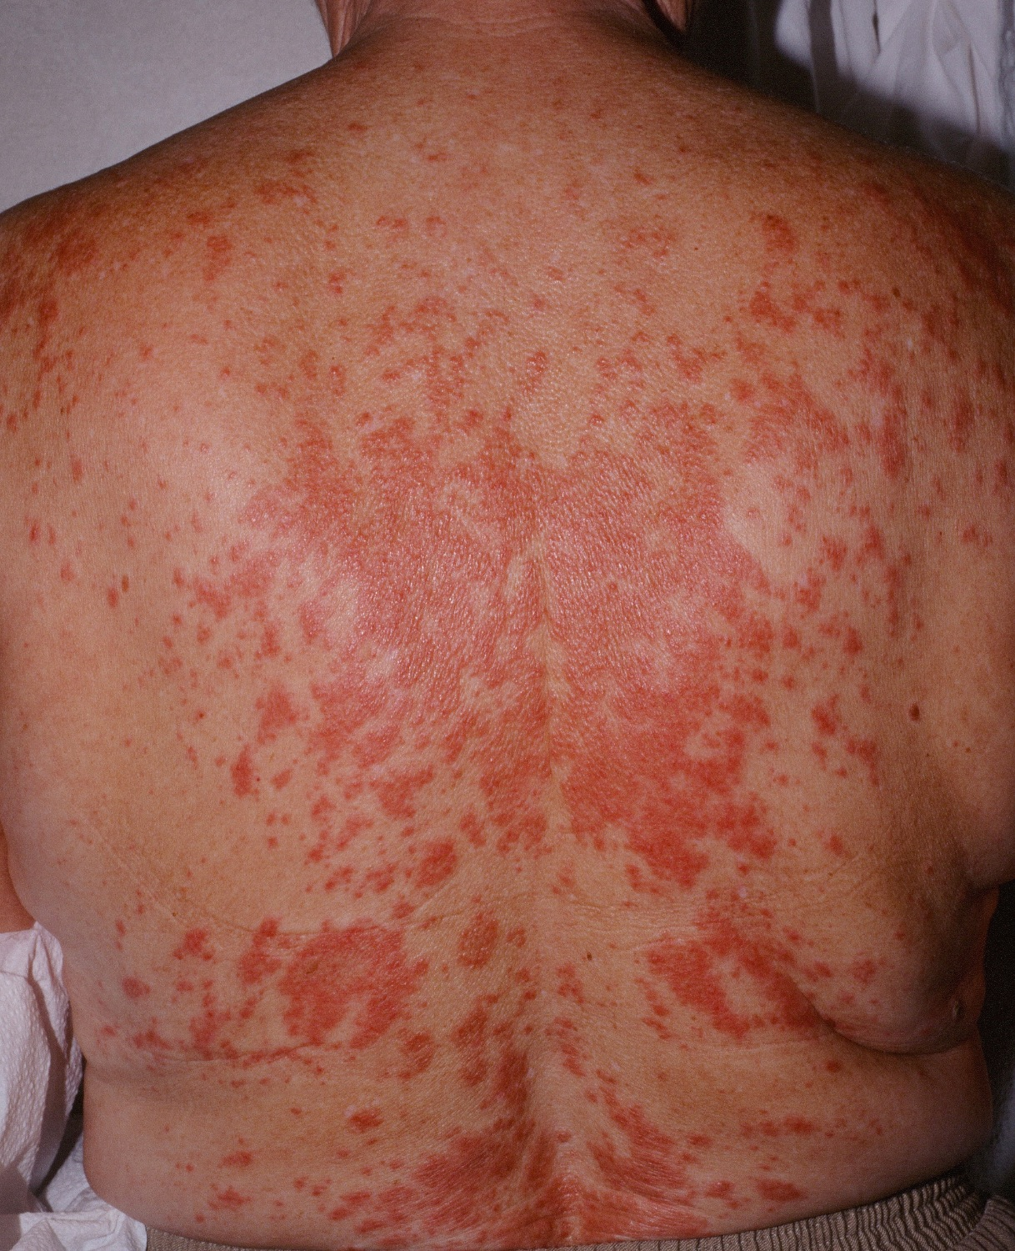

Slide 25
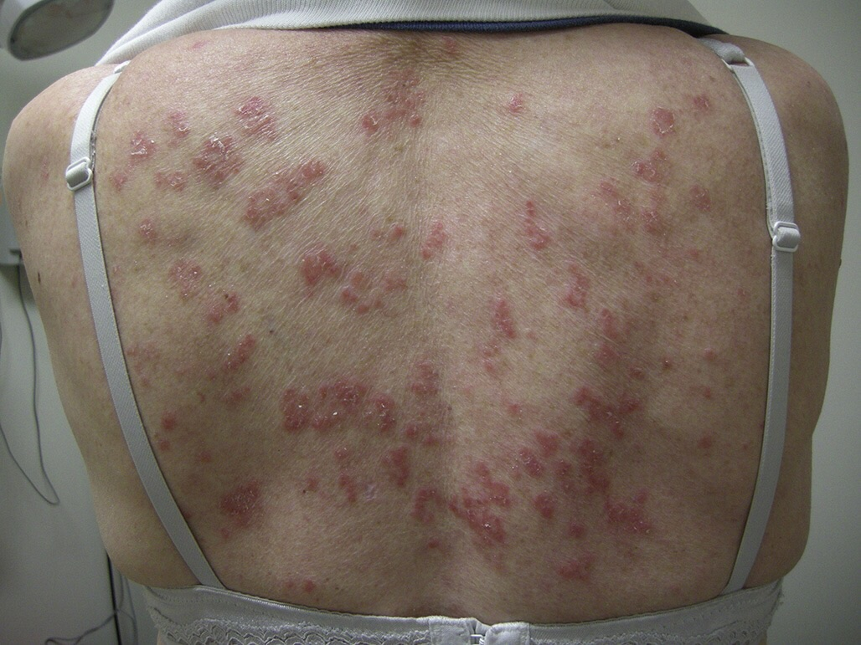

Slide 26
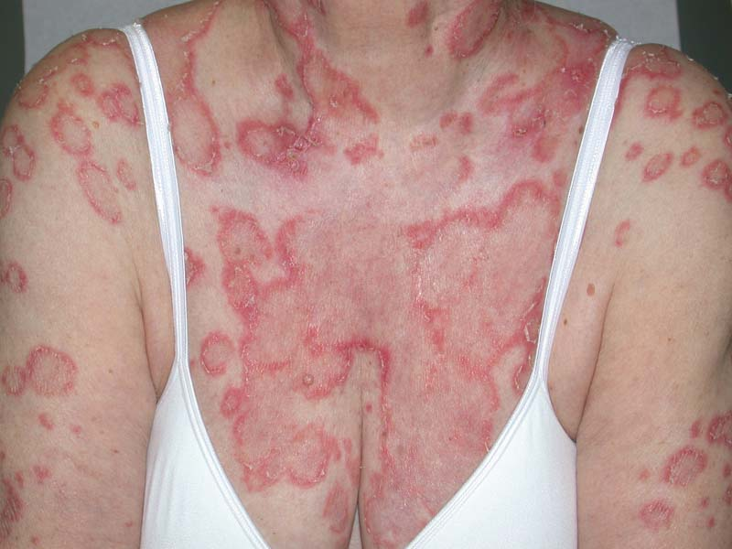

Slide 27
NEONATAL LE :
Develops in fetuses whose mothers have anti-Ro/SSA and/or anti-La/SSB antibodies and more rarely Ribonucleoprotein (RNP) antibodies
Transmission of antibodies over the placenta which can cause congenital heart block and cutaneous manifestations
Resolve spontaneously as the titers of maternal antibodies degrade within the first 6 months

Slide 28
NEONATAL LE :
Photosensitivity
Cutaneous signs include a SCLE-like rash, erythematosus, non-scarring annular plaques most typical occurrence in the face and especially peri-orbital (“raccoon or owl eye”)
Complete Heart block – 90% (need for pacemaker placement )
Hepatobiliary disease, hemolytic anemia and thrombocytopenia or leucopenia

Slide 29
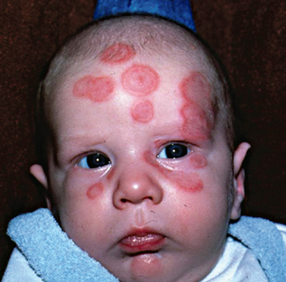

Slide 30
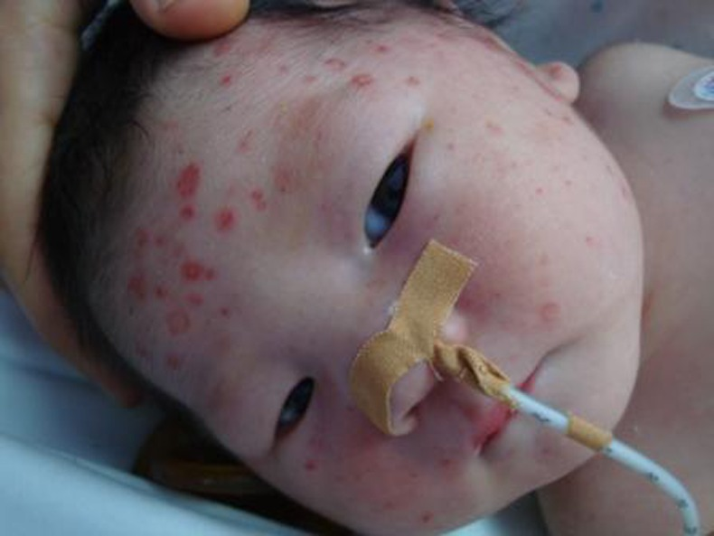

Slide 31
3-Chronic CLE:
A- Discoid LE is the most common subtype of CCLE
60-80% is localized form above the neck and 20-40% is generalized form.
Classical lesion: atrophic, hyperkeratotic with hypopigmentation in the center and hyperpigmentation in the periphery with telangiectasia.
Scalp, ears and cheeks are the most commonly involved areas
Have a chronic course, less chance of remission. More difficult to control

Slide 32
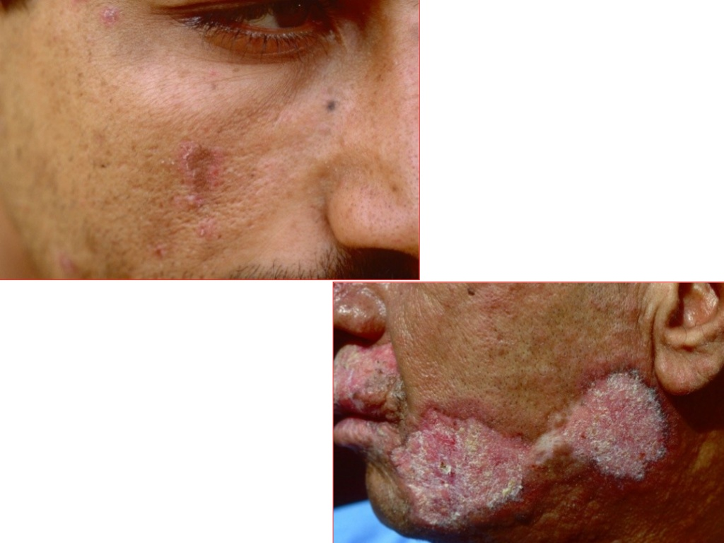

Slide 33
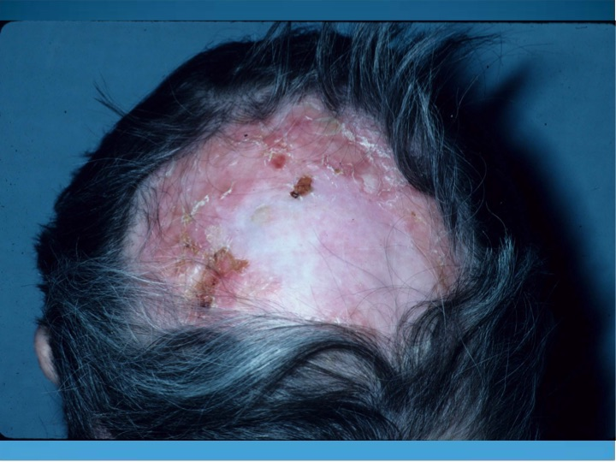

Slide 35
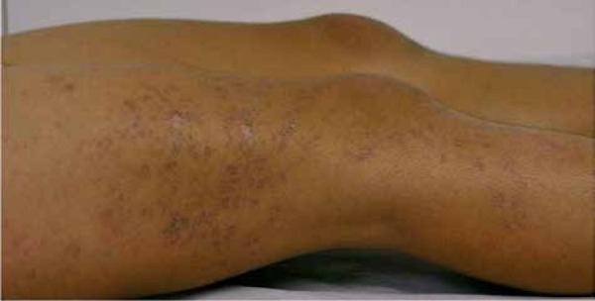

Slide 36
3-Chronic CLE:
B-Verrucous or hypertrophic LE
Wart-like lesions most often on the arms and/or hands
Typical DLE lesions elsewhere
Differential diagnosis – warts, KA, SCC

Slide 37
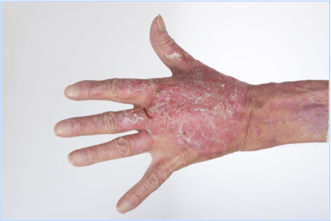

Slide 38
3-Chronic CLE:
C- LE profundus (panniculitis):
Rare presentation of CCLE
Multiple painful, firm, subcutaneous nodules or plaques
Upper arms, shoulders, buttocks, or face.
DDx: Morphea profunda, erythema nodosum and subcutaneous panniculitis-like T-cell lymphoma

Slide 39
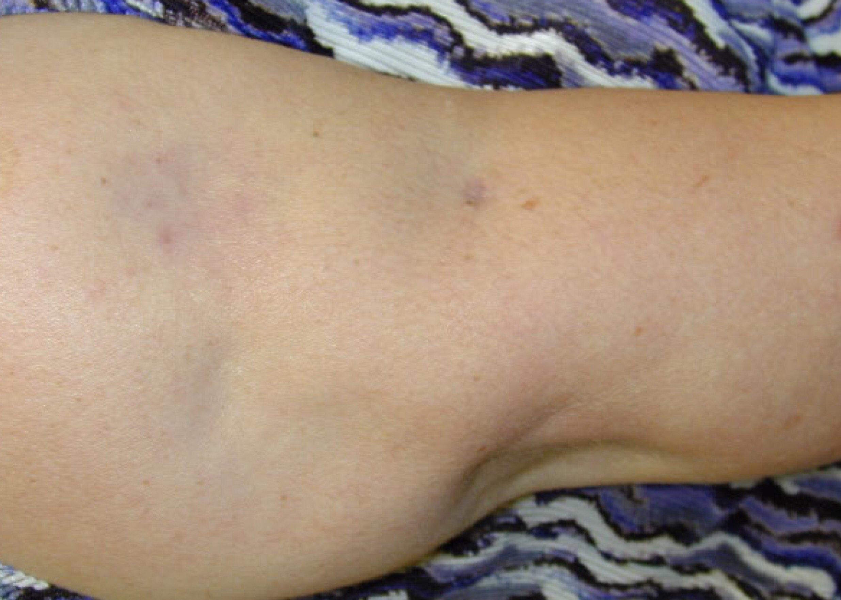

Slide 40
3-Chronic CLE:
D- Lupus Erythematosus Tumidus
Onset in summer
Photosensitivity > 70%(sever type).
Erythematous, edematous, urticarial-like plaques usually over face
Histopathology – periadnexal, perivascular lymphocytic infiltrate with increased mucin
ANA < 10%
Systemic disease – very rare

Slide 41
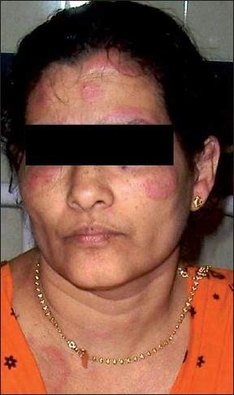

Slide 42
Histopathologically non-specific LE-skin manifestations
photosensitivity
Vasculitis: Palpable and nonpalpable purpura Urticarial-like vasculitis (Hypocomplementemic urticarial vasculitis)
Vasculopathy: Raynouds phenomenon, Livedo reticularis , Erythromelalgia
Urticaria
Non-scarring alopecia: telogen effluvlum, AA, lupus hair
Oral lesions
Bullous lesions( non-specific)
Acanthosis nigricans

Slide 43
Mucinous infiltration
Porphyria cutanea tarda.
Acanthosis nigricans.
Calcinosis Cutis

Slide 44
Differential diagnosis:
CCLE: PS, sarcoidosis, LP
SCLE : PMLE, rosacea, PS diseases, EAC, other figurate erythemas, DM
Tumid LE : Sarcoid, BLI, PMLE, REM
ACLE : rosacea, drug-induced photosensitivity, DM

Slide 45
Cutaneous Lupus Erythematosus (CLE) Workup
Goal: confirm diagnosis and assess for systemic involvement
Thorough review of history and examination
Skin biopsy: H&E and lesional DIF
Basic labs: CBC, LFT’s, creatinine, inflammatory markers (ESR, CRP), urinalysis
Autoimmune serologies,: ANA, dsDNA, complement (C3, C4, total), anti-phospholipid Abs
If considering systemic therapy: Eye exam (antimalarials), hepatitis serologies (methotrexate), thiopurine methyltransferase (TPMT; azathioprine

Slide 46
Cutaneous Lupus Erythematosus (CLE) Management
Goal
Reassure the patient
Improve the patient’s appearance
Prevent the formation of scars, dyspigmentation and atrophy
Stop the formation of new lesions

Slide 47
Cutaneous Lupus Erythematosus (CLE) Management
TREATMENT
A. Prevention
Patient education.
Heat, sun, and drug avoidance is standard
Strict sunscreen adherence is a critical component of therapy, as UVA and UVB irradiation has been shown to induce CLE lesions
B. Topical Therapies
-steroids
-calcineurin inhibitors

Slide 48
Cutaneous Lupus Erythematosus (CLE) Management
C. Systemic Therapies
First-line Systemic Therapies
1- Antimalarial Drugs :
-considered first-line systemic therapy
-Hydroxychloroquine sulfate
-6.5 mg/kg/day

Slide 49
Cutaneous Lupus Erythematosus (CLE) Management
Side effects of antimalarials include xerosis, exanthematous or lichenoid drug eruptions, urticaria, blue-gray skin hyperpigmentation, ocular toxicity, gastrointestinal upset, myopathy, cardiomyopathy, and rare central nervous system side effects (dizziness, headache, insomnia, psychosis).
2- Systemic Corticosteroids:
prednisone of 0.5 to 1.0mg/kg/da
Second-line Systemic Therapies
1- Immunosuppressants:Azathioprine, Methotrexate, Mycophenolate mofetil
2- Biologics : Rituximab
3- Immunomodulators: Thalidomide

Slide 50
Dermatomyositis (DM)
2

Slide 51
Dermatomyositis (DM)
A subtype of idiopathic inflammatory myopathies (IIMs)
Characterized by skin rash, proximal muscle weakness, and inflammatory infiltrates in the muscle tissue.

Slide 52
Dermatomyositis (DM) EPIDEMIOLOGY
Rare disease
10 /1,000,000 in adults and 3.2/1,000,000 in children
Adult F:M is 2:1
Two peaks of onset: ages 10-15, 45-55

Slide 53
Dermatomyositis (DM) Clinical presentation
1- Pathognomonic Cutaneous manifestations :
A- heliotrope rash : violaceous to dusky erythematous rash with or without edema in a symmetrical distribution involving upper palpebra skin
B- Gottron’s papules : slightly elevated, violaceous papules and plaques over extensor surface of finger joints
C- Gottron’s sign: symmetric, nonscaling, violaceous to erythematous macules or patches, often atrophic, in the same distribution as Gottron’s papules

Slide 54
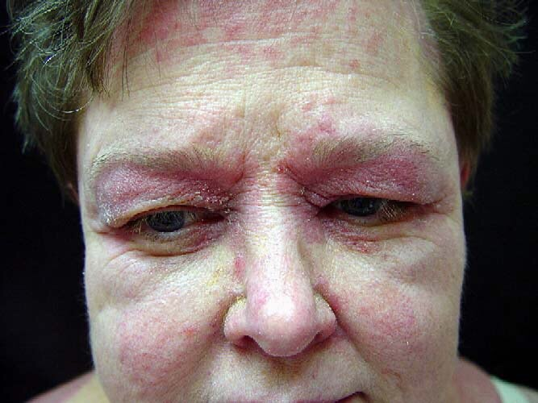

Slide 55
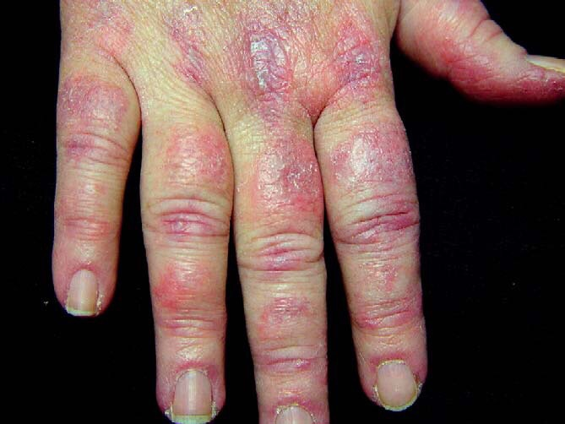

Slide 56
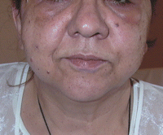
Dermatomyositis (DM) Clinical presentation
2- Cutaneous features are characteristic of the disease but not pathognomonic:
A- Facial erythema and edeama

Slide 57
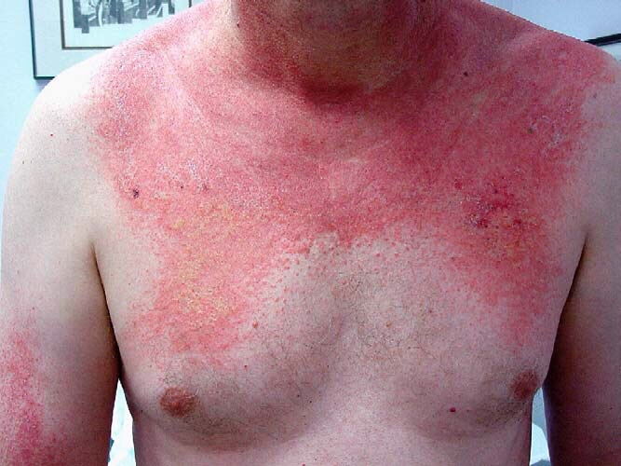
Dermatomyositis (DM) Clinical presentation
B- Poikiloderma in a photosensitive distribution: V-sign

Slide 58
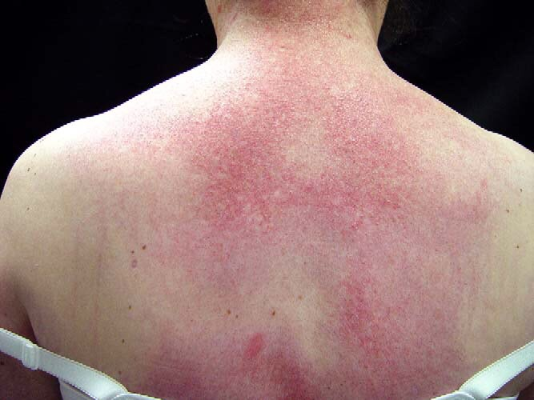
Dermatomyositis (DM) Clinical presentation
C-Poikiloderma over the upper back (shawl sign):

Slide 59
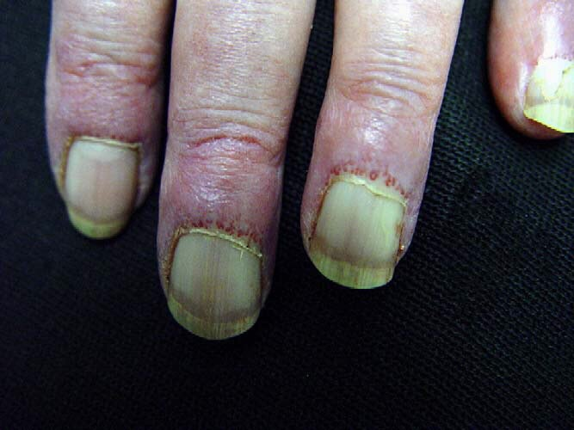
Dermatomyositis (DM) Clinical presentation
D- Periungual and cuticular changes

Slide 60
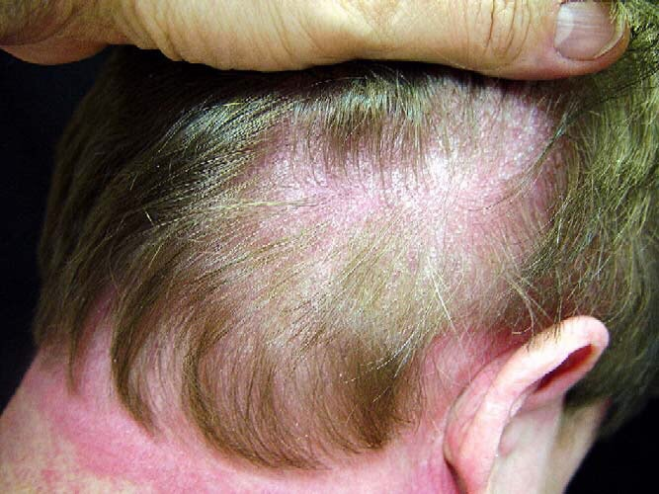
Dermatomyositis (DM) Clinical presentation
E-Scalp : Eythematous to violaceous, psoriasiform dermatitis

Slide 61
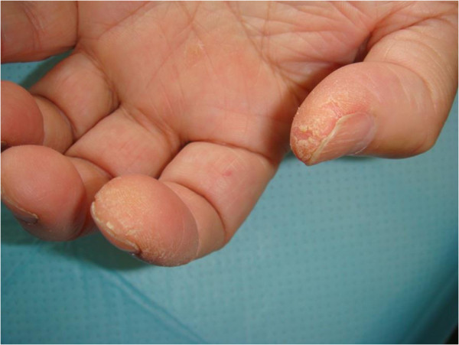
Dermatomyositis (DM) Clinical presentation
F. Mechanic’s hand : - Cracking and fissuring of the skin of the fingerpads.

Slide 62
Dermatomyositis (DM) Clinical presentation
Other skin manifestations:
Photosensitivity
Vasculitis
Nonscarring alopecia
Calcinosis cutis
Vesiculobullous

Slide 63
Dermatomyositis (DM) Clinical presentation
3- Non-cutaneous DM manifestations:
Fever
elevated serum C-reactive protein level and ESR
Muscle pain on grasping or spontaneous pain
Proximal muscle weakness (upper or lower extremity and trunk)
Nondestructive arthritis or arthralgias
Elevated serum creatine kinase or aldolase level
Myogenic changes on electromyography
Positive anti-Jo-1 antibody test (histidyl-tRNA synthetase)
Pathologic findings compatible with inflammatory myositis

Slide 64
Juvenile (childhood) DM

Slide 65
Drug-induced DM
Quinidine, NSIND, d-penicillamine, isoniazid and TNF antagonists
Dermatomyositis and malignancy
Older patients
Ovarian carcinoma , lungs, pancreas, breasts and gastrointestinal tract.
Occur before the onset of DM, concurrently with DM, or after the onset of DM.

Slide 66
Dermatomyositis (DM) Systemic complications/associations
Cardiomyopathy and Cardiac conduction defects
Aspiration pneumonia secondary to respiratory muscle weakness
Diffuse interstitial pneumonitis/fibrosis
Muscle calcification
Ocular complications including iritis, nystagmus, cotton-wool spots, optic atrophy, conjunctival edema and pseudopolyposis
Internal malignancy

Slide 67
Dermatomyositis (DM) Investigations
Muscle enzyme elevation: Serum CK, aldolase, ALT, LDH
CK is useful to monitor the treatment of DM
Autoantibodies: ANA levels,Jo-1: most common antisynthetase
Magnetic resonance imaging (MRI)
Electromyography
Muscle biopsy
skin biopsy

Slide 68
Dermatomyositis (DM) Diagnostic Criteria
1. Symmetric proximal muscle weakness
2. Biopsy evidence of myositis (MRI can subst)
3. Increased serum skeletal muscle enzymes
4. Characteristic EMG pattern
5. Typical DM skin lesions
DM possible (5 + any two of 1-4), probable (5 + any 3), definite (all 1-5)

Slide 69
Dermatomyositis (DM) Treatment
Oral prednisone: 0.5 to 1.5 mg per kg daily until serum creatine kinase normalizes, then slowly taper over 12 months
Methotrexate: Oral: 7.5 to 10 mg per week, increased by 2.5 mg per week to total of 25 mg per week
Azathioprine: 2 to 3 mg per kg per day tapered to 1 mg per kg per day once steroid is tapered to 15 mg per day. Reduce dosage monthly by 25-mg intervals. Maintenance dosage is 50 mg per day.
Cyclosporine
Hydroxychloroquine
Topical steroids

Slide 70
Scleroderma (Hard skin )
3

Slide 71
Scleroderma
Chronic multisystem autoimmune disease.
The hallmark of the disease is thickening and tightness of the skin
characterized by fibrosis of the skin as well as internal organs, e.g., lung, heart, gastrointestinal tract, and kidneys.

Slide 72
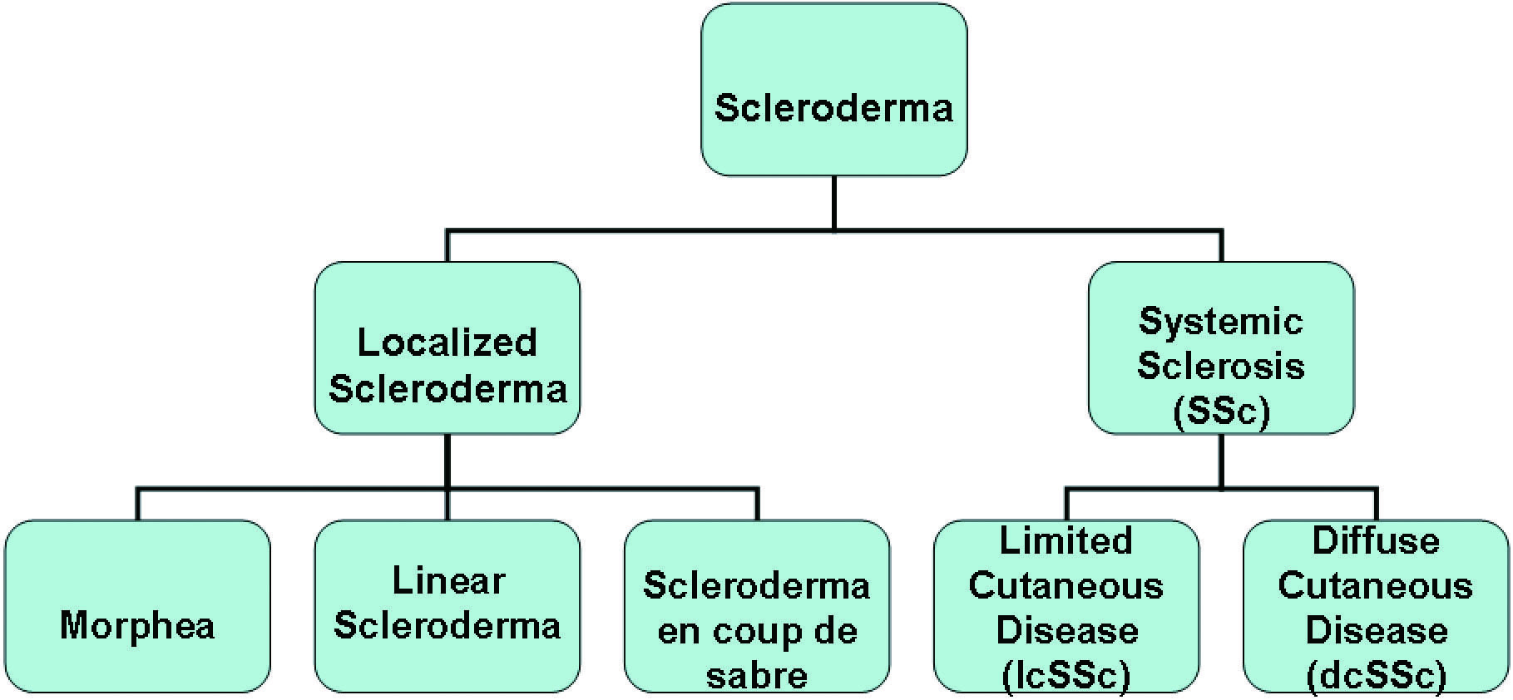
Scleroderma Classification

Slide 73
Scleroderma
1-Systemic scleroderma:
characterised by tissue fibrosis and immune abnormalities
three cardinal pathogenetic features:
a-microvascular involvement
b-activation of the immune system
c-increase of extracellular matrix deposition in the skin and internal organs

Slide 74
Scleroderma EPIDEMIOLOGY
Rare disease
Incidence: 50 cases per million in USA.
Peak occurrence in the 30-40 years age group
F: M 4:1
Very rare in childhood

Slide 75
Scleroderma Pathogenesis
Individual genetic background
Exposure to environmental triggers( virus, drugs, vinyl chloride, silica and nanoparticles from traffic-derived pollution ).
Inducing vascular damage and fibroblast
Activate cells that have ability to give origin to endothelial cells, or collagen producing cells
These cells will migrate into injuried tissues to differentiate into both endothelial cells and fibroblasts, to cause defective vasculogenesis or fibrosis or both, and to have immunomodulatory effects.
The B cells in SSc are activated and produced anti-topoisomerase I and anti-centromere antibodies

Slide 76
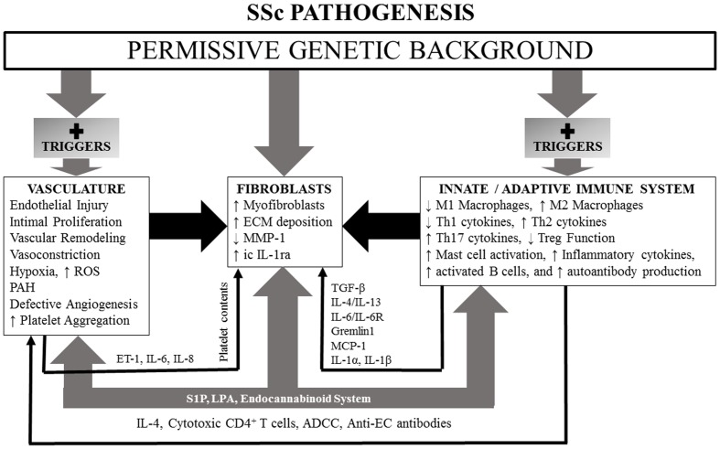

Slide 77
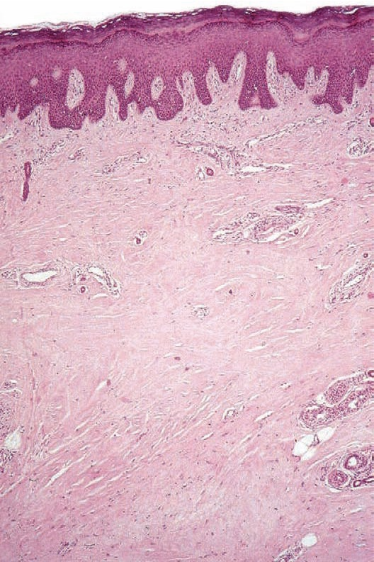
Scleroderma Histopathology

Slide 78
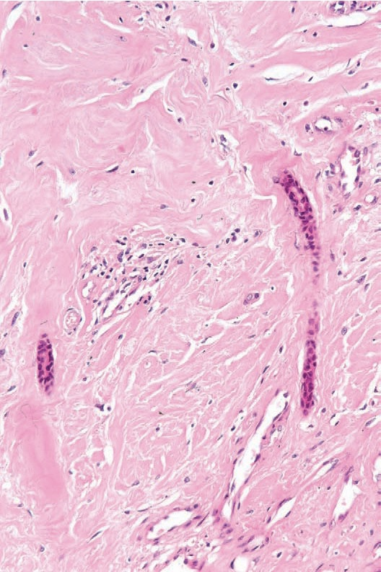
Scleroderma Histopathology

Slide 79
Scleroderma

Slide 80
Scleroderma
1- Limited Scleroderma:
45.5%
Raynauds phenomenon for years
Sclerosis limited to the extremities and face
Can involve perioral skin thickening (pursing of lips)
Less organs involvement
Pulmonary hypertension
Centromere antiboies
Relatively good prognosis, >70% survival at 10 years
CREST syndrome :
Calcinosis, Raynaud's phenomenon, Esophageal dysmotility, Sclerodactyly, Telangiectasia

Slide 81
Scleroderma
2-Diffuse Scleroderma:
32,7%
Raynaud's phenomenon for a few months
Diffuse sclerosis
Tendency to rapid progression of skin change
Early internal manifestations
Pulmonary fibrosis and Renal Crisis are more common.
Variable but overall poor prognosis, survival 40-60% at 10 years
Scl-70 antibodies

Slide 82
Scleroderma
3-Overlap Syndrome 10,9%
4-Undifferentiated(very early) SSc 8,8%
5-Sclerosis sine Scleroderma 1.5%
Notes:
.5%

Slide 83
Scleroderma Clinical features
Cutaneous manifestations:
1-Raynaud’s phenomenon:
Vasospasm of the digital microvasculature resulting in:
- digital ischemia (pallor)
- digital hypoxia (cyanosis)
- digital reactive hypermedia (erythema)

Slide 84
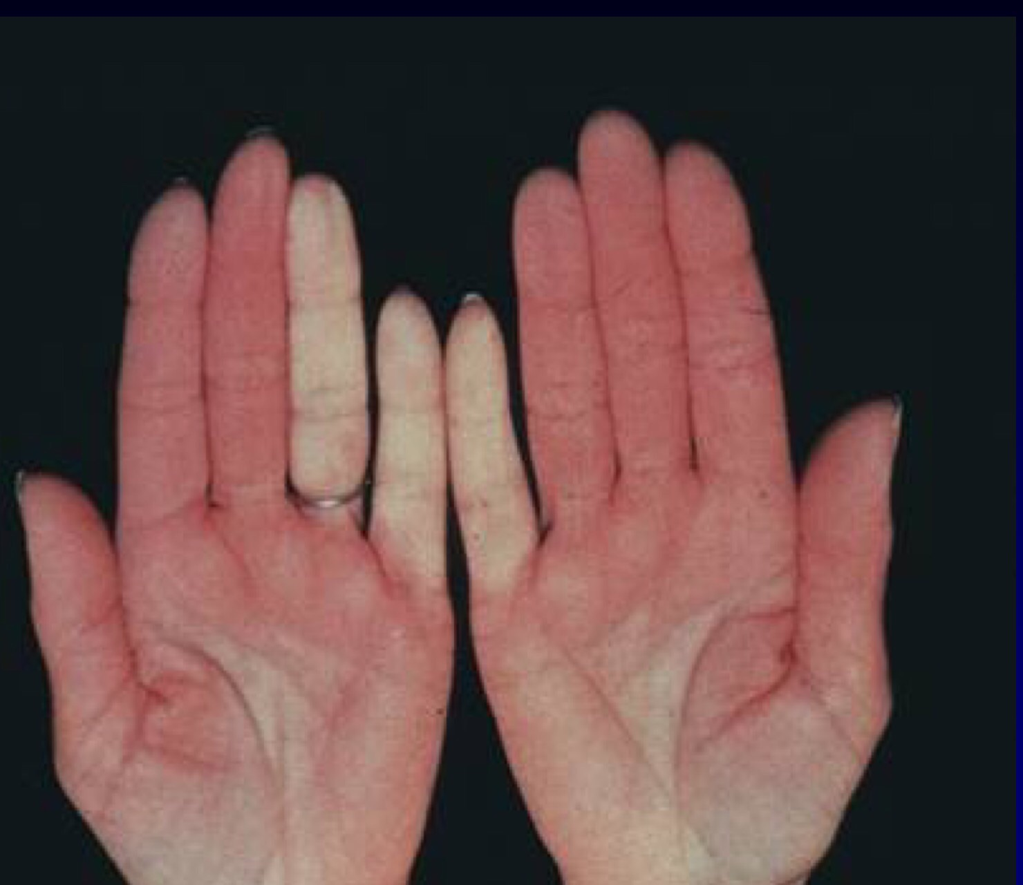
Scleroderma

Slide 85
Scleroderma Clinical features
2-Hand features:
Swelling (non-pitting oedema) of fingers and toes - a common early sign
Sclerodactyly
Swelling and sclerosis reduce hand movements, so patients may be unable to make a fist, or to place the palmar surfaces together - the 'prayer sign'.
Fingertips may have pitting, ulcers or loss of bulk from finger pads

Slide 86
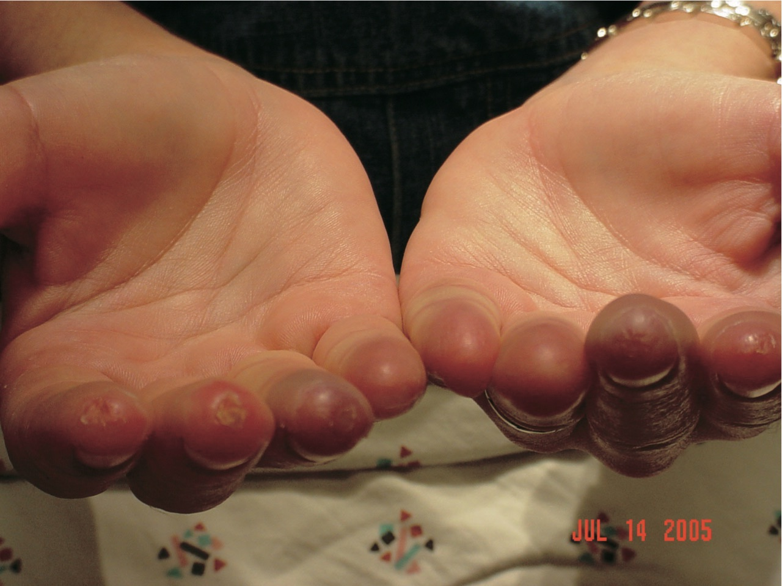
Scleroderma

Slide 87
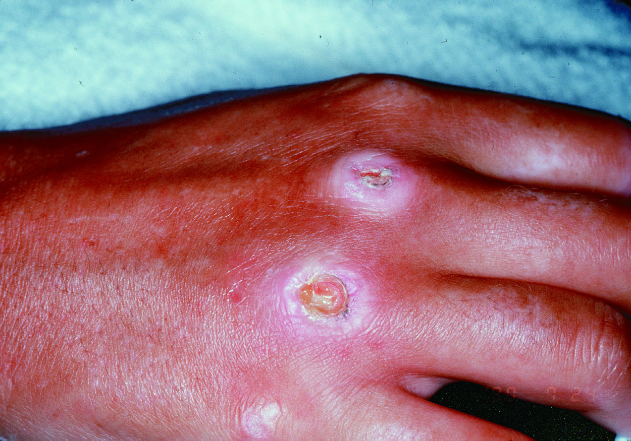
Scleroderma Clinical features
3-Painful ulcerations

Slide 88
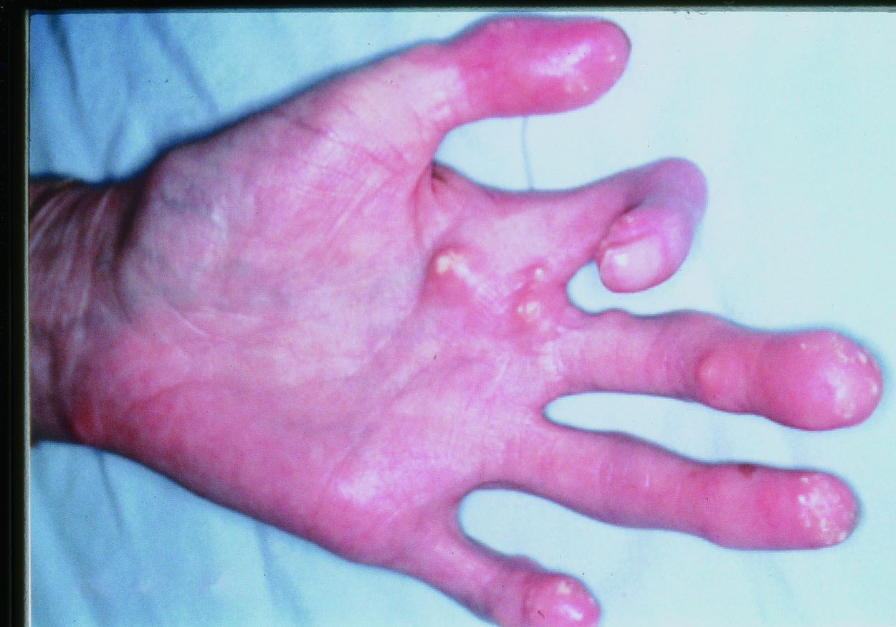
Scleroderma Clinical features
4-Calcinosis: cause white spots or ulcerations and may be quite painful.

Slide 89
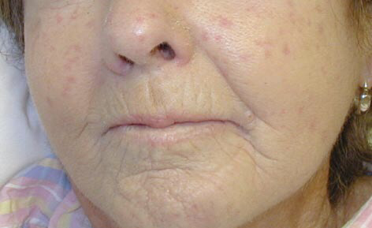
Scleroderma Clinical features
5-Facial features:
Spider veins (telangiectasia)
Tightening of facial skin.
Tight lips (microstomia) - can make dental hygiene difficult.

Slide 90
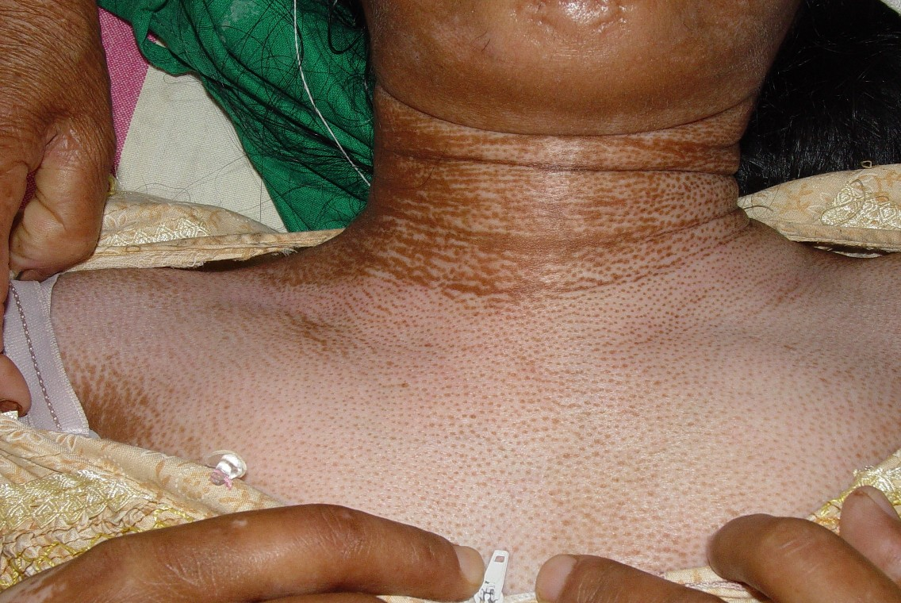
Scleroderma Clinical features
6-Truncal features:
Salt and pepper' appearance of skin, due to areas of hypopigmentation and hyperpigmentation
Dry or itchy skin; reduced hair over affected skin areas

Slide 91
Diagnosis:
1. major criteria: proximal scleroderma
2. minor criteria:
1) sclerodactyly
2) digital pitting scar or loss of substance from the finger pads
3) bibasilar pulmonary fibrosis
*the major or 2 or more minor criteria for diagnosis

Slide 93
Localized scleroderma
CLASSIFICATION
Plaque morphe
< 2.7 cases /100000
F/M 2.4
40-50 years-old
Caucasians
Positive personal or family history of autoimmune diseases
Role of trauma in the distribution of morphea lesions

Slide 94
1-Plaque morphe
Well-circumscribed oval-round red-brown plaques
Trunk and limbs
Different stages: inflammatory
Typical
Post-inflammatory hyperpigmentation

Slide 95
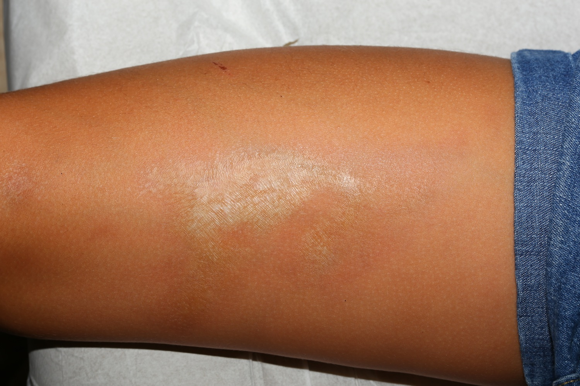

Slide 96
Localized scleroderma
CLASSIFICATION
Generalized morphea: is more severe(4 or more), characterized by extension of skin damage and its association with muscle damage.

Slide 97
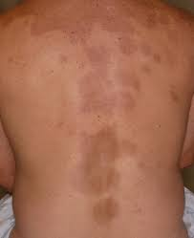

Slide 98
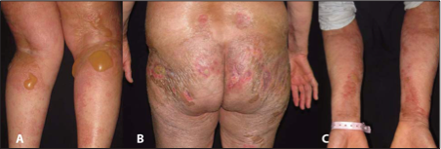
Localized scleroderma
3. Bullous morphea: is characterized by tense subepidermal bullae in the presence of typical morphea or deep morphea.

Slide 99
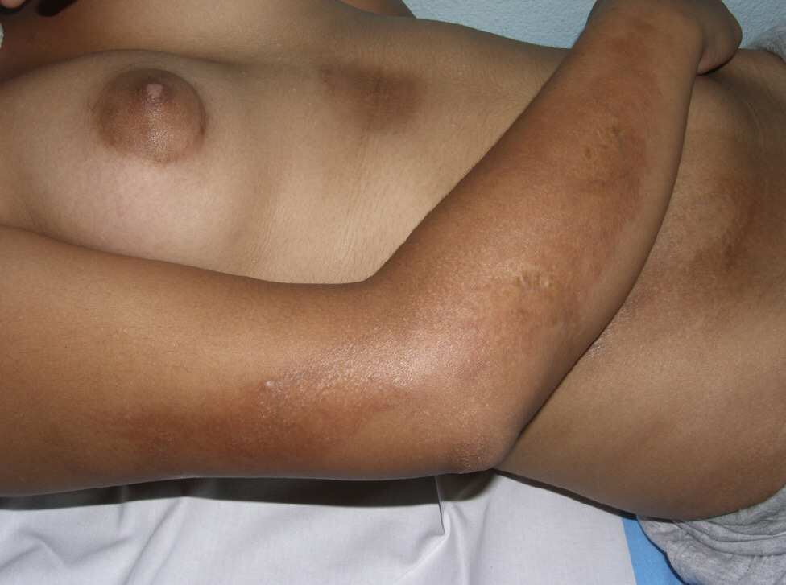
Localized scleroderma
4. Linear scleroderma: is characterized by one or more linear streaks and induration that can involve dermis, subcutaneous tissue, muscle, and bone. It occurs on the extremities, face, or scalp of children and adolescents.

Slide 100
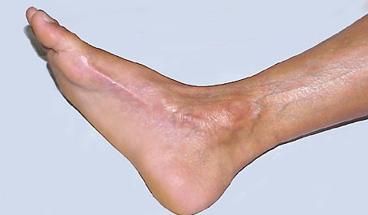

Slide 101
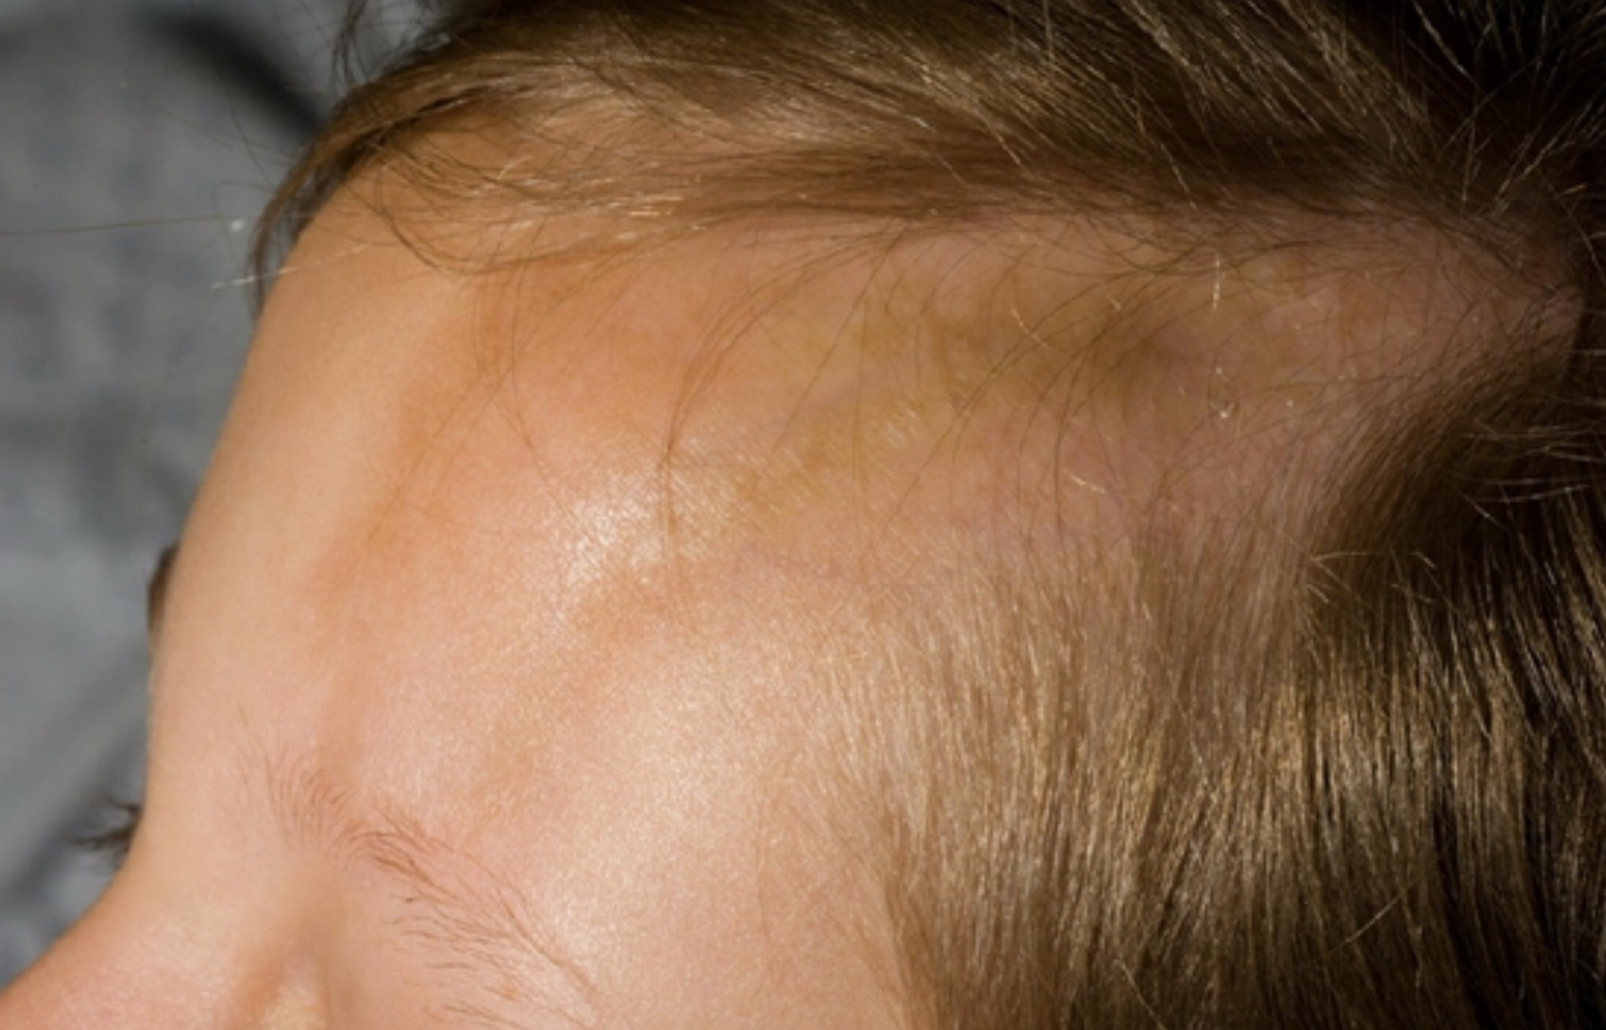
Scleroderma

Slide 102
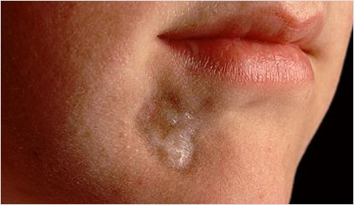
Localized scleroderma
5. Deep morphea: subcutaneous morphea, morphea profunda, disabling pansclerotic morphea of childhood

Slide 103
INVESTIGATIONS
Skin biopsy
Basic investigations:

Slide 104
INVESTIGATIONS
ANA, RF
anti-Scl-70 (DNA topoisomerase I) antibody
1) 20-30% in diffuse scleroderma
2) 10-15% in limited scleroderma
3. anticentromere antibody
1) 50-90% in limited scleroderma
2) 5% in diffuse scleroderma
4. Anti RNA polymerase III Ab: 10- 25% in Diffuse SSc, Renal Disease

Slide 105
Treatment of localized scleroderma
1-Circumsctibed:
-Topical potent steroid
-Tacrolimus
2-Generalized:
-nbUVB
-MTX

Slide 106
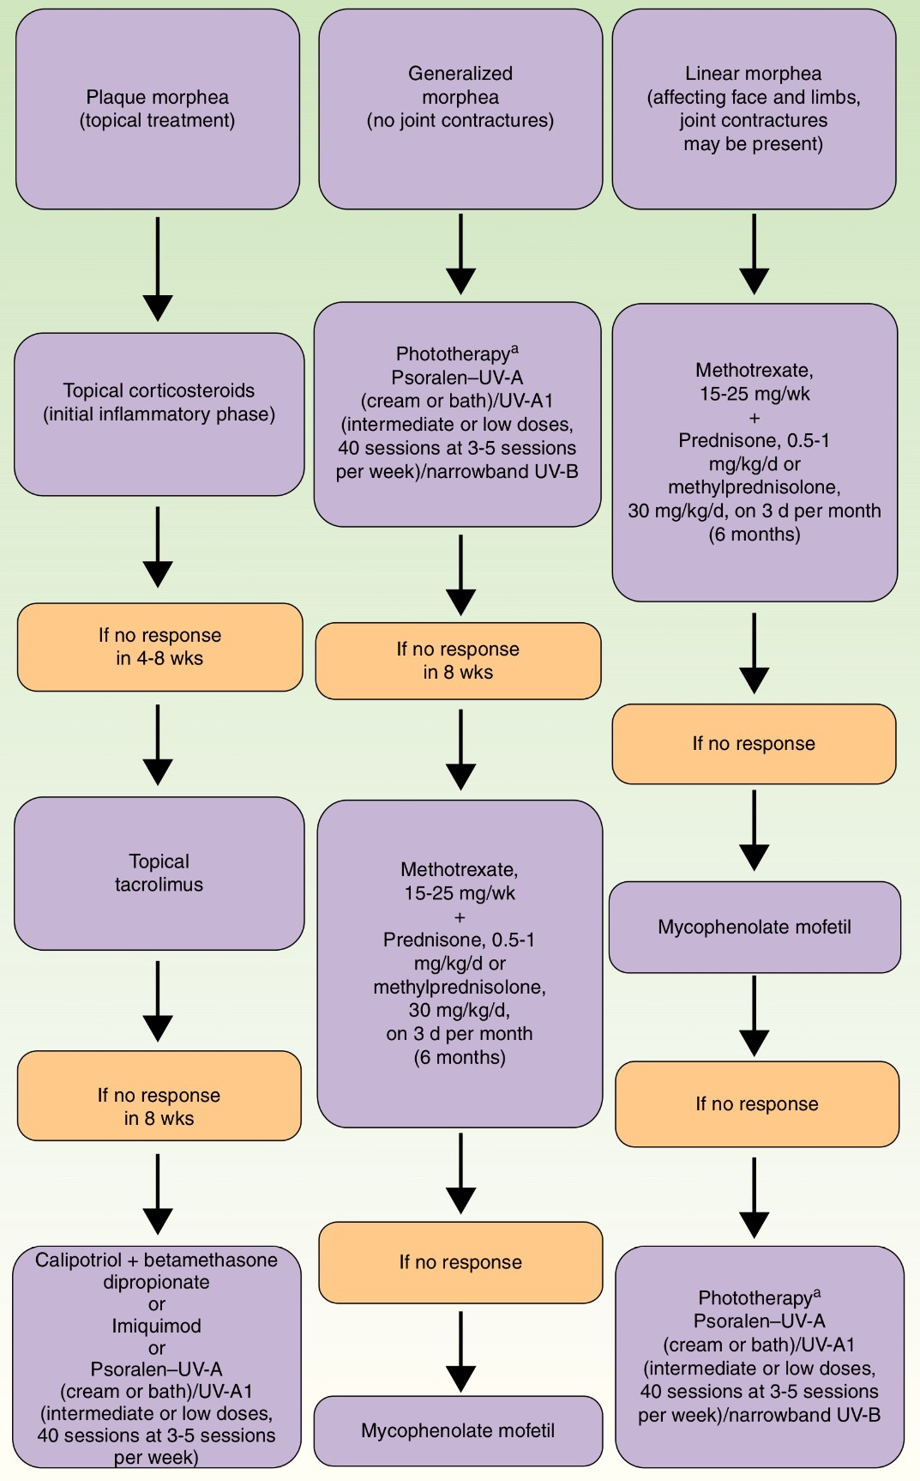

Slide 107
THE END

