Slide 1
Dermatologic Emergencies
By: Dr. Mona Halawani
Consultant Dermatologist

Slide 2
What are the major groups of dermatologic emergencies? Infections cellulitis erysipelas necrotizing fascitis SSSS neonatal herpes neonatal candidiasis
mucormycosis

Slide 3
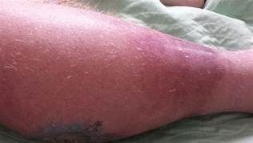

Slide 4
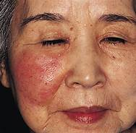

Slide 5
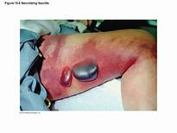

Slide 6
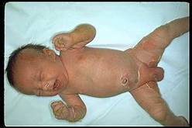
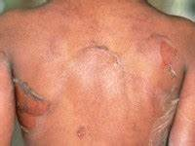

Slide 7
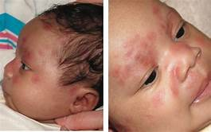

Slide 8
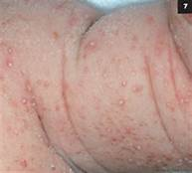

Slide 9
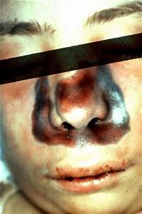

Slide 10
- Urticaria and angioedema, drug eruptions, kawasaki syndrome, exfoliative dermatitis, pustular psoriasis
- Drug reactions: EM, SJS, TEN
- Vesiculobullous disorders
- Autoimmune disorders
- miscellaneous

Slide 11
Urticaria and Angioedma
Essentials of Diagnosis:-
Wheals or hives
Evanescent: individual wheals disappear within 24 hours
and often within minutes.
Changing of configuration.
What is the major mediator of Urticaria?
Pathogenic mechanism:
Immunologic Type I (IgE mediated) or Type III.
Non immunologic (activation of the alternative complement pathway and direct release of histamine) from basophils or tissue mast cells by drugs or chemicals.

Slide 12
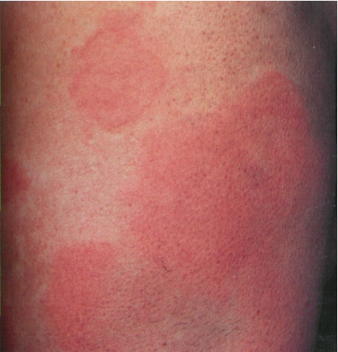

Slide 13
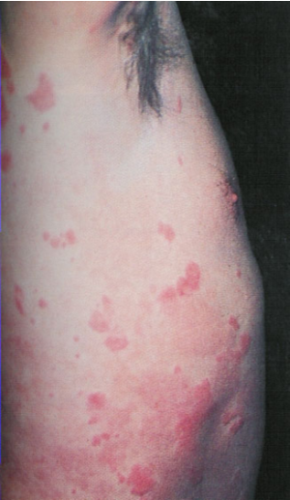

Slide 14
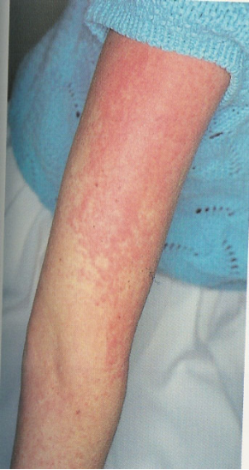

Slide 15
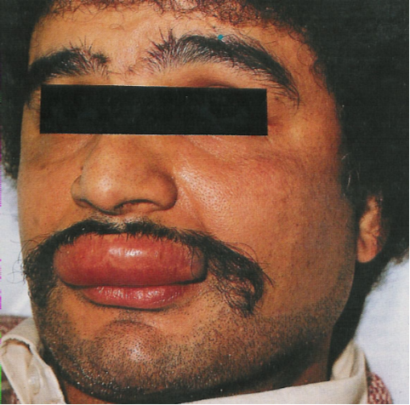

Slide 16
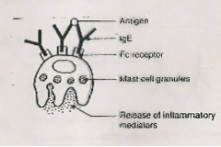
Classification of Hypersensitivity Reactions
Hypersensitivity is a state in which the immune responses frequently take place in such a way that cell damage occurs and harmful pathological lesions may occur.
5 types of hypersensitivity are recognized:
Immediate (Antibody mediated):
Type I: Anaphylaxis
It is IgE-mediated. An antigen (allergen) reacting with specifically sensitized IgE that is fixed to mast cells through its FC portion. Degranulation of mast cells release of their mediators e.g. histamine, leukotrienes, ECF and NCF. The offending antigen is identified by intradermal prick tests giving immediate wheal and erythema reations or by provocation testing. There is a strong familial predisposition and a tendency to produce high levels of IgE. e.g. anaphylaxis, utricaria, atopy

Slide 17
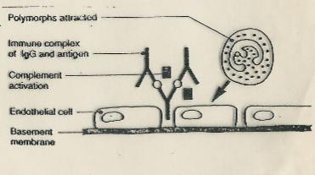
Type III: Immune-Complex Reactions (arthus phenomenon)
The antigen reacts with specific circulating antibodies antigen-antibody complexes that act through : (a) complement activation and PMNL attraction inflammatory response. (b) platelet aggregation microthrombi and vasoactive amine release. E.g. serum sickness, nephritis in SLE, Allergic vasculitis, urticarial vasculitis, ? Bullous pemphigoid.

Slide 18
Acute Urticaria:
Chronic Urticaria:
Urticaria may accompany systemic Anaphylaxis or serum sickness reaction.
Serum sickness:
5d 3weeks after initial exposure (type III) immune complex mediated reaction.
Fever, Urticaria, Angioedema, Joint pain and swelling, lymphadenopathy, occas: nephritis or endocarditis with eosinophilia.
Minor form of Serum sickness: fever, Urticaria, transitory joint tenderness.

Slide 19
Angioedema: Involving oedema of the deep dermis or subcutaneous and submucosal areas.
Causes of Urticaria and angioedema
Drugs- Animal sera, vaccines containing egg protein, desensitizing agents, Antibiotics, ACEI, radiocontrast media, cylogenase inhibitors.
Foods
Inhalants
Infections
Autoimmune disease
Insect bites
Physical causes
Hereditary causes, hereditary Angioedema
Vasculitis
Contactants
Idiopathic
SLE, thyroid dis
Neoplasm (iymphoma, ca of lung and colon)

Slide 20
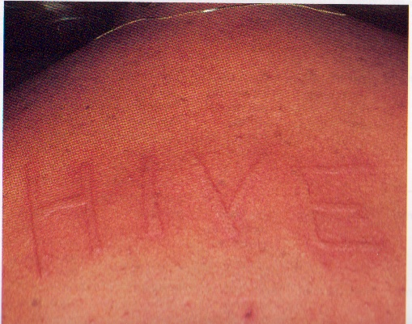
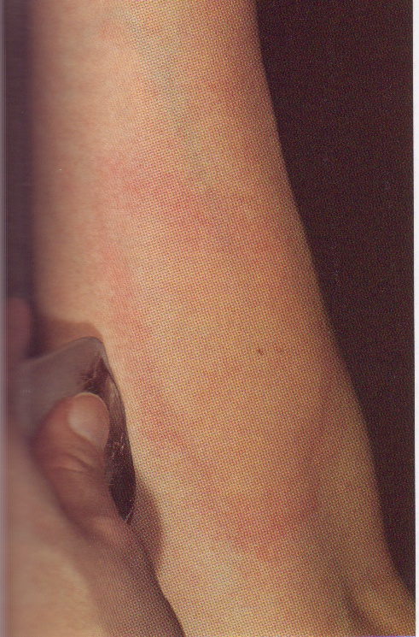
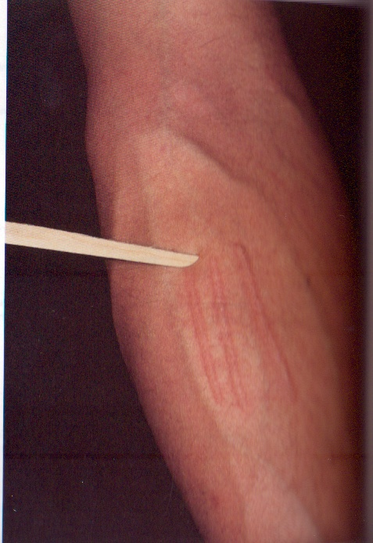

Slide 21
Approach to the patient with chronic Urticaria.
Treatment:
Elimination or avoidance of the causative agent.
Nonsedating H₁ antagonists.
Sedating H₁ antagonists
Addition of H₂ antagonists
Corticosteroids
Epinephrine
Montelukast
Thyroxine
Colchicine
Sulfasalazine
Immunosuppressive therapy
Omalizumab (humanized anti igE monoclonal antibody )
C1-esterase inhibitor deficiency : oral danazole,oral tranexamic acid ,for emergency : C1 inhibitor concentrate , fresh frozen plasma , oestrogen & OCP avoidance .

Slide 22
Treatment (Continued):
In acute emergency episodes
Secure the airway
I.V. line
Adrenaline subcutaneous or I.M., repeated every 10 min.
Diphenhydramine I.M. or I.V.
Hydrcortisone I.V.
Patients with severe angioedema should be admitted for at least 24 hours observation particularly where laryngeal edema has occurred.

Slide 23
Anaphylaxis
Essentials of Diagnosis:-
Laryngeal edema or bronchospasm or both.
Erythema, puritus, urtiaria or angioedma (any or all)
Vomitting, cramps, diarrhea.
Hypotension, cardiac arrythmia or shocks.
General considerations:
Within minutes to hours, severe may be fatal.
IgE mediated
Chemical mediators are released
Anaphylactoid reactions: clinically similar reactions that involve the nonimmunologic (non antigen-antibody) release of similar mediators e.g (reactions to radiographic contrast media, aspirin, local anesthetics)

Slide 24
Causative agents:
Drugs
Foods
Vaccines and Antisera
Insects – bees, wasps
Immunotherapy of allergic rhinitis, asthma or stinging insect sensitivity.
other cases:
Iodinated contrast media, aspirin, local anesthetics – anaphylactoid reactions.
Treatment of anaphylaxis

Slide 25
Erythroderma & Exfoliative Dermatitis
Clinical features
Complications: Hypothermia, fluid and electrolyte loss, infection,
HF., stress induced GIT ulcer, malabsorption., venous thrombosis.
Drug Etiology:
Sulphonamides, antimalarias, penicillin, phenytoin.
Other causes

Slide 26
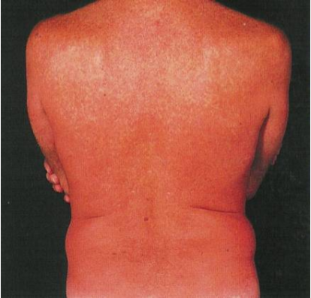

Slide 27
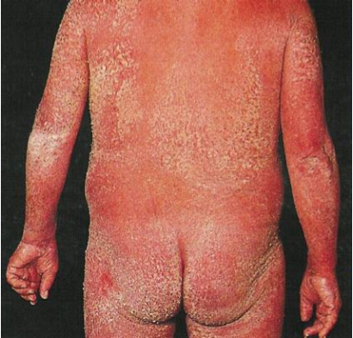

Slide 28
Erythema Multiforme Major, SJS, Toxic Epidermal Necrolysis
SJS , TEN May represent variants of the same disease process.
Clinically: Mucous membrane erosions, target lesions
epidermal necrosis with skin detachment.
SJS < 10% BSA of epidermal detachment ,SJS –TEN Ooverlap 10-30%, TEN > 30%
EM minor little or no mucosal involvment , Preceding herpes labialis in 50% of EM
Systemic symptoms present in EM major & absent or limited in EM minor .

Slide 29
Suspected etiologic factors:
Infections
Drugs > 95% in TEN, anticonvulsants, sulphonamides, allopurinol, NSAI.
Neoplasia
Collagen disease
immunizations

Slide 30
Risk factors for TEN
slow acetylators
Immunosuppression ( HIV, Lymphoms )
Radiotherapy & anticonvulsants
Specific HLA
FDA recently recommended genotyping of all asians for the allele HLAB 1502 prior starting carbazepine

Slide 31
Prognostic factors in TEN
Major cause of death
Differentialdiagnosis

Slide 32
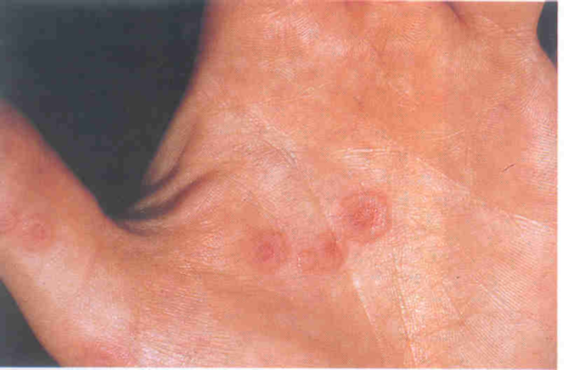

Slide 33
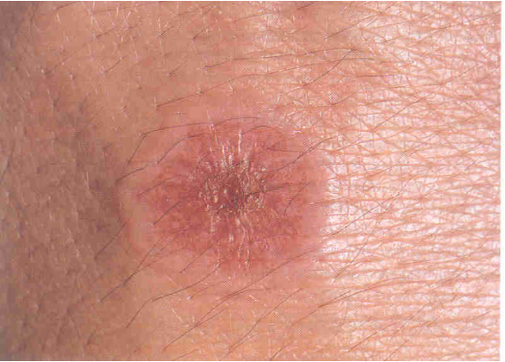

Slide 34
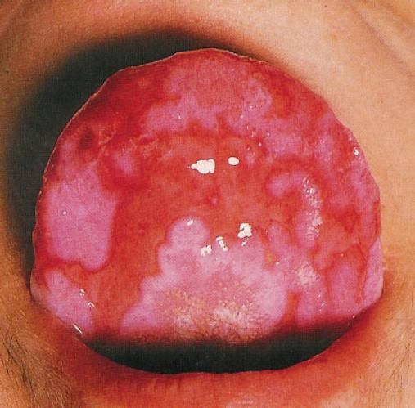

Slide 35
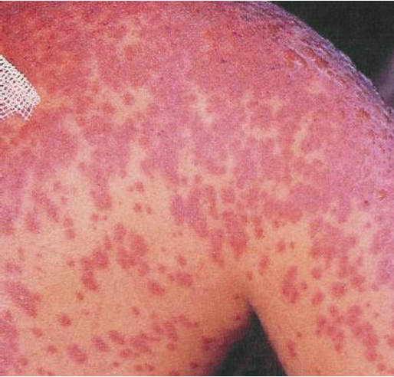

Slide 36
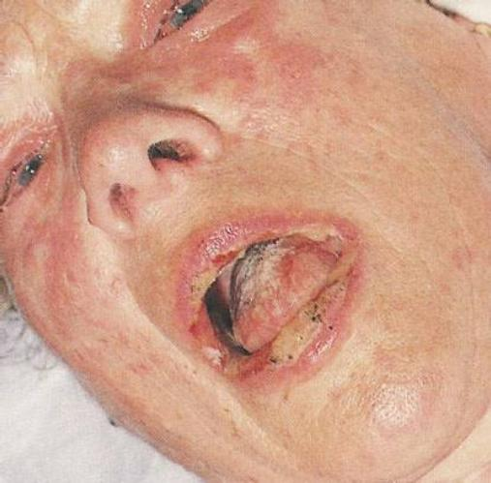

Slide 37
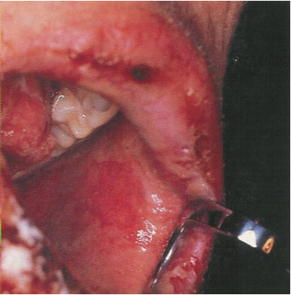

Slide 38
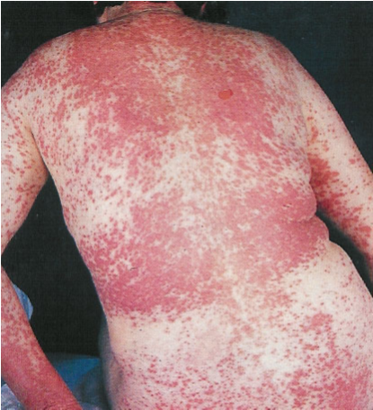

Slide 39
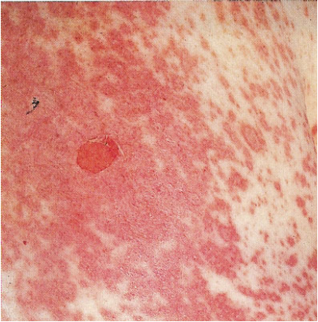

Slide 40
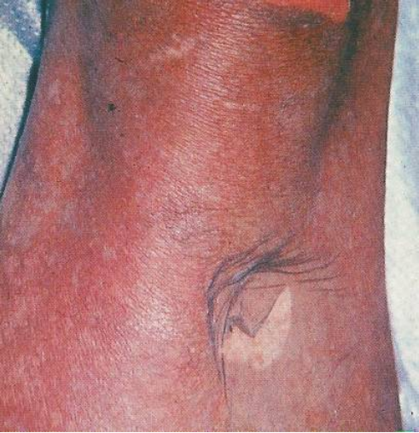

Slide 41
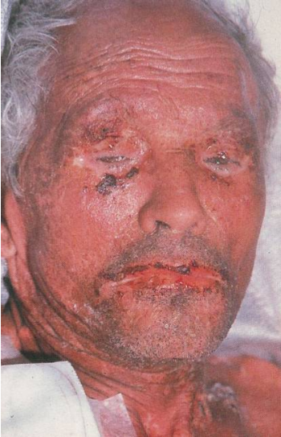

Slide 42
Pathogenesis:
? Metabolic base may trigger an immune response
Prognosis: related to extent of skin involvement.
Mortality for TEN: 30% related to sepsis, fluid and electrolyte imbalance.
Management
Early diagnosis, withdrawal of suspected drug
Patient best cared in a burn or I.C.U.
Replacement of I.V. fluids and electrolytes
Systemic corticosteroids-controversial, IVIg.
CSA, cyclophosphamide, plasmapheresis, N-acetylcysteine, TNF alpha antagonist (etanercept, infliximab)
Care for mucous membrane, eye involvement
diagnose and treat complicating infections
Prevention

Slide 48
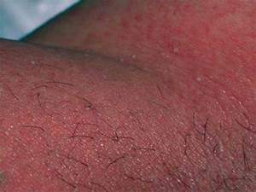
AGEP

Slide 49
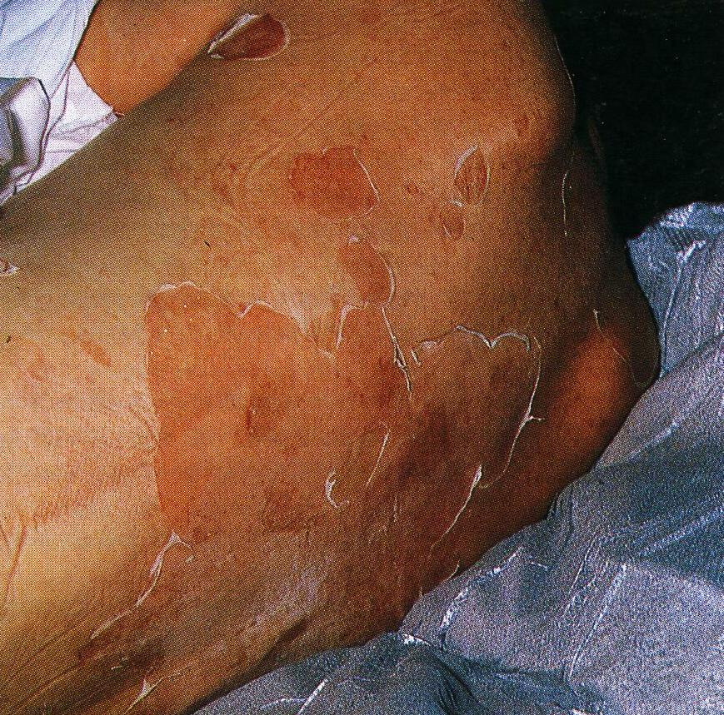

Slide 50
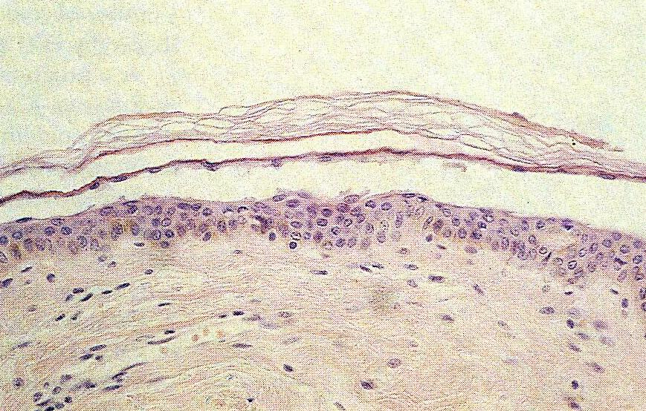

Slide 51
DRUG ERUPTION
Definition:
Incidence
Differential risk of adverse drug reactions amongst patient groups.
Sex
Age
AIDS
Sjogrenis Syndrome
Route of administration

Slide 52
Classification and Mechanism of Drug Reactions
Non immunological
Predictable
Unpredictable
Immunological
Unpedictable

Slide 53
Steps in the Approach to a Suspected Adverse Drug reaction
Clinical Diagnosis
Analysis of Drug exposure
Differential diagnosis
Literature Search
Confirmation
Advice to the patient
Reporting to licensing authorities and/ or manufacturer

Slide 54
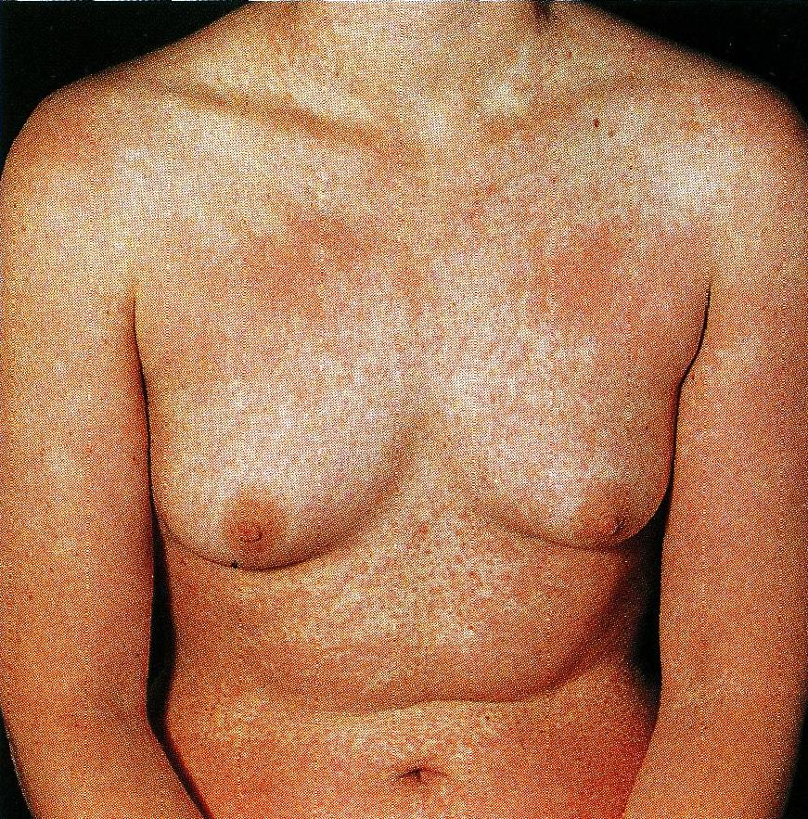
Types of Clinical Reaction
1. Exanthematous (Maculopapular) – the most frequent

Slide 55
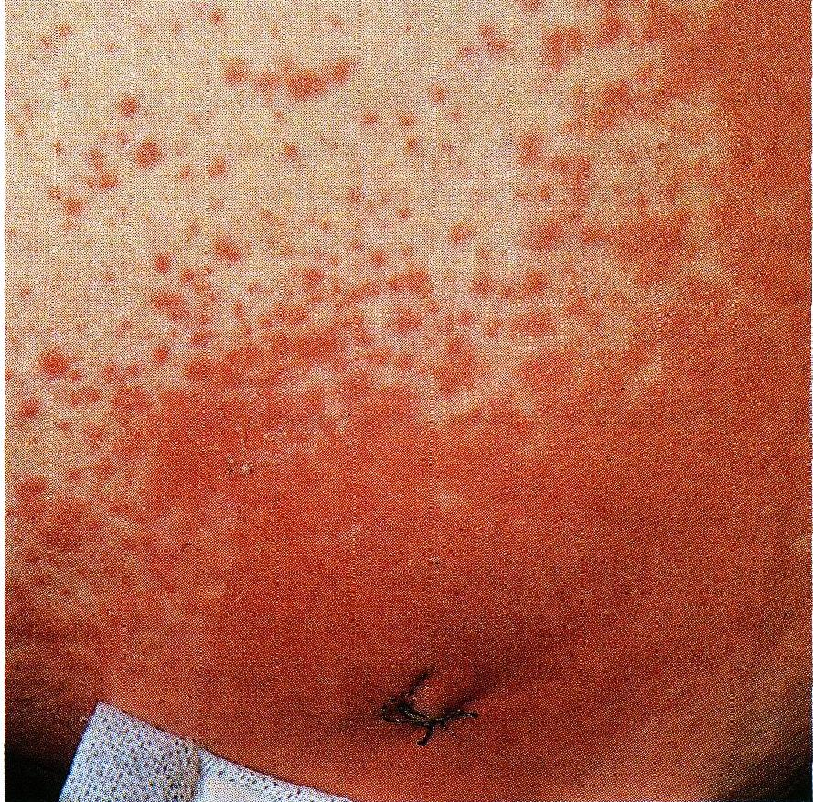

Slide 56
2. Hypersensitivity Syndrome Reaction
Triad of fever, skin eruption and internal organ involvement.
Potentially life threatening syndrome
First exposure
Anticonvulsants, sulfonamide, dapsone, allopurinol - most frequently associated with HSR
Other Drugs : Azathioprine, Minocycline

Slide 57
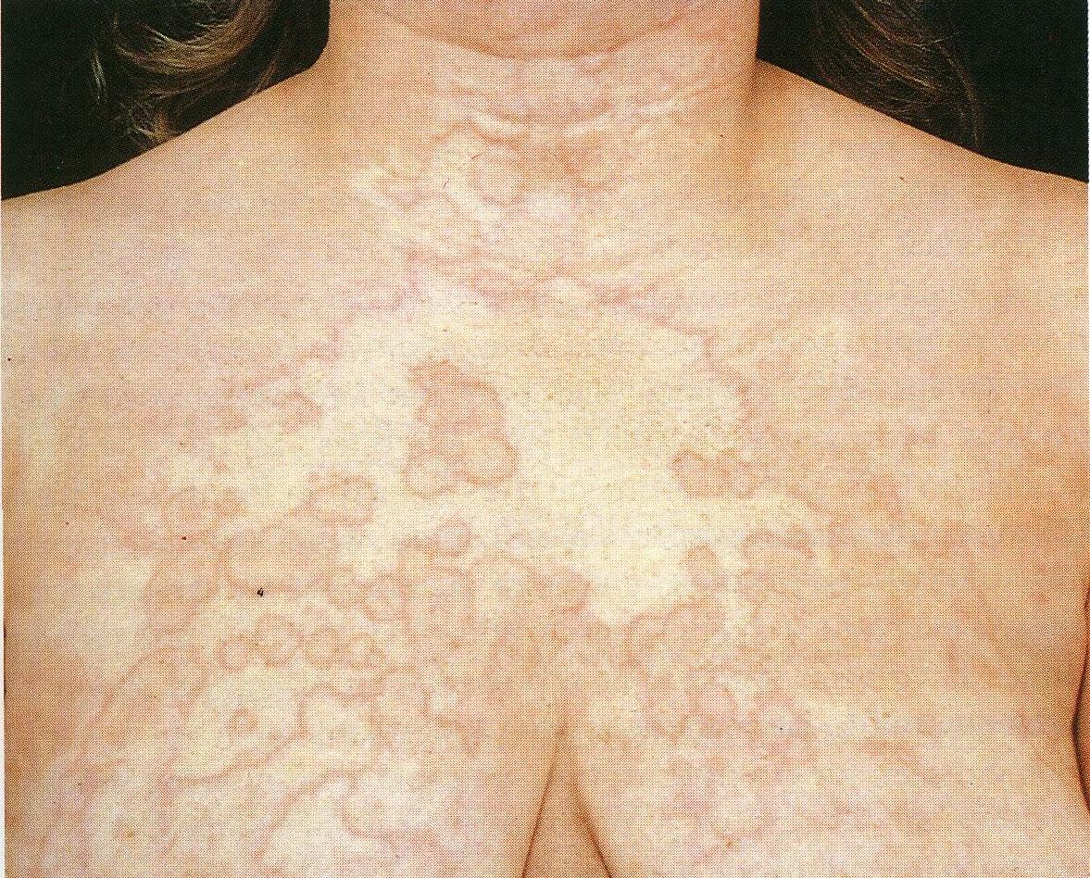
3. Urticaria, Angioedema and Serum sickness

Slide 58
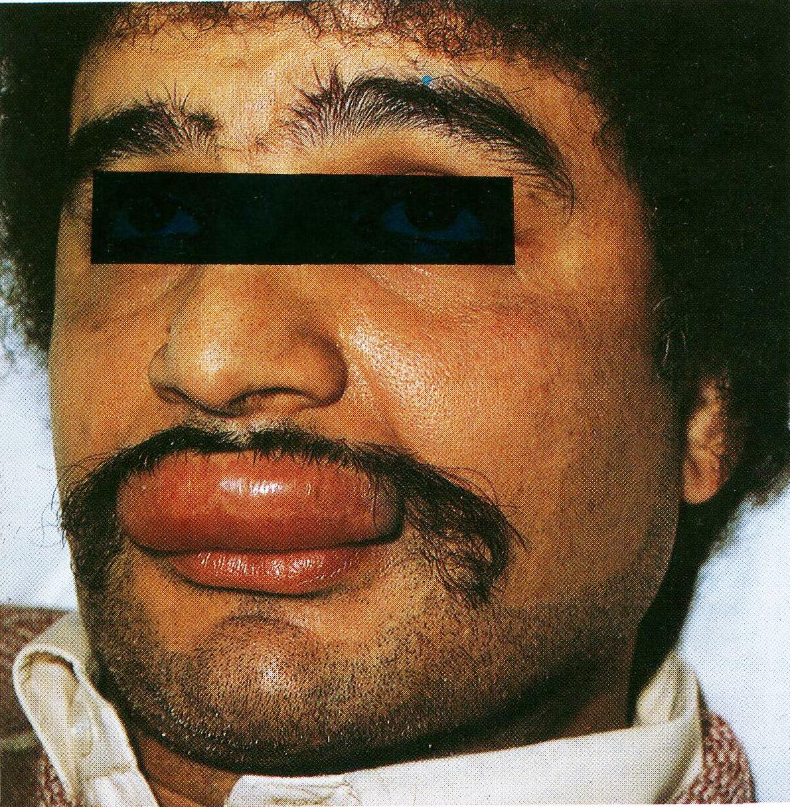

Slide 59
4. Latex Allergy
Typely reaction to natural rubber latex proteins
Clinical Manifestations – Contact Urticaria, Fatal Anaphylaxis
Foods that cross react with latex proteins : Banana, Kiwi, Avocado, Chestnuts
5. Anaphylaxis and Anaphylactoid reactions

Slide 60
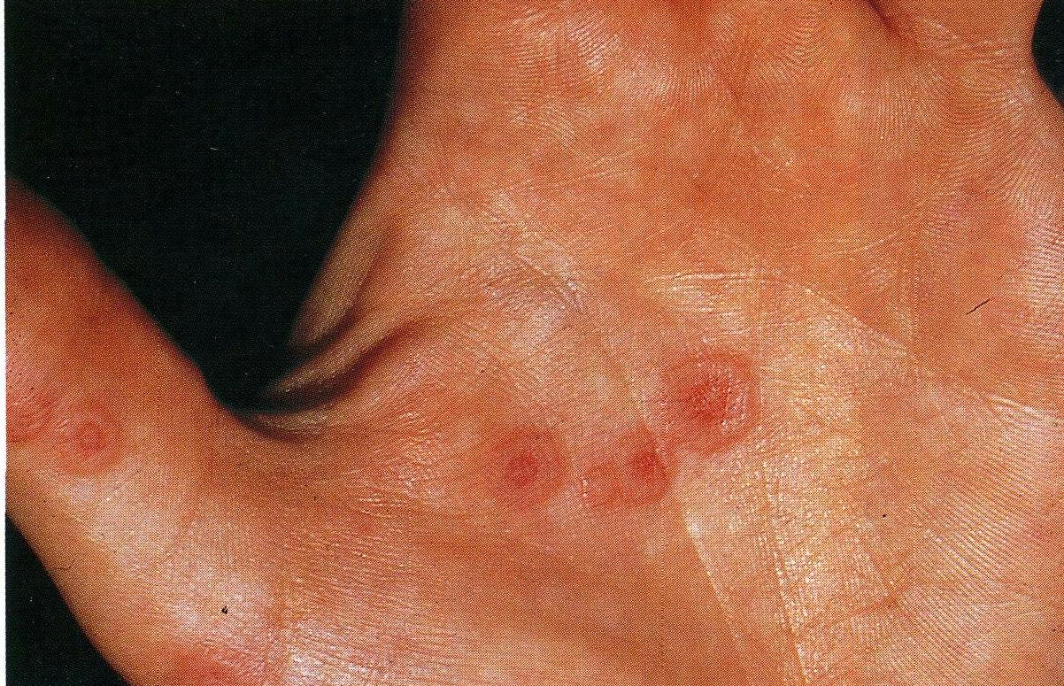
6. Erythema Multiforme and the Steven Johnson’s Syndrome

Slide 61
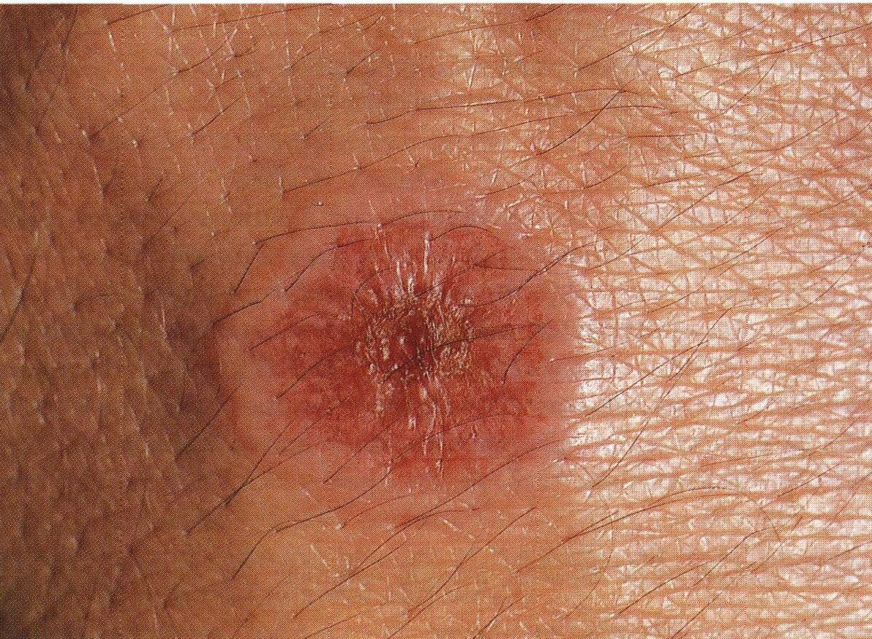

Slide 62
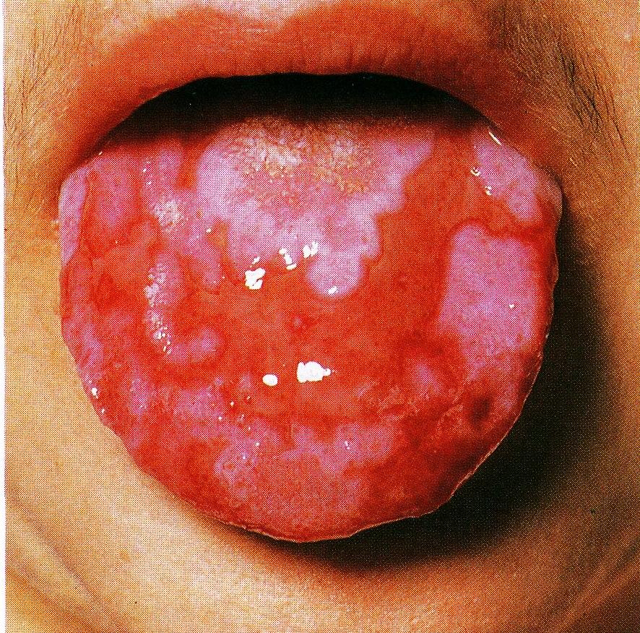

Slide 63
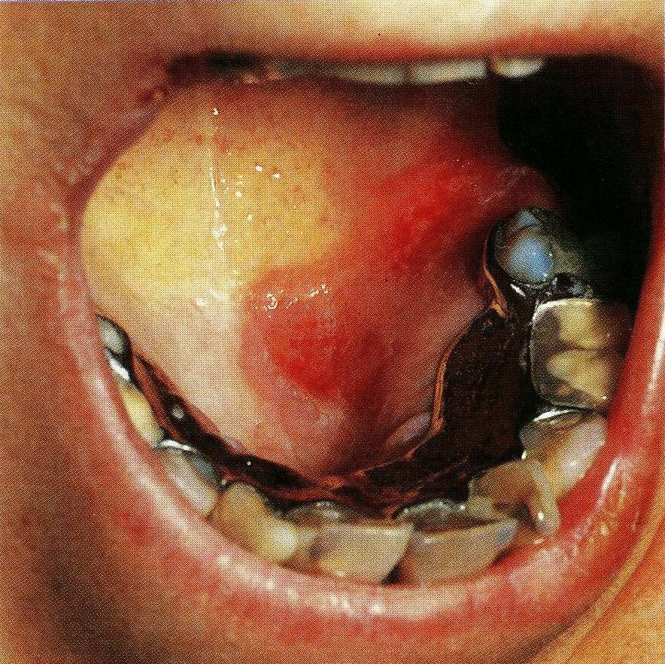

Slide 64
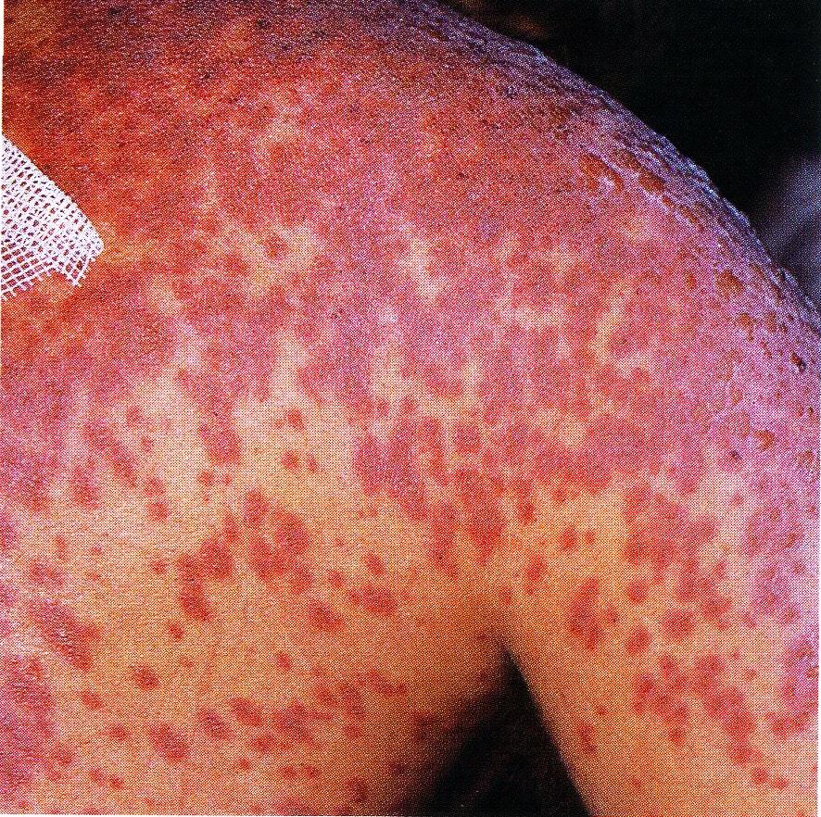

Slide 65
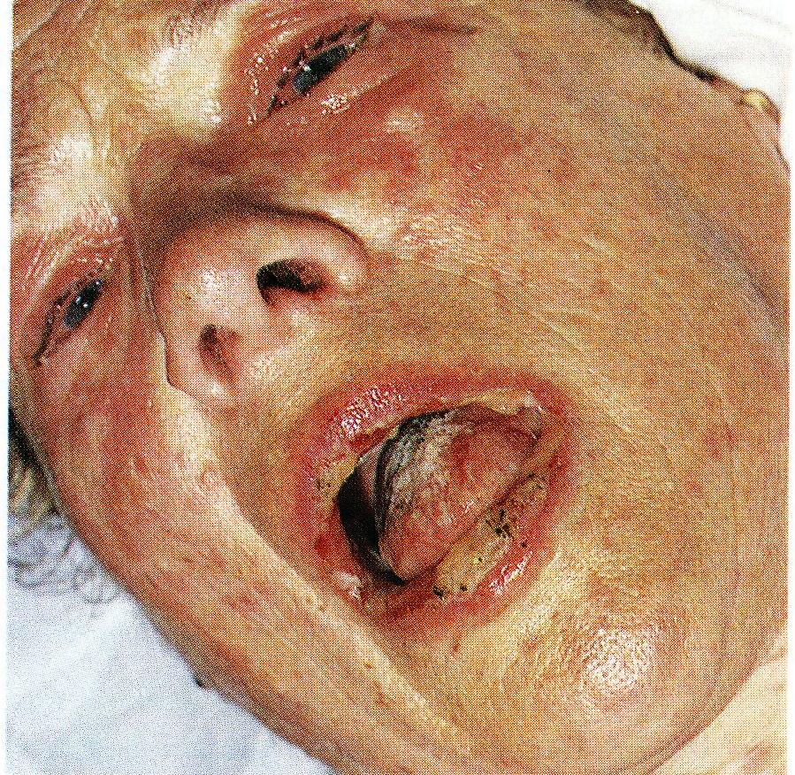

Slide 66
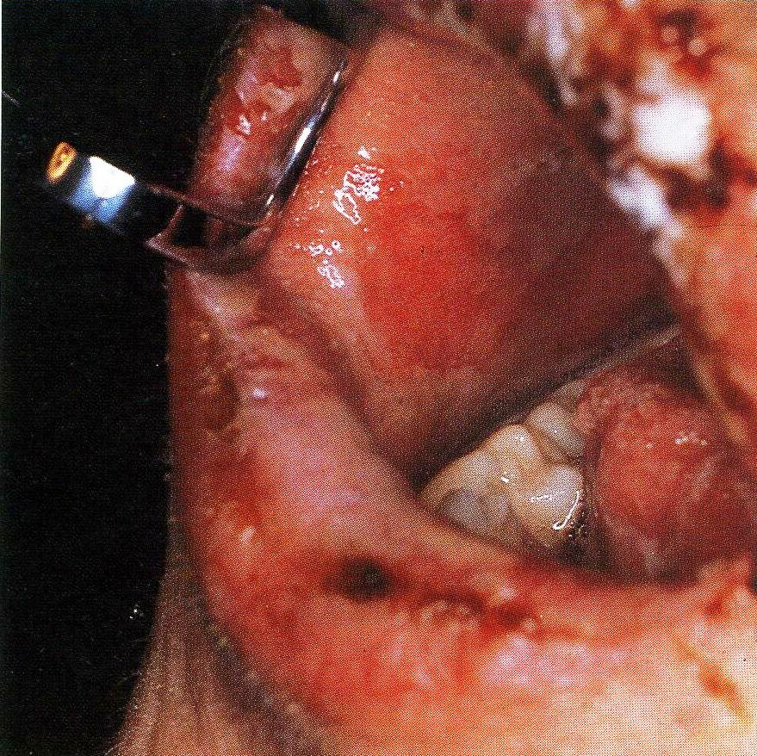

Slide 67
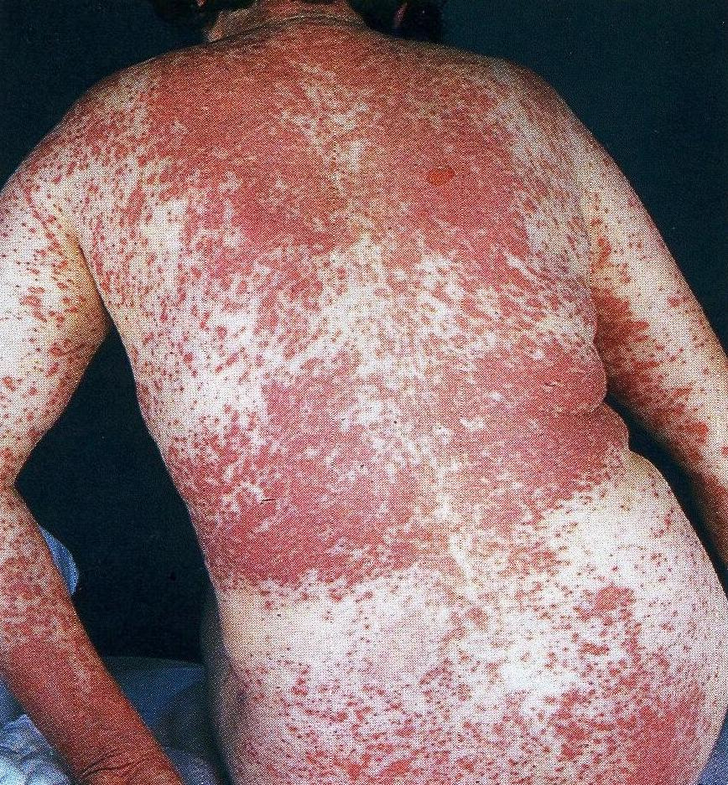
7. Toxic Epidermal Necrolysis

Slide 68
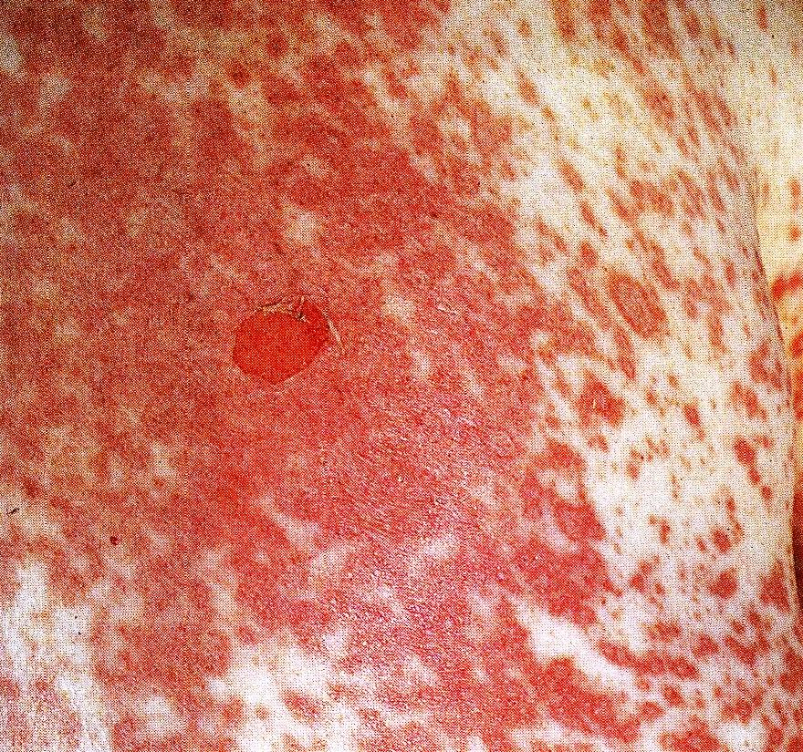

Slide 69
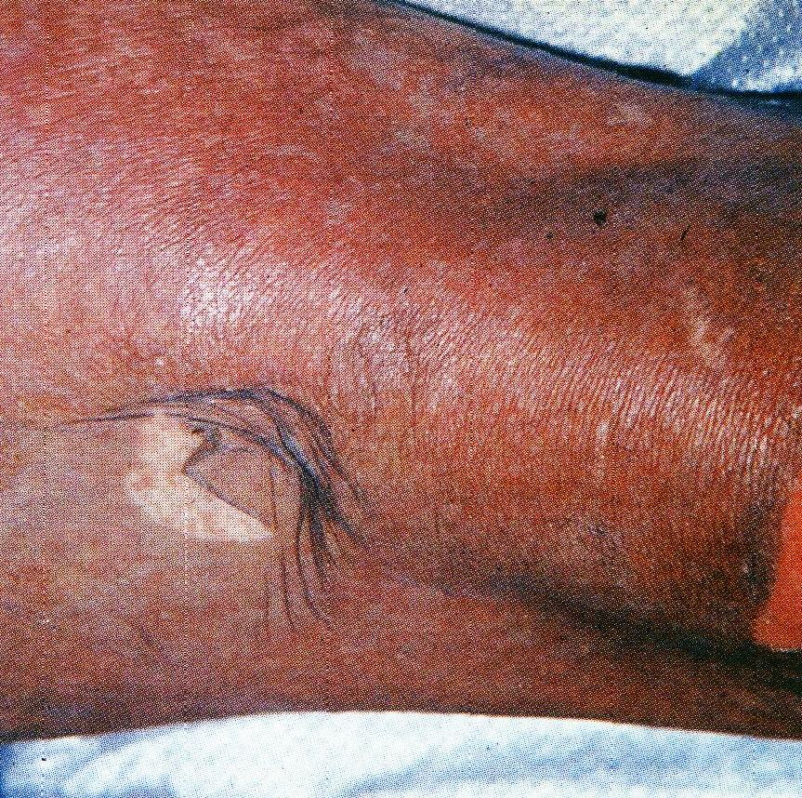

Slide 70
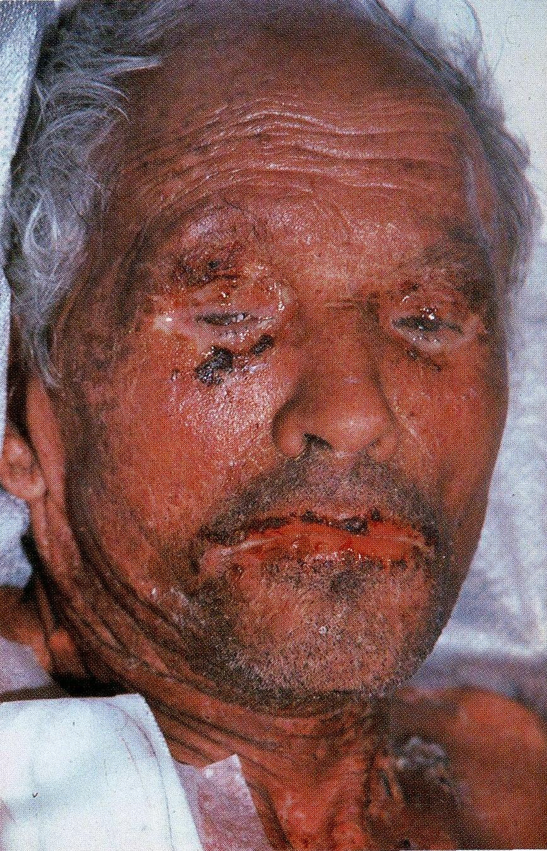

Slide 71
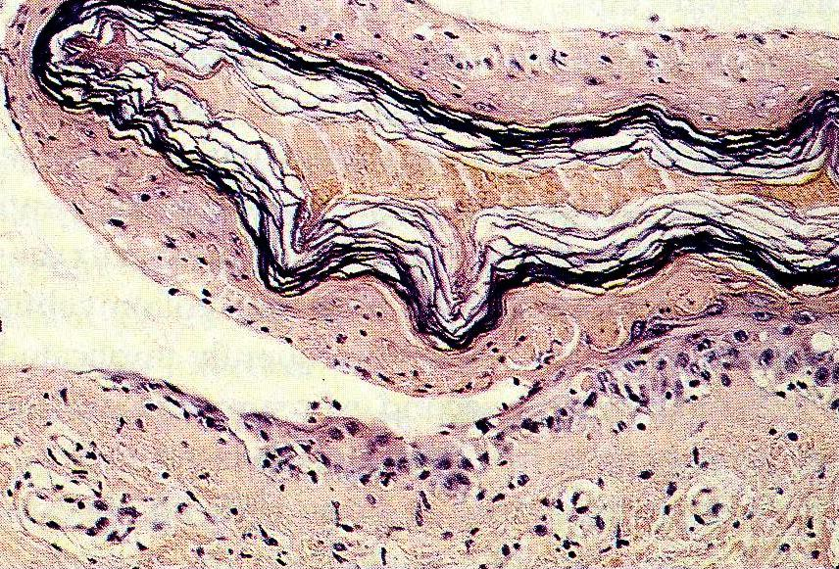

Slide 72
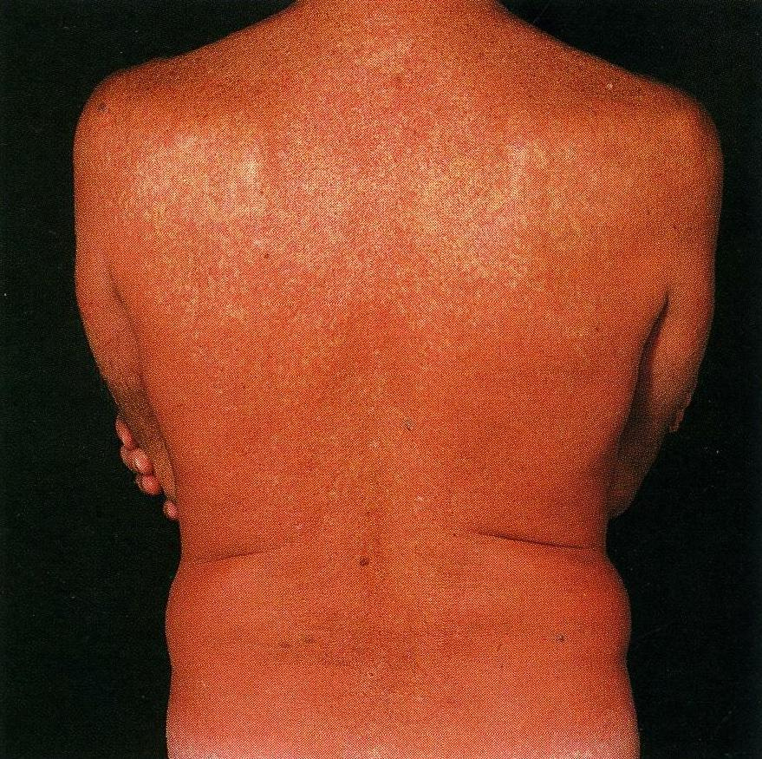
8. Erythroderma and Expoliative Dermatitis

Slide 73
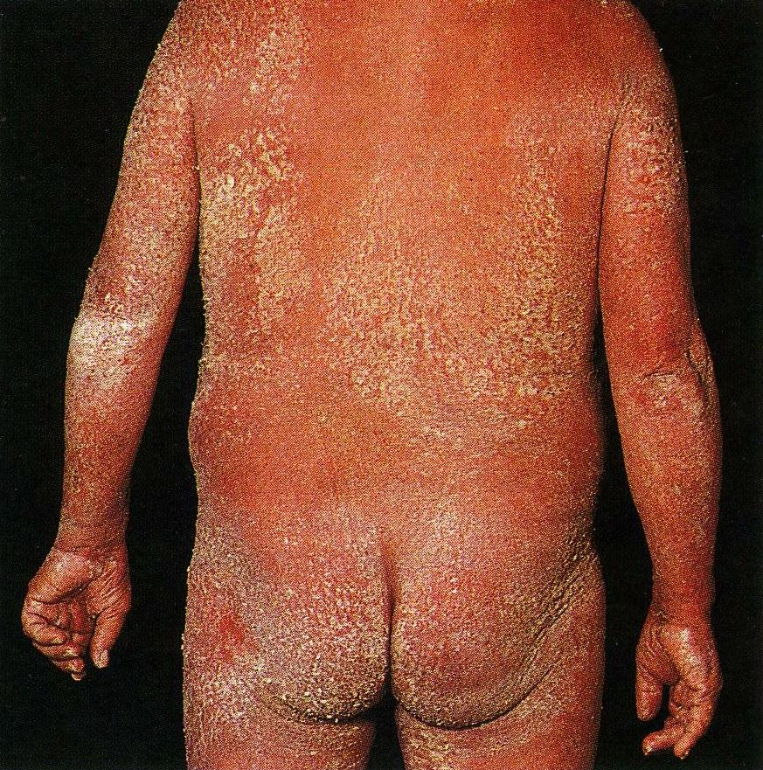

Slide 74
9. Fixed Drug Eruptions

Slide 79
10. Lichenoid Eruptions

Slide 83
11. Photosensitivity

Slide 84
12. Chronic Antinic Dermatitis

Slide 85
- Pigmentary Abnormalities

Slide 86
13. Acneiform and Pustular Erupstions

Slide 89
14. Bullous Eruptions
Fixed drug eruptions
Erythema Multiforme
Drug induced Vasculitis
All may have a bullous component
Drug induced TEN (Widespread blistering)
Drug induced Porphyria and Pseudoporphyria

Slide 91
Drug induced bullous pemphigoid

Slide 93
Drug induced Pemphigus

Slide 95
15. Vasculitis

Slide 99
16. Purpura

Slide 102
17. Annular Erythema

Slide 103
18. Pityriasis rosea like eruptions

Slide 104
19. Psoriasiform drug eruption

Slide 105
20. Lupus Erythematosus-like syndrome induced by drugs

Slide 106
21. Erythema Nodosum

Slide 108
Thank you

Slide 109
Vesiculobullous Disorders
Def: Circumscribed skin lesions containing fluid ≤ 5mm: vesicle.,>5mm:- bulla
Which skiing findings are helpful in evaluating a patient with blister?
Distribution : Generalized skin and oral cavity
Symmetry
Associated lesions
Additional types of skin lesions –urtic.
Characteristic of blisters

Slide 111
Which test are most useful in evaluating Vesiculobullous Dis.?
Cultures (Bact, viruses, fungi)
Smears from blisters (Bact, dermatophytes, multinucleate giant cells of H.S)
Skin biopsy – non infectious cause
When are special tests necessary to diagnose blistering Dis. of the skin?
Routine Hist.
Dif- immunobullous Dis./IIF
EM – EB.
Urine porphyrin- PCT
Zinc levels - ADE

Slide 112
Pemphigus
Essential of
Flaccid blisters, weeping painful erosions
M.M. involv.
Nikolosky’s sign
Asboe – Hansen sign or (bulla spread sign)
Acantholysis and intra epidermal cleft
IgG, C3 in intercellular space of epid.
IF:- S.Abs to epidermal cell surface Ags – Titer reflects Dis. Activ.
Rare, Lethal, Autoimmune blistering Dis.
Age – sixth decade

Slide 113
Classification of pemphigus :
Pempigus vulgaris
Pemphigus vegetans
Pemphigus foliaceus
Pemphigus erythematosus : localized
Fogoselvagem : endemic
Drug induced pemphigus
Paraneoplastic pemphigus
IgA pemphigus

Slide 130
Skin biopsy – light Mic.
IF: IgG, C3 in intercellular substance of epid.
IF: levels reflects the activity of Dis.
Rx
Corticosteroids
Immunosuppressive therapy
(Azathioprine, mycophenolate, mofetil)
IVIG
Anti CD-20, Rituximab

Slide 131
Pemphigoid Group of Dis.
Bullous pemphigoid, herpes gestations, cicatricial pemphigoid: auto immune sub epidermal blistering Dis. With circ.IgGand BMZ- bound IgG ABS α C₃.
Bullous Pemphigoid
Essentials of Diagnosis:
Large bullae on erythematous plaques or normal appearing skin.
No or only mild involv. of mucos.
Sub epidermal blister
IgG, C₃ at dermal epid. Junction.
ABS. against BMZ in patients sera

Slide 138
Age: Elderly
Relatively Benign
Clinical Manif.:
Loc Erythema, Urticaria, Pruritus
Tense blisters, lower part of abdomin, groin, flexors of Arms &
Legs.
Negative Nikolsky’s sign
Course: Variable, untreated B.P. Localized,Spont. Remission, generalized.

Slide 139
Diagnosis:
CBC: Eosinophilia - 50%
IgE: - 70%
HIST
DIF
IIF
Rx
Topical
Systemic: Steroid
Antibiotics: Tetracycline, Minocin
Dapsone
Immuno Suppressive
(Azathioprine, Mycophenolate, Mofetil)
In resistant cases : ivIg ,anti –CD20 immunotherapy (rituximab)

Slide 140
Pemphigoid Group of Dis. (Pemphigoid Gestationis)
Erythematous urticarial Plaques, alone or with papules, vesicles
blisters, erosions, most on abdomen, proximal extr.
Intense pruritus
Sub epidermal blister
C₃, IgG at BMZ, H.G. Factor in Patient’s Sera
2nd, 3rd Trimester, Flares at post partum, OCP

Slide 149
Dermatitis Herpetiformis
Severe Pruritis
Associated with gluten sensitive enteropathy
Pruritic tense blisters on extensors

Slide 152
-Phatology
Sub epidermal blister, prominent neutrophil infiltration
Dif: granular IgA in dermal papillae

Slide 153
Treatment
Gluten free diet
Dapsone – 1st line of treatment
Sulfa pyridine
Tetracycline and Nicotinamide

Slide 154
THANK YOU

