Slide 1
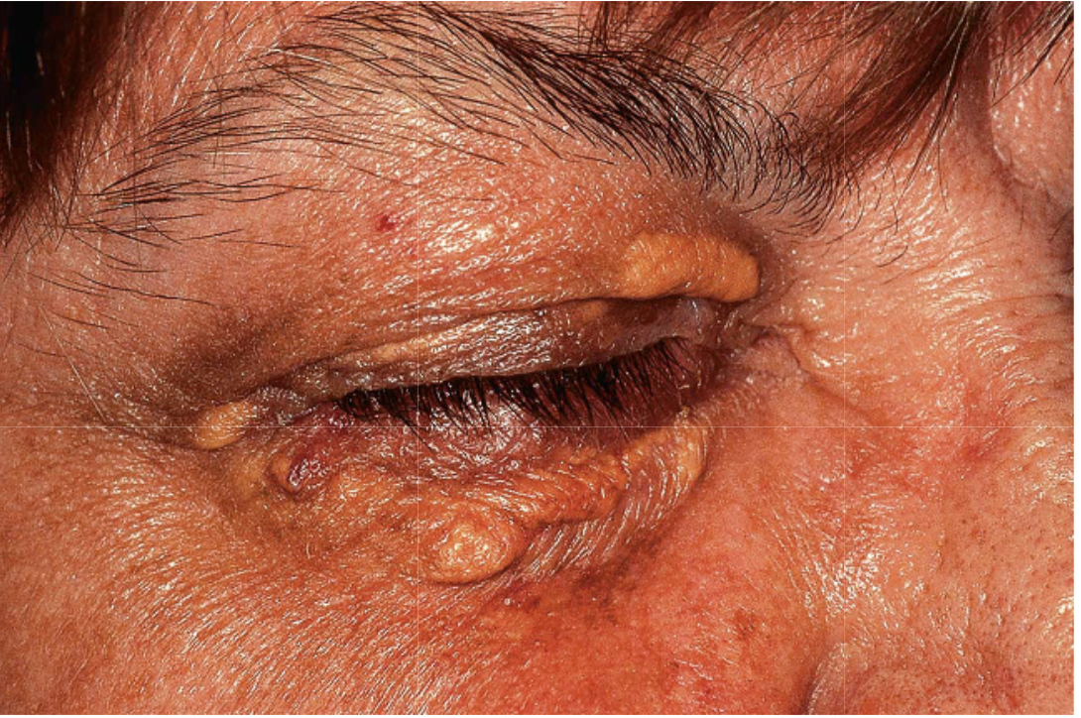
Cutaneous manifestations of systemic diseases
Abdulaziz Madani, M.D
Assistant Professor
Department of Dermatology, College of Medicine
King Saud University

Slide 2
Objectives
To highlight the relation between skin manifestations and common systemic disorders.
To understand various skin clues and their importance in investigating and managing different systemic disease
This lecture is not meant to be inclusive but to highlight important aspects in their diagnosis and management

Slide 3
Systemic diseases
Endocrine diseases
Gastrointestinal diseases
Renal diseases
Hyperlipidemia

Slide 4
Endocrine Diseases

Slide 5
Cutaneous manifestations of endocrine diseases
Diabetes mellitus
Thyroid diseases
Cushing’s syndrome
Addison’s disease

Slide 6
Diabetes Mellitus

Slide 7
Diabetes Mellitus
Acanthosis Nigricans
Acrochordrons “ skin tags”
Diabetic Dermopathy
Necrobiosis Lipodica Diabeticorum
Bullous Diabeticorum
Scleredema Diabeticorum
Acquired Perforating Dermatosis
Bacterial and Fungal infections

Slide 8
Acanthosis Nigricans
Velvety hyperpigmentation of the intertriginous/flexural areas (body folds and creases) and less often, extensor surfaces.
Commonly associated with insulin resistance and Obesity.
More common in Hispanics and people of African descent.
Can be associated with an internal malignancy (gastric adenocarcinoma).
Tx: Weight reduction and treat the underlying cause.

Slide 9
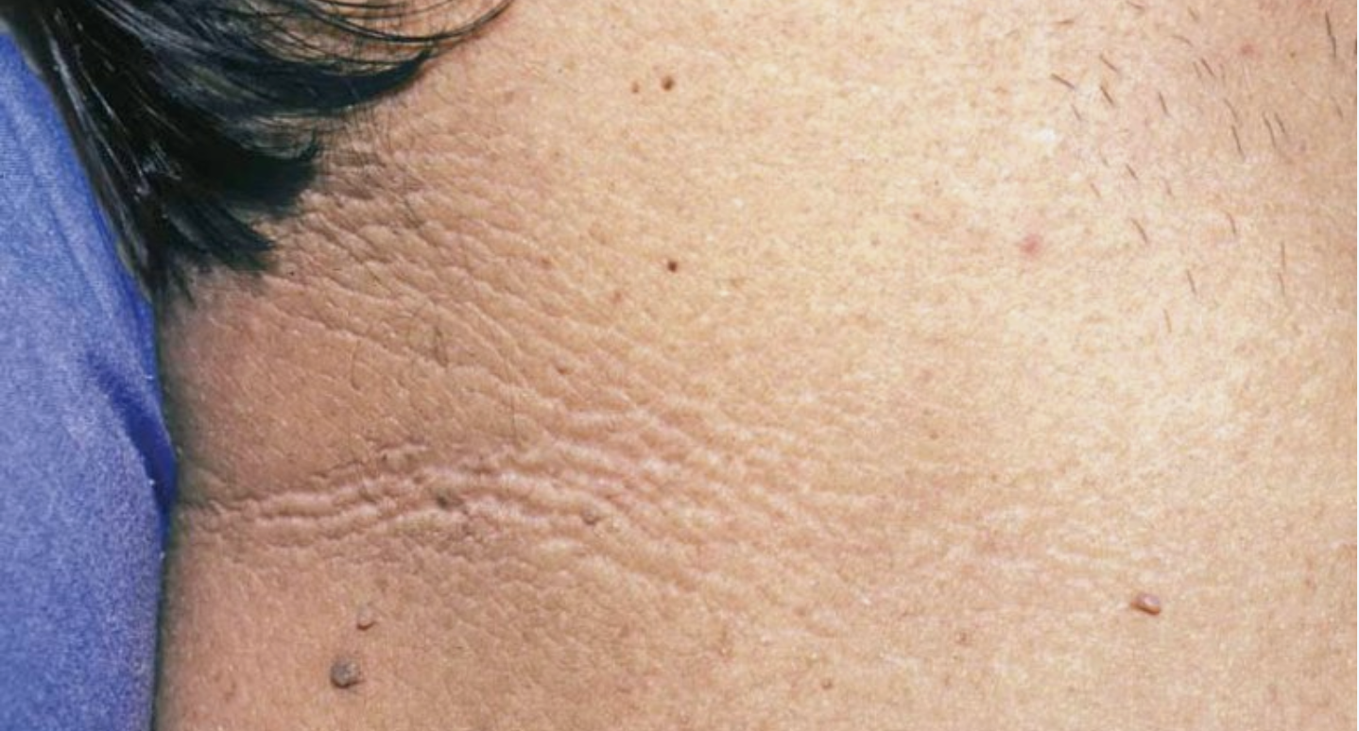
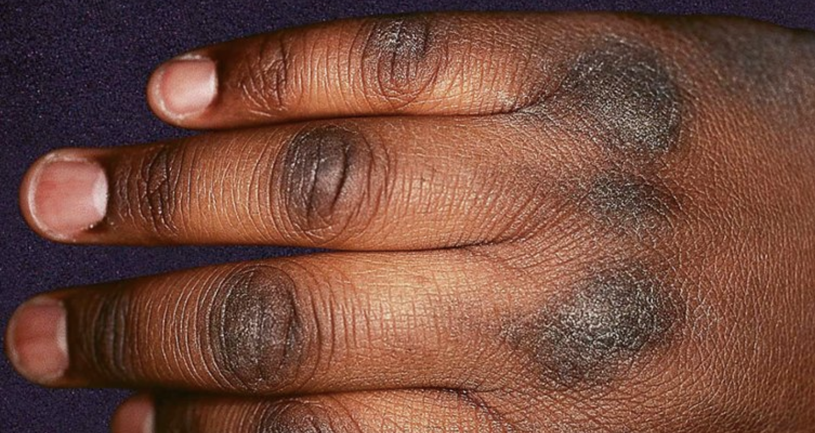

Slide 10
Acrochodrons ‘’Skin Tags’’
Very common.
Soft, skin colored, pedunculated papules.
Neck, axilla and groin.
Asymptomatic.
Can get irritated or infracted.
Tx: Cosmetic removal.

Slide 11
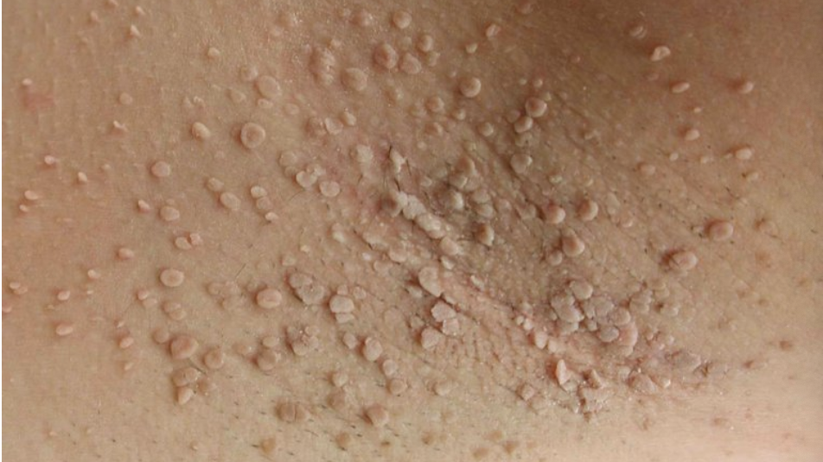

Slide 12
Diabetic Dermopathy
The most common cutaneous sign of DM.
Brown atrophic macules and patches on the legs.
Possibly precipitated by trauma.
They usually do not require treatment and tend to resolve after a few years with improved blood glucose control.

Slide 13
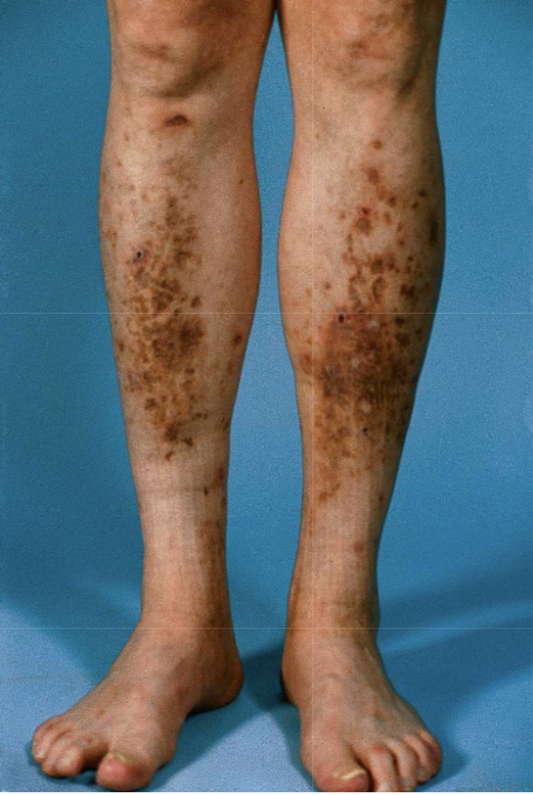
Notes:
Figure 53.19: Diabetic dermopathy.
Note the brown macules and patches on the shins.

Slide 14
Necrobiosis Lipodica Diabeticorum
Plaque with violaceous to red-brown, palpable peripheral rims and yellow-brown atrophic centers with telangiectasis.
The most common site is the shins.
Ulceration can occur following trauma.
The proportion of patients with DM varies from 15% to 65%.
Only 0.03% of patients with DM have NLD.
Pathogenesis is unknown.
Tx: Control of blood glucose does not have significant effect. Can improve with topical/intralesional steroids.

Slide 15
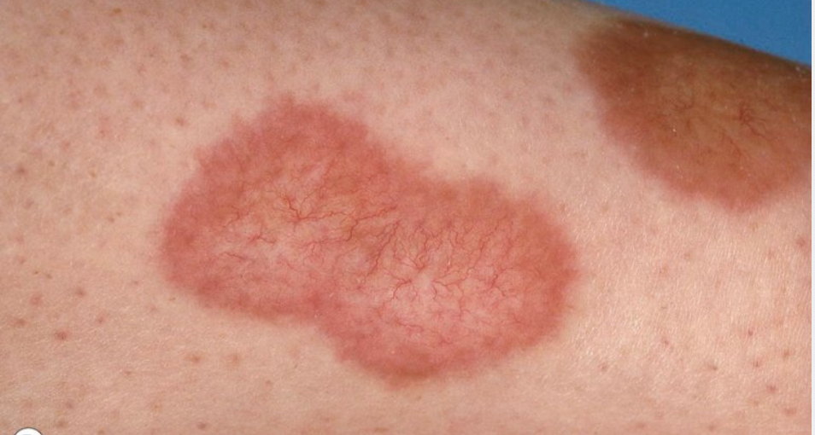
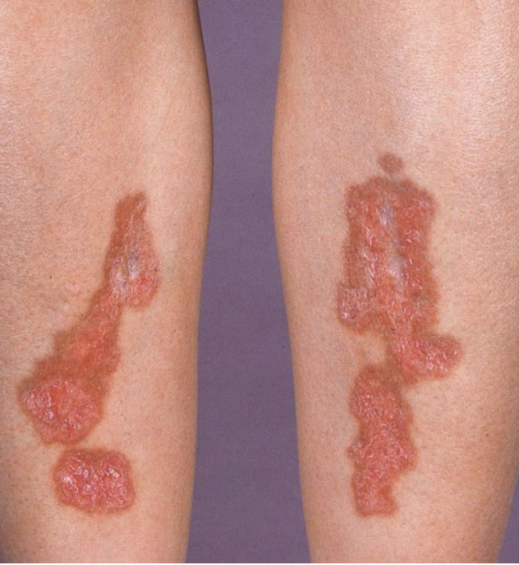
Notes:
Figure 93.14: Necrobiosis lipoidica.
A Pink–brown atrophic plaques on the shins. B Annular plaques with central telangiectasias.

Slide 16
Bullous Diabeticorum
A rare condition associated with DM.
Tense blisters develop on normal-appearing skin in acral sites (feet, lower legs, hands).
There is frequently an association with peripheral neuropathy.
Spontaneous healing usually occurs within 2 to 6 weeks.

Slide 17
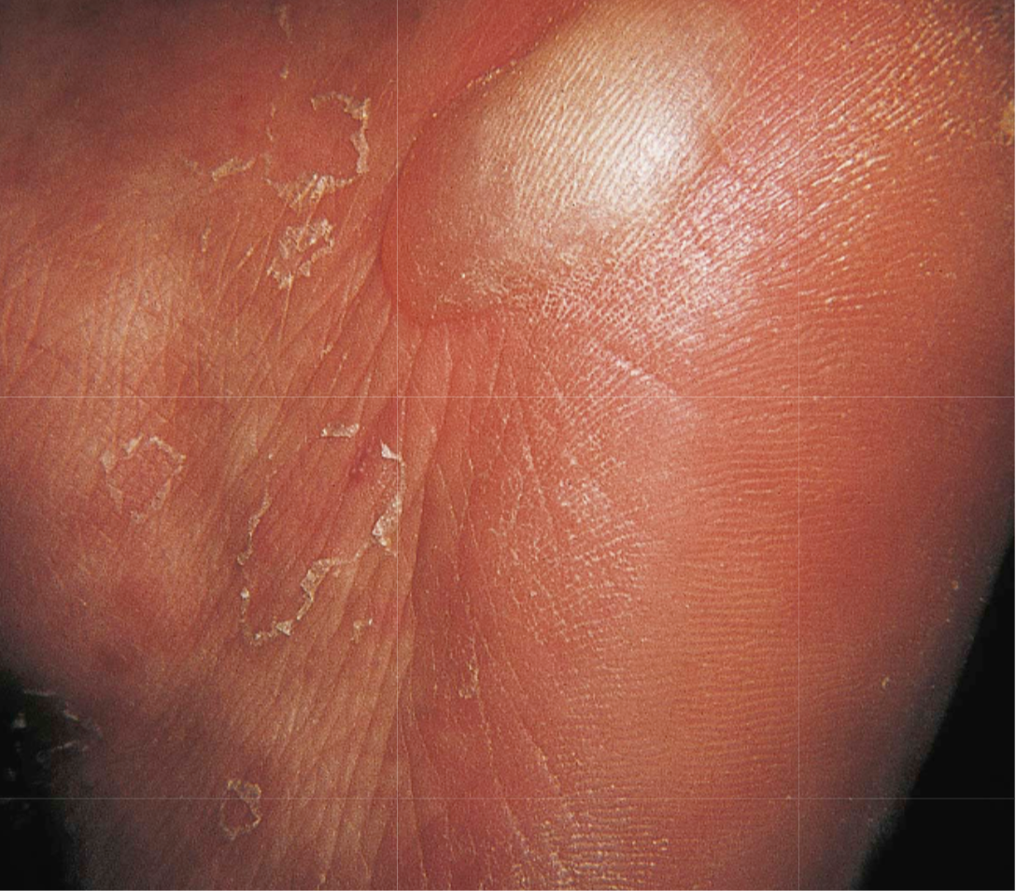
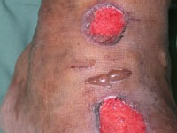

Slide 18
Scleredema
More common in males, often obese, with longstanding, uncontrolled diabetes, that have frequently suffered complications of diabetes ( neuropathy, nephropathy, retinopathy, atherosclerosis).
Presents as woody induration and thickening of the skin of the mid upper back, neck, and shoulders.
Can be associated with infection and monoclonal gammopathies.
Control of diabetes does not affect the course of scleredema

Slide 19
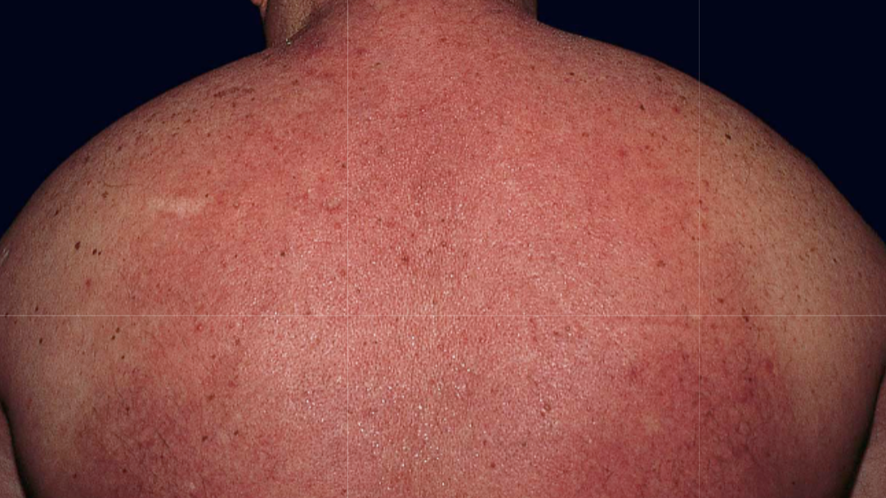
Notes:
Figure 46.8: Scleredema in association with diabetes mellitus.
Diffuse induration of the upper part of the body with overlying erythema.

Slide 20
Acquired Perforating Dermatosis
A skin disorder occurring in patients with chronic renal failure, DM or both.
Characterized by the transepidermal elimination of both collagen and elastic fibers.
They present as 2-10 mm, firm, hyperkeratotic, often umbilicated papules occurring on the trunk and extremities.
Tx: Topical keratolytics, phototherapy, topical/systemic retinoids, topical/intralesional steroids.

Slide 21
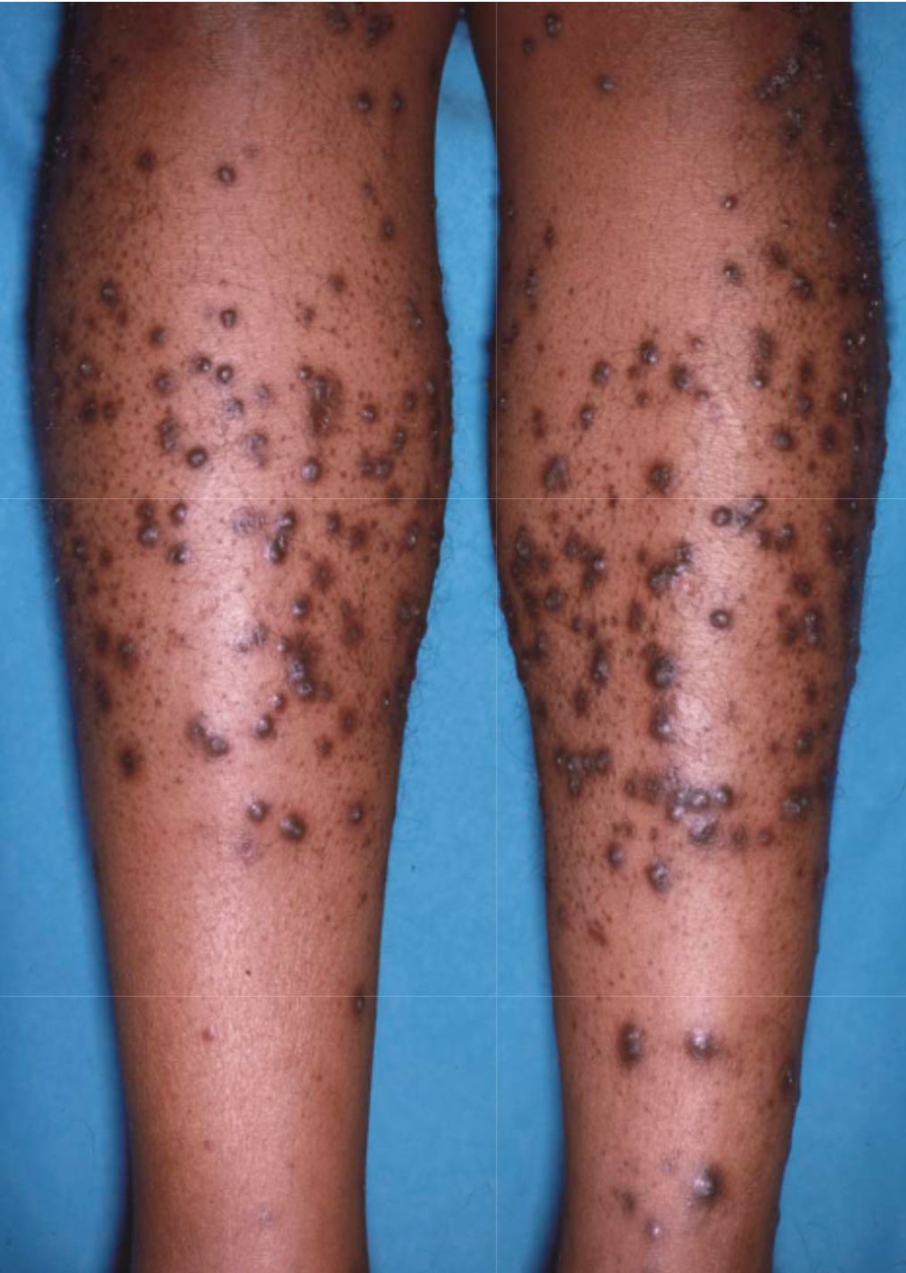
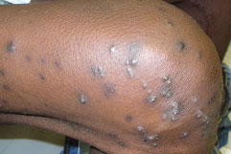
Notes:
Figure 96.5: Acquired perforating dermatosis.
Numerous papules and nodules on the legs in a patient with both renal failure and diabetes mellitus.

Slide 22
Thyroid Diseases

Slide 23
Hyperthyroidism
Warm, moist skin.
Palmoplantar hyperhidrosis.
Pruritis.
Diffuse, non-scarring alopecia. Increased risk of alopecia areata.
Facial flushing.
Hyperpigmentation of the skin, vitiligo.
Nail changes: Plummer’s nails, onycholysis, clubbing.
Pretibial myxedema:
Cutaneous induration of the shins due to mucin deposition.
Most commonly associated with Graves disease.
Skin-colored to brown, waxy, indurated nodules/plaques with characteristic peau d’orange appearance.

Slide 24
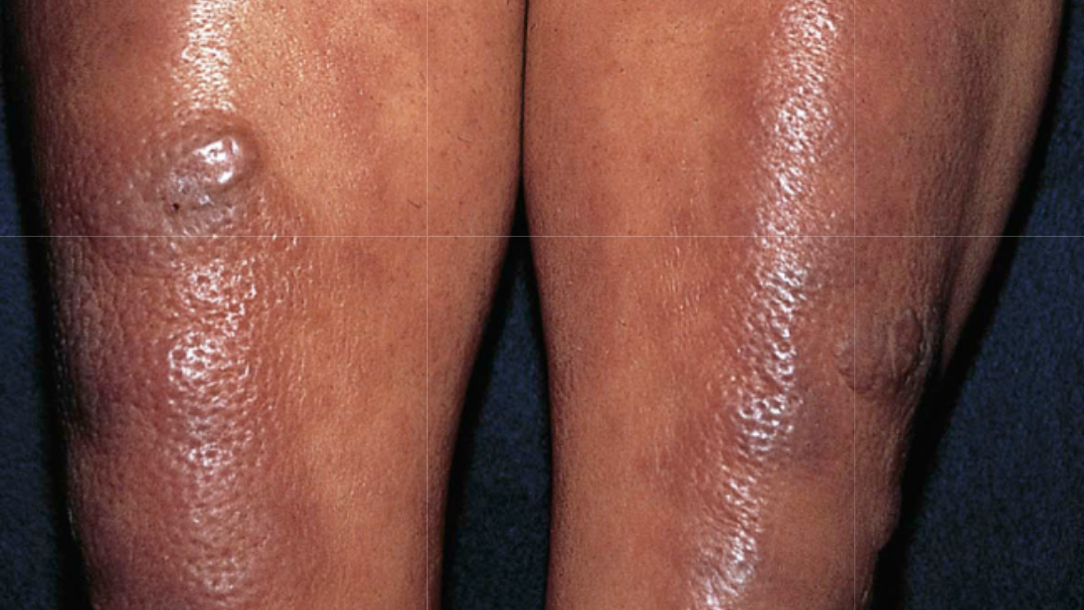
Notes:
Figure 46.10: Pretibial myxedema.
Purple–brown plaques on the shins of a patient with Graves disease. A peau d’orange appearance is present.

Slide 25
Hypothyroidism
Coarse, rough, dry skin.
Pallor.
Pruritis.
Carotenemia.
Diffuse hair loss with dull, coarse, brittle hair.
Loss of the lateral 1/3 of the eyebrow.
Myxedematous facies.
Autoimmune disease – vitiligo, alopecia areata.

Slide 27
Cushing Syndrome

Slide 28
Cushing’s Syndrome
Excessive glucocorticoid activity.
Altered subcutaneous fat distribution: Moon facies, buffalo hump.
Skin atrophy: Striae, prolonged wound healing, purpura.
Infections: Tinea versicolor, onychomycosis, candidiasis.
Adnexal effects: Corticosteroid-related acne, hirsutism.

Slide 29
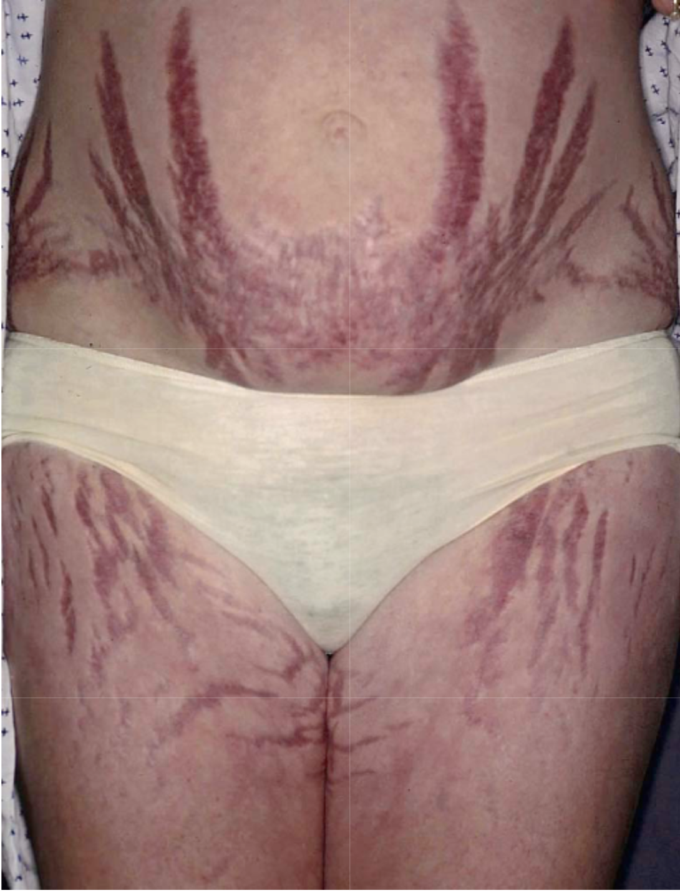
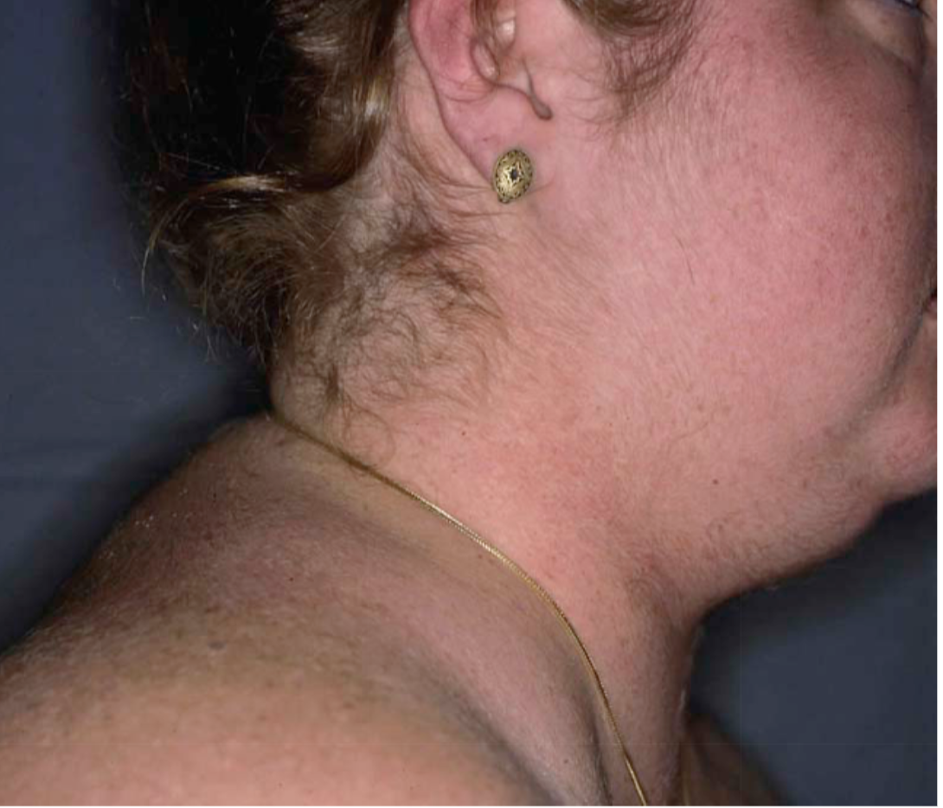
Notes:
Figure 53.23: “Buffalo hump” of Cushing’s syndrome due to fat redistribution.
The patient also has evidence of hirsutism.

Slide 30
Addison’s Disease

Slide 31
Addison’s Disease
Insufficient glucocorticoid activity.
Hyperpigmentation of the skin and mucous membranes due to high levels of circulating ACTH that binds to Melanocortin-1 receptor on the surface of the dermal melanocytes.
Loss of ambisexual hair in post-pubertal women.
Fibrosis and calcification of cartilage including the ear (rare).

Slide 32
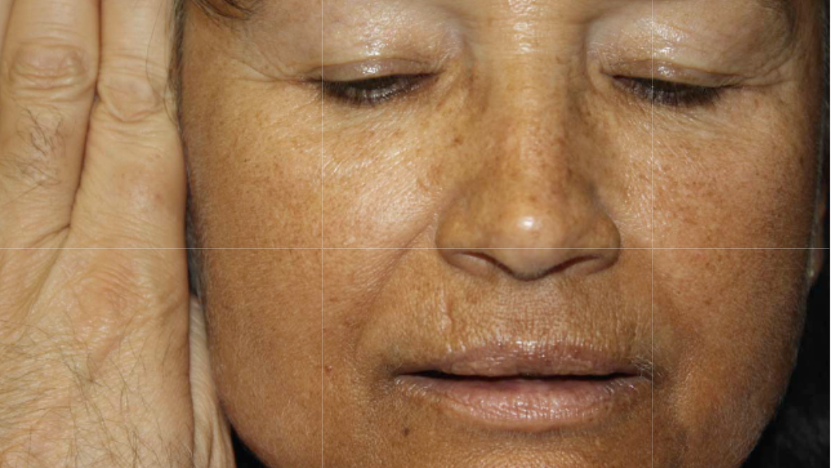
Notes:
igure 53.25: Diffuse hyperpigmentation of Addison’s disease.
The hyperpigmentation (shown in contrast to the physician’s hand) is accentuated in sun-exposed skin and can also involve sites of trauma, skin creases and mucosae.

Slide 33
Gastrointestinal Diseases

Slide 34
Cutaneous Manifestations of Gastrointestinal Diseases
Dermatitis herpetiformis
Acrodermatitis enteropathica
Pyoderma gangrenosum
Peutz Jeghers syndrome
Porphyria cutanea tarda
Hemochromatosis
Liver cirrhosis

Slide 35
Dermatitis herpetiformis
An autoimmune blistering disorder that is often associated with a gluten-sensitive enteropathy.
Small, severly pruritic, clustered vesicular papules or plaques that are symmetrically distributed over the extensor surfaces (elbows, knees, buttocks and shoulders).
Worsening of the disease with dietary intake of gluten.
Considered a cutaneous manifestation of celiac disease.
Direct immunofluorescence (DIF) of prelesional skin shows granular IgA deposits in the dermal papillae.
Tx: Dapsone, Gluten-free diet.

Slide 36
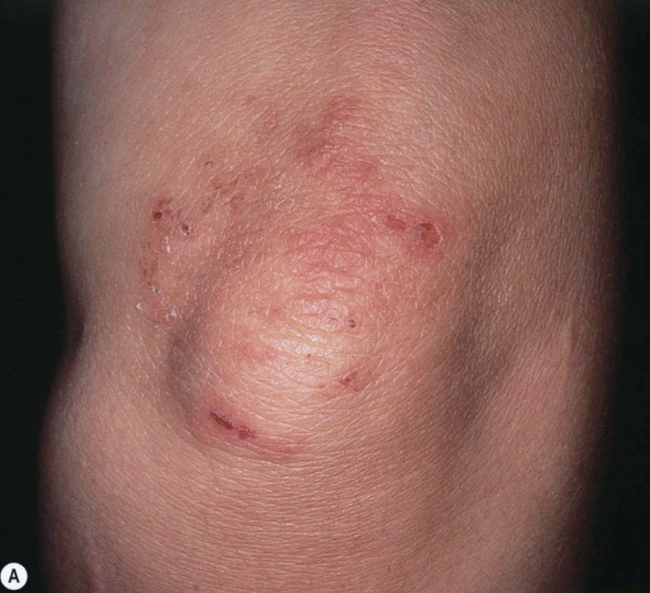
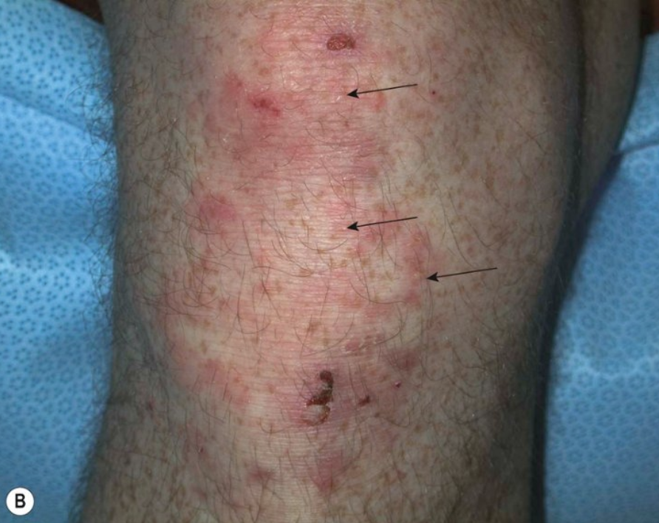
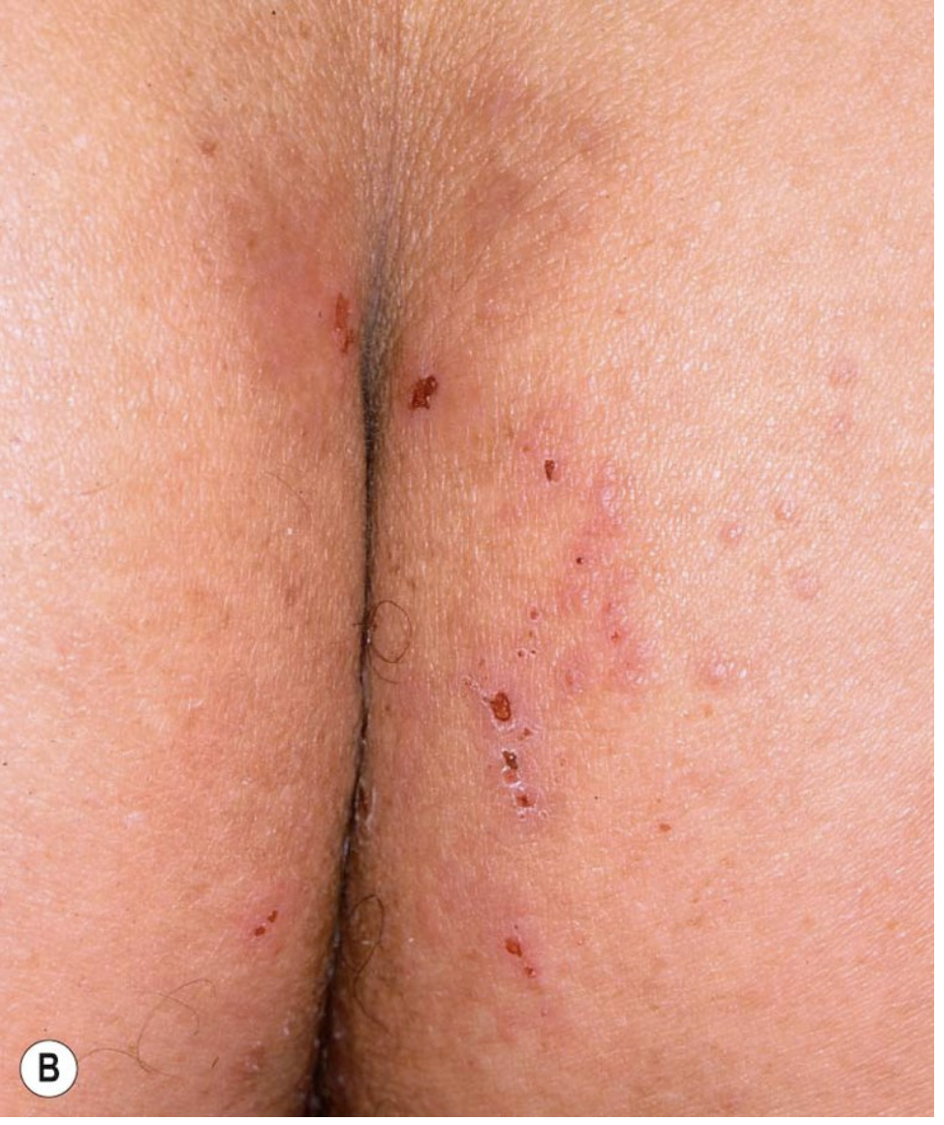
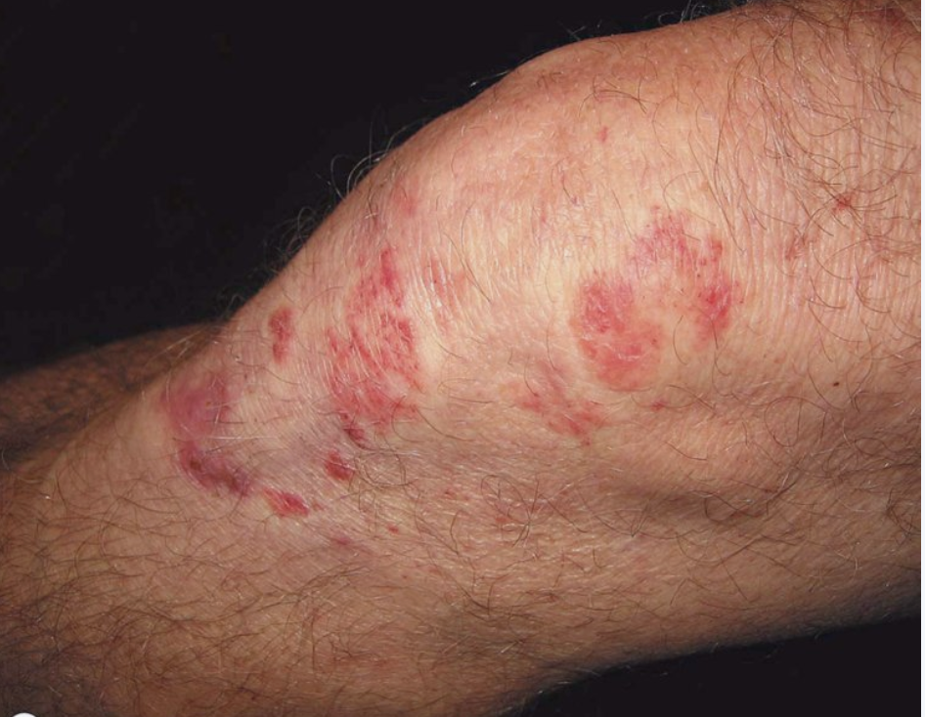
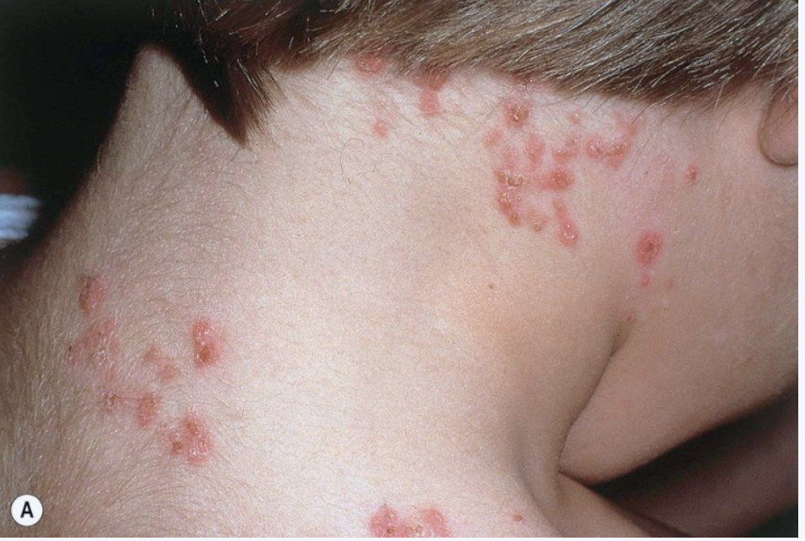
Notes:
Figure 31.2: Dermatitis herpetiformis.
A A few pink papulovesicles, erosions and hemorrhagic crusts on the elbow. B Multiple urticarial pink papules on the knee, in addition to a few erosions and small subtle intact vesicles (arrows); a collarette of scale is seen at the site of a previous vesicle. C Pink plaques on the knee composed of grouped papules and papulovesicles, admixed with tiny hemorrhagic crusts.
---------
Figure 31.3: Dermatitis herpetiformis.
A Grouped pink papulovesicles on the upper back, neck and scalp in a child. B Pruritic pink papules on the buttocks, some of which have central hemorrhagic crusts.

Slide 37
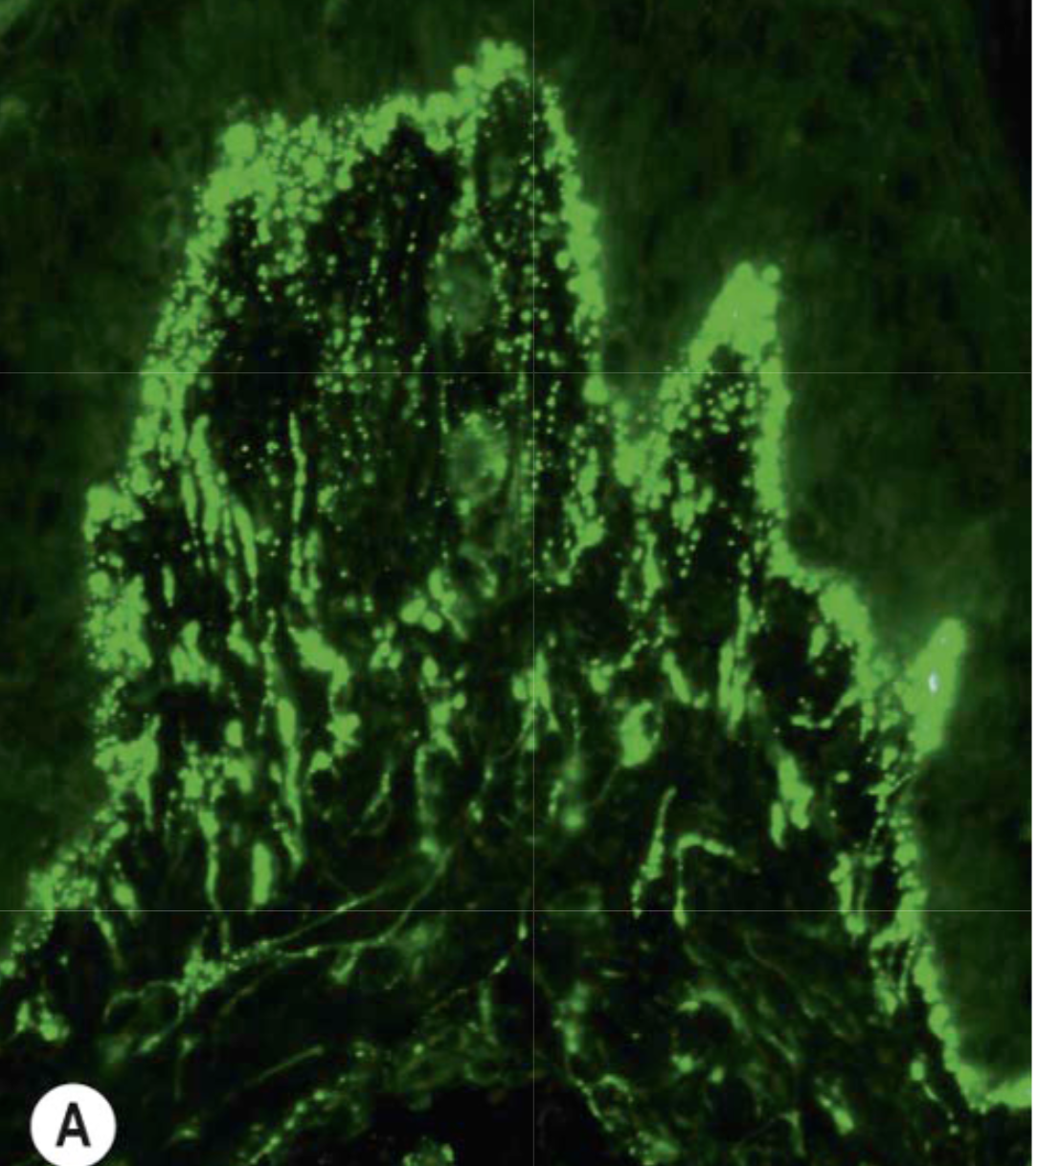
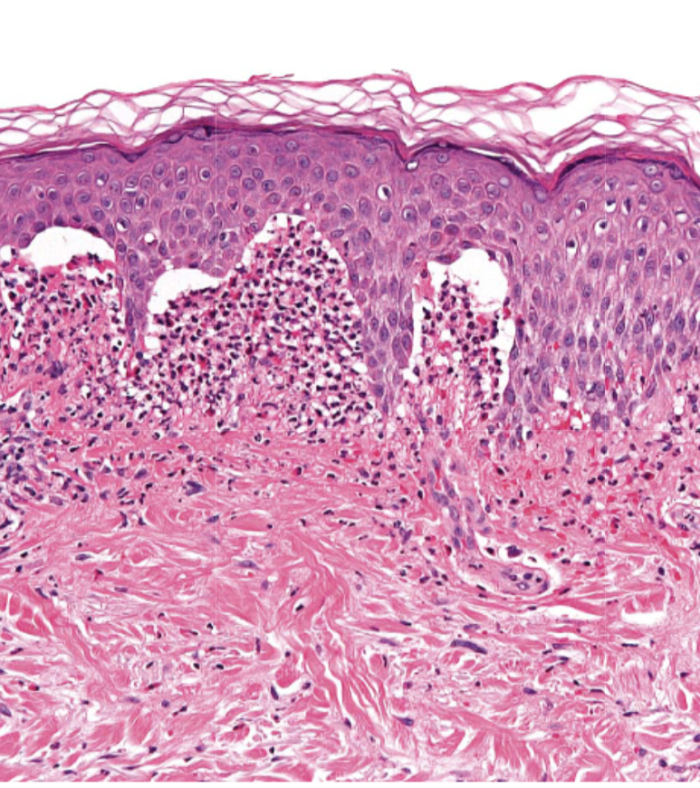
Notes:
Figure 31.4: Dermatitis herpetiformis – histopathologic features.
Subepidermal clefts beneath which are collections of neutrophils within dermal papillae. Scattered eosinophils are also present.
------------
Figure 31.5: Dermatitis herpetiformis – direct immunofluorescence.
A Granular IgA deposition along the dermal–epidermal junction of normal-appearing skin adjacent to a lesion. B Granular deposition of epidermal transglutaminase (TG3) within the dermal papillae, which co-localizes with the IgA.

Slide 38
Acrodermatitis Enteropathica
A rare autosomal recessive disorder that impairs dietary Zinc absorption in the GI tract.
Usually starts manifesting as the infant is weaned from breast milk.
Characterized by periorificial and acral dermatitis, alopecia.
Scaly, erythematous patches and plaques similar to atopic dermatitis but progress to vesicles, crusts, erosions and pustules on the acral, perioral and perianal areas.
Tx: Lifelong dietary Zinc supplementation.

Slide 39
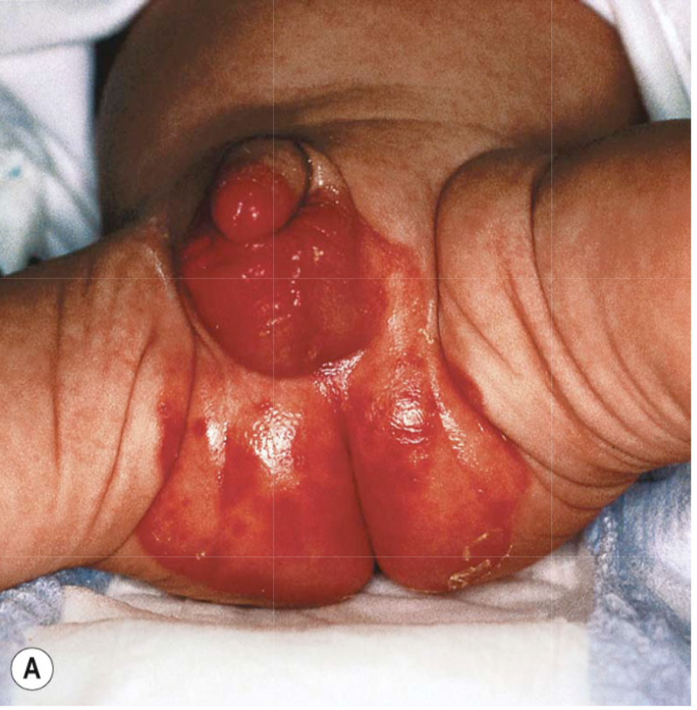
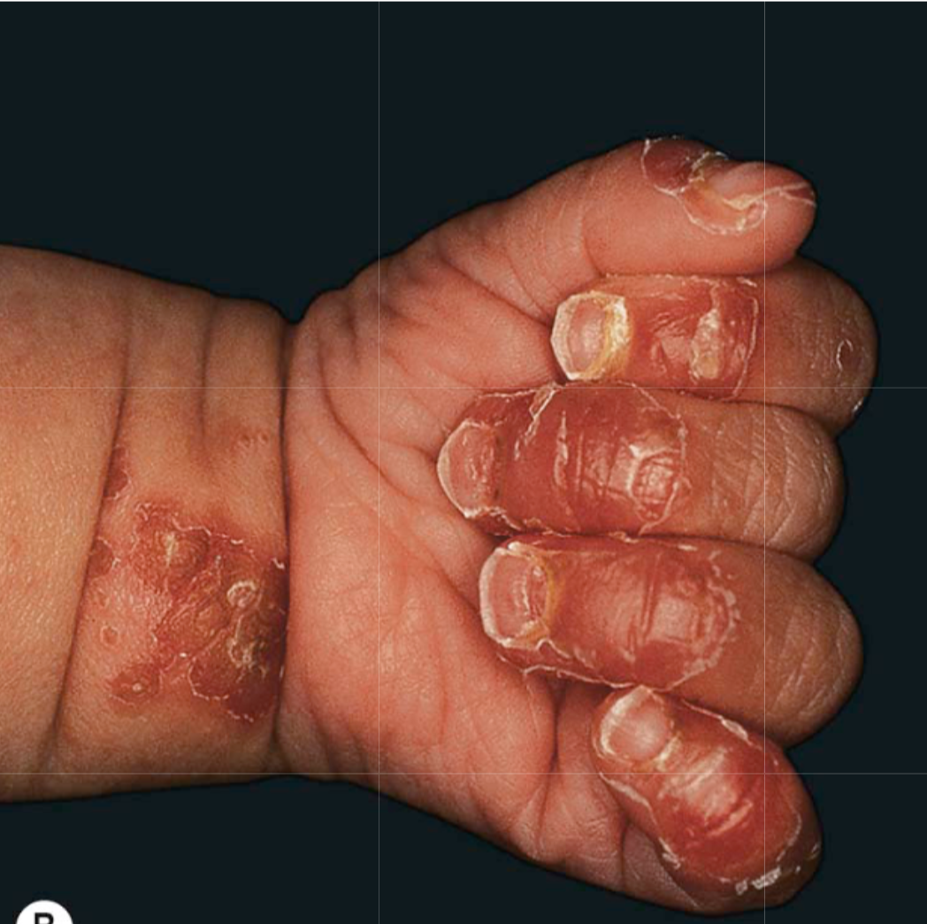
Notes:
Figure 51.11: Zinc deficiency.
Genetic (A, B) and acquired (C, D) forms. Both have erythema with erosions (A, C) as well as crusting and desquamation. Lesions favor acral and periorificial sites.

Slide 40
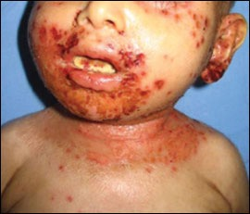

Slide 41
Pyoderma gangrenosum
Painful ulcerative lesions with a well-defined undermined, violaceous border.
Starts as a small red papule or pustule, that subsequently expands to form a large non-infectious ulcer.
Positive pathergy test.
Mostly associated with ulcerative colitis, Crohn’s disease, Rheumatoid arthritis and leukemia.
Tx: topical/intralesional steroids, systemic immunotherapy, biologics.
Surgery is contraindicated.

Slide 43
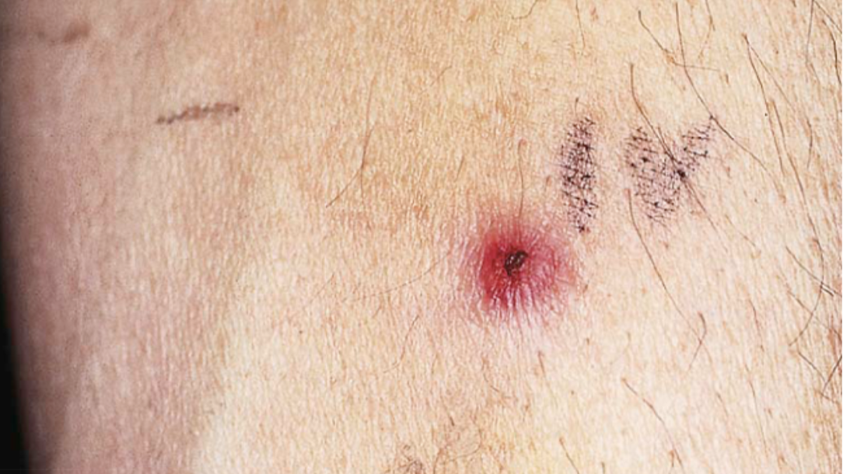
Notes:
Figure 26.9: Pathergy in a patient with pyoderma gangrenosum.
The lesion appeared at the site of an intravenous catheter.

Slide 44
Peutz Jeghers syndrome
Autosomal dominant due to mutations in the STK11 gene.
Skin: Melanotic (brown) macules on mucosal surfaces and less often on acral or perioral skin that first appear very early in life.
GI: Hamartomatous polyps throughout the GI tract. Bleeding may occur.
Increased incidence of breast, ovarian and GI cancers.

Slide 45
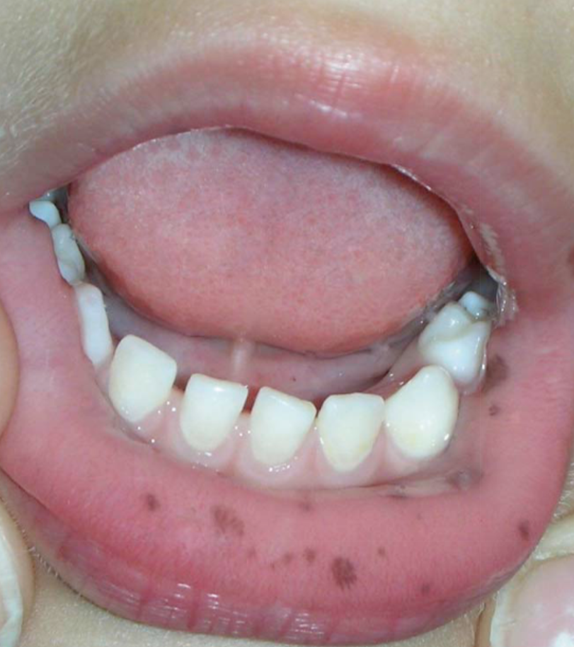
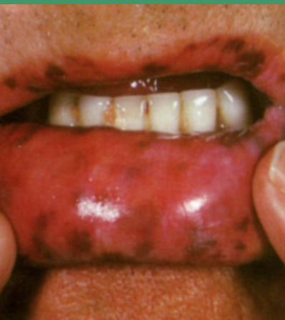

Slide 46
Porphyria cutanea tarda (PCT)
Porphyrias are inherited metabolic disorders resulting from a deficiency of an enzyme in the heme production pathway.
PCT is the most common porphyria occurring in adults.
Deficiency in ‘’ Uroporphyrinogen decarboxylase’’
Photosensitivity, skin fragility of sun-exposed skin after mechanical trauma, leading to erosions and bullae on the hands mainly.
Healing of crusted erosions and bullae leaves milia, hyperpigmentation, and atrophic scars.
Facial Hypertrichosis.
Frequently associated with Hepatitis C infection.
Tx: Phlebotomy, hydroxychloroquine, sun avoidance.

Slide 47
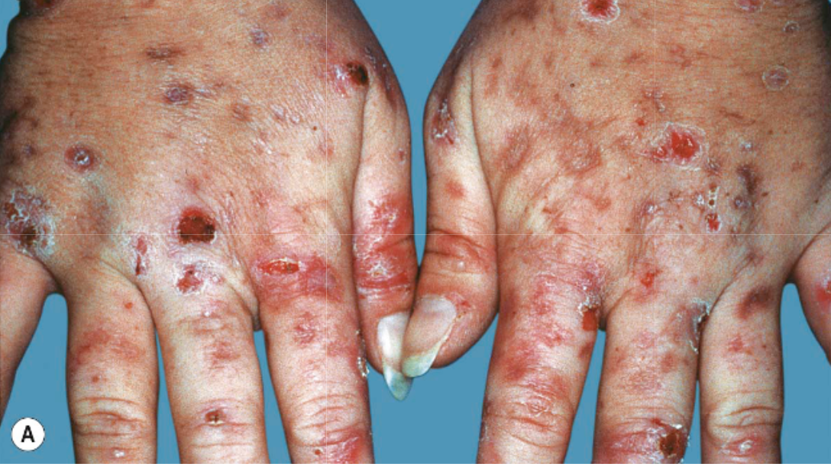
Notes:
A Marked fragility with multiple hemorrhagic crusts, erosions and milia as well as scars.

Slide 48
Hemochromatosis
Autosomal recessive disorder characterized by the abnormal accumulation of iron in several organs leading to organ toxicity.
Cutaneous pigmentation is one of the earliest signs of the disease, most pronounced on sun-exposed areas (face).
Appears as brownish bronze or at times slate gray.
Other findings: ichthyosis-like changes, koilonychia and hair loss.
Tx: Phelebotomy.

Slide 49
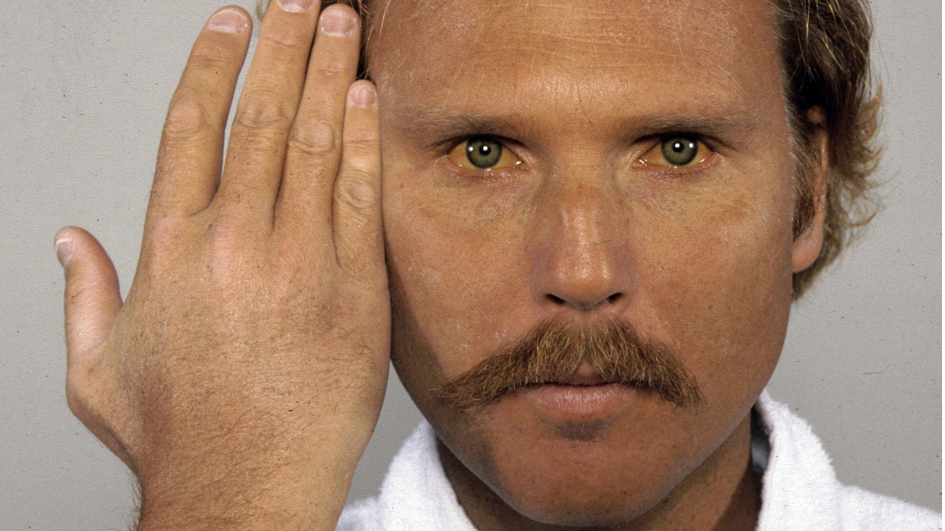

Slide 51
Liver cirrhosis
Jaundice
Pruritis
Spider angioma
Palmar erythema
Purpura
Petechiae
Caput medusae
Loss of body hair.
Notes:
Caput medusae, also known as palm tree sign, is the appearance of distended and engorged superficial epigastric veins, which are seen radiating from the umbilicus across the abdomen.

Slide 52
Renal Diseases

Slide 53
Cutaneous Manifestations of Renal Disease
Manifestations associated with uremia
Nephrogenic systemic fibrosis

Slide 54
Manifestations associated with uremia
Xerosis:
50-90% of dialysis patients
Can improve with routine use of emollients.
Pruritis:
The most common metabolic cause of pruritis.
Manifestations of pruritis include: Excoriations, prurigo nodularis, lichen simplex chronicus.
Resolved after transplantation.
Tx: Antihistamines, emollients, phototherapy, thalidomide, gabapentin…
Half-and-Half nails:
40% of patients on dialysis.
Disappears several months after transplantation.
Dark (Reddish-brown) distal band and a white proximal band.
More common on fingernails but could be seen on the toenails.

Slide 56
Nephrogenic Systemic Fibrosis
Fibrosis of the skin and internal organs.
Caused by exposure to gadolinium-based contrast agents used in imaging in patients who have renal insufficiency on dialysis.
Large areas of thick, woody, indurated skin with fibrotic nodules and plaques on the extremities and trunk.
Tx: Extracorporeal photochemotherapy, immunosuppressive therapy, phototherapy, IVIG.

Slide 57
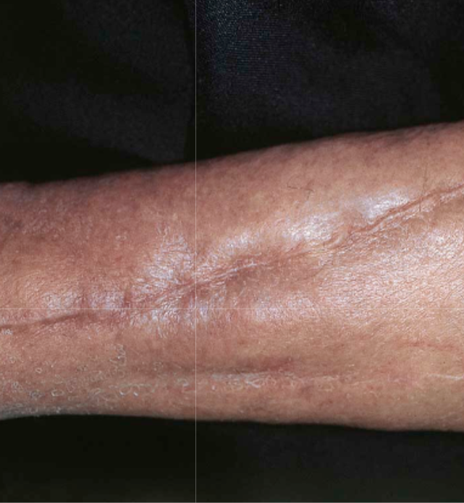
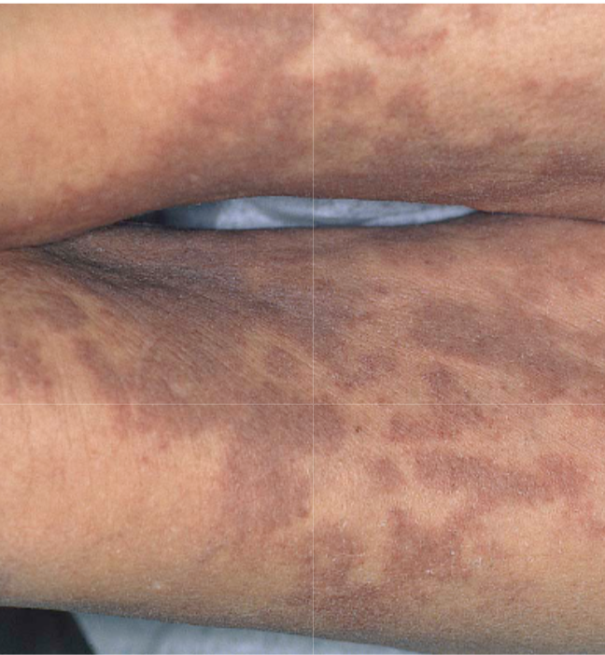
Notes:
Figure 43.14: Nephrogenic systemic fibrosis (NSF) – clinical features.
Thickening and induration of the skin can be obvious (A), or lesions may present as purple–brown plaques (B). Scleral plaques (C) in a patient less than 45 years of age is a minor criterion for NSF.

Slide 58
Hyperlipidemia

Slide 59
Xanthelasma Palpebrarum
Most common cutaneous xanthoma.
Occurs mostly near the inner canthus (upper > Lower eyelid)
Asymptomatic, bilateral.
Can be associated with any type of primary hyperlipoprotenemia but can also occur without hyperlipidemia (50%).
Tx: Surgical excision, laser, cryotherapy.

Slide 61
Tendinous/Tuberous Xanthomas
Tendinous xanthoma:
Commonly seen on the achilles tendon, followed by the hand/feet, elbows/knees.
The least responsive to treatment.
Most seen in patients with familial hypercholesterolemia.
Tuberous Xanthoma:
Firm, non-tender, cutaneous and subcutaneous yellowish nodules on the extensor surfaces.
Mostly associated with familial dyslipoprotenemia.
May resolve after months of treatment with lipid lowering agents.

Slide 62
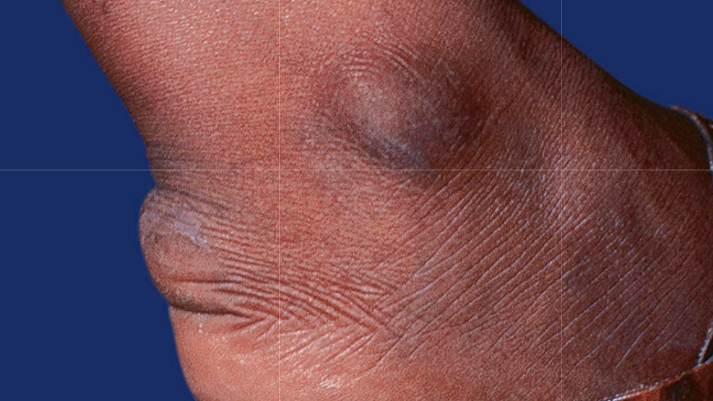
Notes:
Figure 92.7: Tendinous xanthoma.
Linear swelling of the Achilles area, representing a tendinous xanthoma in a patient with dysbetalipoproteinemia.

Slide 63
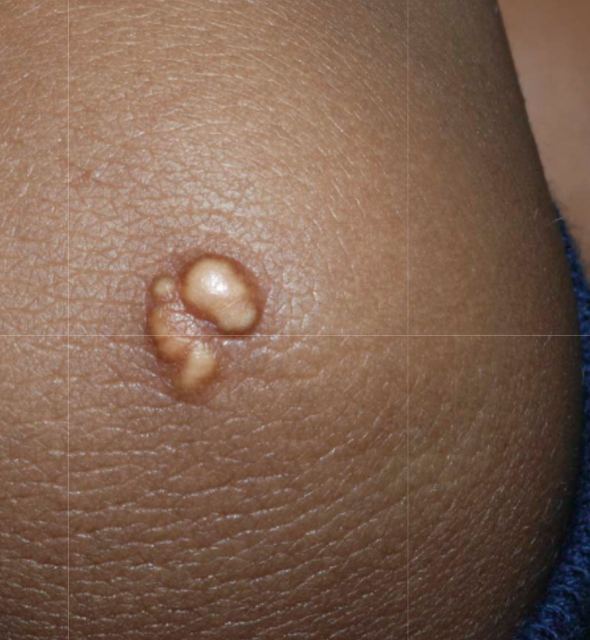
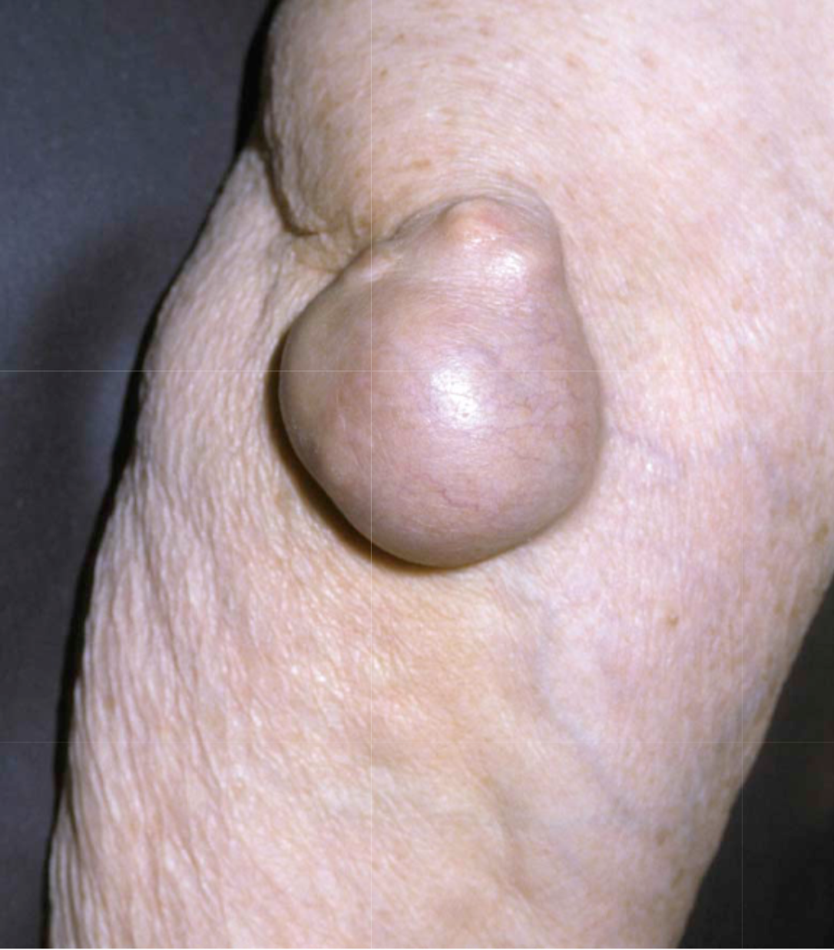
Notes:
Figure 92.6: Nodular tuberous xanthoma of the elbow.
-----
Figure 92.5: Tuberoeruptive xanthomas on the elbow of a child with homozygous familial hypercholesterolemia.
Note the yellowish hue.

Slide 64
Eruptive Xanthomas
Painless, yellowish papules on an erythematous base, that present as grouped lesions on the extremities (knees), trunk, elbows and buttocks.
Usually associated with hypertriglyceridemia.
Could be seen in poorly controlled diabetes and acute pancreatitis.
Usually resolves in a few weeks after therapy.

Slide 65
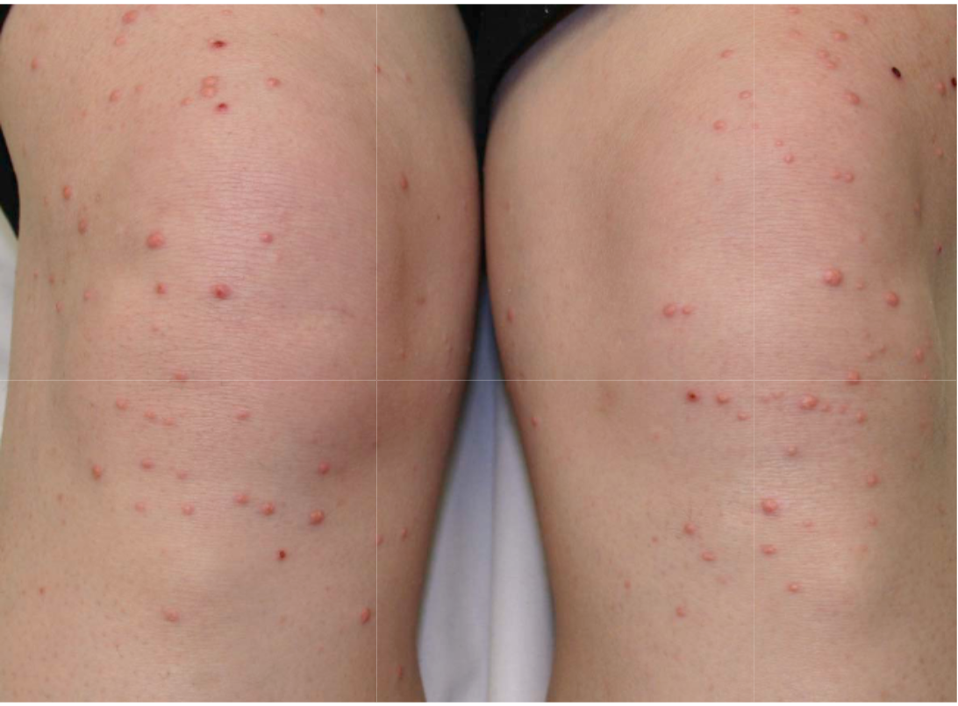
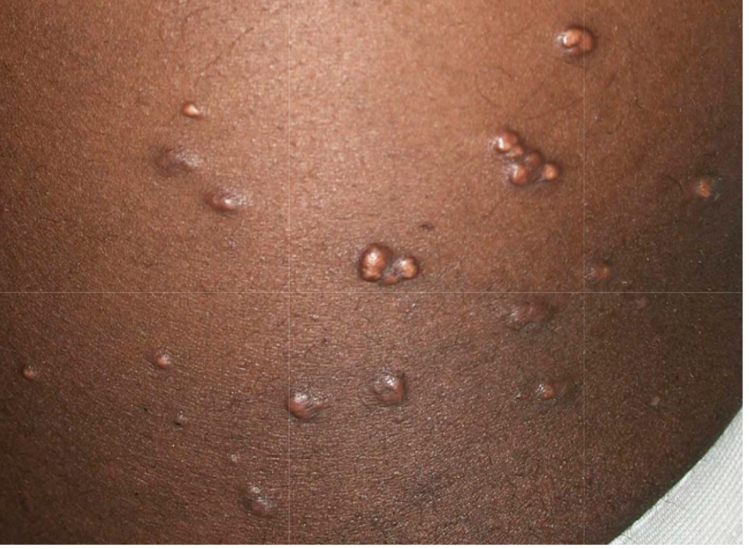
Notes:
Figure 92.3: Eruptive xanthomas.
Note the yellowish hue and the clustering of some of the lesions.
-------
Figure 92.2: Eruptive xanthomas due to hypertriglyceridemia.
The lesions favored the extensor surface of the lower extremities, in particular the knees.

Slide 66
Planar Xanthomas
Yellowish-orange papules, patches or plaques.
Plane xanthomas of the palmar creases (Xanthoma striatum palmare) are almost diagnostic of dysbetalipoprotenemia.
Plane xanthomas of cholestasis may occur as as complication of liver disease (plaques on the hands and feet).
Plane xanthomas can occur in a normolipemic patient and could signal the presence of an underlying monoclonal gammopathy.

Slide 67
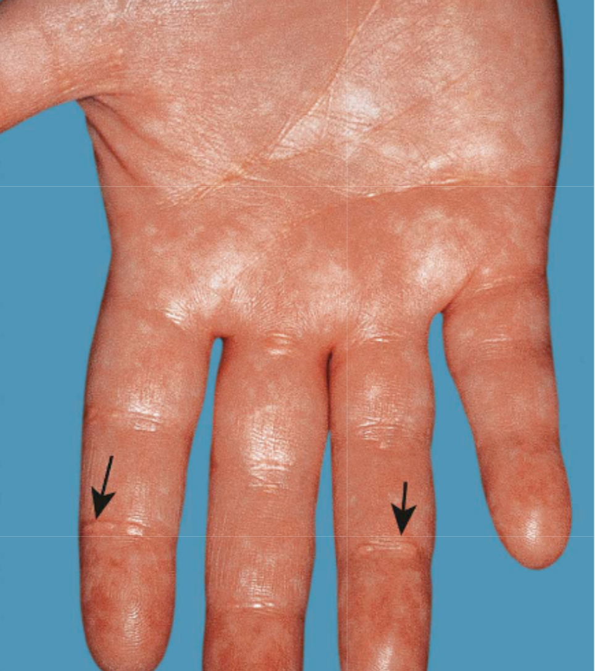
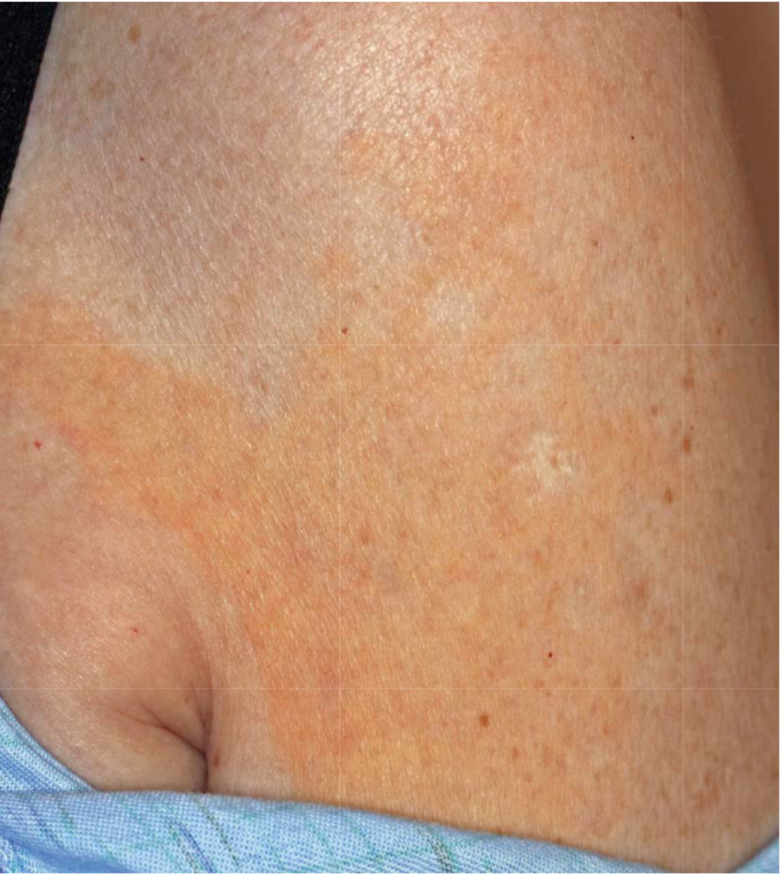
Notes:
Plane xanthomas of the palmar creases (arrows) in a patient with dysbetalipoproteinemia.
They are seen in approximately two-thirds of patients with this disorder.
---------
The large thin plaques have a yellow–orange color. On longitudinal evaluation, the patient was found to have a monoclonal gammopathy.

Slide 68
Verruciform Xanthomas
Asymptomatic solitary plaques averaging 1 to 2 cm in diameter.
Occur primarly in the mouth but sometimes in anogenital sites.
Usually no associated hyperlipidemia.
Lesions persist for years.

Slide 69
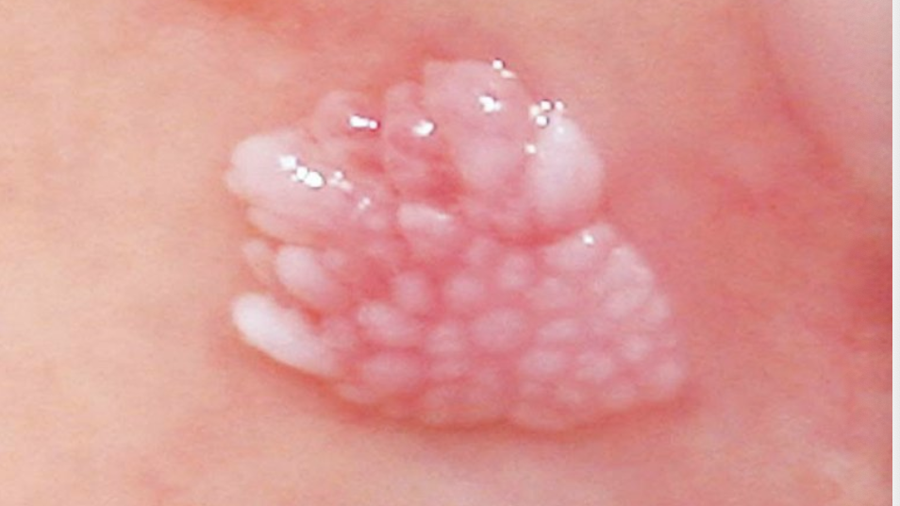
Notes:
Verruciform xanthoma of the oral mucosa.

Slide 70
Amadani1@ksu.edu.sa

