Slide 1
Ear III
A. Alballaa
College of Medicine King Saud University ORL Course 432 ORL Department King Abdulaziz University Hospital

Slide 2
middle Ear
Eustachian (Pharyngo-tympanic) Tube
Tympanum (Middle Ear Cavity):
Ossicles
malleus, incus, and stapes.
Muscles
Stapedius muscle and Tensor tympani
Nerves
Facial nerve
Mastoid Antrum and Air Cells

Slide 3
Otitis media
Chronic Vs. Acute

Slide 4
acute Otitis media
Stages:
I: Tubal occlusion
II: presuppuration
III: Suppuration
IV: Resolution/complications

Slide 5
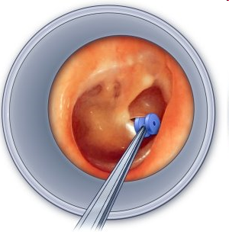
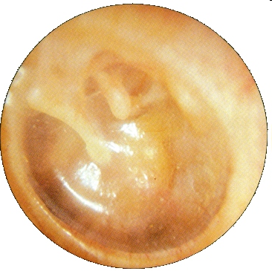
chronic otitis media:
Otitis media with effusion and Adhesive otitis media
glue ear or secretory otitis media (SOM)
dysfunction of the Eustachian tube
Management :
medical: Decongestants, Nasal corticosteroid sprays, OTOVENT
Surgical: myringotomy +/- tube, balloon dilation of the Eustachian tube

Slide 6
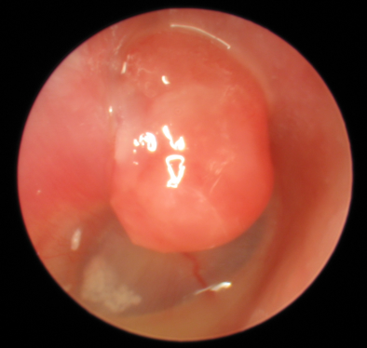
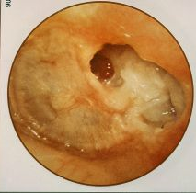
chronic suppurative otitis media
Safe Vs. Unsafe (Cholesteatoma)
Management is Surgery in form of:
a. Tympanoplasty b. Mastoidectomy c. Tympanomastoidectomy

Slide 7
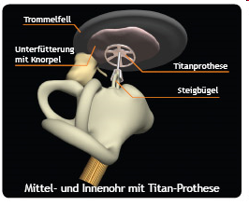
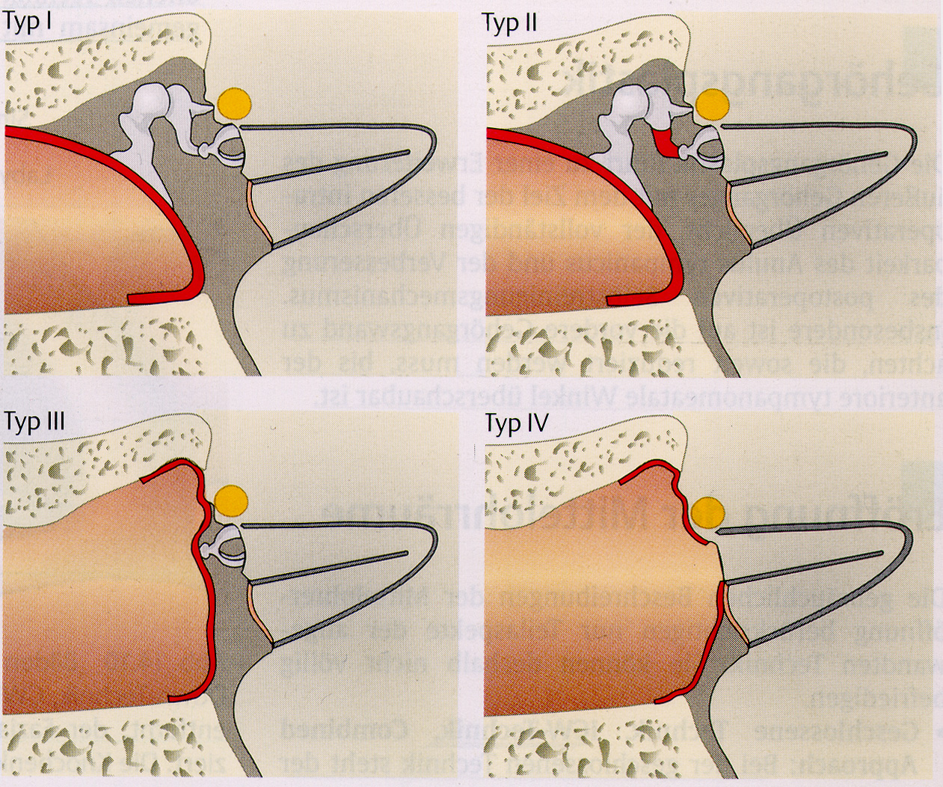
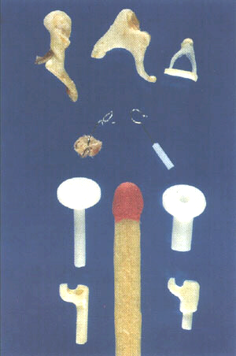
Tympanoplasty

Slide 8
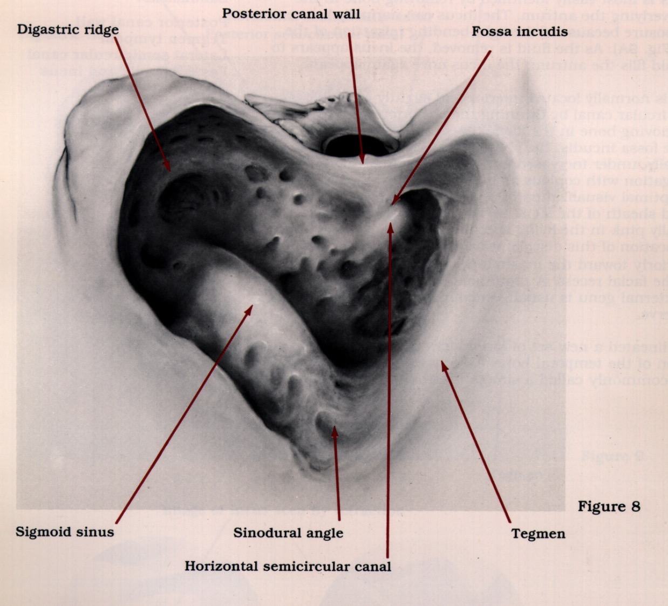
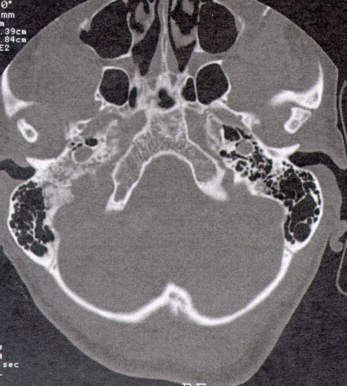
Mastoidectomy

Slide 9
Investigations in chronic otitis media
1. Audiology:PTA, tympanogram, acoustic reflex 2. Radiology: CT, MRI

