Slide 1
Audiology presentation
Murad Almomani, Ph.D., CCC-A, FAAA
American Board of Audiology

Slide 2
Pure tone audiometry
Murad Al-momani, Ph.D., CCC-A, FAAA, American Board in Audiology

Slide 3
Ranges of Hearing Loss
-10 – 25 dB HL = Normal range
26 – 40 dB HL = Mild hearing loss
41 – 55 dB HL = Moderate
56 – 70 dB HL = Moderately Severe
71 – 90 dB HL= Severe
Greater than 90 dB HL = Profound

Slide 4
Normal Hearing

Slide 5
Conductive Hearing Loss

Slide 6
Sensorineural Hearing Loss

Slide 7
Mixed Hearing Loss

Slide 8
Procedures for conventional pure-tone audiometry
After history taking and otoscopy we must choose how to test the hearing thresholds.
Before we do pure tone audiometry (PTA), we usually perform middle ear immitance testing
PTA will be almost done to all pts visiting us in the clinic because it is the basic test and give us a lot of information about the problem.

Slide 9
PTA
With PTA we can determine whether the pt has peripheral hearing loss (that is at the level of outer, middle, inner ear or the auditory nerve).
PTA is administered both by air (air conduction PTA) or by bone (bone conduction PTA).
Air conduction tests are administered by loudspeakers or ear phones.

Slide 10
PTA
After establishing threshold at 1 KHz, we move to the frequencies (2000, 4000, and 8000Hz).
If the difference between any two adjacent frequencies is 20 dB or more, we must measure the threshold at the inter octave frequencies.
After we are done from the high frequencies, we return back and check the 1 KHz again to check for test-retest reliability.
Then we test (500, 250 and 125 Hz).

Slide 11
PTA
If we test in the sound field, we must use warble tones instead of pure tones to avoid the production of standing waves.
When using ear phones make sure that there is no excessive wax in EAC and that the earphone is snugly inserted in the canal.
All equipment (audiometer, earphones, and testing room should be calibrated according the standards (will teach you how to do that in the instrumentation course).

Slide 12
PTA-BONE CONDUCTION
The most commonly used procedure for bone-conduction testing is mastoid placement because it is more convenient.
Frontal bone can be used as the place for the bone vibrator.

Slide 13
PTA.BONE CONDUCTION
We should do bone conduction if the air conduction thresholds are above the normal range otherwise we do not need to do bone conduction testing.
Some exceptions?
We first do unmasked thresholds and then we should apply masking to the contralateral ear in order to get precise threshold measurement in this ear (will talk about masking next lecture).

Slide 14
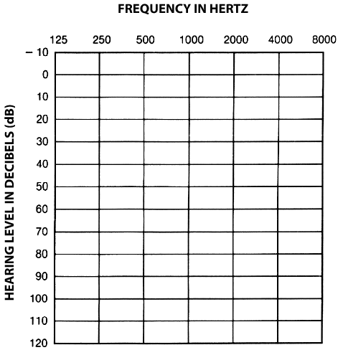
AUDIOGRAM

Slide 16
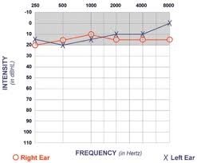

Slide 17
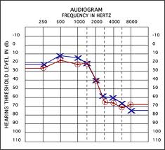

Slide 18
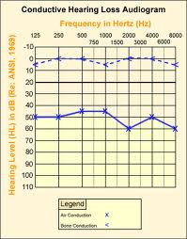

Slide 19
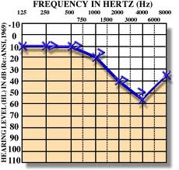

Slide 20
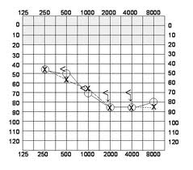

Slide 21
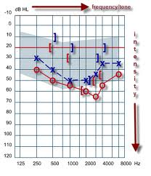

Slide 22
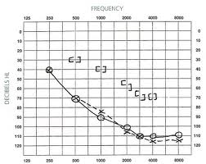

Slide 23
Information we get from audiogram
Degree of hearing loss.
Type of hearing loss.
Configuration of hearing loss.

Slide 24
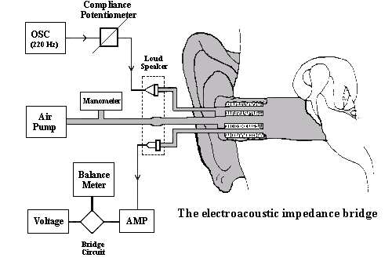

Slide 25
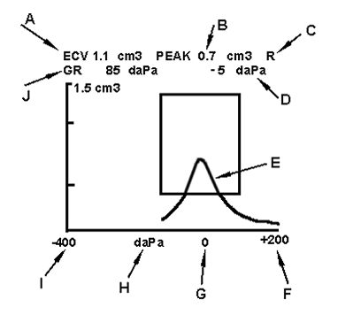

Slide 26
TYMPANOMETRIC FEATURES
Tympanometric shapes.
Static acoustic admittance.
Tympanometric width (gradient).
Tympanometric peak pressure.
Equivalent ear canal volume.

Slide 27
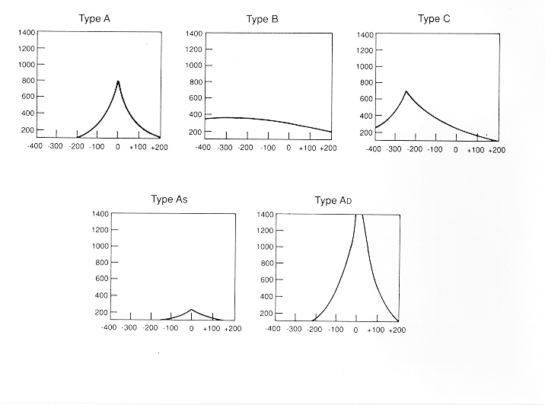

Slide 28
Sensitivity and specificity
Sensitivity has been found to be around 82% for MEE.
Normal type A has 100% specificity.
Overall sensitivity of around 80% and specificity of around 90%.
That is good but means we need to interpret results with caution.

Slide 29
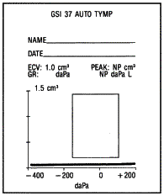
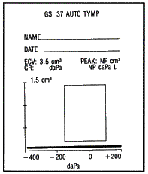
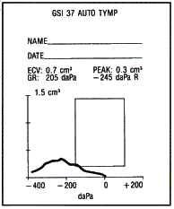
Tympanogram Types

Slide 30
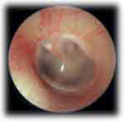
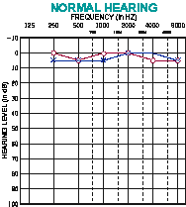
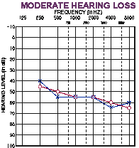
Type A Tympanogram
OE | ME | IE | AN | CNS
AC
A
BC
Normal or SN

Slide 31
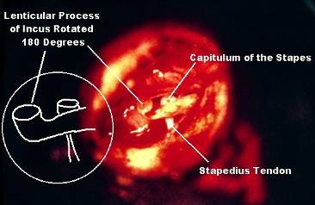
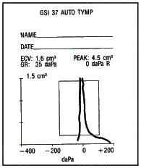
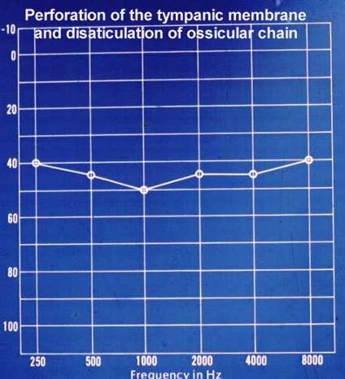
Type AD Tympanogram
OE | ME | IE | AN | CNS
AC
A
D
BC
Disarticulation

Slide 32
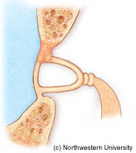
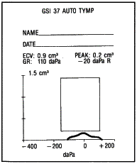
Type AS Tympanogram
OE | ME | IE | AN | CNS
AC
A
S
BC
Otosclerosis

Slide 33
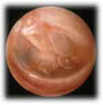
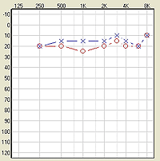
Type BLow Tympanogram
OE | ME | IE | AN | CNS
AC
B
Low
BC
OME

Slide 34
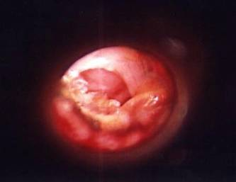
Type BHi Tympanogram
OE | ME | IE | AN | CNS
AC
B
Hi
BC
Perforation

Slide 35
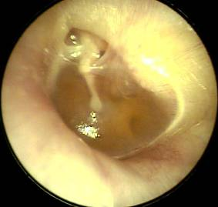
Type C Tympanogram
OE | ME | IE | AN | CNS
AC
C
BC
Eustachian Tube Dysfunction

Slide 36
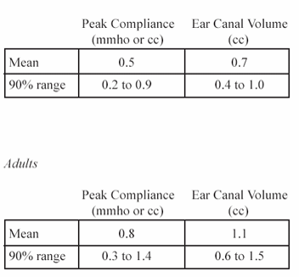
Static Compliance (Peak Compliance)
Acceptable Range by Age
Flaccid: disarticulation, flaccid TM, etc.
0.9
1.4
Normal mobility
0.2
0.3
Stiff: otosclerosis fluid, tympanosclerosis, etc.
Child
Adult

Slide 37
Tympanometry in infants
Studies has found frequent occurrence of double peaked tymps.
Usually we use higher probe frequency when testing infants like 1000 Hz.

Slide 38
otoacoustic emissions

Slide 39
Origin of OAE
Initially reported by Kemp in 1978.
OAE are considered a by-product of sensory OHCs transduction and represent cochlear amplifier that thought to be as a result of the contraction of OHCs in synchrony with BM displacement.
The contraction of the OHCs (movement) is then propagated outward toward the middle ear and moves the TM.
This in turn creates acoustic energy that is picked by the OAE probe.

Slide 40
Recording OAE’s
OAEs are measured by presenting a series of very brief acoustic stimuli, clicks, to the ear through a probe that is inserted in the outer third of the ear canal. The probe contains a loudspeaker that generates clicks and a microphone that measures the resulting OAE’s that are produced in the cochlea and are then reflected back through the middle ear into the outer ear canal.
The resulting sound that is picked up by the microphone is digitized and processed by specially designed hardware and software. The very low-level OAEs are separated by the software from both the background noise and from the contamination of the evoking clicks.

Slide 41
OAE
So in order to record OAE in EAC we need to have normal middle ear function.
Conductive pathologies can prevent the recording of OAE but this does not mean that OAE is not present.

Slide 42
Types of OAE’s
Types
Spontaneous OAE’s
(SPOAE’s)
Distortion Product
OAE’s (DPOAE’s)
Transient Evoked
OAE’s (TEOAE’s)

Slide 43
Spontaneous OAE’s
Occurs in the absence of any intentional stimulation of the ear.
Prevalence is in about 40-60% of normal hearing people.
When you record SOAE’s, you average the number of samples of sounds in the ear and perform a spectral analysis.
The presence of SOAE’s is usually considered to be a sign of cochlear health, but the absence of SOAE’s is not necessarily a sign of abnormality.

Slide 44
Distortion Product OAE’s
Result from the interaction of two simultaneously presented pure tones.
Stimuli consist of 2 pure tones at 2 frequencies (ie, f1, f2 [f2>f1]) and 2 intensity levels (ie, L1, L2). The relationship between L1-L2 and f1-f2 dictates the frequency response.
DPOAEs allow for a greater frequency specificity and can be used to record at higher frequencies than TOAE’s. Therefore, DPOAE’s may be useful for early detection of cochlear damage as they are for ototoxicity and noise-induced damage.

Slide 45
RESPONSE
NOISE

Slide 46
Transient Evoked OAE
TEOAE’s are frequency responses that follow
a brief acoustic stimulus, such as a click or tone burst.
The evoked response from this type of stimulus covers the frequency range up to around 4 kHz.
In normal adult ears, the click-elicited TEOAE typically falls off for frequencies more than 2 kHz, and is rarely present over 4 kHz, because of both technical limitations in the ear-speaker at higher frequencies and the physical features of adult ear canals so that is why DPOAE’s would be more efficacious.
For newborns and older infants, the TEOAE is much more robust by about 10 dB and typically can be measured out to about 6 kHz indicating that smaller ear canals influence the acoustic characteristics of standard click stimuli much differently than do adult ears.
TEOAE’s do not occur in people with a hearing loss greater than 30dB.

Slide 48
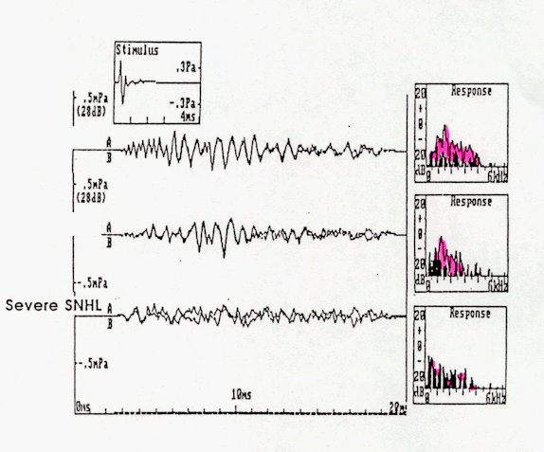
TEOAE results
Normal hearing
High frequency HL
Severe SN HL

Slide 49
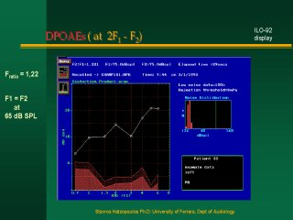
TEOAE & DPOAE

Slide 50
Acquisition
Not affected by sleep but needs test subject to be still and compliant
Very quick

Slide 51
Clinical applications of EOAE
1- can be used in newborn hearing screening. The results will indicate either fail or pass. Fail means that hearing thresholds are worse than 30 dB HL. Pass results means hearing thresholds are 30 dB HL or better.
So, we can not use this tool to measure threshold of hearing.

Slide 52
Applications of OAE
TEOAE can be recorded in all non-pathologic ears that do not display hearing loss of greater than 30 dB.
OAE can be recorded in both adults and infants.
Accordingly TEOAE and DPOAE can be used to screen for hearing loss in infants.
DPOAE provide more frequency specific evaluation that TEOAE.

Slide 53
Clinical applications of EOAE
2- in differential diagnosis of hearing loss (site of lesion). This can help in differentiating sensory from neural hearing loss.
3- monitoring of the effect of ototoxicity or noise exposure.
4- although still under research: DPOAE can be used to screen for the carriers of the recessive hearing loss genes: many studies found that DPOAE is larger (especially at high frequencies) in carriers than in non carriers when using f2/f1 of 1.3 and low stimulus levels of 50-60 dB.

Slide 54
clinical limitations
Problems because of middle ear disease
Not sensitive for neonates within 24 hours of birth
Results affected by test conditions
Noise
Not a test of hearing- limited application

Slide 55
Clinical applications of ABR
Murad Almomani, Ph.D., CCC-A, FAAA

Slide 56
The normal ABR waveform
Is characterized by 5-7 peaks.
Occurs in a latency epoch of 1.4 – 8.0 ms.
Responses are usually displayed with positive peaks reflecting neural activity toward the vertex.
These peaks are labeled with the roman numerals I through XII.
The most prominent waves are I, III, and V.

Slide 58
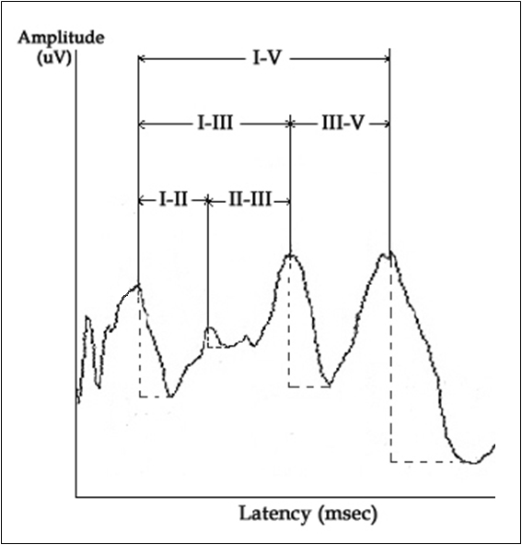

Slide 59
Generators of the ABR
VI
V
IV
III
II
I

Slide 60
Latency, ms

Slide 61
Characteristics of normal ABR
Information to determine normal ABR waveform depends on:
Waves absolute latency.
Waves interpeak intervals.
Latency-intensity function.
Wave V/I amplitude ratio.
Interaural wave V latency difference.
Research established normal ranges of the above parameters.

Slide 62
Characteristics of normal ABR
Normal ranges for the above parameters are not universal.
There are some variation among different research findings.
Many factors affects normal values including age, sex, temp and other factors.
It is always better for each practice to establish its own norms.

Slide 63
Characteristics of normal ABR
Absolute latency of ABR waves in adults:
Wave I: at around 1.6 ms +/- 0.2 ms.
Wave III: at around 3.7 ms +/- 0.2 ms.
Wave V: at around 5.6 ms +/- 0.2 ms.
Interwave latency intervals:
I-III: 2.0 ms+/- 0.4 ms.
III-V: 1.8 ms +/- 0.4 ms.
I-V: 3.8 ms +/- 0.4 ms.

Slide 64
Characteristics of normal ABR
Wave V latency-intensity function: increases by around 0.3 ms per 10 dB decrease of the stimulus level.
V/I amplitude ratio: greater than 1.0.
Wave V latency difference: less than 0.4 ms.

Slide 65
Example Normal Hearing
18 Month-Old – 2000 Hz Tone-Burst
70 dBnHL
10 dBnHL

Slide 66
Clinical applications of ABR
There are two main applications for ABR in the clinical settings:
Neurodiagnosis: to assess the auditory pathway. This feature is specially used in adult populations.
Waves absolute latency.
Interpeak intervals.
Interaural wave V latency difference.
Absence of waves.
Hearing thresholds estimation: mainly used in infants and children population.
Wave V threshold.
Wave V latency-intensity function.

Slide 67
Neurodiagnosis
Who should be tested? Patients with:
Dizziness.
Unilateral tinnitus.
Asymmetrical hearing loss.
Sudden onset of hearing loss.
Progressive hearing loss.

Slide 68
Using ABR to estimate hearing thresholds
Can be obtained by progressively decreasing intensity of the stimulus (click or toneburst) and observing wave V.
The last intensity that wave V appears at is considered its threshold.
ABR threshold is within 10-20 dB from the subjective threshold.

Slide 70
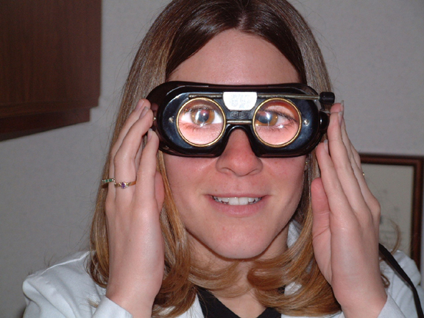
Eye Movement Recording
In performing ENG/VNG, the patient eye movements are measured relative to head position, which can be achieved in a number of ways.
Measuring electric potentials, measuring magnetic potentials, using video cameras or using infrared technology and direct observation.

Slide 71
Nystagmus

Slide 73
Left Beating
Right Beating
Slow
Fast

Slide 74
VNG Test Battery
Calibration
Gaze
Saccade
Pursuit
Optokinetic
Positional
Hallpike
Caloric

Slide 75
Gaze Test
The function of the gaze system is to maintain visual fixation of an object on the fovea of the eye.
To identify the presence of spontanoues eye movement.
Normal gaze, patient able to maintain position with eyes opened and closed.

Slide 76
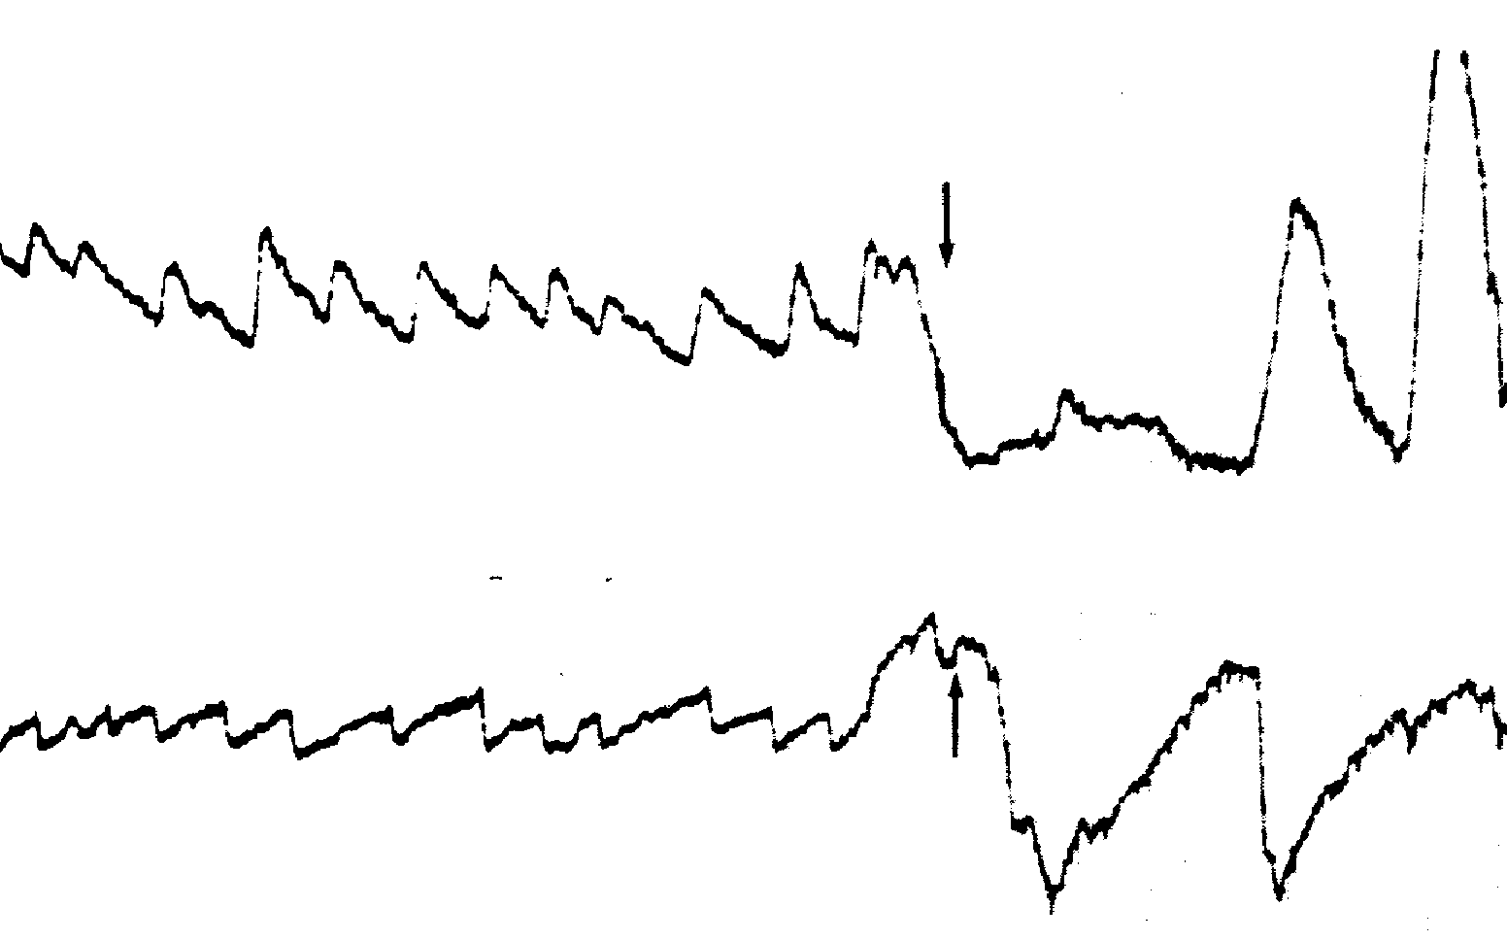
Gaze results with peripheral &central lesions
Horizontal.
Directional fixed.
Suppressed with visual fixation.
Horizontal, vertical or rotatory.
Directional changing.
Enhanced with visual fixation.

Slide 77
Saccade (refixation ) Test.
The function of saccadic eye movement system is to redirect the eye from one target to another in the shortest possible time.
Inaccurate eye movement, where the eye either undershot or overshot the target is abnormal and seen frequently in patients with cerebellar dysfunction.

Slide 78
Saccade Test

Slide 79
Results:
Normal saccadic eye movement test should produce rapid and accurate eye movement.
Inaccurate eye movement, where the eyes overshot or undershot the target .

Slide 80
Saccade

Slide 81
Ocular Pursuit Test
The function of ocular pursuit system is to stabilize a slowly moving object on the fovea of the eye by matching the angular velocity of the eye with that of the moving object.

Slide 82
Pursuit Test

Slide 83
Results:
When the pursuit system is impaired, small corrective saccadic movements replace the smooth pursuit movement, so the eye can catch up the moving target.
It may be the most sensitive subtest in ENG battery for detection of brainstem and cerebellar disorders.

Slide 84
Pursuit

Slide 85
Abnormal Pursuit

Slide 86
Optokinetic Test
Optokinetic system maintain visual fixation when the head is in motion.
Target is rapidly passed in front of the subject in one direction, then the other.
Eye movements are recorded and compared in each direction.
Asymmetry suggestive of central lesion

Slide 87
Optokinetic

Slide 88
Optokinetic

Slide 89
Optokinetic

Slide 90
Dynamic Positional Test ( Hallpike )
The patient complains a motion related vertigo at certain position
It is maneuver that places the patient head in the position that creates the response.
Criteria: Latency period, subjective vertigo, Transient nystagmus, fatigable, lesion in the undermost ear,

Slide 91
Dix Hallpike maneuver
Used to provoke nystagmus and vertigo commonly associated with BPPV.
Head turned 45 degree to maximally stimulate posterior semicircular canal.
Head supported and rapidly placed into head hanging position.
Frenzel glasses eliminate visual fixation suppression of response or can be tested Using VNG.

Slide 92
Dix Hallpike Maneuver

Slide 93
Caloric Test

Slide 94
Caloric Tests
Caloric test is a part of ENG/VNG.
It reflects an attempt to discover the degree to which the vestibular system is responsive and also how symmetric the responses are, between left and right.
It is a test of the lateral semicircular canals.
Most caloric tests are nowadays are done using computerized systems, the computer analyzes the caloric data, computing peak slow-phase velocity.

Slide 95
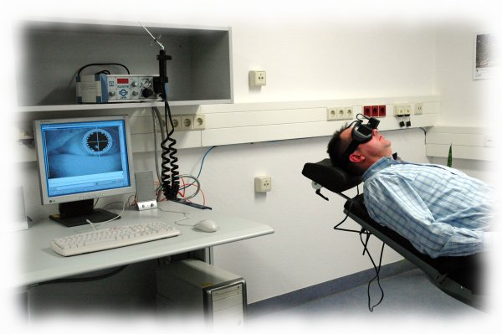
Caloric Test

Slide 96
Caloric Test (Procedure )
Irrigations of EEC performed with cold and warm water or air.
Water - cool = 30 C; warm = 44 C
Air - cool = 24 C; warm = 50 C
Response pattern follows the form of COWS
Nystagmus induced results are calculated to obtain Unilateral Weakness and Directional Preponderance

Slide 97
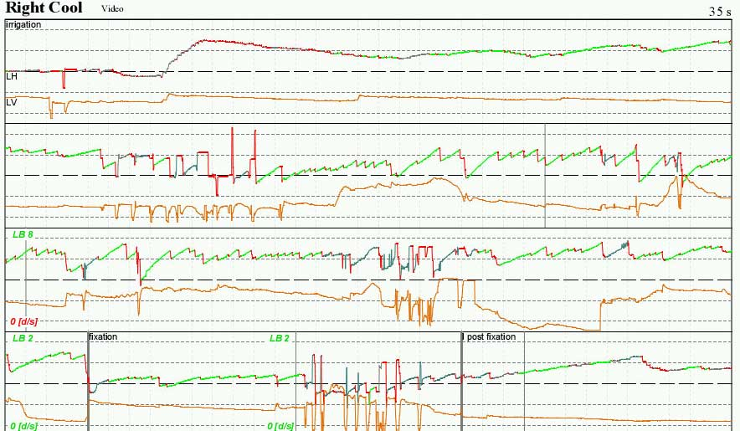
Caloric Test

Slide 98
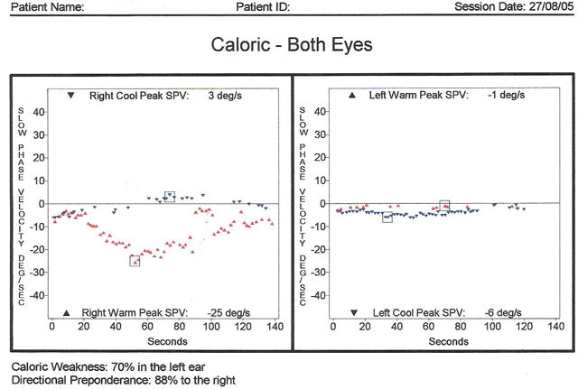
Caloric Test

Slide 99
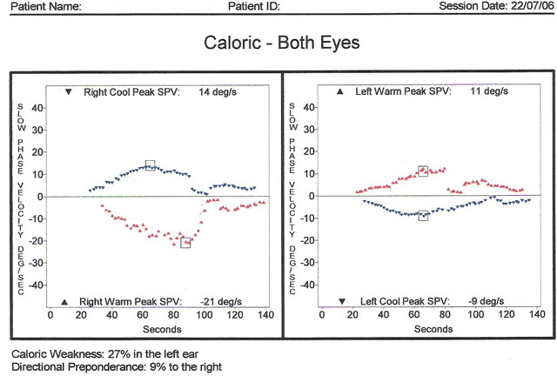
Caloric Test

