Slide 1
King saud university medical city department of obstetrics & gynecology course 482
OPERATIVE VAGINAL DELIVERIES AND
CAESAREAN SECTION
Reem alanazy
Assistant prof. & Gynecological consultant

Slide 2
Definition
Indications of operative delivery
Trial of instrumental delivery
Caesarean Section
Complications of C/S
Measures to reduce C.S. RATE
Post Delivery Care

Slide 3
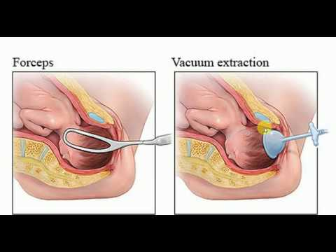
Definition
It is the delivery of the fetus using an instrument through the vaginal route.
Instruments could be : ➔ Forceps
➔ Vacuum
Incidence of operative deliveries is 3.5 %

Slide 4
Indications of operative delivery
MATERNAL
Prolonged or arrested 2nd stage
Poor maternal effort
Maternal cardiac disease
Patients with retinal detachment or post op for similar ocular conditions
FETAL
Fetal distress
Prematurity (Forceps only)
Certain malpositions

Slide 5
Pre-Requisite for forceps and ventouse
Cervix has to be fully dilated
Membranes ruptured
Head has to be engaged
Vertex presentation
Head position known(forceps can be applied on the head for cephalic presentation or after coming head for breech presentation)
Ventouse can only be applied on the head.
Conditions to be fulfilled
Adequate analgesia
Empty bladder
Adequate episiotomy

Slide 6
Complications Of Instrumental Delivery
Maternal
Genital tract lacerations, Cx,,vagina
Hemorrhage
Extensions of episiotomy
Sphincter lacerations
Fecal and flatus incontinence
injury to rectal mucosa
Fetal
Skull fractures
Cephalohematoma
Caput succedaneum
Facial Palsy
Scalp laceration
Intracranial hemorrhage
Infant death

Slide 7
Trial of instrumental delivery
Should be performed in O.R. with anesthetist present + pediatrician to resuscitate.
All teams ready to proceed to C.S. in case failed instrumental delivery

Slide 8
Caesarean Section
Rate ≈ 25%
Maternal mortality 5 – 6 / 100,000 C/S
Perinatal mortality 3/1000 USA
7/1000 U.K
C. S. Could be:
Elective C/S ➔ Planned and timed
Emergency C/S ➔ Unplanned during labor or before
the onset of labor

Slide 9
Different Methods Of Performing Different Types Of C/S
SKIN INCISION
Low transverse
Midline
UTERINE INCISION
Upper Segment (Classical) transverse
vertical
Lower segment
- transverse
- vertical

Slide 10
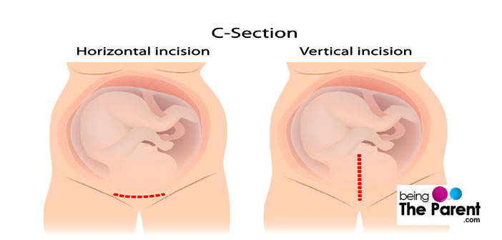

Slide 11
COMPLICATIONS OF UPPER SEGMENT C/S
Bleeding ⬆⬆
Organ injury ➔ Bowel
➔ Bladder
➔ Ureter
Adhesions formation
Rupture scar in future pregnancy higher than lower segment scar
More difficult to repair

Slide 12
COMPLICATIONS OF LOWER SEGMENT
Haemorrhage
Extension of incision ➔ Lateral
➔ Downwards
Organ injury ➔ Bladder
➔ Bowel
➔ Ureter
Rupture scar
Abnormal placentation in future pregnancy
Low lying placenta
Accreta, increta, perceta
Adhesions specially bladder

Slide 13
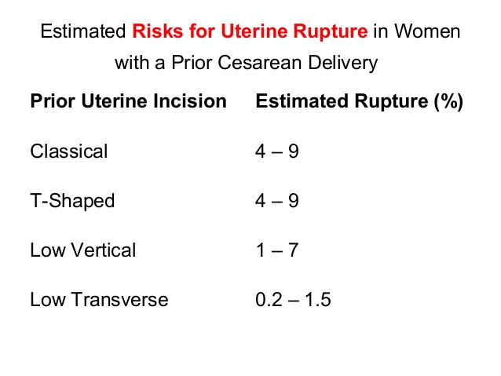

Slide 14
COMMON POST OP COMPLICATIONS
Atelectasi
Infection ➔ Endometritis
➔ Wound
➔ UTI
➔ Pneumonia
DVT & PE

Slide 15
When can a trial of labor be offered after C.S.
VBAC can be offered for non recurrent indications e.g., fetal distress, cord prolapse, placental abruption, breech presentation.
Pelvic adequacy is confirmed by proper clinical radiological methods as needed.
Lower Segment scar
Placental localization

Slide 16
Scar integrity is assured by taking proper post op history
Standard of care is to offer VBAC after one previous C/S and not multiple
Safe set up: Tertiary care center which can perform emergency C.S as needed.
Patients approval

Slide 17
Measures to reduce C.S. RATE
Proper antenatal care ,for early detection and management of conditions that lead to ⬆ C.S. rate
- e.g. controlling macrosomia in diabetes - early detection of HTN
- Post term - Performing ECV for breeches
Prevent infections:
Prophylactic Ab + Aseptic technique
Prevention of anemia
To prevent DVT
TEDS stocking
Thromboprophylaxis
Early ambulation

Slide 18
POST Delivery CARE
VS hourly x 4 hours
I.V. fluids
Analgesia
Checking Fundus + Lochia
Antibiotics
Thromboprohylaxis
Breast care and breast feeding
Urine output + catheter care
Wound care
Early ambulation

Slide 19
Questions?

