Slide 1
AMBLYOPIA

Slide 3
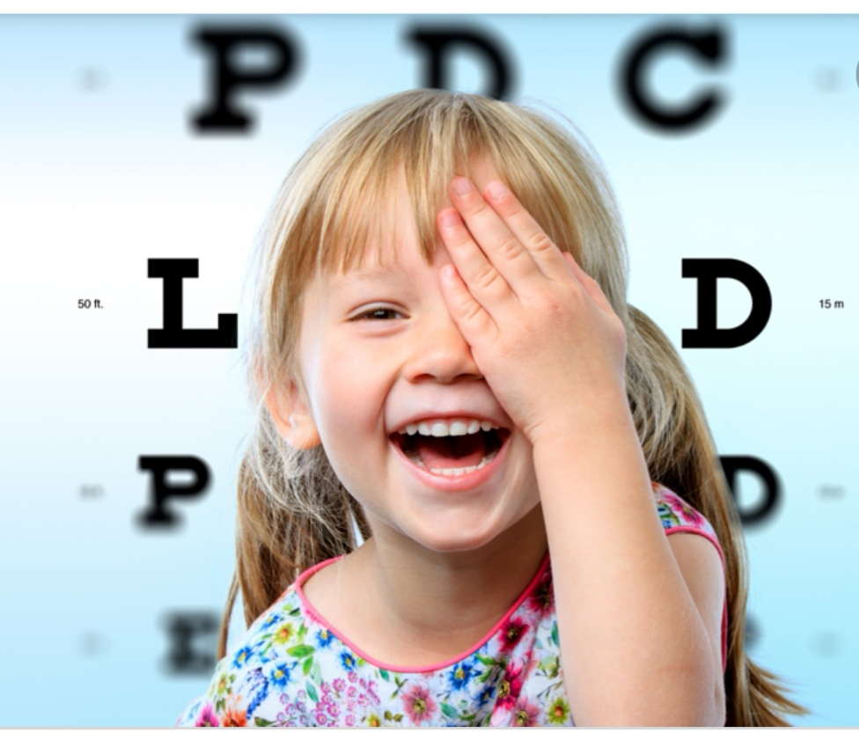
Amblyopia
Decrease in visual acuity of one eye without the presence of an organic cause that explains that decrease in visual acuity.
Cortical ignorance of one eye.
Lazy eye.

Slide 4
Incidence
2-4% of the general population.
The most common cause of visual loss under 20 years of life.

Slide 5
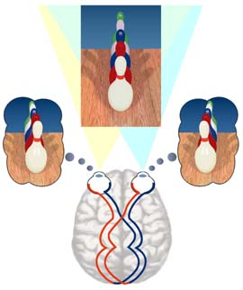
Binocular Vision
.

Slide 6
What if images were totally different or grossly differnet ?
Diplopia.
Confusion.
Suppression.

Slide 7
Why fusion may fail ?
significant anisometropia.
significant aniseikonia (difference in image size)
Strabismus.
Higher cortical problems ( e.g: head trauma, alcohol intake , drugs , … etc).

Slide 9
Anisometropia

Slide 10
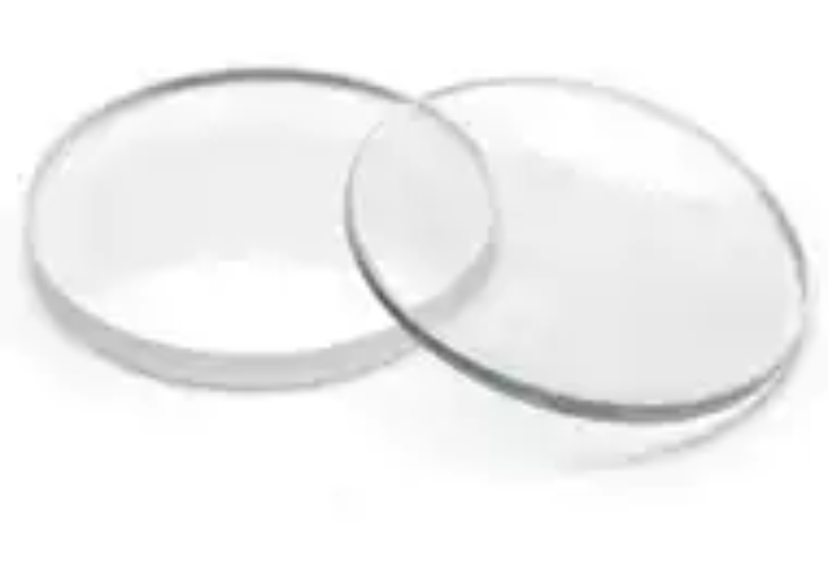
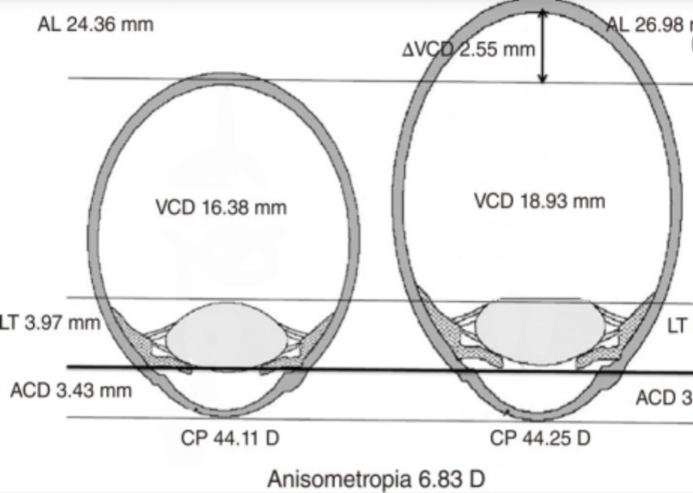
Anisometropia

Slide 11
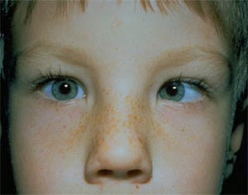
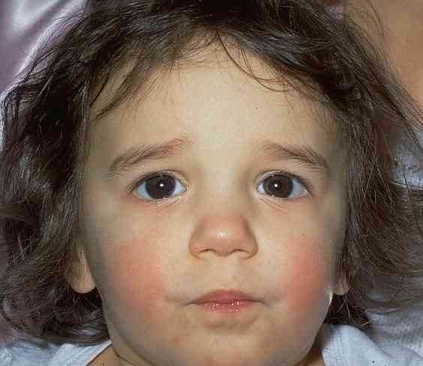
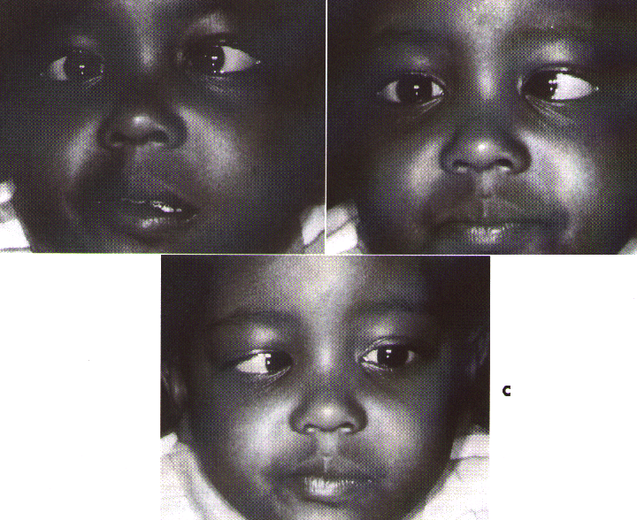
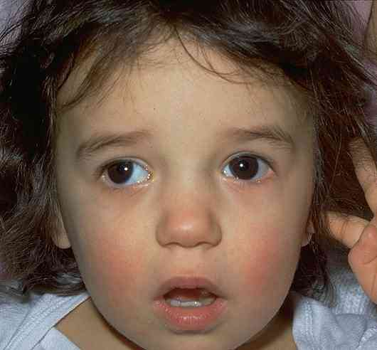
Types of amblyopia
1- Strabismic

Slide 12
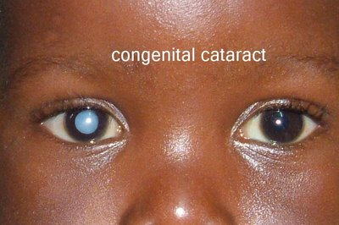
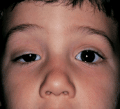
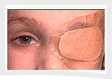
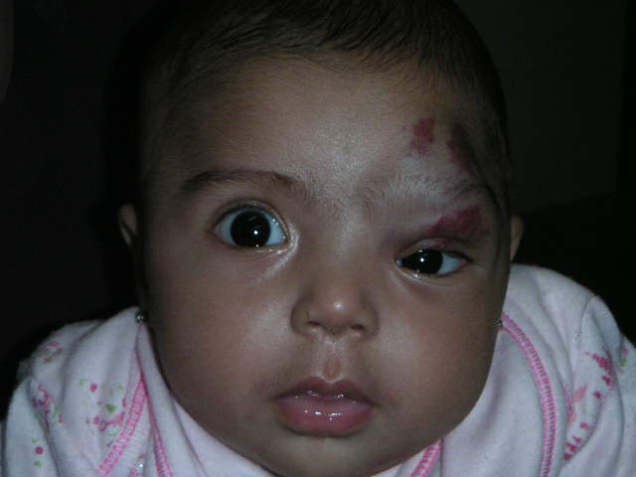
Types
2- Deprivation amblyopia

Slide 13
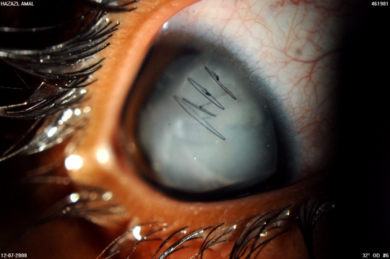
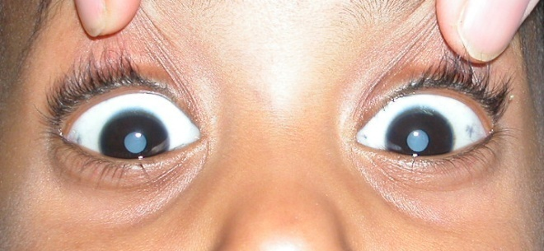
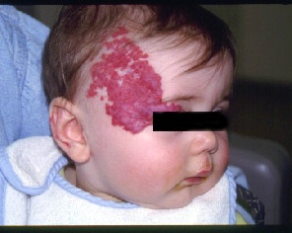
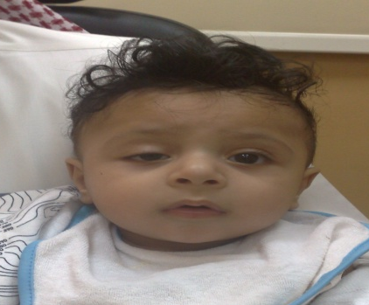
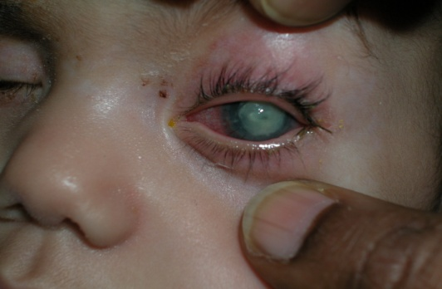
Deprivational Amblyopia
CONG CATARACT
Cataracts and corneal opacities.
Eyelid ptosis, eyelid hemangioma
Results in more severe visual impairment than strabismic or refractive amblyopia

Slide 15
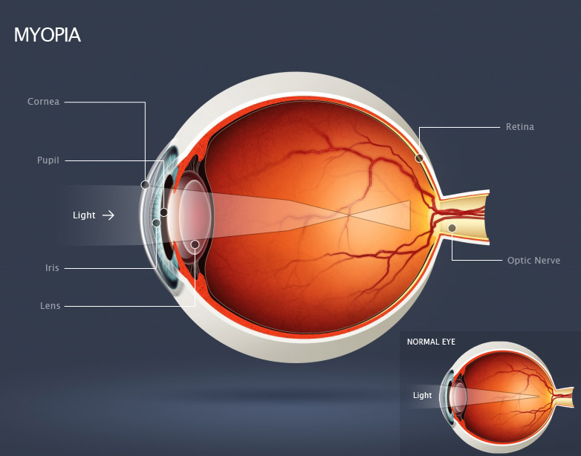
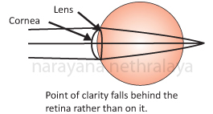
Types
3- Anisometropic amblyopia ( refractive amblyopia)
More common with hypermetropic anisometropia
( Astigmatic ( Meridional) amblyopia=

Slide 16
TREATMENT
Treat the cause of amblyopia: correct the rfractive error , remove the media opacity surgically .
The younger the child , the better out come of amblyopia therapy .
The first five years of child age is the sensitive period where amblyopia can be reversed , after that it become more difficult .

