Slide 1
Leukocoria
Definition : White opacity of the pupil

Slide 2
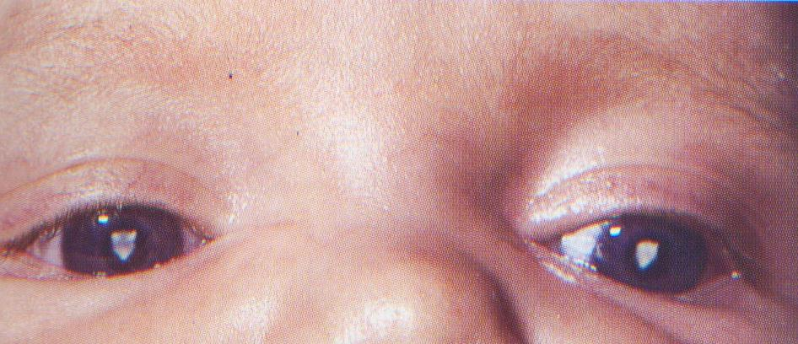
:Causes
1-Cataract: can be congenital or acquired, usually causes blurred vision and glare.

Slide 3
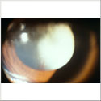
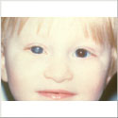
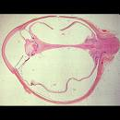
Persistent hyperplastic primary vitreous
PHPV is a congenital condition caused by failure of the normal regression of the primary vitreous. It is usually associated with unilateral vision loss

Slide 4
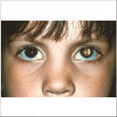
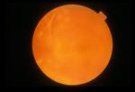
Organized vitreous hemorrhage
vitreous hemorrhage is usually secondary to a neovascular membrane or to a retinal tear. Patients may complain of a red haze, blurred vision, or floaters. As it starts to resolve, color changes to yellow then white and some fibrous sheets may persist. A B-scan is usually diagnostic and vitrectomy is usually required.

Slide 5
Retinal detachment:
risk factors include trauma and surgery, vitreous detachment, high myopia, retinal breaks or tears, retinal vascular disease, and history of detachment in the other eye. symptoms include flashes of light, floaters, curtain-like decrease in vision

Slide 6
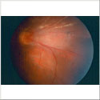
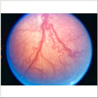
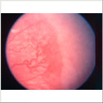
Retinopathy of prematurity
occurs in premature, low-birth-weight infants maintained on oxygen therapy. Signs include neovascularization, fibrous bands, retinal detachments and vitreous hemorrhage. When advanced leukocoria can be present

Slide 7
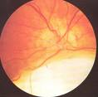
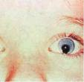
Coloboma
congenital condition caused by incomplete closure of the the fetal fissure. Degree of visual loss related to area affected (iris, retina, choroid, or optic nerve head)

Slide 8
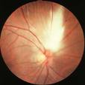
Medullated nerve fibers
congenital anomaly caused by myelination of the retinal nerve fibers and usually asymptomatic. When large areas are involved it can cause leukocoria.

Slide 9
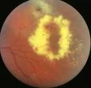
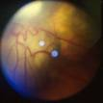
Coat’s disease: typically a unilateral condition found in young boys. It is characterized by retinal telengiectasia and aneurysms that may cause exudative retinal detachments.

Slide 10
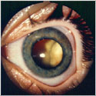
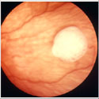
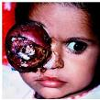
Retinoblastoma
most common primary, malignant, intraocular tumor of childhood but still a rare tumor. Vast majority become apparent before age of 3yrs. It results from malignant transformation of primitive retinal cells before final differentiation. Presentation is most commonly(60%) with leukocoria and strabismus

Slide 11
Summary
Leckocoria is white opacity of pupil.
Can be caused by :
Cataract, PHPV, ROP, Coat disease, Vitreous hemorrhage.
Retinoblastoma has to be ruled out because it is life threatening disease.

