Slide 1
Common Pediatric Fractures
Dr. Khild Bakarman
Associate Professor,
Pediatric Orthopedic Consultant &trauma
2018
Acknowledgement:
Prof. M. Zamzam
Dr.kholoud al zain

Slide 2
Objectives
Introduction
Difference between Ped & adult
Physis # → Salter-Harris classification
Indications of operative treatment
Methods of treatment of Ped # & trauma
Common Ped #:
U.L → clavicle, humeral supracondylar, distal radius
L.L → femur shaft
Example

Slide 3
Pediatric Fractures

Slide 4
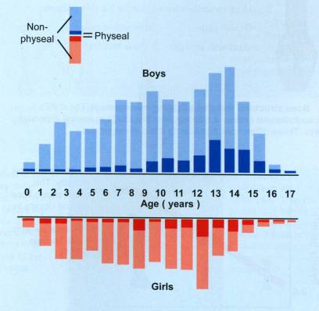
Introduction
Fractures account for ~15% of all injuries in children
Boys > girls
Rate increases with age
Type of fractures vary in various age groups (infants, children, adolescents )
Mizulta, 1987

Slide 5
Difference Between A Child & Adult’s Fractures

Slide 6
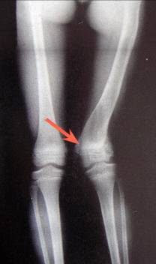
Why are Children’s Fractures Different ?
Growth plate:
Perfect remodeling power
Injury of growth plate may cause:
Angular deformity
Or leg length inequality (L.L.I)

Slide 7
Why are Children’s Fractures Different ?
Bone:
Increased (collagen:bone) ratio
Less brittle
Deformation

Slide 8
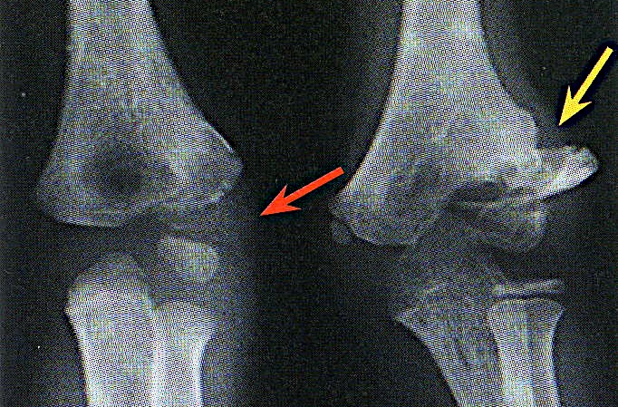
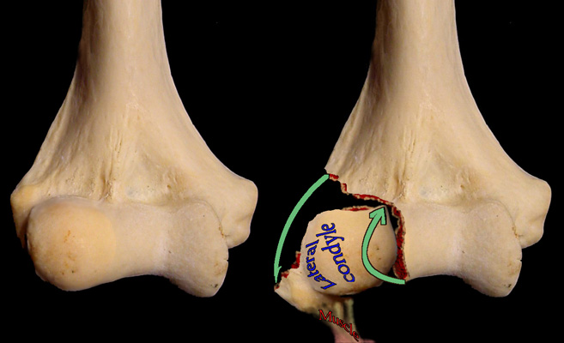
Why are Children’s Fractures Different ?
Cartilage:
Difficult X-ray evaluation
Size of articular fragment often under-estimated

Slide 9
Why are Children’s Fractures Different ?
Periosteum:
Metabolically active
More callus, rapid union, increased remodeling
Thickness and strength
May aid reduction

Slide 10
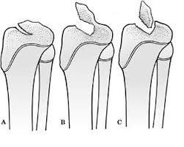
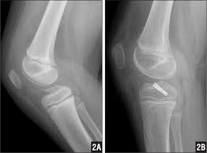
Why are Children’s Fractures Different ?
Ligaments:
Functionally stronger than bone.
Higher proportion of injuries that produce sprains in adults result in fractures in children.

Slide 11
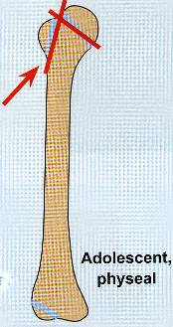
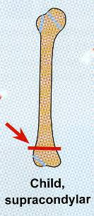
Why are Children’s Fractures Different ?
Age related fracture pattern:
Infants → diaphyseal #
Children → metaphyseal #
Adolescents → epiphyseal

Slide 12
Why are Children’s Fractures Different ?
Physiology
Better blood supply → rare delayed and non-union

Slide 13
Remodeling

Slide 14
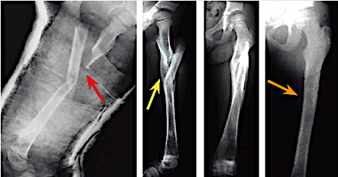
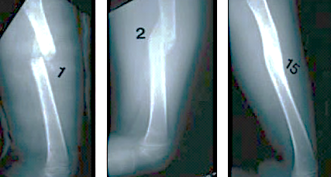

Slide 15
Physis Fractures

Slide 16
Physis Injuries
Account for ~25% of all children’s #
More in boys
More in upper limb
Most heal well rapidly with good remodeling
Growth may be affected

Slide 17
Physis Injuries- Classifications
Salter-Harris

Slide 18
Salter-Harris Classification

Slide 19
Salter-Harris Classification

Slide 20
Physis Injuries- Complications
Physeal bridging → < 1%
Cause → affecting growth (varus, valgus, or even L.L.I)
Keep in mind:
Small bridges (<10%) → may lyse spontaneously
Central bridges → more likely to lyse
Peripheral bridges → more likely to cause deformity

Slide 21
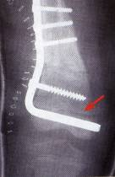
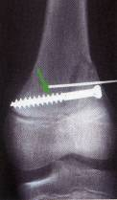
Physis Injuries- Complications
Take care with:
Avoid injury to physis during fixation
Monitor growth over a long period (18-24 m)
When suspecting physeal bar → do MRI

Slide 22
Indications of Operative Treatment

Slide 23
General Management
Indications for surgery
Open fractures
Severe soft-tissue injury
Fractures with vascular injury
Compartment syndrome
Multiple injuries
Displaced intra articular fractures (Salter-Harris III-IV )
Failure of conservative means (irreducible or unstable #’s)
Malunion and delayed union
Adolescence
Head injury
Neurological disorder
Uncooperative patient

Slide 24
Methods of Treatment of Pediatric Fractures & Trauma

Slide 25
1) Casting → still the commonest

Slide 26
1) Casting → still the commonest

Slide 27
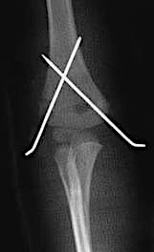
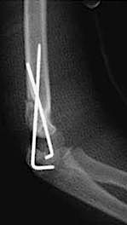
2) K-wires
Most commonly used internal fixation (I.F)
Usually used in → metaphyseal fractures

Slide 28
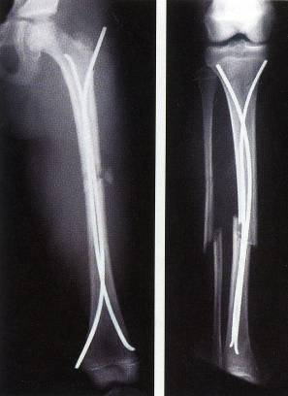
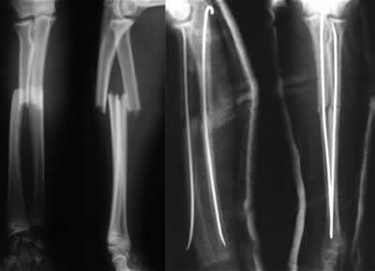
3) Intramedullary wires (Elastic nails)

Slide 29
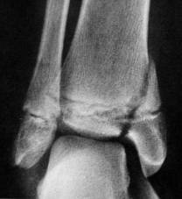
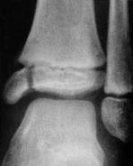
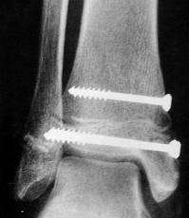
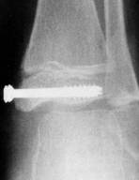
4) Screws

Slide 30
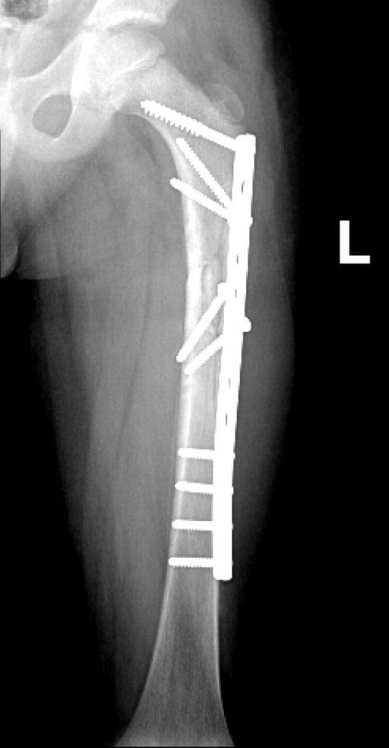
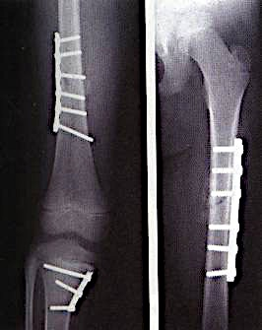
5) Plates → specially in multiple trauma

Slide 31
6) I.M.N → only in adolescents (>12y)

Slide 32
7) Ex-fix → usually in open #

Slide 33
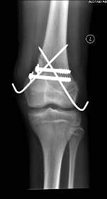
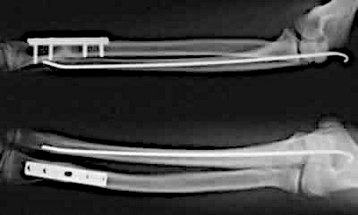
Methods of Fixation
Combination

Slide 34
Common Pediatric Fractures

Slide 35
Common Pediatric Fractures
Upper limb:
Clavicle
Humeral supracondylar
Distal radius
Lower Limbs:
Femur shaft (diaphysis)

Slide 36
Clavicle Fractures

Slide 37
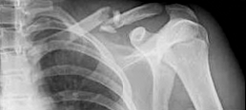
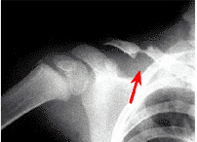
Clavicle # - Incidents
8-15% → of all pediatric #
With delivery:
0.5% → of normal SVD
1.6% → of breech deliveries
The periosteal sleeve always remains in the anatomic position (remodeling is ensured)

Slide 38
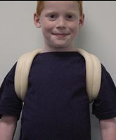
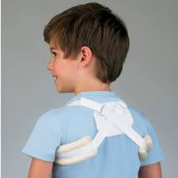
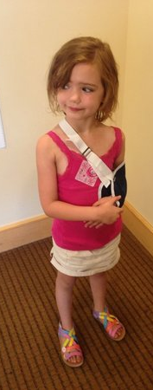
Clavicle # - Treatment
Newborn (< 28 days):
No orthotics
Unite in 1w
1m – 2y:
Figure-of-eight
For 2w
2 – 12y:
Figure-of-eight or sling
For 2-4 weeks

Slide 39
Humeral Supracondylar Fractures

Slide 40
Supracondylar #- Incidences
55-75% → of all elbow #
M:F 3:2
Age → 5 - 8 years
Left (non-dominant) side → most frequently #

Slide 41
Supracondylar #- Mechanism of Injury
Indirect:
Extension type
>95%
Direct:
Flexion type
< 3%
Notes:
Need pic’s

Slide 42
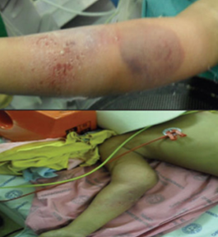
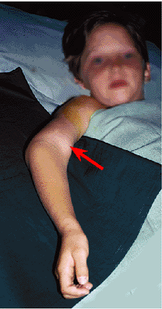
Supracondylar #- Clinical Evaluation
Look
Feel
Move
Neurovascular examination

Slide 43
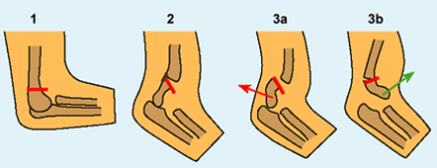
Supracondylar #- Gartland Classification
Type-III Complete displacement (extension type) may be:
Posteromedial (75%), or
Posterolateral (25%)

Slide 44
Supracondylar #- Gartland Classification
Type-III Complete displacement (extension type) may be:
Posteromedial (75%), or
Posterolateral (25%)

Slide 45
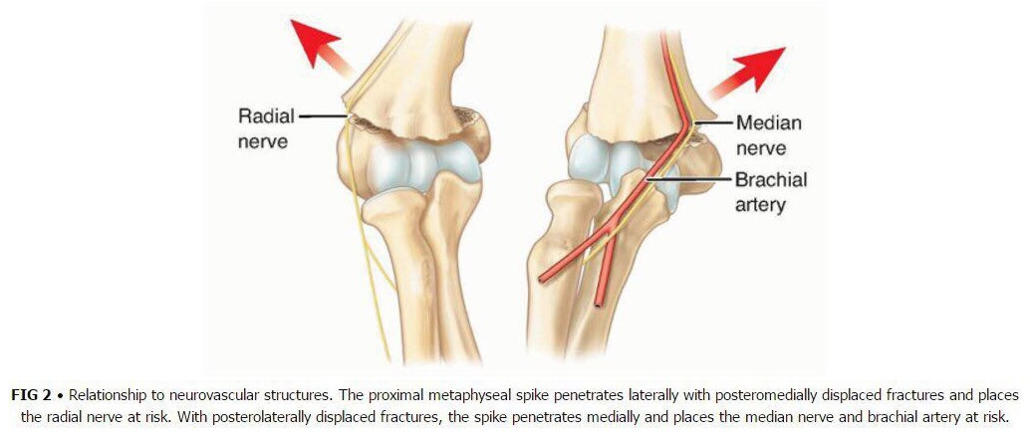
Supracondylar #- Gartland Classification

Slide 46
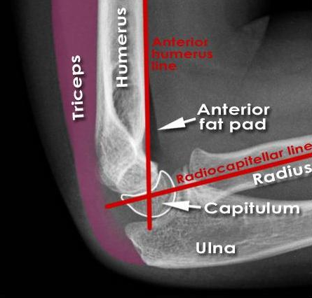
Normal XR Lines
Anterior Humeral Line
Hour-glass appearance
Fat-pad sign
Radio-capitellar line

Slide 47
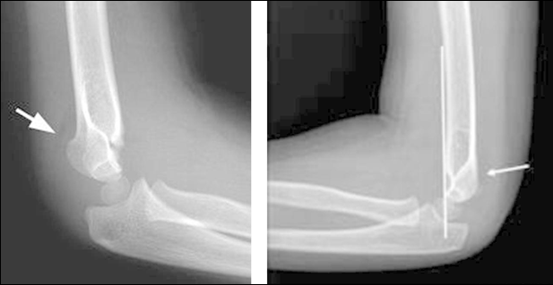
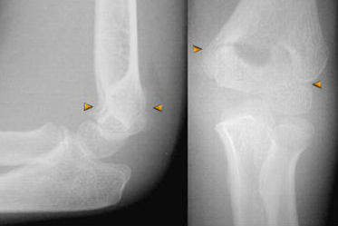
Type 1
Anterior Humeral Line
Hour-glass appearance
Fat-pad sign
Radio-capitellar line

Slide 48
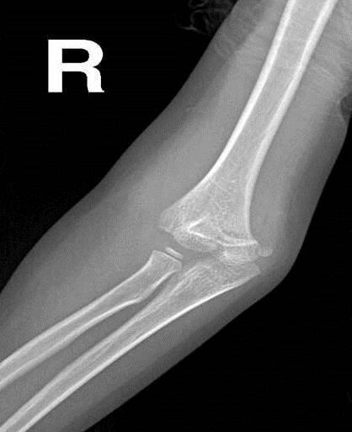
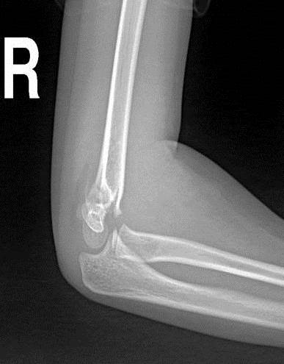
Type 2

Slide 49
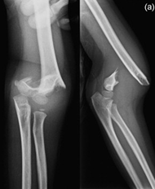
Type 3

Slide 50
Supracondylar #- Treatment
Type-I:
Above elbow cast (or splint)
For 3-6 weeks
Type-II:
Closed reduction & above elbow casting, or
Closed reduction with percutaneous pinning (if: unstable or sever swelling), & above elbow cast (splint)
For 4-6 weeks
Type III:
Attempt closed reduction & percutaneous pinning
If fails → open reduction & pinning (ORIF)
For 4-6 weeks

Slide 51
Supracondylar #- Treatment

Slide 52
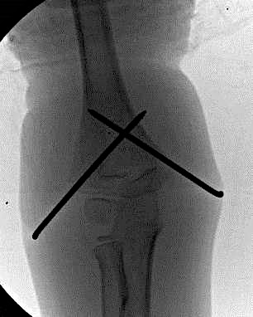
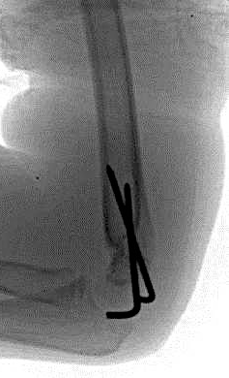
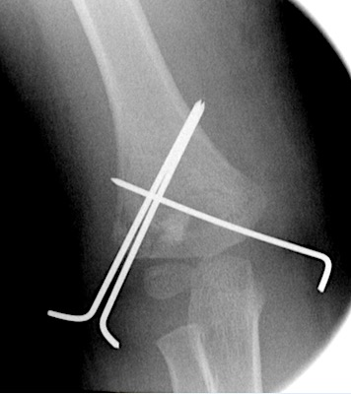
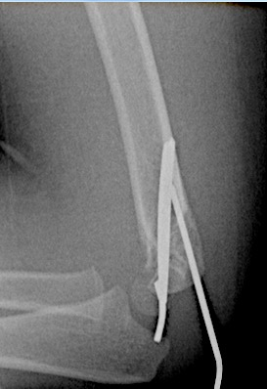
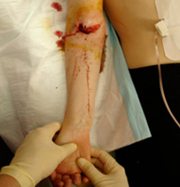
Supracondylar #- Treatment

Slide 53
Supracondylar #- Complications
Neurologic injury (7% to 10%):
Median and anterior interosseous nerves (most common)
Most are neurapraxias
Requiring no treatment
Vascular injury (0.5%):
Direct injury to the brachial artery, or
Secondary to swelling (compartment syndrome)

Slide 54
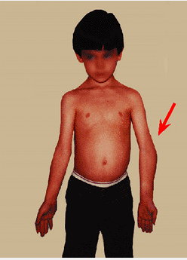
Supracondylar #- Complications
Loss of motion (stiffness)
Myositis ossificans
Angular deformity (cubitus varus)

Slide 55
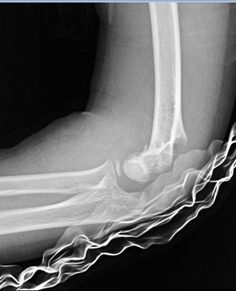
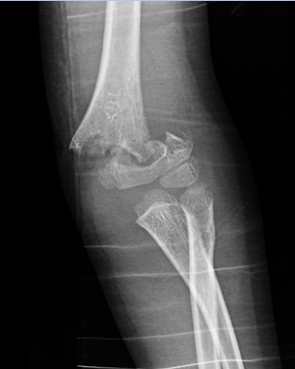
Supracondylar #- Flexion Type 3

Slide 56
Distal Radial Fractures (Metaphysis)

Slide 57
Classification
Depending on pattern:
Torus (buckle) → only one cortex is involved
Incomplete (greenstick)
Complete

Slide 58
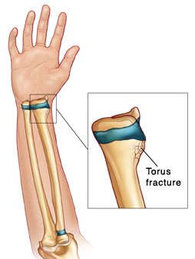
Distal Radius Metaphyseal Injuries
Torus (buckle) fracture:
Are stable
Immobilized for pain relief in below elbow cast, 2-3 weeks

Slide 59
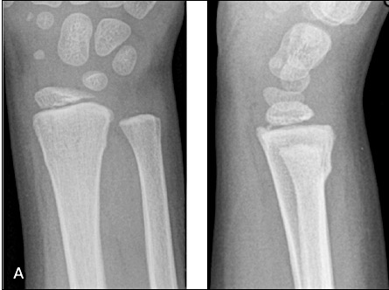
Distal Radius Metaphyseal Injuries
Torus (buckle) fracture:

Slide 60
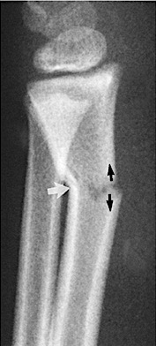
Distal Radius Metaphyseal Injuries
Incomplete (greenstick):
Greater ability to remodel (why ?)
Closed reduction and above elbow cast, 4-6 w

Slide 61
Distal Radius Metaphyseal Injuries
Complete fracture:
Closed reduction, then well molded above elbow cast for 6-8 w
Or open reduction and fixation (internal or external)

Slide 62
Distal Radius Metaphyseal Injuries
Complete fracture:

Slide 63
Distal Radius Meta. Injuries- Complications
Malunion
Residual angulation may result in loss of forearm rotation
Nonunion
Rare
Refracture
With early return to activity (before 6 w)
Growth disturbance
Overgrowth or undergrowth
Neurovascular injuries
With extreme positions of immobilization

Slide 64
Examples of Distal Radial Fractures

Slide 65
Distal Radial Fractures Physeal Injuries

Slide 66
Distal Radial Physeal #- “S.H” Type I

Slide 67
Distal Radial Physeal #- “S.H” Type II

Slide 68
Distal Radial Physeal #- “S.H” Type III

Slide 69
Distal Radial Physeal #- Treatment Types I & II
Closed reduction followed by above elbow cast
We can accept deformity:
50% translation
With no → angulation or rotation
Growth arrest can occur in 25% → with repeated closed reduction manipulations
Open reduction is indicated in:
Irreducible #
Open #

Slide 70
Distal Radial Physeal #- Treatment Types II
AP
Lat

Slide 71
Distal Radial Physeal #- Types III

Slide 72
Distal Radial Physeal #- Treatment Types III
Anatomic reduction necessary → intra-articular
ORIF with smooth pins or screws

Slide 73
Distal Radial Physeal #- Complications
Physeal arrest
Shortening
Angular deformity
Ulnar styloid nonunion
Carpal tunnel syndrome

Slide 74
Femoral Shaft Fractures

Slide 75
Femoral Shaft #
1.6% → of all pediatric #
M > F
Age:
(2 – 4) years years old
Mid-adolescence
Adolescence → >90% due to RTA

Slide 76
Femoral Shaft #- Clinical Evaluation
Look
Feel
Careful neurovascular examination is essential

Slide 77
Femoral Shaft #- Treatment
> 6m:
Pavlik Harness
Closed reduction & immediate hip spica casting
Or traction 1-2w, then hip spica casting

Slide 78
Femoral Shaft #- Treatment
6m – 6y:
Closed reduction & immediate hip spica casting (>95%)
Or traction 1-2w, then hip spica casting

Slide 79
Femoral Shaft #- Treatment
6 – 12y:
Flexible I.M.N
Plating
External Fixation

Slide 80
Femoral Shaft #- Treatment
6 – 12y:
Flexible IMN
Plating
External Fixation

Slide 81
Femoral Shaft #- Treatment
6 – 12y:
Flexible IMN
Plating
External Fixation:
Multiple injuries
Open #
Comminuted #
Unstable patient

Slide 82
Femoral Shaft #- Treatment
12y to skeletal maturity:
Intramedullary fixation with either:
Flexible nails, or
Locked I.M.N

Slide 83
Femoral Shaft #- Complications
Malunion
Remodeling will not correct rotational deformities
Leg length discrepancy
Secondary to shortening or overgrowth
Muscle weakness
Nonunion (rare)

Slide 84
Any Questions?

Slide 85
Remember …

Slide 86
Remember
Pediatric fractures have great remodeling potentials
The importance of growth plates & periosteum in remodeling
A good number of cases can be treated conservatively
Operative fixations aids in avoiding complications

Slide 87
Objectives of Common Pediatric Fractures
To be able to differentiate between adult and pediatric fractures anatomically and physiologically
To identify and differentiate between types of Salter-Harris classification, correlate it with treatments and how to deal with possible complications
To know the different methods of treatment of pediatric fractures and their indications
To identify different mechanisms of injury to the limbs
To diagnose fractures clinically and radiologically
To analyze and explain the radiological workup
To know and explain the treatment guidelines, in different age groups, in different types of fractures, and the priority of each treatment
To enumerate and explain the complications that can occur and how to prevent them

