Slide 1
Common Pediatric Fractures & Trauma
Dr.Kholoud Al-Zain
Prof. Zamzam
Ass. Professor and Consultant Pediatric Orthopedic Surgeon
Nov 2018

Slide 2
Objectives
Introduction
Difference between Ped & adult
Physis # → Salter-Harris classification
Indications of operative treatment
Methods of treatment of Ped # & trauma
Common Ped #:
U.L → clavicle, humeral supracondylar, distal radius
L.L → femur shaft
Example

Slide 3
Pediatric Fractures

Slide 4
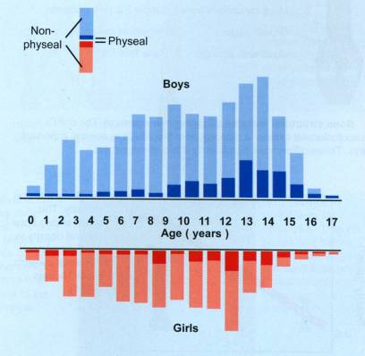
Introduction
Fractures account for ~15% of all injuries in children
Boys > girls
Rate increases with age
Type of fractures vary in various age groups (infants, children, adolescents )
Mizulta, 1987

Slide 5
Difference Between A Child & Adult’s Fractures

Slide 6
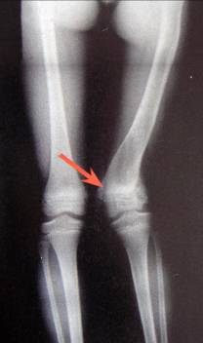
Why are Children’s Fractures Different ?
Growth plate:
Perfect remodeling power
Injury of growth plate may cause:
Angular deformity
Or leg length inequality (L.L.I)

Slide 7
Why are Children’s Fractures Different ?
Bone:
Increased (collagen:bone) ratio
Less brittle
Deformation

Slide 8
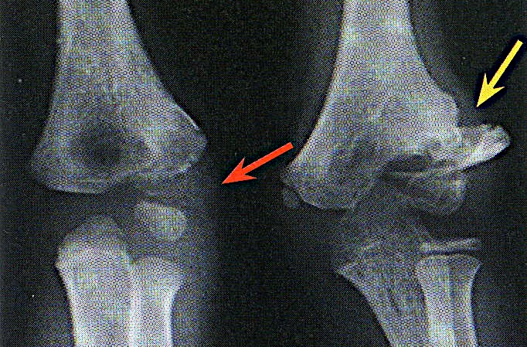
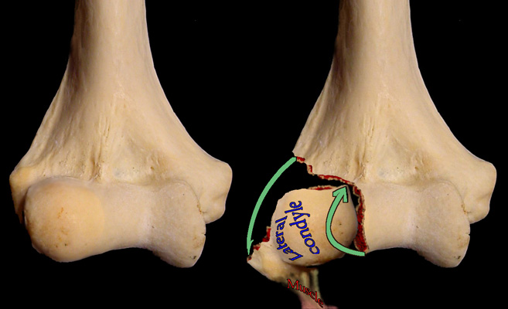
Why are Children’s Fractures Different ?
Cartilage:
Difficult X-ray evaluation
Size of articular fragment often under-estimated

Slide 9
Why are Children’s Fractures Different ?
Periosteum:
Metabolically active
More callus, rapid union, increased remodeling
Thickness and strength
May aid reduction

Slide 10
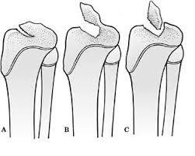
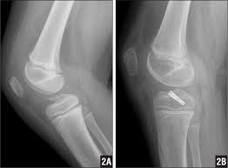
Why are Children’s Fractures Different ?
Ligaments:
Functionally stronger than bone.
Higher proportion of injuries that produce sprains in adults result in fractures in children.

Slide 11
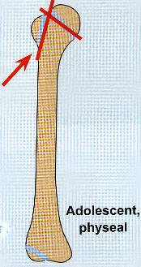
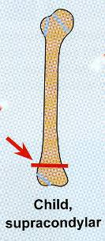
Why are Children’s Fractures Different ?
Age related fracture pattern:
Infants → diaphyseal #
Children → metaphyseal #
Adolescents → epiphyseal

Slide 12
Why are Children’s Fractures Different ?
Physiology
Better blood supply → rare delayed and non-union

Slide 13
Remodeling

Slide 14
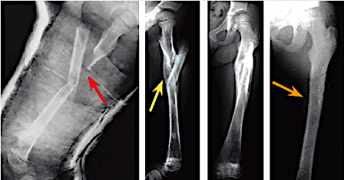
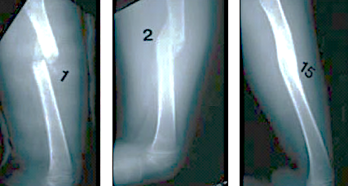

Slide 16
Physis Fractures

Slide 17
Physis Injuries
Account for ~25% of all children’s #
More in boys
More in upper limb
Most heal well rapidly with good remodeling
Growth may be affected

Slide 18
Physis Injuries- Classifications
Salter-Harris

Slide 19
Salter-Harris Classification

Slide 20
Salter-Harris Classification

Slide 21
Physis Injuries- Complications
Physeal bridging → < 1%
Cause → affecting growth (varus, valgus, or even L.L.I)
Keep in mind:
Small bridges (<10%) → may lyse spontaneously
Central bridges → more likely to lyse
Peripheral bridges → more likely to cause deformity

Slide 22
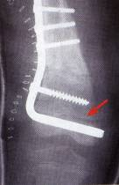
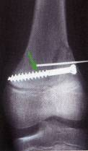
Physis Injuries- Complications
Take care with:
Avoid injury to physis during fixation
Monitor growth over a long period (18-24 m)
When suspecting physeal bar → do MRI

Slide 23
Indications of Operative Treatment

Slide 24
General Management
Indications for surgery
Open fractures
Severe soft-tissue injury
Fractures with vascular injury
Compartment syndrome
Multiple injuries
Displaced intra articular fractures (Salter-Harris III-IV )
Failure of conservative means (irreducible or unstable #’s)
Malunion and delayed union
Adolescence
Head injury
Neurological disorder
Uncooperative patient

Slide 25
Methods of Treatment of Pediatric Fractures & Trauma

Slide 26
1) Casting → still the commonest

Slide 27
1) Casting → still the commonest

Slide 28
1) Casting → still the commonest

Slide 29
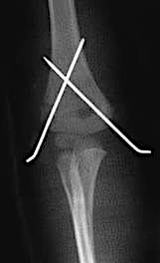
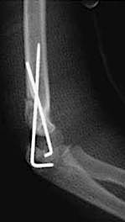
2) K-wires
Most commonly used internal fixation (I.F)
Usually used in → metaphyseal fractures

Slide 30
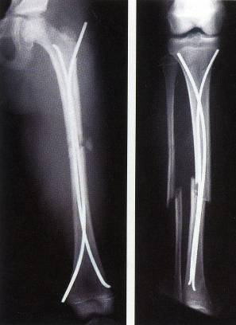
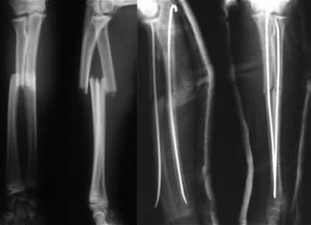
3) Intramedullary wires (Elastic nails)

Slide 31
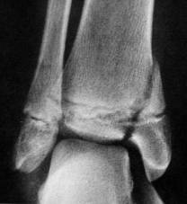
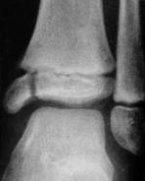
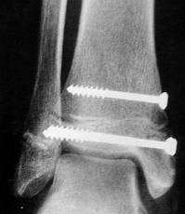
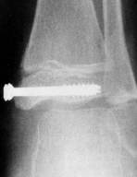
4) Screws

Slide 32
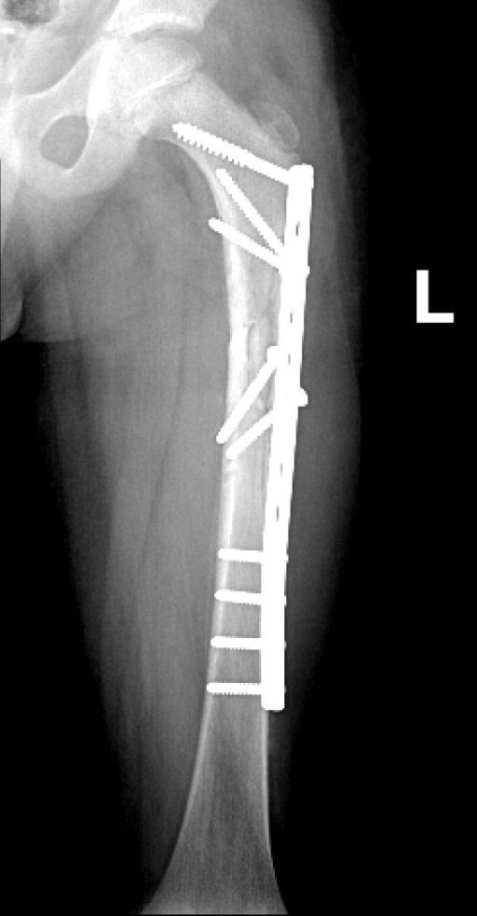
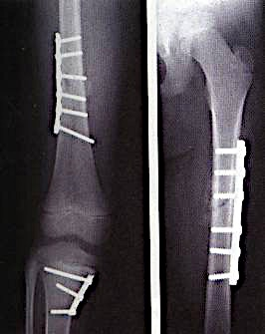
5) Plates → specially in multiple trauma

Slide 33
6) I.M.N → only in adolescents (>12y)

Slide 34
7) Ex-fix → usually in open #

Slide 35
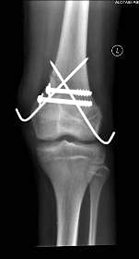
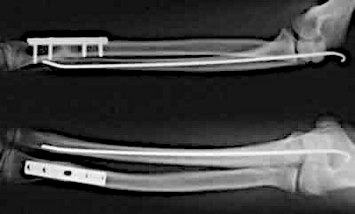
Methods of Fixation
Combination

Slide 36
Common Pediatric Fractures

Slide 37
Common Pediatric Fractures
Upper limb:
Clavicle
Humeral supracondylar
Distal radius
Lower Limbs:
Femur shaft (diaphysis)

Slide 38
Clavicle Fractures

Slide 39
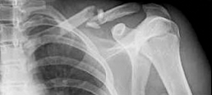
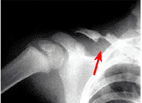
Clavicle # - Incidents
8-15% → of all pediatric #
0.5% → of normal SVD
1.6% → of breech deliveries
90% → of obstetric #
The periosteal sleeve always remains in the anatomic position (remodeling is ensured)

Slide 40
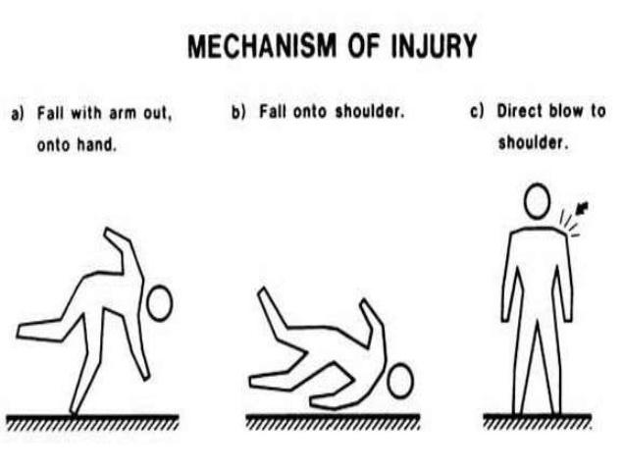
Clavicle # - Mechanism Injury
Indirect → fall onto an outstretched hand
Direct:
The most common mechanism
Has highest incidence of injury to the underlying:
N.V &,
Pulmonary structures
Birth injury

Slide 41
Clavicle # - Examination
Look → Ecchymosis
Feel:
Tender # site
As a palpable mass along the clavicle (as in displaced #)
Crepitus (when lung is compromised)
Special tests → Must assesse for any:
N.V injury
Pulmonary injury

Slide 42
Clavicle # - Reading XR
Location:
(medial, middle, lateral) ⅓ → commonest middle ⅓
Commonest # site → middle/lateral ⅓
Open or closed → see air on XR
Displacement → %
Fracture type

Slide 43
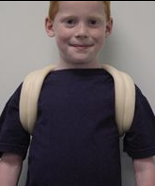
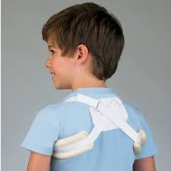
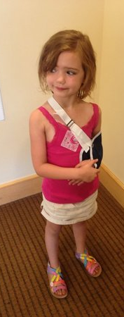
Clavicle # - Treatment
Newborn (< 28 days):
No orthotics
Unite in 1w
1m – 2y:
Figure-of-eight
For 2w
2 – 12y:
Figure-of-eight or sling
For 2-4 weeks

Slide 44
Clavicle # - Remodeling

Slide 45
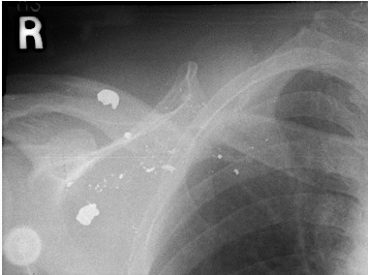
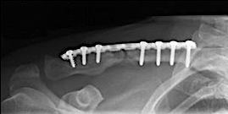
Clavicle # - Treatment
Indications of operative treatment:
Open #’s, or
Neurovascular compromise

Slide 46
Clavicle # - Complications (rare)
From the #:
Malunion
Nonunion
Secondary from healing:
Neurovascular compromise
Pulmonary injury
In the wound:
Bad healed scar
Dehiscence
Infection

Slide 47
Humeral Supracondylar Fractures

Slide 48
Supracondylar #- Incidences
55-75% → of all elbow #
M:F 3:2
Age → 5 - 8 years
Left (non-dominant) side → most frequently #

Slide 49
Supracondylar #- Mechanism of Injury
Indirect:
Extension type
>95%
Direct:
Flexion type
< 3%
Notes:
Need pic’s

Slide 50
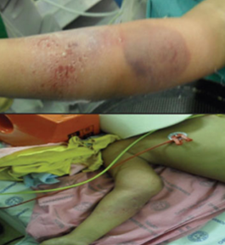
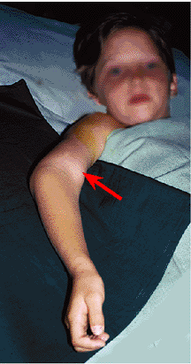
Supracondylar #- Clinical Evaluation
Look:
Swollen
S-shaped angulation
Pucker sign (dimpling of the skin anteriorly)
May have burses
Feel:
Tender elbow
Move:
Painful & can’t really move it
Neurovascular examination

Slide 51
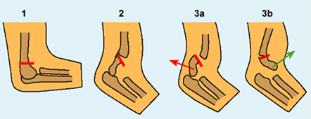
Supracondylar #- Gartland Classification
Type-III Complete displacement (extension type) may be:
Posteromedial (75%), or
Posterolateral (25%)

Slide 52
Supracondylar #- Gartland Classification
Type-III Complete displacement (extension type) may be:
Posteromedial (75%), or
Posterolateral (25%)

Slide 53
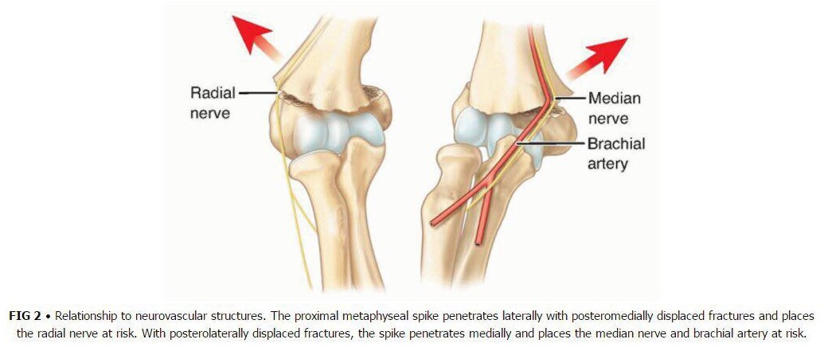
Supracondylar #- Gartland Classification

Slide 54
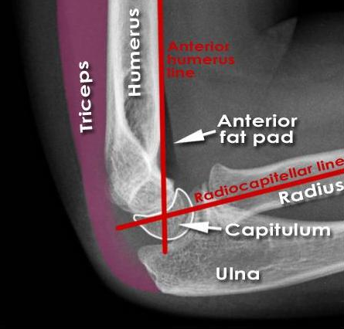
Normal XR Lines
Anterior Humeral Line
Hour-glass appearance
Fat-pad sign
Radio-capitellar line

Slide 55
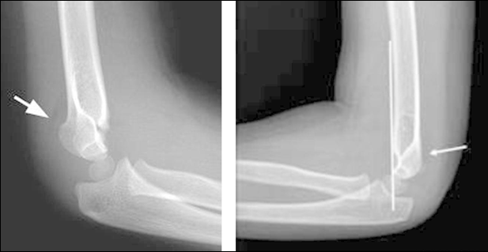
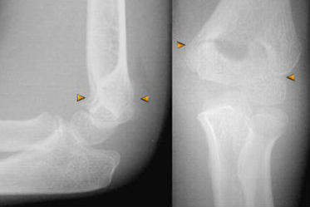
Type 1
Anterior Humeral Line
Hour-glass appearance
Fat-pad sign
Radio-capitellar line

Slide 56
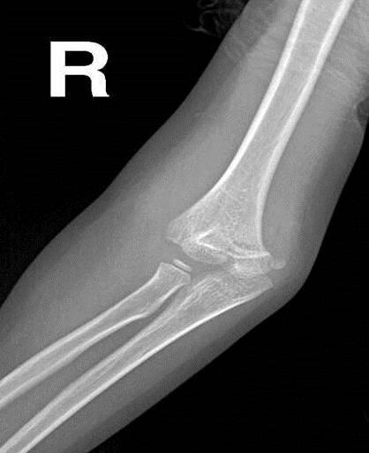
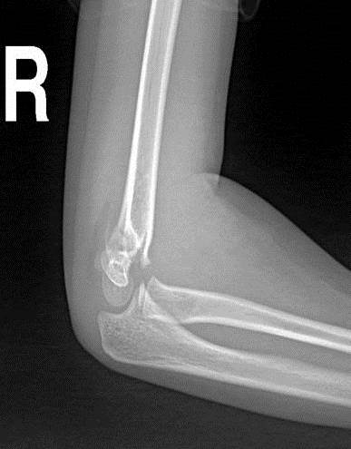
Type 2

Slide 57
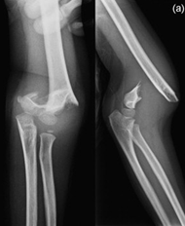
Type 3

Slide 58
Supracondylar #- Treatment
Type-I:
Above elbow cast (or splint)
For 2-3 weeks
Type-II:
Closed reduction & above elbow casting, or
Closed reduction with percutaneous pinning (if: unstable or sever swelling), & above elbow cast (splint)
For 4-6 weeks
Type III:
Attempt closed reduction & percutaneous pinning
If fails → open reduction & pinning (ORIF)
For 4-6 weeks
Direct ORIF if → open #

Slide 59
Supracondylar #- Treatment

Slide 60
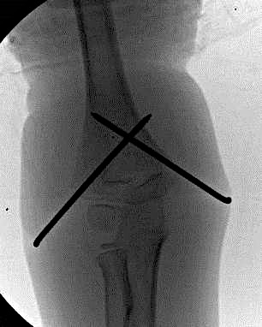
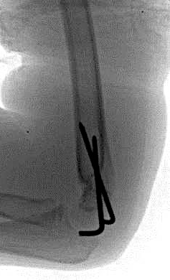
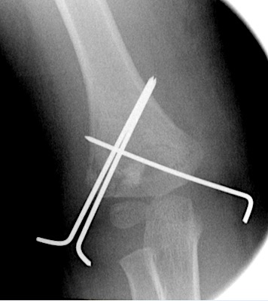
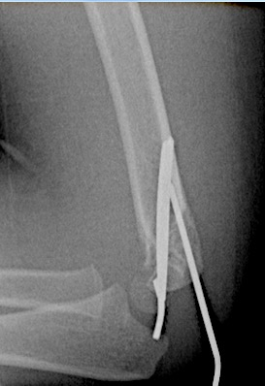
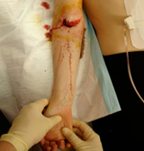
Supracondylar #- Treatment

Slide 61
Supracondylar #- Complications
Neurologic injury (7% to 10%):
Median and anterior interosseous nerves (most common)
Most are neurapraxias
Requiring no treatment
Vascular injury (0.5%):
Direct injury to the brachial artery, or
Secondary to swelling (compartment syndrome)

Slide 62
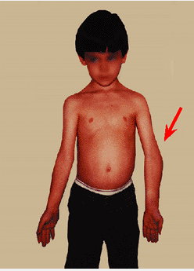
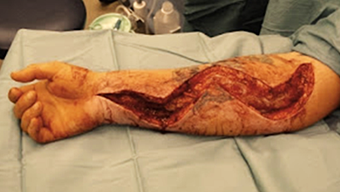
Supracondylar #- Complications
Loss of motion (stiffness)
Myositis ossificans
Angular deformity (cubitus varus)
Compartment syndrome

Slide 63
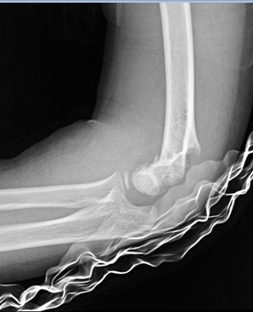
Supracondylar #- Flexion Type 3

Slide 64
Distal Radial Fractures (Metaphysis)

Slide 65
Classification
Depending on pattern:
Torus (buckle) → only one cortex is involved
Incomplete (greenstick)
Complete

Slide 66
Distal Radius Metaphyseal Injuries
Torus (buckle) fracture:
Are stable
Immobilized for pain relief in below elbow cast, 2-3 weeks

Slide 67
Distal Radius Metaphyseal Injuries
Torus (buckle) fracture:

Slide 68
Distal Radius Metaphyseal Injuries
Torus (buckle) fracture:

Slide 69
Distal Radius Metaphyseal Injuries
Incomplete (greenstick):
Greater ability to remodel (why ?)
Closed reduction and above elbow cast

Slide 70
Distal Radius Metaphyseal Injuries
Incomplete (greenstick):

Slide 71
Distal Radius Metaphyseal Injuries
Complete fracture:
Closed reduction, then well molded above elbow cast for 6-8 w
Or open reduction and fixation (internal or external)

Slide 72
Distal Radius Metaphyseal Injuries
Complete fracture:
Closed reduction, then well molded above elbow cast for 6-8 w

Slide 73
Distal Radius Metaphyseal Injuries
Complete fracture: (treatment in O.R)

Slide 74
Distal Radius Metaphyseal Injuries
Complete fracture: (treatment in O.R)

Slide 75
Distal Radius Metaphyseal Injuries
Complete fracture:
Or open reduction and fixation (internal or external)

Slide 76
Distal Radius Metaphyseal Injuries
Complete fracture:
Indications for ORIF:
Irreducible fracture
Open fracture
Compartment syndrome

Slide 77
Distal Radius Meta. Injuries- Complications
Malunion
Residual angulation may result in loss of forearm rotation
Nonunion
Rare
Refracture
With early return to activity (before 6 w)
Growth disturbance
Overgrowth or undergrowth
Neurovascular injuries
With extreme positions of immobilization

Slide 78
Examples of Distal Radial Fractures

Slide 79
Distal Radial Fractures Physeal Injuries

Slide 80
Distal Radial Physeal #- “S.H” Type I

Slide 81
Distal Radial Physeal #- “S.H” Type II

Slide 82
Distal Radial Physeal #- “S.H” Type III

Slide 83
Distal Radial Physeal #- Treatment Types I & II
Closed reduction followed by above elbow cast
We can accept deformity:
50% translation
With no → angulation or rotation
Growth arrest can occur in 25% → with repeated closed reduction manipulations
Open reduction is indicated in:
Irreducible #
Open #

Slide 84
Distal Radial Physeal #- Treatment Types I & II
Closed reduction,
Followed by long arm cast,
With the forearm pronated

Slide 85
Distal Radial Physeal #- Treatment Types II
AP
Lat

Slide 86
Distal Radial Physeal #- Treatment Types II

Slide 87
Distal Radial Physeal #- Types III

Slide 88
Distal Radial Physeal #- Treatment Types III
Anatomic reduction necessary → intra-articular
ORIF with smooth pins or screws

Slide 89
Distal Radial Physeal #- Treatment Types IV & V
Rare injuries
Need ORIF

Slide 90
Distal Radial Physeal #- Complications
Physeal arrest
Shortening
Angular deformity
Ulnar styloid nonunion
Carpal tunnel syndrome

Slide 91
Femoral Shaft Fractures

Slide 92
Femoral Shaft #
1.6% → of all pediatric #
M > F
Age:
(2 – 4) years years old
Mid-adolescence
Adolescence → >90% due to RTA

Slide 93
Femoral Shaft #- Mechanism of Injury
Direct trauma:
RTA,
Fall, or
Indirect trauma:
Rotational injury
Pathologic #:
Osteogenesis imperfecta
Nonossifying fibroma
Bone cysts
Tumors

Slide 94
Femoral Shaft #- Clinical Evaluation
Look:
Pain,
Swelling of the thigh,
Inability to ambulate, and
Variable gross deformity
Careful O/E of the overlying soft tissues to rule out the possibility of an open fracture (puncture wound)
Feel:
Tender # site
Careful neurovascular examination is essential

Slide 95
Femoral Shaft #- Treatment
< 6m:
Pavlik Harness
Closed reduction & immediate hip spica casting
Or traction 1-2w, then hip spica casting

Slide 96
Femoral Shaft #- Treatment
6m – 6y:
Closed reduction & immediate hip spica casting (>95%)
Or traction 1-2w, then hip spica casting

Slide 97
Femoral Shaft #- Treatment
6 – 12y:
Flexible I.M.N
Bridge Plating
External Fixation

Slide 98
Femoral Shaft #- Treatment
6 – 12y:
Flexible IMN
Bridge Plating
External Fixation

Slide 99
Femoral Shaft #- Treatment
6 – 12y:
Flexible IMN
Bridge Plating
External Fixation:
Multiple injuries
Open fracture
Comminuted #
Unstable patient

Slide 100
Femoral Shaft #- Treatment
12y to skeletal maturity:
Intramedullary fixation with either:
Flexible nails, or
Locked I.M nail

Slide 101
Femoral Shaft #- Treatment
Operative Indications:
Multiple trauma, including head injury
Open fracture
Vascular injury
Pathologic fracture
Uncooperative patient

Slide 102
Femoral Shaft #- Complications
Malunion
Remodeling will not correct rotational deformities
Leg length discrepancy
Secondary to shortening or overgrowth
Muscle weakness
Nonunion (rare)

Slide 103
Any Questions?

Slide 104
Remember …

Slide 105
Remember
Pediatric fractures have great remodeling potentials
The importance of growth plates & periosteum in remodeling
A good number of cases can be treated conservatively
Operative fixations aids in avoiding complications

Slide 106
Objectives
Difference between adult & pediatric #
Growth plate # → Salter-Harris classification, treatments, & complications
Methods of treatment of pediatric # & there indications
Know the common pediatric #: mechanism of injury, evaluations (clinical & radiological), treatments, and complications

