Slide 1
Bone and Joint Infections
Munir Saadeddin FRCSEd
Associate Professor and Consultant
King Saud University and KKUH

Slide 2
Original Lecture By:
Dr. Hisham A Al Sanawi.
Dr. Waleed Awwad.

Slide 3
Objectives of Lecture
What is bone and joint infection?
Why we consider bone and joint infection as a red flag.
How does the presentation in children and adults differ.
What are the most involved organisms in children and adults.
How do we diagnose and confirm diagnosis of bone and joint infection.
Principles of management of bone and joint infection.
Complications of bone and joint infection.

Slide 4
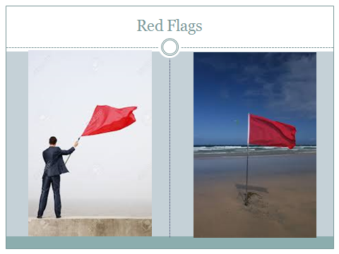
Bone and Joint Infections are

Slide 5
Topics to be discussed
Bone infection= Osteomyelitis
(infection of bone and bone marrow)
- Acute, Chronic, Subacute.
Less common infection of Bone=
- Tuberculosis, Brucellosis, Syphilis and Fungal.
Joint infection

Slide 6
Acute Osteomyelitis
A serious condition.
Most likely hematogenous spread via blood stream from infected focus somewhere in the body.
Less occurrence from direct spread from infected nearby tissues.
It may follow open fracture.

Slide 8
Spread of infection
Infection starts at bone marrow.
Infection spreads to cortex and lifts up periosteom, swelling becomes tense= increase of pain.
Local blood vessels get obstructed.
Periosteom bursts into soft tissues and pus becomes under skin; eventually spontaneous discharge.
If pus bursts into epiphysis; epiphyseal arrest will occur.

Slide 9
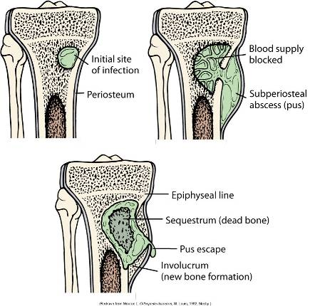

Slide 10
Sequestrum and Involucrum
Sequestrum = Dead bone = separated piece from its surroundings.
This happens when blood supply is cut off from area of bone due to infection.
Involucrum = New bone formed at site of infection and trapping a cavity of bone.

Slide 11
Sequestrum and Involucrum
Plain x-ray showing: Large sequestrum inside involucrum.

Slide 12
Diagnosis
Clinical picture.
Blood investigations.
Radiological investigations.
Definite diagnosis: identifying= obtaining organisms from site of infection.

Slide 13
Clinical Picture
Usually ill child.
Generally=Pain, fever, malaise, restlessness, loss of function( child is not moving involved limb and unable to bear weight on it if it was at lower limb usually).
Locally= swelling at a limb usually near a joint like knee or hip or shoulder with increased local temperature.

Slide 14
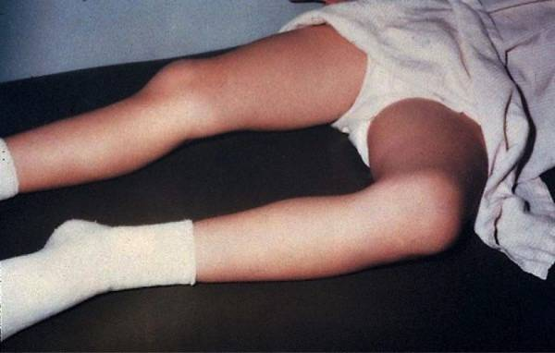
Acute Hematogenous OM Clinical Features
caused by blood-borne organisms
More common in children
Boys > girls
most common in long bone metaphysis or epiphysis
Lower extremity >> upper extremity
Pain
Loss of function of the involved extremity
Soft tissue abscess

Slide 15
Blood investigations
CBC and differentials: usually raised white cell count; predominantly poly morphs.
Elevated ESR, and CRP( C-reactive protein)
CRP is the most sensitive monitor.
Positive blood culture in up to 50% of cases; if blood is drawn whilst there is spike of fever.

Slide 16
Radiological investigations
Early plain x-rays may not reveal any findings except soft tissue swelling at site of infection.
Bony changes take up to 14 days to show suspected bone involvement, but osteopenia may appear earlier( not diagnostic).
Ultrasound: may diagnose soft tissue swelling or abscess early, but it is operator dependent.

Slide 17
Radiological investigations
Isotope bone scan=Nuclear medicine isotope bone scan: Tcm99 bone scan(Tecnetium 99) or Gallium bone scan are diagnostic , as increased local tracer uptake; but take time to appear.
MRI: best tool for radiological diagnosis as it is sensitive and specific, but difficult in young children as they require general anesthesia.

Slide 18
Plain x-rays
In early days : NO bony changes ,but soft tissue swelling may be evident.

Slide 19
Isotope bone scan
In this scan there is: Increased uptake in the lower left femur

Slide 20
Isotope bone Scan
Increased uptake of most of right femur

Slide 21
MRI
shows changes in bone and bone marrow before plain films
decreased T₁-weighted bone marrow signal intensity
increased post gadolinium fat-suppressed T₁-weighted signal intensity
increased T₂-weighted signal relative to normal fat

Slide 22
Differential Diagnosis
Acute septic arthritis.
Cellulitis.
Ewing’s Sarcoma, lymphoma.
Sickle cell bone crisis.
Acute rheumatoid arthritis.

Slide 23
How to confirm diagnosis?
Ultrasound guided aspiration from site of swelling or abscess.
X-ray guided aspiration of suspected bone involvement( according to MRI ).
Via open incision –drainage procedure( drilling of bone) when there is high suspicion.
Aspirated or obtained material at open incision are sent urgently for Direct Smear and C&S including anaerobic, TB and Fungal.
Histo-pathology examinations are recommended as well.

Slide 24
Management of Acute Osteomyelitis
When there is suspicion that the diagnosis is : acute osteomyelitis( Red Flag); patient should be admitted immediately.
Patient should receive adequate hydration and pain relief at the same time as investigations.
Pain relief include: analgesics and splintage.
Broad spectrum IV antibiotics is started after obtaining material for culture or sending blood culture when there is fever.

Slide 25
Definite Diagnosis
Definite diagnosis depends on seeing organisms at direct smear, or culturing organisms.
Histo-pathology confirmation is important but usually result is late.

Slide 26
Empirical Antibiotic Treatment
When patient is acutely ill; empirical IV antibiotic treatment to be started immediately after sending samples for culture.
This empirical treatment depends on suspected organisms according to :
Age: Newborn, young or adult.
Presence of other circumstances: sickle cell disease or Hemodialysis or drug addicts.

Slide 27
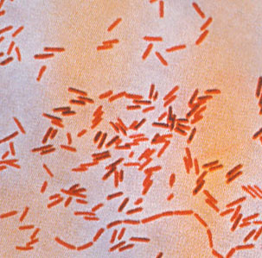
Empirical Treatment Sickle cell anemia
Salmonella is a characteristic organism
The primary treatment → fluoroquinolones (only in adults)
alternative treatment → 3rd -generation cephalosporin

Slide 28
To simplify empirical treatment
To make it simple: always suspect staph aureus: ( oxacillins ) except sicklers.
3rd generation IV antibiotics for special cases

Slide 29
Definitive Antibiotic Treatment
Depends on result of culture of isolated organisms.
Always consult ID( Infection Department)

Slide 30
When do we consider surgery?
When we are sure( as a result of our investigations) there is pus or highly suspect that there is pus inside the bone or in the soft tissues near bone.
We have to let pus out( drain the pus out ) to stop bone and tissue destruction and improve the general condition by getting rid of source of infection in the body.

Slide 31
How do we do Surgery for Bone Infection
Patient should be prepared well for surgery.
Surgery is done under GA usually.
X-ray guidance ( image intensifier ) is used usually to help exact location of site of drainage.
Soft tissue abscesses are drained and bone site of infection is drilled or a window is opened in the cortex to drain pus and curette infected material from inside medulla.
In case of presence of sequestrum it has to be removed.
Drain is to be left at site of drainage till discharge is minimal.

Slide 32
Post Operative management
Definite antibiotic should be continued via IV route for 6 weeks usually.
Monitoring of general condition and blood investigations should be done frequently as in patient, especially CBC, ESR and CRP.
Repeat follow up plain X-rays or CT or MRI may be required.
Patient should be pain free and generally well before discharge.
Long term follow up should be done to exclude late complications.

Slide 33
Complications
Septicemia and distant abscesses.
Septic arthritis.
Growth disturbance in skeletally immature.
Pathological fracture.
Chronic osteomyelitis.

Slide 34
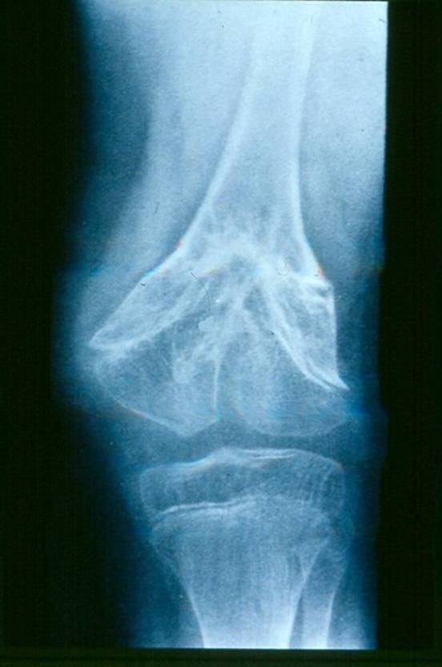
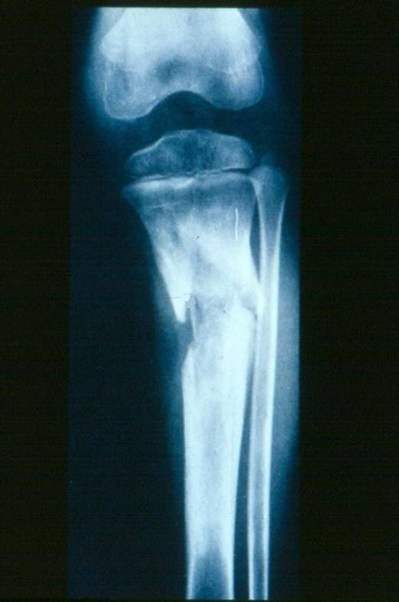
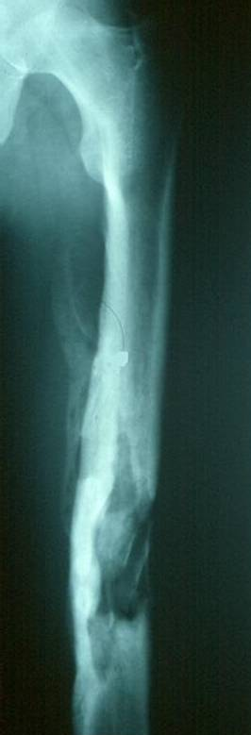
Complications

Slide 35
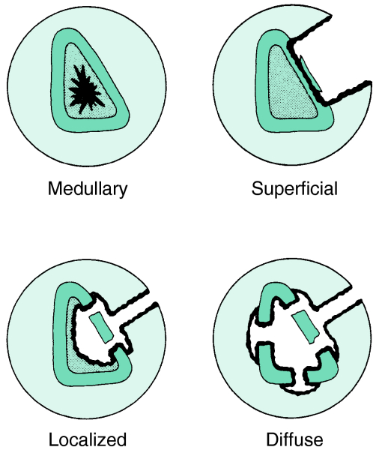
Chronic OM
Common in
Inappropriately treated acute OM
Trauma
Immunosuppressed
Diabetics
IV drug abusers
Anatomical classification →

Slide 36
Chronic OM
Features
Skin and soft tissues involvement.
Sinus tract → may occasionally develop squamous cell carcinoma.
Periods of quiescence → followed by acute exacerbations.
Diagnosis
Nuclear medicine → activity of the disease
Best test to identify the organisms → Operative sampling of deep specimens from multiple foci

Slide 37
Treatment
Empirical therapy is not indicated
IV antibiotics → must be based on deep cultures
Most common organisms
S. aureus
Enterobacteriaceae
P. aeruginosa

Slide 38
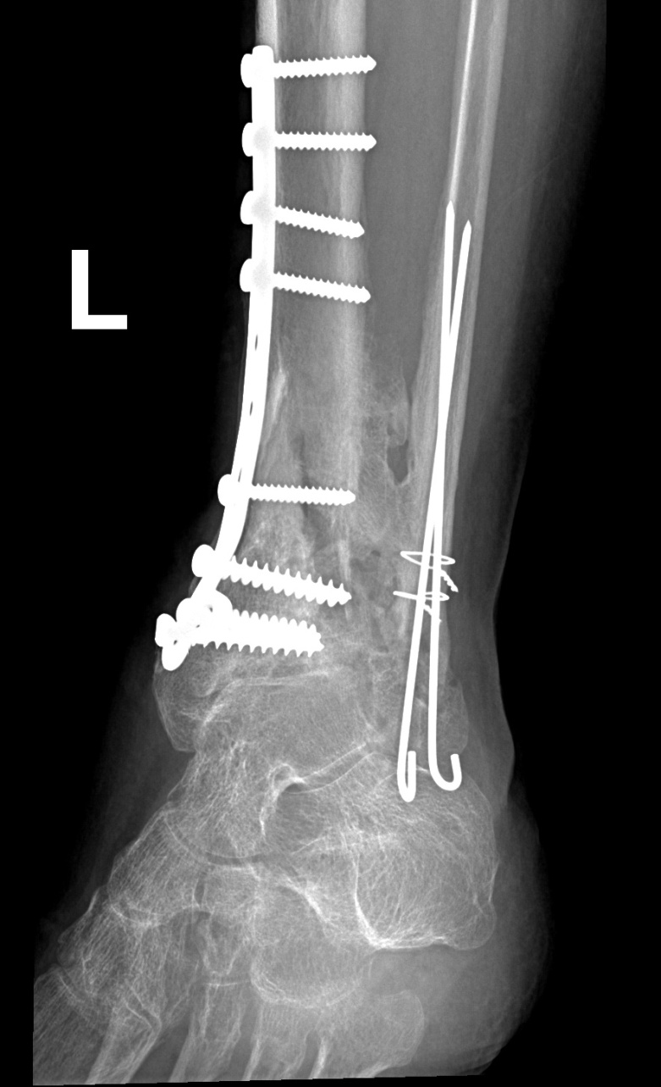
Chronic osteomyelitis
Hardware has to be removed, but stability should be maintained (consider Ex-Fix)
Glycocalyx
exopolysaccharide coating
envelops bacteria
enhances bacterial adherence to biologic implants

Slide 39
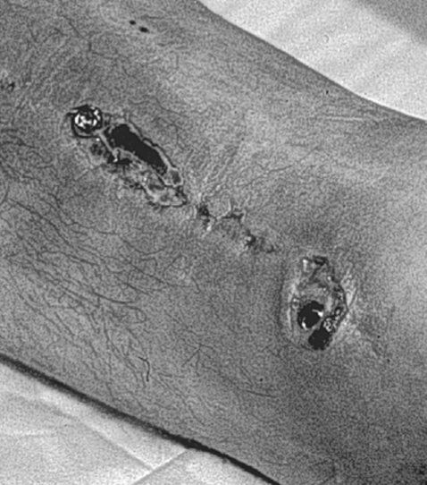
Chronic OM - Treatment
surgical débridement :
complete removal of compromised bone and soft tissue.
Hardware
most important factor
almost impossible to eliminate infection without removing implant.
organisms grow in a glycocalyx (biofilm) → shields them from antibodies and antibiotics.
bone grafting and soft tissue coverage is often required.
amputations are still required in certain cases.

Slide 40
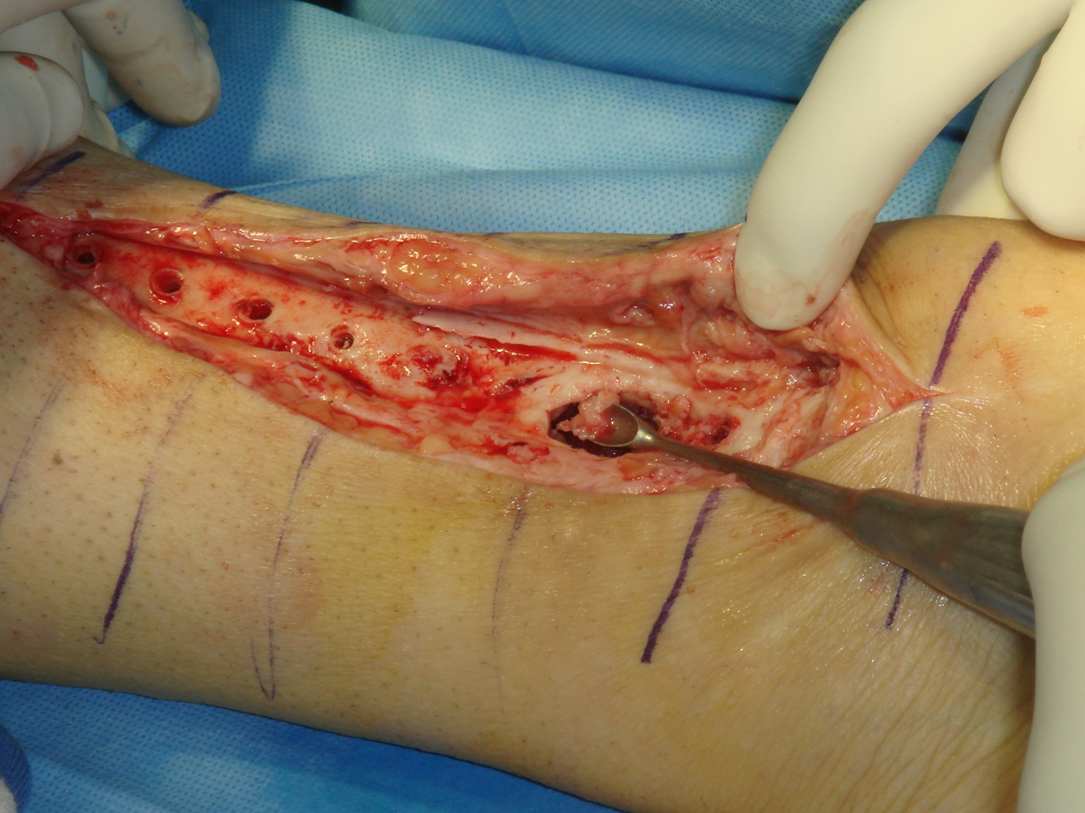

Slide 41
Septic Arthritis
Infection of the joint.

Slide 42
Septic Arthritis
May affect any age and any joint.
The knee and hip are most affected.
Pathology: hematogenous or from the bone
In neonates: transphyseal vessels
In joints where the metaphysis is intracapsular (Hip, shoulder, proximal radius and distal fibula)

Slide 43
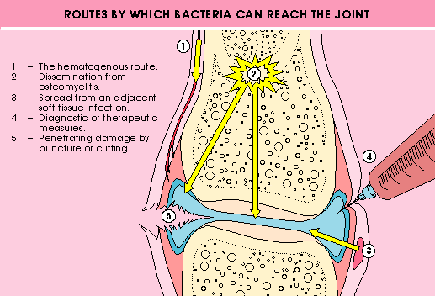

Slide 44
Septic Arthritis
May affect any age and any joint
The knee and hip are most affected
Pathology: hematogenous or from the bone
In neonates: transphyseal vessels
In joints where the metaphysis is intracapsular (Hip, shoulder, proximal radius and distal fibula)

Slide 45
Septic Arthritis
Symptoms : like Acute Osteomyelitis.
Signs: hot swollen joint which is painful to any motion, inability to bear weight.
Joint is fixed in the position of ease.

Slide 46
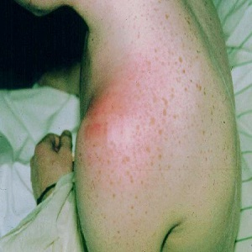
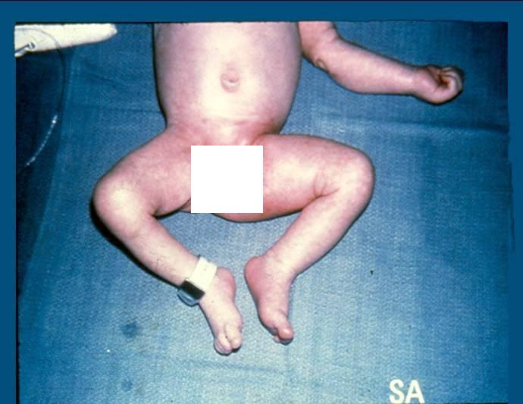
Septic Arthritis

Slide 47
Investigation
Basic lab for infection (CBC,ESR and CRP) and Blood cultures.
Plain films and Ultrasound.
Joint aspiration: WBC >50,000 (>90%PMNL), damaged WBC and No crystals .
Organisms: similar to Acute Osteomyelitis.
Rx: Admission for Emergency arthrotomy and washout, broad spectrum IV antibiotics and splintage.
Main DDx: transient synovitis of the hip.

Slide 49
Differential diagnosis
Acute osteomyelitis.
Transient synovitis (<10 years).
Reactive arthritis.
Vasculitis , eg: Henoch-Schonlein purpura.
Traumatic haemoarthrosis.
Haemophilic arthritis

Slide 50
Management of Septic Arthritis
Emergency drainage of the septic joint:
Either arthroscopic.
Or Open.
Joint should receive lavage and debridement, and a drain should be left at joint till discharge is clear and minimal.
IV antibiotics should be administered for 4 weeks.

Slide 51
Complication
Septicemia.
Abscess.
Osteomyelitis.
Joint destruction.
Joint subluxation and dislocation.
Ankylosed joint.
Avascular necrosis of the femoral head.
Growth disturbance

Slide 52
Granulamatous bone infection=TB
Tuberculosis is chronic bone infection.
May affect any age.
Causative organism is: Mycobacterium Tuberculosis.
It is acid fast bacillus.
Can be diagnosed sometimes by direct smear.
When bacillus is seen it is diagnostic of TB.
It takes up to 6 weeks to culture.

Slide 53
TB at current time
Endemic in poor underdeveloped countries.
Still present sporadically at Saudi Arabia.
In developed countries TB patients are immunocompromised patients.(AIDS and drug addicts)

Slide 54
T.B Histopathology
To confirm diagnosis: we need to see acid fast bacillus.
Also to see: Langhans giant cells.
0r to see : caseation.
in a bed of lymphocytes and monocytes.

Slide 55
TB Follicle

Slide 56
TB spine: Pott’s Disease
Affect any part of spine; most commonly dorsal spine.
Can lead to dorsal kyphosis.
Famous for causing psoas abscesses and para spinal abscesses.
TB spinal abscess may compress spinal cord= Pott’s paraplgia.

Slide 57
TB spine= Dorsal kyphosis

Slide 58
T.B of The Spine: (Pott’s disease)
Infection spreads to adjacent level under the longitudinal ligaments and hematologically
Eventually a kyphotic deformity occurs
Para vertebral abscess is common and may be distant as well
Cervical > retropharyngeal abscess
Lumbar > psoas abscess
Compression of the spinal cord is more likely to occur at the thoracic level

Slide 59
T.B of The Spine: (Pott’s disease)
Neurological deficits occur due to the compression secondary to the deformity or compression from the abscess.
Paraplegia may occur.
Reversible if treated early.
Mostly treated non-surgically.

Slide 60
MRI: TB lesion of dorsal spine

Slide 61
TB spine with Psoas abscess

Slide 62
Diagnosis
Radiology:
Plain x-rays:
Spine:
Erosion and destruction of end plates.
Narrowing of disc space.
Soft tissue mass shadow.
Anterior wedging of vertebrae.
Kyphus deformity.

Slide 63
Diagnosis
Special tests:
Tuberculin( Mantoux )skin test.
Spine:
CT guided needle biopsy
Joints:
Synovial aspiration---- low yield
Should get bone/soft tissue
Send for aerobic/non-aerobic bacteria, fungal, AFB, enriched culture media
Takes up to 4-6 weeks

Slide 64
TB of musculoskeletal system
Usually lesion is secondary to TB at lung, kidney,bowel and lymph nodes.
Famous symptoms :
Fever, malaise, weight loss and night sweat
may not be present these days.
Suspicion of disease , previous history of TB presence of osteopenia and loss of joint space.

Slide 65
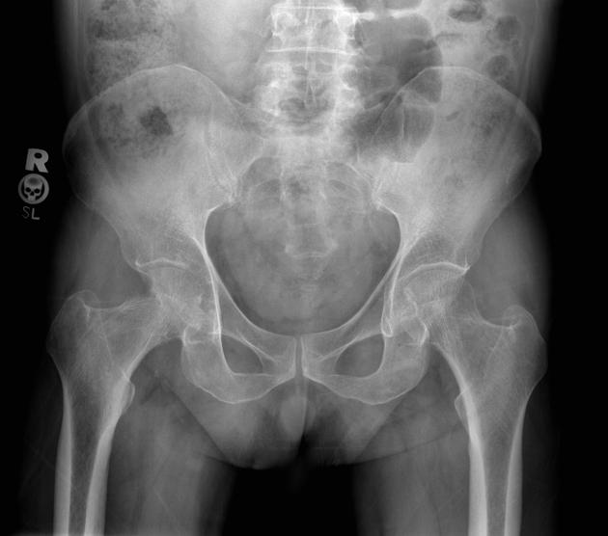

Slide 66
Management of TB
Usually non surgical by Triple or Quadruple drugs=
Isoniazide(INH), Rifampicin, Ethambutol, Pyrazinimide.
Drug therapy to continue up to 18 months.

Slide 67
Surgery in TB
Surgery to be done :
to evacuate abscess
or decompress spinal cord
or to stabilize joint or spine.

Slide 68
Brucellosis
Milk and milk products
Now less incidence in Saudi Arabia due to milk pasteurisation and awareness about not consuming unboiled camel’s milk
Back pain and stiffness
Muscle spasms
Fever (mild)
Sacro-iliac joint
Less destructive than TB, CT guided aspiration
Brucella titer: Diagnostic if > 1/640
Antibiotics:
e.g. Rifampicin – Doxycycline- Septrin

Slide 69
A patient suspected of having Brucellosis Right Sacro-iliac joint
Young patient= 17 years old.
Complaining of severe Low Back Pain radiating to right buttock.
Has antalgic gait right lower limb.
Very tender over Right S-I joint.
ESR= 35mm/1st hour
CRP= 45
Drinks camel milk every weekend.

Slide 70
A patient suspected of having Bruellosis Right Sacro- iliac joint

Slide 71
CT guided needle Aspiration Right Sacro-Iliac Joint

Slide 72
CT guided needle aspiration Right Sacro-iliac joint

Slide 73
After 4 weeks
Patient is pain free.
Normal gait.
ESR=4
CRP=2

Slide 74
Thank u

