Slide 1
Acute compartment syndrome & Acute joint dislocation
Abdulaziz Alomar, MBBS, MSc, FRCSC
Head of Arthroscopy and Sports Medicine Division
Director, Arthroscopy & Orthopaedic Sports Medicine Fellowship
King Khalid University Hospital, King Saud University
Riyadh, Saudi Arabia

Slide 2
Objectives
At the end of this course, students should be able to demonstrate knowledge, able to diagnosis, and initially manages a patient with an acute compartment syndrome & acute joint dislocation. This requires the ability to identify, characterize and differentiate through patient inquiry, examination and limited investigation, and outline management of acute compartment syndrome & acute joint dislocation

Slide 3
Acute compartment syndrome
Review Pathophysiology of Acute Compartment Syndrome
Review Current Diagnosis and Treatment
Risk Factors
Clinical Findings
Management
Complications.

Slide 4
Type of compartment syndrome
Acute vs chronic (exertional)
Adult vs Pediatric

Slide 5
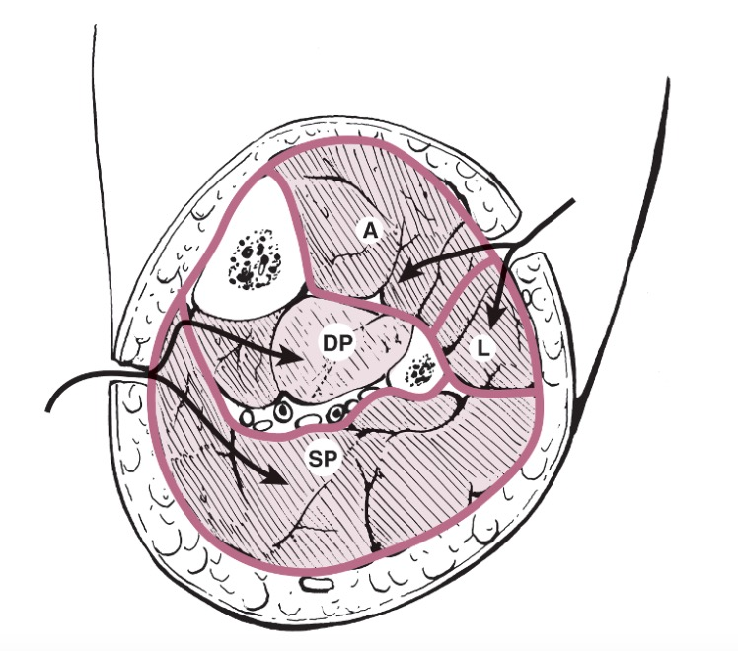
Acute compartment syndrome occurs when the tissue pressure within a closed muscle compartment exceeds the perfusion pressure and results in muscle and nerve ischemia. It typically occurs subsequent to a traumatic event, most commonly a fracture.
Pressure
Inflexible
Fascia
Injured Muscle

Slide 6
Pathophysiology

Slide 7
Pathophysiology

Slide 8
Compartment syndrome is due to a vicious circle
Autoregulatory mechanisms may compensate:
Decrease in peripheral vascular resistance
Increased extraction of oxygen
As system becomes overwhelmed:
Critical closing pressure is reached
Oxygen perfusion of muscles and nerves decreases
Cell death initiates a “vicious cycle”
increase capillary permeability
increased muscle swelling

Slide 9
Vascular Consequences of Elevated Intracompartment Pressure:
A-V Gradient Theory
P_{a} (High)
P_{v} (Low)
artery arteriole capillary venule vein
Local Blood
Flow
P_{a} - P_{v}
R
=
Matsen, 1980

Slide 10
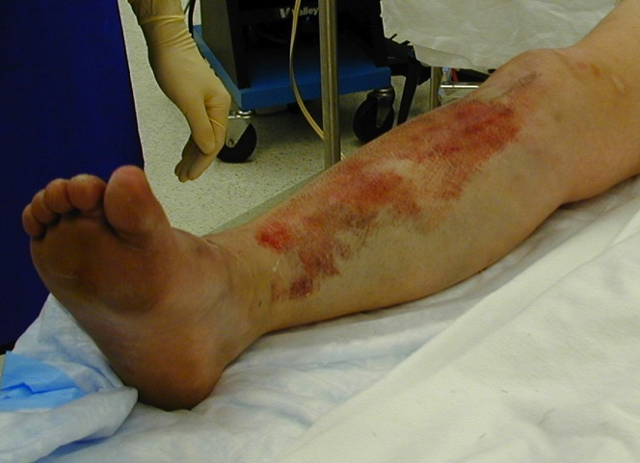
Etiology
Increased Volume-internal
Decreased volume-external
Hemorrhage in to a compartment
Fractures (most common cause)
Tibia shaft
Supracondylar
Bleeding disorders
Swelling from traumatized tissue
Crush syndrome
Soft tissue injury
Increased fluid
Burns\injections
Post-ischemic swelling
Tight casts / dressings

Slide 11
Arterial Injury
Post-ischemic swelling
Reperfusion injury:
Ischemia causes damage to cellular basement membrane that results in edema
With reestablishment of flow, fluid leaks into the compartment increasing the pressure

Slide 12
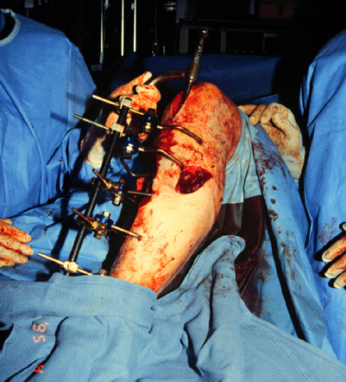
Fracture Treatment Increases IMP
Splinting/casting
Manipulation
Traction
Spanning Ex Fix
Nailing

Slide 13
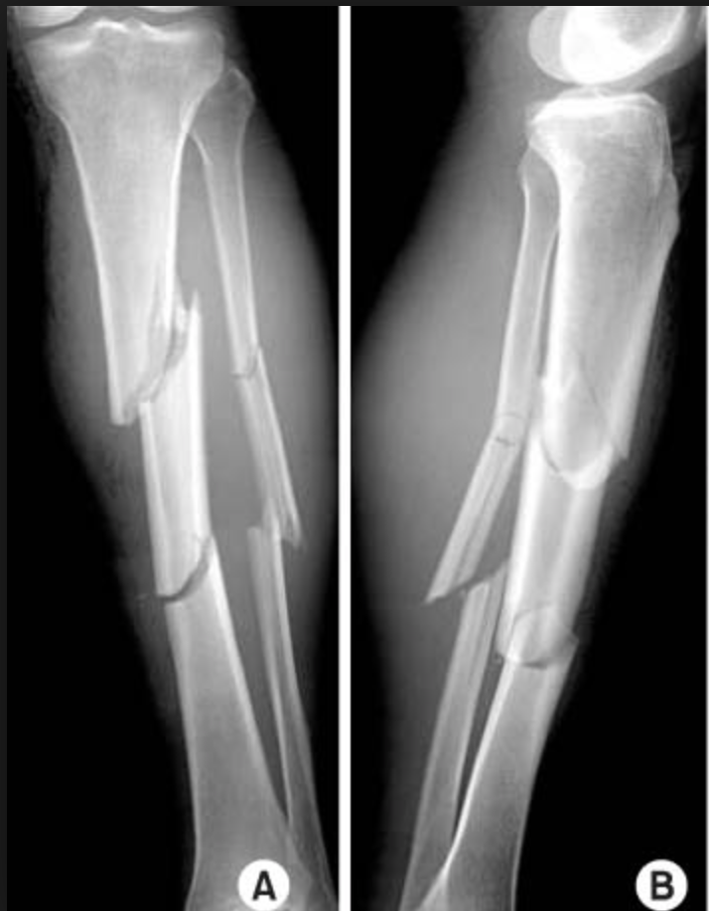
Incidence of ACS
2-10% tibial fractures
10% Calcaneal fractures
18% Schatzker VI plateau fractures
41% foot crush injuries
48% Segmental tibia fractures
53% Medial knee fx/dislocations

Slide 14
Diagnosis
Traditionally based on clinical assessment of the “5 P’s”:
Paresthesia
Paresis
Pain on stretch
Pink Color
Pulse present

Slide 15
Difficult Diagnosis
Classic signs of the 5P’s-ARE NOT RELIABLE:
These are signs of an ESTABLISHED compartment syndrome where ischemic injury has already taken place
These signs may be present in the absence of compartment syndrome.
Palpable pulses are usually present in acute compartment syndromes unless an arterial injury occurs
Sensory changes-paresthesias and paralysis do not occur until ischemia has been present for about 1 hour or more

Slide 16
Pain !
The most important symptom of an impending compartment syndrome is PAIN DISPROPORTIONATE TO THAT EXPECTED FOR THE INJURY and PAIN WITH PASSIVE STRETCH
Pain May be worse with elevation
Patient will not initiate motion on own
Be careful with coexisting nerve injury
In severe trauma or when the patient is unconscious pain may, however, be difficult to assess. Pain is also subjective and can be nonspecific
Pain out of proportion to the injury’ and ‘pain with passive stretching of the muscles in the compartment’ are the earliest (sensitive), most reliable indicators of ACS

Slide 17
Clinical findings vs timing !
Impending/ Early ACS | Late ACS
Pain out proportion to injury | Pulseless
Pain with passive stretch of muscles in the affected compartment | Paralysis
Paresthesia | Paresthesia /sensation loss

Slide 18
Pediatric ACS
5 Ps is not reliable in children
3 As
Increasing Analgesic requirement
Anxiety
Agitation

Slide 19
Physical signs of ACS
Pain with passive stretch of muscles in the affected compartment (early finding)
A firm & tense compartment with a firm "wood-like" feeling
Pallor from vascular insufficiency (uncommon)
Diminished sensation
Reduced two-point discrimination or vibration sense may be found in the early stages
Muscle weakness (onset within approximately two to four hours of ACS)
Paralysis (late finding)

Slide 20
Who is at high risk?
Inability to accurately obtain history and physical exam
Head trauma
Drug/ETOH intake
Pediatric
Multiply injured patients with hypotension and hypoxia
Compartment syndrome can occur at lower absolute pressure
Beware of polytrauma patient

Slide 21
Who is at high risk?
High energy fractures
Severe comminution
Joint extension
Segmental injuries
Widely displaced
Bilateral
Floating knee
Open fractures
The presence of an open fracture does NOT rule out the presence of a compartment syndrome

Slide 22
Who is at high risk?
Impaired sensorium
Alcohol
Drug
Decreased GCS
Unconscious
Chemically unconscious
Neurologic deficit
Cognitively challenged

Slide 23
Who is at high risk?
Post operative patients on analgesia that may mask the development of pain
PCA
Spinal
Regional block

Slide 24
Problems with Physical Diagnosis
Literature meta-analysis found that clinical findings have poor sensitivity.
Sensitivity of 13-19%
Positive predictive value of 11-15%.
Specificity = 97% (3% incidence of C.S. in patients without clinical findings
High index of clinical suspicion is the most important
Ulmer, J Orthop Trauma, 16: 572

Slide 25
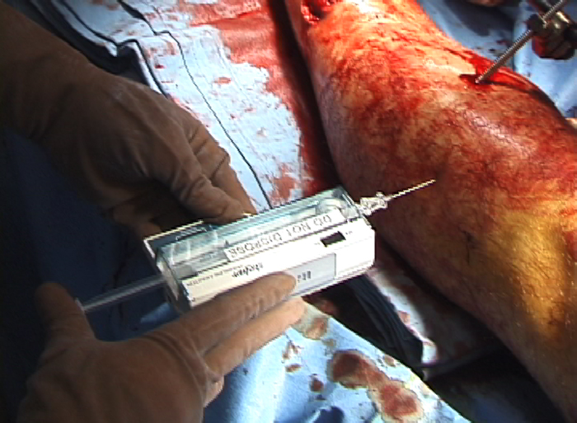
Intramuscular Pressure (IMP) Measurement
Adjunct to clinical examination.
Needed for comatose or otherwise non-evaluable patient:
Anesthesia
Head Injury
Sedated
Intoxicated
Pediatric pts

Slide 26
IMP and DBP !
Delta pressure !

Slide 27
Perfusion Pressure (∆P) Vs IMP
Currently, the “differential pressure” is considered the most reliable indicator of when fasciotomy is not necessary:
MAP- IMP < 45 mm Hg
DBP - IMP < 30 mm Hg
Absolute IMP > 30mm hg
May leads to unnecessary fasciotomies!
failure to perform needed fasciotomies!
DBP
> 30 mm HG
IMP
Notes:
Originally, it was believed that the threshold for compartment syndrome was a constant intramuscular pressure > 30 mm Hg. However, it is now recognized that the key factor is the difference between the diastolic blood pressure (dBP) and the intramuscular pressure (IMP). This determines the mean muscle perfusion pressure (MPP)
MPP = Diastolic blood pressure – intramuscular pressure
If the muscle perfusion pressure is less than 30 mm Hg, there will be hypoxia and anaerobic cell metabolism. It is important to note that blood pressure has a direct relationship to perfusion pressure. Thus, multiply injured patients with hypotension and hypoxia are predisposed to compartment syndrome. Other injuries carrying a high risk of developing compartment syndrome include: vascular injuries with peripheral ischemia, high-energy trauma, severe soft-tissue crush, and comminuted fractures of the tibia [16]. The aim of any therapeutic procedure must be immediate compartment decompression by dermatofasciotomy to achieve reperfusion of the capillary bed.

Slide 28
Perfusion Pressure (∆P)
DBP
Currently, the “differential pressure” is considered the most reliable indicator of compartment syndrome:
MAP- IMP < 45 mm Hg
DBP - IMP < 30 mm Hg
< 30 mm HG
IMP

Slide 29
Muscle Ischemia
4 hours - reversible damage
8 hours - irreversible changes
4-8 hours - variable
Myoglobinuria after 4 hours
Renal failure
Check CK levels
Maintain a high urinary output – Alkalinize the urine

Slide 30
Nerve Ischemia
1 hour - normal conduction
1- 4 hours - neuropraxic damage reversible
8 hours - axonotmesis and irreversible change
Hargens et al. JBJS 1979

Slide 31
Treatment of impending ACS or High risk patients
Immediately assess the patient
Identification and removal of external compressive forces, and releasing casts or dressings down to the skin.
Bi-valving the cast and loosening circumferential dressings
Leg compartment: keep the ankle in neutral to 30 degree plantar flexion
Forearm compartment: avoid deep elbow flexion
The limb should not be elevated above the hear level and instead kept at the level of the heart so as not to decrease arterial flow any further.
Serial physical examination
Maintain normal BP as hypotension may decrease perfusion further and compound any existing tissue injury
Early assessment of metabolic acidosis and myoglobinaemia is mandatory to avoid potential renal failure.

Slide 32
Bi-valving the cast

Slide 33
Compartment Syndrome = Fasciotomy
If you think about it, do it!

Slide 34
Emergent Fasciotomy
Indications
Clinical presentation consistent with compartment syndrome
Compartment pressures within 30 mm Hg of diastolic blood pressure (delta p)
6 -8 hours of total ischemia time
Contraindications
Missed compartment syndrome (high complications)

Slide 35
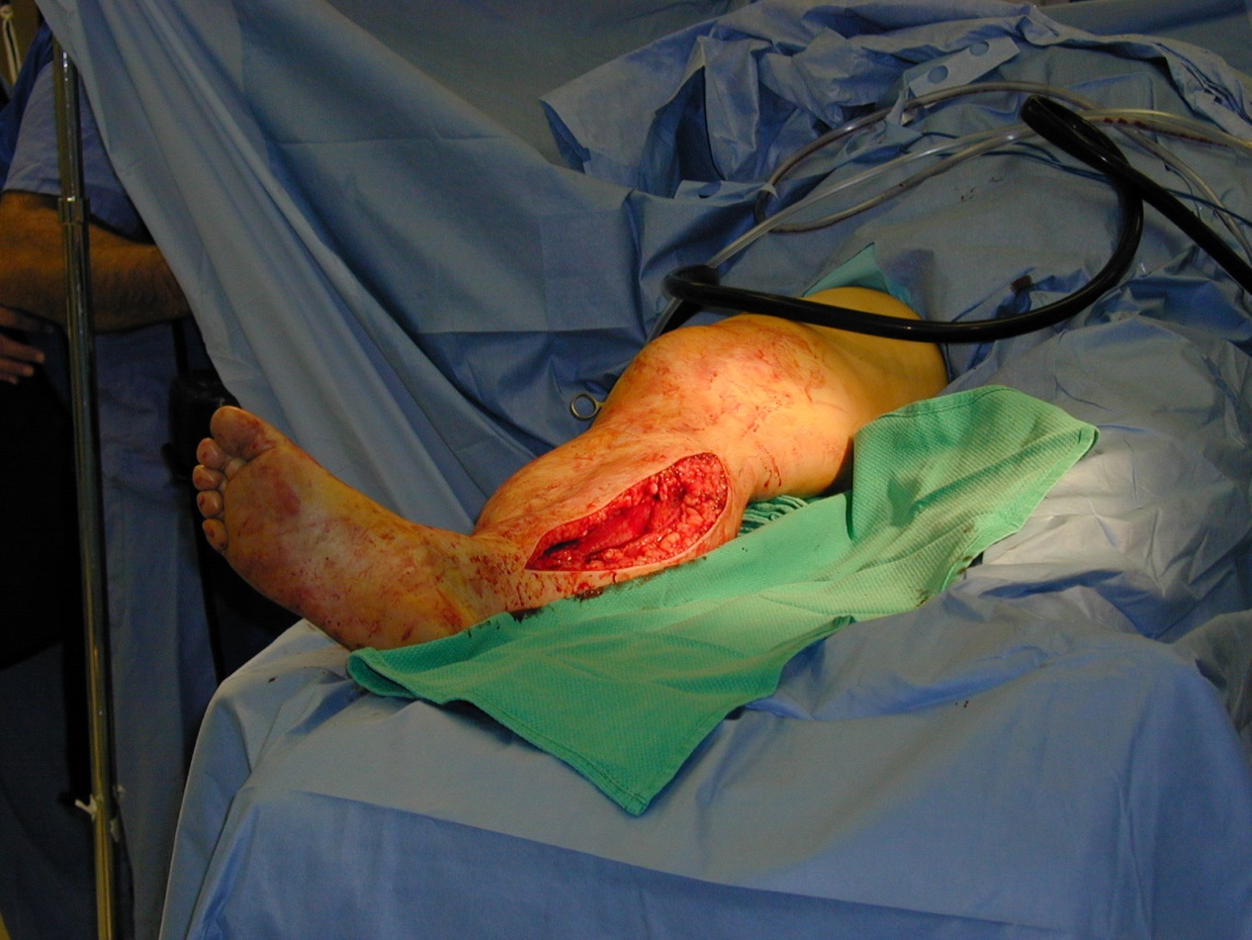
Technique of Fasciotomy
Longitudinal skin incision that extends the entire length of the compartment.
Release of fascia of involved muscle.
Skin left open
Closure of skin is usually achieved after swelling has subsided
Skin grafting is often required
Second and third look surgeries are often required

Slide 36
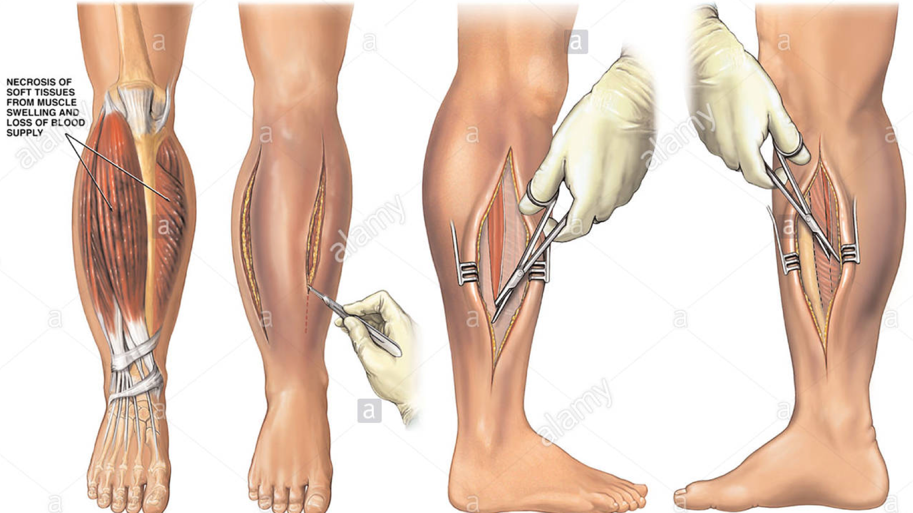
Leg fasciotomy

Slide 37
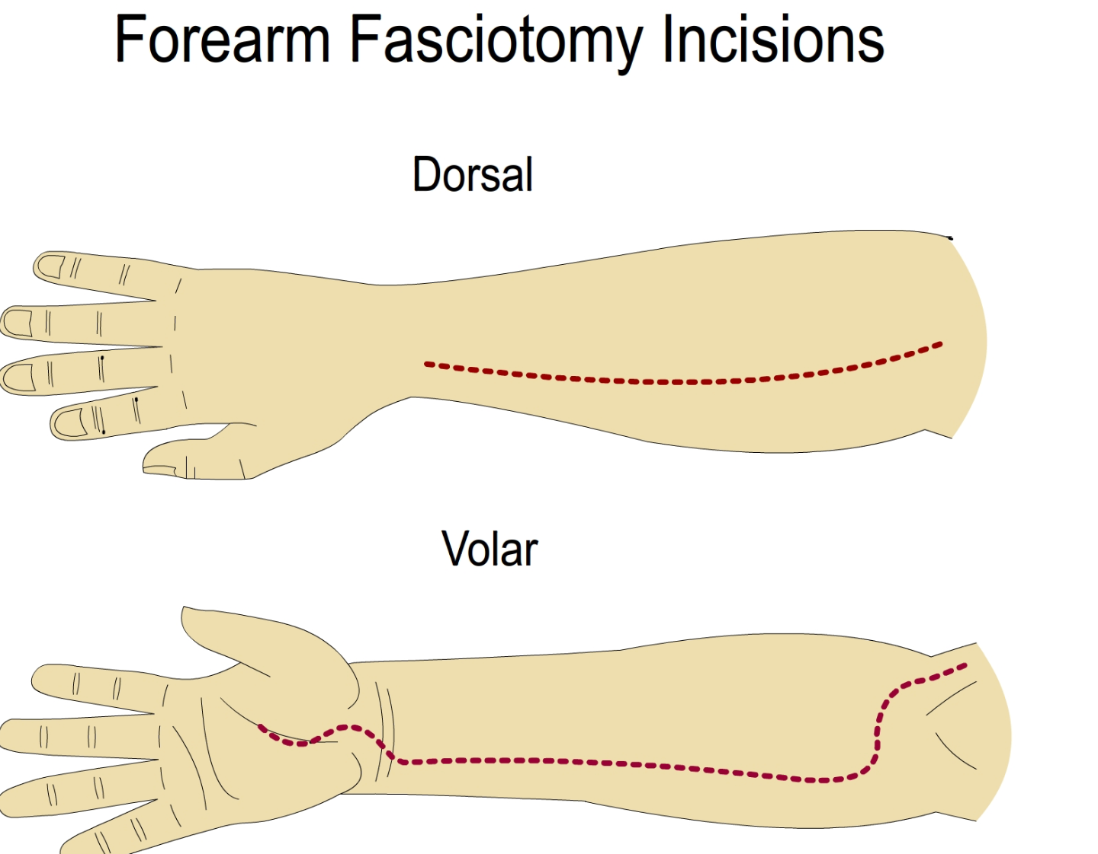

Slide 38
Complications of Fasciotomy
Muscle Weakness
Chronic venous insufficiency
Tethered scars
Impaired sensation
Ulceration
Costs

Slide 39
Consequences of ACS
Ischemic myonecrosis
> Myoglobinuria> kidney tubular damage > acute renal failure
Loss of function of the involved compartment secondary to muscle contracture
Ischemic neuropathy
Paralysis
Loss of sensation
Crush injury
Rhabdomyolysis
Renal failure
Delay in Diagnosis/ Treatment is the cause of a poor outcome

Slide 41
Acute Joint Dislocation
Objectives:
To describe mechanisms of joint stability
To be able diagnose patients with a possible acute joint dislocation
to be able to describe general principles of managing a patient with a dislocated joint
to describe possible complications of joint dislocations in general and in major joints such as the shoulder, hip and knee

Slide 42
Acute Joint Dislocation
Joint stability:
Bony stability
Shape of the joint (ball and socket vs round on flat)
Soft Tissue :
Dynamic stabilizer: Tendons/Muscles
Static stabilizer: Ligaments ± meniscus/labrum
Complex synergy leading to a FUNCTIONAL and STABLE joint

Slide 43
Dislocation Vs Subluxation

Slide 44
Acute Joint Dislocation
It takes higher energy to dislocate a joint with bony stability than a joint with mainly soft tissue stability
Connective tissue disorders may lead to increased joint instability due to abnormal soft tissue stabilizers.
Dislocation of a major joint should lead to considering other injuries.

Slide 45
Acute Joint Dislocation
At risk group:
Major trauma victims
Athletes and sport enthusiasts
Connective tissue disorder patients

Slide 46
Acute Joint Dislocation
When a joint is subjected to sufficient force in certain directions it might sustain a fracture, a dislocation or a fracture dislocation
Different joints have different force victors that may lead to a dislocation
A joint might dislocate in different directions

Slide 47
Acute Joint Dislocation
A joint dislocation is described by stating the location of the distal segment
Anterior shoulder dislocation: anterior displacement of the humeral head relative to the glenoid
Posterior hip dislocation: posterior displacement of the femoral head relative to the acetabulum

Slide 48
Acute Joint Dislocation
Diagnosis:
History of a traumatic event ( major trauma or any trauma with the limb in high risk position)
+++Pain and inability to use the limb
Deformity
Shortening
Malalignment
Malrotation
Neurovascular compromise

Slide 49
Acute Joint Dislocation
Diagnosis:
Should check for other injuries (distracting injury)
Should always check the distal neurovascular status.
Should check for compartment syndrome

Slide 50
Acute Joint Dislocation
Diagnosis:
X-rays:
Should be done urgently without delay if dislocation is suspected
Two perpendicular views of the involved joint
Occasionally, special views are required such as the axillary view for shoulder dislocation
X-rays to the joint above and below

Slide 51
Acute Joint Dislocation
Activate ATLS if high energy trauma or associated with other injuries
Analgesia++
Quick clinical/NV assessment
2 view x-rays
Urgent reduction
Check stability and safety zone
Re-check neurovascular status after reduction
Examine the compartment to R/O CS
Post reduction 2 view X-rays
Immobilize the joint
Consult Orthopaedics

Slide 52
Principles of joint reduction
++ Analgesia (opiod)
+/-IV sedation (to relax the muscles)
Need cardiorespiratory monitoring
Need assistant for help
Gradual traction + counter-traction in the line of deformity to distract the joint
Realignment and rotation to reduce the joint based on direction of dislocation
Check ROM and stability of the joint
Re-check the NV status
Confirm the reduction by 2 view x-rays
Immobilize the joint in the most stable position
Don’t attempt to reduce a fracture dislocation in ER, instead consult the Orthopaedic because patient will need urgent open reduction in OR

Slide 53
Failed reduction in ER
Causes:
Inadequate analgesia/Sedation
Entrapped soft tissue within the joint
Associated fracture
Wrong technique
Associated with significant soft tissue injury for static and dynamic stabilizers
Action:
Urgently consult Orthopaedic surgeon
Patient will need Urgent closed reduction under general anesthesia and possible open reduction if closed reduction fails

Slide 54
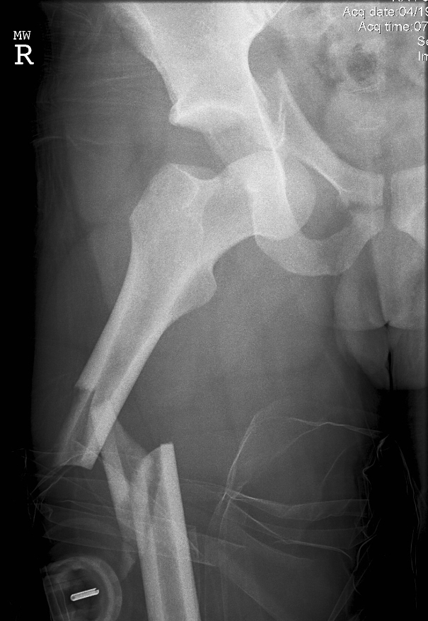
Fracture-Dislocation
A fracture dislocation is usually reduced in an open fashion in the operating room

Slide 55
Sequelae (complications) of acute dislocation
Early
Late
Nerve injury
Chondral (cartilage) injury
Osteochondral fracture
Periarticular fracture
Vascular injury
Ligaments tear
Compartment syndrome
Recurrent dislocation
Instability
Stiffness
Avascular necrosis
Post-traumatic arthritis
Heterotopic ossification

Slide 56
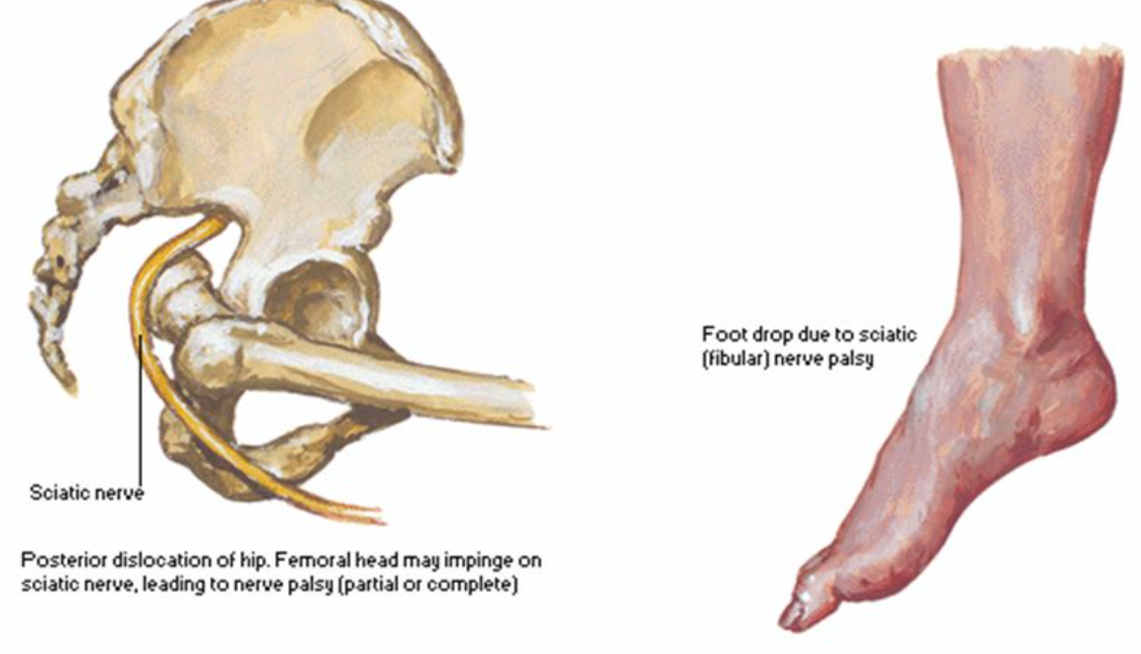
Nerve injury

Slide 57
Vascular injury

Slide 58
Chondral injury
Osteochondral fracture
Hip fracture dislocation
ACL and PCL tear

Slide 59
Sequelae of missed (chronic) dislocated joint
Irreversible (permanent) nerve palsy
Chondrolysis
AVN
Loss of joint function
Stiff joint
Inability to do closed reduction
Post-traumatic arthritis
Poor outcome even after successful open reduction

Slide 60
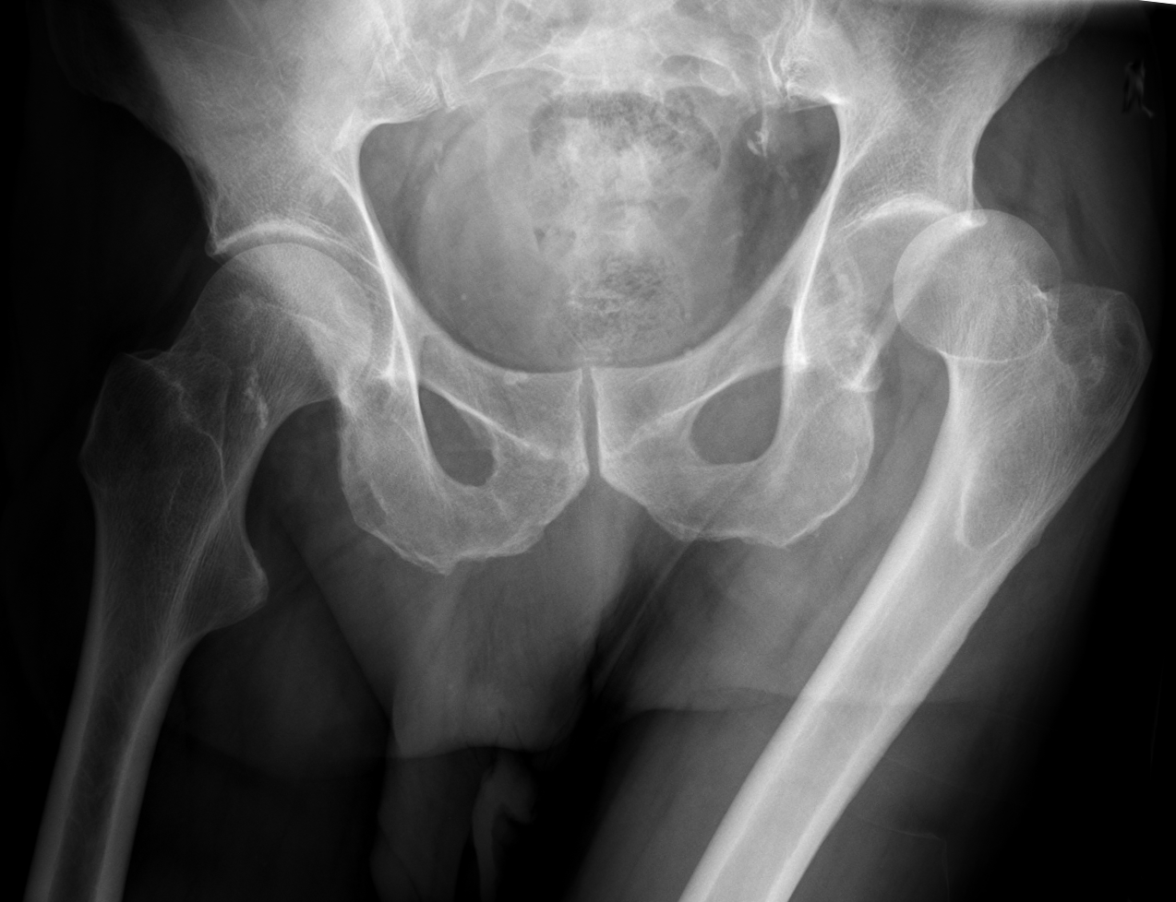
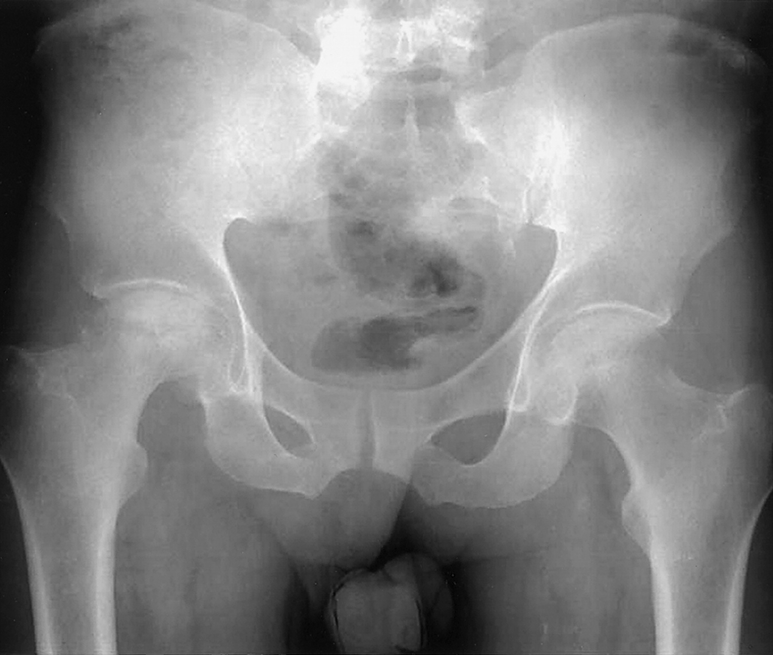
Hip dislocation
Posterior dislocation is commonest
Major trauma with hip flexed (dashboard injury)
Sciatic nerve injury common
High incidence of late avascular necrosis
An orthopedic emergency!!

Slide 61
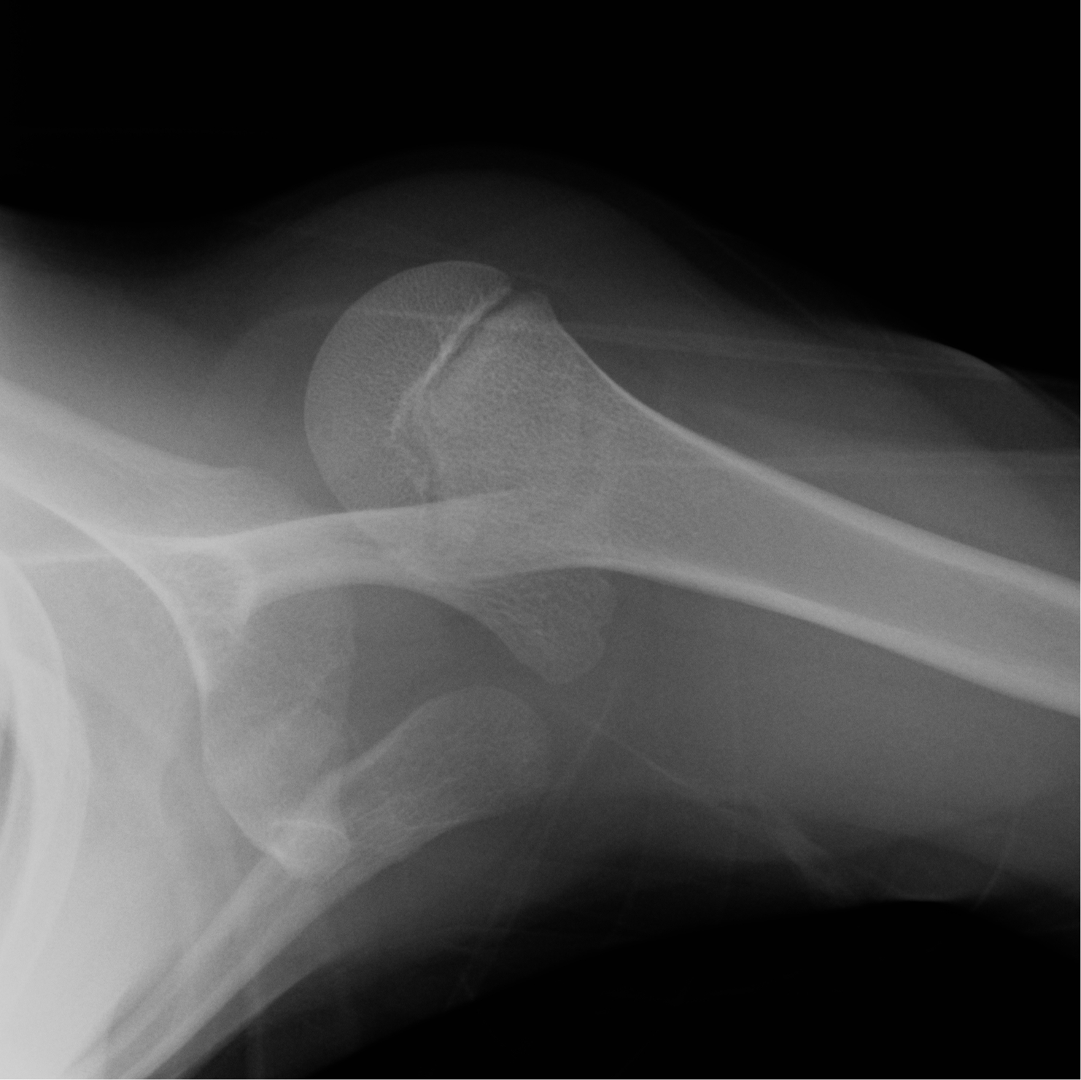
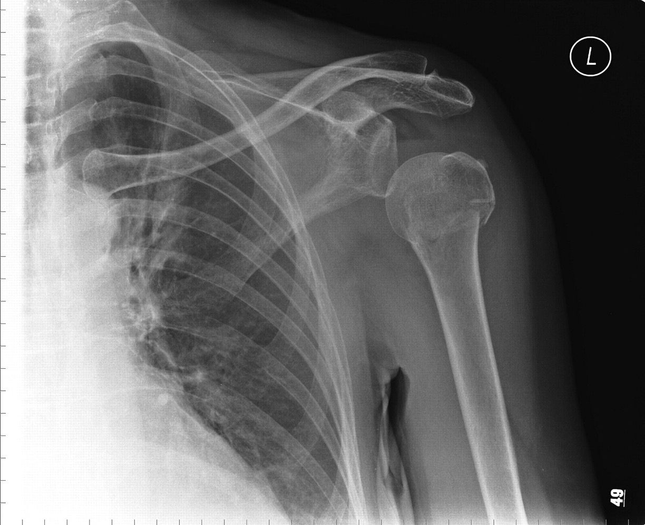
Shoulder Dislocation
Commonest large joint dislocation
Anterior dislocation is more common
Patients with seizures prone to posterior dislocation
May cause chronic instability
Can result in axillary nerve injury

Slide 62
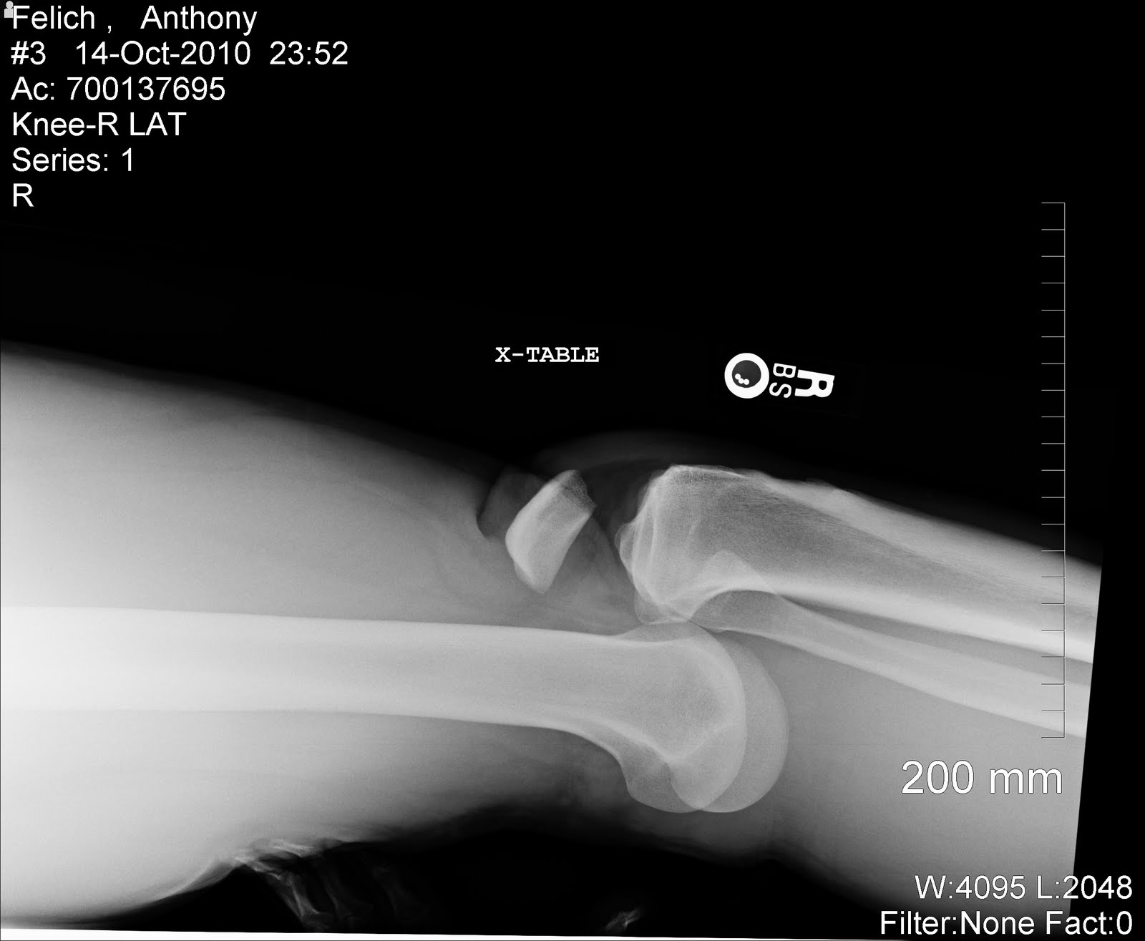
Knee Dislocation
Three or more ligaments
Severe (high energy) trauma
May be associated with popletial artery injury-→ Limb threatening
Very serious emergency
Needs accurate vascular assessment
May be associate with peroneal nerve injury
May be associated with fracture/ compartment syndrome
Most require surgery either early or late or both

