Slide 1
RATIONAL USE OF MEDICATIONS & COMPLIANCE
Dr. Saad M. Al-Saad, MBBS, SBFM, ABFM, CFGM
Assistant Professor & Consultant in Family Medicine, Geriatrics, Public Health
Department of Family and Community Medicine
College of medicine, King Saud University Medical City
Riyadh, KSA
Acknowledgments to Dr.Syed Irfan karim

Slide 2
Why Family Medicine/PHC and Rational Use of Drugs?
Barbara Starfield Study related to the practice of Family Medicine and health outcome indicators’ of a country.

Slide 3
The studies showed relationship b/w more & better primary care & most health outcomes studied.
Evidences shows a positive impact of primary care on prevention of illness & death.
Primary care (in contrast to specialty care) is associated with a more equitable distribution of health in populations.
One primary care physician / 10,000 population.
In US 127,617 deaths /year could be saved by increase in number of primary care physicians.

Slide 4
Is it always Necessary to Prescribe ?
Diagnosis is still in doubt ?
Value of treatment is debatable ?
Combinations & formulations are irrational ?

Slide 5
Why so irrational ?
Increased cost of un-necessary prescription to the health care system.
Harmful prescribing fails to meet acceptable standards.
Chances of poly-pharmacy – effecting vulnerable groups like elderly.

Slide 6
How we can improve prescribing Habits
There is no such thing as
GOOD MEDICINE or BAD MEDICINE
“A good prescribing is the prescribing based on the best available evidence & current guidelines “

Slide 7
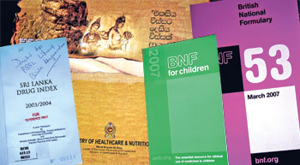
Evidence – Based Prescribing
Failure to do this may:-
Cause patients to suffer unnecessary side effects of ineffective drugs.
Deprive patients the chance to benefit from effective treatments.
Waste valuable resources.

Slide 8
Advantages of Generic
Prescribing
Reduced cost
Professional convenience; everyone knows it
Convenient to the patient
Convenient to the pharmacist

Slide 9
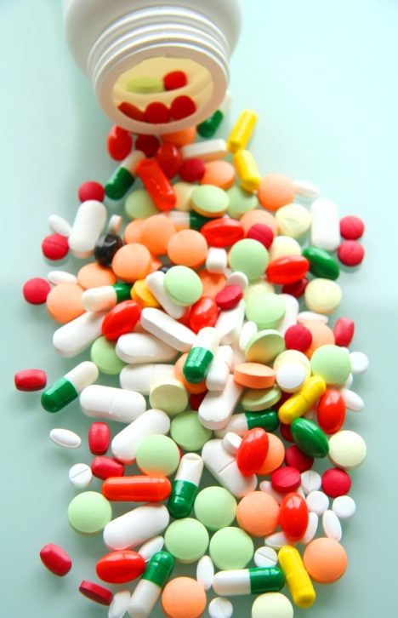
Reason for not Prescribing Generically
Prescribing medicines generically rather than by brand name can improve cost-effectiveness and is encouraged. However, there are some circumstances in which brand-name prescribing is preferred. These include:
Drugs with a low therapeutic index e.g. Lithium, Carbamazepine, Phenytoin (small difference in plasma concentration can be significant)
Modified release formulations, difficult
to standardize e.g. Diltiazem, Nifedipine.
Formulations containing > 2 drugs.
Notes:
Tegretol
Diamicron MR
Glucophage XR
CoAprovel 300/12.5 irbesart/HCTZ

Slide 10
How to prescribe Rationally
Is a drug really required ?
Will it work ?
Will it harm ?
Is it the cost –effective choice ?
Have all alternatives been considered ?
Is the likely risk-benefit ratio acceptable ?

Slide 11
Who is a good prescriber?
One, who ensures that diagnosis is correct.
Makes a positive & correct decision that drug is needed.
Chooses a drug appropriate to patients need.
Who consults patient and ensures his/her informed consent.
Who explains patient’s role and secures his/her
co-operation.
Who terminates treatment when no longer needed.

Slide 12
Social reasons for inappropriate prescribing
Any pressure of pharmaceutical advertising.
Patient’s demand.
Habit , peer group recommendation & ignorance.
To avoid confrontation .
Because of medico legal worries.
To play for time until true picture becomes clearer or natural recovery occurs.
To hasten the conclusion of consultation.
Notes:
Pantoprazol

Slide 13
What is a Placebo medication
A harmless pill, medicine, or procedure prescribed more for the psychological benefit to the patient than for any physiological effect.

Slide 14
Placebo medication
Evidence shows that response can be psychological as well as physiological ;
Conditions that could be helped are . for example:
Anxiety
Depression
Asthma
Headaches
Insomnia
Social problems

Slide 15
Placebo side effects
It has been reported that40% can also experience side effects like ;
Headache
Anorexia
Diarrhea
Dry mouth
Palpitations
Vertigo.

Slide 16
Prevention of Adverse Drug Reactions
Never use a drug unless there is a good indication.
Do not use a drug in pregnancy, unless the need for it is imperative.
Ask if there is H/O allergy/ idiosyncrasy.
Consider possible drug interaction.
Age and hepatic or renal impairment may require much smaller doses.
Notes:
The term idiosyncratic drug reaction denotes an aberrant or bizarre reaction or hypersensitivity to a substance, without connection to the pharmacology of the drug. It is what is known as a Type B reaction. Type B reactions have the following characteristics: They are usually unpredictable, might not be picked up by toxicological screening, not necessarily dose-related, incidence and morbidity low but mortality is high. Type B reactions are most commonly immunological (e.g. penicillin allergy)

Slide 17
Prevention of Adverse Drug Reactions Cont..
Prescribe as few drugs as possible.
Give clear instructions, especially in elderly.
Be particularly alert for adverse reactions or unexpected events, when prescribing new drugs.
Fill the required form in case of suspected adverse reaction.
Warn the patient if serious adverse reactions are liable to occur.

Slide 18
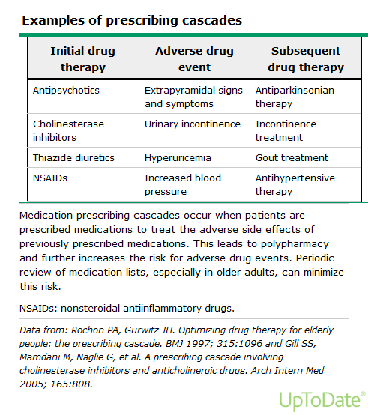
Prescribing cascades
Notes:
When pt prescribed medication to treat adverse side effects of previously prescribed medications this lead to polypharmacy and further increases risk for adverse drug events

Slide 19
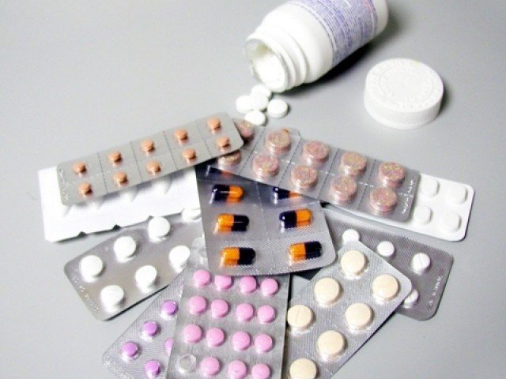
Principles for antibiotic selection
Allow for a number of variables:
H/o allergy / sensitivity
State of renal and hepatic function
Increasing resistance
New information on side effects
Age of patient & duration of therapy
Dosage and route of administration

Slide 20
Principles for antibiotic selection Cont…..
Site, type and severity of infection
Individual response
If female, whether pregnant, breast feeding or on oral contraceptives
Likely organism and antibacterial sensitivity ?

Slide 21
Special Problems in Prescribing
In elderly.
In children.
In hepatic impairment.
In renal impairment.
In pregnancy.
In breast feeding.
In palliative care.
Drug inter-actions.

Slide 22
Prescribing for Elderly
Limit range of drugs.
Reduce dose.
Review regularly.
Simplify regimens.
Explain clearly.
Repeats and disposal.

Slide 23
Prescribing for Children
Special care needed in neonates
Avoid injections if possible
Actions of drugs and their pharmacokinetics may be different than adults
Suitable formulations may not be available for children
Drugs are not extensively tested in children

Slide 24
Prescribing in Hepatic Impairment
Impaired drug metabolism
Hypoproteinaemia
Reduced clotting
Hepatic encephalopathy
Fluid overload
Hepato-toxic drugs

Slide 25
Prescribing in Renal Impairment
A. Reduced renal excretion of a drug
B. Increased sensitivity to some drugs even if elimination is not impaired
C. Many side effects are tolerated poorly
D. Some drugs become ineffective

Slide 26
Prescribing in Pregnancy
Particular care is needed in prescribing for women in child bearing age or men trying to father a child.
First trimester – congenital malformations
Second and third trimester – effect on the growth or the functional status of fetus, including toxic effect on fetal tissues.
Shortly before term or during labour – possible adverse effect on labour or neonate, after delivery.

Slide 27
Prescribing in Breast-feeding
Avoid drugs (if possible) which:
Cause inhibition of sucking reflex (e.g. phenobarbital).
Suppress lactation (e.g. bromocriptine)
Appear in a significant quality in the milk (e.g. fluvastatin).
If not sure, look up at the therapeutic guidelines from a reputable source (e.g. BNF).

Slide 28
Prescribing in Palliative Care
The importance of pain relief and other symptoms are more important than sticking to the usual drugs or dosages.
Oral medications are preferable, if possible.
As few drugs as possible should be prescribed.
4. Doctor – patient relationship is usually more effective than the drug.

Slide 29
Drug Interactions
A Family Physician is not expected to know all the possible drug interactions, but awareness of some important categories is imperative:
Anti-convulsants
Oral contraceptives
Warfarin

Slide 30
Factors Related to Poor Compliance
Purpose of medicine not clear to patient.
Perceived lack of efficacy of medicine.
Real or perceived adverse effects by the patient.
Lack of understanding between the doctor and the patient.
Instructions for administration not clear.
Unpleasant taste.
Complicated regimen – poly-pharmacy.
Physical difficulty in taking medicines.
Medicines too costly.

Slide 31
Compliance/Adherence/Concordance
Compliance: a willingness to follow or consent to the wishes of another person’ Buckman 1997
Adherence: Definition use by NICE 2009: ‘The extent to which the patient’s action matches the agreed recommendations
Concordance The process of prescribing and medicine-taking based on partnership Medicines Partnership
Notes:
Image: http://www.openclipart.org/detail/89911

Slide 32
Compliance/Adherence/Concordance
Compliance
Extent to which patient’s behavior matches recommendations from the prescriber
Adherence
Extent to which the patient’s behavior matches agreed recommendations from the prescriber.
Concordance
Extent to which the patient’s behavior matches agreed recommendations from the prescriber after exploring and discussing the patients beliefs, views and opinions.

Slide 33
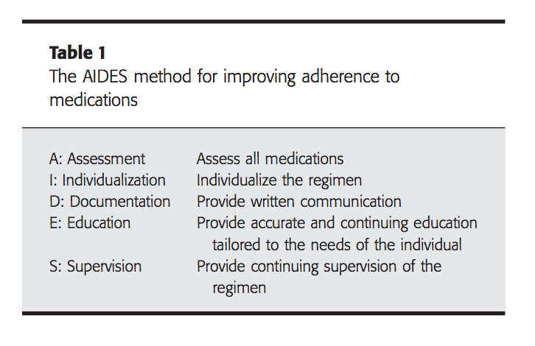
Adherence

Slide 34
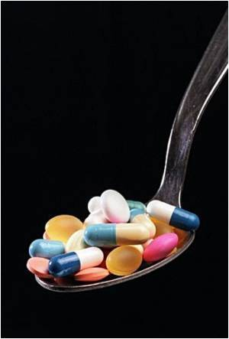
Conclusion
● While prescribing, apply the saying ‘think before you ink’ – by prescribing this drugs are you going to do more harm or more good?
● Factors related to compliance of medications by the patient must be considered.
● Cost-effective and generic prescribing is generally preferable.
● Prescribing in special circumstances requires special attention.

Slide 35
Thank You

