Slide 1


Slide 2
She Wants To Go Home
Ms. Salha suﬀers from a stroke & hemiplegia on the left side received hospitalization.
She has a complicated medical history (DM, CAD,2 coronary stents placed, HTN, Dyslipidemia , Schizophrenia, Major depressive disorder, Neuropathic pain, COPD)
She takes over nine medications.
Despite the stability of the situation still needing long term nursing help , medication management & physiotherapy

Slide 3
He Wants To Go Home
Mr. Ahmed 67 known DM , HTN with severe congestive heart failure for 10 years ago . Suddenly he developed sharp decline in his heart ejection fraction admitted it was decided that the situation is very advanced .. There is no possibility of cure ….

Slide 4
OUTLINE
Why HMC is needed?
Definition of HMC
Goals & Objectives
Procedures & treatments
Types of Staff providing care
Statistics in 2014
How to measure outcomes of HHC ?
New steps in HMC
Next Step

Slide 5
WHY HHC IS NEEDED?
Demographical Changes :
More Elderly Population
Diseases that occur more often in elderly patients
Diseases increase concomitantly as the population ages
Growing elderly population: aged over 65 projected to increase to 12% in 2030 according to
Need More Home Health care

Slide 6
WHY HHC IS NEEDED
Epidemiological Changes:
Less Acute/Infectious Diseases
More Chronic Diseases
Medical advances allow better management of chronic and incurable diseases.
30% of Disabled Need HHC
Need More Home Health care
Sharon etal.Home Care JAMA 2003;290:1203-­‐7

Slide 7
WHY HHC IS NEEDED?
Cost Effectiveness :
Growing Demand for Higher Quality Life.
More widespread availability of high-technology services has resulted in increased hospital cost.
Earlier discharge of hospitalized patients, reducing the length of hospital stays & Need to free occupied beds
Need More Home Health care
Sharon etal.Home Care JAMA 2003;290:1203-­‐7

Slide 8
WHY HHC IS NEEDED?
Patients Choose to Receive Care in Home
…….> Need More Home Health care

Slide 9
WHAT IS HOME CARE (HC)?
DOES IT DIFFER FROM HOME HEALTHCARE (HHC)?

Slide 10
HOME CARE refers to any type of care (medical or non-‐medical) that is provided for the client in their home (companionship/ homemaking services and personal care services)
“Home Health care“ refers to the provision of skilled nursing care and other care such as speech, physical or respiratory therapy

Slide 11
WHAT DO WE MEAN BY “HOME HEALTH CARE”
Any Therapeutic, Diagnostic or Social support service provided in at an individual’s Home
  Sharon etal. Home Care. JAMA 2003;290:1203-­‐

Slide 12
Home Health Care
HHC Improve Health Care ; Is Their Any Evidence ?

Slide 13
Home Health Care: Leads to Improve Medical Care
Clinical outcome majors:
• Studies suggest that home visits can lead to improved medical care through the discovery of unmet health care needs.
• One study found that home assessment of elderly patients with relatively good health status and function resulted in the detection of an average of four new medical problems and up to eight new intervention recommendations per patient.
• Study showed that use of the specialist home care nurses lead to 65% reduction in hospitalization of patients .
Smigelski CW, Hungate B, Boling PA.Transitional model of care: Bridging inpatient to outpatient care [abstract P518]. J Am Geriatr Soc 2004;52:4(suppl):S194. Susan Louisa Montauk. Home Health Care. American Academy of Family Physicians 1998 Nov 1;58(7).

Slide 14
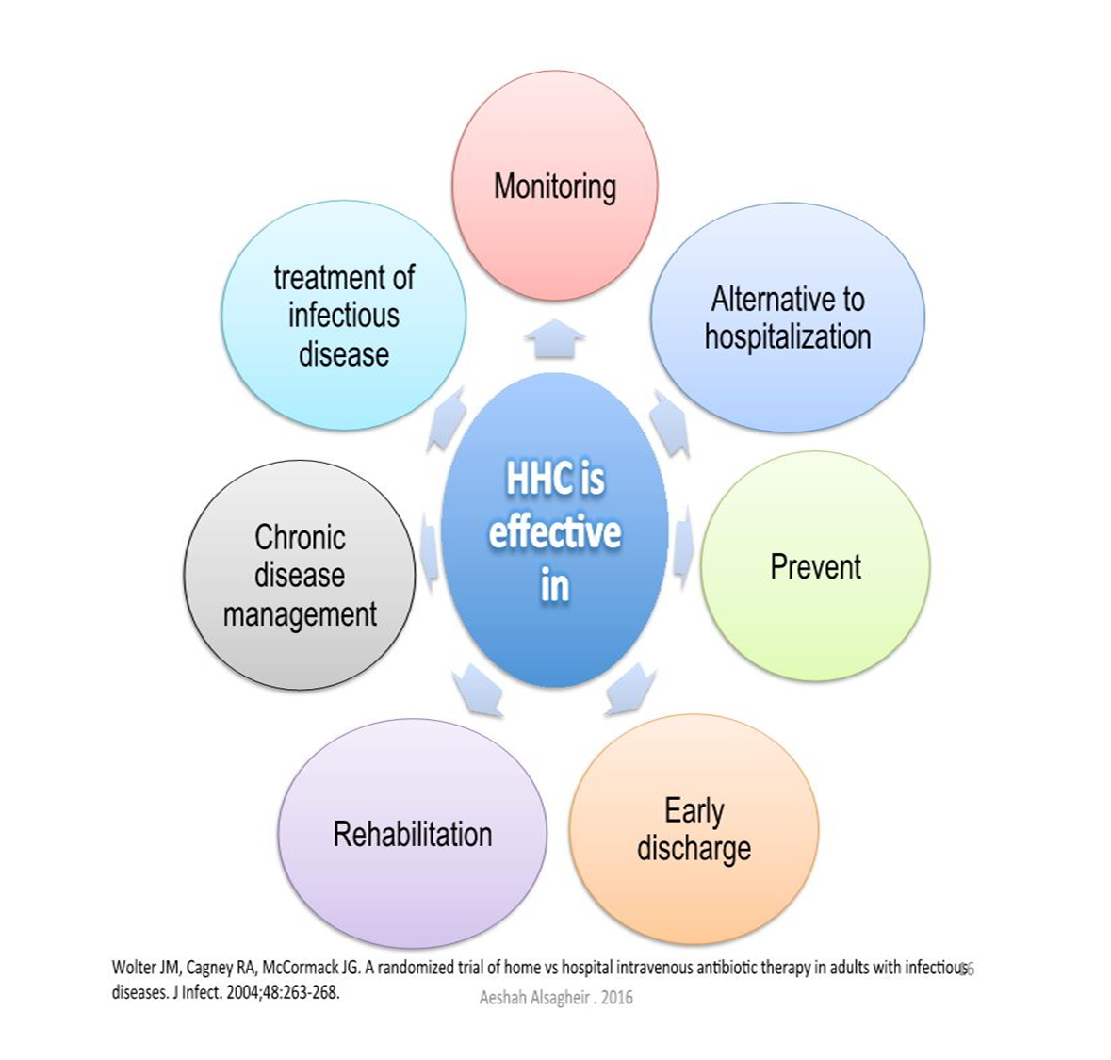

Slide 15
Home Health Care : Lead To Improve Medical Care
Cost Effectiveness :
An Economic Evaluation of Home Care Results From RCT showed that Using home care to reduce hospital stays improved the health outcomes without significantly increasing social costs.
European study showed that HHC lead to 38% decrease in cost
Dougherty, Geoffrey E. MD, MSc, FRCP(C) *; Soderstrom, Lee PhD +; Schiffrin, Alicia MD. Medical Care. 36(4): 586-598, April 1998. Hernandez C, Casas A, Escarrabill J, et al.
Dr. Al-Dahi study in 2007 showed 65% in secondary care & 56%in long stay rehabilitation care cost by using HHC.
Home hospitalisation of exacerbated chronic obstructive pulmonary disease patients. Eur Respir J 2003;21(1):58-67.

Slide 16
HMC VISION
Provide HMC services for all regions & provinces in SA according to the international quality standards

Slide 17
HMC MISSION
Provide the best types of constant & comprehensive health care for the patient at his home, within the framework of Islamic values & traditions of the society using the latest technologies

Slide 18
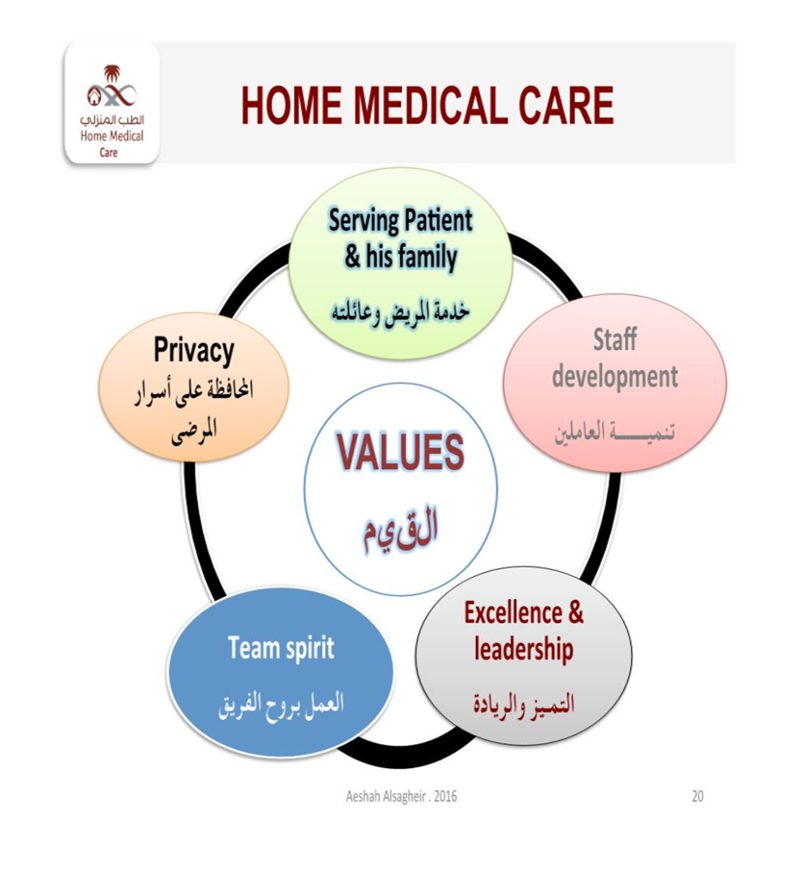

Slide 19
GOALS and OBJECTIVES
• Enhance patient’s quality of life
• ↓the need for unnecessary & prolonged hospitalization
• Prevent readmission to the hospital & ER visits.
• Support patient to be more independent at home.
• Provide equipment & consumables to patient family

Slide 20
GOALS AND OBJECTIVES
Promote healthy lifestyle & provide health education to patients & families.
Ensure safety while taking medication at home.
Improve patient compliance to their medications.
Check appropriateness of chronic medications

Slide 21
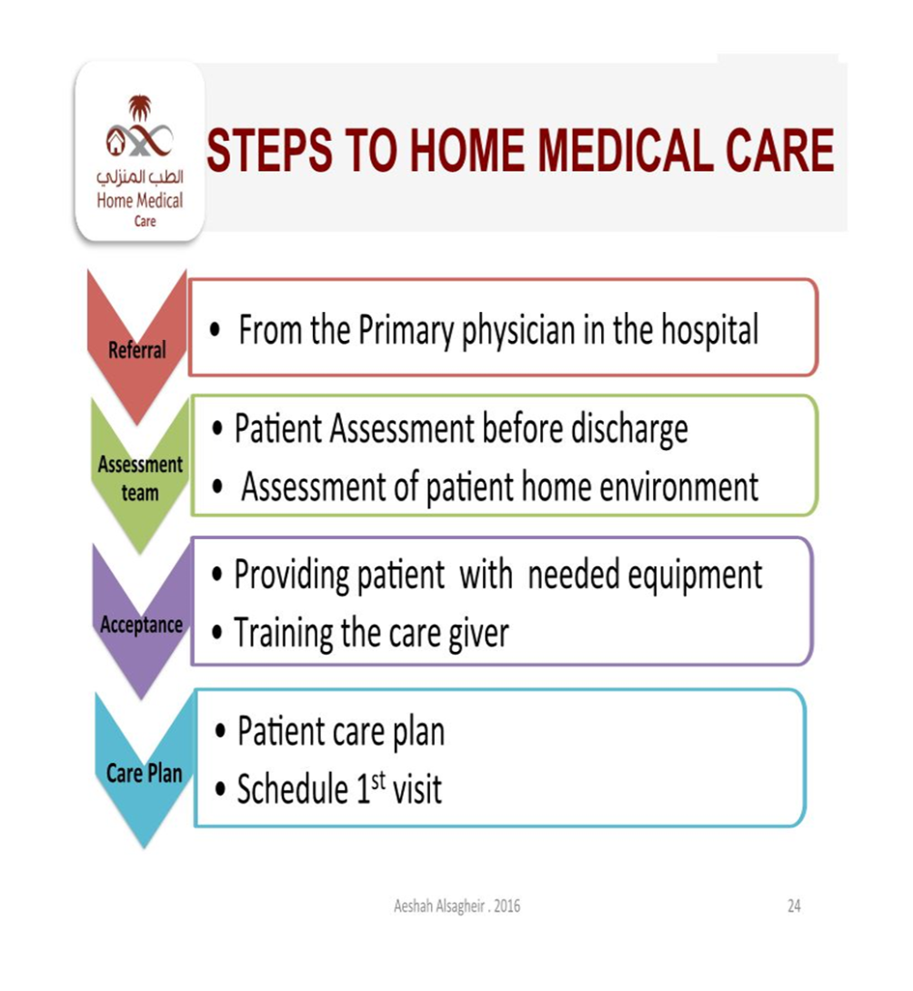

Slide 22
CONDITIONS WHICH BENEFITED FROM HHC
BED SORES
IMMOBILITY
NASOGASTRIC TUBE RELATED COMPLICATIONS
CHEST SECRETIONS RELATED COMPLICATIONS
FOLEYS CATHETER RELATED COMPLICATIONS
GASTROSTOMY TUBE CARE
SUPRAPUBIC CATHETER CARE

Slide 23
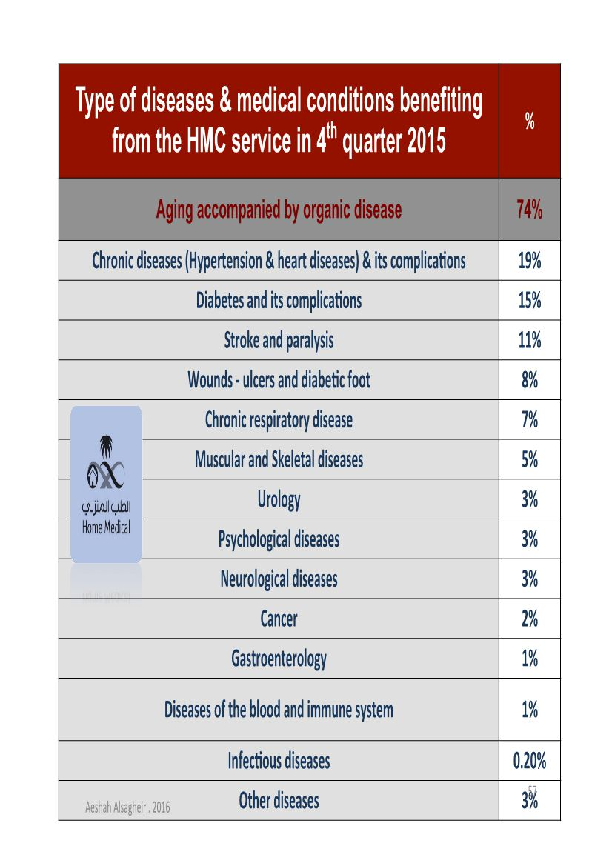

Slide 24

KSUMC-HHC Program

Slide 25
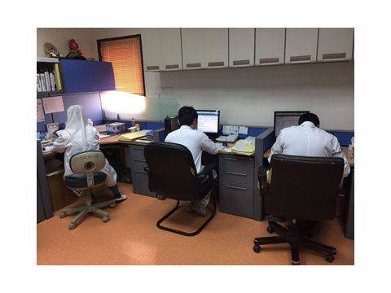
KSUMC-HHC
3 years in the service.
HHC Unit location – 2nd floor, OPD building
Reports to Medical Admin. office

Slide 26
HHC Unit
Head of the Unit/administration
Office development/case manager
Physicians
Nursing staff
Physiotherapists
Other supporting services: SW, Dietician

Slide 27
HHC statistics 2016
Total of enrolled patients: > 220
Number of HHC visit/2016: > 2000
Died, denied service, and discharged: 48
Number of urgent visits : 70

Slide 28
HHC Services
HHC serves all KSU staff and their dependents in Riyadh City.
Received referrals from Inpatient, OPD and from the community.
Integrated with eSiHi system

Slide 29


Slide 30
Home Health Care
Assessment Care Team:
A- Physician ( Team leader )
B- Nurse
C- Social worker

Slide 31
OTHER TEAM MEMBERS
Physiotherapy
Dietician
Respiratory therapist
Family caregiver

Slide 32

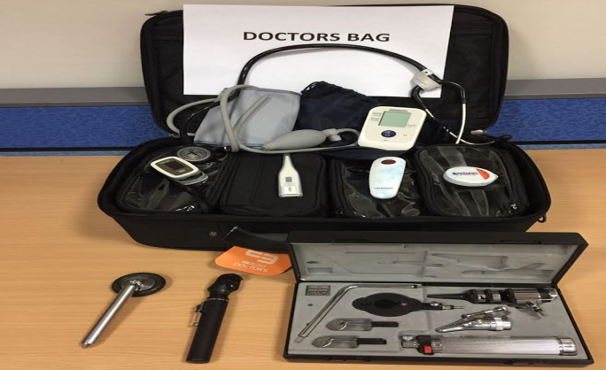
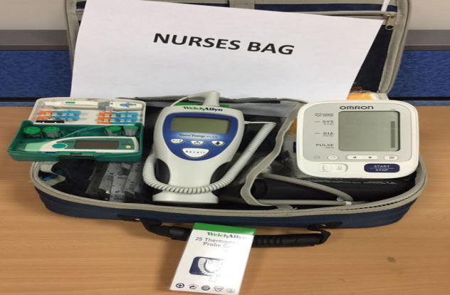
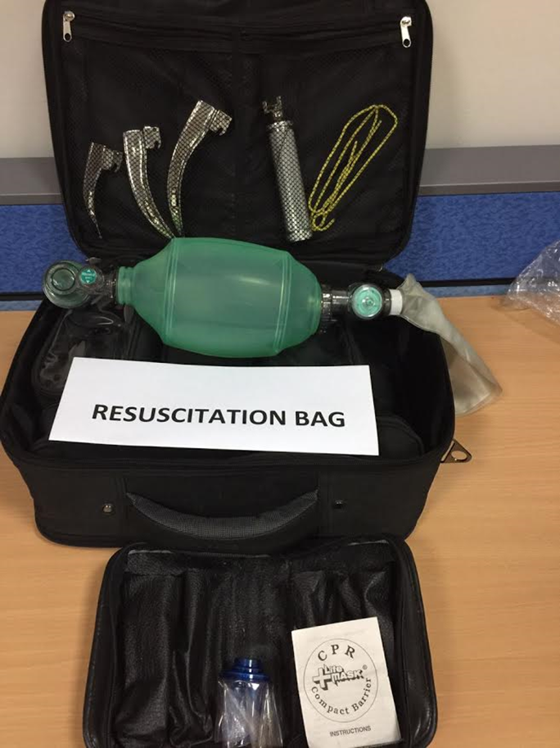
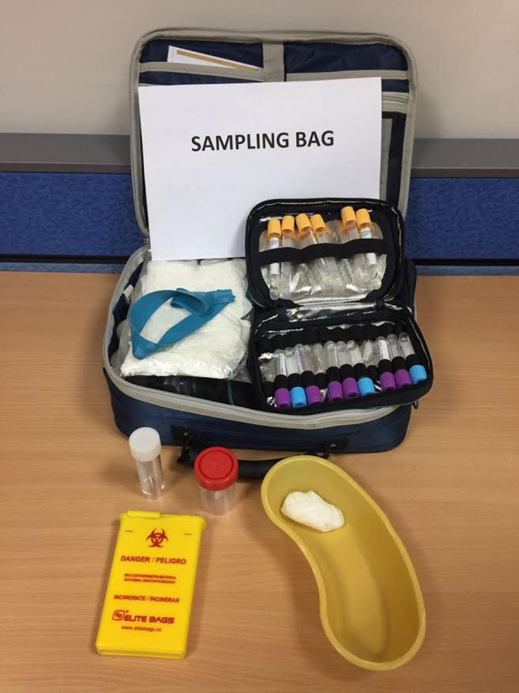
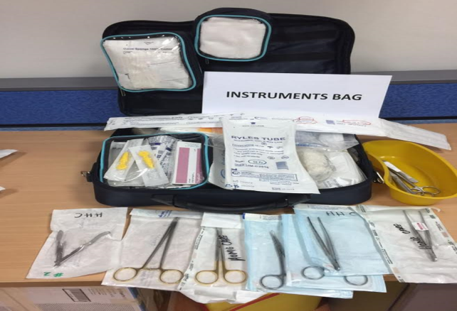
Two HHC Teams going daily to the field.

Slide 33


Slide 34
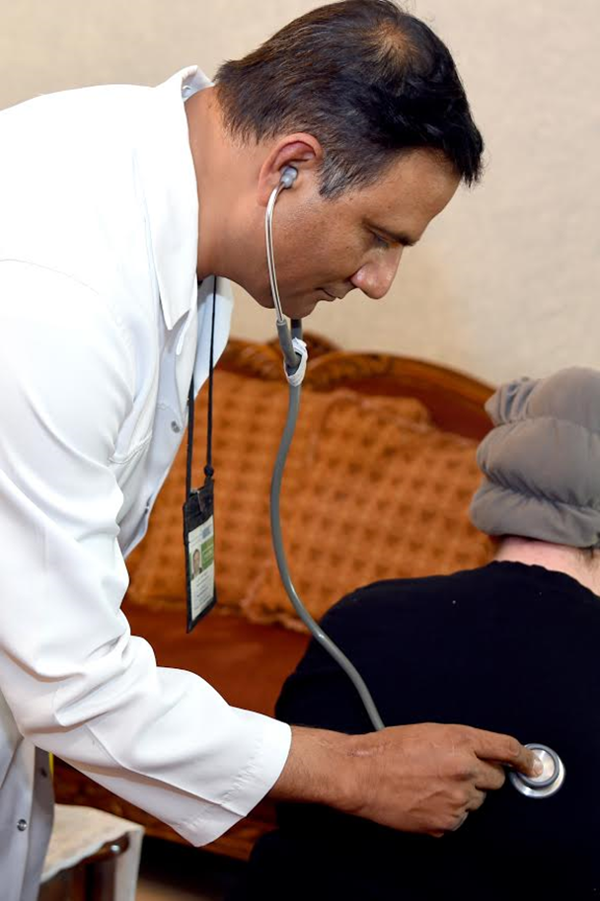
Services provided by HHC
- Medical: Chronic Disease Management: DM,HTN,DLD, BPSD, Ostop.,PD, Fragility
Pain management
Wound Care: Debridement, dressing, wound treatment.
Procedures: NGT, Foleys cath, pot-op care
Polypharmcy management

Slide 35
HHC services
ED admission.
Laboratory investigations: Sampling and transfer
Medication delivery
Equipments & Personal supply: Chairs, beds, mattress, CPAP, O2 nebs, personal care materials

Slide 36

How frequent
Depends on the patient’s condition.
Routine Average of
5 patients per round (Am/pm)
Urgent call visit.
- Physician phone consultations.

Slide 37
Eligible patients for HHC

Slide 38
PATIENT & ASSESSMENT
In the hospital upon referral Patient is done
Medical assessment
Socio-economic assessment
Caregiver assessment
Environmental assessment

Slide 39
How to access the HHC service
Esihi Referral
Submitting KSU staff evidence
Medial report
Consent signature
Nursing acuity level submission
NOK contacts/Home location

Slide 40
HMC Services started from hospitals
Criteria for acceptance
Referral from the physician in the hospital
Coverage area ??
Stable medical condition
Approval of home owner
Appropriate home environment
Capable care giver

Slide 41
Home Health Care
Patient Assessment
Patient evaluation in the hospital prior to discharge to ascertain that HHC can offer the services & medical equipment needed by the patient in the home situation.
Have a patient management plan in place, ensuring continuation of medical services

Slide 42
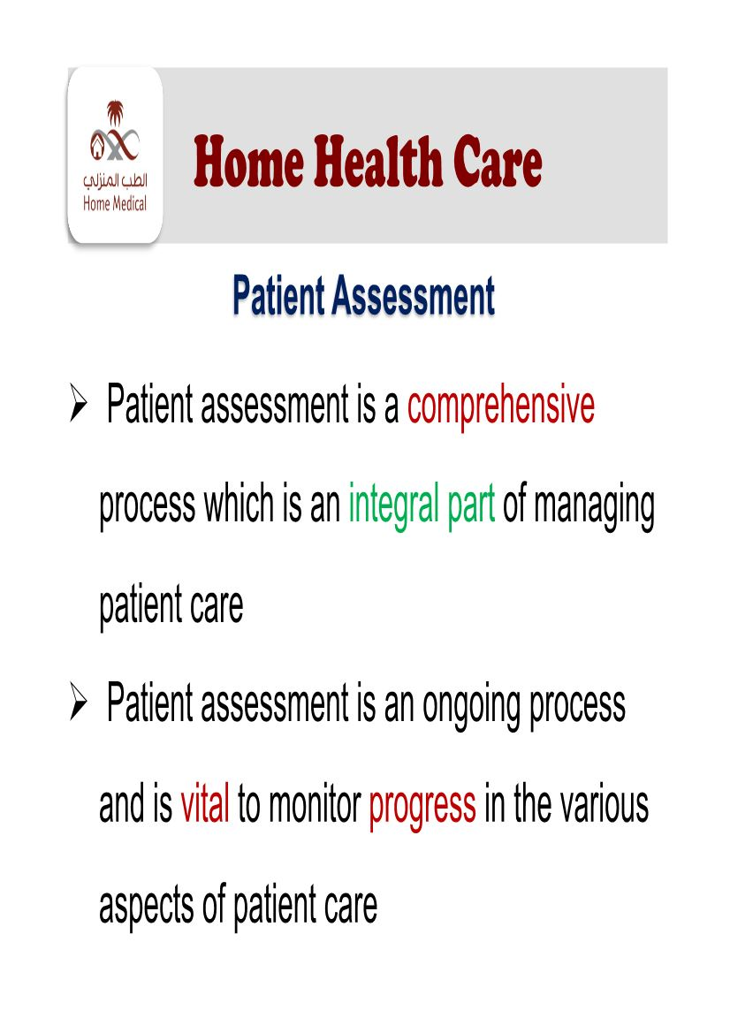

Slide 43
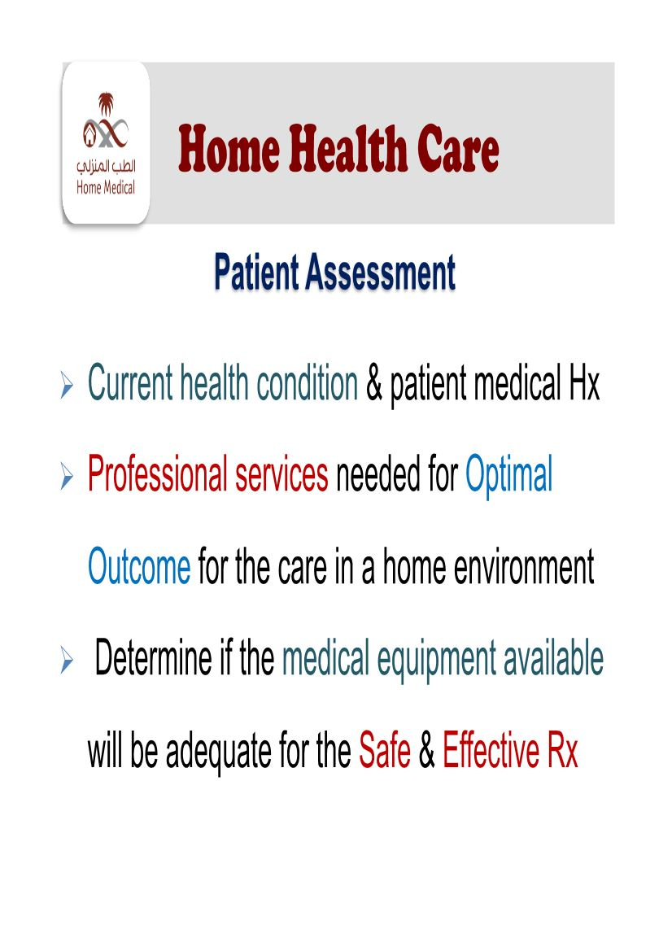

Slide 44
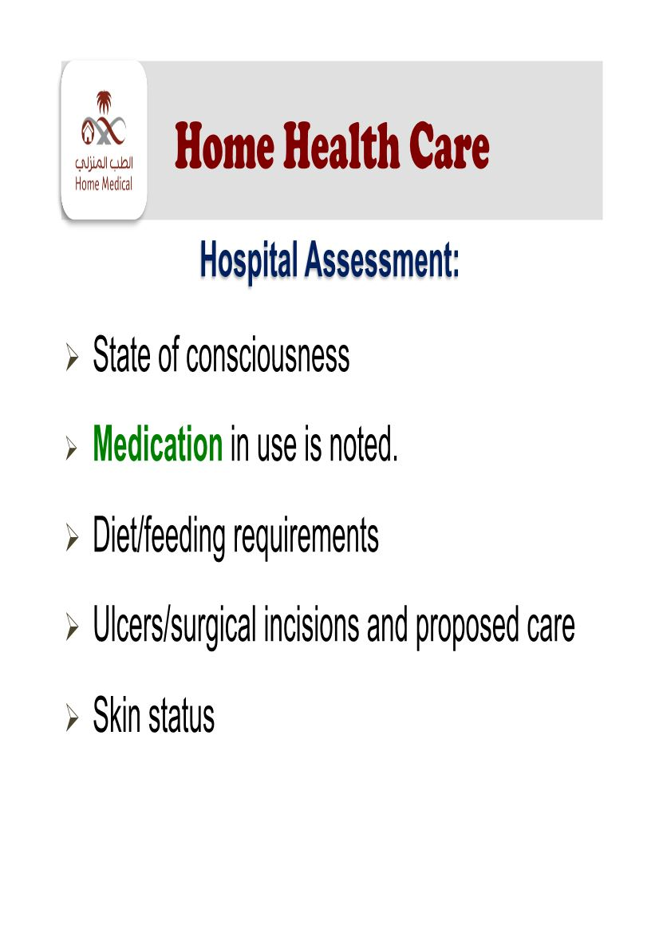

Slide 45
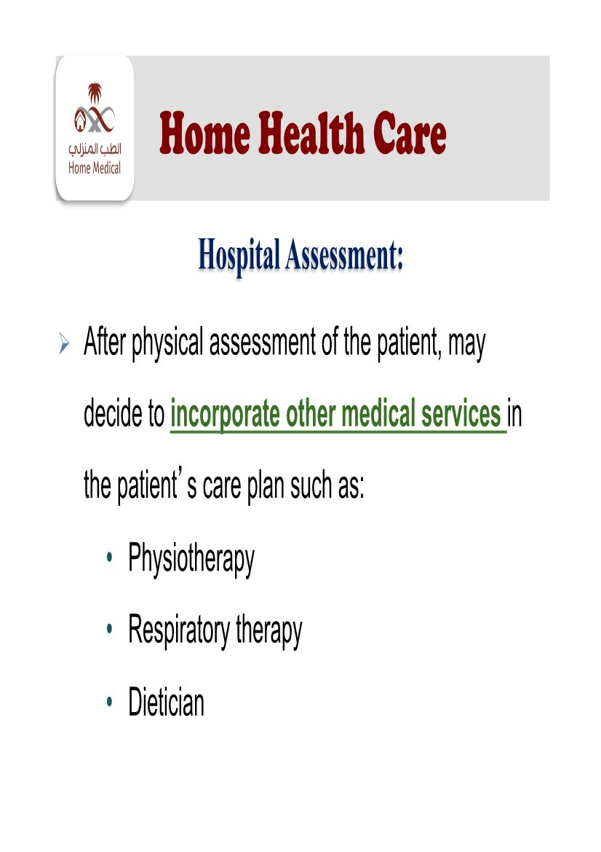

Slide 46
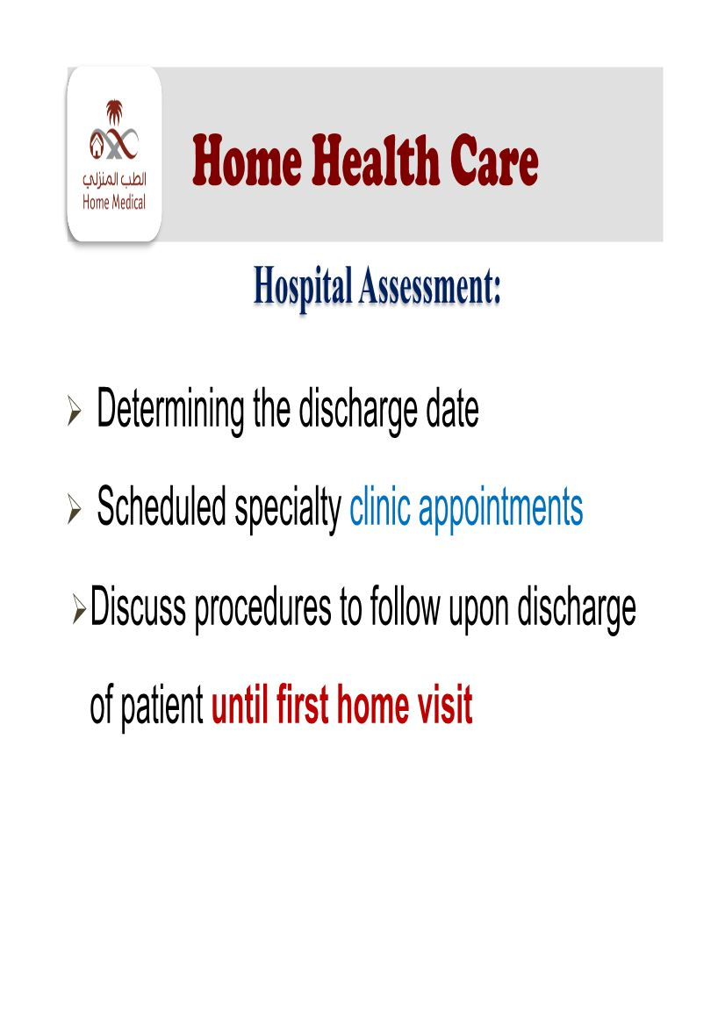

Slide 47
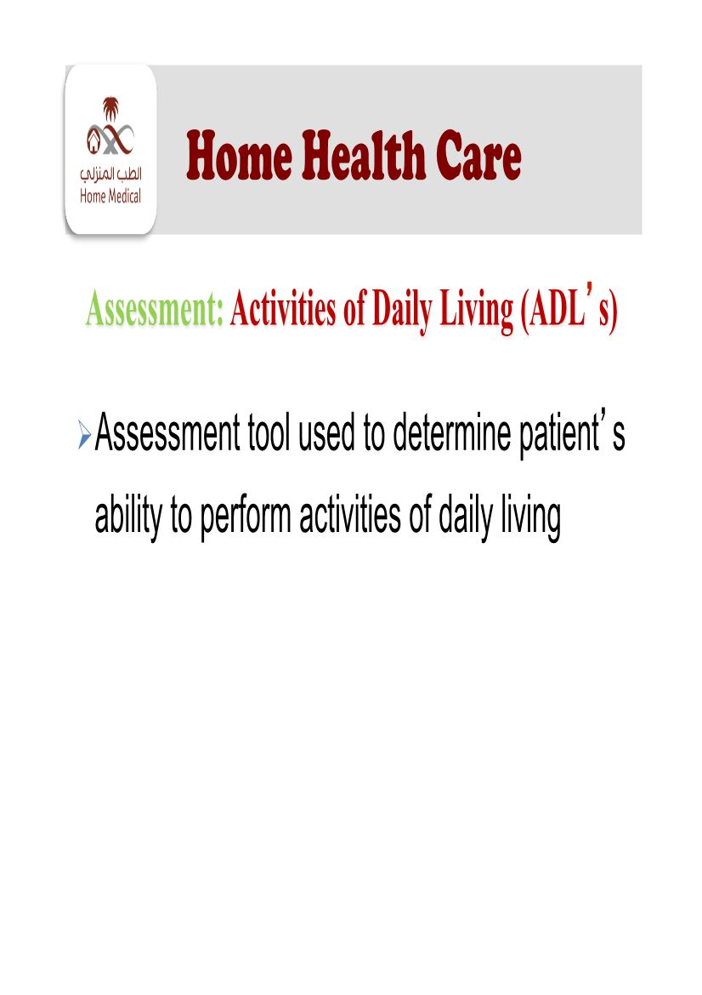

Slide 48


Slide 49


Slide 50
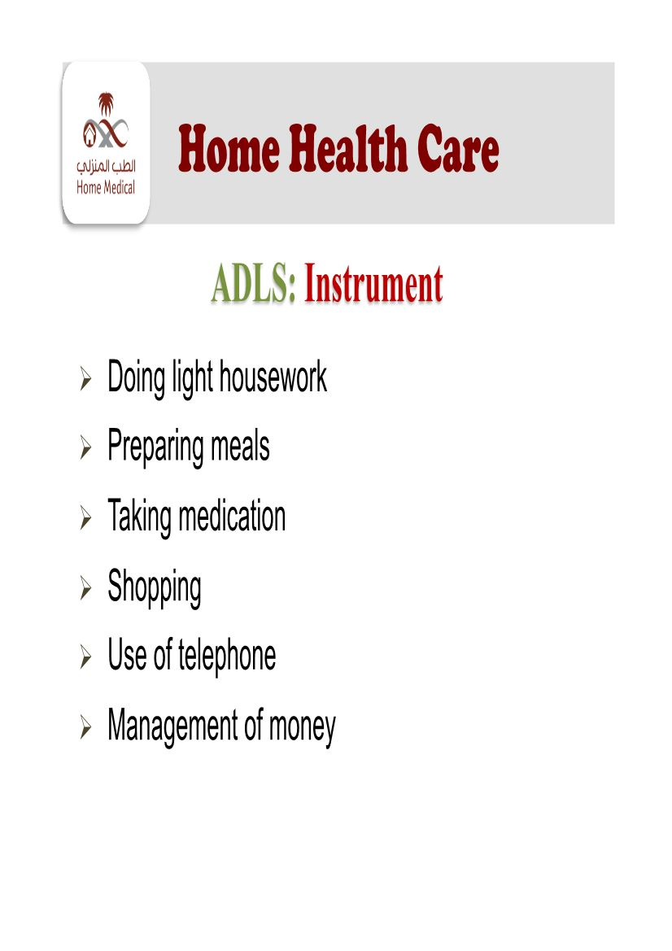

Slide 51
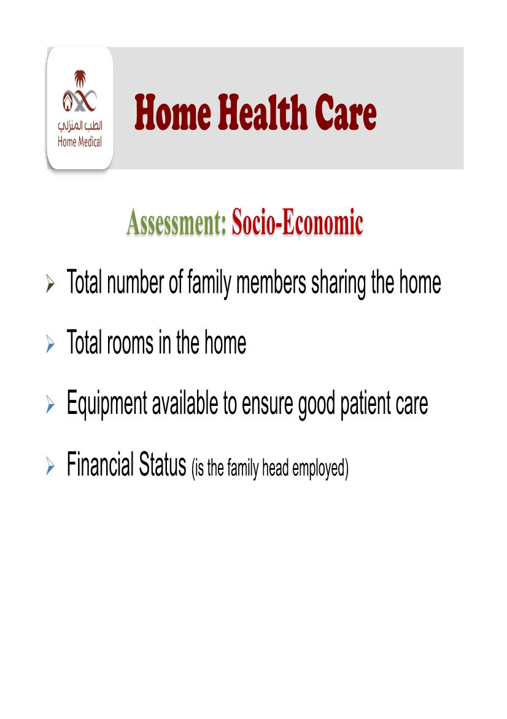

Slide 52
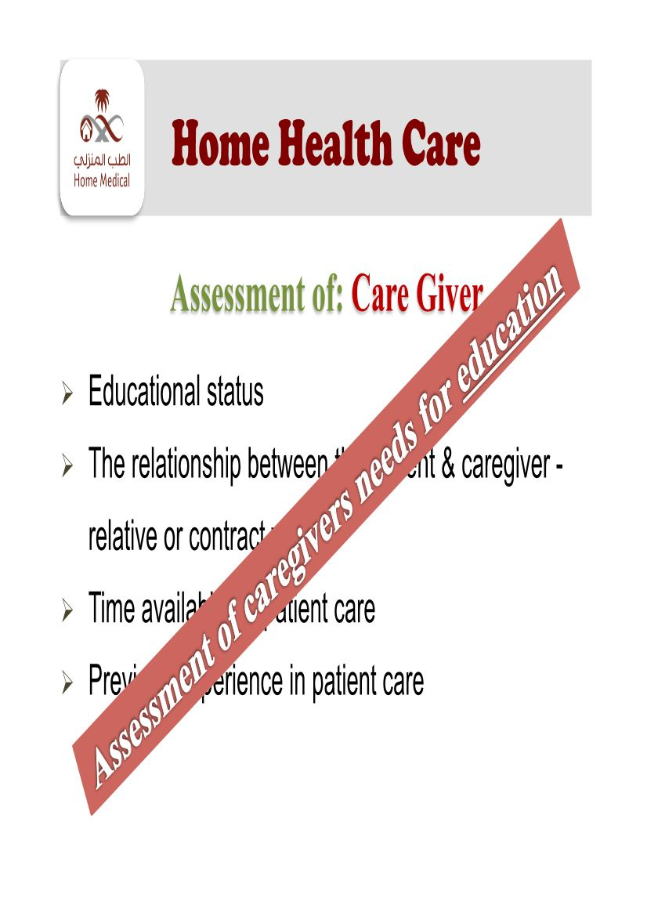

Slide 53


Slide 54
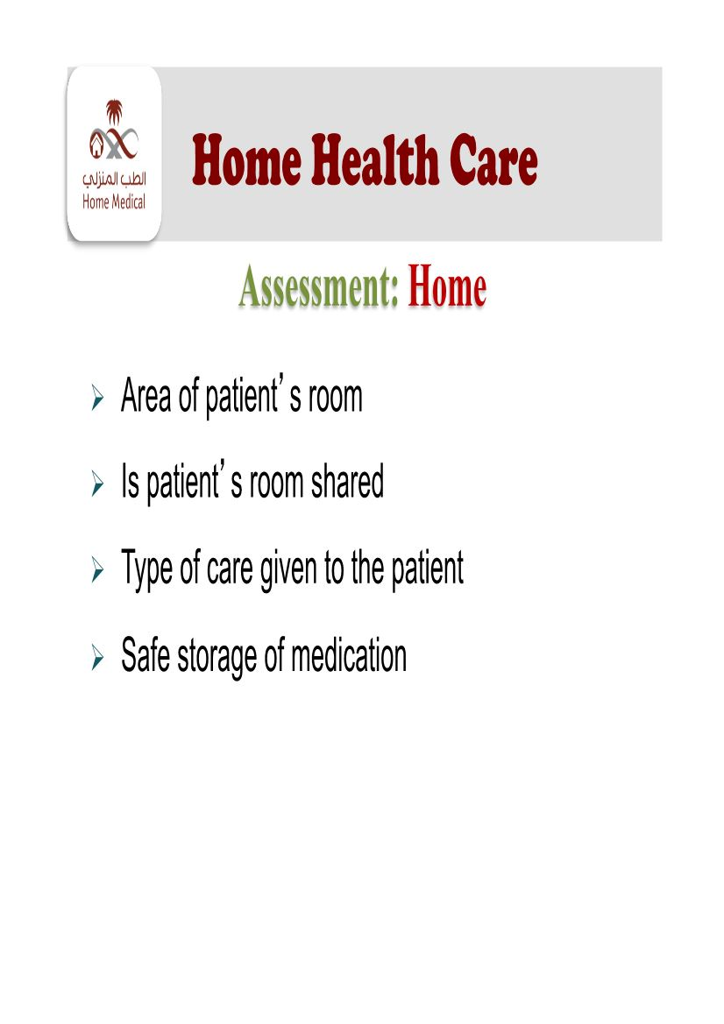

Slide 55


Slide 56


Slide 57
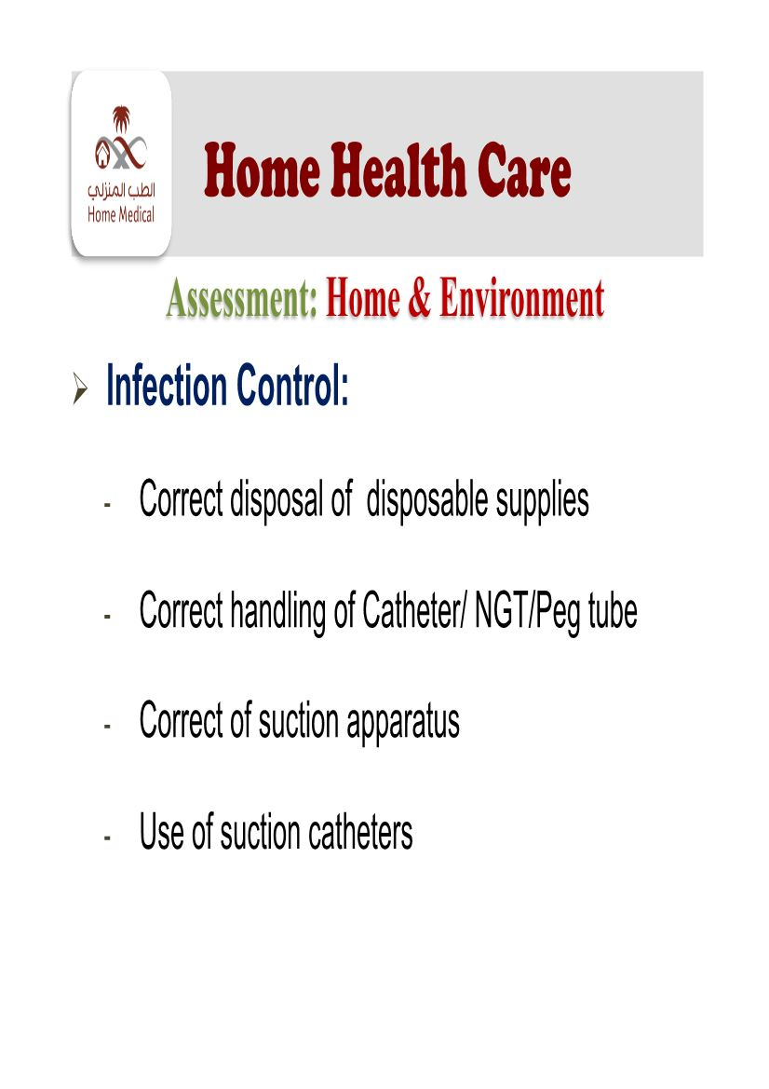

Slide 58
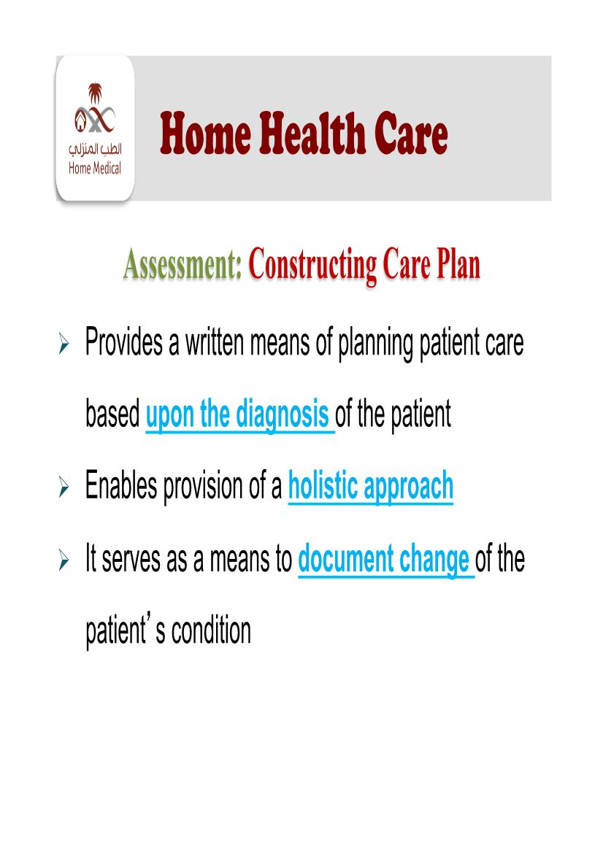

Slide 59
Home Medical Care
What are the Services Provided By Home Medical Care ?

Slide 60
PROCEDURES & TREATMENTS
Including but not limited to
Wound Care and Dressing
Nursing CARE
Chest Physiotherapy
Medication management
Indwelling urinary catheter insertion & care
Ostomy And Ileostomy care
Insertion of nasogastric tube , care and feeding
PEG care, feeding

Slide 61
Home Health Care
Outcomes
4 major outcomes measurement in which HHC agencies must demonstrate ability to document success:
☻ Cost
☻ Clinical
☻ Functional status
☻ Patient satisfaction
Moran NY. Malone MP . Utilizing patient satisfaction to meet the challenges of managed health care . Home health outcomes and resource utilization : integrating today's critical priorities.1997.p.1--‐19.

Slide 63
☺ Study shows that the client reported high level of satisfaction for the element of:
Respect
Attention to concerns
Consistency
Helpfulness
Dependability of staff
Feeling safe
Staff knowledge of health problem
Hamadi AL Refai. Client's Characteristics and Satisfaction Towards Services Provided by The Home health Care Center In AL
Madina AL Munwra.2008

Slide 64
HOME MEDICAL CARE
Future direction of HMC
The face of HHC will change
– Telemedicine- RAHA@KSU
– Electronic Medical Records-Remote access.
– Respiratory Home Care and Home hemodialysis
-Specialized HHC: Palliative and Post-OP patients

Slide 65
Thank You

