Slide 1
Diabetes Mellitus
Dr Mohammed Batais
Assistant Professor & Consultant , Family Medicine, Diabetes and Chronic Disease Management
King Saud University

Slide 2
Genetic predisposition
Insulin Resistance
(Hyperinsulinemia)
β Cell
Defect
IGT
Type 2 Diabetes
Usually 50% of β cells are functioning at time of diagnosis

Slide 4
CLASSIFICATION
Type 1 diabetes (absolute insulin deficiency)
Type 2 diabetes (insulin resistance with relative insulin def.)
Gestational diabetes mellitus
Other types (genetic or secondary types)

Slide 5
Prevalence of DM in Saudi Arabia
A community based study of 17232 subjects conducted between 1995 and 2000 in KSA.
The examining age group, 30-70 years of selected households during 5-year period
Mansour M. Al-Nozha et al,The prevalence of CAD among Saudis of both sexes, in rural as well as urban communities, as well as modifiable risk factors for CAD, Saudi Medical Journal 2004; Vol. 25 (9): 1165-1171

Slide 6
Prevalence of DM in Saudi Arabia
The overall prevalence of DM obtained from this study is 23.7% in KSA.
The prevalence in males and females were 26.2% and 21.5% respectively (p<0.00001).
A large number of diabetics 1116 (27.9%) were unaware of having DM.
Mansour M. Al-Nozha et al,The prevalence of CAD among Saudis of both sexes, in rural as well as urban communities, as well as modifiable risk factors for CAD. Saudi Medical Journal 2004; Vol. 25 (9): 1165-1171

Slide 7
Diagnosis

Slide 8
Prediabetes

Slide 9
Screening for diabetes

Slide 10
Prediabetes
Persons with an A1C of 5.7–6.4%, IGT, or IFG should be counseled on lifestyle changes.
Three large studies of lifestyle intervention has shown sustained reduction in the rate of conversion to type 2 diabetes,
43% reduction at 20 years in the Da Qing study.
43% reduction at 7 years in the Finnish Diabetes Prevention Study (FDPS).
34% reduction at 10 years in the U.S. Diabetes Prevention Program Study (DPPS) .
A consensus panel felt that Metformin should be the choice of drug considered .

Slide 11
When to add Metformin in pre-diabetes?
In addition to lifestyle counseling, Metformin is considered in IFG plus:
Hypertension
Low HDL cholesterol
Elevated triglycerides
Family history of diabetes (first-degree relative)
Obese
HX of GDM
Under 60 years of age

Slide 13
Approach to Management
Diabetes management is a team work
Individualize management
Set Target goals
Glycaemic Targets
BP goals
Lipid goals
Education
Is associated with increased use of primary and preventive services and lower use of acute, inpatient hospital services.

Slide 14
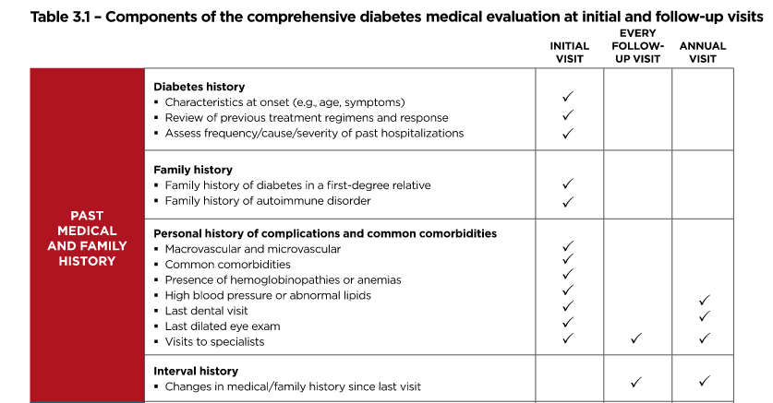

Slide 15
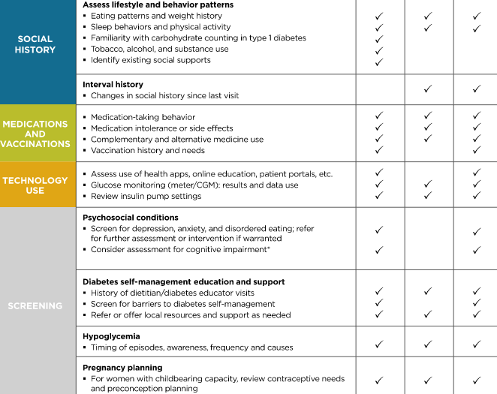

Slide 16
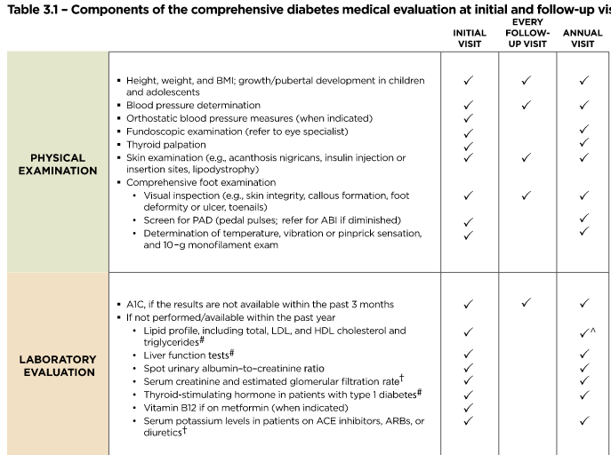

Slide 17
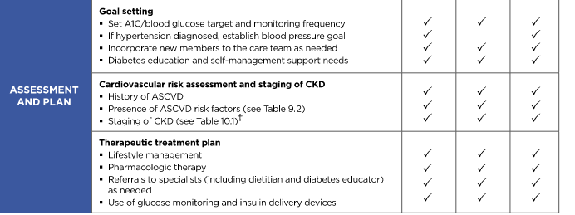

Slide 18
Current Treatment Goals for Glycaemic Control
 | ADA¹ | ACE²
HbA1c | < 7.0% (general goal) | ≤ 6.5%
Preprandial plasma glucose | 70–130 mg/dL (3.9–7.2 mmol/L) | < 110 mg/dL (< 6.1 mmol/L)
Postprandial plasma glucose | < 180 mg/dL (< 10.0 mmol/L) | < 140 mg/dL (< 7.8 mmol/L)
ACE=American College of Endocrinology; ADA=American Diabetes Association; HbA1c=hemoglobin A1c;
Adapted from: ¹ADA / EASD consensus statement: Nathan DM, et al. Diabetes Care. 32:193–203;
²American Association of Clinical Endocrinologists, American College of Endocrinology. Endocr Pract. 2002; 8 (Suppl 1): 5–11;
Notes:
18
Current Treatment Goals for Glycemic Control
This slide reviews the treatment guidelines for diabetes recommended by the American Diabetes Association (ADA), the American College of Endocrinology (ACE), and the International Diabetes Federation (IDF).
In terms of HbA1c, the ADA recommends a goal of <7.0%¹. The ADA / European Association for the Study of Diabetes consensus guidelines point out that this goal is not appropriate or practical for some patients, and clinical judgment based on the potential benefits of and risks for a more intensified regimen needs to be applied for every patient. Factors such as life expectancy, risk for hypoglycemia, and the presence of cardiovascular disease need to be considered for every patient before intensifying the therapeutic regimen¹.
In contrast, ACE and IDF recommend a goal of <6.5% for all patients (ACE: upper limit of normal = 6.0%). Both groups base their recommendation on the epidemiologic analysis of the UK Prospective Diabetes Study data² which showed that the risk for both microvascular and macrovascular complications of diabetes increased at HbA1c values ≥6.5%.^{3,4}
For preprandial glucose, the ADA recommends a therapeutic target of 5.0–7.2 mmol/L (90–130 mg/dL), whereas ACE and IDF suggest using <6.0 mmol/L (<110 mg/dL) as the target.^{1,3–4}
The ADA and IDF recommend that patients test their postprandial glucose (PPG) levels 1–2 hours after a meal. The ADA advises that PPG values not exceed a peak value of 10.0 mmol/L (180 mg/dL), while the IDF recommends <8.0 mmol/L (<145 mg/dL).^{1,4} ACE suggests that PPG measurements be taken 2 hours after a meal and that the value should be <7.7 mmol/L (<140 mg/dL).³ ACE and IDF base their recommendations on the increased cardiovascular risk associated with glucose values above these levels, as well as the fact that in the nondiabetic population, PPG levels rarely exceed 7.7 mmol/L (140 mg/dL).^{3,4}
References
Nathan DM, et al. Medical management of hyperglycemia in type 2 diabetes: a consensus algorithm for the initiation and adjustment of therapy. Diabetes Care. 2009; 32:193–203.
Stratton IM, et al. Association of glycaemia with macrovascular and microvascular complications of type 2 diabetes (UKPDS 35): prospective observational study. BMJ. 2000; 321: 405–412.
American Association of Clinical Endocrinologists, American College of Endocrinology. American College of Endocrinology Consensus Statement on Guidelines for Glycemic Control. Endocr Pract. 2002; 8(suppl 1): 5–11.
International Diabetes Federation. Global Guidelines for Type 2 Diabetes. Brussels: International Diabetes Federation; 2005.

Slide 19
Life Style Modification
For all patients, advise for
Weight Management (in overweight/obese
patients can improve insulin sensitivity)
Exercise (walking 150 mins / week)
Diet (Provided by a Dietitian)
Can reduce HbA1C by 1-2%
Problems
Poor adherence over time

Slide 23
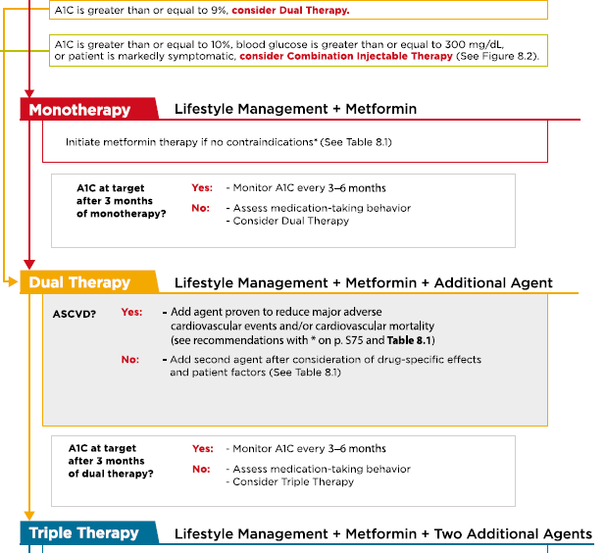

Slide 25
Metformin
Effective & well validated therapy
Choice as initial therapy
Acts by reducing hepatic glucose production (main)
Other
Reduces appetite & may delay absorption
Improves peripheral insulin sensitivity
No hypoglycemia and mild weight loss
Side effects : B12 deficiency , GI , lactic acidosis.
C/I ,, What??
Start with 500 mg once or twice per day with meals and increase every few days till reach maximum dose of 2 gm per day.

Slide 27
Meglitinides (glinides)
Medications: Repaglinide/ Nateglinide
Advantages
Increase insulin secretion
↓ Postprandial glucose excursions
Disadvantages
Hypoglycemia
Dosing flexibility
↑ Weight
Frequent dosing schedule
Costly
DeFronzo RA. Ann Intern Med. 1999 Aug 17;131(4):281-303.

Slide 29
Oral Medication in Type 2 DM
Thiozolidinediones (TZD):
● PIOGLITAZONE (15 – 30 mg)
Reduce insulin resistance
Promotes glucose uptake by skeletal muscles and adipose tissue
Inhibits hepatic gluconeogenesis
Used in combination with metformin and sulphonylurea
Periodic monitoring of liver enzymes
Not given in patients with heart failure
Recently, Debate about increase incidence of Cancer bladder ??

Slide 30
a-Glucosidase inhibitors
Medications: Acarbose / Miglitol
Advantages
Slows intestinal carbohydrate digestion/absorption
↓ Postprandial glucose excursions
Disadvantages
Generally modest A1C efficacy
Rare hypoglycemia
Frequent dosing schedule
? ↓ CVD events in prediabetes (STOP-NIDDM)
Gastrointestinal side effects (flatulence, diarrhea)
DeFronzo RA. Annals of Internal Medicine 1999;131:281-303.

Slide 31
INCRETINS

Slide 33
Physiological effects of GLP-1 Bunck MC, et al. Diabetologia. 2010;53 (Suppl 1):S338.

Slide 34
INCRETINS
The incretin system is impaired in patients with T2DM, which, as a consequence of its insulinotropic actions, contributes to fasting and postprandial hyperglycemia.
The impairment of GLP-1 secretion varies directly with the degree of insulin resistance; those who are more insulin resistant have a lower rise in GLP-1 in response to a meal.

Slide 35
Glucagon-like Peptide-1 (GLP-1)
GLP-1 is secreted throughout the day by intestinal mucosa in response to oral glucose in the gut.
GLP-1 causes anabolic actions on the synthesis of insulin in beta cells by stimulating all steps of insulin biosynthesis.
GLP-1 provides continued and augmented release of insulin for secretion in response to glucose without overproduction that could lead to hypoglycemia.
GLP-1 also acts on islet alpha cells, causing strong inhibition of postprandial glucagon secretion.
GLP-1 slows gastric emptying and acts on brain to promote early satiety with reduced food intake

Slide 36
Dipeptidyl Peptidase-4 (DPP-4)
Within minutes of secretion or exogenous administration, GLP-1 is rapidly degraded bydipeptidyl peptidase-4 (DPP-4).
DPP-4 is found in many body tissues, including liver, renal, and intestinal brush- border membranes; lymphocytes; and endothelial cells.

Slide 37
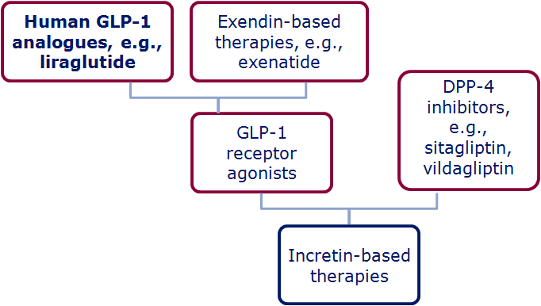
The family of incretin-based therapies
Wick & Newlin. J Am Acad Nurse Pract 2009;21:623–30; White. J Am Pharm Assoc 2009;49(Suppl. 1):S30–40
Notes:
The family of incretin-based therapies
Incretin-based therapies can be broadly divided into:
DPP-4 inhibitors (i.e. sitagliptin, vildagliptin)
GLP-1 receptor agonists (Exenatide, lirgalutide)
Within this second category however, the GLP-1R agonists can be classed as either:
Exendin-based therapies (exenatide, exenatide LAR) which have ~50% sequence identity to human GLP-1
Human GLP-1 analogues (liraglutide) which have share a much higher percentage of amino acids with human GLP-1 (97%)

Slide 38
Medication
Liraglutide: GLP-1 analog, SC, 0.6,1.2 -1.8 mg once daily
For overweight / obese type 2 patients Combined with Metformin +/- Pioglitazone
Sitagliptin (Januvia), (DPP-4) inhibitor, 100 mg OD
Other DPP-4 inhibitors, Vildagliptin, Saxagliptin
Type 2 diabetes only
Monotherapy or with Metformin or TZD
Weight neutral
Does not cause hypoglycemia

Slide 41
DPP 4 inhibitors

Slide 43
Sodium Glucose Transporter 2
SGLT 2 inhibitors

Slide 44
Renal glucose re-absorption in healthy individuals
Filtered glucose load 180 g/day
SGLT2
~ 90%
SGLT1
~ 10%
Gerich JE. Diabet Med. 2010;27:136–142.
Notes:
In healthy subjects, in the kidney, the amount of glucose re-absorbed through the SGLT1 and SGLT2 transporters is equal to the amount of glucose that is filtered by the glomerulus. Glucose re-absorption by the proximal tubule increases linearly with increasing glucose concentration, up to a theoretical threshold of ~ 180 mg/dL.
The SGLT2 transporter mediates 90% of renal glucose re-absorption by coupling glucose transport to the electrochemical sodium gradient. The other 10% of renal glucose re-absorption occurs through SGLT1, a high-affinity, low-capacity transport protein that is found in the more distal, straight section of the proximal tubule (S3), where there is less luminal glucose.
Recent studies suggest that in subjects with low blood glucose, SGLT1 is responsible for a higher percentage of renal re-absorption.

Slide 45
Renal glucose re-absorption in patients with hyperglycaemia
Filtered glucose load > 180 g/day
SGLT2
When blood glucose increases above the renal threshold (~ 10 mmol/l or 180 mg/dL), the capacity of the transporters is exceeded, resulting in urinary glucose excretion
~ 90%
SGLT1
~ 10%
Gerich JE. Diabet Med. 2010;27:136–142.
Notes:
At a certain glucose concentration the glucose flux is to high and the glucose transport system becomes saturated . All the filtered glucose in excess of this threshold is excreted In the urine.
DeFronZo EASD 2012 abstract:
Dapagliflozin reduces renal threshold for glucose excretion in T2D
R.A. DeFronzo1, M. Hompesch2, S. Kasichayanula3, X. Liu3, Y. Hong3, M. Pfister3, L.A. Morrow2,
B.R. Leslie3, D.W. Boulton4, A. Ching3, F.P. LaCreta3, S.C. Griffen3;
1
University of Texas Health Science Center, San Antonio, 2Profil Institute for Clinical Research,
Chula Vista, 3Bristol-Myers Squibb, Princeton, 4Bristol-Myer Squibb, Princeton, USA.
Background and aims: Dapagliflozin is a selective sodium-glucose co-transporter 2 (SGLT2)
inhibitor that reduces hyperglycaemia in T2D by promoting urinary glucose excretion. This
study examined the effect of dapagliflozin on renal glucose kinetics in healthy subjects and subjects
with T2D.
Materials and methods: Renal glucose kinetics were assessed in 12 healthy control subjects (HbA_{1c}
5.5 %, 41 years, 27 kg/m², 7 male/5 female) and 12 subjects with T2D (HbA_{1c} 6.5%, 53
years, 30 kg/m², 7 male/5 female). All subjects had an estimated glomerular filtration rate (eGFR) ≥
60 and ≤ 160 mL/min∙1.73 m² by the Modification of Diet in Renal Disease equation. Subjects
underwent a combined pancreatic and stepped hyperglycaemic clamp at baseline and after 7 days of
dapagliflozin 10 mg/day. The pancreatic/stepped hyperglycaemic clamp was performed with
octreotide and basal insulin/glucagon/growth hormone replacement, and evaluated a plasma glucose
range of 100-550 mg/dL. Subjects with T2D continued on baseline therapy unless taking
metformin, which was held for 48 h before the pancreatic stepped hyperglycaemic clamp. A model
was developed to describe maximum tubular glucose transport (TmG), renal glucose threshold (for
onset of glucosuria), and splay of the glucose titration curve for healthy and T2D
populations, and then used to estimate these parameters from individual titration curves.
Results: At baseline, the TmG (443 vs 326 mg/min, p < 0.04) and splay (28,650 vs 14,248 mg2/min2,
p < 0.0001) were significantly higher in subjects with T2D vs controls. The baseline
threshold was similar in subjects with T2D (196 mg/dL [10.9 mmol/L]) and controls (171
mg/dL [9.5 mmol/L]). Dapagliflozin treatment reduced TmG by 58% in T2D subjects and
53% in healthy subjects. The splay declined similarly by ~ 37% for both groups. Following
dapagliflozin, the modelled threshold was markedly reduced in T2D patients, by 89% (21
mg/dL [1.2 mmol/L]) and in healthy controls, by 78% (37 mg/dL [2.1 mmol/L]). These modelled
threshold values were well below the plasma glucose levels measured in this study. A modest
reduction in GFR (~ 14%) was observed following dapagliflozin treatment in both groups.
Conclusion: In summary, T2D subjects have a higher TmG and splay than healthy
controls. Dapagliflozin treatment for 7 days reduced TmG and splay. However, the markedly
decreased renal glucose threshold was the primary mechanism responsible for the induction of
glucosuria with dapagliflozin in both subjects with T2D and healthy controls.
Clinical Trial Registration Number: NCT01165268
Supported by: AstraZeneca and Bristol-Myers Squibb

Slide 46
Sodium Glucose Transporter 2 inhibitors
Advantages
Low risk of hypoglycemia
Weight loss
Disadvantages
Increased frequency of genital infection
Lack of efficacy with renal impairment
Limited long-term clinical experience at present
Lower blood pressure
CVD protective ( Empa)
Volume depletion

Slide 47
SGLT2 I (Dapagliflozin / Canagliflozin / Empagliflozin)
May play a role in the following settings
Empa >>> patients with overt CVD as second line
Contraindications and precautions
Type 1 diabetes
Pretreatment evaluation
Volume status and renal function (serum creatinine with eGFR) should be assessed
Liver function should be assessed prior to initiation of canagliflozin or dapagliflozin
When weight gain is a significant issue
Type 2 diabetes and (eGFR) <60 mL/min (dapagliflozin) or <45 mL/min (canagliflozin, empagliflozin)
Ketosis-prone type 2 diabetes
Caution in those with low bone mineral density and at high risk for fracture and falls.

Slide 48
Comparison of SGLT-2 inhibitors: HbA_{1c}
Study | Dapagliflozin (Dapa)¹ 52-week data |  |  | Canagliflozin (Cana)² 52-week data |  |  | Empagliflozin (Empa)³ 24-week data
Study arm | Dapa (5 mg) n=137 | Dapa 10 mg n=135 | Placebo n=137 | Cana 100 mg n=368 | Cana 300 mg n=367 | Sita 100 mg n=366 | Empa 10 mg n=217 | Empa 25 mg n=213 | Placebo n=207
Baseline HbA_{1c} (%) | 8.2 | 7.9 | 8.1 | 7.9 | 7.9 | 7.9 | 7.9 | 7.9 | 7.9
0.0
Change in HbA_{1c} from baseline (%)
These are not head-to-head trials
HbA_{1c}, glycosylated haemoglobin; SGLT-2, sodium–glucose cotransporter-2
1. Bailey CJ et al. Lancet 2010;375:2223–2233; 2. Lavalle Gonzalez FJ et al. Diabetologica 2013;56:2582–2592. 3. Häring HU et al. Diabetes Care 2014;37:1650–1659
Notes:
48

Slide 49
Comparison of SGLT-2 inhibitors: Body weight
Study | Dapagliflozin (Dapa)¹ 52-week data |  |  | Canagliflozin (Cana)² 52-week data |  |  | Empagliflozin (Empa)³ 24-week data
Study arm | Dapa (5 mg) n=137 | Dapa 10 mg n=135 | Placebo n=137 | Cana 100 mg n=368 | Cana 300 mg n=367 | Sita 100 mg n=366 | Empa 10 mg n=217 | Empa 25 mg n=213 | Placebo n=207
Baseline body weight (kg) | 84.7 | 86.3 | 87.7 | 88.8 | 85.4 | 87.7 | 79.7 | 81.6 | 82.2
0.0
Change in body weight from baseline (kg)
These are not head-to-head trials
SGLT-2, sodium–glucose cotransporter-2
1. Bailey CJ et al. Lancet 2010;375:2223–2233; 2. Lavalle Gonzalez FJ et al. Diabetologica 2013;56:2582–2592. 3. Häring HU et al. Diabetes Care 2014;37:1650–1659
Notes:
49

Slide 50
Adverse effects
Genitourinary tract
Hypotension
Acute kidney injury
Bone fracture
Diabetic ketoacidosis
Amputations

Slide 52
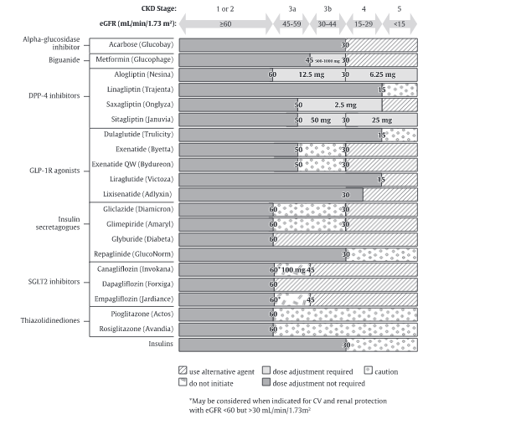

Slide 53
Efficacy of Non-insulin Anti-diabetes Agents*
Drug A1c Reduction (%)
Metformin 1.5–2.0
Secretagogue (SFU/Glinide) 1.5–2.0
GLP1RA 1.0-1.5
TZD 1.0–1.5
SGLT2i¹ 0.8-1.5
DPP4i¹ 0.5–1.5
α−GI 0.5–1.0
Bromocriptine IR² 0.6-0.9
Amylin² 0.4-0.7
Colesevelam² 0.3-0.5
*Not head to head. Baselines and background therapies differ. Information derived from multiple studies.
¹http://resources.aace.com. ²Information taken from manufacturer PI.

Slide 55
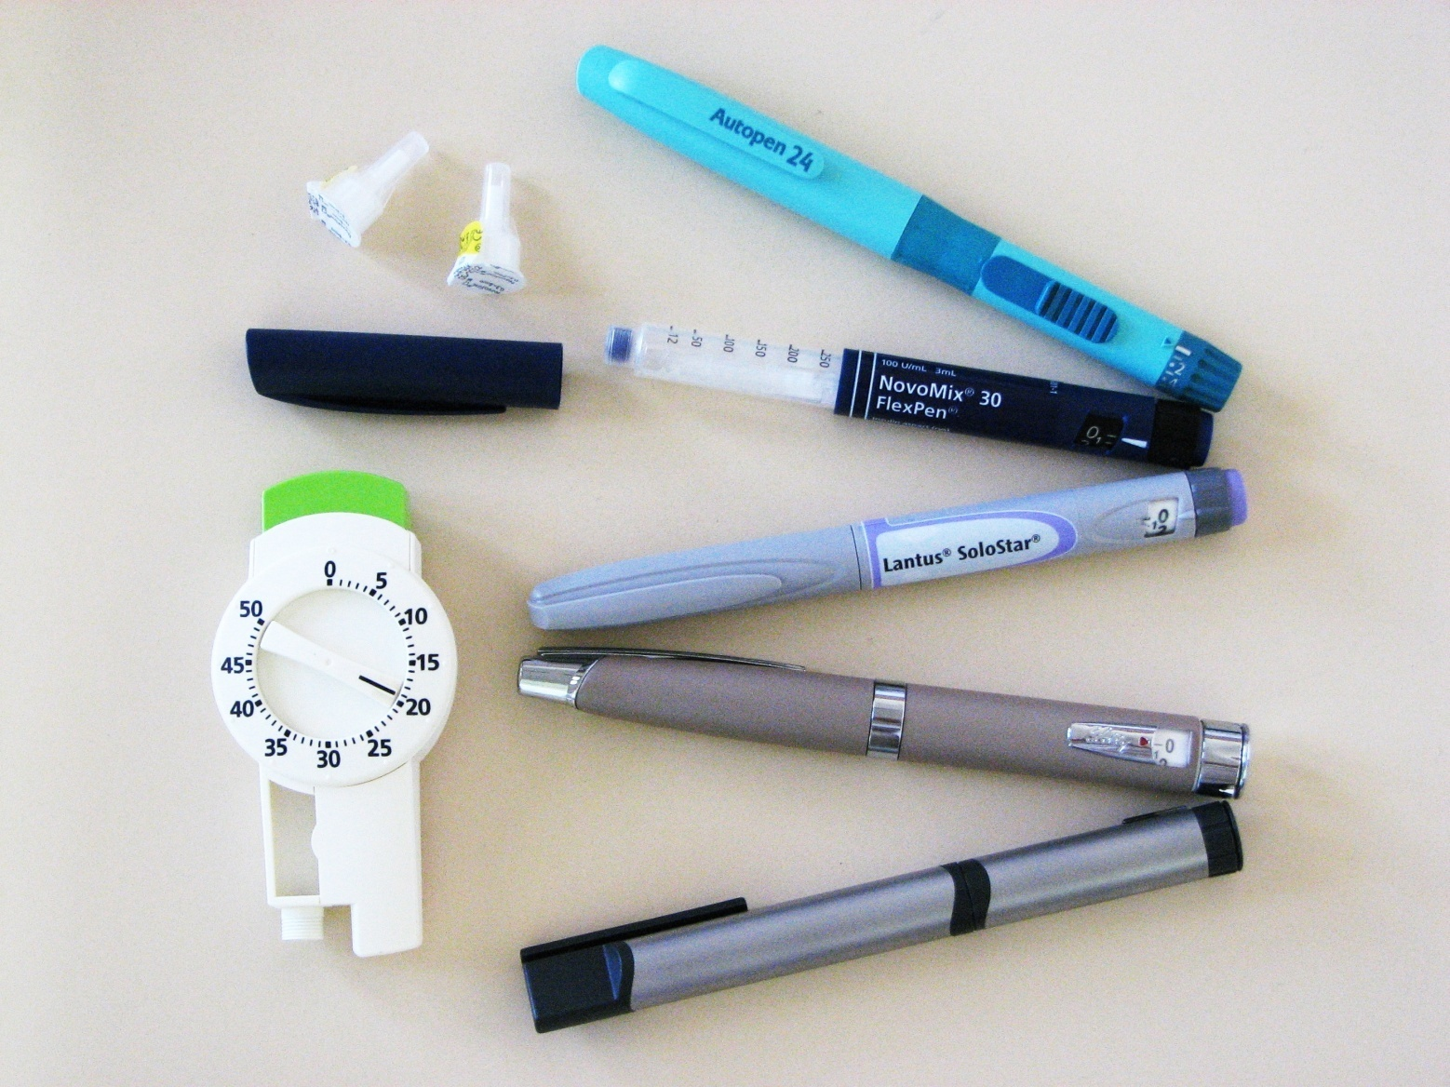
Insulin

Slide 56
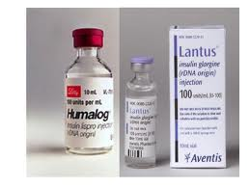
1982 – Human insulin approved
1996 – First rapid acting insulin analogue approved
2004 – First long acting insulin analogue approved

Slide 57
Insulin
Powerful agent
Necessary in 20-30%
Inexpensive
Weight gain
Hypoglycaemia
High level of patient fear

Slide 58
Indication of Insulin in Type 2 DM
If HbA1c is ≥ 9 %
After maximum metformin and suphonylurea
You should consider adding Insulin and taper the Sulphonylurea.

Slide 59
TREATMENT REGIMENS OF TYPE 1 DM
Conventional Insulin Therapy
Two injections of NPH and Regular Insulin
Mixed Insulin
Two injections of 70/30 or 60/40 or 50/50
Multiple Insulin Injections
1 or 2 injections of NPH plus 3 injections of Regular or Rapid Insulin.
One injection of Glargine or Detemir plus 3 injections of rapid insulin(Lispro /Aspart).

Slide 60
INSULIN GLARGINE (LANTUS)
The first clear long-acting insulin
Acidic (pH of 4) when injected it is neutralized by the body, causing Glargine crystals to be precipitated and slowly absorbed.
It is taken once a day
Being acidic, cannot be mixed with other insulin

Slide 61
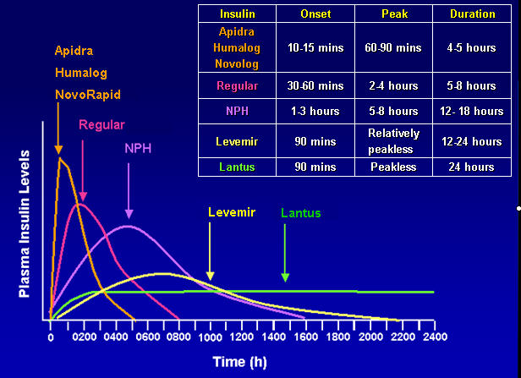

Slide 62
Basal-Bolus Insulin TreatmentWith Insulin Analogues
Lispro, or Aspart
μU/mL
100
B
L
D
Glargine
80
60
40
Normal pattern
20
0600
0800
1200
1800
2400
0600
Time of day
B=breakfast; L=lunch; D=dinner

Slide 63
Glargine / Lispro
Avoids fasting hyperinsulinaemia and hypoglycemia
Can mimic pancreatic ß-cell insulin secretion
36% had hypoglycemia vs
50% on NPH.
Dose: Glargine 50% and
Lispro 50%

Slide 64
Initiation and adjustment of insulin regimens (Multiple injections)
Long acting insulin (Glargine) at bedtime 10 U or 0.2 U/Kg
Check FG, increase by 2 U every 3-4 days until FG 80 – 130 mg/dl
If hypoglycaemia occurs, or FG < 70 mg/dl reduce bedtime by 4 units or 10 % which is greater.
If FG in range, check 2 hrs after breakfast, lunch and dinner and add rapid (Aspart) insulin. Begin with 4 U before each. Adjust by 2 U every 3-4 days Untill 2hpp < 180 mg/dl .
Usually the dose of rapid insulin is near equal or higher than dose of Long acting insulin

Slide 65
Insulin administration
Do not mix Glargine with other insulin products.
Insulin site should be clean, but wiping with alcohol is not needed.
Syringe reuse acceptable but meticulous attention to
cleanliness is needed.
Insulin pens improve the dose accuracy.
Injection site rotation reduces the lipoatrophy.
Abdomen region has a faster absorption rate than the Arm, which is faster than the leg.

Slide 66
Recommendations: Antiplatelet Agents
Consider aspirin therapy (75–162 mg/day) C
As a primary prevention strategy in those with type 1 or type 2 diabetes at increased cardiovascular risk
Includes most men or women with diabetes age ≥50 years who have at least one additional major risk factor, including:
Family history of premature ASCVD
Hypertension
Smoking
Dyslipidemia
Albuminuria
American Diabetes Association Standards of Medical Care in Diabetes. Cardiovascular disease and risk management. Diabetes Care 2017; 40 (Suppl. 1): S75-S87
Notes:
Aspirin has been shown to be effective in reducing cardiovascular morbidity and mortality in high-risk patients with previous MI or stroke (secondary prevention). Its net benefit in primary prevention among patients with no previous cardiovascular events is more controversial, both for patients with and without diabetes.
Multiple recent well-conducted studies and meta-analyses reported a risk of heart disease and stroke that is equivalent if not higher in women compared to men with diabetes, including among non-elderly adults. Thus, the recommendations for using aspirin as primary prevention are now revised to include both men and women aged 50 years or older with diabetes and one or more major risk factors, to reflect these more recent findings.
Recommendations for the use of antiplatelet agents are summarized in three slides.
Consider aspirin therapy as a primary prevention strategy in those with type 1 and type 2 diabetes who are at increased cardiovascular risk. This includes most men or women with diabetes aged 50 years and up who have at least one additional major risk factor (such as family history of premature ASCVD, hypertension, smoking, dyslipidemia, or albuminuria) and are not at increased risk of bleeding.
[SLIDE}
66
References
American Diabetes Association. Standards of medical care in diabetes—2014. Diabetes Care 2014;37(suppl 1):S40–S41
Pignone M, Alberts MJ, Colwell JA, et al.; American Diabetes Association; American Heart Association; American College of Cardiology Foundation. Aspirin for primary prevention of cardiovascular events in people with diabetes: a position statement of the American Diabetes Association, a scientific statement of the American Heart Association, and an expert consensus document of the American College of Cardiology Foundation. Diabetes Care 2010;33:1395–1402

Slide 67
Recommendations: Antiplatelet Agents (2)
Aspirin is not recommended for ASCVD prevention for adults with DM at low ASCVD risk, since potential adverse effects from bleeding likely offset potential benefits. C
Low risk: such as in men or women with diabetes aged <50 years with no major additional ASCVD risk factors)
In patients with diabetes <50 years of age with multiple other risk factors (e.g., 10-year risk 5–10%), clinical judgment is required. E
American Diabetes Association Standards of Medical Care in Diabetes. Cardiovascular disease and risk management. Diabetes Care 2017; 40 (Suppl. 1): S75-S87
Notes:
Aspirin is not recommended for those at low risk of ASCVD (such as men and women with diabetes under age 50 years with no other major ASCVD risk factors; 10-year ASCVD risk under 5%) as the low benefit is likely to be outweighed by the risks of significant bleeding.
Clinical judgment should be used for those at intermediate risk such as younger patients with one or more risk factors or older patients with no risk factors until further research is available. Aspirin use in patients under the age of 21 years is contraindicated due to the associated risk of Reye syndrome.
[SLIDE]
67
Reference
American Diabetes Association. Standards of medical care in diabetes—2014. Diabetes Care 2014;37(suppl 1):S40–S41

Slide 68
Recommendations: Antiplatelet Agents (3)
Use aspirin therapy (75–162 mg/day) as secondary prevention in those with diabetes and history of ASCVD. A
For patients w/ ASCVD & aspirin allergy, clopidogrel (75 mg/day) should be used. B
Dual antiplatelet therapy is reasonable for up to a year after an acute coronary syndrome. B
American Diabetes Association Standards of Medical Care in Diabetes. Cardiovascular disease and risk management. Diabetes Care 2017; 40 (Suppl. 1): S75-S87
Notes:
Average daily dosages used in most clinical trials involving patients with diabetes ranged from 50 to 650 mg but were mostly in the range of 100 to 325 mg/day. There is little evidence to support any specific dose, but using the lowest possible dose may help reduce side effects
Use aspirin therapy (75–162 mg/day) as a secondary prevention strategy in those with diabetes and a history of ASCVD.
For patients with ASCVD and documented aspirin allergy, clopidogrel (75 mg/day) should be used.
Dual antiplatelet therapy is reasonable for up to a year after an acute coronary syndrome.
[SLIDE]
68
References
American Diabetes Association. Standards of medical care in diabetes—2014. Diabetes Care 2014;37(suppl 1):S40–S41
Vandvik PO, Lincoff AM, Gore JM, et al. Primary and secondary prevention of cardiovascular disease: Antithrombotic Therapy and Prevention of Thrombosis, 9th ed: American College of Chest Physicians Evidence-Based Clinical Practice Guidelines. Chest 2012;141:e637S–e668S

Slide 69
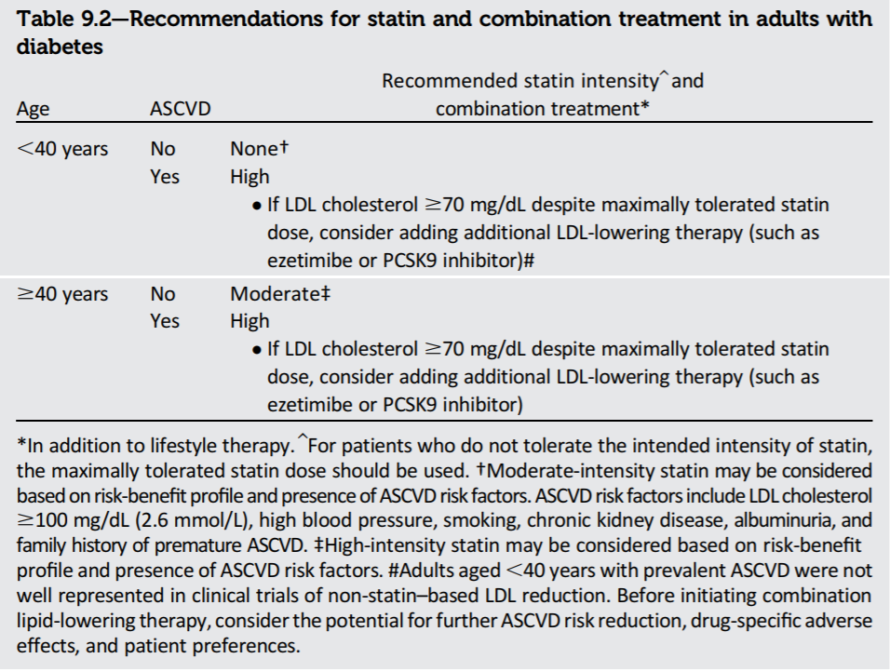
Lipid management in diabetic patients

Slide 70
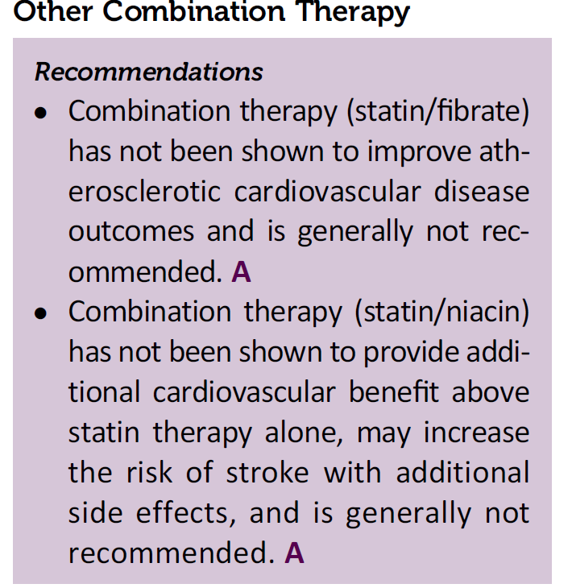

Slide 71
Guidelines specify statin doses
 | High-intensity ↓ LDL-C by ≥50% | Moderate-intensity ↓ LDL-C by 30–50% | Low-intensity ↓ LDL-C by <30%*
Atorvastatin | (40)–80 mg | 10–20 mg | –
Rosuvastatin | 20–40 mg | 5–10 mg | –
Simvastatin | – | 20–40 mg | 10 mg
Pravastatin | – | 40–80 mg | 10–20 mg
Lovastatin | – | 40 mg | 20 mg
Fluvastatin XL | – | 80 mg | –
Fluvastatin | – | 40 mg bid | 20–40 mg
Pitvastatin | – | 2–4 mg | 1 mg
Bold: Statins and doses evaluated in RCTs
Italics: Statins and doses approved by US FDA but not tested in RCTs reviewed
*Should be used in patients unable to tolerate moderate-to high-intensity therapy Asian ancestry may modify the statin dose prescribed
Stone NJ, et al. J Am Coll Cardiol 2013 Nov 7. Epub ahead of print Reproduced with kind permission from American College of Cardiology Jan 2014

Slide 72
Vaccination
Influenza vaccine (yearly)
Pneumococcal vaccine (once in lifetime)

Slide 73
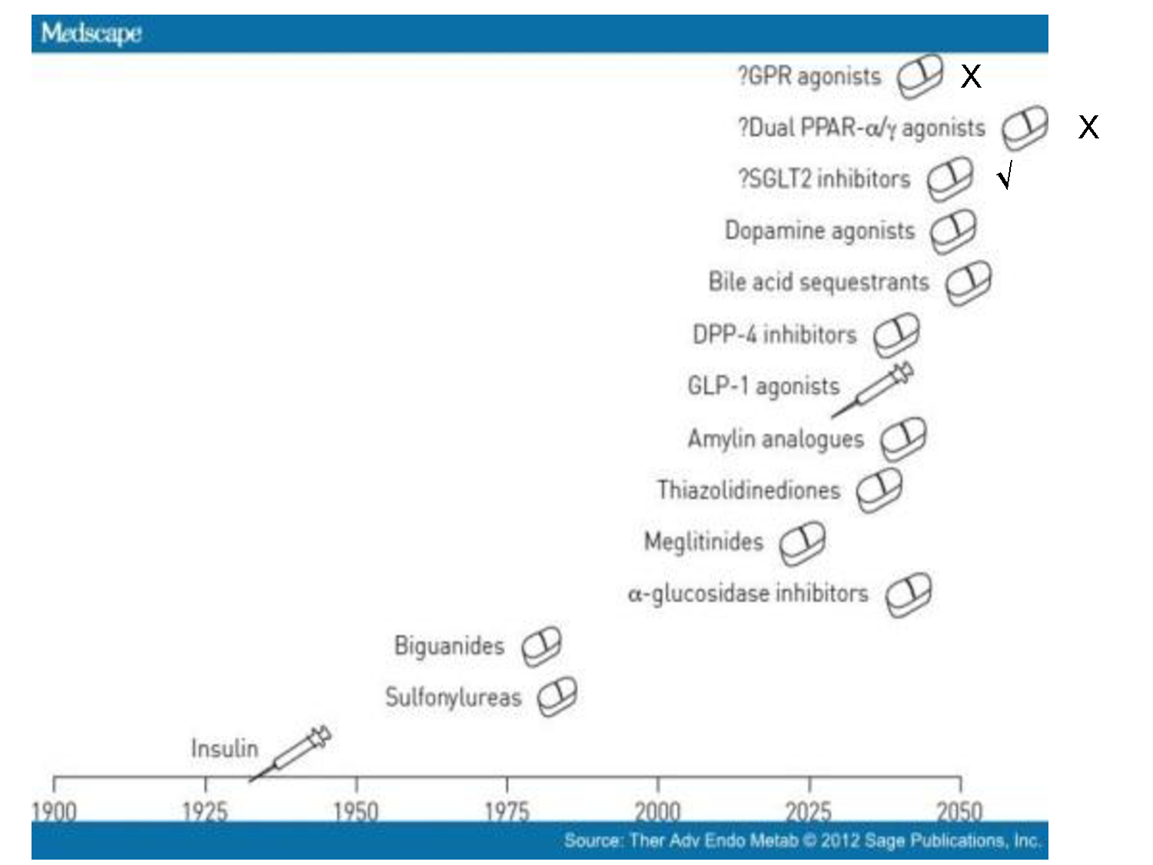

Slide 74
Reference

Slide 75
Thank You

