Slide 1
Sexual Health 101
Lemmese AlWatban
MBBS, CCFP, MCISc
Assistant Professor in the Family Medicine Department
Consultant Women’s Health and Sexual Health

Slide 2
Objectives
Taking a sexual history
Types of sexual dysfunctions in males and females
Sexually transmitted infections (STI) overview:
Bacterial
Viral
Parasite

Slide 3
Sexuality
(WHO): Sexual health is a state of physical, mental and social well-being in relation to sexuality.
Sexuality involves biological, psychological, sociological and spiritual variables.

Slide 4
Why ask patients about “Sex”?
1. Morbidity and mortality—STIs and HIV/AIDS
2. Symptoms of illness
3. Treatment side effects
4. Past may explain present problems
5. Dysfunctions and difficulties are common
6. Association with health and happiness
7. Why not?

Slide 5
Why ‘Sex’ Questions Are Not Asked
1. Unclear what to do with the answers
2. Fear of offending patient
3. Lack of obvious justification
4. Generational obstacles
5. Fear of sexual misconduct charge
6. Sometimes perceived irrelevant
7. Unfamiliarity with some sexual practices

Slide 6
When Should Questions Be Asked?
‘The earlier the better’
Delay in approaching the topic communicates discomfort.
When ?
HPI
Review of Systems
Personal and Social History

Slide 7
What would you ask to screen?
1. Can I ask you a few questions about sexual matters?
2. Are you sexually active? ( last 6 months)
3. With women? men? both? (depends on context)
4. Do you or your partner have any sexual concerns? (or with the addition of examples)

Slide 8
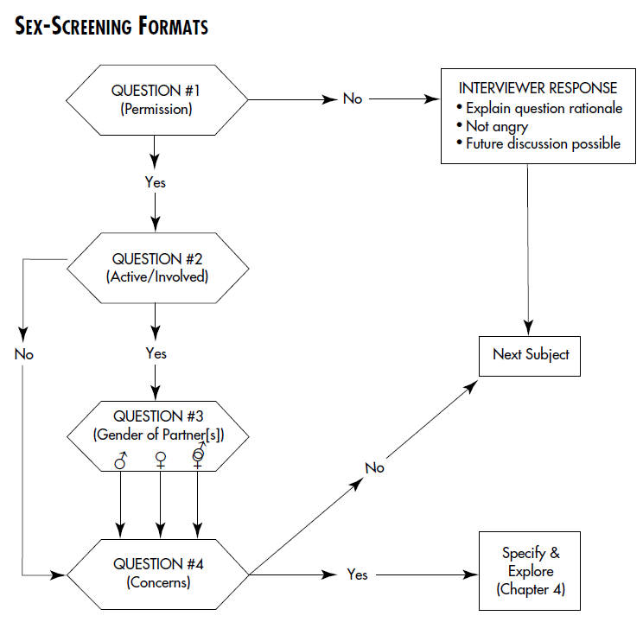

Slide 9
What is a sexual History
sexual histories v.s sexual history
Depends on:
the patient
the problem presented
the amount of time available for questioning
the context in which the patient is seen

Slide 10
Interviewing Versus History-taking
how to ask questions (interviewing) is quite different from what to ask (history-taking)
techniques of inquiry may affect the quality and the quantity of the information gathered

Slide 11
*Interviewing Methods
1. Ask patient’s permission
2. Interviewer takes initiative
3. Language: medical/technical versus slang
4. Statement/Question technique
5. Privacy and Confidentiality
6. Delay sensitive questions
7. Display nonjudgmental attitude
8. Provide explanation
9. Discuss feelings
10. Promote optimistic attitude
from Maurice WL. Sexual medicine in primary care. Toronto: Mosby;1999:41.50

Slide 12
Optimism
patients tend to think of themselves as not simply having a sexual problem; they also think they are less of a man or woman in the process
Hope is one of the most powerful treatment factors

Slide 13
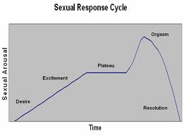
Normal sexual cycle male and female

Slide 14
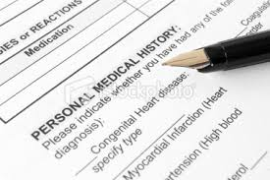
Ask about :
Age, job, martial status, (1st?)
children (ages) ,
Gyn/OB hx
PMHx and Pᴪhx
PSHx
Meds/ contraception /hormones
Drugs / Herbs
Partner hx ( age, job, 1st? PHX, meds..etc)
Desire
Arousal
Orgasm
Pain
Sx of infection (Discharge/ spotting..etc)
Stressors

Slide 15
* PATTERN OF SEXUAL DYSFUNCTION
1. DURATION : lifelong or acquired
2. CIRCUMSTANCES : generalization or situational
3. DESCRIPTION (compare to pt previous, scale useful)
4. PATIENT’S SEX RESPONSE CYCLE (+pain)
5. PARTNER’S SEX RESPONSE CYCLE (direct v.s indirect)
6. PATIENT AND PARTNER’S REACTION
7. MOTIVATION FOR TREATMENT (not CC)

Slide 16
Dx
The American Psychiatric Association (APA) require that a sexual problem be recurrent or persistent and cause personal distress or interpersonal difficulty

Slide 17
Female sexual dysfunctions
Sexual interest/ arousal disorder - absent or reduced:
interest , thoughts / fantasies , reduced or no initiation of sexual activity
excitement / pleasure to sexual activity
Sexual interest/arousal in response to sexual cues (internal or external , written , verbal , visual)
Genital or non-genital sensations during sexual activity
Orgasmic disorder - Persistent or recurrent reduced intensity, delay in, or absence of, orgasm following a normal sexual excitement phase
Genito-Pelvic Pain /Penetration Disorder - Recurrent or persistent difficulty with one or more :
Vaginal penetration during intercourse
Pain with intercourse or penetration attempts
Fear or anxiety about pain in anticipation of penetration
Tensing or tightening of pelvic floor muscles

Slide 18
Male sexual dysfunctions
Hypoactive Sexual Desire Disorder – deficient or absent sexual/erotic thoughts or fantasies and desire for sexual activity
Erectile Disorder – difficulty obtaining, maintaining or decreased rigidity
Premature Ejaculation – occurring during partnered sexual activity with in 1min following penetration and before the individual wishes
Delayed Ejaculation – marked delay , infrequency or absence of ejaculation

Slide 19
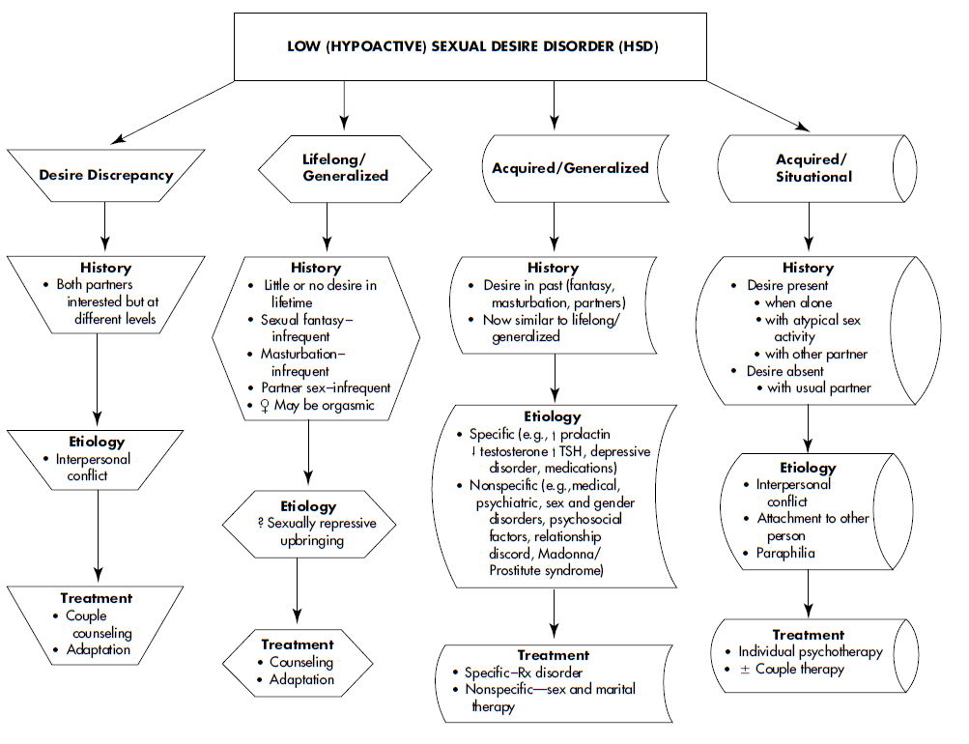

Slide 20
Sexually Transmitted Infection (STI)

Slide 21
Sexually Transmitted Infections (STI)
More than 30 bacteria, viruses and parasites are known to be transmitted through sexual contact.
8 of these pathogens are linked to the greatest incidence of sexually transmitted disease.
4 are currently curable:
syphilis, gonorrhoea, chlamydia and trichomoniasis.
4 are incurable:
(viral) hepatitis B, herpes simplex virus (HSV or herpes), HIV, and human papillomavirus (HPV).

Slide 22
Spread
STIs are spread predominantly by sexual contact, including vaginal, anal and oral sex.
Some STIs can also be spread through non-sexual means such as via blood or blood products or skin to skin contact
Many can be transmitted from mother to child during pregnancy and childbirth.
Eg: chlamydia, gonorrhoea, hepatitis B, HIV, HSV and syphilis
What dosnt transmit can also cause complications

Slide 23
WHO - statistics
More than 1 million sexually transmitted infections (STIs) are acquired every day worldwide.
Each year, there are an estimated 357 million new infections with 1 of 4 STIs: chlamydia, gonorrhoea, syphilis and trichomoniasis.
More than 500 million people are estimated to have genital infection with herpes simplex virus (HSV).

Slide 24
Sexually transmitted infections in Saudi Arabia
Tariq A Madani (1995-1999)
Results: A total of 39049 STIs were reported to the Ministry of Health. Reported STIs included
nongonococcal urethritis (14557 infections, 37.3%), trichomoniasis (10967 infections, 28.1%),
gonococcal urethritis (5547 infections, 14.2%), syphilis (3385 infections, 8.7%), human
immunodeficiency virus (2917 infections, 7.5%), genital warts (1382, 3.5%), genital herpes (216 infections, 0.6%), and chancroid (78 infections, 0.2%). The average annual incidence of STIs per100,000 population for Saudis and non-Saudis, respectively, was as follows: 14.8 and 7.5 for
nongonococcal urethritis, 9.4 and 10.4 for trichomoniasis, 5.2 and 4.2 for gonorrhea, 1.7 and 6.4
for syphilis, 0.6 and 8.0 for HIV, 1.4 and 0.7 for genital warts, 0.1 and 0.4 for genital herpes, and 0.1
and 0.1 for chancroid. The incidence of STIs was somewhat steady over the surveillance period
except for nongonococcal urethritis which gradually increased

Slide 25
Sexually Transmitted Diseases in Domestic Expatriate Workers in Jeddah, Saudi Arabia Sami A. Hamdi, MBBCH, MSc, MD; M. Abdulbari Ibrahim, MD, MPH&TM, DrPh ( 1997)
During routine pre-employment screening. The relative frequencies for syphilis and HIV were 23.8% and 19% respectively
Notes:
STI = Sexually Transmitted Infections
Discuss that terminology changed from STD (Sexually Transmitted Disease) to STI (Sexually Transmitted Infection) because there is an infection which may or may not lead to a disease.

Slide 26
Prevalence and Awareness of Sexually Transmitted Infections among Inmates of a Drug Rehabilitation Center in Saudi Arabia: A Cross-Sectional Study Wafa Fageeh*, etal
Results:
Of the total 115 participants, 18 had one or more STIs, including syphilis (n=11), HIV (n=5), HBV (n=5) and combined HBV and syphilis (n=3). The prevalence of STIs was higher among injecting drug users than among noninjecting drug users. Compared to the group that did not have STIs, very few participants who were positive for STIs were aware that condoms provided protection against STIs.
Not

Slide 27
Sexually Transmitted Infection (STI)
Up to 90% of sexually transmitted infections are asymptomatic
A person can have and spread an STI and not know it
Complications of untreated sexually transmitted infections (STIs) include upper genital tract infections, infertility, chronic pelvic pain, cervical cancer, and chronic infection with hepatitis viruses and HIV
Screening !!
Notes:
Speaking Notes: Why would you be at greater risk of getting an STI that doesn't cause any symptoms?
Notes: If someone doesn't have symptoms they're less likely to get tested and treated, if they don't know they have an infection they are more likely to pass it on to someone else

Slide 28
Who’s at risk?
Behavioral Factors
New sex partner in past 60 days
Risk groups
Young age (15 to 24 years old)
Multiple sex partners or partner with multiple
Hx of STI or PID or sex partner
No use of protection
Engaging in unsafe sexual practices
Men who have sex with men (MSM)
History of domestic violence
HIV-positive status
Pregnant women
Admission to correctional facility or juvenile detention center
Drug use

Slide 29
STI risk screen
History:
Genital symptoms associated with STIs (discharge, dysuria, abdominal pain, testicular pain, rashes, lesions).
Systemic symptoms associated with STIs (fever, weight loss, lymphadenopathy).
Personal risk factors and prevention (condom use, vaccinations ).
Patient’s knowledge of increased risk of STIs.
Have you ever had STI or been treated for one? Do you Have any concerns about STI?
Aim to quickly identify or rule out major risk factors associated with increased risk of STIs

Slide 30
Are you sexually active now, or have you been sexually active? This includes oral sex or anal sex, not just vaginal sex
Do you have any symptoms that might make you think that you have an STI? (Do you have any sores on or around your genitals? Does it hurt or burn when you pee? Have you noticed an unusual discharge from your penis, vagina or anus? Do you have pain during sex?)
What are you doing to avoid pregnancy? (Do you or your partner use any type of birth control?)
What are you doing to avoid STIs including HIV?
Do you have any concerns about sexual or relationship violence or abuse?
Have you or your partner(s) used injection or other drugs?
For women also ask:
“When was your last menstrual period?
When was your last Pap test?

Slide 31
There are 3 types of STIs?

Slide 32
Bacterial
Syphilis
viral
Herpes
Parasitic
Trichomonas vaginalis
Chlamydia
Gonorrhea
HPV (warts)
HIV
Hepatitis B
Lice
Scabies
ZIKV ?
Chancroid
Lymphogranuloma Venereum (LGV)

Slide 33
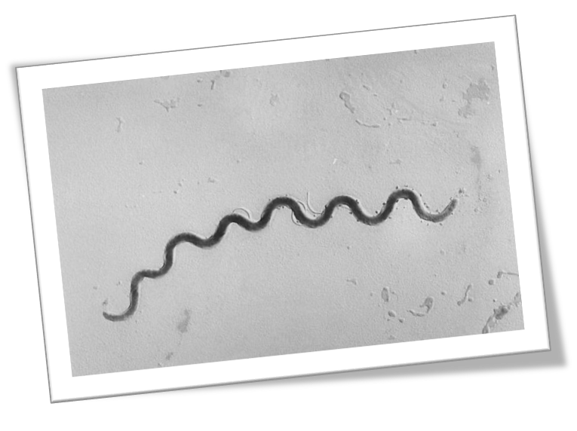
Syphilis
Syphilis is caused by Treponema pallidum.

Slide 34
Stage | Clinical manifestations | Incubation period
Primary (local) | Chancre, regional LN | 3 weeks (3-90 days)
Secondary (blood spread) | Rash, fever, malaise, lymphadenopathy, mucus lesions, condyloma lata, patchy or diffuse alopecia, meningitis, headaches, uveitis, retinitis | 2-12 weeks (2 weeks 6 months)
Latent (suppressed) | Asymptomatic | Early: <1 year Late: ≥1 year
Tertiary (untreated late stage)
Cardiovascular Syphilis | Aortic aneurysm, aortic regurgitation, coronary artery ostial stenosis | 10-30 years
Neurosyphilis | Ranges from asymptomatic to symptomatic with headaches, vertigo, personality changes, dementia, ataxia, presence of Argyll Robertson pupil | At any time
Gumma | Tissue destruction of any organ; manifestations depend on site involved | 1-46 years (most cases 15 years)

Slide 35
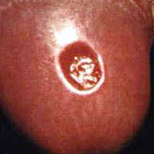
Symptoms and signs
Current or past history of lesions or rash
A high proportion of individuals fail to recall a primary chancre
Symptoms and signs may be modified in the presence of HIV co-infection

Slide 36
Lab tests:
Darkfield microscopy – no longer (Serology !)
Non-treponemal | Treponemal-specific
Non specific ( false positive) | Specific
Can be quantified Reported in titer ( good for FU) | Qualitative only /reported as "reactive" or "nonreactive“ (Life long)
Rapid plasma reagin (RPR) Venereal Disease Research Laboratory (VDRL) Toluidine Red Unheated Serum Test (TRUST) | Fluorescent treponemal antibody absorption (FTA-ABS) Microhemagglutination test for antibodies to T. pallidum (MHA-TP) T. pallidum particle agglutination assay (TPPA) T. pallidum enzyme immunoassay (TP-EIA) Chemiluminescence immunoassay (CIA)

Slide 37
Treatment
Penicillin G
If allergic ( Doxycycline /Cefriaxone)
Duration and dose depends on stage
All sexual contacts of infectious syphilis must be located, tested and treated.
Serial serology Follow up

Slide 38
Chlamydia and Gonorrhea
Infections with Chlamydia trachomatis and Neisseria gonorrhoeae are very common.
In the United States, they are the two most commonly reported communicable diseases.

Slide 39
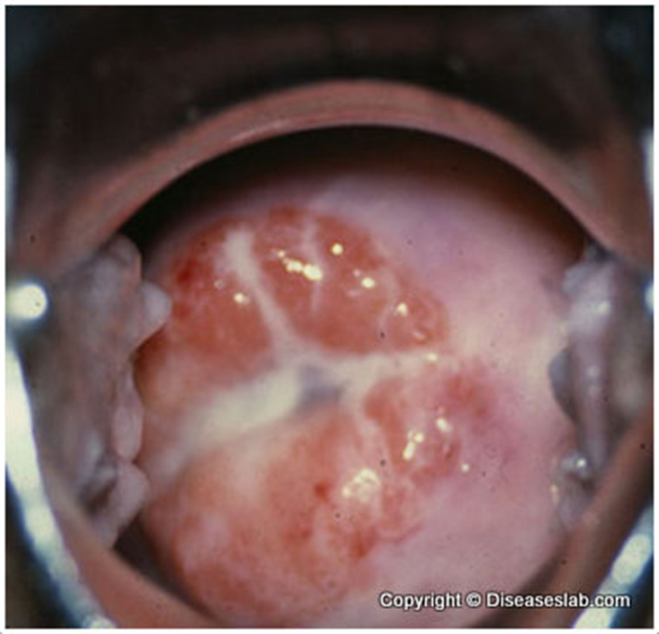
Females | Males
Symptoms and signs
Most often asymptomatic Cervicitis Vaginal discharge Dysuria Lower abdominal pain Abnormal vaginal bleeding Dyspareunia Conjunctivitis Proctitis (commonly asymptomatic) | Often asymptomatic Urethral discharge Urethritis Urethral itch Dysuria Testicular pain Conjunctivitis Proctitis (commonly asymptomatic)
Major sequelae
Pelvic inflammatory disease Ectopic pregnancy Infertility Chronic pelvic pain Reactive Arthitis | Epididymo-orchitis Reactive Arthritis

Slide 40
Lab test:
Nucleic acid amplification testing (NAAT)
vaginal swabs for women
first-catch urine for men
NAAT can also be performed on endocervical (for women) and urethral swab (for men)
Self collected vaginal or urine (compliance)

Slide 41
Treatment
Empirical co-treatment when a diagnosis of N. gonorrhoeae is made without waiting for test results of C. trachomatis due to the significant probability of co-infection (20–42%)
All partners who have had sexual contact with the index case within 60 days prior should be tested and empirically treated regardless of clinical findings and without waiting for test

Slide 42
Treatment
Gonorrhea
Chlamydia
Preferred:
Cefixime 800 mg PO as a single dose + azithromycin 1g PO as a single dose
Alternate
ceftriaxone 250 mg IM as a single dose + azithromycin 1 g PO as a single dose
Preferred:
Azithromycin 1 g PO as a single dose
Alternate:
Doxycycline 100 mg PO BID for 7 days

Slide 43
Lymphogranuloma Venereum (LGV)
Unlike other Chlamydia infection LGV strains are more invasive, affecting the lymph tissue
Early Painless papule at site of inoculation that may ulcerate.
2” lymphadenopathy (groove sign) , 3” possible Destruction of genitalia

Slide 44
Genital Herpes Simplex (HSV)
Herpes simplex virus (HSV) types 1 and 2
Most cases of recurrent genital herpes are caused by HSV-2
mean recurrence rates in persons with genital HSV-2 (4%) infection than in those with HSV-1 (1%)
The incidence and prevalence of HSV-1 genital infection is increasing globally
HSV-1 accounts for 20% of cases, HSV-2 for 80%.(Germany)
It is estimated that the majority of genital herpes infections are transmitted by persons unaware that they have the infection, or are asymptomatic when transmission occur

Slide 45
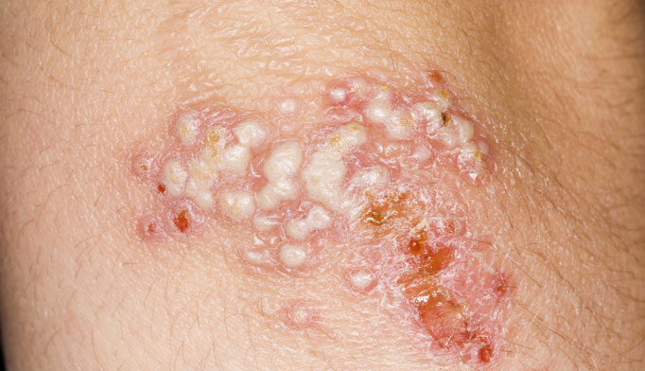
Presentation A diagnostic lesion is a cluster of vesicles on an erythematous background
Primary infection:
Systemic sx (67 percent)
Local pain and itching (98 percent)
Dysuria (63 percent)
Tender lymphadenopathy (80 percent)
Recurrence:
Typical lesioons, less severe than primary or infections.
duration of lesions is shorter (10 versus 19 days)
Systemic symptoms in 5-12%.
Prodromal symptoms in 43-53%, for an average of 1.2-1.5 days.

Slide 46
Lab tests:
Culture is sensitive (70% from ulcers, 94% from vesicles) and permits identification of HSV type
PCR is four times more sensitive than HSV culture and is 100% specific

Slide 47
Management
Counselling is an important component in management. Genital HSV infection is not curable
Transmission of genital herpes is decreased by the following:
Avoidance of contacts with lesions during obvious periods of viral shedding (prodrome to re-epithelialization) from lesions.
Condom use (50%)
suppressive antiviral therapy, which reduces recurrent lesions, asymptomatic viral shedding and transmission.

Slide 48
Management options (Antiviral therapy)
No-Treatment | Episodic therapy | Suppressive therapy
when recurrences are both mild and infrequent in cases where sexual transmission is not a concern | for patients with infrequent (less than 6- 9 outbreaks per year) treatment should be started as soon as possible ( prodromal or within hours of a lesion) | for patients with more than 9 symptomatic outbreaks a year in those who are concerned with disease transmission

Slide 49
Human Papilloma Virus (HPV)
HPV are two types on the basis of their oncogenic potential.
Lowrisk varieties, such as HPV6 and HPV11, give rise to condylomata acuminata (genital warts)
high-risk varieties, such as HPV16 and HPV18, cause neoplasia.

Slide 50
Burden of HPV related cancers
Cancer of the cervix the second most common cancer among women worldwide
Cervical cancer ranks as the 9th leading cause of female cancer in Saudi Arabia

Slide 51
HPV Vaccines
Bivalent vaccine (Cervarix) (HPV types 16 and 18) - responsible for more than 65% of cervical cancers
Quadrivalent vaccine (Gardasil) (HPV types 6 ,11 90% warts) +,(16, 18)
9-valent vaccine (HPV types 6, 11, 16, 18, 31, 33, 45, 52, and 58) an additional 15% of cervical cancers.
For girls and boys vaccines be given at 11 to 12 years of age
not licensed or recommended for persons older than 26 years.

Slide 52
Incidence of cervical cancer
Saudi Arabia : 1.3
Western Asia: 3.6
World Crude incidence:15.8
Annual number of new cancer cases
SA: 152
Western Asia: 3931
World: 529828

Slide 53
What do we do ?
Interpret guidelines
Offer information
Prescribe and administer vaccine if requested

Slide 54
HIV
HIV-positive persons who receive timely and appropriate treatment, with good compliance, now have nearly the same life expectancy as HIVnegative persons
All patients presenting to a physician for the diagnosis or treatment of a sexually transmitted disease should be tested for HIV.
HIV testing requires the patient’s consent

Slide 55
Higher viral load more risk of transmission-- unlikely if the HIV-positive individual has a consistently low viral count (less than 50 copies/mL)
Receptive partner in unprotected anal intercourse - highest risk
The risk of HIV transmission is elevated X 3 to 10 by presence of other STI

Slide 56
When to test
serologic testing is recommended when there is a high index of suspicion
Persons may also present with specific opportunistic infections or other conditions indicative of underlying immunosuppression

Slide 57
Diagnosis of HIV
ELISA
Screening Antibodies ( 2-3wks seroconversion)
PCR
Measures the viral load (acute exposure before seroconversion )
Western Blot
Confirmatory test (after 2 +ve ELISA)

Slide 58
ZIKV
Zika virus (ZIKV) infection is caused by a flavivirus transmitted through the bite of an infected Aedes mosquito
ZIKV infection can cause microcephaly, other congenital abnormalities, fetal death
women planning a pregnancy should wait at least two months after their return from an affected area before trying to conceive. For couples where the male partner has returned from an affected area, it is reasonable to delay trying to conceive for six months

Slide 59
Trichomonas
Infection with the flagellated protozoan Trichomonas vaginalis.
Women are affected more often than men
Men
urethritis, epididymitis, or prostatitis
mild pruritus or burning in the penis after sexual intercourse
Women:
vaginal discharge diffuse, thin, ill-smelling, yellowish-green
Symptoms worse during menstruation, post coital spotting
70–85% have minimal or no symptoms
Untreated asymptomatic infection can persist for months or years

Slide 60
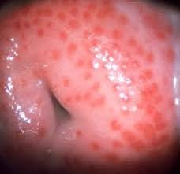
On examination
Erythema of the vulva and vaginal mucosa , discharge 10-30% of symptomatic women
Punctate hemorrhages on the cervix (ie, strawberry cervix) in 2%

Slide 61
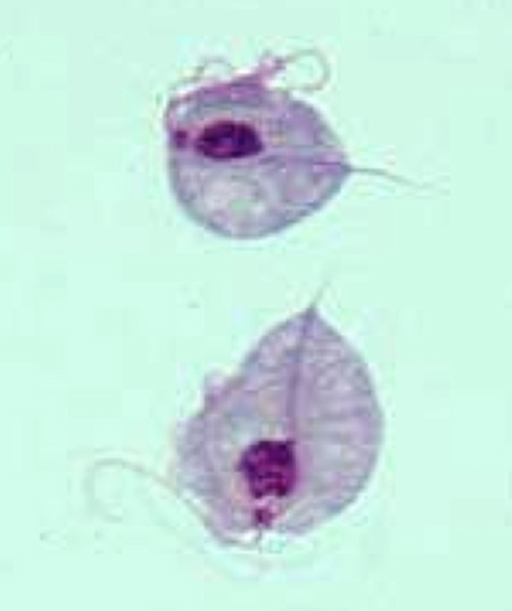
Lab test:
Microscopy is often the first step(positive no need for further testing )
(if negative) ,>>>then nucleic acid amplification tests (NAAT) if not available then >>>rapid diagnostic kits, or culture
organisms remain motile for 10 to 20 minutes after collection of the sample

Slide 62
Microscopy

Slide 63
Treatment
5-nitroimidazole drugs (Metronidazole or Tinidazole) are the only class of drugs that provide curative therapy of trichomoniasis.
Allergy — other ABX cure rates are low (≤50%)
consider referral for desensitization rather than using an alternative class of drugs

Slide 64
In the End…..
Asking patients about their sexual health is part of your medical assessment
Screen patients for sexual issues and STI
When suspecting risk of STI test for ……….
Always treat partner/ sexual contacts

Slide 65
Thank you

