Slide 1
Domestic Violence
Dr Aljohara Almeneessier
KSU, 2019

Slide 2
Learning Objectives
Differentiate violence against women (VAW) from domestic violence (DV)/family violence
Identify different types of violence
Identify different victims of domestic violence
Recognize sign and symptoms of violence
Identify risk factors in domestic violence
List bio-psycho-social consequences of domestic violence
Outline resources of victim support in Saudi Arabia

Slide 3
Definition of domestic violence
Types of violence
Types of victims
Risk factors
Sign and symptoms
Impact of violence
supportive resources in Saudi Arabia

Slide 5
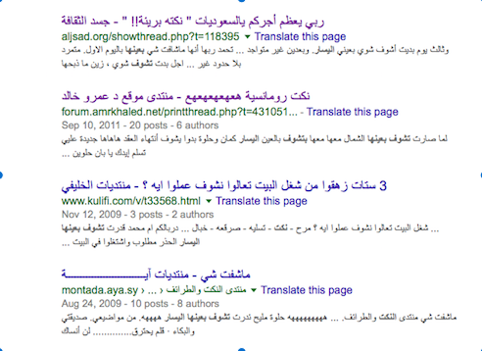

Slide 6
يقولون لك
فيه سورية ولبنانية وسعـــــــــــــودية
أتفقوا إنهم يقولون لأزواجهم إنهم ماراح يشتغلون بالبيت!:
وبعد أسبوع إلتقـوا
قالت السورية: أنا أول يوم وثاني يوم ماشفت شي وثالث يوم غسل ملابسـه بنفسه:
قالت اللبنـانيه:
أنا أول يوم وثاني يوم ماشفت شي وثالث يوم " غـداني برا”
قالت السعودية
انا أول يوم وثاني يوم ماشفت شي وثالث يوم بديت أشوف شوي بعيني اليسار

Slide 7
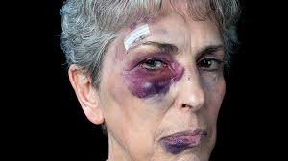
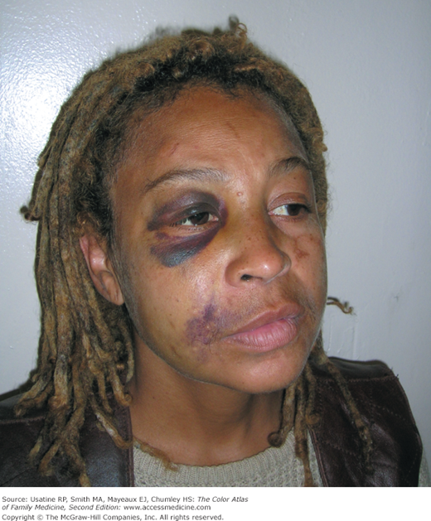
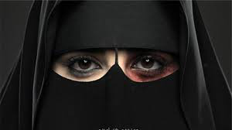
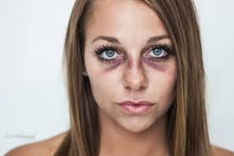

Slide 8
Definition of domestic violence

Slide 9
violence against women
VAW is defined as:
“any act of gender based violence that result in, or likely to result in, physical, sexual or psychological harm or suffering to women, including threats of such acts, whether occurring in public or private life”.
(WHO: putting women first. P7. 2001).

Slide 10
Definition of domestic violence
All behaviors/actions within the family result in mental or physical injury (or death) to another member of the family
Studies show prevalence of domestic violence varies between 10-69%.This variation is due to different study designs and cultural factors.
Saudi Arabia few studies showed similar result (incidence ?)….why

Slide 11
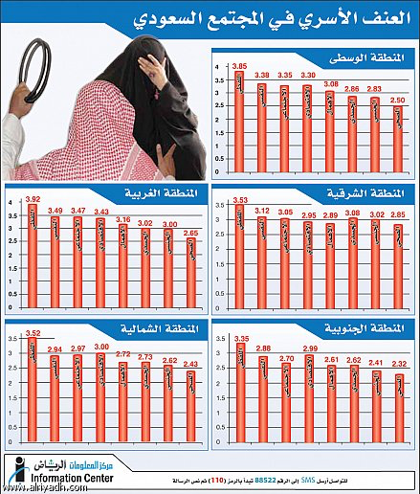
السبت6 محرم 1430هـ - 3 يناير2009م – جريدة الرياض العدد 14803

Slide 12
The annual incidence of all interpersonal violence has been estimated at 47 assaults per 1000 women and 32 assaults per 1000 men.
Other estimates suggest that as a result of the 1.3 million women and 800,000 men who are physically abused in the United States each year, there are over 2 million injuries and 1300 deaths.
Although 28% of female homicide victims were killed by their current or former male partners, only 3% of men were murdered by current or former female partners.

Slide 13
Types of violence
Types of victims

Slide 14
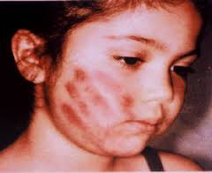
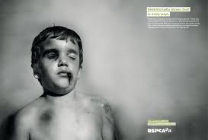
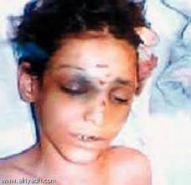
CHILD MALTREATMENT

Slide 15
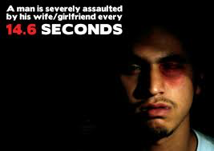
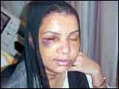
INTIMATE PARTNER VIOLENCE

Slide 16
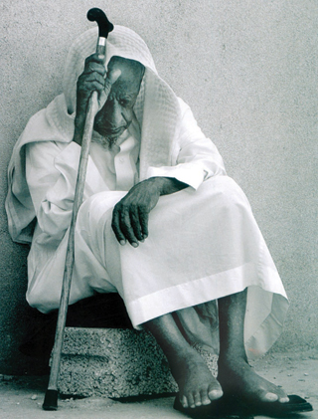
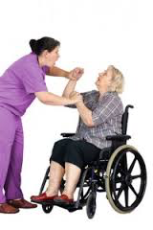
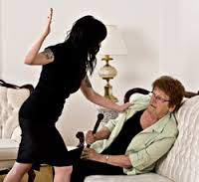
ELDER MISTREATMENT

Slide 17
Physical violence,
as defined by the Centers for Disease Control and Prevention (CDC), is the "intentional use of physical force with the potential for causing death, disability, injury, or harm."
This includes, but is not limited to, the following acts: scratching, pushing, shoving, throwing, grabbing, biting, choking, shaking, slapping, punching, burning, use of a weapon, and use of restraints or one's body, size, or strength against another person.
In the most extreme cases, physical violence may involve homicide.

Slide 18
Emotional/psychological abuse
includes humiliation, controlling behavior, repeated verbal assaults (name-calling), isolation (rejection, withholding attention and affection), threats, and public harassment, all of which can produce psychological trauma that reduces a person's self-worth, value, and sense of efficacy.
Emotional/psychological violence often coexists with chronic physical or sexual violence, but can also stand alone.

Slide 19
Financial abuse
is when a person withholds resources such as money or transportation, or limits freedom of movement or association (eg, domination, isolation) of another person—a tactic often found in abusive relationships.
Financial abuse most often involves the inappropriate transfer or use of an elder's funds for the caregiver's purposes.

Slide 20
Neglect
is the chronic failure of a person who is responsible for the physical and emotional needs of another person to provide for those needs.
This form of abuse most often occurs in family relationships and is directed at children, elders, or disabled family members. However, caregivers in other social/community settings, including child and adult day care, schools, group homes, nursing facilities, and hospitals, may be involved in neglect of a dependent person.

Slide 21
Sexual violence
is any sexual act or attempt to obtain a sexual act by violence or threat, unwanted sexual comments or advances, acts to traffic a person or acts directed against a person's sexuality, regardless of the relationship to the victim.

Slide 23
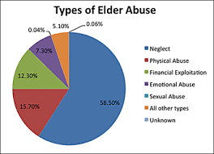
Elder Abuse
The most common form of elder abuse is neglect,
followed by physical abuse, financial exploitation,
emotional abuse, and sexual abuse.

Slide 24
Five Types of abusers/offenders have been postulated:
1- Overwhelmed Offenders
Are well intentioned and enter caregiving expecting to provide adequate care.
Amount of care expected exceeds their comfort level they lash out verbally or physically.
The maltreatment is usually episodic rather than chronic.
This is seen in long term care settings

Slide 25
Typology of abusers
2- Impaired offenders
Are well intentioned but have problems that render them unqualified to provide care.
Advanced age and frail
Physical or mental illness
Developmental disabilities
This type of maltreatment is chronic and the caregiver is unable to recognize the inadequacy of care.

Slide 26
Typology of abusers
3- Narcissistic offenders
Are motivated by anticipated personal gain and not the desire to help others.
They tend to be socially sophisticated and gain a position of trust over the vulnerable elder
Maltreatment is usually in the form of neglect and financial exploitation and is chronic in nature.
These offenders will also use psychological abuse and physical maltreatment to obtain their objective.
This type of offenders may work in a long term care facilities and become involved in stealing from the residents

Slide 27
Typology of abusers
4- Domineering or Bullying offenders
Are motivated by power and control , and are prone to outburst of rage.
Believing their actions are justified by rationalizing that the victim “deserved it”
They know where and when they can get away with abuse
This abuse is chronic, multifaceted and on going with frequent outburst of temper
Abuse take the form physical, psychological and sometimes forced sexual coercion.
The victims are fearful and the abuser may lash out when confronted or attempt to manipulate those who confront them

Slide 28
Typology of abusers
5- Sadistic Offenders
Drive feelings of power and importance by humiliating, terrifying and harming others
They have sophisticated personalities and inflict sever chronic and multifaceted abuse
Signs of this type of abuse include bite, burn, and restrain marks and other signs of physical and sexual assault.
The victims are fearful and experience terror.
If confronted the abuser may attempt to charm and manipulate OR intimidate and threaten the accuser in an attempt to control professionals who are trying to stop the abuse.

Slide 29
جريدة الرياض : غصون صورة ومرآة لباطن مجتمع!
25 كانون الثاني (يناير) 2008 ... فهل الأنظمة الحالية كافية لإنصاف كثير من قضايا العنف الأسري وحماية ضحاياها؟ .... بلطجة عائلية ! عندما يكون الجو مشحون بالتوتر والقلق، تتحول ...
الدعوه للتوعيه المجتمعيه بحقوق المراه والطفل ونبذ اشكال العنف
البعيده المدى ومنها الكابه المزمنه واهمال الذات وخصت في ورقتها العنف ضد الزوجه. وتعرضت د. سهام الصويغ عميده كليه التربيه في ورقتها عن تاثيرات العنف العائلي على الام والطفل الى العلاقه بين العنف ضد المراه
التاريخ : 2005/12/20
العنف ضد المراه... حالات اجرام فرديه مشينه مسيئه للمجتمع
العنف ضد المراه... حالات اجرام فرديه مشينه مسيئه للمجتمع
التاريخ : 2007/01/11
جريدة الرياض : العنف ضد المرأة.. يولد الاكتئاب والشعور بالدونية!!
11 شباط (فبراير) 2005 ... أما موضوع الانتحار أو التفكير بالانتحار فإن النسبة بلغت بين السيدات اللاتي تعرضن للعنف العائلي والايذاء حوالي 40,5٪ مقارنة بحوالي 4,6٪ من ...

Slide 30
جريدة الرياض : غصون صورة ومرآة لباطن مجتمع!
25 كانون الثاني (يناير) 2008 ... فهل الأنظمة الحالية كافية لإنصاف كثير من قضايا العنف الأسري وحماية ضحاياها؟ .... بلطجة عائلية ! عندما يكون الجو مشحون بالتوتر والقلق، تتحول ...
الدعوه للتوعيه المجتمعيه بحقوق المراه والطفل ونبذ اشكال العنف
البعيده المدى ومنها الكابه المزمنه واهمال الذات وخصت في ورقتها العنف ضد الزوجه. وتعرضت د. سهام الصويغ عميده كليه التربيه في ورقتها عن تاثيرات العنف العائلي على الام والطفل الى العلاقه بين العنف ضد المراه
التاريخ : 2005/12/20
العنف ضد المراه... حالات اجرام فرديه مشينه مسيئه للمجتمع
العنف ضد المراه... حالات اجرام فرديه مشينه مسيئه للمجتمع
التاريخ : 2007/01/11
جريدة الرياض : العنف ضد المرأة.. يولد الاكتئاب والشعور بالدونية!!
11 شباط (فبراير) 2005 ... أما موضوع الانتحار أو التفكير بالانتحار فإن النسبة بلغت بين السيدات اللاتي تعرضن للعنف العائلي والايذاء حوالي 40,5٪ مقارنة بحوالي 4,6٪ من ...

Slide 31
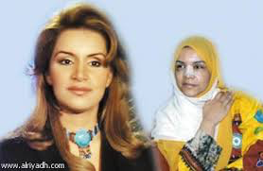
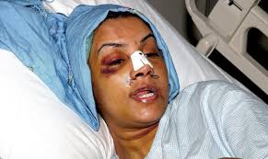
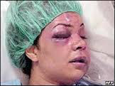

Slide 33
Risk factors

Slide 34
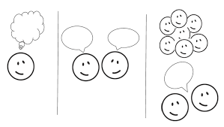
What are the risk factors that make individual be victimized?

Slide 35
Age: Findings are relatively consistent that age is protective against IPV in adulthood.
Gender: The reviewed studies generally indicate that men and women are relatively equally likely to perpetrate IPV
In clinically abusive relationships, men and women used physical abuse, although more women needed medical treatment for injury.
Education appeared to be a more significant predictor than employment status. Income was found to be a relatively strong predictor of IPV
Lussier, Farrington, and Moffitt (2009) found in a long-term study that, after controlling for antisocial behavior, the only developmental risk factor predictive of IPV in adulthood for men was low verbal IQ.
O’Donnell, Smith, and Madison (2002) found that lower income was associated with greater IPV
Capaldi et al. Capaldi et al. Partner Abuse. Author manuscript; available in PMC 2012 June 27.

Slide 36
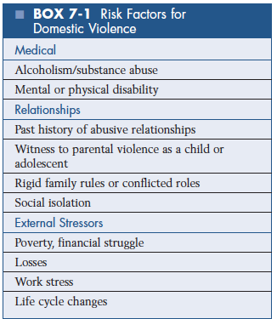

Slide 37
Sign and symptoms

Slide 38
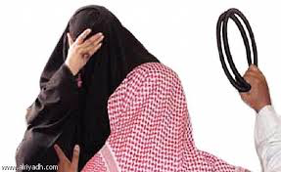
Women may present to the clinic
24 years old Saudi female is frequent attender to KKUH clinic with back-pain
18 years old Saudi female who presented to KKUH clinic with abdominal pain
Physical exam showed extensive post burn scar over the chest and abdomen

Slide 39
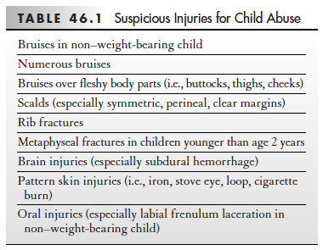

Slide 40
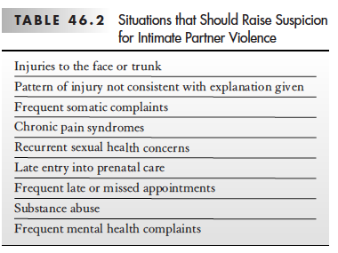
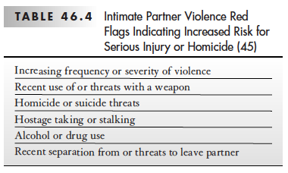

Slide 41
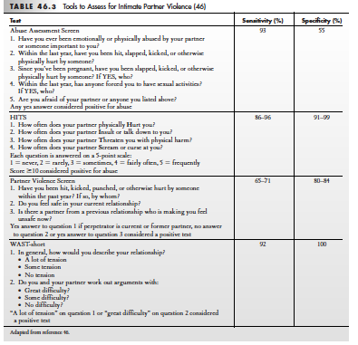

Slide 42
Impact of violence

Slide 43
Why a woman may not wish to report abuse or leave a relationship
• Fear of reprisal or counter charges being laid by their partner
• Too worn down to seek help
• Living in fear of severe violence
• Fear their children will be taken away
• Unable or to recognise the cycle of abuse
• Social isolation
• Financial dependence
• Emotional dependence and fear
• Poor self-esteem
• Cultural or religious issues

Slide 44
Consequences of domestic violenc
Family violence has a significant negative impact on health and wellbeing,
patients present to general practice with varying physical and psychological issues.

Slide 46
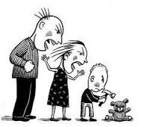

Slide 47
supportive resources in Saudi Arabia

Slide 48
The Nine steps to intervention – the 9 Rs Health practitioners need to understand their:
• Role with patients who are experiencing abuse and violence
• Readiness to be open to
• Recognize symptoms of abuse and violence, ask directly and sensitively and
• Respond to disclosures of violence with empathic listening and explore
• Risk and safety issues
• Review the patient for follow-up and support
• Refer appropriately and also
• Reflect on their own attitudes and management of abuse and violence
• Respect for patients, colleagues and themselves is an overarching principle of this sensitive work
The Royal Australian College of General Practitioners from: Abuse and violence: Working with our patients in general practice, 4th edn. Melbourne: RACGP, 2014

Slide 49
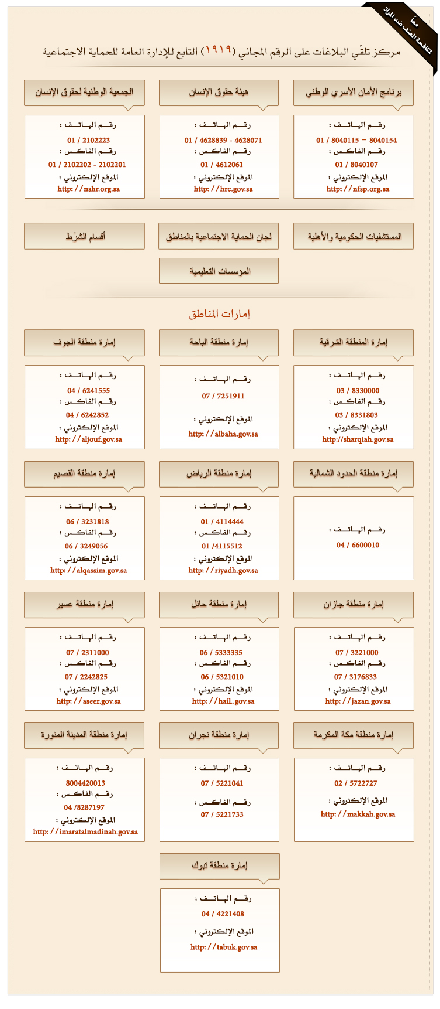
أرقام هواتف وفاكسات لجان الحماية الاجتماعية بالمناطق السعودية

Slide 50
Take-home messages:
Family violence refers to any abuse within a family and includes physical violence, emotional, sexual, economic and social abuse.
Prevalence of the domestic violence is increasing due to increase reporting
Risk factors (gender, health status, education and economy)
Family violence have a significant negative impact on health and are very common in clinical practice.
FPs are in a unique position to recognize, ask and appropriately respond to families who are experiencing violence.
Different women shelters are available for support in the Kingdom of Saudi Arabia

