Slide 1
Dr. Norah Alshehri MBBS, SBFM, ABFM, MSc in Diabetes Assistant Professor and Consultant Postgraduate trainer Family and Community Medicine Department King Saud University drnora@ksu.edu.sa
Patient Counselling

Slide 2
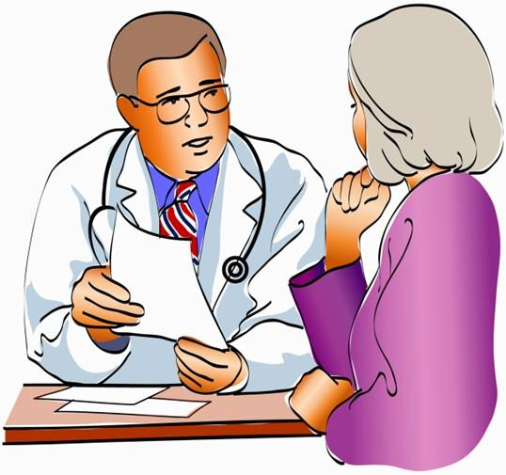
Objectives
To understand the concepts of counseling in family medicine.
To learn the counseling skills and why it is important.
To learn the stages of counseling.
To identify the possible barriers in counselling.
To be able to use counseling techniques

Slide 3
Counselling
Change cycle
Stages of counselling
Skills of counselor
Barriers of counselling

Slide 4
consultation
communication skills
counselling

Slide 5
Definition
“Counselling is a structured conversation aimed at facilitating a client’s quality of life in the face of adversity”
Johnson (2000, p.3)
It is the skilled and principled use of relationship to help the patient develop self-knowledge, emotional acceptance and growth including personal resources.

Slide 6
THE AIMS OF COUNSELLING
The aims of Counselling should always be based on the needs of the client, which are:
to help the clients manage their problems more effectively and develop unused or underused opportunities to cope more fully.
to help and empower clients to become more effective self-helpers in the future (Egan,1998).
Helping is about constructive change and making a substantive difference to the life of the client.

Slide 7
Key skills of counsellor
Listening
Believing in client
Recognize your own limitations.
Patience
Non-judgemental
Stay focused
Knowledgeable.

Slide 8
A 45-year-old lady attends the clinic regarding her symptoms of anxiety due to difficulties in her relationship with her co-workers at a school. Her examination is normal and the doctor has decided that there is no need for any investigation
Which one of the following approaches by a counselor would make counseling for this patient more effective?
Empathy during consultation*
Giving instructions how to deal with others*
Humor (being funny) on directing questions*
Teaching her to stand up for her rights*

Slide 9
6 Micro skills of counsellor
Listen Actively
Accept the clients as they are.
Listen to what your client say and how they say it. Notice the tone of the voice ,facial expression and gesture.
Keep silent sometimes. Give your client to think ,ask question.
Sit comfortably.
Look directly into the client when they speak ,not on your papers and windows.
Ensure that you are continually involved in the conversation by either “nodding head, saying then or oh”

Slide 10
According to communication expert:-
10 % of our communication represented by words.
30 % are represented by sounds we make (by mimimum verbal)
60 % are represented by body language ( eg- eye contact , body posture etc.)

Slide 11
2. Questioning
Ask the question to understand clearly the client problem or worries to help the client go deeper into his/her own awareness or insight.
Question- centered around the concerns of client and open ended.

Slide 12
At the time of asking question: Remember
Ask one question at a time.
Look at one person
Be brief and clear
Ask question that serve for purpose
Use question that enables clients to talk about their feelings and behaviours.
Use question to explore and understand issues and not to collect juicy material for gossip.
Don’t ask
Irrevalent question.
Too many question at one time.

Slide 13
3.Using silence
Give time to the client to think about what to say next.
Provide space to experience feeling.
Allows client to proceed at their own pace.
Give the client freedom to choose whether or not to continue.

Slide 14
Non-verbal behavior

Slide 15
4. Non-verbal behavior
It is not what you say but how you say is important.
Majority –non verbal
Person body language is not similar to what they are saying, it results in verbal confusion/mis-interpretation.
Effective counsellor-sensitive to nonverbal communication .
Examples :-gestures, facial expression, posture, eye contact, tapping fingers, change in voice pitch and fluency of voice.

Slide 16
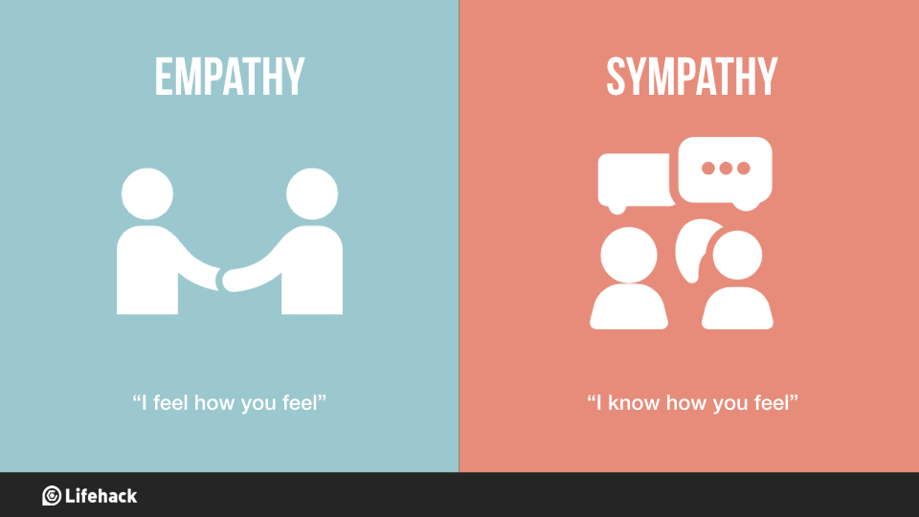
5. Accurate Empathy
Empathy means- recognition and understanding of clients thoughts and emotions.
It is characterized by ability to put oneself into another's shoes i.e experience the view point of another within oneself.
6. Paraphrasing
Counsellor repeat in his/her own words what client has said to show understanding.
Say in few words so that it can give summary of client’s word.

Slide 17
Stages of Counselling GATHER
G = Greet client in a friendly, helpful, and respectful manner.
A = Ask client about needs, concerns, and previous use.
T = Tell client about different options and methods.
H = Help client to make decision about choice of method s/he prefers.
E = Explain to client how to use the method.
R = Return: Schedule and carry out return visit and follow-up of client

Slide 18
Greet
Welcome and register client.
Prepare chart/record.
• Determine purpose of visit.
• Give clients full attention.
• Assure the client that all information discussed will be confidential.
• Talk in a private place if possible.

Slide 19
Ask
• Ask client about her/his needs.
• Write down the client's: age, marital status, number of previous pregnancies and births, number of living children, basic medical history, previous use of family planning methods, history and risk for STDs.
• Assess what the client knows about family planning methods.
• Ask the client if there is a particular method s/he is interested in.
• Discuss any client concerns about risks vs. benefits of modern methods (dispel rumors and misconceptions).

Slide 20
Tell
• Tell the client about the available methods.
• Focus on methods that most interest the client, but briefly mention other available methods.
• Describe how each method works, the advantages, benefits, possible side effects, and disadvantages.
• Answer client concerns and questions

Slide 21
Help
• Help the client to choose a method.
• Repeat information if necessary.
• Explain any procedures or lab tests to be performed.
Explain
• Explain how to use the method (how, when, where).
• Explain to the client how and when s/he can/should get resupplies of the method, if necessary.

Slide 22
Return
• At the follow-up or return visit ask the client if s/he is still using the method.
• If the answer is yes, ask her/him if s/he is experiencing any problems or side effects and answer her/his questions, solve any problems, if possible.
• If the answer is no, ask why s/he stopped using the method and counsel her/him to see if s/he would like to try another method or re-try the same method again.
• Make sure s/he is using the method correctly (ask her/him how s/he is using it).

Slide 23
Counselling and health education
 | Counselling | Health education
1. | Confidential | Not confidential
2. | One to one process or a small group. | For a group of people
3. | Focused, specific and goal directed | Generalized
4. | Facilitates change in attitude and motivates behavior change | Information is provided to increase the knowledge
5. | Problem oriented | Content oriented
6. | Based on needs of client | Based on public health needs.

Slide 24
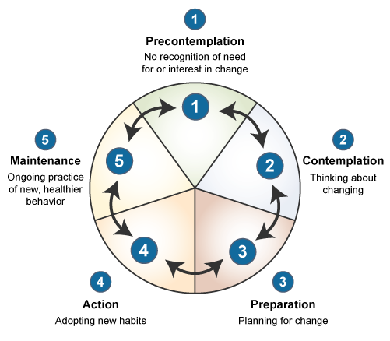
Cycle of changes

Slide 25
https://www.youtube.com/watch?v=Twlow2pXsv0

Slide 26
Barriers to Counseling in Clinical Practice
Personal Barriers
Lack of training: undergraduate/postgraduate
Undervaluing importance of communication
Focus only on treating diseases
Personal Limitations
Organizational Barriers
Lack of time
Pressure of work
Interruptions

Slide 27
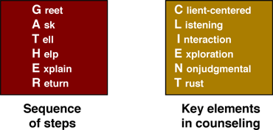
Conclusion
Counselling is a process and not merely a technique through which clients are helped to modify their behavior and cope with their status effectively.
Counselling is not
Telling or directing
Giving advice
A casual concern
A confession
Praying

Slide 28
Roll play

