Slide 1



Evidence-based Health Care (2)
Dr. Nada A. AlYousefi
Associate Professor, Postgraduate Trainer and Consultant of Family Medicine
International Board Certified Lactation Consultant
Department of Family and Community Medicine
College of Medicine, King Saud University (KSU)
nalyousefi@ksu.edu.sa
January 2019

Slide 2
Introduction to Critical Appraisal
WHY APPRAISE THE EVIDENCE?
  Where an article is published, or who wrote it should not be an indication of its trustworthiness and relevance. Using critical appraisal skills and tools enables users of research evidence to reach their own judgements.

Slide 3


Slide 4
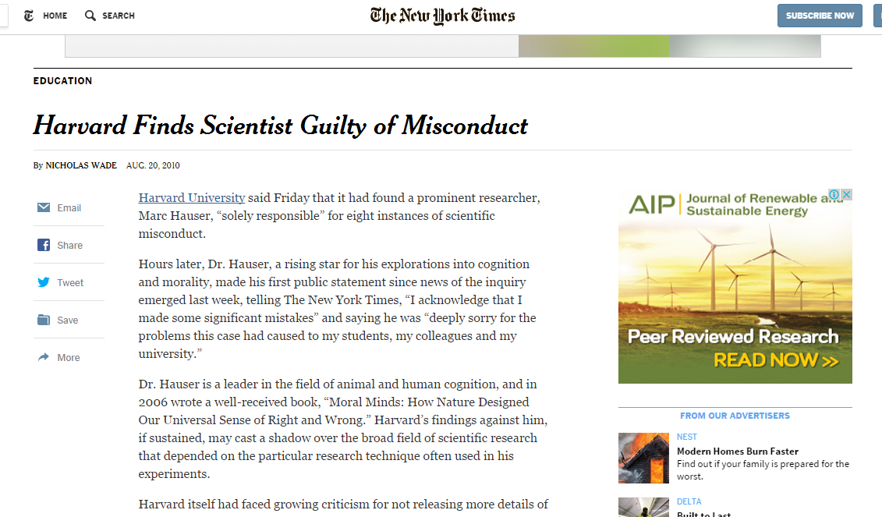

Slide 5

They concluded that Hauser had fabricated data in one study, manipulated results in multiple experiments, and incorrectly described how studies were conducted.

Slide 6
Importance
Combat information overload.
Identify papers that are clinically relevant.
Continuing Professional Development (CPD) - critical appraisal is a requirement for the evidence based medicine component of many membership exams.
Research interest.

Slide 7

How to read a research article?

Slide 8
Structure of an article
1. Title
2. Abstract
3. Introduction
4. Background / review of literature
5. Organizational context
6. Methodology
7. Results
8. Discussion

Slide 9
Structure of an article
Title
Not always a good indication of the content of the article
Example: “The Risks of Autonomy: Empirical Evidence for the Necessity of a Balance Management in Promoting Organizational Innovativeness” ??????

Slide 10
Structure of an article
2. Abstract
Sometimes unclear. What should be in it: a summary of the the research question, key methods, results and conclusions of the study

Slide 11
Structure of an article
3. Introduction
Should contain the research question (PICO) or hypotheses tested
4. Background / review of literature
Research questions occur in the context of an already-formed body of knowledge. The background should address this context, help set the rationale for the study, and explain why the questions being asked are relevant.

Slide 12
Structure of an article
5. Research setting (organizational context)
6. Methodology
Should describe exactly how the research was carried out:
- Sample: characteristics, selection, number, non-response
- Measures: description of tests / questionnaires (validated?), data, outcome measures
- Procedure: study design (qualitative, quantitative, controlled?)

Slide 13
Structure of an article
7. Results
Should tell the reader what the findings were. All outcome measures must be reported and confidence intervals for effect sizes should be presented.
8. Discussion
Interpretation of the results / relation to theory
Comparison with the results of other studies
Weaknesses / limitations of the study
Implications
Recommendations

Slide 14
In general
Don’t let yourself be taken in by scientific jargon and complex use of language. Good articles are written in plain English!
Even authorative journals with a high impact factor contain bad articles and vice versa.
Focus on research question, study design and outcome.
Be critical!! Always ask yourself: does this make sense?

Slide 15
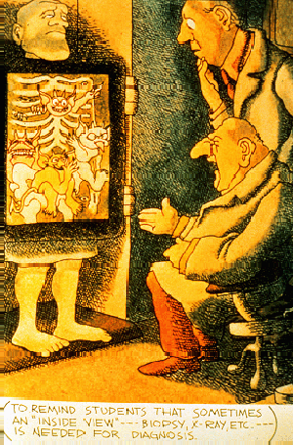

Slide 16
Critical appraisal of different study designs
To critically appraise a journal article, you would have to start by assessing the research methods used in the study.
Checklists - specific to the study design.
The following checklists are commonly used:
  CEBMH http://cebmh.warne.ox.ac.uk/cebmh/education_critical_appraisal.htm

Slide 17

Tools for critical appraisal
CASP: Critical Appraisal Skills Programme Checklists
Critically Appraised Topics: generic systematic reviews (ACP Journal club)
SIGN: Scottish Intercollegiate Guidelines Network
GATE Frame
Notes:
AMSTAR = A measurement tool to assess systematic reviews
Shea et al. BMC Medical Research Methodology 2007 7:10uality of Systematic Reviews

Slide 18
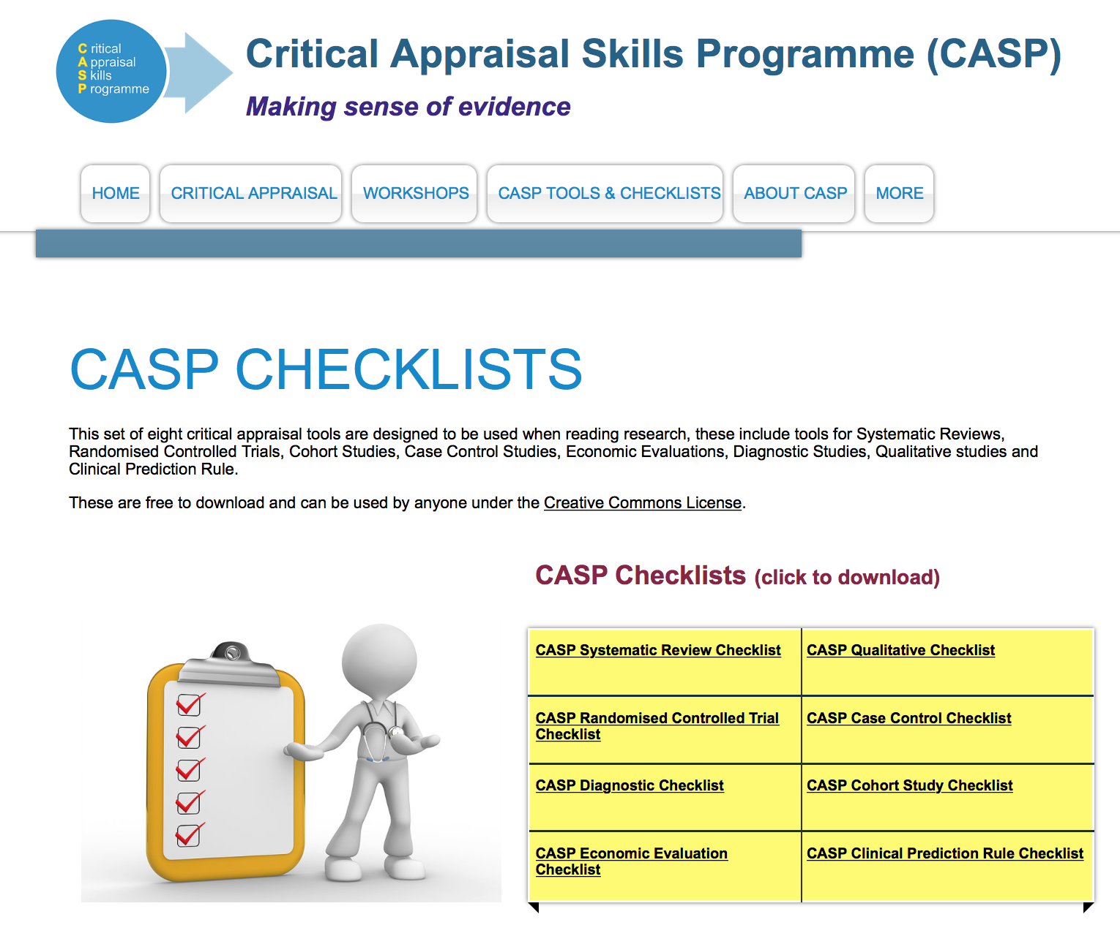

Slide 19
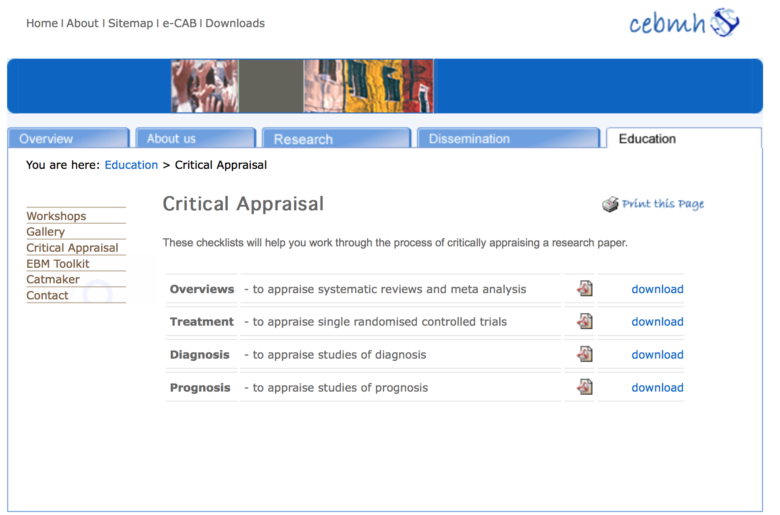

Slide 20
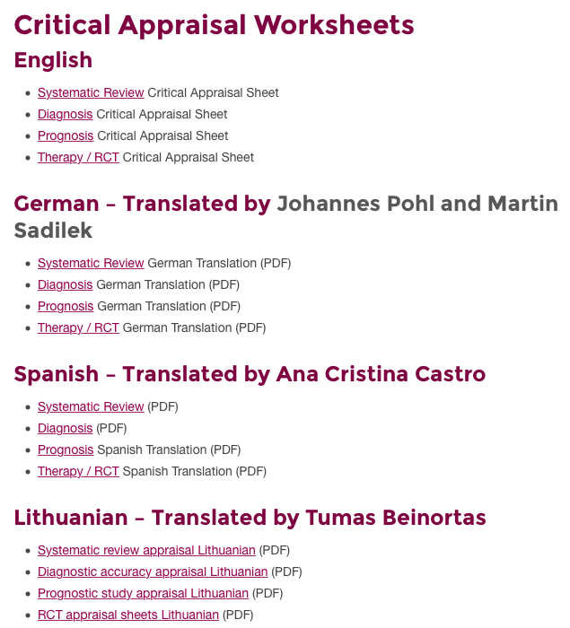


Slide 21
5-step approach
EBM is a 5-step approach
Formulate an answerable question (PICOC)
Search for the best available evidence
Critically appraise the quality of the found evidence
Integrate the evidence with managerial expertise and organizational concerns and apply
Monitor and evaluate the results

Slide 22
APPRAISING THE EVIDENCE
1. Is the study valid?
  Decide whether studies have been undertaken in a way that makes their findings reliable.
2. What are the results?
  Make sense of the results.
3. Are the results useful?
  Know what these results mean in the context of the decision that needs to be made.
Notes:
1. Is the study valid?
The first step is to decide whether the study was unbiased by evaluating its methodological quality. Different criteria for validity of articles are used for different types of questions on: treatment, diagnosis, prognosis and economic evaluation. Depending on the validity of an article we can classify it within a scale of levels of evidence and degrees of recommendation.
2. What are the results?
If we decide that the study is valid, we can go on to look at the results. At this step we consider whether the study’s results are clinically important. For example, did the experimental group show a significantly better outcome compared with the control group? We also consider how much uncertainty there is about the results, as expressed in the form of p values, confidence intervals and sensitivity analysis.
3. Are the results useful?
Once you have decided that your evidence is valid and important, you need to think about how it applies to your question. It is likely, for example, that your patient or population may have different characteristics to those in the study. Critical appraisal skills provides a framework within which to consider these issues in an explicit, transparent way.

Slide 23
What’s A Paper on Therapy?
Randomised Control Trials
Objectives
  Understand why randomised controlled trials produce the most reliable evidence for questions about effectiveness
  Understand the important elements of trial design to minimise bias
  Have critically appraised a randomised controlled trial

Slide 24
What’s A Paper on Therapy?
Clinical Trial (Controlled) Compares
INTERVENTION
with
CONTROL

Slide 25
Clinical Trial Compares
  INTERVENTION
    Drug (New)
    Structured exercise program (e.g. osteoporosis)
    Surgical procedure
  CONTROL
    Placebo, old drug or old intervention
    Usual regular advise given (osteoporosis)
    Another surgical procedure / No surgery

Slide 26
Process of RCTs
Preparation: Randomization, Computer generated list
Eligibility assessment (Inclusion/exclusion)
Consent
Allocation to study arms (Concealment)
Baseline assessment
Initiation of intervention (Blind)
Follow-up
Outcome assessment
Data analysis

Slide 27
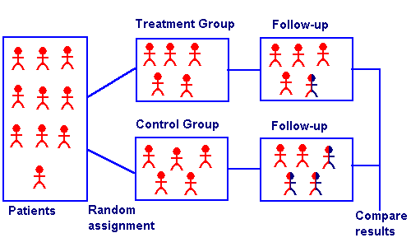

Slide 28
Appraise the Evidence
Assess validity? Correctness (likely to be true)
What are the results? Clinically important
Can we apply the results to our patient? Applicable in and useful for my patients

Slide 29
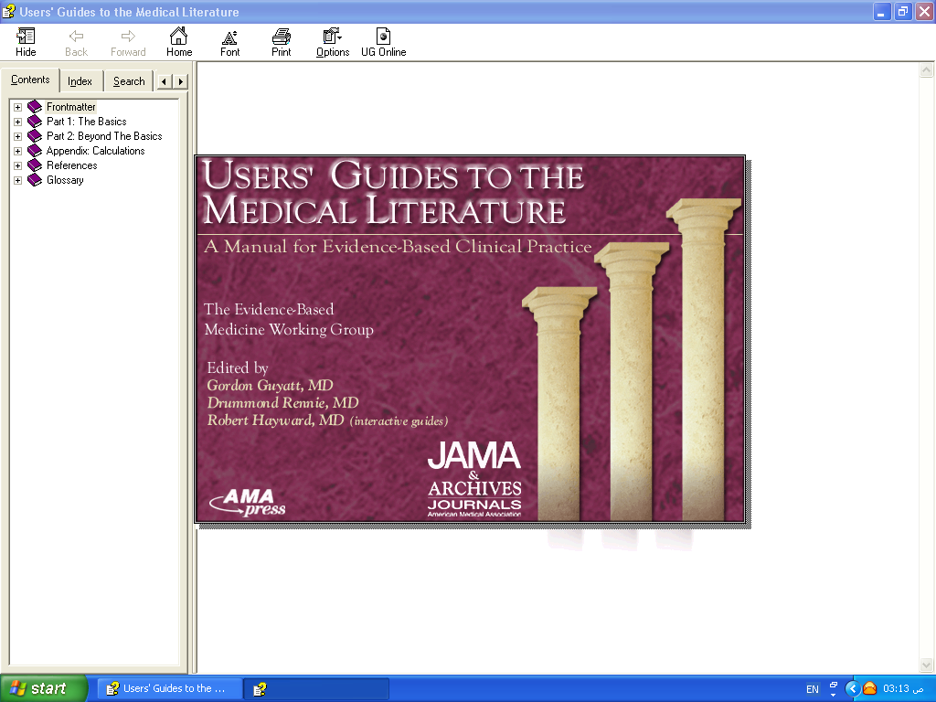
APPLICABILITY
VALIDITY
RESULTS

Slide 30
Validity
Internal validity: How well was the study done? Do the results reflect the truth?
External validity: can I apply these results to MY patients?
Notes:
4
When we consider validity, we really need to look at two types of validity. Internal validity is, basically, how well methodologically was the study performed. In other words, was the study design rigorous enough so that we can be confident that the researchers found what they think they found? We’re asking how well do the results reflect the truth of what actually happens in the world.
External validity asks the results found in the study apply to people not included in the study. In other words, can I apply these results to my patients? We need to determine the generalizability of the study to the population of patients we see. Rarely do we have a study that includes all types of patients and there are usually many types of exclusion and inclusion criteria that frequently do not apply to our patients. It’s important for us to determine whether or not these results really have a probability of similarly affecting our particular patients.
For more on generalizability, see: Altman DG, Bland JM. Generalisation and extrapolation. BMJ 1998;317:409-10.

Slide 31
VALIDITY
Randomization.
Concealment.
Blindness.
Follow up complete.
Intention to treat.
Similar groups at start.
Both groups treated equally.

Slide 32
Are the results of this single preventive or therapeutic trial valid?
 | Was the assignment of patients to treatments randomised? Was the randomisation list concealed?
 | Was follow-up of patients sufficiently long and complete?
 | Were all patients analysed in the groups to which they were randomised?
 | Were patients and clinicians kept "blind" to treatment?
 | Were the groups treated equally, apart from the experimental treatment?
 | Were the groups similar at the start of the trial?

Slide 33
Randomization
Randomisation = similar groups at baseline
Equal (50%) chance to be in either group
How was it randomized?
Was randomization concealed?
- selection
- allocation

Slide 34

Was allocation assignment “concealed”?
Did investigators know to which group the potential subject would be assigned before enrolling them?
Notes:
The gold standard for a therapeutic trial is no longer simply just the concept of randomization, but is also whether or not allocation assignment was concealed from the enrolling investigator (“concealed allocation). It has only been in the last 5 to 8 years that allocation concealment has been discussed or even mentioned in the medical literature. This is a very difficult concept for many and our goal in discussing it now is not for participants to fully understand it, but to grasp its importance. The definition of concealed allocation: Did the investigators know to which group a potential subject would be assigned before they were actually enrolled in this study?

Slide 35
Importance of concealed allocation
Trials with unconcealed allocation consistently overestimate benefit by ~40%
Schulz KF, Chalmers I, Hayes RJ, et al. JAMA 1995;273:408-12
Schulz KF, Grimes DA. Lancet 2002;359:614-18.
Pildal J, et al. Int J Epidemiol 2007;36:847-857
Moher D, et al. Lancet 1998;352:609-13.
Notes:
Dr. Schultz and his colleagues first identified the importance of concealing allocation assignment in 1995. Trials of certain interventions that did not use conceal allocation compared with similar trials that concealed allocation consistently overestimate the benefit of the treatment by 40%. Few clinicians and few studies knew about the importance of allocation concealment before 1995. What we think we know that was published before 1995 may be biased by the lack of allocation concealment.
See: Schulz KF, Chalmers I, Hayes RJ, et al. Subverting randomization in controlled trials. JAMA 1995;273:408-12. Schulz KF, Grimes DA. Allocation concealment in randomised trials: defending against deciphering. Lancet 2002;359:614-18.
Also: Altman DG, Schulz KF. Concealing treatment allocation in randomised trials. BMJ 2001;323:446-7. Schulz KF, Grimes DA. Generation of allocation sequences in randomised trials: change, not choice. Lancet 2002;359:515-9. Torgerson DJ, Roberts C. Randomisation methods: concealment. BMJ 1999;319:375-6.

Slide 36
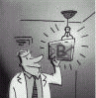
Ensuring Allocation Concealment
BEST – most valid technique
Central computer randomization
DOUBTFUL
Envelopes, etc
NOT RANDOMIZED
Date of birth, alternate days, etc

Slide 37
Conducting a Study
Potential Subjects
Concealed
Allocation
Trial starts
Actual
Subjects
A
Randomization
Blinding, etc
B
Notes:
This is a schematic of the difference between randomization and blindness and concealed allocation. Concealed allocation occurs before the trial even starts. Randomization and blinding occur after the study subjects are enrolled.

Slide 38
Selection bias
Reduced by:
centralised randomisation
on-site computer system with group assignments in a locked file
sequentially numbered, sealed, opaque envelopes
Not: alternation, dates of birth, day of week.

Slide 39
Blindness
Was study “double-blinded”?
Did the patients know to which group they were assigned?
Did the treating physician know?
Did investigators assessing outcomes know (“triple-blinding” – up to 7 levels!)?
  Judicial assessor blind + allocation concealment = surgery RCTs
Schulz KF. Ann Int Med 2002;136:254-9.
Notes:
Do the patients know to which group they were actually assigned? Did they know what treatment they received? Did the physician who gave the treatment know what treatment the patient received? Did the individual assessing the outcome know what treatment the patient received? This is called “triple blinding” when all three don’t know the group assignment. There are actually seven levels of blinding, but the most important are these three.

Slide 40
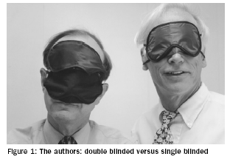
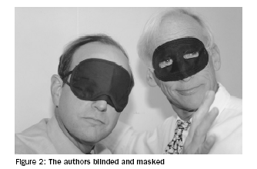
Measurement Bias - minimizing differential error
Blinding – Who?
  Participants?
  Investigators?
  Outcome assessors?
  Analysts?
Most important to use "blinded" outcome assessors when outcome is not objective!
Papers should report WHO was blinded and HOW it was done
Schulz and Grimes. Lancet, 2002

Slide 41
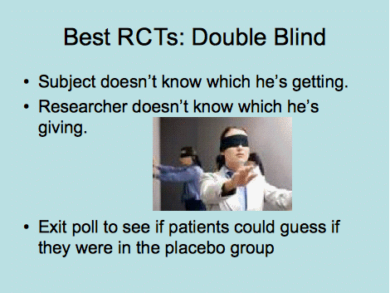

Slide 42
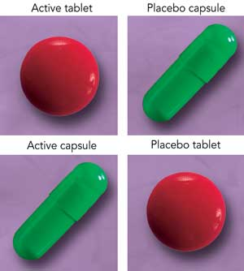
Notes:
42

Slide 43
Blindness
If patient knows: Placebo effect Those who are on effective treatment perform better than those who receive Placebo
If Physician knows: Overestimate Treatment effect (More care, Co-intervention)

Slide 44
Selection bias
Performance bias
Rx
Follow-up
Potential
Subjects
Outcome
Concealed
Allocation
Blindness
C
Intervention starts

Slide 45

Two balanced groups:
Start Balanced: All prognostic factors are equally distributed at the start (Concealed Randomization)
Run Balanced: All prognostic factors are maintained balanced throughout the study (Blindness and the 3C)
End Balanced: All prognostic factors are maintained balanced at the end of the study (ITT)
Intervention
Notes:
Compliance contamination co intervention

Slide 46
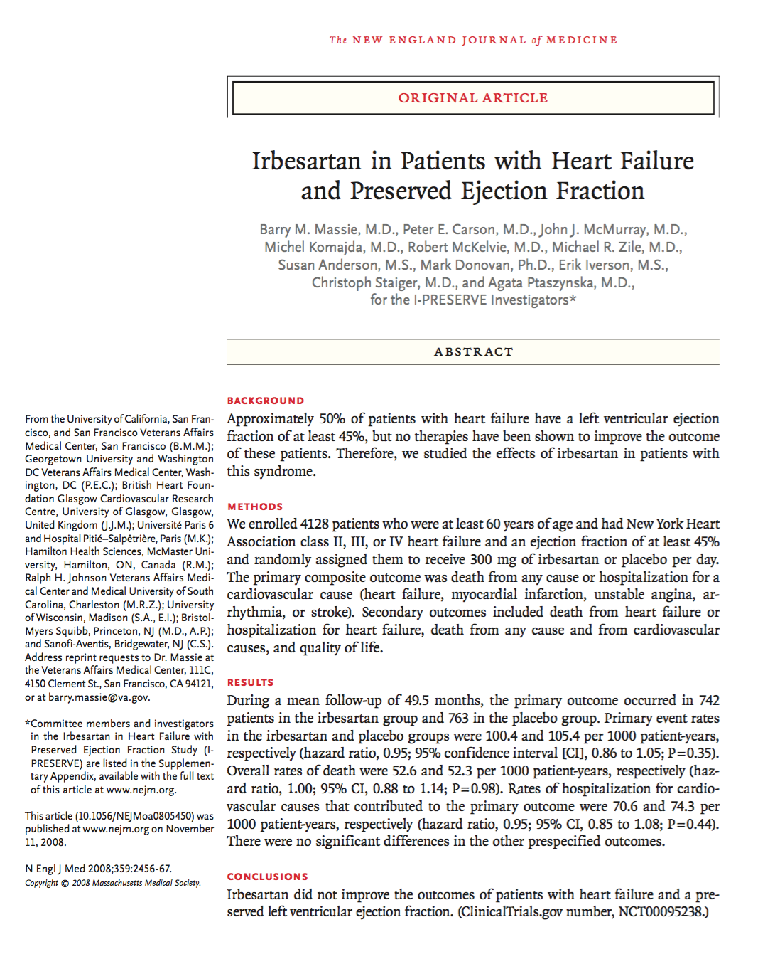

Slide 47
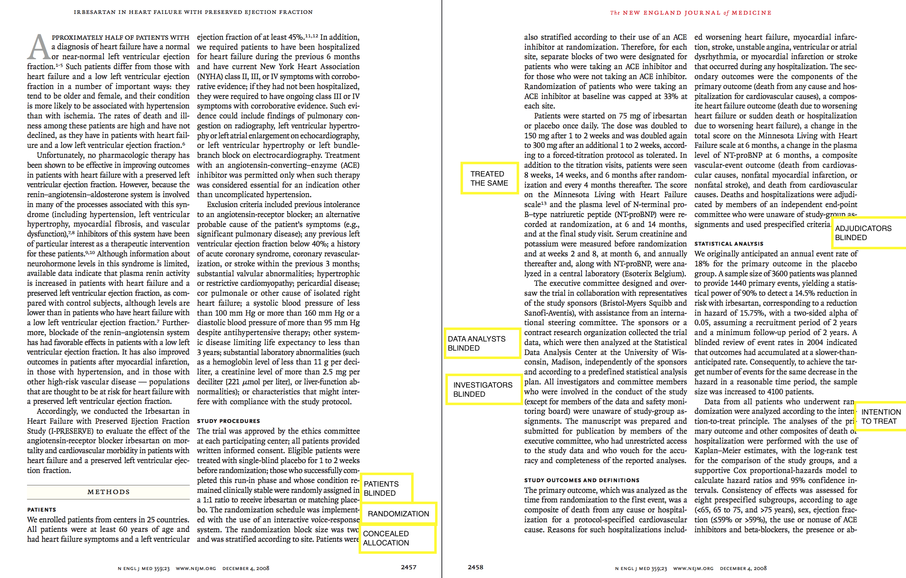

Slide 48
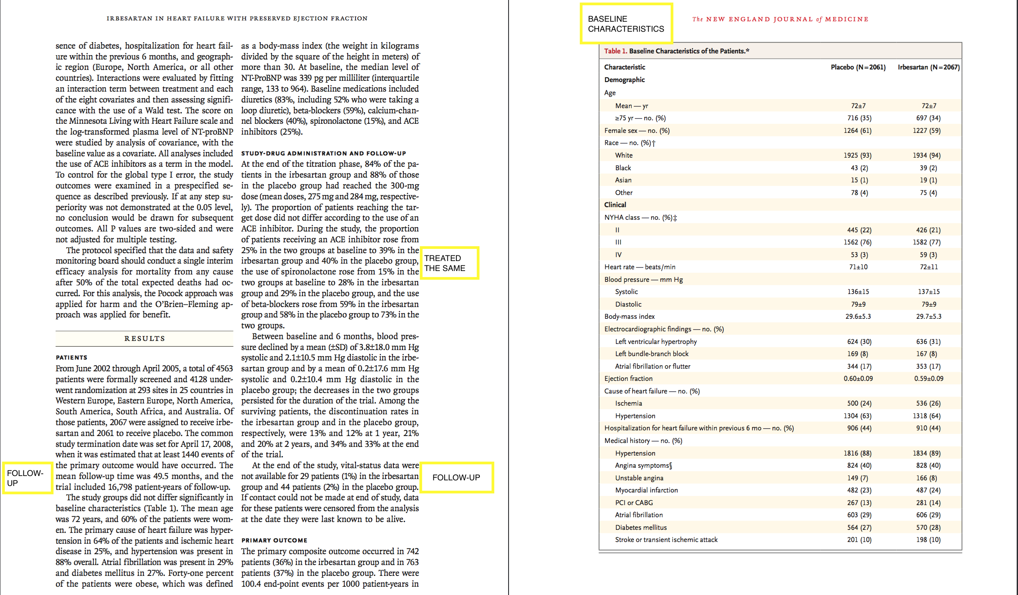

Slide 49
VALIDITY
Randomization.
Concealment.
Blindness.
Follow up complete.
Similar groups at start.
Both groups treated equally.
Intention to treat.

Slide 50
INTENTION TO TREAT
All patients analyzed in the groups
to which they were allocated

Slide 51
INTENTION TO TREAT (ITT)
200
intervention
control
100
100
50
30
Drop out
Drop out
50
70
40
IMPROVED
40
80%
OR
40%
57%
OR
40%

Slide 52
Were all patients analysed in the groups to which they were randomised?

Slide 53
2000 RANDOMIZED
A
1000
B
1000
200
100
800
270=IMPROVED
900
IMPROVED= 130
EER= 270/?
CER=130/?

Slide 54
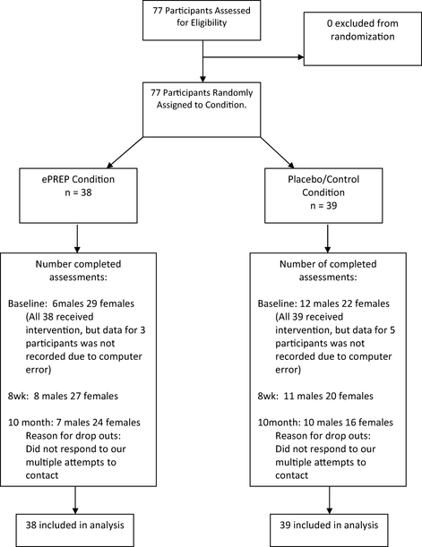

Slide 55
Follow up
● duration of study.
● drop out < 20%.

Slide 56
Was follow-up of patients sufficiently long and complete?

Slide 57
Results
“Importance”
Magnitude (treatment effect)

Slide 58
Definition
Number Needed to Treat (NNT):
  Number of persons who would have to receive an intervention for 1 to benefit.
  NNT=1/ARR

Slide 59
2000 RANDOMIZED
A
1000
B
1000
200
100
800
270=IMPROVED
900
IMPROVED= 130
EER= 270/?
CER=130/?

Slide 60
EER=270/800 = 33%= 0.33
CER= 130/900=14 %=0.14
ARR= 0.33-0.14= 0.19
NNT=1/0.19= 5.2=6
EER=270/1000=27%=0.27
CEER=130/1000= 13%=0.13
ARR=0.27-0.13=0.14
NNT=1/0.14=7

Slide 61
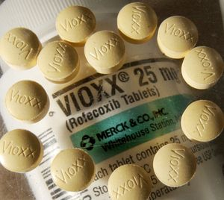
NUMBER NEED TO HARM(NNH)
WHAEN THE OUTCOME IS UNFAVOURABLE

Slide 62
Magnitude (treatment effect):
Absolute effects (ARR & NNT)
Relative effects (RR, RRR )

Slide 63
Result Tabulation
 | Event + Ve | Event - Ve | Total
Experimental | a | b | a+b
Control | c | d | c+d
EER = Experimental Event Rate (a/a+b)
CER = Control Event Rate (c/c+d)

Slide 64
Result Tabulation
 | Bleeding present | Bleeding Absent | Total
Drug A | 20 | 80 | 100
Drug B | 40 | 60 | 100
EER-A (Risk A) = 20/100 = 20% (0.2)
CER-B (Risk B) = 40/100 = 40% (0.4)

Slide 65
Calculations
ARR = CER - EER
NNT = 1 / ARR
RR = EER/CER (Risk A/Risk B)
RRR = 1- RR

Slide 66
Result Tabulation
 | Bleeding present | Bleeding Absent | Total
Drug A | 20 | 80 | 100
Drug B | 40 | 60 | 100
ARR = CER - EER NNT = 1 / ARR
RR = EER/CER RRR = 1- RR

Slide 67
Calculations
ARR = CER – EER = 0.4 – 0.2 = 0.2 (20%)
NNT = 1 / ARR = 1/0.2 = 5
RR = EER/CER = 0.2/0.4 = 0.5
RRR = 1- RR = 1- 0.5= 0.5 (50%)

Slide 68
Precision
Confidence intervals:
  The range within which the likelihood of a true value is expected to be within a given degree of certainty, usually evaluated at 95% CI.
  P value

Slide 69
APPLICABILITY

Slide 70
CAN I APPLY THESE VALID, IMPORTANT RESULTS TO MY PATIENT?
Do these results apply to my patient?
- IS OUR PATIENT SO DIFFERENT?
- IS THE TREATMENT FEASIBLE?
- POTENTIAL BENEFITS AND HARMS
Are my patient’s values and preferences satisfied by the intervention offered?

Slide 71

Summary
Validity - is the paper likely to be true
Importance - size of effect
  NNT
  Percision
Applicability - can it work for me/my setting

Slide 72
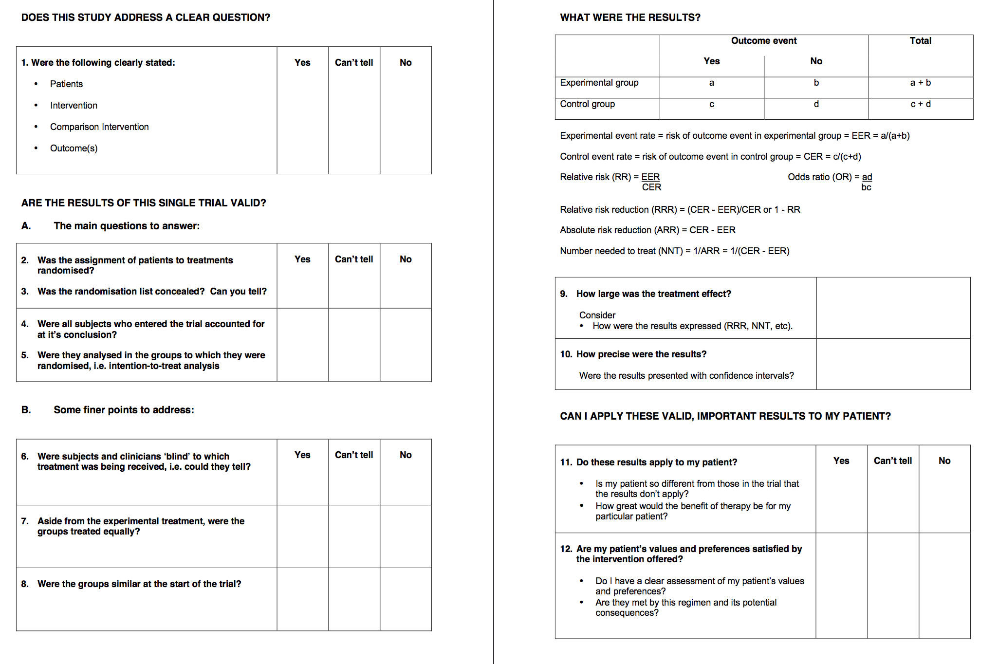

Slide 73

Evaluating Research about Diagnostic Tests

Slide 74
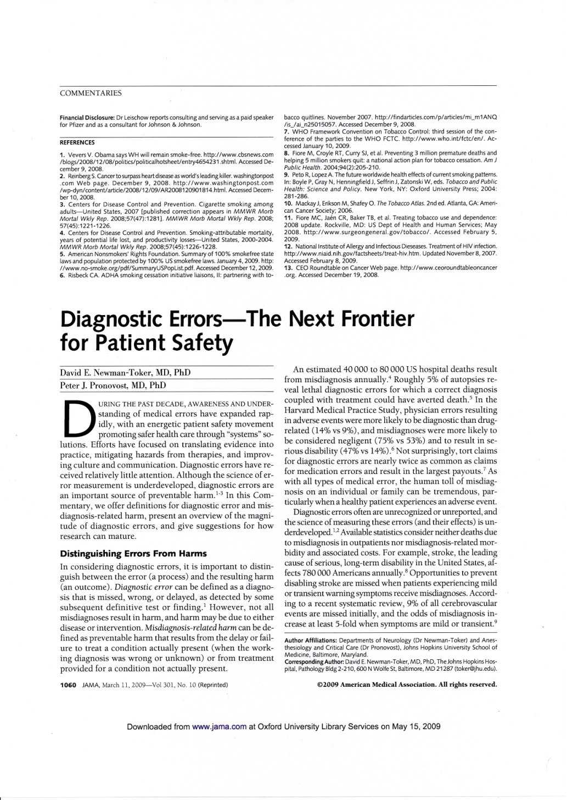
40,000-80,000 US hospital deaths from misdiagnosis per year
Diagnosis uses <5% of hospital costs, but influences 60% of decision making

Slide 75
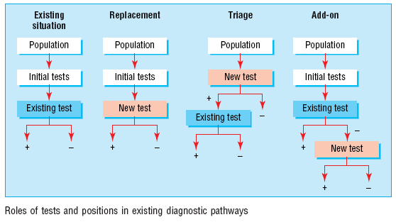
Roles of a new test
Replacement – new replaces old
  E.g., CT colonography for barium enema
Triage – new determines need for old
  E.g., B-natriuretic peptide for echocardiography
Add-on – new combined with old
  ECG and myocardial perfusion scan
Bossuyt et al BMJ 2006;332:1089–92

Slide 76
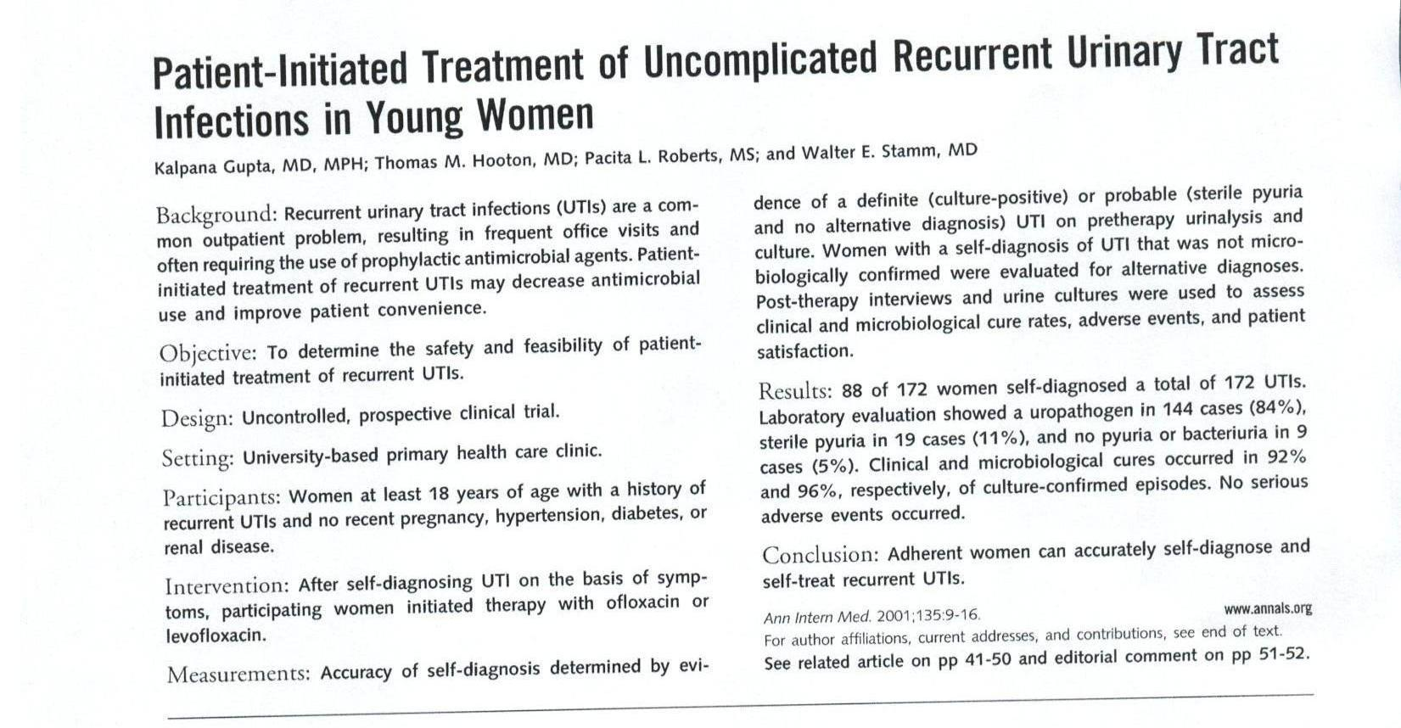
Read this abstract
Scan in UTI abstract

Slide 77
Series of patients
Index test
Reference (“gold”) standard
Compare the results of the index test with the reference standard, blinded

Slide 78
Reference standard
Scan in UTI abstract
Accuracy
Series of patients
Index test

Slide 79
2 by 2 table
Reference test
+
-
+
Index Test
-

Slide 80
2 by 2 table
Reference test
+
-
True positive
False positive
+
Test
False negative
True negative
-

Slide 81
IF only a test had perfect discrimination…
Reference test
+
-
True positive
+
Test
True negative
-

Slide 82
Sensitivity
Disease
+
-
Proportion of people with the disease who have a positive test.
+
a
b
Test
c
d
-
Sensitivity = a / a + c

Slide 83
Specificity
Disease
Proportion of people without the disease who have a negative test.
+
-
+
a
b
Test
c
d
-
Specificity = d / b + d

Slide 84
ROC curves (Receiver Operating Characteristic curves) – What are they and what aren’t they?

Slide 85
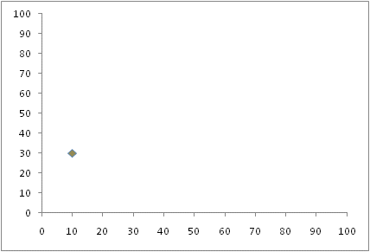
ROC curves – provide accuracy results over a range of thresholds
A test with 30% sensitivity and 90% specificity (10% false positive rate) at one cut-point is plotted in the lower left corner.
Sensitivity
1-Specificity or false positive rate

Slide 86
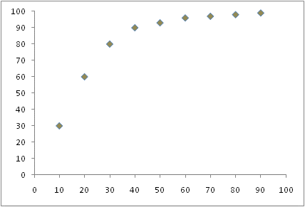
Perfect test = upper left hand corner
Diagonal = no discrimination
Area under the curve (AUC)
0.5 = useless
1.0 = perfect
Sensitivity
1-Specificity

Slide 87
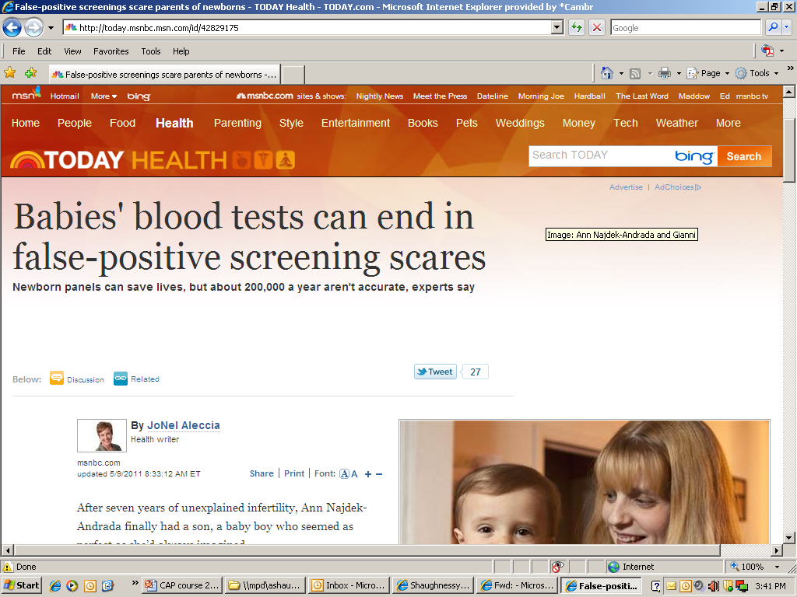
Why this is important
http://today.msnbc.msn.com/id/42829175

Slide 88
What about positive and negative predictive values?

Slide 89
positive predictive value (PPV)
Disease
+
-
PPV = a / a + b
+
a
b
Test
Proportion of people with a positive test who have the disease
c
d
-

Slide 90
negative predictive value (NPV)
Disease
+
-
+
a
b
Test
NPV = d / c + d
c
d
-
Proportion of people with a negative test who do not have the disease

Slide 91
Sensitivity/specificity
Disease status known
Not as dependent on prevalence
but can be affected by disease spectrum eg selection of patients
Positive/Negative predictive values
Test result known
Depend on prevalence

Slide 92
Likelihood Ratios and Bayesian reasoning
Can use in situations with more than 2 test outcomes
Direct link from pre-test probabilities to post-test probabilities

Slide 93
Positive and negative likelihood ratios
LR+ How much more often a positive test occurs in people with compared to those without the disease
LR+ = a/a+c / b/b+d
Or
LR+ = sens/(1-spec)
LR- How less likely a negative test result is in people with the disease compared to those without the disease
LR- = c/a+c / d/b+d
Or
LR- = (1-sens)/(spec)

Slide 94
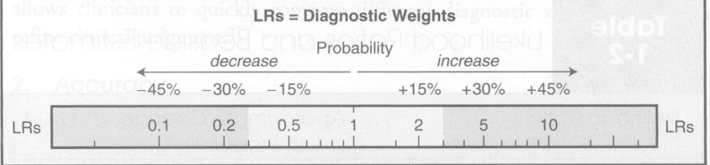
LR=1
No diagnostic value
LR>10 …. strong positive test result
LR<0.1…. strong negative test result

Slide 95
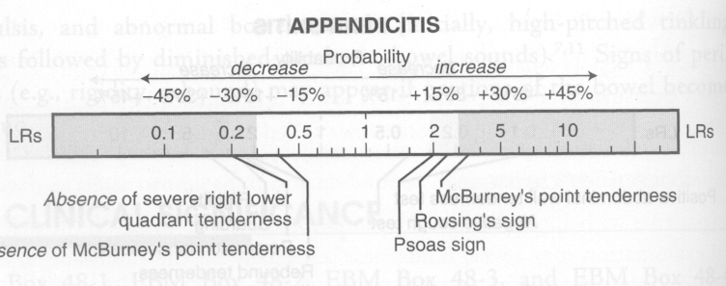
McGee: Evidence based Physical Diagnosis (Saunders Elsevier)

Slide 96
Bayesian reasoning
Post-test odds = Pre-test odds x Likelihood ratio
Post-test odds for disease after one test become pre-test odds for next test etc

Slide 97
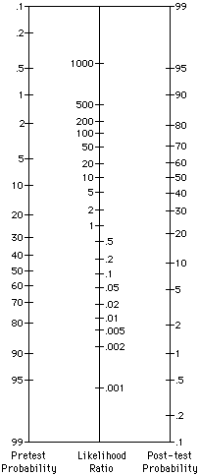
%
Bayesian reasoning using Fagan Nomogram
Pre test 5%
Post test 20%
? Appendicitis:
McBurney tenderness LR+ = 3.4
%

Slide 98
TEST
+
TEST
-
Notes:
98
By convention, the 2 x 2 table is set up this way, with the disease on the top and the test on the side. It’s not absolutely necessary to do it this way, but doing so in a consistent way makes it easier to organize data. Box A includes patients with the disease who test positive (true positives). Box B includes patients who test positive that don’t have the disease (false positives). Box C includes patients with the disease who test negative (false negatives). Box D includes patients without the disease who test negative (true negatives).
See: Sackett DL, et al. Clinical Epidemiology: A Basic Science for Clinical Medicine. 2nd ed. Boston: Little, Brown and Company, 1996. Jaeschke R, Guyatt GH, Sackett DL. Users' guides to the medical literature. III. How to use an article about a diagnostic test. A. Are the results of the study valid? JAMA 1994;271:389-91. Jaeschke R, Guyatt GH, Sackett DL. Users' guides to the medical literature. III. How to use an article about a diagnostic test. B. What are the results and will they help me in caring for my patients? JAMA 1994;271:703-7.

Slide 99
Sensitivity
TEST
+
TEST
-
Notes:
99
The sensitivity of the test is defined as the percentage of people with the disease who test positive (true positives/(true positives + false negatives); a/(a+c). A 100% sensitive test is positive for everyone who has the disease. A test that is positive for only half of those with the disease has a 50% sensitivity.

Slide 100
Specificity
TEST
+
TEST
-
Notes:
100
Specificity is the percentage of people not having the disease who test negative (true negatives/(true negatives + false positives); d/(b+d). A specificity of 99% means that 99% of patients without a particular disease will test negative. There is only one person out of 100 testing positive, or a 1% false positive rate.

Slide 101
Positive Predictive Value
TEST
+
TEST
-
Notes:
101
These slides summarize how the Table can be used to calculate sensitivity, specificity, positive and negative predictive values. For visual learners, the key to these illustrations is that sensitivity and specificity are calculated “up and down,” and the predictive values are calculated horizontally.

Slide 102
Negative Predictive Value
TEST
+
TEST
-
Notes:
102
These slides summarize how the Table can be used to calculate sensitivity, specificity, positive and negative predictive values. For visual learners, the key to these illustrations is that sensitivity and specificity are calculated “up and down,” and the predictive values are calculated horizontally.

Slide 103
Likelihood Ratios
Similar to the concepts of “ruling in” and “ruling out” disease
Pre Test Odds x LR = Post Test Odds
The problem – we don’t think in terms of odds
Clinical decision rules: Do the hard math for us, be we need to enter the appropriate data and interpret results
Notes:
103
The likelihood ratio is a measure, like sensitivity and specificity, that tells us the accuracy with which the test identifies the target disorder. The likelihood ratio tells us, after the test results are known, how much the pretest probability is increased or decreased. A positive likelihood ratio for a specific test of 19, for example, simply means that the likelihood of the disease being present is 19 times higher than the pretest probability (or likelihood) would have us think. Likewise, a negative likelihood ratio of 0.5 simply means that individuals testing negative are half as likely to have the disease as that predicted by their pretest probability.
The best part about likelihood ratios is that, by converting percentages into odds, we can multiply the odds by the likelihood ratio and derive the new odds, and then convert again back to percentages (the last step is unnecessary if you spend a lot of time at the track and can think in terms of odds). This is mathematically difficult for most clinicians and patients to do in their heads, but clinical decision rules found on computers do the math for us. All we have to do is enter the probability (percentage) of patients who have the disease before the test, and the rule calculates the post test probability (percentage) depending on whether the test is negative or positive. We’ll show examples of this in a later section.
See: Jaeschke R, Guyatt GH, Sackett DL. Users’ guides to the medical literature. III. How to use an article about a diagnostic test. B. What are the results and will they help me in caring for my patients? JAMA 1994;271:703-7.

Slide 104
Levels of internal validity
Were there enough subjects in the study?
Was a control group used?
Were the subjects randomly assigned?
Was a pretest used?
Was the study started prior to the intervention or event?
Was the outcome measured in an objective and reliable way?
6x yes = very high (A)
5x yes = high (A)
4-3x yes = limited (B)
2x yes = low (C)
1-0x yes = very low (D)

Slide 105

Appraisal
Critical appraisal questionnaires
www.cebma.org/ebp-tools

Slide 106
Appraisal of a cohort
Did the study address a clearly focused issue?
Was the cohort / panel recruited in an acceptable way? (selection bias)
Was the cohort/ panel representative of a defined population?
Was a control group used? Should one have been used?
Are objective and validated measurement methods used and were they similar in the different groups? (misclassification bias)
Was the follow up of cases/subjects long enough?
Could there be confounding?
Is the size of effect practically relevant?
Are the conclusions applicable?

Slide 107

Downloads:
There are different worksheets available. Click on the title to access the Microsoft word (.doc) versions of the worksheets:
Diagnosis worksheet
Harm worksheet
Prognosis worksheet
Systematic review (of therapy) worksheet
Therapy worksheet
https://ebm-tools.knowledgetranslation.net/worksheet

Slide 108


Slide 109
http://ktclearinghouse.ca/cebm/practise/ca/prognosis

Slide 110
Take-home messages:
Different types of question require different study designs.
Does the study address a clearly focused question?
Did the study use valid methods to address this question?
Are the valid results of this study important?
Are these valid, important results applicable to my patient or population?

Slide 111
Refrences
http://www.casp-uk.net/e-learning
http://www.casp-uk.net/checklists
http://clinicalevidence.bmj.com/x/set/static/ebm/toolbox/665061.html
Critical Appraisal tools and Work sheets http://www.cebm.net/critical-appraisal/
Jane M Young & Michael J Solomo. How to critically appraise an article. Nature Reviews Gastroenterology and Hepatology 6, 82-91 (February 2009) | doi:10.1038/ncpgasthep1331
What is a critical appraisal? http://www.medicine.ox.ac.uk/bandolier/painres/download/whatis/what_is_critical_appraisal.pdf
The BMJ - How to Read a Paper http://www.bmj.com/about-bmj/resources-readers/publications/how-read-paper
Evidently Cochrane http://www.evidentlycochrane.net/
CEBM http://www.cebm.net/

Slide 112
Critical Appraisal (MA/SR/Guidelines)
Dr. Nada A. AlYousefi
Associate Professor, Postgraduate Trainer and Consultant of Family Medicine
International Board Certified Lactation Consultant
Department of Family and Community Medicine
College of Medicine, King Saud University (KSU)
nalyousefi@ksu.edu.sa
January 2019

Slide 113
Types of reviews
Reviews
(narrative/literature/
traditional)
Systematic reviews
Meta-analysis

Slide 114
Narrative reviews
Usually written by experts in the field
Use informal and subjective methods to collect and interpret information
Usually narrative summaries of the evidence
Read: Klassen et al. Guides for Reading and Interpreting Systematic Reviews. Arch Pediatr Adolesc Med 1998;152:700-704.
Notes:
Do not confuse with narrative systematic reviews, which describes the type of synthesis of data.

Slide 115
What is a systematic review?
A review of the evidence on a clearly formulated question that uses systematic and explicit methods to identify, select and critically appraise relevant primary research, and to extract and analyse data from the studies that are included in the review*
*Undertaking Systematic Reviews of Research on Effectiveness. CRD’s Guidance for those Carrying Out or Commissioning Reviews. CRD Report Number 4 (2nd Edition). NHS Centre for Reviews and Dissemination, University of York. March 2001.

Slide 116
Key elements of a systematic review
Structured, systematic process involving several steps :
  Formulate the question
  Plan the review
  Comprehensive search
  Unbiased selection and abstraction process
  Critical appraisal of data
  Synthesis of data (may include meta-analysis)
  Interpretation of results
  All steps described explicitly in the review

Slide 117
Limitations of systematic reviews specific to health promotion
Results may still be inconclusive
There may be no trials/evidence
The trials may be of poor quality
The intervention may be too complex to be tested by a trial
Practice does not change just because you have the evidence of effect/effectiveness

Slide 118
EBM and Systematic Review
EBM
Steps
  Question (PICO)?
  Find the best evidence?
  Appraise?
  Synthesised?
  Apply?
Time: 120 seconds
1 - 20 articles
This patient survives!
Systematic Review
Steps
  Question (PICO)
  Find the best evidence x 2+
  Appraise x 2+
  Synthesize
  ---
Time: 6 months+, team
< 2,000 articles
This patient is dead
Find a systematic review (and appraise it quickly)!
Notes:
So as a pr acticing clinician it’s unlikely you are going to have time to perform a systematic review.
You need to perform a methodological sound search (probably needing an information specialist to help)
You need to check the results of your search – twice (title/abstract, then inclusion/exclusion criteria) and 2 people need to do this
You then both have to appraise the included studies
Then both have to extract the data
Then synthesize – perhaps a statistician needed here
Then apply the results to your practice

Slide 119

The Cochrane Collaboration
International non-profit organisation that prepares, maintains, and disseminates systematic up-to-date reviews of health care interventions
1992
Notes:
The Cochrane Collaboration was established in October 1992.
The Collaboration relies on funding from a number of different sources to complete its work.
I like to think of a review as starting out as a jigsaw puzzle – especially if there is heterogeneity – ie. differences in interventions, settings, study designs, outcomes.

Slide 120
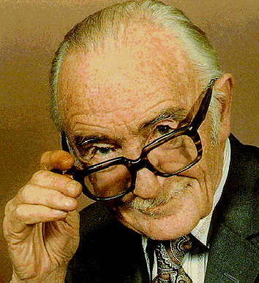
Cochrane Collaboration
Named in honour of Archie Cochrane, a British researcher
In 1979:
“It is surely a great criticism of our profession that we have not organised a critical summary, by specialty or subspecialty, adapted periodically, of all relevant randomised controlled trials”

Slide 121
The Cochrane Library
Cochrane Systematic reviews : Cochrane reviews and protocols
Database of Reviews of Effects: Other systematic reviews appraised by the Centre for Reviews and Dissemination.
Cochrane Central Register of Controlled Trials:
Bibliography of controlled trials (some not indexed in MEDLINE).
Health Technology Assessment Database: HTA reports
NHS Economic evaluation database:
Economic evaluations of health care interventions.
Notes:
DATABASES:
Cochrane Systematic reviews : Cochrane reviews
Database of Reviews of Effectiveness
Other systematic reviews from around the world which have been appraised by the NHS Centre for Reviews and Dissemination.
Cochrane Central Register of Controlled Trials
Bibliography of controlled trials (some not indexed in MEDLINE).
Cochrane database of Methodology Reviews
Cochrane reviews of methodological studies.
The Cochrane Methodology register
Bibliography of studies relating to methodological aspects of research synthesis
About the Cochrane Collaboration: Information about review groups, Fields, Centres, etc. Contact details provided.
Health Technology Assessment Database:
Health Technology Assessment reports from around the world.
NHS Economic evaluation database:
Economic evaluations of health care interventions.

Slide 122
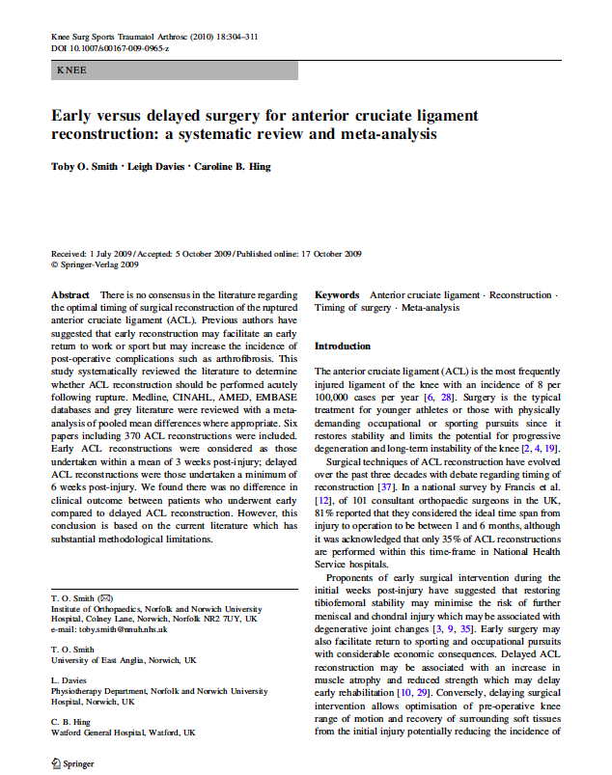
Appraising a systematic review
?

Slide 123
Tools for critical appraisal
CASP: Critical Appraisal Skills Programme Checklists
Critically Appraised Topics: generic systematic reviews (ACP Journal club)
SIGN: Scottish Intercollegiate Guidelines Network
GATE Frame
Notes:
AMSTAR = A measurement tool to assess systematic reviews
Shea et al. BMC Medical Research Methodology 2007 7:10uality of Systematic Reviews

Slide 125
Appraisal of a systematic review
10 questions
  Clearly-focused question
  The right type of study included
  Identifying all relevant studies
  Assessment of quality of studies
  Reasonable to combine studies
  What were the results
  Preciseness of results
  Application of results to local population
  Consideration of all outcomes
  Policy or practice change as a result of evidence
CASP

Slide 126
Appraising a systematic review
3 minutes

Slide 127
Step 1 – Are the results of the review valid?
Question – what is the PICO (etc.)
Finding – comprehensive?
Appraise – did they select good ones?
Synthesise – numerically/appropriate?

Slide 128
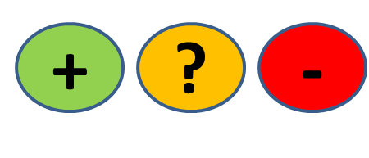
QUESTION
FIND
APPRAISE
SYNTHESISE
1. What question (PICO) did the systematic review address?
  Is question clearly stated early on?
  Treatment/exposure described?
  Comparator/control described?
  Outcome(s) described?
Title, abstract, introduction
Notes:
1 min them, 1 min feedback
Title, abstract or final paragraph of the introduction should state the question.
Our PICO:
P = patients with ACL injury = yes (initial injury suggests not chronic condition but no info on age)
I = Early ACL reconstruction = yes
C = Delayed reconstruction = yes
O = clinical and radiological = unclear
So overall we happy to say yes?
Tip = If cannot ascertain what the focused question is after reading these sections, search for another paper.

Slide 129
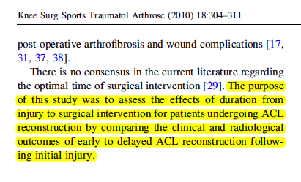
QUESTION
FIND
APPRAISE
SYNTHESISE
P
O’s
I
C
Notes:
1 min them, 1 min feedback
Title, abstract or final paragraph of the introduction should state the question.
Our PICO:
P = patients with ACL injury = yes (initial injury suggests not chronic condition but no info on age)
I = Early ACL reconstruction = yes
C = Delayed reconstruction = yes
O = clinical and radiological = unclear
So overall we happy to say yes?
Tip = If cannot ascertain what the focused question is after reading these sections, search for another paper.

Slide 130
QUESTION
FIND
APPRAISE
SYNTHESISE
2. Is it unlikely that important, relevant studies were missed?
Look for
  Which bibliographic databases were used? More than 1?
  Search terms used (text and MeSH)?
  Search for unpublished as well as published studies?
  Search for non-English studies?
Methods
Notes:
1 min them, 1 min feedback
Title, abstract or final paragraph of the introduction should state the question.
Our PICO:
P = patients with ACL injury = yes (initial injury suggests not chronic condition but no info on age)
I = Early ACL reconstruction = yes
C = Delayed reconstruction = yes
O = clinical and radiological = unclear
So overall we happy to say yes?
Tip = If cannot ascertain what the focused question is after reading these sections, search for another paper.

Slide 131
Is finding all published studies enough?
QUESTION
FIND
APPRAISE
SYNTHESISE
Negative studies less likely to be published than ‘Positive’ ones
How does this happen?
Positive studies SUBMITTED 2.5x more often than negative (Dickersin, JAMA, 1992)

Slide 132
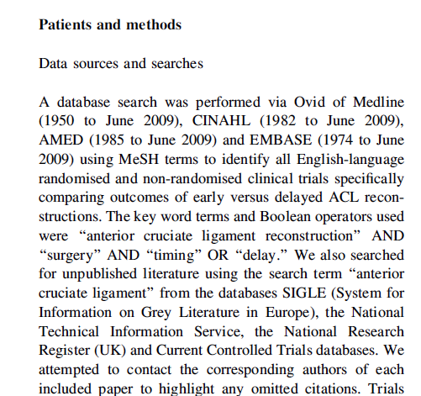
QUESTION
FIND
APPRAISE
SYNTHESISE
Notes:
2 min + 1
Methods and results sections.
1. Was the search strategy described sufficiently? Major bibliographic databases but also reference lists from relevant studies, Citation index, experts. Did they use MESH terms? = yes
2. Search terms used = yes
3. Limited = Yes - English language only. We should use all studies, getting non-English translated. Maybe resources did not allow for this.
4. Unpublished = yes – contacted authors
Results section will tell you numbers of titles/abstracts etc – in this case they also present a nice flow chart which tells us that an additional paper was found by contacting the authors (page 306)
One more aspect of the search strategy that was good and ensured studies were not missed = two investigators selected articles.
Overall it is unlikely important/relevant studies were missed.
Boolean operators – if anyone brings this up these are = AND, OR, NOT as you learnt with Nia last Thursday/Friday?

Slide 133
QUESTION
FIND
APPRAISE
SYNTHESISE
3. Were the criteria used to select articles for inclusion appropriate?
Look for
  Inclusion/exclusion criteria a priori?
  Are eligibility criteria related to PICO?
  Types of studies?
Methods
Notes:
1 min them, 1 min feedback
Title, abstract or final paragraph of the introduction should state the question.
Our PICO:
P = patients with ACL injury = yes (initial injury suggests not chronic condition but no info on age)
I = Early ACL reconstruction = yes
C = Delayed reconstruction = yes
O = clinical and radiological = unclear
So overall we happy to say yes?
Tip = If cannot ascertain what the focused question is after reading these sections, search for another paper.

Slide 134
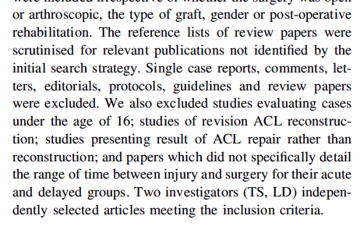
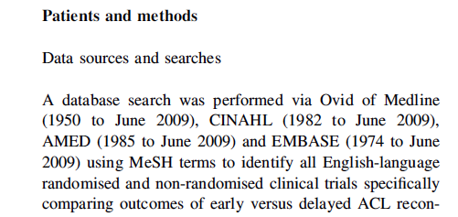
QUESTION
FIND
APPRAISE
SYNTHESISE
Notes:
2 min + 1
1st = Yes in methods section
2nd = Excluded all non-trial studies, under age 16, studies on revised ACL reconstruction, studies that did not detail time between injury and surgery for acute and delayed groups; are they related to PICO = yes.
3rd = Can anyone see a major point about the types of studies selected? = Non-randomised trials also included.
Anyone willing to suggest why? = Nature of the study – impossible to blind patients to early or delayed surgery. But…
…could have blinded surgeons to this (although ethically and logistically difficult)
…but could easily have blinded the assessors.

Slide 135
QUESTION
FIND
APPRAISE
SYNTHESISE
4. Were the included studies sufficiently valid for the type of question?
Look for
  Criteria for quality assessment defined?
  Appropriate for the question?
  Were the assessment results provided?
Methods, Results
Notes:
1 min them, 1 min feedback
Title, abstract or final paragraph of the introduction should state the question.
Our PICO:
P = patients with ACL injury = yes (initial injury suggests not chronic condition but no info on age)
I = Early ACL reconstruction = yes
C = Delayed reconstruction = yes
O = clinical and radiological = unclear
So overall we happy to say yes?
Tip = If cannot ascertain what the focused question is after reading these sections, search for another paper.

Slide 136
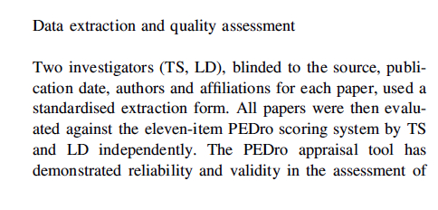
QUESTION
FIND
APPRAISE
SYNTHESISE
  Criteria for quality assessment defined?
Notes:
2 min + 1
Yes = the PEDro scale
Yes = validated for RCTs (unclear whether this holds for non-RCT)
Yes = table in the results section and appraisal page 307
[PEDro: gives score out of 11
Concealment allocation = person(s) deciding eligibility is unaware which arm of study subject is assigned to. If randomization is done at a central location then concealment is typicall assured.
Baseline comparability =must provide demographic details including details of severity of condition and minimum 1 outcome measure
Adequate follow up = score given if study provides info on #allocated to treatment and #assessed for final outcomes plus this #must be at least 85% of overall n.
Intention-to-treat = analysis is based on data from all subjects allocated to treatment and not just those completing the study]….
So are we happy that the studies were sufficiently valid = No or unclear
Okay if you turn over your appraisal sheets we’re now going to look at the actual results themselves.

Slide 137
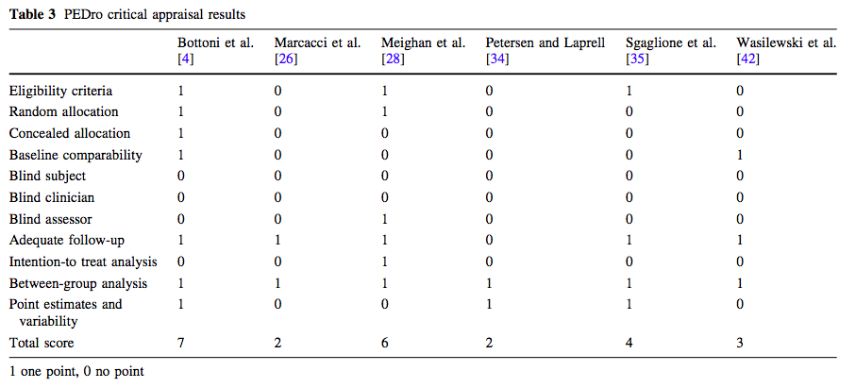
Appropriate for the question?
Were assessment results provided?
QUESTION
FIND
APPRAISE
SYNTHESISE
Notes:
2 min + 1
Yes = the PEDro scale
Yes = validated for RCTs (unclear whether this holds for non-RCT)
Yes = table in the results section and appraisal page 307
[PEDro: gives score out of 11
Concealment allocation = person(s) deciding eligibility is unaware which arm of study subject is assigned to. If randomization is done at a central location then concealment is typically assured.
Baseline comparability =must provide demographic details including details of severity of condition and minimum 1 outcome measure
Adequate follow up = score given if study provides info on #allocated to treatment and #assessed for final outcomes plus this #must be at least 85% of overall n.
Intention-to-treat = analysis is based on data from all subjects allocated to treatment and not just those completing the study]….
So are we happy that the studies were sufficiently valid = No or unclear
Okay if you turn over your appraisal sheets we’re now going to look at the actual results themselves.

Slide 138
QUESTION
FIND
APPRAISE
SYNTHESISE
5. Were the results similar from study to study?
Consider whether
  The results of all the included studies are clearly displayed
  The results are combined (meta-analysis)
    Are studies sufficiently similar
  The reasons for any variations in results are discussed
Notes:
1 min them, 1 min feedback
Title, abstract or final paragraph of the introduction should state the question.
Our PICO:
P = patients with ACL injury = yes (initial injury suggests not chronic condition but no info on age)
I = Early ACL reconstruction = yes
C = Delayed reconstruction = yes
O = clinical and radiological = unclear
So overall we happy to say yes?
Tip = If cannot ascertain what the focused question is after reading these sections, search for another paper.

Slide 139
Meta-analysis
QUESTION
FIND
APPRAISE
SYNTHESISE
= calculated “best guess” of the true effect size
The statistical combination of the results gives a pooled, weighted average of the primary results
It weights the effect size (result) of each study in relation to sample size of the study
Optional part of SR
Systematic
reviews
Meta
analyses
Notes:
P1 - ….from each of the studies included in the meta-analysis
P2 -

Slide 140

FOREST PLOTS
Line of no effect
trials
Confidence interval
Overall effect
Measure of effect

Slide 141
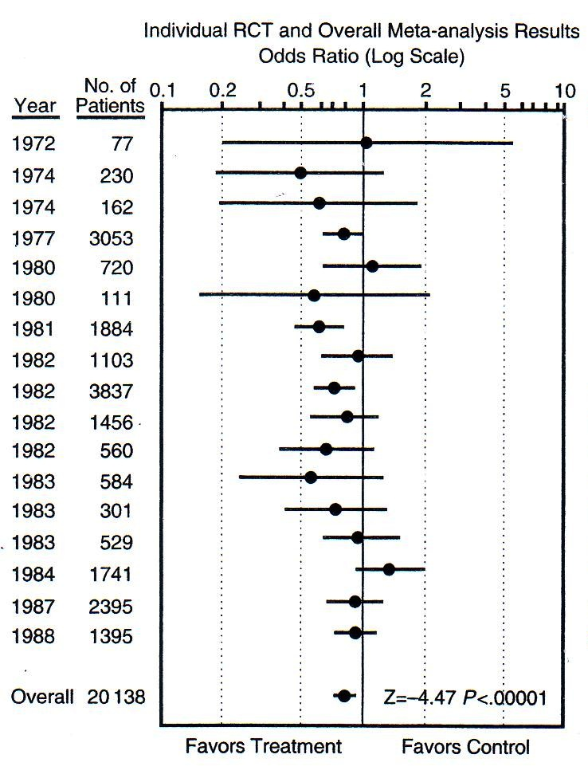
QUESTION
FIND
APPRAISE
SYNTHESISE
Which is the smallest study?
Which is the largest study?
How many are statistically significant?
Smallest
P<0.05
P<0.05
Largest
Is treatment better than control?
How much better?
Notes:
Smallest, largest, significant etc….
Can anyone tell the acute illness of our patient? = MI (streptokinase for reducing risk of mortality post MI from thrombotic event)
Now, based on this forest plot do we give an antithrombotic drug for reperfusion (in this case streptokinase) = YES

Slide 142
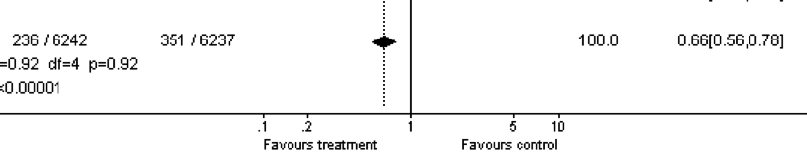

QUESTION
FIND
APPRAISE
SYNTHESISE
Effect size =
1 – 0.66 = 0.34
0.34 x 100 = 34%
There is a 34% reduced risk of mortality in the treatment compared to the control group
Notes:
1 = The overall effect is represented by the diamond at the bottom (labelled ‘Total’) and represents the combined or pooled ratio. The ends of the diamond represent the 95% CI. Here we can see that treatment reduces mortality by 34%

Slide 143
Heterogeneity
QUESTION
FIND
APPRAISE
SYNTHESISE
“The quality or state of being diverse in character or content”

Slide 144
Heterogeneity (diversity)
QUESTION
FIND
APPRAISE
SYNTHESISE
Clinical heterogeneity
Variability in the participants, interventions and/or outcomes studied
Methodological heterogeneity
Variability in study deign and risk of bias
Statistical heterogeneity
The observed intervention effects being more different from each other than we would expect due to random error (chance) alone

Slide 145
High heterogeneity
= appropriate to pool data?
QUESTION
FIND
APPRAISE
SYNTHESISE

Slide 146
QUESTION
FIND
APPRAISE
SYNTHESISE
Are the results similar across studies? 3 tests:
  ‘Eyeball’ test – do they look they same?
  Formal tests
    Proportion of variation not due to chance (I²)
      Variation between tests, now preferred estimate
        0% to 40%: might not be important;
        30% to 60%: may represent moderate heterogeneity;
        50% to 90%: may represent substantial heterogeneity;
        75% to 100%: considerable heterogeneity
    Test of ‘Null hypothesis’ of no variation (p-value)
      Cochrane Chi-square: p<0.10 = heterogeneity
Notes:
Best done when there is a forest plot. In our knee study we don’t have this option. If we go back to example on sheet, the dotted vertical line running through the combined estimate crosses the horizontal lines of all the individual studies = studies are homogenous.
Formal statistical tests = cochrane chi squared test. If this is statistically significant there is definite heterogeneity. Significance set at 0.1 (rather than usual 0.05) as the chi-square test has low power to detect heterogeneity.
Can also use something called I-squared = more recently developed. Ranges between 0 and 100%, measures the variability between studies. As a rule of thumb I2<25% means studies regarded as homogenous and I2>75% means heterogeneity is very high.

Slide 147
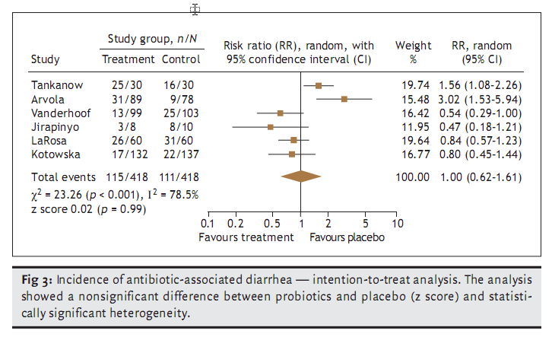
Are these trials different?
QUESTION
FIND
APPRAISE
SYNTHESISE
Notes:
Show of hands if you think there is heterogeneity present between these studies?

Slide 148
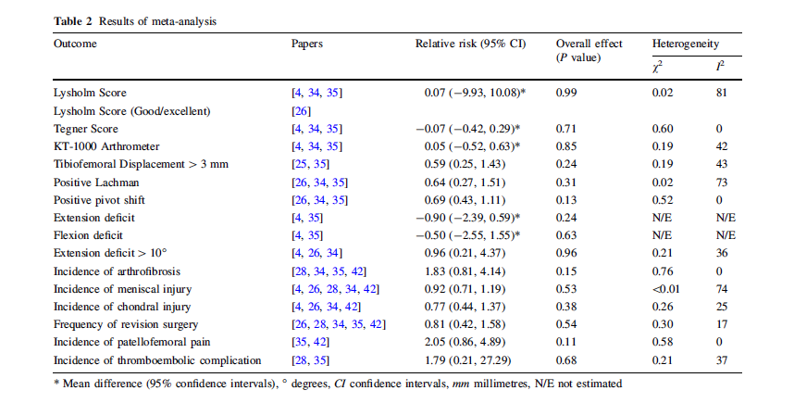
QUESTION
FIND
APPRAISE
SYNTHESISE
5. Were the results similar from study to study?
Notes:
1 min
So what do we think about the similarity of studies in our knee paper?
Indications are that there is high heterogeneity for 2 out of the 7 measures, none for 3 and some for remaining 1.
Do the authors discuss the heterogeneity? = small mention in results and a bit around studies of isokinetic strength, however, no discussion of scores in table 2.
Overall, results similar from study to study = yes and no.

Slide 149
QUESTION
FIND
APPRAISE
SYNTHESISE
Step 2 – What were the results?
Consider
  What these are (numerically if appropriate)
  How were the results presented/expressed (risk ratio, odds ratio, etc.)
  If you are clear about the review’s ‘bottom line’ results
Notes:
1 min them, 1 min feedback
Title, abstract or final paragraph of the introduction should state the question.
Our PICO:
P = patients with ACL injury = yes (initial injury suggests not chronic condition but no info on age)
I = Early ACL reconstruction = yes
C = Delayed reconstruction = yes
O = clinical and radiological = unclear
So overall we happy to say yes?
Tip = If cannot ascertain what the focused question is after reading these sections, search for another paper.

Slide 150
What are we interested in?
Notes:
2 min
Summary table: missing info on treatment and control (how many events, weight of studies?) = therefore weakness of paper.
The main things were interested in are the effect measure and the significant of the effect. In this case the effect measure is relative risk because we are mainly looking at dichotomous outcomes (yes/no) or frequencies (numbers of events/incidence). When we’re looking at continuous measures as outcomes we would assess the mean difference between the groups. An example is given here for first two outcome measures (Lysholm and Tegner scores).
Effect measures = Relative risk: “Are we all happy with relative risks”? More or less?” Okay, so RR is the probability of an event in one group divided by the probability of the event in another group.
A RR of 1 means no difference in risk/probability of an event between groups;
RR <1 = event is less likely to occur in treatment group than control (i.e. favours early surgery);
RR >1 = event is more likely to occur in treatment group (i.e. favours delayed surgery);
So, looking at an example using revision surgery, the relative risk of 0.81 suggests a more favourable outcome for the treatment group and suggests that the risk of revision surgery is 19% lower in the group who received early surgery. But…look at the significance for the effect. Can anyone tell me if it is statistically significant or not? Answer = not because it is greater than the cut-off of 0.05 so we would conclude that there is no difference between groups.
Recall what we said we were interested in:
Return to activity – did anyone find information on this? If you look carefully in the text of first paragraph on page 306 = Marcacci et al paper. Also, Lysholm and Tegnar scores give an indication of the level of PA an individual may return to = no difference.
Recurrent injury – we have three measures. Delaying surgery appears to decrease the risk of arthrofibrosis but again not significant. Risk of other injuries appears higher if surgery delayed but non-significant.
SO OVERALL – appears that delaying surgery will not affect any of the outcomes of concern to me.
“Can anyone think of another way in which these results could have been presented that might have made assessing them easier” = Forest plot. Give praise if someone says this then mention that there is example of a forest plot on their sheet. If no one answers, then say “one way is to use something called a forest plot.”
So our study did not use a forest plot. Any reasons why not?
one reason I can think of is because of the number of outcomes. Each one would require a forest plot = 16. This would most likely have been way beyond the editorial specifications of the journal although they could have put them as a data supplement online.
Authors don’t know how to do them…
Others = ????
So if you turn back to your appraisal sheet, there’s one more thing we need to look at = similarity of the included studies.

Slide 151
Our clinical question
Amongst adults with acute ACL injuries, does
early reconstructive surgery compared with
delayed reconstructive surgery lead to
favourable return to former activity and/or risk of recurrent knee injury?
Population
Intervention
Control
Outcome 1
Outcome 2

Slide 152
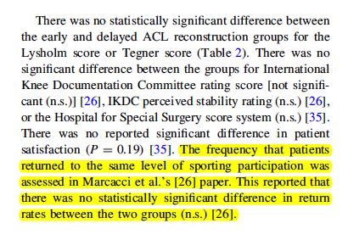
Return to former activity (page 306):

Slide 153
Risk of recurrent knee injury
Notes:
2 min
Summary table: missing info on treatment and control (how many events, weight of studies?) = therefore weakness of paper.
The main things were interested in are the effect measure and the significant of the effect. In this case the effect measure is relative risk because we are mainly looking at dichotomous outcomes (yes/no) or frequencies (numbers of events/incidence). When we’re looking at continuous measures as outcomes we would assess the mean difference between the groups. An example is given here for first two outcome measures (Lysholm and Tegner scores).
Effect measures = Relative risk: “Are we all happy with relative risks”? More or less?” Okay, so RR is the probability of an event in one group divided by the probability of the event in another group.
A RR of 1 means no difference in risk/probability of an event between groups;
RR <1 = event is less likely to occur in treatment group than control (i.e. favours early surgery);
RR >1 = event is more likely to occur in treatment group (i.e. favours delayed surgery);
So, looking at an example using revision surgery, the relative risk of 0.81 suggests a more favourable outcome for the treatment group and suggests that the risk of revision surgery is 19% lower in the group who received early surgery. But…look at the significance for the effect. Can anyone tell me if it is statistically significant or not? Answer = not because it is greater than the cut-off of 0.05 so we would conclude that there is no difference between groups.
Recall what we said we were interested in:
Return to activity – did anyone find information on this? If you look carefully in the text of first paragraph on page 306 = Marcacci et al paper. Also, Lysholm and Tegnar scores give an indication of the level of PA an individual may return to = no difference.
Recurrent injury – we have three measures. Delaying surgery appears to decrease the risk of arthrofibrosis but again not significant. Risk of other injuries appears higher if surgery delayed but non-significant.
SO OVERALL – appears that delaying surgery will not affect any of the outcomes of concern to me.
“Can anyone think of another way in which these results could have been presented that might have made assessing them easier” = Forest plot. Give praise if someone says this then mention that there is example of a forest plot on their sheet. If no one answers, then say “one way is to use something called a forest plot.”
So our study did not use a forest plot. Any reasons why not?
one reason I can think of is because of the number of outcomes. Each one would require a forest plot = 16. This would most likely have been way beyond the editorial specifications of the journal although they could have put them as a data supplement online.
Authors don’t know how to do them…
Others = ????

Slide 154
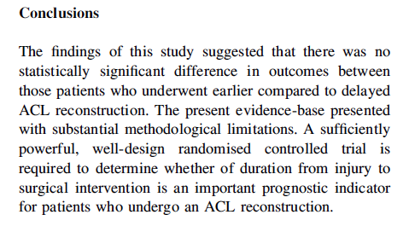
What’s the ‘bottom line’ of the review?
Notes:
Are we happy with the conclusions of the paper?
Are they based on the data they have provided in the paper? = yes

Slide 155
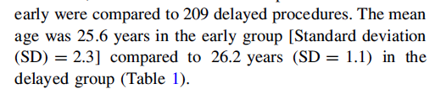
Can I apply these results to my case?
Is my patient so different to those in the study that the results cannot apply?
Notes:
Look back in results section on page 305 – mean age of approx. 26 years suggest very close to my age with acute injury, so results do apply.

Slide 156
‘Clinical pearls’
Don’t forget to ask “Is it worth continuing?”
Look for ‘key’ references: Cochrane Risk of Bias, GRADE, PRISMA
I² >50%: adequate statistical heterogeneity to suggest looking deeper into clinical, methodological heterogeneity reported
Would your patient meet the inclusion criteria of trials/studies in the review?

Slide 157

Publication Bias: Solution
All trials registered at inception,
    The National Clinical Trials Registry: Cancer Trials
    National Institutes of Health Inventory of Clinical Trials and Studies
    International Registry of Perinatal Trials
Meta-Registry of trial Registries
  www.clinicaltrials.org
  www.controlled-trials.com

Slide 158


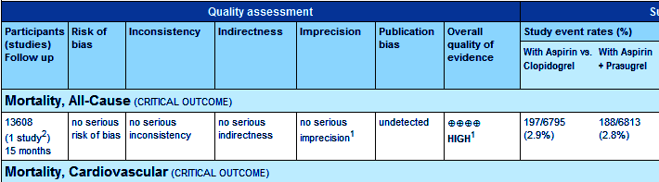
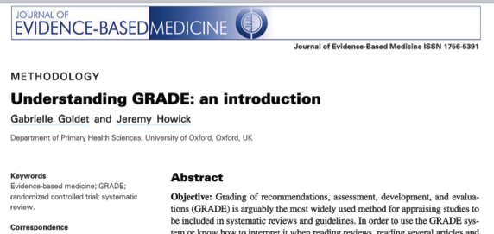
COCHRANE & GRADE
JEBM; 6:50-54
Notes:
This diagram shows the results of a systematic review of RCTs of a short, inexpensive course of a corticosteroid given to women about to give birth too early. The first of these RCTs was reported in 1972. The diagram summarises the evidence that would have been revealed had the available RCTs been reviewed systematically. A decade later it indicates strongly that corticosteroids reduce the risk of babies dying from the complications of immaturity. By 1991, seven more trials had been reported, and the picture had become still stronger. This treatment reduces the odds of the babies of these women dying from the complications of immaturity by 30 to 50 per cent.
Because no systematic review of these trials had been published until 1989, most obstetricians had not realised that the treatment was so effective. As a result, tens of thousands of premature babies have probably suffered and died unnecessarily (and needed more expensive treatment than was necessary). This is just one of many examples of the human costs resulting from failure to perform systematic, up-to-date reviews of RCTs of health care.

Slide 159
PRISMA (QUORUM)
Preferred Reporting Items for Systematic Reviews and Meta-Analyses
Consists of a 27-item checklist and four phase flow diagram
Evidence-based minimum set of items for reporting in systematic reviews and meta-analyses
Can be used for critical appraisal but not designed for it
http://www.prisma-statement.org/

Slide 160

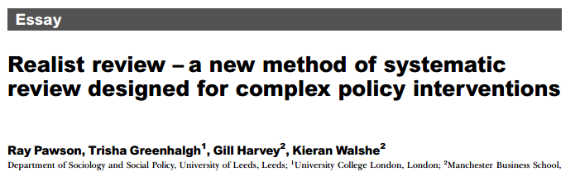
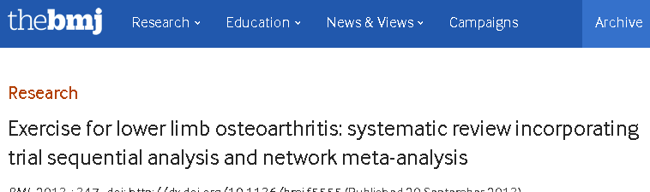
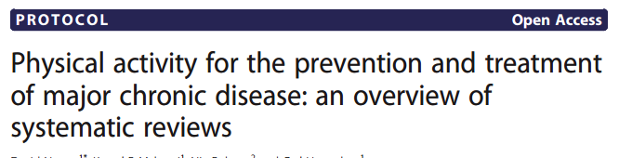
Coming soon….already here?

Slide 161
Publication bias
Occurs when publication of research results depends on their nature and direction
Often happens because smaller (n and effect size) studies not submitted/rejected, selective reporting, selective citation (of +ve results)
Funnel plots help identify if there is a bias:
  Treatment effect vs. study size
  Smaller the study = wider the effects
  Largest studies will be near the average (truth), small studies will spread on both sides = symmetric funnel
  Asymetric funnel indicates publication bias – but not all the time (e.g. heterogeneity)
  Interpretation difficult if only a few studies in meta-analysis

Slide 162
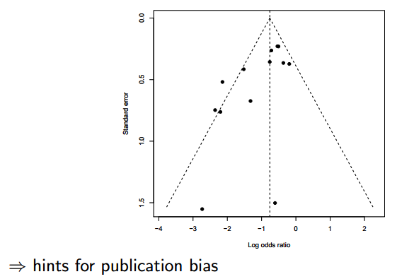
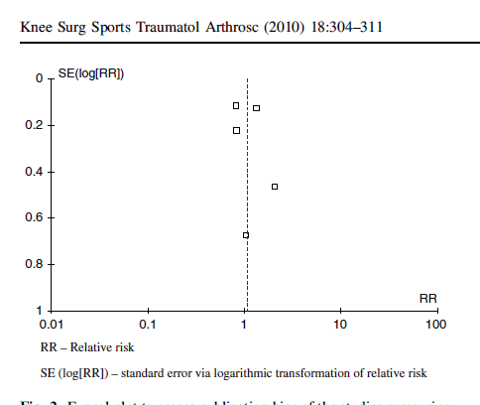
Funnel plots

Slide 163

Funnel plot examples
From: Cooper & Hedges: The handbook of research synthesis. 1994

Slide 164

From: Cooper & Hedges: The handbook of research synthesis. 1994

Slide 165
Effect on Patient-Oriented Outcomes
Symptoms
Functioning
Quality of Life
Lifespan
SORT
A
SORT
B
Effect on Disease Markers
Diabetes (microalbuminuria, GFR, photocoagulation rates)
Arthritis (ESR, x-rays)
Peptic Ulcer (endoscopic ulcers)
SORT
C
Relevance of Outcome
Effect on Risk Factors for Disease
Improvement in markers (blood pressure, HbA1C, cholesterol)
Uncontrolled Observations
&
Conjecture
Physiologic Research
Preliminary Clinical Research
Case reports
Observational studies
Highly Controlled Research
Randomized Controlled Trials
Systematic Reviews
Validity of Evidence
Notes:
This slide shows the inter-relationship between relevance and validity and how they both impact on the SORT taxonomy. Only valid POEMs can achieve an “A” recommendation.

Slide 166
Practice Guidelines

Slide 167
Practice Guidelines
167
The Good,
The Not-So-Good
The Ugly

Slide 168
Where do practice guidelines come from?
Trust us, we’re the experts: Opinion-based/ consensus guidelines
  Whose opinion? Do they have a conflict of interest? What is their perspective?
Trust us, we have the evidence: “Evidence-based”
  How was the evidence used? Patient-oriented? Values?
Evidence-linked:
  Here is how we found the evidence, used the evidence
  Strength of recommendation noted

Slide 169
What is a Clinical Practice Guideline?
A clinical practice guideline is a systematically developed statement designed to help health care professionals make decisions about appropriate health care for specific clinical circumstances.

Slide 170
Guidelines attempt to do this by:
Describing a range of generally accepted approaches for the diagnosis, management, or prevention of specific diseases or conditions.
Defining practices that meet the needs of most patients in most circumstances.

Slide 171
Questions to Ask

Slide 172
Scope and Purpose
Are the overall objectives of the guideline specifically described?
Is the clinical question(s) covered by the guideline specifically described?
Are the patients to whom the guideline is meant to apply specifically described?

Slide 173
Stakeholder Involvement
Does the guideline development group include individuals from all of the relevent professional groups?
Have the patients' views and preferences been sought?
Have the target users of the guideline been clearly defined?
Has the guideline been piloted among target users?

Slide 174
Rigour of Development
Were systematic methods used to search for evidence?
Is the criteria for selecting the evidence clearly described?
Were the methods used for formulating the recommendations clearly described?
Were the health benefits, side effects, and risks considered in formulating the recommendations?
Is there an explicit link between the recommendations and the supporting evidence?
Has the guideline been externally reviewed by experts prior to its publication?
Is a procedure for updating the guideline provided?

Slide 175
Clarity and Presentation
Are the recommendations specific and unambiguous?
Are different options for management of the condition clearly presented?
Are key recommendations clearly identifiable?
Is the guideline supported with tools for application?

Slide 176
Applicability
Have the potential organization barriers in applying the recommendation been discussed?
Have the potential cost implications of applying the recommendations been considered?
Does the guideline present key review criteria for monitoring and/or auditing purposes?

Slide 177
Editorial Independence
Is the guideline editorially independent from the funding body?
Have conflicts of interest of guideline development members been recorded?

Slide 178
Appraisal of Clinical Practice Guidelines

Slide 179
The AGREE
The AGREE (Appraisal of Guidelines for Research & Evaluation) Instrument is a tool that assesses the methodological rigour and transparency in which a guideline is developed and it is used internationally.
The purpose of the AGREE Instrument is to provide a framework for assessing the quality of clinical practice guidelines.

Slide 180


Slide 181
The AGREE
The AGREE Instrument is designed to assess guidelines developed by local, regional, national, or international groups or affiliated government organizations. These include:
  New guidelines
  Existing guidelines
  Updates of existing guidelines
http://www.agreetrust.org

Slide 182
The AGREE II
The original AGREE Instrument has been updated and methodologically refined. The AGREE II is now the new international tool for the assessment of practice guidelines. The AGREE II is both valid and reliable and comprises 23 items organized into the original 6 quality domains.

Slide 183
Find Clinical Practice Guidelines:
Search the National Guideline Clearinghouse
Go to ClinicalKey and click on the link to "Practice Guidelines" at the top of the page.
When searching MEDLINE, click on "Additional Limits", and limit by publication type (Practice Guideline).

Slide 184
National Guideline Clearinghouse
www.ngc.gov
Vetted guidelines from various groups
Standard organization so that information can be compared across various guidelines
184
Notes:
184
The new thinking: probabilistic thinking. What we’re going to do is introduce the idea that the mechanistic approach to medicine – that the body is simply a complexly-engineered machine that has to be tweaked and adjusted – is a limited concept. The new paradigm of outcomes medicine requires us to think in terms of probabilities – not why something works, but what is the likelihood that it will work or, overall, be good for patients. We tend to think in absolutes rather than in probabilities, and it’s a difficult transition.

Slide 186
References
Critical Appraisal tools and Work sheets http://www.cebm.net/critical-appraisal/
Jane M Young & Michael J Solomo. How to critically appraise an article. Nature Reviews Gastroenterology and Hepatology 6, 82-91 (February 2009) | doi:10.1038/ncpgasthep1331
What is a critical appraisal? http://www.medicine.ox.ac.uk/bandolier/painres/download/whatis/what_is_critical_appraisal.pdf
The BMJ - How to Read a Paper http://www.bmj.com/about-bmj/resources-readers/publications/how-read-paper
Evidently Cochrane http://www.evidentlycochrane.net/
CEBM http://www.cebm.net/

Slide 187
References
http://www.casp-uk.net/e-learning
http://www.casp-uk.net/checklists
http://clinicalevidence.bmj.com/x/set/static/ebm/toolbox/665061.html
Critical Appraisal tools and Work sheets http://www.cebm.net/critical-appraisal/
Jane M Young & Michael J Solomo. How to critically appraise an article. Nature Reviews Gastroenterology and Hepatology 6, 82-91 (February 2009) | doi:10.1038/ncpgasthep1331
What is a critical appraisal? http://www.medicine.ox.ac.uk/bandolier/painres/download/whatis/what_is_critical_appraisal.pdf
The BMJ - How to Read a Paper http://www.bmj.com/about-bmj/resources-readers/publications/how-read-paper
Evidently Cochrane http://www.evidentlycochrane.net/
CEBM http://www.cebm.net/

Slide 188


nalyousefi@ksu.edu.saحقوق الاستخدام محفوظة All rights reserved

Slide 189
nalyousefi@ksu.edu.saحقوق الاستخدام محفوظة All rights reserved

