Slide 1
RATIONAL USE OF MEDICATIONS & COMPLIANCE

Slide 2
History
Prescriptions have been in use since ancient times
Latin adopted as standard language
“Rx” = prescription

Slide 3
What is a prescription?
A prescription is a written, verbal, or electronic order from a practitioner or designated agent to a pharmacist for a particular medication for a specific patient

Slide 4
Why Family Medicine/PHC and Rational Use of Drugs?
Barbara Star Field Study related to the practice of Family Medicine and health outcome indicators’ of a country.

Slide 5
The studies showed relationship b/w more & better primary care & most health outcomes studied.
Evidences shows a positive impact of primary care on prevention of illness & death.
Primary care (in contrast to specialty care) is associated with a more equitable distribution of health in populations.
One primary care physician / 10,000 population.
In US 127,617 deaths /year could be saved by increase in number of primary care physicians.

Slide 6
Is it always Necessary to Prescribe ?
Diagnosis is still in doubt ?
Value of treatment is debatable ?
Combinations & formulations are irrational ?

Slide 7
WHAT IS GOOD PRESCRIBING ?
∗Appropriate drug
∗in the correct dose
∗of an Appropriate formulation
∗At the correct frequency of administration
∗For the correct length of time

Slide 8
GOOD PRESCRIBING INCLUDES..
∗ not prescribing any drug at all…

Slide 9
GOOD PRESCRIBING REQUIRES:
DETAILED KNOWLEDGE OF THE PATHOPHYSIOLOGY OF THE DISEASE of the patient.
CLINICAL PHARMACOLOGY OF THE DRUGS you are intended to use.

Slide 10
HOW TO CHOOSE A DRUG ?
∗Ask the following sequence of questions before writing the prescription
∗Is the drug therapy Indicated ?!!
∗Which drug?
∗Which class---which group----which particular drug
∗Which route?
∗Which formulation?
∗What dosage regimen?

Slide 11
Why so irrational ?
Increased cost of un-necessary prescription to the health care system.
Harmful prescribing fails to meet acceptable standards.
Chances of poly-pharmacy – effecting vulnerable groups like elderly.

Slide 12
How we can improve prescribing Habits
There is no such thing as
GOOD MEDICINE or BAD MEDICINE
“A good prescribing is the prescribing based on the best available evidence & current guidelines “

Slide 13
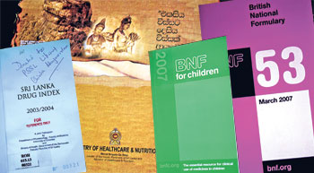
Evidence – Based Prescribing
Failure to do this may:-
Cause patients to suffer unnecessary side effects of ineffective drugs.
Deprive patients the chance to benefit from effective treatments.
Waste valuable resources.

Slide 14
Advantages of Generic
Prescribing
Reduced cost
Professional convenience; everyone knows it
Convenient to the patient
Convenient to the pharmacist

Slide 15
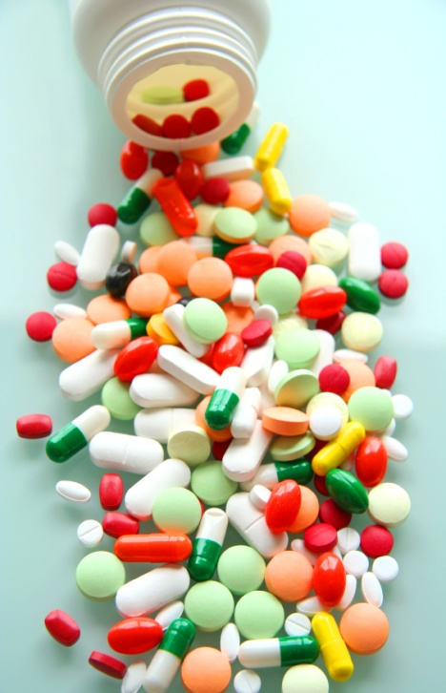
Reason for not Prescribing Generically
Drugs with a low therapeutic index e.g. Lithium, Carbamazepine, Phenytoin (small difference in plasma concentration can be significant)
Modified release formulations, difficult
to standardize e.g. Diltiazem, Nifedipine.
Formulations containing > 2 drugs.

Slide 16
How to prescribe Rationally
Is a drug really required ?
Will it work ?
Will it harm ?
Is it the cost –effective choice ?
Have all alternatives been considered ?
Is the likely risk-benefit ratio acceptable ?

Slide 17
Impact of irrational prescribing:
∗ Delay in cure
∗ More adverse effects
∗ Prolonged hospitalization
∗ Emergence of antimicrobial resistance
∗ Loss of patient’s confidence in the doctor
∗ Loss to the patient/community
∗ Lowering of health standards

Slide 18
Who is a good prescriber?
One, who ensures that diagnosis is correct.
Makes a positive & correct decision that drug is needed.
Chooses a drug appropriate to patients need.
Who consults patient and ensures his/her informed consent.
Who explains patient’s role and secures his/her
co-operation.
Who terminates treatment when no longer needed.

Slide 19
Social reasons for inappropriate prescribing
Any pressure of pharmaceutical advertising.
Patient’s demand.
Habit , peer group recommendation & ignorance.
To avoid confrontation .
Because of medico legal worries.
To play for time until true picture becomes clearer or natural recovery occurs.
To hasten the conclusion of consultation.

Slide 20
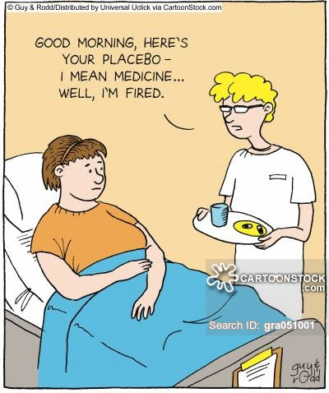
What is a Placebo medication
A harmless pill, medicine, or procedure prescribed more for the psychological benefit to the patient than for any physiological effect.

Slide 21
Placebo medication
Evidence shows that response can be psychological as well as physiological ;
Conditions that could be helped are . for example:
Anxiety
Depression
Asthma
Headaches
Insomnia
Social problems

Slide 22
Placebo side effects
It has been reported that40% can also experience side effects like ;
Headache
Anorexia
Diarrhea
Dry mouth
Palpitations
Vertigo.

Slide 23
Prevention of Adverse Drug Reactions
Never use a drug unless there is a good indication.
Do not use a drug in pregnancy, unless the need for it is imperative.
Ask if there is H/O allergy/idiosyncracy.
Consider possible drug interaction.
Age and hepatic or renal impairment may require much smaller doses.

Slide 24
Prevention of Adverse Drug Reactions Cont..
Prescribe as few drugs as possible.
Give clear instructions, especially in elderly.
Be particularly alert for adverse reactions or unexpected events, when prescribing new drugs.
Fill the required form in case of suspected adverse reaction.
Warn the patient if serious adverse reactions are liable to occur.

Slide 25
Delayed Drug Effects
Some adverse reactions may become manifest months or years after treatment e.g. chloroquine retinopathy.

Slide 26
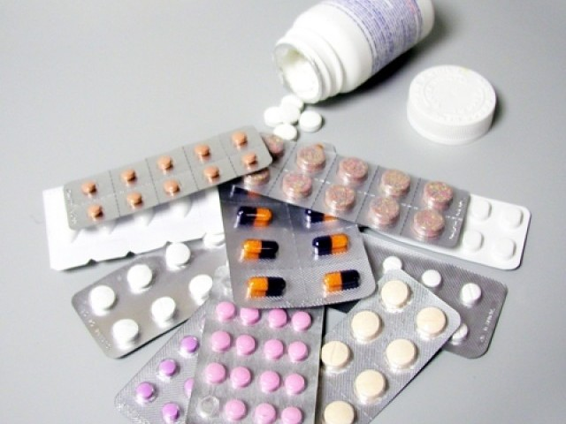
Principles for antibiotic selection
Allow for a number of variables:
H/o allergy / sensitivity
State of renal and hepatic function
Increasing resistance
New information on side effects
Age of patient & duration of therapy
Dosage and route of administration

Slide 27
Principles for antibiotic selection Cont…..
Site, type and severity of infection
Individual response
If female, whether pregnant, breast feeding or on oral contraceptives
Likely organism and antibacterial sensitivity ?

Slide 28
Special Problems in Prescribing
Delayed drug effect.
In elderly.
In children.
In hepatic impairment.
In renal impairment.
In pregnancy.
In breast feeding.
In palliative care.
Drug inter-actions.

Slide 29
Prescribing for Elderly
Limit range of drugs.
Reduce dose.
Review regularly.
Simplify regimens.
Explain clearly.
Repeats and disposal.

Slide 30
Prescribing for Children
Special care needed in neonates
Avoid injections if possible
Actions of drugs and their pharmacokinetics may be different than adults
Suitable formulations may not be available for children
Drugs are not extensively tested in children

Slide 31
Prescribing in Hepatic Impairment
Impaired drug metabolism
Hypoproteinaemia
Reduced clotting
Hepatic encephalopathy
Fluid overload
Hepato-toxic drugs

Slide 32
Prescribing in Renal Impairment
A. Reduced renal excretion of a drug
B. Increased sensitivity to some drugs even if elimination is not impaired
. C. Many side effects are tolerated poorly
D. Some drugs become ineffective

Slide 33
Prescribing in Pregnancy
Particular care is needed in prescribing for women in child bearing age or men trying to father a child.
First trimester – congenital malformations
Second and third trimester – effect on the growth or the functional status of fetus, including toxic effect on fetal tissues.
Shortly before term or during labour – possible adverse effect on labour or neonate, after delivery.

Slide 34
Prescribing in Breast-feeding
Avoid drugs (if possible) which:
Cause inhibition of sucking reflex (e.g. phenobarbital).
Suppress lactation (e.g. bromocriptine)
Appear in a significant quality in the milk (e.g. fluvastatin).
If not sure, look up at the therapeutic guidelines from a reputable source (e.g. BNF).

Slide 35
Prescribing in Palliative Care
The importance of pain relief and other symptoms are more important than sticking to the usual drugs or dosages.
Oral medications are preferable, if possible.
As few drugs as possible should be prescribed.
4. Doctor – patient relationship is usually more effective than the drug.

Slide 36
Drug Interactions
A Family Physician is not expected to know all the possible drug interactions, but awareness of some important categories is imperative:
Anti-convulsants
Oral contraceptives
Warfarin

Slide 37
Risks of self medication
Always risk of drug interaction with prescribed medicine.
Increased risk of self-medication side effects.
Taking wrong preparation & wrong formulations.
Less chances to offer any opportunistic health promotion advice .

Slide 38
Prescription Writing

Slide 39
Who can write a Rx?
Practitioners
Physicians, veterinarians, dentists

Slide 40
Prescription Formatting
Heading
Body
Closing

Slide 41
Heading
Name, address, and telephone number of the prescriber
Name, sex and age of the patient
Date of the prescription

Slide 42
Patient Name and Address
Full first and last name
Middle initial may be helpful
DOB – not required, but will be helpful in further identifying the correct patient to prevent medication errors

Slide 43
Practitioner’s Name, Address, and Phone number
Provides contact information to clarify any questions

Slide 44
Body
Name
dose size or concentration (liquids) of the drug
Amount to be dispensed
Directions to the patient

Slide 45
List of dangerous abbreviations, acronyms, and symbols
Abbreviation | Potential Problem | Preferred Term
U (unit) | Mistaken as zero, four | Write “unit”
IU (international unit) | Mistaken as IV or 10 | Write “international unit”
Q.D., Q.O.D. | Mistaken for each other. Period after Q and O after Q can be mistaken for “I” | Write “daily” and “every other day”
MS, MSO4, MgSO4 | Confused for one another | Write “morphine sulfate” or “magnesium sulfate”

Slide 46
Tablets - tab
Capsule – cap
Syrup – syr
Suspension – susp
Injection – Inj
Metered dose inhaler – as such
Lotion – as such

Slide 47
Strength of the drug
Decimal points
Avoid trailing zeros.
EX. 5 mg vs. 5.0 mg; can be mistaken for 50 mg
Always use leading zeros.
EX. 0.8 ml vs. .8 ml; can be mistaken for 8 ml

Slide 48
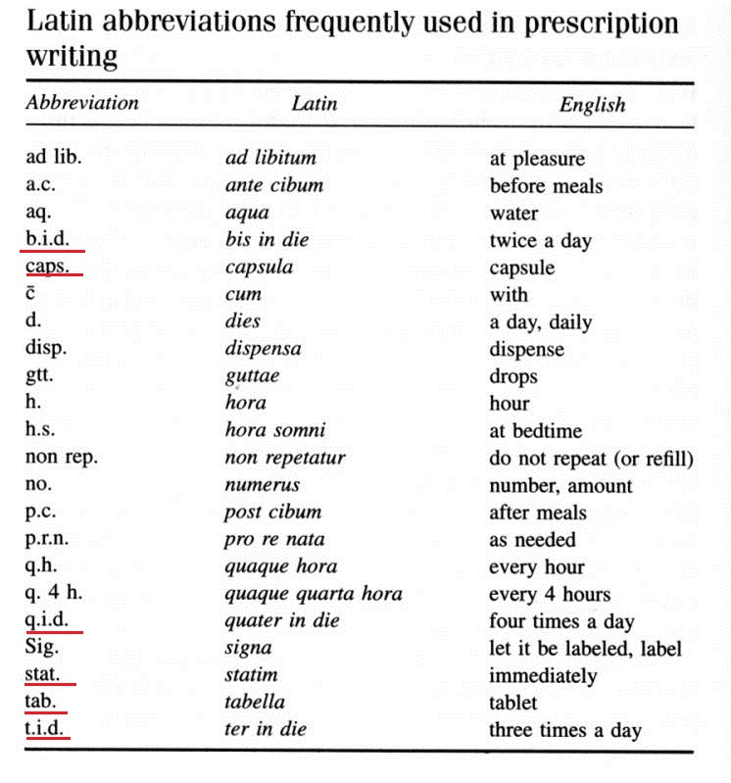

Slide 49
Closing
Prescriber’s signature
Refill instructions
Generic substitution instructions

Slide 50
Patient compliance or adherence (capacitance)

Slide 51
Patient compliance describes the degree to which a patient correctly follows medical advice.
Most commonly, it refers to medication or drug compliance, but it can also apply to other situations such as medical device use, self care, self-directed exercises, or therapy sessions

Slide 53
When is adherence important?
Replacement therapy – insulin, thyroxine
Maintenance of pharmacological effect – antihypertensive drugs
Maintenance of serum drug concentration to control a particular disorder – anticonvulsants
To control diseases of public health – HIV, TB
In chronic diseases
Contraceptive pills
Overdose which causes serious health hazards

Slide 55
Factors Related to Poor Compliance
Purpose of medicine not clear to patient.
Perceived lack of efficacy of medicine.
Real or perceived adverse effects by the patient.
Lack of understanding between the doctor and the patient.
Instructions for administration not clear.
Unpleasant taste.
Complicated regimen – poly-pharmacy.
Physical difficulty in taking medicines.
Medicines too costly.

Slide 56
Methods to detect non-adherence
Direct objective –measure blood or urine levels of drugs
Indirect objective – pill count - Prescription refill
Health outcome measures – BP control, asthma severity
Utilization of health care services
Clinic attendance
Appointment making
Appointment keeping
Indirect subjective – patient interview & diary keeping

Slide 57
Factors affecting compliance

Slide 58
Detection and improvement of compliance
To track the record weather the patient is following the prescribed medications or not: for this electronic access to patient prescription and refill records is checked.
By using electronic questionnaire system.
By appointing nurse case managers which checks the patience adherence and non-compliance at a very personal level.
Utilizing pharmacist as a tool to resolve noncompliance.
Long, complex and redundancy of drug regimens also lead to non compliance so; this point should also betaken care in mind while prescribing the medication.

Slide 59
Detection and improvement of compliance
By the use of generic drugs which are more cost effective as that of branded drugs

Slide 60
Practice Formulary
An effective way to limit prescribing and costs of prescribing:
Essential features:
Evidence of efficacy
Evidence of safety
Cost-effectiveness
Local policy

Slide 61
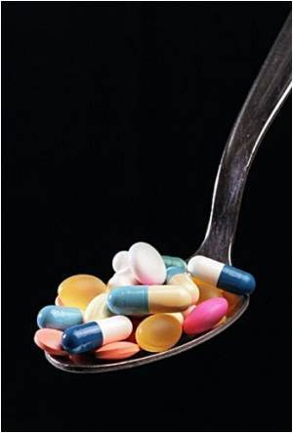
Conclusion
● While prescribing, apply the saying ‘think before you ink’ – by prescribing this drugs are you going to do more harm or more good?
● Factors related to compliance of medications by the patient must be considered.
● Cost-effective and generic prescribing is generally preferable.
● Prescribing in special circumstances requires special attention.

Slide 62
Thank You

