Slide 1
Adolescents Health
Lamees Abdullah Al-tamim
Ghadeer Abdullah Alager –
Luluh Yousef Alzeghayer –
Futoon Suliman alsaleh-
Norah Saud Alfehaid -
Notes:
tal

Slide 2
The Objectives:
Define adolescent age: World health organization definition
Understand adolescent’s physiological and behavioral characteristics
Recognize the importance of adolescent health
Determine adolescent health problems: physical, psychological and social problems
Recognize common adolescent health problems in Saudi Arabia: Retrieved from available evidence-based studies
Understand the comprehensive approach to common adolescent health problems in primary health care
Understand the role of family, school and community in adolescent health care

Slide 3
MCQs 1
The most common cause of depressive symptoms in adolescents is ?
A- Overweight and obesity
B- Vitamin D deficiency
C- Violence
D- Growth changes

Slide 4
MCQs 2
The ratio of adolescents population worldwide is ?
A- 1:6
B- 2:6
C- 3:6
D- 4:6

Slide 5
MCQs 3
The prevalence of bullying among adolescents in US is ?
A- 10%
B- 20%
C- 30%
D- 40%

Slide 6
MCQs 4
The height peak in the males is at the age of…..?
1- 11
2- 12
3- 13
4- 14

Slide 7
MCQs 5
What is the first sign of puberty in females?
1- Voice changes
2- Axillary hair
3- Breast development
4- Menarche

Slide 8
1.Adolescent Age:
Adolescence is the transitional phase of growth and development between childhood and adulthood. The World Health Organization (WHO) defines an adolescent as any person between ages 10 and 19. This age range falls within WHO's definition of young people, which refers to individuals between ages 10 and 24

Slide 9
Adolescent Population in KSA
25%
Notes:
Saudi arabiapopulation account for 34 m
Around 25% consider adolcent( 8m)
Thepapulation of adolcentin Saudi Arabia 25 of population

Slide 10
2.Physiological characteristics
Physical changes precede behavioral changes

Slide 11
Adolescent’s Physiological characteristics
Neuro
developmental
Hormonal
Sexual
Skeletal

Slide 12
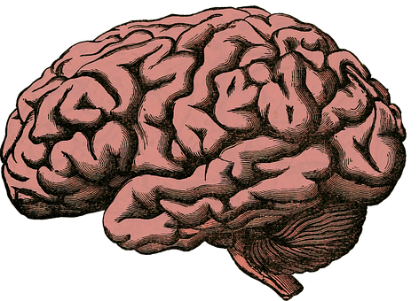
Neurodevelopmental
These developments are linked to hormonal changes
Developments are taking place in regions of the brain:
1- The limbic system: responsible for pleasure seeking , reward processing, emotional responses and sleep regulation.
2- Pre-frontal cortex: responsible for executive functions: decision-making, organization, impulse control and planning for the future.
The limbic system changes occur before the pre-frontal cortex changes

Slide 13
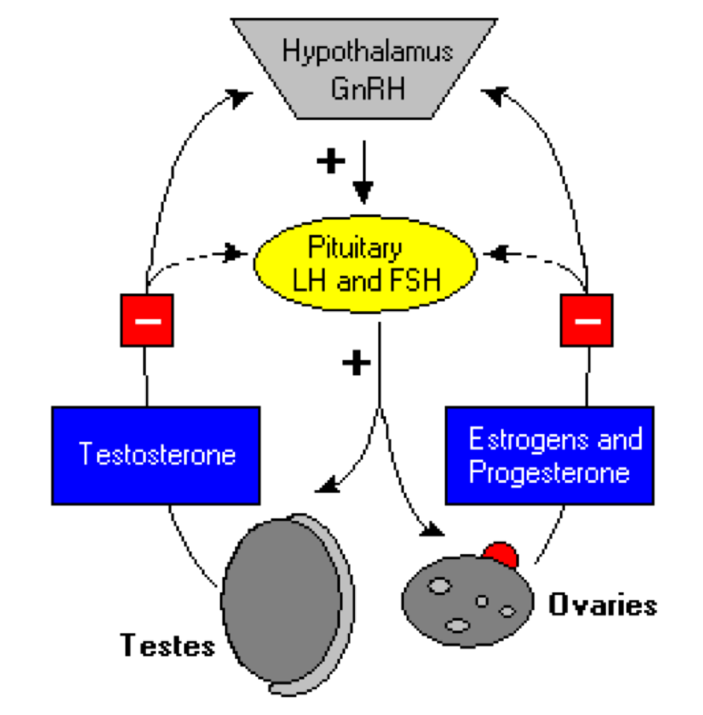
Hormonal
Hypothalamus releases GNRH to anterior pituitary to stimulate it.
Anterior pituitary then releases LH & FSH to testis and ovaries
Sex steroid synthesis
Sexual maturation
Notes:
The GNRH release from hypothalamus which
act on anterior pituitary gland to release LH and FSH
Then the LH and FSH stimulate the
maturation of testis and ovary
they also play a major role in Sex steroid synthesis

Slide 14
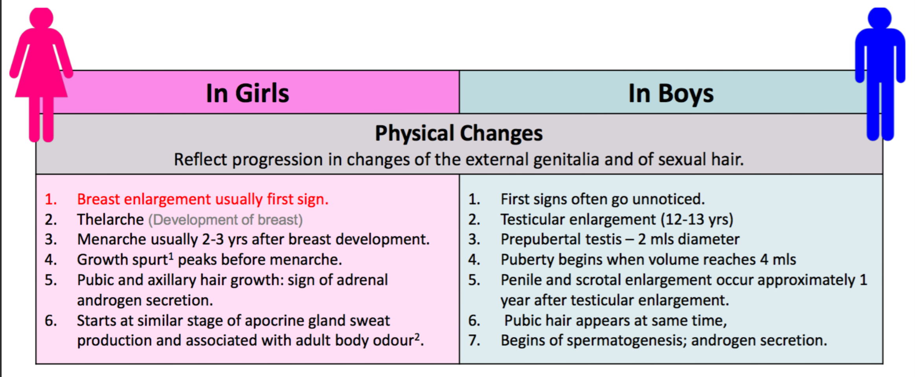
Sexual
Change in voice also occurs as part of the sexual development in males.
Tanner staging system is used to evaluate the sexual characteristics.

Slide 15
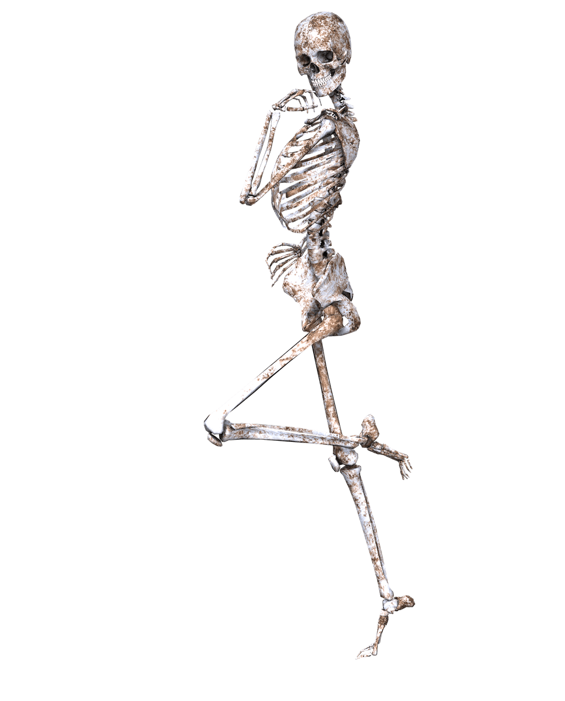
Skeletal
Increase in the skeletal growth (height) & increase in muscle mass.
In boys: height peak at age 13 and weight gain mainly due to increase muscle growth.
In girls: height peak at age 11 and weight gain mainly due to fat that develops in breast and hip.

Slide 16
2.Behavioral Characteristics

Slide 17
Behavioral changes
Cognitive
Developing of reasoning skills, logical and moral thinking
Increasing cognitive and intellectual capacities
Social
Searching for identity
Seeking more independence and responsibility
Looking for new experiences and engaging in more risk.
Influenced more by friends
Communicating in different ways
comes growing concern about other people’s opinions

Slide 18
Behavioral changes
Dietary
1- Eating junk food and physical inactivity leading to obesity.
2- Anorexia nervosa due to physical appearance perception
Emotional
Intense emotions at different times
unpredictable moods.
More sensitive to emotions.
More self conscious specially about physical appearance.

Slide 19
3. Importance of adolescent health

Slide 20
Why is adolescents health important?
1:6 of the world’s population are adolescents.
Most are healthy, but there is still substantial premature death, illness, and injury among adolescents.
Importance of promoting healthy behaviours during adolescence:
prevention of health problems in adulthood,
countries’ future health and development.
Notes:
Delinquency
Cardiomyopathy
Sudden death
Self identification يبغون يثبتون أنفسهم وأصحابهم
Relationship with others
Resbonsibility
Thalssemia and Sickle
فحص الزواج
Multiple sclerosis
Sextual and Reproductive health
Social media addiction

Slide 21
4. Adolescents health problems
Physical | Psychological | Social

Slide 22
A- physical problems
Leading causes of death among adolescents in 2016:
Road traffic injuries
Suicide,
Violence,
Infectious disease: lower respiratory tract infections, HIV/AIDS, and diarrhoeal diseases.
The leading cause of death for 15-19 year-old girls globally is complications from pregnancy and childbirth.
Notes:
What are the ways that can reduce girls getting pregnant and giving birth at too young age?
Regulation against marriage before the age of 18.
Encourrage the use of contraception by adolescents at risk of unintended pregnancy.
●increasing use of skilled antenatal, childbirth and postnatal care among adolescents.

Slide 23
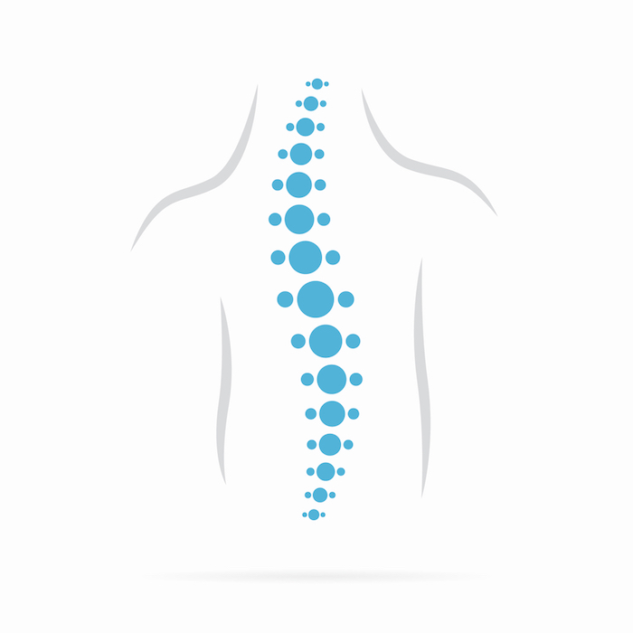
Cardiomyopathy and Sudden death
Uncommon, hereditary, sometimes difficult to diagnose,
Supraventricular or ventricular arrhythmias should be treated aggressively since they may be associated with sudden death.
Thalassemia and Sickle cell anemia
Inherited diseases caused by genetic mutations.
Common in African, Hispanics, Middle Eastern, Indian.
Orthopedic conditions: scoliosis, fractures, strains, SCFE.
Dental health: hygiene, carries, braces, wisdom teeth extraction.
Acne.
Iron deficiency anaemia.
Asthma: Allergy, exercise-induced.
Diabetes type 1
Notes:
may be associated with sudden death - especially during or after exertion.

Slide 24
Multiple sclerosis
Most often in adults. But children or adolescents with MS can have physical disability at an earlier age.
Challenges with thinking and emotions, and may affect their schoolwork, self-image, and relationships with peers.
Sextual and Reproductive health (1):
Births to teens ages 15-19 accounted for 5.3% of all births.
More than half sexually transmitted diseases were among young people between the ages of 15 and 24.
Menstrual disorders
Amenorrhea (PCOS, thyroid).
Dysmenorrhea (PID, fibroids).
Based on the 2015 Youth Risk Behavior Surveillance data
Notes:
Fortunately, the teen birth rate has declined over the years.
Based on the 2015 Youth Risk Behavior Surveillance data

Slide 25
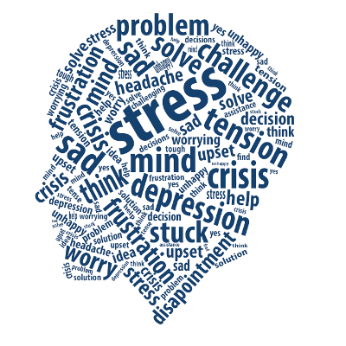
B- psychological problems
Depression is one of the leading causes of illness and disability among adolescents.
Mood disorders, anxiety disorders, and thought disorders (such as schizophrenia)
Eating disorders, such as anorexia nervosa and bulimia nervosa.
Stress can also lead to loss of appetite and sleeplessness.
Self-esteem or confidence issues.

Slide 26
C- social problems
Alcohol, drugs, and Tobacco use
Undernutrition and obesity
Physical activity
Nutrition and micronutrient deficiencies
Social media addiction
Delinquency
Boys may fall into bad company and be drawn to acts of violence, vandalism, and aggression.
Self identification
Notes:
The vast majority of people using tobacco today began doing so when they were adolescents.
●At least 1 in 10 younger adolescents (aged 13 to 15) uses tobacco
Globally, in 2016, over 1:6 adolescents was overweight.

Slide 27
C- social problems
Bullying:
30 % of teens in the U.S. have been involved in bullying—either as a victim or as the bully. (2)
Pressure to perform academically and obtain college admission can be stressful.
Relationship with others
Responsibility
(2) According to Family First Aid research
Notes:
The vast majority of people using tobacco today began doing so when they were adolescents.
●At least 1 in 10 younger adolescents (aged 13 to 15) uses tobacco
Globally, in 2016, over 1:6 adolescents was overweight.
According to research conducted by Family First Aid,

Slide 28
5. common adolescent health problems in Saudi Arabia:
Retrieved from available evidence-based studies

Slide 29
They are Various and highly prevalent health problems, including dietary and sedentary behaviors, lack of safety measures, bullying, and violence.
A
B
C

Slide 30
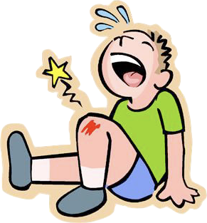
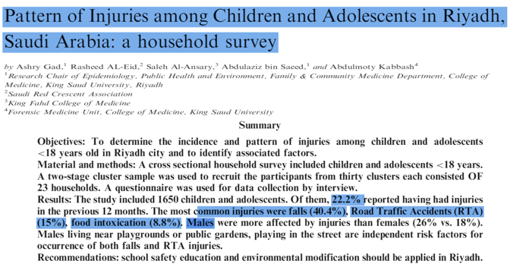
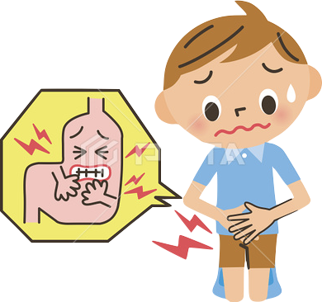
A- physical problems
22.2%
1-INJURIES
2011
40%
15%
8%

Slide 31
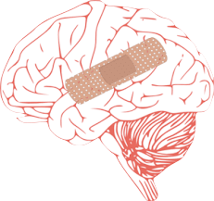
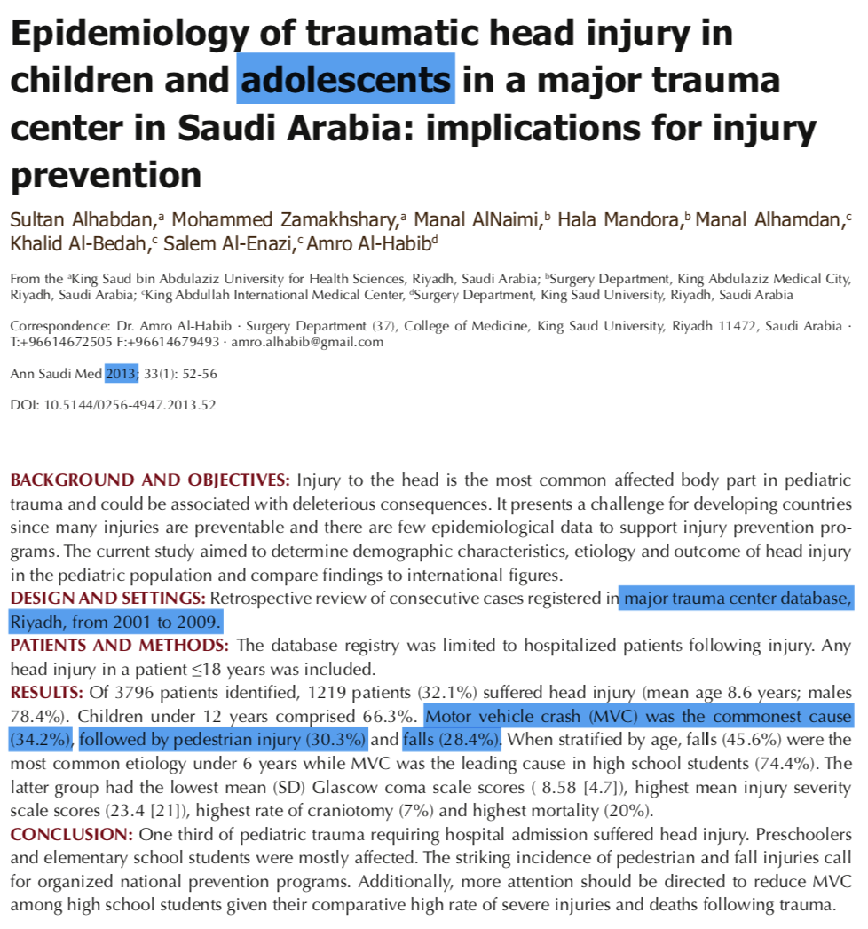
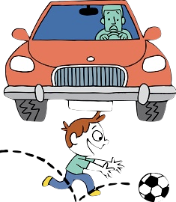
32%
34%
30%
28%

Slide 32
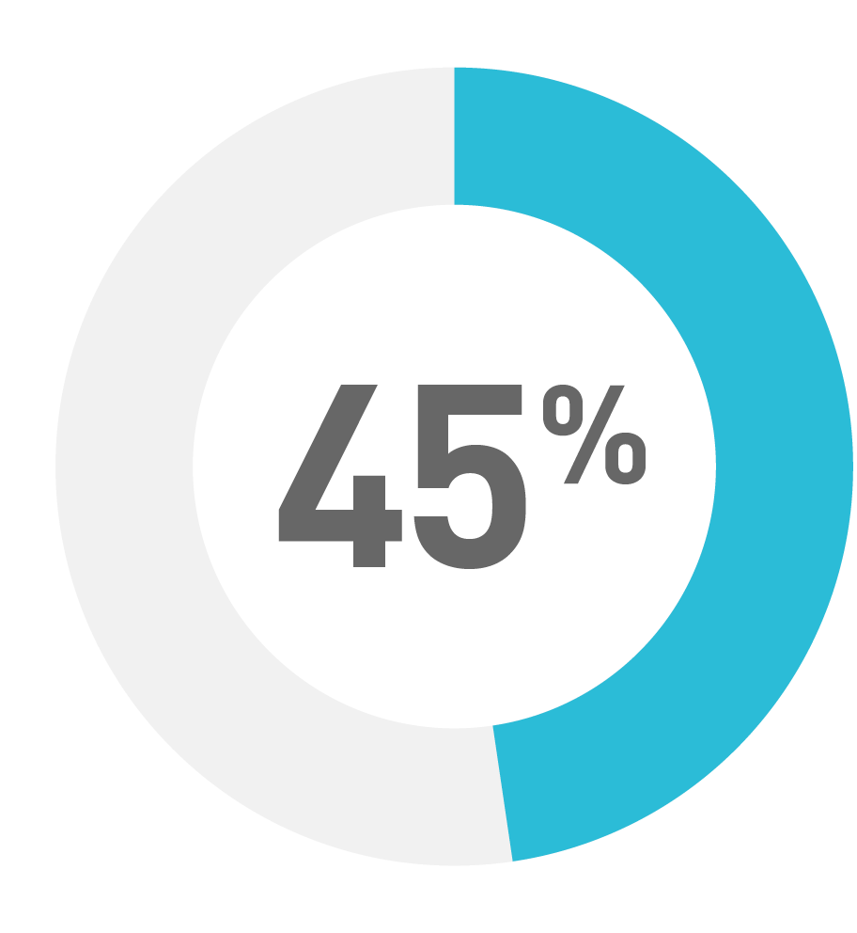
ROAD TRAFFIC COLLISION
2013

Slide 33
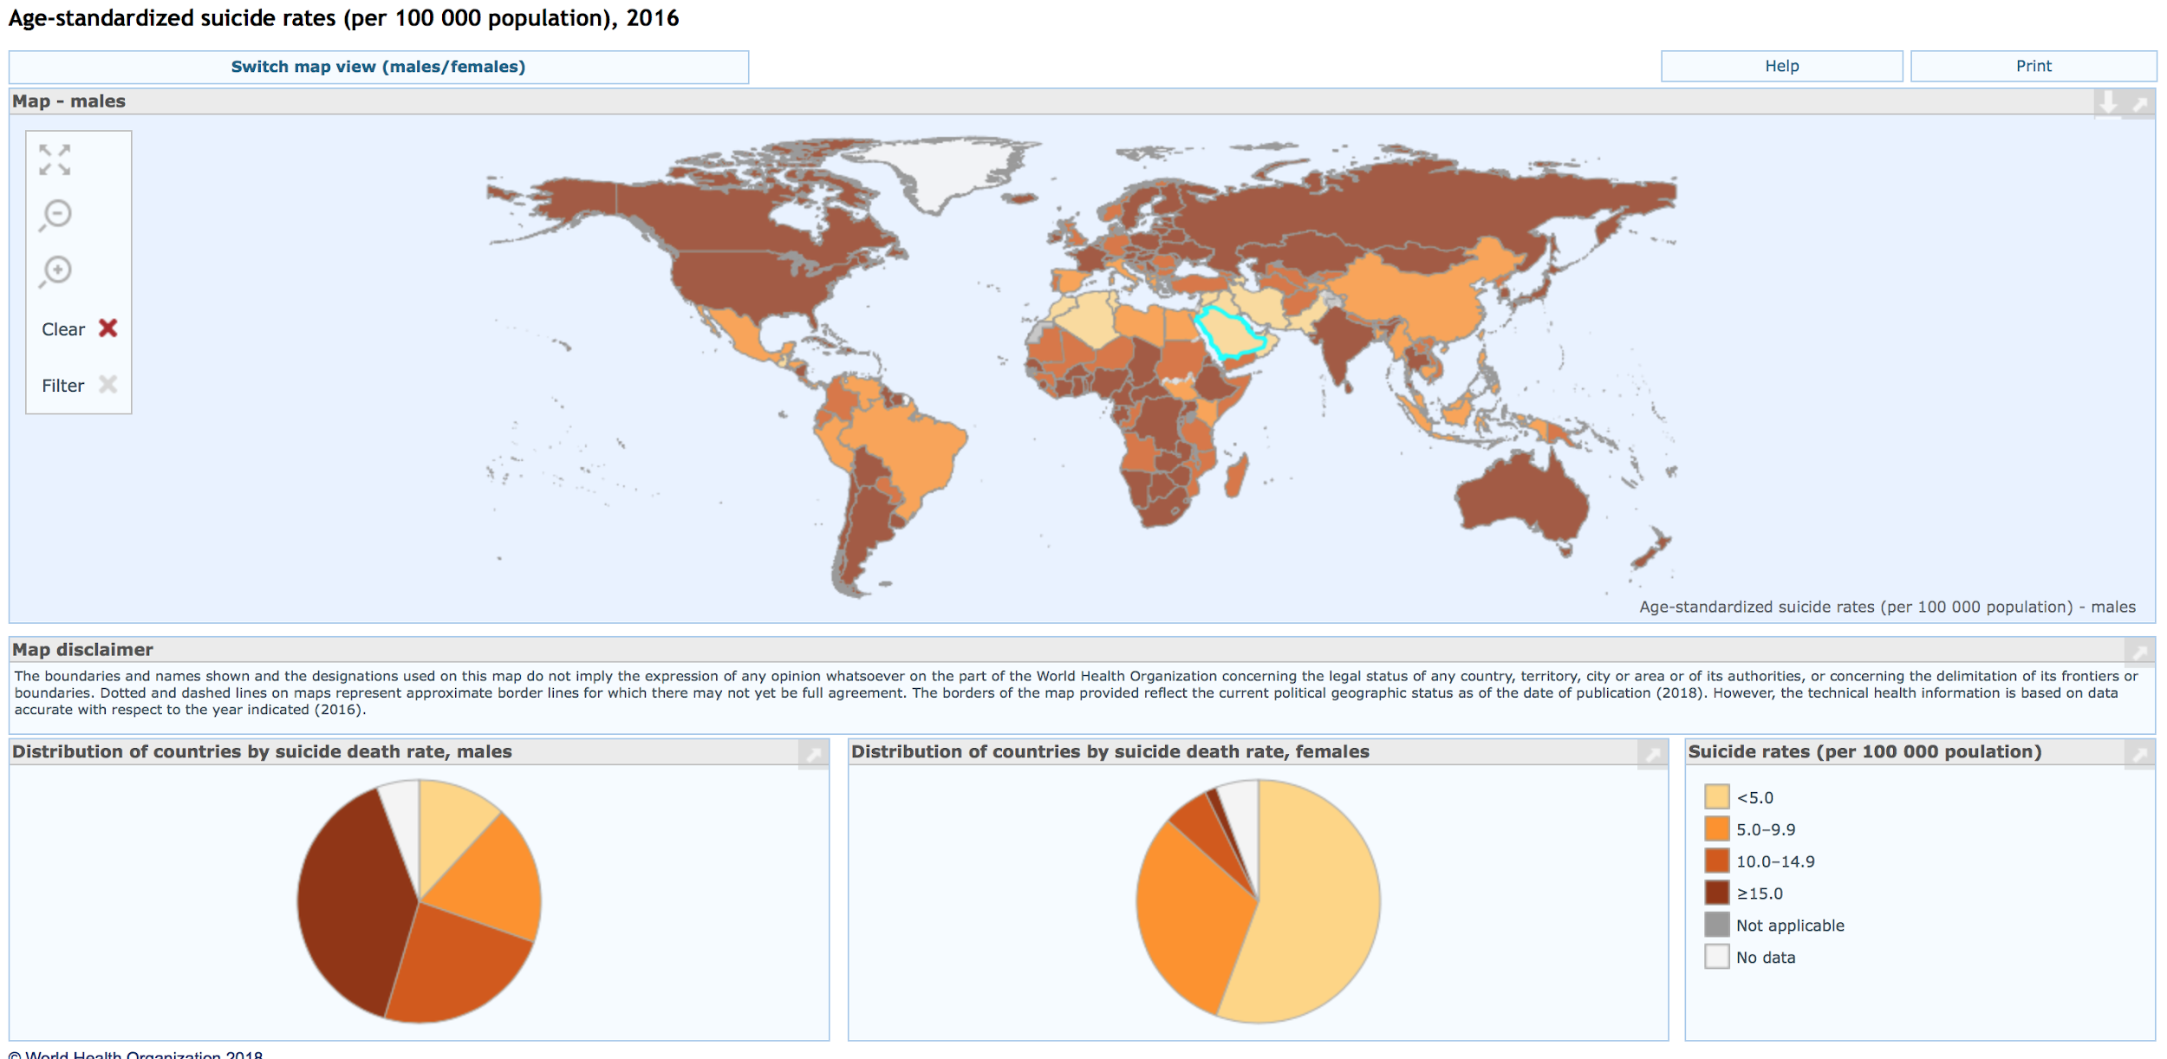
2-Suicide
WHO-Global Health Observatory data repository 2016

Slide 34
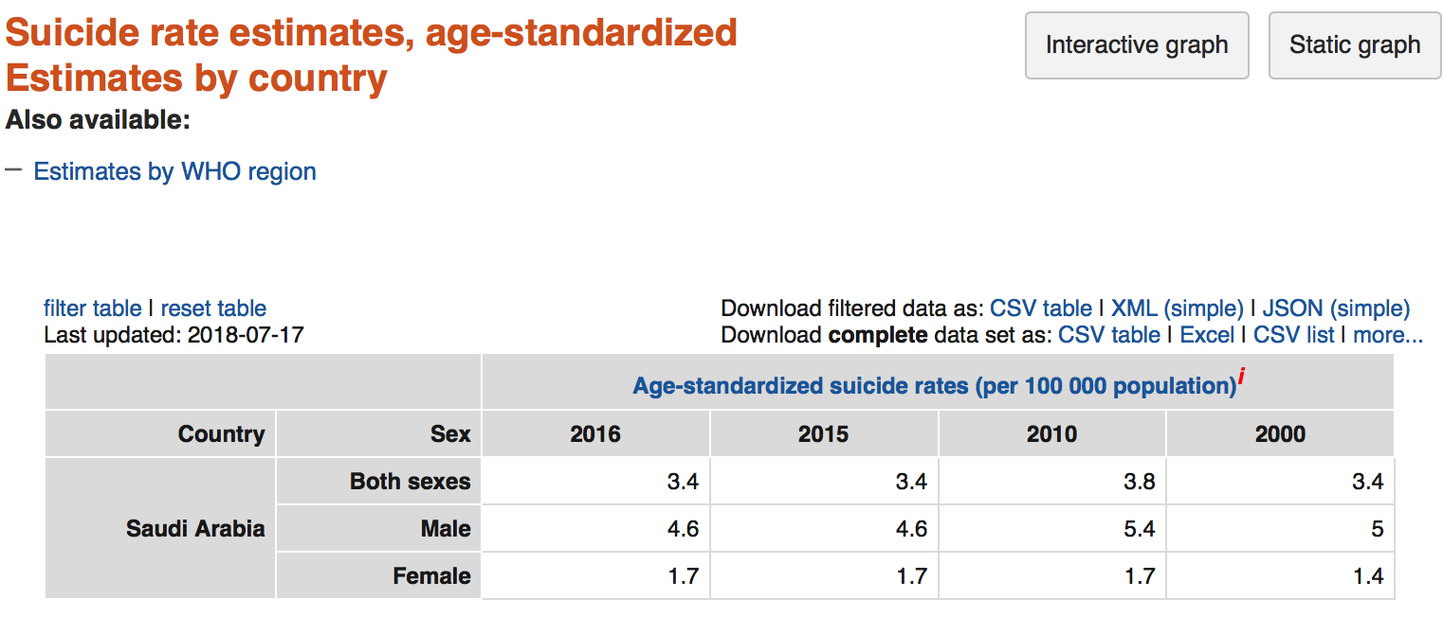
2-Suicide
WHO-Global Health Observatory data repository 2016

Slide 35
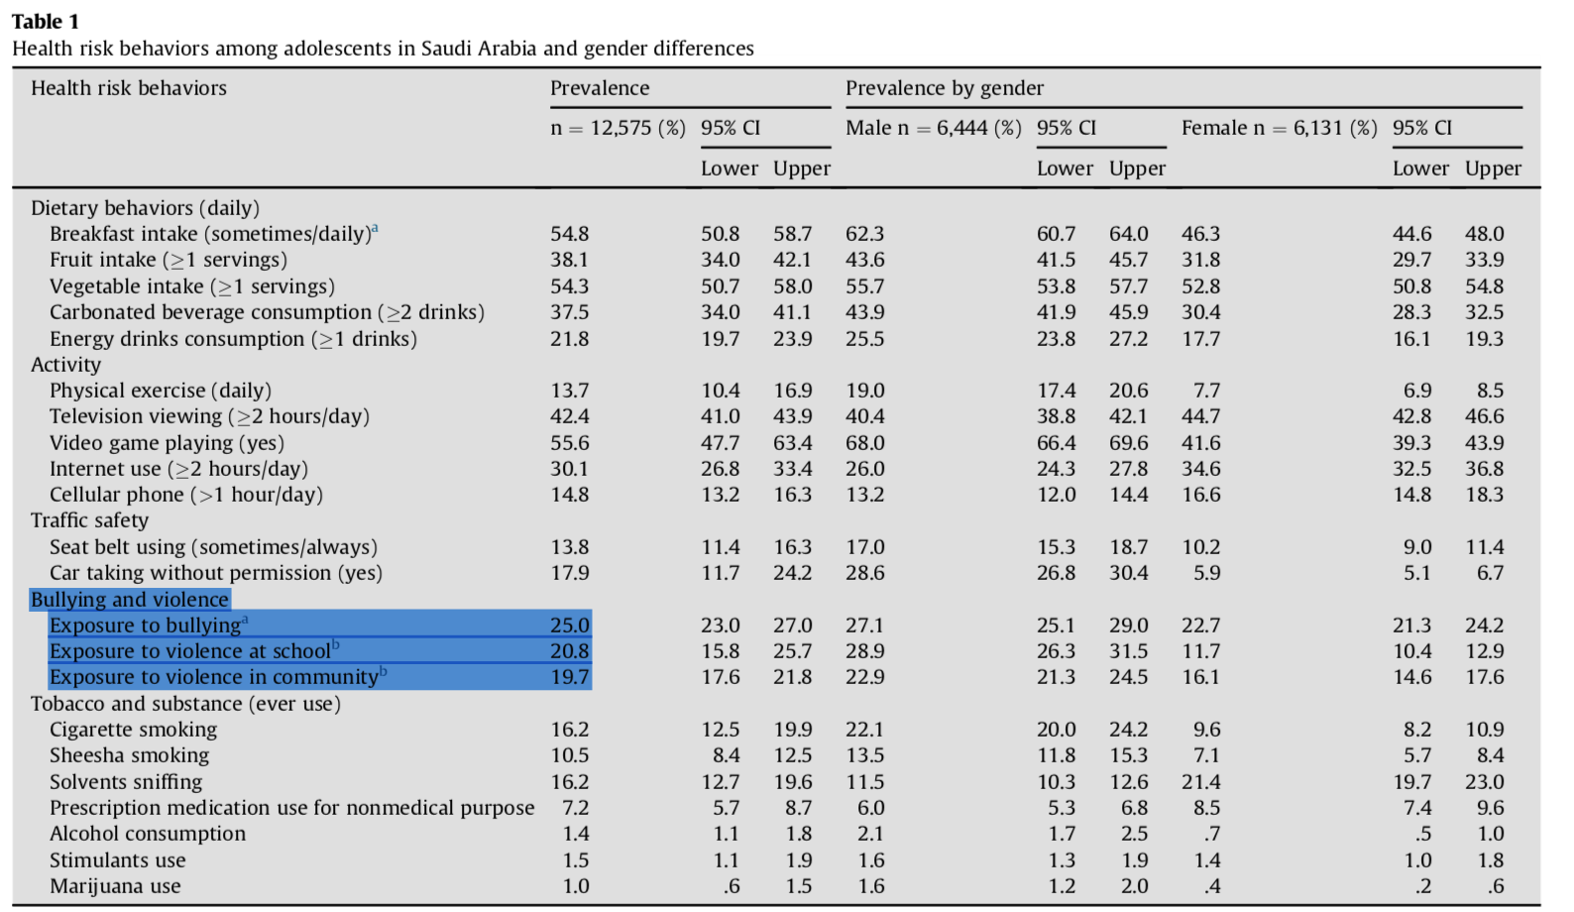
3-Violence
Notes:
25% reported exposure to bullying at school during the 30 days preceding the study 20% were involved in physical violence at school or community during the preceding year.

Slide 36
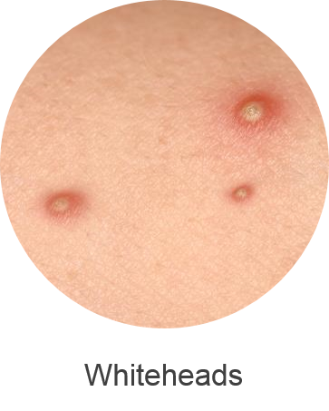
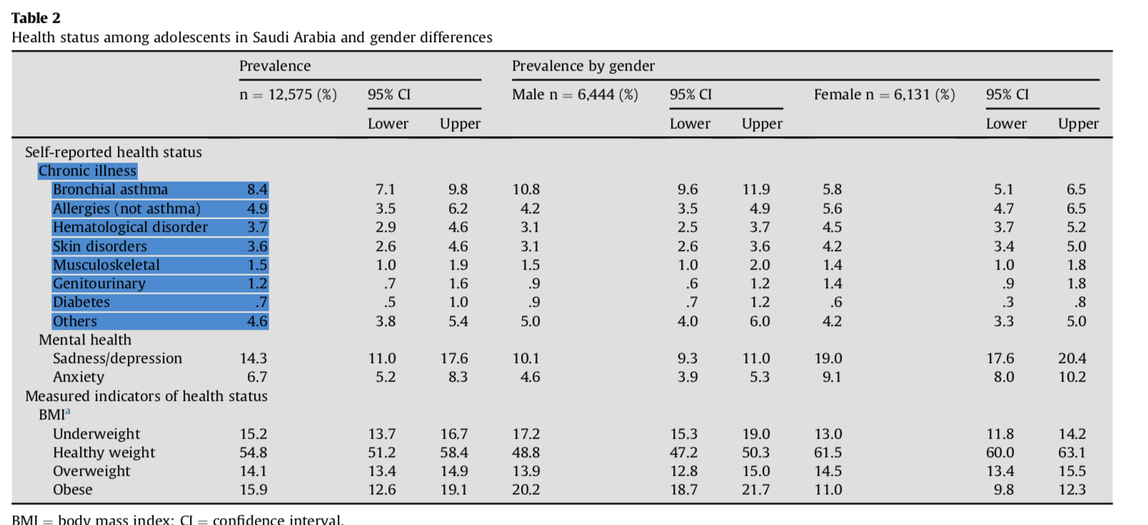
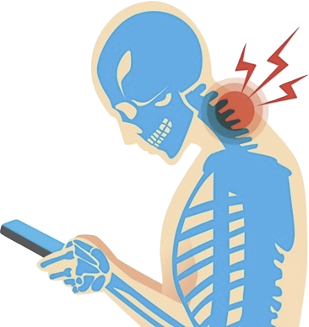
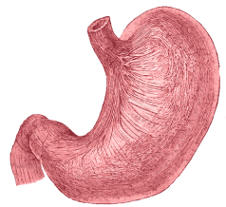
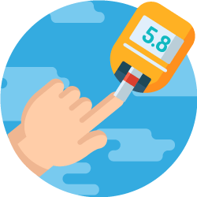
3-Chronic condition:
28.6%
Notes:
Self-reported chronic health conditions. Overall prevalence was 28.6%, with bronchial asthma being the most prevalent.

Slide 37
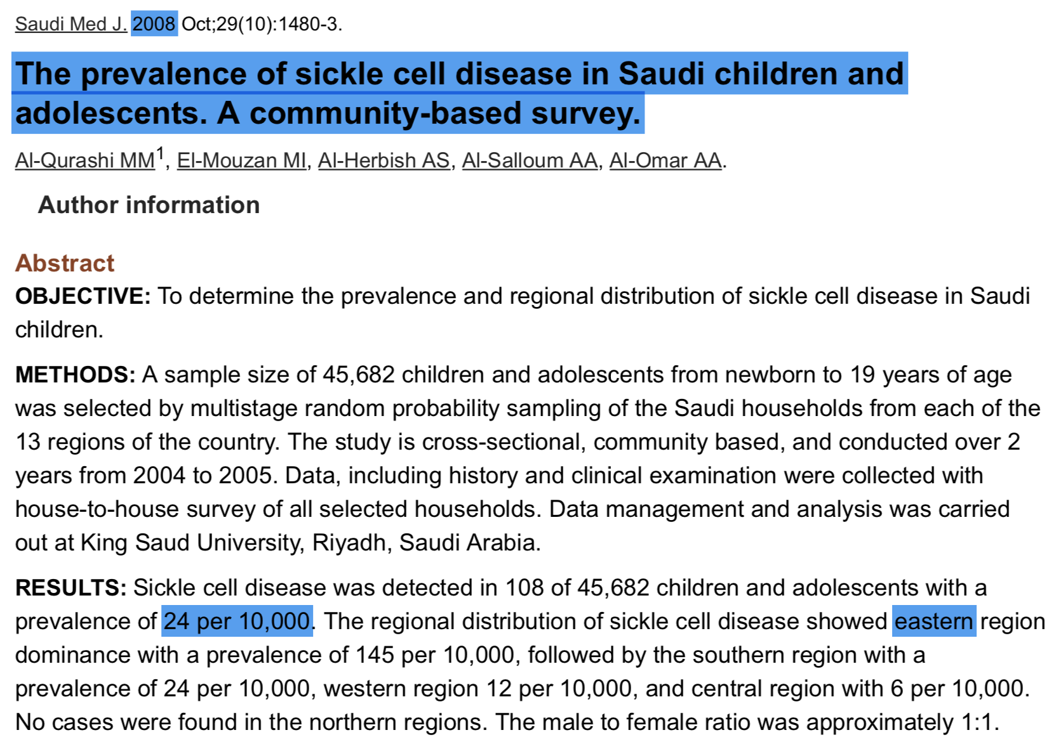
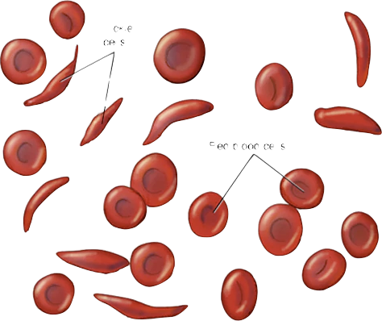
3-Chronic condition:Sickle cell disease

Slide 38
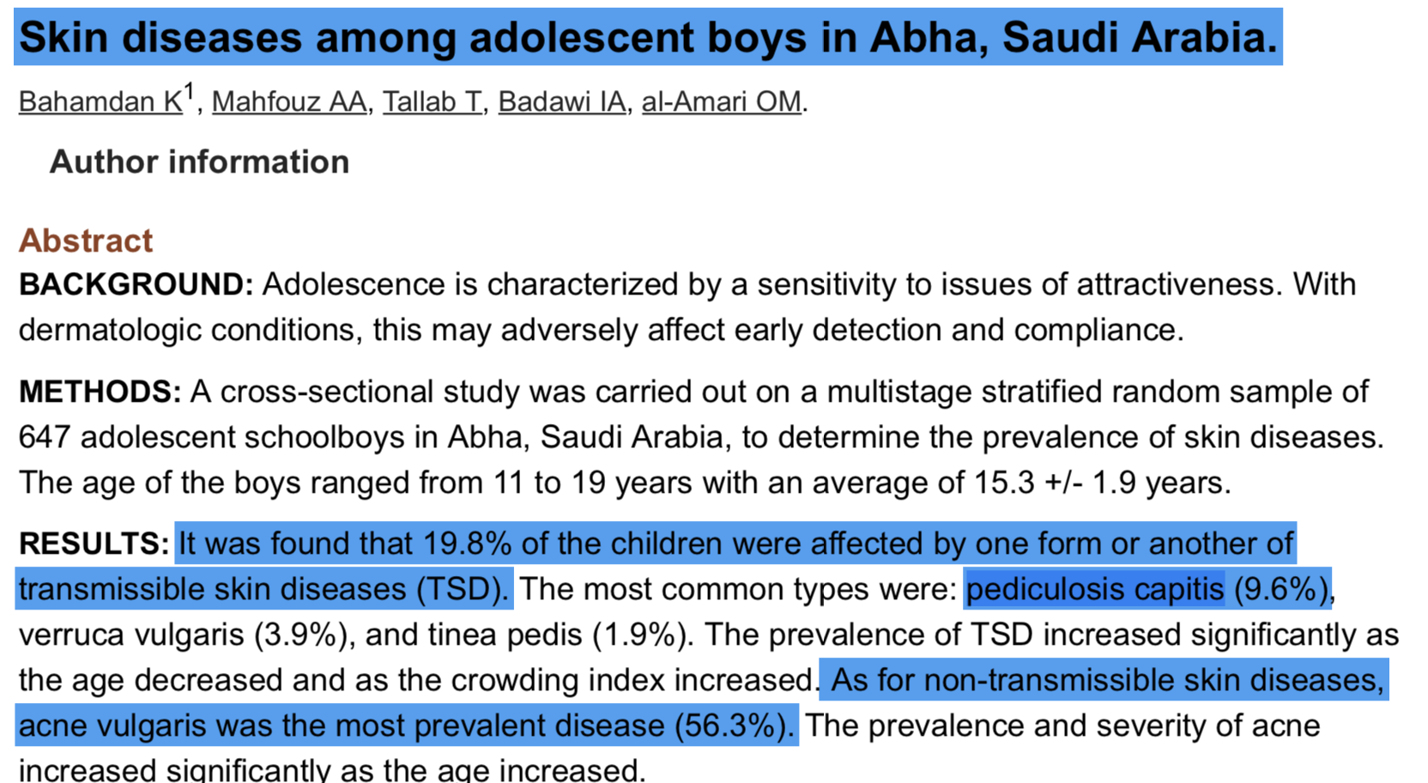
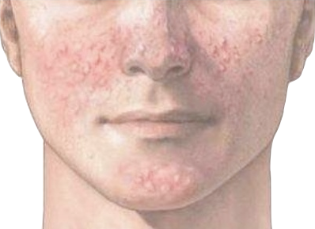
3-Chronic condition:Skin
1996

Slide 39
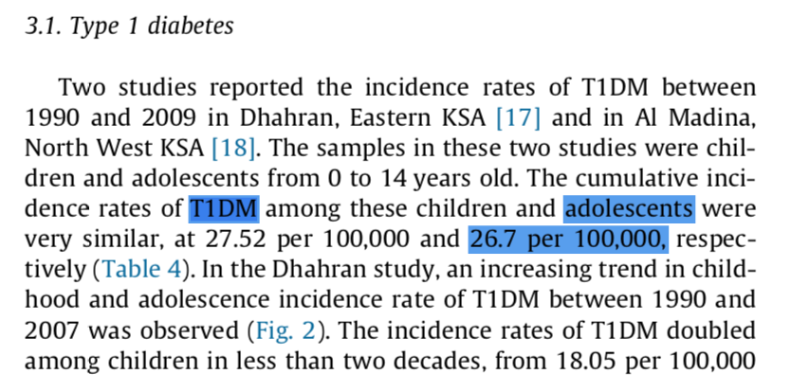
3-Chronic condition: DM1
2017

Slide 40
VITAMIN D DEFICIENCY

Slide 41
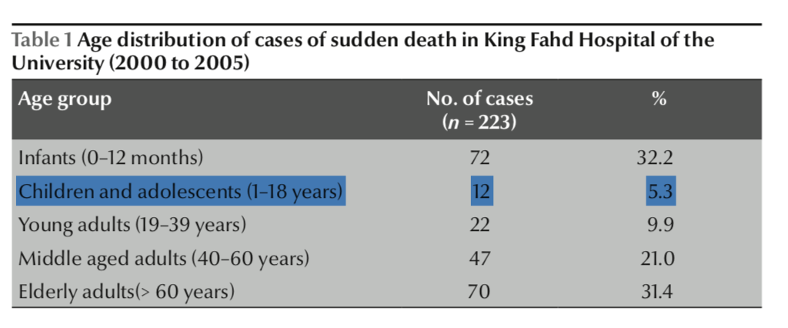
3-Chronic condition: CVD

Slide 42
B- psychological problems

Slide 43
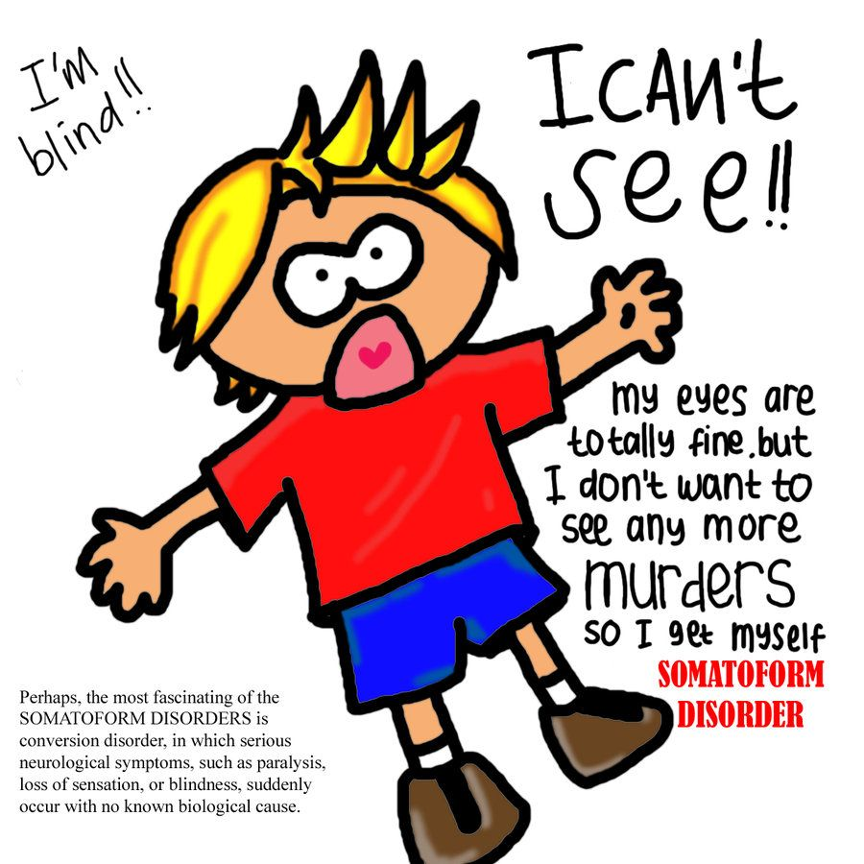
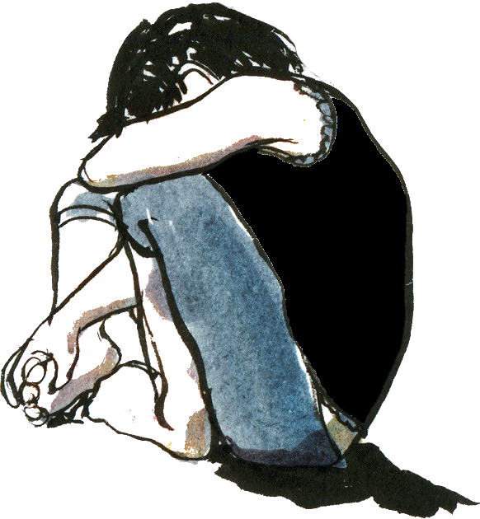
2013
Anxiety (13.5%)
somatic disorders (12.2%)
obsession (10.8%)

Slide 45
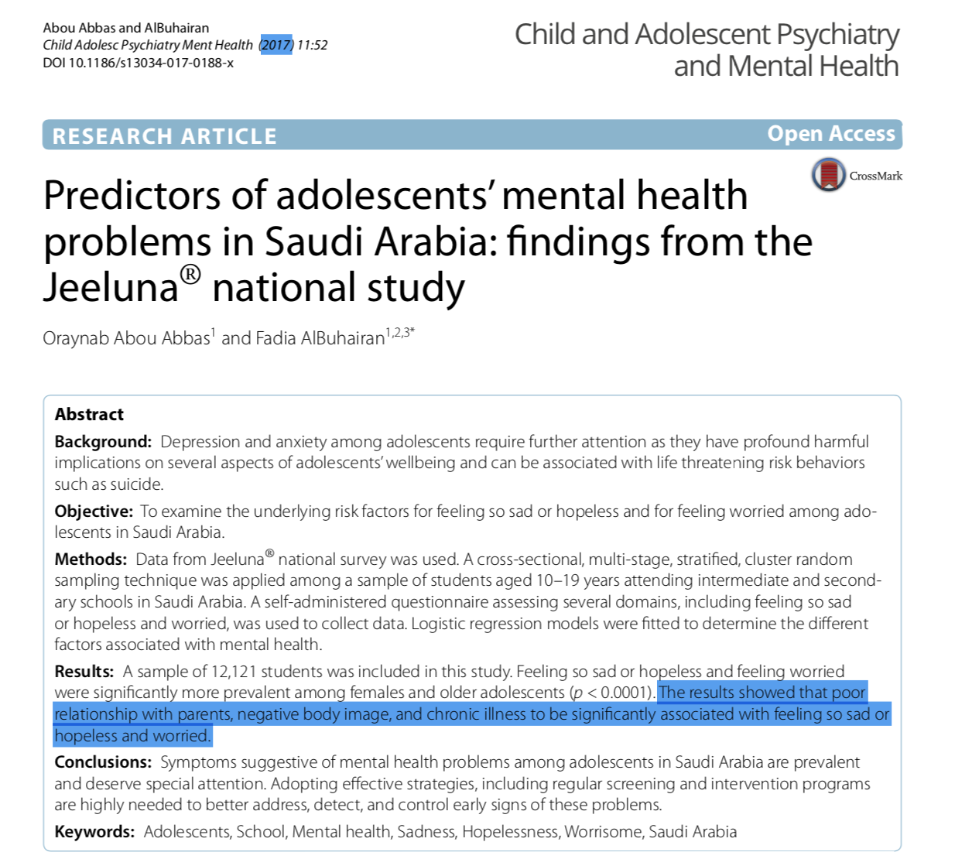
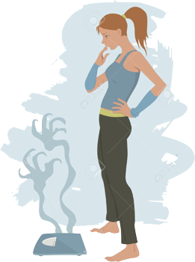
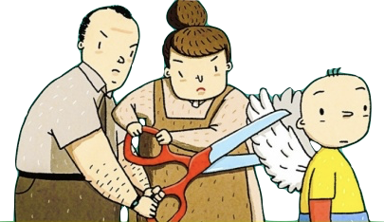

Slide 46
C- social problems

Slide 47
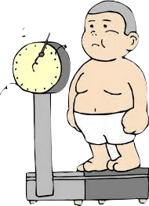
1-Obesity

Slide 48
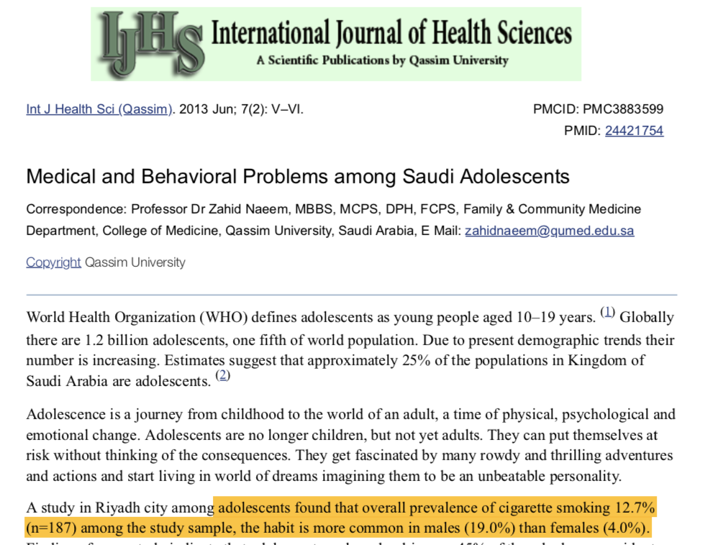
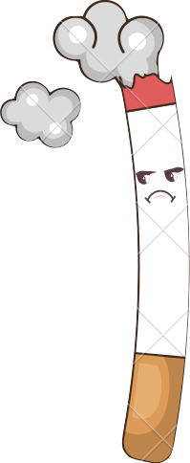
2-SMOKING

Slide 49
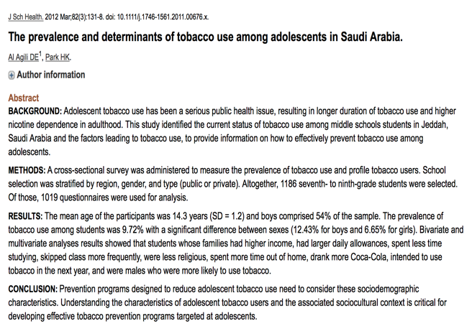
Tobacoo

Slide 50
RESOURCES
1- Fadia S. AlBuhairan, Hani Tamim, Mohammad Al Dubayee, Shahla AlDhukair, Sulieman Al Shehri, Waleed Tamimi, ,Charbel El Bcheraoui, Mohi Eldin Magzoub, Nanne de Vries, and Ibrahim Al Alwan. (2015). Time for an Adolescent Health Surveillance System in Saudi Arabia. Journal of Adolescent Health 57- 263e269
2- Naeem, Z. 2013, "Medical and Behavioral Problems among Saudi Adolescents", International journal of health sciences, vol. 7, no. 2, pp. V-VI.
3-Alhabdan, S., Zamakhshary, M., AlNaimi, M., Mandora, H., Alhamdan, M., Al-Bedah, K., Al-Enazi, S. & Al-Habib, A. 2013, "Epidemiology of traumatic head injury in children and adolescents in a major trauma center in Saudi Arabia: implications for injury prevention", Annals of Saudi medicine, vol. 33, no. 1, pp. 52-56.
4-Gad, A., AL-Eid, R., Al-Ansary, S., bin Saeed, A. & Kabbash, A. 2011, "Pattern of injuries among children and adolescents in Riyadh, Saudi Arabia: a household survey", Journal of tropical pediatrics, vol. 57, no. 3, pp. 179-184.
5-Global Health Observatory data repository-WHO
http://apps.who.int/gho/data/node.main.MHSUICIDEASDR?lang=en

Slide 51
6.Understand the comprehensive approach to common adolescent health problem in primary health care.

Slide 52
What do we mean by the term health services?
service provided by a health worker to a patient aimed at:
1- preventing a health problem.(provision of information,advice,counselling and clinical services aimed atpromoting health and preventing health problems and problem behaviours)
2-Detecting and treating one.
-diagnosis,detection and management of health problems and problem behaviours.
-referral to other health and social service providers,when necessary.
3-change agents in their communities.
-They could make an invaluable contribution in helping educators, religious leaders, political leaders and others understand the needs of adolescents, and the importance of working together to meet these needs.

Slide 53
When adolescents have health-related concerns or are experiencing health problems to whom do they turn for help?
-Those adolescents who fall ill with, for example, commonly occurring conditions such as fevers, coughs and colds, may have no hesitation
in seeking care. On the other hand, they may be less willing to do so for more sensitive matters.
-key factor that influences adolescents’ health care-seeking behaviour is whether or not the act of seeking health care could get them into trouble with their parents or guardians.
-in many instances it is the adults surrounding an adolescent who decide whether or not health care needs to be sought, and if so when and where it should be sought. This is generally true in case of younger adolescents who are dependent on their parents.

Slide 54
What do adolescents perceive as ‘friendly’ health services?
Adolescents want to be treated with respect and to be sure that their confidentiality is protected.9
What is being done to make to make health services adolescent friendly?
Health service providers are non judgemental and considerate
Adolescents are aware of where they can obtain the health services they need,and are both able and willing to do so when needed.
Community members are aware of the health-service needs of different groups of adolescents.

Slide 55
What are the barriers that adolescents face in obtaining the health services they need?
1-Firstly, in many places, health services not available to anyone.
2-health services are not accessible to them
3-health services are not acceptable to them.
4-health services are not equitable to them
SO!! Five objectives identified by the World Health Organization provide a basis for assessing the quality of current and future systems of health services for adolescents: accessibility, acceptability, appropriateness, effectiveness, and equity.
Notes:
Evidence shows that while private office-based primary care services are available to most adolescents, those services depend significantly on fee-based reimbursement and are not:
accessible to adolescents who are uninsured or underinsured.
offered in acceptable settings that foster open communication of sensitive behaviors or health conditions.
provided by personnel who are skilled in addressing health conditions and behaviors that are appropriate for this stage of development.
effective at fostering health promotion or addressing risky behaviors that are prevalent among adolescents, such as substance use and unsafe sexual activity.
Evidence shows that specialty care services for the adolescent population are not accessible to most adolescents. Existing specialty services in the areas of mental health, sexual and reproductive health, oral health, and substance use treatment and prevention are generally insufficient to meet the needs of many adolescents. While evidence-based therapies are available in a number of these areas, they are not integrated into many practice settings.
Even when specialty services are accessible, many adolescents do not find them acceptable because of concerns about disclosure of treatment in sensitive areas (such as substance use or sexual health).
Many specialty providers lack appropriate training to address the needs of adolescent patients, and certification programs for treating adolescents are frequently unavailable in many specialty areas.
The lack of appropriate specialty services that are suitable for adolescents means that effective treatment is often delayed, care is of limited duration, and services are poorly reimbursed.
Limitations in the quality of or access to specialty services are especially prevalent among at-risk adolescents in whom problems in the above areas frequently co-occur, contributing to health care inequities and disparities.
Accessible. Policies and procedures ensure that services are broadly accessible.
Acceptable. Policies and procedures consider culture and relationships and the climate of engagement.
Appropriate. Health services fulfill the needs of all young people.
Effective. Health services reflect evidence-based standards of care and professional guidelines.
Equitable. Policies and procedures do not restrict the provision of and eligibility for services.

Slide 56
What can be done to improve the quality of health service provision to adolescents?
The starting point for any initiative aimed at improving the quality of health service provision to adolescents is the national health policy and strategy developed by the ministry of health, which will provide answers to five critical questions:
What health outcomes are being aimed for?
Among which group (or groups) of adolescents are these health outcomes being aimed for?
What is the place of health service provision to adolescents within an overall strategy to achieve these health outcomes?
What is the package of health services to be provided,to achieve the health outcomes being aimed for?
Where (which type of health facility) and by whom(which type of health service provider)should these health services be provided by?
Precise answers to these questions will provide a sound basis for developing a national strategy to improve the quality of health service provision to adolescents

Slide 57
Safety-Net Primary Care Services..
-“those providers that organize and deliver a significant level of health care and other health-related services to uninsured, Medicaid, and other vulnerable patients
-safety net consists of public hospital systems; academic health centers; community health centers or clinics funded by federal, state, and local public health agencies; and local health departments. An additional feature of the safety net for adolescents is the presence of school-based health centers. The organization and delivery of safety-net services vary widely from state to state and community to community.
PRIMARY CARE SERVICES
Private Office-Based Care
The majority of adolescents have private insurance through family plans offered by one or both parents’ employers. These adolescents commonly receive their primary medical care from private provider offices, usually a pediatrician, family physician, general internist, or nurse practitioner, or for older female adolescents, a gynecologist.

Slide 58
Hospital-Affiliated Primary Care Services
School-Based Health Centers
Community-Based Health Centers

Slide 59
7. ROLE OF FAMILY, SCHOOL, AND COMMUNITY IN ADOLESCENT HEALTH CARE
Notes:
مراكز التنمية المجتمعية

Slide 60
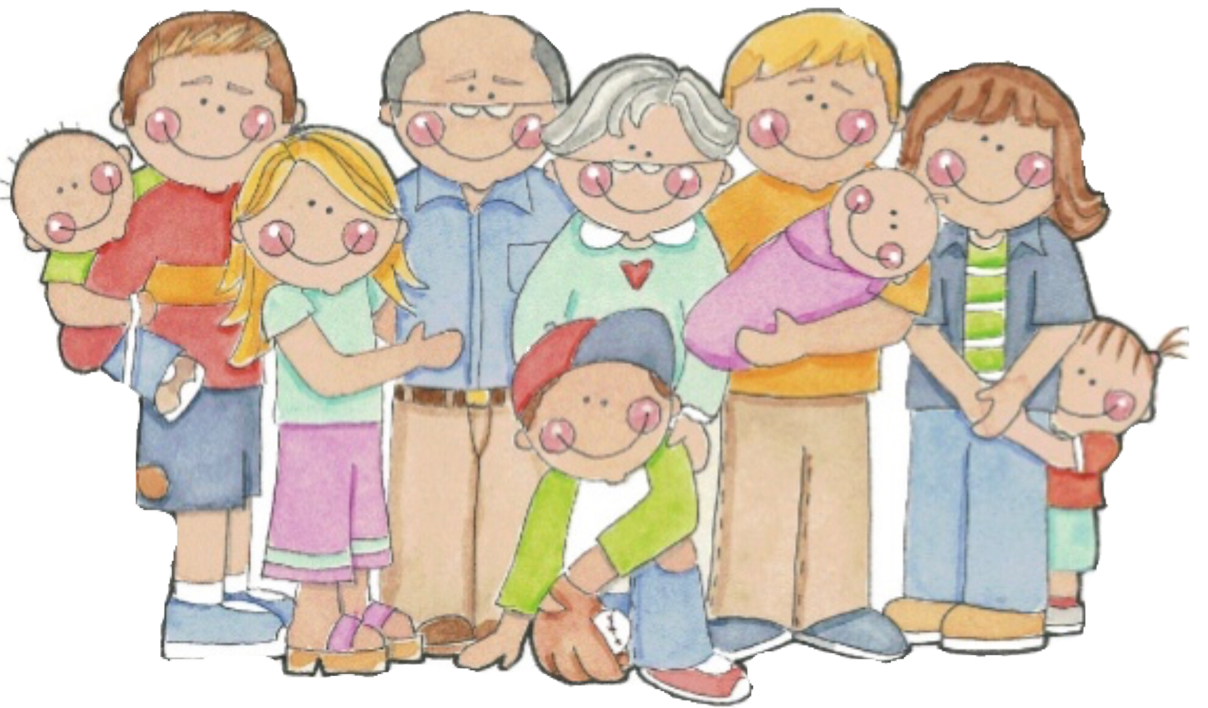
ROLE OF FAMILY:
Active good parenting is very important in promoting the lifelong health and safety of their children. This includes: -Becoming positive role models -Providing guidance and setting boundaries
Adolescents who have good communication and are bonded with an adult are less likely to engage in risky behaviors.

Slide 61
ROLE OF SCHOOL :
School can help in adolescents health by: - Promoting health programs - Promotes healthy eating ( school cafeteria) - Provides areas for physical activity through physical education class (football, basketball, etc.)
Provide a safe environment for adolescents to express their opinion.
The school social environment affects student’s attendance, academic achievement, and behavior.
School environment and behavior of teachers play a major role in character building and personality development of adolescents.

Slide 62
ROLE OF COMMUNITY:
Promoting physical activities through community efforts such as community sponsored sports programs. Such programs will help adolescents stay healthy as well as allow to socialize with others.
Establishing Antismoking program involving prohibition of the sale and use of cigarettes in public places.
Apply a firm traffic laws forbidding adolescents aged less than 18 years from driving.
Raising awareness of health issues for young people among the general public and special groups.
Supervision over media content because, adolescents who are exposed to media portrayals of violence, sexual content, smoking, and drinking are at risk for adopting these behaviors.

Slide 63
Take Home Message
Adolescence is a very critical stage in one’s life. It’s where biological, physiological, and psychological maturation happens.
Taking risks at this age without thinking of the consequences is common. Which may lead to serious illnesses, disabilities, and death.
Unintentional injuries are the leading cause of death among adolescents, and in most cases they’re preventable.
The health problems in adolescents globally are to some extent similar to those in Saudi Arabia. Such as the widespread of smoking, obesity, injuries, mental problems, physical inactivity..

Slide 64
MCQs 1
The most common cause of depressive symptoms in adolescents is ?
A- Overweight and obesity
B- Vitamin D deficiency
C- Violence
D- Growth changes

Slide 65
MCQs 2
The ratio of adolescents population worldwide is ?
A- 1:6
B- 2:6
C- 3:6
D- 4:6

Slide 66
MCQs 3
The prevalence of bullying among adolescents in US is ?
A- 10%
B- 20%
C- 30%
D- 40%

Slide 67
MCQs 4
The height peak in the males is at the age of…..?
1- 11
2- 12
3- 13
4- 14

Slide 68
MCQs 5
What is the first sign of puberty in females?
1- Voice changes
2- Axillary hair
3- Breast development
4- Menarche

Slide 69
References
https://www.who.int/topics/adolescent_health/en/
Adolescents: health risks and solutions: WHO Retrieved May 08, 2017, from http://www.who.int/mediacentre/factsheets/fs345/en/#
Oxford handbook of General practice
https://www.verywellfamily.com/startling-facts-about-todays-teenagers-2608914
Fripp RR. Hypertrophic cardiomyopathy in the adolescent. Pediatrician. 1986;13(4):158-64. https://www.ncbi.nlm.nih.gov/pubmed/3588449
https://www.stanfordchildrens.org/en/topic/default?id=adolescent-health-problems-and-injuries-90-P01578
-National Research Council (US) and Institute of Medicine (US) Committee on Adolescent Health Care Services and Models of Care for Treatment, Prevention, and Healthy Development; Lawrence RS, Appleton Gootman J, Sim LJ, editors.
Washington (DC): National Academies Press (US); 2009.
-World Health Organization Framework for Delivering Adolescent Friendly Health Services.

Slide 70
Thanks!
Any questions?

