Slide 1
Change in bowel habits
Ghadah AleissaRayana Ababtain- Reema Allhidan
Ghadeer Assiry - Reema Bin Tuwaim
Supervisor: Dr. Aljohara Almeneessier

Slide 2
Objectives
Define constipation and diarrhea
Discuss the definition, etiology and classification of irritable bowel syndrome (IBS)
Explain how to diagnose IBS
List the alarm symptoms and differential diagnosis
Provide a comprehensive management plan and follow up for patients with IBS
Recognize when to refer to specialist
Demonstrate history taking and physical examination for patients presented with history suggestive of IBS. i.e Role play.
Practical: Examination of the Abdomen, how to perform the examination?

Slide 3
Quiz:
1-What causes IBS?
1- stress and depression.
2- Bad diet.
3- it's not known.
Notes:
Stress, depression, and diet can make your symptoms worse. They can even trigger them. But doctors aren’t sure what actually causes people to have IBS.

Slide 4
2. IBS is a diagnosis of exclusion:
True
False

Slide 5
3- What is the best way of diagnosing IBS?
1- By excluding other causes. (A diagnosis of exclusion)
2- By Rome IV criteria.
4- By excluding the presence of red flags.
5- By Rome IV criteria and excluding the presence of red flags.

Slide 6
4. Which of the following is not recognized as a symptom that supports the diagnosis of IBS according to the Rome criteria?
A - Altered stool frequency
B- mucus secretion
C- Abdominal bloating or subjective distention
D - Frequent nausea

Slide 7
5. Management of IBS includes:
Lifestyle modification
Pharmacological therapy
Dietary advice
All of the above

Slide 8
Chronic diarrhea
Chronic diarrhea, defined as a decrease in stool consistency for more than four weeks.

Slide 9
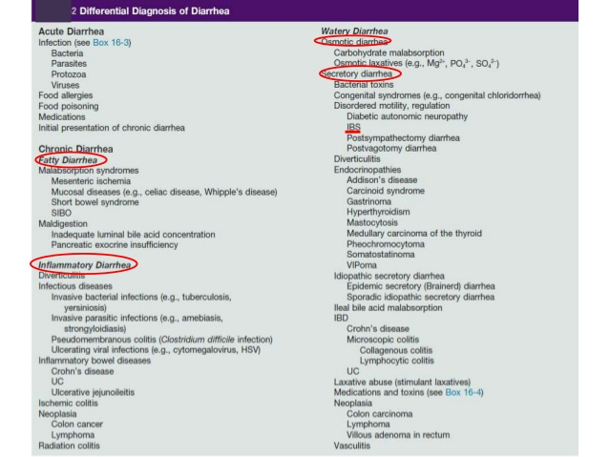

Slide 10
Irritable bowel syndrome (IBS) is the most common cause of functional diarrhea in the developed world. IBS is a symptom complex of crampy abdominal pain accompanied by altered bowel habits, either with diarrhea or constipation. Usually watery diarrhea occurs while awake, often following meals. Discomfort is alleviated by defecation, and stool mucus is noted in one-half of patients.

Slide 11
Chronic constipation
three or fewer bowel movements per week. Having fewer bowel movements is associated with symptoms of lower abdominal discomfort, distension, or bloating.

Slide 12
Differential diagnosis
Secondary:
Medications: Antacids, especially with calcium Iron supplements Opioids
Medical conditions: Cerebrovascular disease Depression Diabetes mellitus Hypothyroidism Irritable bowel syndrome
Primary:
NORMAL TRANSIT CONSTIPATION:
psychosocial stress
SLOW TRANSIT CONSTIPATION:
There is no increase in peristaltic activity that should occur after meals.
OUTLET CONSTIPATION:
pelvic floor dysfunction

Slide 13
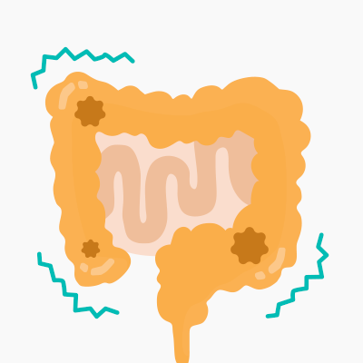
What is IBS?

Slide 14
IBS
Irritable bowel syndrome (IBS) is a chronic, relapsing and often life‑long disorder. It is characterised by the presence of abdominal pain or discomfort, which may be associated with defaecation and/or accompanied by a change in bowel habit.

Slide 15
IBS is a functional (not structure) GI disorder characterized by abdominal pain and altered bowel habits in the absence of a specific and unique organic pathology.

Slide 16
IBS
Symptoms may include disordered defaecation (constipation or diarrhoea or both) and abdominal distension, usually referred to as bloating. Symptoms sometimes overlap with other gastrointestinal disorders.

Slide 17
IBS
IBS most often affects people between the ages of 20 and 30 years and is twice as common in women as in men.

Slide 18
IBS
Prevalence in the general population is estimated to be between 10% and 20%.
Recent trends indicate that there is also a significant prevalence of IBS in older people. IBS diagnosis should be a consideration when an older person presents with unexplained abdominal symptoms.

Slide 19
IBS Risk factors :
young.
female.
Have a family history of IBS.
Have a mental health problem.

Slide 20
Causes Of IBS
The causes of irritable bowel syndrome have not been adequately defined, although there are some possible causes.

Slide 21
Etiology of IBS
gut–brain axis problems :
1- gut hypersensitivity.
2- disturbed colonic motility.
bowel dysfunction after an infection.
- Approximately 10 percent of IBS cases are triggered by an acute gastroenteritis infection.
microbial imbalance in the gut (dysbiosis).
* Stress commonly aggravates the disorder.

Slide 22
Classification of IBS:
Classifying patients with IBS into specific subtypes based on predominant bowel habits is useful as it helps focus treatment on the predominant, and often, the most bothersome symptom. IBS is classified into four subtypes.

Slide 23
1- IBS with constipation (IBS-C) :
hard or lumpy stools for ≥25% of bowel movements and loose (mushy) or watery stools for ≤25% of bowel movements.

Slide 24
2- IBS with diarrhoea (IBS-D):
loose (mushy) or watery stools for ≥25% of bowel movements and hard or lumpy stool for ≤25% of bowel movements.

Slide 25
3- Mixed IBS (IBS-M):
Both hard and soft stools more than 25% of the time.

Slide 26
4- Unspecified IBS:
insufficient abnormality of stool consistency to meet criteria for above subtypes.

Slide 27
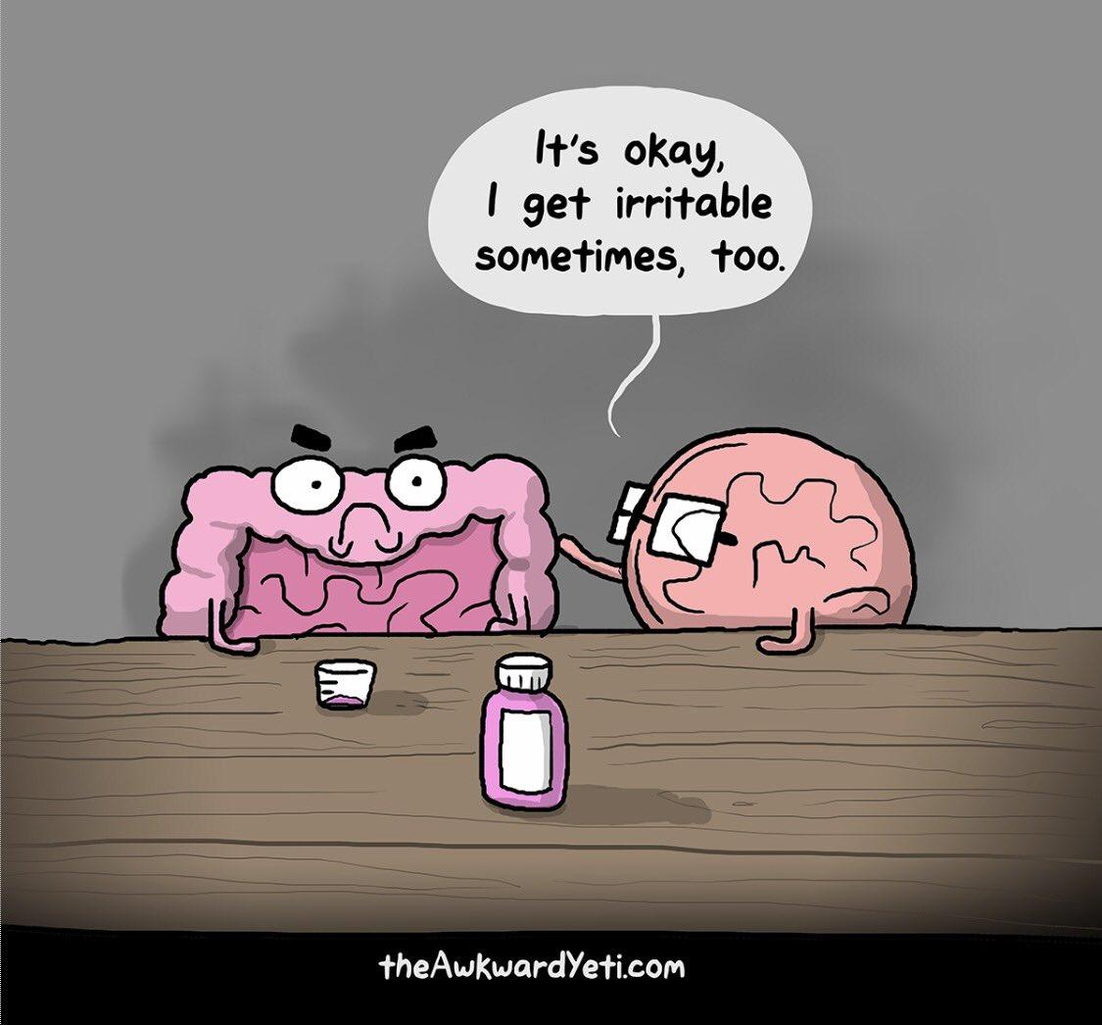

Slide 28
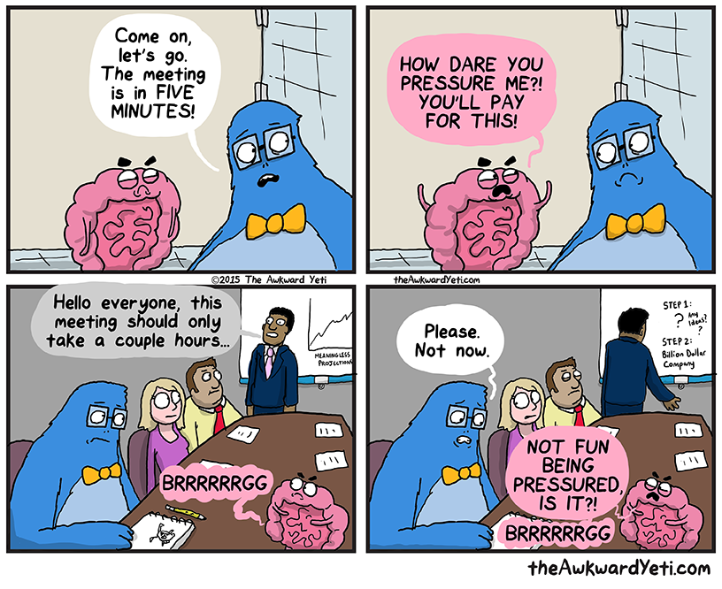

Slide 29
How to diagnose IBS?

Slide 30
How to diagnose IBS?
By History and Investigations

Slide 31
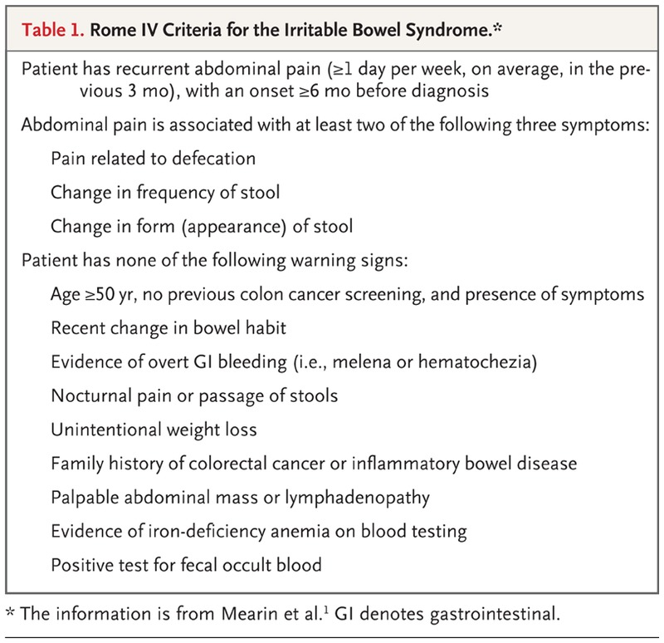
Rome IV criteria (2016)

Slide 32
Supporting symptoms include the following: -Altered stool frequency -Altered stool form -Altered stool passage (straining and/or urgency) -Mucorrhea Abdominal bloating or subjective distention

Slide 33
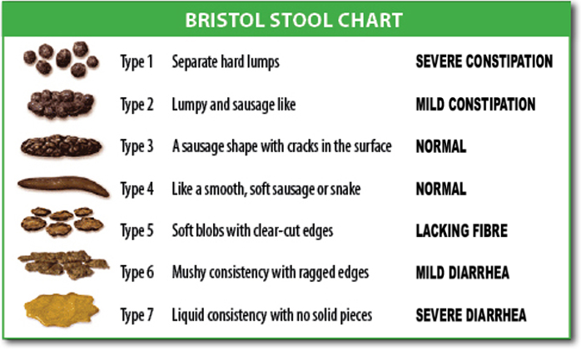

Slide 34
*The usefulness of these subtypes is debatable. Notably, within 1 year, 75% of patients change subtypes, and 29% switch between constipation-predominant IBS and diarrhea-predominant IBS. The Rome IV criteria differ from the Rome III criteria in basing bowel habits on stool forms solely during days with abnormal bowel movements rather than on the total number of bowel movements

Slide 35
NICE Guideline (2017)
Abdominal pain or Discomfort for at least 6 months that is either:
relieved by defaecation or associated with altered bowel habit (frequency or stool form).

Slide 36
This should be accompanied by at least two of the following four symptoms:
1. Altered stool passage (straining, urgency, incomplete evacuation)
2. Abdominal bloating (more common in women than men), distension, tension or hardness
3. Symptoms made worse by eating
4. +/- Specific foods passage of mucus.

Slide 37
* Other features such as lethargy, nausea, backache and bladder symptoms are common in people with IBS, and may be used to support the diagnosis.

Slide 38
Initial assessment for IBS
If the persons had any of the following symptoms of IBS for at least 6 months:
Abdominal pain or discomfort
Bloating
Change In bowel habit.

Slide 39
2. Exclude alarm symptoms (Red Flags):
signs and symptoms of cancer
Inflammatory markers for inflammatory bowel disease.

Slide 40
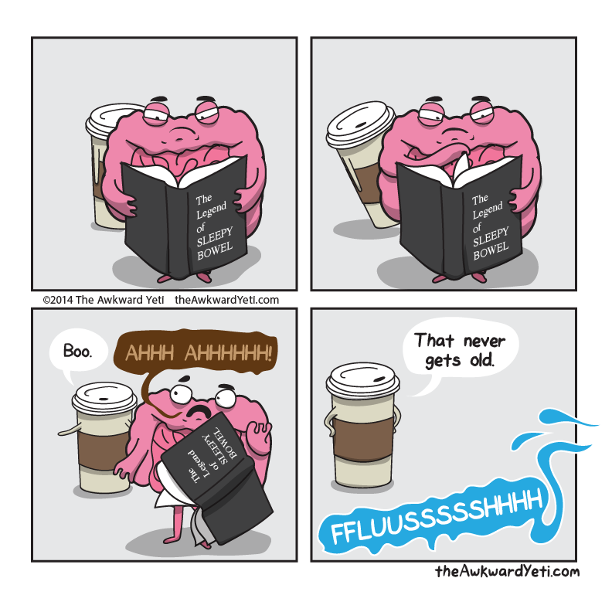

Slide 41
Diagnostic tests: (Investigations)
In people who meet the IBS diagnostic criteria, the following tests should be undertaken to exclude other diagnoses: -Full blood count (FBC)
-Erythrocyte sedimentation rate (ESR) or plasma viscosity
- C-reactive protein (CRP)
-Antibody testing for coeliac disease (endomysial antibodies [EMA] or tissue transglutaminase [TTG]).

Slide 42
Diagnostic tests: (Investigations)
-Full blood count (FBC)
- Erythrocyte sedimentation rate (ESR)
or plasma viscosity - C-reactive protein (CRP)
with differential to screen for anemia, inflammation, and infection is indicated.
are nonspecific screening tests for inflammation.

Slide 43
Diagnostic tests: (Investigations)
- Antibody testing for coeliac disease (endomysial antibodies [EMA] or tissue transglutaminase [TTG]).
Patients with IBS-D or IBS-M should have serologic testing for celiac sprue. Patients aged 50 years and older should have more extensive testing, including a colonoscopy.

Slide 44
The American College of Gastroenterologists does not recommend laboratory testing or diagnostic imaging in patients younger than 50 years, with typical IBS symptoms and without the following “alarm features”:
Weight loss
Iron deficiency anemia
Family history of certain organic GI illnesses (eg, inflammatory bowel disease, celiac sprue, colorectal cancer)

Slide 45
Patients aged 50 years and older should have more extensive testing, including a colonoscopy. *65 y old doctor said

Slide 46
Tests which are not necessary to confirm diagnosis in people who meet the IBS diagnostic criteria: - Ultrasound - Rigid/flexible sigmoidoscopy - Colonoscopy; barium enema - Thyroid function test

Slide 47
- Faecal ova and parasite test - Faecal occult blood - Hydrogen breath test (for lactose intolerance and bacterial overgrowth).

Slide 48
Gallbladder ultrasonography :
should be considered if the patient has recurrent dyspepsia or characteristic postprandial pain.

Slide 49
Abdominal computed tomography (CT) scanning:
is appropriate to screen for tumors, obstruction, and pancreatic disease if these are diagnostic possibilities.

Slide 50
CT and magnetic resonance (MR) enterography or wireless capsule endoscopy:
are employed if red flags exist to suggest enteritis (small bowel inflammation) or a tumor.

Slide 51
A comprehensive metabolic panel to evaluate for metabolic disorders and to rule out dehydration/electrolyte abnormalities in patients with diarrhea is also indicated.

Slide 52
Stool examinations: Ova and parasites (consider obtaining specimens for Giardia antigen as well) Enteric pathogens Leukocytes Clostridium difficile toxin

Slide 53
Colonoscopy:
is appropriate if alarm symptoms are present and in patients who otherwise qualify for screening colonoscopy.

Slide 54
Colonoscopy
is indicated for patients with warning signs, such as bleeding; anemia; chronic diarrhea; older age; history of colon polyps; cancer in the patient or first-degree relatives; or constitutional symptoms, such as weight loss or anorexia.

Slide 55
Anal manometry may reveal a spastic response to rectal distention or other problems.
For many patients with irritable bowel syndrome, endoscopy appropriately includes flexible sigmoidoscopy to assess for inflammation or distal obstruction.

Slide 56
Esophagogastroduodenoscopy with possible biopsy:
is indicated in patients with persistent dyspepsia, if weight loss or symptoms suggest malabsorption, or if celiac disease is a concern.

Slide 57
Hydrogen breath testing:
to exclude bacterial overgrowth may be considered in patients with diarrhea to screen for lactose and/or fructose intolerance.

Slide 58
Dietary Studies
Employ a lactose-free diet for 1 week in conjunction with lactase supplements. Improvement incriminates lactose intolerance, although the patient's clinical history and response to a trial may be unreliable. Therefore, some gastroenterologists recommend a formal hydrogen breath test. Fructose intolerance must also be considered.

Slide 59
Breath testing may also be used to evaluate for small intestinal bacterial overgrowth, as formal jejunal aspiration is rarely performed anymore. Other dietary intolerances include FODMAPs (fermentable oligosaccharides, disaccharides, monosaccharides, and polyols), gluten, and fructose. Low FODMAP diets can be helpful in this situation, though may be found very restrictive.

Slide 60
Thyroid function tests:
are used to screen for hyperthyroidism or hypothyroidism.
Serum calcium testing:
is used to screen for hyperparathyroidism.

Slide 61
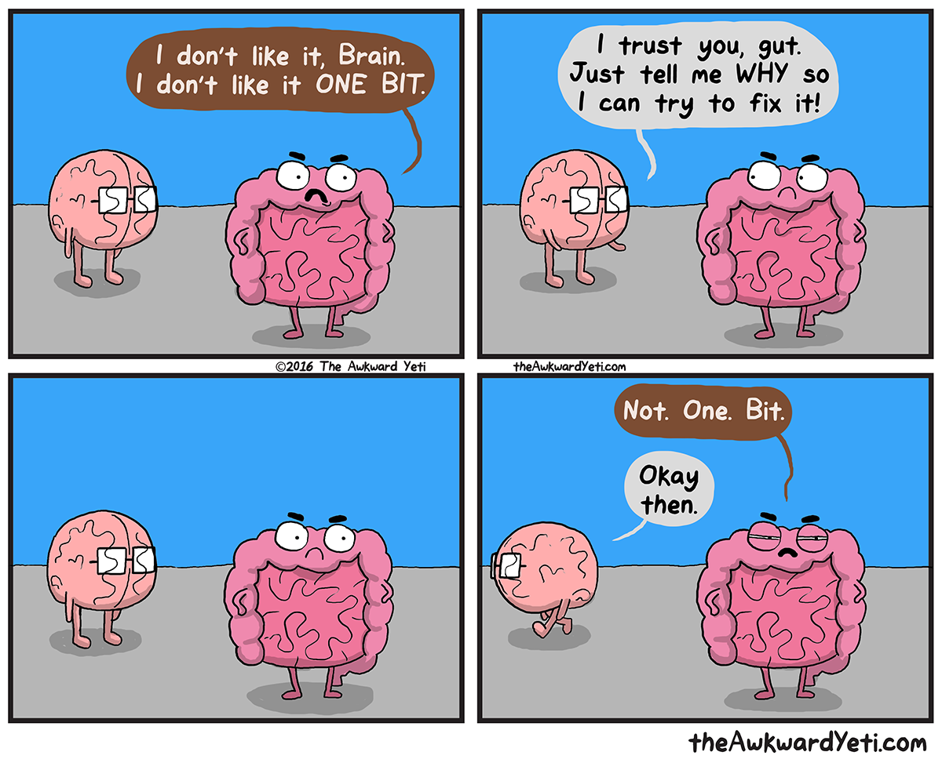

Slide 62
Differential diagnosis.
Notes:
What I will say: Generating a list of differential diagnosis is important in any disease, but it is much more important when it comes to IBS since it is a diagnosis of exclusion. So, we need to take it seriously.

Slide 63
A case scenario:
You are in the primary care clinic, a patient walk in, complaining of abdominal pain/discomfort and/or bloating.
What are your DDx. ?
Notes:
What I will say: I will ask one of the students to read the scenario, and then ask other students to generate DDx.

Slide 64
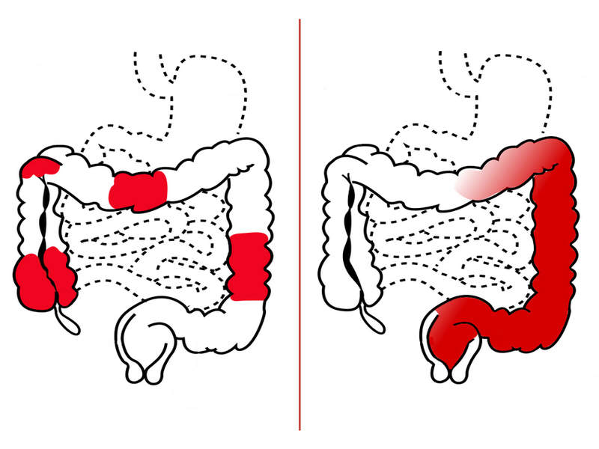
Crohn.
Ulcerative.
Inflammatory bowel diseases.
Differential diagnosis:
Notes:
I will say these are the differences between Crohn’s and Ulcerative colitis. However, this is not our topic today. This’s just to recall. :)

Slide 65
Crohn.
Ulcerative.
Colon Cancer.
Inflammatory bowel diseases.
Differential diagnosis:
Notes:
https://www.emedicinehealth.com/colon_cancer_vs_ibs_irritable_bowel_symptoms/article_em.htm#colon_cancer_vs_ibs_irritable_bowel_syndrome_symptoms_and_signs_quick_comparison
What do you think this color means? Which cancer?

Slide 66
What Are the Differences between Colon Cancer vs. IBS?

Slide 67
Colon Cancer Symptoms and Signs
bleeding from your rectum or blood mixed with stool.
→ It usually, but not always, can be detected through a fecal occult (hidden) blood test.
Rectal bleeding may be hidden and chronic and only show up as an iron deficiency anemia.

Slide 68
It may be associated with fatigue and pale skin due to the anemia.
Positive constitutional symptoms. (weight loss, fevers,headache, fevers of unknown origin, hyperhidrosis, generalized hyperhidrosis).

Slide 69
If the tumor gets large enough:
Abdominal distension.
Unexplained weight loss
Constipation
Sensation of incomplete evacuation after a bowel movement (Trismus).

Slide 70
Signs and symptoms that are NOT IBS, but should still be brought to the attention of a health-care professional since they may be signs and symptoms of other conditions include:

Slide 71
Blood in stools or urine
Black or tarry stools
Pain or diarrhea that interrupts sleep
Fever
Weight loss

Slide 72
Inflammatory bowel diseases.
Colon Cancer.
Differential diagnosis:
Bacterial overgrowth syndrome
Notes:
I will say these are the differences between Crohn’s and Ulcerative colitis. However, this is not our topic today. This’s just to recall. :)

Slide 73
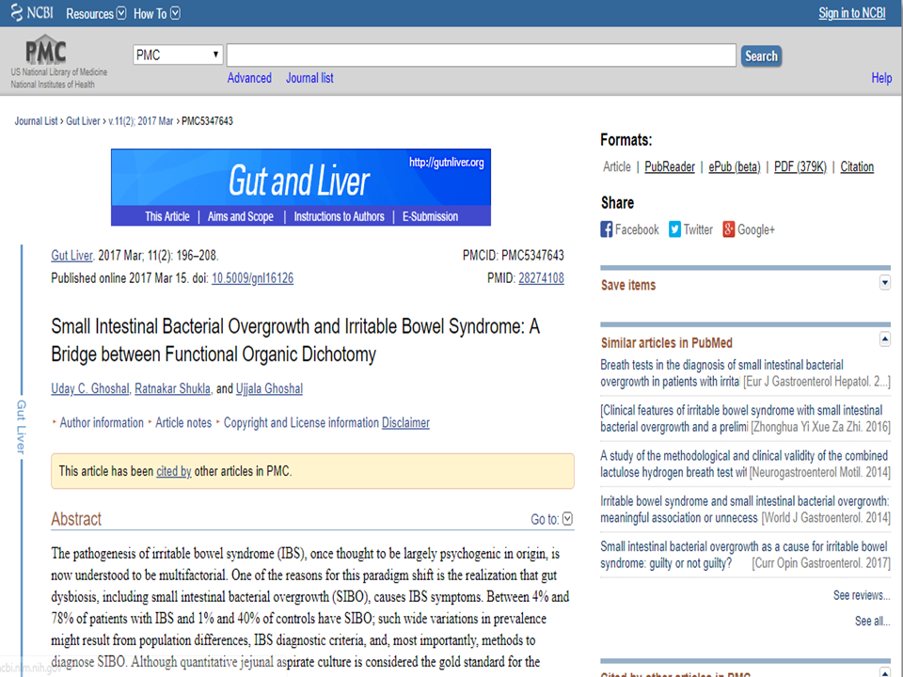

Slide 74
The pathogenesis of irritable bowel syndrome (IBS), once thought to be largely psychogenic in origin, is now understood to be multifactorial. One of the reasons for this paradigm shift is the realization that gut dysbiosis, including small intestinal bacterial overgrowth (SIBO), causes IBS symptoms.

Slide 75
IBS is manifested by abdominal pain and/or discomfort, irregular stool form and passage. Bloating is another common symptom of IBS.

Slide 76
Several therapeutic trials targeting gut microbes using antibiotics and probiotics have further demonstrated that not all symptoms in patients with IBS originate in the brain but rather in the gut, providing support for the micro-organic basis of IBS.

Slide 77
Patients with small intestinal bacterial overgrowth (SIBO), also experience abdominal pain or discomfort, bloating, flatulence and loose motion.

Slide 78
Recent realization that SIBO may be associated with symptoms of IBS, led to a paradigm shift in understanding the pathogenesis of this condition, hitherto thought to be related largely to psychological factors, to more organic nature.

Slide 79
Colon Cancer.
Inflammatory bowel diseases.
Differential diagnosis:
Bacterial overgrowth syndrome
Psychiatric illness
Depression.
Anxiety

Slide 80
Colon Cancer.
Inflammatory bowel diseases.
Differential diagnosis:
Lactose intolerance.
Bacterial overgrowth syndrome
Psychiatric illness
Depression.
Anxiety

Slide 81
Colon Cancer.
Inflammatory bowel diseases.
Differential diagnosis:
Celiac disease.
Bacterial overgrowth syndrome
Psychiatric illness
Depression.
Anxiety

Slide 83
Symptoms of coeliac disease may be similar to those of other conditions such as irritable bowel syndrome.
People can also develop anaemia, lose weight; or have ongoing tiredness, thinning bones, reproductive problems, or problems that affect growth or puberty.

Slide 84
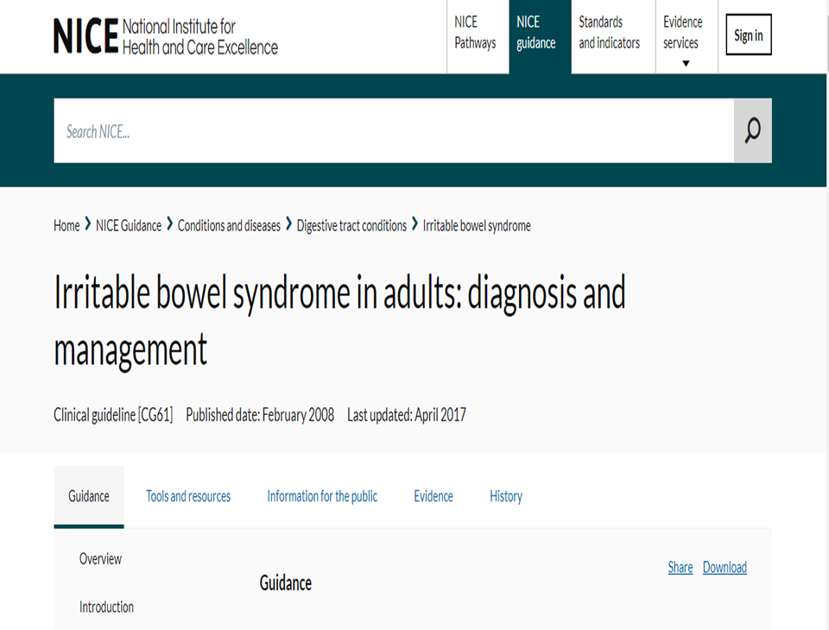

Slide 85
IBS is NOT a diagnosis of exclusion, as this is costly, time-consuming, and quite inconvenient for patients as well as for physicians.

Slide 86
At the 13th International Congress of Gastroenterology in Rome, Italy in 1988, a group of physicians defined criteria to more accurately diagnose IBS. Known as the "Rome Criteria" that outlines symptoms and applies parameters such as frequency and duration make possible a more accurate diagnosis of IBS.

Slide 87
The Rome IV Criteria:
Abdominal symptoms persistent or recurrent for 6 months or more
Symptoms occur on at least three days per month for at least 3 months
Abdominal Pain, bloating or discomfort
Marked change in bowel habits
Change in stool frequency
Change in stool consistency (Constipation or Diarrhea)
Altered stool passage
Straining for normal consistency stool
Urgency of Defecation
Incomplete evacuation
Two or more below
Pain relieved with Defecation
Onset of pain is related to a change in frequency of stool
Onset of pain is related to a change in appearance of stool

Slide 88
For those that meet IBS diagnostic criteria the following tests to be undertaken to exclude other diagnosis:

Slide 89
FBC
ESR or plasma viscosity
CRP
Antibody testing for coeliac diseases (EMA or TTG) faecal calprotectin testing

Slide 90
Patients that may warrant referral for IBS:
1- The presence of alarming symptoms.
2- Some people need a referral to a psychiatrist.

Slide 91
When to refer to a psychiatrist?

Slide 92
Indications for a referral to a psychiatrist:
1- Didn’t respond to pharmacological treatments after 12 months.
2- who develop a continuing symptom profile (described as refractory IBS).

Slide 93
It is also necessary to establish the quantity and quality of the pain or discomfort, and to identify its site (which can be anywhere in the abdomen) and whether this varies. This distinguishes IBS from cancer-related pain, which typically has a fixed site.

Slide 94
Red Flags:

Slide 95
Refer people with possible IBS symptoms to secondary care for further investigation if they have any of the following ‘red flag’ indicators:

Slide 96
Unintentional and unexplained weight loss
Rectal bleeding
A family history of bowel or ovarian cancer
If aged >60 years
Inflammatory markers (Faecal calprotectin) for inflammatory bowel disease.

Slide 97
Anaemia.
Abdominal masses and/or Rectal masses.
Inflammatory markers of inflammatory bowel disease.
Measure serum CA125 in primary care in women with symptoms that suggest ovarian cancer

Slide 98
Nighttime Diarrhea
Nocturnal awakening due to abdominal discomfort
Visible or occult blood in stool
Weight loss
Recurrent Fever
Family History of Colon Cancer

Slide 99
Family History of Inflammatory Bowel Disease
Elderly
Laboratory abnormality:
Leukocytosis
Anemia
Increased Erythrocyte Sedimentation Rate (ESR)

Slide 100
Management:
This should include information on general lifestyle, physical activity, diet and symptom‑targeted medication

Slide 101
Dietary and lifestyle advice
Encourage people with IBS to identify and to create relaxation time.
Assess the physical activity levels; people with minimal activity should be given brief advice to encourage them to increase their activity levels.

Slide 102
Dietary and lifestyle advice
Have regular meals & avoid leaving long gaps between eating.
Drink at least 8 cups of fluid per day, especially water.
Restrict tea and coffee to 3 cups per day.

Slide 103
Dietary and lifestyle advice
4. Reduce intake of alcohol and fizzy drinks.
5. Limit intake of high‑fibre food.
6. People with diarrhoea should avoid sorbitol.

Slide 104
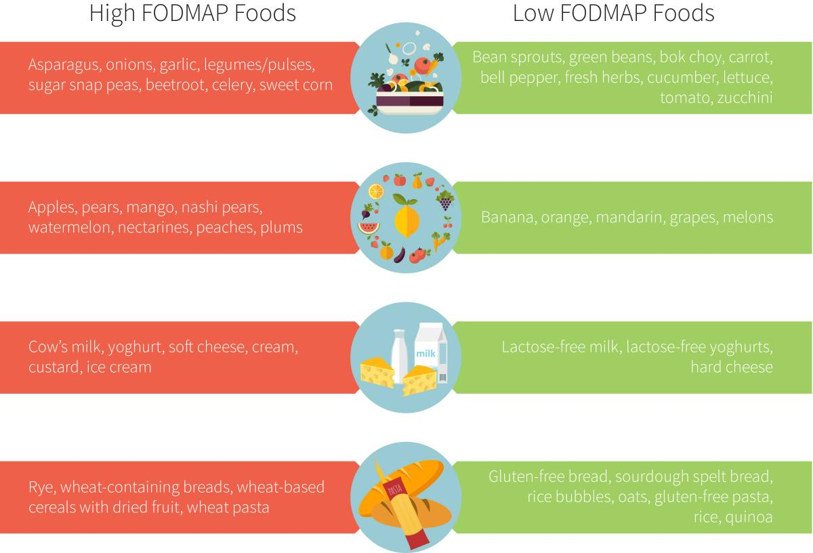

Slide 105
Pharmacological therapy
Decisions should be based on the nature and severity of symptoms.
Antispasmodic agents should be taken as required, alongside dietary and lifestyle advice.

Slide 106
Pharmacological therapy
Constipation
Diarrhea
Laxatives
Loperamide
* People should be discouraged from taking lactulose

Slide 107
Pharmacological therapy
Patients should adjust their doses according to the clinical response, with the aim of achieving a soft, well‑formed stool.
Consider tricyclic antidepressants (TCAs) as second‑line treatment if first line have not helped. *Start treatment at a low dose and review regularly.

Slide 108
Pharmacological therapy
Consider (SSRIs) only if TCAs are ineffective.
Take into account the possible side effects & follow up people taking either of these drugs for the first time at low doses after 4 weeks and then every 6–12 months.

Slide 109
Psychological interventions
Referral for psychological interventions should be considered for people who do not respond to pharmacological treatments after 12 months.

Slide 110
Follow up
Should be agreed between the healthcare professional & the patient based on the response to interventions.
Emergence of any 'red flag' symptoms during management and follow‑up should prompt further investigation and/or referral to secondary care.

Slide 111
The Roleplay
GI History
Abdominal Examination

Slide 112
Quiz answers

Slide 113
Quiz: What causes IBS?
1- stress and depression.
2- Bad diet.
3- it's not known.
Notes:
Stress, depression, and diet can make your symptoms worse. They can even trigger them. But doctors aren’t sure what actually causes people to have IBS.

Slide 114
2. IBS is a diagnosis of exclusion:
True
False

Slide 115
3- What is the best way of diagnosing IBS?
1- By excluding other causes. (A diagnosis of exclusion)
2- By Rome IV criteria.
4- By excluding the presence of red flags.
5- By Rome IV criteria and excluding the presence of red flags.

Slide 116
4. Which of the following is not recognized as a symptom that supports the diagnosis of IBS according to the Rome criteria?
A - Altered stool frequency
B- mucus secretion
C- Abdominal bloating or subjective distention
D - Frequent nausea
D

Slide 117
5. Management of IBS includes:
Lifestyle modification
Pharmacological therapy
Dietary advice
All of the above

Slide 118
References
NICE guideline for Irritable bowel syndrome in adults: diagnosis and management
IBS guidelines CUHFT CCG April 2018
http://www.jnmjournal.org/journal/view.html?uid=1363&vmd=Full&

Slide 119
Diagnostic Approach to Chronic Constipation in Adults
Evaluation of Chronic Diarrhea
Medscape diagnosis of IBS
Abdominal Examination Geeky medics
GI History Geeky medics

Slide 120
http://www.derbyshiremedicinesmanagement.nhs.uk/assets/Clinical_Guidelines/Formulary_by_BNF_chapter_prescribing_guidelines/BNF_chapter_1/Primary_Care_management_of_IBS.pdf

