Slide 1
DM TBL
Lemmese AlWatban
MBBS, CCFP, MCISc
Consultant Women’s Health, and sexual Health

Slide 2
Readiness Assessment TEST

Slide 3
A 24-year-old woman comes to your clinic because she is worried she might have diabetes. She is overweight with a BMI of 28. She is healthy otherwise and has been trying to lose weight over that last few months. Her father was recently diagnosed with diabetes at the age of 65 and her mother has hypertension
Which of the following would be the most suitable recommendations?
She is still too young to start diabetic testing. You inform her to live her life without concern and come back at 45 for testing then
She is at increased risk for diabetes. You request diabetes screening tests and encourage her to continue weight loss and to increase physical activity
She is at increased risk for diabetes. However, she is trying to lose weight and diabetic testing can be delayed till she reaches her weight loss goals
You are not concerned as she appears healthy and is not complaining of any symptoms to suggest diabetes. You reassure her that she does not need testing

Slide 4
2. A 42-year-old man with a history of sickle cell disease presents to your clinic to follow up on diabetic testing he had done. Here are his results:
FPG 138 mg/dl [7.6 mmol/L]
OGTT 250mg/dl [13.8mmol/L]
HgA1c 5.7%
What do you tell the patient?
You are diabetic as you have two abnormal tests in the diabetic range.
You have prediabetes as your HgA1c is in the prediabetes range
Your blood tests are confusing and need to be repeated to make a diagnosis
Monitor your blood sugar at home and we will make a diagnosis from that

Slide 5
DM Mechanism
http://mediacenter.novomedlink.com/v/diabetes-pathophysiology

Slide 7
3. Which one of the following is true concerning the use of hemoglobin A1c levels to diagnose diabetes mellitus?
A level >6.0% is diagnostic of diabetes mellitus
Results can be misleading in patients with sickle cell disease
One abnormal Hg A1c result is sufficient to make a diagnosis
D) The test is useful to diagnose diabetes during pregnancy

Slide 8
Diagnostic Criteria and limitations

Slide 9
Screening for diabetes

Slide 10
Diabetes

Slide 11
Prediabetes
To test for prediabetes, all these tests are equally appropriate.

Slide 12
Prediabetes
Should be counseled on lifestyle changes.
Three large studies of lifestyle intervention has shown sustained reduction in the rate of conversion to type 2 diabetes,
43% reduction at 20 years in the Da Qing study.
43% reduction at 7 years in the Finnish Diabetes Prevention Study (FDPS).
34% reduction at 10 years in the U.S. Diabetes Prevention Program Study (DPPS)

Slide 13
HbA1C values are influenced by red cell survival
Falsely high values in patients with iron, vitamin B12, or folate deficiency anemia.
Falsely low values in patients with hemolysis or anemia and those treated for iron, vitamin B12, or folate deficiency, and patients treated with erythropoietin.

Slide 14
Glycemic Targets
Blood Glucose Targets for Non-Pregnant Adults With Diabetes
A1C <7.0% (53 mmol/L)
Fasting 4.4-7.2 mmol/L (80-130 mg/Dl )
Postprandial <10.0 mmol/L (<180 mg/dL )

Slide 15
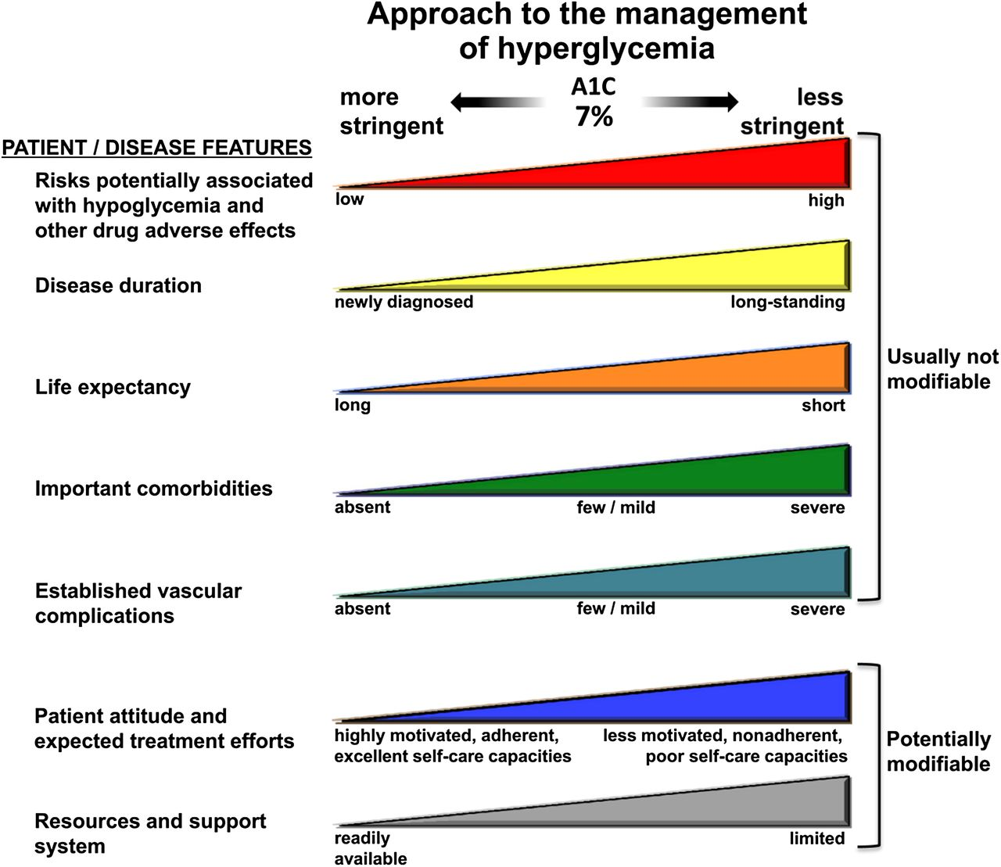

Slide 16
Life Style Modification
For all patients, advise for
Weight Management (in overweight/obese
patients can improve insulin sensitivity targeting a loss of 7% of body weight )
Exercise (walking 150 mins / week)
Diet (Provided by a Dietitian)
Can reduce HbA1C by 1-2%
Problems
Poor adherence over time

Slide 17
When to add Metformin in pre-diabetes?
In addition to lifestyle counseling, Metformin is considered in IFG plus:
Hypertension
Low HDL cholesterol
Elevated triglycerides
Family history of diabetes (first-degree relative)
Obese
HX of GDM
Under 60 years of age

Slide 18
4. A 55-year-old female presents for annual checkup. She developed diabetes mellitus at the age of 45. Currently, she is treated with Metformin 2g . Over the last one year, she has suffered from episodes of dysuria and has received treatment for cystitis on four separate occasions. Her blood pressure is 126/76 mmHg.
Investigations show:
HbA1C: 7.2 %
Urea: 4.5mmol/L (2.5 – 7.5)
Creatinine: 90 mmol/L (60 – 110) (GFR60)
Urinalysis: [Glucose 1+ WBC: nil RBC: nil]
24 hr urine protein: …… 260 mg/ 24 hrs (≤ 150)
What would be the best therapeutic option to deal with her results?
Improve glycemic control
Prescribe a low protein diet
Treat with ACE inhibitor
Use prophylactic antibiotics

Slide 19
5. A 62-year-old man with type 2 diabetes and a BMI of 33 has been controlled on Metformin 2g for 2 years. In the last two visits his HgA1c has been 8%. You would like to add a second glucose lowering medication. Knowing that he drives on a regular basis to AlQaseem for work, he is a smoker and on an ACE inhibitor and statin
What would be your preferred second medication be?
NPH insulin
Glyburide
Insulin Glargine
Liraglutide

Slide 20
6. A 58-year-old female with a 12-year history of hypertension and diabetes, has been treated with metformin 2g, gliclazide 90 mg, atorvastatin 20mg, lisinopril 10 mg, aspirin 81 mg and amlodipine 10 mg daily for the last two years.
At annual review her blood pressure is 138/87 mmHg, fundi reveal background diabetic retinopathy. Her results show:
HbA1c 6.9% (3.8-6.4)
Urea 12.5 mmol/L (2.5-7.5)
Creatinine 176 µmol/L (60-110) (GFR 25)
Cholesterol 4.8 mmol/L
You decided to discontinue one of her medications.
Which of the following drugs should be withdrawn?
Atorvastatin
Gliclazide
Llisinopril
Metformin

Slide 21
7. A 39 y.o. woman with type 2 diabetes on metformin and an ACE inhibitor attends your clinic for her routine follow up. Her BP is 128/65 and her Hg A1c is 7.9.%. Her kidney profile is as follows:
Creatinine 100 µmol/L (60-110) (GFR 56)
Albumin / Creatinine Ratio 10.5 mgA/gCr (0-30)
You decided to add a second medication to help bring her HgA1c closer to target.
What is your preferred medication class?
Alfa glucoside inhibitors (Acarbose)
Thiazolidinediones (Pioglitazone)
Sulfonylureas (Gleglazide )
SGLT2 inhibitors (Empagliflazin)

Slide 22
Oral Medication in Type 2 DM

Slide 26
INCRETINS

Slide 28
INCRETINS
The incretin system is impaired in patients with T2DM, which, as a consequence of its insulinotropic actions, contributes to fasting and postprandial hyperglycemia.
The impairment of GLP-1 secretion varies directly with the degree of insulin resistance; those who are more insulin resistant have a lower rise in GLP-1 in response to a meal.

Slide 29
Glucagon-like Peptide-1 (GLP-1)
secreted throughout the day by intestinal mucosa in response to oral glucose in the gut
stimulates all steps of insulin biosynthesis
provides continued and augmented release of insulin without overproduction
acts on islet alpha cells, causing strong inhibition of postprandial glucagon secretion
slows gastric emptying and acts on brain to promote early satiety

Slide 30
Dipeptidyl Peptidase-4 (DPP-4)
Within minutes of secretion or exogenous administration, GLP-1 is rapidly degraded by dipeptidyl peptidase-4 (DPP-4).
DPP-4 is found in many body tissues, including liver, renal, and intestinal brush- border membranes; lymphocytes; and endothelial cells.

Slide 31
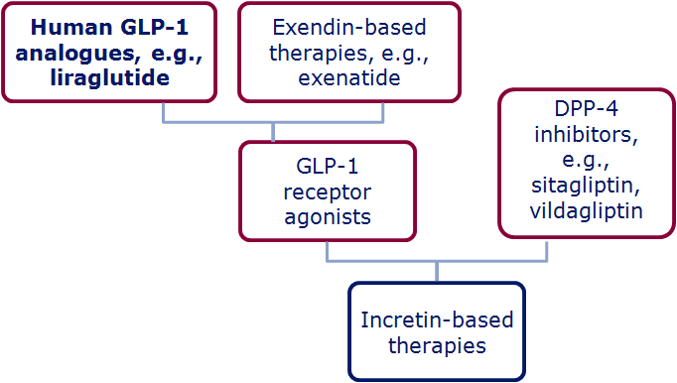
The Family of Incretin Based Therapies
Wick & Newlin. J Am Acad Nurse Pract 2009;21:623–30; White. J Am Pharm Assoc 2009;49(Suppl. 1):S30–40
Notes:
The family of incretin-based therapies
Incretin-based therapies can be broadly divided into:
DPP-4 inhibitors (i.e. sitagliptin, vildagliptin)
GLP-1 receptor agonists (Exenatide, lirgalutide)
Within this second category however, the GLP-1R agonists can be classed as either:
Exendin-based therapies (exenatide, exenatide LAR) which have ~50% sequence identity to human GLP-1
Human GLP-1 analogues (liraglutide) which have share a much higher percentage of amino acids with human GLP-1 (97%)

Slide 34
DPP 4 inhibitors

Slide 36
SGLT2 inhibitors
Promotes the renal excretion of glucose
Modestly reduces (limited by filtered load)
Dose not cause hypoglycemia
Empagliflozin -- CVD
Main use as third line
? Safety of prolonged glucoseuria

Slide 38
Caution and Contraindications
Chronic Kidney Failure: Metformin, Acarbose,Sitagliptin, Insulin
& SUs (reduced dosage)
Heart Failure: TZDs
Osteoporosis: TZDs
Myocardial Infarction: Hypoglycemias should be avoided when Insulin or SUs are taken.
Elderly people (>70 years): Hypoglycemias should be avoided when Insulin or SUs are taken.

Slide 39
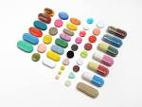
Individualized Therapy

Slide 40
Antihyperglycemic Therapy in T2DM
Notes:
[note to speaker – use either this slide or the next slide depending on the audience and format of your talk]
Here is an overview of the ADA’s treatment algorithm for type 2 diabetes, moving from monotherapy, to duel therapy, to triple therapy, and then to combination injectable therapy. Lifestyle management is emphasized throughout the progression of care, and individualization based on efficacy, hypoglycemia risk, weight, side effects, and costs is recommended.
It is important to note that the ADA’s full Standards of Care provides tables on the properties of these agents, as well as the costs associated with them. Please visit professional-dot-diabetes-org-slash-S-O-C for more information.
The order in the chart was determined by historical availability and the route of administration, with injectables to the right; it is not meant to denote any specific preference. Potential sequences of antihyperglycemic therapy for patients with type 2 diabetes are displayed, with the usual transition moving vertically from top to bottom (although horizontal movement within therapy stages is also possible, depending on the circumstances). DPP-4-i, DPP-4 inhibitor; fxs, fractures; GI, gastrointestinal; GLP-1 RA, GLP-1 receptor agonist; GU, genitourinary; HF, heart failure; Hypo, hypoglycemia; SGLT2-i, SGLT2 inhibitor; SU, sulfonylurea; TZD, thiazolidinedione.
[SLIDE]
40

Slide 41
Notes:
[note to speaker – use either this slide or the previous slide depending on the audience and format of your talk]
Here is an overview of the ADA’s treatment algorithm for type 2 diabetes, moving from monotherapy, to duel therapy, to triple therapy, and then to combination injectable therapy. Lifestyle management is emphasized throughout the progression of care, and individualization based on efficacy, hypoglycemia risk, weight, side effects, and costs is recommended.
It is important to note that the ADA’s full Standards of Care provides tables on the properties of these agents, as well as the costs associated with them. Please visit professional-dot-diabetes-org-slash-S-O-C for more information.
The order in the chart was determined by historical availability and the route of administration, with injectables to the right; it is not meant to denote any specific preference. Potential sequences of antihyperglycemic therapy for patients with type 2 diabetes are displayed, with the usual transition moving vertically from top to bottom (although horizontal movement within therapy stages is also possible, depending on the circumstances). DPP-4-i, DPP-4 inhibitor; fxs, fractures; GI, gastrointestinal; GLP-1 RA, GLP-1 receptor agonist; GU, genitourinary; HF, heart failure; Hypo, hypoglycemia; SGLT2-i, SGLT2 inhibitor; SU, sulfonylurea; TZD, thiazolidinedione.
[SLIDE]
41

Slide 42
8. A 42-year-old man presents to clinic for routine follow up of diabetes.He is taking:
Metformin 500 mg three times daily
Gliclazide 120 mg once daily
Ramipril 10 mg once daily.
His lifestyle is still sensible. Investigations show:
Fasting plasma glucose is 18.7 mmol/l
HbA_{1c} 12.4%
Urinalysis shows 4+ glucose (negative for ketones).
What is the most appropriate regimen of treatment you recommend to him?
Start glitazones like pioglitazone
Increase the dose of metformin and gliclazide
Start insulin therapy
Start DPP 4 inhibitor like sitagliptin

Slide 43
9. You are thinking about adjusting a type 2 diabetic insulin to improve his blood glucose. He is on Insulin Glargine 12 unit but his post prandial readings are always high ranging between (13.7 mmol/L – 17.3 mmol/L)
Which of the following insulin types is appropriate to control such levels?
a. Insulin mixed
b. Insulin NPH
Insulin Aspart
Insulin Detemir

Slide 44
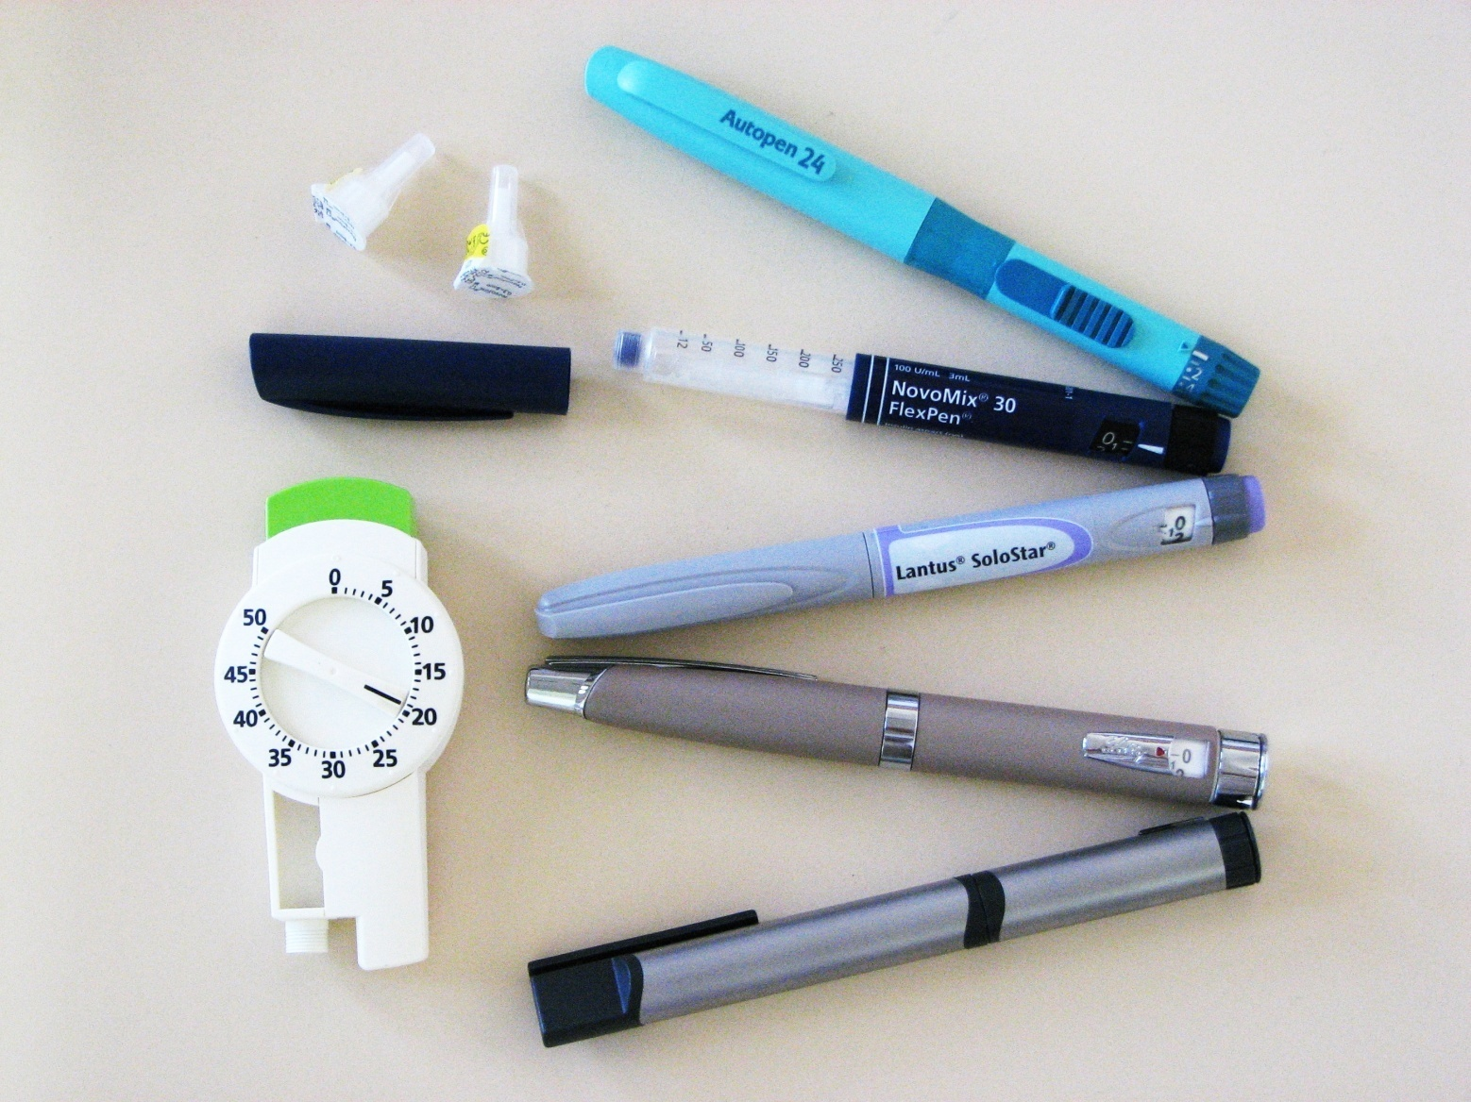
Insulin therapy

Slide 45
INSULIN AS INITIAL THERAPY
Glycated hemoglobin (A1C) >10 percent
Fasting plasma glucose >13.9 mmol/L (>250 mg/dL )
Random glucose consistently >16.7 mmol/L (>300 mg/dL )
Ketonuria, or Unplanned weight loss with hyperglycemia (catabolism)

Slide 46
TREATMENT REGIMENS
Conventional Insulin Therapy
Two injections of NPH and Regular Insulin
Mixed Insulin
Two injections of 70/30 or 60/40 or 50/50
Multiple Insulin Injections
1 or 2 injections of NPH plus 3 injections of Regular or Rapid Insulin
One injection of Glargine or Detemir plus 3 injections of rapid insulin(Lispro /Aspart)

Slide 47
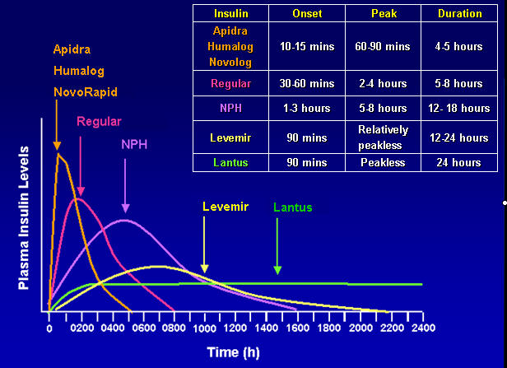

Slide 48
Initiation and adjustment of insulin regimens (Multiple injections)
Long acting insulin (Glargine) at bedtime 10 U or 0.2 U/Kg
Check FG, increase by 2 U every 3-4 days until FG 80 – 130 mg/dl
If hypoglycaemia occurs, or FG < 70 mg/dl reduce bedtime by 4 units or 10 % which is greater.
If FG in range, check 2 hrs after breakfast, lunch and dinner and add rapid (Aspart) insulin. Begin with 4 U before each. Adjust by 2 U every 3-4 days Untill 2hpp < 180 mg/dl .
Usually the dose of rapid insulin is near equal or higher than dose of Long acting insulin

Slide 49
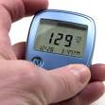
DM visits
Diabetes care is a team work
Individualize management
Set Target goals
Glycaemic Targets
BP goals
Lipid goals
Education
Is associated with increased use of primary and preventive services and lower use of acute, inpatient hospital services.

Slide 50
PHYSICAL EXAMINATION
Height and Weight (BMI)
Blood Pressure (2 readings)
Fundus Examination ( Hard and soft exudates, new vessel formation, macular oedema….)
Cardiac examination
Lower Limbs:
Skin Examination
Evaluation of pulses
Foot Examination
Neurologic Examination

Slide 51
Investigation
FPG and 2 hr PP
Midstream Urine (for Ketones, protein, pus cells,…)
Urea and Creatinine
Lipid Profile (total cholesterol, LDLc, HDLc and triglycerides)
HbA1C (every 3 m for insulin / every 6 m for controlled)
Test for Microalbuminuria or Albumin to creatinine ratio / 24 hr urine collection for protein / Creatinine Clearance
ECG
Chest X-Ray

Slide 52
Yearly Check Up
Investigations
HbA1C
Urea and Creatinine
Lipid Profile (Cholesterol, Triglyceride, LDL-C and HDL-C)
Albumin to creatinine ratio / 24 hour urine collection for protein (Microalbuminuria 30 -<300 mg while Macroalbuminyria ≥ 300 mg).
Check :
Eye: Fundus Examination / eye referral
Feet : Visual inspection and Neurovascular status

Slide 53
10. The post postpartum care of a patient who developed GDM in the last month of her pregnancy would include the following:
A OGTT at 12 weeks, if negative screening every 3 years, instructions to maintain a healthy weight
OGTT 7 days after delivery, only test again if she gets pregnant, advised to live a healthy lifestyle
Do a fasting blood test 6 weeks postpartum, if negative repeat in another 6 months, keep a healthy weight
Fasting blood test at 6 weeks postpartum, must take metformin as she is at increased risk for developing diabetes

