Slide 1
Upper respiratory tract infections
King Saud University,
College of Medicine,
Family medicine department, 2019
Supervisor:
Prof. Aljohara Alquaiz
Group 2 (F2):
Samar AlOtaibi
Ghaida AlJamili
Nouf AlRushaid
Yasmen AlFaresi
Reham AlObaidan

Slide 2
Rhinosinusitis
Samar AlOtaibi
435201438

Slide 3
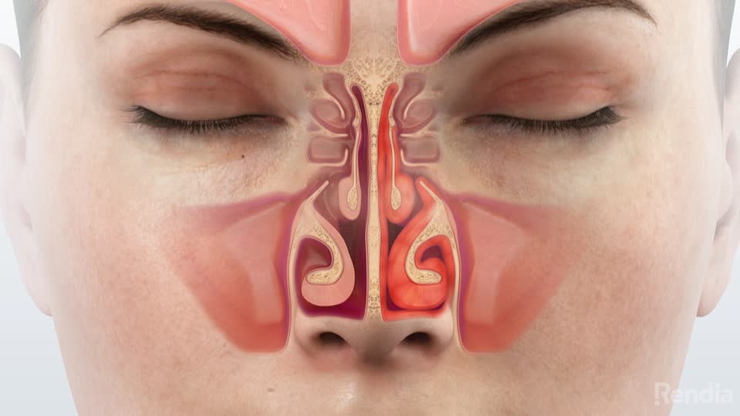
Definition:
Rhinitis: Inflammation of the nasal mucous membranes.
Sinusitis: Inflammation of sinus cavities.
Inflammation of the sinuses rarely occurs without concurrent inflammation of the nasal mucosa; therefore, Rhinosinusitis is a more accurate term!!

Slide 4
Pathophysiology & Etiology
Most important pathologic process in disease is ​obstruction of natural ostia.
Obstruction leads to hypooxygenation.
Hypooxygenation leads to​ ciliary dysfunction and poor mucous quality.​ Collection of secretion.
Ciliary dysfunction leads to retention of Bacteria​l.
Viral and bacterial infections impair the cilia which transport mucus.
Etiology
Infectious
non-infectious
Viral
commonly
bacterial
Common cold
Influenza

Slide 5
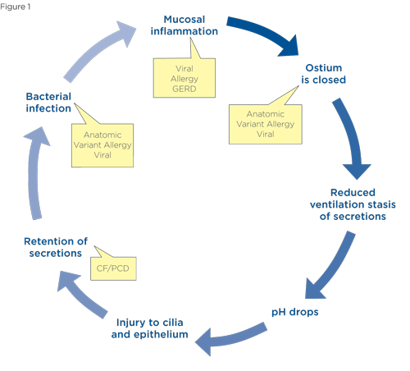
Pathophysiology & Etiology

Slide 6
Classification based on duration:
Acute
Sub-acute
chronic
<4 weeks
4 - 12 weeks
≥ 12 weeks
Recurrent Rhinosinusitis?
Notes:
Four or more episodes per year with complete resolution between episodes; each episode lasts at least seven days

Slide 7
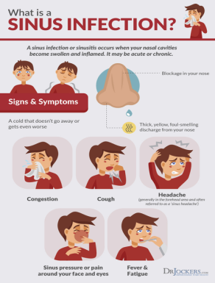
Signs and symptoms:
Facial pain, pressure, or fullness (pain on bending forward)
Nasal Congestion.
Nasal Discharge.
Hyposmia.
Fever and fatigue
Postnasal Drip.
Cough and halitosis.
Sinus Headache.
Toothache.
Otalgia.

Slide 8
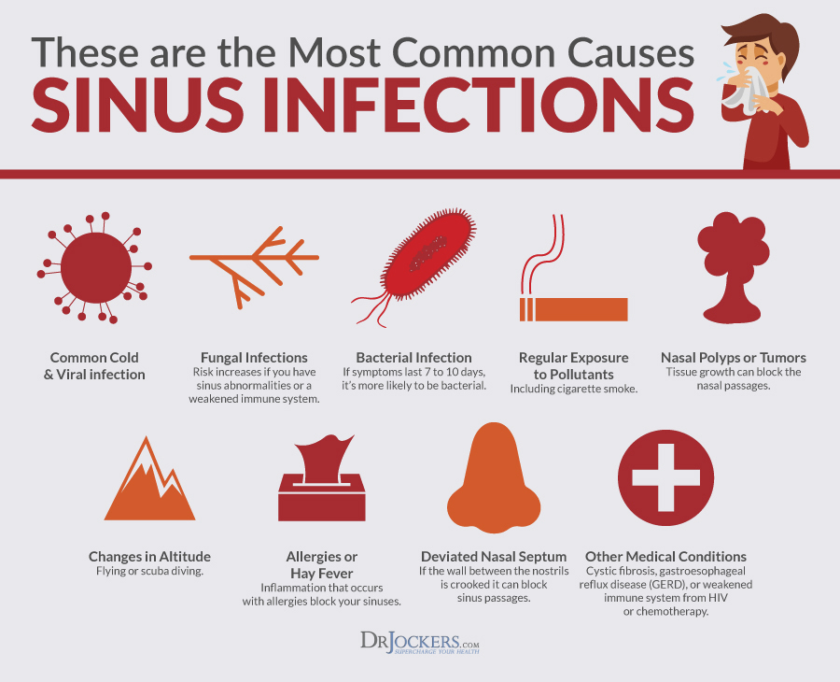
Causes: Infectious!
Influenza:
Family : Orthomyxoviridae, Types of viruses : A,B,C
Common cold:
Family: Rhinoviruses, Coronaviruses, and adenoviruses,Human respiratory syncytial virus (in adults)Parainfluenza viruses
Bacterial :
Streptococcus pneumoniae
Haemophilus influenzae
Staphylococcus aureus
Moraxella catarrhalis.
Fungal:
Aspergillus

Slide 9
Non-infectious: Also risk factors!
Nasal obstruction (allergic rhinitis, nasal polyps, tumors, mucus plug, septal deviation).
Primary ciliary dyskinesia.
Patients with immune deficiency or hyper inflammatory disease such as Wegener's disease.
Cystic fibrosis.

Slide 10
How to Differentiate between Bacterial & Viral Rhinosinusitis?
Most commonly viral.
BUT!!! If any of the following are true it’s probably bacterial!!!!!
Persistent symptoms or signs compatible with acute rhinosinusitis, lasting for ≥10 days without any evidence of clinical improvement.
Onset with severe symptoms or signs of high fever (≥38.8/39) and purulent nasal discharge or facial pain lasting for at least 3–4 consecutive days at the beginning of illness.
Worsening symptoms or signs characterized by the new onset of fever, headache, or increase in nasal discharge following a typical viral URTI that lasted 5–6 days and were initially improving (‘‘double sickening’’)
Immunocompromised patient.
0.5%-2% of viral Rhinosinusitis are complicated by bacterial infection!

Slide 11
Diagnosis:
History:
PODS:
●Pain (site)
●Obstruction (uni/bi)
●Discharge ( Thickness, Consistency, Color, Amount, Frequency )
●Smell disorder
Other: Fever, Fatigue, Headache, Earache.
Physical examination:
Tenderness overlying sinuses.
Hyponasality.
Purulent nasal secretions.
Erythema (facial, Mucosal).
Oral cavity examination.

Slide 12
Investigation:
Investigations:
CBC, ESR (nonspecific).
Culture (if life threatening).
CT (for complications).
MRI (for complications).
Fiberoptic endoscopy (structural lesion).
Cultures:
Not routinely done:
Done if :
Patient In ICU
Immunocompromised
Children not responding to medical management..
complications.
Imaging:
Done :
Complication ( orbital, intracranial, or soft tissue involvement )
Alternative diagnosis (malignancy, other noninfectious causes of facial pain)
Radiographic imaging is not recommended for evaluating uncomplicated acute rhinosinusitis.

Slide 13
When should you suspect & test for MERS-CoV in someone with acute rhinosinusitis?
History of exposure to a confirmed or suspected MERS-CoV in the 14 days prior to onset of symptoms.
History of contact with camels or camel products in the 14 days prior to onset of symptoms.
Unexplained acute febrile (≥38°C) illness, body aches, headache, diarrhea, or nausea/vomiting, with or without respiratory symptoms, AND leukopenia & thrombocytopenia.

Slide 14
Management:
Acute viral: Supportive care!
Acute VRS may not completely resolve within 10 days but is expected to improve.
Symptomatic management:
Rest, fluids
Analgesics paracetamol NSAIDS
Antipyretics
SNI saline nasal irrigation
INCS intranasal corticosteroids
Decongestants
Antihistamine
Treat complications, e.g. antibiotics for secondary bacterial infection; treatment of exacerbations of COPD or asthma.
Notes:
Rest, fluids
Analgesics paracetamol NSAIDS
Antipyretics
SNI saline nasal irrigation ( safe , inexpensive , soften viscous secretions and improve mucociliary clearance)
INCS intranasal corticosteroids ( not approved for use in patients with acute rhinosinusitis, current guidelines consider them an option based on an individualized decision)
Decongestants ( reduce mucosal edema and facilitate aeration and drainage , does not extend to the paranasal sinuses)
Antihistamine (may complicate drainage by over-drying the nasal mucosa, leading to further discomfort. Therefore, antihistamines should not be used for symptomatic relief of acute sinusitis except in patients with a history of allergy)
Treat complications, e.g. antibiotics for secondary bacterial infection; treatment of exacerbations of COPD or asthma

Slide 15
Watchful waiting (without antibiotics)
assurance of follow-up
Acute bacterial :
Prescribe initial antibiotic therapy for adults with uncomplicated ABRS.
Amoxicillin±clavulanate is the first-line therapy for 5 to 10 days for most adults.
Notes:
Antibiotic therapy is started if:
patient’s condition fails to improve by 7 days after ABRS diagnosis.
Or
if it worsens at any time.
immunocompromised

Slide 16
Antibiotic failure:
If the patient worsens or fails to improve with the initial management option by 7 days after diagnosis, reassess the patient to:
Confirm ABRS
Exclude other causes of illness
Detect complications.
If ABRS is confirmed:
▷ antibiotic therapy should be started.
▷If the patient was initially managed with an antibiotic, the clinician should change the antibiotic.

Slide 17
Complications of rhinosinusitis:
Bony:
Osteomyelitis , Pott's puffy tumor
(Subperiosteal abscess)
Intracranial:
Cavernous sinus thrombosis
Epidural abscess
Intracranial abscess
Meningitis
Subdural abscess
Superior sagittal sinus thrombosis
Orbital: ( most commonly involved )
Cavernous sinus thrombosis
Inflammatory edema and erythema (preseptal cellulitis)
Orbital abscess
Orbital cellulitis
Subperiosteal abscess

Slide 18
Prevention of RHINOSINUSITIS:
Good Sinus hygiene.
Hydration (to keep nasal secretions thin).
Saline nasal sprays (keep the nasal passages moist, helping in removal of infectious agents).
Smoking cessation.
Allergen avoidance.

Slide 19
2) Influenza virus
Reham AlObaidan
434201288

Slide 20
Influenza virus
Family of Influenza virus is Orthomyxoviridae.
incubation period 1-7 days
Types
A
B
C
antigenically highly variable and is responsible for most cases of epidemic influenza.
may exhibit antigenic changes and sometimes causes epidemics.
antigenically stable and causes only mild illness in immunocompetent individuals
No epidemic
Not in the vaccine!
Type D primarily affect cattle and are not known to infect or cause illness in people.

Slide 21
Sign and symptoms of INFLUENZA
Influenza spread:
Characterized by the abrupt onset of constitutional and respiratory signs and symptoms (e.g., fever, myalgia, headache, malaise, nonproductive cough, sore throat, and rhinitis)
Contact:
Direct (e.g. shaking hands)
Indirect (contaminated items)
Droplet transmission (unprotected sneeze or cough) travel up to 6 ft.
Airborne transmission
You may be able to pass on the flu to someone else before you know you are sick! as well as while you are sick.

Slide 22
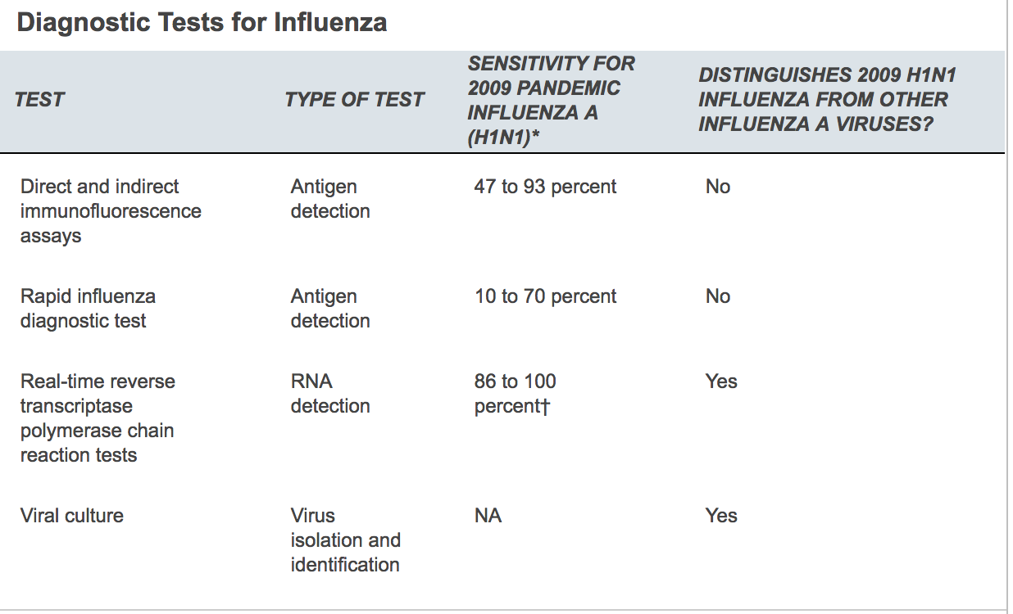
Diagnostic tests for influenza
Rapid Influenza Diagnostic Tests (RIDTs):
Antigen detection tests
Quick results
Sensitivity 62.3%
Specificity 98.2%
-ve result does NOT exclude a diagnosis of influenza in a patient with suspected influenza.
Reverse transcription polymerase chain reaction (RT-PCR) and Viral culture:
More accurate but takes longer time.
When influenza is suspected and antiviral treatment is indicated, antiviral treatment should begin as soon as possible and should not wait for the results of testing.

Slide 23
Prevention of INFLUENZA:
Good hygiene.
Avoid contact with sick people.
Vaccination?
It’s content? | 3-4 strains (it changes from season to season).
Given when? | Flu season (It takes about 2 weeks for the antibodies to develop in the body).
For who? | Everyone from six months and older without contraindications
Contraindications? | A previous severe allergic reaction to influenza vaccine.
How frequent? | Yearly
Associated Food allergy? | Egg ??

Slide 24
Egg allergy and INFLUENZA vaccination:
The ACIP recommendations for persons with a history of egg allergy:
who have experienced
Only hives
after exposure to egg
who have had reactions to egg involving symptoms other than hives(e.g., angioedema, respiratory distress)
OR who required epinephrine.
should receive any of the recommended influenza vaccines
may receive the cell culture–based or recombinant influenza vaccines

Slide 25
How to Differentiate Between Common Cold and Influenza?
It is difficult to differentiate between them based on symptoms alone.
In general, the flu is worse than the common cold.
Flu can have very serious associated complications (such as pneumonia, bacterial infections, or hospitalizations).

Slide 26
Candidates for antiviral therapy:
Special group (children < 2 years and adults > 65 years.)
persons with chronic diseases:
Pulmonary (e.g. asthma).
Cardiovascular (except hypertension alone).
Renal.
Hepatic.
Hematological (including SCA).
Metabolic disorders (including DM).
Neurological and neurodevelopmental conditions (e.g. CP, epilepsy, stroke).
Persons with immunosuppression (caused by medications or by HIV infection).
Pregnant or postpartum women (Oral oseltamivir is the preferred agent)
Persons < 19 years who are receiving long-term aspirin therapy.
Persons who are morbidly obese (i.e. BMI > 40).

Slide 27
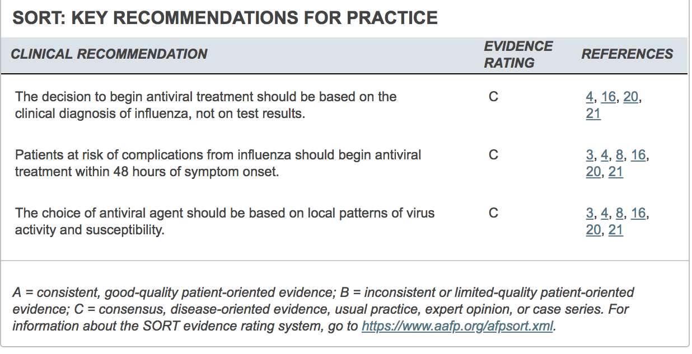

Slide 28
A 25 year old male came to the PHC to have a shot of Influenza vaccine. He was ill and his vital signs show fever. In his record there was a documentation of previous allergic reaction to vaccination 5 years ago. What does the pt. have as contraindication to Influenza vaccine ?
A. fever
B. headache
C. A previous severe allergic reaction.
D. Muscle and joint pain
Notes:
C

Slide 29
3) Pharyngitis
Nouf AlRushaid
435200788
Notes:
Acute pharyngitis accounts for 1.1 percent of visits in the primary care setting and is ranked in the top 20 reported primary diagnoses resulting in office visits. Peak seasons for sore throat include late winter and early spring.

Slide 30
Sore Throat Vs. Pharyngitis
Sore Throat:
Refers to pain, itchiness, or irritation of the throat. Patients may have difficulty swallowing food and liquids, and the pain may get worse when they try to swallow.
Pharyngitis|:
Defined as rapid onset of sore throat and inflammation or irritation of the pharynx.
Notes:
Acute pharyngitis accounts for 1.1 percent of visits in the primary care setting and is ranked in the top 20 reported primary diagnoses resulting in office visits. Peak seasons for sore throat include late winter and early spring.

Slide 31
Etiology of Pharyngitis (Sore Throat)

Slide 32
Sore Throat:
Infectious:
Viral: Most common, Eg.Influenza virus, Parainfluenza virus, Rhinovirus, Coronavirus, Adenovirus, Respiratory syncytial virus, Epstein-Barr virus
Bacterial : Eg. Group A β-hemolytic streptococcus (GAS) (Most common), Group C & G Streptococcus, Fusobacterium Necrophorum, Chlamydia Pneumoniae, Mycoplasma Pneumoniae.
Non-Infectious:
Post-nasal drainage due to allergic rhinitis
Sinusitis
Gastroesophageal reflux disease
Acute thyroiditis
Persistent cough

Slide 33
Who is at Risk of developing bacterial pharyngitis?

Slide 34
Risk of Group A β-hemolytic Streptococcus
According to the Patient’s Age Group:
In patients with sore throat, the likelihood of GABHS = (GAS) pharyngitis is highest in:
Children from 5 to 15 years of age (37%).
Lower in younger children (24%).
Adults (5% to 15%).

Slide 35
How to differentiate between viral & bacterial pharyngitis?

Slide 36
Clinical Characteristics: Bacterial vs.Viral
Viral Sore Throat | Bacterial Sore Throat
Cough Conjunctivitis Coryza (inflammation of the mucus membranes of the nose) Hoarseness Diarrhea Discrete ulcerative stomatitis or vesicles Viral exanthema | Tonsillar exudates (White patches or pus on tonsils) Fever Tender anterior cervical adenopathy abdominal pain (especially in children due to abdominal lymphadenopathy).

Slide 37
Alarming Symptoms:
SHOULD BE ASKED TO RULE OUT SERIOUS ETIOLOGY/COMPLICATIONS IN A SORE THROAT HISTORY:
Drooling.
Respiratory distress .
Stiff neck .
Inability to open mouth fully, trismus = lockjaw.
Fevers, Weight loss, night sweats.
Muffled voice or hot potato voice
History of recent foreign body impaction or oropharyngeal procedure (trauma).
Notes:
1 (might be a bacterial infection known as epiglottitis that might interfere with breathing )
3 (meningitis)
4 (retropharyngeal abscess)
6(peritonsillar or retropharyngeal abscess).

Slide 38
Diagnosis of pharyngitis patient!

Slide 39
Diagnosis:
Wide range of illnesses must be considered.
Infectious causes range from generally benign viruses to GABHS.
Inflammatory presentations may be the result of allergy, reflux disease or, rarely, neoplasm or Kawasaki disease.
Integrated information from the history, physical examination, environmental and epidemiologic factors also may need to be assessed.
Notes:
Kawasaki disease is probably an infectious disease caused by an unknown agent. The disease most often affects children younger than five years and presents with a constellation of symptoms, including sore throat. Characteristic signs and symptoms include fever, bilateral nonpurulent conjunctivitis, anterior cervical node enlargement, erythematous oral mucosa, and an inflamed pharynx with a strawberry tongue. Dermatologic features of the disease become apparent within three days of the onset of fever

Slide 40
Diagnosis: Approach specific to GABHS!
Important historical elements include:
Onset, duration, progression, and severity of the associated symptoms (e.g., fever, cough, respiratory difficulty, swollen lymph nodes),
Exposure to infections.
Presence of comorbid conditions (e.g., diabetes).
The pharynx should be examined for:
Erythema, hypertrophy, foreign body, exudates, masses, petechiae, and adenopathy.
Assess the patient for fever, rash, cervical adenopathy, and coryza. When streptococcal pharyngitis is suspected, listen for the presence of a heart murmur and evaluate the patient for hepatosplenomegaly.

Slide 41
Diagnosis: Approach specific to GABHS!
CLINICAL DECISION RULES: Using Centor Score:
The original Centor score uses four signs and symptoms to estimate the probability of acute streptococcal pharyngitis in adults with a sore throat.
The score was later modified by adding age and validated in 600 adults and children.
The cumulative score determines the likelihood of streptococcal pharyngitis and the need for antibiotics.

Slide 42
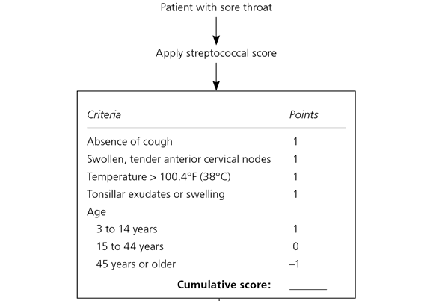
Modified/McIsaac Centor Score
Notes:
Note:
Can’t be used in <3 years old.
Use if symptoms onset <3 days.

Slide 43
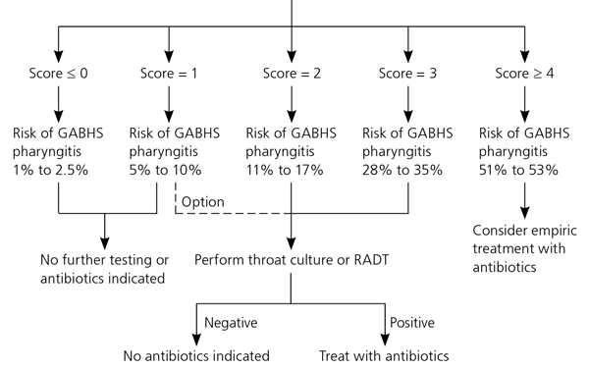
Modified/McIsaac Centor Score

Slide 44
Investigations:
Throat swabs: Culture of a throat swab on a sheep- blood agar plate has been the standard for the documentation of the presence of GAS pharyngitis, the disadvantage of throat cultures is the delay (overnight or longer) in obtaining results
Rapid antigen detection test (RADT): detect the presence of GABHS antigen in throat swab in 10-15 minutes, >90% specificity and 59%-95% sensitivity (higher in newer kits).
Backup throat cultures: A negative RADT should be accompanied by a follow-up or back-up throat culture in children and adolescents, while this is not necessary in adults under usual circumstances.
Notes:
(Because children are at higher risk of complications such as peritonsillar abscess, rheumatic fever, and poststreptococcal glomerulonephritis)

Slide 45
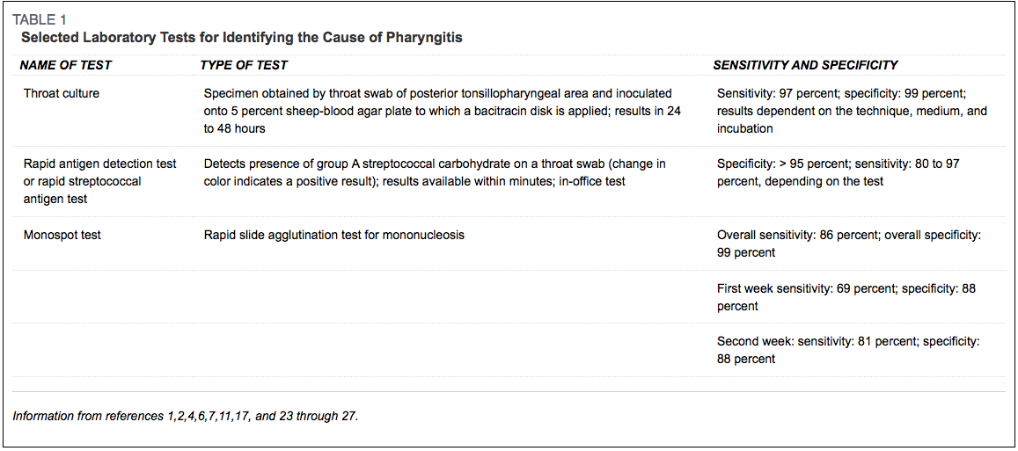
Notes:
Throat swabs: Culture of a throat swab on a sheep- blood agar plate has been the standard for the documentation of the presence of GAS pharyngitis, the disadvantage of throat cultures is the delay (overnight or longer) in obtaining results
Rapid antigen detection test (RADT): detect the presence of GABHS antigen in throat swab in 10-15 minutes, >90% specificity and 59%-95% sensitivity (higher in newer kits).
Backup throat cultures: A negative RADT should be accompanied by a follow-up or back-up throat culture in children and adolescents, while this is not necessary in adults under usual circumstances (Because children are at higher risk of complications such as peritonsillar abscess, rheumatic fever, and poststreptococcal glomerulonephritis)

Slide 46
Management!

Slide 47
Management
Symptomatic | Advise analgesia and antipyretics (e.g. paracetamol and/or ibuprofen) NSAIDs ( be aware of GI and renal side effects, aspirin should be avoided in children)
Antibiotic | First-line treatment for GABHS pharyngitis includes a 10-day course of penicillin or amoxicillin. Patients allergic to penicillin can be treated with first-gen cephalosporins (for eg cephalexin) for 10 days, clindamycin or clarithromycin for 10 days, or azithromycin for 5 days antibiotics. Antibiotics give a modest benefit in symptom relief (8h less symptoms) and may confer slight protection against some complications (e.g. quinsy = peritonsillar abscess, otitis media)

Slide 48
Antibiotics Role..
In a meta-analysis of 14 randomized trials comparing penicillin with placebo in over 8000 adults and children with sore throat, penicillin decreased the risk of rheumatic fever by about two-thirds.
Antibiotics probably prevent poststreptococcal glomerulonephritis based on a meta-analysis of 10 randomized trials comparing antibiotics with placebo in adults and children with sore throat.
Reasons To Give Antibiotics Immediately:
Acute sore throat where more than 4 centor criteria are present.
Patient is systemically very unwell.
Symptoms and signs suggestive of serious illness and/or complications (e.g. peritonsillar abscess, peritonsillar cellulitis)
High risk of serious complications because of pre-existing comorbidity (e.g. significant heart, lung, renal, liver, or neuromuscular disease, immunosuppression, cystic fibrosis, and young children born prematurely)

Slide 49
Pharyngitis Complications!

Slide 50
Pharyngitis Complications:
Quinsy (peritonsillar abscess):
Signs: unilateral peritonsillar swelling, difficulty swallowing (even saliva), and trismus (difficulty opening jaw).
Rx: refer for IV antibiotics + incision and drainage
Retropharyngeal abscess: Occurs in children
Signs:inability to swallow, fever.
Rx: for IV antibiotics + incision and drainage
Rheumatic fever:
60% develop chronic rheumatic heart disease (70% mitral valve) Likelihood correlates with severity of initial disease
Recurrence may occur after further streptococcal infection or be precipitated by pregnancy or combined hormonal contraception
Scarlet fever (occurs at the same time with pharyngitis).
Acute glomerulonephritis.

Slide 51
Prevention & General Considerations

Slide 52
Prevention:
Try to avoid close contact with sick people.
If you are sick with flu-like illness, CDC recommends that you stay home for at least 24 hours after your fever is gone.
Cover your nose and mouth with a tissue when you cough or sneeze. Throw the tissue in the trash after you use it.
Wash your hands often with soap and water. If soap and water are not available, use an alcohol-based hand rub.
Avoid touching eyes, nose and mouth.
Clean and disinfect surfaces and objects that may be contaminated with germs.

Slide 53
General Considerations..
Chronic GABHS Carrieres..
It is recommended that GAS carriers do not ordinarily justify efforts to identify them nor do they generally require antimicrobial therapy because GAS carriers are unlikely to spread GAS pharyngitis to their close contacts and are at little or no risk for developing suppurative or non-suppurative complications (e.g. acute rheumatic fever)
Contact with GABHS Pharyngitis..
Diagnostic testing or empiric treatment of asymptomatic household contacts of patients with acute streptococcal pharyngitis is not routinely recommended,

Slide 54
A 13-year-old adolescent boy presents with fever and sore throat for the last 2 days. His vital signs was: temperature 38°C puls: 120 beats /min. upon physical examination there was tender, enlarged left cervical lymphadenopathy. His pharynx is erythematous but without tonsillar enlargement or exudate. He had no cough. What is the best step in management?
Treat empirically with antibiotic.
Order rapid strep test and, if positive, treat with antibiotics.
Neither further testing nor antibiotics.
Order throat culture and, if positive, treat with antibiotics.
Notes:
A

Slide 55
4) Otitis media
Ghaida AlJamili
435200125

Slide 56
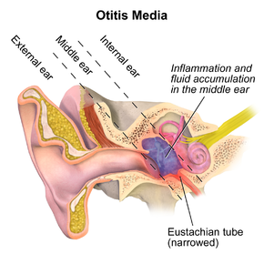
Definition & Etiology:
Acute infection​​ of the mucous membrane lining of the middle ear cleft.
Etiology: Usually, AOM is a complication of eustachian tube dysfunction that occurred during an acute viral upper respiratory tract infection. Bacteria can be isolated from middle ear fluid cultures in 50% to 90% of cases of AOM and OME.
Notes:
AOM is inflammation of the middle ear, It is mainly a disease of childhood.

Slide 57
Causes:
Eustachian tube dysfunction/obstruction/abnormality:
Swelling of tubal mucosa (e.g. URTI)
obstruction/infiltration of Eustachian tube ostium.
Inadequate tensor palati function: cleft palate (even after repair)
Abnormal Eustachian tube
Disruption of action of:
Cilia of Eustachian tube (Kartagener's syndrome)
Mucus secreting cells
Capillary network that provides humoral factors, PMNs, phagocytic cell
Immunosuppression/deficiency due to:
Chemotherapy, steroids, DM, hypogammaglobulinemia, cystic fibrosis.

Slide 58
Risk factors:
Pediatrics:
Age (younger)
No breastfeeding (supine Bottle feeding)
Pacifier use
Gastroesophageal reflux (GERD)
ِِAttending day care group
All age groups:
Allergies
Craniofacial abnormalities
Exposure to environmental smoke or other respiratory irritants
Family history of recurrent acute otitis media
Immunodeficiency
Upper respiratory tract infections (URTI)

Slide 59
Common causative organism:
* H. influenzae has become the most prevalent organism among children with severe or refractory AOM following the introduction of the pneumococcal conjugate vaccine.
Bacterial: (SMH) Streptococcus pneumonia Haemophilus influenzae Moraxella catarrhalis | Viral: Rhinovirus Parainfluenza virus Influenza virus

Slide 60
Signs & Symptoms:
Otalgia
Fever (especially in younger children)
Headache
Deafness
Irritability
Otorrhea
Vomiting
Loss of appetite

Slide 61
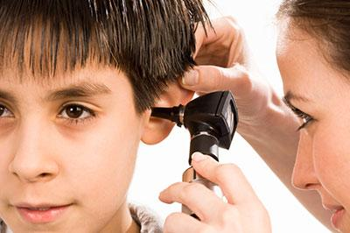
Examination:
Otoscopy of Tympanic membrane :
Bulging.
Impaired mobility. (assessed by pneumatic otoscopy)
Redness or cloudiness.

Slide 62
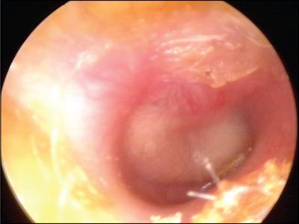
Otoscopic view of acute otitis media. Erythema and bulging of the tympanic membrane with loss of normal landmarks are noted.

Slide 63
Diagnosis:
Criteria for diagnosis:
Moderate to severe bulging of the tympanic membrane.
New onset of otorrhea not caused by otitis externa.
Mild bulging of the tympanic membrane associated with recent onset of ear pain (less than 48 hours) or erythema.
Notes:
Acute otitis media is diagnosed in patients with acute onset, presence of middle ear effusion, physical evidence of middle ear inflammation.
Previous diagnostic criteria for AOM were based on symptomatology without otoscopic findings of inflammation. The updated American Academy of Pediatrics guideline endorses more stringent otoscopic criteria for diagnosis.
An AOM diagnosis requires moderate to severe bulging of the tympanic membrane (Figure 1),
new onset of otorrhea not caused by otitis externa,
or mild bulging of the tympanic membrane associated with recent onset of ear pain (less than 48 hours) or erythema.
AOM should not be diagnosed in children who do not have objective evidence of middle ear effusion.
An inaccurate diagnosis can lead to unnecessary treatment with antibiotics and contribute to the development of antibiotic resistance

Slide 64
Management:
Antipyretics/analgesics (e.g. paracetamol and/or ibuprofen)
Observation VS Antibiotic therapy When do we give ABx??!
Children 6 months or older with otorrhea or severe signs or symptoms | Children 6 to 23 months of age with bilateral acute otitis media without severe signs or symptoms | Children 6 to 23 months of age with unilateral acute otitis media without severe signs or symptoms | Children 2 years or older without severe signs or symptoms
ABx for 10 days | ABx for 10 days | Observation or ABx for 10 days | observation or ABx for 5 - 7 days
Severe signs or symptoms?
Moderate or severe otalgia. | Otalgia for at least 48 hours. | Temperature of 102.2°F [39°C] or higher.
Notes:
Management of acute otitis media should begin with adequate analgesia. Antibiotic therapy can be deferred in children two years or older with mild symptoms. High-dose amoxicillin (80 to 90 mg per kg per day) is the antibiotic of choice for treating acute otitis media in patients who are not allergic to penicillin. Children with persistent symptoms despite 48 to 72 hours of antibiotic therapy should be reexamined, and a second-line agent, such as amoxicillin/clavulanate, should be used if appropriate. Otitis media with effusion is defined as middle ear effusion in the absence of acute symptoms. Antibiotics, decongestants, or nasal steroids do not hasten the clearance of middle ear fluid and are not recommended. Children with evidence of anatomic damage, hearing loss, or language delay should be referred to an otolaryngologist.
*Ibuprofen and acetaminophen are recommended for symptoms of ear pain, fever, and irritability.

Slide 65
Management:
If symptoms persist 48-72 hours after initiating therapy?
Re-examination: If a bulging, inflamed tympanic membrane is observed, therapy should be changed to a 2nd line agent.
Antibiotics Treatment
1st line | High-dose Amoxicillin (80-90 mg/kg/d into two doses). For patients who are allergic to penicillin →Oral cephalosporins, such as cefuroxime (Ceftin)
2nd line | For patients initially on amoxicillin → Amoxicillin/clavulanate For patients initially on oral cephalosporin → intramuscular ceftriaxone, clindamycin, or tympanocentesis may be considered.
* A common side effect to antibiotic treatment of OM is diarrhea.
Notes:
Management of acute otitis media should begin with adequate analgesia. Antibiotic therapy can be deferred in children two years or older with mild symptoms. High-dose amoxicillin (80 to 90 mg per kg per day) is the antibiotic of choice for treating acute otitis media in patients who are not allergic to penicillin. Children with persistent symptoms despite 48 to 72 hours of antibiotic therapy should be reexamined, and a second-line agent, such as amoxicillin/clavulanate, should be used if appropriate. Otitis media with effusion is defined as middle ear effusion in the absence of acute symptoms. Antibiotics, decongestants, or nasal steroids do not hasten the clearance of middle ear fluid and are not recommended. Children with evidence of anatomic damage, hearing loss, or language delay should be referred to an otolaryngologist.

Slide 66
Complications:
Inter-temporal Complications: Hearing loss & Language delay Mastoiditis (most common & serious) Facial Nerve Paralysis Labyrinthitis Labyrinthine fistula | Intra-cranial Complications: Extradural Abscess Subdural Abscess Meningitis Sigmoid Sinus Thrombosis Brain Abscess

Slide 67
Prevention:
Parent education about risk factors.
Eliminate bottle propping and pacifiers. (sucking on a pacifier increases the reflux of nasopharyngeal secretions into the middle ear)
Eliminate exposure to passive smoke.
Pneumococcal and influenza vaccine.
Check for allergies.
Notes:
Check for undiagnosed allergies leading to chronic rhinorrhea

Slide 68
Which of the following is the most sensitive physical finding for otitis media?
Redness.
Immobility.
Bulging.
Decreased light reflex.
Decreased hearing.
Notes:
B

Slide 69
A 4 year-old boy brought to the PHC by his mother as chief complaint of sudden onset of deafness in his right ear, his mother mention a history of fever and otalgia for the last week, which has been resolved. Upon otoscopy examination, what do you expect to see:
A. Bulging of tympanic membrane
B. Ruptured tympanic membrane
C. Swollen and reddened tympanic membrane
D. Retraction of tympanic membrane
Notes:
B

Slide 70
5) Allergic Rhinitis
Yasmen AlFaresi
435201118

Slide 71
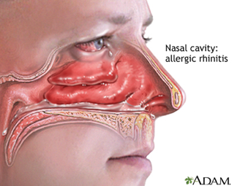
Definition
Is a type of rhinitis, which is an inflammation of the nasal mucosa, mediated by an IgE-associated response to ubiquitous indoor and/or outdoor environmental allergens.
characterized by:
Nasal pruritus
Sneezing
Rhinorrhoea± Nasal congestion

Slide 72
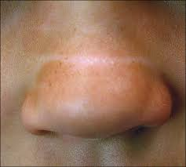
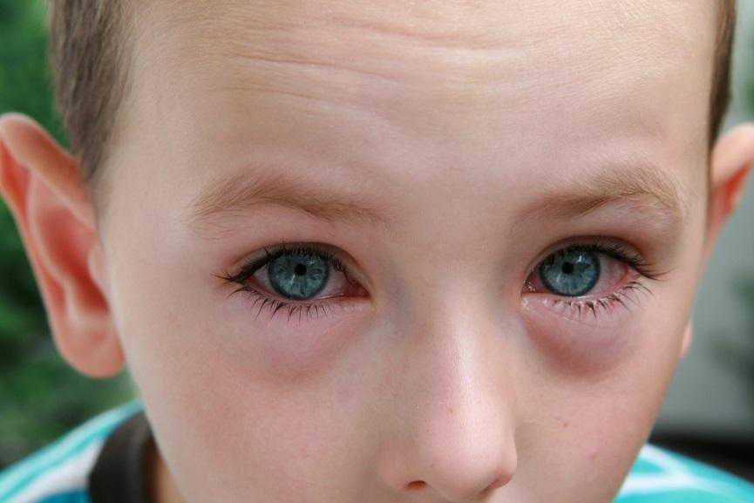
Clinical signs:
Allergic Salute: The use of the hand palm to rub and raise the tip of the nose
Nasal Crease: results from a chronic upward rubbing of the nose
Allergic shiners: are dark circles under the eyes, caused by venous stasis due to nasal congestion
* Ultimately, prolonged symptoms could lead to facial distortion

Slide 73
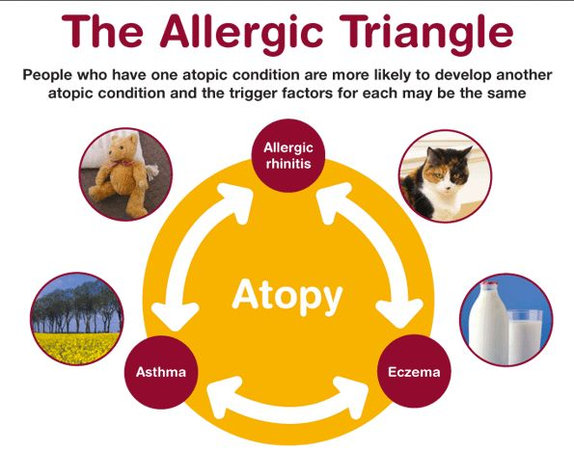

Slide 74
Classification:
1.Based on the temporal pattern:
a.Seasonal (e.g. cyclic pollens)
b.Perennial [all year] (e.g. dust mite)
2.Based on frequency:
a.Persistent (>4 days/week and >4 weeks)
b.Intermittent (<4 days/week or <4wk at a time)
3. Based on Severity:
a.Mild
b.Moderate
c.Severe

Slide 75
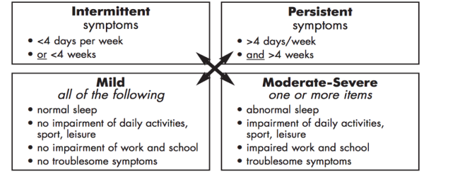
4 categories:(Mildintermittent, Mildpersistent,
Moderate-Severeintermittent,Moderate-Severepersistent)

Slide 76
Triggers:

Slide 77
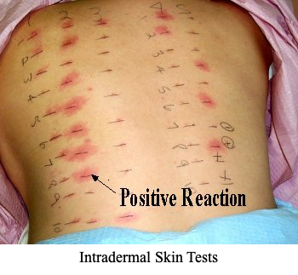
Allergy testing:
When?
treatment is ineffective.
A diagnosis of allergic rhinitis is uncertain.
identification of a certain allergen could affect therapy, or to aid in titration of therapy.
Coexisting persistent asthma and/or recurrent sinusitis/otitis media.
patient's desire to try to avoid the allergen rather than take medications to control symptoms.

Slide 78
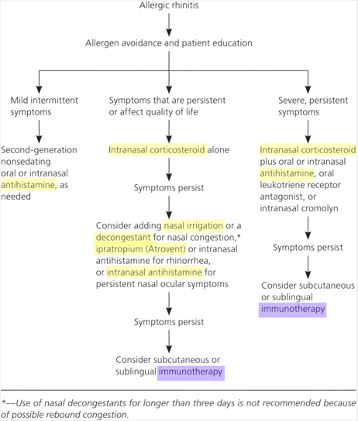
AR treatment:
Allergen avoidance
Is a major principle and first-line therapy for AR.
Immunotherapy:
Only treatment that changes the natural course of allergic rhinitis (acts directly on the cause rather than symptoms)

Slide 79
A pt. Come to the PHC complaining of runny nose and itchiness. You were attending that clinic and the doctor ask you “Which conditions are associated with allergic rhinitis”:
Asthma
Allergic dermatitis
Allergic conjunctivitis
All of the above
Notes:
D

Slide 80
CASE DISCUSSION / ROLE PLAY

Slide 81
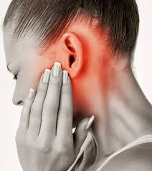
Case!
A 19 y/o female comes to your clinic complaining of pain in her left ear that started 2 days ago.
How will you approach her?
Notes:
Hx: there is fluid

Slide 82
History:
SOCRATE
Rule out other DDx:
Acute laryngitis: fever, cough, dysphonia or a hoarse voice.
chronic sinusitis: Nasal obstruction,congestion, Chronic unproductive cough.
Temporal Bone Fractures: recent trauma.
Malignancies: constitutional symptoms

Slide 83
Physical examination:
Vital signs.
Otoscope.
Complete ENT examination.

Slide 84
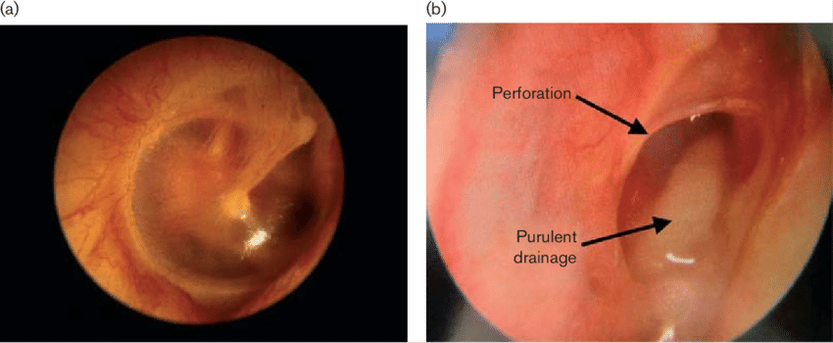
Summery:
A 19 y/o female comes to your clinic complaining of pain in her left ear that started 2 days ago. The patient had no history of cough or hoarseness in her voice, no nasal obstruction or congestion or constitutional symptoms.
Vital signs: Temperature was 38.3℃.
Otoscope: shows fluid coming out from the ear, erythematous eardrum and bulging tympanic membrane.
Neck ex: non tender lymph nodes.
How you will manage her?

Slide 85
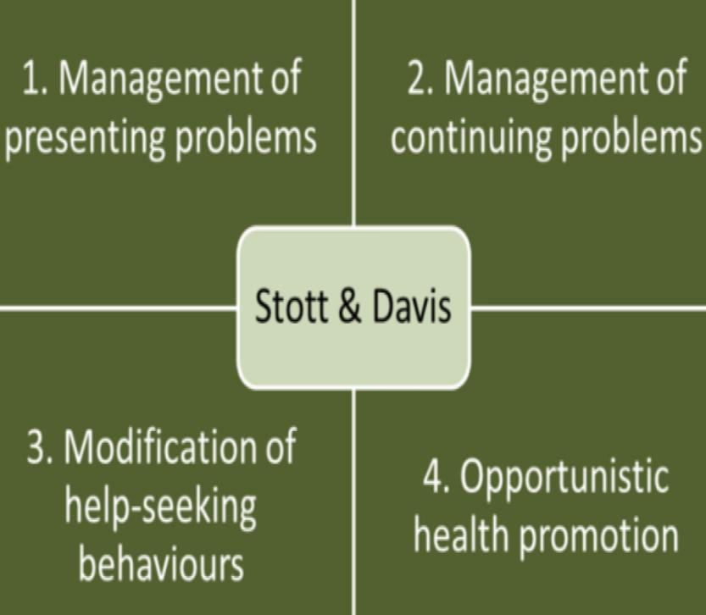
Model of consultation:

Slide 86
References:
Oxford GP Handbook
AACA | Allergy Testing Austin, Tx. (n.d.). Retrieved from https://nosneezes.com/resources/allergy-testing/
Satapthy, R. (n.d.). Assured homeopathy treatment with best homeopathy medicines give a long term 6 Best Homeopathic Medicines for Allergy,HAYFEVER Treatment. Retrieved from http://multicarehomeopathy.com/diseases/6-best-homeopathic-medicines-for-allergy-hayfever-treatment
Sur, D. K., & Plesa, M. L. (2015, December 01). Treatment of Allergic Rhinitis. Retrieved from https://www.aafp.org/afp/2015/1201/p985.html
Aring, A. and Chan, M. (2019). Acute Rhinosinusitis in Adults. [online] Aafp.org. Available at: https://www.aafp.org/afp/2011/0501/p1057.html [Accessed 29 Jan. 2019].
Erlikh, I., Abraham, S. and Kondamudi, V. (2019). Management of Influenza. [online] Aafp.org. Available at: https://www.aafp.org/afp/2010/1101/p1087.html#afp20101101p1087-t3 [Accessed 31 Jan. 2019].
American family physician- Otitis Media: Diagnosis and Treatment https://www.aafp.org/afp/2013/1001/p435.html

Slide 87
THANK YOU
Any Questions?

