Slide 1
Neuro-Cognitive Disorders

Slide 2
Case study
Abdullah is a 72-year-old male. He was brought to the Emergency Department by his son for vomiting, new onset urinary incontinence, confusion, and incoherent speech for the past 2 days.
The patient was disoriented and could see people climbing trees outside the window. He had difficulty sustaining attention, and his level of consciousness waxed and waned. He had been talking about his deceased wife. Patient was also trying to pull out his intravenous access line.
Past history included diabetes mellitus, hyperlipidemia, osteoarthritis, and stroke.

Slide 3
Case study
On examination, the patient was drowsy and falling asleep while practitioners were talking to him. Patient was not cooperative with the physical examination and with a formal mental status examination.
Limited examination of the abdomen indicated that it was flat and soft with normal bowel sounds. The patient moves all 4 limbs and plantar is bilateral flexor.
Laboratory test results revealed elevated BUN and creatinine levels, and the urine analysis was positive for urinary tract infection. CT scan of the head showed cortical atrophy plus an old infarct.
The patient's family physician had recently prescribed Tylenol with codeine for the patient's severe knee pain 5 days earlier.

Slide 4
A- Analysis of symptoms, MSE and psychopathology especially perception; differential diagnosis discussion (including drug intoxication and withdrawal):
Analyze the symptoms (presented and expected) in this case and signs, including mood, thoughts, cognition, perception and physical aspects
Discuss other elements related to the case includes possible etiological reasons
Discuss the initial possible diagnosis of this case and different types of such clinical presentation

Slide 5
Neurocognitive Disorders
Disruption in one or more of the cognitive domains, and are also frequently complicated by behavioral symptoms.
Neurocognitive disorders exemplify the complex interface between neurology, medicine, and psychiatry
In (DSM-5), Neurocognitive Disorders are:
Delirium
Major Neurocognitive Disorder (Dementia)
Mild Neurocognitive Disorder
Notes:
Major or Mild Neurocognitive Disorder Due to:
Alzheimer’s Disease
Frontotemporal Lewy Bodies
Vascular Traumatic Brain Injury
Substance/Medication-Induced HIV Infection
Prion Disease
Parkinson’s Disease
Huntington’s Disease
Another Medical Condition
Multiple Etiologies
Unspecified

Slide 6
Delirium
Acute onset of fluctuating cognitive impairment (global)and a disturbance of consciousness.
Delirium is a syndrome, not a disease, and it has many causes, all of which result in a similar pattern of signs and symptoms.
Delirium is acute brain failure.
A common disorder:
Hospitalized medically ill 10-30%
Hospitalized elderly 10-40%
Postoperative patients up to 50%
Near-death terminal patients up to 80%
Notes:
10 to 30 percent of medically ill inpatients
30 percent of patients in intensive care units
40 to 50 percent of patients who are recovering from surgery for hip fractures
Underrecognized and undertreated !!

Slide 7
Classically, delirium has a sudden onset (hours or days)
A brief and fluctuating course
Rapid improvement when the causative factor is identified and eliminated
Abnormalities of mood, perception, and behavior are common psychiatric symptoms.
Reversal of sleep-wake pattern.
Tremor, asterixis, nystagmus, incoordination, and urinary incontinence are common

Slide 8
Delirium has bad prognosis
May progress to stupor, coma, seizures or death, particularly if untreated.
Increased risk for postoperative complications, longer postoperative recuperation, longer hospital stays, long-term disability.
Elderly patients 22-76% chance of dying during that hospitalization
Several studies suggest that up to 25% of all patients with delirium die within 6 months

Slide 9
Risk Factors
Extremes of age
Number of medications taken
Preexisting brain damage (e.g., dementia, cerebrovascular disease, tumor)
History of delirium
Alcohol dependence
Diabetes
Cancer
Sensory impairment
Malnutrition

Slide 10
Causes: “I WATCH DEATH”
I nfections
W ithdrawal
A cute metabolic
T rauma
C NS pathology
H ypoxia
D eficiencies
E ndocrinopathies
A cute vascular
T oxins or drugs
H eavy metals
Notes:
44% estimated to have 2 or more etiologies
This mnemonic worked for me, so I’ll pass it on to you. I watch death is a catchy little phrase that always reminds you of the grave nature of delirium.
I nfections
W ithdrawal
A cute metabolic
T rauma
C NS pathology
H ypoxia
D eficiencies
E ndocrinopathies
A cute vascular
T oxins or drugs
H eavy metals
I will give examples on the next few slides.

Slide 11
“I WATCH DEATH”
Infections: encephalitis, meningitis, sepsis
Withdrawal: ETOH, sedative-hypnotics, barbiturates
Acute metabolic: acid-base, electrolytes, liver or renal failure
Trauma: brain injury, burns
Notes:
The most common infections would be those affecting the brain like encephalitis and meningitis, but any systemic infection can certainly cause delirium.
As mentioned previously, withdrawal from drugs is one of the 4 major contributors to delirium. Alcohol, sedatives and barbiturates are the most common.
Any acute metabolic change can account for altered mental status: altered acid-base status. Electrolyte imbalance, and particularly liver or renal impairment.
The most likely traumatic contributors are burns and brain injury.

Slide 12
“I WATCH DEATH”
CNS pathology: hemorrhage, seizures, stroke, tumor (don’t forget metastases)
Hypoxia: CO poisoning, hypoxia, pulmonary or cardiac failure, anemia
Deficiencies: thiamine, niacin, B12
Endocrinopathies: hyper- or hypo- adrenocortisolism, hyper- or hypoglycemia
Notes:
Direct CNS damage causes delirium, specifically, hemorrhage, seizures, stroke, and tumor. It’s good to think about brain mets in any cancer patient who appears delirious.
Anything that can reduce the supply of blood (ie. Oxygen) to the brain counts: so CO, hypoxia from pulm or cardiac origins, and anemia- acute blood loss, usually.
Vitamin deficiencies- usually thiamine, niacin, or B12. (worry about alcoholics)
Endocrinopathies: too much or too little cortisol or glucose. DKA is classic for delirium.

Slide 13
“I WATCH DEATH”
Acute vascular: hypertensive encephalopthy and shock
Toxins or drugs: pesticides, solvents, medications, (many!) drugs of abuse
anticholinergics, narcotic analgesics, sedatives (BDZ)
Heavy metals: lead, manganese, mercury
Notes:
Vascular causes include hypertensive encephalopathy and shock. Toxins cover anything from pesticides and solvents, to prescription meds. Any textbook will provide a list of at least 100 potential offenders. I want you to remember three major classes that are the most common culprits: anticholinergics- like phenergan, benadryl, tricyclics, narcotic analgesics- like demerol, morphine,and sedatives- like ativan and valium.These account for the majority of troublemakers.The next slide will show possible drugs of abuse that can cause delirium.
Rarely, heavy metal exposure will be the cause.

Slide 14
Life threatening causes of delirium(WHHHIMP)
Wernicke’s encephalopathy
Hypoxia
Hypoglycemia
Hypertensive encephalopathy
Intracerebral hemorrhage
Meningitis/encephalitis
Poisoning

Slide 15
DSM-5 Diagnostic Criteria for Delirium
A) A disturbance in attention (reduced ability to focus, sustain and shift attention) and awareness (reduced orientation to the environment).
B) The disturbance develops over a short period of time (usually hours to days) and tends to fluctuate in severity during the course of the day.
C) An additional disturbance in cognition ( e.g. memory deficit, disorientation, language, visuospatial ability) or perception.
D) The changes in criteria A & C are not better explained for by a preexisting, established or evolving neurocognitive disorder or not in the context of coma.
E) There is evidence from the history, physical examination, or laboratory findings that the disturbance is caused by the direct physiological consequences of another medical condition or substance

Slide 16
Clinical features
Prodrome (Restlessness ,Anxiety, Sleep disturbance)
Fluctuating course
Attentional deficits
Arousal /psychomotor disturbance
Impaired cognition
Sleep-wake disturbance
Altered perceptions
Affective disturbances
Notes:
These are the core clinical features of delirium. I will go through each one separately.
Prodrome
Fluctuating course
Attentional deficits
Arousal disturbances
Disturbances in normal arousal are key features of DELERIUM.
Hyperactive (agitated, hyperalert)
Hypoactive (lethargic, hypoalert)
Mixed
It is important to note that patients don’t have to be slowed down, or unresponsive, in order to have delirium. And the fluctuation in the level of alertness is often a key diagnostic feature.
Psychomotor abnormalities
Sleep-wake disturbance
Impaired cognition
Altered perceptions
Emotional disturbances

Slide 18
Workup
History
Interview- also with family, if available
Physical, cognitive, and neurological exam
Vital signs, fluid status
Review of medical record
Anesthesia and medication record review - temporal correlation?
Notes:
The most important part of the workup for delirium is to have the suspicion. As with most other diagnoses, the answer can often be found in the history and interview. Speaking with family members to see if the new behavior is a change from baseline is a huge help. Physical, cognitive, and neurological exams should be performed, to include vital signs and fluid status. Perhaps the most important piece of investigative work is the review of medical and anesthesia records. This will often point to an event that precipitated the worsened mental status.

Slide 19
Mini-mental state exam
Tests orientation, short-term memory, attention, concentration, constructional ability
30 points is perfect score
< 20 points suggestive of problem
Not helpful without knowing baseline
Notes:
This is a brief test of cognition and neuropsych. functioning.
Tests orientation, short-term memory, attention, concentration, constructional ability
30 points is perfect score
< 20 points indicated probably ORGANIC etiology (delirium or dementia)
Not helpful without knowing baseline, but is useful for following over time.

Slide 20
Workup
Electrolytes
CBC
EKG
CXR
EEG- not usually necessary
Notes:
Laboratory Workup of the Patient with Delirium
Blood chemistries (including electrolytes, renal and hepatic indexes, and glucose)
Complete blood count with white cell differential
Thyroid function tests
Serologic tests for syphilis
Human immunodeficiency virus (HIV) antibody test
Urinalysis
Electrocardiogram
Electroencephalogram
Chest radiograph
Blood and urine drug screens
The workup should include lab evaluations based on the investigating you have already done . They may include: Electrolytes for metabolic derangements, CBC for infection, anemia, EKG for heart function, CXR for lung function and An EEG has fairly good sensitivity for delirium- showing generalized slowing, but is not often indicated since other causes are usually evident.

Slide 21
Workup
Arterial blood gas or Oxygen saturation
Urinalysis +/- Culture and sensitivity
Urine drug screen
Blood alcohol
Serum drug levels (digoxin, theophylline, phenobarbital, cyclosporin, lithium, etc)
Notes:
Others include:
Arterial blood gas or Oxygen saturation
Urinalysis +/- Culture and sensitivity
Urine drug screen
Blood alcohol
Serum drug levels (digoxin, theophylline, phenobarbital, cyclosporin, lithium, etc)

Slide 22
Workup
Arterial blood gas or Oxygen saturation
Urinalysis +/- Culture and sensitivity
Urine drug screen
Blood alcohol
Serum drug levels (digoxin, theophylline, phenobarbital, cyclosporin, lithium, etc)
Notes:
And ---
Arterial blood gas or Oxygen saturation
Urinalysis +/- Culture and sensitivity
Urine drug screen
Blood alcohol
Serum drug levels (digoxin, theophylline, phenobarbital, cyclosporin, lithium, etc)

Slide 23
Workup
Consider:
- Heavy metals
- Lupus workup
- Urinary porphyrins
Notes:
And if still no likely cause, Consider:
- Heavy metals
- Lupus workup
- Urinary porphyrins

Slide 24
Differential Diagnosis
Major Neurocognitive Disorder (Dementia)
Mild Neurocognitive Disorder
Depression
Schizophrenia

Slide 25
Management
Identify and treat the underlying etiology
Increase observation and monitoring – vital signs, fluid intake and output, oxygenation, safety
Discontinue or minimize dosing of nonessential medications
Coordinate with other physicians and providers

Slide 26
Management
Monitor and assure safety of patient and staff:
- suicidality and violence potential
- fall & wandering risk
- need for a sitter
- remove potentially dangerous items from the environment
- restrain ONLY when other means not effective (it may worsen delirium).

Slide 27
Management
Assess individual and family psychosocial characteristics
Establish and maintain an alliance with the family and other clinicians
Educate the family – temporary and part of a medical condition – not “crazy”
Provide post-delirium education and processing for patient

Slide 28
Treatment
The primary goal is to treat the underlying cause
The other important goal of treatment is to provide physical, sensory, and environmental support

Slide 29
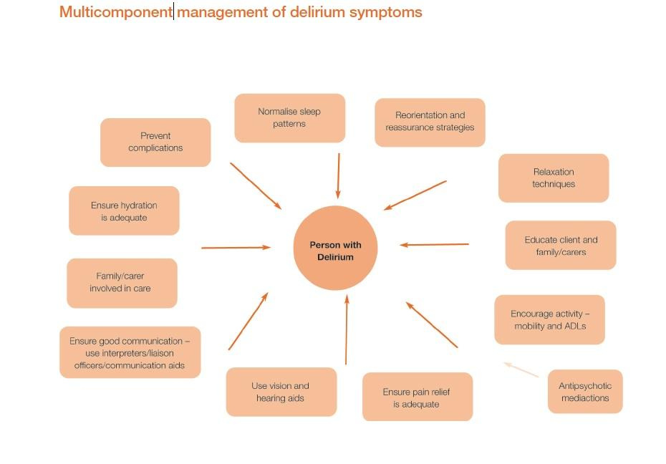

Slide 30
Management
Pharmacologic management ( the primary treatment of delirium) :
- Low doses of high potency antipsychotics (i.e. haloperidol) po, im or iv
- Atypical antipsychotics (risperidone, olanzapine, quetiapine, aripiprazol).
*Rarely, some antipsychotics are associated with torsade de pointes arrhythmia by lengthening the QT interval; avoid or monitor this by ECG monitoring.

Slide 31
Summary
Delirium is common and is often a harbinger of death- especially in vulnerable populations
It is a sudden change in mental status, with a fluctuating course, marked by decreased attention
It is caused by underlying medical problems, drug intoxication/withdrawal, or a combination
Recognizing delirium and searching for the cause can save the patient’s life

Slide 32
Case Development 1:
Past history inquiry indicated that he has two years of deteriorating memory. He forgot mostly recent things. He has difficulty to name some familiar people to him. 6 months ago, he lost his ability to drive and to pray appropriately. However, his attention was well except of few days’ prior current admission. There is positive family history of sever memory problem in his eldest brother.
Analyze the symptoms (presented and expected) in this case and signs, including mood, thoughts, cognition, perception and physical aspects
Discuss other elements related to the case includes possible etiological reasons
Discuss the initial possible diagnosis of this case and different types of such clinical presentation
Discuss Cognitive disorders related psychopathology

Slide 33
Dementia
Global impairment of cognitive functions occurring in clear consciousness
Difficulty with memory, attention, thinking, and comprehension.
Other mental functions can often be affected, including mood, personality, judgment, and social behavior
Can be progressive or static !
Permanent or reversible (e.g., vitamin B12, folate, hypothyroidism)
50 to 60 percent have the most common type of dementia, dementia of the Alzheimer's type
Vascular dementias account for 15 to 30 percent of all dementia cases

Slide 34
DSM-5 criteria of major neurocognitive disorder (dementia)
A. Evidence of significant cognitive decline from a previous level of performance in one or more cognitive domains (complex attention, executive function, learning and memory, language, perceptual-motor, or social cognition) based on:
1. Concern of the individual, a knowledgeable informant, or the clinician that there has been a significant decline in cognitive function; and
2. A substantial impairment in cognitive performance, preferably documented by standardized neuropsychological testing or, in its absence, another quantified clinical assessment.
B. The cognitive deficits interfere with independence in everyday activities (i.e., at a minimum, requiring assistance with complex instrumental activities of daily living such as paying bills or managing medications).
C. The cognitive deficits do not occur exclusively in the context of a delirium.
D. The cognitive deficits are not better explained by another mental disorder (e.g., major depressive disorder, schizophrenia).

Slide 35
Specify whether due to:
Alzheimer’s Disease
Frontotemporal
Lewy Bodies
Vascular
Traumatic Brain Injury
Substance/Medication-Induced
HIV Infection
Prion Disease
Parkinson’s Disease
Huntington’s Disease
Another Medical Condition
Multiple Etiologies
Unspecified
Specify:
Without behavioral disturbance
With behavioral disturbance (specify disturbance): If the cognitive disturbance is accompanied by a clinically significant behavioral disturbance (e.g., psychotic symptoms, mood disturbance, agitation, apathy, or other behavioral symptoms).
Specify current severity:
Mild: Difficulties with instrumental activities of daily living (e.g., housework, managing money).
Moderate: Difficulties with basic activities of daily living (e.g., feeding, dressing).
Severe: Fully dependent.

Slide 36
Possible Etiologies of Dementia
Degenerative dementias Alzheimer's disease Frontotemporal dementias (e.g., Pick's disease) Parkinson's disease Lewy body dementia Miscellaneous Huntington's disease Wilson's disease Psychiatric Pseudodementia of depression Cognitive decline in late-life schizophrenia Physiologic Normal pressure hydrocephalus Metabolic Vitamin deficiencies (e.g., vitamin B₁₂, folate) Endocrinopathies (e.g., hypothyroidism) Chronic metabolic disturbances (e.g., uremia) Tumor Primary or metastatic (e.g., meningioma or metastatic breast or lung cancer)
Traumatic Dementia pugilistica, posttraumatic dementia Subdural hematoma Infection Prion diseases (e.g., Creutzfeldt-Jakob disease, bovine spongiform encephalitis, Gerstmann-Straussler syndrome) Acquired immune deficiency syndrome (AIDS) Syphilis Cardiac, vascular, and anoxia Infarction (single or multiple or strategic lacunar) Binswanger's disease (subcortical arteriosclerotic encephalopathy) Hemodynamic insufficiency (e.g., hypoperfusion or hypoxia) Demyelinating diseases Multiple sclerosis Drugs and toxins Alcohol, Heavy metals, Carbon monoxide

Slide 37
Dementia of the Alzheimer's Type
The most common type of dementia
Progressive dementia
The final diagnosis of Alzheimer's disease requires a neuropathological examination of the brain
Genetic factors
Acetylcholine and norepinephrine, both of which are hypothesized to be hypoactive in Alzheimer's disease

Slide 38
Vascular Dementia
The primary cause of vascular dementia, formerly referred to as multi-infarct dementia, is presumed to be multiple areas of cerebral vascular disease
Vascular dementia is more likely to show a decremental, stepwise deterioration than is Alzheimer's disease.

Slide 39
Diagnosis and Clinical Features
The diagnosis of dementia is based on the clinical examination
Memory impairment is typically an early and prominent feature
Early in the course of dementia, memory impairment is mild and usually most marked for recent events; As the course of dementia progresses, memory impairment becomes severe, and only the earliest learned information are intact
Orientation can be progressively affected

Slide 40
Personality change, intellectual impairment, forgetfulness, social withdrawal, anger and lability of emotions are common
Hallucinations………….20 to 30 percent
Delusions………………30 to 40 percent
Physical aggression and other forms of violence are common in demented patients who also have psychotic symptoms.
Depression and anxiety symptoms
Pathological laughter or crying

Slide 41
Physical Findings, and Laboratory Examination
A comprehensive laboratory workup must be performed when evaluating a patient with dementia
The purposes of the workup are to detect reversible causes of dementia
The evaluation should follow informed clinical suspicion
Differential Diagnosis
Delirium
Depression (pseudodementia )
Schizophrenia
Normal Aging

Slide 42
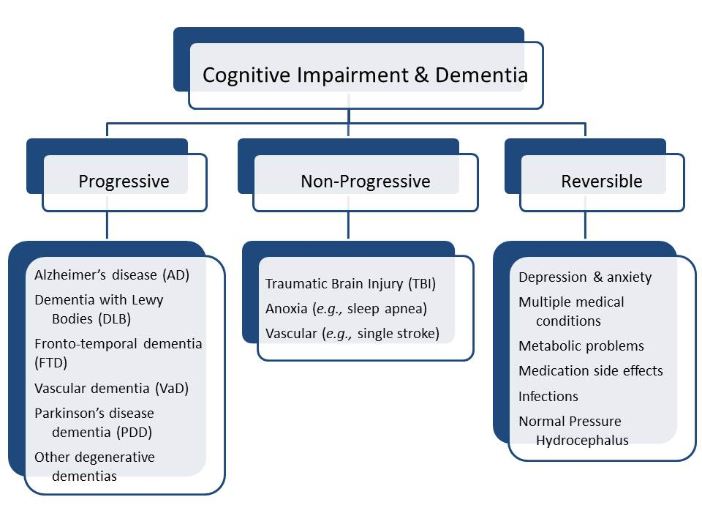

Slide 43
Case Development 2
Abdullah’s son reluctantly reported that his father has current history of occasional alcohol drinking and using Diazepam to sleep well.
He admits that he were heavy alcohol drinker 10 years ago. He had bouts of memory impairments and family problem secondary to his heavy drinking. He used to have tremors and craving for drinking at early morning. After searching patient’s old medical notes, you found that the patient has been admitted to ICU 10 year ago with fever, sweating, tremor, dilated eyes, disorientation, confusion and seeing small animals.
Discuss possible differential diagnosis.

Slide 45
Case Management Discussion including ability to give consent and take decision: (Considering the case above)
Discuss about the acute use of antipsychotics and benzodiazepine
Discuss about Dementia treatments, indication, side effects, etc
Discuss about ability to give consent and take decision

Slide 46
Delirium Vs Dementia
Features | Delirium | Dementia
Onset | Acute | Insidious
Course | Fluctuating | Progressive
Duration | Days to weeks | Months to years
Consciousness | Altered | Clear
Attention | Impaired | Normal, except in severe dementia
Psychomotor changes | Increased or decreased | Often normal
Reversibility | Usually | Rarely

Slide 47
Treatment
The first step in the treatment of dementia is verification of the diagnosis.
Preventive measures are important
Supportive and educational psychotherapy
Any areas of intact functioning should be maximized by helping patients identify activities in which successful functioning is possible
Caregivers

Slide 48
Pharmacotherapy
Primary treatments:
Cholinesterase inhibitors :
Donepezil (Aricept), rivastigmine (Exelon), galantamine (Remiryl), and tacrine
NMDA glutamate receptors antagonist: Memeantine
Drugs with high anticholinergic activity & Benzodiazepines should be avoided.

Slide 49
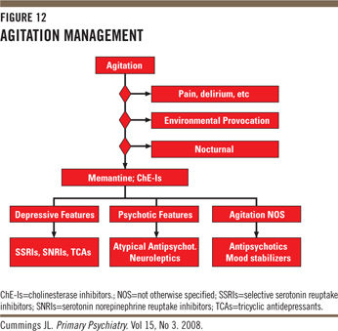
Management of agitation/aggression in demented patients

Slide 50
Capacity vs. Competency
Clinical vs. Legal term that denotes the ability to make rational and reasonably well informed decisions by a particular patient (vs. person) in their treatment and/ or life decision/s
Capacity is a clinical determination that addresses the integrity of mental functions.
Competency is a legal determination that addresses societal interest in restricting a person’s right to make decisions or do acts because of incapacity.

Slide 51
Valid Informed Consent
Permission voluntary given by a competent person without any elements of force, deceit, coercion after explanation and disclosure of
Purpose and details of procedure or treatment
Risks, Benefits and available alternative treatment/s
The right to withdrawal consent verbally or in written forms at anytime

Slide 52
Exceptions
Life threatening situation
Patient who waive their rights to disclose and consent (do not want to be informed)
Instances where “ disclosure’ may be harmful to the patient “ Therapeutic privileges”

Slide 53
Rules of capacity
Being mentally ill doesn’t in itself imply a loss of capacity or competency.
Having Capacity or being Competent should be presumed until proven otherwise.

Slide 54
Steps in Mental Capacity Assessment
A.
General perspective or specific (Psychiatric hospitalization, ECT)
Find out the best language of communication
Determine if patient has adequate information on which to base a decision
MMSE: attention, concentration, memory
Inform the patient about the nature of the disorder, AND the risk and benefit of the PROPOSED treatment, and of ALTERNATIVE treatments or of NO treatment
B.
Repeat information number of times and in different ways.
Let the patient paraphrase or restate the understanding.
Evaluate nature of questions that patient asks regarding treatment plan
Periodical Reassessment of capacity ( if any change in clinical conditions or, mental status such as in delirium or any modifications in treatment plan)
C.
If patient has “severe deficit” in understanding information-→ No Capacity to make informed consent or make decision→ Arrange a process for “ a substitute decision maker”
Notes:
Alternate decision maker/ Health care Proxy Vs. Health care Surrogate/ Living will and advanced directives
Proxy order> Spouse, adult children, parents, young siblings, adult relatives, friend/s
If non of the above, then it is a Legal Process. Emergency Temporary guardian if situation is emergency. Then the court determine that pt being incompetent, then a “ legal guardian” is designated who takes decision for the patient in the area specified by the court.

Slide 56
THANK YOU

