Slide 1
Neurocognitive/Neuropsychiatric Disorders
Dr. Ali Bahathig, FRCPC
Assistant Professor and Consultant of psychiatry, Consultation-Liaison Psychiatrist
Psychosomatic Unit, Psychiatry Department
King Khalid University Hospital

Slide 2
Objective:
Delirium.
Major Neurocognitive Disorders (MCD):
Dementia.
Amnestic syndrome.
Traumatic Brain Injury (TBI).

Slide 3
Introduction:
Cognition Functions Vs Cognitive Disorders.

Slide 4
Cognitive functions vs Cognitive disorders
Cognitive functions:
Attention
Concentration
Memory.
Processing speed
Orientation.
Impulse control.
Language processing
Executive function

Slide 5
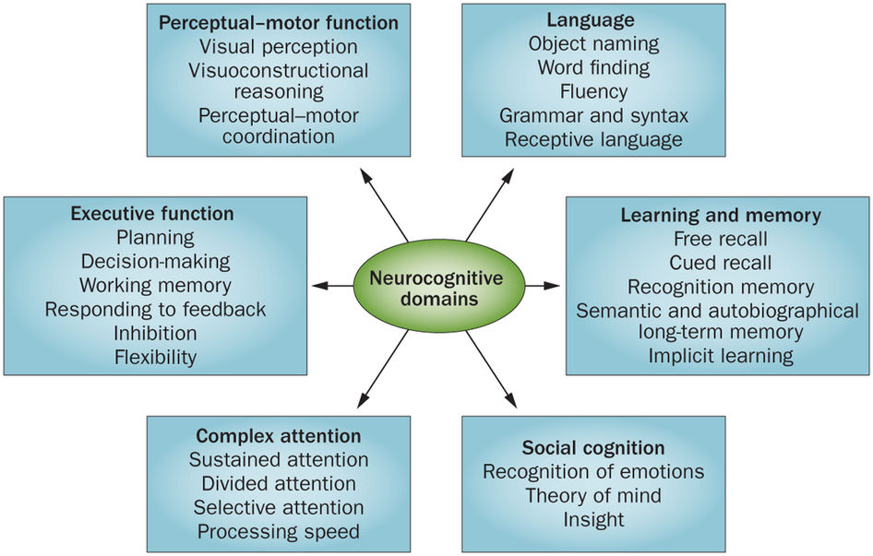

Slide 6
Cognitive/Neurocognitive disorder:
Cognitive deficits
That present in many mental disorders.
Were not present from birth or very early in life
Represent a decline from a previously attained level of functioning.
Cognitive Processes: our ways of thinking and conclusion formations.
Cognitive Therapy:
Type of psychotherapy that concerned with detection of wrong thoughts and thinking process.
It is not treatment for cognitive disorders.

Slide 7
In the the Diagnostic and Statistical Manual of Mental Disorders, fifth edition DSM-5:
Neurocognitive disorders:
Delirium.
Mild Neurocognitive Disorders.
Major Neurocognitive Disorder
Dementias
Amnestic syndromes

Slide 8
Delirium:
Short-term confusion and changes in cognition
Acute global cognitive disorder with disturbed consciousness
Major Neurocognitive Disorder:
Dementias:
Severe impairments in memory, judgment, orientation, and cognition.
Chronic global cognitive decline without disturbed consciousness.
Amnestic syndrome: (major neurocognitive disorder caused by other medical condition):
marked primarily by memory impairment or specific disorder of short-term memory caused by :
Medical condition.
Toxins or medications.
Unknown causes.
DSM V; Kaplan & Sadock (2014; 2009)

Slide 9
Case number 1

Slide 10
75 year old male with long standing history of HTN, DM type 2, and hypercholesterolemia and hx of BPH.
Presented to the ER with 3 days history of low-grade fever, lethargy, and dysuria.
He also started to have poor sleep for three days and therefore, his daughter give him unknown medication that she bought from the pharmacy.
On the same day of ER presentation, he started to have high grade fever and he stared to be confused.
His daughter stated, that he was talking non-sense and it seems that he was seeing unobserved images. There was history of fluctuating consciousness and he was disoriented to place, person, and time.

Slide 11
There were periods where her father was less confused and less disoriented. and it seems that he went back to his normal self. And there were periods of complete confusion and disorientation.
Past medical history: HTN, DH, Hypercholesterolemia, and BPH.
Personal/social history: smoke tobacco.
Patient was admitted to the hospital and Dx to have UTI and mild urinary retention.
Few hours later, after hospital admission:
He started to be aggressive and agitated.
Pulled out his IV lines.
Insisted to be discharge from hospital because he was thinking that nursing staff want to kill him.

Slide 12
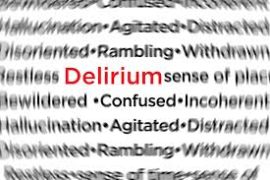

Slide 13
Delirium ( الهذيان )
Definition: Acute transient reversible global cognitive impairment with impaired consciousness due to a medical problem.
Many terms are used to describe delirium:
Acute confusional state
Acute organic syndrome
Acute brain failure.
Acute brain syndrome.
Acute cerebral insufficiency.
Exogenous psychosis.
Metabolic encephalopathy.
ICU psychosis
Toxic encephalopathy.

Slide 14
Epidemiology:
It may occur at any age but more in elderly and children.
Community Prevalence: General: 1-2% > 85yr: ~ 14%.
10-30% Medically Ill Hospitalized patients.
~ 10 to >50% Post-Operative Patients.
> 90% Post-cardiotomy Patients.
~ 70-85% ICU.
60% in nursing homes or post-acute care settings.
~ 80% at end of life.
Underdiagnosed when patient is hypoactive and somnolent. Such cases may be misdiagnosed as depression.
DSM V; Kaplan & Sadock (2014; 2009)

Slide 15
Delirium complicates at least 25% of all hospitalizations in the elderly
Fong et al 2009

Slide 16
Clinical features
Acute onset of mental status change with fluctuating course.
Attentional deficits.
Confusion or disorganized thinking.
Perceptual disturbances.
Disturbed sleep/wake cycle. (Sundowning phenomena)
Altered psychomotor activity.
Disorientation and memory impairment.
Behavioral and emotional abnormalities.
Other cognitive deficits

Slide 17
The Diagnostic and Statistical Manual of Mental Disorders, Fifth Edition (DSM-5)diagnostic criteria for delirium is as follows:
A) Disturbance in:
Attention (I.E., Reduced ability to direct, focus, sustain, and shift attention)
Awareness (reduce orientation to the environment).
B) The disturbance
Develops over a short period (usually hours to days)
Represent a change in the baseline attention and awareness.
Tends to fluctuate in severity during the course of a day.
C) An additional disturbance in cognition:
Memory deficit, disorientation, language, perceptual disturbance

Slide 18
D) Disturbance in criteria A and C:
Not due to another preexisting, established, or evolving dementia.
Do not occur in the context of a severely reduced level of arousal, (e.g. coma)
E) There is evidence from the history, physical examination, or laboratory findings that the disturbance is caused by a direct physiologic consequence of:
General medical condition
An intoxicating substance
Medication use
More than one cause

Slide 19
Diagnostic criteria (Simplified)
A) Consciousness is disturbed (i.e., awareness of the environment is impaired but patient not in coma).
B) Cognitive functions are impaired +/- perceptual disturbance (illusions or hallucinations)
C) Acute onset with fluctuating symptoms (within hours during the day) & transient course (few days).
D) Caused by a physical problem (e.g. hypoxia, hypoglycemia, infection..etc.)
M. A. Al-Sughayir-Manual of basic Psychiatry September-2014/Neuro-cognitive D

Slide 20
Type of delirium (DSM-5 specifiers)
1) Hyperactive 30% (most clear and least controversial)
Hyperactive psychomotor activity.
May have mood lability, agitation, refusal to cooperate with medical care.
2) Hypoactive 24% (most difficult type to identify)
Hypoactive psychomotor activity.
May be have sluggishness or lethargy that approaches stupor.
Inappropriately diagnosed and treated as depression.
3) Mixed level of activity 46% (Classic wax and waning pattern)
Normal psychomotor activity with disturbed attention and awareness.
May have rapidly fluctuating activity level.
DSM V (2013); Maldonado (2008)

Slide 21
Why it is important to discover delirium?
It is a very serious medical and psychiatric condition and that due to high risk of:
1) Death (due to associated serious medical condition)
2) Violence toward medical staff.
3) Self-harm or suicidal risk.
4) Impaired judgment.
5) Psychosis

Slide 22
↑ morbidity and mortality
↑ length of hospital stay
↑ Rates of admission to long term care facilities
20% of patients discharged post hip # still had evidence of delirium.
(Journal of American Geriatric Society 2001 May;49(5):678-9).

Slide 23
Why dose a delirious patient become suicidal or aggressive?
Due to severe disturbance in the patient’s perception, mood, judgment, thinking, and behavior.
Patient may act on hallucinations, illusions or delusional thoughts as if they were genuine dangers (e.g., blood extraction by a nurse might be perceived as an attack).
Clinical presentation are differs from patient to patient.
Some patient may be excessively somnolent.
Other may fluctuate from one state to the other, usually restless at night and sleepy during the day with lucid intervals.

Slide 24
Delirium Risk factors/Predisposing Factors:
> 60 years of age
Male sex
Visual/hearing impairment
Underlying brain pathology such as stroke, tumor, vasculitis, trauma, or dementia
Major medical illness
Recent major surgery
Depression
Functional dependence
Dehydration
Substance abuse/dependence
Hip fx
Metabolic abnormalities
Polypharmacy

Slide 25
Maldonado (2008)
Demographics General Medical Hx | Psychiatric Hx | Current Medical Problem | Medications | Current Status
Male Age >75 Functional Impairment Immobility Low levels of activity Sensory Impairment Fall Hx | Hx of Delirium Dementia Depression Bipolar Schizophrenia Drug/ETOH/ Toxins | Severe Illness Multiple Illnesses Abn. Blood Work Metabolic D/O CNS pathology Trauma Burns Post-Op Poor O2 States | >3 drugs Psychoactive Meds Anticholinergic Meds 5HT Meds Examples: Opioids* Corticosteroids* Benzodiazepines* NSAIDS Chemo Meds | Dehydration Malnutrition Sleep Deprivation Over Sedation Pain Abnormal VS Catheters IV Restraints

Slide 26
Etiology (Delirium Precipitating Factors): I watch death
I: Infections.
W: Withdrawal.
A: Acute metabolic.
T: Trauma.
C: CNS pathology.
H: Hypoxia.
D: Deficiencies.
E: Endocrinopathies.
A: Acute vascular.
T: Toxins.
H: Heavy metal.

Slide 27
Infections (encephalitis, meningitis, HIV, syphilis, sepsis, typhus, malaria)
Withdrawal from substance of the abuse (alcohol, sedative-hypnotic, barbiturates)
Acute metabolic (acidosis, alkalosis, liver/kidney failure)
Trauma (closed head trauma, heatstroke, recent surgery, severe burns)
CNS pathology (abscess, tumor, seizures, hydrocephalus)
Hypoxia (anemia, hypoperfusion due to heart/lung failure, co poisoning )
Deficiencies of vitamins (B12, folate, thiamine, niacin)
Endocrinopathies (Hyper/Hypoglycemia, Hypo/Hyperadrenocorticism, Hyperparathyroidism)
Acute vascular (hypertension, stroke, TIA, arrhythmia)
Toxins (medications, illicit drugs, pesticides, solvents)
Heavy metal (lead, manganese, mercury)

Slide 28
Life threatening causes of delirium
Wernicke’s encephalopathy.
Alcohol/Benzodiazepine withdrawal
Hypoxia.
Hypoglycemia.
Hypertensive encephalopathy.
Intra-cerebral hemorrhage.
Meningitis/encephalitis.
Poisoning

Slide 30
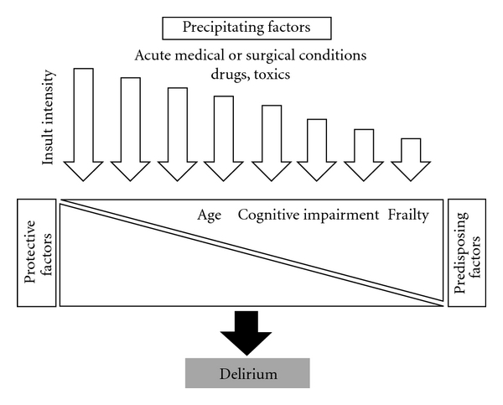

Slide 31
Delirium Management/Interventions:
Treatment of the underlying medical cause and ensure patient / staff safety

Slide 32
Delirium Management
Treat delirium symptomatology
Non-Pharmacological interventions
Treat underlying medical cases
Investigations
Pharmacological interventions
Medical management
Rule out other possible Differential diagnoses

Slide 33
Delirium differential diagnoses
1) Dementia:
Occasionally, delirium occurs in a patient with dementia, a condition known as beclouded dementia. However, a dual diagnoses (i.e., delirium in top of dementia) can only made when there is a definite history of pre-existing dementia.
2) Substance abuse: alcohol, inhalants, sedatives, and opioids
3) Amnestic syndrome (see later)

Slide 34
4) Acute functional psychosis (brief psychosis, mania, exacerbation of schizophrenia):
Patients usually experience no change in their level of consciousness or in their orientation. The hallucination and delusions are more constant and better organized than those of patients with delirium.
5) Severe depression: patients with hypoactive symptoms of delirium may appear somewhat similar to severely depressed patients, but can be distinguished on the basis of EEG (normal in depression)
When delirious patients treated with TCA, cognitive functions deteriorate further because of the anticholinergic effects of TCA.

Slide 35
Feature | Dementia | Delirium
onset | Slow/gradual (except for vascular dementia | Rapid
Duration to develop | months to years | hours to weeks
Attention | Preserved | Fluctuates
Awareness | Unchanged | Reduced
Consciousness | intact | impaired
Course | Chronic/deteriorating | transient/clears within 7-10 days

Slide 36
1) Investigations:
There is no specific diagnostic investigation for delirium.
A) Good clinical skills are essential:
1) Careful History and physical examinations:
Acute onset + review medical conditions/diseases + cognitive & consciousness disturbances.
2) Collateral history:
Baseline cognition
Presence of sensory impairments
Exposure to risk factors
Review medications, procedures, tests,…etc.

Slide 37
B) MSE: proper assessment of mental functions
Mini-Mental state exam
Tests orientation, short-term memory, attention, concentration, constructional ability.
30 points is perfect score.
< 20 points suggestive of problem
Hot helpful without knowing patient’s baseline

Slide 38
First line investigations:
Complete blood count (CBC) and differentials WBCs
Electrolytes, Mg, ca, and po4 tests.
Liver function tests.
Renal function tests
Urinalysis + cultures & sensitivity
Blood cultures & sensitivity
Thyroid function test
Electrocardiogram (ECG)
Blood glucose.
Chest x-rays
Second line investigations:
Drug screen.
Cardiac enzymes
Blood gas (ABG)
Serum folate / B12
Electroencephalography (EEG)
Cerebrospinal fluid examinations.
Brain CT scan
Brain MRI

Slide 39
Treatment of delirium symptomatology
1) Non-Pharmacological interventions
Symptomatic measures involving attention to fluid and electrolyte balance, nutritional status, and early treatment of infections.
Environmental interventions:
Reduce unfamiliarity by providing a calendar, a clock, family pictures, and personal objects.
Maintain a moderate sensory balance in the patient by avoiding sensory overstimulation or deprivation.
Minimize staff changes, limit ambient noise and the number of visits from strangers, and provide a radio or a television set, a nightlight, and where necessary, eyeglasses and hearing aids.
Proper communication and support are critical with these patients

Slide 40
Treatment of delirium symptomatology
2) Pharmacological interventions
All the patient’s medications should be reviewed, and any unnecessary drugs should be discontinued.
These patients should receive the lowest possible dose and should not get drugs such as phenobarbital or benzodiazepine.
Their effects may increase disorientation, drowsiness, ataxia, and possible falls, head trauma and fractures
For agitation or aggressive behaviour: haloperidol 1mg oral, IV, IM) or olanzapine (5 mg oral or IM).
Intramuscular administration may be preferable for some patients with delirium who are poorly compliant with oral medications or who are too sedated

Slide 41
Delirium course and Prognosis:
The course usually short (7-10 days)
Symptoms of delirium usually persist as long as the causally relevant factors are present.
The longer the patient has been delirious and the older the patient,
The longer the delirium takes to resolve.
Delirium may spontaneously resolved or progress rapidly into death because of the serious nature of the associated medical conditions.
When treated, it usually resolves rapidly.
Some residual deficit may persist.
Some patients may develop depression symptoms or Post Traumatic Stress Disorder (PTSD)

Slide 42
Major Neurocognitive Disorders

Slide 43
Aging is a normal part of development.
Unlike childhood development, there are no specific motor, speech or cognitive milestone for adults to meet as they enter old age.
Instead, aging is often accompanied by accumulating losses in functioning that gradually increase the risk of mortality.
Many of these changes (including some degree of memory loss) are considered to be completely within the realm of normalcy.
However, there are also a variety of conditions associated with old age that cause distress and dysfunction not only for the patient themselves but also for their family and caregivers.

Slide 44
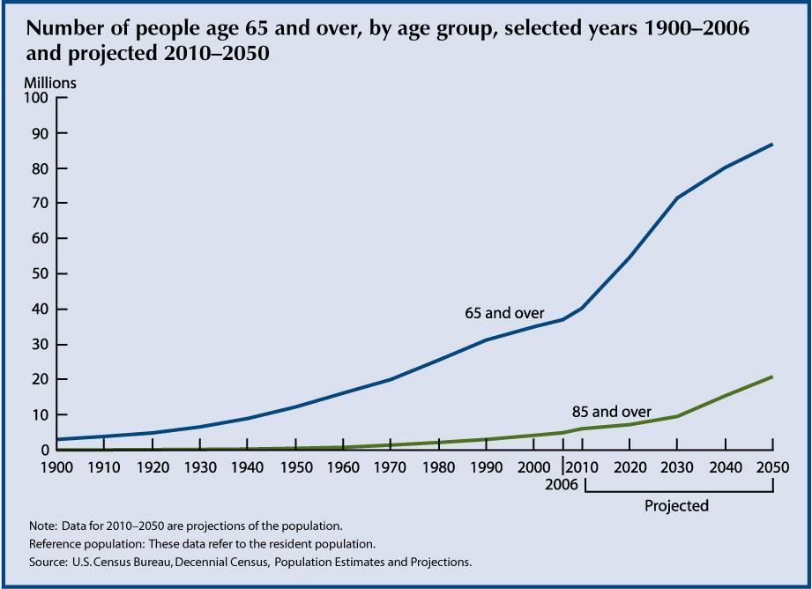
People > 65 make up one of the fastest growing segment of population

Slide 45
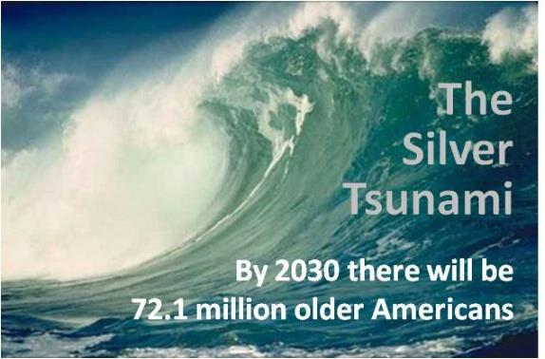

Slide 46
Case number 2

Slide 47
73 years old lady, she was diagnosed for many years to have DM, HTN, Hypercholesterolemia, and Osteoporosis.
Her family noticed in the last year that she start to be more isolated and not socially engaged. She started to be more forgetful and repeating the same questions over and over. More recently she started to misplaces things like her keys and her personal items. Also, there were few occasions where she left refrigerator open.
More recently patient’s family discovered that patient is either not taking her oral medications or taking her medications wrongly. In addition, she started to be more irritable and sometimes aggressive towards her family. She has poor insight about her current situation.
Throughout patient’s history, There is no history of loss of consciousness. And there is no motor abnormality. There is no history of abnormal perception or unusual thinking; however, more recently patient started to be more suspicious.

Slide 48
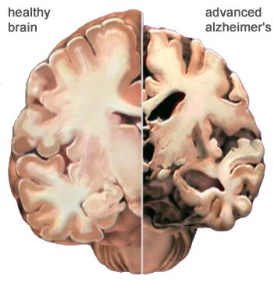
Dementia

Slide 49
Dementia
Dementia refers to a disease process marked by:
Progressive cognitive impairment in clear consciousness.
Does not refer to low intellectual functioning or mental retardation because these are developmental conditions.
Cognitive deficits represent a decline from a previous level of functioning.
Involves multiple neurocognitive domains.
Cognitive deficits cause significant impairment in social or occupational functioning or both.

Slide 51
The Dementia Syndrome
A) Global deterioration of intellectual function (learning & memory, complex attention, language, executive function, perceptual-motor abilities, social cognition).
B) Clear consciousness (rule out delirium).
C) Impairment in performance of personal activities of daily living and social or occupational activities due to the decline in intellectual function.
D) Noncognitive psychopathological symptoms and/or deterioration in emotional control, motivation, or personality frequently present but not necessary for diagnosis.
E) Duration of at least 6 months.
Lobo a: manual de psiquiatria general. Madrid, editorial panamericna s.a., 2013

Slide 52
Epidemiology
No gender difference.
Increasing age is the most important risk factor. It is primarily a disorder of the elderly.
The prevalence of of moderate to severe dementia in the general population is 5 % > 65 years.
20-40 % in > 85 years.
15-20 % In outpatient general medical practice.
50 % in chronic care facilities.
Affective symptoms, including depression and anxiety are seen in 40 to 50 % of demented patients.
Delusion and hallucination occur in 30 %

Slide 53
Dementia Presentation:
In early stage cognitive impairment may not be apparent:
Gradual loss of social and intellectual skills ( first noticed in work setting where high performance is required)
Mild memory impairment.
Subtle changes in personality.
Changes in affect (irritability, anger,…)
Multiple somatic complaints and vague psychiatric symptoms .

Slide 54
Dementia Presentation:
In the late stages cognitive disturbances emerge:
Increasing memory impairment (esp. recent memory)
Attention impairment.
Disorientation: particularly to time, and when severe to place and person.
Language: vague and imprecise speech with inappropriate repetition of the same thoughts (perseveration).
Impaired judgment.
Potential aggression (verbal & physical).
Psychotic features: hallucination &delusions.
Emotional lability.
Catastrophic reaction: marked by agitation secondary to subjective awareness of intellectual deficits under stressful circumstances.

Slide 55
Causes of dementia:
1) Alzheimer’s disease (AD) (50-60 %)
Gradual onset and a continuous slow but steady decline in prior intellectual and functional capacities, especially memory.
Age of onset: before age 65 (5%), after age 65 (95%).
Live an average of 10 years following diagnosis.
Risk factors:
Old age, female, low education, first-degree relative with AD, cigarette smoking, depression, mild cognitive impairment, and social isolation.

Slide 56
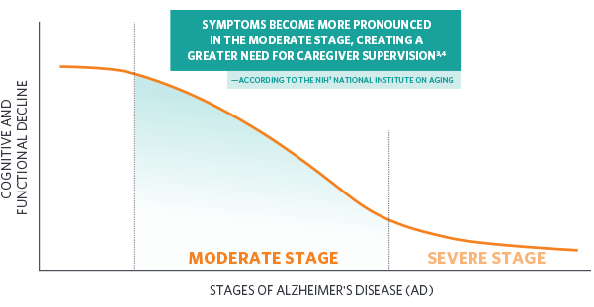

Slide 57
Causes of dementia:
2) Vascular (multi-Infarct) dementia (10-20 % of dementias):
Declining Stepwise deterioration of intellectual functioning due to multiple infarcts of varying sizes or arteriosclerosis in the main intracranial vessels.
Risk factors for vascular dementia:
Age > 60
Male
Pervious stroke
Stroke risk factors:
HTN, heart disease/atrial fibrillation, DM, Smoking, obesity, and hypercholesterolemia

Slide 58
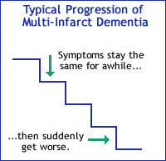

Slide 59
3) Medical conditions (reversible conditions; 15 % of dementias):
A variety of non-psychiatric, non-neurologic conditions can cause cognitive symptoms which can strongly resemble dementia.
Referred as reversible dementias, as treating the underlying condition can effectively restore cognitive function back to its pervious state.
Common causes of reversible dementia:
Drugs (Benzodiazepines, anticonvulsants, anticholinergics…) , alcohol/substance abuse.
Sensory impairments (Vision, hearing loss)
Metabolic abnormalities (Poorly treated DM)
Endocrinological problems (Hypothyroidism)
Nutritional deficiency (Vitamin B12 deficiency)
Infections (HIV, neurosyphilis)

Slide 60
4) Lewy Body dementia: characterized by fluctuating in cognition, vivd visual hallucinations, parkinsonian features ( tremor, rigidity, gait problems/falls)
5) Frontotemporal dementia: degeneration of the frontal and temporal lobe and characterized by inappropriate behavior ( hypersexuality), personality changes, and loss of impulse control.
6) Other type of dementia:
Parkinson’s disease: 20-30 % of patients with Parkinson’s disease have dementia.
Normal-pressure hydrocephalus: progressive memory impairment, slowness and marked unsteady gait (+ urine incontinence in the late stage)
Huntington’s disease: intellectual impairments with extra pyramidal features.
Creutz-feldt-jakob’s disease.
Traumatic Brain Injury (TBI).
Prion disease.

Slide 61
Dementias are classified as:
Cortical:
Alzheimer’s disease
Frontotemporal dementia.
Dementia with Lewy Body.
Subcortical:
Huntington’s disease.
Parkinson’s disease.
Normal-pressure hydrocephalus.
Subcortical dementias are associated with psychomotor retardation, movement disorders, gait incoordination, apathy, and akinetic mutism.

Slide 62
Dementia workup:
1) Comprehensive history and physical examination.
2) Investigations:
Essential workup to detect treatable causes:
Blood work:
CBC with differential, blood glucose, electrolytes, Ca, Mg, vitamin B12, folate, liver and renal function tests.
Other tests: serum HIV.
Neuropsychological testing (MoCA)
Neuroimaging:
CT scan and MRI

Slide 63
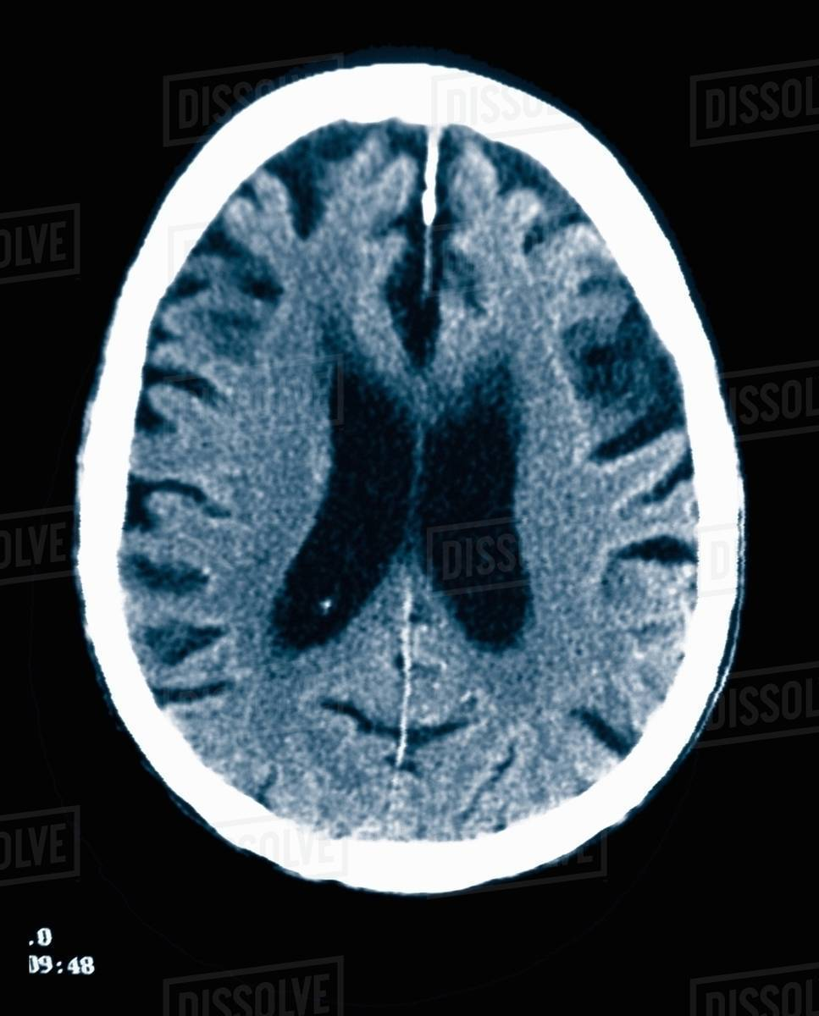
Neuroimaging
Alzheimer’s dementia:
Cortical atrophy
Wide sulci & gyri
Wide ventricles

Slide 64
Neuroimaging
Vascular dementia:
Lesions and atrophy of cortical and/or subcortical structures corresponding to infarcts.

Slide 65
Dementias Differential Diagnoses:
1) Normal aging:
Age-related cognitive decline (the course is not progressively deteriorating), no loss of social or occupational functioning.
2) Depression in the elderly (Pseudo-dementia):
Cognitive disturbance is relatively of rapid onset and preceded by depressive features. The differentiation is sometimes difficult as demented patients may also become depressed as they begin to comprehend their progressive cognitive impairment. EEG and CT scan are normal in pseudo-dementia.
3) Delirium:
The onset is rapid and consciousness is impaired. Some demented patients may develop delirium. Diagnosis of dementia cannot be made before delirium clears

Slide 67
Dementias Treatment/Management:
1) Supportive measures:
A) Ensure patient safety
B) Provide good meals & hygiene.
C) Encourage family’s involvement.
D) Support
Keep in familiar settings if possible to avoid accidents and possible agitation

Slide 68
Dementias Treatment/Management:
2) Specific measures:
A) Identify and correct any treatable or controllable condition
Hypothyroidism, Vitamin B12 deficiency, hypertension, diabetes.
B) Symptomatic treatment:
I) Agitation/aggression: small dose of antipsychotics (e.g. olanzapine 5mg, risperidone 2mg, or quetiapine 25mg).
II) Insomnia: small dose of antipsychotics (e.g. olanzapine 5mg) or benzodiazepine (e.g. lorazepam 1 mg )
III) Depression: give a small dose of antidepressant (e.g. escitalopram 5 mg or sertraline 25mg)
Be aware of possible side effects (over-sedation, fall risk “head trauma/fractures”, central anticholinergic activity that may cause delirium)

Slide 69
Dementias Treatment/Management:
C) Cognitive-enhancing medications (mainly for Alzheimer’s dementia):
1) Cholinesterase inhibitors:
I) Donepezil (Aricept):
5 mg at night & can be increased gradually to 10 mg. It is well tolerated (S/E: diarrhea , weight loss ,bradycardia ,and syncope).
II) Rivastigmine ( Exelon ):
1.5 mg twice/day & can be increased gradually to maximum 6mg twice/day (S/E: anorexia , fatigue , somnolence, and dizziness )
III) Galantamine ( Reminyl):
4mg twice/day & can be increased gradually to 12mg twice/day (S/E: similar to rivastigmine )

Slide 70
Dementias Treatment/Management:
2) NMDA receptor antagonist:
Memantine (Epixa, Akatinol):
an N-methyl-D-aspartate (NMDA) receptor antagonist , protects neurons from neurodegenerative process induced by glutamate excitotoxicity.
Memantine has been shown to have a modest effect in moderate to severe Alzheimer’s disease and in dementia with Lewy body. In general, well tolerated.
Adverse drug reactions include confusion, dizziness, drowsiness, headache, insomnia, agitation, and/or hallucination. Less common adverse effects include vomiting, anxiety, hypertonia, cystitis, and increased libido.

Slide 71
Course and prognosis:
The course and prognosis depend on the cause
Alzheimer’s dementia
Shows a progressive slow deterioration.
The patient may become incontinent of urine and/or stool.
Vascular dementia
Shows stepwise deterioration
Stationary course after a massive stroke that is then followed by a good control of the risk factors e.g., HTN, DM…..etc

Slide 72
Case number 3

Slide 73
A 48 years old male. Has long standing history of:
Hypertension.
DM type 2.
Hypercholesterolemia
Presented with significant cognitive and behavioural problems.
He had difficulty with learning new information and making appropriate plans.
Personal/social history: smoke tobacco and consume alcohol in almost daily basis for many years.

Slide 74
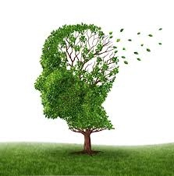
Amnestic syndrome

Slide 75
Definition:
Impairment in short term memory (retention of new information; temporal lobe function) due to a specific organic cause, in the absence of generalized intellectual impairment.
Impairment in the ability to create new memories
It leads to social and occupational dysfunctioning.
The patient may show confabulation (filling memory gaps with incorrectly retrieved information.
The insight is partially impaired.
In contrast to delirium, the immediate memory is usually intact. (i.e. digit span test “frontal lobe function” is normal.
In contrast to dementia, the remote memory is intact.

Slide 76
Etiology (major causes of amnestic disorders):
Head injury lesions
( hippocampus, posterior hypothalamus and nearby midline structures)
Thiamine (B1) Deficiency
(associated with alcohol abuse, poor nutrition (e.g., starvation), gastric carcinoma, persistent vomiting, hemodialysis.
Thiamine is essential for the enzyme transketolase, which essential for glucose metabolism.

Slide 78
Wernicke-Korsakoff’s syndrome
Wernicke Encephalopathy
Acute Syndrome
Then Progresses to
Korsakoff’s syndrome /psychosis
Chronic syndrome
Is an amnestic syndrome caused by thiamine deficiency, most commonly associated with poor nutritional habits of people with chronic alcohol use.

Slide 79
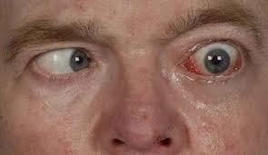
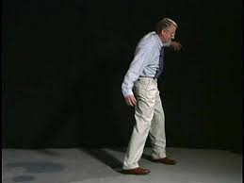
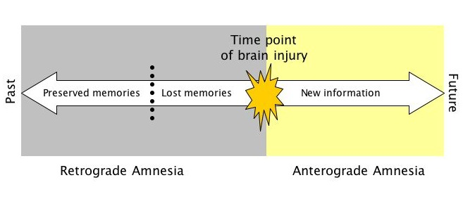
Wernicke encephalopathy
Acute syndrome
Impaired consciousness (confusion)
Ophthalmoplegia.
Ataxia
Memory impairment
Korsakoff’s syndrome
Chronic syndrome
Peripheral neuropathy.
Irritability and personality changes.
Apathy
Profound anterograde amnesia and inability to form a new memories. Confabulate or make up information when asked questions.

Slide 80
Treatment:
Identify and reverse the cause if possible.
Thiamine supply (if due to thiamine deficiency)
Supportive medical measures; fluids & nutrition.
Prognosis:
If it is due to thiamine deficiency and thiamine is provided promptly.
Prognosis is good
Otherwise, the course is usually chronic and may be progressive.

Slide 81
Case number 4

Slide 82
Hamad is a 19-year-old male was involved in a road traffic accident. He lost his consciousness for 5 days, and remained 3 weeks in the hospital.
After discharge, his parents noticed that he become
Impulsive
Disinhibited
And sometimes aggressive
More recently they noticed that he started to be more depressed and sometimes feeling so anxious

Slide 83
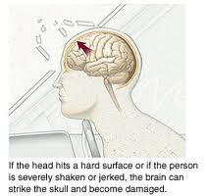
Traumatic Brain Injury (TBI)

Slide 84
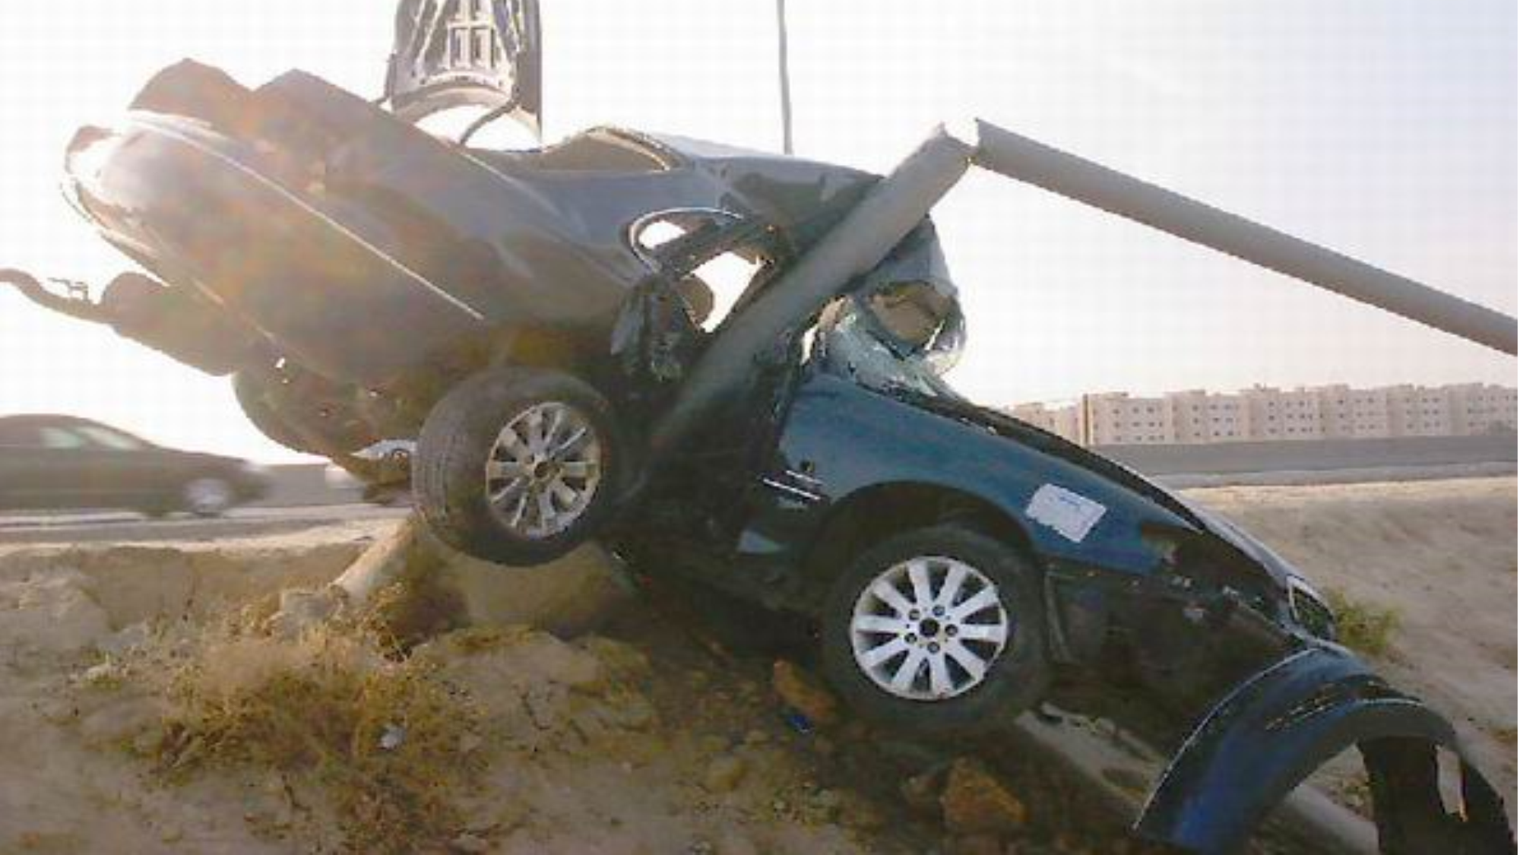

Slide 85
Definition:
An insult to the brain from an external mechanical force, possibly leading to permanent or temporary impairment of cognitive, physical, and psychosocial functions, with an associated diminished or altered state of consciousness.
Area of function affected:
1- Cognitive
2- Sensory/perceptual
3- Seizures
4- Other physical changes
5- Social-emotional

Slide 86
Acute consequences:
Impaired consciousness in varying duration (hours, days, weeks or months) long duration suggests poor prognosis.
Delirium (after severe head trauma).
Memory defects : on recovery of consciousness, defects of memory are usually present.
Anterograde (post-traumatic) amnesia:
Amnesia for events in the time between the trauma and the resumption of normal continuous memory. It is a good prognostic factor: probably full recovery when anterograde amnesia was less than 12 hours.
Retrograde amnesia:
Amnesia for events in the time between the trauma and the last clearly recalled memory before the injury. It is not a good predictor of outcome.

Slide 87
Chronic Consequences:
Lasting cognitive impairment:
There is more likelihood of cognitive impairment when the injury has caused a prolonged post traumatic amnesia (of more than 24 hours).Cognitive impairment was particularly associated with parietal and temporal damage, especially on the left side. Recovery of function may be very slow and may continue over the years.
Emotional disturbances:
Depressive, anxiety and phobic features are common, and associated with somatic complaints such as headache, fatigue and, dizziness.
Personality changes:
There may be irritability, reduced control of aggressive impulses, sexual disinhibition and some coarsening of behaviour and premorbid personality traits, particularly after frontal lobe injury.

Slide 88
Psychotic features:
Psychotic features related to depression (non-dominant frontal damage). Paranoid psychosis (temporal lobe damage)
Social consequences:
Many patients and their relatives experience severe distress of head injury, and have to make substantial changes in their way of life.
Medico-legal aspects:
Compensation issue is more likely to contribute to disability if patient feels someone else is at fault, financial compensation is possible, low social status and in industrial injury.

Slide 89
Factors affecting the outcome of head trauma:
1) Duration of loss of consciousness.
2) Duration of anterograde (Post-traumatic) amnesia.
3) Amount and location of brain damage.
4) Premorbid personality and past psychiatric history.
5) Development of seizures.
6) Medico-legal factors e.g. compensation.

Slide 90
Treatment:
A plan for long-term treatment should be made as early as possible after head trauma.
The treatment of the cognitive and behavioral disorders is similar to the treatment approaches used in other patients.
However, head trauma patients may be particularly susceptible to the side effects associated with antipsychotics.
Drugs should be initiated in lower dosages than usual.
Should be titrated upward more slowly than usual.

Slide 91
Treatment:
Aggression and impulsivity can be treated with antipsychotics or anticonvulsants.
Treatment should include physical and psychological rehabilitation.
Continuing psychosocial help should be provided to patients and caregiver by a special team

Slide 92
Thank you

