Slide 1

Approach to patient with Back pain
Supervised by: Dr. Amr Jamal
Notes:
Image source: Google
http://www.genusit.com

Slide 2
Rayan AL-Qarni
Ibrahim Fetyani
Fouad Bahgat
Abdullah Abuamarah
Abdulmajeed Alammar

Slide 3
Objectives
Diagnosis including history, Red Flags, and Examination
Brief comment on Mechanical, Inflammatory, Root nerve compression, and Malignancy.
Common causes
Role of primary health care in management
When to refer to a specialist
Prevention and Education

Slide 4
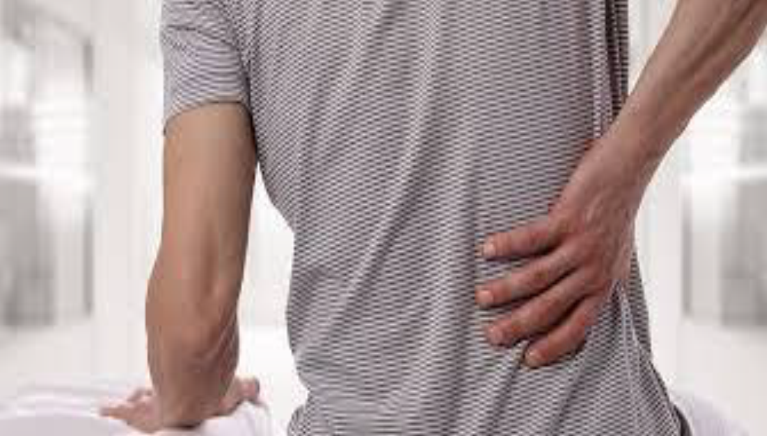
Back pain
53.2%
79.2%
In Saudi Arabia Seven studies were cross-sectional and found a prevalence and pattern ranging from 53.2% to 79.17%.

Slide 5

MCQ’s

Slide 6
MCQ
1- Which of the following is the most common cause of Lower Back Pain ?
a. Metastatic bone disease
b. Inflammatory back pain
c. Lumbosacral sprain or strain
d. Herniation

Slide 7
MCQ
2- Which of the following is considered as Red flag in Lower Back Pain?
a. History of dysmenorrhea
b. Steroid use
c. Night pain
d. Age more than 40

Slide 8
MCQ
3- Which of the following is a feature of inflammatory process?
a. Usually acute in progression
b. Worse while exercise
c. 60 minutes of morning stiffness
d. Age more than 50

Slide 9
MCQ
4- Patient came to FM clinic complaining of intermittet LBP for 2 years that radiates to thigh and legs, it gets worse with prolonged standing and relived by forward flexion. No motor deficits or any other worrisome symptoms.
How would you manage this patient ?
a. Increase physical activity time
b. Bed rest
c. Analgesia (NSAIDS)
d. Refer to neurology

Slide 10
MCQ
5- Positive Adams Forward bending test indicates …………. ?
a.Lordosis
b. Kyphosis
c. Compression fracture
d. Scoliosis

Slide 11
How to approach LBP ?
History taking ?

Slide 12
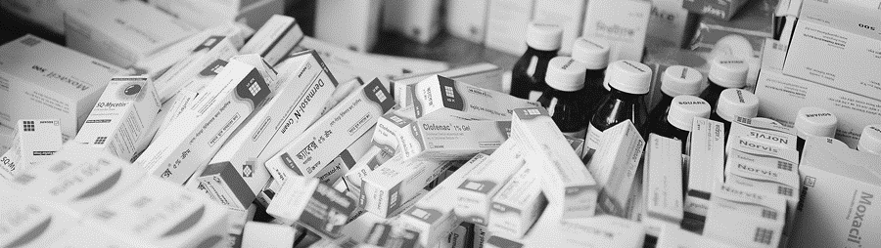
Main types of back pain
Mechanical Causes
Systemic Causes
Referred Back Pain
1. Fracture
2. Lumbar Strain/sprain
3. Herniated disc
4. Spinal stenosis
5. Spondylolysis
6. Spondylosis
7. Spondylolisthesis
8. Discs and/or facets degeneration
Malignancy
Infection
Inflammation
- Primary tumors
- Secondary tumors: Metastatic
- Osteomyelitis
- TB (Pott’s Spine)
- Brucellosis
-Spondylitis
Ruptured Abdominal Aortic Aneurysm
Prostatitis
Endometriosis
Stones
Pyelonephritis
Pancreatitis
1 2 3 4 5 6 7 12 9 10
Notes:
Image source: Google
https://www.dhakatribune.com

Slide 13
HISTORY TAKING OF BACK PAIN
1-Personal History ( Name - Age - Occupation )
2-Chief complaints
3-History of presenting illness (SOCRATES)
4-Constitutional symptoms & red flags
5-PMHx
6-PSHx, trauma history and blood transfusion
7-Medications history and allergy
8-Family history
9-Social history
10-Systemic review

Slide 14
HISTORY OF PRESENTING ILLNESS
Site?
Associated?
Onset?
Timing?
Character?
Exacerbating?
Radiation?
Severity?

Slide 15
PAST HISTORY
-Past medical history (Including cancer and psychiatric issues)
-Past surgical History
-Past trauma
-History of blood transfusion

Slide 16
RED FLAGS & CONSTITUTIONAL SYMPTOMS
-Fever
-Weight loss
-nausea & vomiting
-Loss of appetite
-Night sweat
-Urinary retention or incontinence
-Fecal incontinence or urgency
-Impotence

Slide 17
FAMILY HISTORY
-Of similar condition
-Any inherited diseases that run in the family.
-History of Cancer
MEDICATIONS HISTORY
-INCLUDING ALLERGY OR STEROIDS
SOCIAL HISTORY
-Smoking
-Alcohol
-Illicit drug usage
-Recent Travel
-Contact with infected people
-Immunization history

Slide 18
Don’t forget ICE
IDEAS
Concerns
Expectations
How does it affect the patient functionally and mentally?

Slide 19
What is our next step?
Physical examination

Slide 20



inspection
Physical examination has 4 parts
palpation
Movements
Special tests
1 2 3 4 5 6 7 8 9 10
Notes:
Content source:
https://new.siemens.com

Slide 21
Inspection:
Expose the trunk and lower limbs properly.
Examine front and back.
Alignment, Deformity (Kyphosis, Scoliosis, Hyperlordosis…), Muscle wasting, skin changes, swelling, scars, Hairy tuft, “cafe au lait” spots.
Are shoulders and pelvis level symmetrical?
Gait:
Abnormal gait types: Antalgic, Trendelenburg, Waddling.
Heel and toe walking: For nerve roots.
Heel walk = Examining L4.
Toe walk = Examining S1.
Inspection
inspection

Slide 22
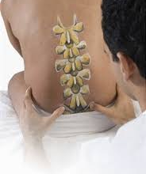
Palpate spinous processes for tenderness, steps or gaps. (Check for the spinous processes alignment if it is central).
Soft tissues: Temperature, tenderness
Palpation
Palpation

Slide 23
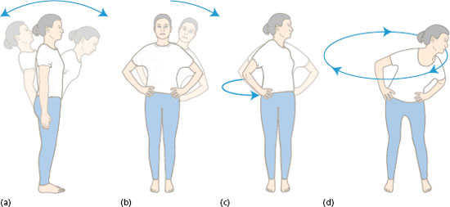
Start with Active ROM in all 6-directions:
Flexion: Record as such (able to touch toes/shins/knee/thighs…) (Make sure the leg is straight/ knee extended)
Extension: Normal around 30°.
Lateral bending: Normal around 30°.
Rotation: Normal around 40°. (When assessing rotation, it’s mandatory to put your hands on each side of the patient’s pelvis !!)
Note if Painful/Painless. Attempt passive ROM if Active is limited and painless, record.
Movement
Movments

Slide 24
Special tests
Adams forward bending test:
(The examiner stands behind the patient to assess)
Full forward flexion until back is horizontal to the floor. (with complete knee extension and hands in the air not touching the knee).
If thoracic Scoliosis is present, then rib hump will become visible
Straight raise leg test:
With the patient supine, passively elevate the leg, the examiner’s hand behind the heel-with knee extended while observing the patient’s face for any signs of discomfort.
A positive test is reproduction of sciatica (Sharp shooting pain radiating below knees- between 30° and 70° of hip flexion.
The pain is aggravated with ankle dorsiflexion and relieved with knee flexion

Slide 25
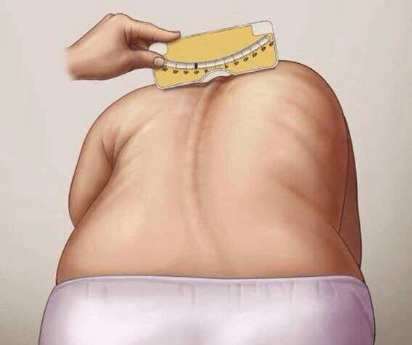
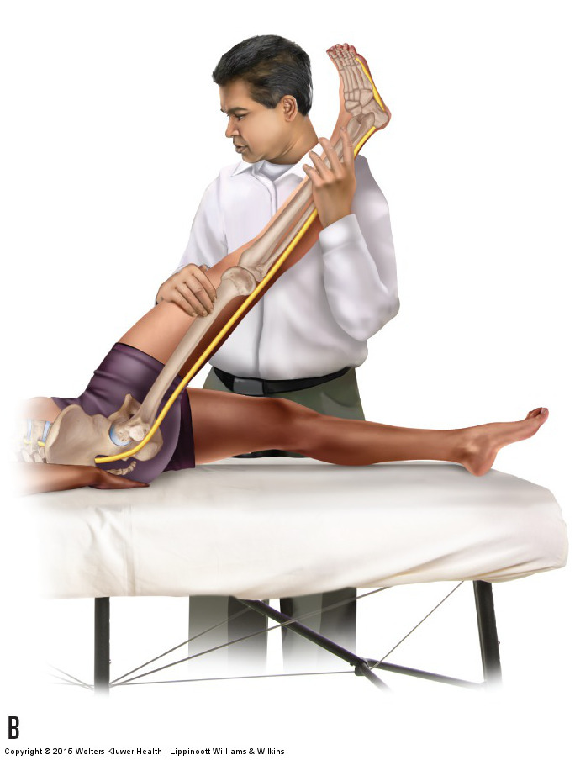
Special tests
Adams Forward bending Test
https://www.youtube.com/watch?v=JmvGHszR_X4
Straight leg raise test
https://www.youtube.com/watch?v=1EPii3Pz6V0

Slide 26
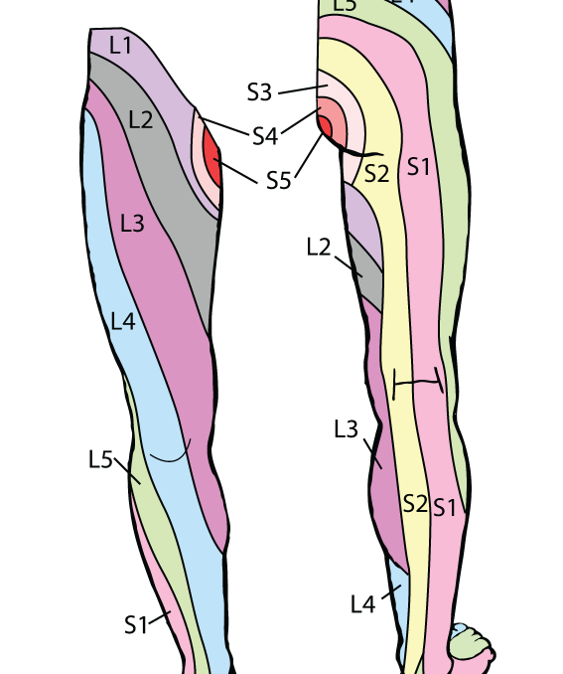
1.Motor:
Hip flexion=L2
Knee extension=L3
Ankle dorsiflexion=L4
EHL (great toe extension-Extensor Hallucis Longus)=L5
Ankle plantar flexion=S1
2.Sensory: Dermatomes.
3.Tone: Normal, Flaccid or rigid.
4.Reflexes: Knee & ankle jerks.
Neurological examination
Neurological examination

Slide 27
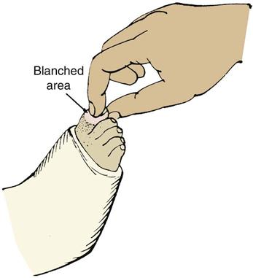
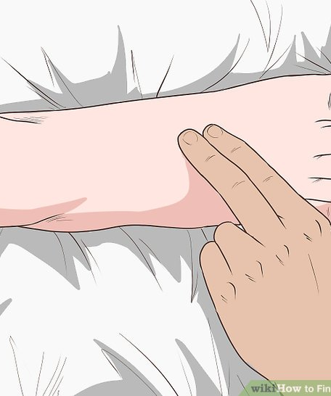
Pedal pulses: Dorsalis Pedis , posterior Tibial arteries
Capillary refill time: Normal < 2 seconds
Vascular examination
pulses

Slide 28
After completing History and Physical examination we move to our next step ……….
investigations

Slide 29
What are the available investigations
X-ray. These images show the alignment of your bones and whether you have arthritis or broken bones. These images alone won't show problems with your spinal cord, muscles, nerves or disks.
MRI or CT scans. These scans generate images that can reveal herniated disks or problems with bones, muscles, tissue, tendons, nerves, ligaments and blood vessels.
Blood tests. These can help determine whether you have an infection or other condition that might be causing your pain.
Bone scan. In rare cases, your doctor might use a bone scan to look for bone tumors or compression fractures caused by osteoporosis.
Nerve studies. Electromyography (EMG) measures the electrical impulses produced by the nerves and the responses of your muscles. This test can confirm nerve compression caused by herniated disks or narrowing of your spinal canal (spinal stenosis).

Slide 30
Laboratory investigations
FBC – suspected infection, malignancy, non-spinal cause of back pain.
ESR – suspected infection, malignancy, ankylosing spondylitis.
Bloods cultures – febrile and suspected infection.
Coagulation studies – neurosurgery anticipated.
Other pathology tests including UECs, LFTs, lipase, urinalysis etc. should be considered when suspecting a non-spinal cause of back pain.

Slide 31
Indications of different modalities
MRI:
Major risk factors for cancer
signs of cauda equina syndrome(Urinary retention, faecal incontinence, saddle anaesthesia.)
Risk factors for spinal infection
Severe neurological deficits
Progressive motor weakness, motor deficits at multiple neurological levels.
CT:
If an MRI is contra-indicated or unavailable and the above diagnoses are suspected a CT lumbar spine may be indicated after discussion with a neurosurgeon and radiologist.
Vertebral fracture suspected with significant trauma.
X-RAY
Vertebral fracture suspected in:
  Osteoporotic bone (elderly, corticosteroid use) with minimal or no trauma

Slide 32
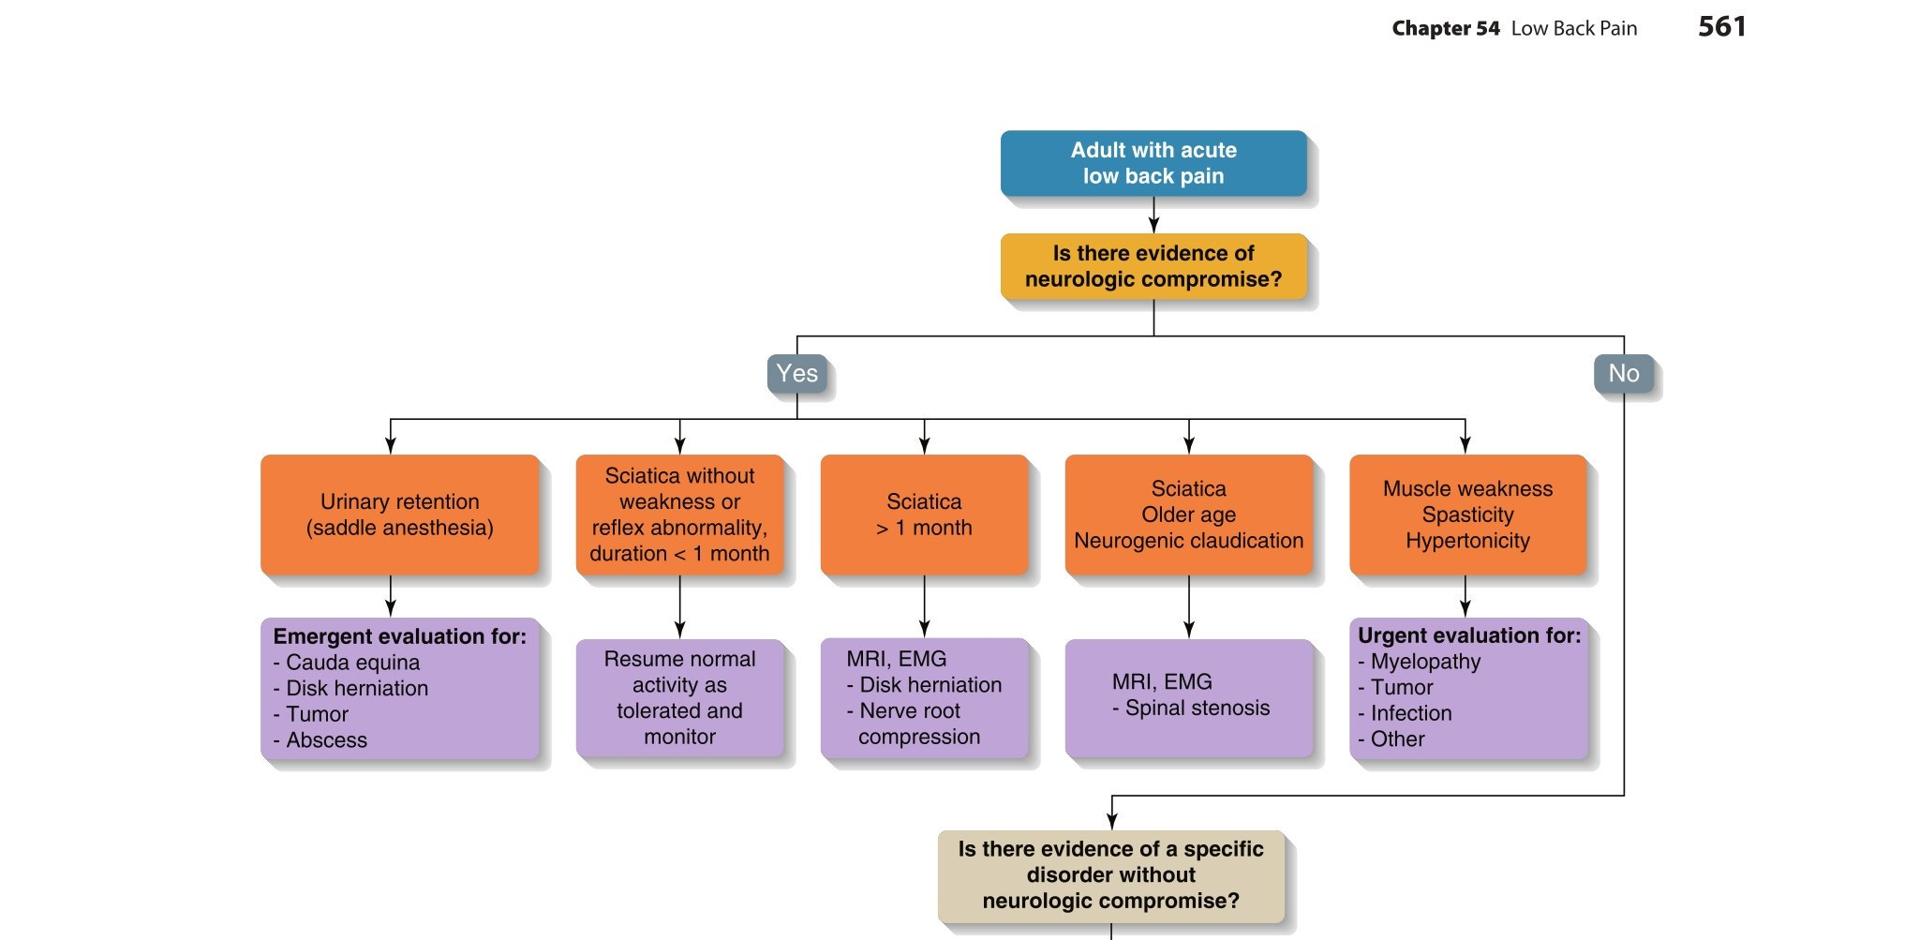

Slide 33
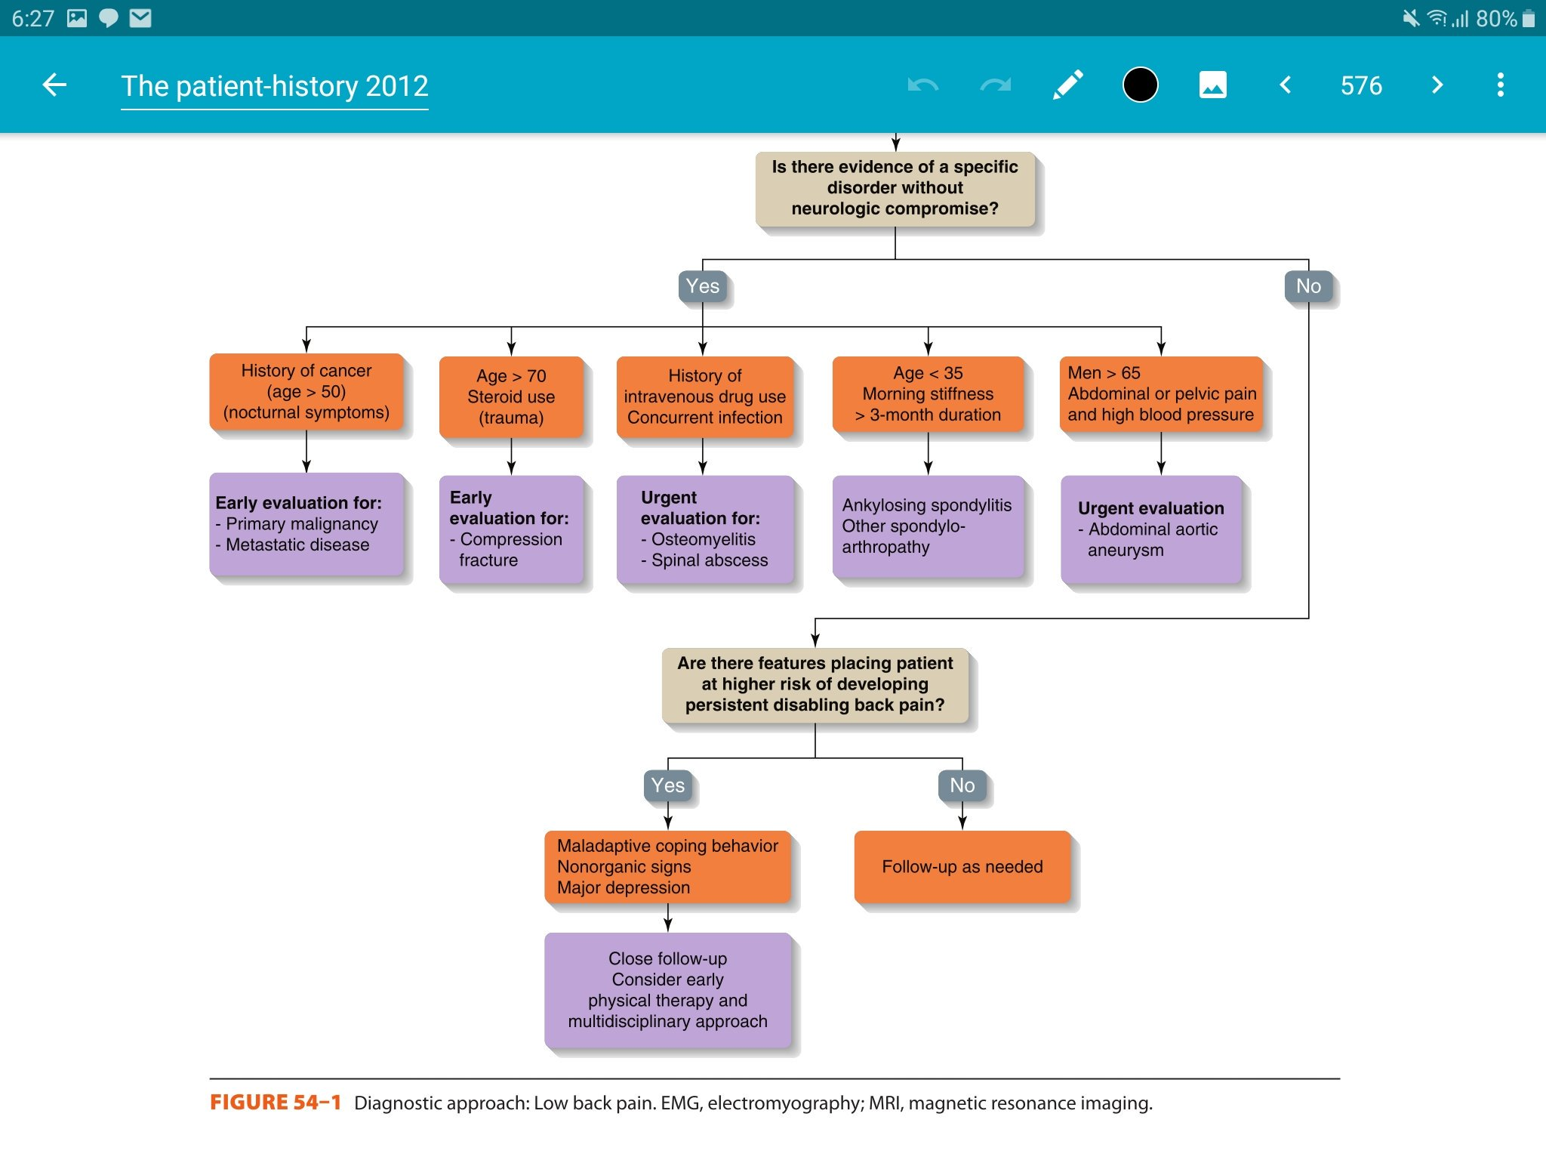

Slide 34
Cases
A 50-year-old man comes to the emergency department because of urinary incontinence for the past 5 hours. His past medical history is noncontributory. He says the onset was sudden and accompanied by worsening back pain. He now cannot feel anything as he wipes after voiding his bowel or bladder. He also feels "pins and needles,“ along both medial thighs. Which of the following is the most likely diagnosis?
A.cauda equina
B.conus medullaris
c.lumbar disc herniation
ANSWER:A
What is the best investigation to confirm the diagnosis?
A.CT
B.MRI
C.X-RAY
ANSWER:B

Slide 35


Role play

Slide 36
Mechanical.
Brief comment on:
inflammatory.
Malignancy
root nerve compression. .
1 2 3 4 5 6 7 8 9 10
Notes:
Content source:
https://new.siemens.com

Slide 37
Mechanical pain Sx
\
1- better or worse depending on position
2-worse during activity and movement
3-can be sudden or gradual
4-poor posture or lifting something heavy with bad posture
5-minor injury
1 2 3 37 5 6 7 8 9 10
Notes:
Content source:
https://new.siemens.com

Slide 38
Mechanical pain DDx
Spinal stenosis
Degenerative processes of disks and facets.
Herniated disc
Osteoporotic fracture
Traumatic fracture
Transitional vertebrae spondylosis
Congenital disease - severe scoliosis and kyphosis.
1 2 3 38 5 6 7 8 9 10
Notes:
Content source:
https://new.siemens.com

Slide 39
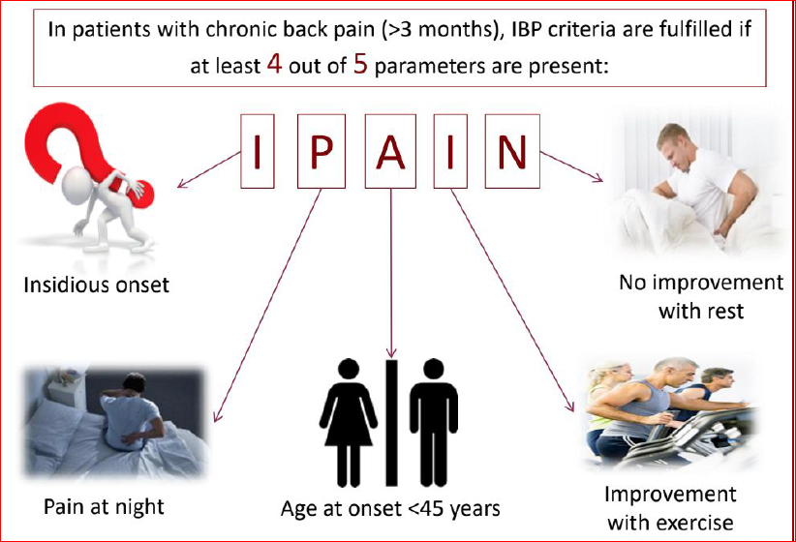
Inflammatory pain Sx
“I’m pain”
Back pain >3months
Early morning pain &
Stiffness.
Tenderness over the joint
1 2 3 39 5 6 7 8 9 10
Notes:
Content source:
https://new.siemens.com

Slide 40
Inflammatory pain DDx
Inflammatory arthritis
Ankylosing spondylitis
Psoriatic spondylitis
Reiter syndrome
IBD
1 2 3 40 5 6 7 8 9 10
Notes:
Content source:
https://new.siemens.com

Slide 41
Malignancy pain Sx
History of malignancy is important (male/female).
Patient presents with pain at night and rest, fever, weight loss, loss of appetite and N/V.
Neurological deficits if the tumor destruction is extensive or causing compression.
1 2 3 41 5 6 7 8 9 10
Notes:
Content source:
https://new.siemens.com

Slide 42
Malignancy pain DDx
Multiple myeloma.
Metastatic carcinoma.
Lymphoma and leukemia.
Spinal cord tumor.
Retroperitoneal tumors.
Primary vertebral tumors.
1 2 3 42 5 6 7 8 9 10
Notes:
Content source:
https://new.siemens.com

Slide 43
Nerve root Compression Sx
Characterized by radicular pain arising from nerve root impingement due to herniated discs.
Radicular pain: Pain that radiates into the lower extremity directly along the course of a spinal nerve root.
1 2 3 43 5 6 7 8 9 10
Notes:
Content source:
https://new.siemens.com

Slide 44
Nerve root innervation
Nerve root | Motor deficit | Reflex affected | Sensory area affected
L4 | Dorsiflexion of the foot | Knee jerk | Inner calf
L5 | Dorsiflexion of the toe | None | Inner forefoot
S1 | Eversion of foot | Ankle jerk | Outer foot

Slide 45
Nerve root compression DDx
Causes
  Trauma /injury to the disc
  Degeneration
  Congenital
Risk factors
Age
Smoking
Obesity
Trauma
Work
1 2 3 45 5 6 7 8 9 10
Notes:
Content source:
https://new.siemens.com

Slide 46
Common causes of back pain

Slide 47
Case scenario
A 51-year-old woman presents to your clinic with a complaint of low back pain, which began acutely 2 weeks earlier, 1 day after a 10-km run. The pain is described as achy, intermittent, and located in the central region of her low back. It is associated with an occasional electrical sensation shooting down her left leg. The pain is aggravated by rolling over in bed, prolonged sitting, and running; it is relieved by rest, changing positions, and ibuprofen

Slide 48
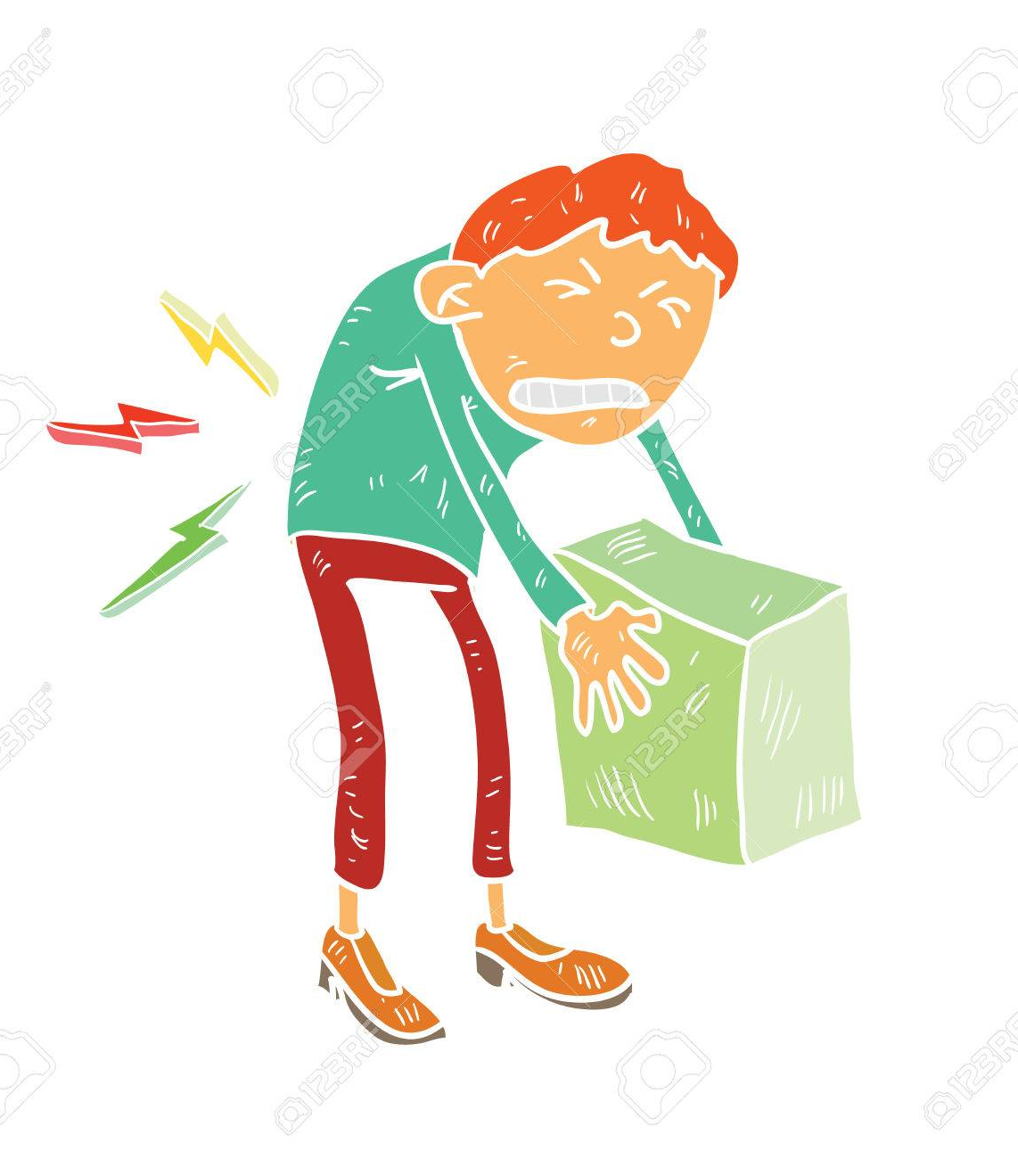
Lumbar muscle strain/sprain

Slide 49
Clinical presentation, Risk factors, Investigations and Management
The most common source of back pain
Clinical presentation
-Sharp intense pain for 1 to 2 days; muscle spasm; most patients recover within 3 months
-Stiffness, and/or soreness of the lumbosacral region (underneath the twelfth rib and above the gluteal folds) persisting for <12 weeks.
Risk factors
Lifting a heavy object, or twisting the spine while lifting
Sudden movements that place too much stress on the low back, such as a fall
Poor posture over time
Sports injuries, especially in sports that involve twisting or large forces of impact
What is the difference between strain and sprain?
Notes:
Sprains are ligamentous injuries that are caused by a sudden violent contraction, sudden torsion, severe direct blows, or a forceful straightening
All major ligaments (ie, anterior longitudinal, posterior longitudinal, intertransversal, interspinosus, supraspinosus)
Strains are defined as tears, either partial or complete, of the muscle-tendon unit. Muscle strains and tears most frequently result from a violent muscular contraction during an excessively forceful muscular stretch.

Slide 50
Clinical presentation, Risk factors, Investigations
Management
Investigations:
<4 Weeks ….. Clinical diagnosis
>6 Weeks …. Lumbar Spine X-Ray, MRI, CT and Labs.
Management:
Acute (< 4 Weeks) | Subacute (4-12 Weeks) | Chronic (> 12 Week)
1st Line: Patient Education + Normal Activity. | 1st Line: Patient Education + Normal Activity. | 1st Line: CBT
+: Self care temp. treatment Heat ,Ice | Adjunctive: Active physiotherapy and exercise therapy. | Adjunctive: Rehabilitation/TCA/Opioid/Surgery.
Adjunctive: Analgesics/Muscle relaxant.
Notes:
For the Muscle relaxant:
NSAIDs if the first line. (Cochrane)
Paracetamol (Evidence C)
*Although sprain and strain injuries only involve the soft tissue, standard anteroposterior and lateral radiographs of the lumbar spine should be routinely obtained to (1) exclude a fracture, rheumatic disease, or a tumor growth; and (2) to evaluate degenerative joint disease as well as overall spinal alignment.

Slide 51
Case scenario
A 45-year-old man without significant past medical history presents with severe back pain after lifting boxes at work two days ago. Other than his back pain his review of symptoms is negative, the pain radiates from his lower back down his posterior thigh to his great toe, when you perform both a straight leg raise test and a contralateral leg raise are positives. His strength sensation, and reflexes are preserved

Slide 52
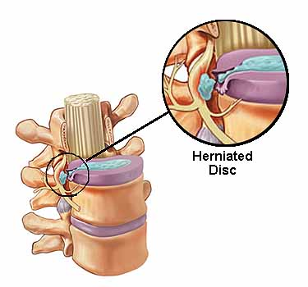
Herniated nucleus pulposus (herniated disc)

Slide 53
Clinical presentation, Risk factors, Investigations
Management
Clinical presentation:
-Low back pain with or without the concurrence of radicular lower limb symptoms in the presence of radiologically-confirmed degenerative disc disease.
-The pain is exacerbated by activity, but may be present in certain positions, such as sitting.
-It is associated with radiating lower extremity pain in a dermatomal distribution
-History of bowel or bladder dysfunction, bilateral sciatica, and saddle anesthesia may be symptoms of severe compression of the cauda equine.
-Positive straight-leg raise or contralateral straight leg (reproduced below 60° of hip flexion); positive femoral stretch test may suggest upper lumbar disc herniation.

Slide 54
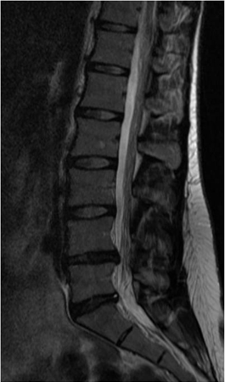
Clinical presentation, Risk factors, Investigations
Management
Investigations:
MRI: herniated disc
Management:
Saddle anesthesia, sphincter dysfunction, bladder retention, and leg weakness = Cauda Equina Syndrome (CES)
Urgent referral to the hospital with emergency decompression of the spinal canal within 48 hours after the onset of symptoms
< 3 Months | > 3 Months
1st Line: Paracetamol | 1st Line: Continue pain management
Adjunctive: Topical analgesics/Opioid/Muscle Relaxant | Refer to pain clinic. If with Axial back pain: +Physiotherapy.

Slide 55
Case scenario
A 63-year-old woman presents with low back pain and cramping in both posterior thighs and numb- ness radiating into the feet with ambulation. It worsens with standing and walking and improves with sit- ting and bending forward. She has no bowel or bladder complaints.
On examination, she has full strength, normal sensation, reflexes are symmetric, and she has 2+ peripheral pulses. Straight leg raise is negative.

Slide 56
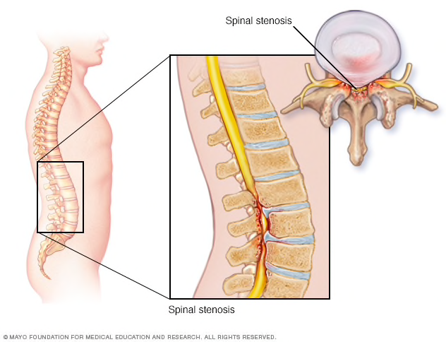
Spinal stenosis
Notes:
Progressive narrowing of the spinal canal may occur alone or in combination with acute disc herniations. , is part of the aging process , degenerative process can be managed, but it cannot be prevented by diet, exercise, or lifestyle.
ligamentum flavum hypertrophy, inferior articulating process (IAP), facet hypertrophy of the cephalad vertebra, vertebral body osteophytosis, vertebral body compression fractures, and herniated nucleus pulposus (HNP).

Slide 57
Clinical presentation, Risk factors, Investigations
Management
Clinical presentation: symptoms result from neural compression of the cauda equina, exiting nerve roots, or both.
Intermittent pain radiating to the thigh or legs, Worse with prolonged standing, activity, or lumbar extension.
Pain is typically relieved by sitting, lying down, and/or lumbar flexion; patient may describe intermittent burning, numbness, heaviness, or weakness in their legs, unilateral or bilateral radicular pain, motor deficits, bowel and bladder dysfunction, and back and buttock pain with standing and ambulation.
Patients walk with a forward flexed gait; patients with vascular claudication have diminished pulses and typical skin changes, such as mottled discoloration, thinning and shiny skin
Notes:
Lumbar spondylosis refers to degenerative conditions of the lumbar spine that narrow the spinal canal, lateral recesses, and neural foramina. Facet joint and ligamentous hypertrophy, intervertebral disc protrusion, and spondylolisthesis may all contribute to the stenosis

Slide 58
Clinical presentation, Risk factors, Investigations
Management
Investigations: MRI
Management:
significant acute neurological deficit | No significant acute neurological deficit: pain affecting quality of life and/or functional activities | Chronic symptoms
1st Line: surgical decompression | 1st Line: analgesics (NSAIDs) | 1st analgesics
 | Adjunct: non-pharmaceutical measures*/Oral corticosteroids | Adjunct: Non-pharmaceutical measures* / Chronic pain agents / Surgery
 | 2nd Line: epidural corticosteroid injection
**Non-Pharmaceutical measures:
-Temporary reduction in physical activity is recommended; patients should be careful to avoid bending, lifting, or twisting movements until the pain subsides.
-Bed rest is not recommended. Prolonged bed rest (>4 days) is contra-indicated, especially in older patients as it may lead to rapid de-conditioning and increased risk of DVT.
Notes:
The diameter of the normal lumbar spinal canal varies from 15 to 27 mm. Lumbar stenosis results from a spinal canal diameter of less than 12 mm in some patients; a diameter of 10 mm is definitely stenotic.

Slide 59
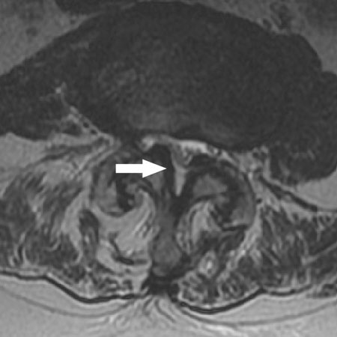

Slide 60
A 72-year-old male smoker with chronic obstructive pulmonary disease presents to your clinic with severe low back pain. The pain began acutely yesterday after moving furniture in his living room. It is located in the central aspect of the upper lumbar spine and is described as sharp and intermittent. It is aggravated by walking, standing, and moving from a sitting to a standing position. It is relieved with rest. He used the clinic wheelchair to come to your office because the pain is limiting ambulation. On examination, he is a thin male having sharp bursts of pain with movement, although he is comfortable while sitting still between these episodes. He has severe tenderness to palpation over the L1 spinal process with milder pain to palpation over the paraspinous muscles.
What is your leading diagnosis?

Slide 61
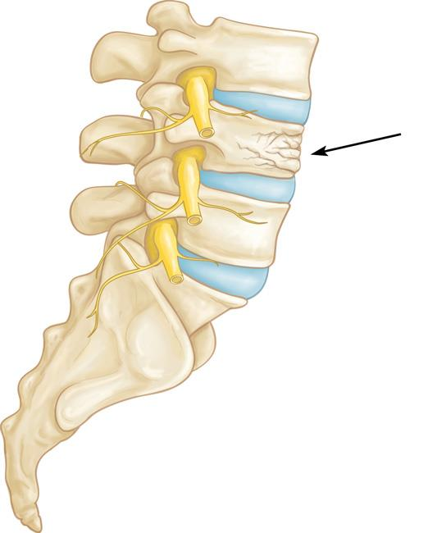
Vertebral Compression fracture
Most osteoporotic spinal compression fractures represent an isolated failure of the anterior spinal column due to a combination of flexion and axial compression loading.
The stability of the spine is not compromised with this type of fracture. These fractures are traditionally considered benign injuries that heal without complications.

Slide 62
Vertebral Compression fracture
Epidemiology incidence:
  vertebral compression fractures (VCF) are the most common fragility fracture
  700,000 VCF per year in US
  70,000 hospitalizations annually
  15 billion in annual costs
Demographics:
  affects up to:
    25% people over 70 years
    50% people over 80 years

Slide 63
Continue..
Risk factors:
Previous history of 2 compression fractures the strongest predictor.
Osteoporosis.
Age.
Trauma.
Female

Slide 64
Symptoms and signs of compression fracture
Symptoms:
Pain usually at area of fracture,25% of patients with VCF seek medical attention due to pain.
From the kyphosis can affect the pulmonary condition.
Signs:
focal tenderness
Local kyphosis
Spinal cord injury
Nerve root deficits

Slide 65
Management:
Non operative:
Observation
Bracing
Medical management:
calcitonin (<5days)
Bisphosphonates
Extension orthosis.(compliance)
Operative:
Vertebroplasty
Kyphoplasty
Surgical decompression and stabilization.

Slide 66
Low back pain (LBP) is a common clinical problem with major socioeconomic importance.
Approximately 70% to 85% of adults are affected by LBP at some point during their lifetime.
Role of PHC
90% of patients recover without sequelae.
1 2 3 4 5 6 7 8 9 10
Notes:
Content source:
https://new.siemens.com

Slide 67
Ask
about and address the patient’s
concerns and goals.
(patient centered care)
Relief pain
Referral
Role of PHC
Prevention
Educate
patient about the natural history of back pain.
Maximize
functional status.
Improve
associated symptoms, such as sleep or mood disturbances or fatigue.
1 2 67 4 5 6 7 8 9 10

Slide 68
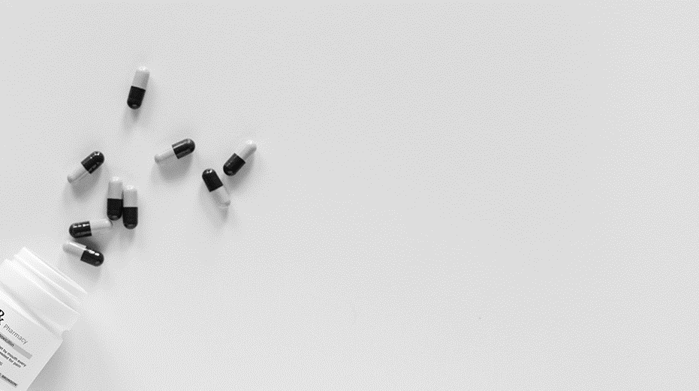
“
Patients in CORE group had a two-fold sustained improvement in pain and function status. And had used 3x less specialized imaging tests at 3 months.
1 2 3 4 5 68 7 8 9 10
Notes:
coordination of primary health care (CORE)

Slide 69
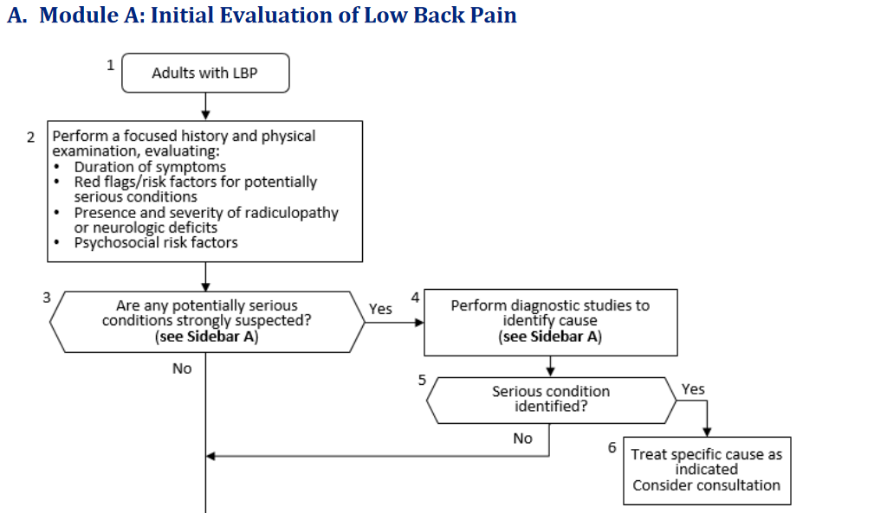

Slide 70
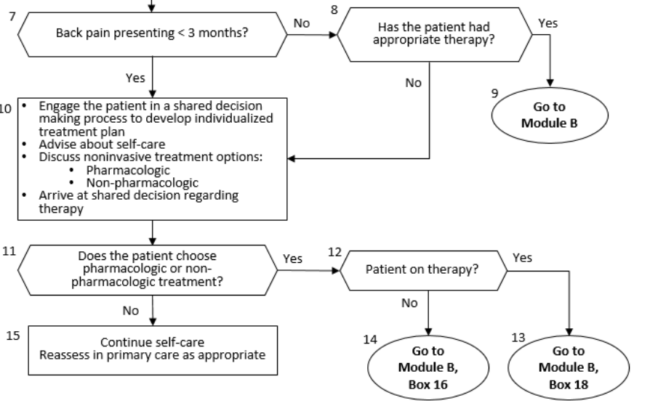

Slide 71
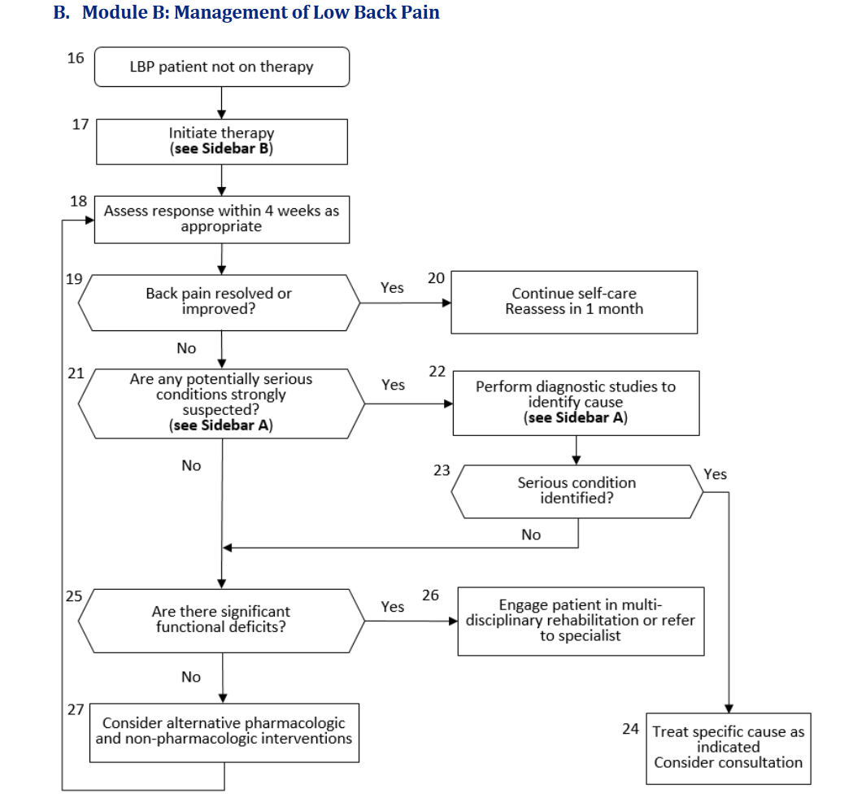

Slide 72
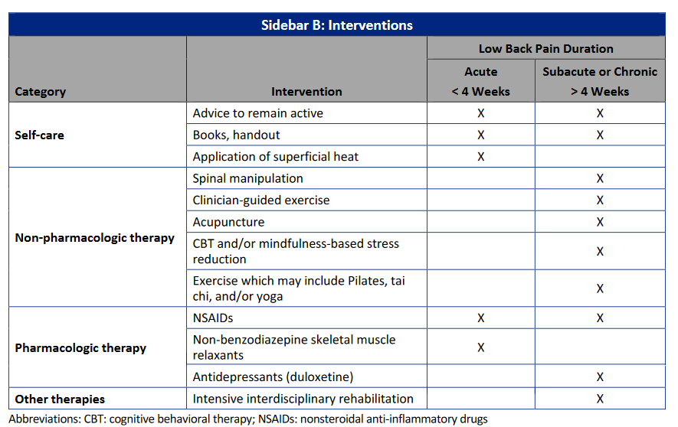

Slide 73

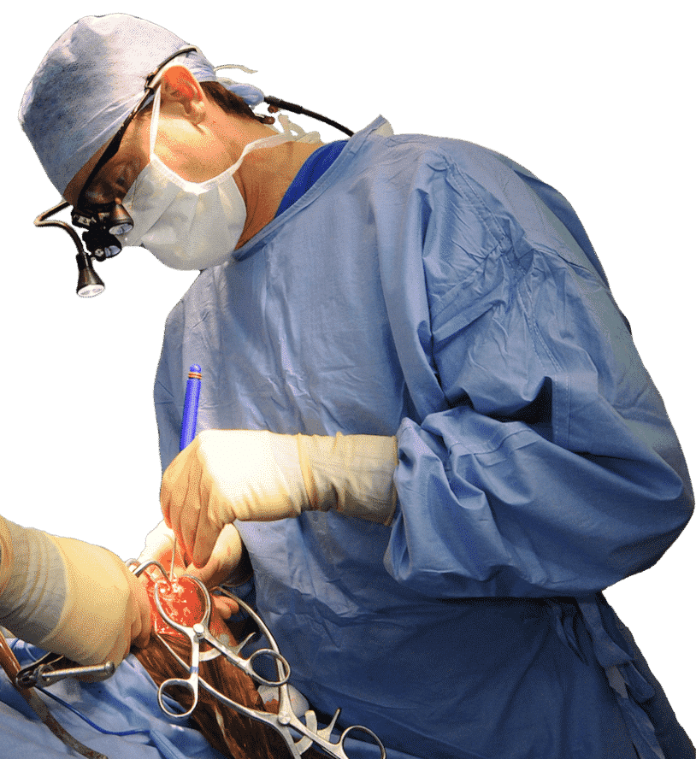
When to refer surgical?
Cauda equina.
Severe or progressive neurological defect.
Meets 4 of the criteria :
1- Leg pain is equal to or worse than back pain.
2- +SLRT.
3- No response to conservative therapy for 4 to 6 weeks in disc herniation.
4- Imaging shows lesion corresponding to symptoms.
1 2 3 4 5 6 7 8 73 10
Notes:
Image source: Google
https://www.indianapharmacists.org/

Slide 74

When to refer diagnostic?
No improvement with conservative therapy in sciatica patients.
Suspicion of fracture, infection and tumors.
Sometimes referral is simply to provide reassurance.
1 2 3 4 5 6 7 8 74 10
Notes:
Image source: Google
https://www.indianapharmacists.org/

Slide 75
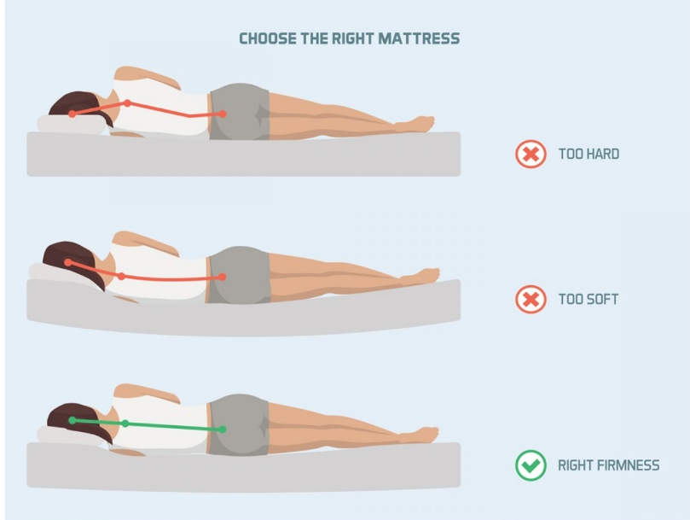
Prevention and education
Weight loss + exercise
Sleep
Footwear
Obese women and men had an approximately 20% increased risk of chronic pain in both the low back and the neck/shoulders. Exercising for 1 or more hours per week compensated, to some extent, for the adverse effect of high BMI on risk of chronic pain.
Flat foot and hyper-pronation/ Hyper-supination can lead to back pain so proper footwear/orthotics can help in these cases.
1 2 3 4 5 6 7 75 9 10
Notes:
Image source: Google
https://www.dhakatribune.com

Slide 76
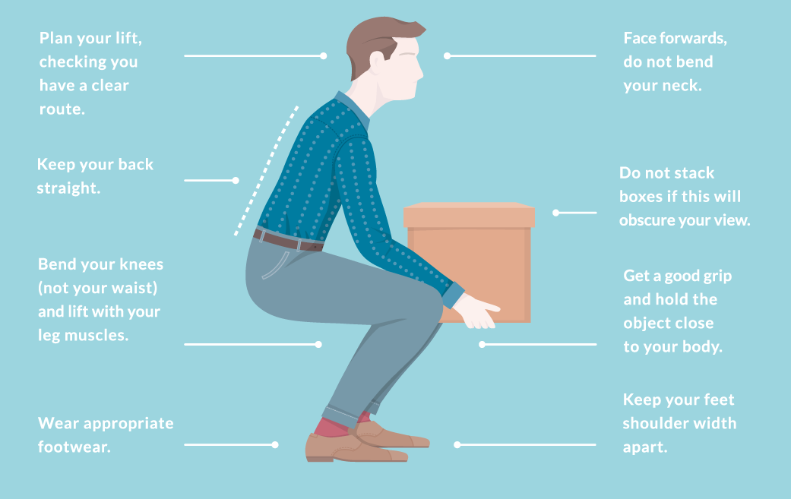
Lifting and carrying
One of the biggest causes of back injury is lifting or handling objects incorrectly.
Push rather than pull – if you must move a heavy object across the floor, it is better to push it rather than pull it.
Repeated heavy lifting or a sudden awkward movement can strain back muscles and spinal ligaments.
constant strain on the back can cause painful muscle spasms.
1 2 3 4 76 6 7 8 9 10
Notes:
Content source:
Google

Slide 77
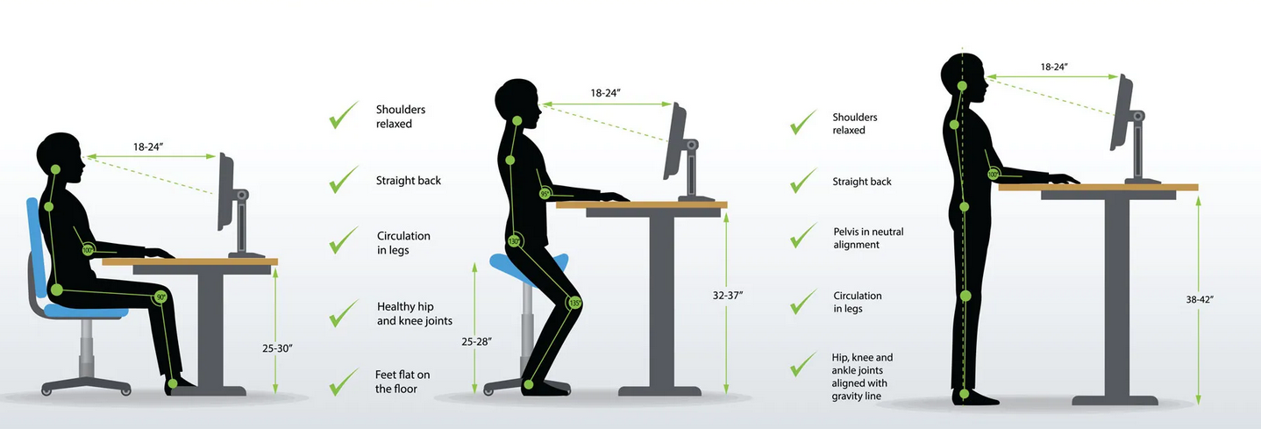
Posture
1 2 3 4 5 6 77 8 9 10
Notes:
Image source: Google
https://thedoctorweighsin.com

Slide 78
MCQ
1- Which of the following is the most common cause of Lower Back Pain ?
a. Metastatic bone disease
b. Inflammatory back pain
c. Lumbosacral sprain or strain
d. Herniation

Slide 79
MCQ
2- Which of the following is considered as Red flag in Lower Back Pain?
a. History of dysmenorrhea
b. Steroid use
c. Night pain
d. Age more than 40

Slide 80
MCQ
3- Which of the following is a feature of inflammatory process?
a. Usually acute in progression
b. Worse while exercise
c. 60 minutes of morning stiffness
d. Age more than 50

Slide 81
MCQ
4- Patient came to FM clinic complaining of intermittet LBP for 2 years that radiates to thigh and legs, it gets worse with prolonged standing and relived by forward flexion. No motor deficits or any other worrisome symptoms.
How would you manage this patient ?
a. Increase physical activity time
b. Bed rest
c. Analgesia (NSAIDS)
d. Refer to neurology

Slide 82
MCQ
5- Positive Adams Forward bending test indicates …………. ?
a. Lordosis
b. Kyphosis
c. Compression fracture
d. Scoliosis

Slide 83
THANK
YOU
1 2 3 4 5 6 7 8 9 83
Notes:
Image source: Google
https://www.labce.com

Slide 84
References
Hengel KM, Visser B, Sluiter JK. The prevalence and incidence of musculoskeletal symptoms among hospital physicians: A systematic review. International Archives of Occupational and Environmental Health. 2011;84(2):115-9.
Awaji M. Epidemiology of Low Back Pain in Saudi Arabia. J Adv Med Pharm Sci [Internet]. 2016;6(4):1–9. Available from: http://sciencedomain.org/abstract/13544
Swanson’s Family Medicine Review (7th Ed.)
Henderson M, Tierney L, Smetana G. The patient history. New York: McGraw-Hill Medical; 2012.
Assessment of back pain [Internet]. BMJ Best Practice; 2018 [cited 4 September 2018]. Available from: https://bestpractice.bmj.com/topics/en-gb/189/pdf/189.pdf

Slide 85
References
Low back pain and sciatica in over 16s: assessment and management. NICE guideline; 2016.
Evaluation of low back pain in adults [Internet]. Uptodate.com. 2018 [cited 4 September 2018]. Available from: https://www.uptodate.com/contents/evaluation-of-low-back-pain-in-adults?search=evalu%20ation-of-low-back-pain-in adults&source=search_result&selectedTitle=1~150&usage_type=default&display_rank=1
Dog and Rooster I. Disc Herniation Case Studies| Spine Institute of San Diego : Center for Spinal [Internet]. Sdspineinstitute.com. 2018 [cited 6 September 2018]. Available from: http://www.sdspineinstitute.com/case-studies/disc-herniations/lumbar.html
Practitioners T. RACGP - Back pain in a cancer patient: a case study [Internet]. Racgp.org.au. 2018 [cited 6 September 2018]. Available from: https://www.racgp.org.au/afp/2014/august/back-pain-in-a-cancer-patient/

Slide 86
References
Evaluation of the child with back pain [Internet]. Uptodate.com. 2018 [cited 4 September 2018]. Available from: https://www.uptodate.com/contents/evaluation-of-the-child-with-back-pain
Kleiber B, Jain S, Trivedi MH. Depression and Pain: Implications for Symptomatic Presentation and Pharmacological Treatments. Psychiatry (Edgmont). 2005;2(5):12-18.
Musculoskeletal lower back pain [Internet]. BMJ Best Practice. 2018 [cited 4 September 2018]. Available from: https://bestpractice.bmj.com/topics/en-gb/778
Osteoporosis - Symptoms, diagnosis and treatment | BMJ Best Practice [Internet]. Bestpractice.bmj.com. 2018 [cited 6 September 2018]. Available from: https://bestpractice.bmj.com/topics/en-us/85/case-history

Slide 87
References
Rossignol, M., Abenhaim, L., Séguin, P., Neveu, A., Collet, J. P., Ducruet, T., & Shapiro, S. (2000, January 15). Coordination of primary health care for back pain. A randomized controlled trial.
Carragee EJ, Hannibal M. Diagnostic evaluation of back pain. Orthop Clin North Am. 2004 Jan;35(1):7-16.
Tom Ivar Lund Nilsen, Andreas Holtermann, Paul J. Mork, Physical Exercise, Body Mass Index, and Risk of Chronic Pain in the Low Back and Neck/Shoulders: Longitudinal Data From the Nord-Trøndelag Health Study, American Journal of Epidemiology, Volume 174, Issue 3, 1 August 2011, Pages 267–273,

