Slide 1
Maternal and child health
SAIF ALOSAIMI
Abdulrahman Alshiekh
Abdullah Alotaibi

Slide 2
Objectives:-
Health behaviors and health systems indicators that affect the health, wellness, and quality of life of women, children, and families.
Factors affecting pregnancy and childbirth, including preconception health status, Age, access to appropriate preconception and interconnection health care, and poverty.
Health risks that include hypertension and heart disease, diabetes, depression, genetic conditions, sexually transmitted diseases (STDs), inadequate nutrition, unhealthy weight, tobacco use and alcohol abuse.
Social and physical determinants of maternal health.
Social and physical determinants of infant and child health.
How to improve the health and well-being of women, infants, children, and families.

Slide 3
Q1
Which one of the following nutrient deficiency in a pregnant woman can lead to neural defect in her child?
A) Iron
B) Folate
C) Calcium
D) Omega 3

Slide 4
Q2
Which of the following side effects are associated with maternal smoking during pregnancy?
A) Cleft lip
B) cleft palate
C) Sudden infant death syndrome
D) All of them

Slide 5
Q3
Which one of the following is considered as a long-term complication of prematurity?
A) Breathing difficulties
B) Infections
C) Jaundice
D) Retinopathy of prematurity

Slide 6
Q4
Which one of the following is considered as the most common congenital defect?
A) Hearing loss
B) Vision loss
C) Cleft palate
D) Spina bifida

Slide 7
Q5
Which one of the following is the major cause of maternal mortality in Saudi Arabia ?
A) Infection
B) High blood pressure
C) Hemorrhage
D) Unsafe abortion

Slide 8
What is maternal health?
Maternal health refers to the health of women during pregnancy, childbirth and the postpartum period.

Slide 9
What is a health indicator?
Health indicators are: variables that reflect the state of health of persons in a community. (Oxford Dictionary of Epidemiology).
They inform about the quality of healthcare, and access of health care, and they are considered as quantitative measures.

Slide 10
The 11 indicators of maternal, newborn and child health
Maternal mortality ratio
Under-five child mortality, with the proportion of newborn deaths
Children under five who are stunted
Proportion of demand for family planning satisfied
Antenatal care coverage (at least four times during pregnancy)
Skilled attendant at birth
Postnatal care for mothers and babies within two days of birth

Slide 11
The 11 indicators of maternal, newborn and child health
Antiretroviral (ARV) prophylaxis among HIV positive pregnant women to prevent HIV transmission and antiretroviral therapy for [pregnant] women who are treatment-eligible
Exclusive breastfeeding for six months
Three doses of combined diphtheria-tetanus-pertussis (DTP3) immunization coverage (12–23 months) video
Antibiotic treatment for suspected pneumonia

Slide 12
Maternal mortality ratio
Maternal death is the death of a woman while pregnant or within 42 days of termination of pregnancy, irrespective of the duration and site of the pregnancy, from any cause related to or aggravated by the pregnancy or its management but NOT from accidental or incidental causes.
The maternal mortality ratio (MMR) is the ratio of the number of maternal deaths during a given time period per 100,000 live births during the same time-period.
All maternal deaths occurring within a reference period (usually 1 year) ______________________________________________________ x100,000
Total number of live births occurring within the reference period

Slide 14
Sub-Saharan Africa and Southern Asia accounted for approximately 86% (254 000) of the estimated global maternal deaths in 2017.
Sub-Saharan Africa alone accounted for roughly two-thirds (196 000) of maternal deaths, while Southern Asia accounted for nearly one-fifth (58 000).

Slide 16
COUNTRY | 2000 | 2017
KUWAIT | 10 | 12
UAE | 6 | 3
Bahrain | 27 | 14
QATAR | 14 | 9
OMAN | 20 | 19
YEMEN | 301 | 164
EGYPT | 64 | 37

Slide 17
Key facts (WHO)
Every day in 2017, approximately 810 women died from preventable causes related to pregnancy and childbirth.
Between 2000 and 2017, the maternal mortality ratio (MMR, number of maternal deaths per 100,000 live births) dropped by about 38% worldwide.
94% of all maternal deaths occur in low and lower middle-income countries.
Skilled care before, during and after childbirth can save the lives of women and newborns

Slide 18
Preconception

Slide 19
scenario
A 36 years old with two sons her youngest son has autism and she wants to have another child but she is scared

Slide 20
Preconception
Defined as:
Giving protection: against infectious diseases, and congenital anomalies
Managing conditions: DM, HTN, and STDs
Avoiding exposures to teratogenic: Medications, Tobacco and Alcohol
To achieve an optimal outcome of pregnancy for mother and child

Slide 21
Access to preconception health care
Preconception health should be provided to all women irrespective of pregnancy plans
Women are not likely to come for preconception care
Part of routine primary care for women of reproductive age
Identify modifiable and non-modifiable risk factors

Slide 22
Interconception Health care
Chronic disease profile
Nutritional status
Infectious diseases
Substance use
Medications
Reproductive history
Family/genetic history

Slide 23
AGE
Under age 20
Over age 35
Higher risk of :
Prematurity
Low birth weight
Preeclampsia
Higher risk of
Birth defects
Miscarriage
Risk of developing
Hypertension
Gestational diabetes

Slide 24
Poverty
Mothers are likely to face multiple stressful life events
Including teenage pregnancies, unemployment, crowded or polluted environments
Increased risks of
Preterm birth, intrauterine growth restriction, and neonatal or infant death
Delayed cognitive development and poor school performance

Slide 25
Health risks

Slide 26
Blood pressure
Hypertension Lead to:
Decreased blood flow to the placenta
Placental abruption
Premature delivery
Preeclampsia - new-onset hypertension in later pregnancy
associated with proteinuria (usually closer to term)
Preeclampsia increase risk of CVD
Safer medications

Slide 27
Heart disease
Blood volume & heart rate increase
Cardiac Output increase during pregnancy
Women with heart failure may be advised an early therapeutic abortion
Heart failure can cause premature labor

Slide 28
Pre-existing Diabetes
Pre-pregnancy assessment
Glycemic and Blood pressure control
Weight and diet advises
Access complications
Higher risk of:
Maternal complications
Congenital anomalies
Neonatal complications (Metabolic disorders)
Oral hypoglycemic should be discontinued and insulin started

Slide 29
Gestational Diabetes
Can cause
Big baby (may need to induced labour or a caesarean section)
Premature labour
Preeclampsia
Stillbirth

Slide 30
Depression
14-23% of women struggle with depression during pregnancy
Untreated can lead to
Poor nutrition , drinking, smoking, and suicidal behavior
Premature birth, low birth weight, and developmental problems
Most important step is to seek help

Slide 31
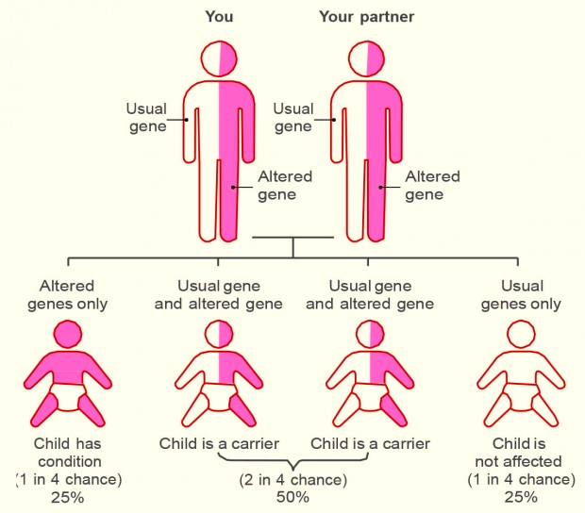
Genetic conditions
Factors that increase risk of genetic disorder :
Family history
Prior child with a genetic disorder
Maternal age (35 or older)
Multiple miscarriages
Teratogenic disorders exposed to substances during pregnancy
Single gene disorders e.g. cystic fibrosis & sickle cell anemia
Chromosomal abnormalities missing or extra chromosomes e.g. Down syndrome

Slide 32
STDs
Screening for STDs in first prenatal visit for all pregnant women
HIV transmitted during pregnancy, labor and vaginal delivery, or breast-feeding
If diagnosed before or early in pregnancy, steps can be taken to reduce risk of transmission
Hepatitis B.
Transmission occurs when pregnant women become infected close to delivery
Infants should be treated shortly after birth

Slide 33
Nutrition
Overweight Mother
Underweight Mother
likely to be diagnosed with:
gestational diabetes
preeclampsia
Deliver
Prematurely
Underweight child

Slide 34
Nutrition supplements
Folic acid - should take a 400 micrograms every day
deficiency can lead to neural tube defects
vitamin D - 10 micrograms
Iron - Lean meat, green leafy vegetables, dried fruit, and nuts
iron supplements
Vitamin C - variety of fruit and vegetables
Calcium - dairy products and vegetables (kale)
All women of reproductive age should be assessed for nutritional adequacy and given a multivitamin supplement

Slide 35
Tobacco
Smoking during pregnancy increases risk of :
Preterm delivery
Low birth weight
Birth defect of the mouth and lip
Sudden infant death syndrome

Slide 36
Alcohol abuse
There is no known safe amount of alcohol
Fetal alcohol spectrum disorders

Slide 37
Social and Physical Determinants of Maternal Health

Slide 38
Social and Physical Determinants of Maternal Health
range of biological, social, environmental, and physical factors have been linked to maternal, infant, and child health outcomes.
Race , Ethnicity,, such as income level, educational attainment, medical insurance coverage, access to medical care are considered socioeconomic factors.
where as age, parity knowledge of services, previous obstetric history and general health status are considered as physical determinants

Slide 39
Why it is important?
1-To appreciate factors affecting the well-being of mothers, infants, and children and to address them accordingly .
2- educating patients in a culturally sensitive manner about steps they can take to prevent diseases.

Slide 40
Social and Physical Determinants of Child Health

Slide 41
Biological
Birth Weight: low birth weight (< 2.5 kg) & high birth weight (> 4 kg)
Age of The Mother : <19 years) or >over 30 years
Repeated pregnancies : risk of miscarriage
Birth Spacing: < 1 year = 2-4 times risk of mortality
Multiple Births: more risk due to low birth weight
Family Size: 3 or more children, more frequent/prolonged illness

Slide 42
Socio-economic Factors
Low income countries Rural areas
Low education And Nutrition
Breast & formula milk use
Health care quality
Violence (wife beating, infanticide, child abuse)
Environmental conditions

Slide 43
Cultural Factors
Religion
Customs
Early marriages
Sex of child
Quality of mothering Traditions affecting
cleanliness,
eating, clothing,
child care

Slide 44
Do you know that:
•approximately 830 women die every day from causes related to pregnancy and childbirth.
•5.9 million children under age five died in 2015, 16000 every day.
•With quality health care, many of these deaths could be prevented.

Slide 45
the major reasons of maternal mortality?
Women die from a wide range of complications in pregnancy, childbirth or the postpartum period. The four major killers are:
severe bleeding (mostly bleeding postpartum)
infections (also mostly soon after delivery)
hypertensive disorders in pregnancy (eclampsia)
obstructed labor

Slide 46
How to improve the health and well-being of women, infants, children, and families.
First 24 hours : assessment of vaginal bleeding, uterine contraction, temperature and heart rate should be done routinely during the first 24 hours
Breastfeeding should be assessed
women should be asked about their emotional wellbeing, what family and social support they have
Iron and folic acid supplementation should be provided for at least 3 months after delivery.

Slide 47
Post partum depression
After 10–14 days, all women should be asked about postpartum depression
approximately 10 to 15% of women suffer from postpartum mood disorders (PPMDs), including postpartum depression (PPD), postpartum anxiety/OCD and postpartum psychosis

Slide 48
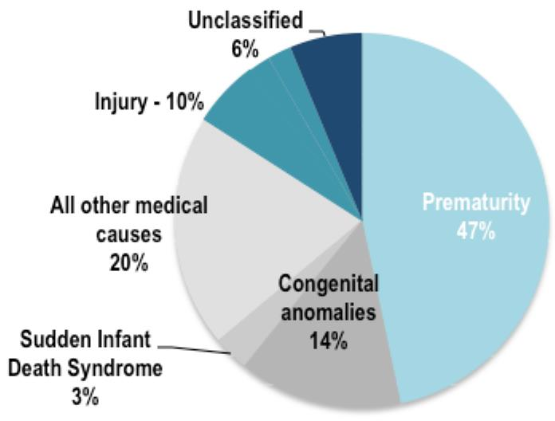
for every 1,000 babies that are born, almost 6 die during their first year, 45% of child deaths under the age of 5 years take place during the neonatal period.

Slide 49
• Infant mortality:
Causes:
Birth defects
Preterm birth and low birth weight
Congenital anomalies
Maternal complications of pregnancy.
Sudden Infant Death Syndrome (SIDS).
Injuries (e.g., suffocation).

Slide 50
How to improve infancy health
promote early and exclusive breastfeeding (EBF):
Evidence shows EBF reduces the risks of mortality and morbidity and improves post-neonatal outcomes
Preterm and low-birth-weight babies should be identified as soon as possible and should be provided special care.
A full clinical examination should be done 1 hour after birth. This includes giving vitamin K prophylaxis and hepatitis B vaccination (within 24 hours).

Slide 51
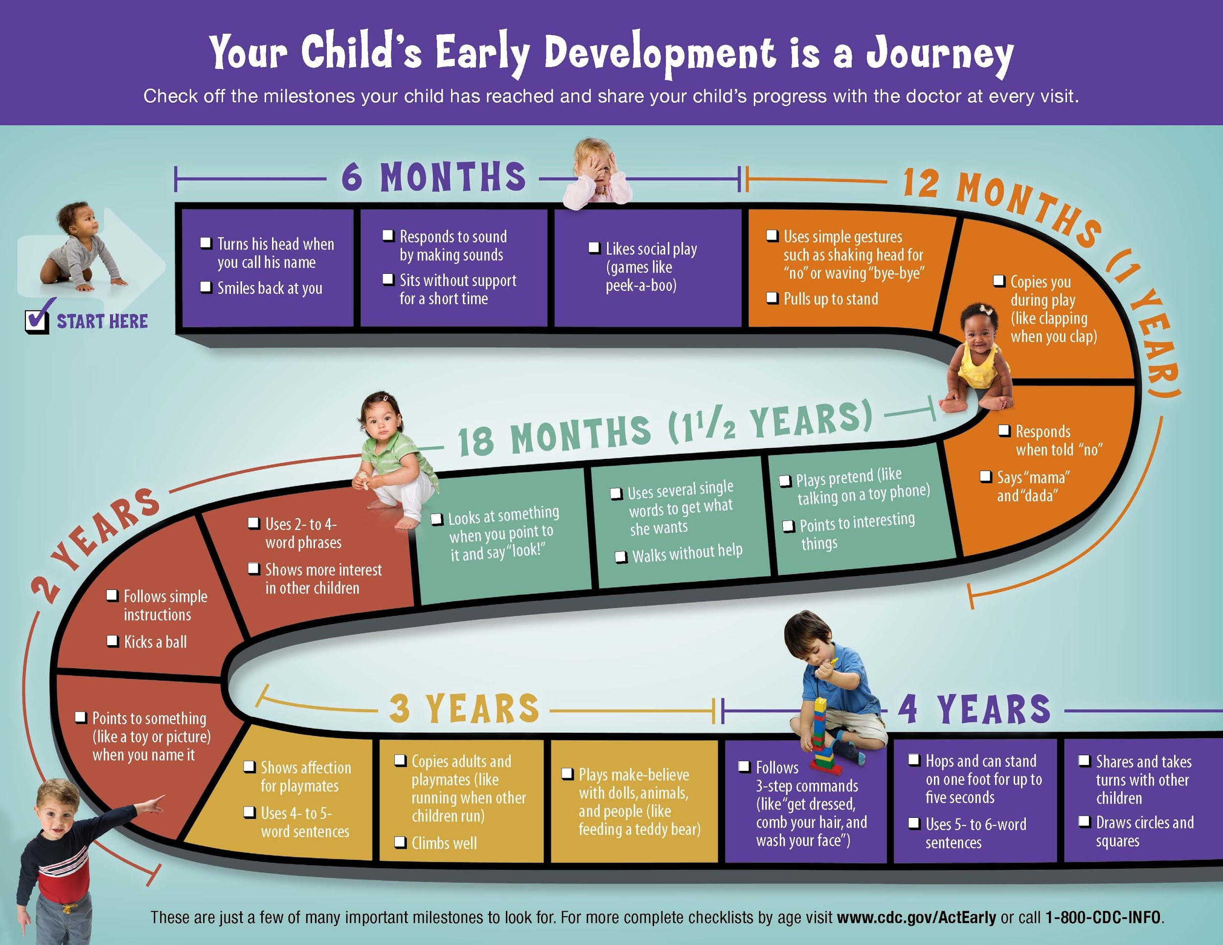
Milestones
A growth chart is used by pediatricians and other health care providers to follow a child's growth over time.

Slide 53
Q1
Which one of the following nutrient deficiency in a pregnant woman can lead to neural defect in her child?
A) Iron
B) Folate
C) Calcium
D) Omega 3

Slide 54
Q2
Which of the following side effects are associated with maternal smoking during pregnancy?
A) Cleft lip
B) cleft palate
C) Sudden infant death syndrome
D) All of them

Slide 55
Q3
Which one of the following is considered as a long-term complication of prematurity?
A) Breathing difficulties
B) Infections
C) Jaundice
D) Retinopathy of prematurity

Slide 56
Q4
Which one of the following is considered as the most common congenital defect?
A) Hearing loss
B) Vision loss
C) Cleft palate
D) Spina bifida

Slide 57
Q5
Which one of the following is the major cause of maternal mortality in Saudi Arabia ?
A) Infection
B) High blood pressure
C) Hemorrhage
D) Unsafe abortion

Slide 58
https://www.ncbi.nlm.nih.gov/pmc/articles/PMC3081498/
https://www.ncbi.nlm.nih.gov/pmc/articles/PMC4458502/
https://www.ncbi.nlm.nih.gov/pmc/articles/PMC2528810/
https://heart.bmj.com/content/85/6/710
https://www.who.int/health-topics/maternal-health - tab=tab_1
http://mmr2017.srhr.org/

Slide 59
Thank you for listening

