Slide 1
Adolescent Health
SLS Group 4

Slide 2
Objectives
The student will define adolescent age according to World health organization.
The student will describe adolescent physiological and behavioral characteristics.
The student will recognize the importance of adolescent health.
The student will determine adolescent health problems according to physical, psychological and social aspects.
The student will evaluate common adolescent health problems in Saudi Arabia from best available evidence based studies
The student will summarize the Comprehensive approach to common adolescent health problems in primary health care
The student will assess the Role of family, school and community in adolescent health care

Slide 3
Interactive Questions

Slide 4
Question 1
Which of the following is the age group of adolescents according to WHO:
15-24
10-19
10-16
10-24

Slide 5
Question 2
The adolescent percentage of the whole world population is:
7%
9%
16%
28%

Slide 6
Question 3
Increase activity levels, by creating safe and enabling environments for physical activity for adolescents is a role of:
School
Community
Family
Friends

Slide 7
Question 4
Which of the following consider as social health problem in adolescents:
Drug abuse
Depression
Pneumonia
Road traffic accident

Slide 8
Question 5
The best clinical setting for a physician to consult an adolescent is setting in the clinic with:
The patient.
The patient and his parents.
the parents.
the patient and chaperone.

Slide 9
Adolescent definition
and age

Slide 10
Definition
Definition of adolescent according to WHO:
WHO defines Adolescents as individuals in the 10 -19 age group
While young people between the age of 10-24 years.
Adolescennce is a stage of transition from which a child moves from being teenager towards an adult

Slide 11
Adolescent physiological and behavioral characteristics.

Slide 12
Physiological characteristic
Boys
Girls
Voice become deeper.
The adam’s apple becomes bigger.
The shoulders become wider than hip.
Hair grows on the face, body and pubic area.
The skin on the upper arms and thighs become rough.
Breast develop.
The hips become wider than the shoulders.
Hair grows on the underarm and pubic area.

Slide 13
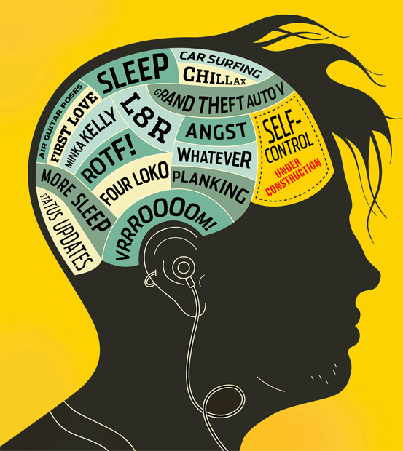
Cognitive

Slide 14
Cognitive
Growing new brain cells
Strenghening connections
Abstract thinking
Advanced reasoning
Metacognition

Slide 15
Emotional
Shows strong feeling and intense emotions, so teens are more
easly swayes by emotions and have difficulty making decions
that adult can easly make
More sensitive to others emotions
More self concious : especially about physical appearance and
self esteem
Acting without thinking

Slide 16
Behavioral
Expanding their social circles
Expanding their social roles
Looking for more independence
Thinking more about right and wrongs

Slide 17

Moral
Seeing the world I in a gray of shades
Understanding the reason behind rules
Forming their moral code
Becoming more interested in big questions

Slide 18
Importance of
Adolescent Health

Slide 19
Importance of Adolescent Health
There are nearly 1.2 billion adolescents in the world (about 16% of world's population).
Promoting and protecting adolescent health will lead to great public health, economic and demographic benefits.

Slide 20
Importance of Adolescent Health
Adolescent period is a key transitional and dynamic period in life course (critical period).
Impact upon lifelong health outcomes.
They are the future generation.

Slide 21
“
“Adolescent health is a smart investment. Not only will it improve adolescent health and survival in the short-term, but will bring benefits for their future health as adults, and for the next generation to come.”
- Valentina Baltag, WHO

Slide 22
Adolescent Health
Problems

Slide 23
More than 1.1 million adolescents aged 10-19 years died in 2016, over 3000 every day, mostly from preventable or treatable causes.
Key facts
Road traffic injuries were the leading cause of death among adolescents in 2016. Other major causes of adolescent deaths include suicide, interpersonal violence, HIV/AIDS and diarrhoeal diseases.
Half of all mental health disorders in adulthood start by age 14, but most cases are undetected and untreated.

Slide 24

Adolescent Health Problems
Could be:

Slide 25
Physical Health Problems
1- Injuries:
Unintentional injuries are the leading cause of death and disability among adolescents.
Examples:
Road traffic accidents (In 2016, over 135,000 adolescents died as a result of RTA)
Drowning is also among the top 10 causes of death among adolescents (nearly 50,000 adolescents are estimated to have drowned in 2016)

Slide 26
Physical Health Problems
2- HIV/AIDS:
An estimated 2.1 million adolescents were living with HIV in 2016; the great majority in the African Region.
3- Other infectious diseases:
Diarrhea and lower respiratory tract infections are estimated to be among the top 10 causes of death

Slide 27
Physical Health Problems
4- Early pregnancy and childbirth:
The leading cause of death for 15-19 year-old girls globally is complications from pregnancy and childbirth.
5- obesity:
in 2016, over one in six adolescents aged 10–19 years was overweight.

Slide 28
Psychological Health Problems
Mental health
Depression is one of the leading causes of illness and disability among adolescents.
Suicide is the third leading cause of death in 15-19-year-olds.
Violence, poverty, humiliation and feeling devalued can increase the risk of developing mental health problems.

Slide 29
“
“The conflict between the need to belong to a group and the need to be seen as unique and individual is the dominant struggle of adolescence “
- Jeanne Elium

Slide 30
Social Health Problems
1- Alcohol and drugs:
It is a major concern in many countries
It reduces self-control and increases risky behaviors, such as dangerous driving.
It can also lead to health problems in later life and affects life expectancy.
2- Tobacco use:
The vast majority of people using tobacco today began doing so when they were adolescents, Globally, at least 1 in 10 adolescents aged 13 to 15 years uses tobacco.

Slide 31
Adolescent Health Problems
Violence:
Interpersonal violence is a leading cause of death in adolescents
nearly one in three adolescent girls aged 15 – 19 years (84 million) has been a victim of emotional, physical and/or sexual violence.

Slide 32
Common adolescent health problems in Saudi Arabia

Slide 33
Common Adolescent Health Problems In Saudi Arabia
Social
Physical
Psychological

Slide 34
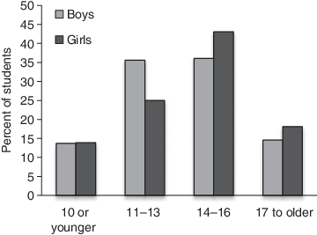
Age which First Cigarette ever smoked

Slide 35
Common Adolescent Health Problems In Saudi Arabia
Social:
-Smoking → 2 Studies:
1# Cross-sectional study carried out in Riyadh during 2014 on 1430 Adolescents aged between 14-19 from 12 different schools
reported 20% having ever smoked a whole cigarette, boys more than girls.
2# school-based cross-sectional study was carried out in the Madinah region
during 2013.
The prevalence of cigarette smoking in the respondents’ 3322 adolescents was 15.17%.
The most important predictors were most or all friends smoking. Other
significant less important factors were parental smoking, cigarette
advertisement in mass media, and pocket money.

Slide 36
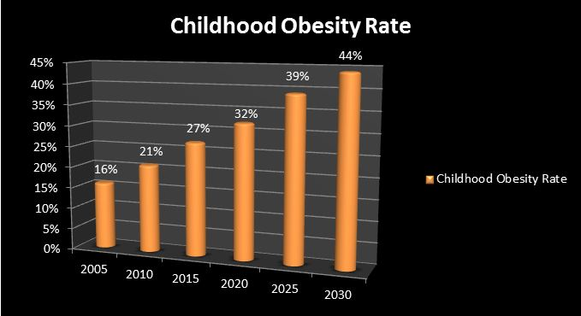

Slide 37
Common Adolescent Health Problems In Saudi Arabia
Physical:
-Obesity:
A sample was drawn from adolescent males and females enrolled in the secondary schools in three major cities of Saudi Arabia; Riyadh, Jeddah, and Al-Khobar gave that:
The prevalence of overweight was 19.5% in males and 20.8% in females.
While that of obesity was 24.1% in males and 14% in females.

Slide 38
Common Adolescent Health Problems In Saudi Arabia
Psychological:
A cross-sectional study, that included 354 students randomly selected from grade 12 in four high schools in the National Guard Housing (Iskan), in Kashmalaan.
The overall prevalence of mental disorders was found to be 48% (41% in males and 51% in females); more than 80% of these cases were mild to moderate. Females showed significantly more severe disorders than males and students with excellent performance degrees showed a significantly lower rate of mental disorders than others.

Slide 39
Approach to common adolescent health problems in primary health care

Slide 40
Gain trust
If adolescents do not trust their physicians, they will not feel comfortable discussing sensitive health concerns.
How to gain this trust ?

Slide 41

Gain trust
A useful beginning is an initial introductory meeting with both the adolescent and parents.
we establish what the parents' concerns are, obtain a family
history, and ask about
previous medical problems.

Slide 42

What to do next ?
Leave the parents with the patient and establish the rapport?
Or
transition from parent to teen as the medical historian.
We next ask parents to wait in the waiting room so that we can speak privately with the adolescent.

Slide 43
Progress
We interview the adolescent alone, perform a physical examination with a chaperone, and then invite the parents back into the room at the conclusion of the visit to discuss our findings.

Slide 44
Why It is important for teens to establish a separate relationship with the physician
parents may express some resistance.
The importance of an adolescent having a physician with whom the teen can confide and discuss difficult issues that may arise in the future

Slide 45
During our discussion with the adolescent
we listen carefully to both what is said and what is not said.
The goal is to assist the adolescent in identifying potentially risky behaviors that may endanger their health and assessing their motivation to change those behaviors.

Slide 46
Use the technique of motivational interviewing,
which provides adolescents with feedback on risks and promotes a sense of responsibility for their health.
Teens want factual information rather than authoritative instruction on what to do.

Slide 47
Using slang
Avoid
because most teens will be aware that this is not your customary language

Slide 48
We use five premises that our trainees find useful when caring for adolescents.

Slide 49
The five “F”s
Explain Facts: adolescents should have a clear understanding of their illness.

Slide 50
The five “F”s
2. Explore Fears adolescents may have concerning their illness or its effects on their life.
They may also be worried about their body image, their identity, their peers, or other interpersonal relationships.

Slide 51
The five “F”s
3.Address any Fables (myths): adolescents may be misinformed about their illness or about adolescence.

Slide 52
The five “F”s
4.Explore the adolescent's relationship with their Family.
What are communication and trust like within the family unit?
How does the teen settle conflicts that arise at home?

Slide 53
The five “F”s
5. Ask how the adolescent views the Future.
We make it clear that we are accessible, and the teen is given a contact phone number.

Slide 54
Clinic settings
scheduling times when only teens will be seen may be helpful.
play educational videotapes
educational brochures.

Slide 55
advantage of an adolescent's visit to your clinic
offering a psychosocial screening examination.

Slide 56
(HEADSSS)
Home.
Education.
Activities.
Drugs.
Sexuality.
Suicide or depression.
Safety.

Slide 57
Closing
consult with the adolescent about what you will discuss and what will remain confidential.
Both the adolescent and the parents should be offered a chance to ask questions.
The parents may ask to see the physician alone.
Remember that the teen, not the parent, is your patient.

Slide 58
The care of adolescent patients can be extremely rewarding.
At times it can be frustrating and challenging, but following our guidelines, physicians and teens will be able to work together to improve the teens' health.

Slide 59
Role of family, school, And community in adolescence Health care

Slide 60

Role of family
Adolescents who have good communication and are bonded with an adult are less likely to engage in risky behaviors.
Parents supervision and involvement with their adolescents' activities are promoting a safe environment.
Teaching children and adolescents to swim is an essential intervention to prevent drowning.
Building life skills in children and adolescents can help promote good mental health.
Effective and empathetic care for adolescent survivors of violence including ongoing support can help with the physical and psychological consequences.
Developing healthy eating habits in adolescence are foundations for good health in adulthood.

Slide 61

Role of school
School health clinics for health education & counselling has an important role.
providing them with psychosocial support in schools can help promote good mental health.
The school social environment affects student’s attendance, academic achievement, and behavior.
A safe and healthy school environment protects against risky behaviors.
Healthy students are more effective learners.

Slide 62

Role of community
Programmes to help strengthen the ties between adolescents and their families are also important.
Promoting nurturing relationships between parents and children early in life, providing training in life skills, and reducing access to alcohol and firearms can help to prevent injuries and deaths due to violence.
Antismoking program should be established, including prohibition of the sale and use of cigarettes in public places.
Application of firm traffic laws forbidding adolescents aged less than 18 years from driving.
increase activity levels, by creating safe and enabling environments and opportunities for physical activity for all adolescents.
Reducing the marketing of foods high in saturated fats, trans-fatty acids, free sugars, or salt and providing access to healthy foods

Slide 63
Interactive Questions

Slide 64
Question 1
Which of the following is the age group of adolescents according to WHO:
15-24
10-19
10-16
10-24

Slide 65
Question 2
The adolescent percentage of the whole world population is:
7%
9%
16%
28%

Slide 66
Question 3
Increase activity levels, by creating safe and enabling environments for physical activity for adolescents is a role of:
School
Community
Family
Friends

Slide 67
Question 4
Which of the following consider as social health problem in adolescents:
Drug abuse
Depression
Pneumonia
Road traffic accident

Slide 68
Question 5
The best clinical setting for a physician to consult an adolescent is setting in the clinic with:
The patient.
The patient and his parents.
the parents.
the patient and chaperone.

Slide 69
References
https://www.who.int/maternal_child_adolescent/topics/adolescence/why-invest/en/
https://www.who.int/health-topics/adolescents/coming-of-age-adolescent-health
https://data.unicef.org/topic/adolescents/overview/
https://www.who.int/en/news-room/fact-sheets/detail/adolescents-health-risks-and-solutions
https://www.who.int/news-room/fact-sheets/detail/adolescent-mental-health
https://adc.bmj.com/content/99/Suppl_2/A251.3#:~:targetText=In%20Saudi%20Arabia%2C%20the%20prevalence,for%20Saudi%20youth%20in%20Riyadh.
http://www.childtrends.org/wp-content/uploads/2013/03/Child_Trends-2009_04_16_RB_FamilyStrengths.pdf
http://www.saudijobesity.com/article.asp?issn=2347-2618;year=2014;volume=2;issue=1;spage=13;epage=18;aulast=Al-Enazy
http://www.jfcmonline.com/article.asp?issn=2230-8229;year=2012;volume=19;issue=1;spage=47;epage=51;aulast=Al-Sughayr
https://www.ncbi.nlm.nih.gov/pmc/articles/PMC1070800

Slide 70
Thanks!
Any questions?

