Slide 1
Approach to Obese Patient
DONE BY :
Abdulmalik Alghannam
Salim Basamad
Motasem Alhasani
Abdulrahman Alrajhi
Meshal AlEiaidi

Slide 2
Objectives
To define obesity and classify the degree of obesity based on BMI, waist circumference and waist-hip-ratio.
The prevalence of obesity in Saudi Arabia.
Common causes of obesity in the community.
Common health problems associated with obesity.
Methods to prevent obesity in the community.
The evidence based approach to reducing weight (exercise, dieting, drug treatment, and bariatric surgical intervention)
The roles of health team, medical students, and school health professionals in addressing the problems of obesity in the community

Slide 3
MCQ 1
When to consider bariatric surgery ?
BMI less than 35
BMI less than 35 with comorbidity
BMI more than 40
When non-surgical intervention is successful
Notes:
A

Slide 4
MCQ 2
What is the recommended amount of weekly moderate intensity exercise for a healthy person?
200 minutes per week
350 minutes per week
130 minutes per week
150 minutes per week
Notes:
C

Slide 5
MCQ 3
The target for deficit calories per day is?
200-500 kcal/day
500-1000 kcal/day
1000-1500 kcal/day
1500-2000kcal/day
Notes:
C

Slide 6
MCQ 4
Which one of the following is a routine interval to do lab tests for patient undergo bariatric surgery ?
Every month
2,4,8 months
3,6,9 months then annually
Every 6 months then annually
Notes:
C

Slide 7
Is Obesity the same as being overweight?
What is BMI and how to calculate it?
Notes:
C

Slide 8
Obesity is defined as abnormal or excessive fat accumulation that may impair health.
It’s also defined by a BMI of greater than or equal to 30.

Slide 9
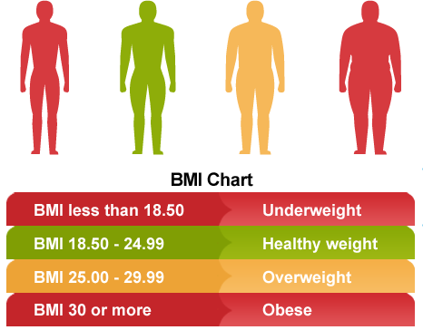
Weight (Kg)
Height² (m²)
Based on BMI =

Slide 10
Based on Waist circumference

Slide 11
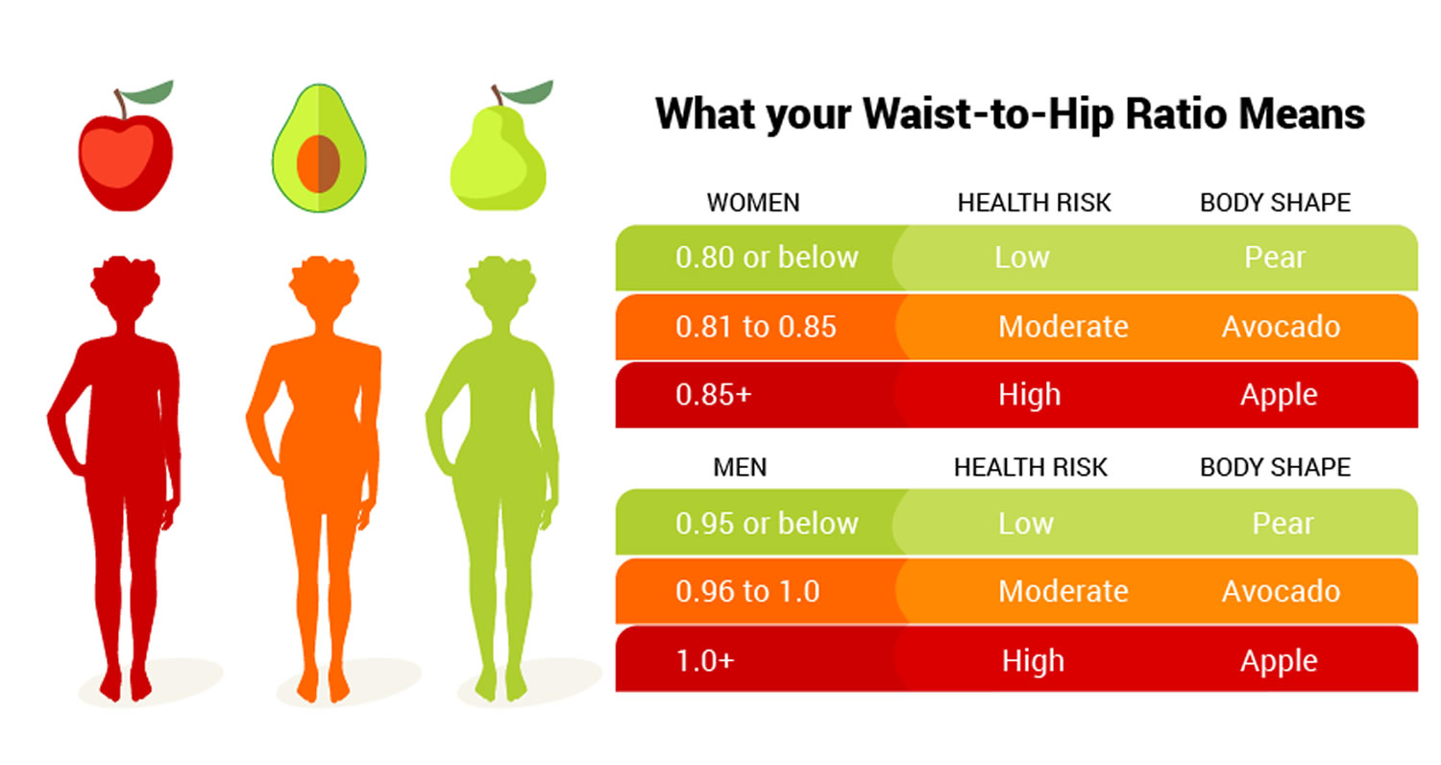
Based on Waist Hip Ratio

Slide 12
Obesity Prevalence in KSA
National study in 2013 (Age 15+) have estimated:
28.7% were obese (body mass index ≥30 kg/m²)
Higher among women 33.5% compared to men 24.1%
School-based multi-centre study in 2014 (Age 14-19)have estimated:
Prevalence of Overweight was 19.5% in males and 20.8% in females.
Prevalence of Obesity was 24.1% in Male and 14% in females.
The overall obesity will increase to 41% in men and 78% in women by 2022.
And if things continue as they are

Slide 13
Tertiary
prevention
Secondary prevention
Primary prevention
Coronary heart disease
Hypertension
Type 2 DM
Dyslipidemia
Metabolic syndrome
Behavioral:
Unhealthy diet
Low physical activity
Obesity
Osteoarthritis
Organic:
Genetic
Hypothyroidism
Cushing’s syndrome
Cancers: breast, endometrial, colon
Sleep apnea

Slide 14
Prevention

Slide 15
Primary Prevention:
Education: For behavioral causes
Maintaining a balanced diet and a healthy behavior:
5-2-1-0 plan for ages 5 and up ( especially children )
5= Encourage intake of daily 5 portions of fruits and vegetables.
2= Encourage eating with the child in a sociable atmosphere without distractions, separate eating from other activities and keep recreational screen time to less than 2 hours,
1= Include at least 1 hour or more of active play every day
0= Skip sugar sweetened beverages, drink more water every day
Exercising and active life style:
Exercise for 30 minutes or more, 5 days a week.
Reduce time spent in front of TV, computer, and mobiles.
Breastfeeding:
Recommend exclusive breastfeeding from birth to six months

Slide 16
Secondary Prevention:
Exercise
Diet
Drug Management
Bariatric surgery
Indications?

Slide 17
Tertiary Prevention:
Decreasing the progression of obesity and it’s complications

Slide 18
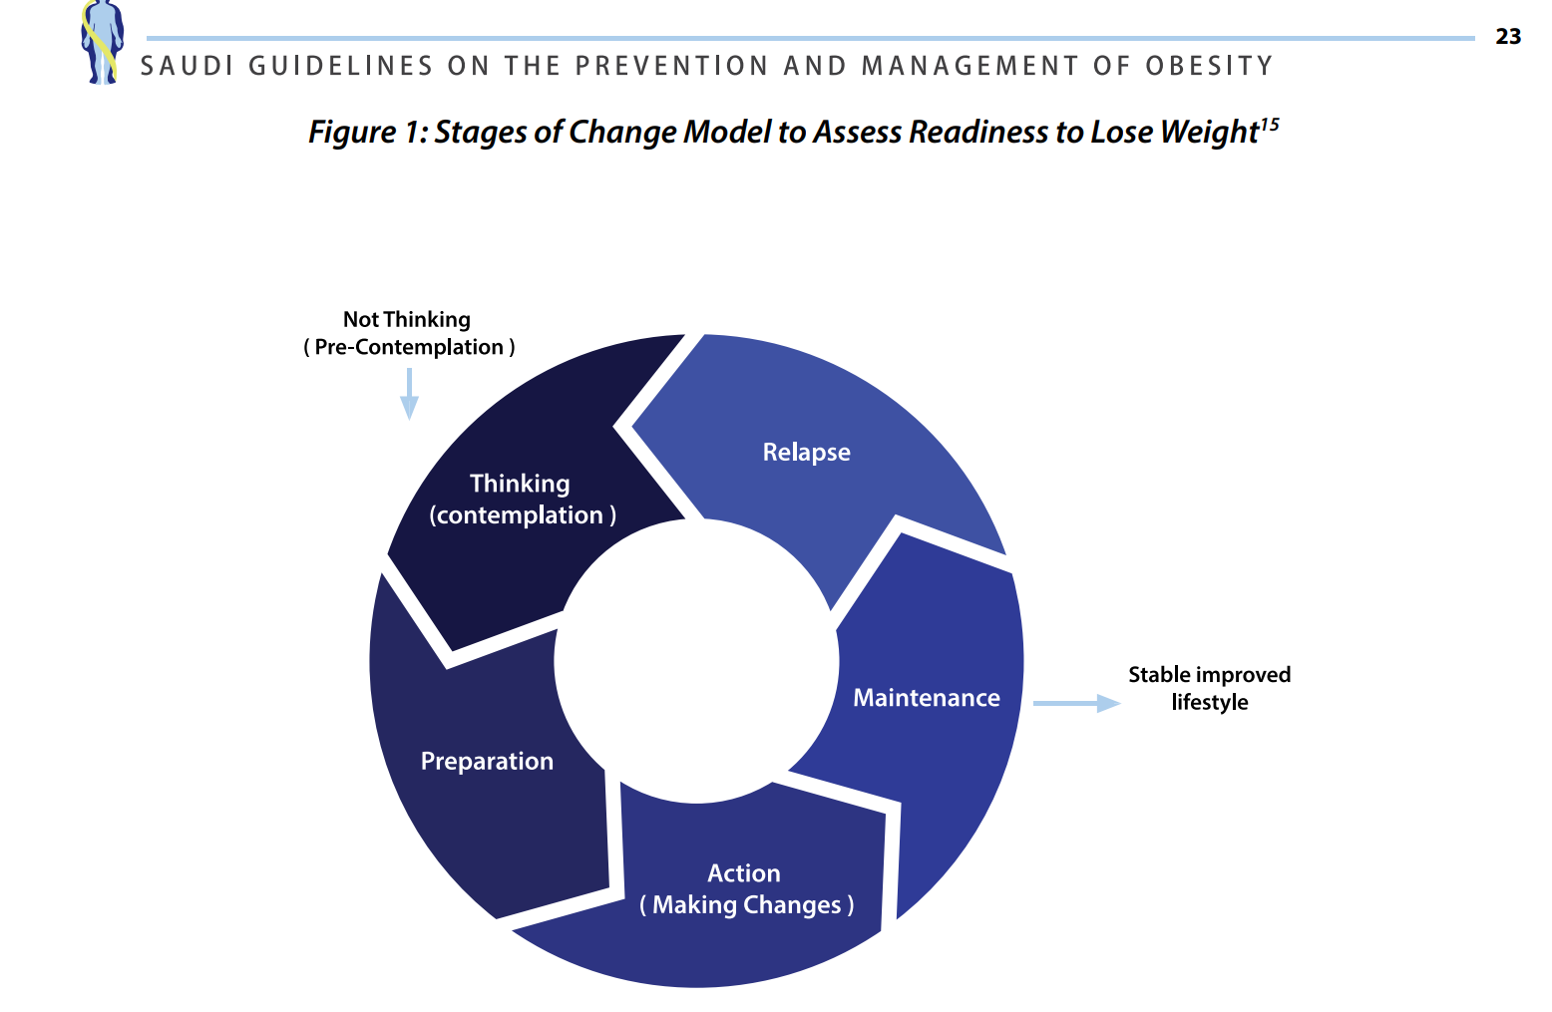

Slide 19
Weight management
For adults with BMI 25-35 kg/m2 the target is to lose 5-10% of body weight (0.5-1 kg per week)
- For adults with BMI>35 kg/m2 and obesity-related co-morbidities the target is to lose a greater than 15-20% of body weight.
Lifestyle modification should target at reducing energy intake, increasing energy expenditure and assisting in behavioral change (NHMRC, evidence grade A)
Optimal dietary plan for achieving healthy body weight should be developed with a qualified and experienced health professional team together with the individual and family.

Slide 20
Diet
Target energy deficit of 500-1000 kilo-calorie per day (3,500 kcal/week)((NHMRC, evidence grade A)
Provide advice on dietary modification
choose low energy-dense foods (e.g. whole-grains, cereals, fruits, vegetables, and salads)
reduce intake of energy-dense foods (e.g. animal fats, sugary drinks (SIGN, evidence grade B)

Slide 21
Diet
- undertake regular self-weighing (SIGN, evidence grade B)
• Strictly supervise patients on very low-calorie diets prescribed for rapid weight loss, (SIGN, evidence grade D)
Fat: < 30% of total daily caloric intake

Slide 22
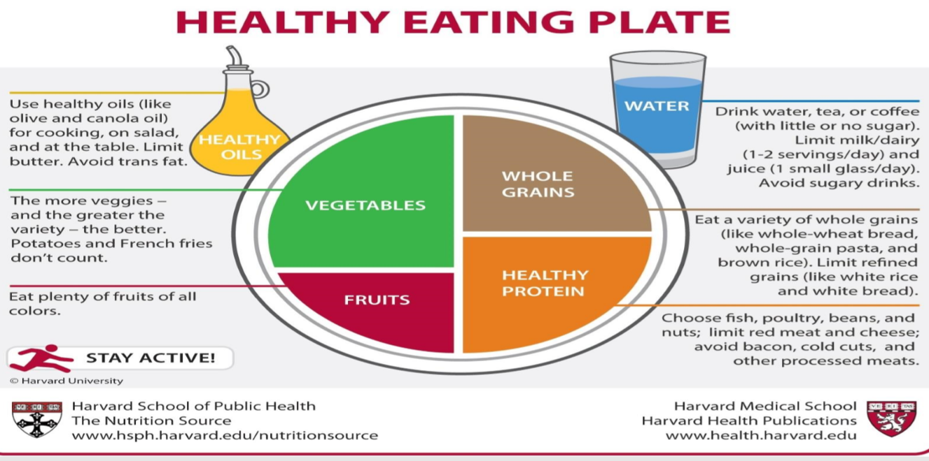

Slide 23
Physical activity
30 min/day for at least 5 days/week (150 min/week) WHO recommendation
• Encourage overweight or obese individuals to be physically active and to avoid sedentary behavior (SIGN, evidence grade B)
• Prescribe a volume of physical activity that produce energy deficit of approximately 1,800-2,500 kcal/week. This could be achieved through 5 sessions of 45-60 min/week of moderate intensity physical activity, or lesser amounts of vigorous physical activity (SIGN, evidence grade B)

Slide 24
Physical activity
encourage non-weight-bearing moderate intensity physical activities (e.g. cycling, swimming, water aerobics) for obese patients suering from joint problems (BMI over 35 kg/m2)
Build up the pace of physical activity gradually over time. The volume of physical exercise should be sustainable and tailored to the individual condition (Canadian, evidence grade A, level 2) 3
muscle-strengthening activities should be done involving major muscle groups on 2 or more days a week.

Slide 25
Benefits of Exercise
Reduce your risk of heart diseases
body manage blood sugar and insulin levels.
Improve your sleep
Help you quit smoking
Improve your sexual health

Slide 26
Benefits of Exercise
Increase your chances of living longer.
Improve your mental health and mood.
Strengthen your bones and muscles
Reduce your risk of some cancers
Reduce your risk of falls

Slide 27
Diet or exercise
Diet or Exercise
Diet only: short term effects unless maintained.
Exercise only: help in preventing weight gain but not in significant weight loss.
Therefore, both of them are required as lifestyle modifications for obesity.*
*Alfadda AA, Al-Dhwayan MM, Alharbi AA, Al Khudhair BK, Al Nozha OM, Al-Qahtani NM, Alzahrani SH, Bardisi WM, Sallam RM, Riva JJ, Brożek JL. The Saudi clinical practice guideline for the management of overweight and obesity in adults. Saudi medical journal. 2016 Oct;37(10):1151.

Slide 28
Bariatric surgery

Slide 29
Bariatric surgery
When to consider?
BMI ≥ 40 kg/m2
or BMI ≥35 kg/m2 with obesity-related comorbidity (e.g., hypertension, diabetes, sleep apnoea, GERD)
When non-surgical methods have failed.

Slide 30
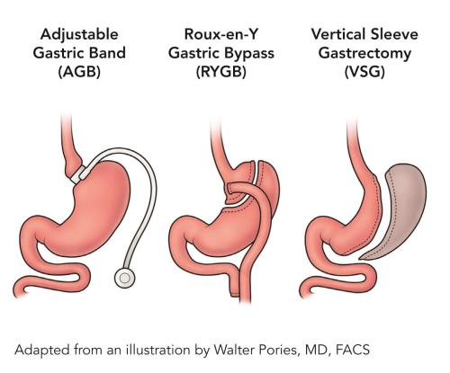
Bariatric surgery
How does it reduce weight?
Reduces food intake by altering hunger and satiety.
Techniques: (Laparoscopic vs open)
Sleeve gastrectomy (USA, KSA)
Gastric bypass
Adjustable gastric banding (UK)

Slide 32
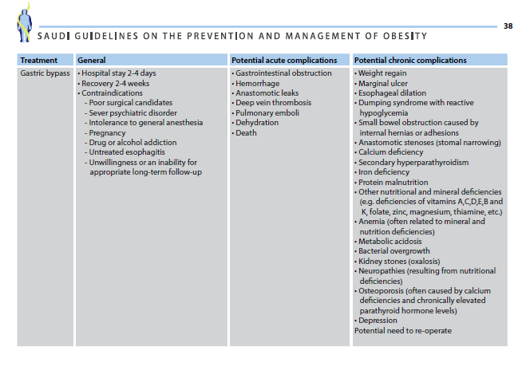

Slide 33
Bariatric Surgery Long-Term Risks
Dumping syndrome
Low blood sugar
Malnutrition
Cholilithiasis
Marginal Ulcers
Bowel obstruction
Hernias

Slide 34
Bariatric surgery after discharge
1. Diet
2. Weight measuring
3. Labs
4.When to refer back to Bariatric Surgery

Slide 35
Bariatric surgery after discharge
1. Diet
Immediate :
Full liquid diet for 2-3 weeks.
Gradually changed to soft, solid food (salads, fruits,
vegetables and soft proteins)
400-800 kcal/day for the 1st month.
Vitamin and mineral supplements
(ex. multivitamins, Iron, Calcium, Vitamin D, Vitamin B12)

Slide 36
Bariatric surgery after discharge
Diet
In the 1st 12 months:
Healthy diet
No meals skipping
Regular dietician visits.
For epigastric pain and vomiting:
Eat slowly
Stop eating once they reach satiety
No food and beverages at the same time

Slide 37
Dumping syndrome
a group of symptoms, including weakness, abdominal discomfort, and sometimes abnormally rapid bowel evacuation, occurring after meals in some patients who have undergone gastric surgery.
In dumping syndrome, food and gastric juices from your stomach move to your small intestine in an uncontrolled, abnormally fast manner.
Eating too much or too fast, eating foods high in fat or sugar, and not chewing your food adequately can all cause nausea or vomiting after meals.

Slide 38
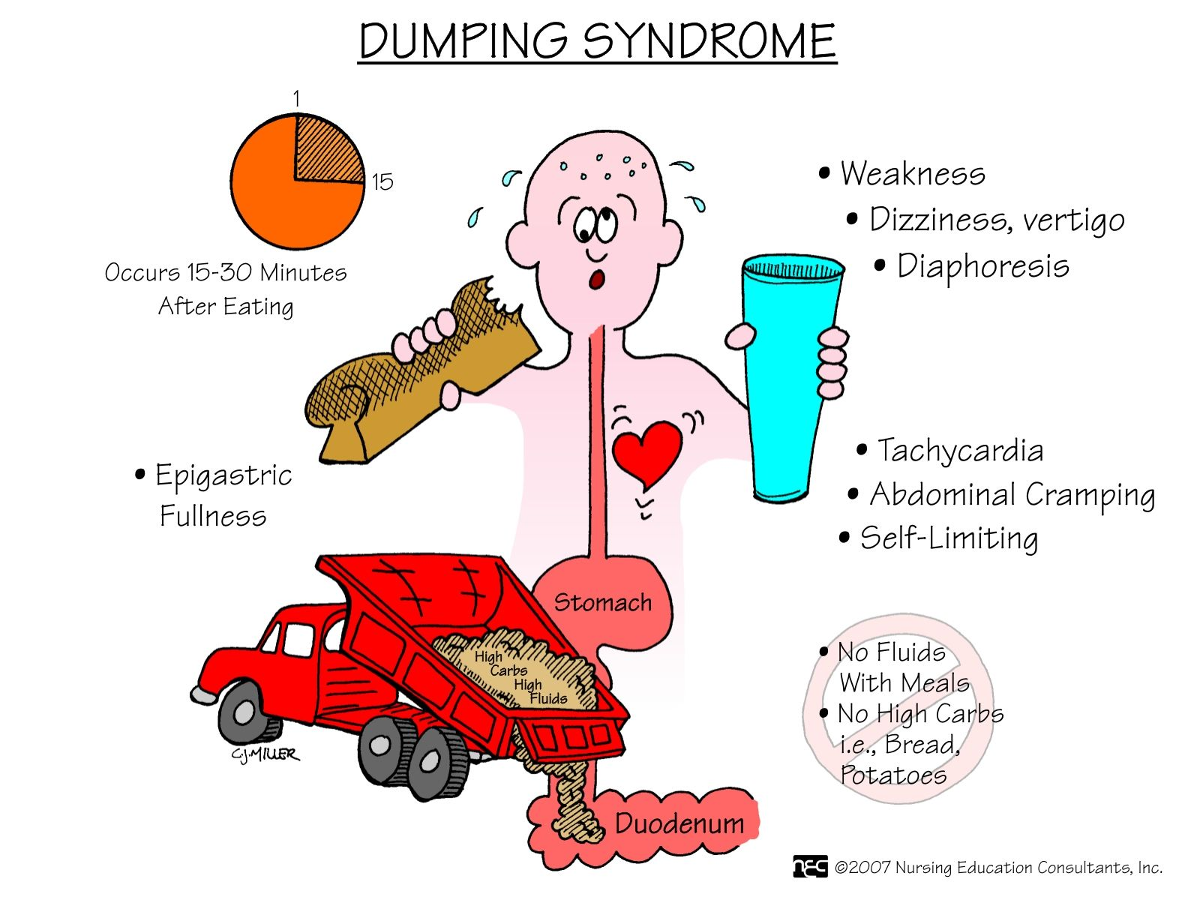
Dumping syndrome

Slide 39
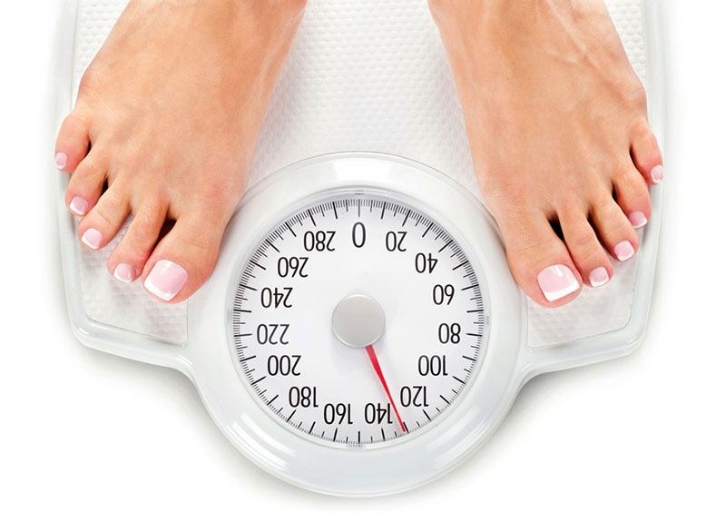
Weight Measuring
Weekly in the 1st 4-6 months (Rapid weight loss phase)
Then at 8, 10 and 12 months.
Then annually.

Slide 40
Labs
(3,6,9 months then annually)
CBC
Electrolytes
Glucose and Glucose
Tolerance test
Complete lipid profile
Complete iron studies
Vitamin B12, Folate(B9) and thiamine (B1)
Aminotransferases, alkaline phosphatase, bilirubin, GGT (LFT)
Total protein and Albumin
25-hydroxyvitamin D, parathyroid
hormone
Zinc and Copper

Slide 41
When to refer back to Bariatric Surgery
Immediate Direct to the emergency or trauma center | Urgent Appointment timeframe within 30 days | Routine Appointment timeframe greater than 30 days depending on clinical need
Severe abdominal pain or intolerance of fluids after bariatric surgery Fever or shortness of breathe after bariatric surgery | Vomiting or severe reflux following bariatric surgery | Assessment for bariatric surgery

Slide 42
Reducing Your Bariatric Surgery Risks
Decreasing your Body Mass Index
Increasing your amount of exercise
Stop smoking

Slide 43
Maintenance
Once weight loss is achieved, the patient should be followed up to maintain his/her body weight.

Slide 44
Obesity Health problems ? How To Address?

Slide 45
How To Address
Health Team
Work with other health care team members to develop a comprehensive scheme for them.
Create non-judgmental atmosphere.
Consider barriers people might have.

Slide 46
School Health Professionals
Promoting Healthy Nutrition at School
Increase daily physical activity of the students
Implement a screening program to detect and provide appropriate care

Slide 47
Medical Students
Aware their relatives and friends
Be a role model

Slide 48
MCQs

Slide 49
MCQ 1
When to consider bariatric surgery ?
BMI less than 35
BMI less than 35 with comorbidity
BMI more than 40
When non-surgical intervention is successful
Notes:
A

Slide 50
MCQ 1
When to consider bariatric surgery ?
BMI less than 35
BMI less than 35 with comorbidity
BMI more than 40
When non-surgical intervention is successful
Notes:
A

Slide 51
MCQ 2
What is the recommended amount of weekly moderate intensity exercise for a healthy person?
200 minutes per week
350 minutes per week
130 minutes per week
150 minutes per week
Notes:
C

Slide 52
MCQ 2
What is the recommended amount of weekly moderate intensity exercise for a healthy person?
200 minutes per week
350 minutes per week
130 minutes per week
150 minutes per week
Notes:
C

Slide 53
MCQ 3
The target for deficit calories per day is?
200-500 kcal/day
500-1000 kcal/day
1000-1500 kcal/day
1500-2000kcal/day
Notes:
C

Slide 54
MCQ 3
The target for deficit calories per day is?
200-500 kcal/day
500-1000 kcal/day
1000-1500 kcal/day
1500-2000kcal/day
Notes:
C

Slide 55
MCQ 4
Which one of the following is a routine interval to do lab tests for patient undergo bariatric surgery ?
Every month
2,4,8 months
3,6,9 months then annually
Every 6 months then annually
Notes:
C

Slide 56
MCQ 4
Which one of the following is a routine interval to do lab tests for patient undergo bariatric surgery ?
Every month
2,4,8 months
3,6,9 months then annually
Every 6 months then annually
Notes:
C

Slide 57
References
NICE guideline and Recommendations https://www.nice.org.uk/guidance/cg189/resources/obesity-identification-assessment-and-management-pdf-35109821097925
http://www.who.int/mediacentre/factsheets/fs311/en/ http://obesity.imedpub.com/a-review-of-prevalence-of-obesity-in-saudi-arabia.php?aid=17699
NHLBI Obesity Education Initiative Expert Panel on the Identification, Evaluation, and Treatment of Obesity in Adults (US). Clinical Guidelines on the Identification, Evaluation, and Treatment of Overweight and Obesity in Adults: The Evidence Report.
https://www.nhlbi.nih.gov/files/docs/guidelines/ob_gdlns.pdf
Scottish Intercollegiate Guidelines Network. Management of obesity: a national clinical guideline. Scottish Intercollegiate Guidelines Network; 2010.
Al Kadi, A., Siddiqui, Z. R., Malik, A. M., & Al Naami, M. (2017). Comparison of the efficacy of standard bariatric surgical procedures on Saudi population using the bariatric analysis and reporting outcome system. Saudi medical journal, 38(3), 251-256.

Slide 58
References
Gilden Tsai A, Wadden TA. The evolution of very-low-calorie diets: an update and meta-analysis. Obesity 2006;14(8):1283-93
Alfadda AA, Al-Dhwayan MM, Alharbi AA, Al Khudhair BK, Al Nozha OM, Al-Qahtani NM, Alzahrani SH, Bardisi WM, Sallam RM, Riva JJ, Brożek JL. The Saudi clinical practice guideline for the management of overweight and obesity in adults. Saudi medical journal. 2016 Oct;37(10):1151.
Frantzides C, Luu M. Obesity in Adults [Internet]. London: BMJ Publishing Group Ltd. 2015 [cited 2015 Jun 9]. Available from: Best Practice
Simon Chantal, Chapter eight, Oxford Handbook of General Practice.
Management and Prevention of Pediatric Obesity in Canada
https://www.alfredhealth.org.au/contents/resources/referral-guidelines/Bariatric-Surgery-Referral-Guidelines.pdf
Elrazek, A. E., Elbanna, A. E., & Bilasy, S. E. (2014). Medical management of patients after bariatric surgery: Principles and guidelines. World journal of gastrointestinal surgery, 6(11), 220-8.

Slide 59
Role Play
Obesity
Counseling

Slide 60
Thank You
For Your Listening
Any Questions ?

