Slide 1
Sexually Transmitted Infections
Done by:
Abdulmalik Alhadlaq
Khalid Alzayani
Abdulaziz ALMohammed
Saad Alshalawi
Ahmed Badahdah
Supervised by:
Dr.Haytham AlSaif

Slide 2
OBJECTIVES
Recognize that sexually transmitted infections (STIs) are caused by a wide array of organisms.
Describe the different routes of transmission of common STIs.
Recognize the epidemiology of STIs in KSA.
Communicate properly with a patient presenting with a suspected STI.
Apply the medical knowledge to properly take history, examine, order and interpret laboratory tests, manage, and counsel a patient presenting with:
urethral or vaginal/endocervical discharge.
genital ulcer
anogenital wart
Recognize latent syphilis and able to order screening tests for it.
Recognize the common complications of common STIs.
Discuss the natural history of HIV, interpret the results of HIV tests, and manage a patient with a positive result.
Manage a spouse of a patient who is HBsAg +ve.

Slide 3
OUTLINES
Questions
Introduction
History
Physical Examination
Investigations
Management
HIV & Hepatitis B
Role Play
Answers to Questions

Slide 4
Question 1
What types of HPV that are detected in around 90% of anogenital warts?
HPV 6 and/or 11
HPV 16 and/or 18
HPV 1 and/or 2
HPV 7 and/or 10

Slide 5
Question 2
A 20 y/o woman who reports unprotected sex with a new partner 2 weeks ago, develops fever and left lower quadrant abdominal pain with onset in association with her menstrual period. Neisseria gonorrhoeae is cultured for her endocervix. The diagnosis is gonococcal pelvic inflammatory disease.
What is the common complication of this infection?
Cancer of the cervix
Infertility
Urethral strictures
Vaginal-rectal fistula

Slide 6
Question 3
Which ONE of the following is the most infectious phase of syphilis disease?
Latent phase.
Secondary phase.
Primary phase
Tertiary phase

Slide 7
Question 4
Which of the following provides a 100% protection from STIs?
Avoiding alcohol and drugs
Condom
Abstinence from sexual activity
All of the above

Slide 8
Question 5
A male patient, who was recently tested for HIV, came to check his results. The ELISA test for anti-HIV antibody and p24 antigen was positive.
What would be the best next step?
Reassure the patient.
Perform a confirmatory test (western blot).
Check the viral load.
Repeat the same test.

Slide 9
Introduction

Slide 10
Epidemiology
There are a lot of infections that are considered STIs.
More than 30 different bacteria, viruses and parasites are known to be transmitted through sexual contact.

Slide 11
Causative Organisms
bacteria | Chlamydia Trachomatis
 | Neisseria Gonorrhoeae
 | Bacterial Vaginosis
 | Treponema Pallidum
 | Chlamydia trachomatis serovars L1, L2, or L3 (Lymphogranuloma Venereum LGV)
viruses | HIV
 | Hepatitis B
 | Hepatitis A
 | Hepatitis C
 | Human papilloma virus (HPV)
 | Herpes simplex virus (1&2)
 | Molluscum contagiosum
Parasite | Trichomonas Vaginalis
 | Sarcoptes scabiei (scabies)
Insect | Pediculosis pubis (lice)
Notes:
Chlamydia D-K cause genitourinary infections

Slide 12
Routes of Transmission
STIs can be transmitted through vaginal, anal, oral, and skin contact.
STI | Transmission
HPV | transmitted through direct contact with infected skin or mucosa.
Herpes Simplex 1-2 | occurs via oral-oral, oral-genital, or genital-genital contact, as well as contamination of skin abrasions with infected oral secretions.
Chlamydia | Hetero- and homo-sexual intercourse.
Neisseria gonorrhoeae | Hetero- and homo-sexual intercourse and oral-genital contact.
Hepatitis B | Hetero- and homo-sexual intercourse.

Slide 13
Route of Transmission (HIV*)
Sexual exposure | Risk per 10,000 exposures to an infected source (risk)
Receptive anal intercourse | 138 (1/72)
Insertive anal intercourse | 11 (1/900)
Receptive penile-vaginal intercourse | 8 (1/1250)
Insertive penile-vaginal intercourse | 4 (1/2500)
Receptive or insertive penile-oral intercourse | 0-4
*HIV transmission is less among circumcised males.

Slide 14
Epidemiology of STIs in KSA
Notes:
This table is from a retrospective analysis of the annual STI cases as obtained from the Ministry of Health (MOH) KSA, from 2005 to 2012. The data are based on the annual registry statistics of adults with STIs as obtained from the Department of Preventive Medicine, the main source of data.
*Nongonococcal urethritis (NGU): Urethral inflammation that is not the result of infection with Neisseria gonorrhoeae.

Slide 15
Incubation period
Infection | Incubation Period
Chlamydia trachomatis | Men: 5-10 days
 | women: 7-14 days
N. Gonorrhea | Men: 4-8 days
 | Women: 10 days
Trichomonas vaginalis | 4-28 days
HSV | 2-7 days
Primary Syphilis | 7 to 90 (median is 21 days)

Slide 16
Asymptomatic Infections
Infection | Percentage of asymptomatic infection
 | Men | Women
Chlamydia trachomatis | 70% | 85%
N. Gonorrhea | 60% | 70%
Trichomonas vaginalis | 75% | 70-85%
HSV | 75-80%

Slide 17
HISTORY APPROACH OF STI

Slide 18
Establishing Proper Communication
Explain the rationale for some of the questions asked.
Using clear and understandable language which both the clinician and patient are comfortable (for example: you can use slang).
Awareness of the signs of anxiety and distress from the patient.
Recognizing non-verbal cues from the patient.
It is important to ensure privacy and confidentiality to the patient during history taking of a patient with a suspected STI.

Slide 19
Complaints where an STI is very likely

Slide 20
1-Urethral discharge or vaginal/endocervical discharge:
Most common cause is NGU.
most common organism responsible for NGU is chlamydia thachomatis, followed by Mycoplasma genitalium.
Another common organism responsible for NGU is trichomonas vaginalis.
Also neisseria gonorrhoeae is a common cause for urethral/vaginal discharge (gonococcal urethritis).
Please note that vaginal discharge can be caused by:
non-sexually transmitted infections such as bacterial vaginosis and vulvovaginal candidiasis.
other non-infectious causes such as: the use of spermicides and soap on genital area, might irritate the urethra causing non-infectious urethritis.

Slide 21
History of presenting illness
Consistency of the discharge: can range from mucoid or watery to frankly purulent, and can be associated with mucus threads.
Amount: copious or scant (Sometimes the discharge is so scant that patient only notice stained underwear in the morning).
Timing: may be present throughout the day or may be scanty and only present on the first morning void.
Smell: odorless or malodorous.
Associated symptoms in both genders: dysuria, polyurea,
Associated symptoms in males: testicular pain or swelling.
Associated symptoms in females: vaginal pruritus, intermenstrual or post coital bleeding or menorrhagia.

Slide 22
2-Ulcer in the sexual contact area:
The majority of genital ulcers are caused by sexually transmitted infections (STIs), although there are noninfectious etiologies that should be considered once STIs have been ruled out.
The most common STI cause is herpes simplex viruses (HSV) 1 or 2.
Syphilis caused by Treponema pallidum.
Lymphogranuloma venereum (LGV) caused by L1, L2, and L3 serovars of Chlamydia trachomatis.
Chancroid caused by Haemophilus ducreyi.
Genital ulcers increase the risk of acquiring HIV.

Slide 23
History of presenting illness
1) The number of lesions.
2) Whether the lesions are painful, Painful ulcers tend to be more typical of HSV and chancroid, while ulcers associated with syphilis, LGV are usually painless.
3) The presence of swelling in the inguinal area (lymphadenopathy).
4) Constitutional symptoms.
5) Anatomic location of a genital ulcer which may cause painful urination in a female with an ulcerative labial or urethral lesion, or in a male with an ulcer at the urethral meatus or on the glans.
6) Are the ulcers recurrent? A history of recurrent ulcers would suggest HSV infection.
7) If the ulcers are recurrent, are they proceeded by any prodromal symptoms such as local mild tingling or shooting pains in the buttocks, legs, and hips?

Slide 24
3-Anogenital warts (condyloma acuminate):
External anogenital warts are typically found on the vulva, penis, groin, perineum, anal skin, perianal skin, and/or suprapubic skin
The warts are typically asymptomatic (painless) but occasionally can be pruritic.
What is the organism responsible for anogenital warts?
Anogenital warts are caused by genital HPV which are divided into low-risk and high-risk types based upon associated risk for cancer in any body area.
There are more than 200 types of HPV, The low-risk types HPV 6 and/or HPV 11 are detected in around 90% of anogenital warts.

Slide 25
Associated symptoms
1-dysurea.
2-lower abdominal/pelvic/peri anal/anal/inguinal/penile/scrotal pain.
3-Scrotal/inguinal swelling.
4-Dysparunia (in females).
5-Post coital and intermenstrual bleeding (suggestive of cervicitis).
6-rectal discharge or bleeding.
7-fever.

Slide 26
What is the 5Ps mnemonic that you should ask any patient with a suspected STI?
Partners
Practices
Prevention of Pregnancy
Protection from STDs
Past History of STDs

Slide 27
What should ask in social history in a patient with a suspected STI?
Married or single?
History of sexual contact in the last 90 days?
If yes marital or extra-marital?
When did it exactly happen? (in order to determine the incubation period).
How many partners?
Homosexual, heterosexual, or both?
Sites of sexual contact (oral, genital, rectal).
Was protection used or not?
Does the partner have a known STI?
Travel history: visiting suspicious places (massage parlors, night clubs…etc) or dealing with suspicious people (private dancers, sex workers).
Use of alcohol or illicit drugs.

Slide 28
Why Drug history is important in a patient with a suspected STI?
Patients should be questioned about medication use since reactions to medications, systemically or locally (e.g. over-the-counter products such as antibacterial ointments), may cause genital ulcers.
What should ask in the past medical history in a patient with a suspected STI?
Past history of other STIs and prior STI testing.
Don’t forget to ask female patients about their last menstrual period.

Slide 29
PHYSICAL EXAMINATION

Slide 30
1-Vital Sings:
1-Body temperature
2-Pulse rate
3-Respiration rate
4-Blood pressure
5-SpO2

Slide 31
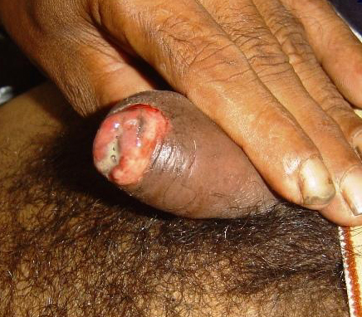
2-EXAMINATION RELATED TO URETHRAL/VAGINAL OR CERVICAL DISCHARGE
In men:
may be grossly evident or May only be detectable after ”stripping” or “milking”.
Mucopurulent or purulent discharge confirms urethritis diagnosis in a symptomatic male patient.
Examine the scrotum for swelling and tenderness as epididymitis is one of the possible complications.
Digital rectal examination should be done in those who have symptoms that may indicate underlying prostatitis.

Slide 32
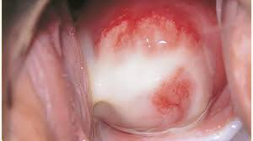
2-EXAMINATION RELATED TO URETHRAL/VAGINAL OR CERVICAL DISCHARGE
In women:
Gonorrhea and chlamydia most commonly affect the cervix.
You will need to do a speculum examination.
You should look for swelling, erythema and mucopurulent discharge at the cervical opening.
endocervical bleeding is easily induced by gentle passage of a cotton swab through the cervical opening in case of cervicitis.

Slide 33
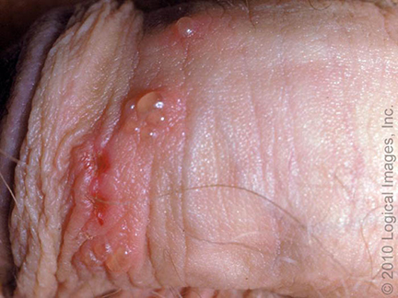
3-EXAMINATION RELATED TO GENITAL ULCER:
The number and appearance of lesions can help with the diagnosis.
Herpetic lesions:
can begin as one or a group of vesicles an erythematous base.
These vesicles subsequently open, resulting in shallow ulcers/erosions that may coalesce.
In areas under the foreskin or around the labia and rectum, vesicles often break prior to being noticed
Notes:
As an example, infection due to HSV or H. ducreyi (chancroid) typically presents as multiple ulcers, whereas syphilis usually presents as a single ulcer.

Slide 34
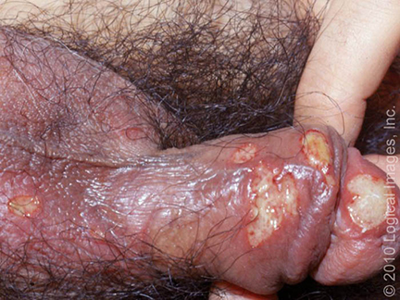
3-EXAMINATION RELATED TO GENITAL ULCER:
The number and appearance of lesions can help with the diagnosis.
Syphilitic lesions:
is classically a single, indurated, well-circumscribed painless ulcer on a clean base (please note that the chancre can be painful if it develops a secondary infection), the chancre will heal spontaneously.
The ulcers associated with chancroid begin as papules that go on to ulcerate. The ulcers are characteristically deep and ragged with a purulent, yellow-gray base, and an undermined, violaceous border.
Notes:
Violet colored

Slide 35
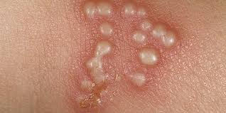
4-EXAMINATION RELATED TO ANOGENITAL WARTS:
Anogenital warts can be single or multiple.
The shape can be flat, dome-shaped, pedunculated amongst other various shapes.
The surface can be smooth, verrucous, or lobulated.
The color can be white, erythematous, skin colored, violaceous, brown or hyperpigmented.
They are usually soft to palpation and can range in the diameter from 1mm to several centimeters.

Slide 36
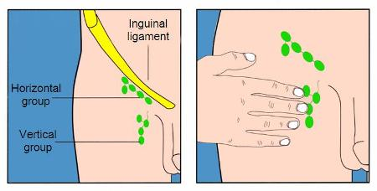
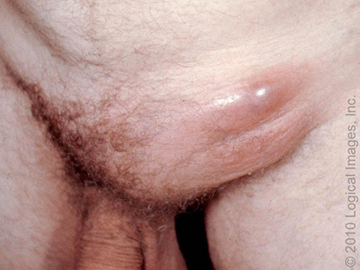
5-EXAMINATION OF THE LYMPH NODE:
You should examine the inguinal lymph nodes for lymphadenopathy and tenderness.
Inguinal lymphadenopathy is commonly seen in patients with infectious causes of genital ulcers.
The lymph nodes are often tender in patients with HSV, chancroid, and LGV.
Rubbery, non-tender nodes are often seen in late primary syphilis

Slide 37
What is the differential diagnosis of anogenital warts?
Common benign papular cutaneous condition (seborrheic keratosis)
STDs (Condyloma latum of secondary syphilis)
Inflammatory conditions (papulosquamous lesions of lichen planus)
Premalignant or malignant disorders (Bowenoid papulosis)

Slide 38
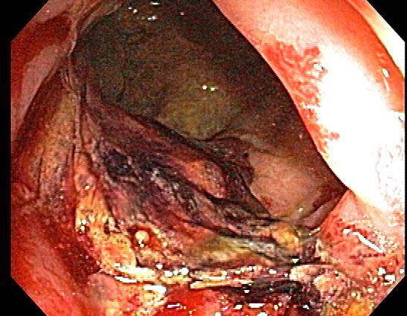
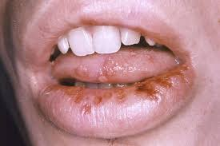
6-GENERAL EXAMINATION
other anatomical sites, such as the pharynx or rectum, may be affected by sexually transmitted infections, and pharyngitis, proctitis, or (more commonly) asymptomatic infection at these extragenital sites may accompany the presenting STI.
*if the patient is presenting with any of the three complaints you have to check him/her for the other two during examination.

Slide 39
Are history and physical examination enough to determine the etiology of a genital ulcer?
No, because it may lead to a false diagnosis and treatment.
The symptoms, signs and appearance my vary due to individual pathogens and a presence of a coinfection.
Immunocompromised patients may have atypical presentations, such as a widespread and severe disease.

Slide 40
Investigations

Slide 41
What should be your general approach to testing in a patient with a genital ulcer?
Patients should be tested for common STIs regardless of the clinical presentation, Patients with an ulcerative sexually transmitted infection (STI) are at increased risk for coinfection with other STIs.
Thus, individuals should also be tested for HIV, gonorrhea, and chlamydia.
Also, testing for hepatitis B and hepatitis C may also be considered.
Some patients may have a known cause for their STI (e.g. they know the infection their partner has or have recurrent herpes simplex virus [HSV] infection).
For such patients, we still test for other common STIs because more than one infection may be present.

Slide 42
What if initial testing for STI causes of genital ulcer came back negative?
If initial testing for STIs is negative:
test for non-sexually transmitted infections and noninfectious causes.

Slide 43
What should be included in the baseline testing of a patient with a genital ulcer or urethral/vaginal discharge?
Patients who present with genital ulcers should undergo testing for common causes of genital ulcers, such as HSV 1&2 and syphilis.
Patients who present with urethral/vaginal or endocervical discharge should undergo testing for common causes of urethritis/vaginitis or cervicitis such as chlamydia and gonorrhea.
As well as other STIs (e.g. HIV, hepatitis B, and hepatitis C).

Slide 44
What tests can you order for a patient presenting with urethral/vaginal discharge?
1- Gram stain and culture of urethral (men), endocervical swab:
The Gram stain should be examined for the presence of WBCs (specifically polymorphonuclear neutrophils [PMNs]) and any organisms:
The presence of PMNs without any visible organisms is consistent with NGU.
whereas gonococcal urethritis may be diagnosed by the demonstration of gram-negative intracellular or extracellular diplococci in the urethral exudate.
A Gram stain has low sensitivity in women compared with men ?
Notes:
A: due to the possible presence of other nonpathogenic gram-negative diplococci in cervical secretions

Slide 45
What tests can you order for a patient presenting with urethral/vaginal discharge?
2- In men First-void or first-catch urine:
First-void urine: the initial portion of the first urinary stream after awakening ?
First-catch urine: the initial portion of any urinary stream. (ideally at least one hour after the previous micturition).

Slide 46
Cont.
Both can be examined using the following:
Dipstick: positive leukocyte esterase (this is diagnostic of urethritis).
microscopy: the presence of ≥10 WBC/hpf (this is diagnostic of urethritis).
Nucleic acid amplification testing (NAAT) for identification of the causative organism:
Can detect: n. gonorrhea, chlamydia t., trichomonas vaginalis, Mycoplasma genitalium, and ureaplasma urealyticum
There are several ways of amplification including polymerase chain reaction (PCR), strand displacement assay (SDA), or transcription mediated assay (TMA).

Slide 47
What tests can you order for a patient presenting with urethral/vaginal discharge?
3- In women self- or clinician-collected vaginal swab or a clinician-collected endocervical swab or a urine sample (urine sample NAAT is less sensitive in women) can be examined using:
Nucleic acid amplification testing (NAAT) for identification of the causative organism.

Slide 48
Why is it important to identify the organism causing the urethral/vaginal discharge?
For accurate diagnosis and notification to ministry of health in order to monitor the epidemiology of STIs.
For partner treatment.

Slide 49
What tests can you order to diagnose herpes simplex 1 or 2?
1-The lesion should be swabbed and directly tested for HSV.
Nucleic acid amplification methods (NAATs), including polymerase chain reaction (PCR) assays, are now commercially available and are the test of choice, as they have a higher sensitivity than culture or direct immunofluorescent antibody testing.
2-If HSV PCR is not available:
A viral culture of the base of the ulcer can be obtained.
If a vesicle is present, vesicular fluid is preferred because of its higher diagnostic yield.

Slide 50
What are the types tests done to screen for or diagnose syphilis?
There are Direct methods and serological tests:
Direct methods:
such as Darkfield microscopy and direct fluorescent antibody (DFA) testing.
They are not routinely available in clinical settings because these methods require special equipment to perform the test, as well as considerable experience and expertise to properly interpret the results.

Slide 51
Cont.
Serological tests which are divided into:
1-Nontreponemal tests:
rapid plasma reagin (RPR) test and the Venereal Disease Research Laboratory (VDRL) test.
2-Treponemal test:
Treponema pallidum hemagglutination assay (TPHA), T.pallidum enzyme immunoassay (TP-EIA), and Fluorescent treponemal antibody absorption (FTA-ABS)

Slide 52
What is the difference between treponemal and non-treponemal tests?
Nontreponemal tests:
Determine the presence of a nontreponemal antibody directed against cardiolipin antigens.
Treponemal tests:
Are based on the detection of treponemal antibody—the antibody that attacks T. pallidum, the spirochete that causes syphilis—in the blood.

Slide 53
In a patient with a suspected primary syphilis (chancre) which type of test should I order and why?
The definitive method for diagnosing syphilis is visualizing the Treponema pallidum bacterium via darkfield microscopy of a swab from the ulcer. (this technique is rarely performed today).
Serologic testing to diagnose syphilis should include the use of both nontreponemal and treponemal tests.
Either type of test can be used as the initial screening test (please note that treponemal tests Becomes reactive earlier in primary syphilis than nontreponemal tests).
Confirmatory testing using the other type is necessary due to the potential for a false positive screening test result.
In other words if you use nontreponemal for screening, confirm with treponemal and vice versa.

Slide 54
Which type of serological syphilis tests can be used to follow up response to treatment?
Nontreponemal test antibody titers might correlate with disease activity and are used to follow treatment response.

Slide 55
What if both nontreponemal and treponemal tests came back negative in a patient suspected to have primary syphilis?
• If there is a high clinical suspicion for primary syphilis, treat the patient and repeat serologic testing at a later time point (e.g. two to four weeks later) in order to confirm the diagnosis.

Slide 56
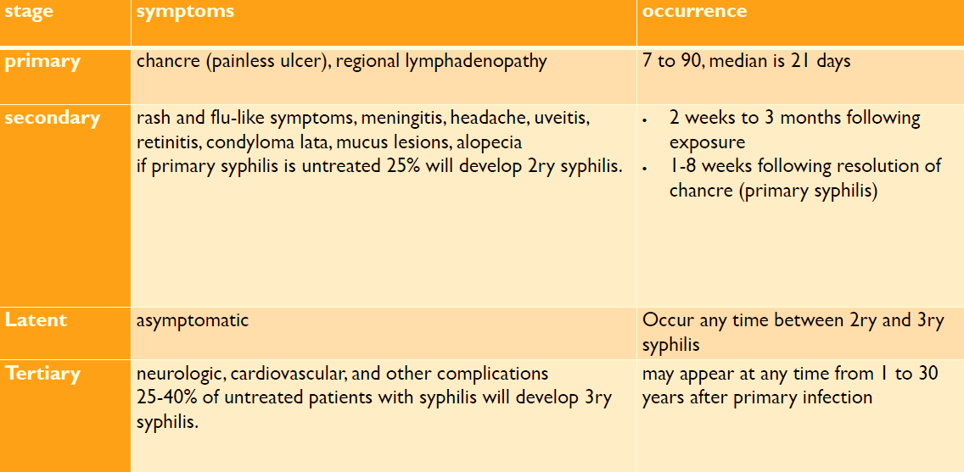

Slide 57
When can we say a patient has latent syphilis?
• Patients without a past diagnosis of syphilis who have both a reactive nontreponemal test (e.g. rapid plasma reagin) and a reactive treponemal test
• Patients with a prior history of syphilis (1ry or 2ry) who have a current nontreponemal test titer that demonstrates a fourfold or greater increase from the last nontreponemal test titer.

Slide 58
Latent syphilis is classified into 2 types, what are they and what is the difference between them?
Early latent syphilis:
Asymptomatic syphilis acquired within preceding year
Infectious
Late latent syphilis
Asymptomatic phase of syphilis acquired > 1 year previously
Not thought to be infectious

Slide 59
I am not sure from history and clinical examination that the wart is caused by HPV, what should I do to confirm the diagnosis?
Excise the wart and biopsy it to confirm the diagnosis and rule out malignancy

Slide 60
Women with reproductive potential and an STI should undergo pregnancy testing.

Slide 61
TREATMENT OF SEXUAL TRANSMITTED INFECTION

Slide 62
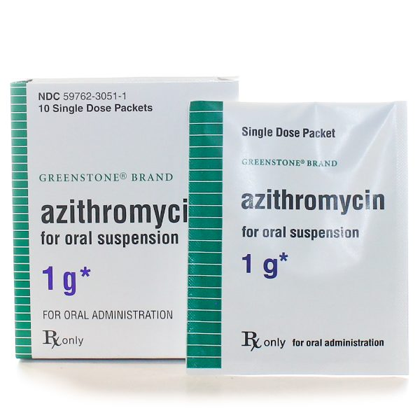
TREATMENT FOR STI CAUSING URETHRITIS/VAGINITIS OR CERVICITIS
Gonococcal infections:
Dual therapy:
Ceftriaxone:
For gonococcal infection
Intramuscular
Single dose
250 mg
Azithromycin:
For treatment of potential chlamydia coinfection and for possible additional activity against N.Gonorrhea
Oral
Single dose
1 gram

Slide 63
TREATMENT FOR STI CAUSING URETHRITIS/VAGINITIS OR CERVICITIS
Non-Gonococcal infections:
Targeted against C. trachomatis as the most likely pathogen
Azithromycin:
Oral
Single dose
1 gram
Doxycycline:
Oral
Twice daily for 7 days
100 mg

Slide 64
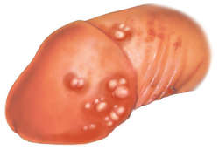
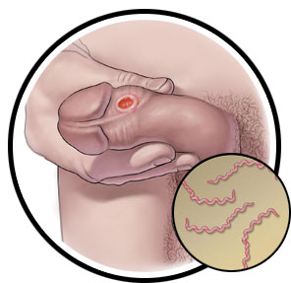
EMPIRICAL TREATMENT FOR GENITAL ULCER IF:
A known exposure to an STI
Genital ulcers suggestive of HSV (multiple or panful ulcer)
Genital ulcers suggestive of syphilis (single or painless ulcer) in patients who are at high risk for infection such as:
Sexually active men who have sex with men (MSM)
Commercial sex workers
Individuals who exchange sex for drugs
HIV patients

Slide 65
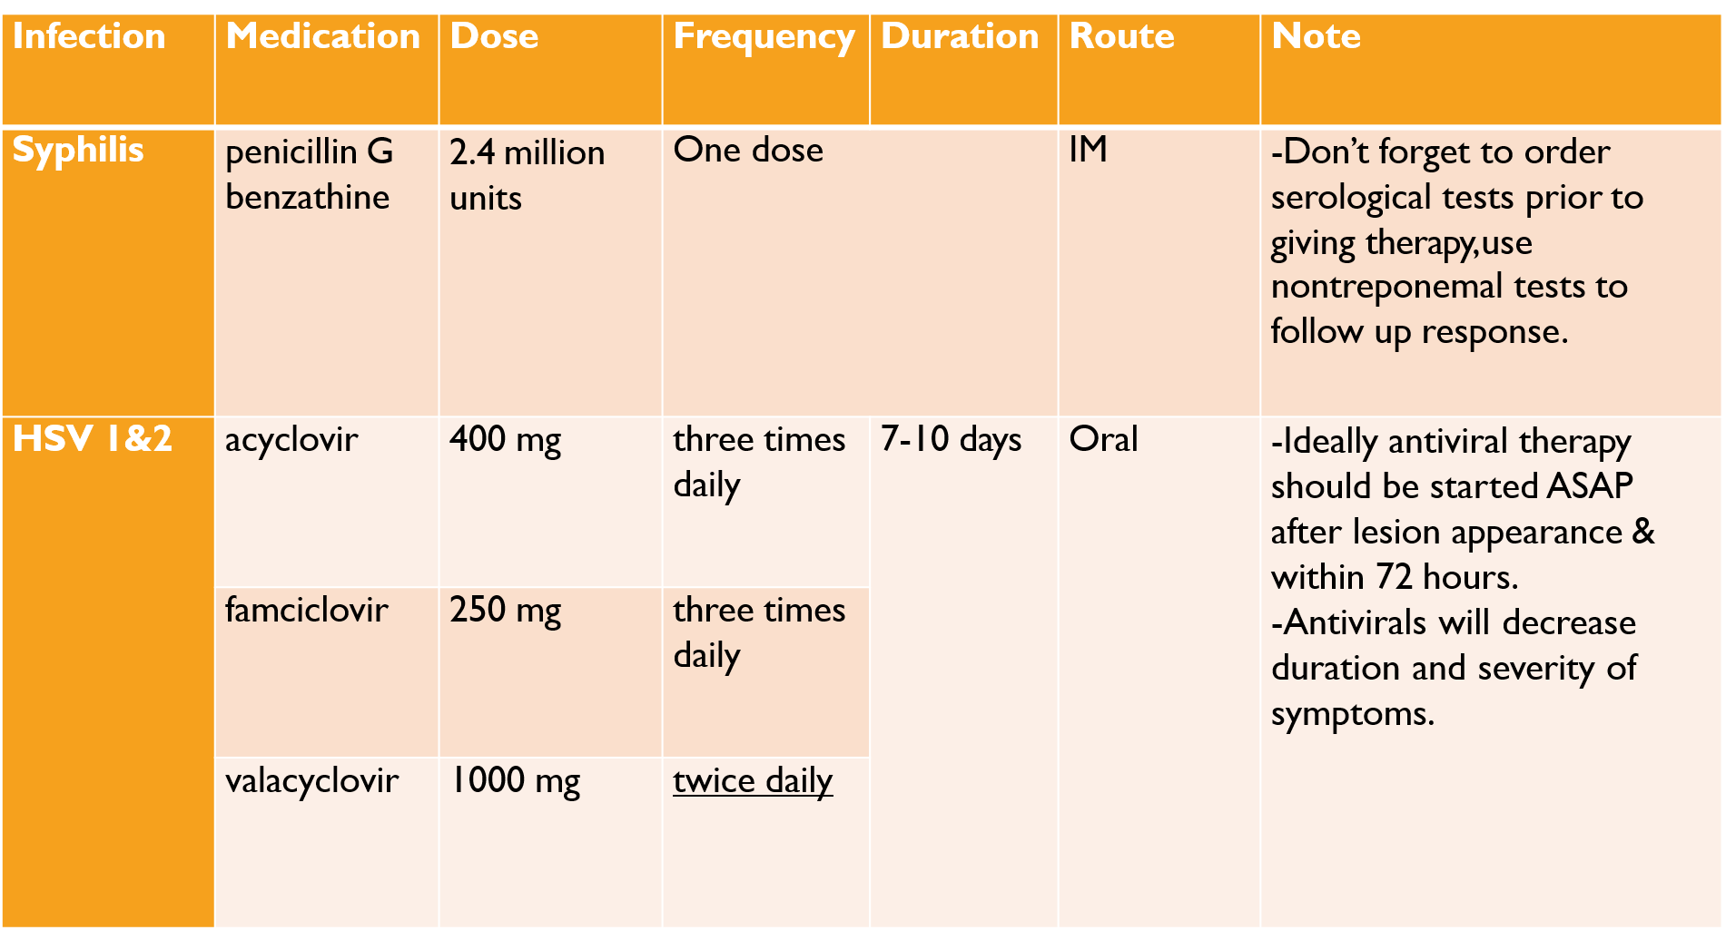

Slide 66
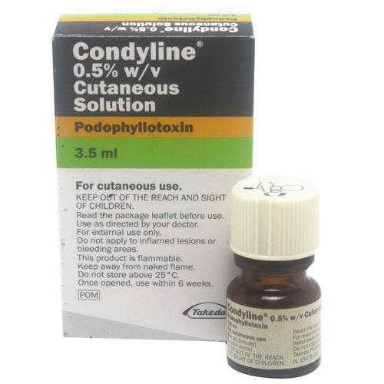
TREATMENT OPTIONS FOR ANOGENITAL WARTS
First-line patient-applied therapies include:
Topical Imiquimod.
Topical Podophyllotoxin
First-line clinician-administered therapies include:
Cryotherapy
Surgical removal (excision, electrosurgery, or laser)

Slide 67
How long should a patient treated or suspected to have an STI abstain from sexual activity?
All patients should be advised to refrain from sexual activity while awaiting test results and, if empiric therapy was initiated, for at least 7 days after both the patient and his/her partner are treated.
What should be included in your counseling to a patient with an STI?
Counseling regarding partner/contact testing and treatment.
if the patient was exposed to an STI during an extramarital relationship, he/she should be advised to avoid extramarital sexual activity.

Slide 68
Behavior:
Abstinence: it is the only way to avoid STIs 100%.
Condom use: reduce STI transmission significantly but not 100% effective.
Avoiding alcohol and illicit drug use: these affects mental status and might lead to risky sexual practices.
Avoid suspicious places during travel, massage parlors, night clubs, sex workers…etc.

Slide 69
Vaccines:
Hepatitis A & B.
HPV vaccine.

Slide 70
Instruction:
Avoid sexual contact at least for 7 days after starting treatment and until symptoms have resolved.
Retesting:
Repeat testing to confirm cure is recommended for all pregnant women with an STI.

Slide 71
PARTNER MANAGEMENT
All individuals who have had sexual contact with patients diagnosed with N. gonorrhoeae or C. trachomatis within the 60 days prior to the diagnosis should be evaluated and treated.
Contacts of a patient with primary syphilis within the preceding 90 days, even if their serologic test for syphilis is negative.
Contacts of a patient with chancroid within the preceding 10 days.
No need to empirically treat contacts of patients with genital herpes simplex virus (HSV) but:
should be counseled and educated about the symptoms and presentation of HSV
And can be offered Type-specific antibody testing (IgM & IgG) to assess their HSV status and potential risk for HSV transmission.

Slide 72
FOLLOW UP
Scheduled within 1 week of the initial visit to check for:
Resolution of symptoms
Results of tests.

Slide 73
Common complications of common STIs:
Infection | Gender | Complications
Chlamydia and gonorrhea | Men | urethral strictures, epididymitis, infertility.
 | Women | Pelvic inflammatory disease (PID), infertility, ectopic pregnancy, perinatal infection, chronic pelvic pain.
 | Both | reactive arthritis or Reiter syndrome (arthritis, uveitis, and urethritis), increased risk of acquiring and transmitting HIV.
Genital Herpes (HSV-1 and -2) | Both | Recurrent episodes, vertical transmission to the baby during delivery, increased risk of acquiring and transmitting HIV.
Syphilis | Both | 2ry, latent, & 3ry syphilis, congenital syphilis (mother to baby transmission), increased risk of acquiring and transmitting HIV.
HPV | Women | Cervical, vulvar, and vaginal cancer.
 | Men | Penile cancer.
 | Both | Rectal cancer.

Slide 74
HIV & Hepatitis B

Slide 75
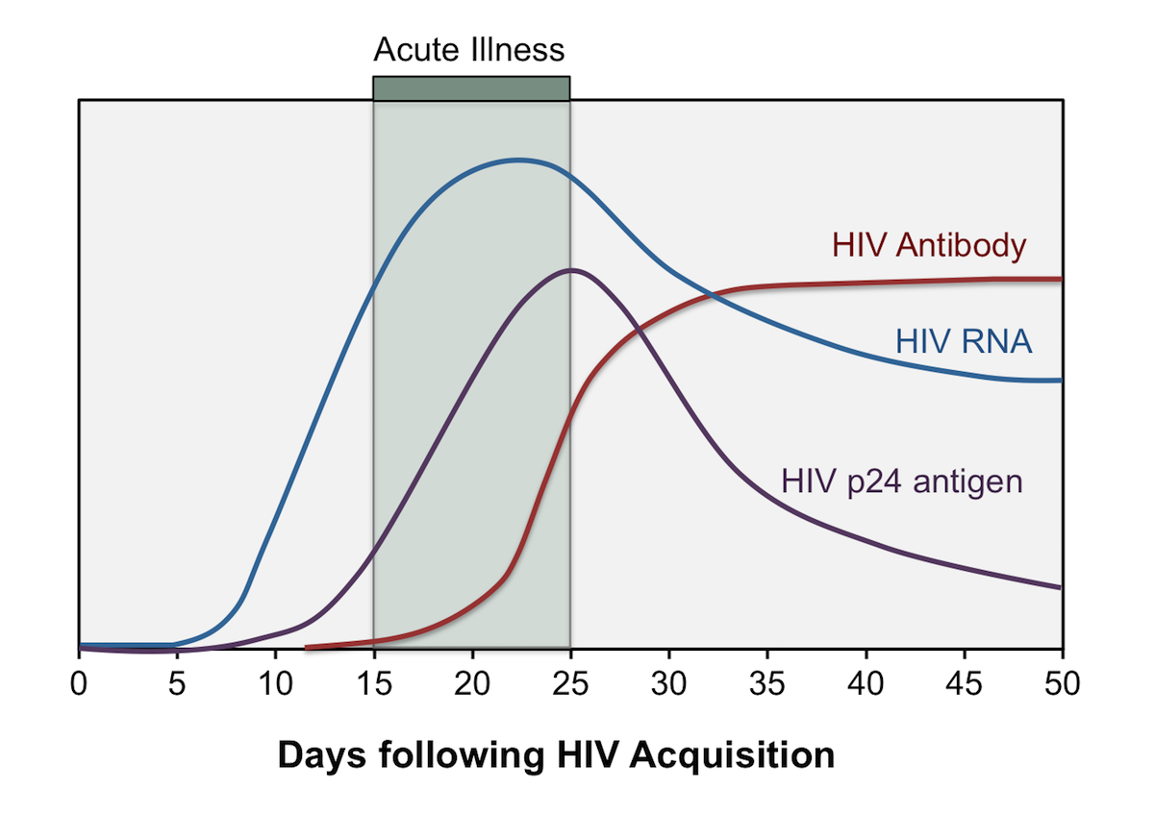
Natural History of HIV
Window period: Time between infection and development of anti-HIV antibodies; when serologic tests (ELISA, Western blot) are negative.

Slide 76
Indications for Testing
In KSA it is part of pre-marital screening and some pre-employment screening (for example Health care providers)
In case of suspected exposure and a symptomatic manifestations of an early HIV infection (fever, lymphadenopathy, sore throat, rash, myalgia/arthralgia, diarrhea, weight loss, and headache) also called (retroviral syndrome):
perform the most sensitive screening immunoassay available (ideally, a combination antigen/antibody immunoassay) in addition to an HIV virologic (viral load) test using PCR.
In case of suspected exposure and no symptoms (this is the common scenario).

Slide 77
HIV Testing
Anti-HIV antibodies detectable after a median of 3 weeks, virtually all by 3 months (therefore 3 months window period).
initial screening test (3rd generation antibody test):
enzyme linked immunosorbent assay (ELISA) detects serum antibody to HIV; sensitivity >99.5%
increasingly, combination p24 antigen/HIV antibody tests (4th generation) used for screening; improved sensitivity in early or acute infection and sensitivity/specificity approach 100% for chronic infection.
confirmatory test:
If the screening test was positive, an HIV-1/HIV-2 antibody differentiation using western blot or line immunoassay is performed; specificity >99.99%

Slide 78
 | Enzyme linked Immunoassay (3rd or 4th gen) | confirmatory test (western blot or line immunoassay) | viral load | interpretation
Scenario 1 | Negative | No need | No need if the patient is asymptomatic | HIV negative
Scenario 2 | Positive | Negative or intermediate | Negative | If the patient is at low risk for HIV: reassure that HIV infection is very unlikely. if the patient is not at low risk or you are not sure about his risk level repeat viral load after 1-2 weeks
Scenario 3 | Positive | Negative or intermediate | Weakly positive (RNA level <1000 copies/mL) | may rarely represent a false positive viral test the viral load test should be immediately repeated on a new blood specimen
Scenario 4 | Positive | Negative or intermediate | Positive | HIV positive
Scenario 5 | Positive | Positive | Not needed for diagnosis | HIV positive

Slide 79
Rapid HIV screening tests:
Designed to provide results in less than 20 minutes.
Although these tests can be performed in the laboratory (using serum or plasma), they can also be performed in community-based settings supervised by trained personnel, or at home, using whole blood or oral secretions.
The accuracy of most rapid tests is quite high (>99% sensitivity and specificity) for patients with chronic infection.
In one study, rapid antibody tests missed approximately 12 percent of acute HIV infections.
In addition, testing on oral fluids appears to be less sensitive than testing on finger stick blood samples.

Slide 80
Managing a patient with a positive HIV screening test:
Breaking bad news.
MOH notification.
Referral to infectious diseases specialist.
Screening of sexual contacts and family member.

Slide 81
Hepatitis B
A patient who is a HBsAg +ve married or planning to marriage came to you asked you is it safe to have sexual intercourse with his/her partner?
Yes, people who are HBsAg +ve can have sexual intercourse with their partners.
If the partner is immune:
they can have normal sexual intercourse without need for condom.
If the partner is not immune:
they can have sexual intercourse using condom.
the partner should receive a hepatitis B vaccination series (3 doses at 0, 1 month, & 6 months), then 1-2 months after finishing the series he/she should be tested for immunity against Hep B, if immune they can have intercourse without condom.

Slide 82
Hepatitis B
When can we say the patient is immune after vaccination?
anti-HBs ≥10 milli-international units/mL
When an STI is detected in a child, evaluation for sexual abuse is mandatory.

Slide 83
Approach to a male patient with suspected urethritis

Slide 84
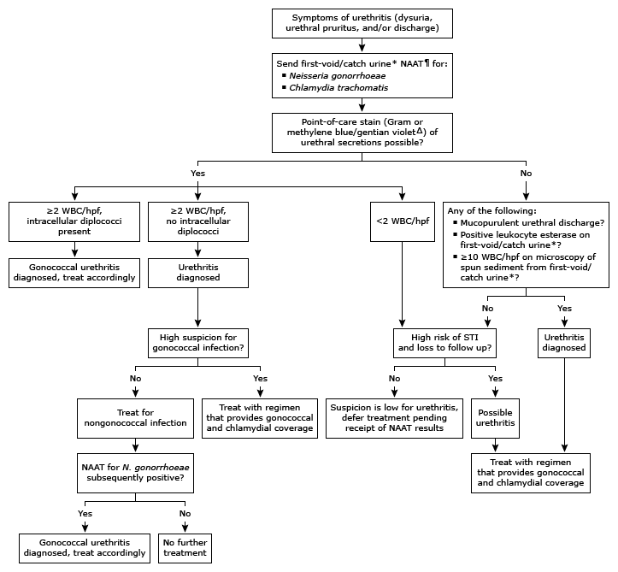

Slide 85
Approach to a patient with a genital ulcer

Slide 86
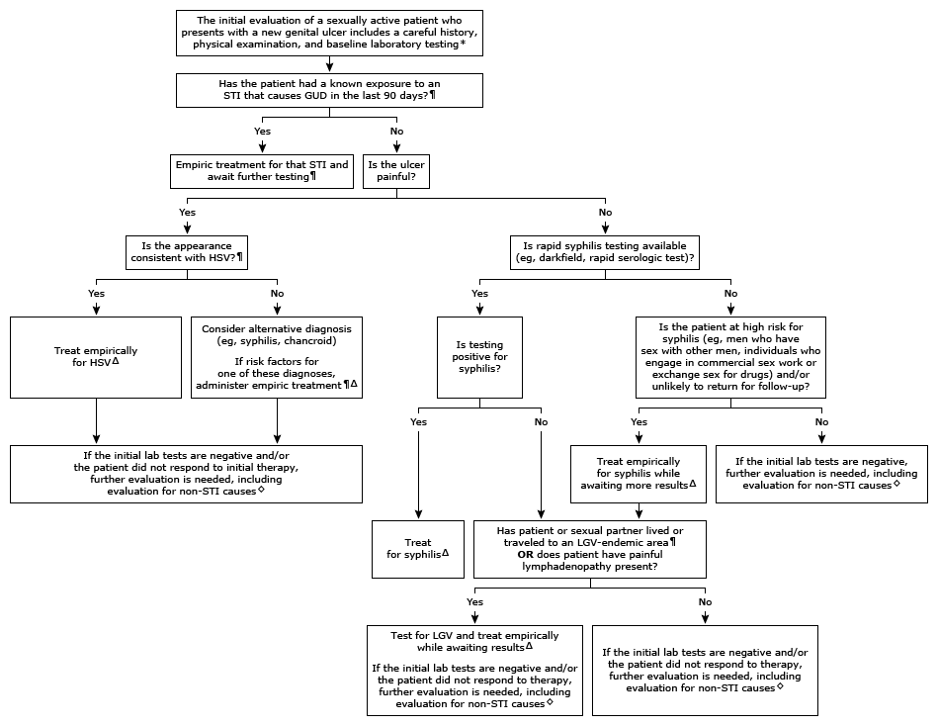

Slide 87
Role Play

Slide 88
Answers to Questions
Q1:What types of HPV that are detected in around 90% of anogenital warts?
HPV 6 and/or 11
HPV 16 and/or 18
HPV 1 and/or 2
HPV 7 and/or 10

Slide 89
Answers to Questions
Q2: A 20 y/o woman who reports unprotected sex with a new partner 2 weeks ago, develops fever and left lower quadrant abdominal pain with onset in association with her menstrual period. Neisseria gonorrhoeae is cultured for her endocervix. The diagnosis is gonococcal pelvic inflammatory disease.
What is the common complication of this infection?
Cancer of the cervix
Infertility
Urethral strictures
Vaginal-rectal fistula

Slide 90
Answers to Questions
Q3:Which ONE of the following is the most infectious phase of syphilis disease?
Latent phase.
Secondary phase.
Primary phase
Tertiary phase

Slide 91
Answers to Questions
Q4: Which of the following provides a 100% protection from STIs?
Avoiding alcohol and drugs
Condom
Abstinence from sexual activity
All of the above

Slide 92
Answers to Questions
Q5: A male patient, who was recently tested for HIV, came to check his results. The ELISA test for anti-HIV antibody and p24 antigen was positive.
What would be the best next step?
Reassure the patient.
Perform a confirmatory test (western blot) .
Check the viral load.
Repeat the same test.

Slide 93
Thank you

Slide 94
Reference
A suggested approach to STIs for family physicians in KSA, prepared by Dr. Haytham AlSaif from the following resources: UpToDate, Dynamed, Toronto notes, CDC, WHO, and local studies.

