Slide 1
SlS ( changes in bowel habits)
Fahad Alajlan
Hisham Algosy
Abdulkarim alharbi
Faisal Alyahya
Faisal Alzeer

Slide 2
objectives
Define constipation and diarrhea
Discuss the definition, etiology and classification of irritable bowel syndrome (IBS)
Demonstrate history taking, physical examination, and management for patients presented with history suggestive of IBS. i.e Role play.
Discuss the alarm symptoms in patients presenting with change bowel habit.
Identity the criteria for the referral to specialist
Practical: Examination of Abdomen, How to do?

Slide 3
Test your knowledge..

Slide 4
1-A 37-year-old woman reports a 10-year history of intermittent abdominal pain and constipation alternating with diarrhea. She has no weight loss, fever, or worrisome features on examination. Which of the following agents is clini­cally indicated as a first-line treatment for mild-to-moderate abdominal pain associated with IBS?
Amitriptyline
B. Lubiprostone
C. Dicyclomine
D. Fluoxetine

Slide 5
2) What is the best way of diagnosing IBS?
A- By excluding other causes. (A diagnosis of exclusion)
B- By Rome IV criteria.
C- By excluding the presence of red flags.
D- By Rome IV criteria and excluding the presence of red flags.

Slide 6
3- A 27-year-old graduate student in psychology is evaluated for intermittent abdominal pain. She is diagnosed with IBS. She asks whether there is a relationship between psychiatric disorders and IBS. Which of the following statements is most accurate?
A. IBS is usually caused by the underlying psychiatric disorder.
B. Psychiatric conditions may worsen coexisting IBS.
C. Successfully treating the psychiatric comorbidity causes remission of IBS.
D. No evidence supports a relationship between IBS and psychiatric disorders.

Slide 7
4- Which of the following is an indication for referral in IBS patients ?
Significant unexplained weight loss
Age of onset before 50 years
Anemia with explained cause
Minimal rectal bleeding

Slide 8
5- A 65-year-old man reports a lifelong history of IBS with alternating bouts of constipation and diarrhea. He denies any so-called alarm symptoms, but does report that his symptoms have worsened over the last several months. He reports never having a colonoscopy before. Stool is negative for blood and leukocytes. Which of the following is the most important next step?
A. Esophagogastroduodenoscopy (EGO).
B. Explore possible underlying psychiatric symptoms.
C. Colonoscopy.
D. Increase fiber intake.

Slide 9
Diarrhea
Diarrhea is defined either as the presence of more than three bowel movements per day, water content exceeding 75%, or a stool quantity of at least 200–250 g per day.
Classification ?

Slide 10
DDX of diarrhea
Functional disorders: IBS
Organic disorders:
Inflammatory bowel disease
Microscopic colitis
Malabsorption syndromes
Post-cholecystectomy diarrhea
Chronic infections
Medications

Slide 11
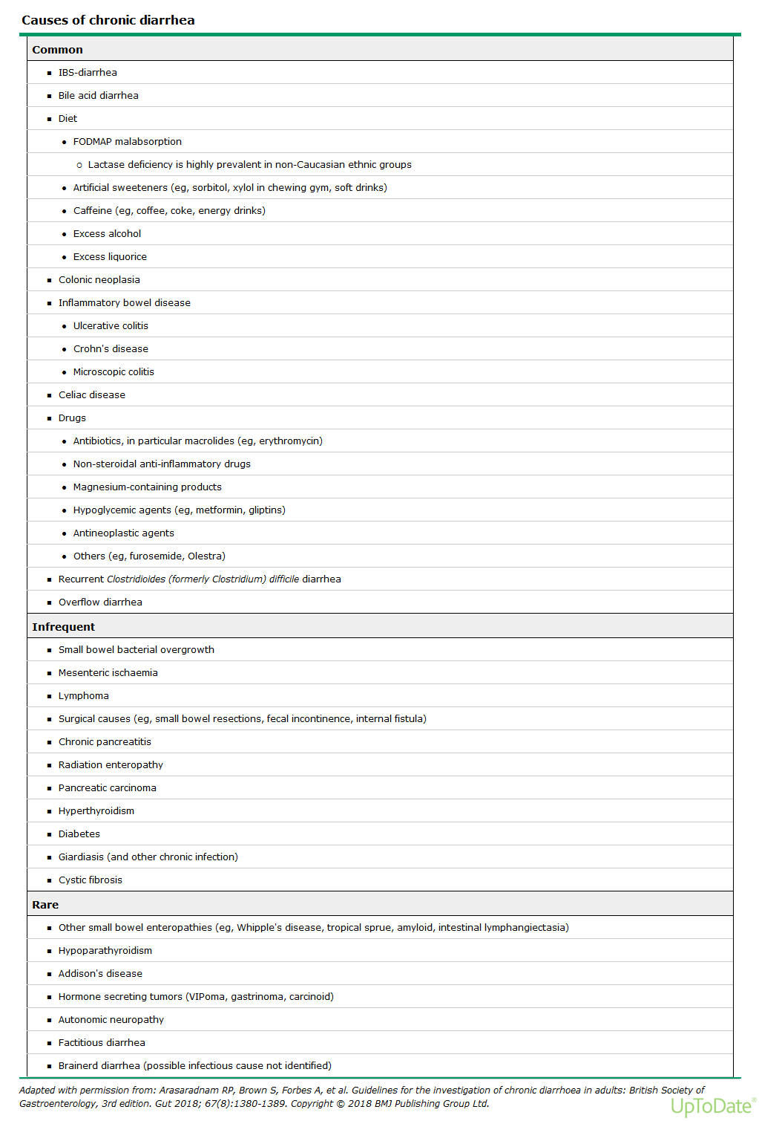

Slide 12
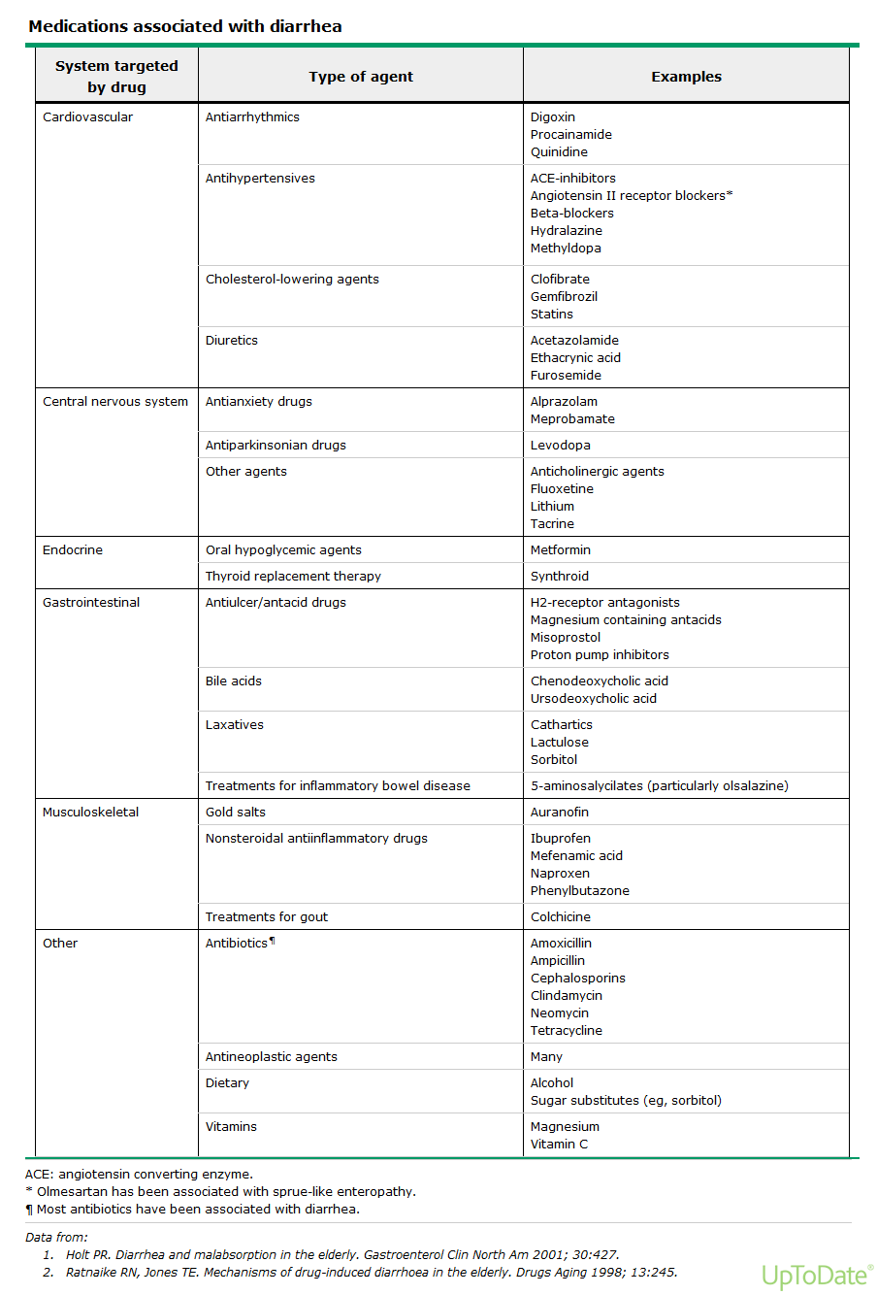

Slide 13
constipation
Constipation is defined as infrequent passage of hard stools. Or as three or fewer bowel movements per week.
Patients may complain of straining, a sensation of incomplete defecation and either perianal or abdominal discomfort.

Slide 14
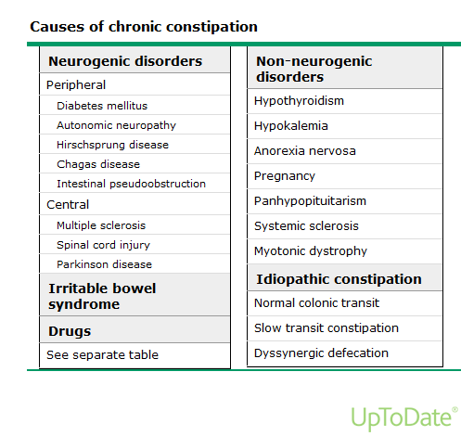

Slide 15
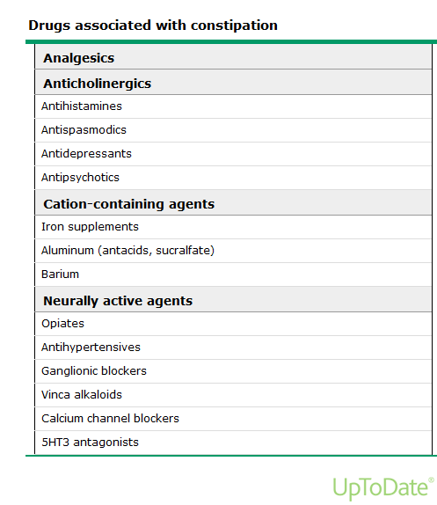

Slide 16
Case scenario
22-year-old woman with a 2-year history of abdominal pain and diarrhea Experiences intermittent episodes of lower abdominal cramping and bloating associated with 4-6 loose bowel movements occurring ~2 days per week Abdominal pain seems to occur shortly after meals or at times of increased stress, and subsides after a bowel movement

Slide 17
WHAT IS IBS ?
it is a life-long (chronic) functional “not structural” disorder of the digestive system that affect the large intestine. It is characterized by the presence of abdominal pain or discomfort with altered bowel habits for at least 6 months, in the absence of a specific organic pathology.

Slide 18
Prevalence
Prevalence in the general population is estimated to be between 10 % and 20 %.
IBS most often affects people between the ages of 20 and 30 years.
It is twice as common in women as in men

Slide 19
ETIOLOGY
The causes of irritable bowel syndrome have not been adequately defined, but Factors that appear to play a role :
Disturbed colonic motility.
Nervous system (Gut hypersensitivity).
Inflammation in the intestines : Some IBS patients have an increased number of immune -system cells in their intestines. This immune-system response is associated with pain and diarrhea.
Severe infection(gastroenteritis)
Microbial imbalance in the gut (dysbiosis).
Changes in bacteria in the gut (microflora).

Slide 20
CLASSIFICATION OF IBS
Classifying patients with IBS into specific subtypes based on predominant bowel habits is useful as it helps focus treatment on the predominant, and often, the most bothersome symptom.
IBS is classified into four subtypes:
IBS with constipation (IBS-C)
IBS with diarrhea (IBS-D)
Mixed IBS (IBS-M)
Unspecified IBS (IBS-U)

Slide 21
CLASSIFICATION OF IBS
IBS with constipation (IBS-C): hard or lumpy stools for more than 25% of bowel movements and loose (mushy) or watery stools for less than 25% of bowel movements.
IBS with diarrhoea (IBS-D): loose or watery stools for more than 25% of bowel movements and hard or lumpy stool for more than 25% of bowel movements.
Mixed IBS (IBS-M): hard or lumpy stools for less than 25% of bowel movements and loose (mushy) or watery stools for ≤25% of bowel movements.
Unspecified IBS: insufficient abnormality of stool consistency to meet criteria for above subtypes.

Slide 22
Approach to IBS patient
History taking
DDx
Physical Examination
DDx
Investigations
DDx
Diagnosis
Treatment

Slide 23
History
Personal information
Chief complaint
Presenting illness
Past medical/surgical, medications, social, family history
Systematic review

Slide 24
Chief compliant 1
A-Abdominal pain
B-Changing in bowel habits
C-Bloating
D-Change in stool stool form or appearance

Slide 25
Chief compliant 2
Intermittent
for >= 3 months

Slide 26
HPI Key information A1
Site and radiation of pain
(diffuse non-radiating in the left lower abdomen)
Onset of pain
(chronic and superimposing acute episodes)
Frequency of pain
(>=1 per week)

Slide 27
HPI Key information A2
Severity of pain
(mostly low in chronic and moderate in acute episodes )
Character of pain
(dull in chronic, sharp in acute episodes)
Alleviating and Aggravating Factors of pain
(meals aggravate and defecation alleviate)

Slide 28
HPI Key information B1
Alternating constipation and diarrhea
Usually one predominates
Postprandial urgency
Constipation is not well responding to laxitives

Slide 29
HPI Key information C1
Bloating:
Aggravated by meals
relived by defecation

Slide 30
HPI Key information D1
Change in stool form or appearance:
Mucoid
Loose low volume in diarrhea , or hard narrow caliber in constipation

Slide 31
HPI Key information Extra 1
Exclude Other causes
alarm Sx

Slide 32
Past medical/surgical, social, etc
History of chronic disease
History of malignancy
Medications
smoking
alcohol.
recent travel.
Diet
Allergies
family history of chronic disease. similar problem, malignancy

Slide 33
DDX?
Cholithiasis ,Cholangitis, Biliary colic, cholecystitis
Peptic ulcer disease
Food allergy
Bacterial Gastroenteritis, diverticulitis, infectious colitis
IBD
Chronic Pancreatitis
Intestinal ischemia
Hepatitis
GI neoplasm
Drug adverse effect

Slide 34
Physical examination 1
General appearance ( normal or slightly distressed if currently in pain)
Vitals (normal)
Weight
Height
BMI

Slide 35
Physical examination 2
Abdominal examination
Mainly normal but might have sigmoid tenderness

Slide 36
DDx?
IBS
Food intolerances, including lactose, fructose
enteritis, enteritis, diverticulitis, infectious colitis
IBD
GI neoplasm
Medication adverse effect

Slide 37
investigations
CBC to detect anemia indicative of malignancy
Dietary Studies (lactose-free diet for 1 week)

Slide 38
Diagnosis
Criteria Rome IV criteria
recurrent abdominal pain on average at least 1 day per week during the previous 3 months
associated with two or more of
Related to defecation (may be increased or unchanged by defecation)
Associated with a change in stool frequency
Associated with a change in stool form or appearance

Slide 39
Management 1
Education and reassurance
(chronic disease, does increase risk of cancer)
lifestyle and dietary modification alone for mild cases.
(avoid: gas producing food such as onions, and fermentable sugars such as honey)
(Physical Exercise)

Slide 40
Management 2
pharmacologic therapy is indicated in moderate to severe cases and in failed initial treatment in mild cases.
In constipation predominant :
soluble fiber (eg, psyllium), if failed → use polyethylene glycol (PEG), if failed → use lubiprostone
in diarrheal predominant :
antidiarrheals (eg, loperamide), if failed → use bile acid sequestrants (eg, cholestyramine), if failed → serotonin receptor antagonists (Alosetron)

Slide 41
Management 3
For abdominal pain :
Antispasmodic agents (e.g hyoscyamine)
others:
CBT
Probiotics

Slide 42
Alarming Symptoms
Age of onset after age 50 years
Rectal bleeding or melena
Nocturnal diarrhea
Progressive abdominal pain
Unexplained weight loss
Laboratory abnormalities (iron deficiency anemia, elevated C-reactive protein or fecal calprotectin/lactoferrin)
Family history of IBD or colorectal cancer

Slide 43
Colon cancer
Symptoms :
Change in bowel habits ( most common presentation)
Rectal bleeding in combination with change in bowel habits
Rectal mass or abdominal mass
Iron deficiency anemia
Abdominal pain as a single symptom ( least common presentation )

Slide 44
Role play

Slide 45
Indications for referral:
Unexplained weight loss
Unexplained iron deficiency anemia
More than minimal rectal bleeding
Nocturnal symptoms
Family history of colon cancer, IBD or celiac sprue

Slide 46
Patients presenting IBS symptoms should be clinically examined for the following 'red flag’:
Anemia
abdominal masses
rectal masses
inflammatory markers for inflammatory bowel disease

Slide 47
1-A 37-year-old woman reports a 10-year history of intermittent abdominal pain and constipation alternating with diarrhea. She has no weight loss, fever, or worrisome features on examination. Which of the following agents is clini­cally indicated as a first-line treatment for mild-to-moderate abdominal pain associated with IBS?
Amitriptyline
B. Lubiprostone
C. Dicyclomine
D. Fluoxetine

Slide 48
2) What is the best way of diagnosing IBS?
A- By excluding other causes. (A diagnosis of exclusion)
B- By Rome IV criteria.
C- By excluding the presence of red flags.
D- By Rome IV criteria and excluding the presence of red flags.

Slide 49
3- A 27-year-old graduate student in psychology is evaluated for intermittent abdominal pain. She is diagnosed with IBS. She asks whether there is a relationship between psychiatric disorders and IBS. Which of the following statements is most accurate?
A. IBS is usually caused by the underlying psychiatric disorder.
B. Psychiatric conditions may worsen coexisting IBS.
C. Successfully treating the psychiatric comorbidity causes remission of IBS.
D. No evidence supports a relationship between IBS and psychiatric disorders.

Slide 50
4- Which of the following is an indication for referral in IBS patients ?
Significant unexplained weight loss
Age of onset before 50 years
Anemia with explained cause
Minimal rectal bleeding

Slide 51
5- A 65-year-old man reports a lifelong history of IBS with alternating bouts of constipation and diarrhea. He denies any so-called alarm symptoms, but does report that his symptoms have worsened over the last several months. He reports never having a colonoscopy before. Stool is negative for blood and leukocytes. Which of the following is the most important next step?
A. Esophagogastroduodenoscopy (EGO).
B. Explore possible underlying psychiatric symptoms.
C. Colonoscopy.
D. Increase fiber intake.

Slide 52
References
Medscape
UpToDate

Slide 53
Thank you for listening.

