Slide 1

APPROACH TO
BREAKING BAD NEWS
Supervised by: Dr. Syed Irfan Karim

Slide 2
Ali Al-Nasser
Mohammed Baqais
Ahmed alqahtani
Sadiq arab
Khalid Aleedan

Slide 3
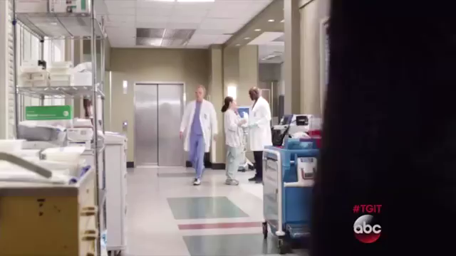


Slide 4
Objectives
Define bad news.
Describe the strategies to deliver bad news.
Describe the impact receiving bad news can have on patients and family.
Describe the physician’s responsibilities when breaking bad news.
Demonstrate the six-step protocol for breaking bad news eg. Reports of cancer, hepatitis B or C, newly diagnosed diabetes, HIV positive report etc. (role play).

Slide 5
Q1: which of the following should never be used when breaking bad news?
Compassion
Appropriate body language
Professional jargon
Touch

Slide 6
Q2:What was true about breaking bad news in the past ?
It was considered the patient’s right
It is a burden and should be avoided
Tell it to the family members
Tell it over the phone

Slide 7
Q3:In the ABCDE approach of breaking bad news, “A” stands for
Allow Questions
Allow time to process the news
Avoid emotion
Advance preparation

Slide 8
Q4:In SPIKES protocol of breaking bad news, Which of the following Questions helps in about the patient’s perception?
“Would you prefer if a family member or a friend be present”
“What’s upsetting you the most”
“How are you feeling about hearing the news”
“ Do you have any ideas on what the problem might be”

Slide 9


Q5:Which of the following is the best setting of Breaking Bad news ?
A
B
C
D

Slide 10


Slide 11
“The Father of Medicine” because he started one of the first medical schools in ancient Greece.
His Hippocratic Oath is still taken by doctors today.
He was one of the first doctors to diagnose heart and lung diseases.
He was also a big believer in walking and nutritious food to cure diseases.

Slide 12
Introduction
Hippocrates advised “concealing most things from the patient while you are attending to him. Give necessary orders with cheerfulness and serenity… revealing nothing of the patient’s future or present condition.”
In 1847, the American Medical Association’s first code of medical ethics stated, “The life of a sick person can be shortened not only by the acts, but also by the words or the manner of a physician.

Slide 13
Introduction
‘The task of breaking bad news is a testing ground for the entire range of our professional skills and abilities.
If we do it badly
The patients or family members may never forgive us
If we do it well
They will never forget us’
Robert Buckman

Slide 14

Definition
Any news that drastically and negatively alters the patient’s view of his or her future.”
Delivering serious, bad, or life-altering news to a patient.
Bad news is stereotypically associated with a terminal diagnosis.
Family physicians encounter many situations that involve imparting bad news.
Bad news is subjective to the patient so you might not realize how it would really affect the patient.

Slide 15
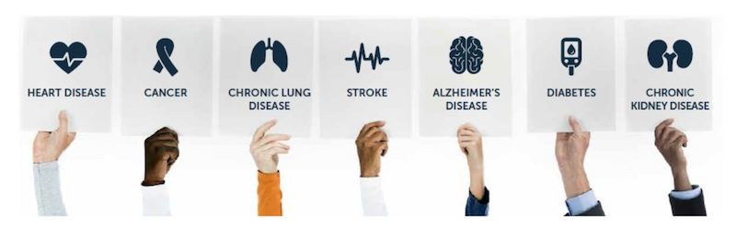
Examples
Chronic disease : DM , HTN , Bronchial Asthma
Terminal disease : Cancer
Infectious disease : Hepatitis A , B , C , HIV
Debilitating disease : Alzheimer’s disease , Multiple Sclerosis

Slide 16

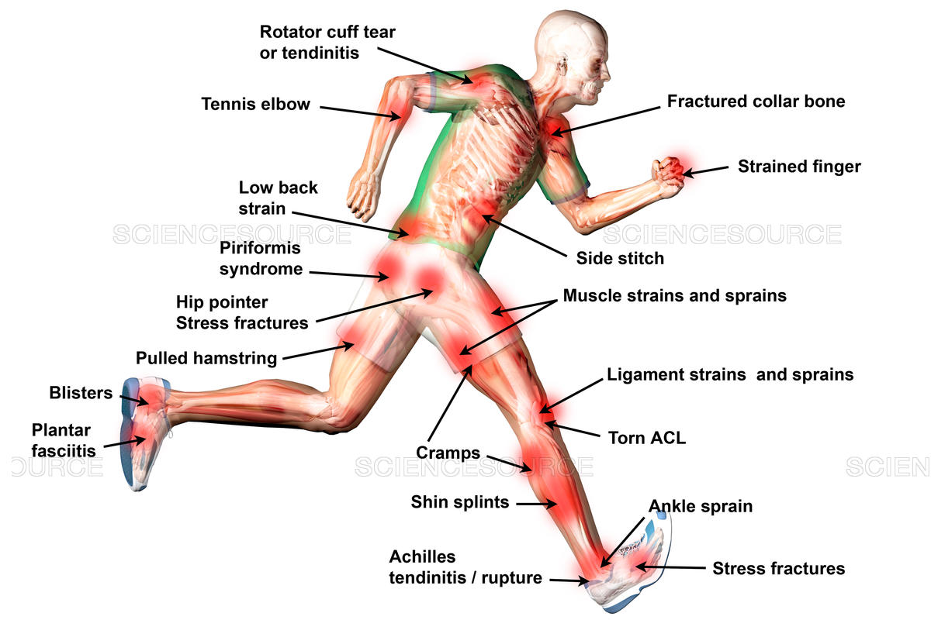
Examples
Congenital disease : Congenital Heart Disease , Down syndrome, Cleft palate
Trauma e.g RTA , Sports Injury
Disability
Death

Slide 17

Breaking bad news is one of a physician’s most difficult duties, yet medical education typically offers little formal preparation for this daunting task.
Numerous study results show that patients generally desire frank and empathetic disclosure of a terminal diagnosis or other bad news.
The amount of information patients want to receive about their diagnosis varies based on Culture, Education level, Age, and Gender.

Slide 18
Why it’s important?
The beginning of a patient-physician journey.
Ensuring the patient’s autonomy and self empowerment.
To maintain patient-doctor trust.
Patient satisfaction on the healthcare provided.
To ensure the patient moves forward and fully understands in order to have a positive therapeutic outcome.

Slide 19
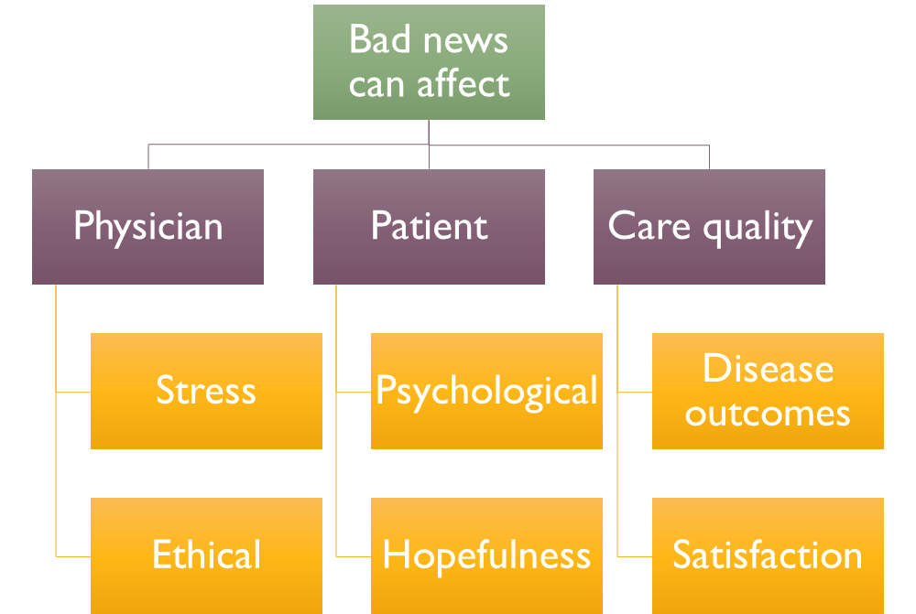

Slide 20
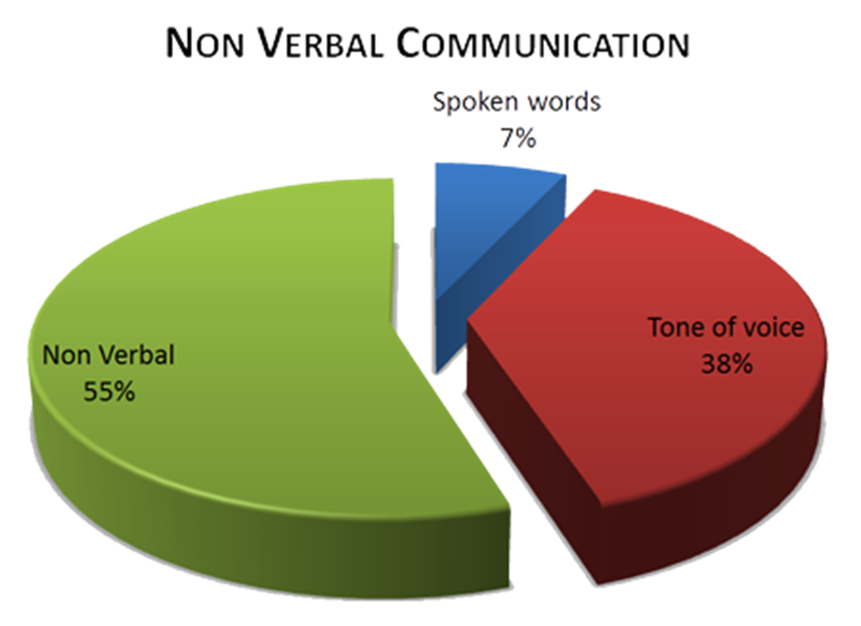
Patient centered approach
Physician Communication skills , Training , Experience
This communication skill is typically learned through trial and error or observation of senior colleagues.
Conveying bad news is more difficult when the clinician has a long-standing relationship with the patient, when the patient is young, or when strong optimism had been expressed for a successful outcome.

Slide 21
Basic Principles
When to be informed ?
As soon as information is clearly known
Don’t pass on unsure information too soon
Where to be informed ?
Private setting
In person
Support persons present
Both parents
Other support people, Family, Friends, Hospital support

Slide 22
Barriers to Effectively Breaking Bad News
Differences in cultural beliefs and values.
Language barriers.
The level of involvement of the family in discussions and decisions.
Fear of causing pain or being blamed for therapeutic failure.
Lack of training in breaking bad news.
Knowledge and ability to answer questions.
Notes:
**Breaking bad news: Evidence from the literature and recommended steps**

Slide 23


Prepare yourself
Ensure Privacy and Adequate Time
Adequate space for the free flow of emotions must be given.
Be direct and specific
Listen and be receptive
Provide Information About Support Services
Don’t Break bad news over the phone.
Don’t be in a hurry
Don’t be vague
Don’t Be judgmental
Don’t Give excessive information
Don’t Give a definite time span
Avoid blocking behaviors.

Slide 24
Some of the blocking behaviors : Offering premature reassurances and advices before addressing the main concerns of the patient, explaining the distress as normal, playing down the problems, changing the topic of discussion, cracking untimely jokes.
What the patient thinks about the disease and even the diagnosis itself can be explored. (ICE)
Make sure that the patient’s safety is ensured once they leave the room. He/she should not be permitted to drive back home all alone and find whether someone at home can provide support. Patient may even try to commit suicide if he/she feels extremely desperate.

Slide 25
Hadith Shareef
قال النبي ﷺ: ( إِنَّ عِظَمَ الْجَزَاءِ مَعَ عِظَمِ الْبَلاءِ، وَإِنَّ اللهَ إِذَا أَحَبَّ قَوْمًا ابْتَلاهُمْ، فَمَنْ رَضِيَ فَلَهُ الرِّضَا، وَمَنْ سَخِطَ فَلَهُ السُّخْطُ )

Slide 26

Breaking bad News

Slide 27
Preperation for consulitation:
1- Introduction :
Check patient ID
Introduce your name , role and purpose of interview
Gain consent
2-Display active listing skills :
Eye contact
Sitting position and body language
Nodding
Avoid interrupting the patient
3-Try to establish a rapport with your patient

Slide 28
Approaches to breaking bad news :
1-ABCDE Approach:
A - ADVANCE PREPARATION
B – BUILD A THERAPEUTIC ENVIRONMENT/RELATIONSHIP
C-COMMUNICATE WELL
D–DEAL WITH PATIENT AND FAMILY REACTIONS
E-ENCOURAGE AND VALIDATE EMOTIONS
2-SPIKES Approach:
S – Setting
P – Perception
I - Invitation
K – Knowledge
E – Emotions and Empathy
S – Strategy

Slide 29

A - ADVANCE PREPARATION
Relevant clinical information.
Time & place arrangement.
Mental rehearsal.
Prepare emotionally.

Slide 30

B – BUILD A THERAPEUTIC ENVIRONMENT/RELATIONSHIP
Patient’s preferences.
Family members or other supportive persons presence?
  Introduce yourself to everyone present
Foreshadow the bad news.
Assure the patient you will be available.

Slide 31

C – COMMUNICATE WELL
Ask if the patient already knows and understand.
Speak frankly but compassionately.
Allow silence and tears.
Have the patient tell you his/her understanding of what you have said.
Summarize and make follow-up plans

Slide 32

D–DEAL WITH PATIENT AND FAMILY REACTIONS
Assess and respond to emotional reactions.
Be empathetic.
Do not argue with or criticize colleagues

Slide 33

E–ENCOURAGE AND VALIDATE EMOTIONS
Offer realistic hope.
Explore what the news means to the patient.
Use interdisciplinary services.
Attend to your own needs during and following the delivery of bad news.

Slide 34
Now I will speak about secound one SPIKES Approach
2-SPIKES Approach:
S – Setting
P – Perception
I - Invitation
K – Knowledge
E – Emotions and Empathy
S – Strategy

Slide 35

S - Setting
Arrange for some privacy.
Involve significant others.~
Ensure you and patients and relative are sitting down.
Arrange the chairs if necessary and avoid physical barriers .
Ensure you have uninterrupted time during the meeting ~
Make connection with the patient (Maintaining eye contact)

Slide 36

P – Perception
Discuss the events leading up to now e:g : scans , biopsies etc
Establish What the patient already knows or is expecting
Establish what the patient`s current emotional state
Try to get them say the diagnosis
“Could you tell me what happened so far”
“ Do you have any ideas on what the problem might be”
“ Is there anything you have been worried about”

Slide 37
I - Invitation
Check if the patient wants to know the results and if he or she would like a family member present. ~
“I do have the results here today would you like me to explain it to you now”
“would you prefer if a family member or a friend be present”

Slide 38
K – Knowledge
Build up to the result “ give a warning shot”~
Chunk the diagnosis
Pause and wait after every statement ~ to allow to patient to digest what you have told them
If the silence is awkward ask how he/she is feeling.
Use patient’s language (simple language )~
As we know we took a biopsy and the result is not as we hoped.”
PAUSE AND WAIT
I’m sorry to tell you it’s a tumor

Slide 39
E – Emotions and Empathy
Acknowledge and reflect their emotions.
Just listen.
if the silence is awkward ask the patient how he’s feeling.
“What’s upsetting you the most”
“How are you feeling about hearing the news”

Slide 40
S – Strategy
Agree on a plan
Summarize concerns
Ask how they are left feeling

Slide 41
The impact of receiving bad on patients and family:
Patient and family expectations :
Patients have a right to :
Privacy
Empathy
Dignity
Clarity of message
Competency
Time for questions
Accurate and true information.
Receive or not to receive bad news.
Decide who should be present during the consultation e.g. family members.
Decide who should be informed about their diagnosis.

Slide 42
Cont..
Bad news impact on patients:
1- Physiological Impact How does a patient react to bad news?
When the patients receive bad news they will be physiologically stressed:
stress causes increases in blood pressure, heart rate, sympathetic nerve activity and circulating catecholamines, and activation of the hypothalamic–pituitary–adrenal axis leading to increases in glucocorticoids.
The magnitude and quality of such reaction in patients under bad news impact still deserves investigation.

Slide 43
Cont..
2- Psychological impact: What does the patient experience?
Studies around the world have pointed out that not all patients want to know their diagnosis and prognosis.
One study in Japan has looked specifically at the wishes of cancer patients and found that out of all patients 66% recalled being given a diagnosis and only 61% wanted to discuss the prognosis. Also, 12% of the patients did not want to be informed that they had little time left to live.
In Albania, among 150 cancer patients, only 46% wanted full information of their diagnosis.

Slide 44
Cont..
for example, when a mother knows the diagnosis of her child she acts differently around him and the child notices that something is not right by these different behaviors.
In cases of sudden illnesses and accidents, the patients’ body may “shut down” because the news is unexpected and/or because they are not prepared to hear the information.
They can eventually faint or enter in a state of shock. Patients described physical and psychological responses when hearing bad news as: “body may feel cold or hot”, they may “shake uncontrollably”, the news act like a “physical blow to the body” (“cold sensation in the stomach”), “body stands still and mind moves rapidly”, turns the persons world “upside down”, they hear but don’t comprehend everything and a sensation of “bodily flush”. They react by sobbing, crying and reaching for physical contact.

Slide 45
Cont..
Usually they don’t process the news immediately after being told and it may take some time to accept the new situation. Patients who find the news too threatening may employ forms of denial, shunning or minimizing the significance of the information.
When reading the descriptions of patients, Patients diagnosed with cancer, may experience an anticipatory grief due to all the losses they had or to all the ones that they will experience:
loss of functioning, identity, role definition and possible death. Not only the patients but their families and friends suffer too. The bad news has impact on all people that relate to the patient.
An interesting note is that patients’ biggest fear is a breakdown in family relationship and/or changes in friends’ attitudes.

Slide 46

Summary:
Denial
Shock
Anger
Guilt
Blame
Agitation
Helplessness
Sense of unreality
Misinterpreting
information
Regret/ anxiety

Slide 47
Describe the physician’s responsibilities when breaking bad news

Slide 48
Describe the physician’s responsibilities when breaking bad news :
How Should Bad News Be Delivered?
ABCDE approach:
Advance preparation
Build a therapeutic environment/relationship
Communicate well
Deal with patient and family reactions
Encourage and validate emotions

Slide 49
A–ADVANCE PREPARATION
Familiarize yourself with the relevant clinical information:
Having the patient’s chart or laboratory data on hand during the conversation.
provide information about prognosis and treatment options.
Arrange for adequate time in a private, comfortable location:
Instruct the staff that there should be no interruptions.
Mentally rehearse how you will deliver the news:
practice out loud, as prepare for public speaking.
Script specific words and phrases to use or avoid.
If you have limited experience delivering bad news, observe a more experienced colleague or role play a variety of scenarios.
Prepare emotionally.

Slide 50
B–BUILD A THERAPEUTIC ENVIRONMENT/RELATIONSHIP
Determine patient’s preferences for what and how much they want to know.
Family members or other supportive persons presented (at the patient’s discretion):
If bad news is anticipated, ask in advance who would like to present and how they would like the others to be involved.
Introduce yourself to everyone present
ask for names and relationships to the patient.
Foreshadow the bad news, “I’m sorry, but I have bad news.”
Touch where it’s appropriate.
Some patients or family members prefer not to be touched.
Be sensitive to cultural differences and personal preference.
Avoid inappropriate humor or flippant comments; depending on your relationship with the patient
Assure for the patient your vacancy.
Schedule follow-up meetings
Advise appropriate staff and colleagues of the situation.

Slide 51
C–COMMUNICATE WELL
Speak frankly but compassionately. Avoid medical terms. Use the words cancer or death.
Allow silence and tears, and avoid the urge to talk to overcome your own discomfort. Proceed at the patient’s pace.
Have the patient tell you his or her understanding of what you have said.
Encourage questions, use repetition and corrections as needed.
Be aware that the patient will not retain much of what is said after the initial bad news.
Write things down, use sketches or diagrams, and repeat key information.
At the conclusion of each visit, summarize and make follow-up plans.

Slide 52
D–DEAL WITH PATIENT AND FAMILY REACTIONS
Assess and respond to emotional reactions.
Be aware of cognitive coping strategies (e.g., denial, blame, intellectualization, disbelief, acceptance).
Be attuned to body language.
With subsequent visits, monitor the patient’s emotional status, assessing for despondency or suicidal ideations.
Be empathetic;
it is appropriate to say “I’m sorry” or “I don’t know.”
Do not argue with or criticize colleagues; avoid defensiveness regarding your, or a colleague’s, medical care.

Slide 53
E–ENCOURAGE AND VALIDATE EMOTIONS
Offer realistic hope:
Even if a cure is not realistic, offer hope and encouragement about what options are available.
Discuss treatment options at the outset, and arrange follow-up meetings for decision making.

Slide 54
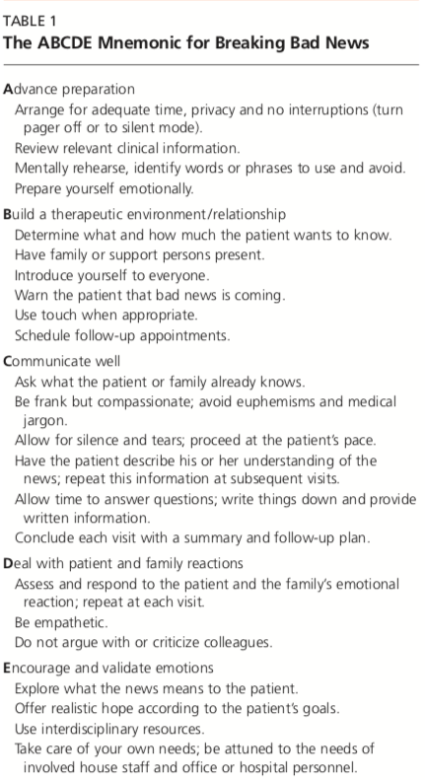

Slide 55
Interactive case

Slide 56
case
35 years old gentleman presented to your clinic complaining of severe headache , that interferes with his life .
The headache started 4 weeks ago and it is progressing with time
The headache usually comes at night and it is associated with night sweating
He lost more than 10 kilos the last 2 weeks

Slide 57
After taking detailed history and doing appropriate physical exam and doing the initial lab test , you requested an MRI
And it shows the following

Slide 58
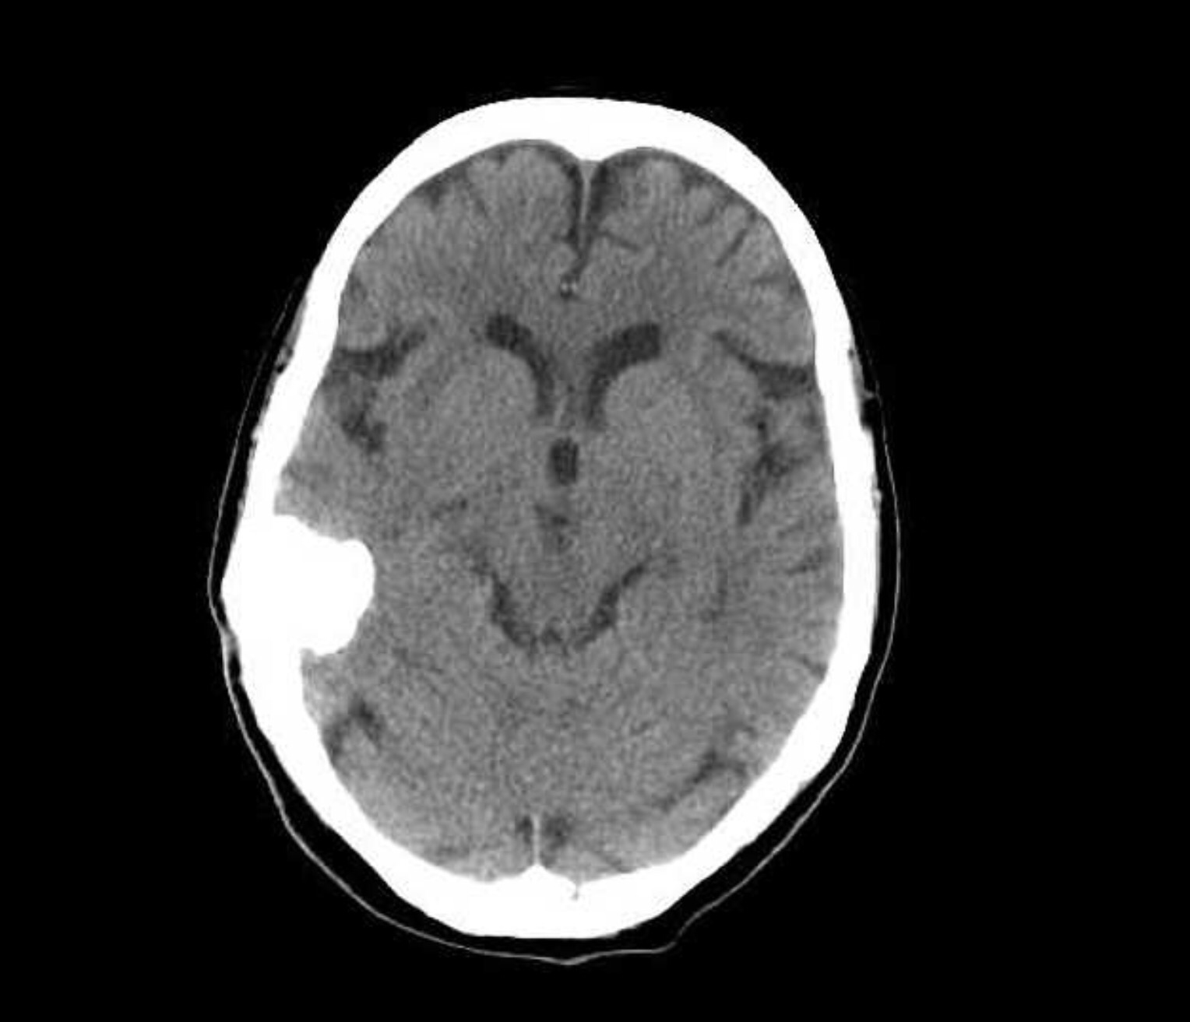

Slide 59
Meningioma of the brain was confirmed

Slide 60
How you are going to approach this patient ?

Slide 61
Q1: which of the following should never be used when breaking bad news?
Compassion
Appropriate body language
Professional jargon
Touch

Slide 62
Q2:What was true about breaking bad news in the past ?
It was considered the patient’s right
It is a burden and should be avoided
Tell it to the family members
Tell it over the phone

Slide 63
Q3:In the ABCDE approach of breaking bad news, “A” stands for
Allow Questions
Allow time to process the news
Avoid emotion
Advance preparation

Slide 64
Q4:In SPIKES protocol of breaking bad news, Which of the following Questions helps in about the patient’s perception?
“Would you prefer if a family member or a friend be present”
“What’s upsetting you the most”
“How are you feeling about hearing the news”
“ Do you have any ideas on what the problem might be”

Slide 65
Q5:Which of the following is the best setting of Breaking Bad news ?
A
B
C
D

Slide 66


Slide 67
References
https://www.aafp.org/journals/afp.html
https://www.ncbi.nlm.nih.gov/pmc/articles/PMC3144432/
https://patient.info/doctor/breaking-bad-news
http://www.journeyofhearts.org/kirstimd/AMSA/abcde.htm
Baile WF, Buckman R, Lenzi R, Glober G, Beale EA, Kudelka AP. SPIKES: a six-step protocol for delivering bad news: application to the patient with cancer. Oncologist. 2000; 5(4):302–311
J.T. Ptacek, E.G. McIntosh, Physician challenges in communicating bad news, Journal of Behavioral Medicine 32 (4) (2009) 380–387.
http://theoncologist.alphamedpress.org/content/5/4/302.long

Slide 68
