Slide 1
SMOKING AND SUBSTANCE ABUSE
SUPERVISED BY:
PROF.JAMAL ALJARALLAH

Slide 2
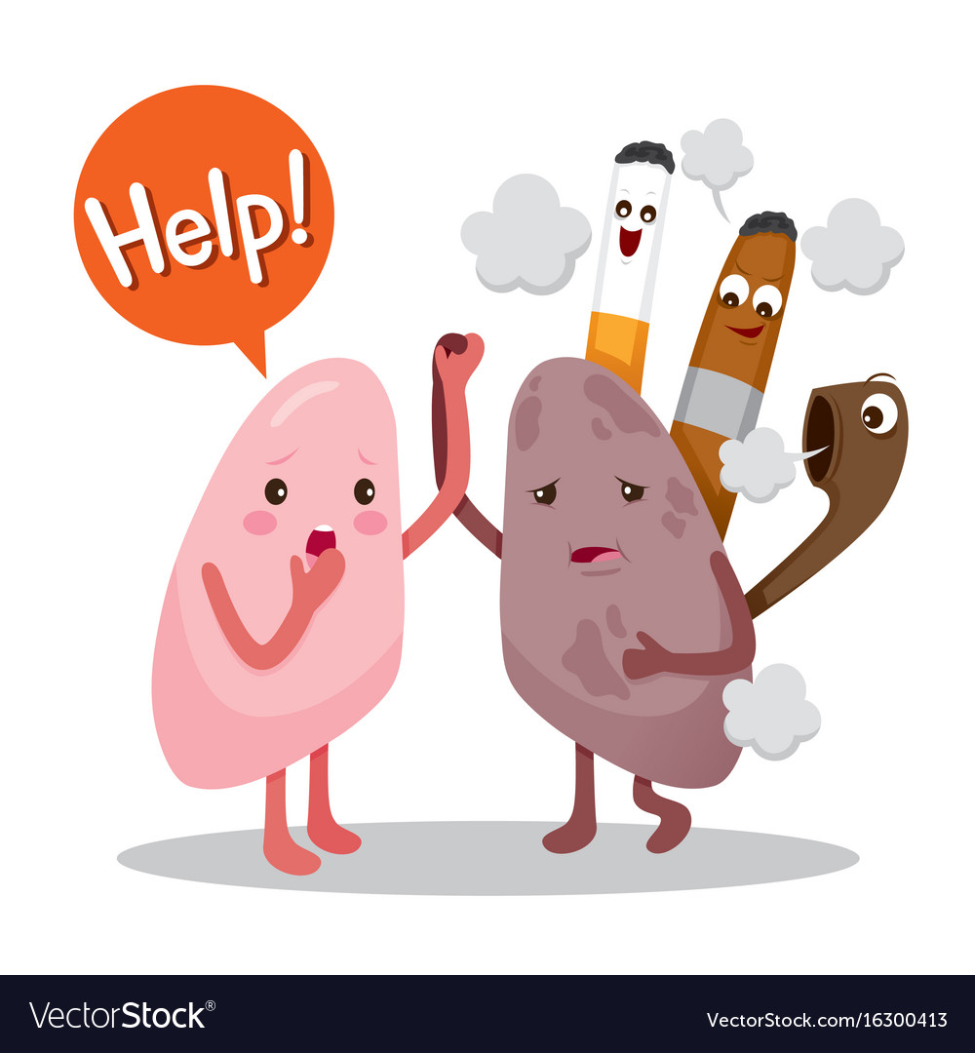

Slide 3
OBJECTIVES
Describe the Epidemiology of smoking in Saudi Arabia.
Recognize Risks of smoking (Mortality and Morbidity).
Appreciate the Effect of passive smoking on pregnancy, children… .
Be able to help the smoker to quit with smoking cessation aids and overcoming nicotine withdrawal symptoms.
Appreciate the role of PHC physician in “smoking cessation clinic”.
Discuss the smoking cessation medications, Nicotine preparations, Varenicline, Bupropion, … .
Recognize Factors that lead to substance abuse.
List types of substance abuse.
Appreciate Method to approach subjects with substance abuse.

Slide 4
MCQs
Q1) what is the prevalence of smoking in KSA ?
13% .
34% .
21% .
42% .

Slide 5
MCQs
Q2) How would you screen for substance abuse ?
physical Examination
single question screening
blood samples
Full history

Slide 6
MCQs
Q3) Children exposed to secondhand smoking during early life are at most risk for developing which of the following?
lower respiratory tracts infections
lung cancer
cardio vascular disease
migraine

Slide 7
MCQs
Q4) One of the individual’s risk factors that lead to substance abuse is?
peers pressure
Maternal abuse
ADHD
parents- relationship

Slide 8
MCQs
Which of the following is NON NICOTINE REPALCEMENT THERAPY?
chewing gum
skin patches
lozenges
Bupropion

Slide 9
1. Epidemiology of smoking in Saudi arabia . 2.risks of smoking.
By: HUSSAM ALASHHAB

Slide 10
Smoking Facts “ WHO”
Over 1 billion individuals have smoked tobacco .
Males more than females .
Responsible for 6 million deaths yearly.
It is recognized by the World Health Organization as the second leading risk factor for death worldwide.

Slide 11
EPIDEMIOLOGY
One of the latest studies in SAUDI ARABIA among adults aged 18 years or older in2018 showed that:
The prevalence of cigarette smoking is 21% .

Slide 13
Risks of smoking

Slide 14
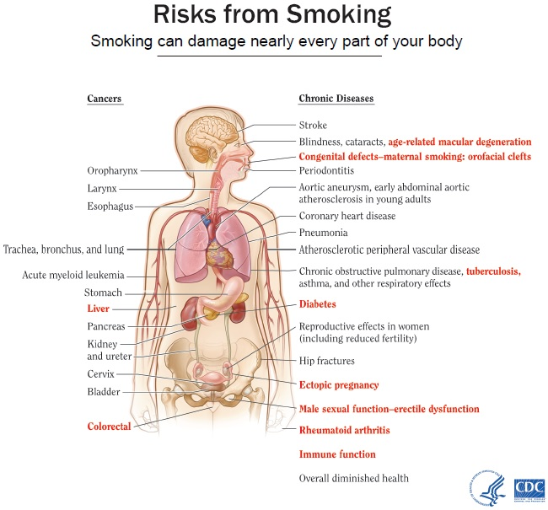
Smoking is responsible for around 6 million deaths yearly
it affects variety of organs in the body and it causes many disease ( COPD,IHD ,Stroke )
lung is the most affected
mortality in smokers is 3 times greater than non smokers
Even if you only smoke one cigarette a day it can have serious health consequences

Slide 15
Smoking and Respiratory diseases
Smoking is the most common cause of ( COPD ) one of the leading cause of death worldwide .
causes most common cases of lung cancer.
causes 90% of lung cancer deaths.
Smoking worsens conditions like asthma and URTI.

Slide 16
Smoking and Cardiovascular diseases
Smoking results in narrowing in the blood veesels which increase the risk of heart disease and stroke .
It is a major risk factor for IHD and peripheral arterial disease .
It decreases HDL in the blood and increases BP

Slide 17
Smoking and Cancer
Poisons in cigarette can weaken the body’s immune system, making it harder to kill cancer cells. When this happens, cancer cells keep growing without being stopped .
Lung cancer is now the leading cause of cancer death in the world.

Slide 18
3.Appreciate the Effect of of passive smoking…. 4.help the smoker to quit…
By: ABDULAZIZ ALMOTAIRI.

Slide 19
Secondhand smoking
It is The Inhalation of smoke by person other than the active smoker. It harms children and adults.
Secondhand smoking causes the same health concerns as active smoking including cardiovascular disease, lung cancer and respiratory disease. Incidence is correlated with amount of exposure.

Slide 20
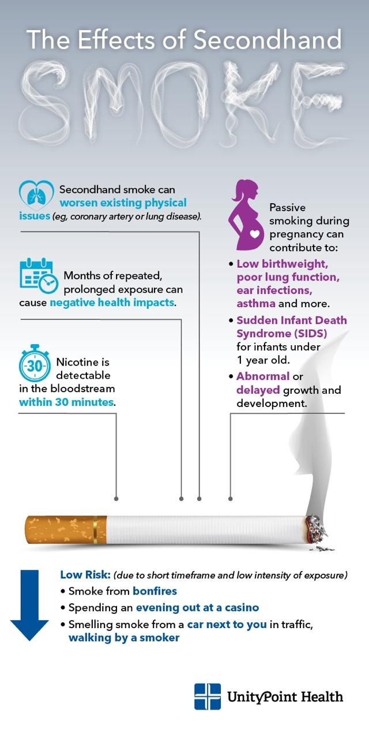
Effects of passive smoking on pregnancy
Affects both mother and baby.
Toxins in secondhand smoke can cross the placenta and reach the fetus, affecting its blood circulation and oxygen supply leading to hypoxia and growth retardation, causing :
Higher risk for pre- term birth
Low birth weight and smaller head circumference.
Higher incidence of SIDS.
Learning or behavioral deficiencies in the child.

Slide 21
Effects of passive smoking on children
Children exposed to secondhand smoking during early life are at most risk for developing:
Respiratory symptoms (cough, wheezing, phlegm)
Lower respiratory infections (bronchitis, bronchiolitis, pneumonia).
Exacerbation of asthma. Incidence of asthma especially if early prenatal and postnatal exposure to smoke.
Ear infections.
Decreased lung growth.
Maternal smoking has greater effect than parental.

Slide 22
How to minimize risk of passive smoking?
Greater no-smoke laws in indoor places.
Smoking outside home, car and workplace. (third hand smoking).
Hand washing after cigarette use to reduce contact with toxic residues.
Positive smoke-free role models for youth to reduce number of smokers in community.

Slide 23
Helping the smoker to quit
Cold turkey.
Behavioral therapy.
Nicotine replacement therapy.
Medication
Combo treatments

Slide 24
nicotine withdrawal

Slide 25
5.Phc physician role. 6.smoking cessation medications. 7.FACTORS THAT LEAD TO SUBSTANCE ABUSE.
By: MAJED ALZAHRANI
&
MOHAMMED ALGHAMDI

Slide 26
PHC physician role:
PHC physician has an essential role in helping patients to quit smoking by:
Opportunistic Health Promotion.
educating the patient about smoking risks and benefits of cessation.
Prescribing smoking cessation pharmacological tools.
Explaining about each pharmacological tool’s advantages, disadvantages, and contraindications.

Slide 30
Pharmacological management:
1- Nicotine Replacement Therapies (NRT).
2- Non NRT’s.
bupropion
varenicline

Slide 31
NICOTINE REPLACEMENT THERAPEIS.

Slide 32
Nicotine Replacement Therapies (NRT).
NRT can reduce the cravings and withdrawal symptoms you experience that may hinder your attempt to give up smoking. NRTs are designed to wean your body off cigarettes and supply you with a controlled dose of nicotine while sparing you from exposure to other chemicals found in tobacco.
The U.S Food and Drug Administration (FDA) approved five types of NRT:
chewing gum
skin patches
lozenges
intranasal spray (prescription only)
inhaler (prescription only)
Contraindications for NRT’S :
Hypersensitivity
Smokers in postmyocardial infarction period
Life-threatening arrhythmias
Severe or worsening angina pectoris
Nonsmokers.
Pregnancy
Hypertension

Slide 33
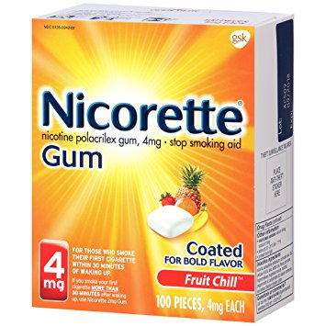
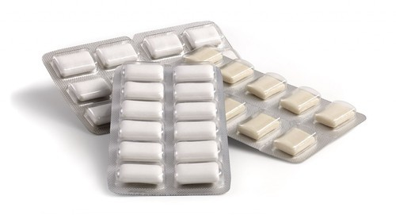
Nicotine chewing gum
Advantages: used to help people to stop smoking, it works by providing nicotine to your body to decrease the withdrawal symptoms experienced when smoking is stopped and as a substitute oral activity to reduce the urge to smoke.
Side effects:
Nausea / vomiting
Dizziness
Mouth / tooth or jaw problems.
Diarrhea
Weakness
Rash
Breathing difficulty
Mouth blisters
palpitation
Contraindicated in active temporomandibular joint disease.

Slide 34
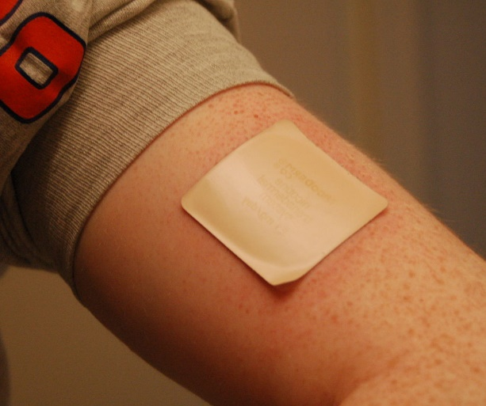
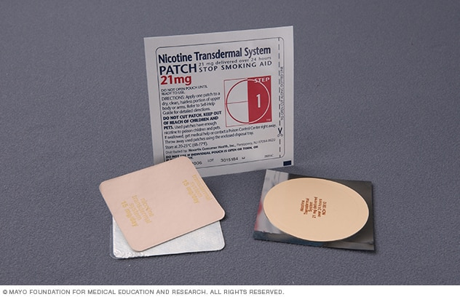
Nicotine transdermal patches
Advantages: used to help people stop smoking cigarettes. They provide a source of nicotine that reduces the withdrawal symptoms experienced when smoking is stopped.
Side effects:
Nausea / vomiting.
Headache
Increased blood pressure
Acne
Anorexia
others.

Slide 35
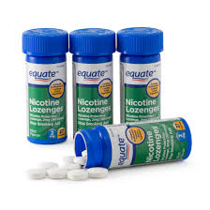
Nicotine lozenges
Side effects:
increased blood pressure
Nausea / vomiting.
Tachycardia
Dizziness
Insomnia

Slide 36
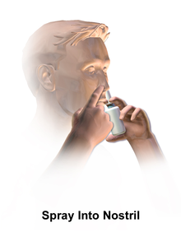
Nicotine nasal spray
Advantages:
Nicotine nasal spray is user-controlled dose and easy to use.
This medication gets rid of symptoms faster than any other medication.
Disadvantages:
Nicotine nasal sprays can be costly, and there is no generic form currently on the market.
This medication requires a prescription
Side effects:
Local irritation.
CNS and psychological manifestations.
Fatigue
Weight gain
sweating.

Slide 37
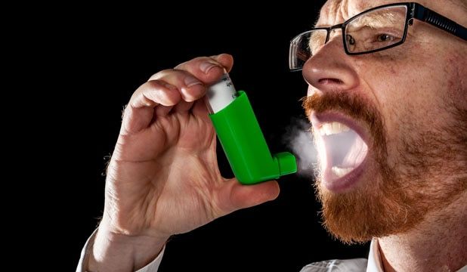
Nicotine inhalers
Advantages:
-It is easy to use.
-You can easily control the doses.
-Nicotine Inhaler works much more quickly than the nicotine gum.
-You can use it as per your requirement.
-If you use this according to the directions prescribed, then you can easily quit smoking.
Disadvantages:
It is more expensive than nicotine gum.
Side effects:
Mouth/throat irritation
Nausea / vomiting
Cough
Headache
Rhinitis
Dyspepsia

Slide 38
NON NICOTINE REPALCEMENT THERAPY Bupropion (zyban) Varinecline (Chantix/Champix)

Slide 39
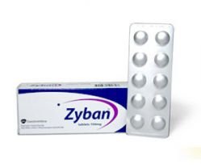
bupropion (zyban)
It’s a medication used as an antidepressant and a smoking cessation aid.
It is a norepinephrine-dopamine reuptake inhibitor (NDRI) and a nicotinic receptor antagonist.
Side effects:
seizures
dry mouth
trouble in sleeping
Agitation
headaches
Contraindications:
Epilepsy
Alcohol / benzodiazipines users.
Active brain tumors.
Pregnancy/breast feeding
Age under 18

Slide 40
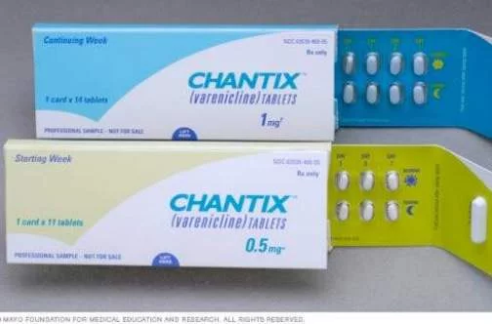
Varinecline (Chantix/Champix)
It’s under smoking cessation aid class, used along with counseling and education to help people quit smoking. It works by blocking pleasant effect of nicotine (from smoking) on the brain.
Side effects:
Nausea
Headache
Sleeping troubles
nightmares.
Contraindications:
pregnancy/ breast feeding.
Age under 18.

Slide 41
SUBSTANCE ABUSE
Definition of SUBSTANCE ABUSE.
Factors that leads to substance abuse.

Slide 42
SUBSTANE ABUSE.
Substance abuse, also known as drug abuse, is a patterned use of a drug in which the user consumes the substance in amounts or with methods which are harmful to themselvess or others, and is a form of substance-related disorder.
Widely differing definitions of drug abuse are used in public health, medical and criminal justice contexts.
In addition to possible physical, social, and psychological harm, use of some drugs may also lead to criminal penalties, although these vary widely depending on the local jurisdiction

Slide 45
Factors that leads to substance abuse
INDIVIDUAL FACTORS
FAMILIAL FACTORS
ENVIROMENTAL/SOCIAL FACTORS
Deviant Peer Relationships.
Anxiety and depression.
Bullying.
Gang Affiliation.
Childhood maltreatment (including abuse and neglect).
Parental or familial substance abuse.
Marital status of parents (divorced).
level of parental education.
Familial socioeconomic status.
Parent-child relationships.
Child perception that parents approve of their substance use.
Attention deficit disorder (ADHD).
Post-traumatic stress disorder (PTSD).

Slide 46
8.TYPES OF SUBSTANCE ABUSE 9.approach subjects with substance abuse
By: MESHAL ALAQIDI

Slide 47
1- Alcohol:
A colourless volatile flammable liquid which is produced by the natural fermentation of sugars and is the intoxicating constituent of wine, beer, spirits, and other drinks.
Side effects: Slurred speech, Drowsiness, Vomiting, Diarrhea, Upset stomach, Headaches, Breathing difficulties, Distorted vision and hearing, Impaired judgment, Decreased perception and coordination, Unconsciousness, Coma, Blackouts.

Slide 48
2- Central Nervous System Depressants:
Medications that slow brain activity, which makes them useful for treating anxiety and sleep problems. (Barbiturates, Benzodiazepines)
Side effects: Drowsiness, slurred speech, poor concentration, confusion, dizziness, problems with movement and memory, lowered blood pressure, slowed breathing
3- Cocaine:
A powerfully addictive stimulant drug made from the leaves of the coca plant native to South America.
Side effects: Narrowed blood vessels, enlarged pupils, increased body temperature, headache, abdominal pain and nausea, euphoria, increased energy, insomnia, restlessness, anxiety, violent behavior, panic attacks, paranoia, psychosis, heart attack, stroke, seizure, coma.

Slide 49
4- Heroin:
An opioid drug made from morphine, a natural substance extracted from seed pod of opium poppy plants.
Side effects: Euphoria, dry mouth, itching, nausea, vomiting, analgesia, slowed breathing and heart rate.
5- Marijuana (Cannabis):
Made from Cannabis sativa. The main psychoactive (mind-altering) chemical in marijuana is delta-9-tetrahydrocannabinol, or THC.
Side effects: Enhanced sensory perception and euphoria followed by drowsiness/relaxation, slowed reaction time, problems with balance and coordination, increased heart rate, problems with memory, anxiety

Slide 50
6- Opioids:
Pain relievers with an origin similar to that of heroin. Opioids can cause euphoria and are often used nonmedically, leading to overdose deaths.
Side effects: pain relief, drowsiness, nausea, constipation, euphoria, slowed breathing, death.
7- Inhalants:
Solvents, aerosols, and gases found in household products such as spray paints, markers, glues, and cleaning fluids; also nitrites (e.g., amyl nitrite), which are prescription medications for chest pain.
Side effects: Confusion, nausea, slurred speech, lack of coordination, euphoria, dizziness, lightheadedness, hallucinations/delusions, headaches, death from asphyxiation, suffocation, convulsions or seizures, coma, or choking

Slide 51
8-Amphetamine :
Amphetamine is a central nervous system stimulant that affects
chemicals in the brain and nerves that contribute to hyperactivity
and impulse control.
it is used to treat attention deficit hyperactivity disorder (ADHD).
Side effects: Agitation , anxiety , bladder pain , bloody urin ,
delusion , false sense of well-being , mental depression, etc.

Slide 52
Approaching substance abuse
Substance misuse screening:
Single-question screen:
“How many times in the past year have you used an illegal drug or used a prescription medication for nonmedical reasons?”

Slide 53
Approaching substance abuse
Substance abuse is characterized by the development of consequences from substance use, and these consequences can serve as motivators for change.
Principles and techniques derived from motivational interviewing can be used to manage resistance and increase readiness to change.
For patients with substance abuse, experts generally recommend advising abstinence

Slide 54
Cont.
For patients who are not committed to abstinence harm reduction strategies is an appropriate alternative .
Harm reduction strategies reduce the negative health consequences of substance use for example:
providing clean needles to persons who continue to inject drugs.
Avoid driving while intoxicated.

Slide 55
Approaching substance abuse
Substance dependence is a chronic relapsing and remitting illness, Patients require chronic care approach that can include:
Pharmacotherapy
Referral to specialty treatment
Mutual help meetings
Ongoing counseling and care coordination.
Engage family members in the treatment plan as family support is important in the recovery process.

Slide 56
Motivational interviewing
The aim of motivational interviewing is to empower and motivate individuals to take responsibility and change their substance use behavior.
Stage 1: Understanding why they need to change
Stage 2: Planning and making the changes
Stage 3:Maintaining the change

Slide 57
Stage 1
Understanding why they need to change.
Help the person explore their desire to change.
Do they want to change?
Do they need to change?
What can the health-care provider do?

Slide 58
Stage 1
Step 1: Give feedback about the person‟s personal risk or impairment (e.g. how is the substance use harming them/impacting on them and how it is harming others?).
•Step 2: Encourage them to take responsibility for their substance use choices.
•Step 3: Ask them about the reasons for their substance use.
•Step 4: Ask about both the perceived positive and negative consequences of their substance use.

Slide 59
Stage 2
Planning and making changes Supports the person to make changes
Step 1: Ask them about their person goals for their future. Support them to explore whether their substance use is helping them reach those goals or not?
Step 2: Discuss the reasons, consequences, benefits, harms and goals the person has so they gain a deeper understanding of how their substance use is impacting on them.
Step 3: Discuss realistic changes the person could make to change.
Step 4: Support them to enact that plan. Arrange a follow up session with them so you can see how that plan is going and make necessary changes to it if they have lapsed.

Slide 60
STAGE 3
Maintaining the change:
The person has achieved the change they want but it can be easy to lapse or relapse and start using old patterns of behavior.

Slide 61
THANK YOU

