Slide 1
Anaesthetic emergencies in the operating theatre&post operative complication
Dr. Massoun Taha Jasser

Slide 2
Lecture Objectives..
Students at the end of the lecture will be able to:
Learn a common approach to emergency medical problems encountered in intraoperative and postoperative period.
Study post-operative respiratory and hemodynamic problems and understand how to manage these problems.
Learn about the predisposing factors, differential diagnosis and management of PONV.
Understand the causes and treatments of post-operative agitation and delirium.
Learn about the causes of delayed emergence and know how to deal with this problem.
Learn about different approaches of post-Operative pain management

Slide 3
Anaesthetic emergencies in the operating theatre
Introduction
Emergencies are not common but when they do occur they are
often life threatening and require immediate action.
Factors in the mnemonic COVER ABCD accounts for approximately
95% of critical incidents.

Slide 4
Colour – saturation, central cyanosis;
Oxygen – ensure adequate and correct delivery;
Ventilation – e.g. breathing circuit, air entry, CO2 trace, vaporizer;
Endotracheal tube – kinks, obstruction, endobronchial;
Review monitors – correctly sited, checked, calibrated;
Airway – failed intubation, laryngeal spasm, foreign body,
aspiration;
Breathing – difficult to ventilate, e.g. tube occlusion, bronchospasm,
pneumothorax, aspiration, lack of neuromuscular blocking drug
(NMBD), pulmonary oedema;
Circulation – hypotension: excess anaesthetic agent, dysrhythmia,
myocardial ischaemia/MI, hypovolaemia from any cause (e.g. dehydration,
bleeding), sepsis, tension pneumothorax, sympathetic block
(e.g. spinal or epidural anaesthetic);
Drugs – anaphylaxis, wrong drug/dose/route;
Embolism – air/fat/cement/amniotic fluid;
Others – related to CVP line (pneumothorax [see Chapter 25]/cardiac
tamponade); awareness; endocrine and metabolic (MH, phaeochromocytoma).

Slide 5
Aspiration
Definition:- inhalation of gastric contents can occur in patients who do not have fully functional upper airway reflexes. Impaired protective airway reflexes.
Signs
• Gastric contents visible within breathing circuit/airway adjunct (e.g. LMA)
• SaO2
• Wheeze/stridor
• Tachycardia
• Airway pressure

Slide 6
Regurgitation of gastric contents can happen in any patient who does not have fully functioning upper airway protective reflexes Those at risk include:
• Inadequate period of preoperative starvation
• Delayed gastric emptying (e.g. opiates, pain, bowel obstruction, pregnancy at term; see Figure 6.2)
• Insufficient/lack of cricoid pressure at induction of anaesthesia early extubation in an at-risk patient in supine postion .

Slide 7
Treatment
• 100% oxygen
• Call for help
• 30% Head-down position to prevent/limit aspiration
• Oropharyngeal suction
• Tracheal intubation if needed, including tracheal
suctioning
• Postoperatively: physiotherapy, oxygen.
Some advocate antibiotics and steroids

Slide 8
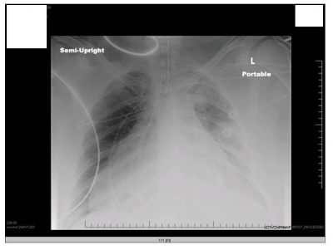

Slide 9
Air embolism
Definition:- air embolism results from inadvertent introduction of air into the circulation, usually via the venous system.
Causes:
Neurosurgery (dural sinuses are non-collapsible)
Caesarean section (e.g. if exposed veins are raised above level of heart)
Central line insertion/removal
Epidural catheter placement
(if loss of resistance to air is used)
Entrainment through an intravenous line (especially if pressure-assisted)
Situations where high pressure
gas is used (laparoscopy)

Slide 10
Signs:
• HR
• BP
• SaO2
• ETCO2 (acute due to ventilation–perfusion mismatch)
• Murmur (millwheel,due to air circulating around the cardiac champers )

Slide 11
Treatment:
• 100% Oxygen
• Airway, breathing, circulation and call for help
• Flood surgical site with saline
• Position patient in Trendelenburg/left lateral decubitus
position
• Consider inserting a central venous catheter to
aspirate gas
• Consider hyperbaric chamber if indicated.

Slide 12
Laryngospasm
Definition:- is the complete or partial adduction of the vocal cords, resulting in a variable degree of airway obstruction.
Causes:
• Airway manipulation
• Blood/secretions in oropharynx
• Patient movement
• Surgical stimulus
• Failure to deliver anaesthetic agent

Slide 13
Signs
• Partial/complete airway obstruction
• Paradoxical respiratory effort in a spontaneously breathing patient (abdominal/ chest see-saw movements as respiratory effort attempts to overcome the obstruction).

Slide 14
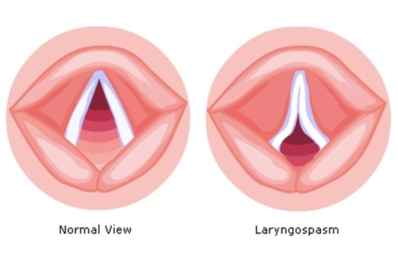

Slide 15
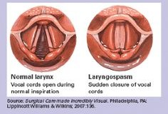

Slide 16
Treatment
Some or all might be needed:
• Positive pressure ventilation with high flow oxygen (e.g. CPAP or IPPV)
• Deepening of anaesthesia (e.g. i.v. propofol)
• Suxamethonium with or without tracheal intubation – causes rapid muscle relaxation and ceases vocal cord opposition .

Slide 17
Complications
SaO2
Aspiration
Bradycardia (especially in children)
Pulmonary oedema

Slide 18
Failed intubation (reproduced from the Difficult Airway Society, with permission)
1. Assess the likelihood and clinical impact of basic management problems:
• Difficulty with patient cooperation or consent
• Difficult mask ventilation
• Difficult supraglottic airway placement
• Difficult laryngoscopy
• Difficult intubation
• Difficult surgical airway access

Slide 19
Failed intubation
(reproduced from the Difficult Airway Society, with permission)
Direct laryngoscopy
Any problems
Call for help

Slide 20
2. Actively pursue opportunities to deliver supplemental oxygen throughout the
process of difficult airway management.
3. Consider the relative merits and feasibility of basic management choices:
• Awake intubation vs. intubation after induction of general anesthesia
• Non-invasive technique vs. invasive techniques for the initial approach to intubation
• Video-assisted laryngoscopy as an initial approach to intubation
• Preservation vs. ablation of spontaneous ventilation

Slide 21
Plan A: Initial tracheal intubation plan
•Initial tracheal intubation plan
Direct laryngoscopy
– check: neck flexion and head extension
• Laryngoscope technique and vector
• External laryngeal manipulation
– by laryngoscopist
• Vocal cords open and immobile
• If poor view:
Introducer (bougie) – seek clicks or hold-up
and/or alternative laryngoscope

Slide 22
Failed intubation

Slide 23
Plan B
Secondary tracheal intubation plan
ILMA or LMA
  Not more than 2 insertions
  Oxygenate and ventilate
Failed oxygenation
  (e.g. SpO2 < 90% with FiO2 1.0)
  via ILMATM or LMATM

Slide 24
Plan C
Maintenance of oxygenation, ventilation,
  postponement of surgery and awakening
Revert to face mask
Oxygenate and ventilate
Reverse non-depolarising relaxant
1 or 2 person mask technique
(with oral ± nasal airway)

Slide 25
Failed ventilation and oxygenation

Slide 26
Plan D
Rescue techniques for
can't intubate, can't ventilate’ situation

Slide 28
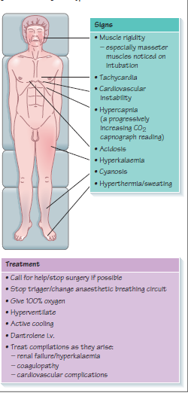
Malignant hyperthermia
Definition:- this occurs after exposure to a triggering agent (volatile anaesthetics or suxamethonium) and results in loss of normal calcium homeostasis within skeletal muscle cells.

Slide 29
Anaphylaxis
Definition:- this is an acute severe type 1 hypersensitivity reaction when an antigen (trigger) reacts with immunoglobulin IgE bound to histamine rich mast cells and basophils.
Symptoms
• Anxiety, feeling of impending doom
• Rash, itch
• Wheeze, shortness of breath
• Abdominal pain, diarrhoea, vomiting
• Chest pain
Signs
• Angioedema, e.g. skin, lips, throat
• Rash, flushing, urticaria
• Tachycardia, bradycardia, dysrhythmias
• Hypotension
• Bronchospasm

Slide 30
Treatment
• Basic resuscitation based on Airway Breathing Circulation (ABC)
• Remove suspected cause
• Call for help
• Give patient 100% oxygen, tracheal intubation if necessary
• Elevate legs if hypotension (increases venous return)
• Start cardiopulmonary resuscitation (CPR) if needed
• Give epinephrine 50μg in repeated doses; consider epinephrine infusion
• Give large volumes of fluid, e.g. normal saline or Hartmann’s solution
Secondary treatment
• Chlorpheniramine 10mg (H1 antagonist)
• Hydrocortisone 200mg
• Consider alternative vasopressor if unresponsive to epinephrine
• Consider salbutamol i.v./nebulizer, aminophylline, for persistent
bronchospasm
• High dependency or intensive care transfer

Slide 31
Cardiac arrest
Advanced life support algorithm

Slide 32
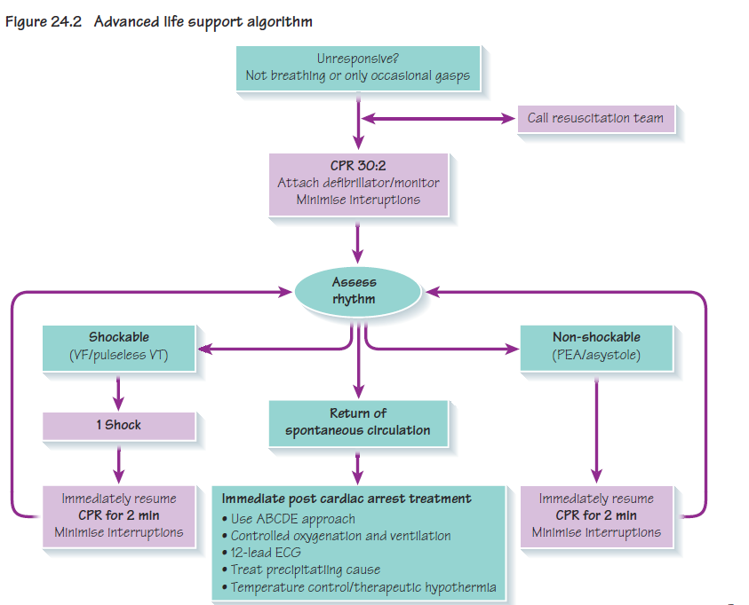


Slide 33
Reversible causes
• Hypoxia
• Hypovolaemia
• Hypo-/hyperkalemia/metabolic
• Hypothermia
• Thrombosis – coronary or pulmonary
• Tamponade – cardiac
• Toxins
• Tension pneumothorax
During CPR
• Ensure high-quality CPR rate, depth, recoil
• Plan actions before interrupting CPR
• Give oxygen
• Consider advanced airway and capnography
• Continuous chest compressions when advanced airway in place
• Vascular access (intravenous, intraosseous)
• Give adrenaline every 3–5 min
• Correct reversible causes

Slide 34
Status asthmaticus
This is a severe acute exacerbation of asthma refractory to conventional β2 agonist therapy and is a medical emergency.
Signs:-
• tachypnoea;
• use of accessory respiratory muscles (e.g. abdominal, sternocleidomastoid),
and intercostal and subcostal recession;
• wheeze might be minimal or absent;
• tachycardia;
• pulsus paradoxus >10 mmHg (a reduction in blood pressure on
inspiration);
• sweating;
• tiring;
• confusion.
Treatment
• give supplemental oxygen to maintain SaO294–98%;
• β2 agonist (either salbutamol or terbutaline) via O2 driven
nebulizer;
• continuous nebulization can be used if there is a poor initial response;
• intravenous β2 agonists should only be used when the inhaled route
is unreliable;
• steroids – either oral prednisolone or i.v. hydrocortisone;
• nebulized ipratropium (anticholinergic);
• consider i.v. magnesium sulphate when life-threatening or poor
initial response to treatment; aminophylline might also be considered
in this situation.

Slide 35
Post Anesthesia Care Unit (PACU)
The role of the anaesthetist is not limited to theatres. There may be a
number of postoperative responsibilities to undertake, both in the
recovery room and on the surgical ward.
After receiving anesthesia for a surgery or procedure a patient is sent to the PACU to recover and wake up .
The PACU is a critical care unit where the patient’s vital signs are closely observed ,pain management begins , and fluids are given .
The nursing staff is skilled in recognizing and managing problems in patients after receiving anesthesia .
The PACU is under the direction of the Department of Anesthesiology.

Slide 36
PACU
Design should match function
Location:
  Close to the OR.
  Access to x-ray, blood bank & clinical labs.
Monitoring equipment
Emergency equipment
Personnel

Slide 37
Admission to PACU
Steps:
Coordinate prior to arrival,
Assess airway,
Administer oxygen,
Apply monitors,
Obtain vital signs,
Receive report from anesthesia personnel.

Slide 38
PACU - ASA Standards
Standard I
  All patients should receive appropriate care
Standard II
  All patients will be accompanied by one of anesthesia team
Standard III
  The patient will be reevaluated & report given to the nurse
Standard IV
  The patient shall be continually monitored in the PACU
Standard V
  A physician will signing for the patient out of the PACU

Slide 39
Patient Care in the PACU
Admission
  Apply oxygen and monitor
  Receive report
Monitor & Observe & Manage
  ➔ To Achieve
    Cardiovascular stability
    Respiratory stability
    Pain control
Discharge from PACU

Slide 40
Monitoring in the PACU
Baseline vital signs.
Respiration
  RR/min, Rythm
  Pulse oximetry
Circulation
  PR/min & Blood pressure
  ECG
Level of consciousness
Pain scores

Slide 41
Initial Assessment
Color
Respiration
Circulation
Consciousness
Activity

Slide 42
Aldrete Score
Score | Activity | Respiration | Circulation | Consciousness | Oxygen Saturation
2 | Moves all extremities | Breaths deeply and coughs freely. | BP + 20 mm of preanesth. level | Fully awake | Spo2 > 92% on room air
1 | Moves 2 extremities | Dyspneic, or shallow breathing | BP + 20-50 mm of preanesth. level | Arousable on calling | Spo2 >90% With suppl. O2
0 | Unable to move | Apneic | BP + 50 mm of preanesth. level | Not responding | Spo2 <92% With suppl. O2

Slide 43
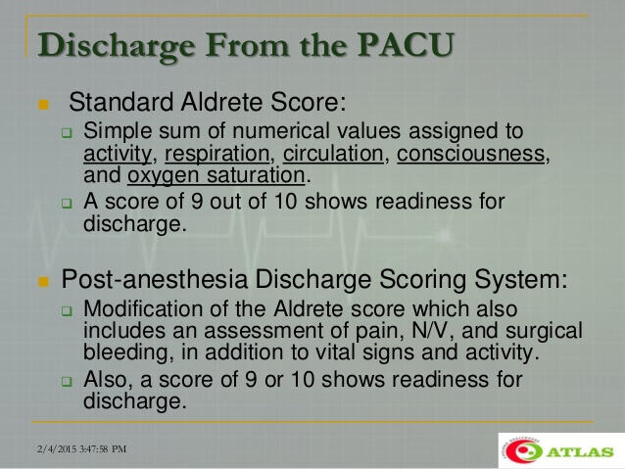

Slide 44
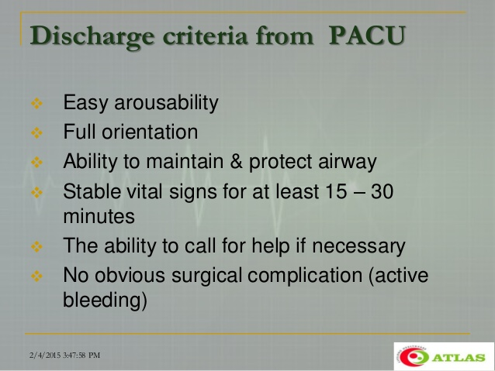

Slide 45
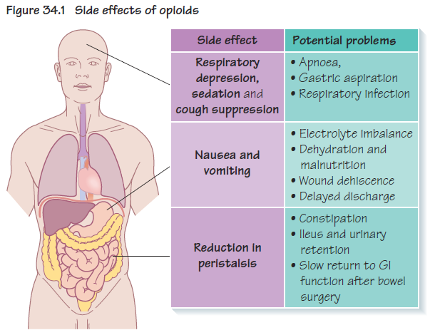
Postoperative management

Slide 46
Common PACU Problems
Airway obstruction
Hypoxemia
Hypoventilation
Hypotension
Hypertension
Cardiac dysrhythmias
Hypothermia
Bleeding
Agitation
Delayed recovery
“PONV”
Pain
Oliguria

Slide 47
1. Airway Obstruction
Most common: tongue fall back
➔ posterior pharynx
May be foreign body
Inadequate relaxant reversal
Residual anesthesia

Slide 48
Management of Airway Obstruction
Patient’s stimulation,
Suction,
Oral Airway,
Nasal Airway,
Others:
  Tracheal intubation
  Cricothyroidotomy
  Tracheotomy

Slide 49
2. Hypoventilation
Residual anesthesia
  Narcotics
  Inhalation agent
  Muscle Relaxant
Post oper - Analgesia
  Intravenous
  Epidural

Slide 50
Treatment of Hypoventilation
Close observation,
Assess the problem,
Treatment of the cause:
  Reverse (or Antidote):
    Muscle relaxant ⇦ Neostigmine
    Opioids ⇦ Naloxone
    Midazolam ⇦ Anexate

Slide 51
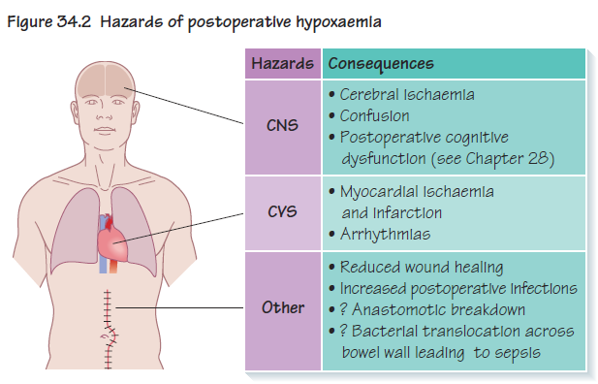
Oxygen therapy

Slide 52
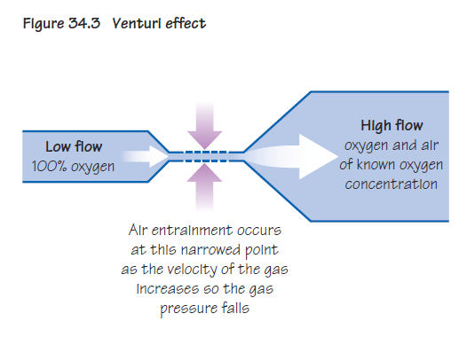

Slide 53
Treatment of Hypoventilation
Close observation,
Assess the problem,
Treatment of the cause:
  Reverse (or Antidote):
    Muscle relaxant ⇦ Neostigmine
    Opioids ⇦ Naloxone
    Midazolam ⇦ Anexate

Slide 54
3. Hypertension
Common causes: e.g.
  Pain
  Full Bladder
Hypertensive patients
Fluid overload
Excessive use of vasopressors

Slide 55
Treatment of Hypertension
Effective pain control
Sedation
Anti-hypertensives:
  Beta blockers
  Alpha blockers
  Hydralazine (Apresoline)
  Calcium channel blockers

Slide 56
4. Hypotension
Decreased venous return
  Hypovolemia,
    ⬇ fluid intake
    ⬆ losses
    Bleeding
  Sympathectomy,
  3rd space loss,
  Left ventricular dysfunction

Slide 57
Fluids
Patients will require i.v. fluids until they are able to drink normally
• maintenance and interoperative fluid losses;
• replacement of pre-existing losses (e.g. dehydration preoperatively);
• replacement of postoperative losses (e.g. nasogastric losses,
bleeding).
The types of fluid are:
• isotonic crystalloid (most often used);
• colloids (for maintaining intravascular volume, early bleeding);
• blood and blood products (for significant haemorrhage,
coagulopathy).

Slide 58
5. Dysrhythmias
Secondary to
  Hypoxemia
  Hypercarbia
  Hypothermia
  Acidosis
  Catecholamines
  Electrolyte abnormalities.

Slide 59
Treatment of Dysrhythmia
Identify and treat the cause,
Assure oxygenation,
Pharmacological

Slide 60
6. Urine Output
Oliguria
  Hypovolemia,
  Surgical trauma,
  Impaired renal function,
  Mechanical blocking of catheter.
Treatment:
  Assess catheter patency
  Fluid bolus
  Diuretics e.g. Lasix

Slide 61
7. Post op Bleeding
Causes:
Usually Surgical Problem,
Coagulopathy,
Drug induced

Slide 62
Treatment of Post op Bleeding
Treatment:
Start i.v. lines ➢ push fluids
Blood sample,
  CBC,
  Cross matching,
  Coagulopathy
Notify the surgeon,
Correction of the cause

Slide 63
8. Hypothermia
Most of patients will arrive cold
Treatment:
  Get baseline temperature
  Actively rewarm
  Administer oxygen if shivering
  Take care for:
    Pediatric,
    Geriatric.

Slide 64
9. Altered Mental Status
Reaction to drugs?
  Drugs e.g. sedatives, anticholinergics
  Intoxication / Drug abusers
Pain
Full bladder
Hypoventilation
Low COP
CVA

Slide 65
Treatment of Altered Mental Status
Reassurances,
Always protect the patient,
Evaluate the cause,
Treatment of symptoms,
Sedatives / Opioids if necessary.

Slide 66
10. Delayed Recovery
Systematic evaluation
  Pre-op status
  Intraoperative events
  Ventilation
  Response to Stimulation
  Cardiovascular status

Slide 67
Delayed Recovery
The most common cause:
  Residual anesthesia ➢ Consider reversal
Hypothermia,
Metabolic e.g. diabetic coma,
Underlying psychiatric problem
CVA

Slide 68
11. Postoperative Nausea & Vomiting “PONV”
Risk factors
  Type & duration of surgery,
  Type of anesthesia,
  Drugs,
  Hormone levels,
  Medical problems,
  Autonomic involvement.

Slide 69
Prevention of PONV
NPO status
Dexamothasone,
Droperidol,
Metoclopramide,
H₂ blockers,
Ondansetron,
Acupuncture

Slide 70
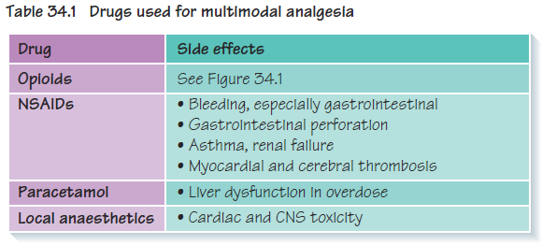
Analgesia

Slide 71
12. Postoperative Pain
Causes:
Incisional Skin and subcutaneous tissue
Laparoscopy Insuflation of Co₂
Others:
  Deep cutting, coagulation, trauma
  Positional nerve compression, traction & bed sore.
  IV site needle trauma, extravasation, venous irritation
  Tubes drains, nasogastric tube, ETT
  Surgical complication of surgery
  Others cast, dressing too tight, urinary retention

Slide 72
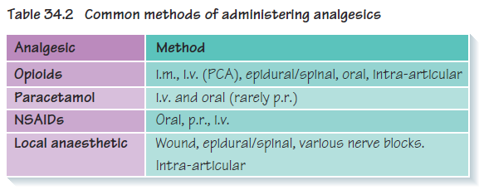

Slide 73
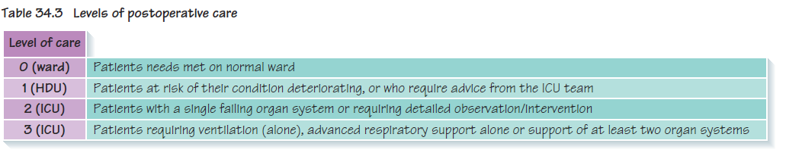
Referral to high dependency unit/intensive care unit

Slide 74
Thank you

