Slide 1
Anesthetic Monitoring
Definition
What is Monitoring ?

Slide 2
Anesthetic Monitoring
Definition
What is Monitoring ?
observe and check the progress or quality of (something) over a period of time; keep under systematic review.

Slide 3
Anesthetic Monitoring
What do you Monitor in a patient?

Slide 4
Anesthetic Monitoring
What do you Monitor in a patient?
Vitals
Color/skin
Wakefulness

Slide 5
Anesthetic Monitoring
How and by which means do you Monitor in a patient?
Physical exam
Equipments ( advances in technology)

Slide 6
Anesthetic Monitoring
What are the Standards to follow for monitoring a patient
Responsibilities?

Slide 7
Anesthetic Monitoring
What determines the Standards of Care for monitoring a patient
Basic monitoring
Advanced monitoring

Slide 8
Anesthetic Monitoring
What determines the Standards of Care for monitoring a patient
Patient/ illness
Equipments/ technology
Rules/ legislation

Slide 9
Anesthetic Monitoring
What determines the Standards of Care for monitoring a patient
Anesthesia type?
General
Regional/neuraxial
Monitored Anesthesia Care/Sedation

Slide 10
Anesthetic Monitoring
What is Anesthesia?
Hypnosis
Analgesia
Paralysis

Slide 11
Anesthetic Monitoring
What would happen for the body during anesthesia?
Neurodepression/respiratory
Cardiodepression/BP CO
Vasodilation
Low BP affects perfusion to vital organs
Low Oxygen affects metabolism of organs

Slide 12
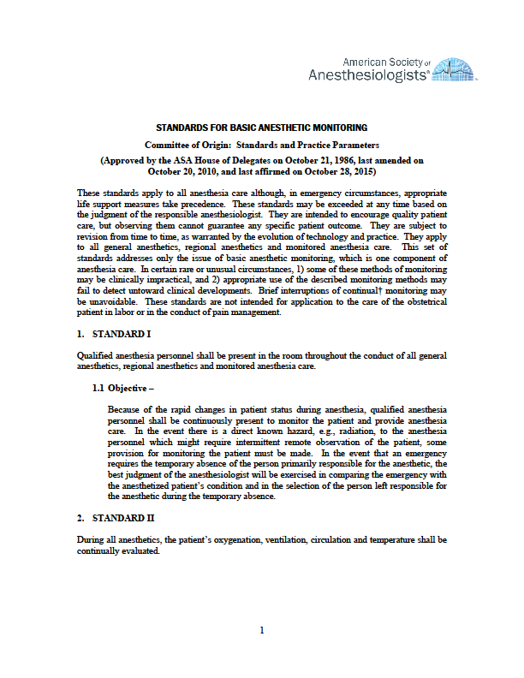
Anesthetic Monitoring
Standards for Anesthetic Monitoring

Slide 13
Anesthetic Monitoring
Standards for Anesthetic Monitoring
These standards
apply to all anesthesia care although, in emergency circumstances, appropriate life support measures take precedence.
may be exceeded at any time based on the judgment of the responsible anesthesiologist.
They are intended to encourage quality patient care, but observing them cannot guarantee any specific patient outcome.
They are subject to revision from time to time, as warranted by the evolution of technology and practice.
They apply to all general anesthetics, regional anesthetics and monitored anesthesia care.

Slide 14
Anesthetic Monitoring
Standards for Anesthetic Monitoring
This set of standards addresses only the issue of basic anesthetic monitoring, which is one component of anesthesia care.
In certain rare or unusual circumstances,
1) some of these methods of monitoring may be clinically impractical,
and 2) appropriate use of the described monitoring methods may fail to detect untoward clinical developments.

Slide 15
Anesthetic Monitoring
Standards for Anesthetic Monitoring
Brief interruptions of continual monitoring may be unavoidable.
Note that “continual” is defined as “repeated regularly and frequently in steady rapid succession” whereas “continuous” means “prolonged without any interruption at any time.”

Slide 16
Anesthetic Monitoring
Standards for Anesthetic Monitoring
Standard I
Qualified anesthesia personnel shall be present in the room throughout the conduct of all general anesthetics, regional anesthetics and monitored anesthesia care.
Due to the rapidity of occurrence of physiologic derangement during surgical interference

Slide 17
Anesthetic Monitoring
Standards for Anesthetic Monitoring
Standard I
In the event there is a direct known hazard, e.g., radiation, to the anesthesia personnel which might require intermittent remote observation of the patient, some provision for monitoring the patient must be made.

Slide 18
Anesthetic Monitoring
Standards for Anesthetic Monitoring
Standard I
In the event that an emergency requires the temporary absence of the person primarily responsible for the anesthetic, the best judgment of the anesthesiologist will be exercised in comparing the emergency with the anesthetized patient’s condition and in the selection of the person left responsible for the anesthetic during the temporary absence.

Slide 19
Anesthetic Monitoring
Standards for Anesthetic Monitoring
Standard II
During all anesthetics, the patient’s oxygenation, ventilation, circulation and temperature shall be continually evaluated

Slide 20
Anesthetic Monitoring
Standards for Anesthetic Monitoring
Standard II
Frequency of mandatory monitoring varies between each category, but never exceeds five minutes.

Slide 21
Anesthetic Monitoring
Standards for Anesthetic Monitoring
Standard II
Frequency of mandatory monitoring varies between each category, but never exceeds five minutes.
If not used, a reason should be recorded on the patient record.

Slide 22
Anesthetic Monitoring
Standards for Anesthetic Monitoring
Standard II
iii. The following are all specifically mandated.
Oxygen analyzer with a low inspired concentration limit alarm during general anesthesia
Quantitative assessment of blood oxygenation
Ensuring adequate ventilation during all anesthetic care including verification of expired oxygen (when possible), quantitative measurement of tidal volume, and capnography in all general anesthetics.
Qualitative evaluation of ventilation is required during all other care.
Ensure correct placement of endotracheal tube or laryngeal mask airway via expired carbon dioxide (CO2).
Alarms for disconnects when a mechanical ventilator is used

Slide 23
Anesthetic Monitoring
Standards for Anesthetic Monitoring
Standard II
iii. The following are all specifically mandated.
Continuous display of ECG
Determination of arterial BP and heart rate at least every 5 minutes.
Adequacy of circulation is to be determined by quality of pulse either electronically, through palpation, or auscultation
The means to determine temperature must be available and should be employed when changes in temperature are anticipated or intended.

Slide 24
Anesthetic Monitoring
Standards for Anesthetic Monitoring
Standard II
iii. The following are all specifically mandated.
Oxygen analyzer
Most modern anesthesia machines monitor both inspired and expired concentrations of O2
This is essential during anesthesia because it is possible to deliver a hypoxic gas mixture when mixing O_{z}, air, nitrous oxide, and/or volatile anesthetic agents.

Slide 25
Anesthetic Monitoring
Standards for Anesthetic Monitoring
Pulse oximetry
Provides quantitative analysis of the patient's saturation of hemoglobin with O2.

Slide 26
Anesthetic Monitoring
Standards for Anesthetic Monitoring
Carbon dioxide (CO2)
Inspired and expired CO₂ should be monitored.
b) Expired CO2 is frequently displayed through capnography with a displayed value correlating to the peak expired CO₂ of each breath.

Slide 27
Anesthetic Monitoring
Standards for Anesthetic Monitoring
Carbon dioxide (CO2)
c) Capnography
  Provides qualitative and quantitative information regarding expired CO2.
  Quantitatively, this is useful to ensure the endotracheal tube is within the respiratory tract as well as to ensure adequate cardiac output.
d) Inspired CO2
  Monitored to ensure that the CO2 absorber of the anesthesia machine is adequately removing all CO2 from the circuit.
  If inspired CO2 is greater than zero, changing of the absorbent should be considered. The color of absorbent turns blue when its capacity is exhausted.

Slide 28
Anesthetic Monitoring
Standards for Anesthetic Monitoring
Multiple expired gas analysis
Allows determination of the percent inspired and expired of the volatile agents and nitrous oxide.
This allows the ability to better determine the delivery of an adequate anesthetic without over or under dose.

Slide 29
Anesthetic Monitoring
Standards for Anesthetic Monitoring
ECG
a) The minimum of three leads is to be used, although five leads are used for most adults.
b) Consideration must be taken for the surgical field and patient positioning.
i) Lead placement is commonly altered for cases involving the chest, shoulders, back, and neck.

Slide 30
Anesthetic Monitoring
Standards for Anesthetic Monitoring
ECG
c) Five Lead ECG
    Includes the right arm (RA), left arm (LA), right leg (RL), left leg (LL), and V.
    The five lead arrangement can be used to display I, II, III, aVR, aVL, aVF, and/or V
d) Three lead ECG
    i) Includes the RA, LA, and LL leads and can be used to display leads I, II,and/or Ill
        A three lead ECG can be modified to display V5 by moving the LA lead to the V5 position in the fifth intercostal space at the anterior axillary line

Slide 31
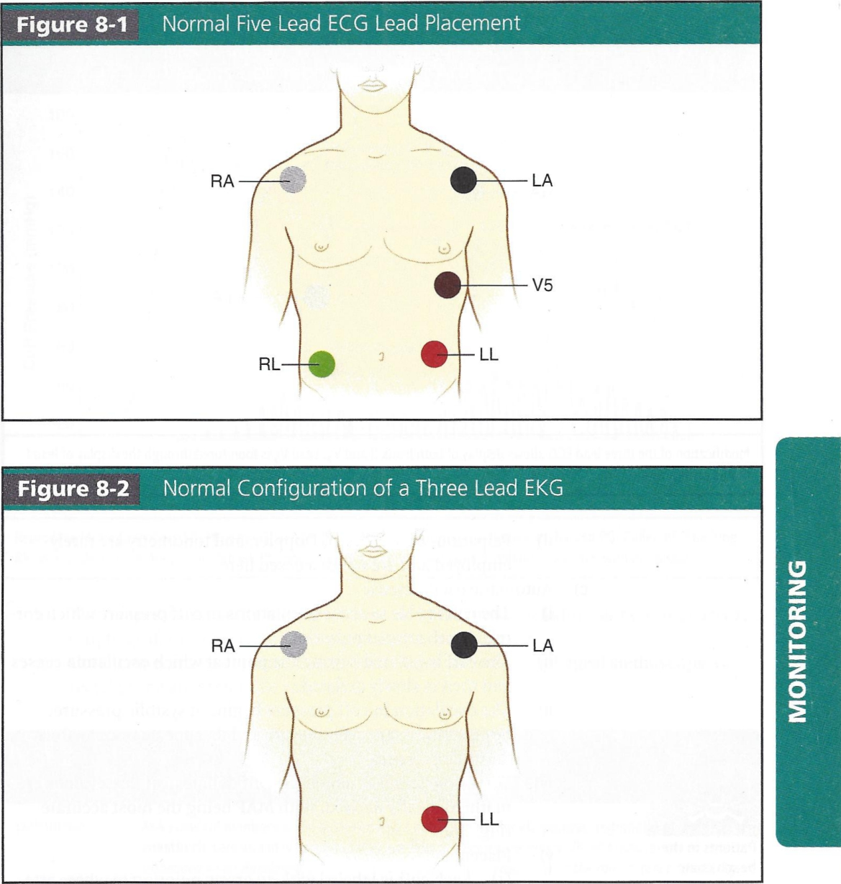
Anesthetic Monitoring
Standards for Anesthetic Monitoring

Slide 32
Anesthetic Monitoring
Standards for Anesthetic Monitoring
(2) If an arrhythmia or ischemic event appears to be present, the ability to viewing all leads simultaneously may be helpful for diagnostic purposes.

Slide 33
Anesthetic Monitoring
Standards for Anesthetic Monitoring
7) Arterial blood pressure (BP)
  BP can be monitored invasively or non-invasively.
  Non-invasive methods
    Include oscillometric cuff , and rarely palpation, ausculatation, Doppler probe.

Slide 34
Anesthetic Monitoring
Standards for Anesthetic Monitoring
7) Arterial blood pressure (BP)
c) Automatic oscillometric
  The cuff is able to sense oscillations in cuff pressure which correlate with arterial pulsation.
  Placement
    Each cuff is labeled with an arrow pointing to where arterial pulsation is felt best.
    The cuff is then placed on the arm over the brachial artery, forearm over the radial artery, or thigh/calf over the popliteal artery.
  Patient positioning
    When monitoring non-invasive pressure, consideration must be taken of patient position.
  Invasive BP monitoring

Slide 35
Anesthetic Monitoring
Standards for Anesthetic Monitoring
8) Temperature
Temperature changes should be anticipated and expected under any general anesthetic and therefore any general anesthetic requires temperature measurement.
  Very brief procedures may be an exception, but the availability of temperature monitoring should be recorded.

Slide 36
Anesthetic Monitoring
Standards for Anesthetic Monitoring
8) Temperature
  The temperature may be measured from many locations including skin, nasopharynx, esophageal, bladder, rectal, or a pulmonary arterial catheter.
  Core temperatures obtained from a pulmonary catheter, esophageal stethoscope, or rectal probe are preferable sources.

Slide 37
Anesthetic Monitoring
Modalities for Anesthetic Monitoring
Pulse Oximetry
Is one of the most commonly employed monitoring modalities in anesthesia.
It is a non-invasive way to monitor the oxygenation of a patient's hemoglobin.
A sensor with both red and infrared wavelengths is placed on the patient.
Absorption of these wavelengths by the blood is measured and oxygen saturation (Sp0₂) can be calculated.

Slide 38
Anesthetic Monitoring
Modalities for Anesthetic Monitoring
Oximetry
i) Basic Concepts
There are two main types of oximetry. Fractional oximetry and functional oximetry
Fractional oximetry. Oxyhemoglobin/(oxyhemoglobin + deoxyhemoglobin + methemoglobin + carboxyhemoglobin) Fractional oximetry measures the arterial oxygen saturation (SaO2)
(i) Can only be measured by an arterial blood sample
Functional oximetry
oxyhemoglobinl(oxyhemoglobin + deoxyhemoglobin) = SpO₂ Functional oximetry gives you the SpO2
Can be measured noninvasively by a standard pulse oximeter

Slide 39
Anesthetic Monitoring
Modalities for Anesthetic Monitoring
How pulse oximetry works
A pulse oximeter emits two wavelengths of light: red (660 nm) and infrared (940 nm)
Deoxyhemoglobin absorbs more light in the red band
Oxyhemoglobin absorbs more light in the infrared band
b) Sensors in the oximeter detect the amount of red and infrared light absorbed by the blood
c) Photoplethysmography is then used to identify pulsatile arterial flow (alternating current [AC]) and non-pulsatile flow (direct current [DC])
d) The ratio of AC/DC at both 66o and 94o nm is measured using the equation: (AC/DC)₆₆₀/(AC/DC)₉₄₀

Slide 40
Anesthetic Monitoring
Modalities for Anesthetic Monitoring
How pulse oximetry works
e) The pulse oximeter calculates the SpO₂ by taking the above equation and using an algorithm built into the software to derive the SpO2
The calibration to derive SpO2 from the (AC/DC)₆₆0/(AC/DC)₉₄₀
ratio was made from studies of healthy volunteers

Slide 41
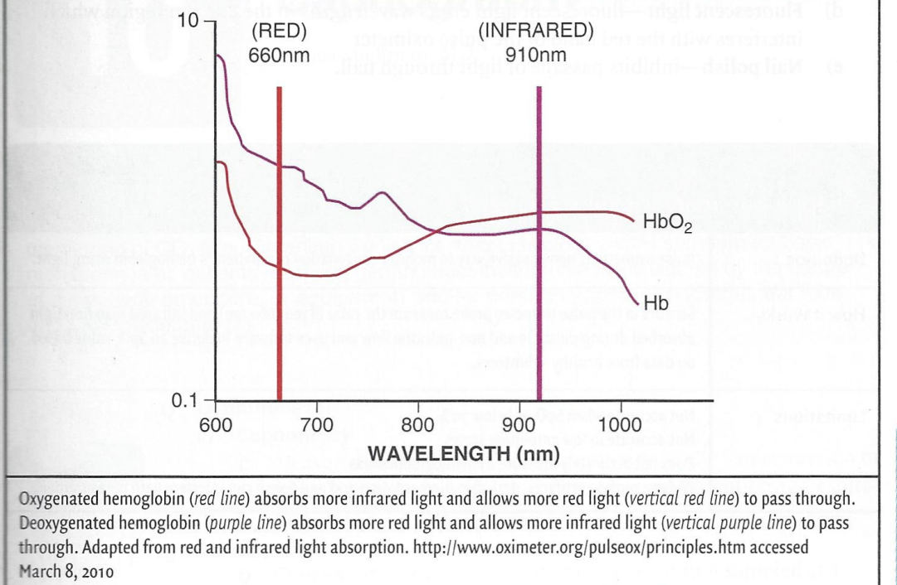
Anesthetic Monitoring
Modalities for Anesthetic Monitoring
Light absorption with Oxygenated and Deoxygenated Hemoglobin

Slide 42
Anesthetic Monitoring
Modalities for Anesthetic Monitoring
3) Accuracy of the pulse oximeter
a) If the SpO2 is between 70% and 100%, the pulse oximeter is accurate to within 5%
i) It is not accurate below 70% because calibration of the pulse oximeter involved healthy volunteers whose SpO2 did not routinely reach levels <70%

Slide 43
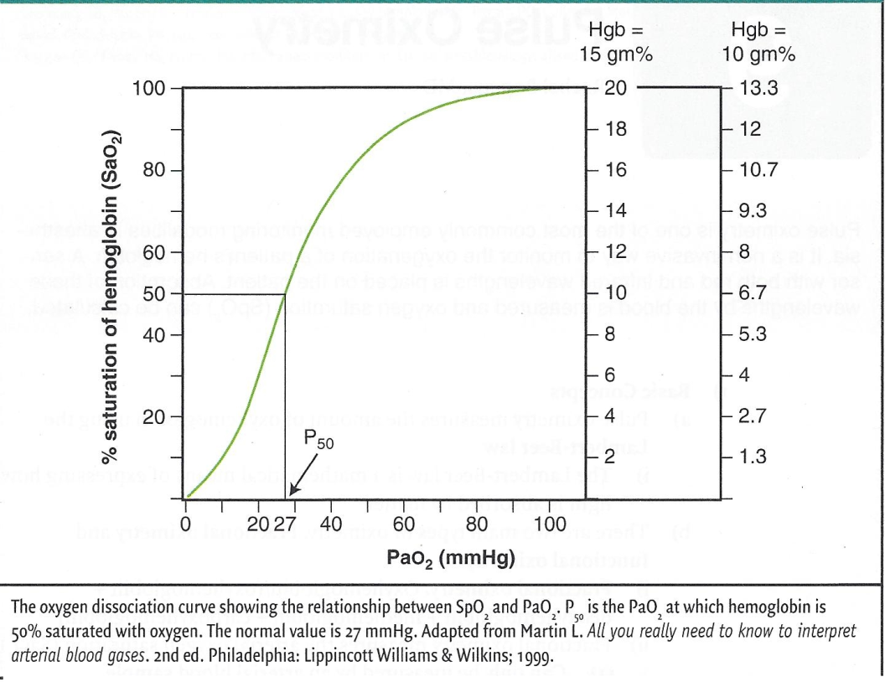
Anesthetic Monitoring
Modalities for Anesthetic Monitoring

Slide 44
Anesthetic Monitoring
Modalities for Anesthetic Monitoring
For the relationship between SaO2 and PaO2
The absorption spectrum of deoxygenated hemoglobin is very steep at 600 nm in the red range so small changes in the amount of deoxyhemoglobin can cause very wide variances in SpO2
Pulse oximetry is not as accurate in low amplitude states
Low perfusion makes it difficult for the pulse oximeter to distinguish a true signal from background noise

Slide 45
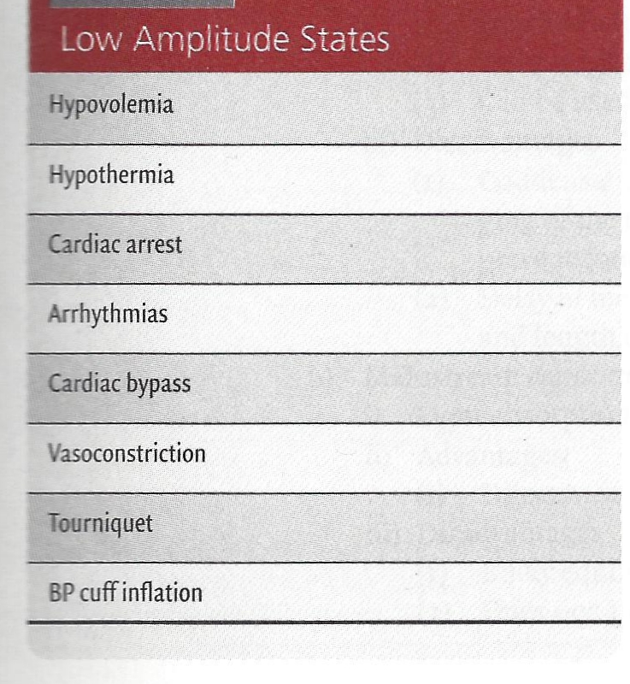
Anesthetic Monitoring
Modalities for Anesthetic Monitoring
Low perfusion makes it difficult for the pulse oximeter to distinguish a true signal from background noise

Slide 46
Anesthetic Monitoring
Modalities for Anesthetic Monitoring
Dyshemoglobinemias
Pulse oximetry only accurately measures oxyhemoglobin and deoxyhemoglobin—all other forms of hemoglobin are not accurately measured
  Carboxyhemoglobin is measured as 90% oxyhemoglobin and 10% deoxyhemoglobin
    Thus, when there are high amounts of carboxyhemoglobin it will overestimate the SpO2
    This is an important consideration in patients exposed to smoke or fires
  Methemoglobin absorbs equal amounts of red and infrared light so the SpO2 will read 85%
    Methemoglobin is formed when iron goes from it's +2 ferrous form to the +3 ferric state
(2) The ferric state of iron displays a left shift on the oxygen dissociation curve and releases oxygen less easily

Slide 47
Anesthetic Monitoring
Modalities for Anesthetic Monitoring
Dyshemoglobinemias
Methemoglobinemia can be caused by many drugs.
Patients with sickle cell anemia presenting in a vasoocclusive crisis can have an inaccurate SpO2 reading
High levels of bilirubin do not alter SpO₂ readings

Slide 48

Anesthetic Monitoring
Modalities for Anesthetic Monitoring
Dyshemoglobinemias
Methemoglobinemia

Slide 49
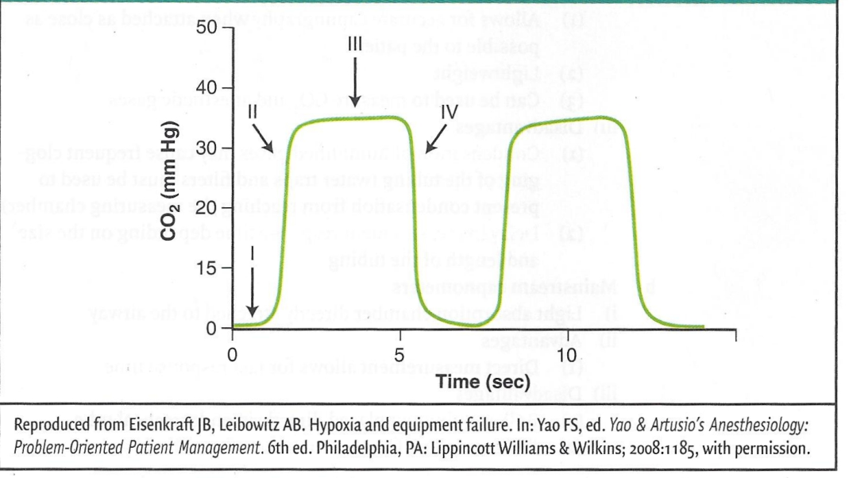
Anesthetic Monitoring
Standards for Anesthetic Monitoring
NOrmal capnogram
a) Phase I
  Initiation of expiration
  CO₂ free gas from anatomic dead space
b) Phase II
Expiration of mixture of dead space and alveolar gas
c) Phase III
  Alveolar plateau
  CO2-rich gas from alveoli
d) Phase IV or o
Inspiration

Slide 50
Anesthetic Monitoring
Standards for Anesthetic Monitoring
Clinical uses of capnography
Confirmation of endotracheal intubation
Monitoring of adequacy of ventilation in controlled or spontaneously ventilating patients
Noninvasive estimate of PaCO2
  Assumes the normal 2 to 5 mm Hg difference between expired (PETCO2) and arterial (PaCapnography in the awake state is present)
The gradient between PETCO2 and PaCO2 may be increased with age, pulmonary disease, pulmonary embolus, low cardiac output, and hypovolemia

Slide 51
Anesthetic Monitoring
Standards for Anesthetic Monitoring
Clinical uses of capnography
Detection of patient disease
i) Causes of increased CO2 production
  Fever
  Sepsis
  Malignant hyperthermia
  Hyperthyroidism
  Shivering
ii) Causes of decreased PETCO2
  Decreased cardiac output
  Hypovolemia
  Pulmonary embolism
  Hypothermia
  Hyperventilation
iii) Airway obstruction may be detected due to abnormalities in the capnography tracing.

Slide 52
Anesthetic Monitoring
Standards for Anesthetic Monitoring
Clinical uses of capnography
Detection of problems with the anesthetic breathing system
Rebreathing
Incompetent valves
Circuit disconnect
Circuit leak

Slide 53
Anesthetic Monitoring
Standards for Anesthetic Monitoring
Clinical uses of capnography
Interpretation of abnormal capnograms
a) Rebreathing of CO
  Elevation in baseline CO₂ and Phase I
  Can eliminate by increasing fresh gas flow or changing CO2 absorber
b) Obstruction to expiratory gas flow
  Prolonged Phase II and steeper Phase III slope
  Occurs with bronchospasm, COPD, kinked endotracheal tube

Slide 54
Anesthetic Monitoring
Standards for Anesthetic Monitoring
Clinical uses of capnography
Interpretation of abnormal capnograms
c) Curare Cleft
  Dip in Phase III
  Indicates return of spontaneous respiratory efforts
d) Cardiogenic oscillations
  Oscillations of small gas movements during phase III and IV (or o)
  Produced by aortic and cardiac pulsations

Slide 55
Anesthetic Monitoring
Standards for Anesthetic Monitoring
Clinical uses of capnography
Interpretation of abnormal capnograms
Increased CO2
  Elevated plateau height
  Indicates increased CO2 production states other source of CO2 (as in laparoscopic surgery), or inadequate minute ventilation
Decreased measured CO2
  Decreased plateau height
  May indicated decreased CO2 production state or increased minute ventilation

Slide 56
Anesthetic Monitoring
Standards for Anesthetic Monitoring
Clinical uses of capnography
Interpretation of abnormal capnograms
Incompetent inspiratory valve
  Prolonged Phase III with elevation of baseline CO_{z} and plateau height
  Results in rebreathing
  May be difficult to detect without simultaneous analysis of flow waveforms (7)
Esophageal intubation
  Initial presence of CO2 followed by no CO2

Slide 57
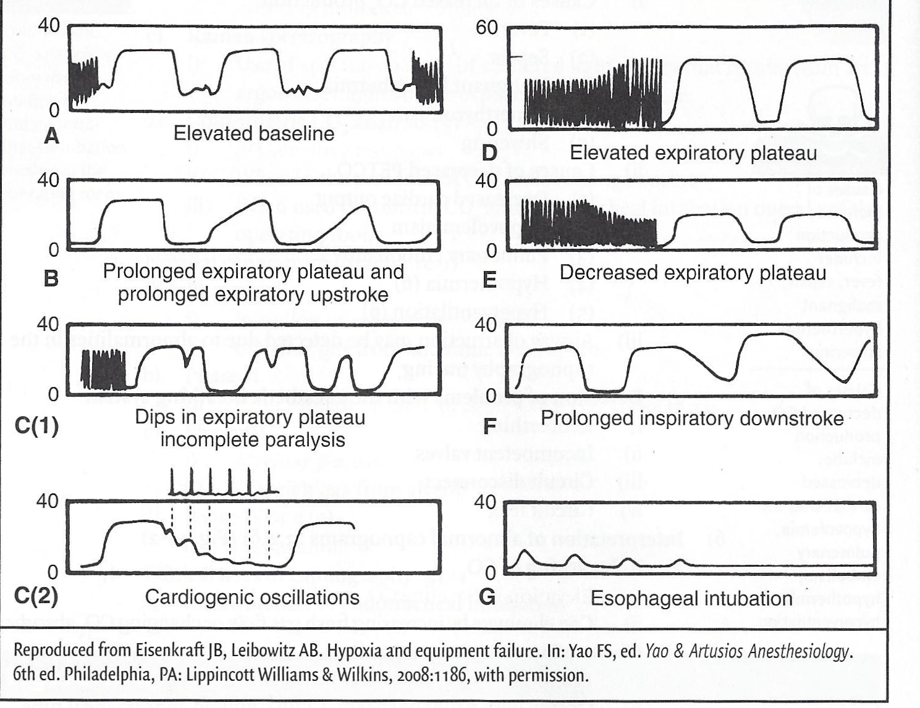
Anesthetic Monitoring
Standards for Anesthetic Monitoring

Slide 58
Anesthetic Monitoring
Modalities for Anesthetic Monitoring
Processed EEG and Awareness Monitoring
Intra-operative awareness with recall involves explicit recall of sensory perceptions during general anesthesia including aspects of their surgical environment, procedure, and even pain related to the intervention.
Intra-operative awareness with recall is defined as a patient having an unexpected and undesirable recall of wakefulness
Processed EEG analysis has been developed as a method to monitor depth of anesthesia intraoperatively and can be used as an effect-site monitor to aid in titration of anesthetic drugs and may be useful in reducing the incidence of intra-operative awareness with recall.

Slide 59
Anesthetic Monitoring
Modalities for Anesthetic Monitoring
Processed EEG and Awareness Monitoring
Intraoperative awareness
Symptoms
The most common symptoms reported by patients suggesting awareness with recall are auditory perceptions such as voices or noises, followed by loss of motor function (inability to move, sensation of weakness, or paralysis), pain, and feelings of helplessness, anxiety, panic, impending death, or catastrophe.
Awareness with recall can lead to anxiety, sleep difficulties, insomnia, irritability, nightmares, and posttraumatic stress disorder.

Slide 60
Anesthetic Monitoring
Modalities for Anesthetic Monitoring
Processed EEG and Awareness Monitoring
Incidence of awareness
The incidence of awareness with recall varies among studies, countries, anesthetic techniques, patient characteristics, and types of surgery.
The most commonly cited rate of intra-operative awareness is 0.2% .
This figure is thought to reflect the incidence in routine cases but not including cardiac or obstetric surgeries.
When further stratified, awareness occurs in approximately 1.14% to 1.5% of cardiac surgery cases, o.4% of obstetric cases, and 11% to 43% of trauma surgeries.
Awareness with recall associated with pain is estimated to occur in 0.01% to 0.03% of cases.

Slide 61
Anesthetic Monitoring
Modalities for Anesthetic Monitoring
Processed EEG and Awareness Monitoring
Factors associated with increased risk of awareness with recall include
"light" anesthesia (e.g., delivering a low level of inhaled anesthetic minimum alveolar concentration),
history of intra-operative awareness
chronic use of central nervous system depressants
younger age
obesity
inadequate or misused anesthesia delivery systems

Slide 62
Anesthetic Monitoring
Modalities for Anesthetic Monitoring
Processed EEG and Awareness Monitoring
Detecting episodes of intra-operative awareness
Often it is difficult to know for sure that intra-operative awareness with recall occurred.
If the patient is not asked specifically about it they may not report it voluntarily.
Or, the patient may recollect hearing sounds during surgery, when in fact they are remembering something that occurred in the recovery room.

Slide 63
Anesthetic Monitoring
Modalities for Anesthetic Monitoring
Processed EEG and Awareness Monitoring
d) Detecting episodes of intra-operative awareness
One accepted method to assess intra-operative awareness with recall is to conduct three structured interviews with open ended questions at intervals of 24 hours, between 24 and 72 hours, and at 30 days after surgery (awareness may not arise until days to weeks postoperatively).

Slide 64
Anesthetic Monitoring
Modalities for Anesthetic Monitoring
Processed EEG and Awareness Monitoring
Prevention or vigilance for detecting intraoperative awareness
a) Monitor delivered volatile anesthetic levels
The unintended inadequate delivery of volatile anesthetic agents ("light anesthesia") during maintenance of anesthesia may be avoided by the addition of a low alarm limit to end-tidal gas monitoring settings, as well as use of a "near empty" alarm in anesthetic vaporizers.

Slide 65
Anesthetic Monitoring
Modalities for Anesthetic Monitoring
Processed EEG and Awareness Monitoring
Prevention or vigilance for detecting intraoperative awareness
b) Monitor processed EEG signals
Depth of anesthesia monitoring, via the processed EEG, has proved useful in reducing the amount of anesthetic drugs, optimizing extubation times, and in some studies reducing awareness with recall.
Although most anesthesiologists in the UK, USA, and Australia accept that clinical signs are unreliable indicators of awareness, few believe that monitors of anesthetic depths should be used for all routine cases

Slide 66
Anesthetic Monitoring
Modalities for Anesthetic Monitoring
Processed EEG and Awareness Monitoring
Prevention or vigilance for detecting intraoperative awareness
b) Monitor processed EEG signals
Depth of anesthesia monitors
Several brain-function monitors based on the processed electroencephalogram
(EEG) or evoked potentials have been developed to assess anesthetic depth.
  BIS (Aspect Medical Systems). The most widely used monitor is the BIS monitor. This device integrates several parameters of an EEG into a calculated, dimensionless variable (o to 10o).
  It is important to note that bispectral index (BIS)is a probability distribution where a measure of 40 does not provide a 100% guarantee of no awareness.

Slide 67
Anesthetic Monitoring
Modalities for Anesthetic Monitoring
Processed EEG and Awareness Monitoring
Several brain-function monitors based on the processed electroencephalogram
(EEG) or evoked potentials have been developed to assess anesthetic depth.
  The term bispectral applies because it incorporates both power and phase spectrums of an EEG into the calculated 0 to 100 value.
  BIS values between 40 and 60 purportedly indicate adequate general anesthesia for surgery, and values below 40 indicate a deep hypnotic state. Targeting a range of BIS values between 40 and 60 is marketed to help prevent anesthesia awareness while allowing for minimization the anesthetic dose.

Slide 68
Anesthetic Monitoring
Modalities for Anesthetic Monitoring
Processed EEG and Awareness Monitoring
Prevention or vigilance for detecting intraoperative awareness
b) Monitor processed EEG signals
  M-Entropy Module (GE-Healthcare).

Slide 69
Anesthetic Monitoring
Modalities for Anesthetic Monitoring
Processed EEG and Awareness Monitoring
M-Entropy Module (GE-Healthcare). A mathematical approach that quantifies EEG using non-linear dynamics. This mode measures spectral entropy and applies it to the power spectrum of EEGs. Two variables, state and response entropy, which measure EEG and combined EEG/EMG activity respectively, are displayed on the awareness monitor as a dimensionless unit (0 to 100)
Mid-latency auditory evoked potentials (MLAEPs). This method is thought to be an alternative to the use of EEG monitoring. MLAEP are electroencephalographic responses to auditory stimuli.

Slide 70
Anesthetic Monitoring
Modalities for Anesthetic Monitoring
Neurophysiologic Monitoring and
Anesthetic Management
Neurophysiologic monitoring or neuromonitoring allows early detection of events that may increase postoperative neurological morbidity. The aim of monitoring is to identify changes in brain, spinal cord, and peripheral nerve function prior to irreversible damage. Neuromonitoring is also useful in identifying anatomical structures.

Slide 71
Anesthetic Monitoring
Modalities for Anesthetic Monitoring
Neurophysiologic Monitoring and
Anesthetic Management
Electromyography (EMG)
EMG is the recording of electrical activity of muscle and therefore an indirect indicator of function of the innervating peripheral nerve.
This technique is also used to identify and verify the integrity of a peripheral nerve, including cranial nerves as well as pedicle screw testing during spine surgery.
EMG is only sensitive to neuromuscular blocking agents.

Slide 72
Anesthetic Monitoring
Modalities for Anesthetic Monitoring
Neurophysiologic Monitoring and
Anesthetic Management
Somatosensory evoked potentials (SSEP)
SSEP are the recording, usually at the cerebral cortex, of responses from electrically stimulated peripheral afferent nerves.
The most commonly used peripheral nerves are median, ulnar, posterior tibial, and common peroneal nerves.

Slide 73
Anesthetic Monitoring
Modalities for Anesthetic Monitoring
Neurophysiologic Monitoring and
Anesthetic Management
Brainstem auditory evoked potentials (BAEP)
  BAEP are the recording of brainstem responses to auditory stimuli.
  BAEP monitors the function of the entire auditory pathway along the acoustic nerve, through the brain stem to the cerebral cortex.

Slide 74
Anesthetic Monitoring
Modalities for Anesthetic Monitoring
Neurophysiologic Monitoring and
Anesthetic Management
Motor evoked potentials (MEP)
MEP is the recording obtained from electrical stimulation of the motor cortex, which elicits potentials in the spinal cord or (myogenic) potentials from the innervated muscle.
Monitors motor pathway function

Slide 75
Anesthetic Monitoring
Modalities for Anesthetic Monitoring
Neurophysiologic Monitoring and
Anesthetic Management
Electroencephalography (EEG)
i) EEG monitoring can be a useful supplement to surgery when
  )Seizure foci need to be identified
  The general state of cerebral metabolism needs monitoring
  Cerebral ischemia can occur
ii) EEG is a standard of care in many institutions for carotid endarterectomy.

Slide 76
Anesthetic Monitoring
Modalities for Anesthetic Monitoring
Neurophysiologic Monitoring and
Anesthetic Management
Electroencephalography (EEG)
  iii) EEG is the recording of brain electrical activity and is highly dependent on anesthetic depth.
      (I) Alpha waves are rhythmically regular waves of 8 to 12 Hz seen in a lightly anesthesized patient.
        A faster, disorganized beta (>12 Hz) rhythm is seen upon awakening.
        Slower theta waves (4 to 8 Hz) are seen with deep inhalation or moderate dose narcotic anesthesia.
Slow delta waves (<4 Hz) indicate deep anesthesia, or ischemia if the amplitude is low.

Slide 77
Anesthetic Monitoring
Modalities for Anesthetic Monitoring
  Invasive pressure monitoring
  Arterial : allows for continuous beat to beat monitoring of arterial blood pressure displayed as a waveform and provides access for arterial sampling

Slide 78
Anesthetic Monitoring
Modalities for Anesthetic Monitoring
  Invasive pressure monitoring
  Central Venous Pressure
  Central venous catheterization involves placement of a sterile catheter into one of the large central veins and allows for multiple modalities of intervention along with the option of monitoring central venous pressure (CVP).
  CVP monitoring can be a useful tool for evaluating intravascular volume and preload in the absence of left ventricular (LV) dysfunction (ejection fraction <40%), severe mitral valve disease, pulmonary hypertension, or significant reduction in LV compliance (ischemia/diastolic dysfunction).

Slide 79
Anesthetic Monitoring
Modalities for Anesthetic Monitoring
  Invasive pressure monitoring
  Pulmonary artery Pressure
  The pulmonary artery (PA) catheter is a controversial but potentially powerful tool, offering information about cardiac filling pressures, cardiac output (CO), derived parameters of cardiac performance, and mixed venous oxygen saturation (Sv0₂). ASA consensus opinion is that "PA catheter monitoring may reduce perioperative complications if critical hemodynamic data obtained are accurately interpreted and appropriate treatment is instituted.

Slide 80
Anesthetic Monitoring
Modalities for Anesthetic Monitoring
  TransEsophageal Echocardiography
Transesophageal echocardiograpy (TEE) is a monitoring modality gaining popularity in the field of anesthesiology due to its versatility, reliability, and safety.
It was initially used as a diagnostic tool primarily by cardiologists but has become a mainstay in intraoperative cardiac anesthesia and its utility is extending into other areas as well.

Slide 81
Anesthetic Monitoring
Modalities for Anesthetic Monitoring
  Neuromuscular Relaxation
  Electrolytes/Acid Base
  Coagulation

