Slide 1
Intravenous Access
The ability to obtain intravenous (IV) access is an essential skill in medicine and is performed in a variety of settings by paramedics, nurses and physicians.
Although the procedure can appear deceptively simple when performed by an expert, it is in fact a difficult skill which requires considerable practice to perfect.

Slide 2
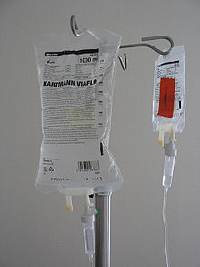
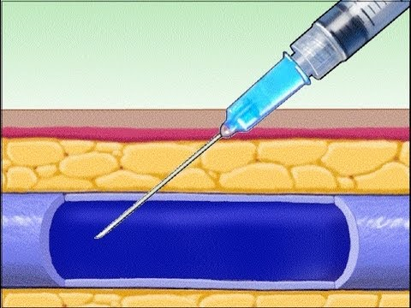
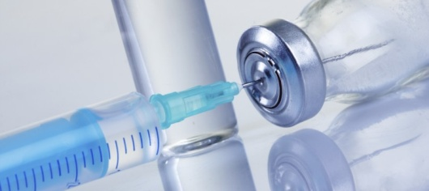
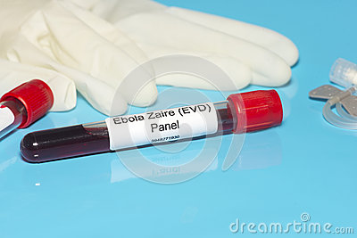
Intravenous Access
Used for access to body's circulation
Indications:
Administer fluids
Administer drugs
Obtain laboratory specimens

Slide 3
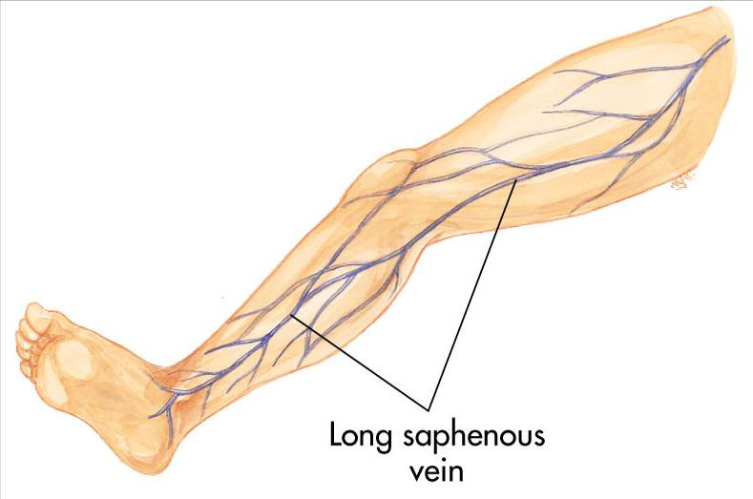
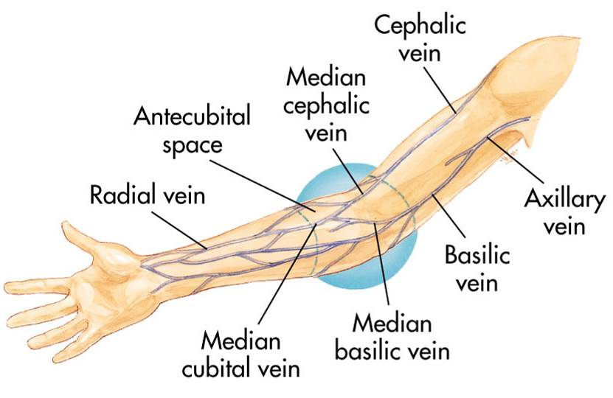
Intravenous Access
Route of choice for fluid replacement is peripheral vein in an extremity.

Slide 4
Intravenous Access
What is an IV access?

Slide 5
Intravenous Access
What is an IV access?
It is an access to the IntraVenous compartment, by mean of a catheter of a certain type and size, inserted at a specific site of the patient body.

Slide 6
Intravenous Access
What is an IV access?
It is an access to the IntraVenous compartment, by mean of a catheter of a certain type and size , inserted at a specific site of the patient body.

Slide 7
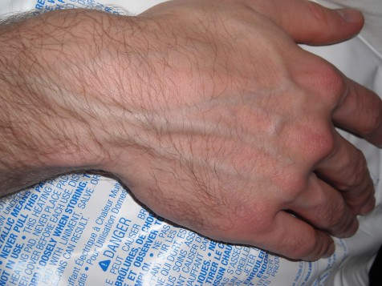
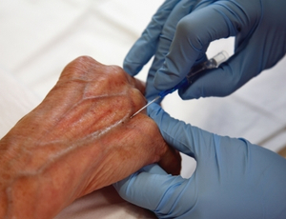
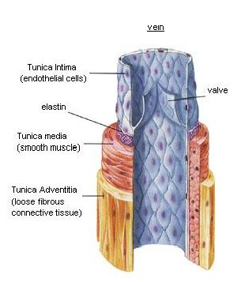
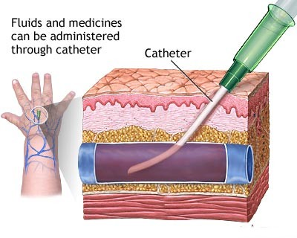
Intravenous Access
What is an IV access?
IntraVenous compartment

Slide 8
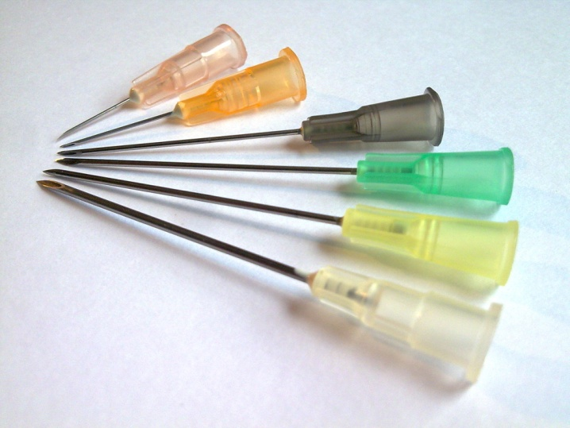
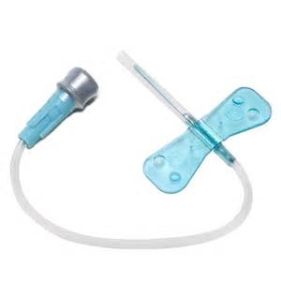
Intravenous Access
What is an IV access?
IntraVenous catheter type
Hollow needles
Butterfly type

Slide 9
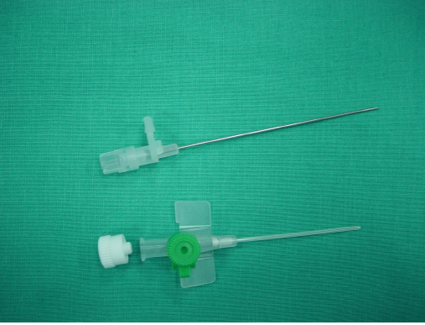
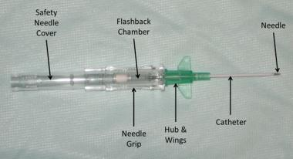
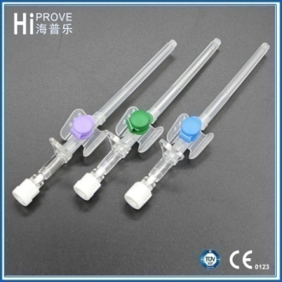
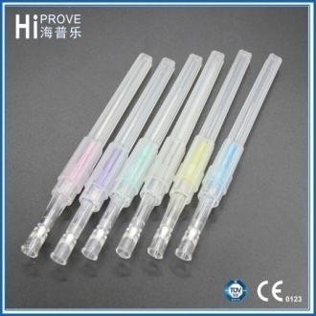
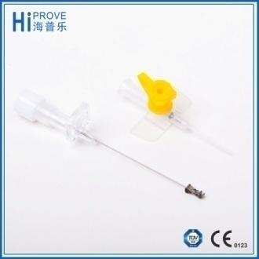
Intravenous Access
What is an IV access?
IntraVenous catheter type
Indwelling plastic catheter over hollow needle

Slide 10
Intravenous Access
What is an IV access?
IntraVenous catheter type
Indwelling plastic catheter over hollow needle

Slide 11
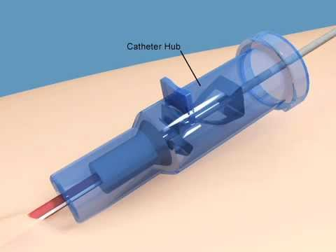
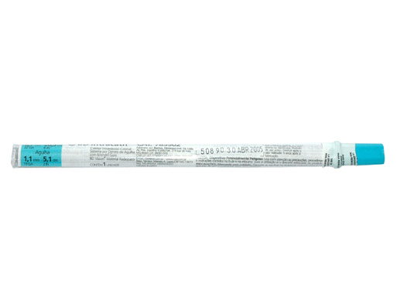
Intravenous Access
What is an IV access?
IntraVenous catheter type
Indwelling plastic catheter inserted through a hollow needle
Intracath

Slide 12
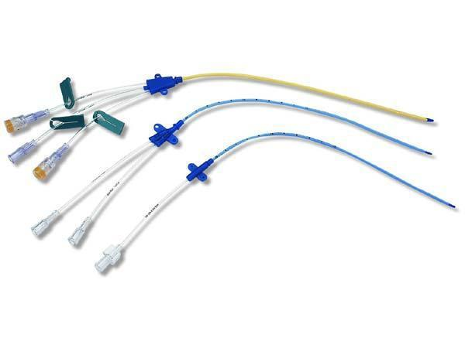
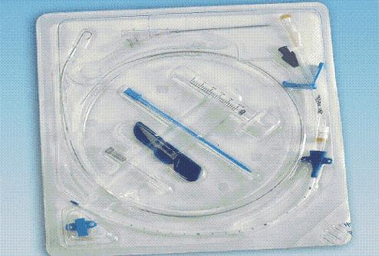
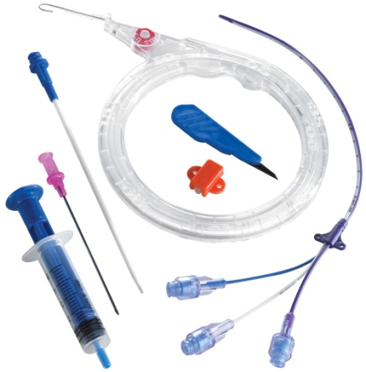
Intravenous Access
What is an IV access?
IntraVenous catheter type
Central Catheter

Slide 13
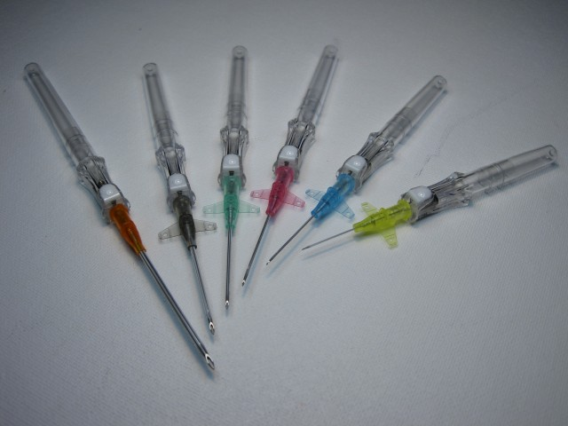
Intravenous Access
What is an IV access?
IntraVenous catheter size

Slide 14
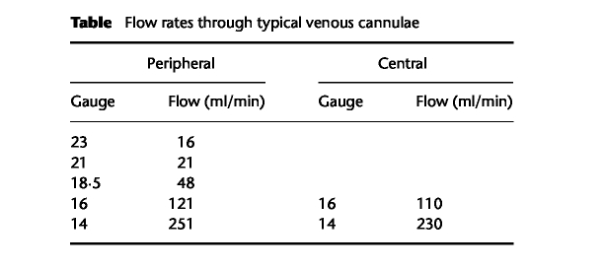
Intravenous Access

Slide 15
Intravenous Access
IV Cannula and fluid flow rates
Maximum achievable flow rate is mainly limited by the size of the IV cannula and its length
Other important factors include pressure of infusion and viscosity of fluid (e.g. saline faster than blood)
Flow is directly proportional to the 4th power of the radius [Pouseuille's law] - i.e. small changes in cannula diameter = large changes in flow
Fluid resuscitation requires at least 16 G cannula

Slide 16
Intravenous Access
IV Cannula and fluid flow rates
Cannula size | Colour | Time to infuse 1000ml Normal saline under ideal circumstances
22 G | Blue | 22 min
20 G* | Pink | 15 min
18 G | Green | 10 min
16 G | Grey | 6 min
14 G* | Red | 3.5 min
* French system - 4F = 20G, 6F = 14G

Slide 17
Intravenous Access
IV Cannula and fluid flow rates
French Size | Diameter | Examples of use
4F | 1.3 mm | Paediatric long lines
6F | 1.9 mm | Paediatric long lines
8F - 20F | 3.8-6.4 mm | Vascath
10F-18F | 3.2-5.7mm | NGT
24F - 32F | 7.6-10.4 | Adult chest drains
French system
Size = Outer diameter
French system - 4F = 20G, 6F = 14G

Slide 18
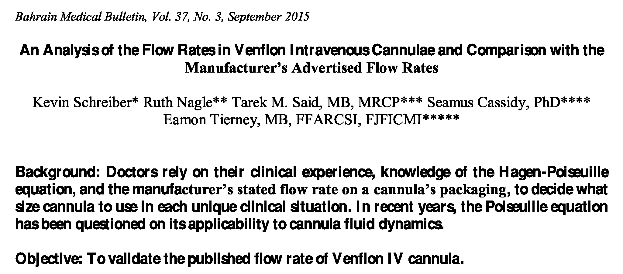
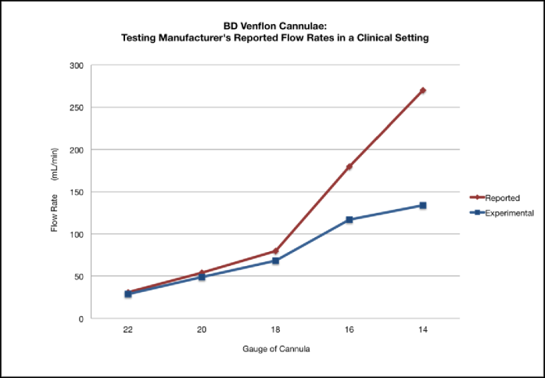
Intravenous Access
IV Cannula and fluid flow rates
there are noticeable differences between the reported and the experimental flow rates with the larger gauges.

Slide 19
Intravenous Access Indications
By starting a peripheral IV, you gain access to the peripheral circulation of a patient, which will enable you to sample blood as well as infuse fluids and IV medications.
IV access is essential to manage problems in all critically ill patients.
High volume fluid resuscitation may be required for the trauma patient, in which case at least two large bore (14-16 G) IV catheters are usually inserted.
All critically ill patients require IV access in anticipation of future potential problems, when fluid and/or medication resuscitation may be necessary.

Slide 20
Intravenous Access
No general or regional anaesthetic procedure should start without intravenous access.
A large bore cannula (14 or 16 gauge) or occasionally a small cannula (21 or 23 gauge)may be used, depending on the type of surgery.
For any surgical procedure in which rapid blood loss may occur, nothing smaller than a 16 gauge cannula should be used.

Slide 21
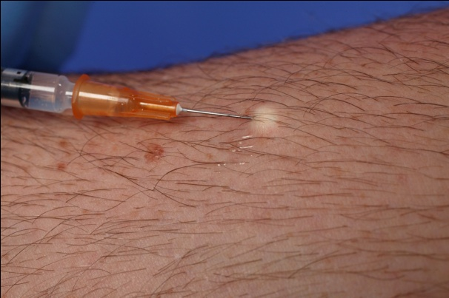
Intravenous Access
For major surgery at least one 14 gauge cannula is essential.
The major determinant of the flow rate achieved through a cannula is the fourth power of the internal radius.
All large-bore intravenous cannulae that are inserted before induction of anaesthesia should be placed after the intradermal infiltration of lignocaine using a 25 gauge needle.
The ‘sting’ of the local anaesthetic is trivial compared with the pain of a large intravenous cannula pushed through the skin.

Slide 22
Intravenous Access Contraindications
Some patients have anatomy that poses a risk for fluid extravasation or inadequate flow and peripheral IVs should be avoided in these situations.
Examples include extremities that have massive edema, burns or injury; in these cases other IV sites need to be accessed.
For the patient with severe abdominal trauma, it is preferable to start the IV in an upper extremity because of the potential for injury to vessels between the lower extremities and the heart.
For the patient with cellulitis of an extremity, the area of infection should be avoided when starting an IV because of the risk of inoculating the circulation with bacteria.

Slide 23
Intravenous Access Contraindications
Avoid sites that have injury or disease:
Trauma
Dialysis fistula
History of mastectomy
(concerns about adequate vascular flow)

Slide 24
Intravenous Access Complications
The main complications of an IV catheter are infection at the site and development of superficial thrombophlebitis in the vein that is catheterized.
It is also common for the IV sites to leak interstitially.

Slide 25
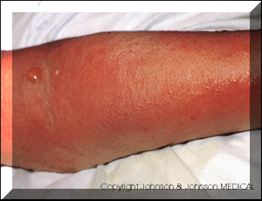
Intravenous Access Complications
Cellulitis
Inflammation of loose connective tissue around insertion site.
- Caused by poor insertion technique
- Red swollen area spreads from insertion site outwardly in a diffuse circular pattern
- Treated w/antibiotics

Slide 26
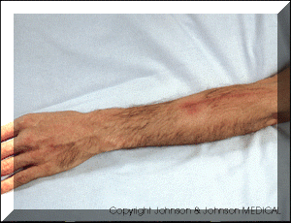
Intravenous Access Complications
Phlebitis/Thrombophlebitis
Chemical
- Infusate chemically erodes internal layers. Warm compresses may help while the infusate is stopped/changed. Anti-inflammatory and analgesic medications are often used no matter what the cause
Mechanical
- Caused by irritation to internal lumen of vein during insertion of vascular access device and usually appears shortly after insertion. The device may need to be removed and warm compresses applied
Bacterial
- Caused by introduction of bacteria into the vein. Remove the device immediately and treat w/antibiotics. The arm will be painful, red and warm; edema may accompany

Slide 27
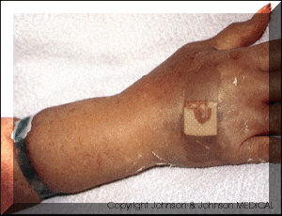
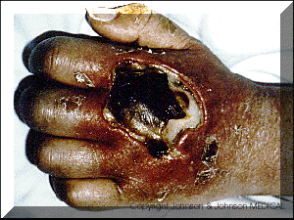
Intravenous Access Complications
Infiltration/Extravasation
The most common cause is damage to the wall during insertion or angle of placement.
STOP INFUSION and treat as indicated by Pharmacy, Medication package insert or drug reference book.

Slide 28
Intravenous Access Complications
Septicemia/Pulmonary Edema/Embolism
Septicemia
- Severe infection that occurs to a system or entire body
- Most often caused by poor insertion technique or poor site care
- Discontinue device immediately, culture and treat appropriately
Pulmonary edema- caused by rapid infusion
Pulmonary embolism - Caused by any free floating substances that require thrombolytic therapy for several months. Increased risk w/lower ext.
Air embolism- caused by air injected into IV system. Keep insertion site below level of heart

Slide 29
Intravenous Access Universal precautions
The potential for contact with a patient's blood while starting an IV is high and increases with the inexperience of the operator.
Gloves must be worn while starting an IV and if the risk of blood splatter is high, such as an agitated patient, the operator should consider face and eye protection as well as a gown.
Trauma protocol calls for all team members to wear gloves, face and eye protection and gowns.
As well, once removed from the protective sheath, IV catheters should either go into the patient or into an appropriate sharps container.

Slide 30
Intravenous Access Universal precautions
Important: Recapping needles, putting catheters back into their sheath or dropping sharps to the floor (an unfortunately common practice in trauma) should be strictly avoided.
Recapping of needles is one of the commonest causes of preventable needle stick injuries in health care workers.

Slide 31
Intravenous Access Peripheral IV sites
Generally IV's are started at the most peripheral site that is available and appropriate for the situation.
This allows cannulation of a more proximal site if your initial attempt fails.
If you puncture a proximal vein first, and then try to start an IV distal to that site, the fluid may leak from the injured proximal vessel.
The preferred site in the emergency department is the veins of the forearm, followed by the median cubital vein that crosses the antecubital fossa.
In trauma patients, it is common to go directly to the median cubital vein as the first choice because it will accommodate a large bore IV and it is generally easy to catheterize.

Slide 32
Intravenous Access Peripheral IV sites
In circumstances where the veins of the upper extremities are inaccessible, the veins of the dorsum of the foot or the saphenous vein of the lower leg can be used.
In circumstances in which no peripheral IV access is possible a central IV can be started.

Slide 33
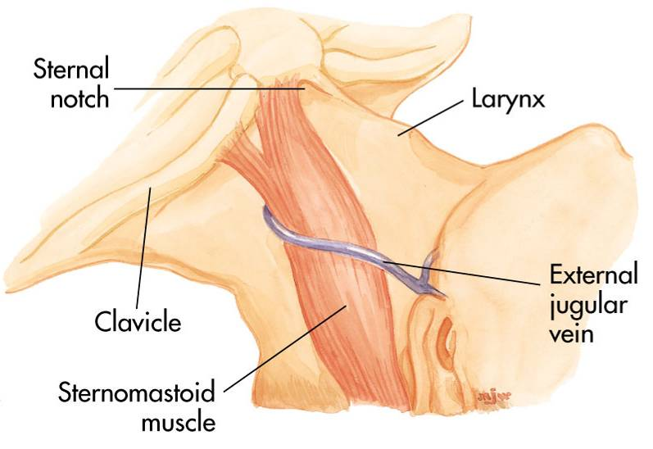
Intravenous Access Alternate sites
External jugular veins
Central vein

Slide 34
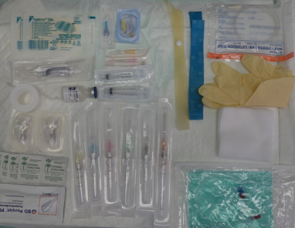
Intravenous Access Equipment
All necessary equipment should be prepared, assembled and available at the bedside prior to starting the IV. Basic equipment includes:
gloves and protective equipment
appropirate size catheter 14-25 G IV catheter
non-latex tourniquet
alcohol swab/other cleaning instrument
non-sterile 2x2 gauze
sterile 2x2 gauze (this is not practiced in nursing)
Transparent Dressing
3 pieces of 2.5 cm tape approximately 10 cm in length
IV bag with solution set (tubing) (flushed and ready) or saline lock
sharps container

Slide 35
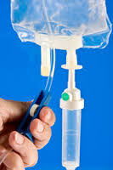
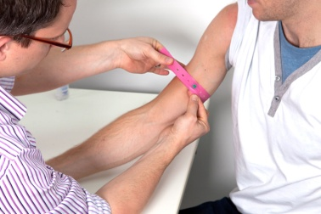
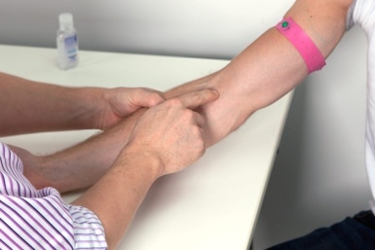
Intravenous Access Establishing a peripheral intravenous line
Wash your hands
Introduce yourself to the patient and clarify the patient’s identity. Explain the procedure to the patient and gain informed consent to continue. It is also worth explaining that cannulation may cause some discomfort but that it will be short lived
Inspect fluid for contamination, appearance, and expiration date
Prepare infusion set
Attach infusion set to bag of solution
Assemble your equipment.
Put a pair of appropriately sized non-latex examination gloves.
Apply tourniquet to the IV arm above the site.
Visualize and palpate the vein.
Cleanse the site with a chlorhexidine swab using an expanding circular motion.

Slide 36
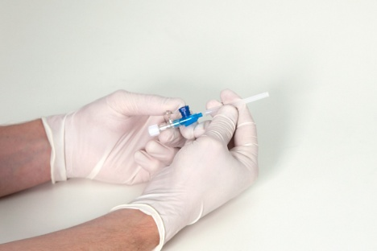
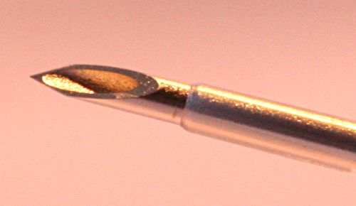
Intravenous Access Establishing a peripheral intravenous line
Prepare and inspect the catheter: Remove the catheter from the package.
Push down on the flashback chamber to ensure it is tight.
Remove the protective cover.
Inspect the catheter and needle for any damage or contaminants.
Spin the hub of the catheter to ensure that it moves freely on the needle
Do not move the catheter tip over the bevel of the stylet.

Slide 37
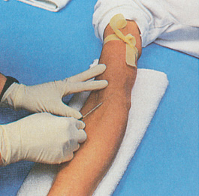
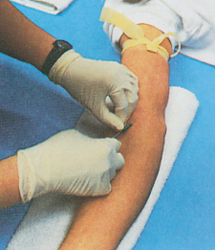
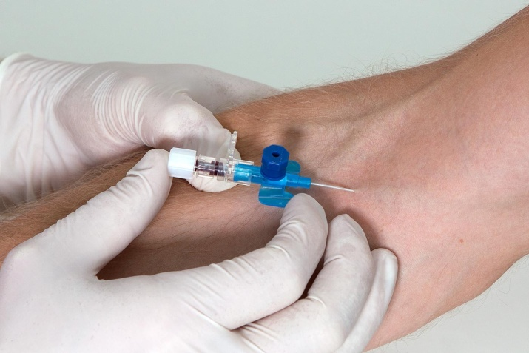
Intravenous Access Establishing a peripheral intravenous line
Stabilize the vein and apply countertension to the skin.
Insert the stylet through the skin and then reduce the angle as you advance through the vein.
Observe for "flash back" as blood slowly fills the flash back chamber.

Slide 38
Intravenous Access Establishing a peripheral intravenous line
Advance the needle approximately 1 cm further into the vein.

Slide 39
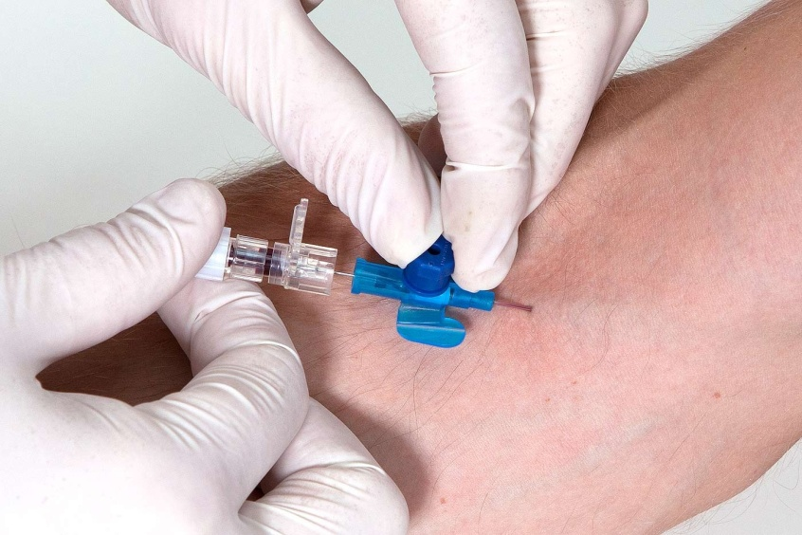
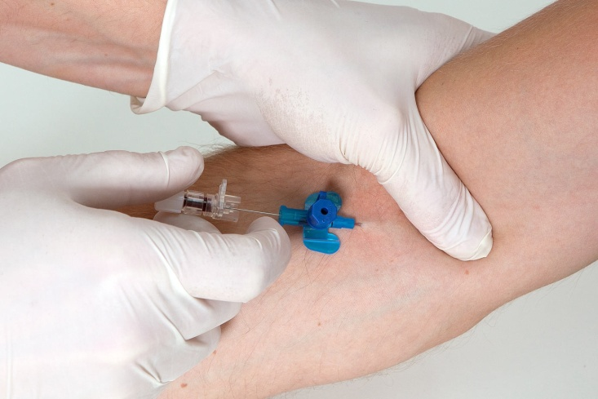
Intravenous Access Establishing a peripheral intravenous line
Holding the end of the catheter with your thumb and index finger, pull the needle (only) back 1 cm.
Slowly advance the catheter into the vein while keeping tension on the vein and skin.

Slide 40
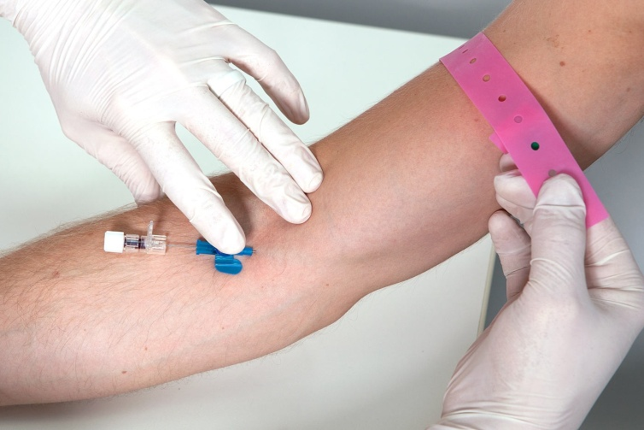
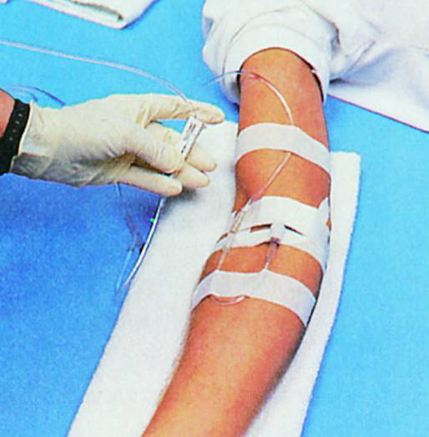
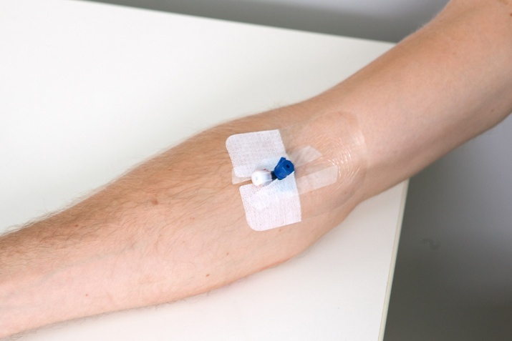
Intravenous Access Establishing a peripheral intravenous line
Remove the tourniquet.
Secure the catheter by placing the dressing over the lower half of the catheter hub taking care not to cover the IV tubing connection
Occlude the distal end of the catheter with the 3rd, 4th and 5th fingers of your non-dominant hand.
Cover puncture site dressing

Slide 41
Intravenous Access Establishing a peripheral intravenous line
Antibiotic ointment if indicated by protocol
Anchor tubing
Secure catheter
Document procedure
Monitor flow

Slide 42
Intravenous Access Establishing a peripheral intravenous line
http://www.youtube.com/watch?v=R7CJkgjSkvk

Slide 43
Intravenous Access Removal of the IV
Shut off the IV by closing the roller camp.
Remove the tape and IV dressing from the tubing and catheter.
Place a non-sterile 2x2 gauze over the IV site and remove the catheter from the arm and secure it in place with a piece of tape.

Slide 44
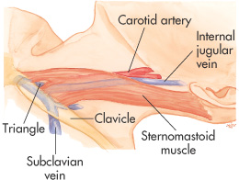
Intravenous Access Central line
Internal Jugular Anatomy

Slide 45
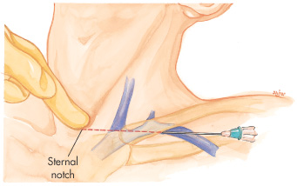
Intravenous Access Central line Subcalvian Vein Anatomy

Slide 46
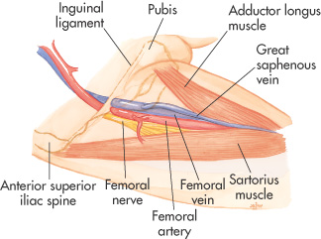
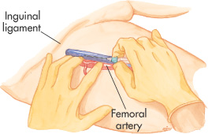
Intravenous Access Central line
Femoral Vein Anatomy

Slide 47
Intravenous Access Central line

Slide 48
Intravenous Access Central line
Advantages
Available when peripheral vessels collapse
Access to central pressure measurements
In-hospital procedure
Safer vasopressor administration

Slide 49
Intravenous Access Central line Indications
Central venous catheterization is indicated for
Monitoring central venous pressure (CVP)
Administration of fluid to treat hypovolemia and shock
Infusion of caustic drugs and total parenteral nutrition
Aspiration of air emboli
Insertion of transcutaneous pacing leads
Gaining venous access in patients with poor peripheral veins.
Continuous monitoring of central venous oxygen saturation with specialized catheters

Slide 50
Intravenous Access Central line Contraindications
Relative contraindications include
tumors
Clots
tricuspid valve vegetations that could be dislodged or embolized during cannulation.

Slide 51
Intravenous Access Central line Contraindications
Other contraindications relate to the cannulation site.
e.g : Subclavian vein cannulation is relatively contraindicated in patients who are receiving anticoagulants (due to the inability to provide direccompression in the event of an accidental arterial puncture).
Some clinicians avoid central venous cannulation on the side of a previous carotid endarterectomy due to concerns about the possibility of unintentional carotid artery puncture.
The presence of other central catheters or pacemaker leads may reduce the number of sites available for central line placement.

Slide 52
Intravenous Access Central line Techniques & Complications
Central venous cannulation involves introducing a catheter into a vein so that the catheter’s tip lies with the venous system within the thorax.
Generally, the optimal location of the catheter tip is just superior to or at the junction of the superior vena cava and the right atrium.
When the catheter tip is located within the thorax, inspiration will increase or decrease CVP, depending on whether ventilation is controlled or spontaneous.
Measurement of CVP is made with an electronic transducer (mm Hg). The pressure should be measured during end expiration.

Slide 53
Intravenous Access Central line Techniques & Complications
Various sites can be used for cannulation
All cannulation sites have an increased risk of line-related infections the longer the catheter remains in place.

Slide 54
Intravenous Access Central line Techniques & Complications
Compared with other sites, the subclavian vein is associated with a greater risk of pneumothorax during insertion, but a reduced risk of other complications during prolonged cannulations (eg, in critically ill patients).

Slide 55
Intravenous Access Central line Techniques & Complications
The right internal jugular vein provides a combination of accessibility and safety
Left-sided internal jugular vein catheterization has an increased risk of pleural effusion and chylothorax.
The external jugular veins can also be used as entry sites, but due to the acute angle at which they join the great veins of the chest, are associated with a slightly increased likelihood of failure to gain access to the central circulation than the internal jugular veins.
Femoral veins can also be cannulated, but are associated with an increased risk of line-related sepsis.

Slide 56
Intravenous Access Central line Techniques & Complications
There are at least three cannulation techniques:
a catheter over a needle (similar to peripheral catheterization)
a catheter through a needle (requiring a large-bore needle stick)
and a catheter over a guidewire (Seldinger’s technique; overwhelming majority of central line placement.

Slide 57
Intravenous Access Central line Techniques & Complications
Placement of an internal jugular venous line.
The patient is placed in the Trendelenburg position to decrease the risk of air embolism and to distend the internal jugular (or subclavian) vein.
Venous catheterization requires full aseptic technique, including scrub, sterile gloves, gown, mask, hat, bactericidal skin preparation (alcohol-based solutions are preferred), and sterile drapes.

Slide 58
Intravenous Access Central line Techniques & Complications
The two heads of the sternocleidomastoid muscle and the clavicle form the three sides of a triangle.
A 25-gauge needle is used to infiltrate the apex of the triangle with local anesthetic.

Slide 59
Intravenous Access Central line Techniques & Complications
The internal jugular vein can be located using ultrasound, and we strongly recommend that it be used whenever possible

Slide 60
Intravenous Access Central line Techniques & Complications
Alternatively, it may be located by advancing the 25-gauge needle—or a 23-gauge needle in heavier patients—along the medial border of the lateral head of the sternocleidomastoid, toward the ipsilateral nipple, at an angle of 30° to the skin.
Aspiration of venous blood confirms the vein’s location.
It is essential that the vein (and not the artery) be cannulated.
Cannulation of the carotid artery can lead to hematoma, stroke, airway compromise, and possibly death.

Slide 61
Intravenous Access Central line Techniques & Complications
An 18-gauge thin-wall needle or an 18-gauge catheter over needle is advanced along the same path as the locator needle ( Figure 5–16B ), and, with the latter apparatus, the needle is removed from the catheter once the catheter has been advanced into the vein.

Slide 62
Intravenous Access Central line Techniques & Complications
When free blood flow is achieved, a J wire with a 3-mm radius curvature is introduced after confirmation of vein puncture.
The needle (or catheter) is removed, and a dilator is advanced over the wire.
The catheter is prepared for insertion by flushing all ports with saline, and all distal ports are “capped” or clamped, except the one through which the wire must pass.

Slide 63
Intravenous Access Central line Techniques & Complications
Next, the dilator is removed, and the catheter is advanced over the wire.
The guidewire is removed, with a thumb placed over the catheter hub to prevent aspiration of air until the intravenous catheter tubing is connected to it.
The catheter is then secured, and a sterile dressing is applied. Correct location is confirmed with a chest radiograph.
The catheter’s tip should not be allowed to migrate into the heart chambers. Fluid-administration sets should be changed frequently, per medical center protocol.

Slide 64
Intravenous Access Central line Techniques & Complications
The possibility of placement of the vein dilator or catheter into the carotid artery can be decreased by transducing the vessel’s pressure waveform from the introducer needle (or catheter, if a catheter over needle has been used) before passing the wire (most simply accomplished by using a sterile intravenous extension tubing as a manometer).
Alternatively, one may compare the blood’s color or PaO₂ with an arterial sample. Blood color and pulsatility can be misleading or inconclusive, and more than one confirmation method should be used.

Slide 65
Intravenous Access Central line Techniques & Complications
In cases where transesophageal echocardiography (TEE) is used, the guide wire can be seen in the right atrium, confirming venous entry.

Slide 66
Intravenous Access Central line Complications
The risks of central venous cannulation include
line infection
blood stream infection
air or thrombus embolism
arrhythmias (indicating that the catheter tip is in the right atrium or ventricle)
hematoma
pneumothorax
Hemothorax
Hydrothorax
Chylothorax
cardiac perforation, cardiac tamponade
trauma to nearby nerves and arteries
thrombosis.

Slide 67
Intravenous Access Central line
Clinical Considerations
Normal cardiac function requires adequate ventricular filling by venous blood.
CVP approximates right atrial pressure.
Ventricular volumes are related to pressures through compliance.
Highly compliant ventricles accommodate volume with minimal changes in pressure.

Slide 68
Intravenous Access Central line
Clinical Considerations
Noncompliant systems have larger swings in pressure with less volume changes.
Consequently, an individual CVP measurement will reveal only limited information about ventricular volumes and filling.
Although a very low CVP may indicate a volume-depleted patient, a moderate to high pressure reading may reflect either volume overload or poor ventricular compliance.
Changes associated with volume loading coupled with other measures of hemodynamic performance (eg, blood pressure, HR, urine output) may be a better indicator of the patient’s volume responsiveness.
CVP measurements should always be considered within the context of the patient’s overall clinical perspective.

Slide 69
Intravenous Access Central line
Clinical Considerations
The shape of the central venous waveform corresponds to the events of cardiac contraction
a waves from a trial contraction are absent in atrial fibrillation and are exaggerated in junctional rhythms (“cannon” a waves);
c waves are due to tricuspid valve elevation during early ventricular contraction;
v waves reflect venous return against a closed tricuspid valve;
and the x and y descents are probably caused by the downward displacement of the tricuspid valve during systole and tricuspid valve opening during diastole.

Slide 70
Intravenous Access Central line

Slide 71
Intravenous Access Central line
Disadvantages
Excessive time for placement
Sterile technique
Special equipment
Skill deterioration
High complication rate
Pneumothorax, arterial injury, abnormal placement, etc…
Chest x-ray should be obtained immediately

Slide 72
Intravenous Access Central line
Air Embolism
Uncommon but can be fatal
Air enters bloodstream through catheter tubing
Risk greatest with catheter in central circulation
Negative pressure may pull air in

Slide 73
Intravenous Access Central line
Air Embolism
Signs and symptoms
Hypotension
Cyanosis
Weak and rapid pulse
Loss of consciousness

Slide 74
Intravenous Access Central line
Air Embolism
Management
Close the tubing
Turn patient on left side with head down
Check tubing for leaks
Administer high-concentration oxygen
Aspirate

Slide 75
Intravascular Access
Cannulation of the radial artery.
A : Proper
positioning and palpation of the artery are crucial. After
skin preparation, local anesthetic is infi ltrated with
a 25-gauge needle. B: A 20- or 22-gauge catheter is
advanced through the skin at a 45° angle. C: Flashback
of blood signals entry into the artery, and the catheter–
needle assembly is lowered to a 30° angle and advanced
1–2 mm to ensure an intraluminal catheter position.
D: The catheter is advanced over the needle, which is
withdrawn. E: Proximal pressure with middle and ring
fi ngers prevents blood loss, while the arterial tubing
Luer-lock connector is secured to the intraarterial catheter

Slide 76
Arterial Line Placement
Provide continuous blood pressure (BP) monitoring
Arterial blood sampling

Slide 77
Indications for arterial line placement
Continuous arterial BP monitoring - more accurate than sphygmomanometric BP
Inability to use indirect BP monitoring (eg, in patients with severe burns or morbid obesity)
Frequent blood sampling
Frequent arterial blood gas sampling

Slide 78
Contraindications for arterial line placement
Absolute
Relative
Absent pulse
Thromboangiitis obliterans (Buerger disease)
Full-thickness burns over the cannulation site
Inadequate circulation to the extremity
Raynaud syndrome
Anticoagulation
Atherosclerosis
Coagulopathy
Inadequate collateral flow
Infection at the cannulation site
Partial-thickness burn at the cannulation site
Previous surgery in the area
Synthetic vascular graft

Slide 79
Technical Considerations
Not entirely without risks,
Requires appropriate knowledge of the anatomy and procedural skills.
Arterial line placement is considered a safe- major complications that is below 1%.
Common site of cannulation
radial, ulnar, brachial, axillary, posterior tibial, femoral, and dorsalis pedis arteries.

Slide 80
Radial artery Aatomic consideration
Originates in the cubital fossa from the brachial artery
At the wrist, the radial artery sits proximal and medial to the radial styloid process and just lateral to the flexor carpi radialis tendon.

Slide 81
Femoral artery Aatomic consideration
Originates at the inguinal ligament from the external iliac artery
Medial to the femoral nerve and lateral to the femoral vein and lymphatics.

Slide 82
Arterial Line Placement Equipment
Sterile gloves
Sterile gauze
Sterile towels
Chlorhexidine or povidone-iodine skin preparation solution
1% Lidocaine needle
5-mL syringe
Appropriate-sized cannula for artery
Scalpel (No. 11 blade)
Nonabsorbable suture (3-0 to 4-0)
Adhesive tape or strips
Sterile nonabsorbable dressing
Three-way stopcock
Pressure transducer kit
Pressure tubing
Arm board of appropriate size for the patient (eg, neonate, pediatric, adult)
Needle holder
Intravenous (IV) tubing T-connector

Slide 83
Arterial Line Placement Patient Preparation
UNCOSCIOS PATIENT
Anesthesia/ Sedation is not required.
CONSCIOUS PATIENT
provided LA -lidocaine 1%
UNCOPERATIVE PATIENT
sedation or general anesthesia may be required.

Slide 84
Arterial Line Placement Positioning
The patient is placed in the supine position.
The arm is placed up on a flat surface in neutral position, with the palm up and the wrist adequately exposed.
The wrist is dorsiflexed to 30-45° and supported in this position with a towel or gauze under its dorsal aspect

Slide 85
Arterial Line Placement
The most commonly used methods
Catheter over needle
Catheter over wire (including direct Seldinger and modified Seldinger techniques)

Slide 86
Catheter over needle technique

Slide 87
Catheter over needle technique

Slide 88
Radial artery cannulation (Seldinger). Advancement of catheter over guide wire.

Slide 89
Complications of arterial line placement
Common
Less common
Temporary radial artery occlusion (19.7%)
Hematoma/bleeding (14.4%)
Localized catheter site infection (0.72%) - The risk increases with the length of time the catheter is in place
Hemorrhage (0.53%)
Sepsis (0.13%)
Permanent ischemic damage (0.09%)
Pseudoaneurysm formation (0.09%)

Slide 90
Medical Asepsis
Removal or destruction of disease-causing organisms or infected material
Sterile technique (surgical asepsis)
Clean technique
Copyright © 2007, 2006, 2001, 1994 by Mosby, Inc., an affiliate of Elsevier Inc.

Slide 91
Antiseptics and Disinfectants
Chemical agents used to kill specific microorganisms
Disinfectants
Used on nonliving objects
Toxic to living tissue
Antiseptics
Applied to living tissue
More dilute to prevent cell damage
Some chemical agents have antiseptic and disinfectant properties
Copyright © 2007, 2006, 2001, 1994 by Mosby, Inc., an affiliate of Elsevier Inc.

Slide 92
Universal Precautions
Universal Standard precautions on every patient
When administering drugs, observe hand washing and gloving procedures if indicated
Face shields indicated during administration of endotracheal drugs
Copyright © 2007, 2006, 2001, 1994 by Mosby, Inc., an affiliate of Elsevier Inc.

Slide 93
Intravenous Access
Establishing a peripheral intravenous line
http://www.youtube.com/watch?v=R7CJkgjSkvk
IJ Ultrasound Guidance for Central Venous Access, Part 1 (8 min)
http://www.youtube.com/watch?v=vRIIaMZL9XI&feature=player_detailpage
IJ Ultrasound Guidance for Central Venous Access - Part 2 - SonoSite, Inc. (9min)
http://www.youtube.com/watch?v=zV3hw_QbgK4&feature=player_detailpage#t=13s
PLACEMENT OF A FEMORAL VENOUS CATHETER (13min)
http://www.youtube.com/watch?v=GHfGdpVJuMA&feature=player_detailpage
US GUIDED SUBCLAVIAN CENTRAL LINE (12min)
http://www.youtube.com/watch?v=jzv99DBa2jE&feature=player_detailpage
Percutaneous Sheath insertion
http://www.youtube.com/watch?v=0EPTfXx0Np8

