Slide 1
POST OP PAIN MANAGEMENT
Dr .Fatma Al-Dammas
Assistant Professor
Anesthesia consultant
Anesthesia program director
Acute &chronic Pain management

Slide 2
The management of pain is a multidisciplinary team effort involving physicians, psychologists, nurses, and physical therapists

Slide 3
Post Operative Pain Management Objectives
    Goal Of Pain Treatment
    Pain Physiology
    Classification Of Pain
    Systemic Response To The Pain
    Pain assessment including different scores of pain assessment
    Post operative pain management including WHO ladder step with patient control analgesia and epidural analgesia , PCA .

Slide 4
GOAL OF PAIN TREATMENT
Improve quality of the pt .
Facilitate rapid recovery &return to full function .
Reduce morbidity .
Allow early discharge from hospital .

Slide 5
Pain Physiology

Slide 6

Pain
Pain is subjective
and
difficult to quantify
Notes:
6

Slide 7

PAIN
An unpleasant sensory and emotional experience associated with actual or potential tissue damage or described in terms of such damage.
( International association of study of pain 1979)
Notes:
7

Slide 8
According to Pathophysiology
CLASSIFICATION OF PAIN
Nociceptive;
Due to activation, sensitization of peripheral nociceptors.
Neuropathic:
Due to injury or acquired abnormalities of peripheral OR central nervous system.
Notes:
8

Slide 9
CLASSIFICATION OF PAIN
According to Etiology
Post operative
OR
Cancer pain
Notes:
9

Slide 10
CLASSIFICATION OF PAIN
According to Type of organ affected
      Toothache
      Earache
      Headache
      Low backache
Notes:
10

Slide 11
ACUTE PAIN
.
Notes:
11

Slide 12
ACUTE PAIN
Caused by noxious stimulation due to injury, a disease process or abnormal function of muscle or viscera
It is nearly always nociceptive
Nociceptive pain serves to detect, localize and limit the tissue damage.
Notes:
12

Slide 13
TYPES OF ACUTE PAIN
Somatic
OR
Visceral
Notes:
13

Slide 14
SOMATIC PAIN
Superficial
OR
Deep
Notes:
14

Slide 15
SUPERFICIAL SOMATIC PAIN
Nociceptive input from skin, sub-cutaneous tissue and mucous membranes
Well localized and described as sharp, pricking, burning and throbbing
Notes:
15

Slide 16
DEEP SOMATIC PAIN
Arise from Muscles, Tendons and Bones
Dull, aching quality and is less well localized
Intensity and Duration of stimulus affects the degree of localization
Notes:
16

Slide 17
VISCERAL PAIN
Due to disease process, abnormal function of internal organ or its covering, e.g. Parietal pleura, Pericardium or Peritoneum.
Notes:
17

Slide 18
SUBTYPES OF VISCERAL PAIN
      True localized visceral pain
      Localized parietal pain
      Referred Visceral pain
      Referred parietal pain
Notes:
18

Slide 19
VISCERAL PAIN
Dull, diffuse and in midline
Frequently associated with abnormal sympathetic activity causing nausea, vomiting, sweating and changes in heart rate and blood pressure.
Notes:
19

Slide 20
PARIETAL PAIN
Sharp, often described as stabbing sensation either localized to the area around the organ or referred to a distant site.
Notes:
20

Slide 21
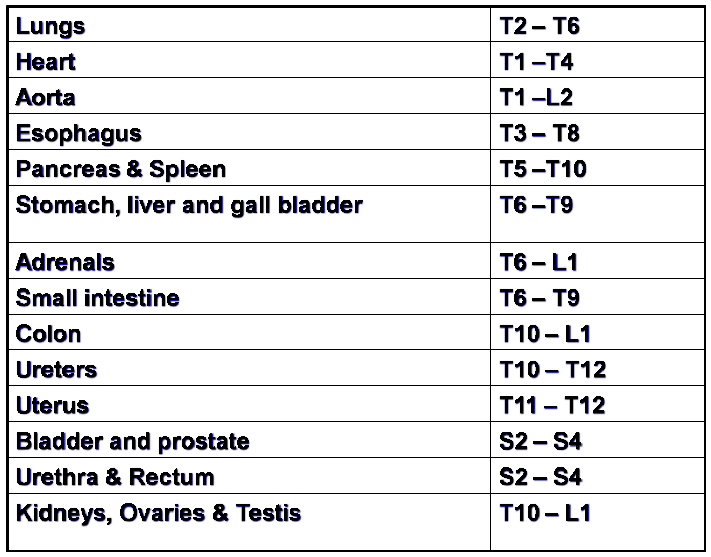
Patterns Of Referred Pain
Notes:
21

Slide 22
SYSTEMIC RESPONCES TO ACUTE PAIN
Notes:
22

Slide 23
SYSTEMIC RESPONCES TO ACUTE PAIN
Efferent limb of the pain pathway is
Sympathetic nervous system
Endocrine system.
Notes:
23

Slide 24

Cardiovascular effects
Tachycardia
Hypertension
Increased systemic vascular resistance
Notes:
24

Slide 25
RESPIRATORY SYSTEM
Increased oxygen demand and consumption
Increased minute volume
Splinting and decreased chest excursion
Atelactasis, increased shunting, hypoxemia
Reduced vital capacity, retention of secretions and chest infection
Notes:
25

Slide 26
Gastrointestinal and Urinary Effects
Increased sympathetic tone
Decreased motility, ileus and urinary retention
Hypersecretion of stomach
Increased chance of aspiration
Abdominal distension leads to decreased chest excursion
Notes:
26

Slide 27
ENDOCRINE EFFECTS
Increase secretion of Catecholamine, Cartisol and Glucagon
Decreased secretion of Insulin and testosterone
Notes:
27

Slide 28
HEMATOLOGICAL EFFECTS
Increased platelet adhesiveness
Reduced fibrinolysis and hypercoagulatability
Notes:
28

Slide 29
IMMUNE EFFECTS
Leukocytosis
Lymphopenia
Depression of reticuloendothetial system
Notes:
29

Slide 30
GENERAL SENSE OF WELL-BEING
Anxiety
Sleep disturbances
Depression
Notes:
30

Slide 31
POSITIVE ROLE OF PAIN
Acute pain plays a useful positive physiological role by providing a warning of tissue damage .

Slide 32
Acute Pain management
Pain management continues to be a challenge to nurses.
PCA &epidural analgesia are advance in analgesia that may assist nurse with this challenge
Pain management can be evaluated in terms of its ability to meet 2 main goals:
  To relieve postoperative pain.
  To relieve patient of inhibition of respiratory movement without sedation.
Notes:
32

Slide 33
CHRONIC PAIN
Notes:
33

Slide 34
CHRONIC PAIN
Chronic pain is defined as that which persists beyond the usual course of an acute disease or after a reasonable time for healing to occur
period varies between 6 or > months in most definitions.
Notes:
34

Slide 35
CHRONIC PAIN
Chronic pain may be nociceptive, neuropathic, or a combination of both.
Notes:
35

Slide 36
CHRONIC PAIN
Pt with chronic pain often have an absent nuroendocrine stress response
Have prominent sleep and affective (mood) disturbances.
Notes:
36

Slide 37
Classification – division according to duration of time
Chronic pain Acute pain
Lasts longer than expected
Is uncoupled from the
causative event
Becomes a disease in its own right
Its intensity no longer correlates with a causal stimulus
Has lost its warning and protective function
Is a special therapeutic challenge
Requires interdisciplinary procedures
Is caused by external or internal injury or damage
Its intensity correlates with the triggering stimulus
It can be easily located
Has a distinct warning and protective function
Notes:
37

Slide 38
2

Slide 39
pain assessment
“ THE FIFTH VITAL SIGN ”
For additional advice see
Dale Carnegie Training®
Presentation Guidelines
Notes:
39

Slide 40
Ask your patients about their pain

Slide 41
Assessment of pain:
Its intensity and character
Onset
Location
Description
Aggravating and relieving factors
Previous treatment
Effect
Intensity

Slide 42
ASSESSMENT OF PAIN
Measurement tools provide a valuable means of overcoming this problem.

Slide 43
Pain Assessment:
Visual analog scale -
No pain
Pain as bad as it could possibly be
What is the severity of the pain?
Descriptive intensity scale -
No pain
Mild pain
Moderate pain
Severe pain
Worst possible pain
Numerical intensity scale -
0 1 2 3 4 5 6 7 8 9 10
11 of 16

Slide 44
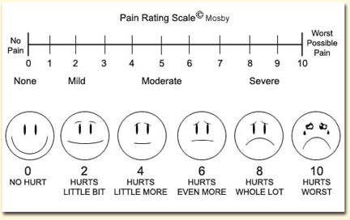
PAIN RATING SCALE
The WONG BAKER FACES SCALE.
0-No pain
10-Severe pain.
User friendly.
Easy to explain to patient.
Compact to carry

Slide 45
Wong Baker Faces Pain Rating Scale could be used as three scales because it combines
Facial expression.
Numbers.
Words.
(Ask patient to point to the faces that matches their feeling.The number used to record the score)

Slide 46
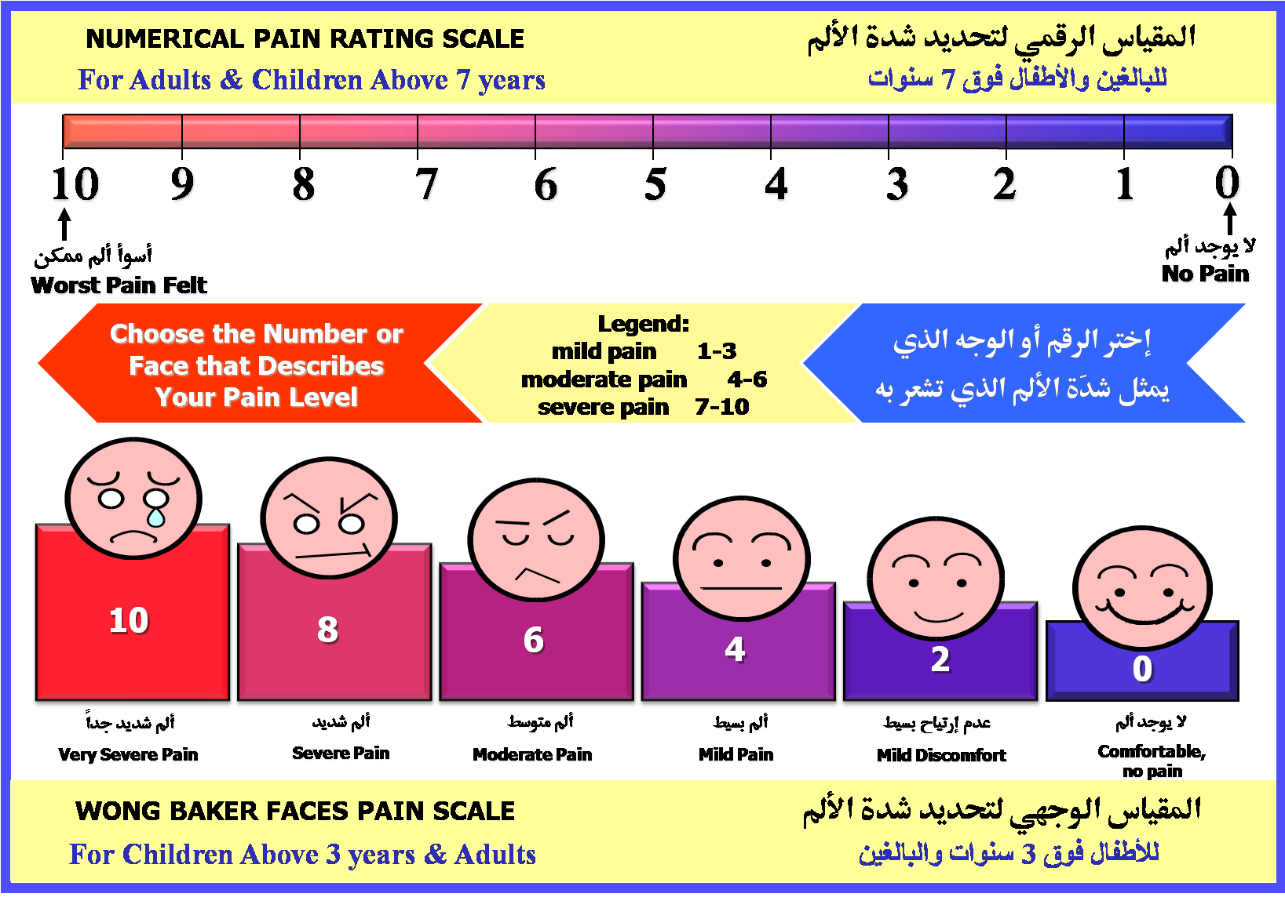

Notes:
46
46

Slide 47
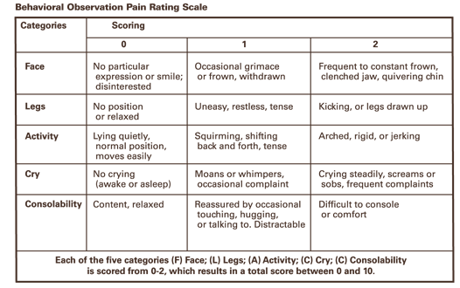
FLACC scale
Notes:
47

Slide 48
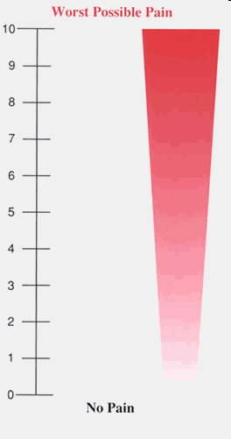
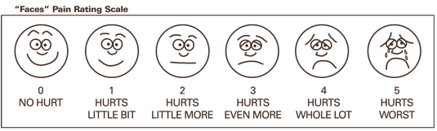
Children between 3-8 years
Usually have a word for pain
Can articulate more detail about the presence and location of pain; less able to comment on quality or intensity
Examples:
  Color scales
  Faces scales
Notes:
48

Slide 49
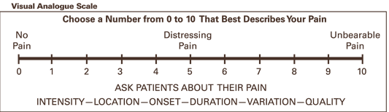
Children older than 8 years
Use the standard visual analog scale
Same used in adults

Slide 50
Pharmacology of Pain Management
“ THE FIFTH VITAL SIGN ”
For additional advice see
Dale Carnegie Training®
Presentation Guidelines
Notes:
50

Slide 51
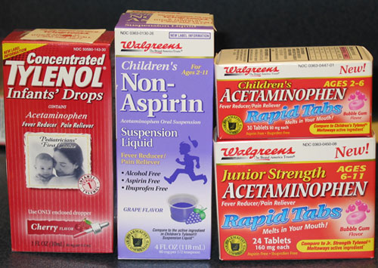
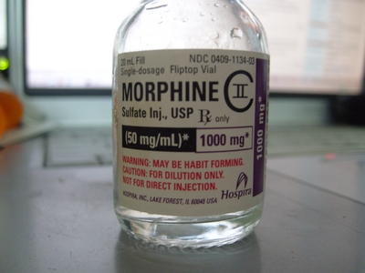
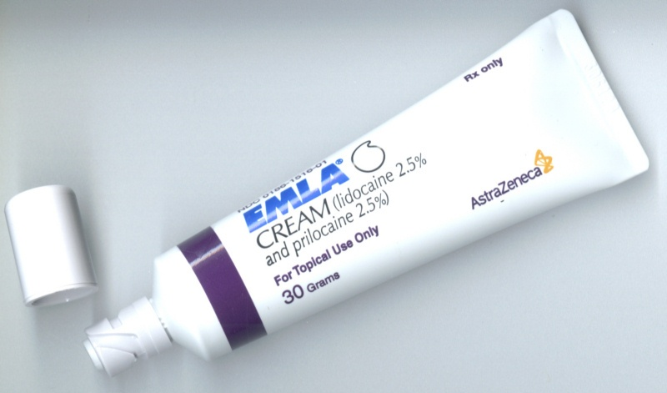
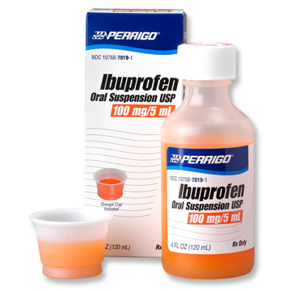
Pharmacology of Pain Management

Slide 52
There are many different techniques,non-pharmacological &pharmacological , both regional and non-regional to provide post op analgesia.
Notes:
52

Slide 53
Nonpharmacologic Approaches to Relieve Pain and Prevent Suffering
hydrotherapy
intradermal water blocks
movement & Positioning
touch and massage
acupuncture
(TENS)
aromatherapy
heat and cold
audioanalgesia.
Notes:
53
techniques, arranged
roughly in order of findings of effectiveness, were reviewed:

Slide 54
PHARMACOLEGICAL
WHO Ladder
An essential principle in using medications to manage pain is to individualize the regimen to the patient
Notes:
54

Slide 55
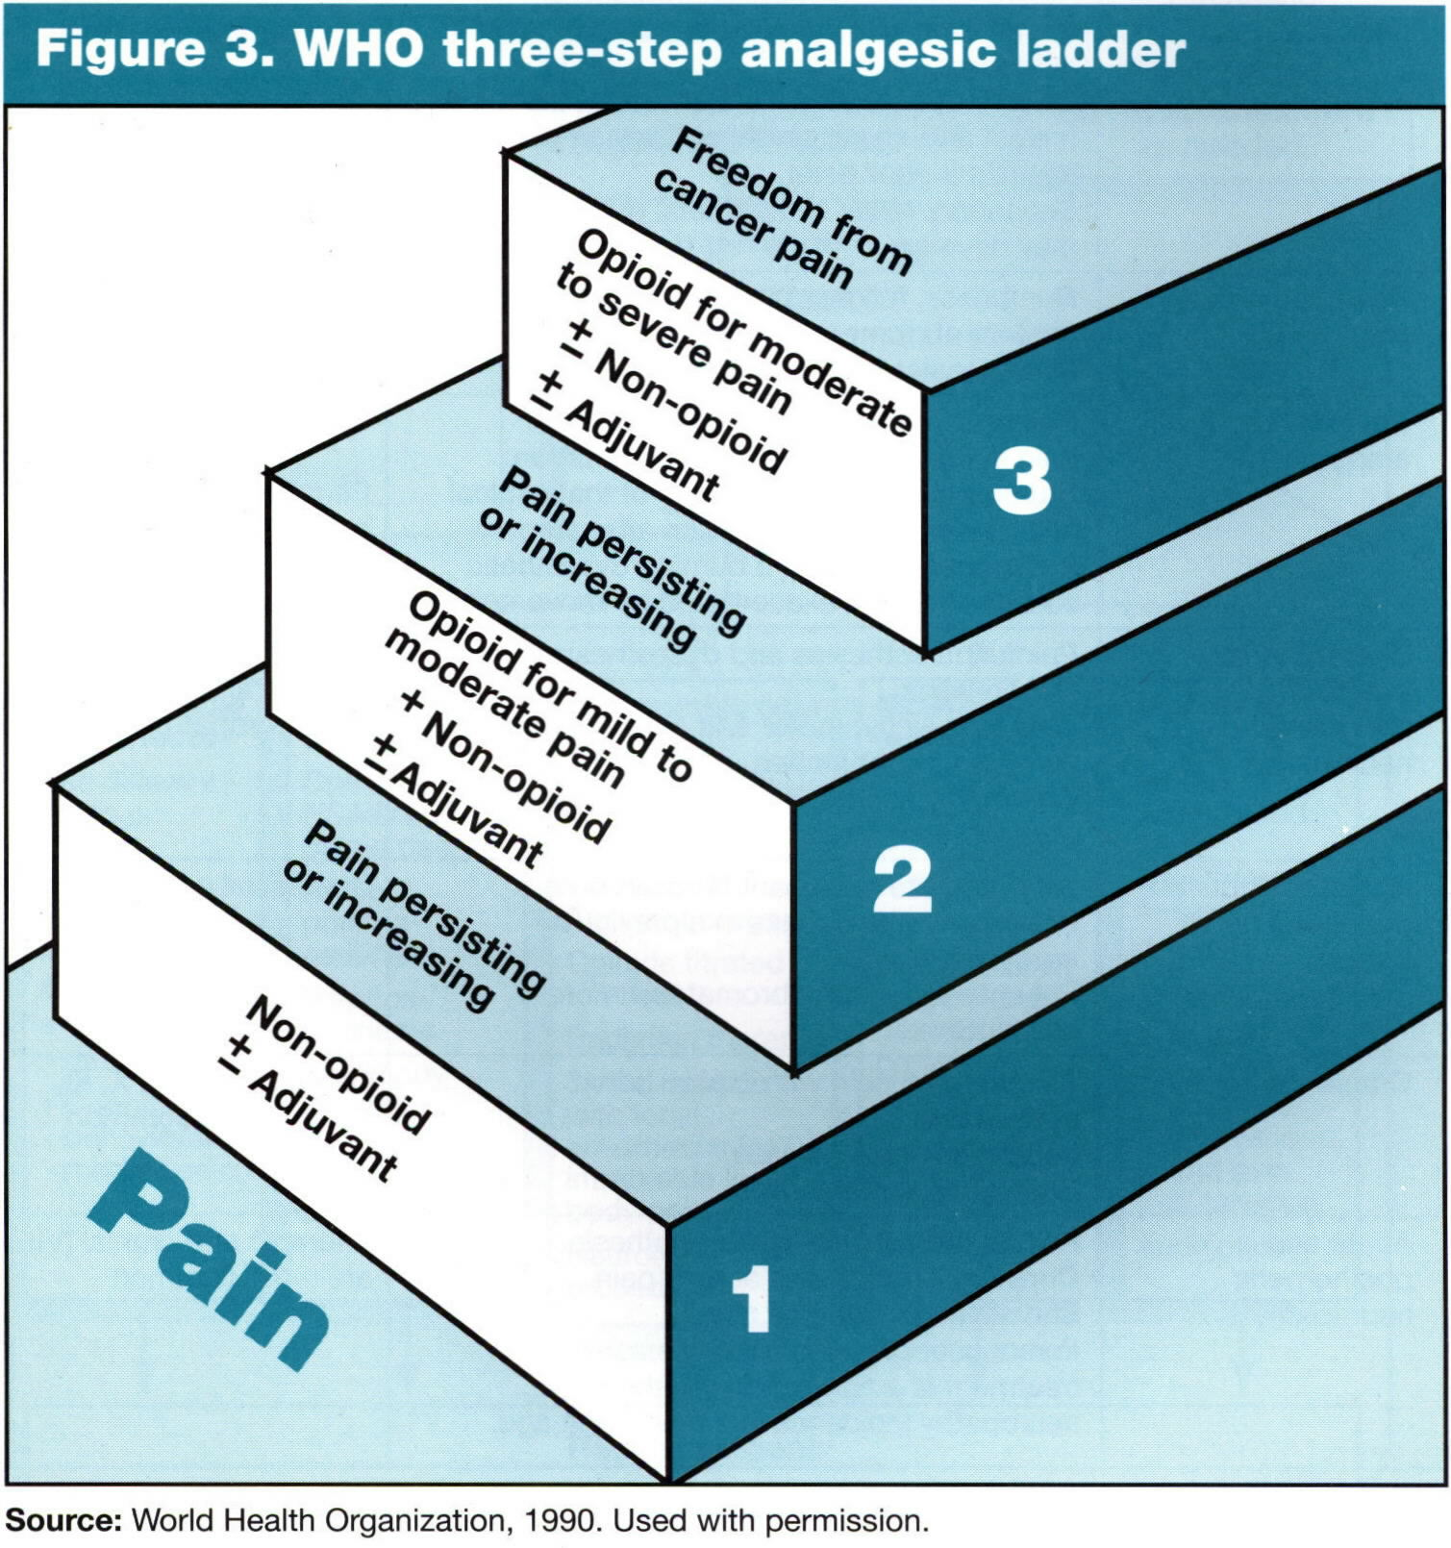
Notes:
55

Slide 56
WHO step Ladder
3 severe
Morphine
Hydromorphone
Methadone
Pethidine
Fentanyl
Oxycodone
± Adjuvants
2 moderate
Codeine
Hydrocodone
Oxycodone
Dihydrocodeine
Tramadol
± Adjuvants
1 mild
ASA
Acetaminophen
NSAIDs
± Adjuvants
Notes:
56

Slide 57
WHO analgesic guidelines
Oral medications whenever possible
Dose “by the clock” – but always have “as needed”medications for breakthrough pain
Titrate the dose
Use appropriate dosing intervals
Be aware of relative potencies
Treat side effects
Notes:
57

Slide 58
Pharmacological approach
NON OPIOID
Acetamenophen
NSAIDs
OPIOID
WEAK OPIOID
Tramal
Strong Opioids
morphine
Adjuvents therapy
  Anticonvulsant
  Antidepressants
  NMDA antagonists
  Muscle relaxants
  Clonidine
  Corticosteroids
  Local Anesthetics
  Sedatives
Notes:
58

Slide 59
Methods of Acute Postoperaive Pain Relief
For additional advice see
Dale Carnegie Training®
Presentation Guidelines
Notes:
59

Slide 60
Methods of Acute Postoperaive Pain Relief
Intramuscular
Intravenous - Intermittent Bolus
Intravenous-Continuous Infusion
Patient Control Analgesia (PCA)
Epidural analgesia
Peripheral Blocks
Notes:
60

Slide 61
PATIENT CONTROL ANALGESIA
For additional advice see
Dale Carnegie Training®
Presentation Guidelines
Notes:
61

Slide 62
Acute Pain
Postop pain is a type of “Acute Pain”
  Recent onset,
  Limited duration,
  Has a causal relationship,
  Variable pain intensity,
  Variable response to analgesia
PCA

Slide 63
Patient Controlled Analgesia
PCA is based on the belief that patients are the best judges of their pain.
They should be allowed an active role in controlling their pain.
That pain relief should be secured as quickly as possible.

Slide 64
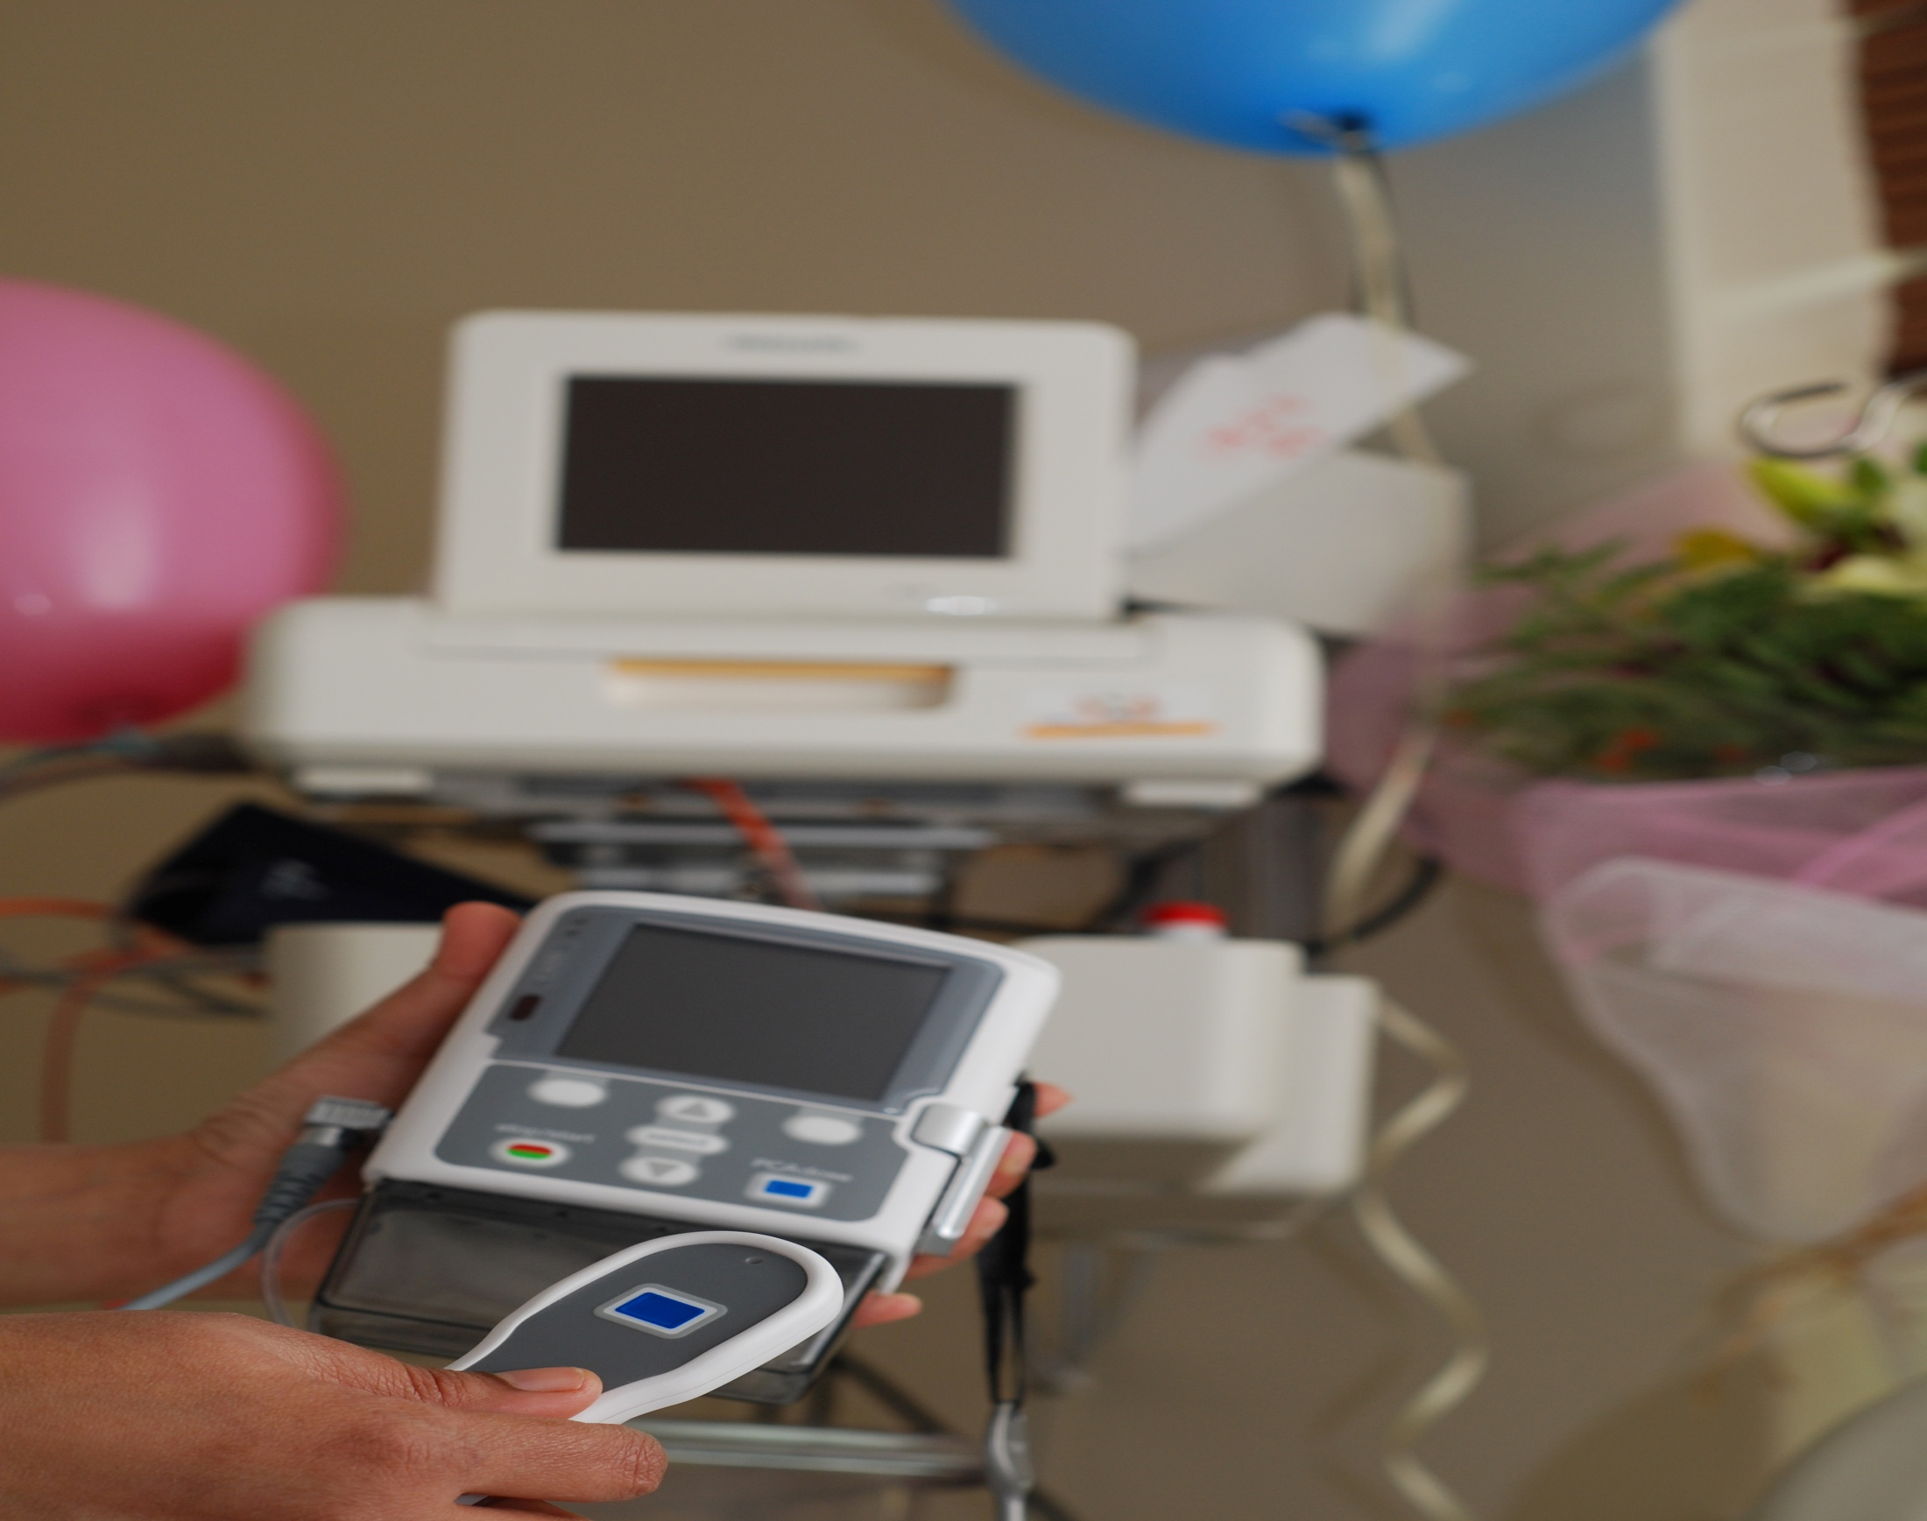
P C A
PCA are modified infusion pumps that allow patient to self administer a small dose of opioid when pain is present , thus allowing patients to titrate their level of analgesia against the amount of pain they are experiencing.

Slide 65
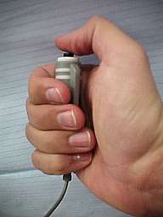
PATIENT SELECTION
Patient should not be denied access to this modality simply because of age.
Screen for cognitive and physical ability to manage their pain by using the PCA.
Should have the understanding of pain relief , using the demand button and when to use the demand button.

Slide 66
PATIENT SELECTION
PCA not offered to confused patient and those who become confused should have PCA discontinued.
The same patient selection guidelines and consideration for the use of PCA apply to children.
Important to remind parents and caregivers not to press the demand button .

Slide 67
P C A
PCA is well tolerated.
Offer flexibility in dose size and dose interval in individual patients.
Therapeutic serum level can be reached relatively quickly because the drug is administered into the vascular system directly.

Slide 68
P C A
Patient can secure an early therapeutic serum level with loading doses titrated to individual pain needs.
A steady state plasma level occurs because the elimination of the drug from the plasma is balanced by the patients self administered drug injection.

Slide 69
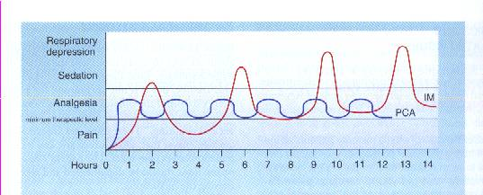
Relationship of mode of delivery of analgesia to serum analgesic level
IM and IV PCA

Slide 70
PCA
PCA allows patient control over their pain and therefore gives greater satisfaction.
PCA also eliminates the lag time between pain sensation and administration of analgesia.

Slide 71
PATIENT FEELS PAIN
PAIN CYCLE
I.M PRN ANALGESIA
Sedation
Calls Nurse
Drug Absorbed
Nurse Screen
I.M Given
Meds Prepared

Slide 72
PATIENT FEELS PAIN
Analgesia
PCA
Calls Nurse
Drug Absorbed
Nurse Screen
I.M Given
Meds Prepared

Slide 73
PCA
The pump documents the total number of mg of drug delivered, the number of times the patient requests a bolus and number of times medication is delivered in response to demands.
This information is helpful when assessing whether the established PCA parameters are appropriate to patient’s need.

Slide 74
BENEFITS
Decreased nursing time
Increased patient satisfaction.
Used in a variety of medical and post-op surgical conditions.
Decreased narcotic usage.
Decreased level of sedation.
Earlier ambulation.

Slide 75
BENEFITS
Decreased overall pain scores reported by patients.
Increased compliance to post op care.
Less anxiety.
More autonomy regarding pain control.
Improved rest and sleep pattern

Slide 77
EPIDURAL ANALGESIA
“ THE FIFTH VITAL SIGN ”
For additional advice see
Dale Carnegie Training®
Presentation Guidelines
Notes:
77

Slide 78
Benefits of Epidural Analgesia
Better pain control
Earlier ambulation
Improved Pulmonary Mechanics
Decreased incidence of DVT
Faster return of bowel function

Slide 79
DEFINITIONS
EPIDURAL=administration of medication into epidural space
INTRATHECAL=administration of medication into subarachnoid space
Notes:
79

Slide 80
OVERVIEW
OF THE
SPINAL ANATOMY
Notes:
80

Slide 81
SPINAL CORD
Located and protected within vertebral column
Extends from the foramen magnum to lower border 1st L1 (adult) S2 (kids)
SC taper to a fibrous band - conus medullaris
Nerve root continue beyond the conus- cauda equina
Surrounded by the meninges,(dura,arachnoid &pia mater.)
Notes:
81

Slide 82
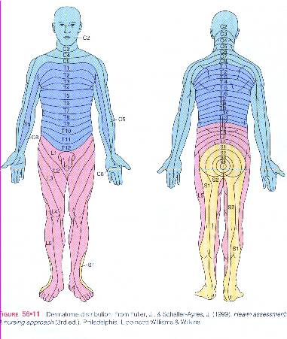
Notes:
82

Slide 83
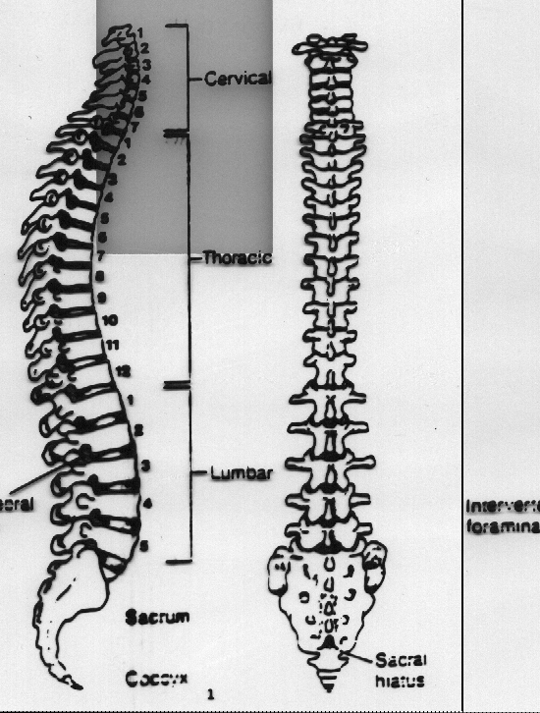
Notes:
83

Slide 84
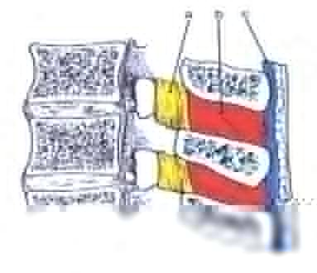
Notes:
84

Slide 85
EPIDURAL SPACE
Potential space
Between the dura mater,luigamentum flavum
Made up of vasculature, nerves, fat and lymphatic
Extends from foramen magnum to the sacrococcygeal ligament
Notes:
85

Slide 86
INDICATIONS
The objective of epidural analgesia is to relieve pain.
Major surgery
Trauma (# ribs)
Palliative care (intractable pain)
Labour and Delivery
Notes:
86

Slide 87
CONTRAINDICATIONS
Patient refusal
Known allergy to opioid or local anesthetic
Infection/abscess near the proposed injection site
Sepsis
Coagulation disorder
Hypotension / hypovolemia
Spinal deformity/increased ICP
Notes:
87

Slide 88
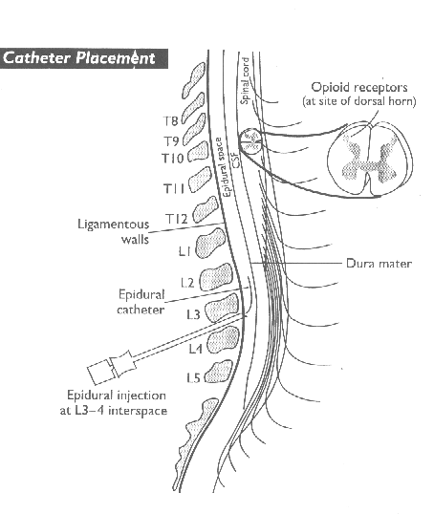
Notes:
88

Slide 89
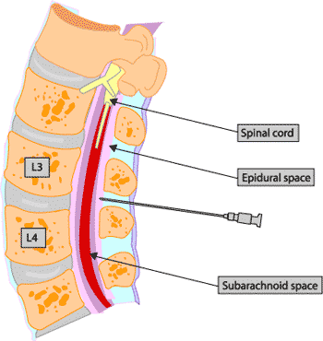
Notes:
89

Slide 90
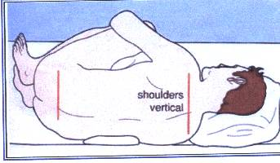
Patient assume a sitting or side-lying position with the back arched toward the physician.Help to spread the vertebrae apart
Notes:
90

Slide 91
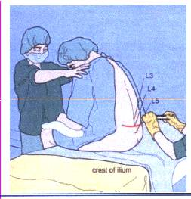
Height of sensory block
Lumbar-T4
Thoracic-T2
Notes:
91

Slide 92
INSERTION OF EPIDURAL CATHETER
Positioning of patient
The site is dependent upon the area of pain
Fixing the catheter
Incision Level
Thoracic T4-T6
Upper abdo T6-T8
Lower abdo T8-T10
Pelvic T8-T10
Lower extremity L1-L4
Notes:
92

Slide 93
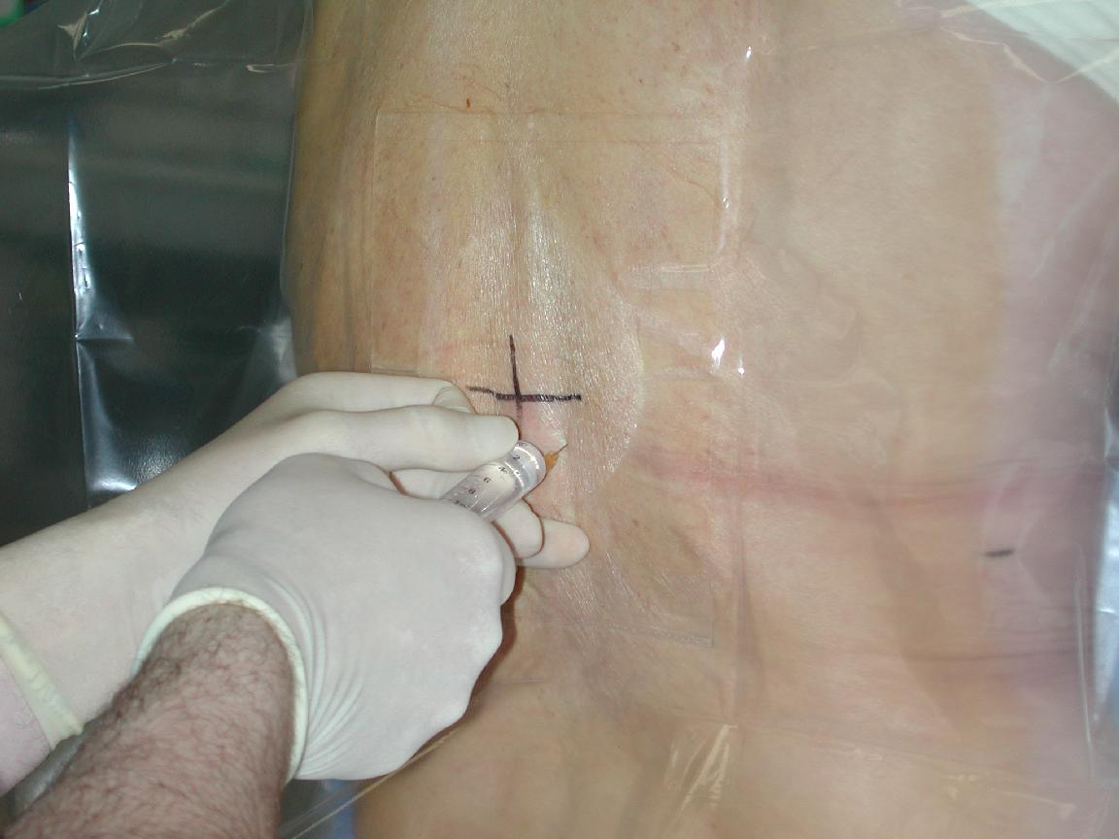
Notes:
93

Slide 94
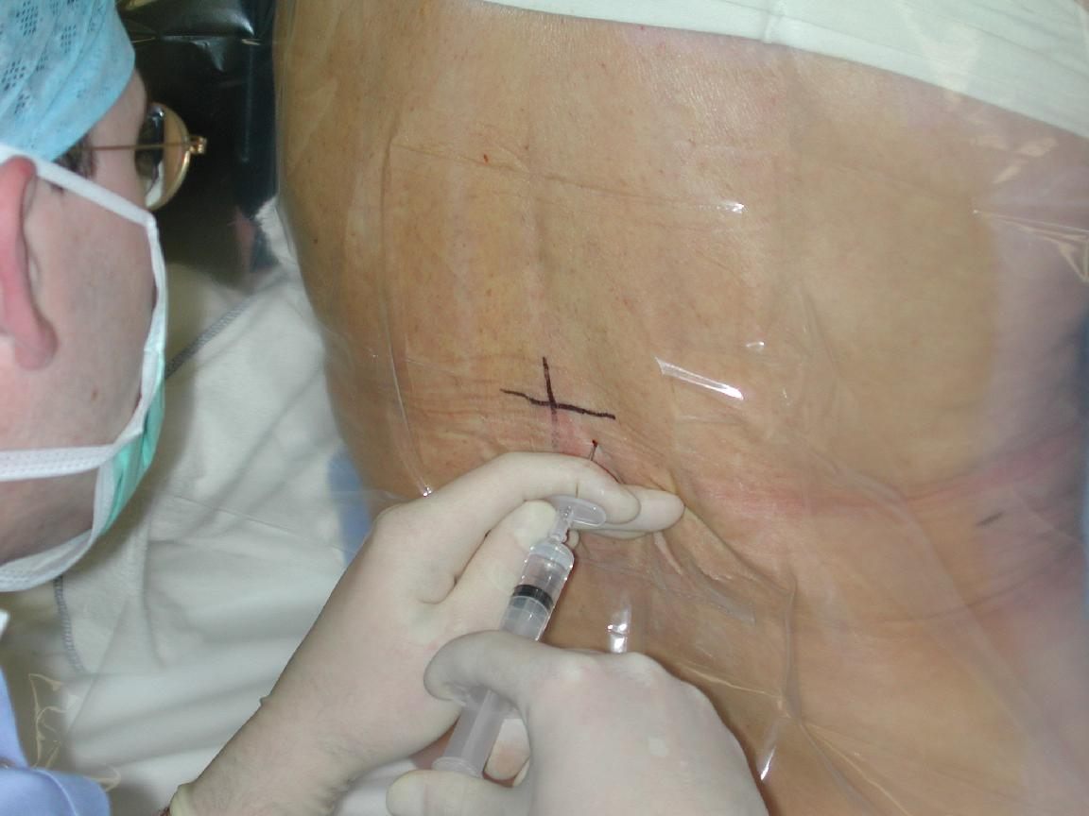
Notes:
94

Slide 95
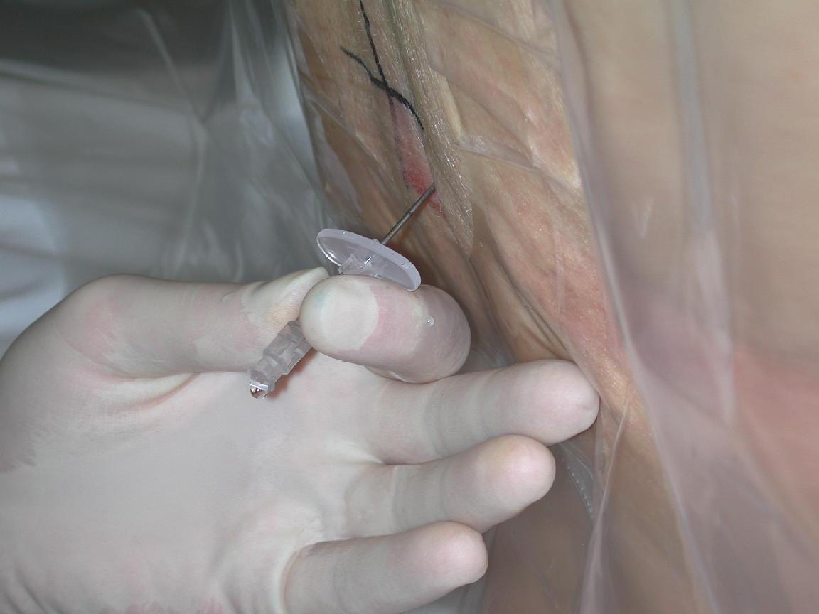
Notes:
95

Slide 96
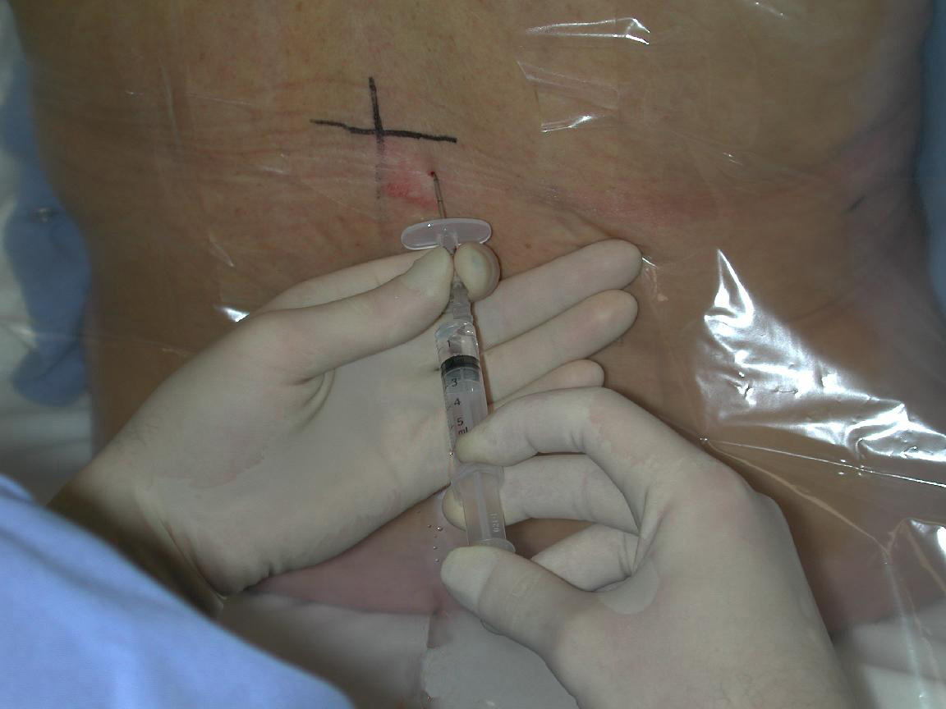
Notes:
96

Slide 97
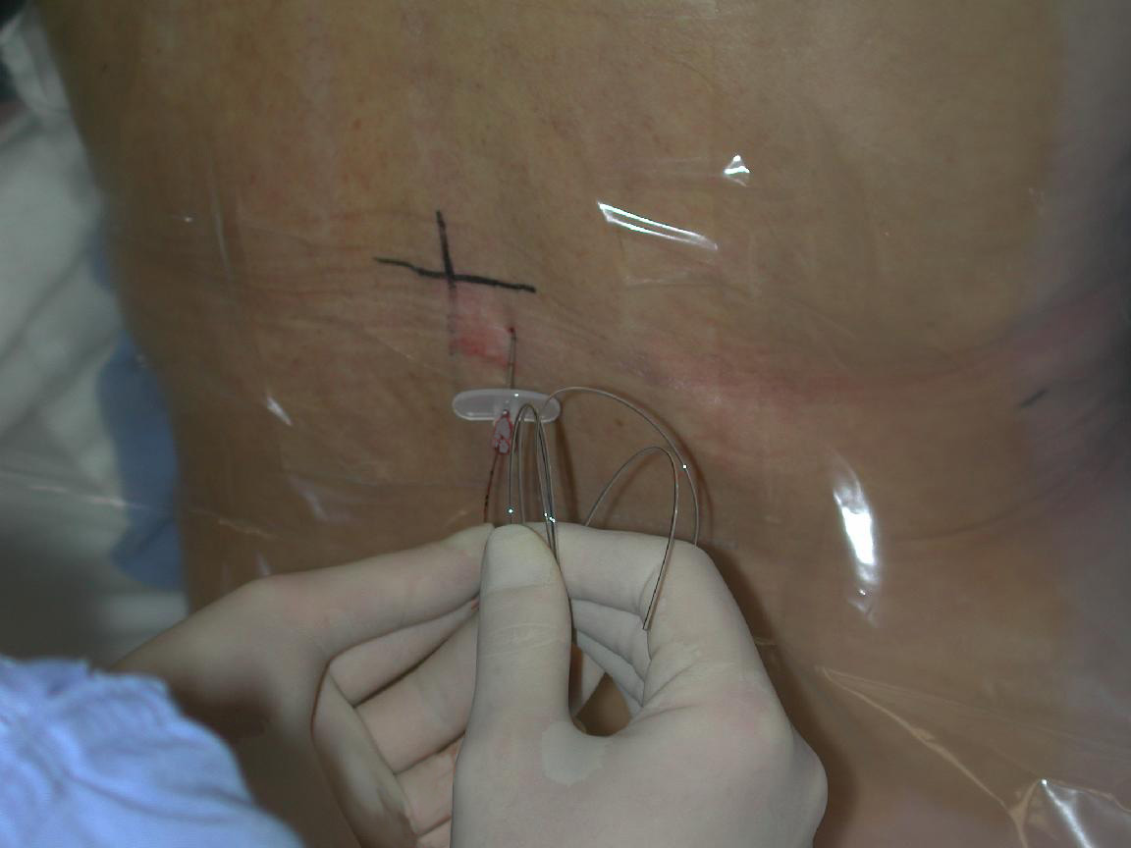
Notes:
97

Slide 98
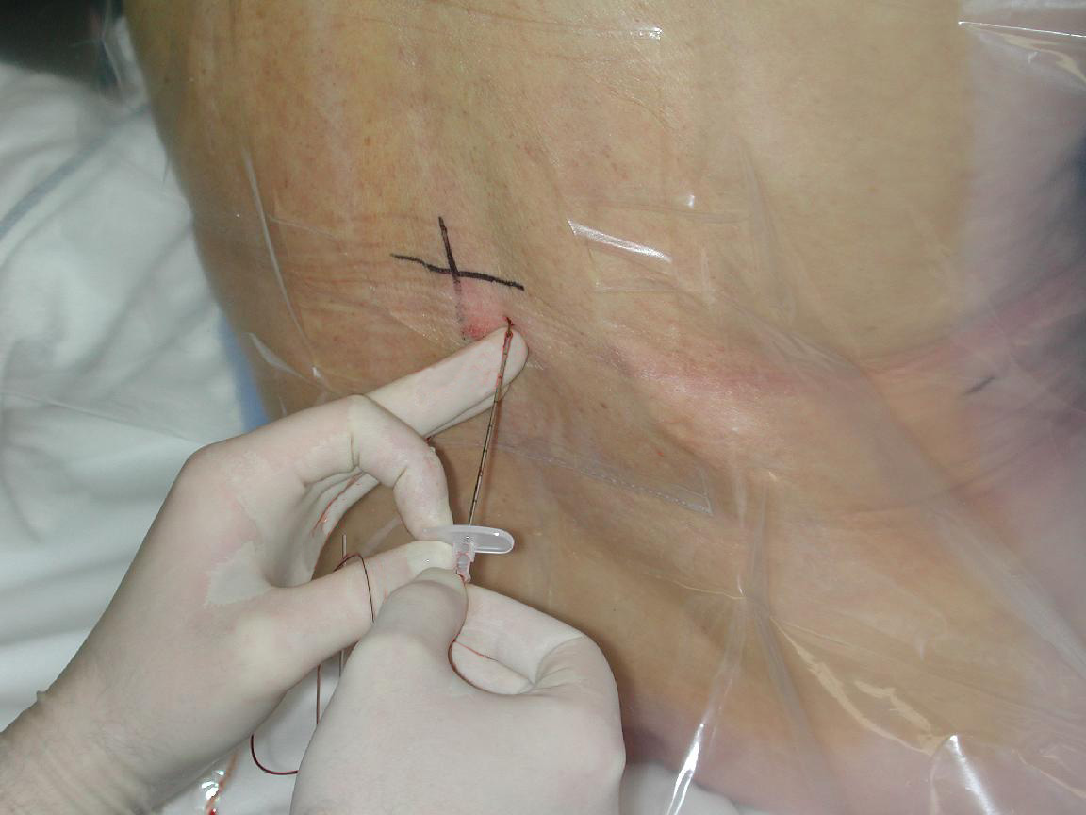
Notes:
98

Slide 99
Notes:
99

Slide 100
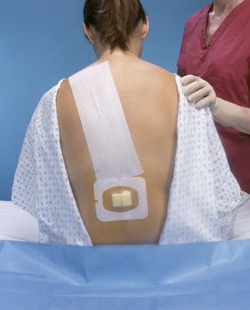

Slide 101
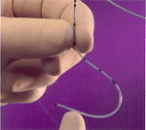
EPIDURAL CATHETERS
Ideal Placement (adult) 10-12 cm at the skin
Epidural catheters have markings that indicate their length.
= there is a mark at the tip of the catheter
= the 1st single mark up the catheter is 5cm
= double mark up the catheter is 10 cm
= triple mark on the catheter is 15 cm
= four mark together indicate 20cm
A change in depth of the catheter indicates migration either into or out of the epidural space.
Notes:
101

Slide 102
CATHETER MIGRATION
Catheter migration into a blood vessel in the epidural space or subarachnoid space
rapid onset LOC
Decrease loss of sensory or motor loss (marcain)
Toxicity
Profound hypotension
Notes:
102

Slide 103
CATHETER MIGRATION
Out of the epidural space
ineffective analgesia
no analgesia
drugs deposited into soft tissue.
Notes:
103

Slide 104
MEDICATION COMMONLY USED
OPIOIDS-Fentanyl +Morphine
(affect the pain transmission at the opioid receptors)
L.A.-Bupivacaine(marcaine)
(inhibits the pain impulse transmission in the nerves with which it comes in contact)
Notes:
104

Slide 105
METHODS OF ADMINISTRATION
BOLUS (FENTANYL, DURAMORPH)
CONTINUOUS INFUSION(MARCAINE+FENTANYL)
All drugs administered epidural should be preservative free.
All epidural opioids should be diluted with normal saline prior to intermittent bolus administration.
Notes:
105

Slide 106
Motor and Sensory Assessment
Motor assessment
Sensory assessment
Notes:
106

Slide 107
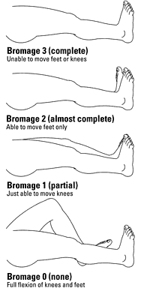
Assessment of motor block
Bromage Score
Notes:
107

Slide 108
Motor and Sensory Assessment
Sensory assessment:
Use ice in the tip of a glove
Start in upper neck and move down thorax bilaterally assessing all potential dermatomes
Level of block is where intensity of cold changes or the cold sensation is absent
assess the dermatomes below the pelvis
Notes:
108

Slide 109
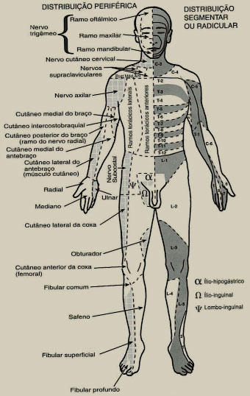

Slide 114
Adverse Effects L.A
Hypotension-
-assess intravascular volume status
-no trendelenberg positioning
Teach patient to move slowly from a lying position to sitting to standing position.
Treatment
fluids
Notes:
114

Slide 115
Cont.
Temporary lower-extremity motor or sensory deficits.
Tx: lower the rate or
concentration.
Urine retention
Tx: catheter
Local anesthetic toxicity (neurotoxicity)
Tx: stop infusion.
Resp. insufficiency
Tx:stop infusion
- ABC(100% o2
call for help)
- Assess spread
and
height of block
- Alt.analgesia
Notes:
115

Slide 116
OTHER COMPLICATIONS
Headache (dural puncture)
Tx: symptomatic treatment Autologous blood patch
Infection
nausea and vomiting.
Intravenous placement of catheter
Subdural placement of catheter
Haematoma
Notes:
116

Slide 117
EPIDURAL ANALGESIA(GUIDELINES)
Collect items
Assess patient
Inspect site
Wash hands
Aspiration test – Glucose test
Administer
Document
Evaluate the outcome
Notes:
117

Slide 118
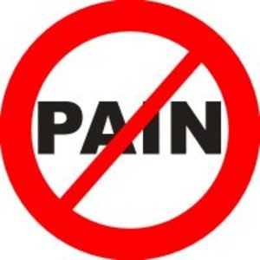
Unrelieved pain is morally and ethically unaccepted.
Notes:
118

