Slide 1
Vascular Access
Dr. Mueen Ullah Khan
Associate Professor and Consultant
Department of Anesthesia
King Saud University Riyadh

Slide 2
Lecture Objectives..
At the end of the lecture you will be able to:
Examine the construction of the commonly used venous catheters.
Anatomical considerations regarding peripheral and central venous access.
Discuss the choice of catheter size.
Prepare and set-up an IV infusion set.
Discuss the choice of sites for placement of IV catheters.
What are the different sites suitable for central venous catheter and arterial catheter placement?
Discuss universal precautions.
Indications and complications of central venous access

Slide 3
Medical Asepsis
Removal or destruction of disease-causing organisms or infected material
Sterile technique (surgical asepsis)
Clean technique
Copyright © 2007, 2006, 2001, 1994 by Mosby, Inc., an affiliate of Elsevier Inc.

Slide 4
Antiseptics and Disinfectants
Chemical agents used to kill specific microorganisms
Disinfectants
Used on nonliving objects
Toxic to living tissue
Antiseptics
Applied to living tissue
More dilute to prevent cell damage
Some chemical agents have antiseptic and disinfectant properties
Copyright © 2007, 2006, 2001, 1994 by Mosby, Inc., an affiliate of Elsevier Inc.

Slide 5
Universal Precautions
Universal Standard precautions on every patient
When administering drugs, observe hand washing and gloving procedures if indicated
Face shields indicated during administration of endotracheal drugs
Copyright © 2007, 2006, 2001, 1994 by Mosby, Inc., an affiliate of Elsevier Inc.

Slide 6
Types of IV Catheters
Hollow needles
Butterfly type
Indwelling plastic catheter over hollow needle
Indwelling plastic catheter inserted through a hollow needle
Intracath
Copyright © 2007, 2006, 2001, 1994 by Mosby, Inc., an affiliate of Elsevier Inc.

Slide 7
Needles
Vary in length and gauge
Larger gauge means a smaller needle
Copyright © 2007, 2006, 2001, 1994 by Mosby, Inc., an affiliate of Elsevier Inc.

Slide 8
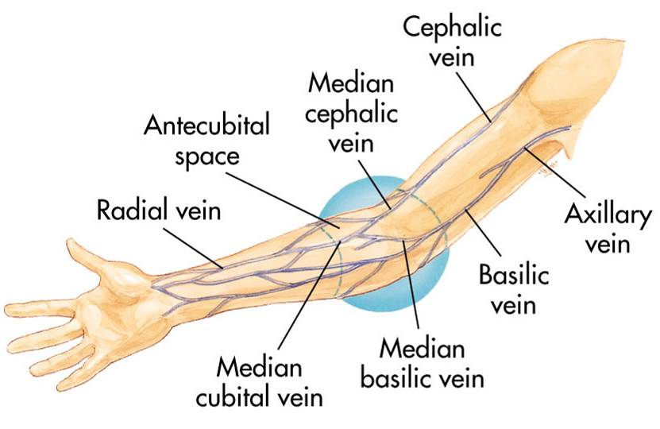
Peripheral IV Insertion
Common sites:
Hands and arms
Antecubital fossa (AC space)
Copyright © 2007, 2006, 2001, 1994 by Mosby, Inc., an affiliate of Elsevier Inc.

Slide 9
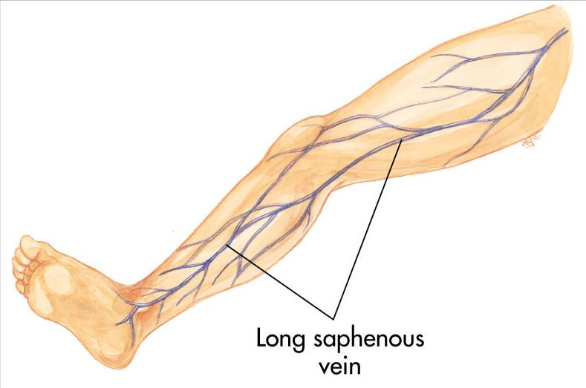
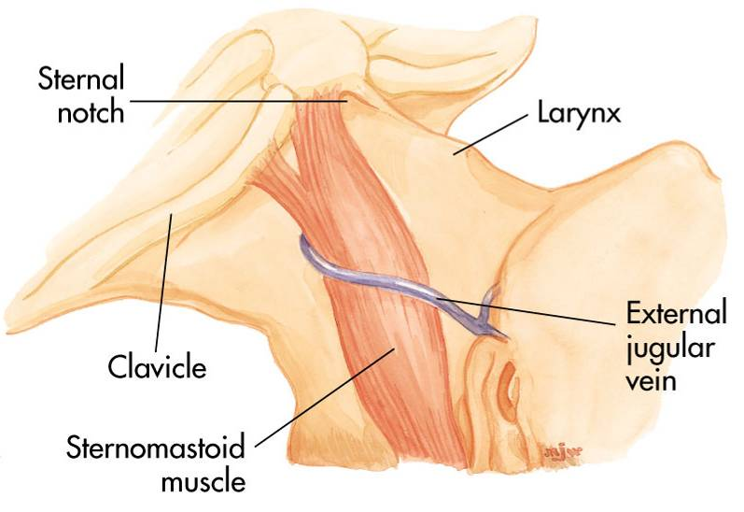
Peripheral IV Insertion
Alternate sites:
Long saphenous veins
External jugular veins
Embolism and infection rates higher
Copyright © 2007, 2006, 2001, 1994 by Mosby, Inc., an affiliate of Elsevier Inc.

Slide 10
Peripheral IV Insertion
Avoid sites that have injury or disease:
Trauma
Dialysis fistula
History of mastectomy
Copyright © 2007, 2006, 2001, 1994 by Mosby, Inc., an affiliate of Elsevier Inc.

Slide 11
Peripheral IV Procedure
Explain procedure
Assemble equipment
Inspect fluid for contamination, appearance, and expiration date
Prepare infusion set
Attach infusion set to bag of solution
Copyright © 2007, 2006, 2001, 1994 by Mosby, Inc., an affiliate of Elsevier Inc.

Slide 12
Peripheral IV Procedure
Clamp tubing and squeeze reservoir on infusion set until it fills half way
Open clamp and flush air from tubing
Close clamp
Maintain aseptic technique
Copyright © 2007, 2006, 2001, 1994 by Mosby, Inc., an affiliate of Elsevier Inc.

Slide 13
Peripheral IV Procedure
Select catheter:
Large-bore catheter used for fluid replacement
14 to 16 gauge
Smaller bore catheter used for “keep open” lines
18 to 20 gauge
Prepare other equipment
Copyright © 2007, 2006, 2001, 1994 by Mosby, Inc., an affiliate of Elsevier Inc.

Slide 14
Peripheral IV Procedure
Put on gloves
Select site
Apply tourniquet above antecubital space
Prepare site
Cleanse area with alcohol or iodine wipes (per protocol)
Check for iodine allergy
Copyright © 2007, 2006, 2001, 1994 by Mosby, Inc., an affiliate of Elsevier Inc.

Slide 15
Peripheral IV Procedure
Stabilize vein
Apply pressure and tension to point of entry
Copyright © 2007, 2006, 2001, 1994 by Mosby, Inc., an affiliate of Elsevier Inc.

Slide 16
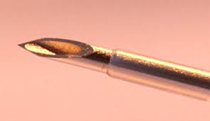
Peripheral IV Insertion
Bevel of the needle up in adults
May be down in infants and children
Pass needle through skin into vein from side or directly on top
Copyright © 2007, 2006, 2001, 1994 by Mosby, Inc., an affiliate of Elsevier Inc.

Slide 17
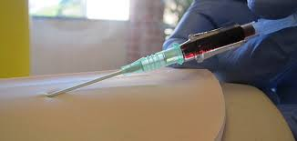
Peripheral IV Procedure
Advance needle and catheter about 2 mm past point where blood return is seen in hub of needle
Slide catheter over needle and into vein
Copyright © 2007, 2006, 2001, 1994 by Mosby, Inc., an affiliate of Elsevier Inc.

Slide 18
Peripheral IV Procedure
Withdraw needle while stabilizing catheter
Lock in protective sheath if present
Apply pressure on proximal end of catheter to stop escaping blood
Obtain blood samples if needed
Copyright © 2007, 2006, 2001, 1994 by Mosby, Inc., an affiliate of Elsevier Inc.

Slide 19
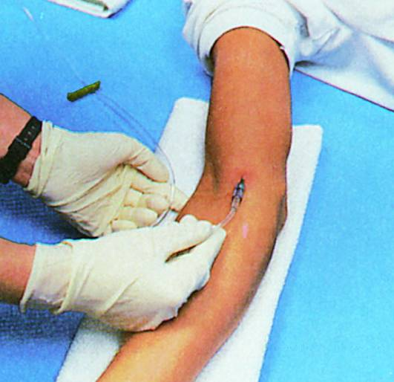
Peripheral IV Procedure
Release tourniquet
Attach IV tubing
Copyright © 2007, 2006, 2001, 1994 by Mosby, Inc., an affiliate of Elsevier Inc.

Slide 20
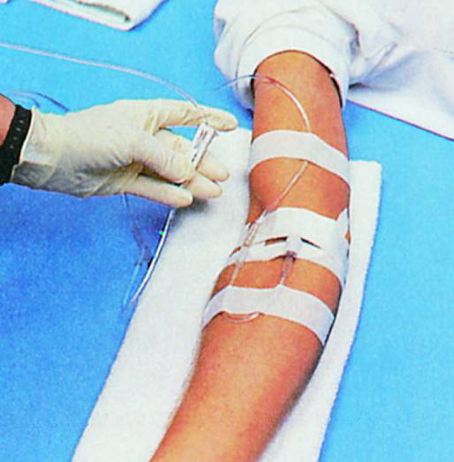
Peripheral IV Procedure
Open tubing clamp and allow fluid infusion to begin at prescribed flow rate
Copyright © 2007, 2006, 2001, 1994 by Mosby, Inc., an affiliate of Elsevier Inc.

Slide 21
Peripheral IV Procedure
Cover puncture site dressing
Antibiotic ointment if indicated by protocol
Anchor tubing
Secure catheter
Document procedure
Monitor flow
Copyright © 2007, 2006, 2001, 1994 by Mosby, Inc., an affiliate of Elsevier Inc.

Slide 22
Central Venous Access
Within scope of paramedic practice in some EMS systems
Requires special training
Authorization from medical direction
Not for rapid fluid replacement in prehospital setting
Copyright © 2007, 2006, 2001, 1994 by Mosby, Inc., an affiliate of Elsevier Inc.

Slide 23
Central Venous Access
Sites include:
Femoral vein
Internal jugular vein
Subclavian vein
Copyright © 2007, 2006, 2001, 1994 by Mosby, Inc., an affiliate of Elsevier Inc.

Slide 24
Central Venous Access
Prepare as for peripheral veins
Success depends on:
Patient's body position
Paramedic's knowledge of anatomy
Familiarity with the procedure
Copyright © 2007, 2006, 2001, 1994 by Mosby, Inc., an affiliate of Elsevier Inc.

Slide 25
Femoral Vein Anatomy
Copyright © 2007, 2006, 2001, 1994 by Mosby, Inc., an affiliate of Elsevier Inc.

Slide 26
Femoral Vein Cannulation
Copyright © 2007, 2006, 2001, 1994 by Mosby, Inc., an affiliate of Elsevier Inc.

Slide 27
Internal Jugular Vein Anatomy
Copyright © 2007, 2006, 2001, 1994 by Mosby, Inc., an affiliate of Elsevier Inc.

Slide 28
Internal Jugular Vein Cannulation
Posterior approach
Copyright © 2007, 2006, 2001, 1994 by Mosby, Inc., an affiliate of Elsevier Inc.

Slide 29
Internal Jugular Vein Cannulation
Central approach
Copyright © 2007, 2006, 2001, 1994 by Mosby, Inc., an affiliate of Elsevier Inc.

Slide 30
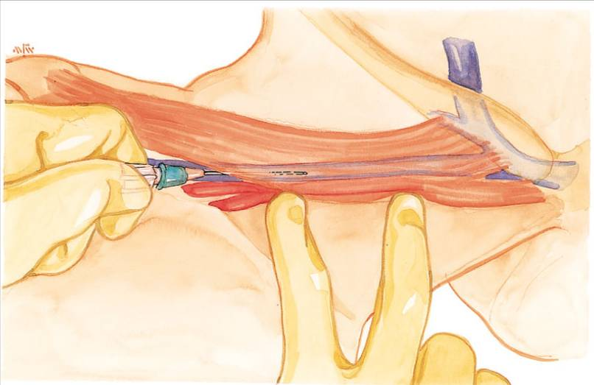
Internal Jugular Vein Cannulation
Anterior approach
Copyright © 2007, 2006, 2001, 1994 by Mosby, Inc., an affiliate of Elsevier Inc.

Slide 31
Subclavian Vein Anatomy
Copyright © 2007, 2006, 2001, 1994 by Mosby, Inc., an affiliate of Elsevier Inc.

Slide 32
Subclavian Vein Cannulation
Copyright © 2007, 2006, 2001, 1994 by Mosby, Inc., an affiliate of Elsevier Inc.

Slide 33
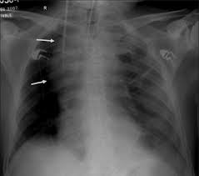

Slide 34
Central Venous Access
Advantages
Available when peripheral vessels collapse
Access to central pressure measurements
In-hospital procedure
Safer vasopressor administration
Copyright © 2007, 2006, 2001, 1994 by Mosby, Inc., an affiliate of Elsevier Inc.

Slide 35
Central Venous Access
Disadvantages
Excessive time for placement
Sterile technique
Special equipment
Skill deterioration
High complication rate
Pneumothorax, arterial injury, abnormal placement
Chest x-ray should be obtained immediately
Copyright © 2007, 2006, 2001, 1994 by Mosby, Inc., an affiliate of Elsevier Inc.

Slide 36
Central Venous Access
Disadvantages
Can’t initiate during other patient care activities
Not generally considered to be a useful prehospital technique
Lower flow rates than peripheral IV
Copyright © 2007, 2006, 2001, 1994 by Mosby, Inc., an affiliate of Elsevier Inc.

Slide 37
Local Complications
Pain and irritation
Infiltration and extravasation
Phlebitis
Thrombosis and thrombophlebitis
Hematoma formation
Venous spasm
Vessel collapse
Cellulitis
Nerve, tendon, ligament, and limb damage
Copyright © 2007, 2006, 2001, 1994 by Mosby, Inc., an affiliate of Elsevier Inc.

Slide 38
Systemic Complications
Contamination and infection
Hypersensitivity reactions
Sepsis
Speed shock
Emboli (blood clot, air, and catheter)
Copyright © 2007, 2006, 2001, 1994 by Mosby, Inc., an affiliate of Elsevier Inc.

Slide 39
Infiltration—Causes
Dislodgement of catheter or needle cannula during venipuncture
Puncture of vein wall during venipuncture
Leakage of solution into surrounding tissue from insertion site
Poorly secured IV
Poor vein or site selection
Irritating solution inflames vein’s intima
Improper cannula size
High delivery rate or pressure
Copyright © 2007, 2006, 2001, 1994 by Mosby, Inc., an affiliate of Elsevier Inc.

Slide 40
Infiltration—Signs & Symptoms
Cool skin around IV site
Swelling at IV site
With or without pain
Sluggish or absent flow
Infusion flows when pressure is applied to vein above tip of cannula
No backflow of blood into IV tubing when clamp is fully opened and solution container is lowered below IV site
Copyright © 2007, 2006, 2001, 1994 by Mosby, Inc., an affiliate of Elsevier Inc.

Slide 41
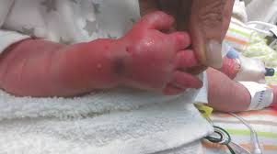

Slide 42
Infiltration—Management
Lower fluid reservoir to check for presence of backflow of blood into the tubing
Absence of backflow suggests infiltration
Discontinue IV infusion
Remove needle or catheter
Apply a pressure dressing to the site
Choose new site
Initiate IV therapy with new equipment
Document
Copyright © 2007, 2006, 2001, 1994 by Mosby, Inc., an affiliate of Elsevier Inc.

Slide 43
Air Embolism
Uncommon but can be fatal
Air enters bloodstream through catheter tubing
Risk greatest with catheter in central circulation
Negative pressure may pull air in
Copyright © 2007, 2006, 2001, 1994 by Mosby, Inc., an affiliate of Elsevier Inc.

Slide 44
Air Embolism
Air can enter circulation
During catheter insertion
If tubing is disconnected
If enough air enters the heart chamber:
Blood flow is impeded
Shock develops
Copyright © 2007, 2006, 2001, 1994 by Mosby, Inc., an affiliate of Elsevier Inc.

Slide 45
Air Embolism
Signs and symptoms
Hypotension
Cyanosis
Weak and rapid pulse
Loss of consciousness
Copyright © 2007, 2006, 2001, 1994 by Mosby, Inc., an affiliate of Elsevier Inc.

Slide 46
Air Embolism
Management
Close the tubing
Turn patient on left side with head down
Check tubing for leaks
Administer100% Oxygen
Notify medical direction
Copyright © 2007, 2006, 2001, 1994 by Mosby, Inc., an affiliate of Elsevier Inc.

Slide 47
Complications—Central Veins
Femoral vein
Local complications
Systemic complications
Internal jugular and subclavian veins
Local complications
Systemic complications
Copyright © 2007, 2006, 2001, 1994 by Mosby, Inc., an affiliate of Elsevier Inc.

Slide 48
IV Medications
IV injection may be given in:
An established IV line
Heparin or saline lock
Implantable port
Port-A-Cath, Hickman catheter
Directly into the vein
IV injections generally less than 5 mL
IV push or IV bolus medications
Copyright © 2007, 2006, 2001, 1994 by Mosby, Inc., an affiliate of Elsevier Inc.

Slide 49
Intravenous Therapy
IV solution
Infusion set
Macrodrip or microdrip
Tubing clamp
Injection port
Copyright © 2007, 2006, 2001, 1994 by Mosby, Inc., an affiliate of Elsevier Inc.

Slide 50
Intermittent Infusion
IV piggybacks
Setup is secondary to primary IV infusion
Piggyback medication hung in tandem and connected to primary setup
Copyright © 2007, 2006, 2001, 1994 by Mosby, Inc., an affiliate of Elsevier Inc.

Slide 51
Intermittent Infusion
Calculate rate of secondary infusion
Drops per minute
Lower primary infusion reservoir
Center of gravity lower than secondary infusion reservoir
Open piggyback line flow clamp
Adjust flow rate
Copyright © 2007, 2006, 2001, 1994 by Mosby, Inc., an affiliate of Elsevier Inc.

Slide 52
Volume-Control IV Devices
Permit accurate delivery of IV medications
Electronic flow-rate regulators
Regulate precise doses of drugs that can cause toxicity
Vasopressors
Antidysrhythmics
Follow manufacturer’s instructions
Copyright © 2007, 2006, 2001, 1994 by Mosby, Inc., an affiliate of Elsevier Inc.

Slide 53
Drug Pump
Slow injection of medication
Syringe with battery attachment that regulates injection of medication
To administer medication SC
Can attach to indwelling vascular devices
Port-A-Cath
Hickman catheter
Copyright © 2007, 2006, 2001, 1994 by Mosby, Inc., an affiliate of Elsevier Inc.

Slide 54
Indwelling Vascular Devices
Heparin or saline lock
Copyright © 2007, 2006, 2001, 1994 by Mosby, Inc., an affiliate of Elsevier Inc.

Slide 55
Indwelling Vascular Devices
Single-, dual-, and triple-lumen catheters
Copyright © 2007, 2006, 2001, 1994 by Mosby, Inc., an affiliate of Elsevier Inc.

Slide 56
Ultrasound guided IV insertion

Slide 57
Ultrasound guided CVC insertion

Slide 58
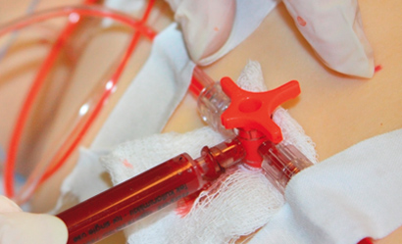
Arterial Line Placement
Provide continuous blood pressure (BP) monitoring
Arterial blood sampling

Slide 59
Indications for arterial line placement
Continuous arterial BP monitoring - more accurate than sphygmomanometric BP
Inability to use indirect BP monitoring (eg, in patients with severe burns or morbid obesity)
Frequent blood sampling
Frequent arterial blood gas sampling

Slide 60
Contraindications for arterial line placement
Absolute
Relative
Absent pulse
Thromboangiitis obliterans (Buerger disease)
Full-thickness burns over the cannulation site
Inadequate circulation to the extremity
Raynaud syndrome
Anticoagulation
Atherosclerosis
Coagulopathy
Inadequate collateral flow
Infection at the cannulation site
Partial-thickness burn at the cannulation site
Previous surgery in the area
Synthetic vascular graft

Slide 61
Technical Considerations
Not entirely without risks,
Requires appropriate knowledge of the anatomy and procedural skills.
Arterial line placement is considered a safe- major complications that is below 1%.
Common site of cannulation
radial, ulnar, brachial, axillary, posterior tibial, femoral, and dorsalis pedis arteries.

Slide 62
Radial artery Aatomic consideration
Originates in the cubital fossa from the brachial artery
At the wrist, the radial artery sits proximal and medial to the radial styloid process and just lateral to the flexor carpi radialis tendon.

Slide 63
Femoral artery Aatomic consideration
Originates at the inguinal ligament from the external iliac artery
Medial to the femoral nerve and lateral to the femoral vein and lymphatics.

Slide 64
Arterial Line Placement Equipment
Sterile gloves
Sterile gauze
Sterile towels
Chlorhexidine or povidone-iodine skin preparation solution
1% Lidocaine needle
5-mL syringe
Appropriate-sized cannula for artery
Scalpel (No. 11 blade)
Nonabsorbable suture (3-0 to 4-0)
Adhesive tape or strips
Sterile nonabsorbable dressing
Three-way stopcock
Pressure transducer kit
Pressure tubing
Arm board of appropriate size for the patient (eg, neonate, pediatric, adult)
Needle holder
Intravenous (IV) tubing T-connector

Slide 65
Arterial Line Placement Patient Preparation
UNCOSCIOS PATIENT
Anesthesia/ Sedation is not required.
CONSCIOUS PATIENT
provided LA -lidocaine 1%
UNCOPERATIVE PATIENT
sedation or general anesthesia may be required.

Slide 66
Arterial Line Placement Positioning
The patient is placed in the supine position.
The arm is placed up on a flat surface in neutral position, with the palm up and the wrist adequately exposed.
The wrist is dorsiflexed to 30-45° and supported in this position with a towel or gauze under its dorsal aspect

Slide 67
Arterial Line Placement
The most commonly used methods
Catheter over needle
Catheter over wire (including direct Seldinger and modified Seldinger techniques)

Slide 68
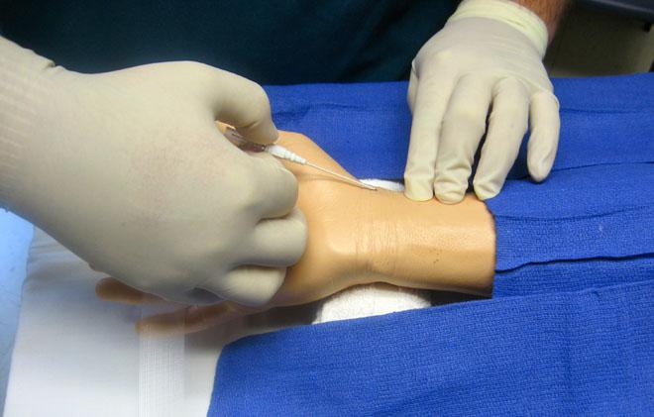
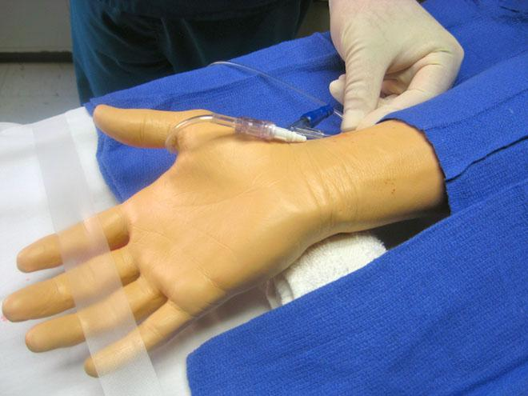
Catheter over needle technique

Slide 69
Catheter over needle technique

Slide 70
Radial artery cannulation (Seldinger). Advancement of catheter over guide wire.

Slide 71
Complications of arterial line placement
Common
Less common
Temporary radial artery occlusion (19.7%)
Hematoma/bleeding (14.4%)
Localized catheter site infection (0.72%) - The risk increases with the length of time the catheter is in place
Hemorrhage (0.53%)
Sepsis (0.13%)
Permanent ischemic damage (0.09%)
Pseudoaneurysm formation (0.09%)

Slide 72
Reference book and the relevant page numbers..

Slide 73
Questions?
Copyright © 2007, 2006, 2001, 1994 by Mosby, Inc., an affiliate of Elsevier Inc.

Slide 74
Thank You ☺
Dr.
Date:

