Slide 1
Papulosquamous Diseases
DR.MOHAMMED ALSHAHWAN
Consultant & Associate professor

Slide 2
Psoriasis

Slide 3
Psoriasis is an immune-mediated polygenic skin disorder. Various environmental triggering factors, e.g. trauma , stress, infections and medications, may elicit disease in genetically predisposed individuals

Slide 4
Epidemiology:
2% of population (0.7% of Asian/African )
0.7% juvenile psoriasis
Only 25% have severe psoriasis
Bimodal disease ( 20-30s/50-60s)
Two third of patients have family history of psoriasis
Child risk : one parent 14% two parent 40%

Slide 5
Nine psoriasis susceptibility regions (PSORS1–9) in different chromosomal locations.
PSORS1 (on chromosome 6p), account for up to 50% of psoriasis risk. PSORS1 contains genes such as HLA-Cw6 .
HLA-Cw6 is strongly linked to the age of onset of psoriasis.
90% of the patients with early-onset psoriasis
50% of the patients with late-onset psoriasis
Early-onset psoriasis, positive family history and expression of HLA-Cw6
( type I psoriasis)
Late-onset disease, no family history and a lack of expression of HLA-Cw6
(type II psoriasis)

Slide 6
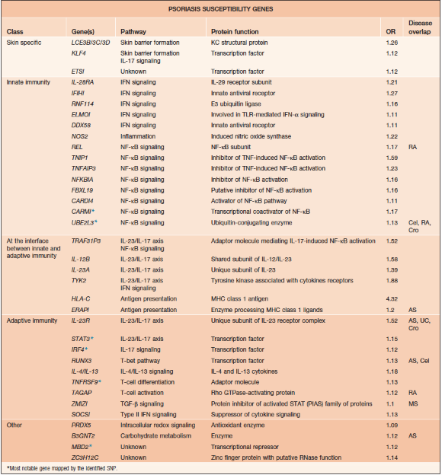

Slide 7
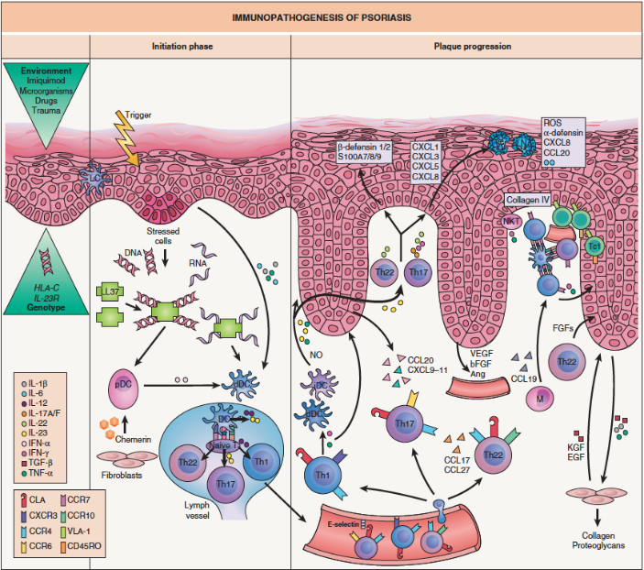

Slide 8
Triggers
Trauma
Stress
Infections: e.g. Streptococcal infections, especially pharyngitis
Drugs: e.g. lithium, IFNs, β-blockers, and antimalarial
Hypocalcemia has been reported to be a triggering factor for generalized pustular psoriasis.

Slide 9
chronic plaque psoriasis
Symmetric sharply defined erythematous plaques with thick silvery scale over the scalp, elbows, knees and lumbosacral area which is associated sometimes with hyperketatosis of the hands and feet
Guttate psoriasis (more common in children and adolescents and preceded by an upper respiratory tract infection )
Flexural psoriasis
sebopsoraisis : indeterminate stage

Slide 10
Pustular psoriasis
Generalized pustular psoriasis (von Zumbusch pattern)
ill patient with constitutional symptoms present with generalized abrupt painful eruption with erythema and pustulation starting over the intertriginous areas and trunk.
Palmopalnter pustulosis
Associated with SAPHO syndrome (synovitis, acne, pustulosis, hyperostosis and osteitis)
Acrodermatitis continua of Hallopeau
pustules over the distal portions of the fingers followed by scaling and crust formation. Pustules may also form subungual which might cause shedding of nail plates.
Erythrodermic Psoriasis

Slide 11
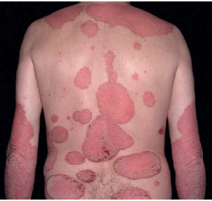

Slide 12
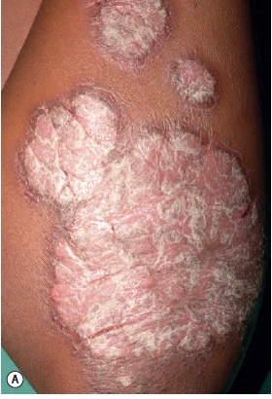

Slide 14
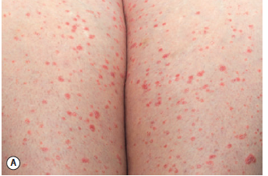

Slide 15
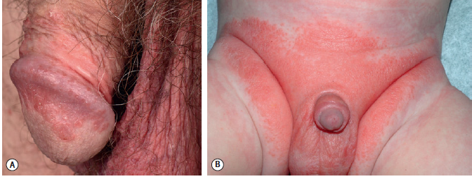

Slide 16
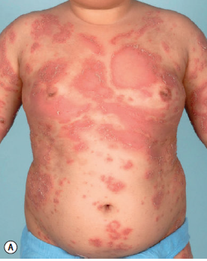

Slide 17
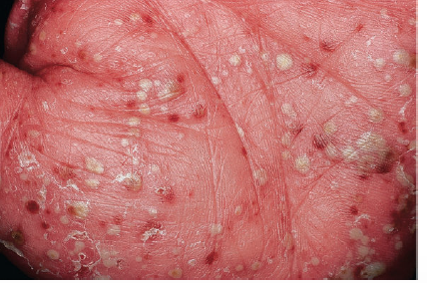

Slide 18
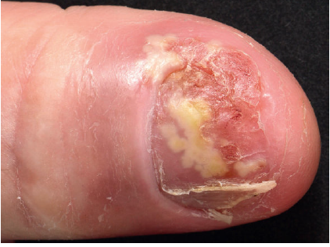

Slide 19
Nail :
Involved in 80% of patients
Patients with nail involvement appear to have an increased incidence of psoriatic arthritis.
Pitting ( parakeratosis of the nail matrix)
Oil-spot (leukocytes beneath the nail plate)
Onycholysis with subungual hyperkeratosis (parakeratosis of the distal nail bed)
Oral mucosa:
Migratory annular erythematous lesions with hydrated white scale over the tongue (geographic tongue) observed mainly in pustular psoriasis patients.

Slide 20
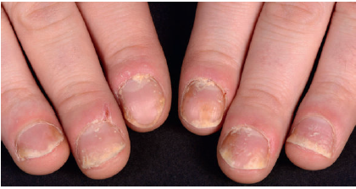

Slide 21
Psoriatic Arthritis
25% of patients
Asymmetric mono-oligoarthritis (most common type) Inflammation of the DIP and PIP joints of the hands and feet Involvement of both the DIP and PIP joints of a single digit can result in “sausage” digit
Least common presentations:
Rheumatoid arthritis-like (Symmetric polyarthritis that involves small and medium-sized joints)
Arthritis Mutilans
Spondylitis and Sacroiliitis

Slide 22
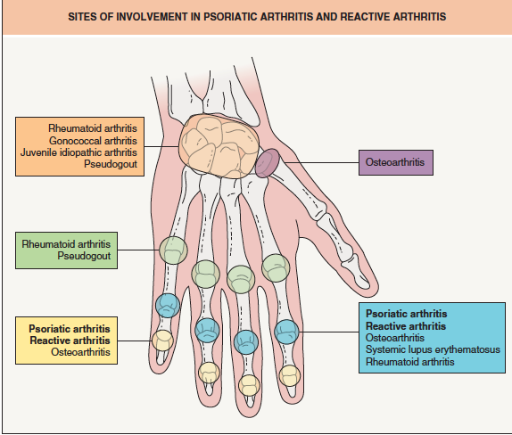

Slide 23
Associations:
Hyperlipidemia and metabolic syndrome
Atherosclerosis
Non-alcoholic steatohepatitis
Depression
Substance addiction
parkinsonism

Slide 24
Pathology:
Classically, Superficial perivascular lymphocytic infiltrate with even elongation of rete ridges ,dilated capillaries in papillary dermis which associated with spongiosis, acanthosis and parakeratosis .
In late lesions, accumulation of neutrophils within a spongiotic pustule “spongiform pustule of Kogoj” or sub-corneal accumulation of neutrophil “microabscess of Munro” ( exaggerated in pustular psoriasis)

Slide 25
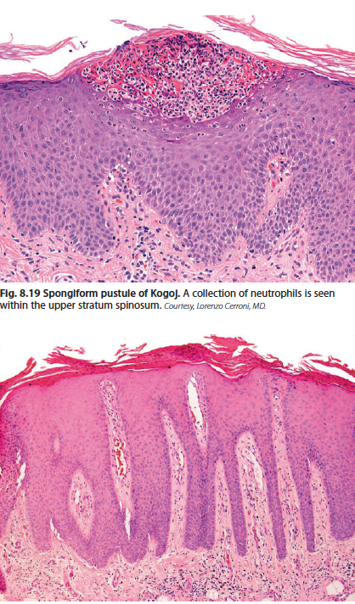

Slide 26
Treatment:
Focal disease
Topical corticosteroids
VitD3 analogues( calcipotriene)
Coal tar
Anthralin
Tazarotene
10% salicylic acid

Slide 27
Widespread disease:
Chronic plaque type Pustular type
MTX Retinoids NBUVB/PUVA Cyclosporine
Anti-TNF MTX Anti-IL 12/23 NBUVB/PUVA
Anti-IL 17A
cyclosporine
Retinoids (acitretin)

Slide 28
Lichen planus

Slide 29
Lichen Planus is an immune-mediated polygenic skin disorder. Various environmental triggering factors, e.g. Stress, infections and medications may elicit the disease in genetically predisposed individuals

Slide 30
Cutaneous LP affects less than 1% of population
Oral LP ( 1-5%)
It usually affect adult (30-60 years) but it can rarely affect children
It doesn't have any gender/race predilection
Familial cases are underestimated (some about 10%)
75% of cutaneous LP have mucosal involvment sp. Oral
25% of Oral LP have cutaneous LP
Some expert consider them separate disease

Slide 31
Causes
Idiopathic complex polygenetic condition
Genetic predisposition
*Six single nucleotide polymorphisms (SNPs) were found to be associated the HLA-DQB1*05:01 haplotype associated with LP
*HLA-A5 ,HLA-A3,147,148, HLA-B7,143 HLA-DR1,149,150 HLA-DR10 in Arab population
HLA-DRB1*01:01 in Sardinian &Mexican population

Slide 32
Antigenic Triggers
Pathogens (Viral hepatitis-HCV)
~ geographic variation
~ IFN therapy initiate or worsen LP
~ Liver disease e.g. sclerosing cholangitis
chronic liver disease
Vaccination
Medication ( Lichenoid drug eruption)
Contact sensitizer e.g. mercury amalgam, color film developers, methacrylic acid esters, dimethylfumarate in sofas and radiotherapy

Slide 33
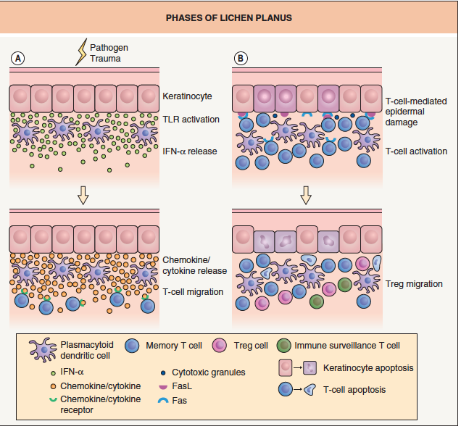

Slide 34
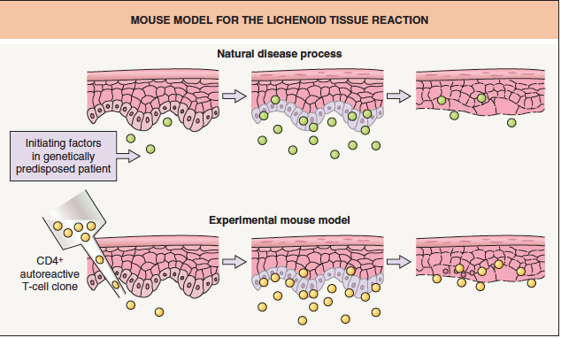

Slide 35
Clinical presentation
Itchy (rubbing) pruritic polygonal purple flat-toped papule & plaques with Wickham's striae over flexural surface of extremities ,wrist, legs, lower abdomen and genitalia.
Variants:
*Hypertrophic-leg * Annular-penis
*Atrophic * Linear
* Ulcerative-palm/soles
*Bullous

Slide 36
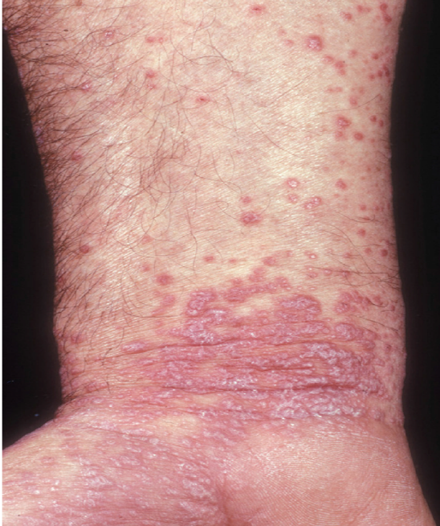

Slide 37
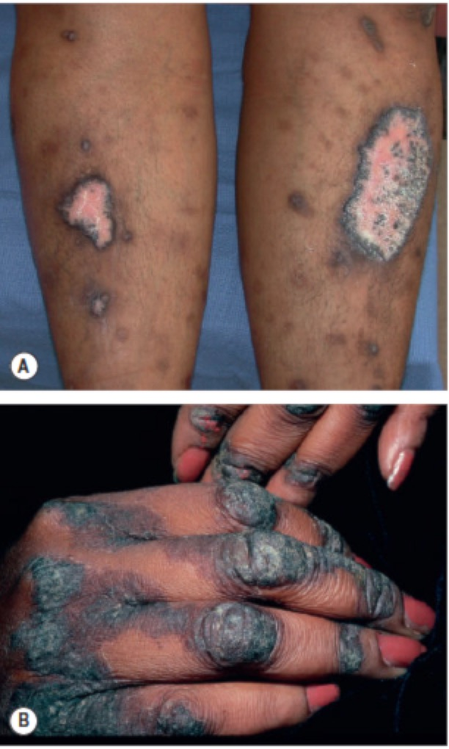

Slide 39
LP Pigmentosus
It is more common in dark skin people and it presents as well-defined brown to slate-gray patchs with/without violaceous indurated border or hypopigmented halo over axilla/groin & proximal limbs
LP Actinicus (sun exposed area)

Slide 41
Mucosal LP
The most common site of involvment is the oral mucosa which usually present as well-defined reticulated violaceous plaques over buccal mucosa ,lips and gingiva- Reticulated
Erosive ( less than 1% risk of SCC)
Atrophic
Hypertrophic
It can affect other mucosal surfaces e.g. vulvar, vaginal and penile-Vulvovaginogingival syndrome

Slide 44
Nail LP
Nail involvment usually occur in 20% and it is more common in children
Dorsal Pteryigum
Lateral thinning
Longitudinal ridging
Distal splitting
20 Nail Dystrophy

Slide 46
Lichen planopilaris-LPP
It usually present as multiple, keratotic plugs surrounded by a narrow violaceous rim are observed primarily on the scalp, although other hair bearing areas can also be affected. The inflammatory process usually result in scarring alopecia
Graham-Little–Piccardi–Lassueur syndrome is triad of :
(1) non-scarring alopecia of pubic and axillary hairs and disseminated spinous or acuminated follicular papules
(2) Typical cutaneous or mucosal LP
(3) Scarring alopecia of the scalp
Frontal fibrosing alopecia
It usually affect postmenopausal female
It presents as frontal hair-line scarring alopecia with eyebrows thinning

Slide 48
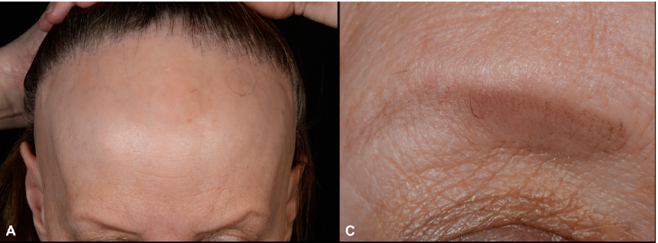

Slide 49
Lichnoid drug eruption
It is a drug eruption that resemble LP with the following clinical differences
Morphology: more psoriasiform/eczematous
Distribution: start as photo-distributed then generalized
Usually no mucosal involvment and Wickham's striae
It can appear anytime between weeks and years after exposure

Slide 50
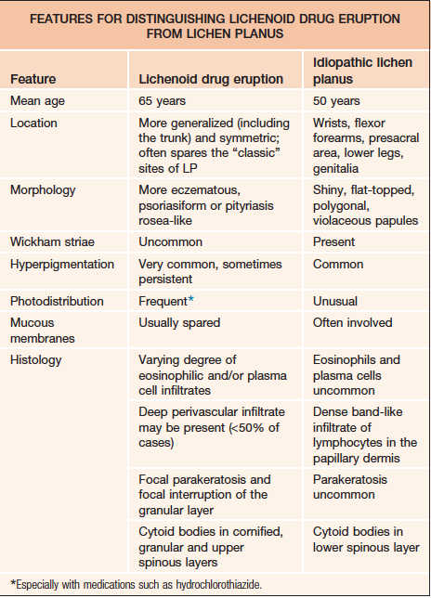

Slide 51
Pathology
Classic LP pathology & IF
Superficial lymphocytic infiltrate with vacuolar interface reaction at the DEJ with dyskeratotic keratinocyte (Civatte bodies) & colloid bodies which is associated with “wedge-shaped” hypergranulosis and “saw-tooth” rete ridges
IF Shaggy band of fibrinogen along the DEJ and colloid bodies staining with immunoglobulins at the papillary dermis
Lichenoid drug eruption
The infiltrate is more deep with eosinophils/plasma cell with the presence of parakeratosis

Slide 52
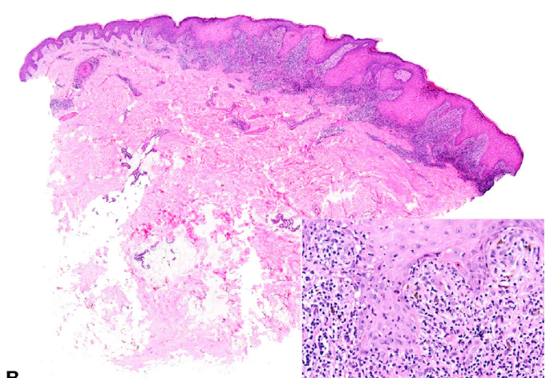

Slide 53
LP course
It follow a relatively short course with relapse/remit nature that self-limit usually within 1-2 years except for oral and follicular LP which tend to be more chronic.

Slide 54
Treatment
Focal
Topical corticosteroids
Intralesional corticosteroids -LPP
Generalized
Phototherapy
NBUVB/PUVA
Systemic therapy
Systemic Corticosteroids
Systemic Retinoids e.g. Acitretin
Antimalaria- Hydroxychloroquine- LPP
Immunosuppressive therapy- MTX
Cyclosporine

Slide 55
PITYRIASIS ROSEA

Slide 56
PR is a common acute self-limiting exanthematous eruption that usually affect adolescent (10-30 years)
It doesn't have any gender/race predilection
The etiology of PR is unknown but most expert believe that the reactivation of HHV6/7 play a significant rule in the pathogenesis of the disease
Although, PR can be seen all year around, it is more frequent in winter, fall and spring.

Slide 57
Typical PR
Single well-defined oval (~4cm) pink-erythematous patch with collarette scale over the trunk/proximal limbs (Herald patch 50%) followed after average of 2 weeks with similar daughter lesions on the trunk /proximal limbs(~ charismas tree) with whole illness ranging between 6-12 weeks
75% complain of pruritus
75% complain of Viral prodrome
10% oral lesions : erosion/ulcer (most common), purpura and erythematous patch

Slide 58
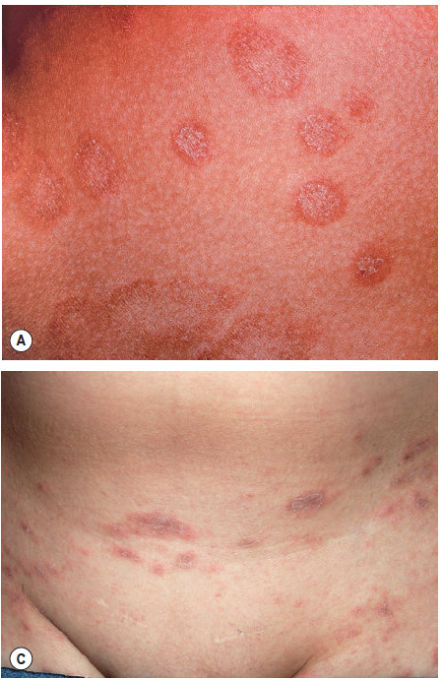

Slide 59
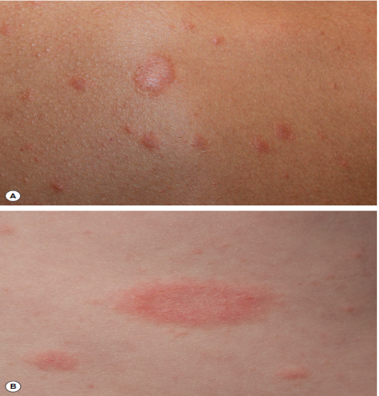

Slide 60
Atypical PR
Herald patch
No
multiple
Morphology
papular~ common in dark skin people and children
vesicular
Some PR have purpura or Targetoid lesion
Distribution
PR Inversa~ affect axilla, groin and distal extremities

Slide 61
Course and duration
Persistent PR~ duration longer that 12 weeks and usually up to 6 months with aggressive course and presentation.
Relapsing PR~ more than estimated (~5%) but carry a mild and shorter course with few attacks over 3-5 years duration
(usually due to the time the immune system take to gain full control over HHV6/7)

Slide 62
PR & Pregnancy
Since pregnancy is a state of altered immune response, a risk of viral reactivations and intrauterine transmission of HHV-6/7 exists.
On the whole, the total abortion rate among women with pregnancy PR is the same as that of the general population but noteworthy, when PR develops within the 15th gestational week, the abortion rate is higher probably because the risk of intrauterine transmission of HHV-6 (or less commonly HHV-7) is increased.

Slide 63
Histopathology of PR
focal parakeratosis, spongiosis and acanthosis of the epidermis with superficial perivascular lymphohistocytic infiltrate accompanied by some extravasated RBC

Slide 64
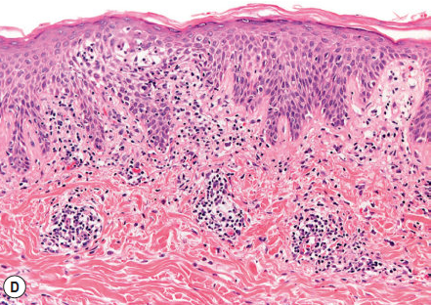

Slide 65
PR-like eruption
An eruption that resemble PR with the following differences:
lacking herald patch and viral prodrome
Papular morphology
Acrofacial distribution
Histology : Superficial perivascular lymphocytic infiltrate with eosinophil and vacuolar interface reaction and necrotic keratinocytes within the epidermis
HHV6/7 serology negative

Slide 66
Medications
Barbiturates, methopromazine, captopril, clonidine, gold, metronidazole, D –penicillamine, isotretinoin, levamisole, Pyribenzamine, NSAID, omeprazole, terbinafine, ergotamine tartrate, tyrosine kinase inhibitors & Adalimumab
Vaccinations e.g. diphtheria, smallpox, pneumococcal, hepatitis B virus, BCG and HPV

Slide 67
Treatment of PR
Symptomatic with topical corticosteroids and antihistamine
Antiviral treatment (Acycolvir 800mg 5 times for 10 days) indicated in the following settings :
Persistent PR
Relapsing PR
Severe PR at the first trimester of pregnancy

