Slide 1
ATOPIC Dermatitis eczema
Abdullah ALAKEEL, MD
Assistant Professor
Consultant Dermatologist
Department of Dermatology- KSU

Slide 2
Eczema
Definition: inflammation of the skin
Eczema vs. dermatitis

Slide 3
Eczema
Acute eczema:
erosion, oozing and vesicles

Slide 6
Eczema
Chronic eczema:
lichenification, dark pigmentation and thick papules and plaques

Slide 9
Dermatitis 101
Atopic
Seborrheic
Contact
Allergic
Irritant
Nummular
Asteatotic
Stasis
Neurodermatitis/Lichen Simplex Chronicus

Slide 10
Atopic Dermatits
Definition: chronic relapsing itchy skin disease in genetically predisposed patients.
Associated diseases: bronchial asthma, allergic rhinitis, allergic congectivitis
Incidence: up to 15% in developed countries
Grow out tendency!

Slide 11
Atopic Dermatitis
Pathogenesis:
Multifactorial;
“Atopy”: genetic predisposition
Dry (atopic) skin (decrease human B-defensin 3 predisposing patients to frequent skin infections).
T-Cell (elevated Th2 cytokines and increased IgE production.
Recent studies showed a potential role for the Th17 pathway, with increased circulating Th17 cells in atopic patients, & increased Th17 in acute eczematous lesions. A decreased Th17 in chronic eczema argues for a dynamic role for the Th17 pathway.
Allergy, increased tendency to certain allergens.

Slide 12
Atopic Dermatitis
Prevalence and association with other atopic disorders:
Prevalence is almost 20% in US, representing a marked increase during the past several decade.
Studies before 1960 estimated the prevalence to be up to 3%.
AD is often the 1st manifestation of the ”atopic march”
AD → asthma → allergic rhinitis

Slide 13
Atopic Dermatitis
Asthma occurs in up to 50% of children who develop AD during the first 2 years of life;
Allergic rhinitis develop in 43-80% of children with AD.
In general children showing more severe dermatitis have a higher risk of developing asthma, as well as sensitization to foods and environmental allergens.

Slide 14
Atopic Dermatitis
AD occurs more frequently in urban areas than in rural areas, in smaller families, and in higher socioeconomic classes.
Ultimately 80% of patients will develop increased IgE levels.

Slide 15
Atopic Dermatitis
Loss-of-function mutations in profilaggrin (FLG) cause ichthyosis vulgaris, a common genetic disorder characterized by dry, scaling skin and hyperlinear palms that has long been known to be common in individuals with AD.
Distinct mutations in FLG have been discovered in the European and Japanese populations, but all are strongly linked with AD, particularly of early onset.

Slide 16
Atopic Dermatitis
Histology:
Edema within the epidermis (spongiosis) and infiltration with lymphocytes and macrophages in the superficial dermis.

Slide 17
Atopic Dermatitis
Clinical Variants:
Infantile AD
Childhood AD
Adult AD

Slide 18
Atopic Dermatitis
Infantile AD:
60% of case AD present in the first year of life, after 2 months of age
Begin as itchy erythema of the cheeks
Distribution include scalp, neck, forehead, wrist, and extensors

Slide 21
Atopic Dermatitis
Childhood AD:
Characterized by less acute lesions
Distribution: antecubital and popliteal fossae, flexor wrist, eyelids, and face.
Severe atopic dermatitis involving more than 50% of body surface area is associated with growth retardation.

Slide 25
Atopic Dermatitis
Adult AD:
Distribution: antecubital and popliteal fossae, the front side of the neck, the forehead, and area around the eyes.
Atopic individuals are at greater risk of developing hand dermatitis than are the rest of the population
70% develop hand dermatitis some times in their lives

Slide 28
Erythroderma: is a very rare complication of atopic dermatitis

Slide 29
Atopic Dermatitis
Atopic individuals have a distinct tendency toward an extra line or groove of the lower eyelid, so called ”atopic pleat”, is present at birth or shortly after and usually retained throughout life, referred to as “Dennie-Morgan fold”.
Another feature, an exaggerated linear nasal crease, caused by frequent rubbing of the nasal tip (allergic salute), although not a specific sign of AD.

Slide 30
Atopic Dermatitis
Complications:
Secondary infections
Eczema herpeticum
Growth retardation
Psychological
PIH

Slide 32
Impitigo: Bacterial infection

Slide 33
Cellulitis

Slide 34
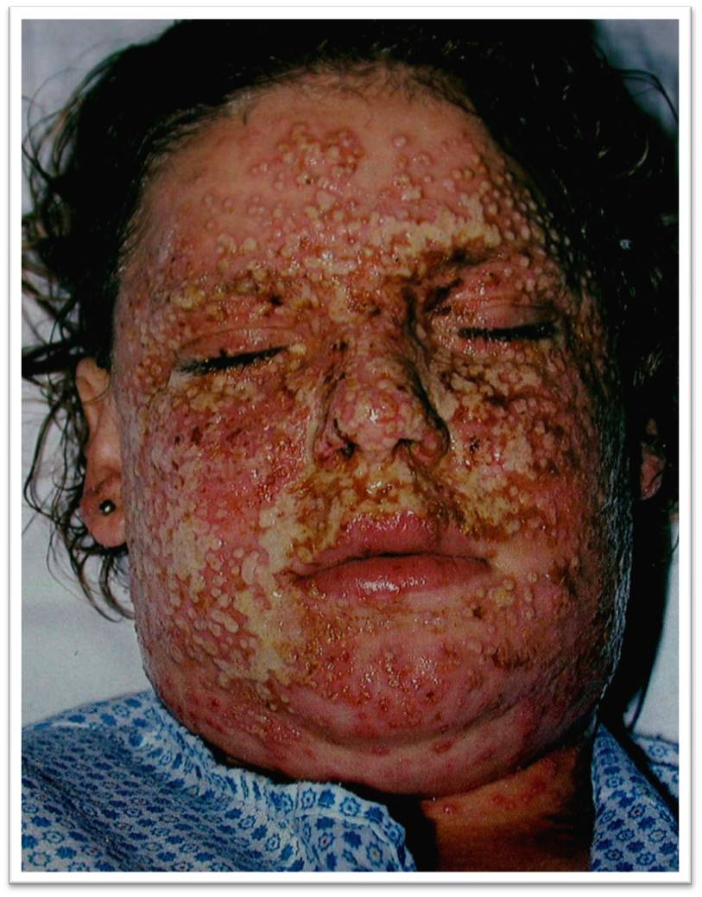
Eczema Herpiticum is a serious complicaiton that needs admission and systemic antiviral

Slide 36
Atopic Dermatitis
Investigations:
????????

Slide 37
Atopic Dermatitis
Management:
Education! Education! Education!
Support!
Skin care: moisturizing the skin
Topical therapy: (topical steroids, Tacrolimus, Pimecrolimus)
Phototherapy
Systemic therapy: steroids, Cyclosporin, Methotrexate, Azathioprine

Slide 39
Atopic Dermatits
AD and Food!
minor role

Slide 40
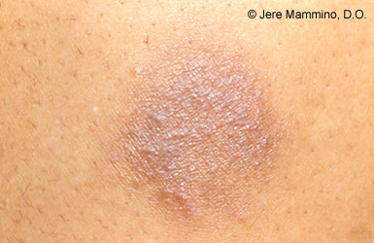
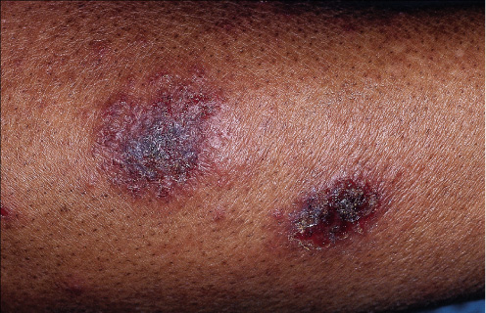
Nummular dermatitis
Coin shaped patches and plaques
Secondary to xerosis cutis
Primary symptom itch
Notice the surrounding xerosis

Slide 41
Regional eczema
Ear eczema
Eyelid dermatitis
Nipple eczema
Hand eczema
Diaper dermatitis
Juvenile plantar dermatosis

Slide 43
Ear eczema
Most frequently caused by seborrheic or atopic dermatitis
Staph, Strep, or Psoeudomonas
Earlobe is pathognomonic of nickel allergy

Slide 45
Nipple dermatitis
Painful fissuring, seen especially in nursing mothers
Maybe an isolated manifestation of atopic dermatitis
If it persists more than 3 month, and/or unilateral, biopsy is mandatory to rule out Pagets disease

Slide 46
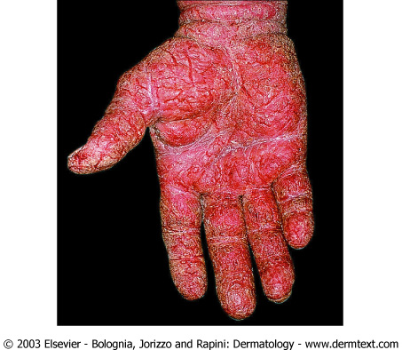

Slide 47
Hand eczema
Spongiosis histologically
Irritant hand dermatitis- seen in homemakers, nurses. Resulting from excessive exposure to soaps
Pompholyx- tapioca vesicles, on sides of fingers, palms, and soles
Irritant versus allergic

Slide 48
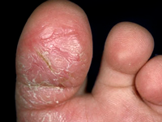
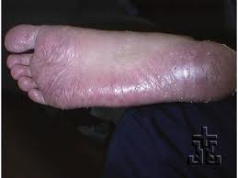
Juvenile plantar dermatosis
Begins as a patchy symmetrical, smooth, red, glazed macules on the base of the great toes
Affect age 3 to puberty.
Symmetrical lesions on weight bearing area
Virtually always resolve after puberty

Slide 49
Xerotic eczema
Aka winter itch, nummular eczema, eczema craquele, and asteototic eczema.
Anterior shins, extensor arms, and flank
Elderly person predisposed.
Use of bath oils in bath water is recommended to prevent water loss
Moisturizers – urea or lactic acid.

Slide 51
Allergic contact dermatitis
Type 4 Hypersensitivity Response
Classically well demarcated/patterned
Exposure can be infrequent (once a month)
Patch testing is gold standard for diagnosis

Slide 52
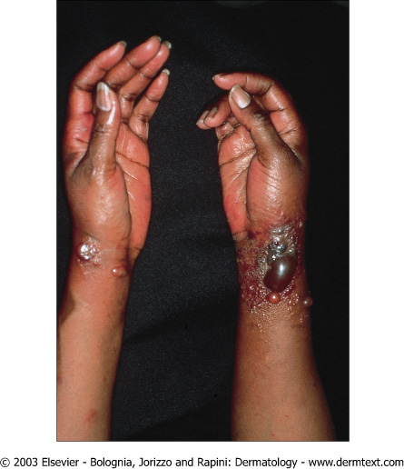
Allergic contact dermatitis
Poison Ivy/Oak/Sumac

Slide 53
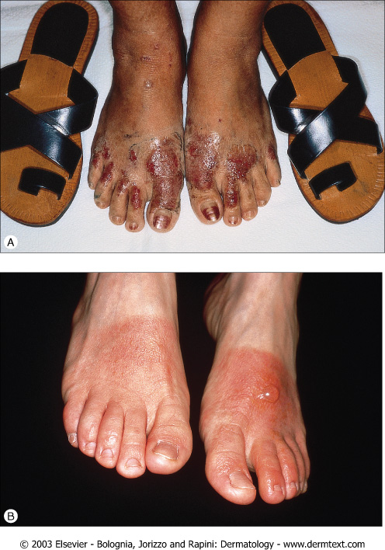
Allergic contact dermatitis
Potassium Dichromate
in Leather

Slide 54
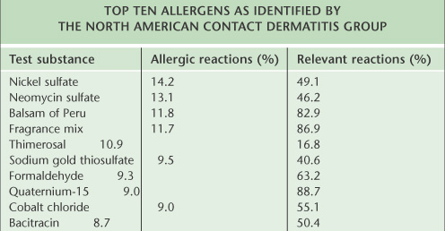
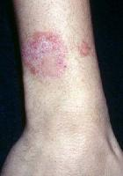
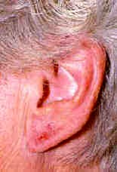
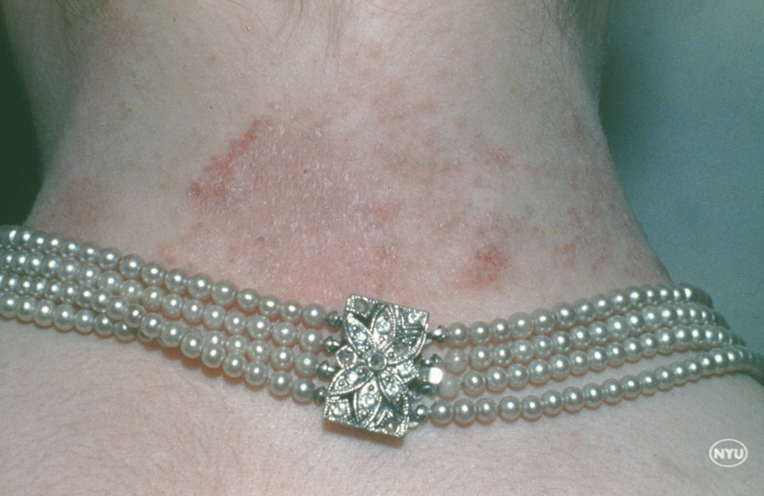
Allergic Contact Dermatitis

Slide 55
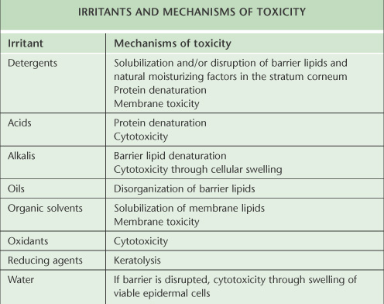
Irritant Contact Dermatitis
Most contact dermatitis is irritant in nature
Occupational morbity
Irritant vs allergic
Prevention is key!

Slide 56
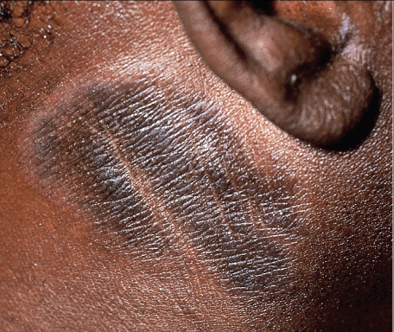
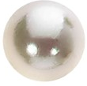
Neurodermatitis/Lichen Simplex Chronicus
Paroxysmal pruritus
Habitual excoriating or rubbing
Skin thickens to defend
Consider underlying disease
Increased skin markings

Slide 57
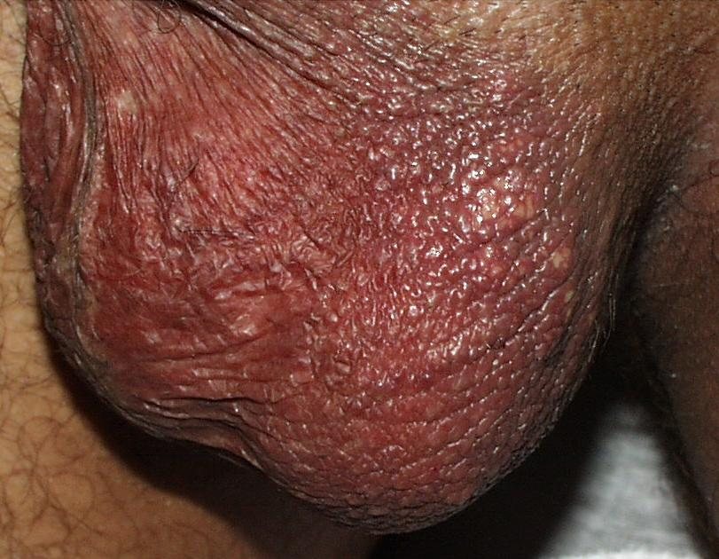
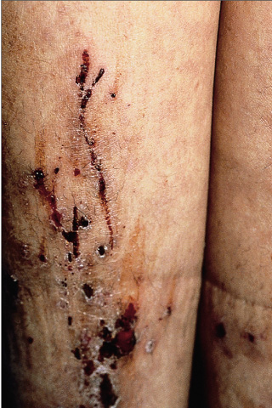
Lichen simplex chronicus
No fungus on the scrotum!
Prurigo simplex

Slide 58
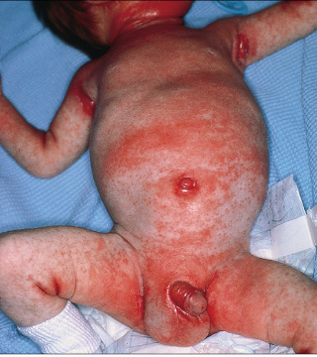
Seborrheic Dermatitis
Distribution
Face, scalp, axillae, upper chest
Pityrosprum ovale “ malassezia furfur”
Oily greasy skin
Nasolabial folds

Slide 61
Thank You

