Slide 1
Pigment and Hair Disorders
Mohammed Al-Haddab,MD,FRCPC
Assistant Professor, Consultant Dermatologist, Dermasurgeon

Slide 2
Objectives
To be familiar with physiology of melanocytes and skin color.
To be familiar with common cutaneous pigment disorders, pathophysiology, clinical presentation and treatment
To be familiar with physiology of hair follicle
To be familiar with common hair disorders, both acquired and congenital, their presentation, investigation and management
Reference is the both the lecture and the TEXTBOOK

Slide 3
Skin Pigment
Reduced hemoglobin: blue
Oxyhemoglobin: red
Carotenoids : yellow
Melanin : brown
Human skin color is classified according to Fitzpatrick skin phototype.

Slide 4
www.steticsensediodolaser.es

Slide 5
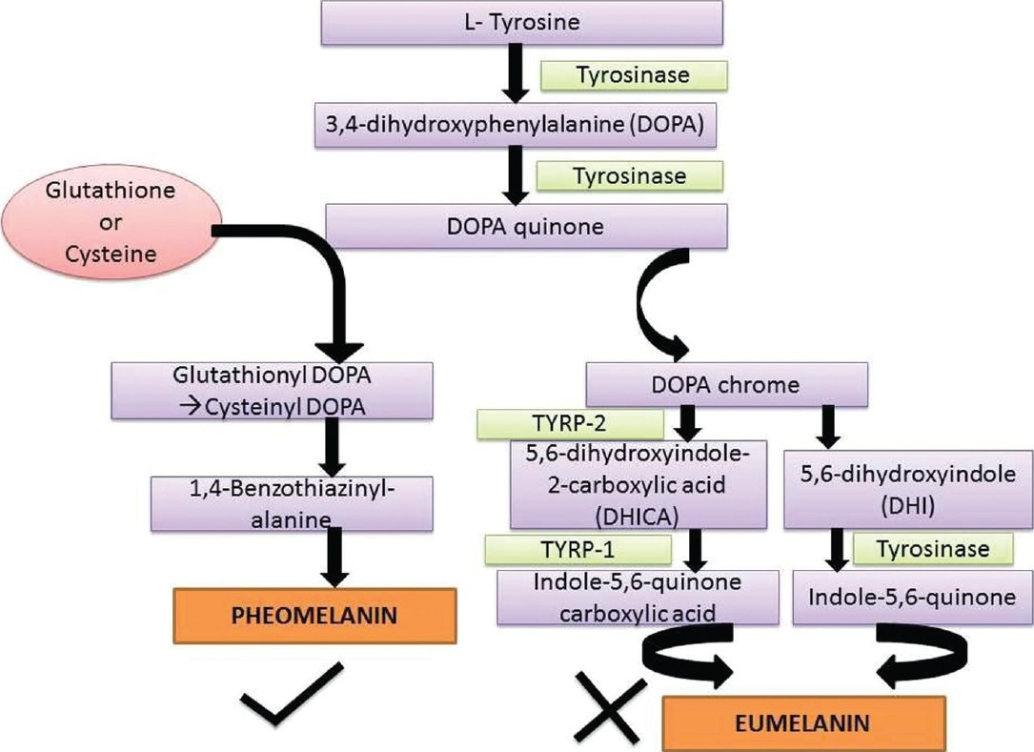
www.ijdvl.com

Slide 6
Vitiligo
Incidence 1%
Early onset
A chronic autoimmune disease with genetic predisposition
Complete absence of melanocytes
Could affect skin, hair, retina, but Iris color no change
Rarely could be associated with: alopecia areata, thyroid disease, pernicious anemia, diabetes mellitus
Koebner phenomenon

Slide 7
Vitiligo
Ivory white macules and patches with sharp convex margins
Slowly progressive or present abruptly then stabilize with time
Focal
Segmental
Generalized (commonest)
Trichrome
Acral
Poliosis

Slide 8
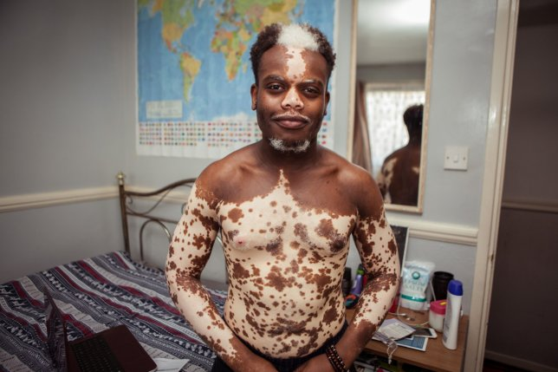
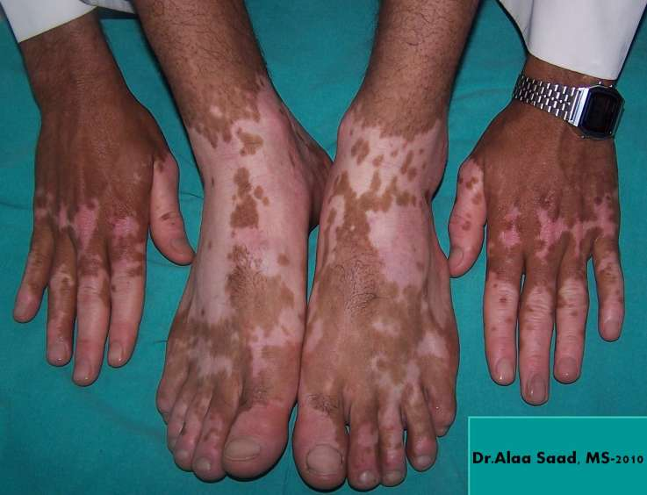
www.metro.co.uk
www.dermrounds.com

Slide 9
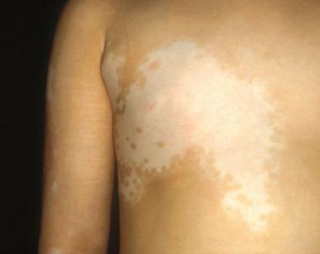
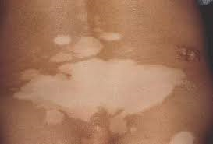
www.medscape.com
www.jaad.org

Slide 10
Vitiligo
Diagnosis usually clinically
Wood’s lamp for early vitiligo, white person
Pathology shows normal skin with no melanocytes

Slide 11
Differential Diagnosis of Vitiligo
Pityriasis alba
leprosy
Hypopigmented pityriasis Versicolor
Discoid lupus erythematosus
Post inflammatory hypopigmentation
Mycosis fungoides
Chemical leukoderma
Nevus anemicus
Nevus depigmentosus
Hypomelanosis of Ito
Piebaldism

Slide 12
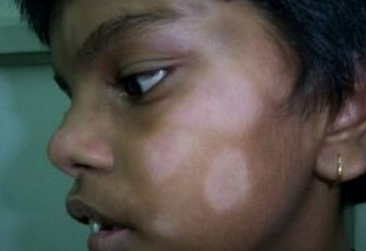
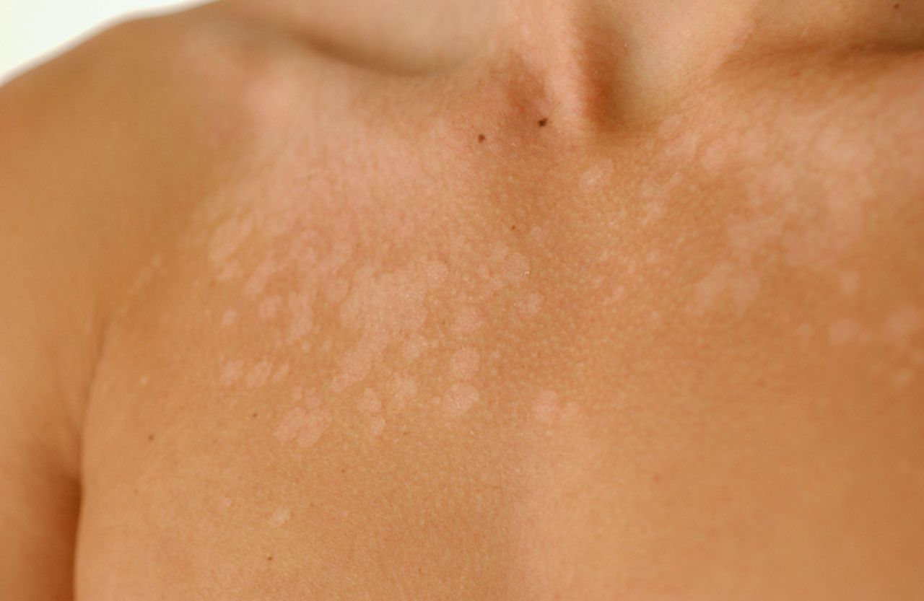
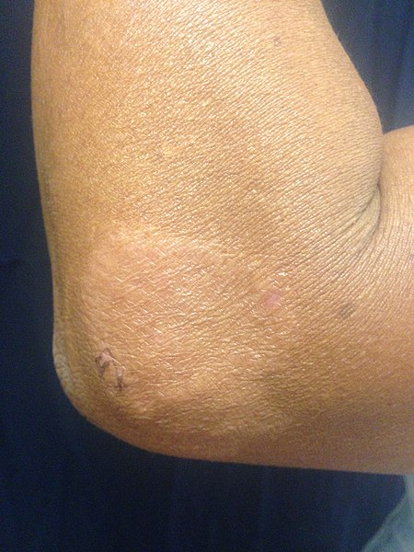
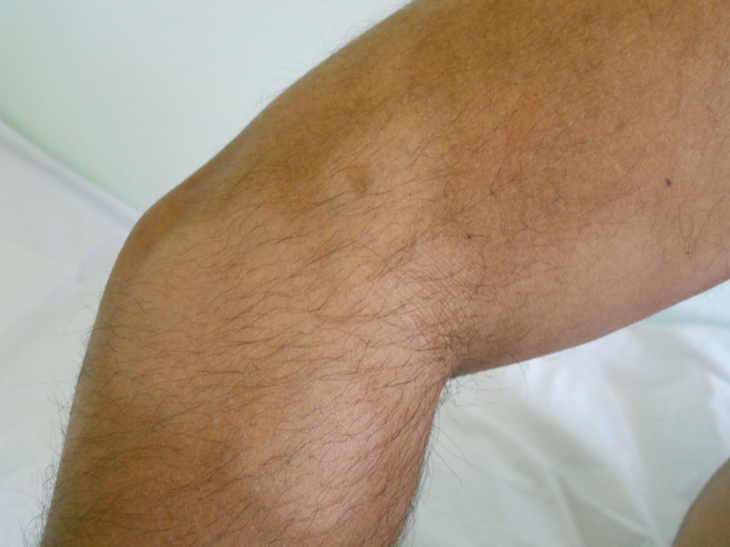
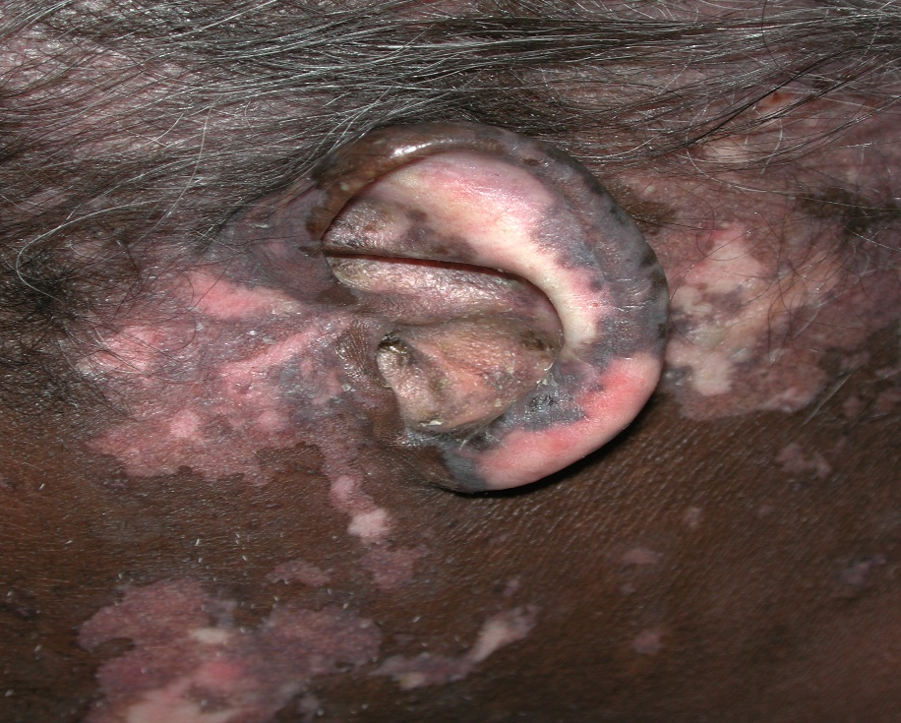
www.healthsaline.com
www.bmj.com
casereports.bmj.com
www.mdedge.com
www.wikiwand.com

Slide 13
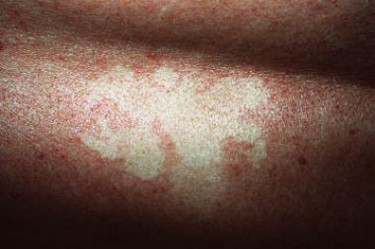
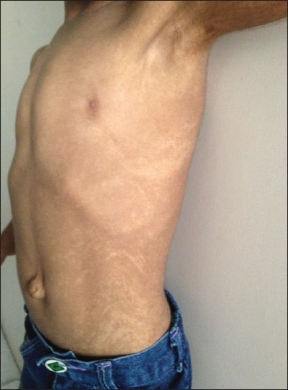
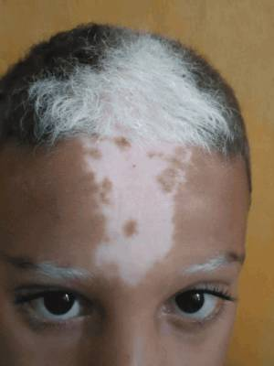
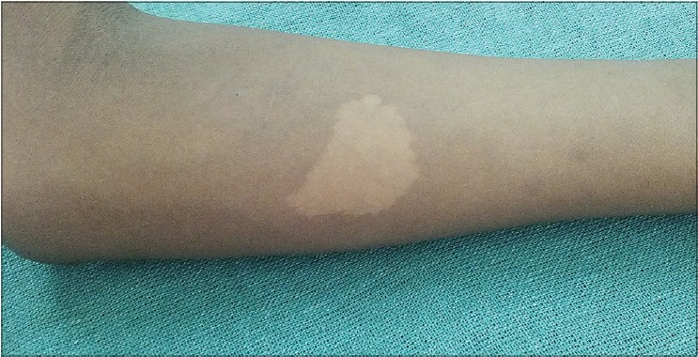
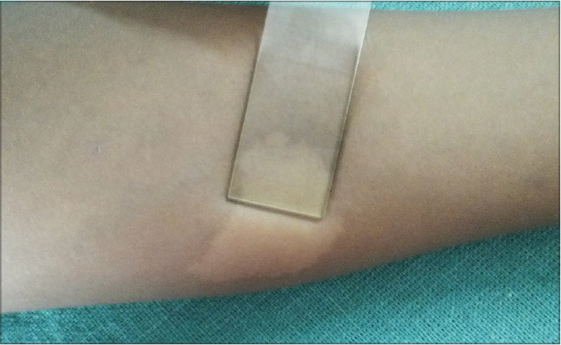
www.emedicine.medscape.com
www.ijhas.in
www.pcds.org.uk
www.pigmentinternational.com

Slide 14
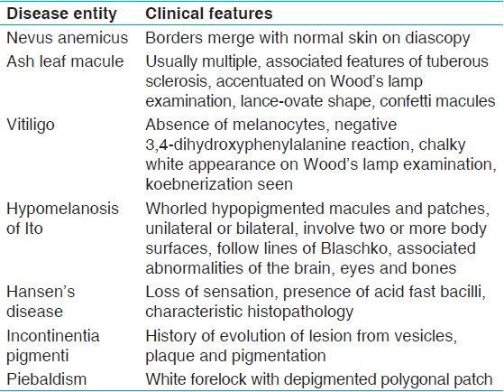
www.pigmentinternational.com

Slide 15
Post Inflammatory Hypopigmentation
Could happen after any inflammatory dermatosis
Pityriasis versicolor hypopigmentation secondary to dicarboxylic acid
Post chemical peel or laser
Post intralesional corticosteroid injection
Treatment: make up, tattoo, Excimer laser, NB-UVB

Slide 16
Pityriasis Alba
Macular scaly hypopigmented macules and patches in children
Prevalence 5%
Affects mostly face and neck
Associated with atopic dermatitis and dry skin
Ill defined margins, not itchy, fine scales
Self limited
Might be treated by topical corticosteroids, tacrolimus

Slide 17
Nevus Anemicus
Congenital, at birth pale whitish macule or patch <10 cm
No enhancement with Wood’s lamp
After rubbing: no erythema while surrounding skin is red
Blood vessels in the patch are more sensitive to catecholamines
Pathology: normal skin
No need for treatment

Slide 18
Nevus Depigmentosus
Congenital, solitary depigmented patch
Cutaneous mosaicisim with altered clones of melanocytes with decreased ability to produce melanin
Stable
Mostly in trunk and extremities
Treatment: make up, tattoo, melanocyte transfer

Slide 19
Vitiligo Management
Face and trunk with good response
Acral location or poliosis with poor response
Sun protection: sun-avoidance, clothes, hats, sunscreens
Make up
Tattoo
Psychological Support

Slide 20
Vitiligo Management
Focal disease:
Corticosteroids
Tacrolimus
8-MOP topical phototherapy
Excimer laser
NB-UVB
Surgical: melanocytes transfer, blister graft, punch graft
Experimental: topical JAK inhibitors (topical Ruxolitinib)

Slide 21
Vitiligo Management
Generalized:
NB-UVB
Oral PUVA
Depigmentation with 20% monobenzylether of hydroquinone cream
Depigmentation with Q-switched laser and cryotherapy
Systemic therapy: oral corticosteroids, methotrexate, cyclosporine, mycophenolate mofetil, azathioprine
JAK inhibitors orally with very high relapse rate

Slide 22
Melasma
Acquired symmetrical blotchy hyperpigmentation mostly on face
Epidermal, dermal, mixed (most common)
Mostly in young females(20-40), only 10% males
Genetic predisposition, excessive sun exposure, pregnancy, oral contraceptives, hypothyroidism can trigger the disease
Present as sharply marginated macules and patches with irregular borders on cheeks and forehead

Slide 23
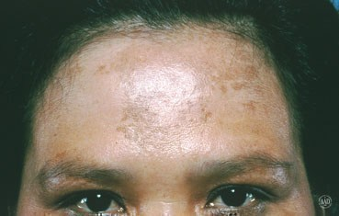
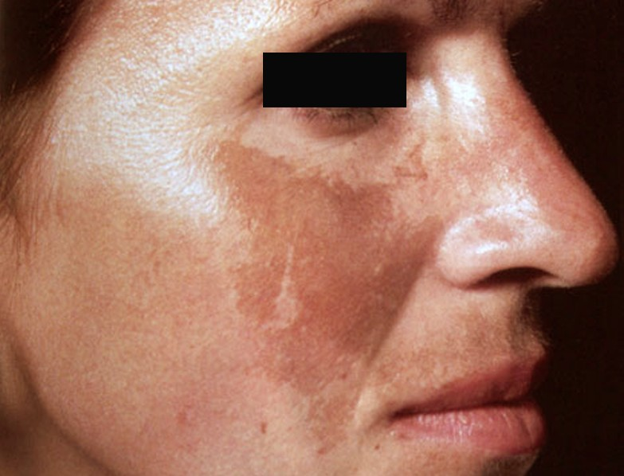
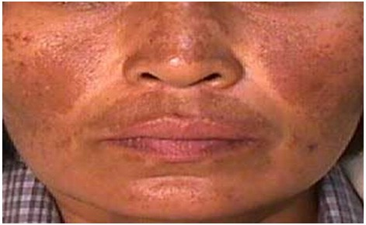
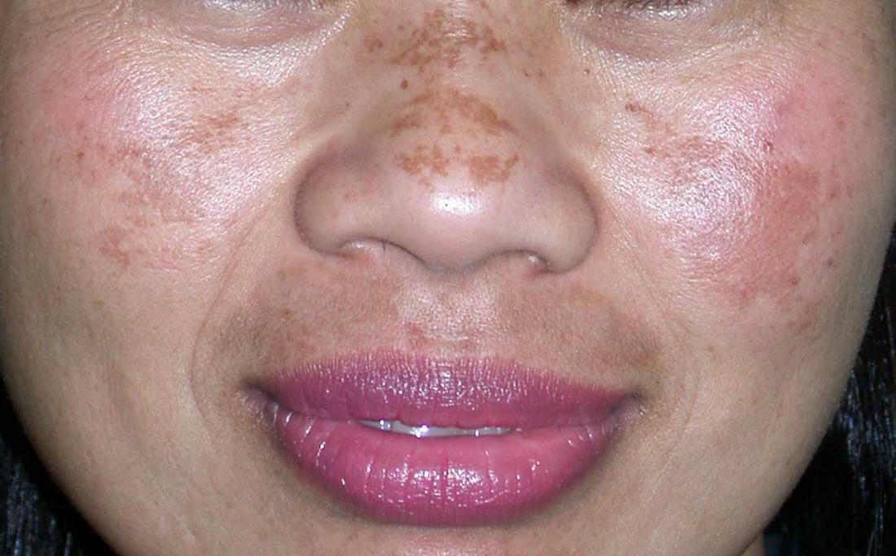
www.aad.org
www.skinofcolorsociety.org
www.aesthetics.venkatcenter.com
www.medicalnewstoday.com

Slide 24
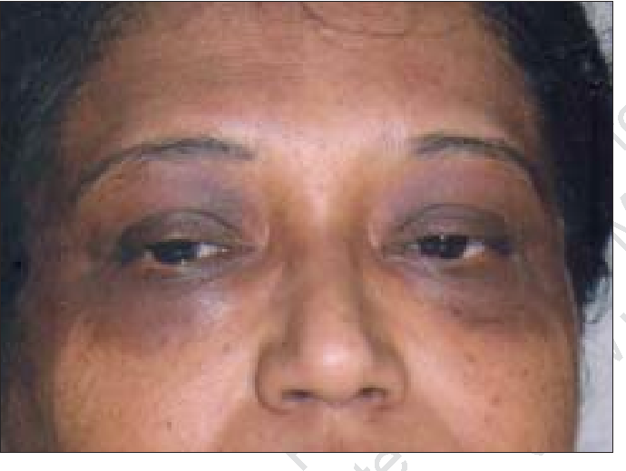
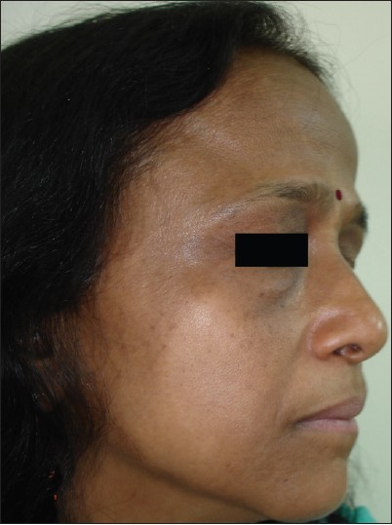
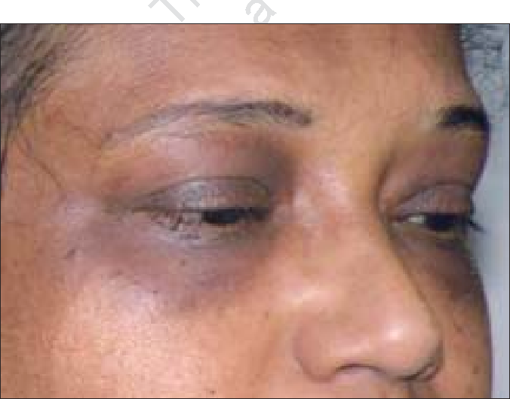
www.semanticscholar.org
www.ijdvl.com

Slide 25
Melasma Management
Sun protection
Kligman’s formula: Hydroquinone+Tretinoin+corticosteroid
Hydroquinone 4% cream
Glycolic acid, azelaic acid, kojic acid
Arbutin, mulberry extract, licorice
Chemical peels: glycolic acid, TCA, phenol, resorcinol
Fractional laser
Oral tranexamic acid

Slide 26
Post Inflammatory Hyperpigmentation
Any inflammatory disease can cause it
Acne, eczema, psoriasis, trauma, laser hair removal, burns, etc.
More severe with lichen planus
Improve with time but may persist for years
Treatment as melasma

Slide 27
Macular Amyloidosis
Reticulated brown patches mostly from excessive scratching and rubbing
Affect young women
Upper back, shins, arms
Deposition of amyloid protein in papillary dermis
Amyloid is derived from keratinocytes
Not associated with systemic disease
Treatment: control pruritus, topical corticosteroids, oral sedative antihistamines, bleaching agents, peels, laser

Slide 28
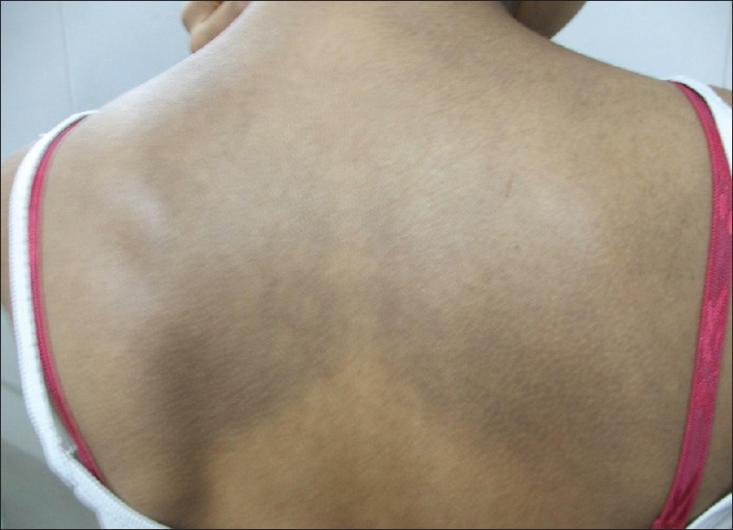
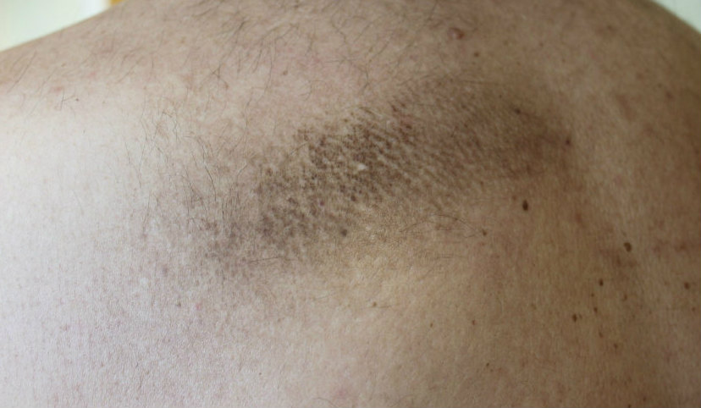
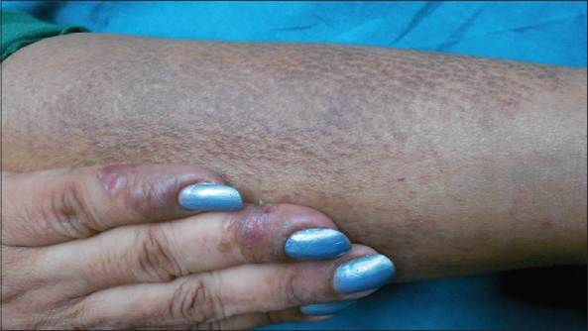
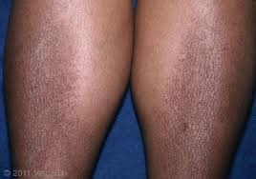
www.e-ijd.org
www.pcds.org.uk
www.e-ijd.org
cdn.ymaws.com

Slide 29
Disorders of Hair Follicle

Slide 30
Hair Cycle
Anagen
Growth phase
Determines the ultimate length of the hair
80-85% of hair
3-6 years
Telogen
Resting phase
5-15%
3-4 months
Catagen
Transitional phase between anagen and telogen (apoptosis driven)
1% of hair
1-2 weeks
Exogen

Slide 31
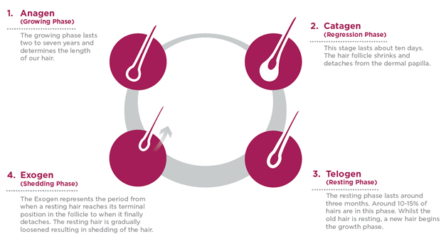
www.viviscal.com.au

Slide 32
www.pt.slideshare.net

Slide 33
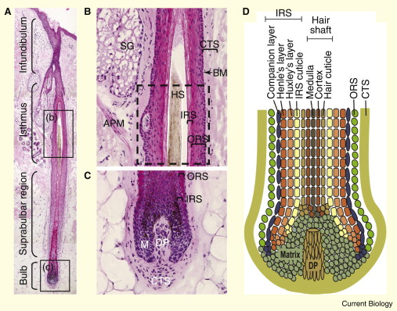
www.sciencedirect.com

Slide 34
Types of Hair
Lanugo hair: fetus, shed before birth
Vellus hair: fine, non-pigmented hair
Terminal hair: thick pigmented hair

Slide 35
Diagnosis
Hair pull test: 6+ is positive
Trichogram: 50 hair pull for anagen/telogen hair ratio
Trichoscopy: dermatoscope
Scalp biopsy
Scanning Electron Microscopy

Slide 36
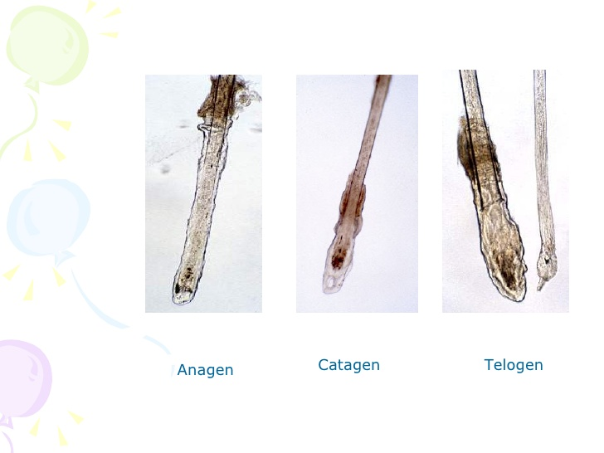
www.slideshare.net

Slide 37
Male Pattern Hair Loss
Most common type in adult men
Genetic predisposition and androgen hormones
Susceptibility genes inherited from both mother and father
Chinese and Japanese are less affected
Genetic sensitivity of hair follicle receptors to Dihydrotestosterone(DHT)
DHT decrease anagen phase from years to months or weeks
DHT is regulated by 5 alpha reductase

Slide 38
Male Pattern Hair Loss
Testosterone: growth of axillary & pubic hair, sex drive, penis and scrotum growth, spermatogenesis
DHT in prostate and skin: growth of hair, prostate, androgenic alopecia and acne
Testosterone → 5alpha reductase I&II→ DHT
Type I 5 alpha reductase: sebaceous &adrenal glands, kidney, liver
Type II alpha reductase: scalp&beard hair, seminal vesicle, prostate, epididymis, scrotum
Finasteride 5 alpha reductase II inhibitor, has no affinity for androgen receptors (2% of patients might have reversible erectile dysfunction and decrease libido)

Slide 39
Male Pattern Hair Loss
Hair miniaturization:
scalp hair grow in tufts of 3-4 hairs, in MPHL the tufts progressively lose hair, hair become finer with decrease length and diameter
Present as receding hair line and hair loss on frontal area and vertex

Slide 40
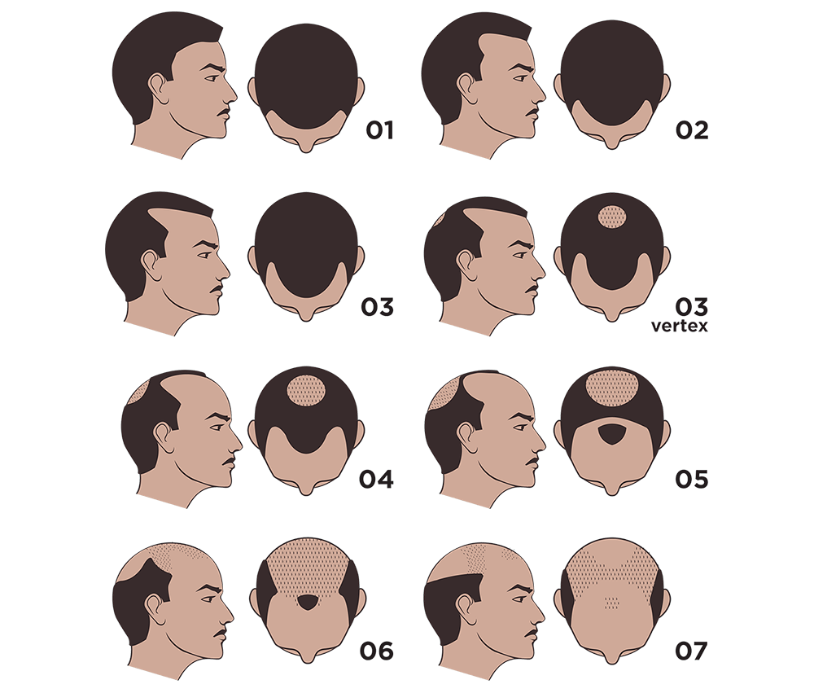
www.naturaltransplants.com

Slide 41
Management
Minoxidil solution 2% and 5%
Finasteride 1mg/d (type II 5 alpha reductase inhibitor)
Dutasteride 2.5mg/d (type I & II)
Platelet rich plasma
Hair transplant
Hair piece
Tattoo
powder

Slide 42
Female Pattern Hair Loss
40% of women ages 50 has some hair loss
Diffuse thinning of hair due to shedding and decrease volume
Genetic predisposition, polygenic, either parent
Normal androgen level
More common after menopause, ? Estrogen stimulate hair growth
Comes in waves of severe hair shedding then normal shedding, but progress over time
Psychological stress in women than men
Polycystic Ovarian Syndrome(PCOS), Congenital Adrenal Hyperplasia(CAH)

Slide 43
www.researchgate.net

Slide 44
Differential Diagnosis
Diffuse pattern alopecia areata
Telogen effluvium
Hair loss secondary to:
Systemic lupus erythematosus, thyroid disease, severe iron deficiency anemia, or drugs

Slide 45
Investigation
Trichogram
CBC, Iron, Ferritin, TIBC
LH/FSH
DHEAS
Prolactin
Free testosterone
Thyroid function test
ANA
Scalp biopsy

Slide 46
Management
Minoxidil 2%, 5%(may cause hypertrichosis on face and neck)
Finasteride and dutasteride
Spironolactone and flutamide
Cyproterone acetate
Oral minoxidil 0.25mg/d + spironolactone 25mg/d in one study
Hair spray, powder, hair piece
Hair transplant
?Platelet Rich Plasma PRP

Slide 47
Alopecia Areata
Autoimmune with T-cells around hair follicles
50% in childhood, 80% before age of 40
Genetic predisposition, 10-20% positive family history
Association with vitiligo, thyroid disease, atopic dermatitis and Down syndrome
Triggers: viral infection, trauma, hormonal changes, severe emotional stress

Slide 48
Alopecia Areata
Patchy AA ( the most common)
Patchy hair loss of scalp, beard, eyebrow, eyelash hair
Sudden onset
Progressively increase the size of the patch then stabilize
Regrowth of hair spontaneously after months in many cases but my persist for years
Regrowth of white hair then pigment comes back
Exclamation marks are 2-3 mm broken hair with distal end broader than proximal ! at the margin of the hairless patch
Nail pitting and ridging in 10-50% of patients

Slide 49
Alopecia Areata
Alopecia totalis: all scalp hair, 5%
Alopecia universalis: whole body, 1%
Ophiasis: occipital and lateral scalp
Diffuse alopecia areata:
Sudden diffuse thinning of hair
Persisting hair turn grey
Positive hair pull test

Slide 50
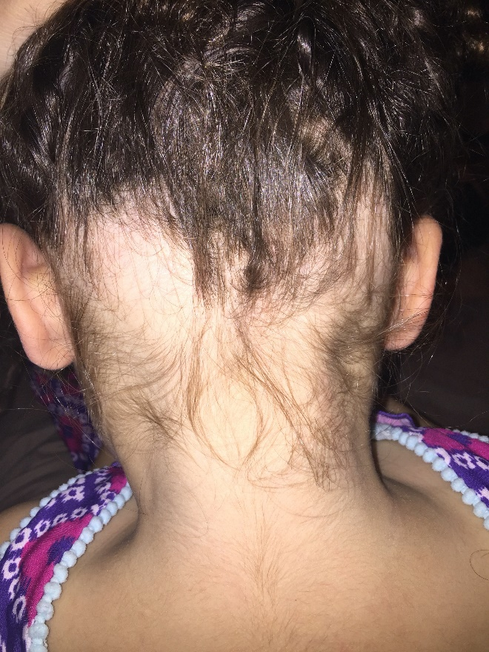
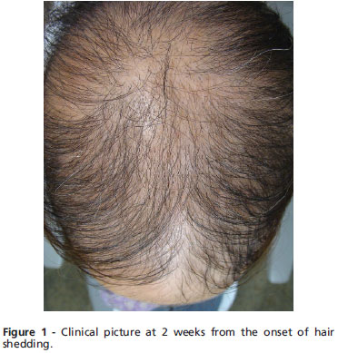
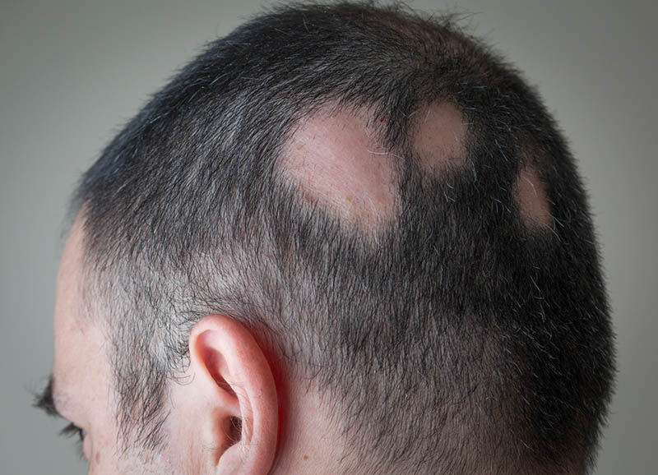
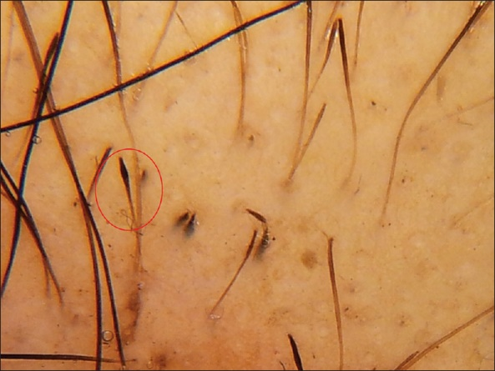
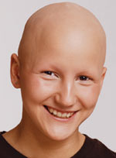
www.daniwachs.wordpress.com
www.scielo.br
www.embellishmentshairrestorationstudio.com
www.newhorizonsatlanta.com
www.ijdvl.com

Slide 51
Management
Intralesional corticosteroids
Minoxidil solution
Dithranol
Diphencyprone (DPCP)
phototherapy
Systemic corticosteroids, pulse therapy
Methotrexate, azathioprine
JAK inhibitors (Tofacetinib, Ruxolitinib)
IL-15 may be a future target
Artificial eyelashes, eyebrow tattoo, hair piece

Slide 52
Prognosis
Single patch: 80% resolution in 1 year
Poor prognostic factors:
Extensive disease
Duration >1 year
Ophiasis pattern
Nail involvement
Childhood onset
Positive family history
Other concomitant autoimmune diseases
Atopy
Down syndrome

Slide 53
Telogen Effluvium
Temporary hair loss of telogen hair
System shock: change anagen hair to telogen
Up to 70% of anagen hair could be affected leading to severe hair loss
Fever, surgery with general anesthesia, childbirth, severe emotional trauma, severe weight loss
Drugs: heparin, warfarin, B-blockers, Ace-inhibitors, lithium, anticonvulsants(especially valproic acid)
Might take 2 months after shock to start losing hair
Usually last for 6-9 months with incomplete recovery
Could be chronic, but doesn’t cause complete baldness

Slide 54
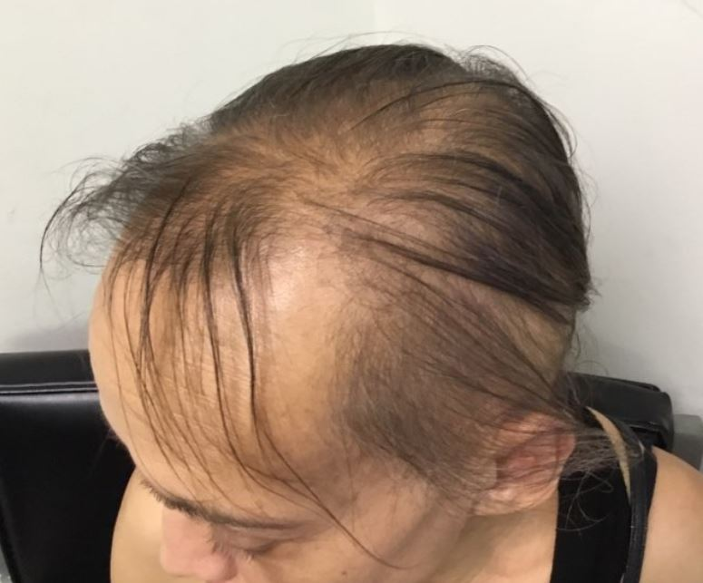
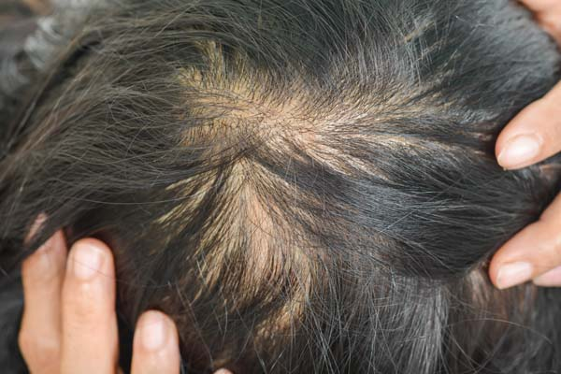
www.clinicaladvisor.com
www.embellishmentshairrestorationstudio.com

Slide 55
Tufted Hair Folliculitis
Folliculitis decalvans
Rare progressive, chronic scarring alopecia in adults
Presence of 10-15 hairs emerging from single follicle opening
Cause unknown, not contagious
Positive culture of staphylococcus aureus, ? Role
Could be associated with drugs: cyclosporine, lapatinib
Scarring hairless patches with hair tufts, tender, with swelling, crusts, and pus could be expressed form lesion
Culture and biopsy
Hyperkeratosis, parakeratosis, hyperplastic epidermis, with follicular plugging and perifollicular mixed inflammatory infiltrate
Antibiotics (clindamycine,rifampicin), I/L steroids, isotretinoin, surgery

Slide 56
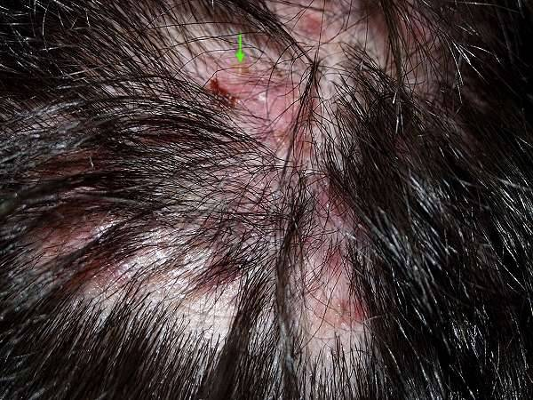
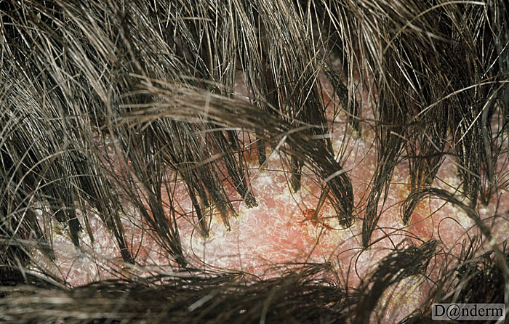
www.pcds.org.uk
www.danderm.dk

Slide 57
Scarring Alopecia
Lichen planopilaris LPP
Frontal fibrosing alopecia: post menopausal women
Central centrifugal cicatricial alopecia
Pseudopelade: non inflammatory
Discoid lupus erythematosus of scalp
Traction alopecia
Trichotillomania: non-scarring psychiatric alopecia, might lead to scarring alopecia, different length of hairs, RBCs around hair bulb
Acne keloidalis nuchae

Slide 58
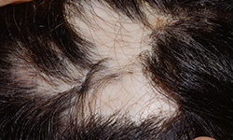
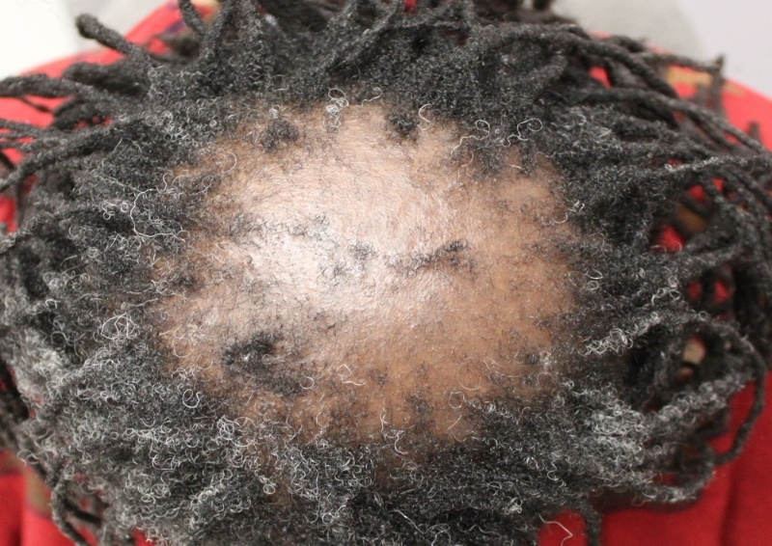
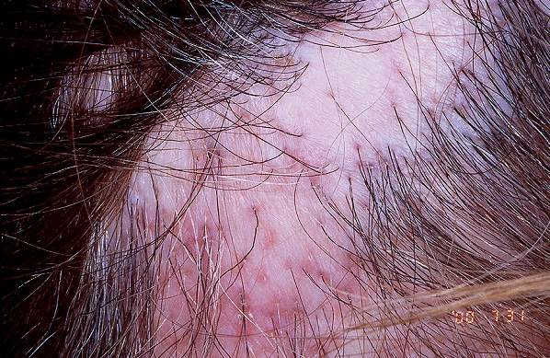
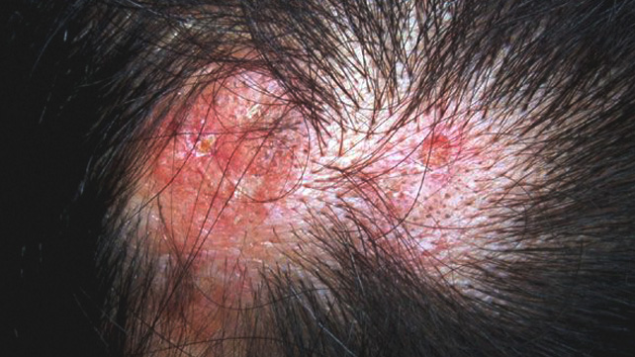
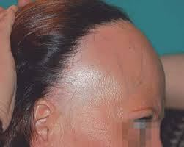
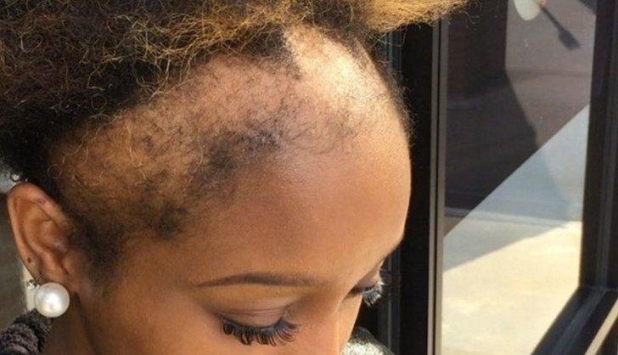
www.skinandhairacademy.in
www.canadianhairlossfoundation.org
www.pcds.org.uk
www.healthline.com
rossinajulissablog.wordpress.com
www.self.com

Slide 59
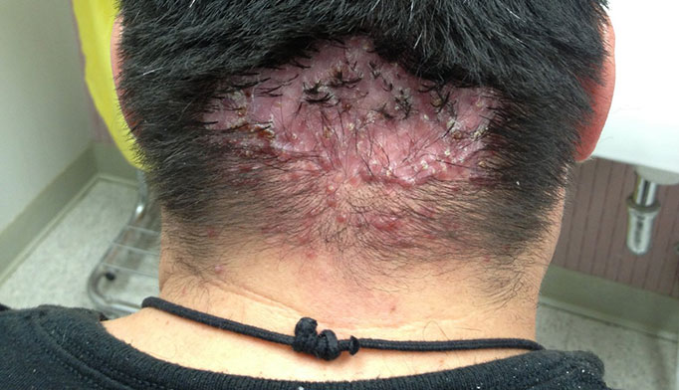
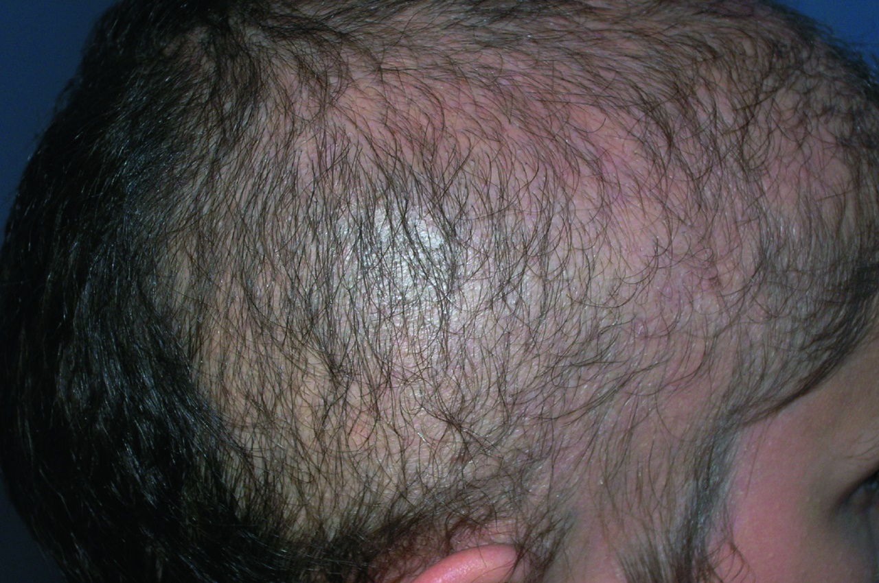
www.clinicaladvisor.com
www.msdmanuals.com

Slide 60
Hirsutism
Male pattern hair growth in women
Genetically determined, 10% of women affected
Increase androgen and testosterone
PCOS
Weight gain
Stopping oral contraceptives
Cushing syndrome
CAH ( 21 hydroxylase deficiency)
Tumors of adrenal glands (almost always malignant)
Ovarian tumors (arrhenoblastoma)
Pituitary gland (ACTH dependent)

Slide 61
Hirsutism
Androgen change anagen phase, dermal papilla size and dermal papilla cells activity (both keratinocytes &melanocytes)
Facial hair, below umbilicus, around nipple, upper back, inner thighs
Associated findings: acanthosis nigricans, galactorrhea, striae, acne, virilization(increase muscle bulk& size of clitoris, deep voice, baldness, menstrual irregularities
Oral corticosteroids are pure with no androgenic activity so it cause hypertrichosis but not hirsutism
Ferriman-Gallaway scale: 9 area, from 1-4, hirsutism if score >8

Slide 62
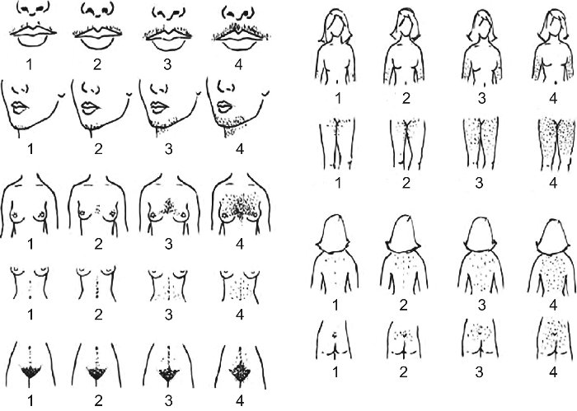
www.women-info.com

Slide 63
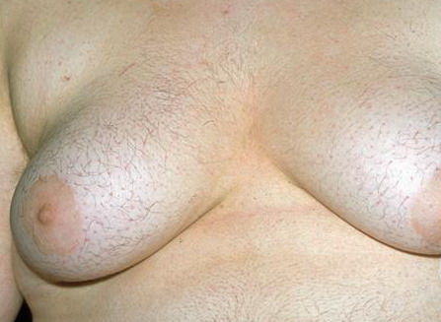
kinleymbbsmed.blogspot.com
www.pcds.org.uk
www.gponline.com

Slide 64
Investigation
Free testosterone, prolactin, thyroid function
LH/FSH ratio: PCOS
Dihydroepiandrosterone sulfate (DHEAS): Adrenal (↑testo+↑DHEAS)
Androstenedione: Ovary (↑testo + normal DHEAS)
17-hyroxyprogesterone: CAH
Urinary and serum cortisol
Dexamethasone suppression test: to exclude ACTH dependent hirsutism
Prostate specific antigen(PSA): a marker for increase androgens
U/S pelvis, CT-Scan, MRI

Slide 66
Management
No drug is FDA approved for hirsutism
Treat the underlying cause
Drugs are either decrease androgen production or inhibit androgens in the skin
Spironolactone 50-200 mg/d (blocks androgen receptors)
Flutamide 125mg/d (hepatitis)
Oral contraceptives
Cyproterone 50-200 mg x10 days per cycle
Metformin
Finasteride
Corticosteroids (ACTH dependent hirsutism)

Slide 67
www.reproductivefacts.org

Slide 68
Hypertrichosis
Excessive growth of lanugo, vellus, or terminal hair
Congenital or acquired
Generalized hypertrichosis: porphyria cutanea tarda, malnutrition, malignancy, hypothyroidism, drugs(minoxidil, cyclosporine, phenytoin, androgenic steroids)
Localized: increased vascularity, chronic itching and rubbing, topical minoxidil, topical corticosteroids, PUVA
Nevoid hypertrichosis: spina bifida
Hypertrichosis associated with nevi: congenital melanocytic nevus, Becker’s nevus, vascular malformation
Trichomegaly (Bimatoprost, Erlotinib)

Slide 69
Hypertrichosis
Congenital hypertrichosis lanuginosa
Only 50 cases reported
Hair grow up to 2 year of age
Most will lose the hair with time
No associated abnormalities
Palms, soles, glans penis, mucous membrane, labia minor are spared
Ambras syndrome (werewolf syndrome)

Slide 70
www.ijdvl.com

Slide 71
www.maxmag.gr
www.pinterest.com

Slide 72
Questions ????

