Slide 1
COMMON SKIN INFECTIONS
Dr. Abdulmajeed Alajlan
Associate Professor
Consultant Dermatologist & Laser surgeon
Department of Dermatology- KSU

Slide 3
Objectives
To know the main types of skin infection
To recognize the primary presentation of each type
To know the scheme of managements lines

Slide 4
INFECTIONS
BACTERIAL INFECTIONS
VIRAL INFECTIONS
FUNGAL INFECTIONS
INFESTATIONS

Slide 5
BACTERIAL INFECTIONS

Slide 6
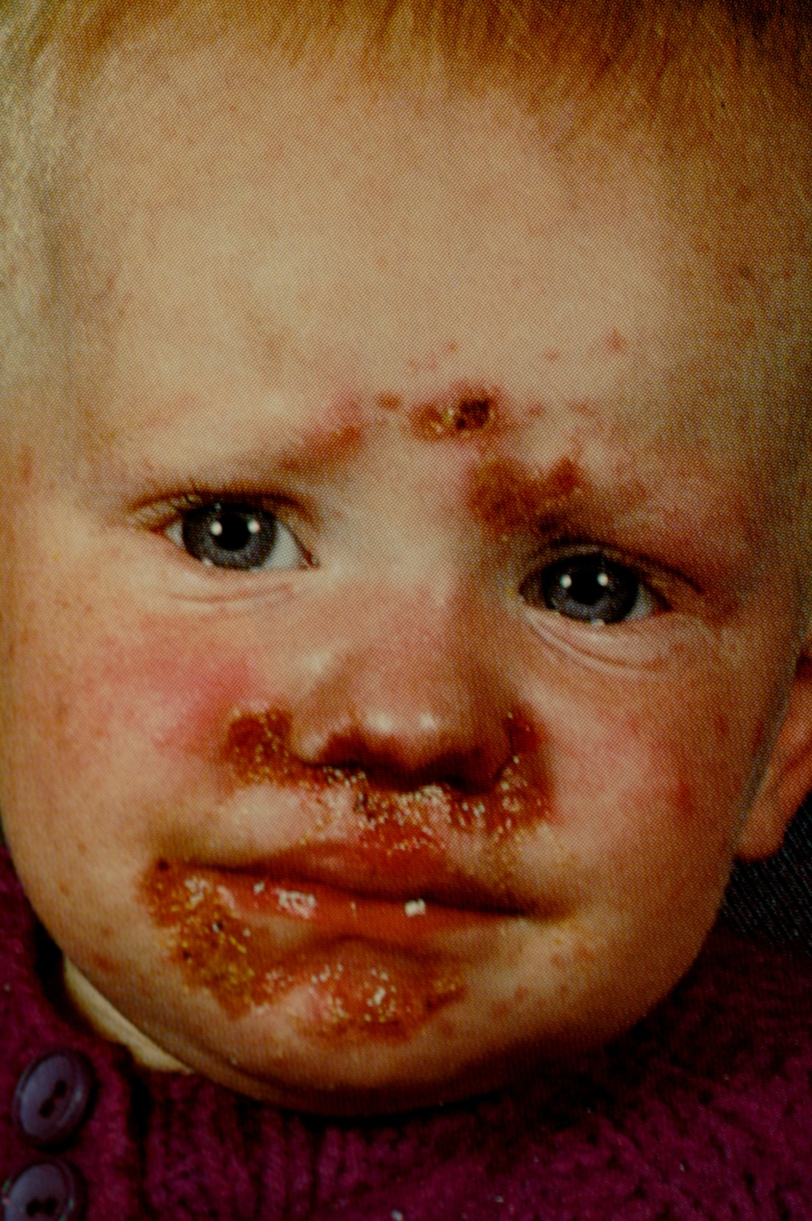

Slide 7
Impetigo

Slide 8
Bullous Impetigo

Slide 9
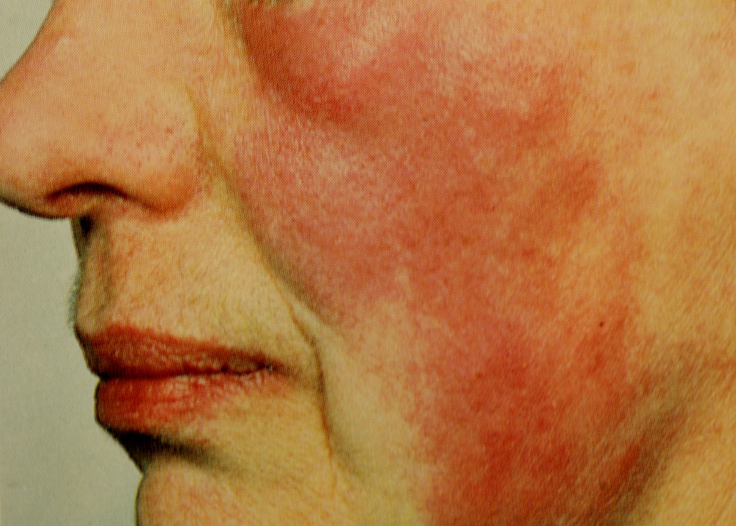

Slide 10
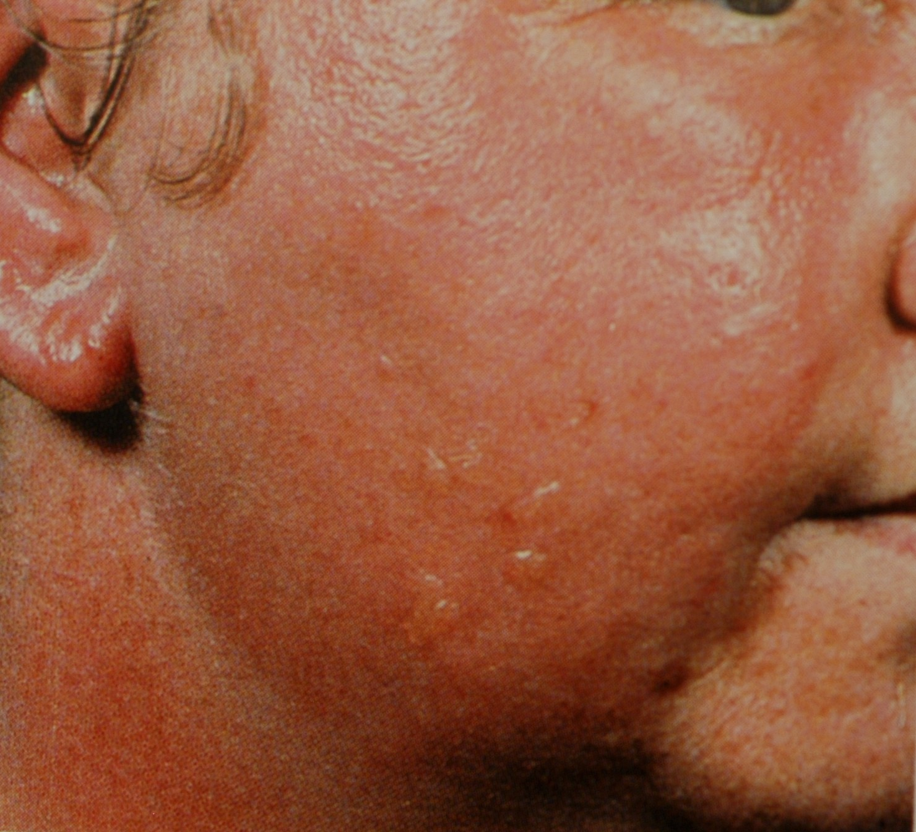
Cellulitis

Slide 11
Cellulitis

Slide 12
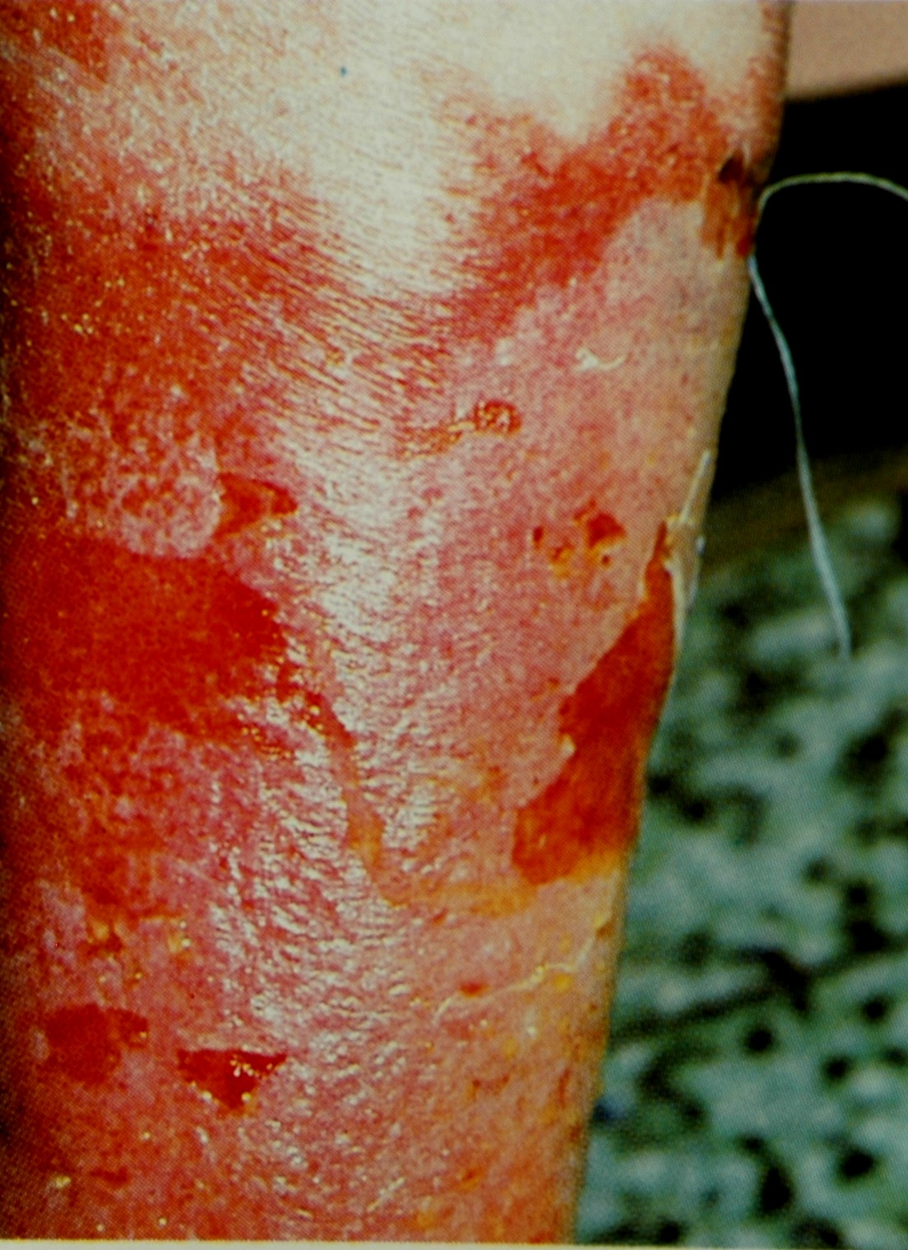

Slide 13
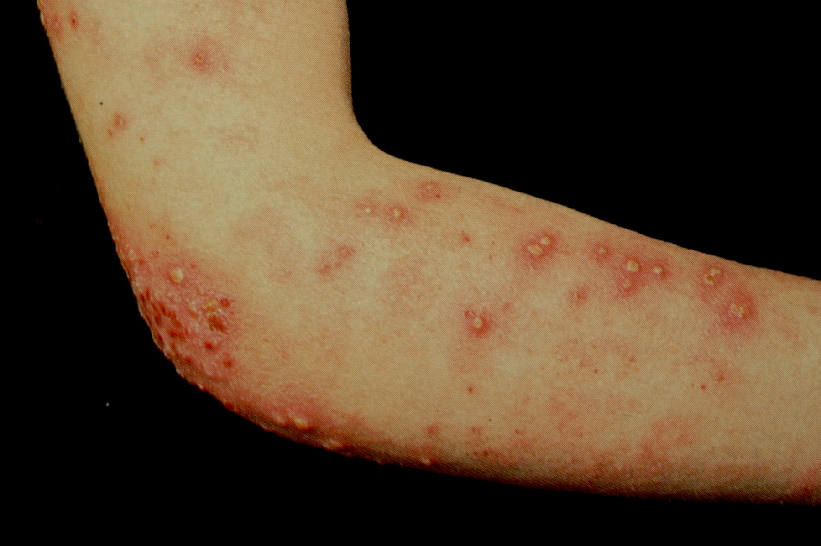

Slide 14
Folliculitis

Slide 15
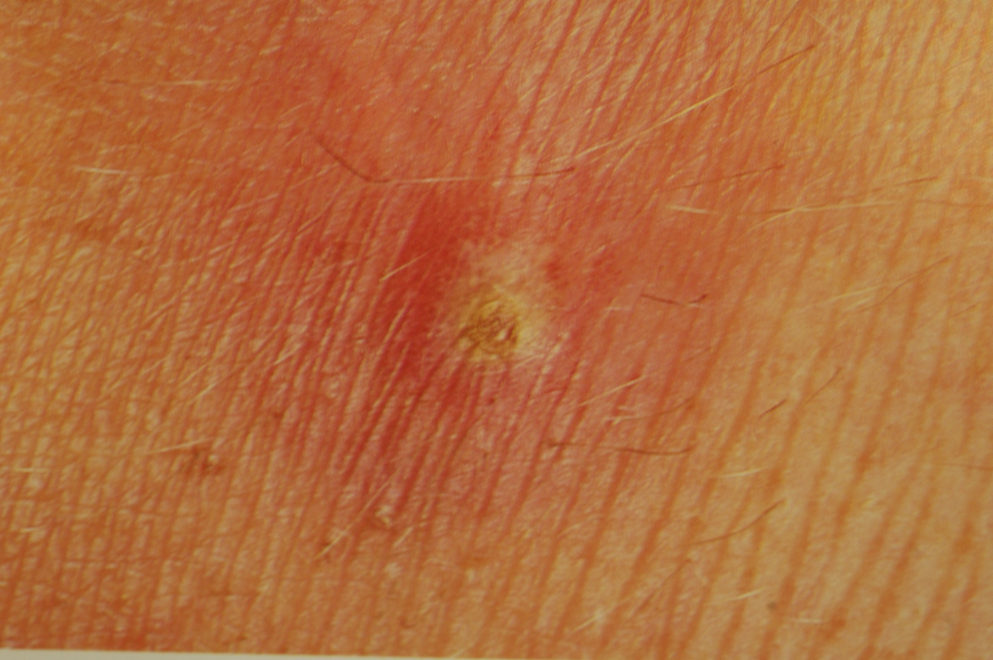
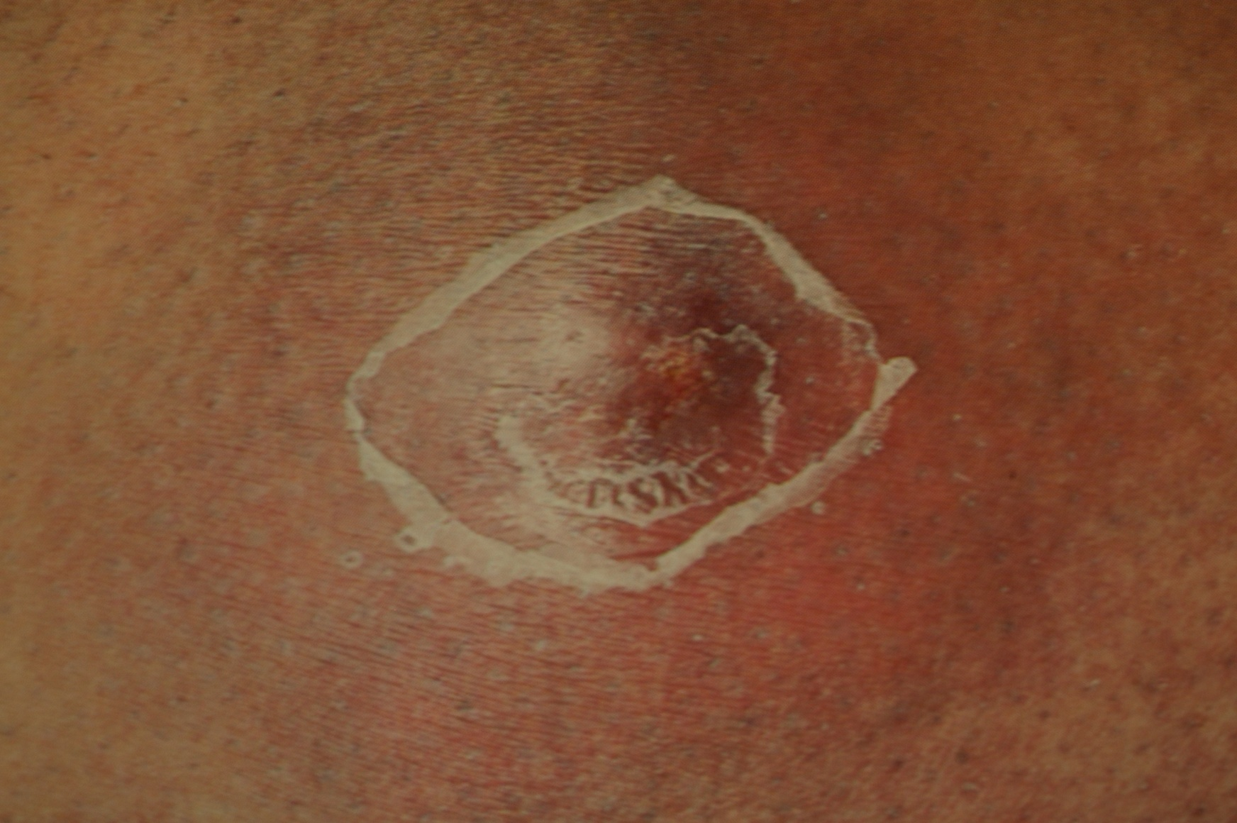
Furuncle
Carbuncle

Slide 16
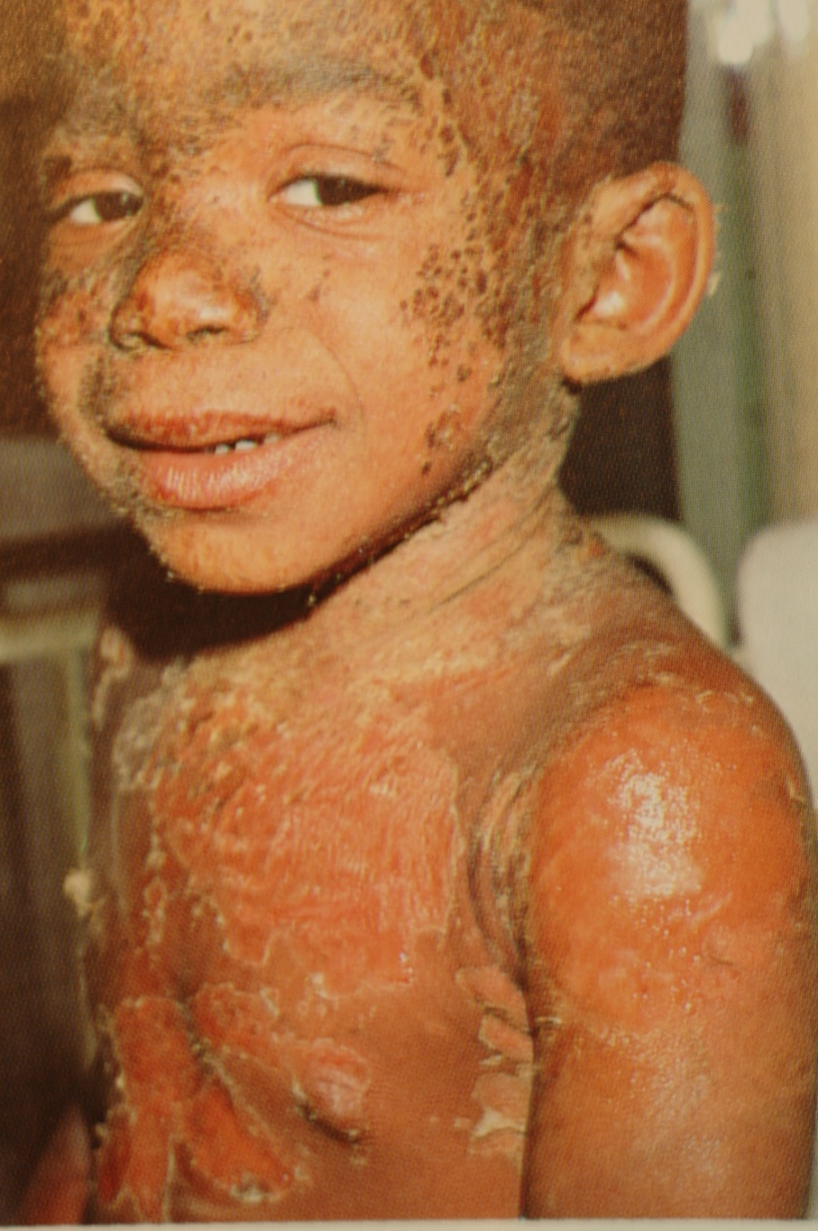
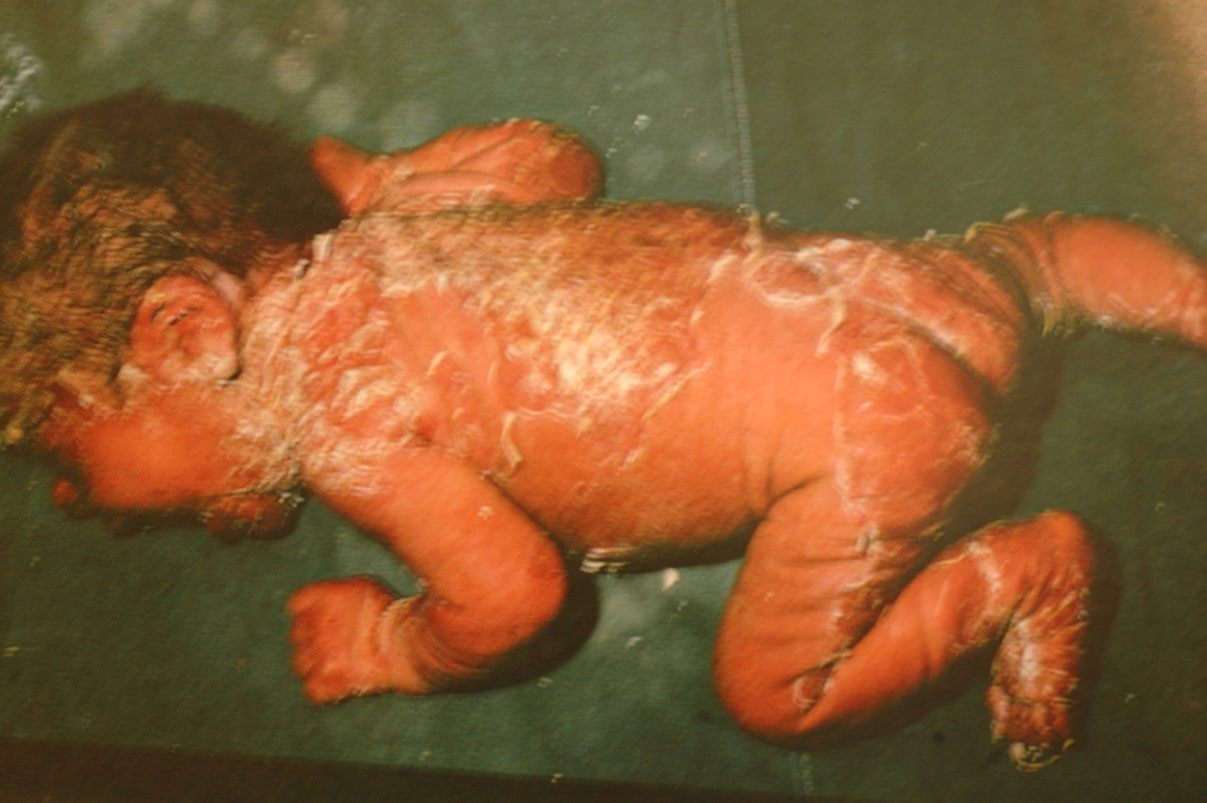
Staph Skin Scalded Syndrom (SSSS)

Slide 18
VIRAL INFECTIONS

Slide 20
Warts(HPV)

Slide 21
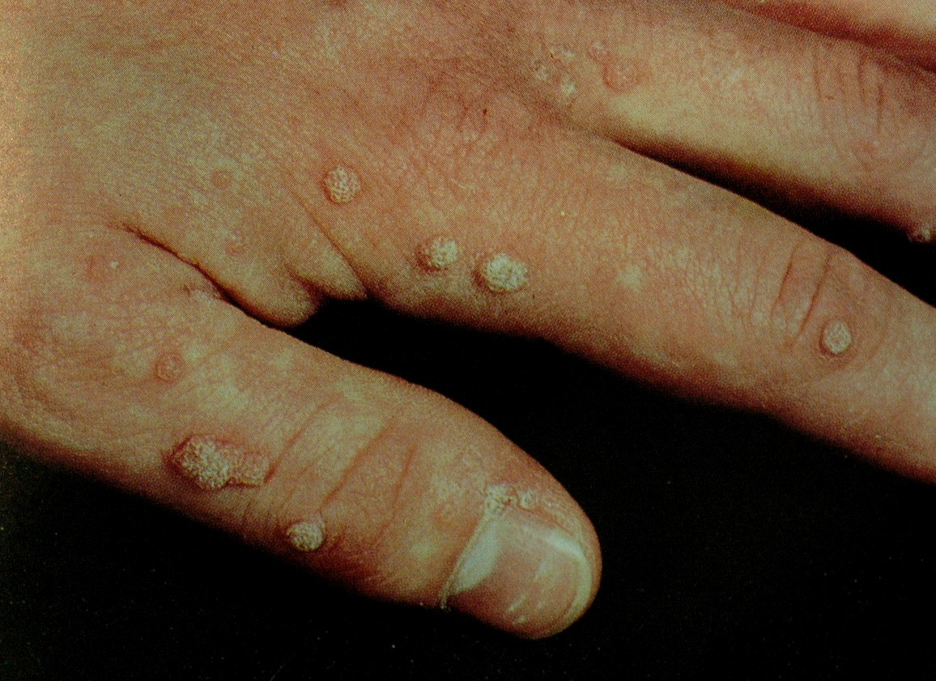
Warts

Slide 22
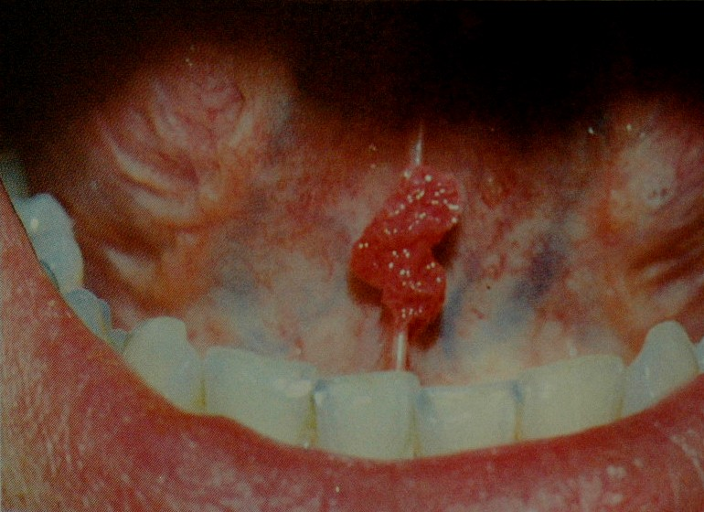
Warts

Slide 23
Warts

Slide 24
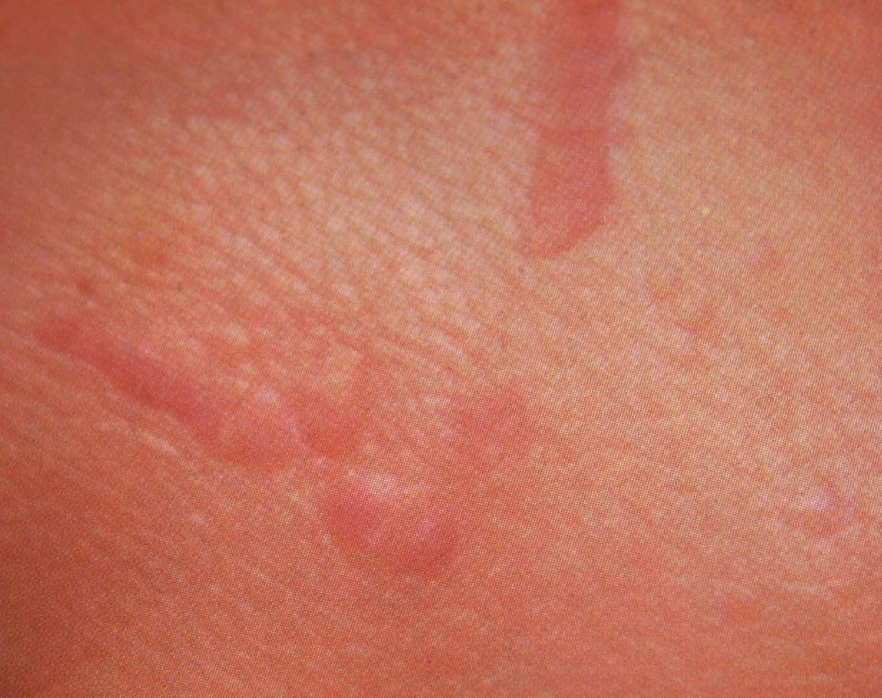
Plane warts

Slide 25
Warts (Condyloma acuminata)

Slide 27
Molluscum Contagiosum (Poxivirus)

Slide 28
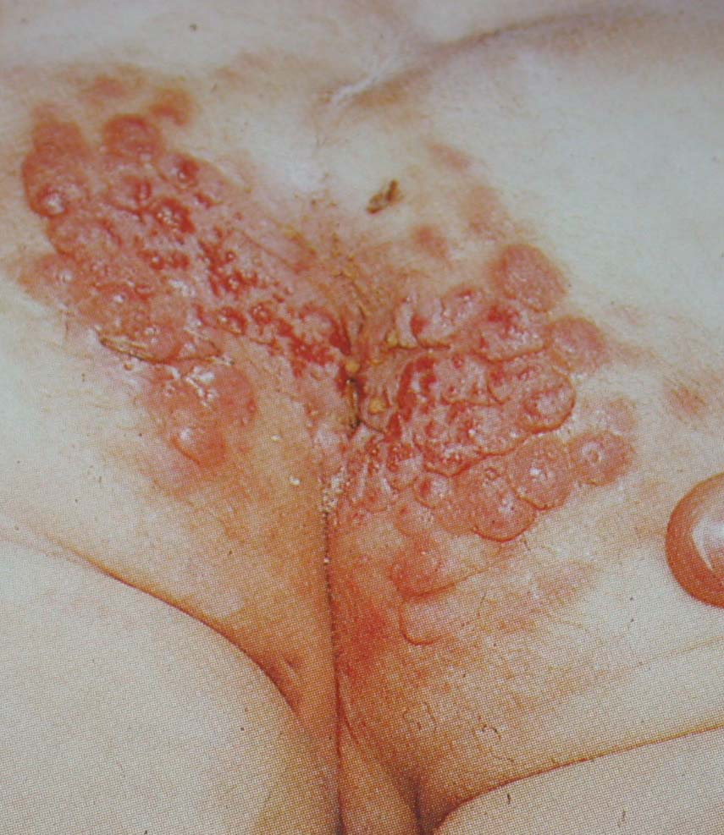
Molluscum Contagiosum

Slide 31
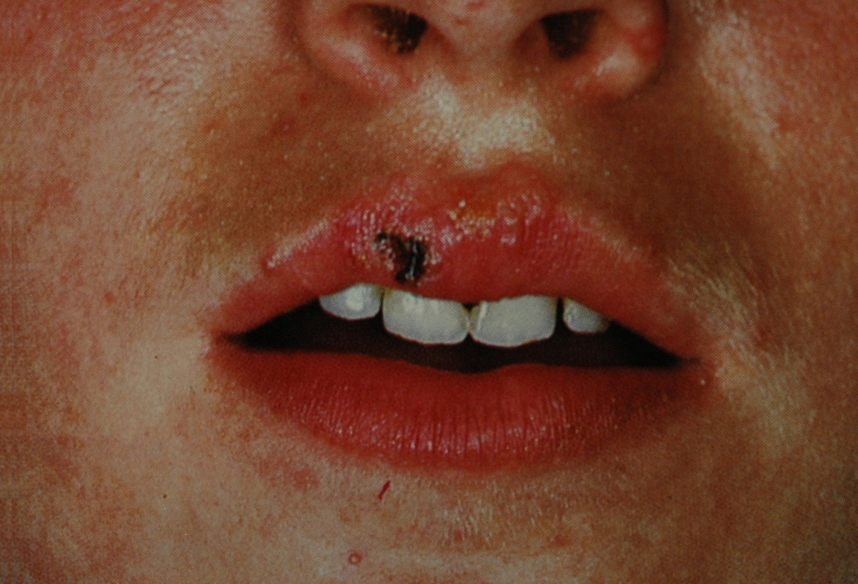
Herpes Simplex (HSV I)

Slide 32
Eczema Herpeticum

Slide 34
Herpes Simplex (HSV II)

Slide 35
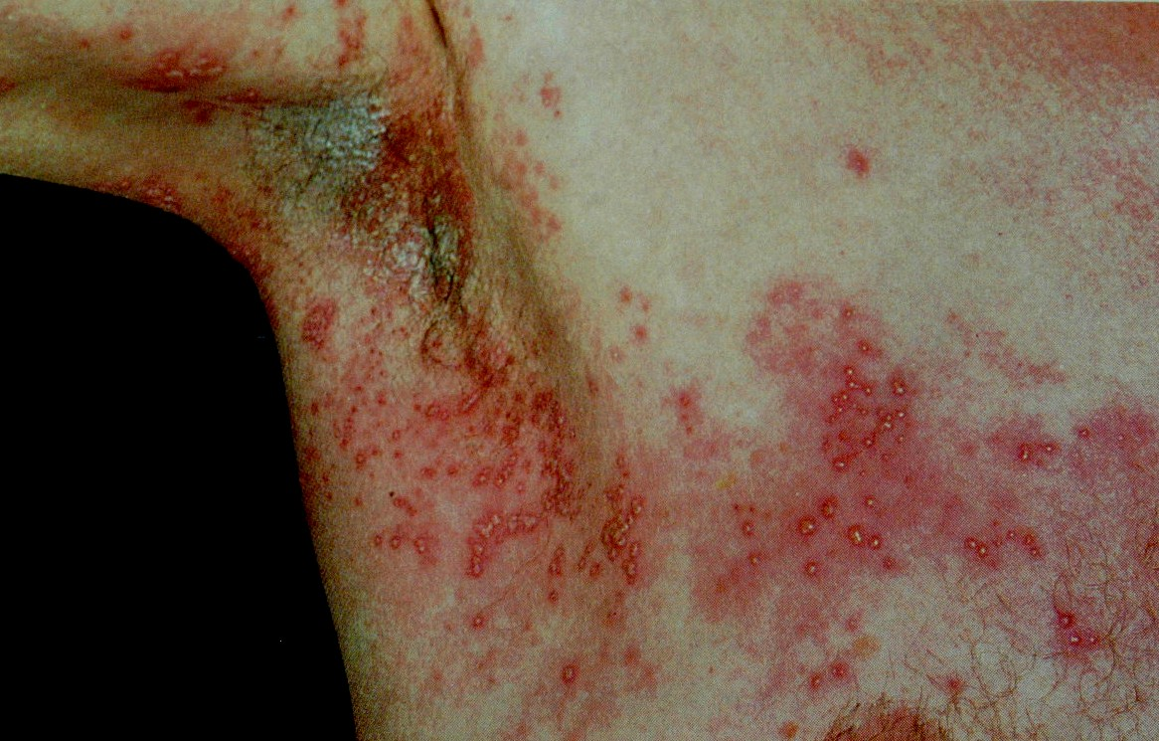
Herpes Zoster

Slide 36
Herpes Zoster

Slide 38
Varicella (Chicken pox)

Slide 39
Measles
Measles

Slide 40
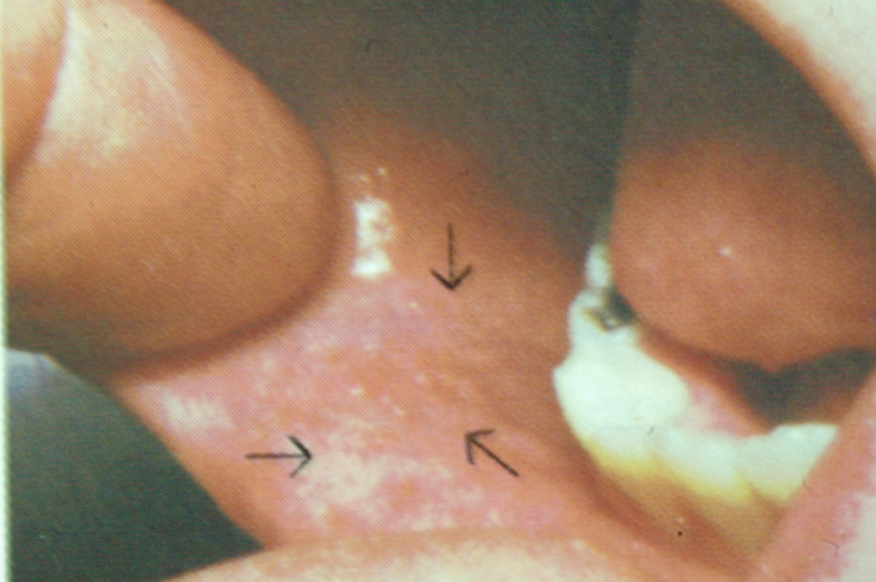
Measles

Slide 42
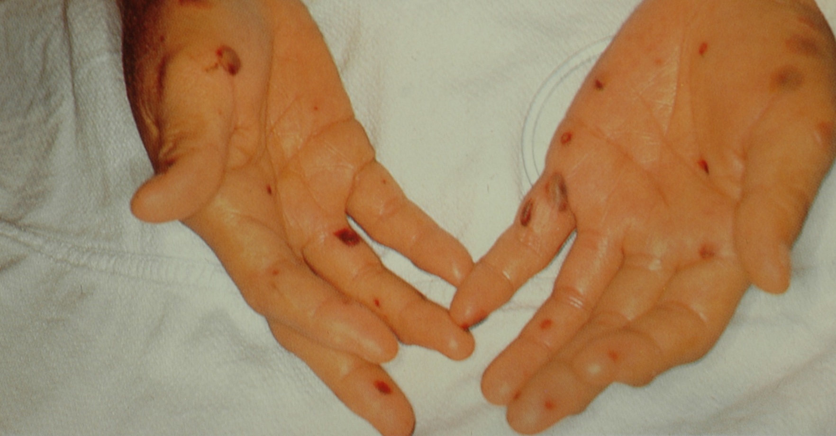
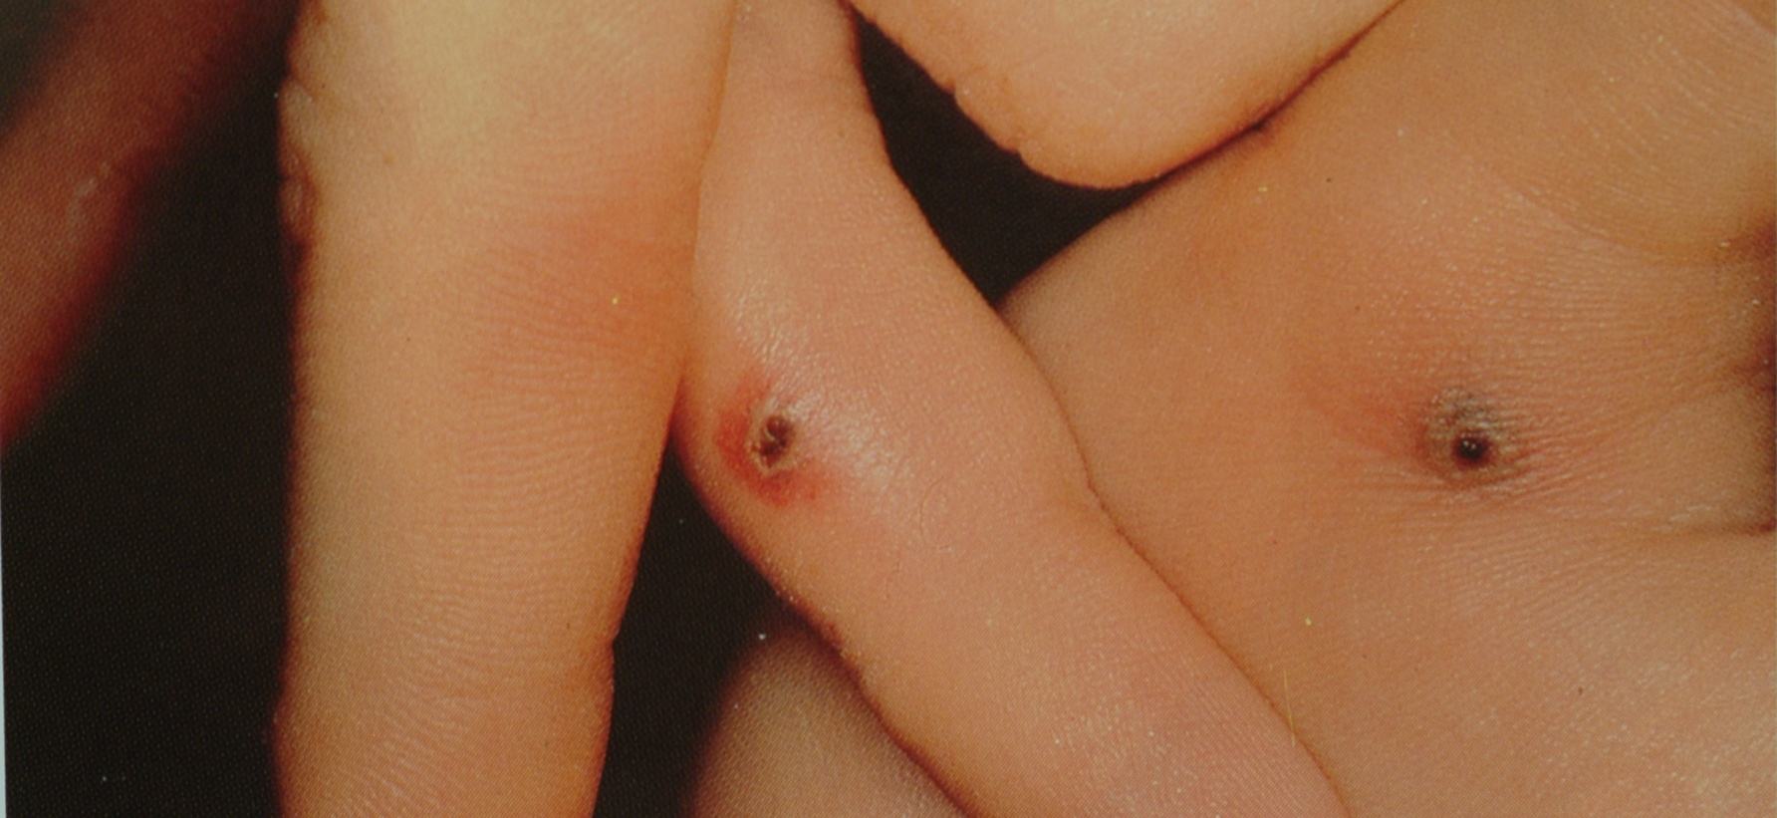
Maningococcimia

Slide 45
Fungal INFECTIONS

Slide 46
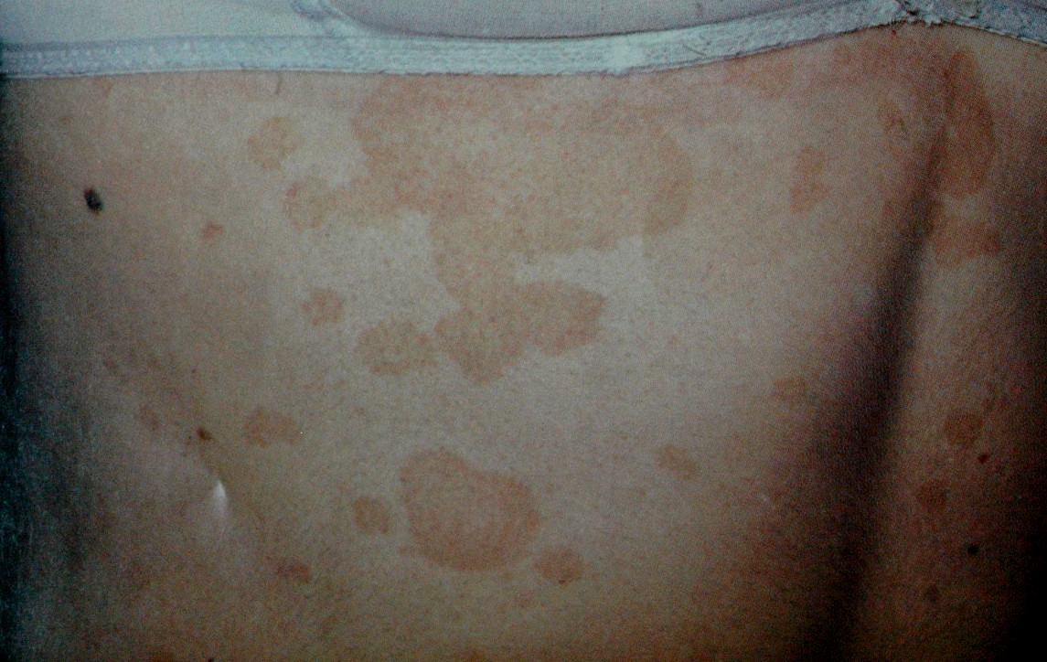
Tinea Versicolor

Slide 47
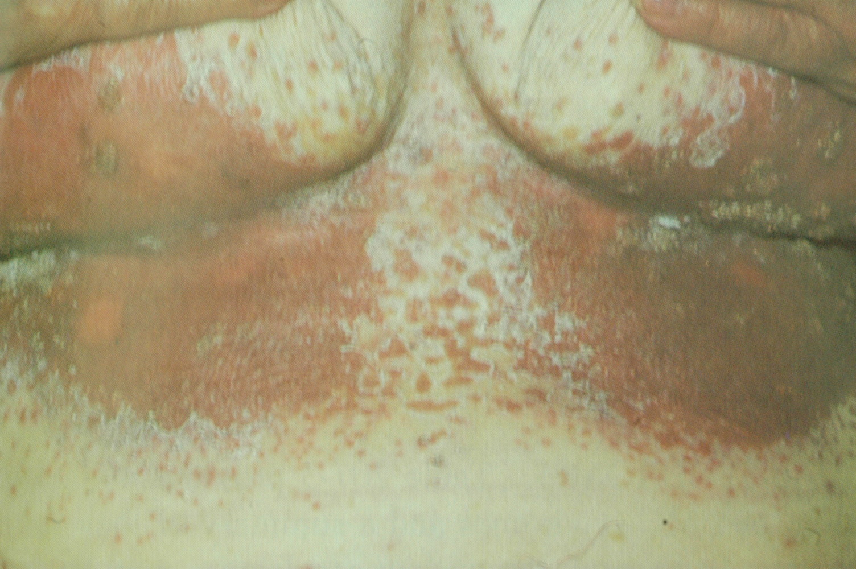
Candida Infection (intertrigo)

Slide 48
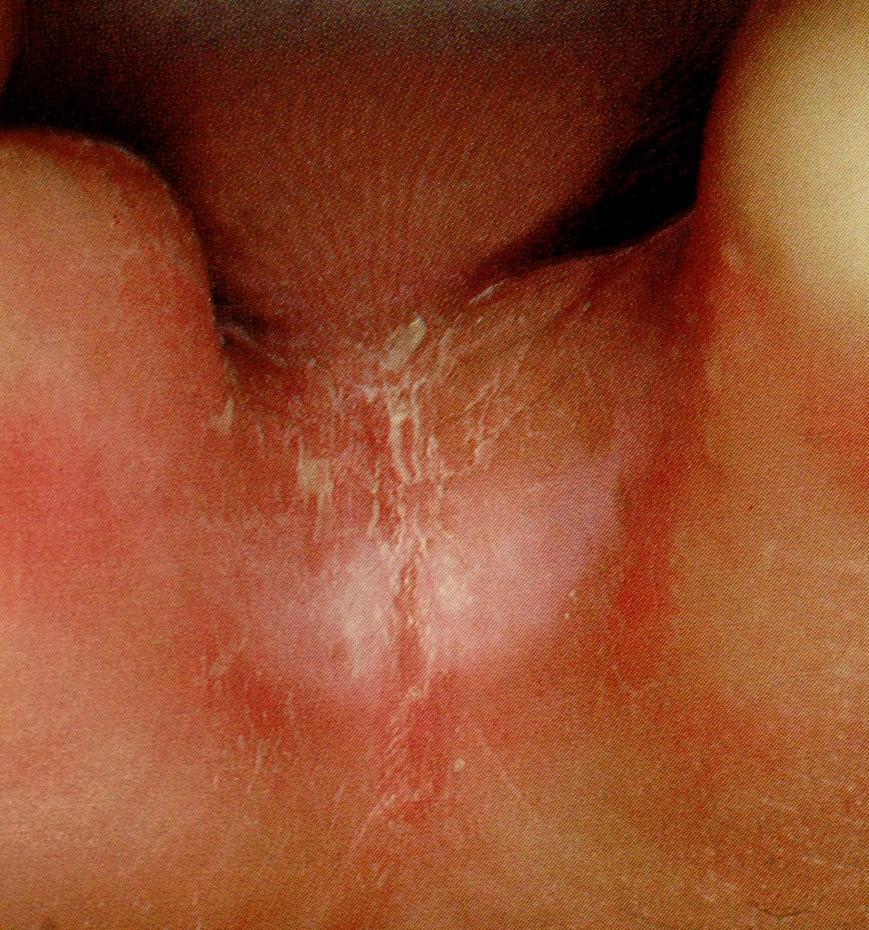
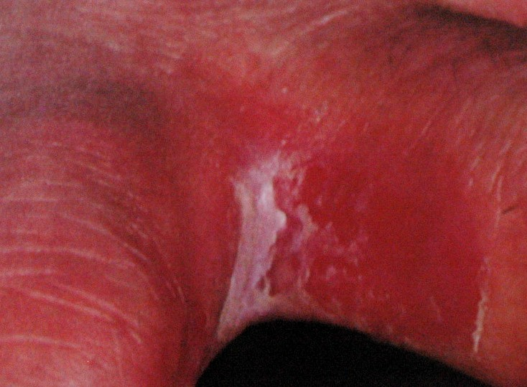
Tinea Pedis

Slide 49
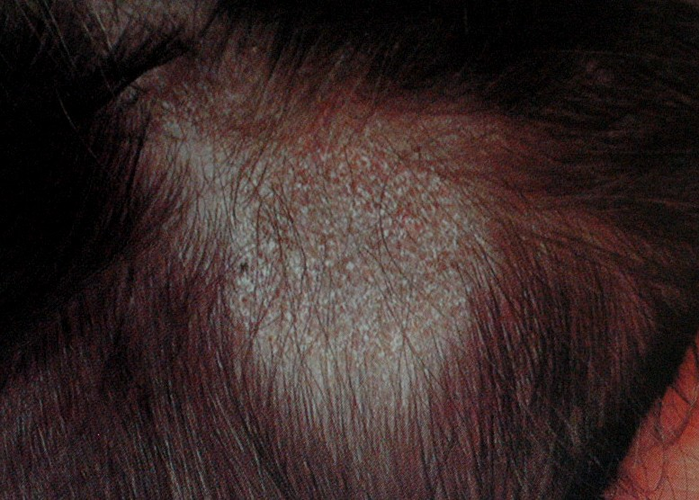
Tinea Capitis

Slide 50
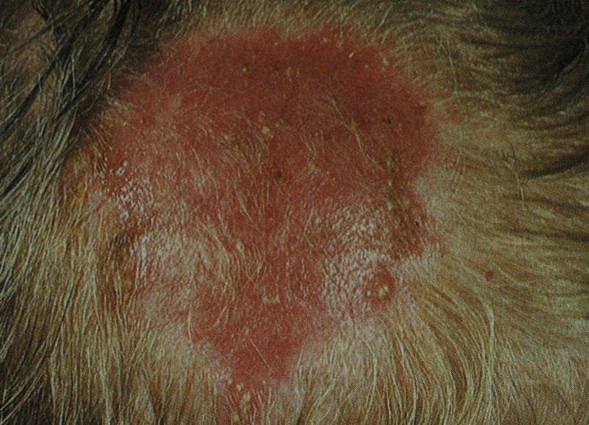
Tinea Capitis

Slide 51
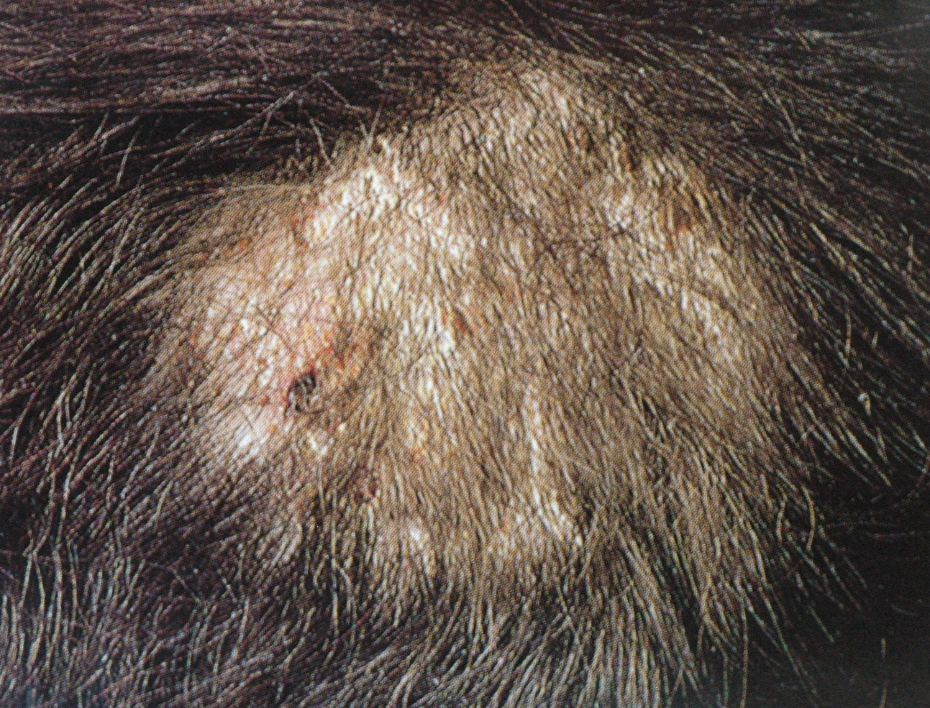
Tinea Capitis

Slide 52
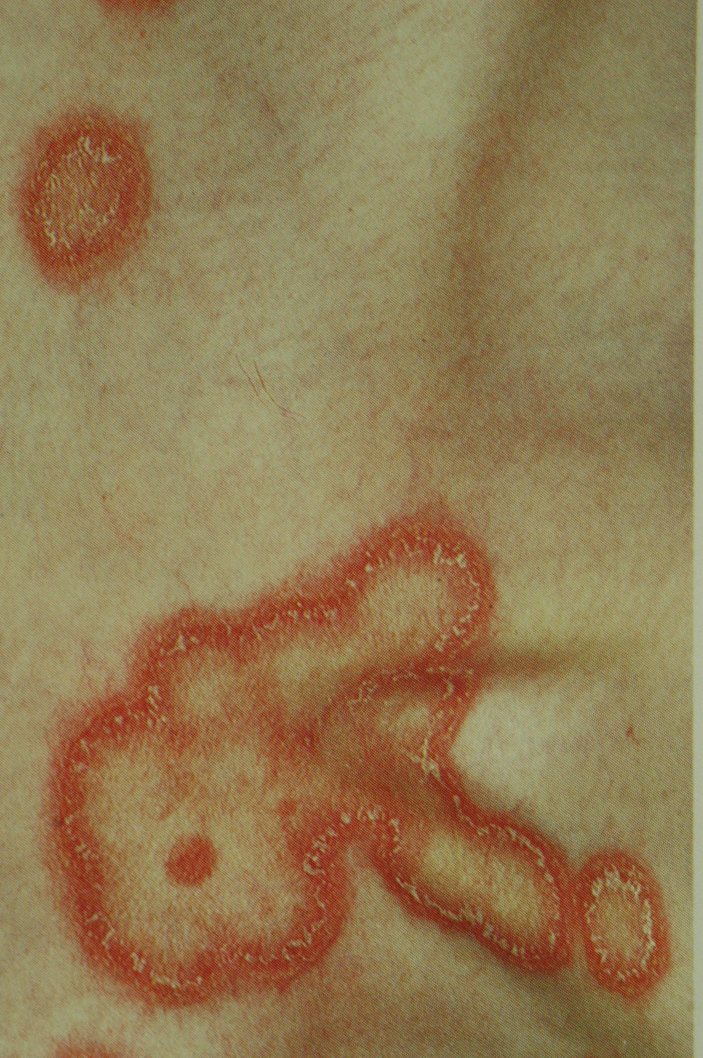
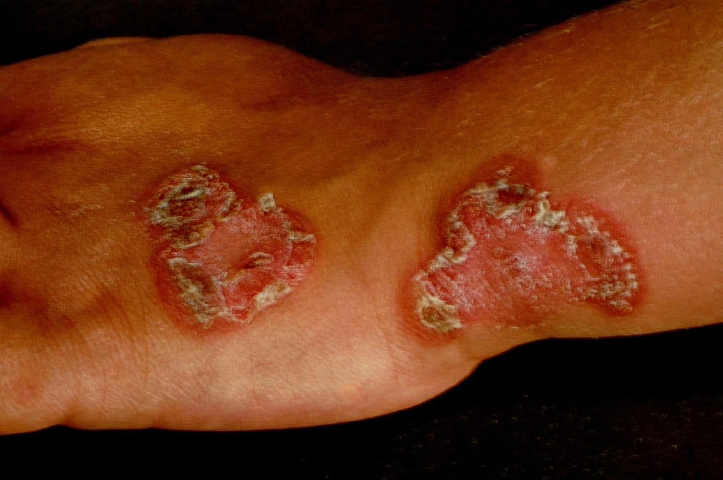
Tinea Corporis

Slide 54
INFESTATIONS

Slide 55
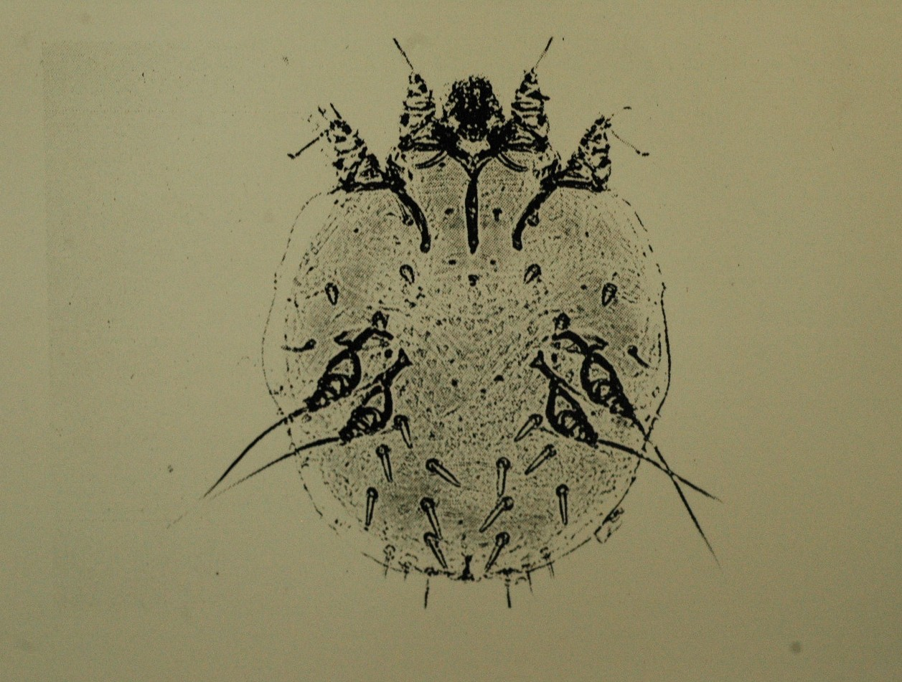
Scabies

Slide 56
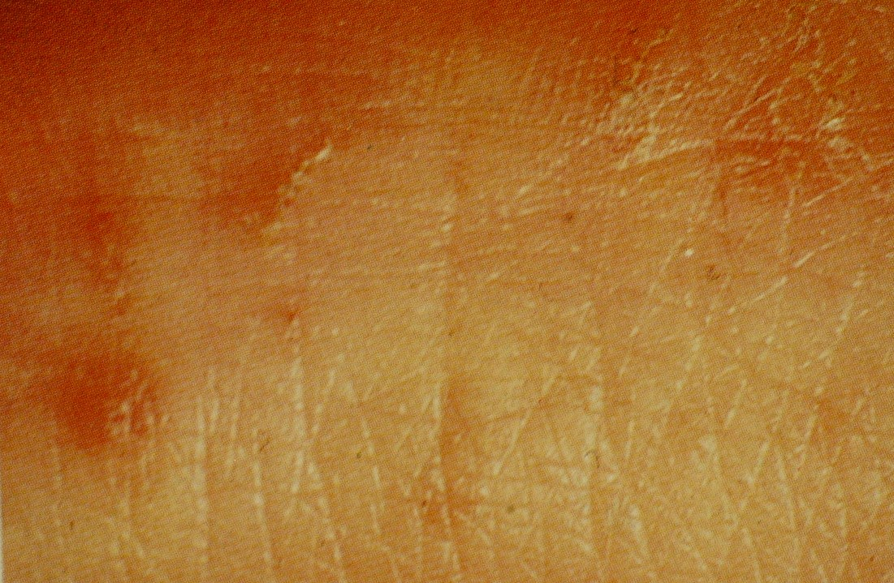
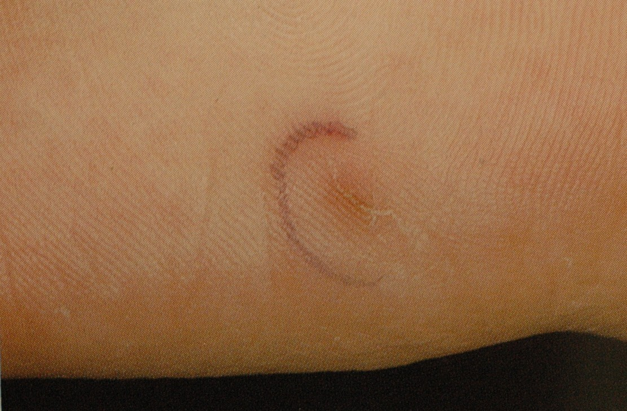
Scabies

Slide 57
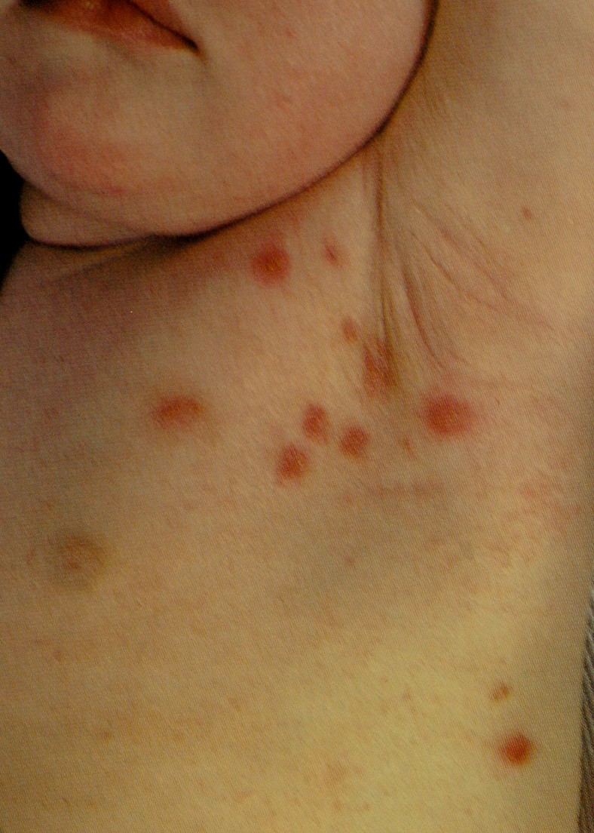

Slide 58
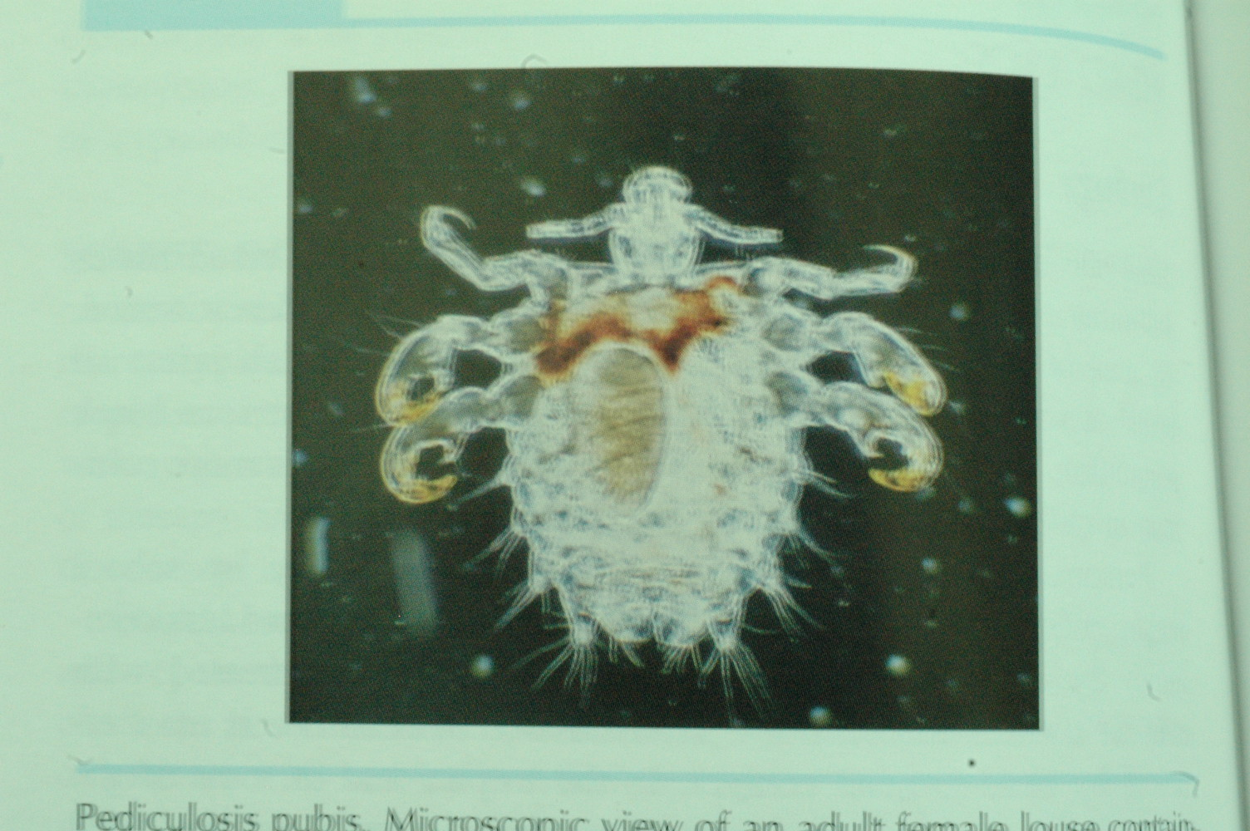
Pediculosis

Slide 59
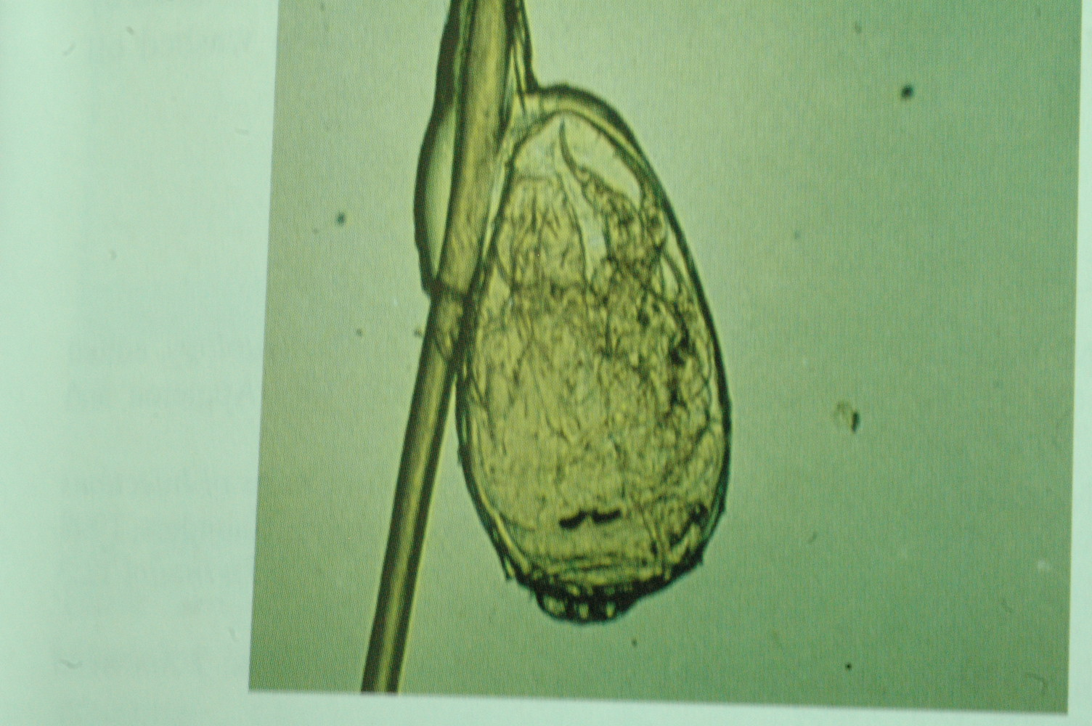

Slide 60
Quiz?!

Slide 61
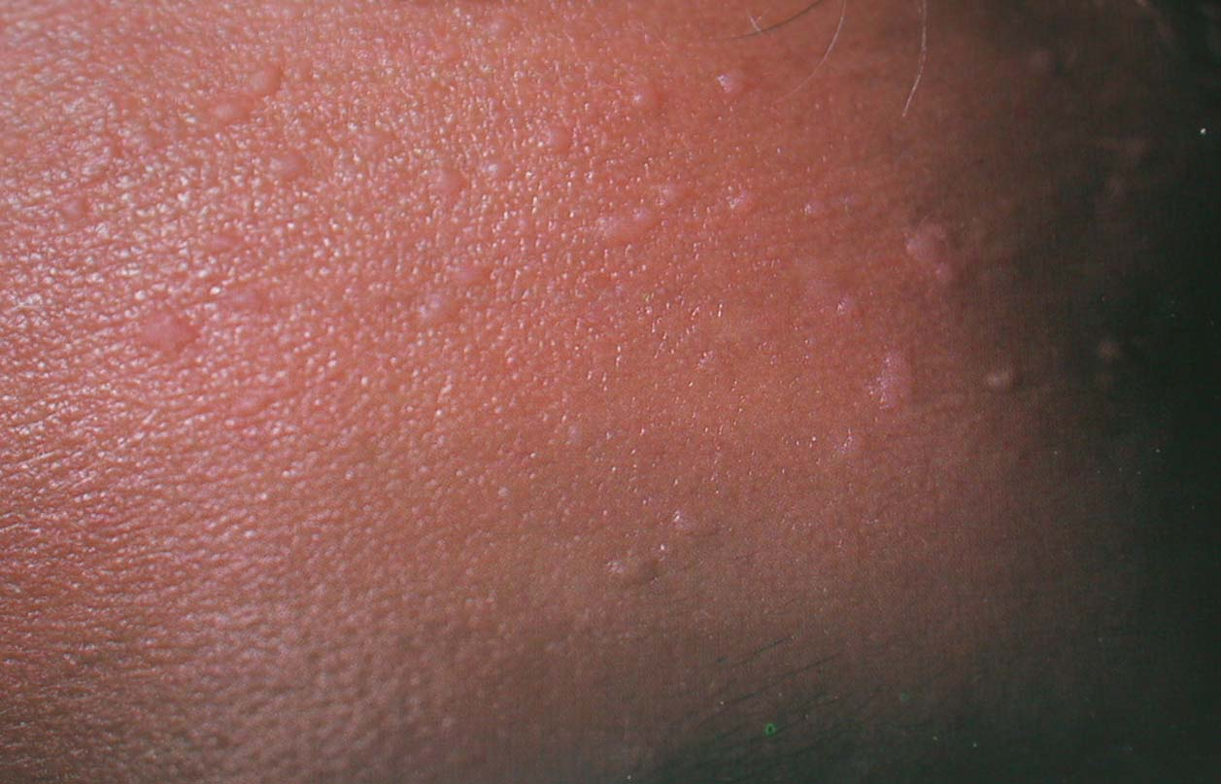
Plane wart

Slide 62
Wart

Slide 63
Cellulitis

Slide 64
Impetigo

Slide 65
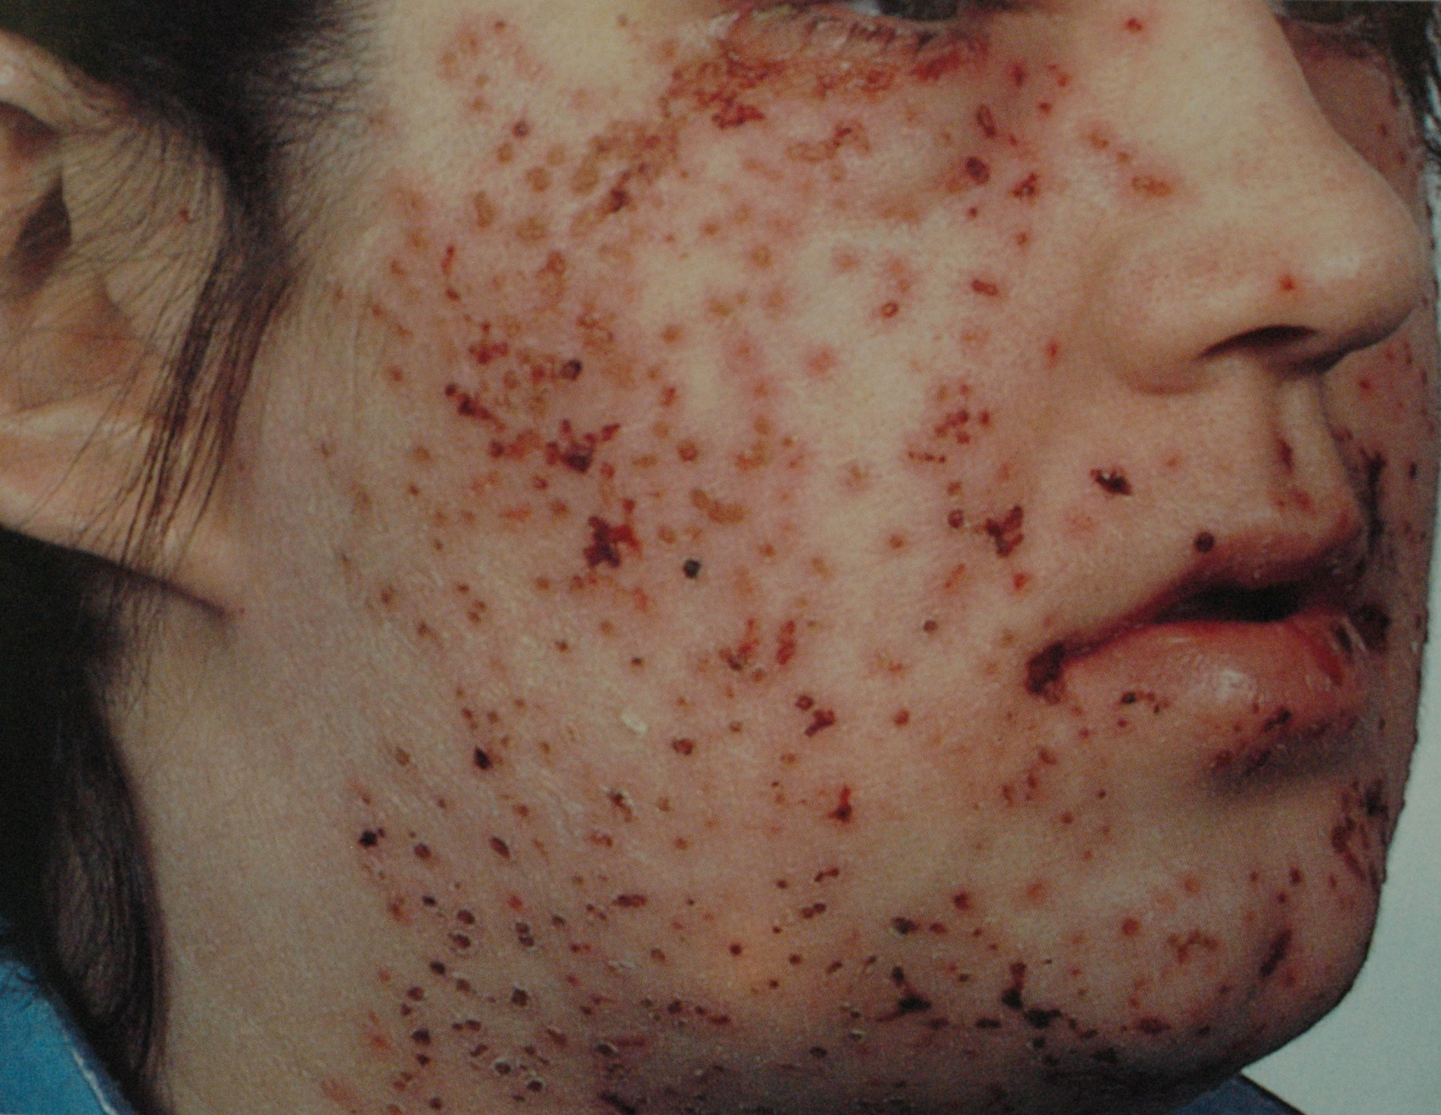
Eczema Herpeticum

Slide 66
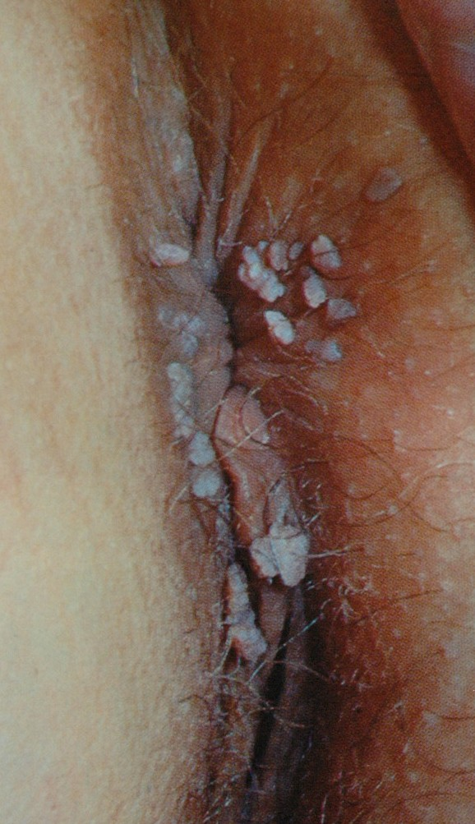
Condyloma Acuminata

Slide 67
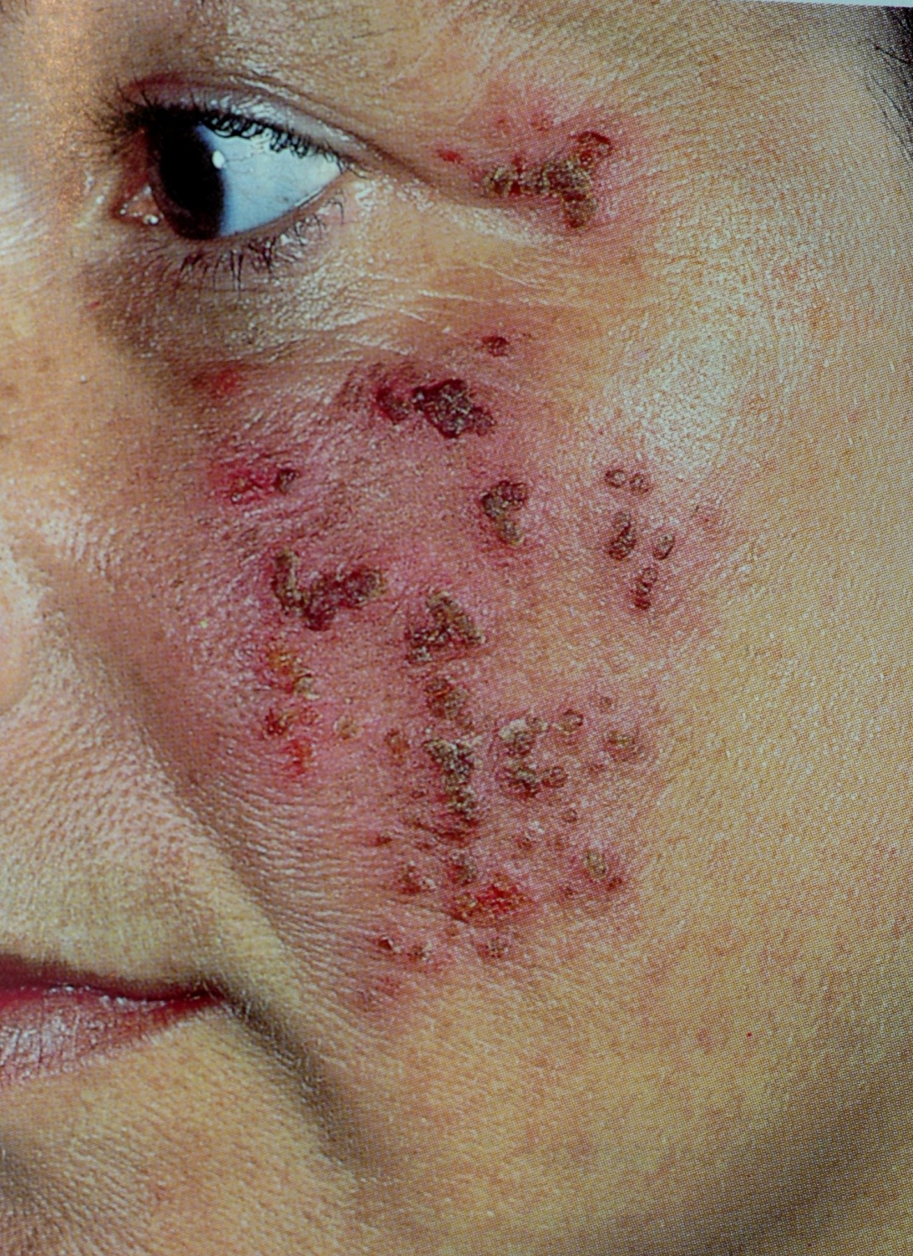
HSV I

Slide 68
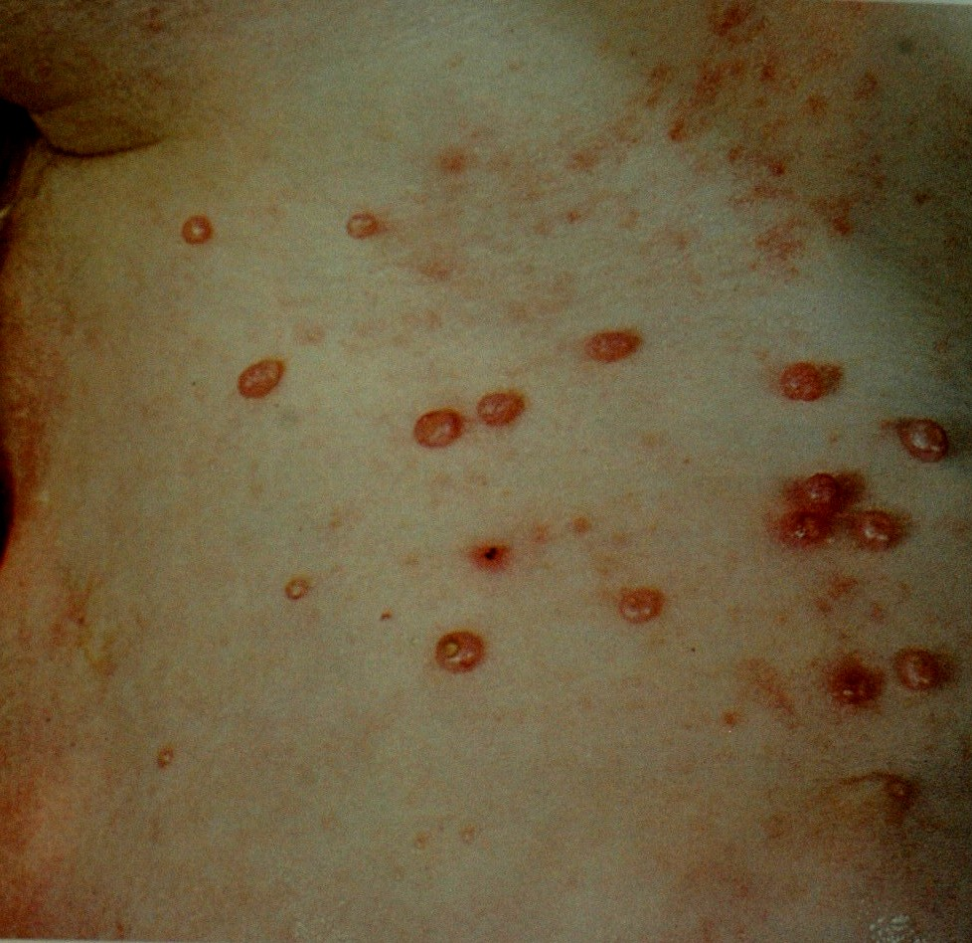
Mollascum Contagiosum

Slide 69
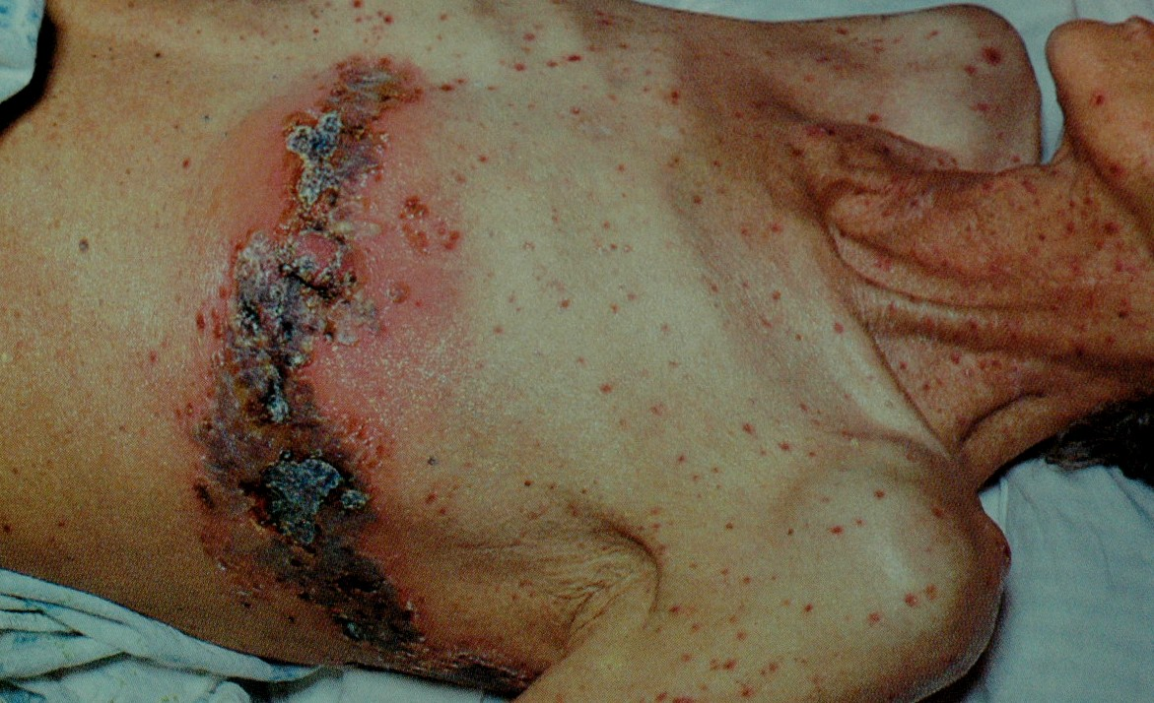
Herpes Zoster

Slide 70
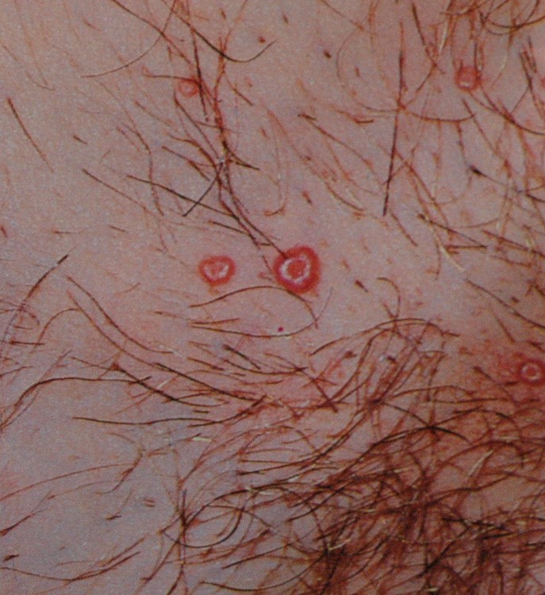
Molluscum Contagiosum

Slide 71
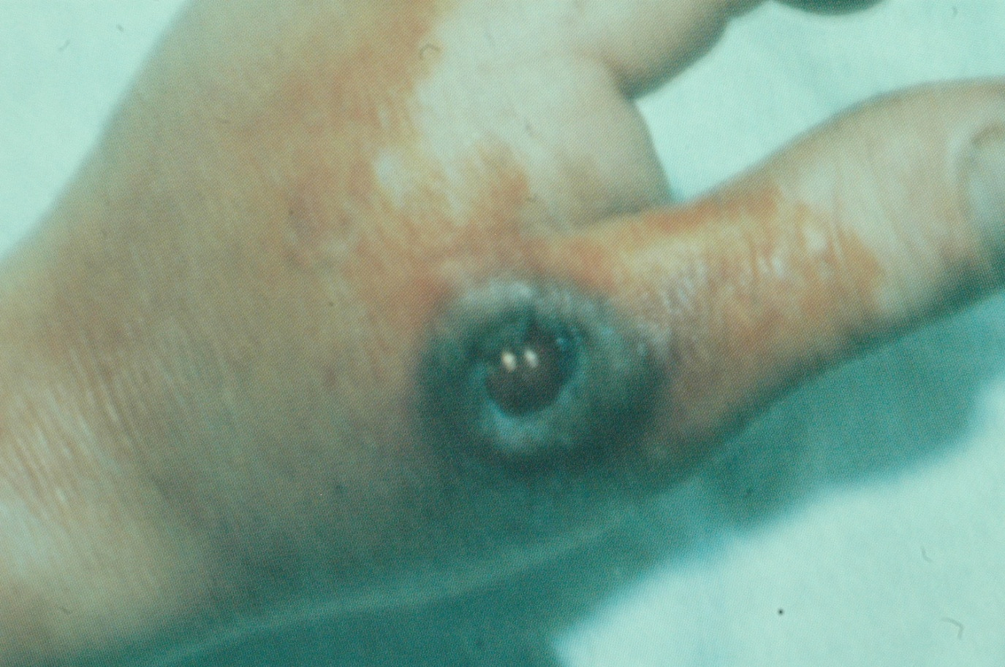
Anthrax

Slide 72
Thank you

