Slide 1
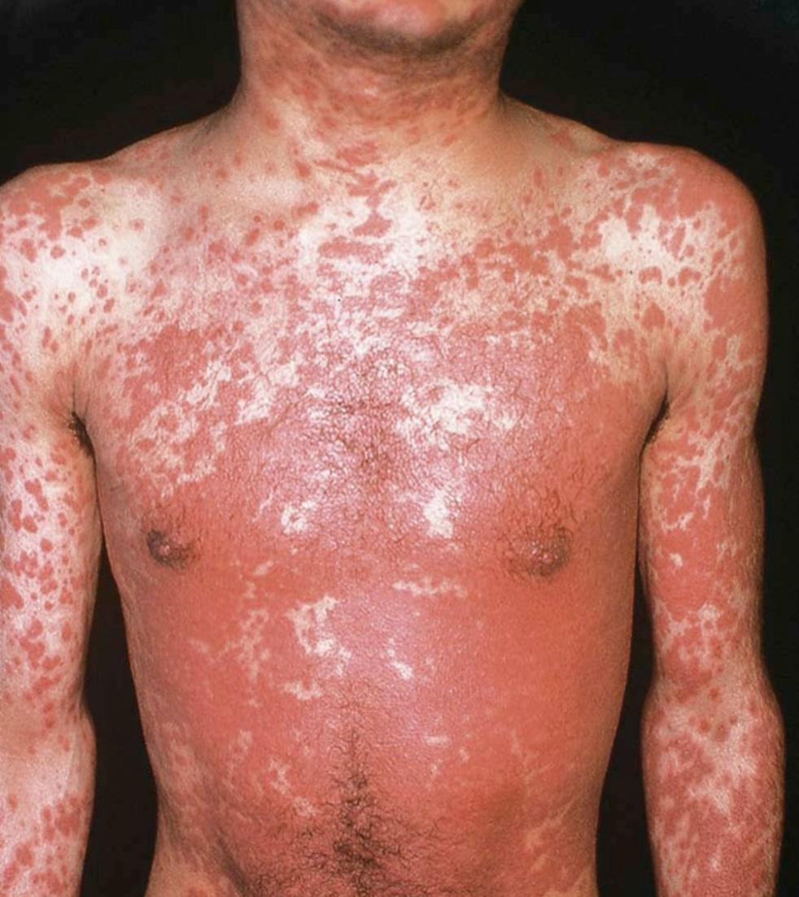
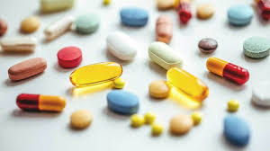
Drug Eruptions
Abdulaziz Madani, M.D
Assistant professor, consultant
Department of Dermatology, College of medicine
King Saud university

Slide 2
Introduction
The skin is one of the most common targets for adverse drug reactions.
1-5% of patients receiving antibiotics and anticonvulsants may develop a drug eruption.
~2% of all drug-induced skin reactions are considered ‘’serious’’
Skin reactions to drugs are responsible for ~3% of all disabling injuries that occur during hospitalizations.
Either due to:
Immunologic response
Non-immunologic (Overdose, side effect, drug-drug interaction, metabolism…etc)

Slide 3
Diagnostic approach for drug eruptions
Clinical characteristics
Type of primary lesion
Distribution and number of lesions
Mucous membrane involvement, facial edema
Associated signs and symptoms.
Chronological factors
Document all drugs to which the patient has been exposed
Date of eruption, time interval..
Literature search

Slide 4
Major drug-induced eruptions
Exanthematous eruptions
Urticaria
Anaphylaxis
Fixed drug eruption
Acute generalized exanthematous pustulosis (AGEP)
Drug reaction with eosinophilia and systemic symptoms (DRESS)
Stevens-Johnson syndrome (SJS)
Toxic epidermal necrolysis (TEN)

Slide 5
Exanthematous Drug Eruptions
The most common drug reaction affecting the skin.
Classically begins 7 to 14 days after the start of a new medication.
Begins as erythematous macules (symmetric) that sometimes becomes palpable.
Begins on the trunk and upper extremities and progressively becomes confluent.
Mucous membranes are usually spared.
Pruritis and low-grade fever and often present.
The eruption disappears spontaneously after 1-2 weeks without complications.
The following classes of drugs have a significantly higher incidence: Aminopenicillins, Sulfonamides, Cephalosporins and anticonvulsants.

Slide 6
Notes:
Numerous pink papules on the trunk due to a cephalosporin (A). Confluence of lesions on the trunk (B) and annular plaques on the forehead (C) secondary to phenobarbital.

Slide 7
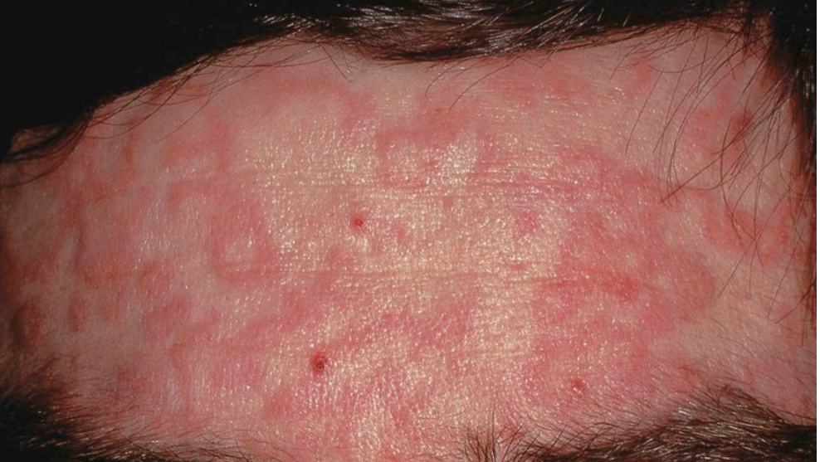
Notes:
Numerous pink papules on the trunk due to a cephalosporin (A). Confluence of lesions on the trunk (B) and annular plaques on the forehead (C) secondary to phenobarbital.

Slide 8
Exanthematous Drug Eruptions
Always look for the following:
Edema of the face + blood eosinophilia (DRESS)
Mucous membrane lesions or painful dusky skin (SJS, TEN)
Histology:
Nonspecific changes, eosinophils may be present.
The major DDx
Viral exanthem (often indistinguishable)
Drug etiology favored in adults, viral favored in pediatric patients.
The presence of peripheral blood eosinophilia favors a drug reaction.
Treatment:
Supportive
Discontinue the offending drug. (risk vs benefit)
Topical antipruritics and corticosteroids may help to alleviate pruritis.

Slide 9
Urticaria, Angioedema and Anaphylaxis
Urticaria:
Transient erythematous and edematous papules and plaques that are usually associated with pruritis.
They can appear anywhere in the body including palms,soles and scalp.
Duration is usually a few hours to 24 hours.
Skin is normal after they resolve.
Acute: Less than 6 weeks. Chronic: Persist longer.
Drugs associated with <10% of all cases of urticaria (acute > chronic)
Mostly antibiotics (Penicillins, cephalosporins).
Tx: Discontinue drug, Antihistamines.

Slide 10
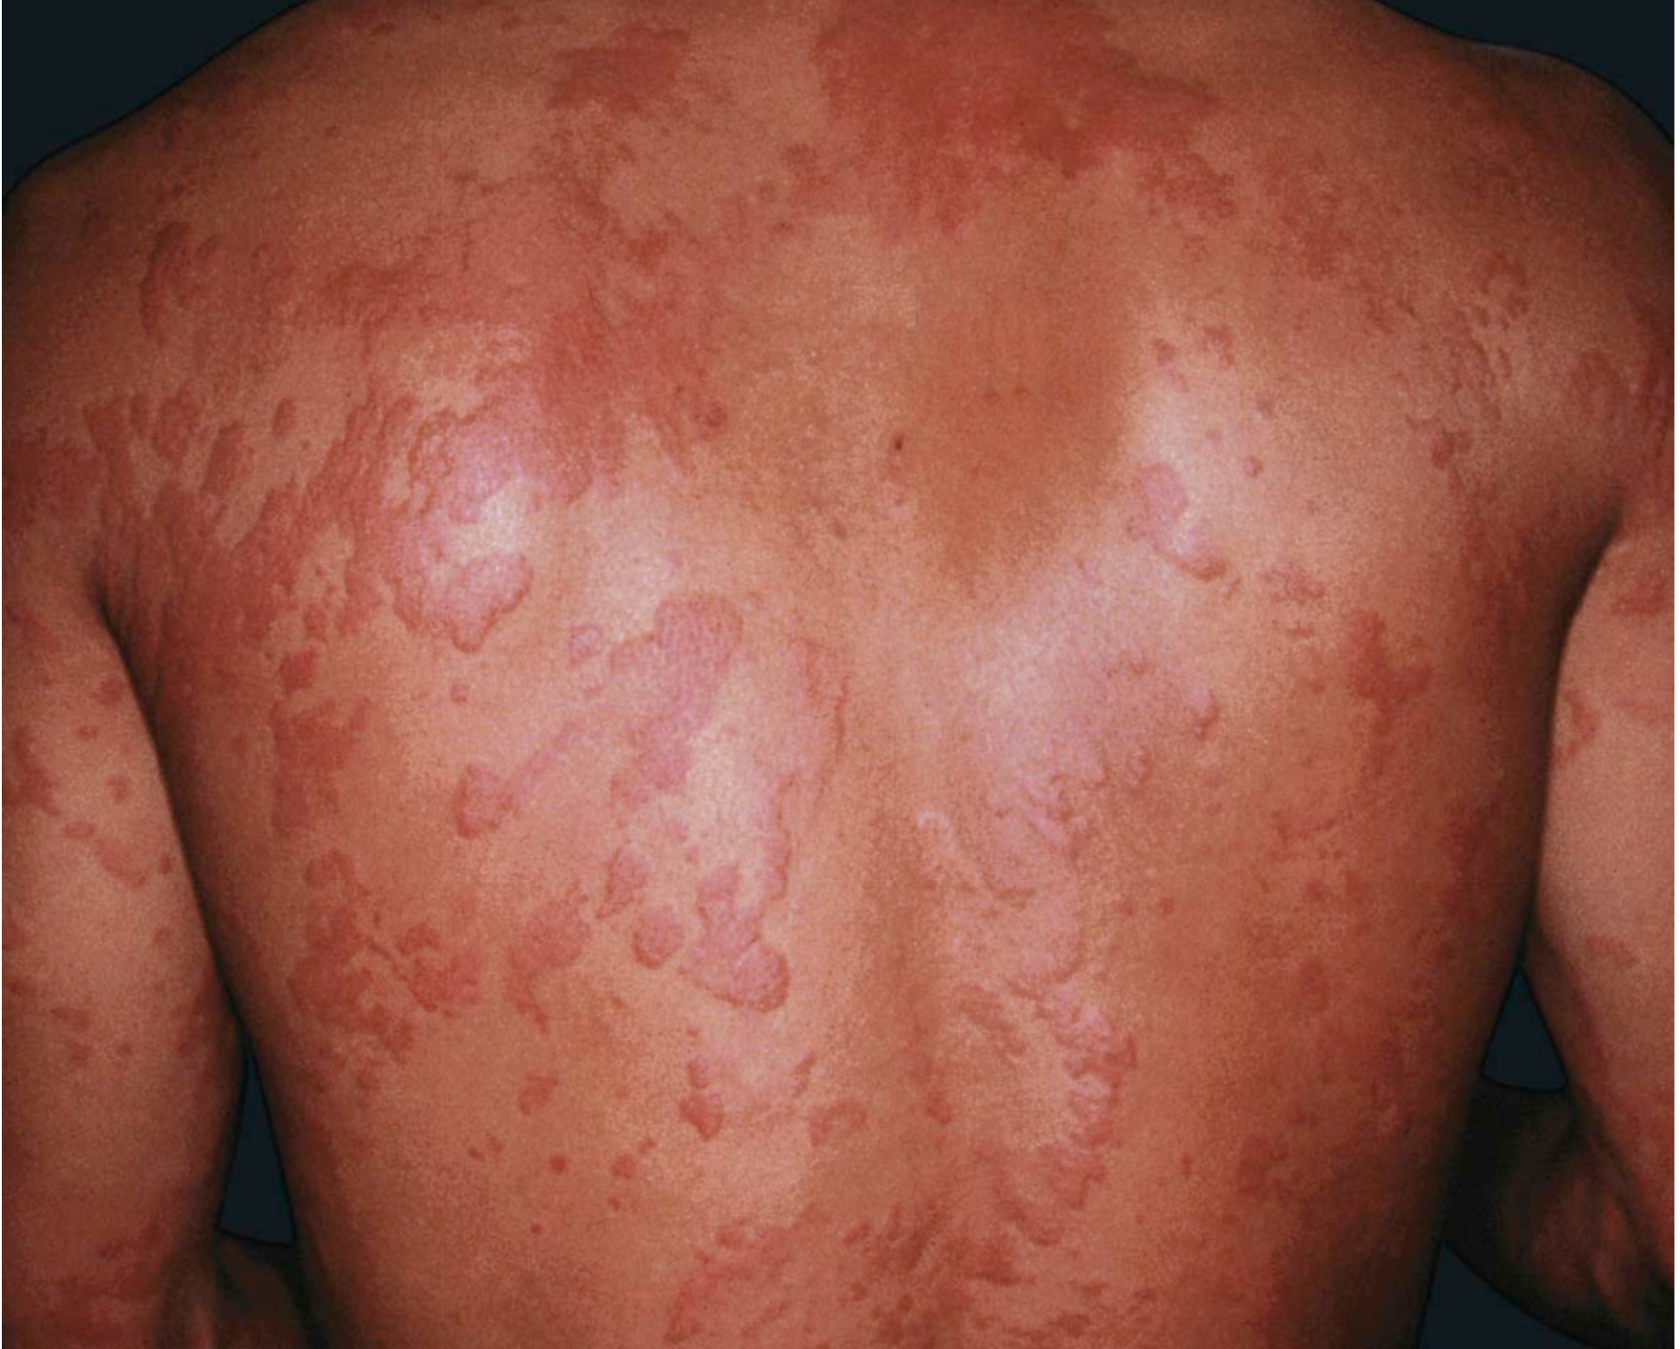
Notes:
Urticaria secondary to penicillin.
Several of the lesions have a figurate appearance.

Slide 11
Urticaria, Angioedema and Anaphylaxis
Angioedema:
Transient edema of the dermal, subcutaneous and submucosal tissue.
Associated with urticaria in 50% of cases.
May be complicated by life-threatening anaphylaxis.
ACE inhibitors (1 day to several years after starting)
Usually on the face (eyelids, lips), less often on genitals and extremities.
Unilateral or asymmetric.
Can involve the larynx, epiglottis, oropharynx and intestinal wall.
ACE inhibitors, Penicillins and NSAIDs.

Slide 12
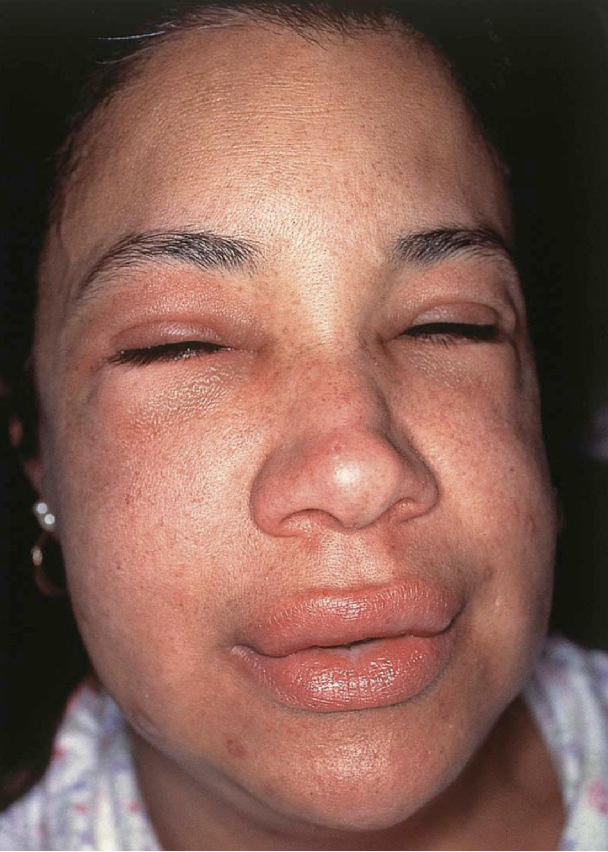

Slide 13
Urticaria, Angioedema and Anaphylaxis
Anaphylaxis:
An acute life-threatening reaction that can results from exposure to a number of drugs.
Penicillin (1 per 5000)
Combines skin with systemic manifestations (hypotension, tachycardia).
Serious cases tend to appear within minutes and more common with parenteral administration as compared to oral ingestion.
Treatment:
Discontinue drug and strict avoidance in the future.
Systemic steroids
SubQ epinephrine in cases of life-threatening angioedema or anaphylaxis.

Slide 14
Photosensitivity

Slide 15
Photosensitivity
Cutaneous photosensitivity may be:
Idiopathic
Due to endogenous photosensitizers (Porphyrins)
Due to Exogenous photosensitizers (Medications)
The photosensitivity drug reactions are classically divided into 2 major types:
1- Phototoxic (more common)
2- Photoallergic

Slide 16
Phototoxicity
Fairly common and predictable.
Can occur in any person who receives a sufficient amount of a phototoxic drug together with sufficient exposure to UVR.
Clinically: an exaggerated sunburn in a shorter than expected time.
Limited to sun-exposed areas and followed by hyperpigmentation.
Most common drugs: Tetracyclines (doxycycline), NSAIDs, Fluoroquinolones.
Administring a short half-life drug in the evening decreases the risk.

Slide 17
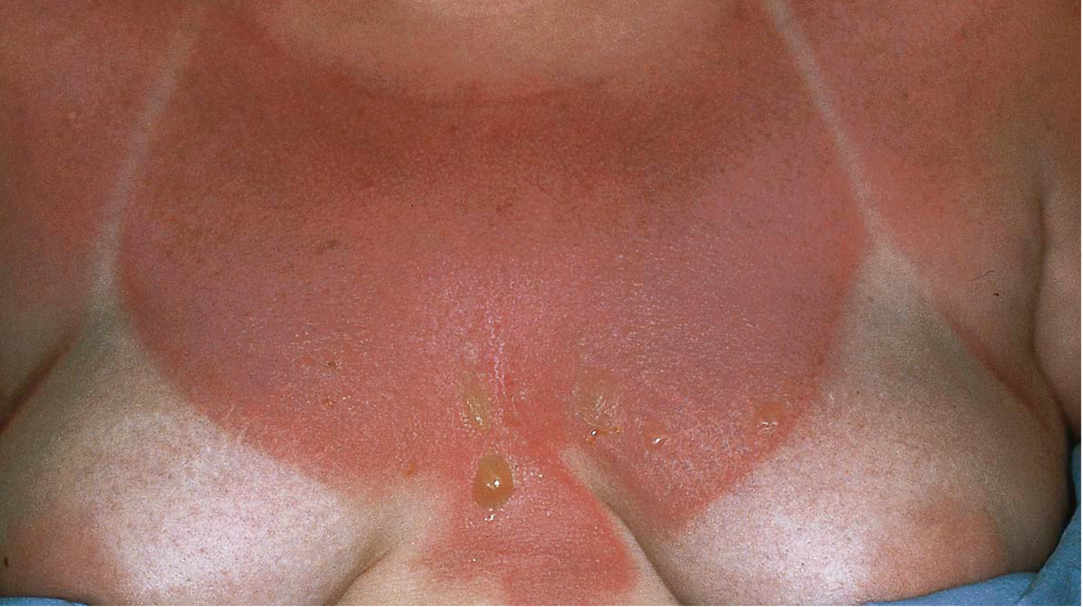
Notes:
Phototoxic reaction in a patient receiving methotrexate.
The erythema and bullae are obviously limited to sun-exposed sites and resemble an exaggerated sunburn. Patients on methotrexate can also experience a “sunburn-recall” phenomenon.

Slide 18
Photoallergy
Occur as a result of cell-mediated hypersensitivity (to an allergen activated or produced by the effect of light on a drug).
UVR is required to convert the drug into an immunologically active compound (Photo-allergen) that induces the immune response.
More chronic than phototoxic.
Clinically: Pruritic and resemble dermatitis or lichen planus but primarily in sun-exposed sites.
Most common drugs: Thiazide diuretics, Sulfonamides antibiotics, Sulfonylureas and phenothiazines (all contain sulfur)
Tx: Drug withdrawal, Topical steroids, physical barriers, reduce sun exposure + broad-spectrum sunscreens.

Slide 19
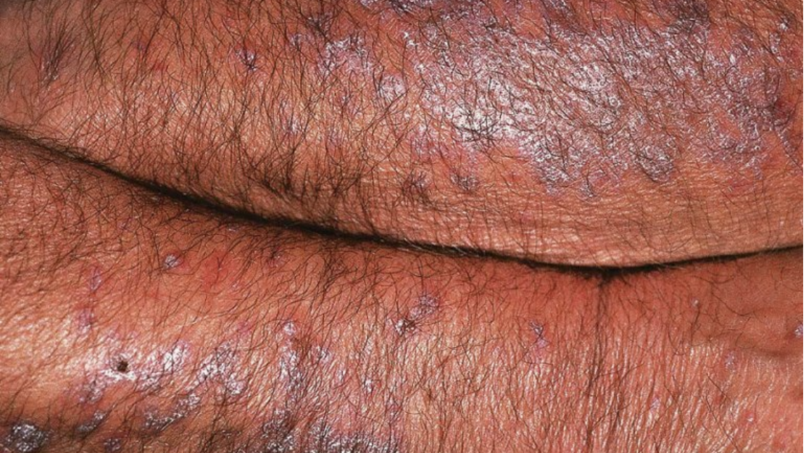
Notes:
Photolichenoid drug eruption due to hydrochlorothiazide.
The lesions favored the extensor surfaces of the forearms.

Slide 20
Vasculitis
~10% of the cases are due to drugs.
Clinically: Purpuric papules on the lower extremities.
Systemic involvement is very unusual.
Occurs 7-21 days after drug administration and less than 3 days following re-challenge.
Most common drugs: Penicillins, NSAIDs, Sulfonamides and cephalosporins.

Slide 22
Neutrophilic drug eruptions
Acute generalized exanthematous pustulosis (AGEP)
Sweet’s syndrome (Acute febrile neutrophilic dermatosis)

Slide 23
Acute generalized exanthematous pustulosis (AGEP)
Acute febrile drug eruption.
Numerous small, non-follicular, sterile pustules, arising within large areas of edematous erythema.
More than 90% of cases are drug-induced.
The onset is usually within 2 days of starting the medication.
Lesions begin on the face or intertriginous zones (groin, axillae) and then disseminate within a few hours.
The lesions last for 1 to 2 weeks and are followed by a superficial desquamation.
DDx: Acute pustular psoriasis
Drugs: Antibiotics (Beta-lactam and macrolides), CCB and Antimalarials.

Slide 24
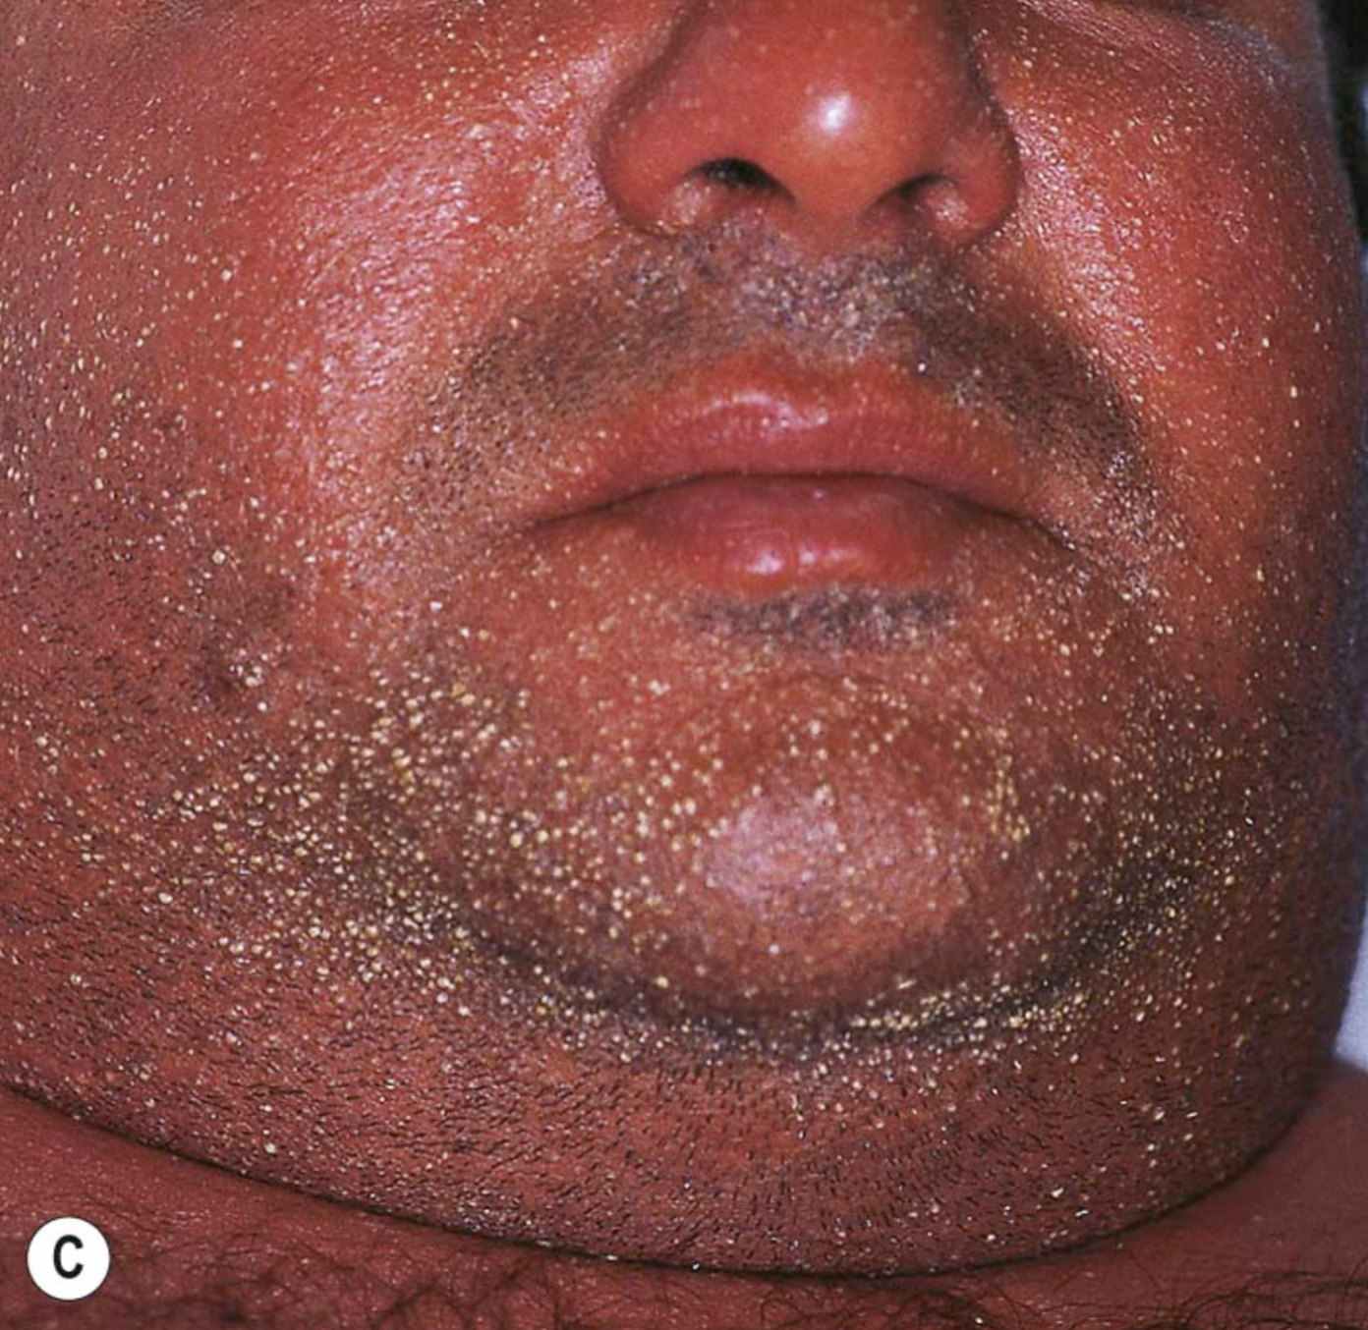
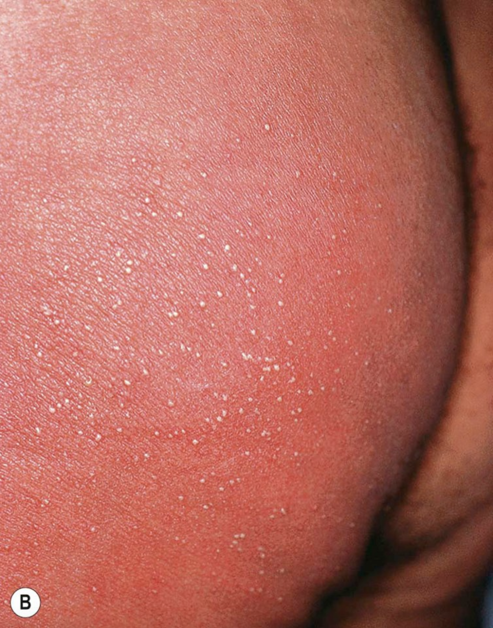
Notes:
Acute generalized exanthematous pustulosis (AGEP).
A A positive patch test result 4 days following the application of 0.75% metronidazole in a patient with a previous pustular drug eruption to that medication. Diffuse erythema of the buttock (due to cephalosporin, B) and face (due to metronidazole, C) studded with sterile pustules. Spongiform pustules are seen within the epidermis of lesional skin (D).

Slide 25
Sweet’s syndrome (Acute febrile neutrophilic dermatosis)
This syndrome is characterized by fever, peripheral blood neutrophilia, and painful erythematous plaques that favor the face and upper extremities.
Drugs represent <5% of all cases and starts about a week after the onset of drug administration.

Slide 26
Drug reaction with eosinophilia and systemic symptoms (DRESS)
AKA Drug-induced hypersensitivity syndrome (DIHS)
Due to alteration in the metabolism of drugs + immune mechanisms.
Possible role for viruses HHV-6 and HHV-7?
Drugs: Anticonvulsants (phenobarbital, Carbamazepine and phenytoin) and sulfonamides.
Clinically:
Starts 2-6 weeks after drug initiation.
Fever (85%) and a cutaneous eruption (75%) are the most common symptoms.
Begins as a morbilliform eruption, which later becomes edematous, with follicular accentuation.
The face, upper trunk and extremities are the initial sites of involvement.
Edema of the face is a hallmark of DRESS.

Slide 27
DRESS
Lymph nodes are often enlarged.
The most common and most severe site of visceral involvement is the liver (majority of deaths associated with this syndrome.
Other organs involved: Heart, lungs, kidneys and thyroid.
Prominent eosinophilia is a very characteristic feature.
Treatment:
Early withdrawal the offending drug. (may not be sufficient for obtaining a full recovery)
Topical steroids for mild cases.
Systemic steroids for life-threatening heart and lung involvement.

Slide 28
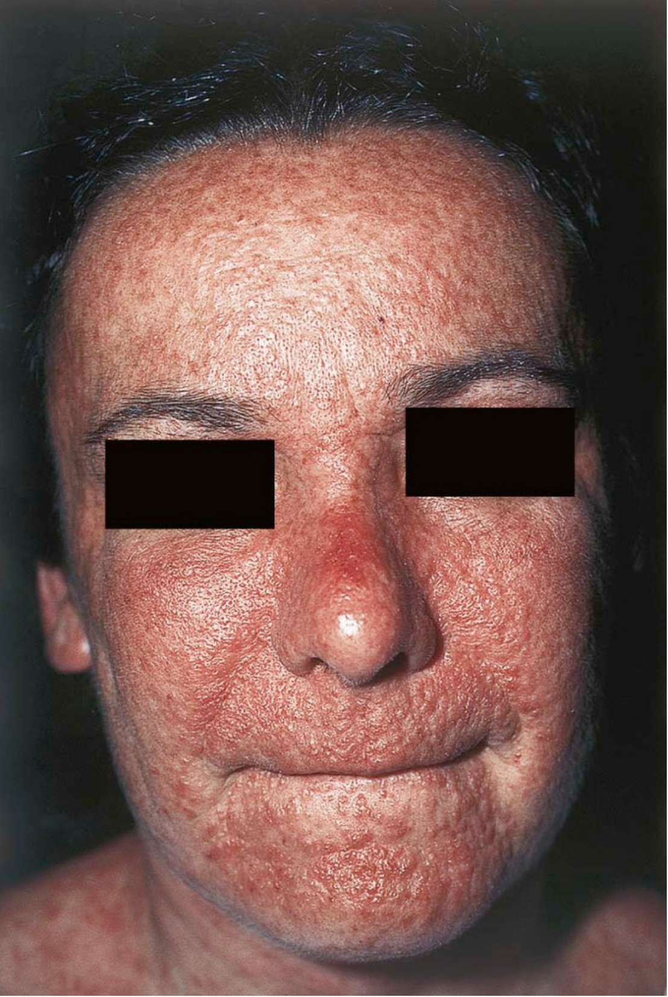
Notes:
Drug reaction with eosinophilia and systemic symptoms (DRESS)/drug-induced hypersensitivity syndrome (DIHS).
Multiple edematous papules are present.

Slide 29
Bullous Eruptions
Fixed drug eruption
Linear IgA bullous dermatosis
Drug-induced bullous pemphigoid
Drug-induced pemphigus
Steven-Johnson syndrome and TEN

Slide 30
Fixed drug eruption
Lesions develop 1-2 weeks after a first exposure and within 24 hours within subsequent exposures.
One or a few round, sharply demarcated, erythematous and edematous plaques are seen.
Sometimes a dusky, violaceous hue and a central blister may be seen
Favors the lips, face, hands, feet and genitalia.
The lesions progressively fade over several days (leaving PIH behind).
Lesions recur at exactly the same sites upon re-administration of the drug.
There is a generalized form of FDE (similar clinically to EM/SJS).
A non-pigmenting variant of FDE occurs mainly with pseudoephedrine.
Drugs: Sulfonamides, NSAIDs, Barbiturates, Tetracyclines and Carbamazepine.

Slide 31
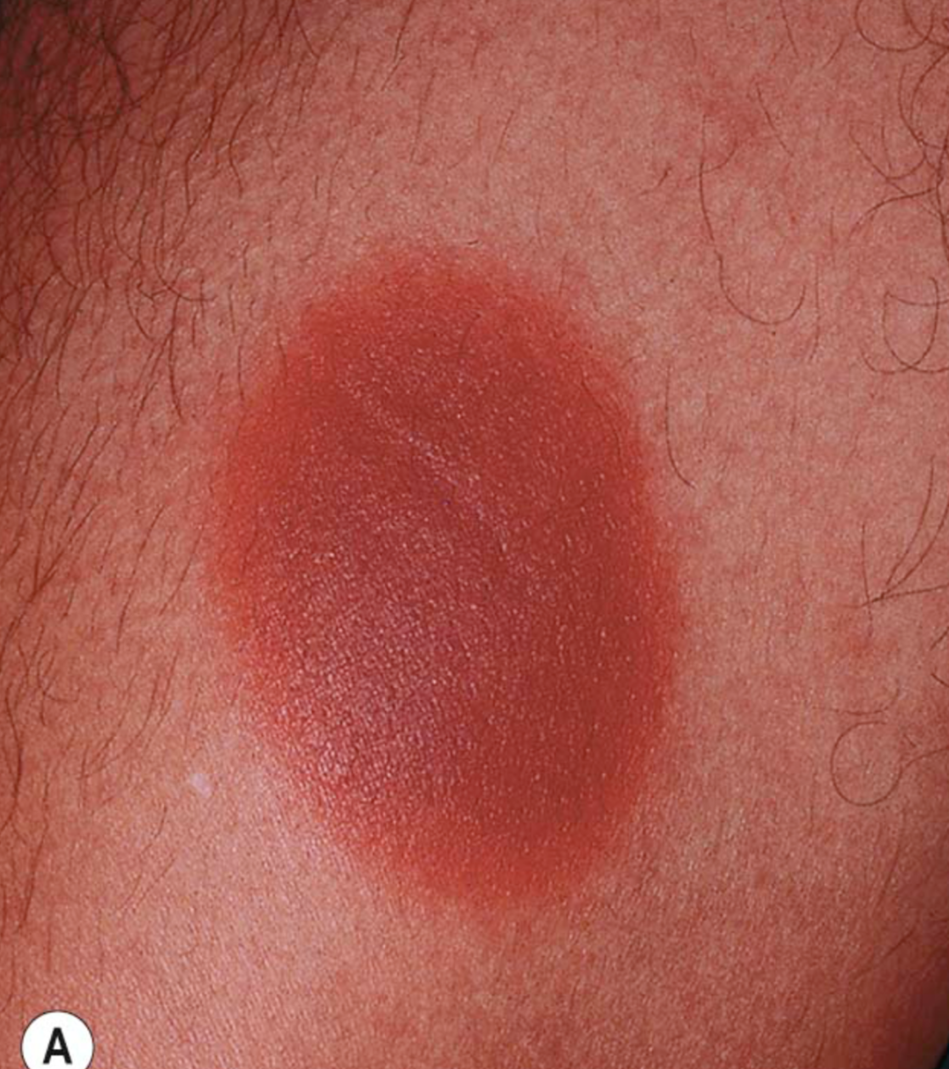
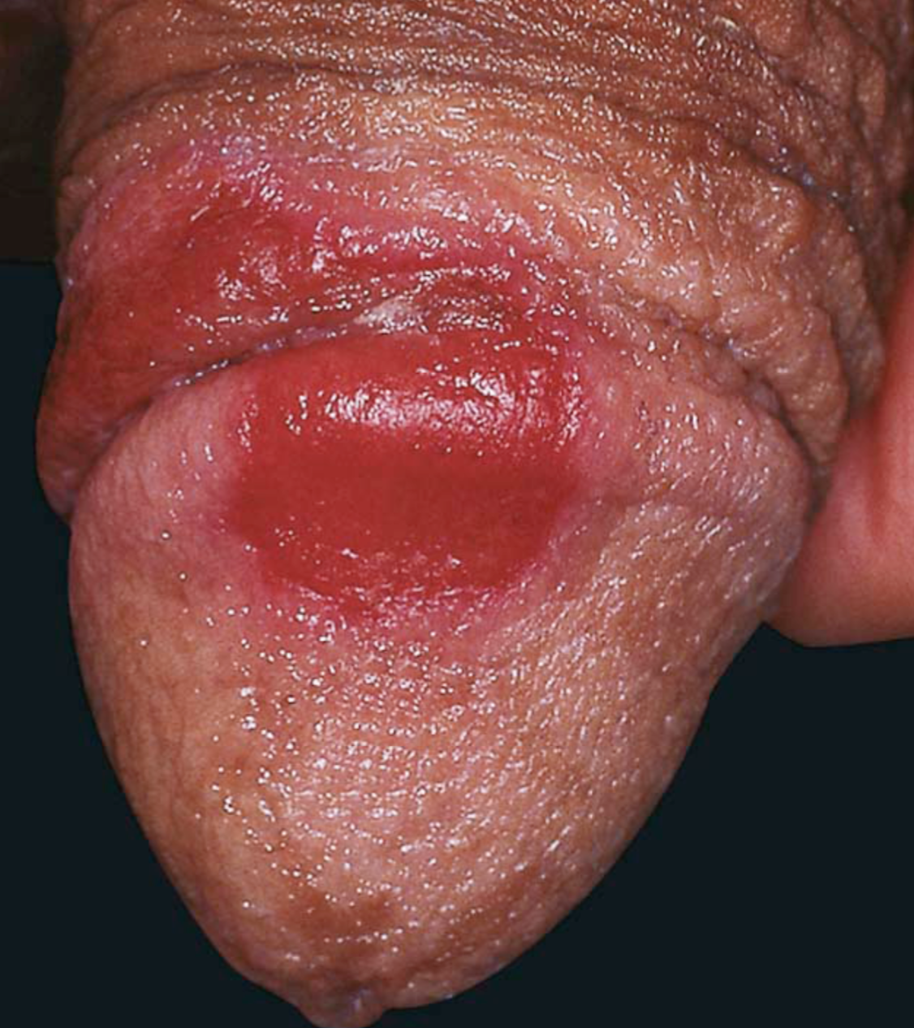
Notes:
Fixed drug eruptions.
Well-demarcated erythematous (A) to violet–brown plaques that can develop a detached epidermis (B), bulla (C) or erosion (D,E) centrally. As lesions heal, circular or oval areas of hyperpigmentation are commonly seen (F). Histologically, serous crust, a few necrotic keratinocytes, mild vacuolar changes at the dermal–epidermal junction, papillary dermal edema and melanophages can be seen as well as a mononuclear infiltrate (G). Responsible drugs were phenolphthalein (A), naproxen (B), ciprofloxacin (D), allopurinol (E) and trimethoprim–sulfamethoxazole (F).

Slide 32
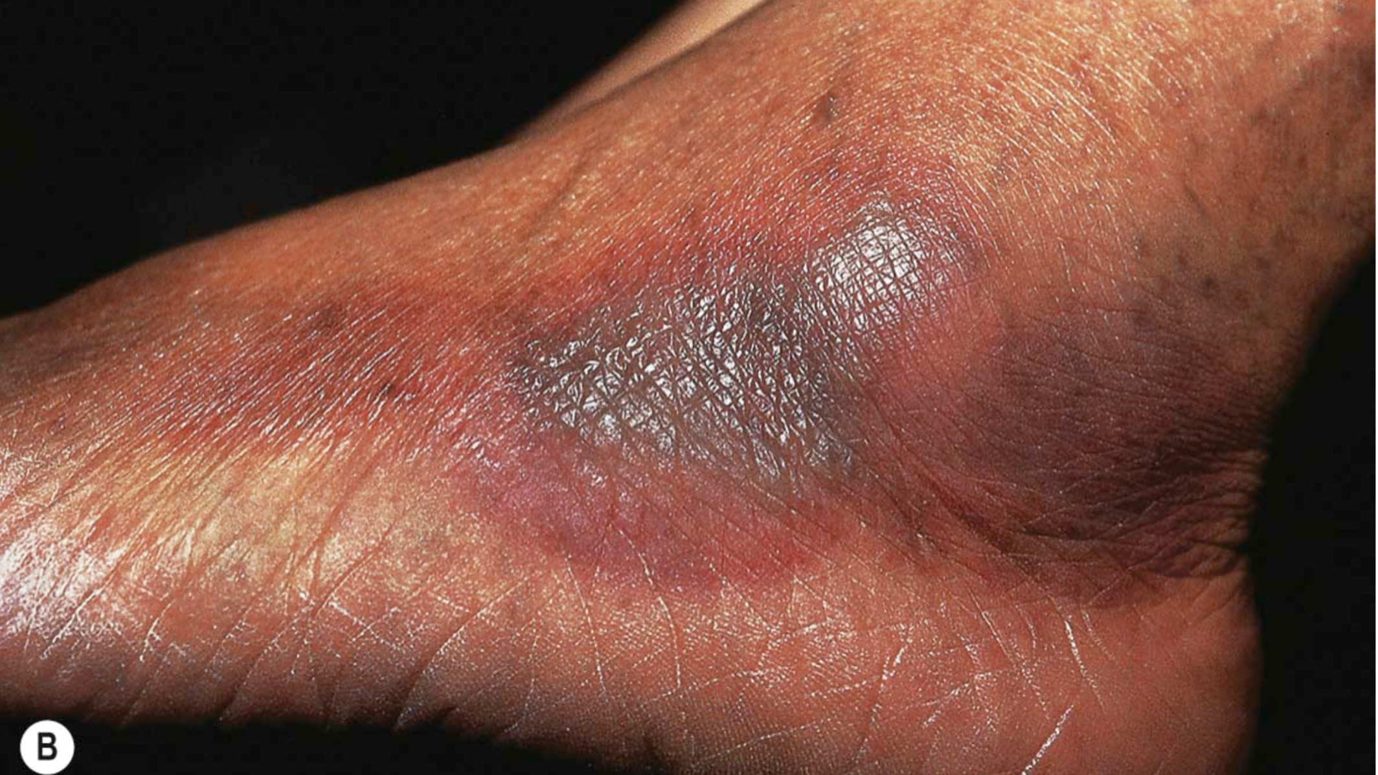
Notes:
Fixed drug eruptions.
Well-demarcated erythematous (A) to violet–brown plaques that can develop a detached epidermis (B), bulla (C) or erosion (D,E) centrally. As lesions heal, circular or oval areas of hyperpigmentation are commonly seen (F). Histologically, serous crust, a few necrotic keratinocytes, mild vacuolar changes at the dermal–epidermal junction, papillary dermal edema and melanophages can be seen as well as a mononuclear infiltrate (G). Responsible drugs were phenolphthalein (A), naproxen (B), ciprofloxacin (D), allopurinol (E) and trimethoprim–sulfamethoxazole (F).

Slide 33
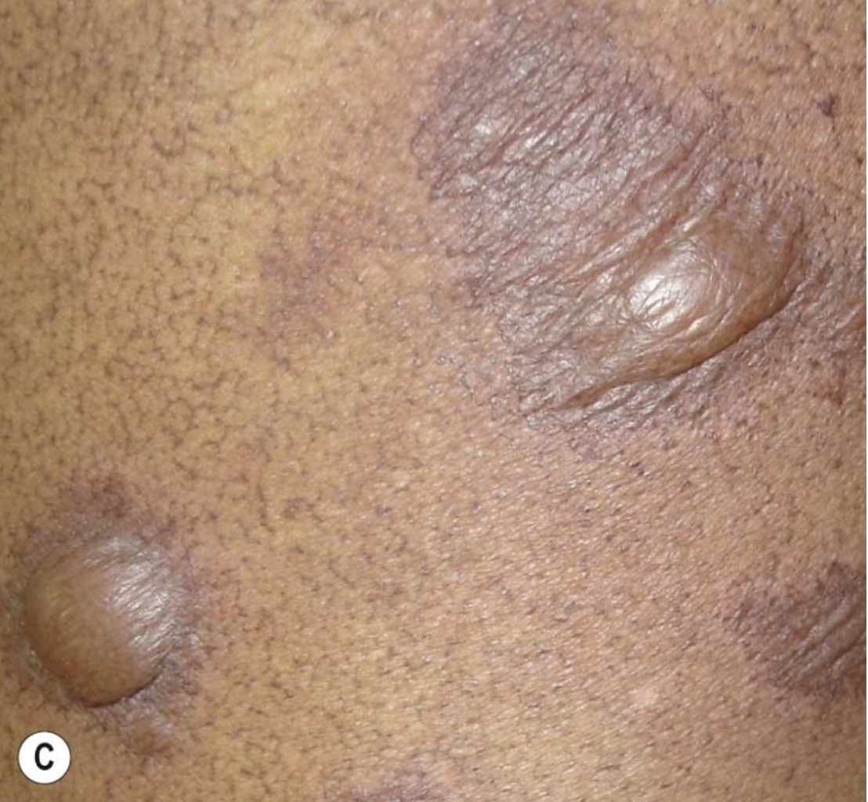
Notes:
Fixed drug eruptions.
Well-demarcated erythematous (A) to violet–brown plaques that can develop a detached epidermis (B), bulla (C) or erosion (D,E) centrally. As lesions heal, circular or oval areas of hyperpigmentation are commonly seen (F). Histologically, serous crust, a few necrotic keratinocytes, mild vacuolar changes at the dermal–epidermal junction, papillary dermal edema and melanophages can be seen as well as a mononuclear infiltrate (G). Responsible drugs were phenolphthalein (A), naproxen (B), ciprofloxacin (D), allopurinol (E) and trimethoprim–sulfamethoxazole (F).

Slide 34
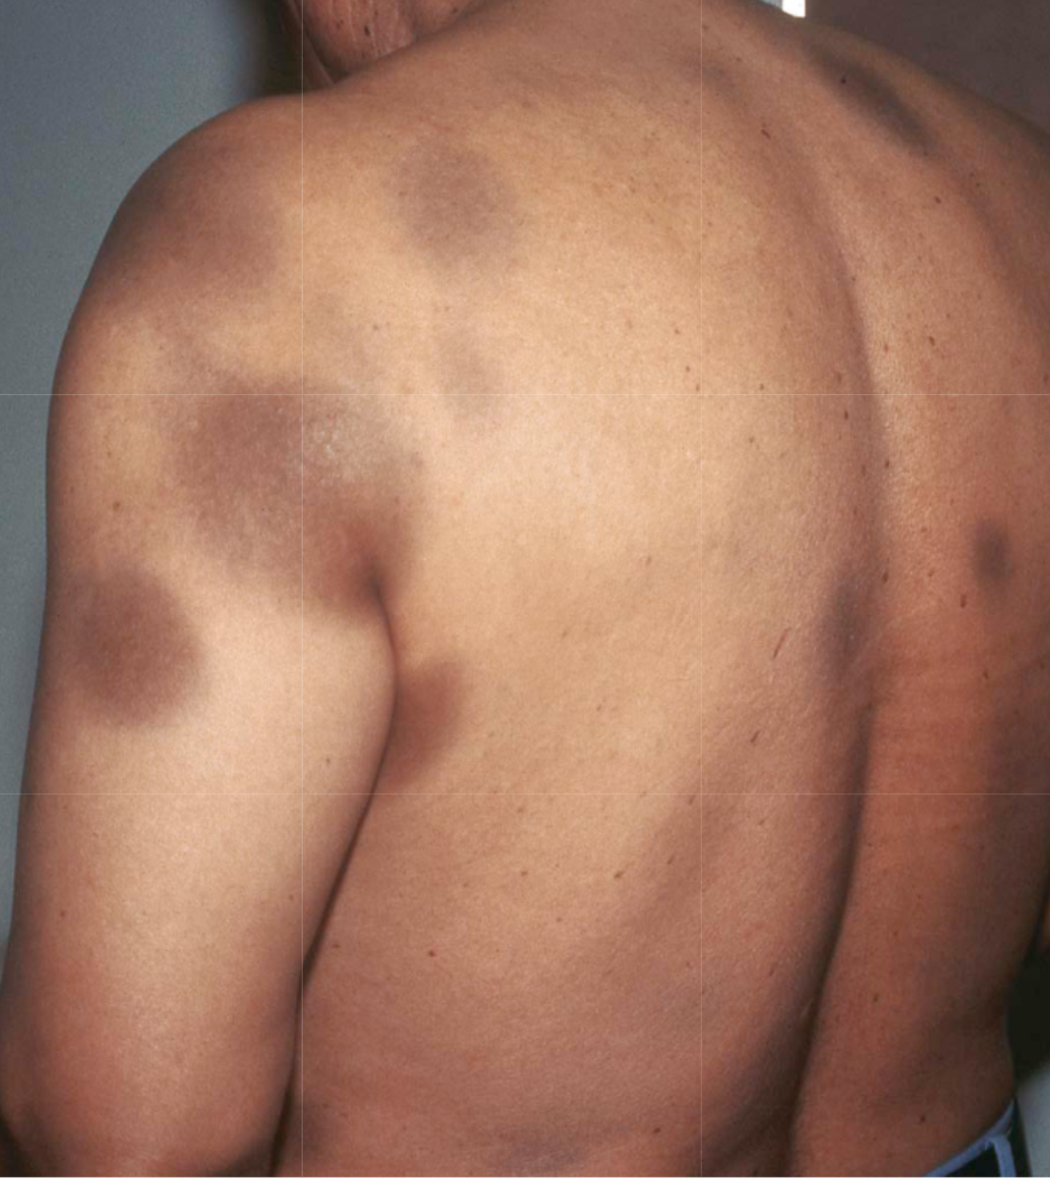
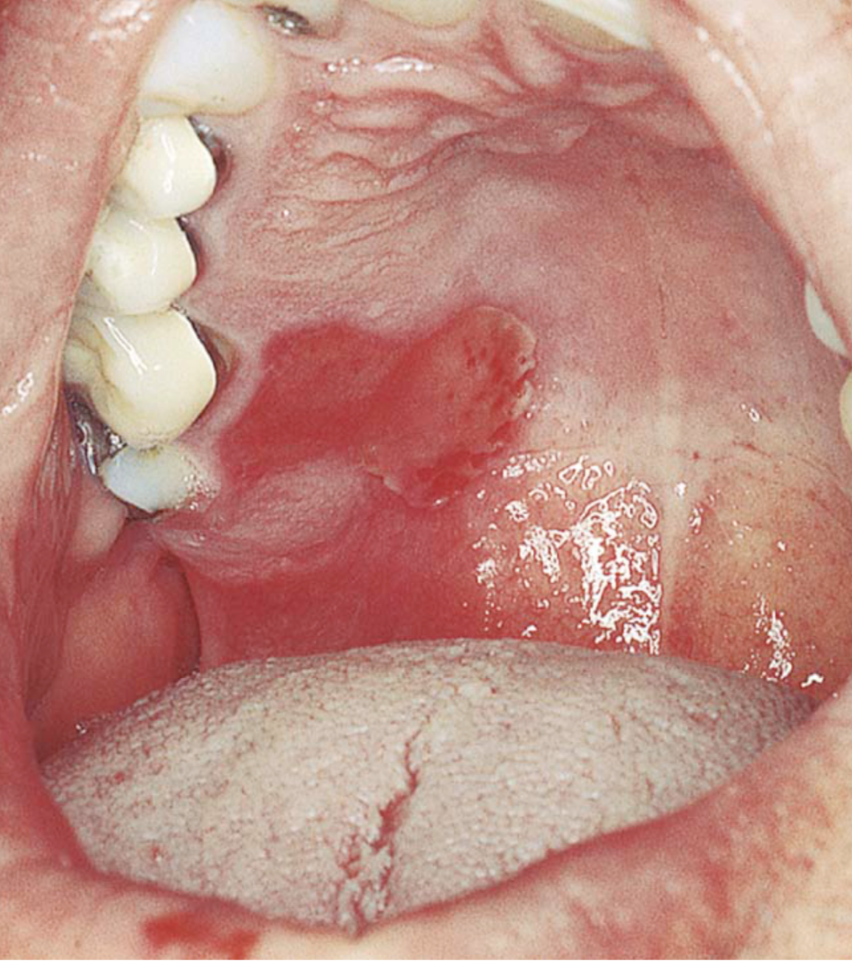
Notes:
Fixed drug eruptions.
Well-demarcated erythematous (A) to violet–brown plaques that can develop a detached epidermis (B), bulla (C) or erosion (D,E) centrally. As lesions heal, circular or oval areas of hyperpigmentation are commonly seen (F). Histologically, serous crust, a few necrotic keratinocytes, mild vacuolar changes at the dermal–epidermal junction, papillary dermal edema and melanophages can be seen as well as a mononuclear infiltrate (G). Responsible drugs were phenolphthalein (A), naproxen (B), ciprofloxacin (D), allopurinol (E) and trimethoprim–sulfamethoxazole (F).

Slide 35
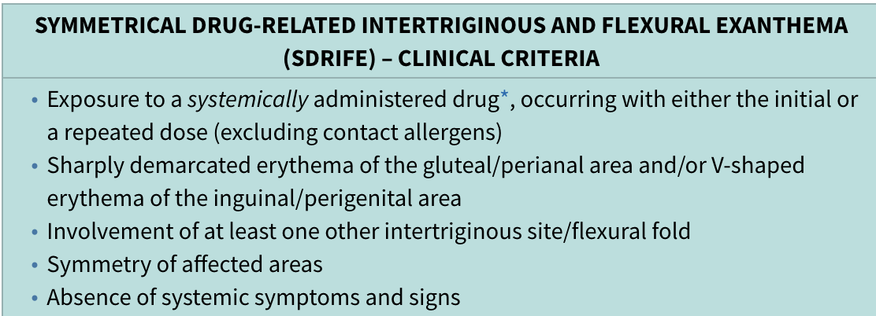
Symmetrical drug-induced intertriginous and flexural exanthema (SDRIFE)
Sharply demarcated, symmetrical areas of erythema over the anogenital region after exposure to systemic drugs.
Aminopenicillin & Cephalosporin are the most common drugs.
There is usually involvement of at least one flexural site.

Slide 36
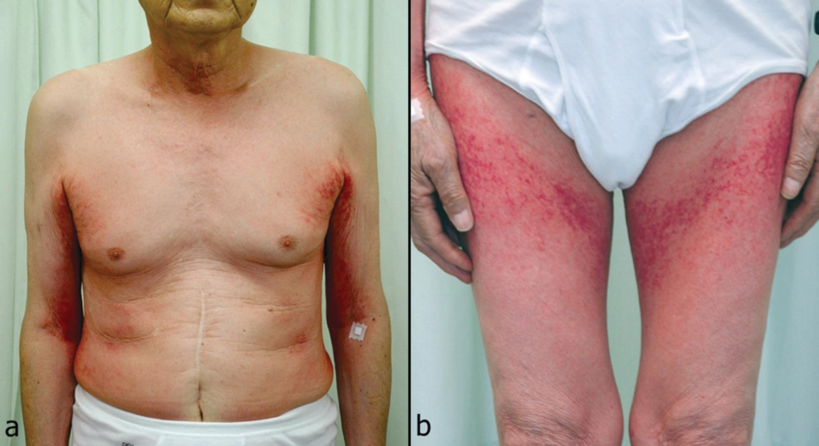

Slide 37
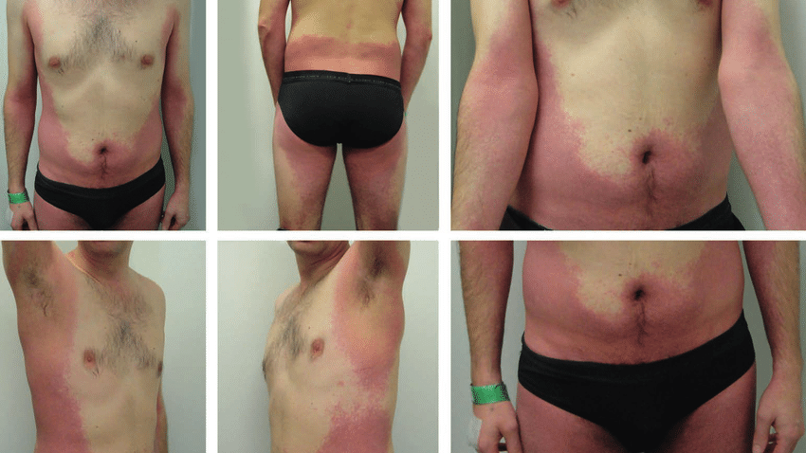

Slide 38
Others
Anticoagulant-induced skin necrosis
Serum sickness-like eruption
Drug-induced lupus
Drug-induced psoriasis
Acneiform eruptions
Pigmentary changes
Pseudolymphoma
Chemotherapy reactions

Slide 39
Anticoagulant-induced skin necrosis
Rare, sometimes life-threatening.
Induced by Warfarin or Heparin.
Begins 2 to 5 days after therapy.
Erythematous, painful plaques evolve into hemorrhagic blisters and necrotic ulcers.
Mainly over the breasts, thighs and buttocks.
Patients with hereditary deficiency of protein C are at highest risk.
Tx: Discontinue warfarin & start Vitamin K + I.V infusion of protein C.

Slide 40
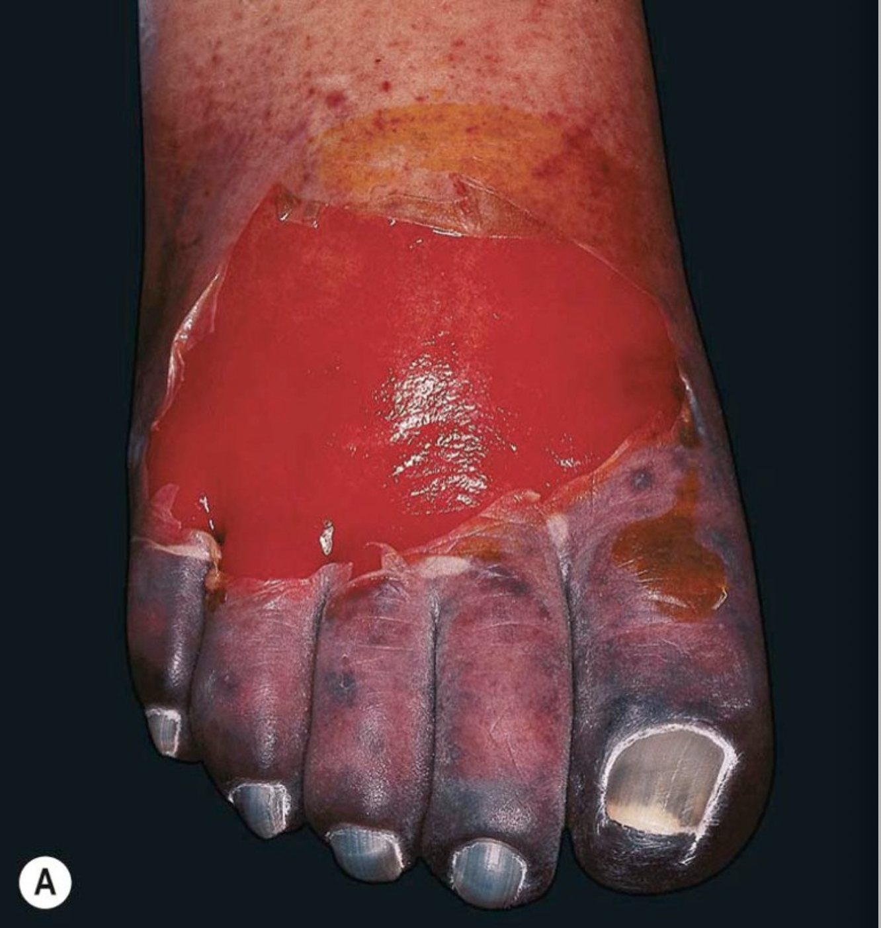
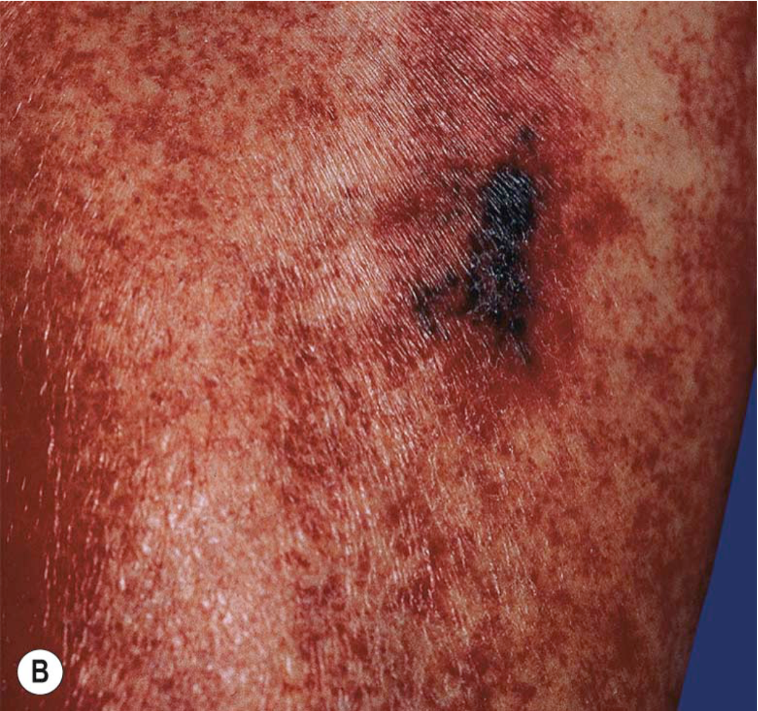
Notes:
Heparin-induced thrombocytopenia with thrombosis syndrome.
A Ischemia and necrosis of the foot. B Petechiae due to thrombocytopenia and an irregular area of cutaneous necrosis due to thrombosis.

Slide 41
Serum sickness-like eruption
Mainly in children
Fever, Arthralgias, arthritis, rash and lymphadenopathy.
1 to 3 weeks after drug exposure.
Unlike true serum sickness, hypocomplementemia, vasculitis and renal disease are absent.
Occurs in approximately 1 in 2000 children given cefaclor.

Slide 42
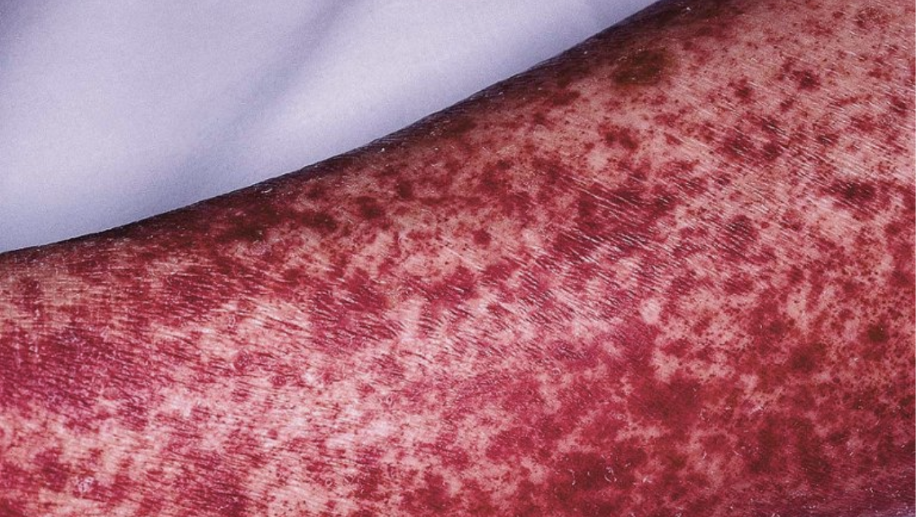
Notes:
Serum sickness due to antithymocyte globulin.
The purpuric lesions are due to small vessel vasculitis in this patient with aplastic anemia.

Slide 43
Drug-induced Lupus
Drug-induced systemic lupus:
- Fever, weight loss, pericarditis and pulmonary inflammation.
- Skin involvement is rare but includes: malar-erythema, photo eruption and discoid lesions.
- Vasculitis, renal and neurologic involvement is rare.
- Starts over a year after the medication is initiated.
- +ve anti-histone Abs in 95% of cases. (-ve DsDNA)
- Clinical symptoms resolve within 4 to 6 weeks.
Procainamide, hydralazine, chlorpromazine, isoniazid, methyldopa, quinidine, D-penicillamine and Minocycline.
Drug induced subcutaneous lupus:
Psoriasiform and annular lesions on the upper trunk and extensor arms.
Hydrochlorothiazide, CCBs, Terbinafine, NSAIDs, Griseofulvin.
Resolution of the rash may or may not occur after discontinuation of the responsible drug.

Slide 44
Drug-induced Psoriasis
Drugs can affect a patient in 3 different ways:
Exacerbation of pre-existing psoriasis
Induction of lesions of psoriasis in clinically normal skin in a patient w psoriasis.
De novo psoriasis.
Terbinafine, NSAIDs, Antimalarials, ACE inhibitors, Lithium and B-blockers.
TNF-induced Psoriasis.
Lesions of drug-induced psoriasis usually regress within weeks to a few months of discontinuing the inciting drug.

Slide 45
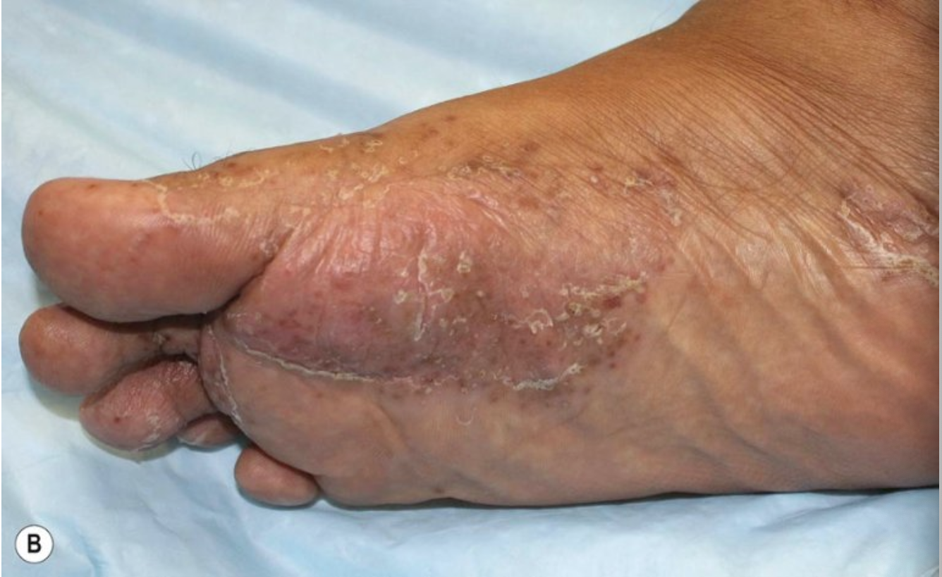
Notes:
Psoriasiform eruptions due to TNF-α inhibitors.
A Widespread papulosquamous lesions in a patient being treated with infliximab for gastrointestinal GVHD. Histologically, there was no evidence of cutaneous GVHD. B Sterile pustulosis of the plantar surface developed in this patient with rheumatoid arthritis who had received infliximab for the previous 5 years. Neither patient had had a reduction in immunosuppression prior to the onset of the psoriasiform eruption.

Slide 46
Acneiform eruptions
Represent ~1% of drug-induced skin eruptions.
Clinically, just like acne but comedones are absent.
Corticosteroids, Androgens, hydantoins, lithium, progestin-containing OCPs.

Slide 47
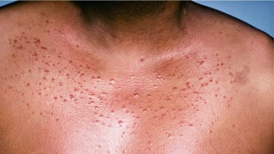

Slide 48
Pigmentary changes
Hyperpigmentation:
Usually more pronounced in sun-exposed areas.
Minocycline
Antimalarials
Amiodarone
Silver, gold and arsenic
Bleomycin
Hypopigmentation:
- Chronic use of topical steroids

Slide 49
Notes:
Gray–violet discoloration of the face due to amiodarone.
Biopsy specimens demonstrate yellow–brown granules within dermal macrophages. Note sparing of the lower eyelid.

