Slide 1
ACNE AND ACNE RELATED DISORDERS

Slide 2
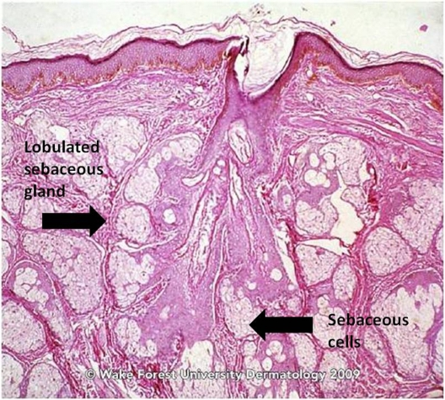
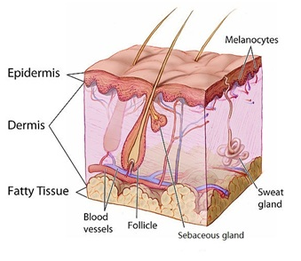

Slide 3
OBJECTIVE OF THE LECTURE:
To know the multiple pathogenetic mechanisms causing acne
To recognize the clinical features of acne.
To differentiate acne from other acniform eruptions such as rosacea.
To know the different types of treatment
To recognize the clinical features of rosacea, it’s variable types, differential diagnosis and treatment.
To recognize the features of hidradenitis supprativa and treatment.

Slide 4
ACNE
Is a chronic inflammatory skin disease affecting the pilosebaceous unit.
Affects around 85% of the population at some point in their lives.
Occurs mostly during adolescence

Slide 5
Etiopathogenesis
Four key pathogenic processes lead to the formation of acne lesions:
Increased and altered sebum production under androgen control
Alteration of follicular keratinization that leads to comedones.
Follicular colonization by Propionibacterium acnes
Inflammatory mechanisms

Slide 6
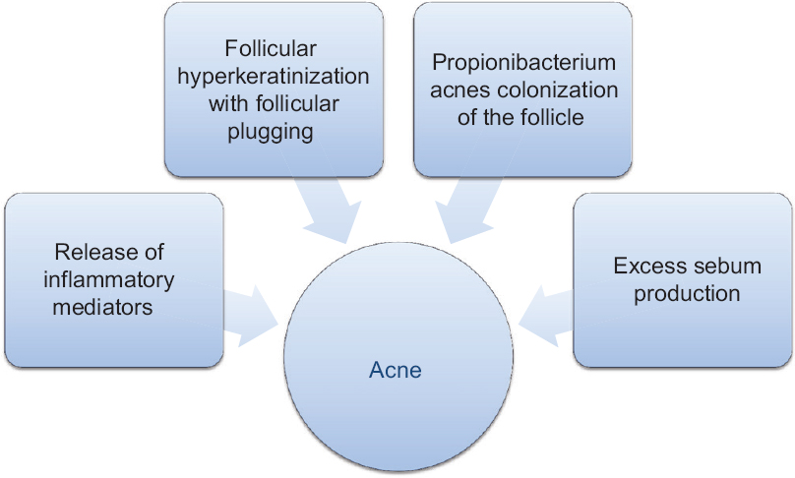

Slide 8
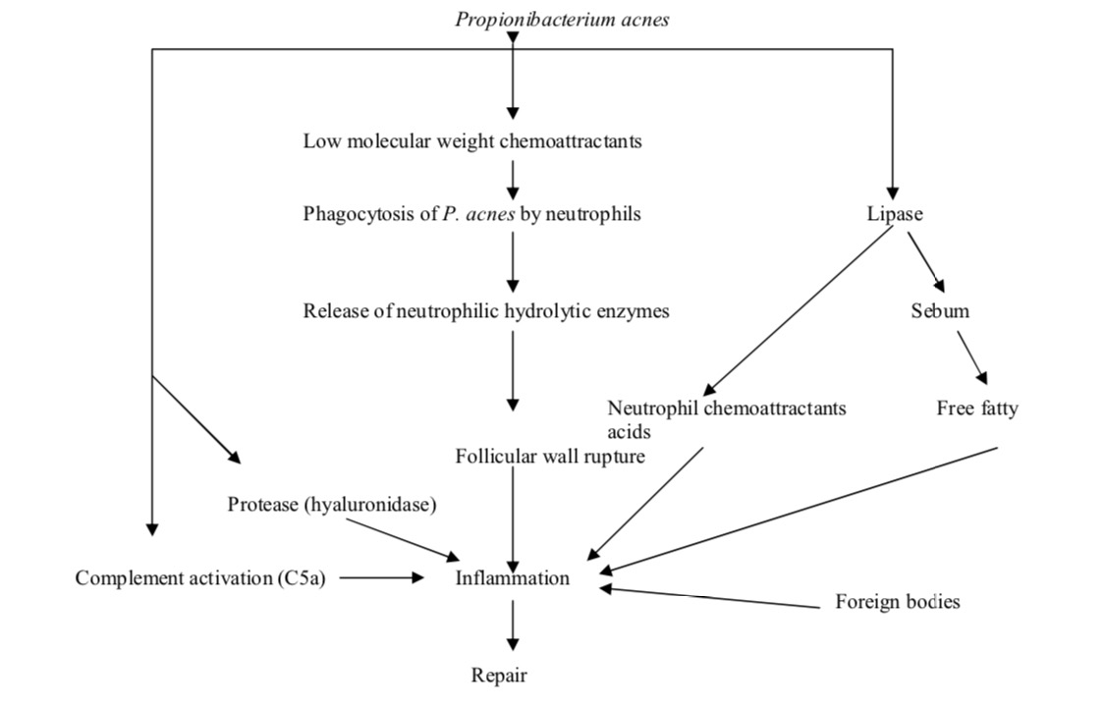

Slide 9
Others factors which can contribute to the pathogenesis of acne:
Family history of severe acne (early disease onset and a severe clinical course)
Diet (hyperglycemic diet)
Environmental factors (smoking )
Occlusive cosmetics

Slide 10
Types of acne according to the onset

Slide 11
Acne vulgaris (acne of the adolescent)
Epidemiology :
Most common type of acne
85% prevalence rates in those aged 12-24 years
Has a peak incidence in 14-17-year-old girls and in 16-19-year-old boys
Women have a high prevalence and incidence when compared with men, especially after 25 years of age
Acne often persists into adulthood, with 26% of women and 12% of men reporting acne in their 40s.(late-onset acne)
About 20% of the affected individuals develop severe acne which results in scarring.
Asians and Africans tend to develop severe acne

Slide 12
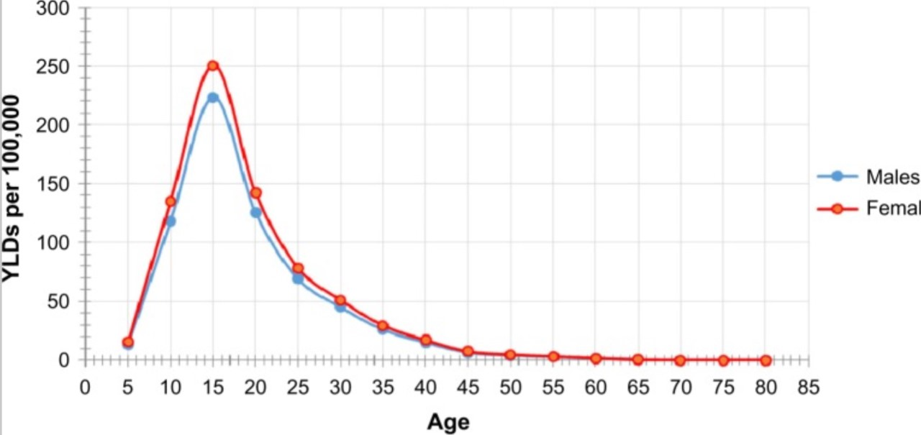

Slide 13
CLINICAL FEATURES
-Acne commonly affects:
1- face
2-shoulders
3-upper part of the chest and back
-Has pleomorphic appearance:
1-primary skin lesions
2-secondary skin lesions
primary: non-inflammatory and inflammatory lesions
-clinical features of primary lesions: hyperseborrhea, open and closed comedones,
papules, pustules and nodules

Slide 14
1-Comedones:
-Hyperkeratotic plug made of sebum and keratin in follicular canal.
A-Microcomedone:
1-Closed Comedo ( Whitehead):Closed follicular orifice, accumulation of sebum and keratin
2-Open Comedo ( Blackhead):Opened follicular orifice packed with melanin and oxidized lipids
B-Macrocomedone:
2-Papules and pustules:
3-Nodules:

Slide 15
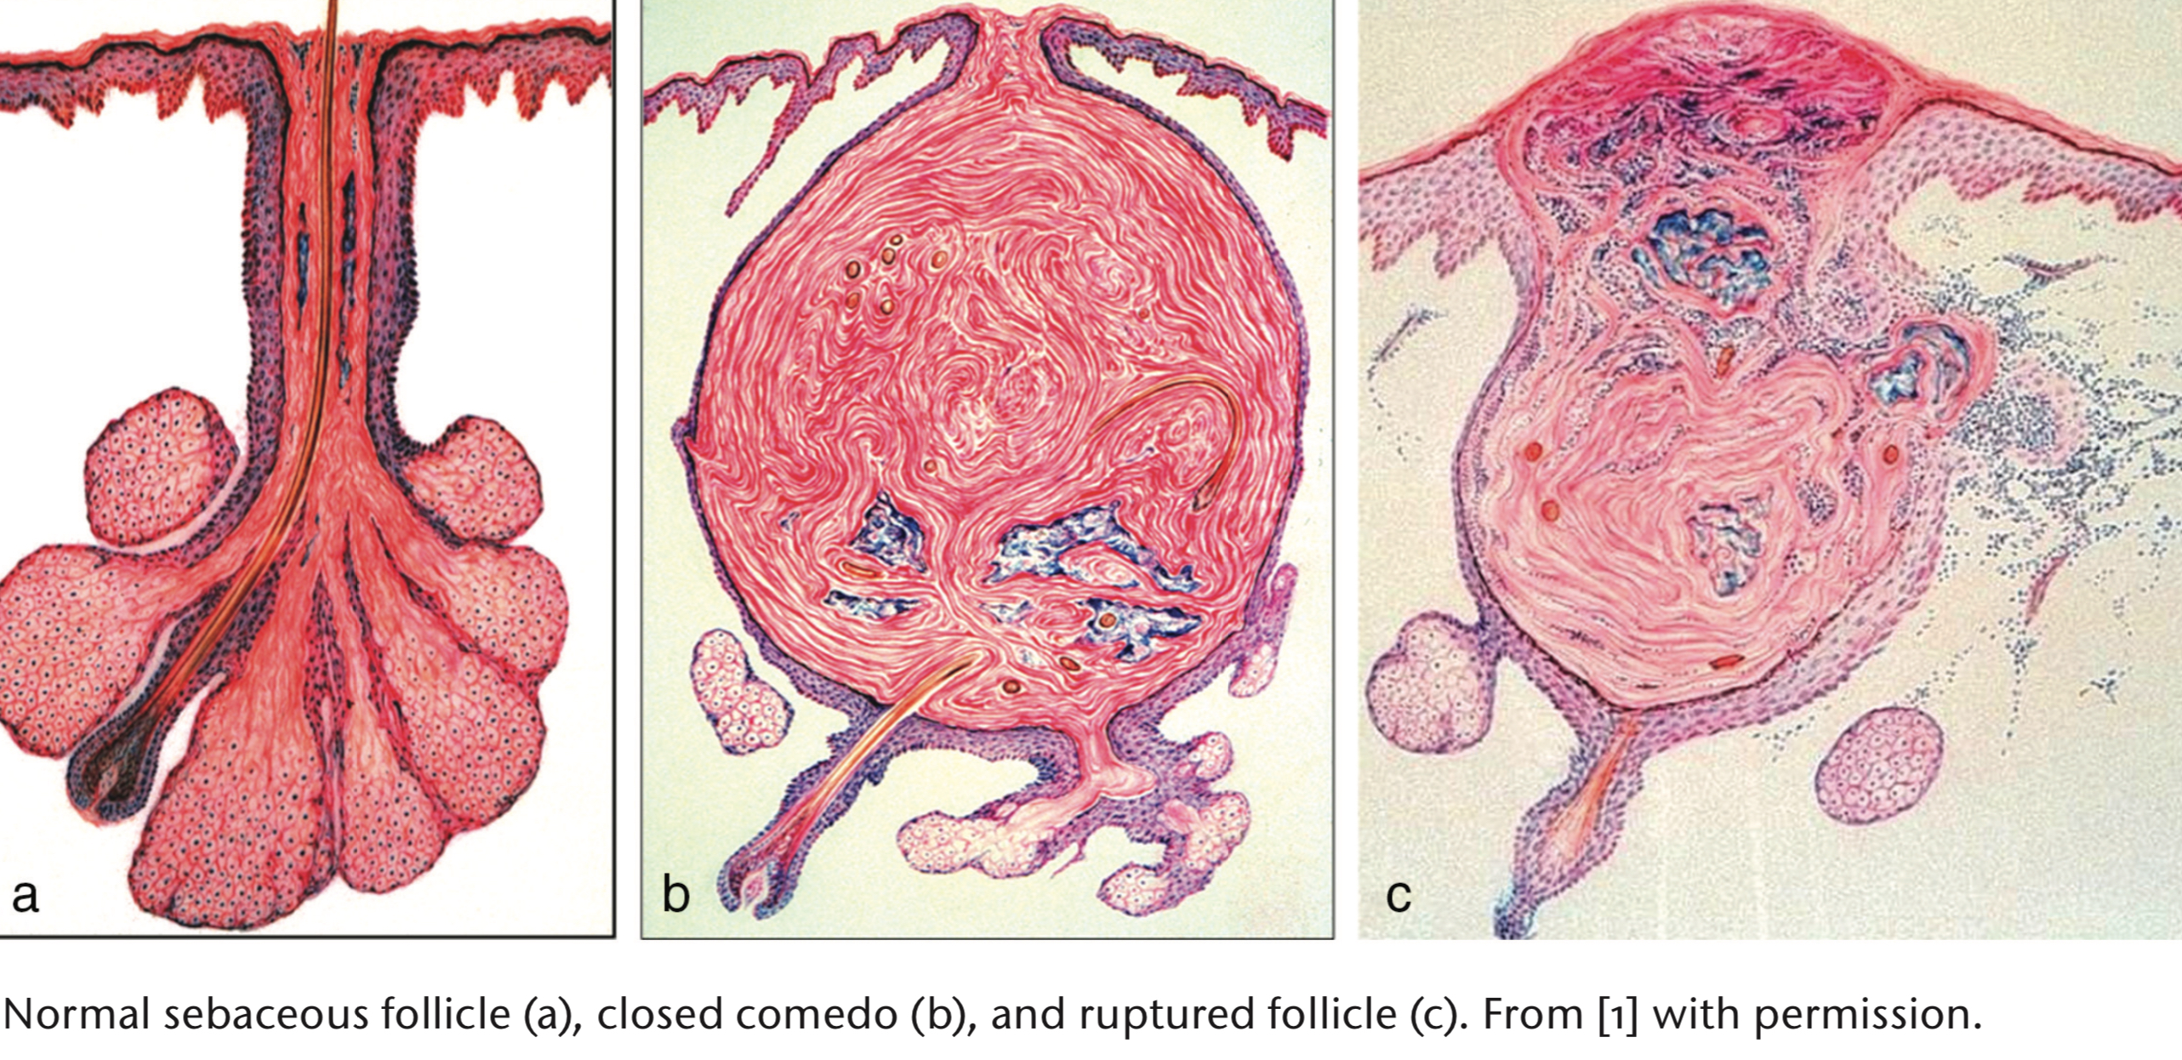

Slide 16
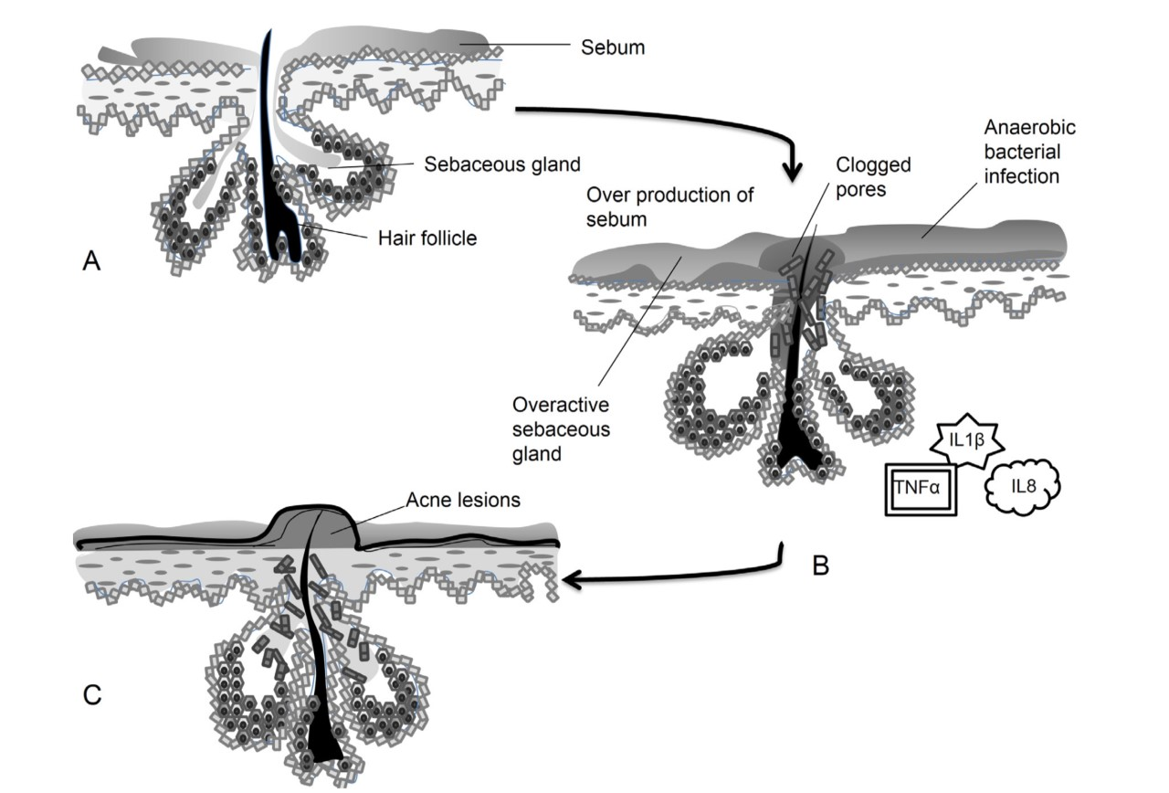

Slide 17
Secondary acne lesions:
1-Abscesses
2-Cysts
3-Post-inflammatory hyperpigmentation
4-Excoriations
5-Scars

Slide 18
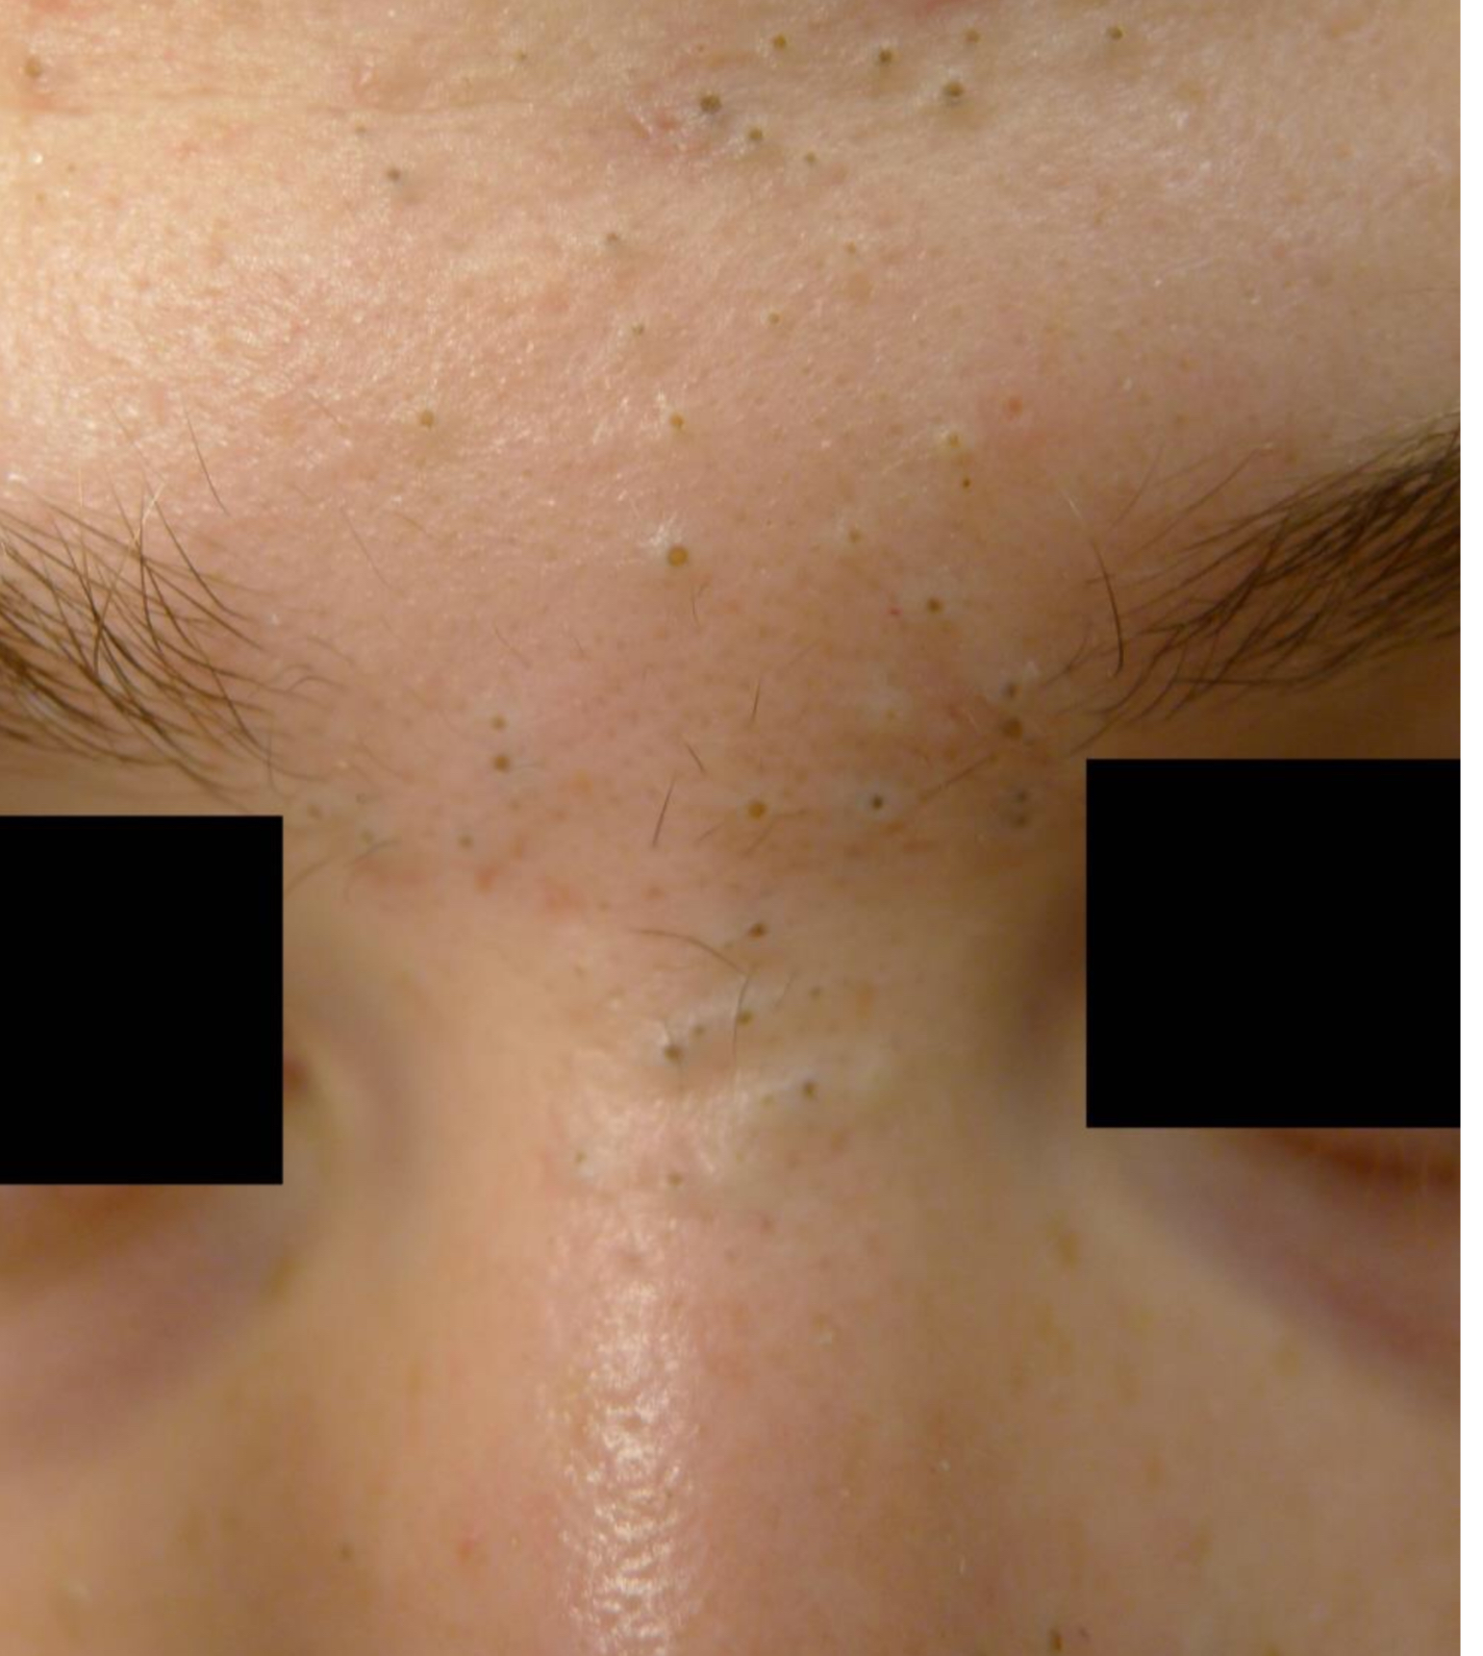
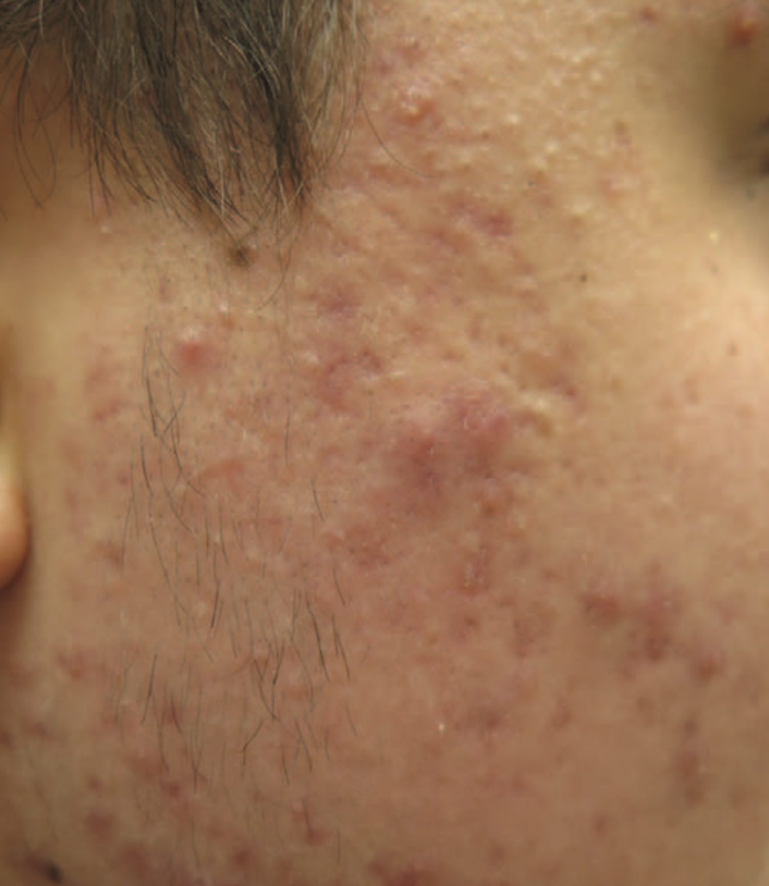

Slide 19
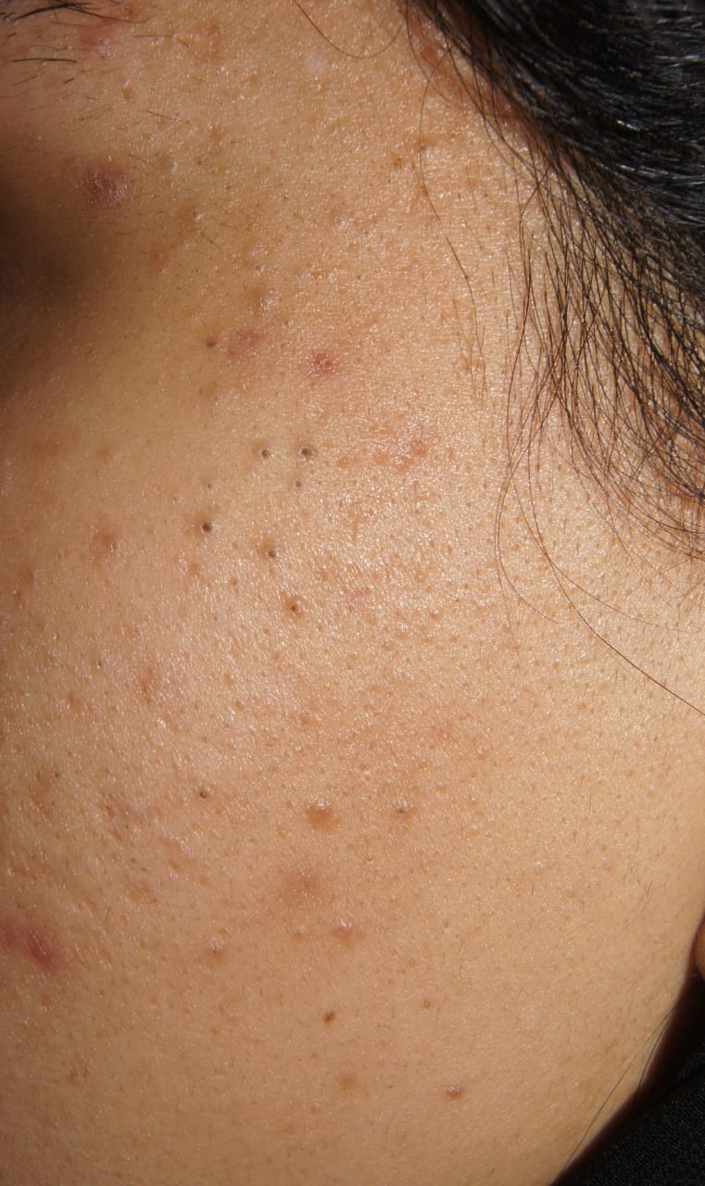
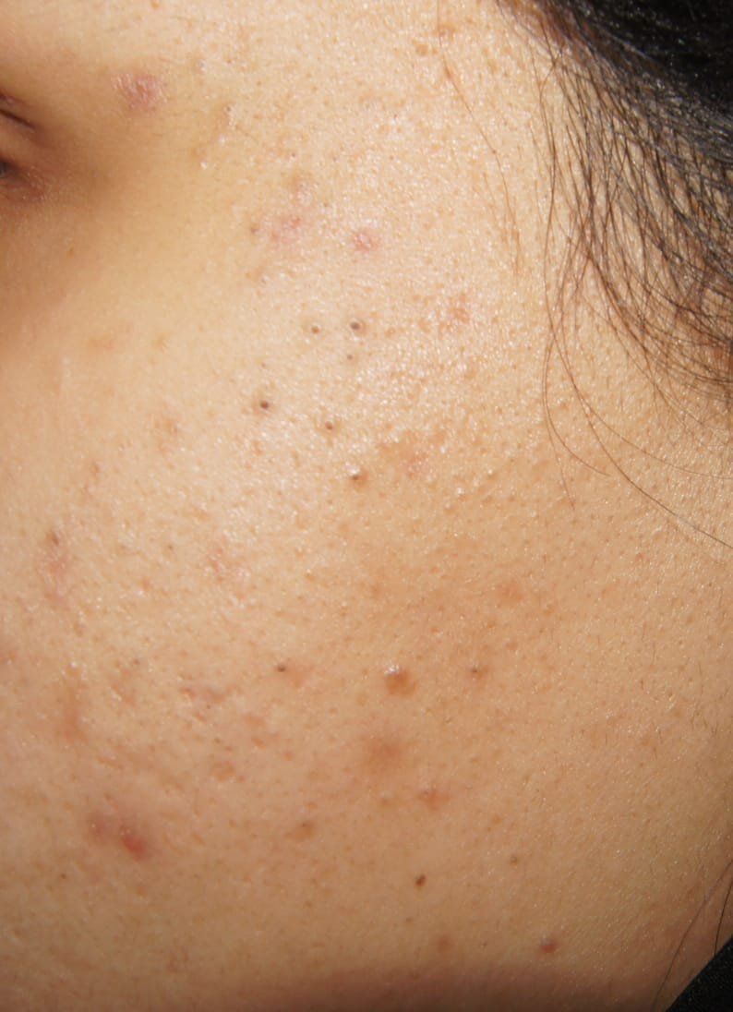

Slide 20
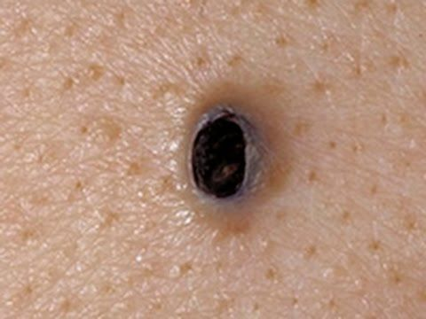
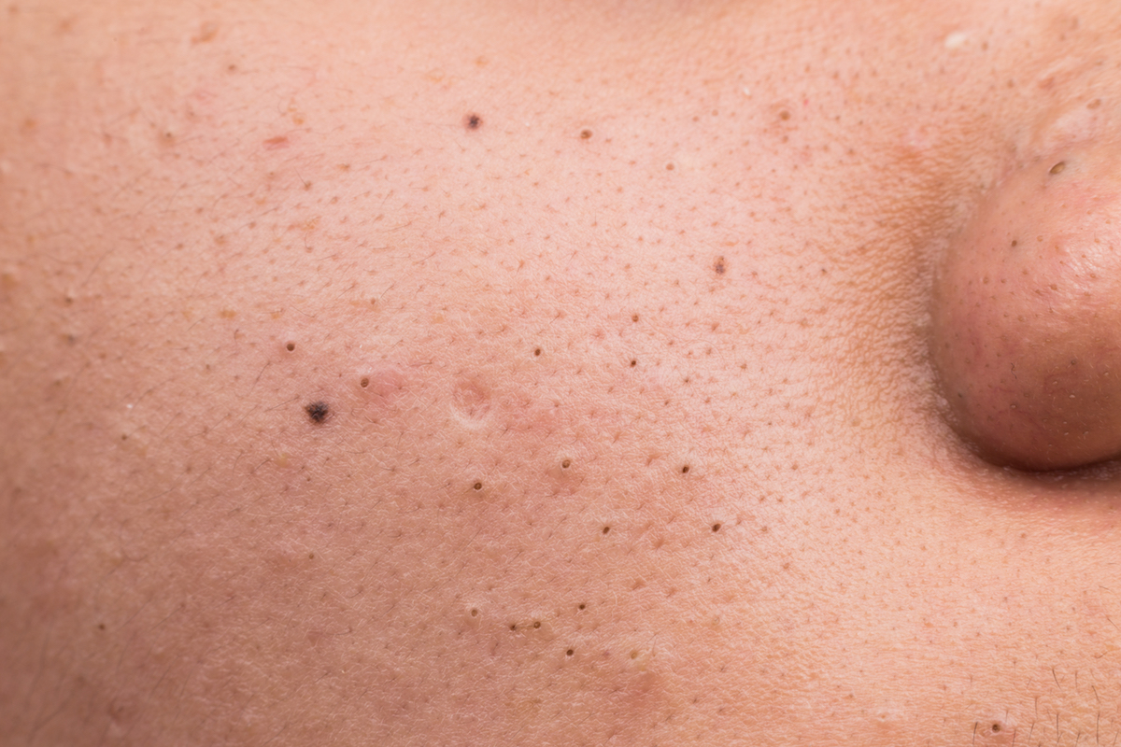

Slide 21
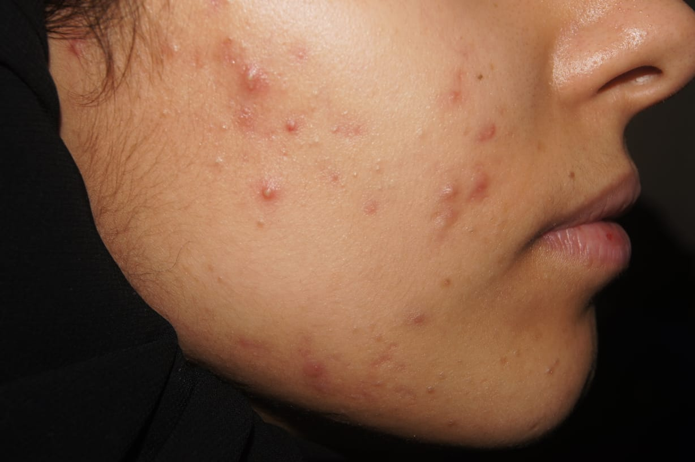

Slide 22
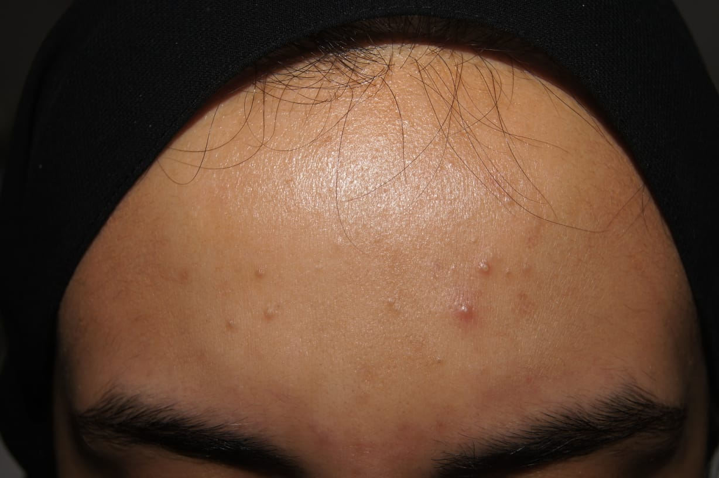

Slide 23
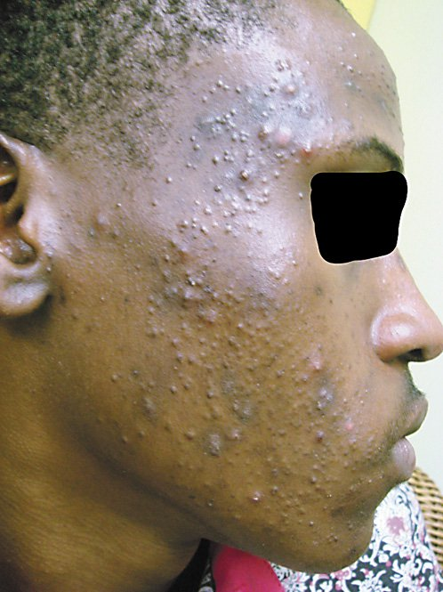
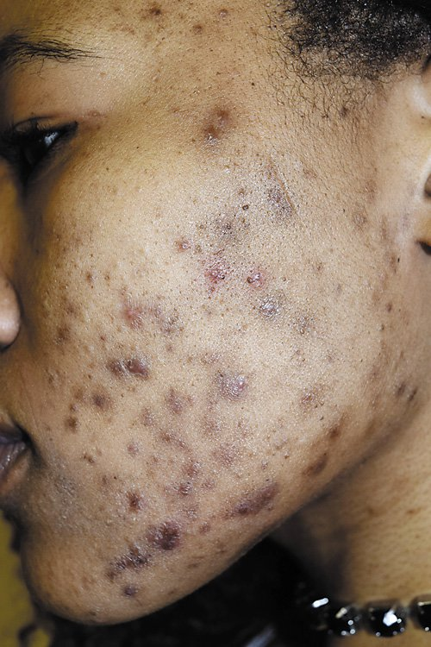

Slide 24
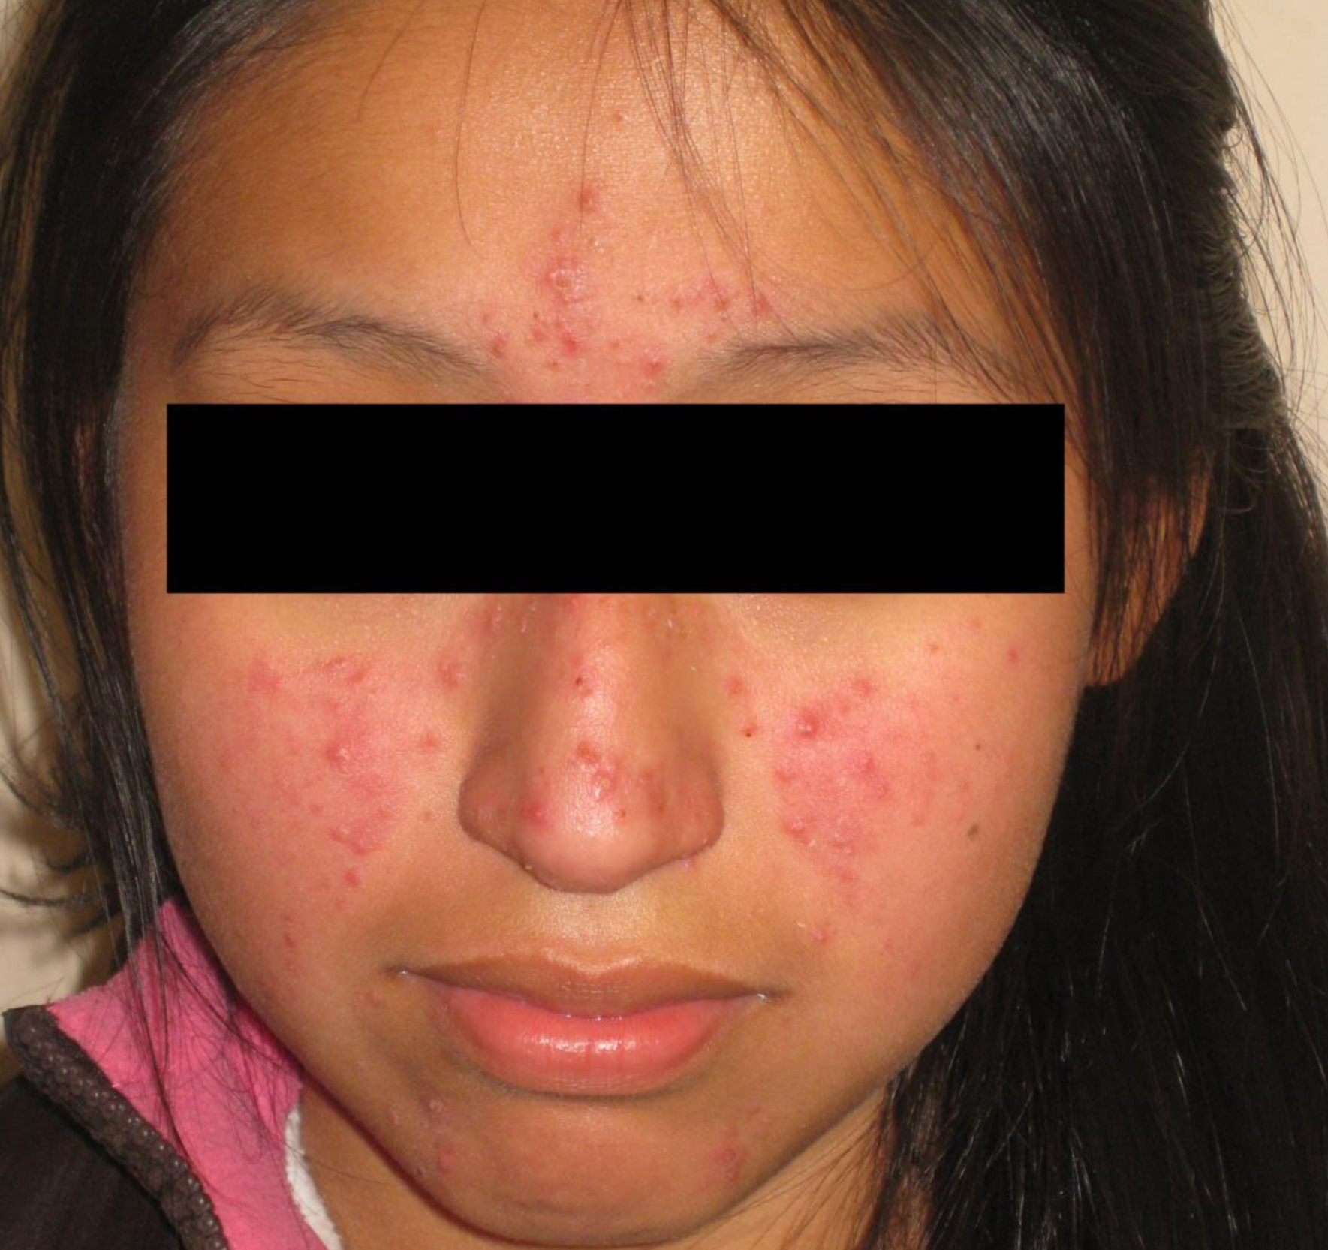
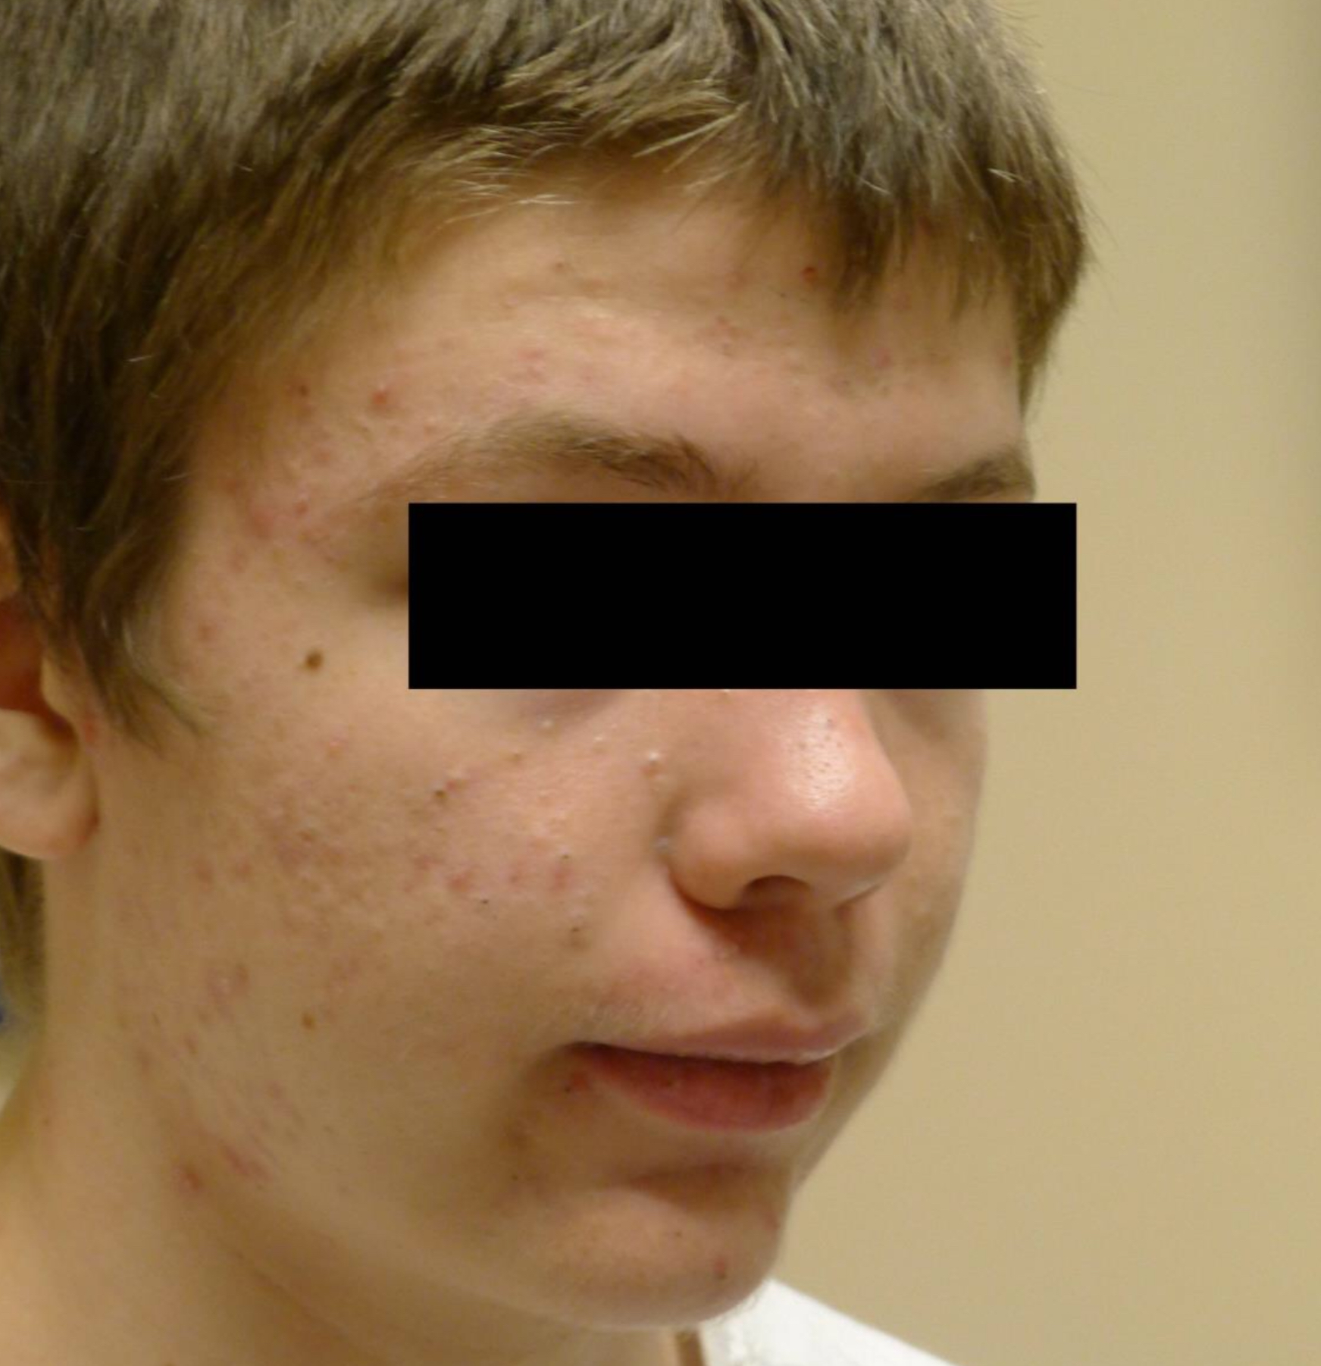

Slide 25
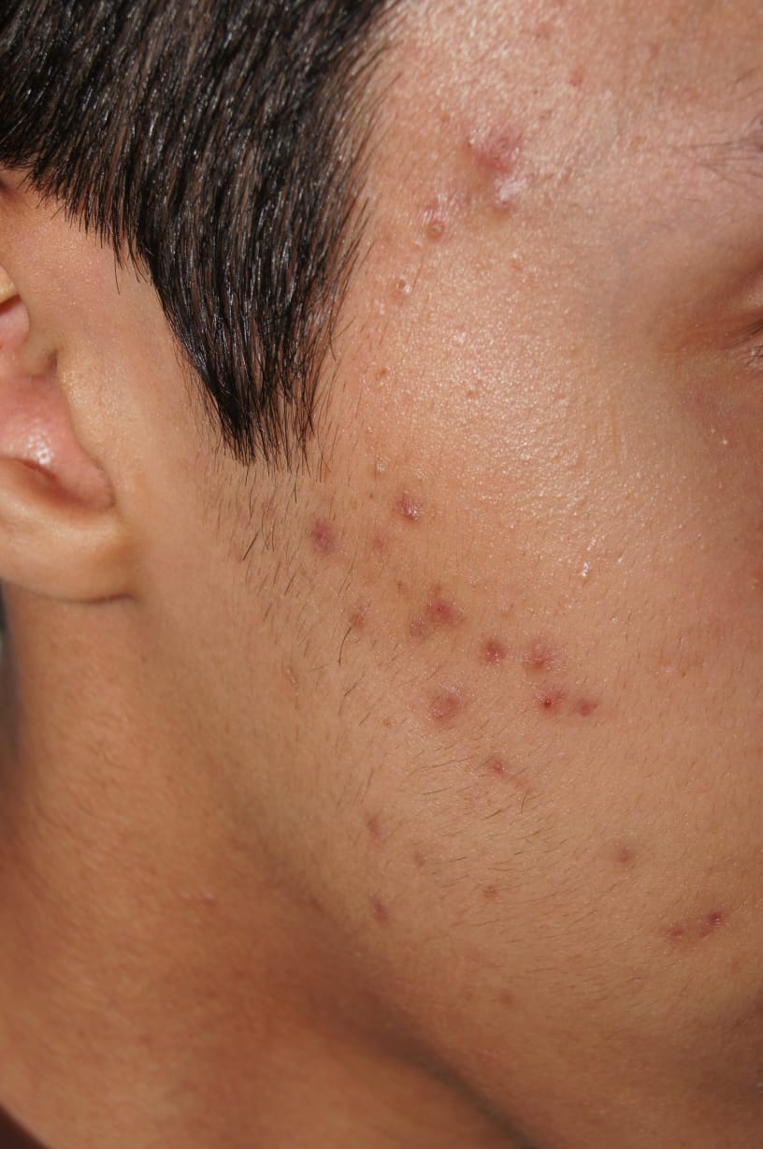
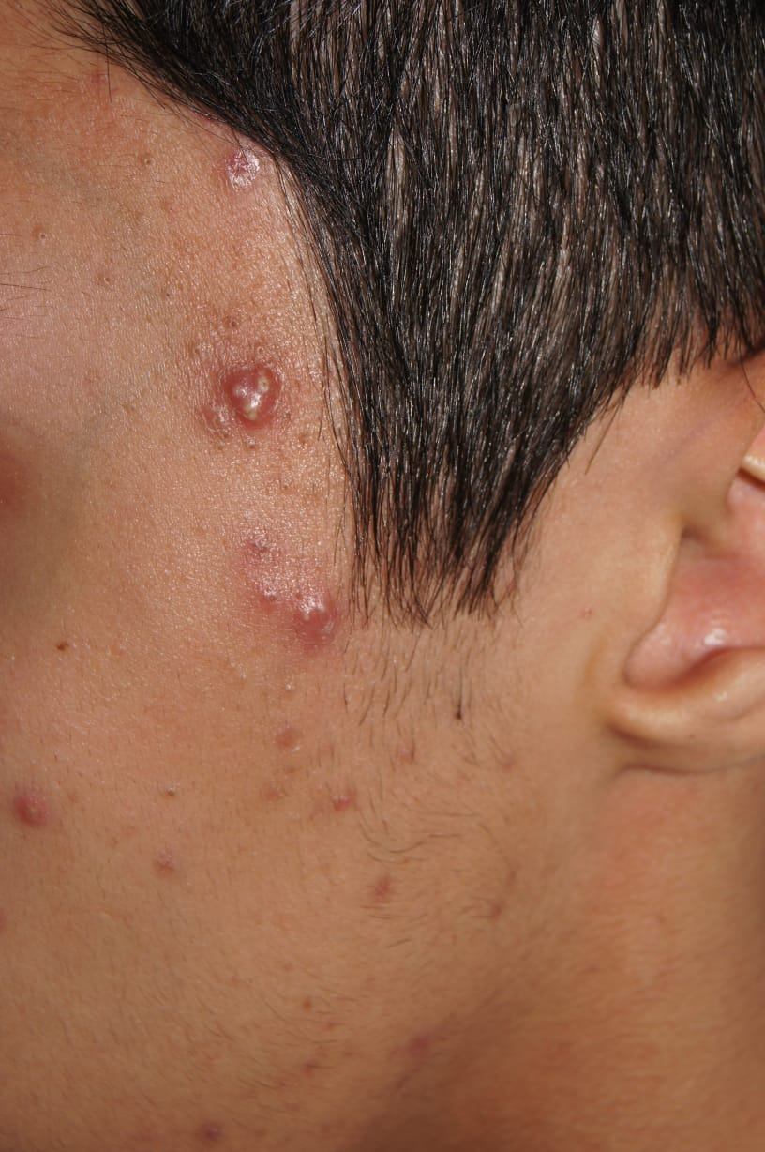

Slide 26
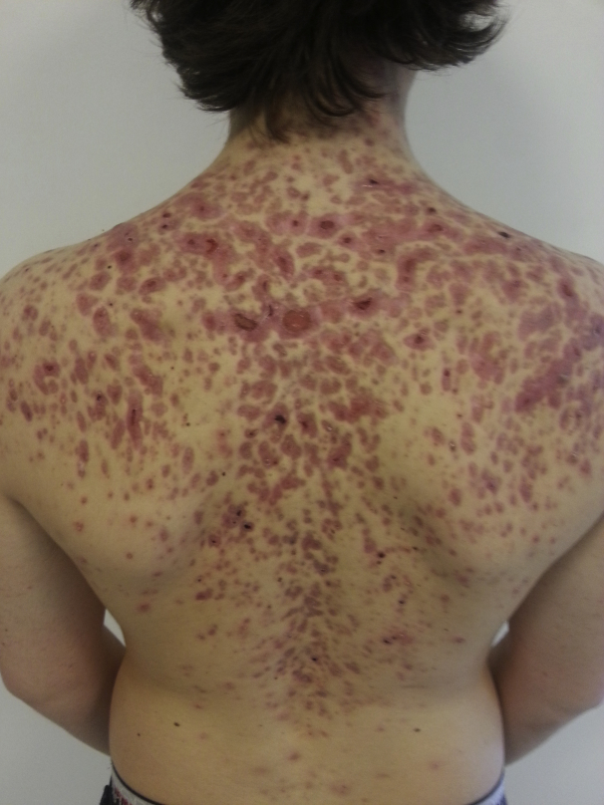
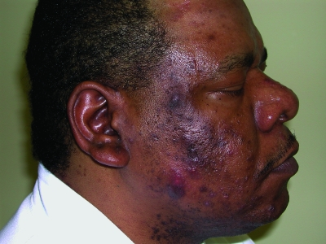

Slide 27
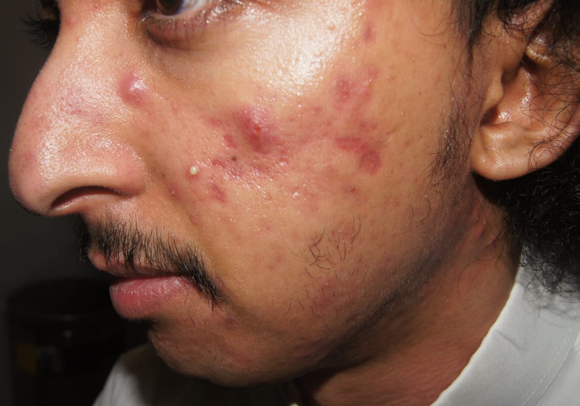

Slide 28
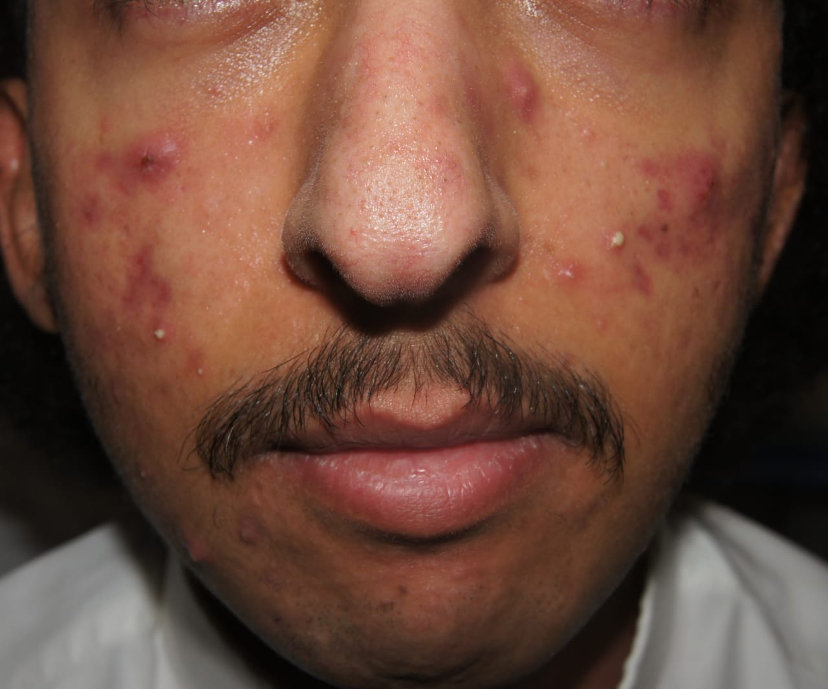

Slide 29
Scoring systems in acne vulgaris
-Grading versus lesion counting
-simple grading system:
Grade 1: Comedones, occasional papules.
Grade 2: Papules, comedones, few pustules.
Grade 3: Predominant pustules, nodules, abscesses.
Grade 4: Mainly cysts, abscesses, widespread scarring.
-mild,moderate,severe:

Slide 31
ACNE SUBTYPES

Slide 32
A-Neonatal Acne
Onset between 0-6 w of age.
Most commonly in boys
Affect up to 20% of newborn
Presents as comedones and small papulopustules on the cheeks and nasal bridge
Due to the self- limited and benign nature of neonatal acne and acneiform eruptions, the use of a gentle daily cleanser and water is all that is required therapeutically.
Topical retinoid with or without benzoyl peroxide

Slide 33
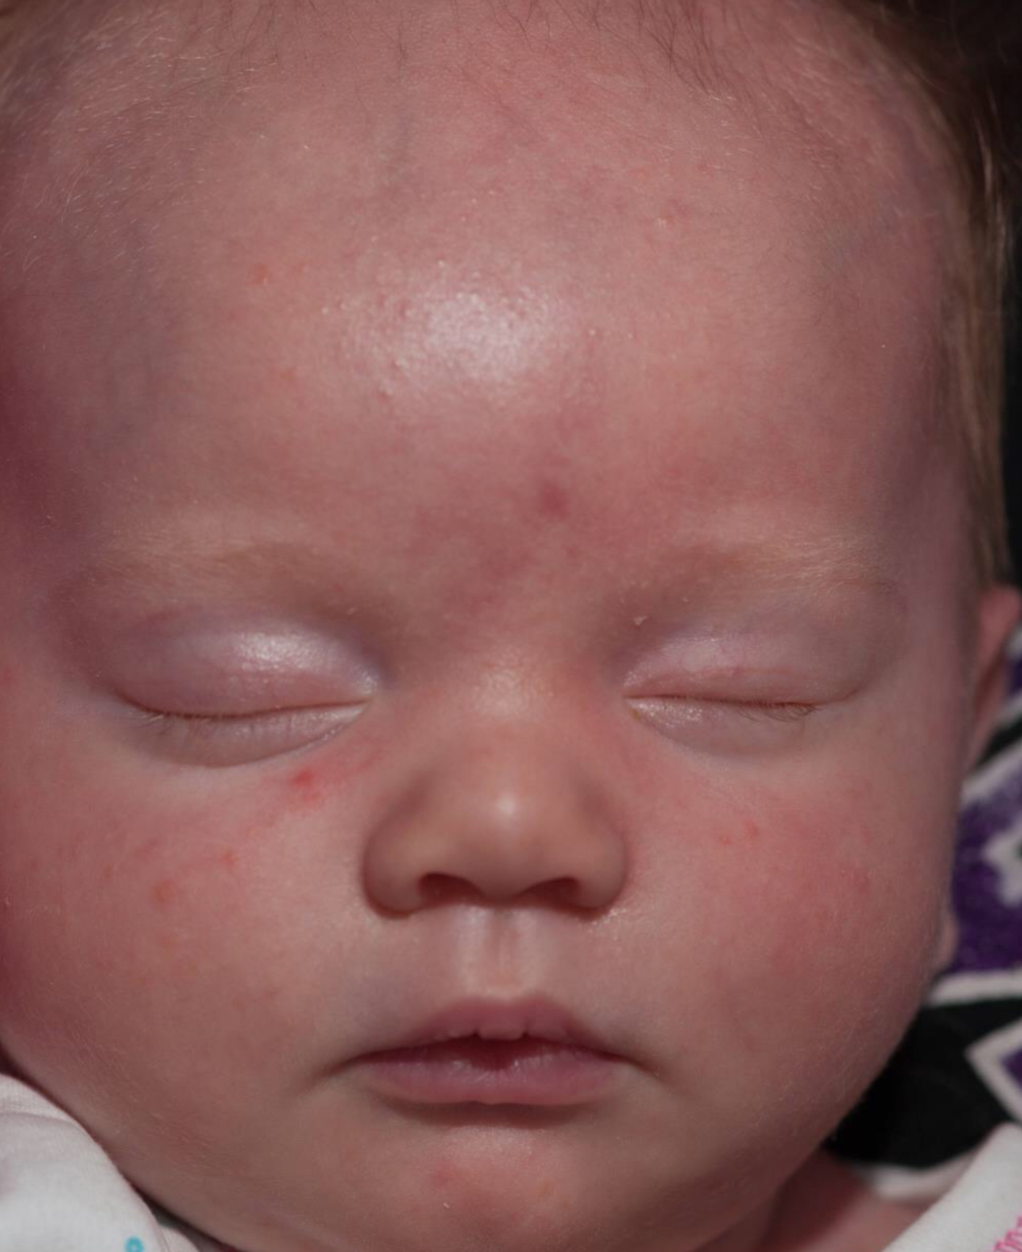
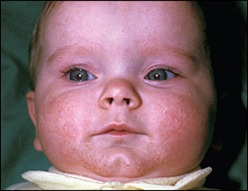

Slide 34
B- Infantile Acne:
Affects less than 2% of infants
Anytime between 6 weeks and 12 months
Male predominance
Genetic predisposition and heightened sebaceous gland activity in response to normal levels of circulating androgens
In rare cases, infantile acne can be a sign androgen-secreting (or corticosteroid-secreting) disorder.
Closed and open comedones, papules, pustules, nodules, and cysts
Commonly over face
Have a moderate course at best requiring no treatment, resolving within 6 to 12 months
Topical retinoid or benzoyl peroxide with topical antibiotic (e.g., erythromycin or clindamycin)
In sever cases: oral erythromycin. If the patient has a resistant strain of Propionibacterium acne, then we can used sulfamethoxazole-trimethoprim.

Slide 35
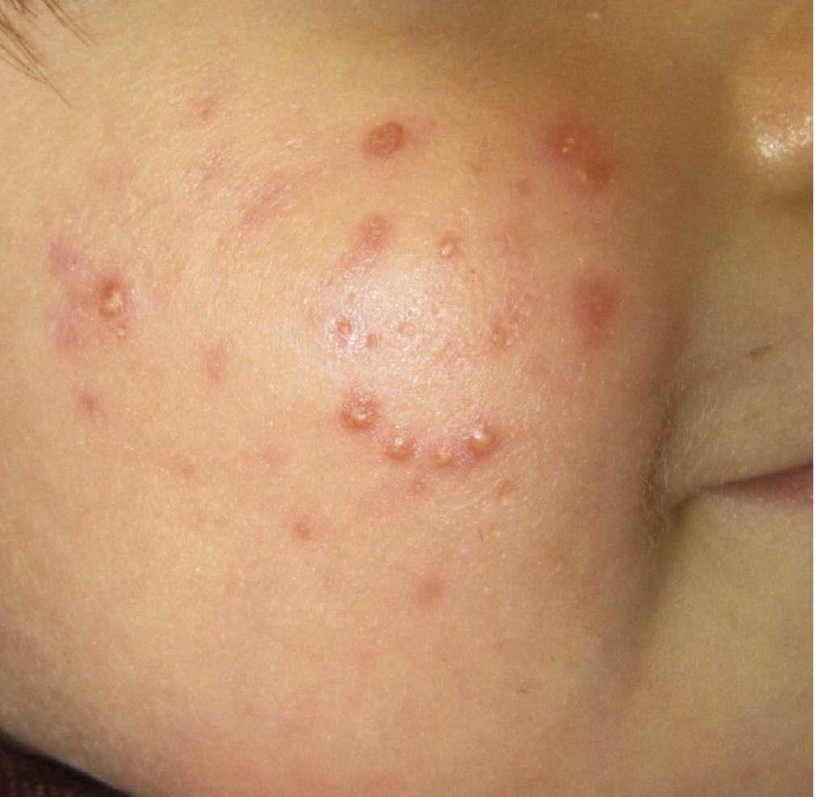
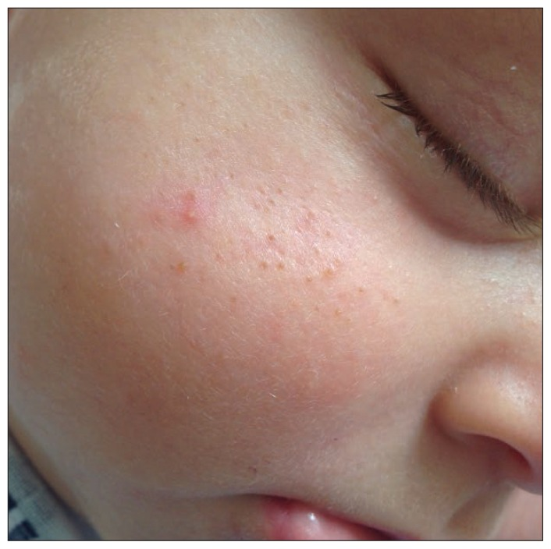

Slide 36
C-Childhood acne:
Between the ages of 1 and 8 years
More in boys.
May be the first sign of puberty.
Consider possibility of underlying condition such as polycystic ovary syndrome or late onset congenital adrenal hyperplasia
Clinical features and Treatment is similar to the adolescent algorithms

Slide 37
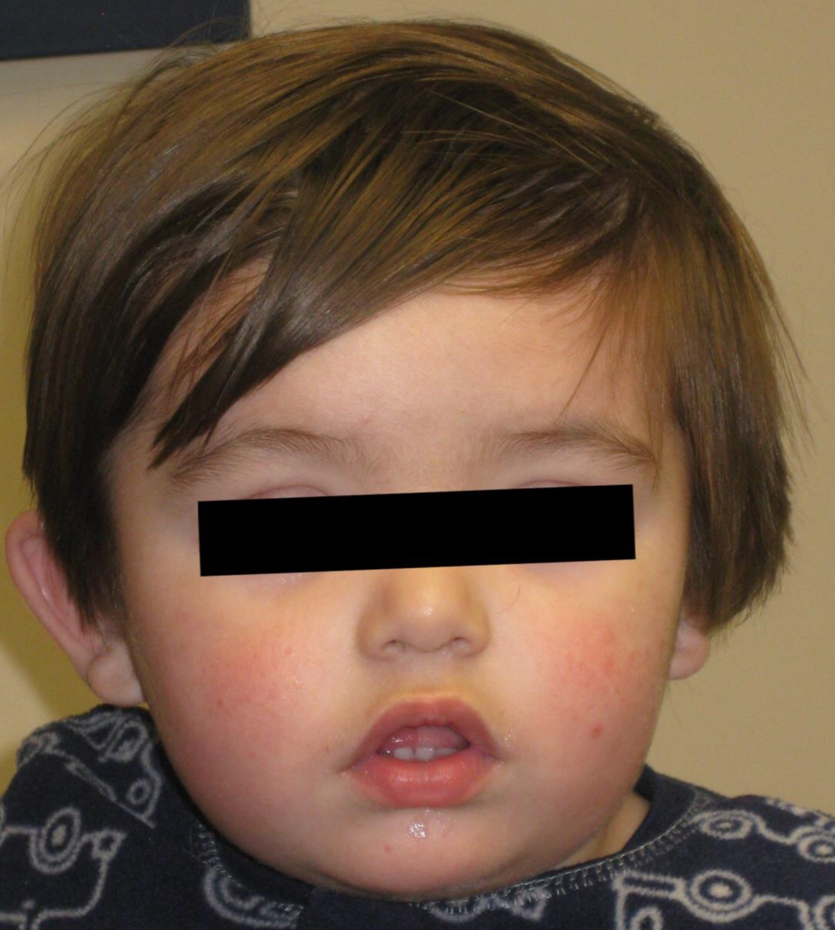
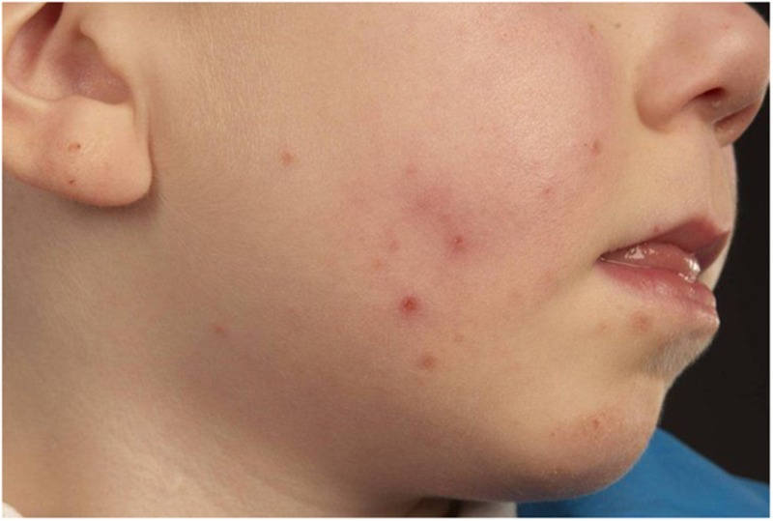

Slide 38
D-Adult Acne:
More in female
35.2 percent, 26.3 percent, and 15.3 percent among women:30 to 39 years, 40 to 49 years, and 50 years and older
Smoking
IF associated with hirsutism, irregular periods evaluate for hyper secretion of ovarian androgens (e.g. Polycystic ovary syndrome).
Two subtypes of adult acne are recognized: persistent(70%) and late-onset(30%)

Slide 40
The classical presentation of adult acne consists of inflammatory papulopustular lesions in the lower half of the face specially jawline

Slide 41
E-Acne Conglobata:
A rare but severe form of acne
Men > women
Second and third decade of life
Believed that Propionibacterium acnes may play an important role in the disease by changing its reactivity as an antigen. The hypersensitivity to this antigen induces an intense immunological reaction that presents with a chronic inflammatory state.
Paired or aggregates of blackheads on the trunk, neck, upper arms, and buttocks.
Highly inflammatory lesions: nodules, abscesses, draining sinuses, over the back and chest .
Heals with scars (Depressed or Keloidal).
Isotretinoin for 20 to 28 weeks or in some cases even longer. Some experts even recommend the use of oral prednisone (1 mg/kg/d) for 14 to 28 days.

Slide 42
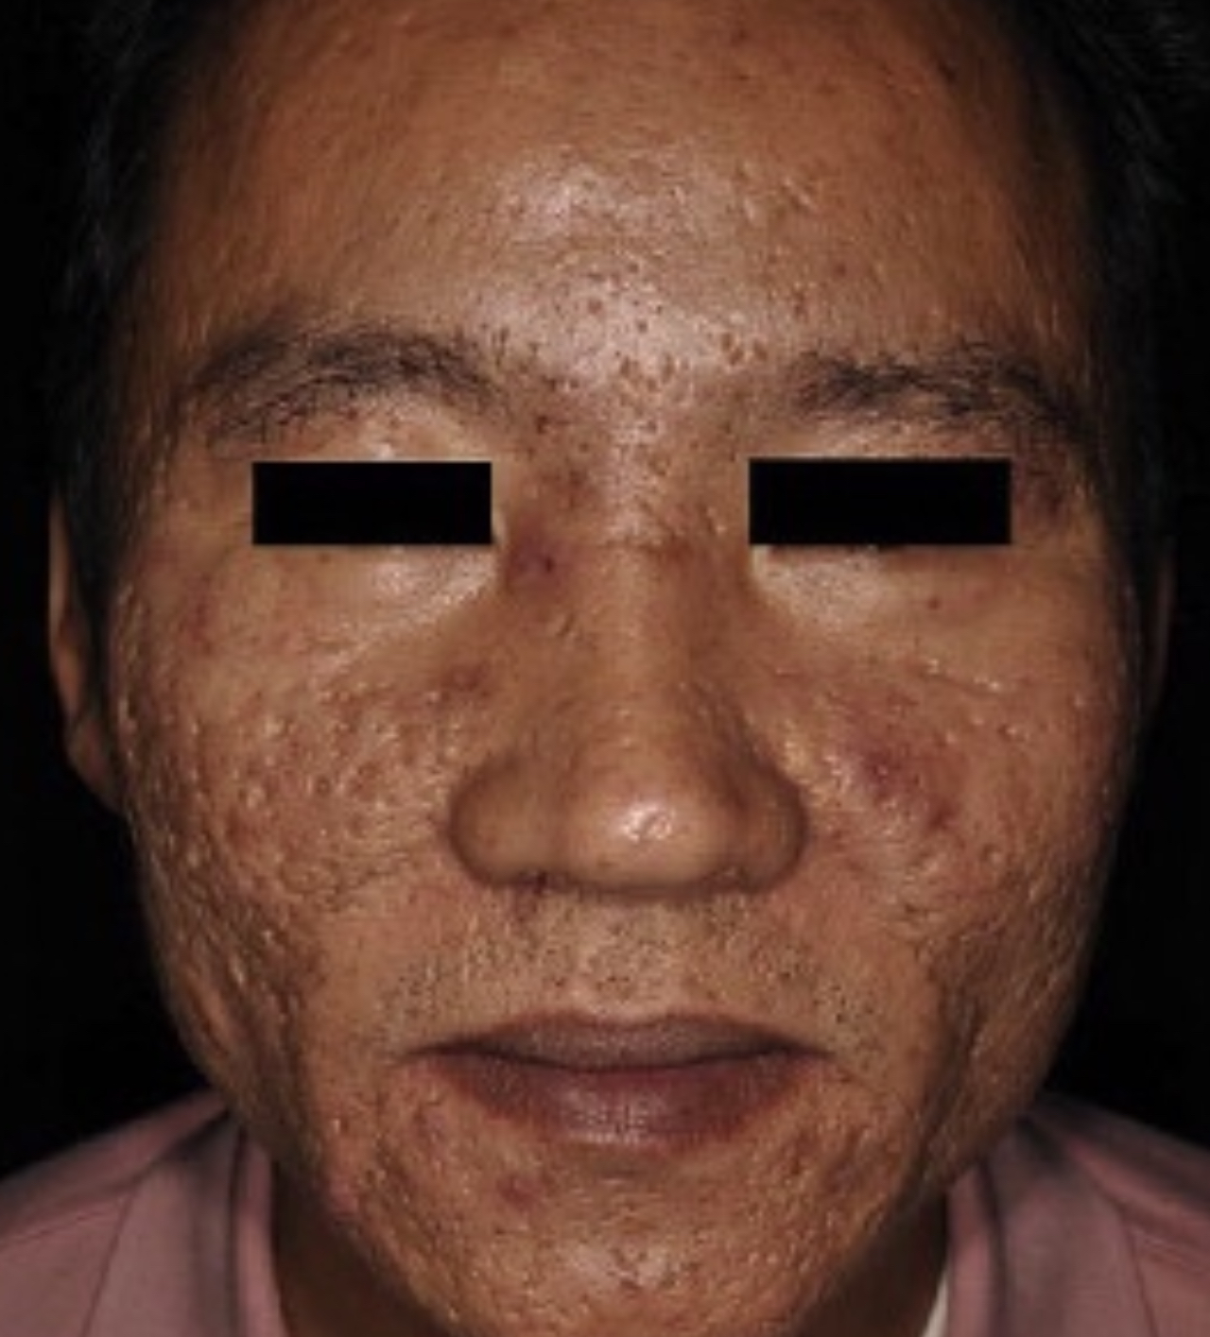

Slide 43
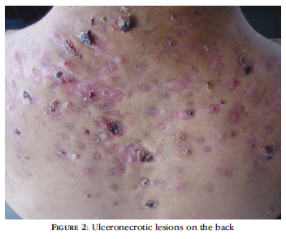

Slide 44
F-Drug Induced Acne:
The characteristic feature: absence of comedons and monomorphic lesions as small pustules and papules .
Class of agent | Examples
Hormones
 | Corticosteroids and corticotropin
 | Androgens and anabolic Steroid medications
 | Hormonal contraceptive medications
Neuropsychotherapeutic drugs
 | Tricyclic antidepressant medications
 | Lithium
 | Antiepileptic drugs
 | Aripiprazole
 | Selective serotonin reuptake inhibitors
Vitamins
 | Vitamins B1, B6, and B12
Cytostatic drugs
 | Dactinomycin (actinomycin D)
Immunomodulating molecules
 | Cyclosporine
 | Sirolimus
Antituberculosis drugs
 | Isoniazid
 | Rifampin
 | Ethionamide
Halogens
 | Iodine
 | Bromine
 | Chlorine
Targeted therapies
 | Epidermal growth factor receptor inhibitors
 | Multitargeted tyrosine kinase inhibitors
 | Vascular endothelial growth factor inhibitor
 | Proteasome inhibitor

Slide 45
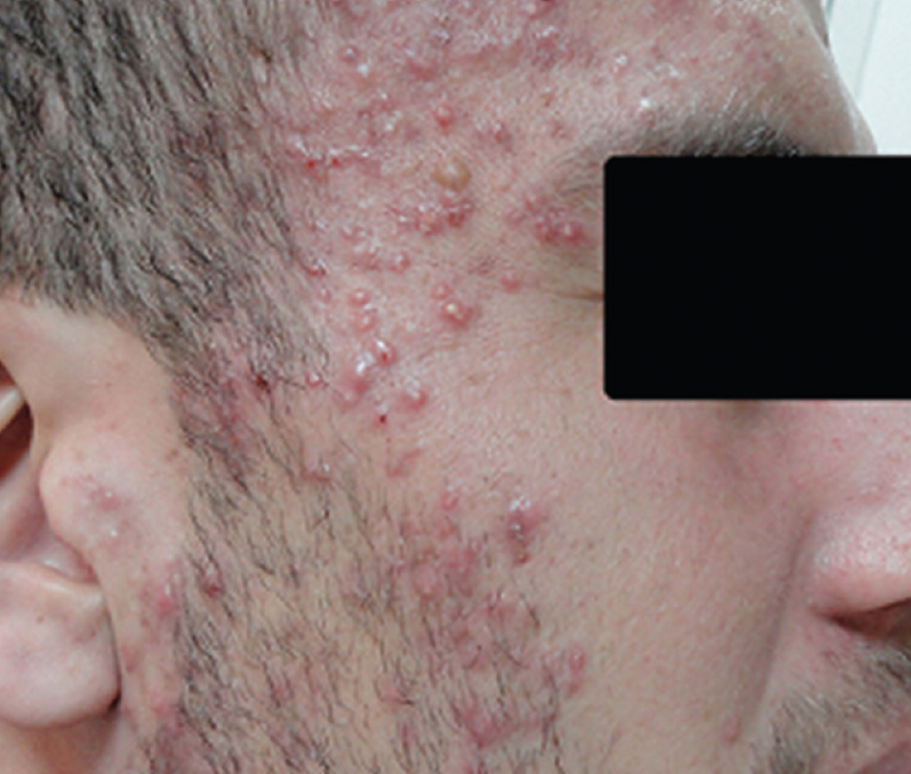

Slide 46
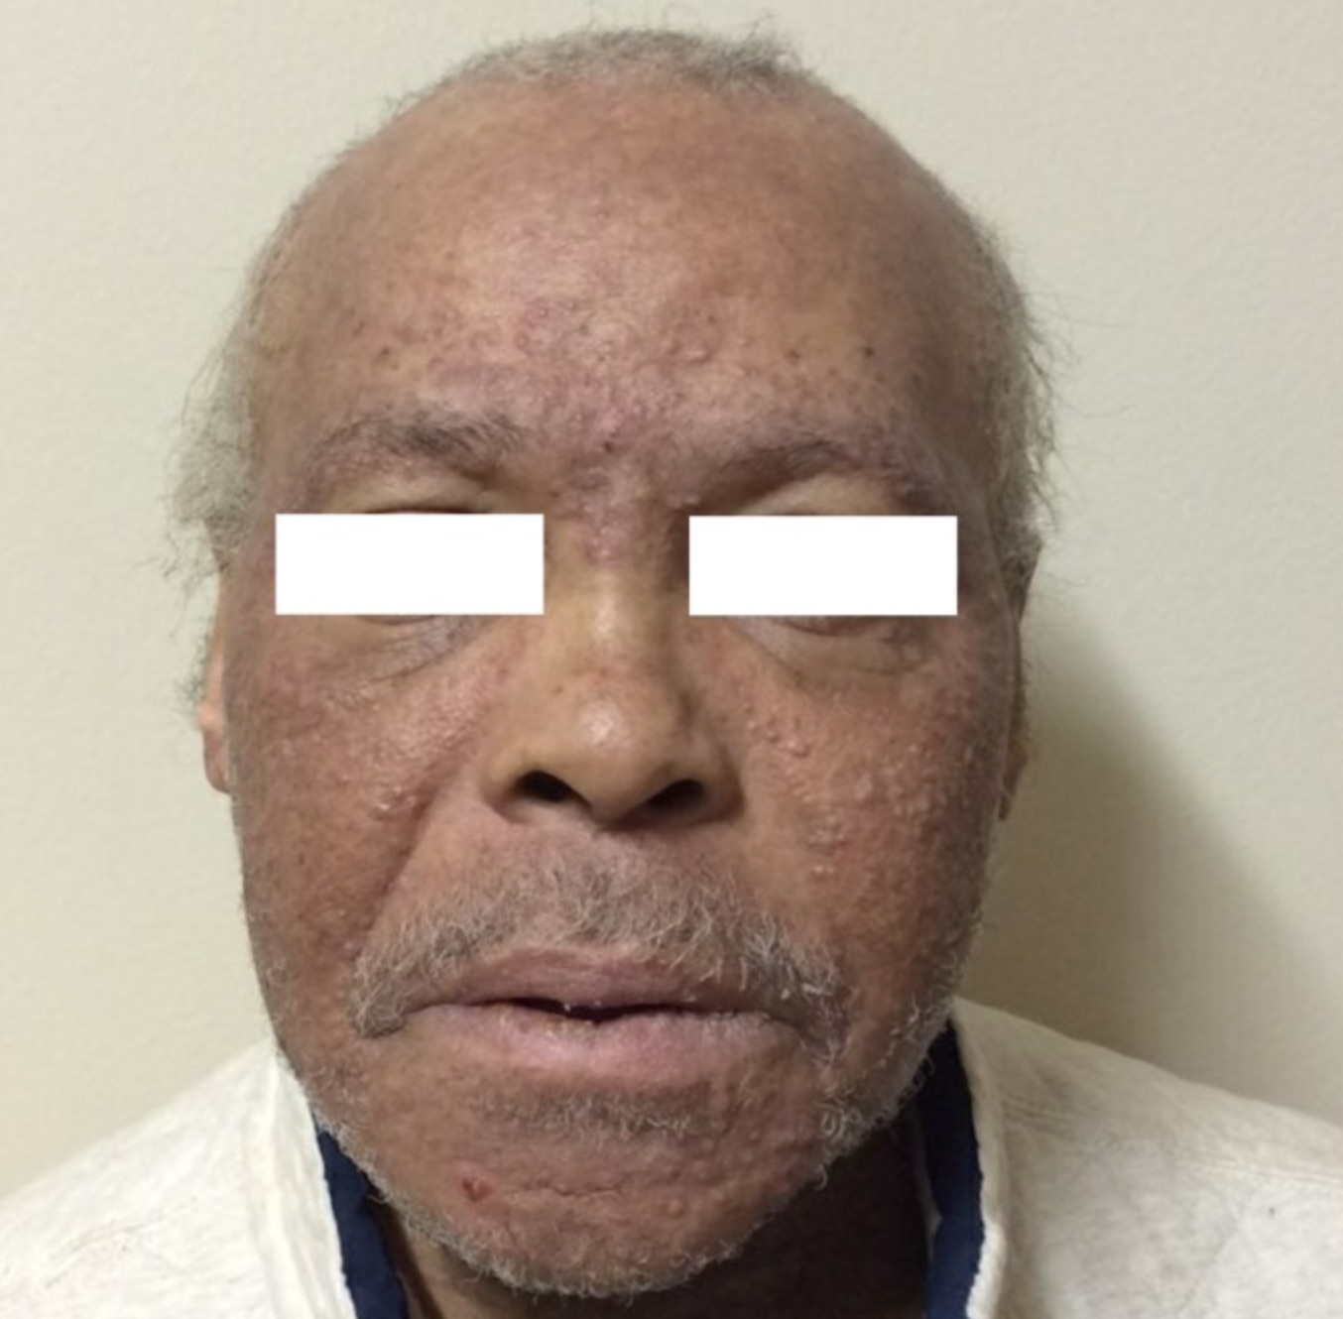
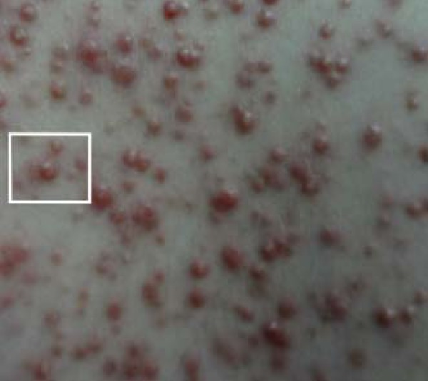

Slide 47
G-Others rare acne subtypes:
Acne Fulminans
Chloracne
SAPHO(Synovitis, acne, pustulosis, hyperostosis and osteitis)
Acne excoriée
Acne Aestivalis

Slide 48
Acne complications:
Quality of life: significant association between severity of acne and QOL
Hyperpigmentation: skin-colored patients
Scars: types of acne scars
1-Atrophic acne scars
2-Hypertrophic or keloid scars

Slide 49
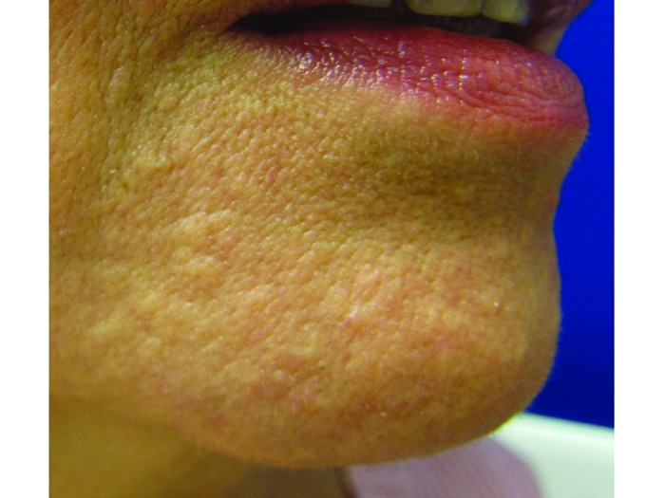
The 4 types of atrophic acne scars: 1-icepick scar 2-box scar 3-rolling scar 4-popular scar ( cobblestone-like papules)

Slide 50
Acne managements
A- Education about: course, diet, smoking,,,,,,,
B- Cleansing:
Washing Frequency:
Soaps bars (Benzoyl Peroxide, Salicylic Acids, Alpha Hydroxy Acids)
Gentle Liquid Cleansers

Slide 51
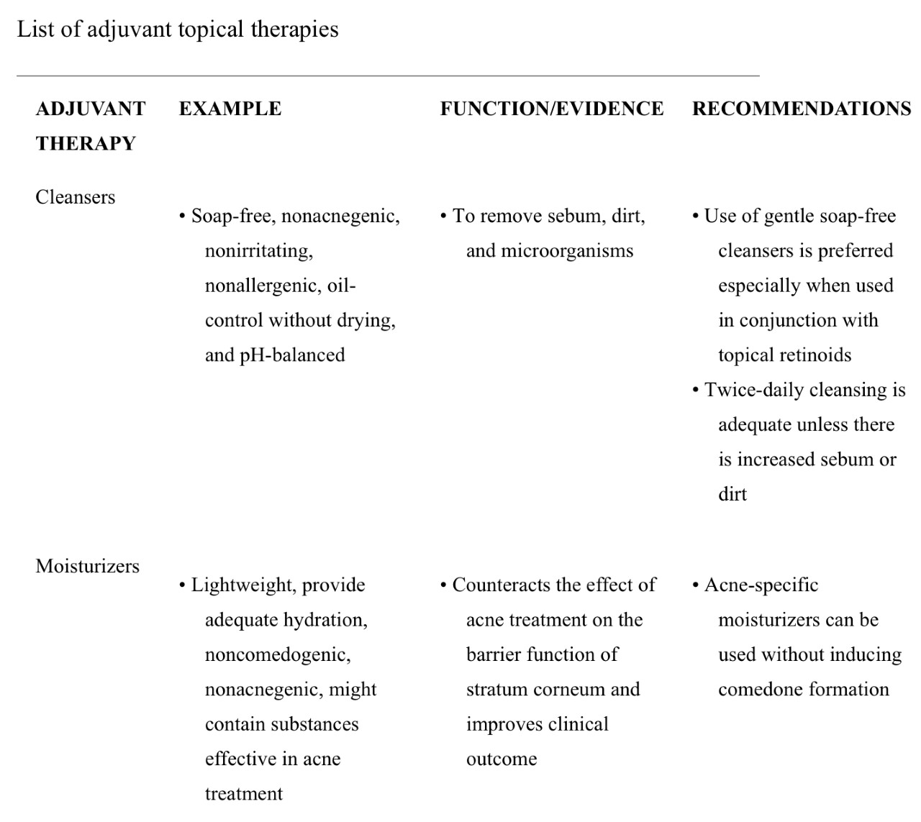

Slide 52
C-Topicals:
Retinoid (trifarotene, Adapalene,tretinoin,tazarotene)
Benzoyl Peroxide
Azelaic Acid
Topical Antibiotics: erythromycin, clindamycin. minovycline and Dapsone Gel, 7.5%

Slide 53
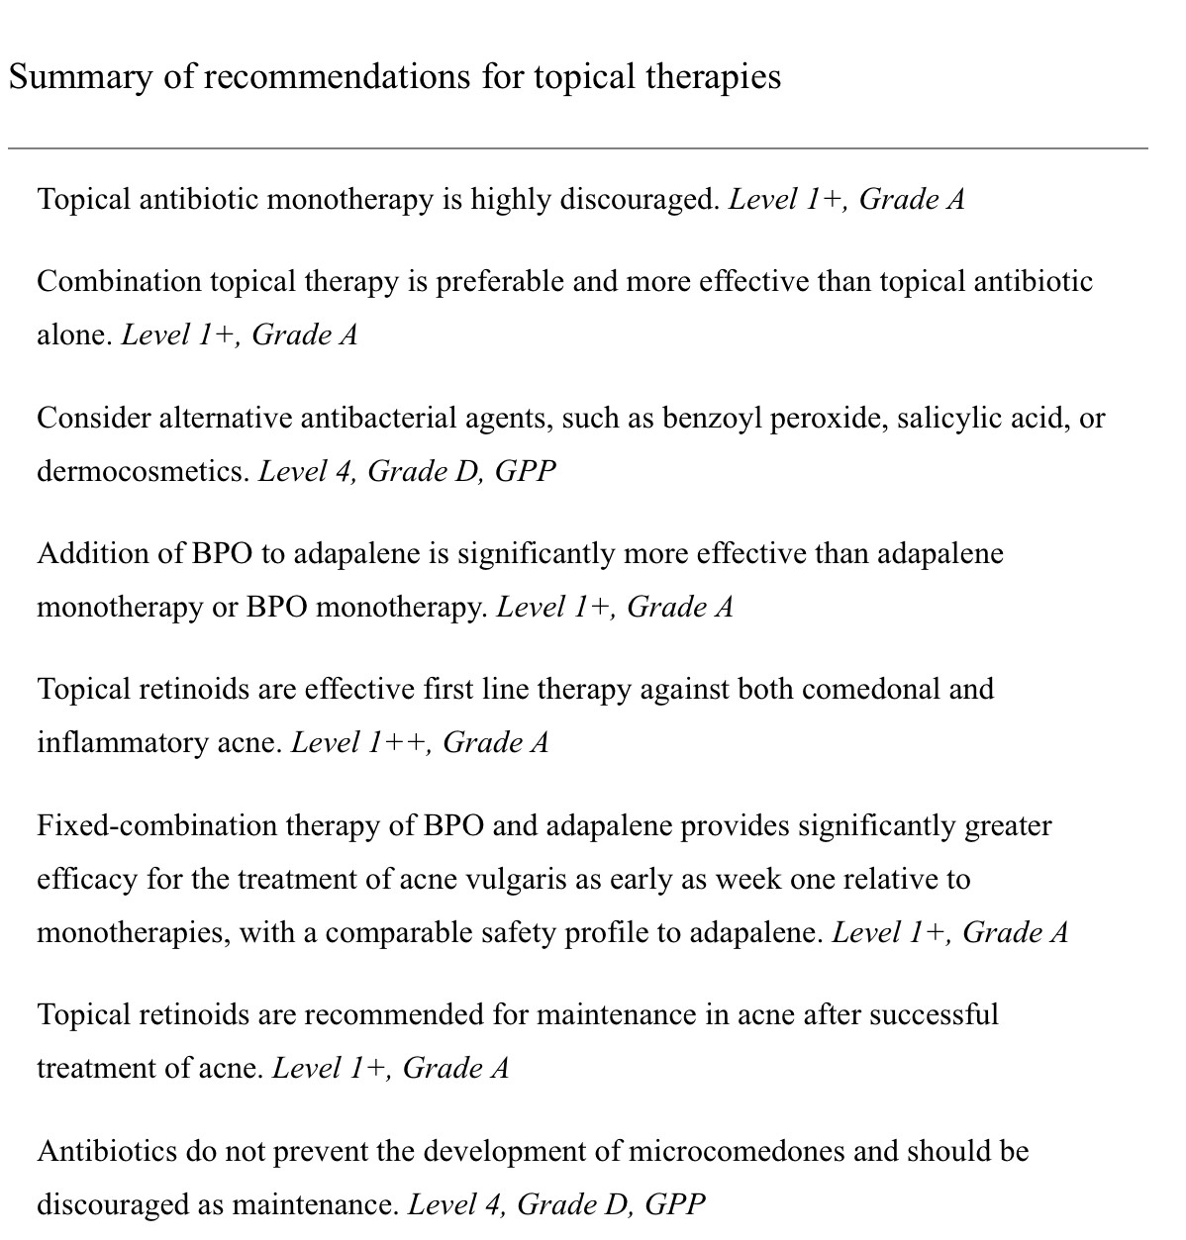

Slide 54
D-Systemic Treatmens:
1-Oral antibiotics:
-Tetracycline group: minocycline,doxycycline, Oxytetracycline, Lymecycline, Sarecycline(1.5 mg/kg )
-Erythromycin,Roxithromycin,azithromycin
-Trimethoprim
-Clindamycin
-Antimicrobial Resistance and Antibiotic Use in Acne Vulgaris

Slide 56
2-ISOTRETINOIN:
Isotretinoin works to normalize all four key pathogenic features of acne vulgaris.
If patients have very severe acne, scarring acne or significant acne that has not responded to therapy within 3 – 4 months, isotretinoin treatment should be considered.
Standard dose : 0.5-1mg/kg with a total cumulative dose between 120mg-150mg/kg
Side effects:
A recent meta-analysis of 31 controlled studies demonstrated that:
No evidence of increased depression or suicide rates with acne treatment using isotretinoin
Not associated with the occurrence of hypertrophic scars or keloids
lab abnormalities:
Dryness
Teratogenic effects
Headache

Slide 57
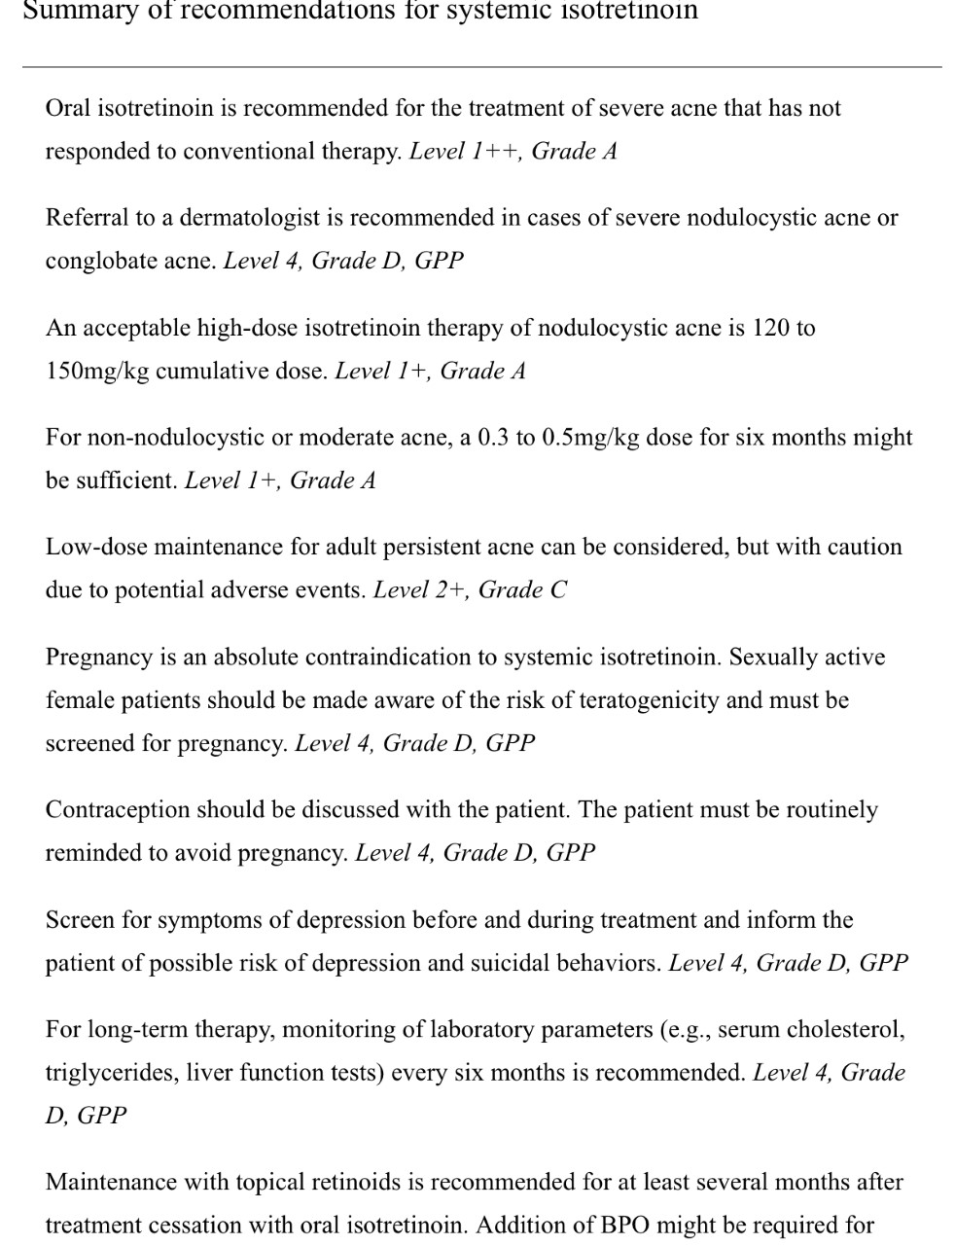

Slide 58
3-Hormonal: (for female) -Combined oral contraceptives (COCs) are effective in the treatment of both noninflammatory and inflammatory acne - they are suitable for long-term therapy because they have no potential to induce bacterial resistance and represent an alternative to systemic antibiotics. - recommended in the following situations: presence of severe seborrhea; worsening in the premenstrual period; presence of endocrine changes; persistent recalcitrant inflammatory acne in which standard treatments have failed. -cyproterone acetate, spironolactone, drospirenone and flutamide.

Slide 59
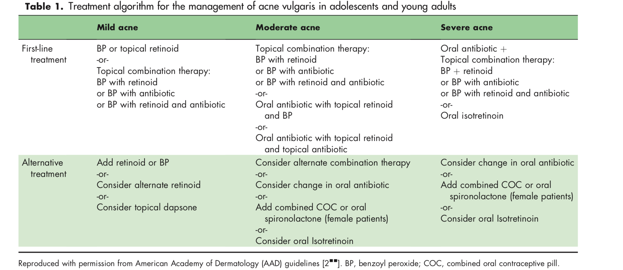

Slide 60
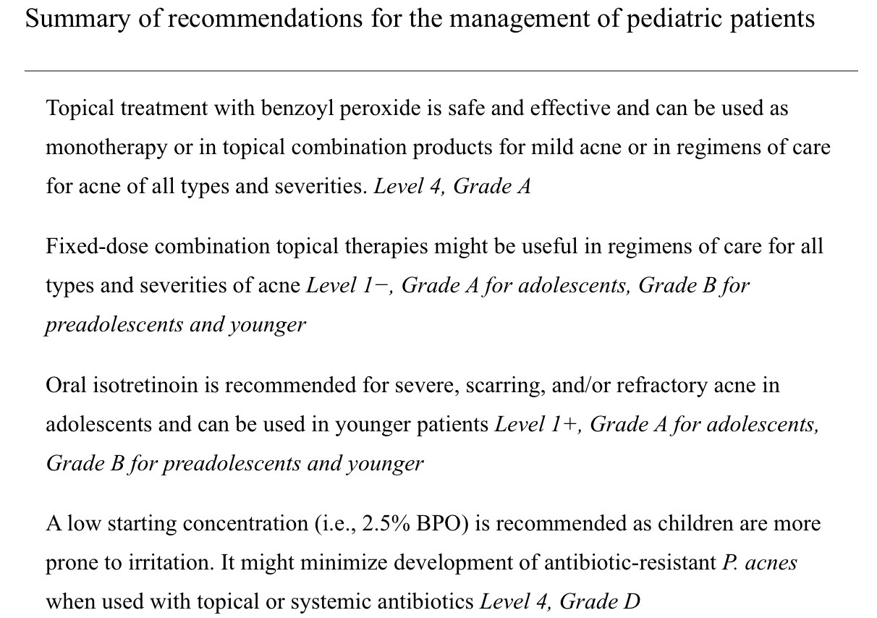

Slide 61
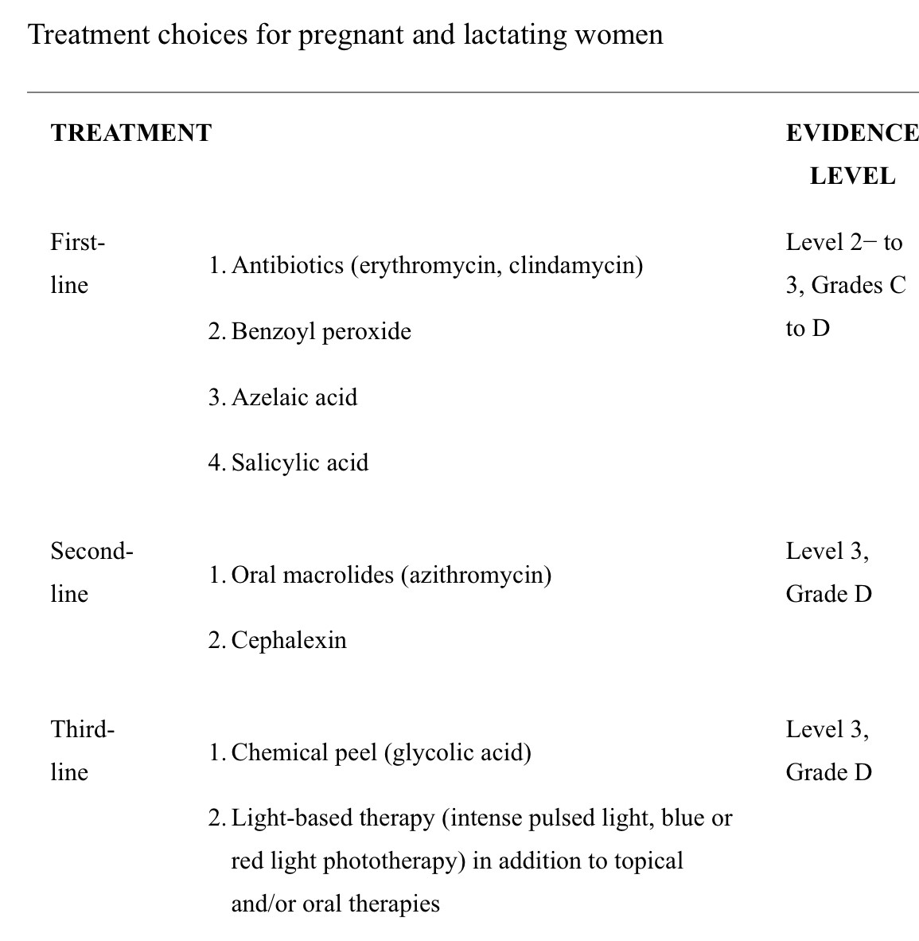

Slide 62
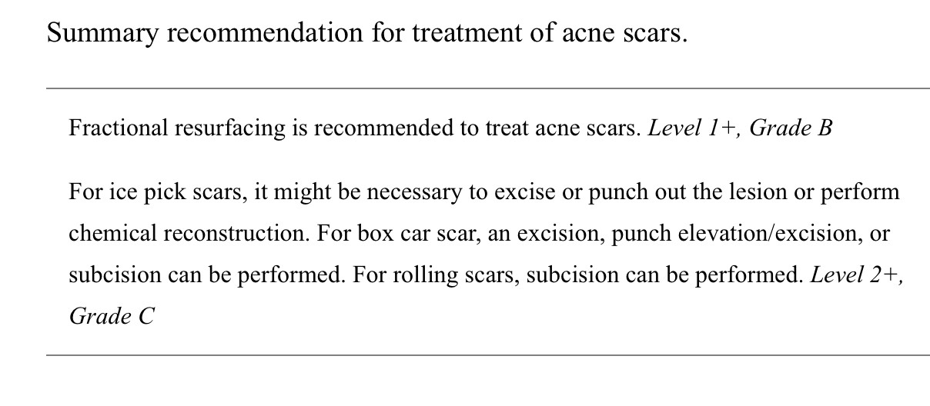

Slide 63
Rosacea (acne Rosacea)
-Is a common chronic inflammatory skin disease of the central facial skin and is of unknown origin
Epidemiology:
-Affecting approximately 10% of the population
-More in Fitzpatrick skin type I or II and from northern European or Celtic ancestry
-Females = males

Slide 64
Pathogenesis
The pathogenesis of rosacea is a complex interplay of genetic, immunologic, and neurovascular factors
Genetic predisposition (38%have a relative).
Sunlight and heat.
Constitutional predispostion to flushing & blushing.
Demodex folliculorum mite.
H. Pylori infection.

Slide 65
TRIGGERS
Hot or cold temperatures or Wind.
Hot drinks, Caffeine, Spicy food, Alcohol.
Exercise.
Emotions.
Topical products that irritate the skin and decrease the barrier.
Medications that cause flushing and photosensitivity (amiodarone, nicotinamide).

Slide 66
clinical features
Patient history
-Does the patient describe experiencing a warm sensation over the face, or flushing?
-Does the patient recognize his or her own redness, or erythema?
-Burning or stinging in association with skin care products.
-History of acne diagnosis and failed acne treatments
-Triggers, such as heat, spicy foods, and stress.
-Family history.
-Recognition of signs and symptoms of rosacea

Slide 67
clinical features
Examination:
classification of rosacea:
A-Erythemato-telangiectatic rosacea:
-Flushing
-Persistent redness of the central face
-Telangiectasias
-Very sensitive skin, and may feel as if their skin stings or burning sensation

Slide 68
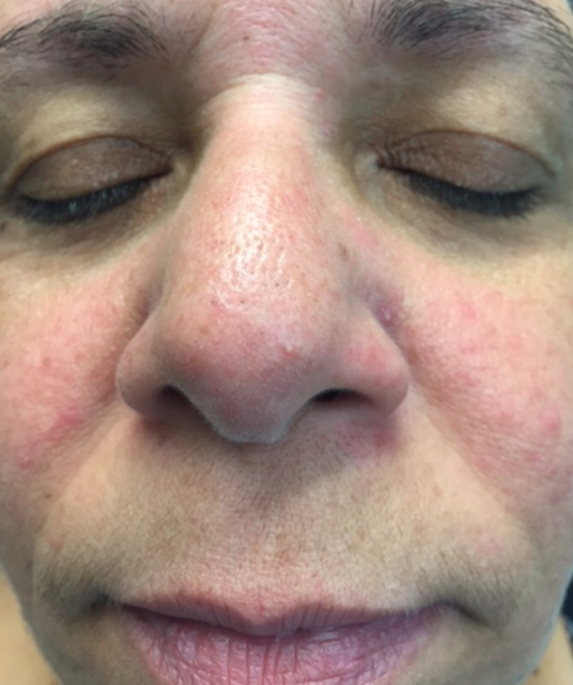
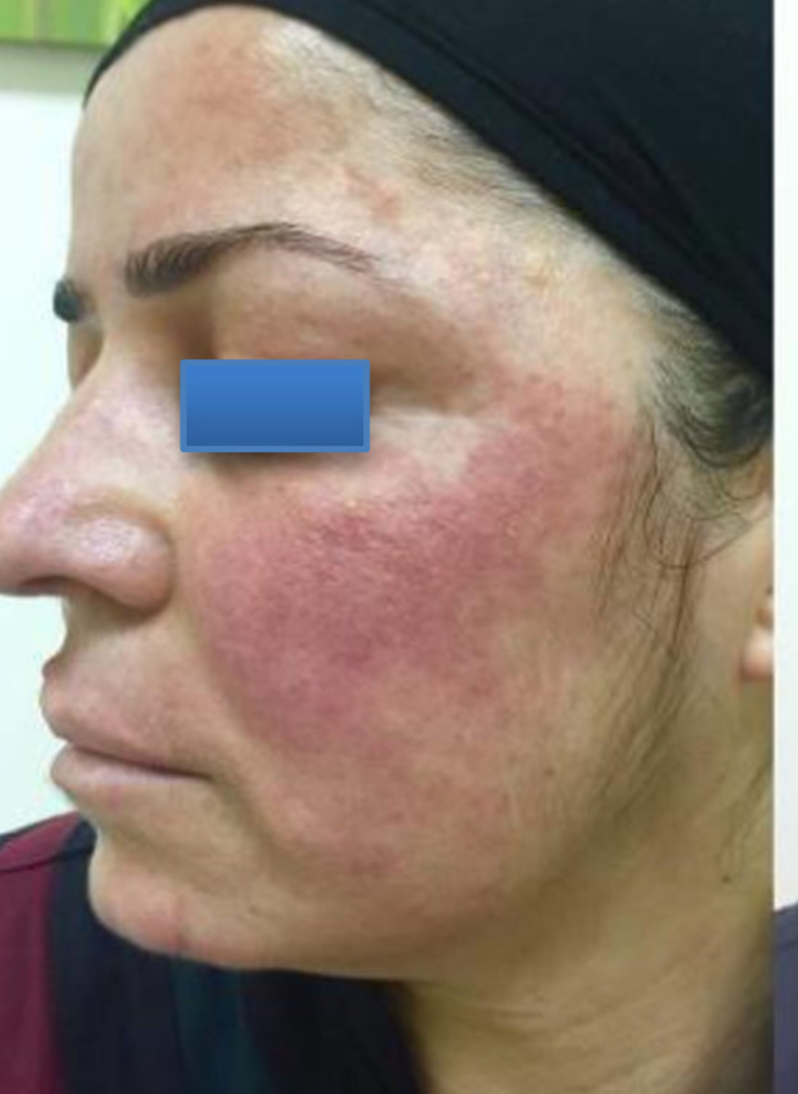

Slide 69
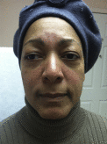
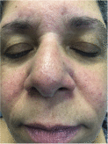

Slide 70
B-Papulopustular rosacea:
May occur along with the facial redness and flushing of rosacea subtype
Papules and/or pustules that come and go, combined with transient or persistent facial redness
On the central face: burning and stinging; small visible blood vessels (telangiectasia); raised, scaly red patches known as plaques

Slide 71
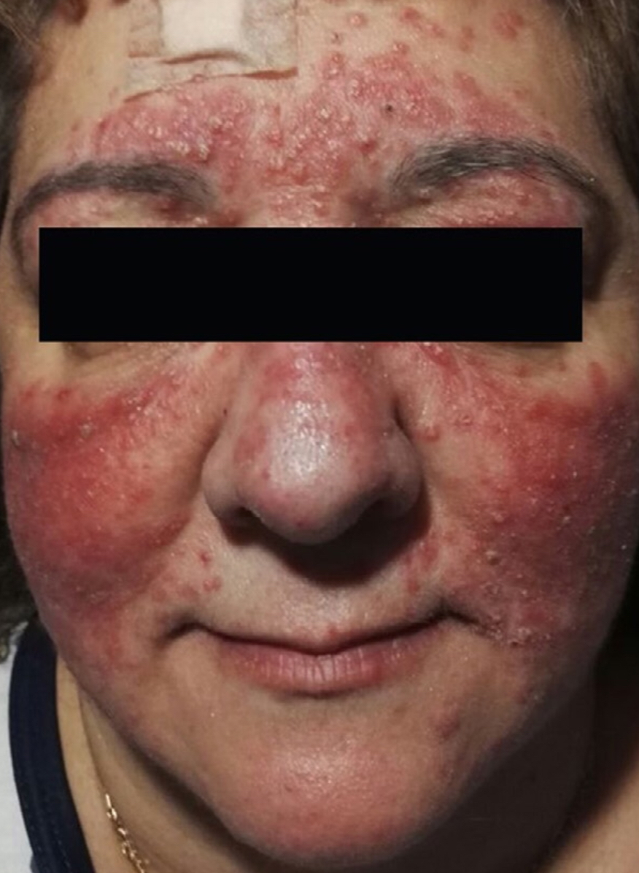
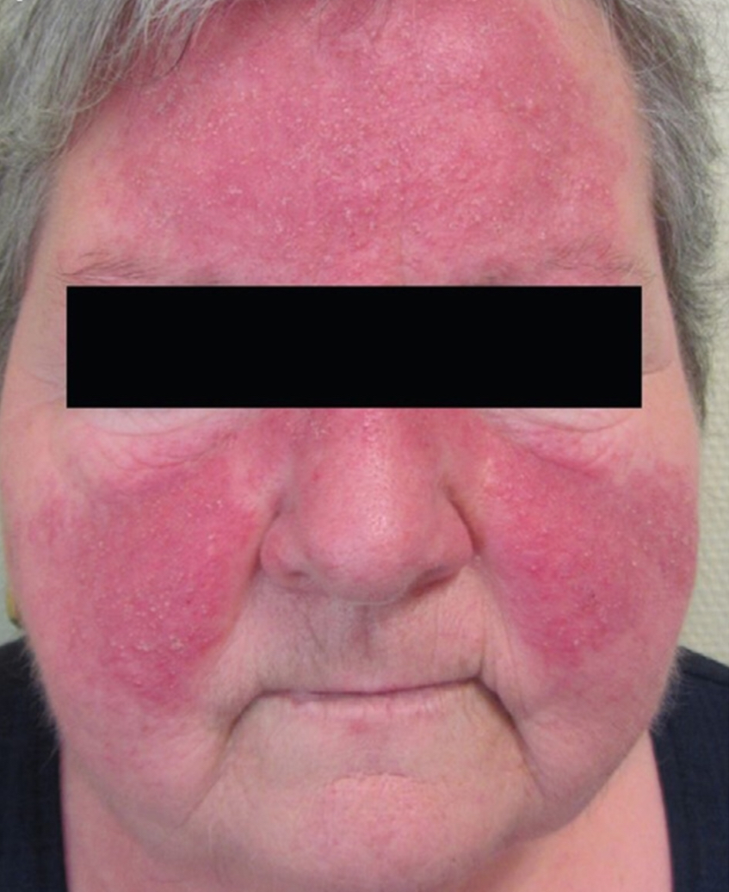

Slide 73
C-granulomatous rosacea
Rare
Characterized by erythematous papules and plaques
Histological examination showed granulomatous dermatitis with the presence of Demodex folliculorum

Slide 76
D-Phymatous rosacea
Phymatous rosacea can affect nose (rhinophyma), chin (gnatophyma), forehead (metophyma), ears (otophyma) and eyelids (blepharophyma).
shows marked skin thickenings and irregular surface nodularities
Telangiectasia
Fibrosis and increased volume of sebaceous glands

Slide 79
E-Ocular rosacea
Ocular rosacea range from minor irritation to sever inflammatory keratitis.
Ocular findings include:
lid margin and conjunctival telangiectasias
Blepharoconjunctivitis
Eyelid thickening, eyelid crusts and scales
Punctate epithelial erosions, corneal infiltrates, corneal ulcers, corneal scars, and vascularization.

Slide 82
Mangment
A-General measures
Chronic relapsing nature
Avoid recognized triggers
Change work(sailars)
Gentle skin care regimen to maintain skin hydration and barrier function
Gentle, nonalkaline, fragrance-free, emollient cleanser once per day in the evening
Light, water-based cosmetics (but powders are preferable to creams)
Photoprotection

Slide 84
B-Topical therapies
Metronidazole 0.75% (gel, cream, and lotion; twice-daily application), metronidazole 1% (gel and cream; once-daily application).
Azelaic acid 15% gel ( twice-daily)
Ivermectin1% cream (once-daily application)
Brimonidine tartrate 0.33% gel(MIRVASO Gel): (topical treatment of persistent facial erythema associated with rosacea. Brimonidine gel is a selective α2-adrenergic receptor agonist with vasoconstrictive activity)
Permethrin
Topical calcineurin inhibitors

Slide 85
C-Systemic therapies
-Doxycycline:40mg daily
-Oral isotretinoin therapy:(0.3 mg/kg daily) for how long?
D-Physical modalities
-Pulsed dye laser (PDL 585–595 nm) for telangiectasia
-CO2 laser therapy for rhinophyma

Slide 87
Hidradenitis suppurativa (HS) (Acne inversus)
Chronic inflammatory follicular occlusive disease predominantly involving the intertriginous areas

Slide 88
Epidemiology
Prevalence rates for HS range from 0.03 to 4.1
These numbers are likely underestimated because of under-reporting and misdiagnosis
Female-predominance with a 3:1
Onset is commonly between puberty and age 40
Usually in adolescents (0.57%) and adults (0.47%) than in children

Slide 89
Pathophysiology of HS
-Terminal follicular hyperkeratosis, hyperplasia of the follicular epithelium and perifolliculitis.
-Cyst formation, followed by rupture of the hair follicle
-Induces an inflammatory response and subsequent formation of abscess, sinus tracts, fibrosis and scars.
-Worsened by secondary infection
-Mediated by tumor necrosis factor (TNF)-α, IL-23/T-helper (Th) 17 and IL-12/Th1 pathways
-Genetics: One-third of patients with HS report a positive family history,
-Smoking: More than 70 percent of patients with HS are smokers, and a strong association between smoking and HS has been demonstrated
-Obesity: is a risk factor for HS

Slide 90
Clinical features of HS
The diagnosis of HS relies on the clinical features
Typically: recurrent, painful, inflamed nodules, most commonly in the axillae and/or inguinal areas
To diagnosed HS: requires the following three criteria:
Typical morphology (nodules, abscesses, sinus tracts, scars)
Characteristic distribution or typography of lesions (intertriginous areas, axillae, inframammary folds, groins, buttocks, perianal and perineal areas)
A relapsing, chronic disease course.

Slide 91
Staging of HS

Slide 96
Comorbidity hS
High prevalence rates of cardiovascular disease risk factors: including metabolic syndrome and atherosclerosis
Crohn’s disease and pyoderma gangrenosum
Depression

Slide 97
COMPLICATIONS
Secondarily infections: Erysipelas and sepsis
Extensive fibrosis and scarring
Lymphedema
Squamous cell carcinoma

Slide 99
TREATMENT
A-General measures:
-Weight reduction
-Smoking
-Management of pruritus
-Friction
-Local antiseptics

Slide 100
B-Topical treatments
-Clindamycin
-Fusidic acid
-Benzoyl peroxide associated to clindamycin
-Intralesional steroid
C-Systemic treatment
-Antibiotics (minocycline , doxycycline and Rifampicin associated to clindamycin
-Isotretinoin or Acitretin
-Biologic treatmen (infliximab, adalimumab)

Slide 101
D-SURGICAL TREATMENT
-Incision and drainage of abscess better avoided
-Excision of sinus tracts and chronic nodules
-Complete excision of the area with or without grafting.
-CO2 laser

Slide 104
Thank you

